Slide 1

Milano
Oliver Wieland, con il contributo di tutto il GR 3

Slide 2
Per studiare come si aggregano i costituenti elementari della materia, i quark, quando si formano i nuclei atomici, gli esperimenti attuali sfruttano le collisioni tra particelle ad alta energia.
La collisione fra un elettrone e un nucleo - come previsto dalla collaborazione INFN al Jefferson Lab - permetterà di avere una fotografia tridimensionale dell'interno del nucleo mentre la collisione tra nuclei di piombo - al CERN di Ginevra - può dare vita per pochi istanti a una
bolla di plasma di quark e gluoni, lo stato dell’Universo primordiale.
I meccanismi di formazione delle stelle, comparse nell’Universo solo quando si fu sufficientemente espanso e raffreddato, sono oggetto di studio nei Laboratori Nazionali dell'INFN.
Ai Laboratori Nazionali del Gran Sasso, ad esempio, il piccolo acceleratore Luna è in grado di studiare la formazione dei nuclei a energie paragonabili a quelle che si trovano in una stella, molto più basse rispetto a quelle ottenute nei normali acceleratori di particelle.
Acceleratori e rivelatori tra i più sofisticati al mondo sono invece installati ai
Laboratori Nazionali di Legnaro e ai Laboratori Nazionali del Sud per la produzione e lo studio delle caratteristiche dei nuclei instabili. Uno degli obiettivi pimari di questi esperimenti è la comprensione dei meccanismi di formazione dei nuclei pesanti, di massa superiore al ferro, in stelle di grandi dimensioni.
Continua inoltre ai Laboratori Nazionali di Frascati lo studio della forza nucleare in presenza dei quark "strani", importante tra l’altro per comprendere il comportamento delle stelle a neutroni.
Oliver Wieland, con il contributo di tutto il GR 3

Slide 3
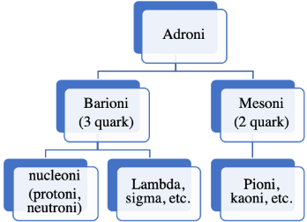
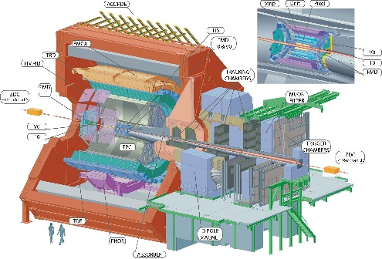
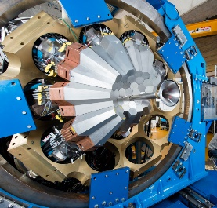
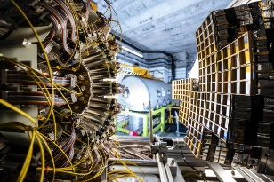
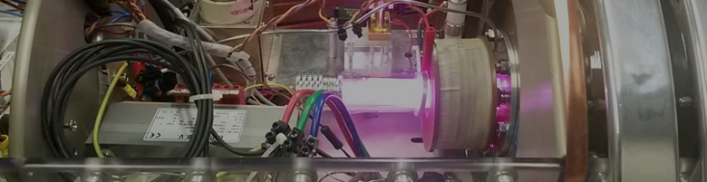
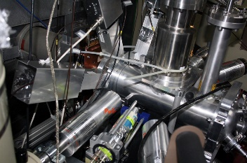
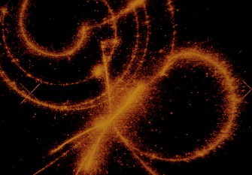
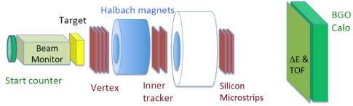

Linea | Esperimento
1 | EPIC
1 | JLAB12
1 | KAONNIS
1 | MAMBO
1 | REST
1 | ULYSSES
2 | ALICE
2 | NA60_PLUS
3 | CHI-NEXT
3 | FORTE
3 | GAMMA
3 | NUCL-EX
3 | NUMEN_GR3
4 | ASFIN2
4 | ERNA2
4 | LUNA3
4 | n_TOF
4 | PANDORA_GR3
5 | FAMU
5 | JEDI
5 | LEA
5 | VIP
6 | FOOT
6 | SPES_MED
LINEE 1-5
KAONNIS
1. Dinamica dei quark e degli adroni
2. Transizioni di fase della materia nucleare e adronica
3. Struttura nucleare e dinamica di reazione
4. Astrofisica nucleare
5. Simmetrie e interazioni fondamentali
6. Applicazioni e benefici per la società
ALICE
GAMMA CHI-NEXT
LUNA3
LEA FAMU
FOOT SPES MED

Slide 4
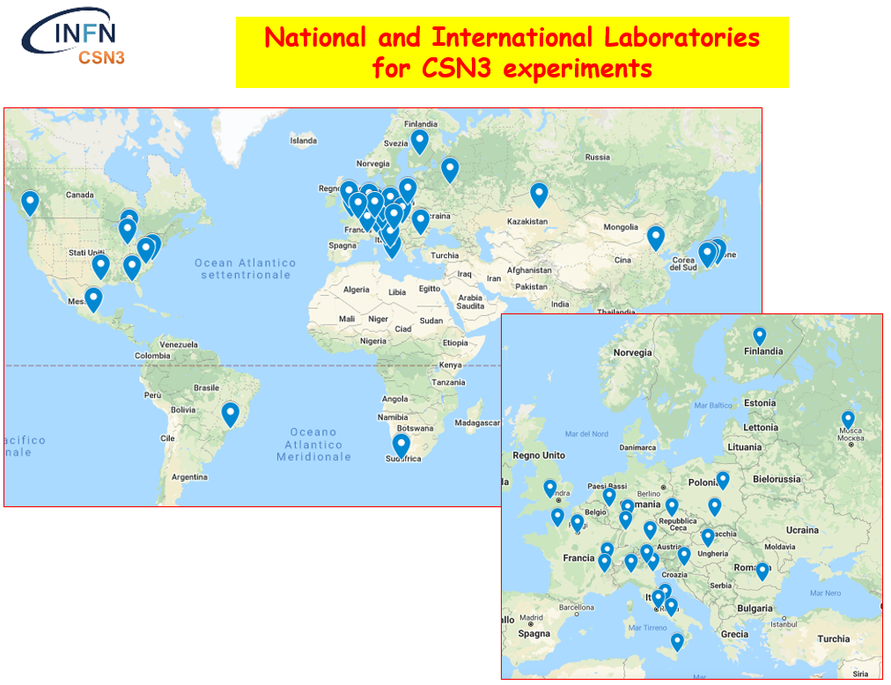
1 Quark and Hadron Dynamics
2 Phase Transitions of Nuclear and Hadronic Matter
3 Nuclear Structure and Reaction Dynamics
4 Nuclear Astrophysics and Interdisciplinary Researches
5 Symmetries and Fundamental Interactions
6 Applications and societal benefits (G. Bisogni)

Slide 5
GRUPPO 3 MILANO
8 Sigle in 5 Linee Presenti:
KAONNIS→ Giacomo Borghi
CHI-NEXT→ Chiara Guazzoni
GAMMA→ Agnese Giaz →NEW
LUNA3→ Rosanna Depalo
FAMU (sotto dotazione di gruppo 3)→ Stefano Capra→NEW
LEA → Marco Giammarchi
FOOT→ Silvia Muraro
SPESMED→Simone Manenti
A Milano su 8 sigle 4 responsabili locali donne 50%
A livello di csn3 la percentuale è circa 30%
La sigla KAONNIS sarà presentata da Giacomo Borghi
La sigla FAMU sarà presentata da Stefano Capra

Slide 6
GRUPPO 3 MILANO
ANAGRAFICA 2026
In totale 61 persone di cui 18 tra dottorandi ed assegnisti 42.55 FTE
SIGLA | PERSONE | FTE | FTE/PERS. | PHD o ASSEGNO
KAONNIS | 4 | 3.5 | 88% | 3
CHI-NEXT | 5 | 4.6 | 92% | 3
GAMMA | 28 | 19.6 | 70% | 6
LUNA3 | 3 | 3 | 100% | 1
FAMU | 2 | 0.2 | 10% | 0
LEA | 10 | 7.2 | 72% | 3
FOOT | 4 | 2.55 | 64% | 1
SPESMED | 5 | 1.9 | 38% | 1
TOTALE | 61 | 42.55 | 70% | 18

Slide 7
GRUPPO 3 MILANO
ANAGRAFICA 2026
In totale 61 persone di cui 18 tra dottorandi ed assegnisti 42.55 FTE
vs 2024 61 persone e 42.20 FTE
2026 SIGLA | PERSONE | FTE | FTE/PERS. | PHD o ASSEGNO
KAONNIS | 4↓ | 3.5↓ | 88% | 3↑
CHI-NEXT | 5↑ | 4.6↑ | 92% | 3↑
GAMMA | 28↓ | 19.6↓ | 70% | 6↓
LUNA3 | 3= | 3= | 100% | 1
FAMU | 2↑ | 0.2↑ | 10% | 0
LEA | 10↑ | 7.2↑ | 72% | 3↑
FOOT | 4= | 2.55↑ | 64% | 1
SPESMED | 5= | 1.9= | 38% | 1
TOTALE | 61 | 42.55 | 68% | 18
2024/5 SIGLA | PERSONE | FTE | DOTT/ASS
KAONNIS | 5 | 3.7 | 3
CHIRONE | 4 | 3.6 | 2
GAMMA | 30 | 22.8 | 9
LUNA3 | 3 | 3 | 1
FAMU (dot) | 1 | 0.1 | 0
LEA | 9 | 5.2 | 2
FOOT | 4 | 1.8 | 1
SPESMED | 5 | 2 | 1

Slide 8
ATTIVITA’ DI COMMISSIONE 3
-Riunioni generali brevi una volta al mese (online, durata circa 2 ore) e
4 riunioni generali lunghe (2-3 gg) in presenza.
Nelle riunioni lunghe viene sempre dato spazio a presentazioni di «giovani»
(ad esempio i vincitori del premio Villi)
-Riunione di bilancio dal 22 al 25 settembre a ROMA con diverse riunioni preparatorie
presidente Paolo Giubellino dal 1 luglio 2024
Per informarsi del futuro sito sul
Nuclear physics mid-term plan in Italy:
https://web.infn.it/nucphys-plan-italy/
https://doi.org/10.1140/epjp/s13360-023-04108-9

Slide 9
GRUPPO 3 MILANO
LINEA 1
Dinamica dei quark e degli adroni
KAONNIS
Strong interaction studies al low energy through precise X-ray spectroscopy measurements of Kaonic atoms transitions
La sigla KAONNIS sarà presentata da G. Borghi

Slide 10
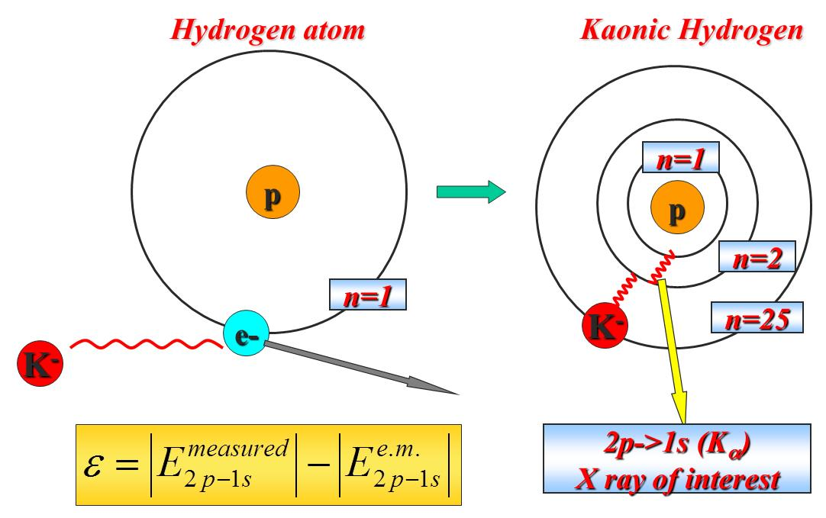
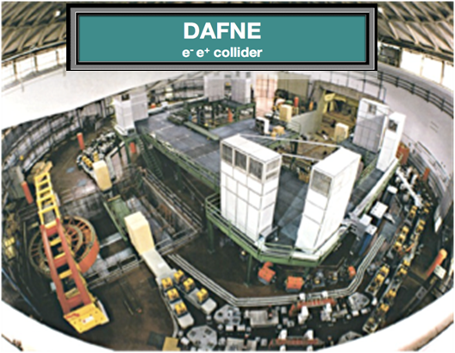
SIDDARTHA-2 Experiment
Goal of the Experiment
KAONNIS
Strong interaction studies al low energy through precise X-ray spectroscopy measurements of Kaonic atoms transitions
Main Goals:
Measurement of the strong interaction induced shift and width of the 1s state of kaonic deuterium and other heavier nuclei
Notes:
The measurements of the x-rays emitted by kaonic atoms allow to investigate the strong kaon-nuclei interaction at the low-energy frontier. The low-energy experimental data for kaonic atoms can be used to estimate the free parameters of the various phenomenological models describing strong interaction at low energies (below 1 GeV).
A kaonic atom is formed when a K− meson, stopped in a target material, is captured in an atomic system through its electromagnetic interaction with the nucleus. The captured K− meson replaces an electron in a highly excited atomic level, followed by an electromagnetic cascade process which can bring it to the innermost atomic level, where the strong interaction between the kaon and the atomic nucleus induces a shift and broadening of the ground state with respect to the purely electromagnetic values, which become detectable with advanced x-ray spectroscopy techniques. The measurements of the 2p → 1s transitions in Kaonic Hydrogen (KH) and Kaonic Deuterium (KD) allow to extract the energy shift and width of the 1s levels resulting from the strong kaon-nucleon interaction. From their values, one can extract the antikaon-nucleon isospin-dependent scattering lengths.
The main goal of the SIDDHARTA-2 experiment is to measure the 2p → 1s atomic transition in KD and to extract the energy shift and width of the 1s atomic level, generated by the strong K−-N interaction.

Slide 11
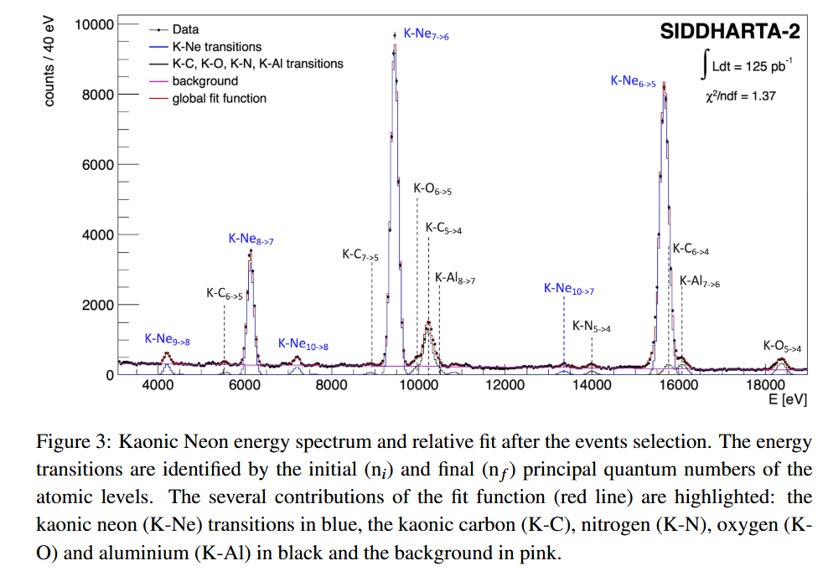
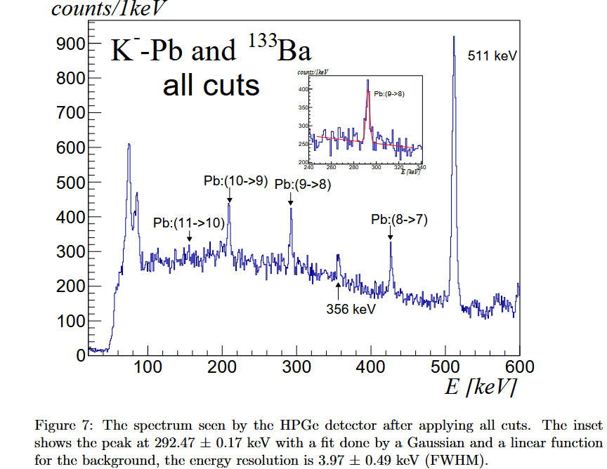
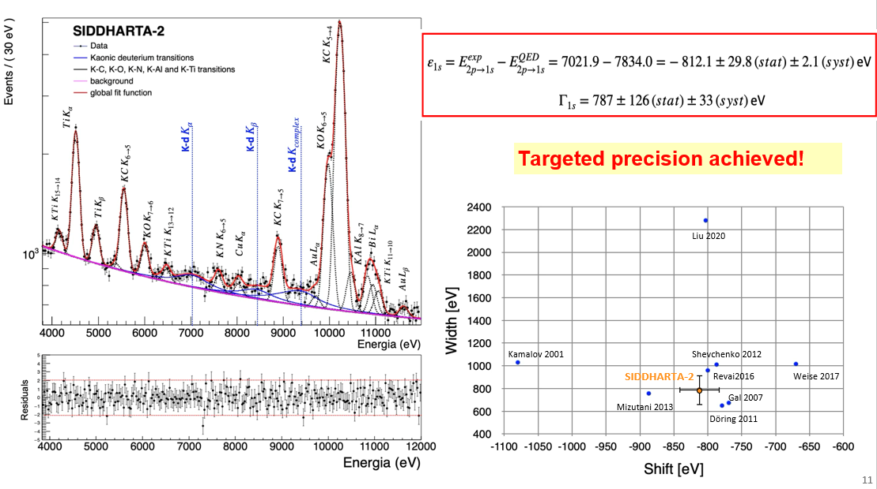
Main Outcomes of the SIDDARTHA-2 Experiment in 2024/2025
First Measurements with new Kaonic Atoms
(1)
(2)
Experimental activity in recent years:
2022: full SIDDHARTA-2 setup in run at DAFNE (till July 2022) with KHe and Kd (test run);
April 2023: SIDDHARTA-2 run with kaonic neon for debug and degrader optimization;
Until July 2024: Kaonic deuterium run (about 1000 pb-1; +kaonic atoms with SDDs, CZT; HPGe)
Main scientific outcomes in 2024/25:
(1) High precision spectroscopy of kaonic neon (first meas. ever) → Phys.Lett.B 865 (2025) 139492
(2) Kaonic lead measurement with HPGe (kaon mass) → Nucl.Instrum.Meth.A 1069 (2024) 169966
First Stability Characterization for a CZT Detection System in an e+e− Collider Environment → Sensors 24 (2024) 23, 7562
Measurement of the mesonic decay branch of the K¯NN quasibound state → Phys.Rev.C 110 (2024) 1, 014002
(3) Measurement of the 2p → 1s transitions in Kaonic Deuterium (KD) → paper in preparation: high-impact journal
(3)
Notes:
In 2022, the full SIDDHARTA-2 setup was installed in DAΦNE collider. The setup is made of 48 SDD arrays, each one made of 8 channels, silicon thickness 450 um. The experiment took test data with kaonic helium and other light kaonic atoms.
In 2023, SIDDHARTA-2 made a test run with kaonic neon for debug and degrader optimization. Since May it started the measurement of the 2p → 1s transition in KD. This measurement was performed with two periods of runs (Run 1 and Run 2) in 2023, and continued in 2024 with Run 3, achieving the required 800 pb⁻¹ of integrated luminosity. During these runs, measurements of other kaonic atoms, such as kaonic helium and neon for calibration purposes, also delivered unprecedented precision results, published in a series of articles.
During this period, the collaboration also started a program to develop detectors to measure atomic transitions in heavier kaonic atoms, in an energy range >15keV. The program was based on the development of:
An updated version of the current apparatus based on 1mm-thick SDDs, for energies up to 30keV. Milano group was responsible for the development of this new SDD detection module (see next slides)
Cadmium-zinc-telluride (CZT) detectors for intermediate kaonic atoms measurements (30keV-300keV)
High purity germanium detectors for heavy kaonic atoms measurements

Slide 12
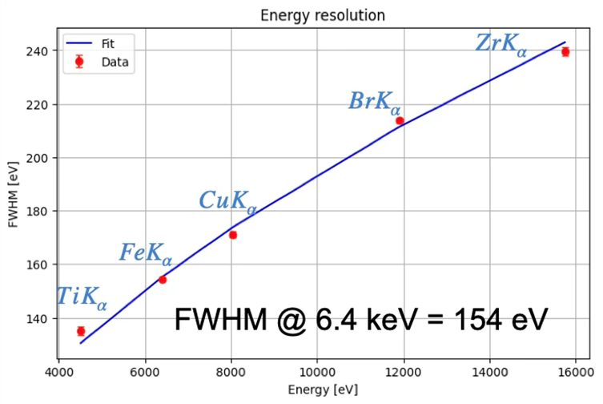
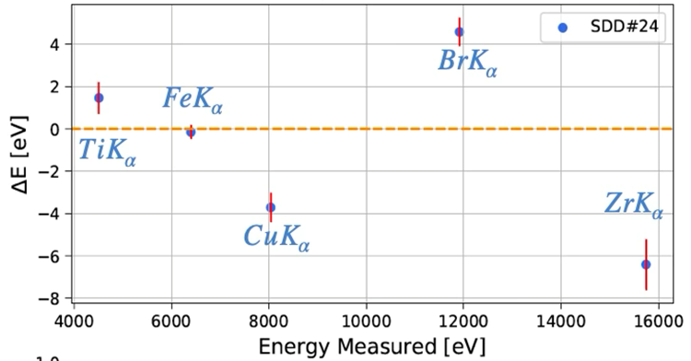
Work of Politecnico di Milano Group
Development and Production of the new SDD Detector Modules
New single-SDD module (upgrade of current SDD modules):
1-mm-thick SDDs to improve sensitivity to high-energies
New focusing electrode to reduce charge sharing
Main results:
4 modules assembled by Milano group and tested
Good energy resolution (~140 eV @ Mn-kα line)
Focusing electrode effective in reducing spectra background
2 modules tested in BTF run (cryogenic conditions)
More tests performed with X-ray tube @LNF: good energy resolution and linearity
Assembly process transferred to FBK by Milano group for series production (60 modules):
Technical discussions and tests to transfer the process
Procurement of all the components needed to assemble the detector
Design, production and delivery to the partner of the electronic boards required to test the detectors
Preproduction results:
12 modules fully assembled and preliminarily tested in FBK: yield ~100 %
2 modules now under test at cryo temp. @ LNF with good results
Notes:
In 2024, Milano group worked on the development and testing of a new SDD module based on the new 1mm-thick SDD modules. The novelties introduced in the module are:
Adaptation of the geometry to the new sensor dimension (larger termination regions due to the thicker substrate)
New PCB substrate material to increase number of layers and improve signal integrity (from ceramic PCB to halogen-free material)
Particular attention was dedicated to checking that the new PCB substrates do not contain trace elements that could generate contamination signals. Thermal cyclings at cryogenic temperatures were also performed to test the mechanical robustness of the module to large temperature variations.
As a result of this work, four (partially) working modules were assembled in Milano using the final module design and were delivered to Frascati for a BTF run and for further spectroscopic tests performed with the new version of the readout electronics developed by Frascati. These 1-mm-thick detectors achieved an energy resolution <=140 keV @ Mn-Kα energy (5.9keV) and demonstrated the effectiveness of the focusing electrode introduced on the detector window to reduce the charge sharing between channels.
Since the mid of 2024 Milano group also investigated different options to find an external partner (company or research institute) who could carry out the production in series of the single-SDD modules (about 60 modules). The most interesting option resulted to be Fondazione Bruno Kessler (FBK), where the SDDs were also produced.
In 2025, Milano group worked to transfer to FBK the assembly process and took care of the procurement of all the components needed for the series production (ASICs, PCBs, mechanical pieces, etc). In spring 2025, FBK built the first 12 modules to test the assembly procedure (pre-production) and made preliminary spectroscopic test on them at -20C: the yield was excellent since 100% of channels were working.
Modules have been transferred now to LNF, were a couple of them are now under test at cryogenic temperatures.

Slide 13
Polimi Budget Requests and FTE
For 2026
Richieste preventivi 2026 – Sezione di Milano
Consumo: tot. 20.0 keuro
Produzione di ASIC di preamplificazione a basso rumore ottimizzati per CZT 12.0k
Materiale per bonding 2.0k
Schede PCB e componenti per test rivelatori + assemblaggio esterno 4.5k
Materiale per stampe 3D componenti per moduli rivelazione e box di alloggiamento 1.5k
Manutenzione: tot 2.0 keuro
Riparazione oscilloscopio 2.0k
Licenze software: tot 2.0 keuro
Contributo per licenza Cadence (ASIC design) 2.0k
Missioni: tot 8.0 keuro
Missioni Italia 6.0k
Missioni Estero 2.0k
Totale Milano: 32.0 keuro
Partecipanti all’esperimento 2026 – Sezione di Milano: tot. 3.5 FTE
Giacomo Borghi (responsabile locale) – Prof. Associato 0.5 FTE
Giacomo Ticchi – Assegnista 1.0 FTE
Pietro Barcella – Dottorando 1.0 FTE
Nassi Leonardo – Dottorando 1.0 FTE
Notes:
In 2026, Milano group will participate to the Siddharta experiment with 4 people (3.5 FTE).
Beyond SIDDHARTA-2, the KAONNIS project will work on the EXKALIBUR (EXtensive Kaonic Atoms research: from LIthium and Beryllium to URanium) proposal. The aim of EXKALIBUR is to perform unique kaonic atom measurements along the whole periodic table, to build a solid basis for all theories and models relying on kaonic atoms.
The LNF scientific committee encouraged the experiment to continue their good work developing and testing X-ray detectors for EXKALIBUR, yet to explore also how these developments can be used in other experimental setups in particular if DAΦNE will not further operate in collider mode.
Main financial requests of Milano group for 2026 are linked to the development and production of a low-noise preamplifier ASIC optimized for CZT detectors, since the development of these new detectors for kaonic atom spectroscopy will be one of the main R&D topic for 2026.

Slide 14
SIGLA | FTE | Meccanica mesi/uomo | Elettronica mesi/uomo | Missioni k€ | Consumo k€ | Inv. Appa. Etc … k€
KAONNIS | 3.5 | 0 | 0 | 8 | 20 | 2+2=4

Slide 15
GRUPPO 3 MILANO
LINEA 3
Struttura nucleare e dinamica di reazione
CHI-NEXT … nuova sigla …ex CHIMERA !
Nuova Sigla: Multirivelatore CHImera - Neutron EXotic Tagging: study Reactions and EOS…

Slide 16
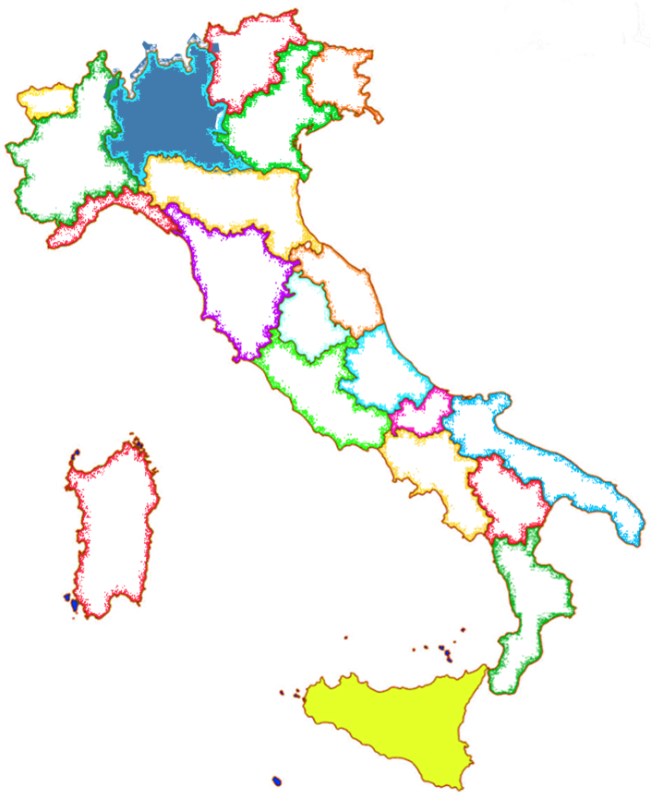
CHI-NEXT (2026-2028)
CHImera – Neutron EXotic Tagging
Resp. Nazionali: Sara Pirrone (INFN-CT) & Paolo Russotto (INFN-LNS)
Sezione di Milano (RL: C.Guazzoni)
Richieste Servizi Milano 2026
      = Servizio Elettronica:
      1.5 mesi/uomo (nella persona di Ciro Boiano, per conoscenza setup)
      = Uso CleanRoom e Bonding Machine (???)
      = Servizio Officina Meccanica:
      1 mese/uomo
      - supporti bonding rivelatore
      piccole lavorazioni flange
      stampa particolari 3D
      consulenza struttura meccanica sistema di tagging
      consulenza meccanica montaggio rivelatori per beam test
Sezione di Catania (RL: Ε. Geraci)
LNS (RL: E.V.Pagano)
Anagrafica Milano 2026
C. Guazzoni (PA, RL) 0.8 FTE
Castoldi (PO) 0.8 FTE
M. Pozzi (AdR Polimi) 1 FTE
M. Ghisetti (AdR Polimi) 0.5 FTE
Mason (PhD Polimi) 1 FTE
TOT FTE @ Milano 2026: 4.1 FTE in crescita rispetto a CHIRONE

Slide 17
CHI-NEXT (2026-2028)
CHImera – Neutron EXotic Tagging
Resp. Nazionali: Sara Pirrone (INFN-CT) & Paolo Russotto (INFN-LNS)
Sezione di Milano (RL: C.Guazzoni)
Richieste Servizi Milano 2026
      = Servizio Elettronica:
      1.5 mesi/uomo (nella persona di Ciro Boiano, per conoscenza setup)
      = Uso CleanRoom e Bonding Machine (???)
      = Servizio Officina Meccanica:
      1 mese/uomo
      - supporti bonding rivelatore
      piccole lavorazioni flange
      stampa particolari 3D
      consulenza struttura meccanica sistema di tagging
      consulenza meccanica montaggio rivelatori per beam test
Sezione di Catania (RL: Ε. Geraci)
LNS (RL: E.V.Pagano)
Anagrafica Milano 2026
C. Guazzoni (PA, RL) 0.8 FTE
Castoldi (PO) 0.8 FTE
M. Pozzi (AdR Polimi) 1 FTE
M. Ghisetti (AdR Polimi) 1 FTE
Mason (PhD Polimi) 1 FTE
TOT FTE @ Milano 2026: 4.6 FTE in crescita rispetto a CHIRONE

Slide 18
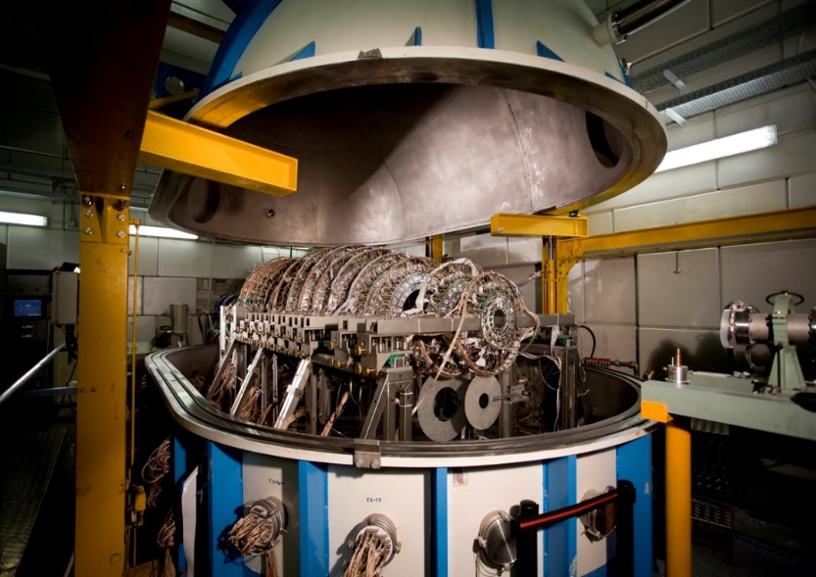
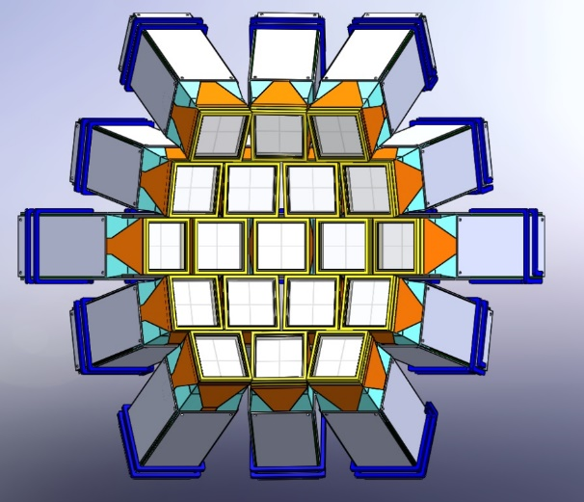
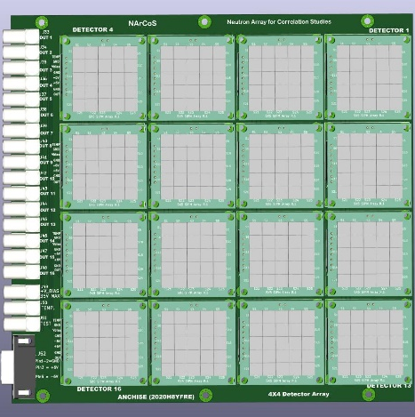
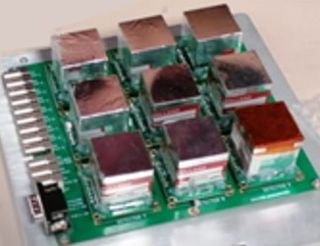
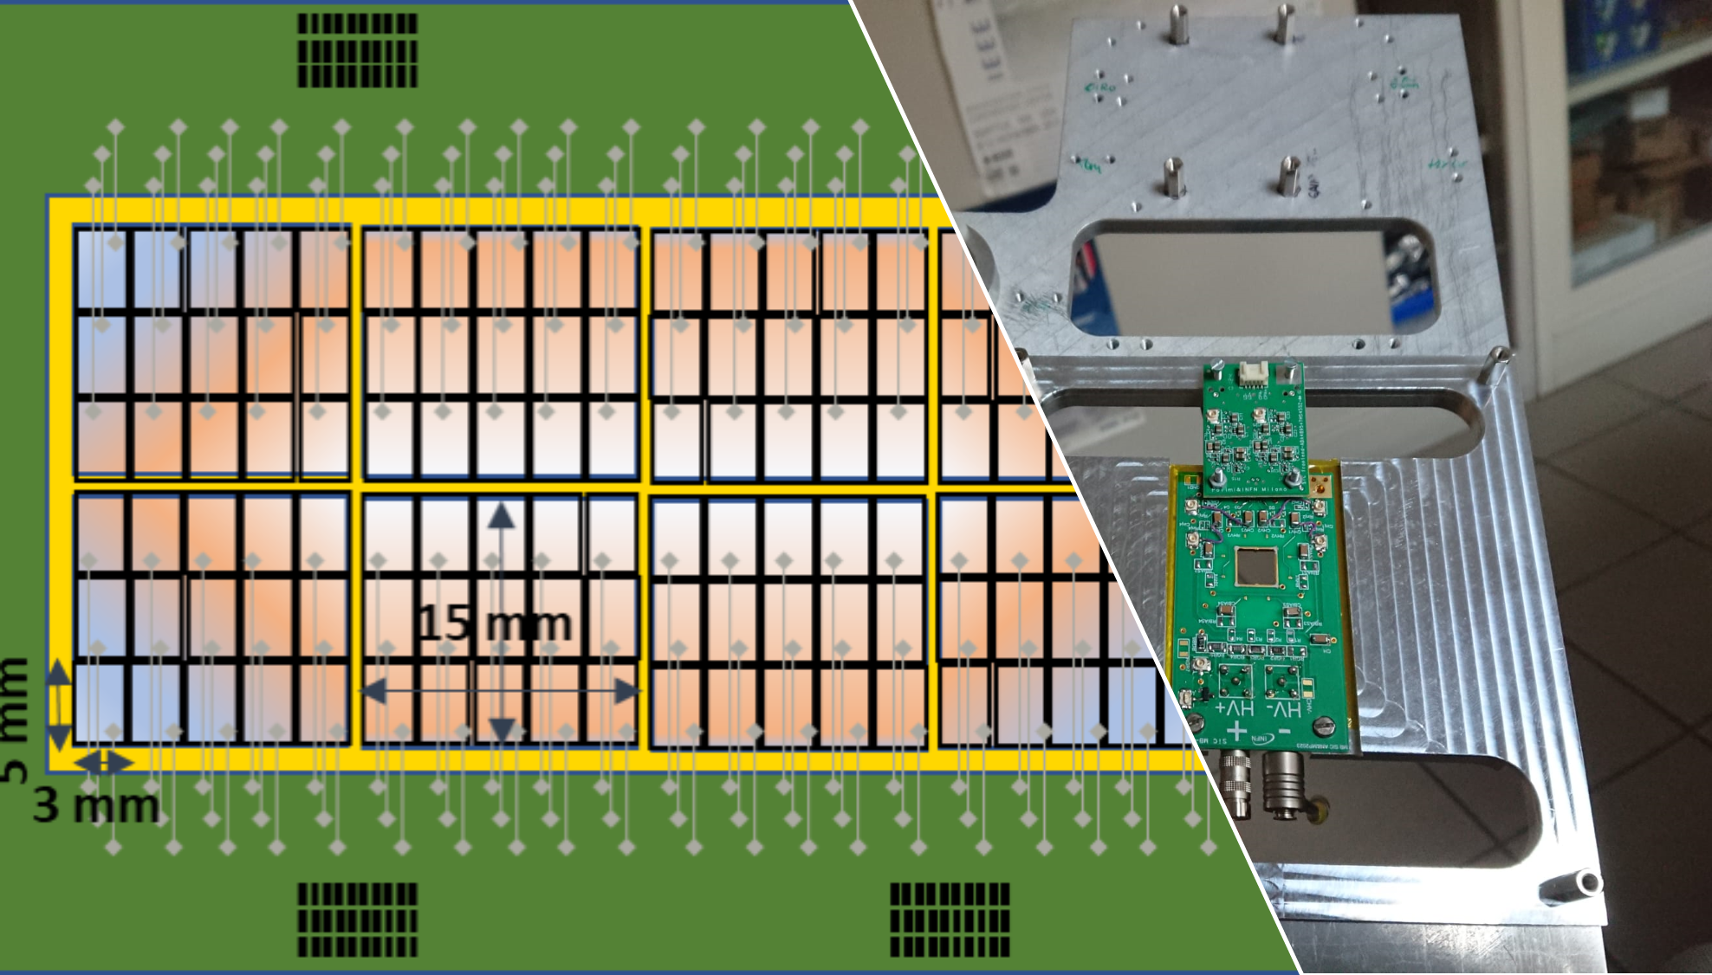
CHIRONE & CHI-NEXT: the detectors
CHIMERA
FARCOS – Femtoscopy Arrayfor Correlation and Spectroscopy
Upgraded during CHIRONE experiment
To Digital Data Acquisition and continuosly maintened
Commissioned during CHIRONE experiment – modules used at GSI
Under development…
NARCOS – Neutron Array for Correlation and Spectroscopy
SiC based Beam Tagging System

Slide 19
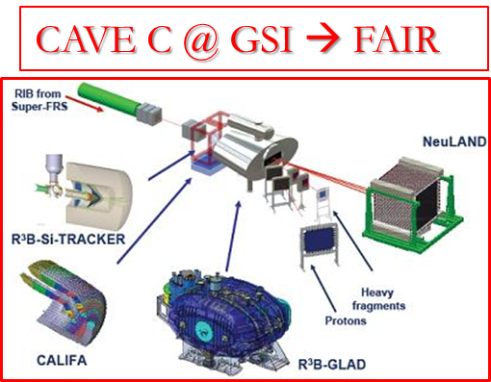
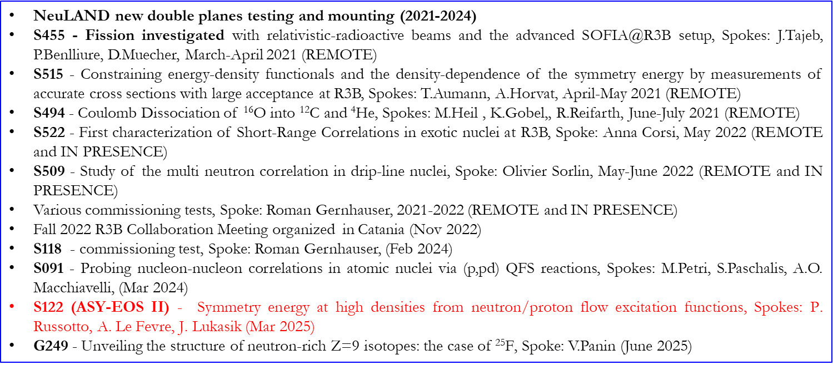
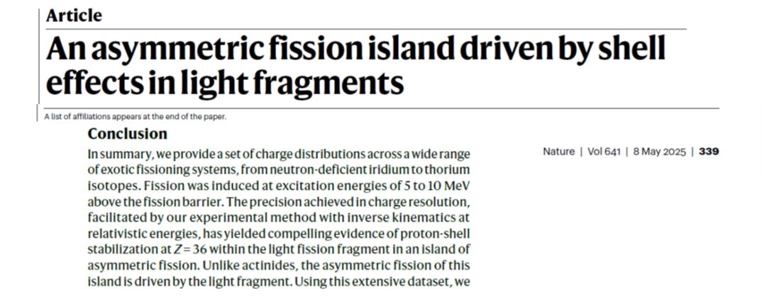
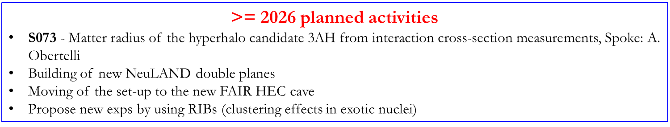
Experiments @ GSI within the R3B collaboration

Slide 20
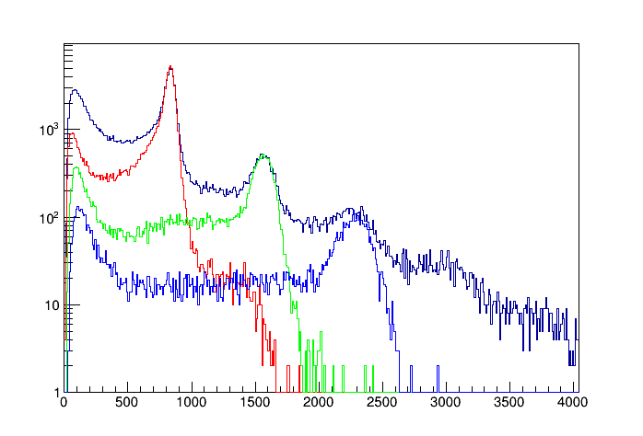
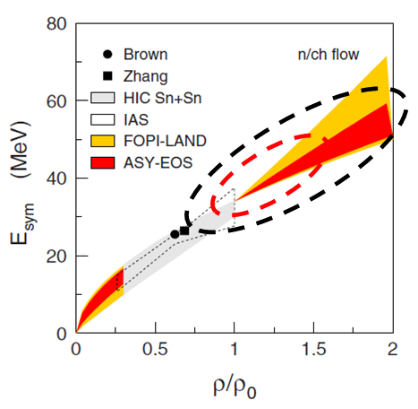
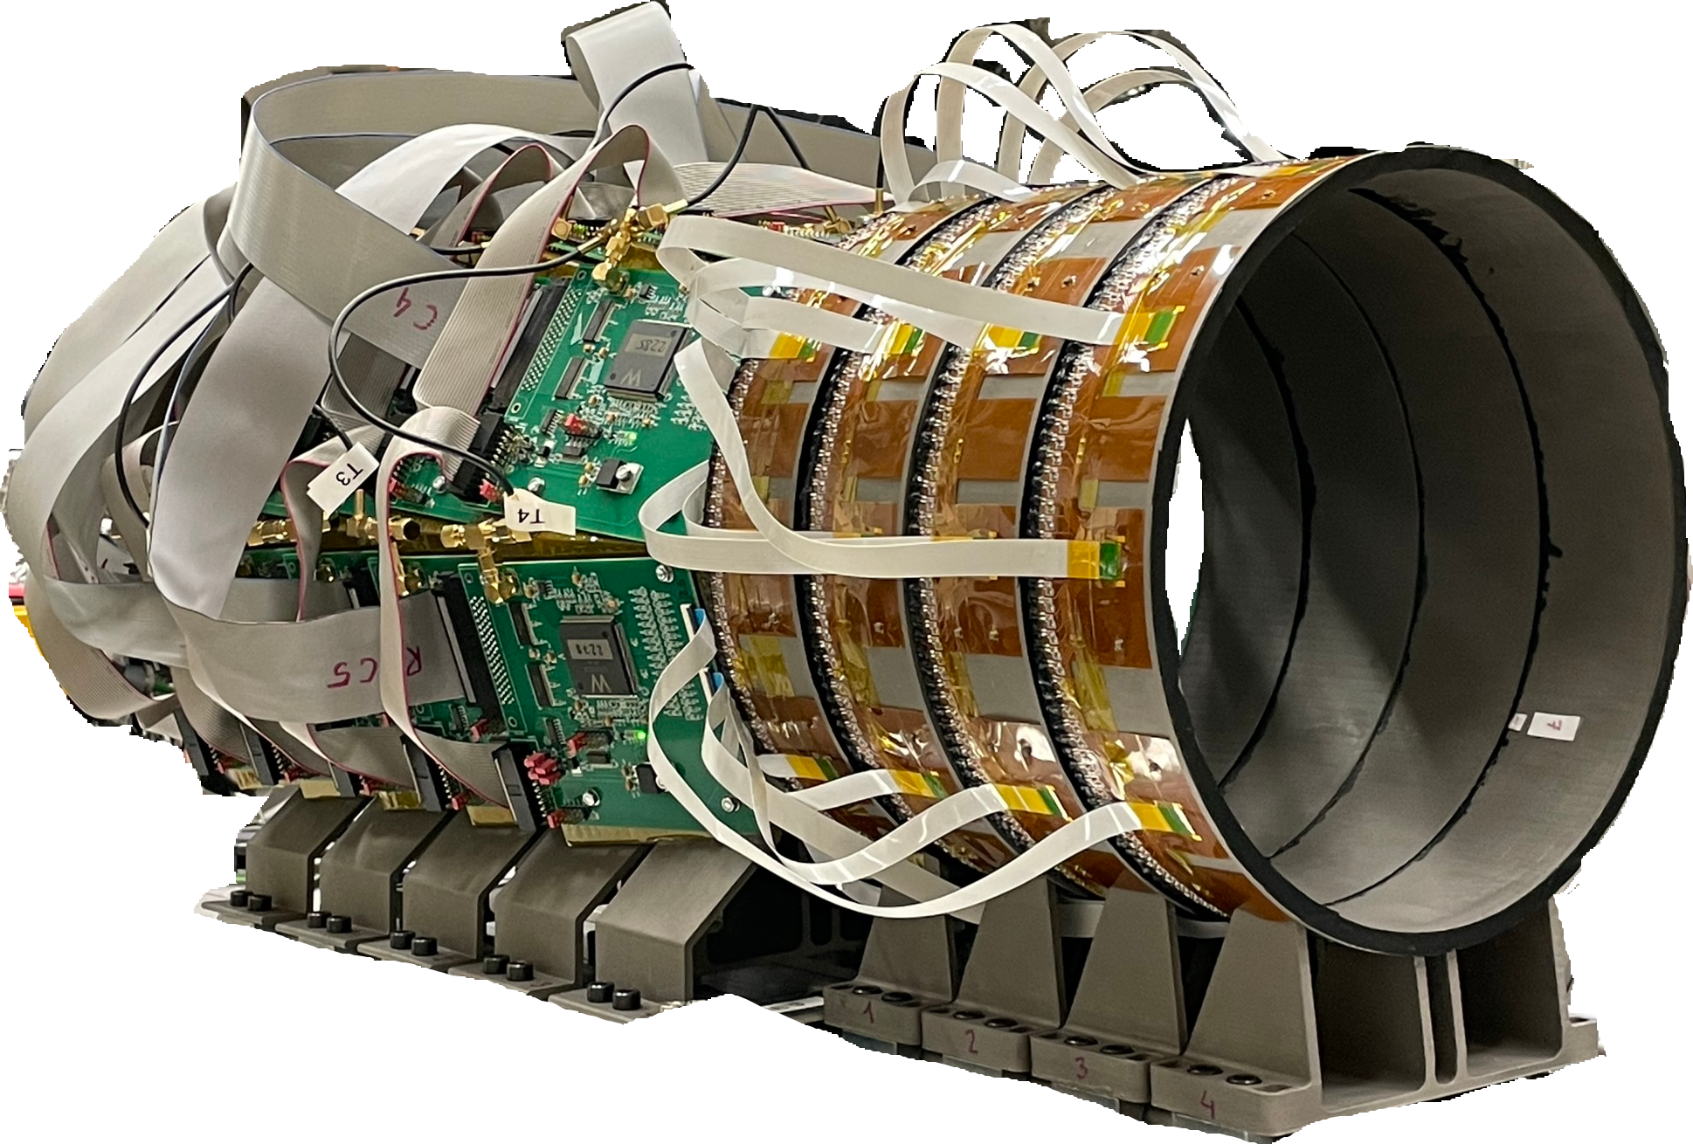
S122 (ASY-EOS II)@GSI - Symmetry energy at high densities from neutron/proton flow excitation functions (Mar 2025)
Density probed in the ASY-EOS II exp, most relevant for neutron star physics
improved resolution…
ASY-EOS I (2011): Au+Au @ 400 AMeV
P. Russotto et al., PRC 94, 034608 (2016)
KRAB: new detector for reaction plane determination and on-beam centrality selection
Mass (arb.units.)
density probed by the ASY-EOS I
NeuLAND: capability to resolve p,d,t
…and higher densities
¹³²Sn+¹²⁴Sn (b=1 fm)
Bao-An Li, NPA 708 (2002)
Beam | Energy [AMeV] | Justification
¹⁹⁷Au+¹⁹⁷Au | 250 | highest sensitivity on K_{sym}
¹⁹⁷Au+¹⁹⁷Au | 400 | reference to ASY-EOS I, n/p tests higher densities than before
¹⁹⁷Au+¹⁹⁷Au | 800 | highest sensitivity on L, high-density tested

Slide 21
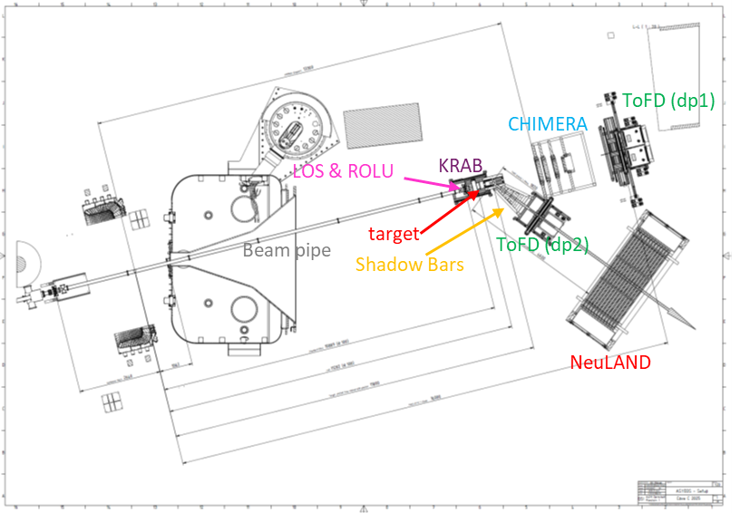
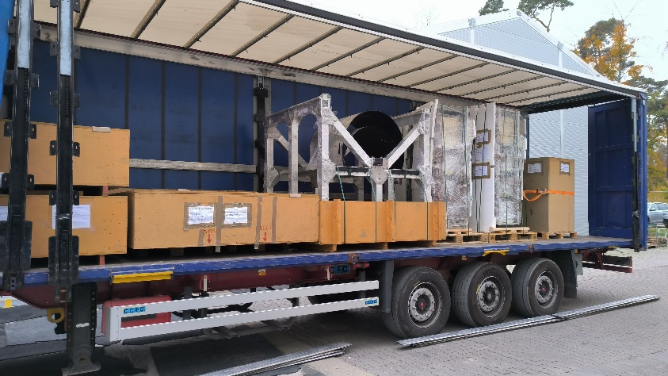
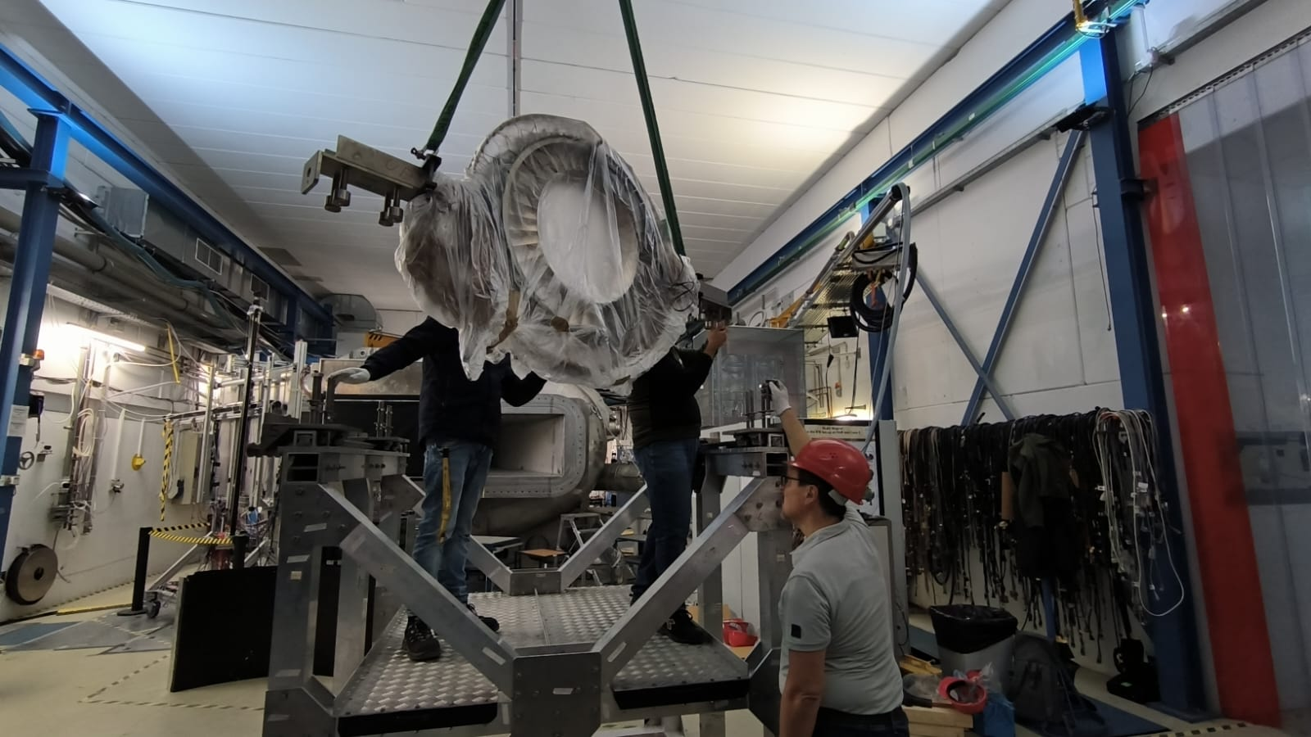
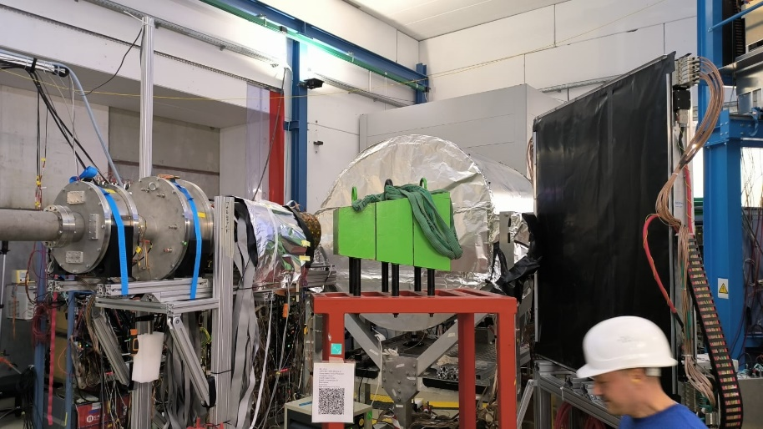
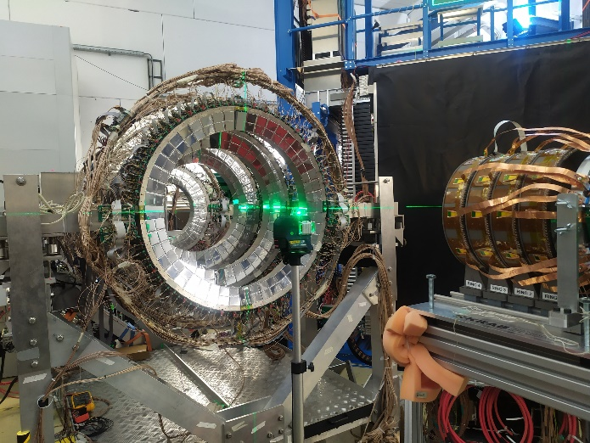
S122 (ASY-EOS II) - Symmetry energy at high densities from neutron/proton flow excitation functions (Mar 2025)

Slide 22
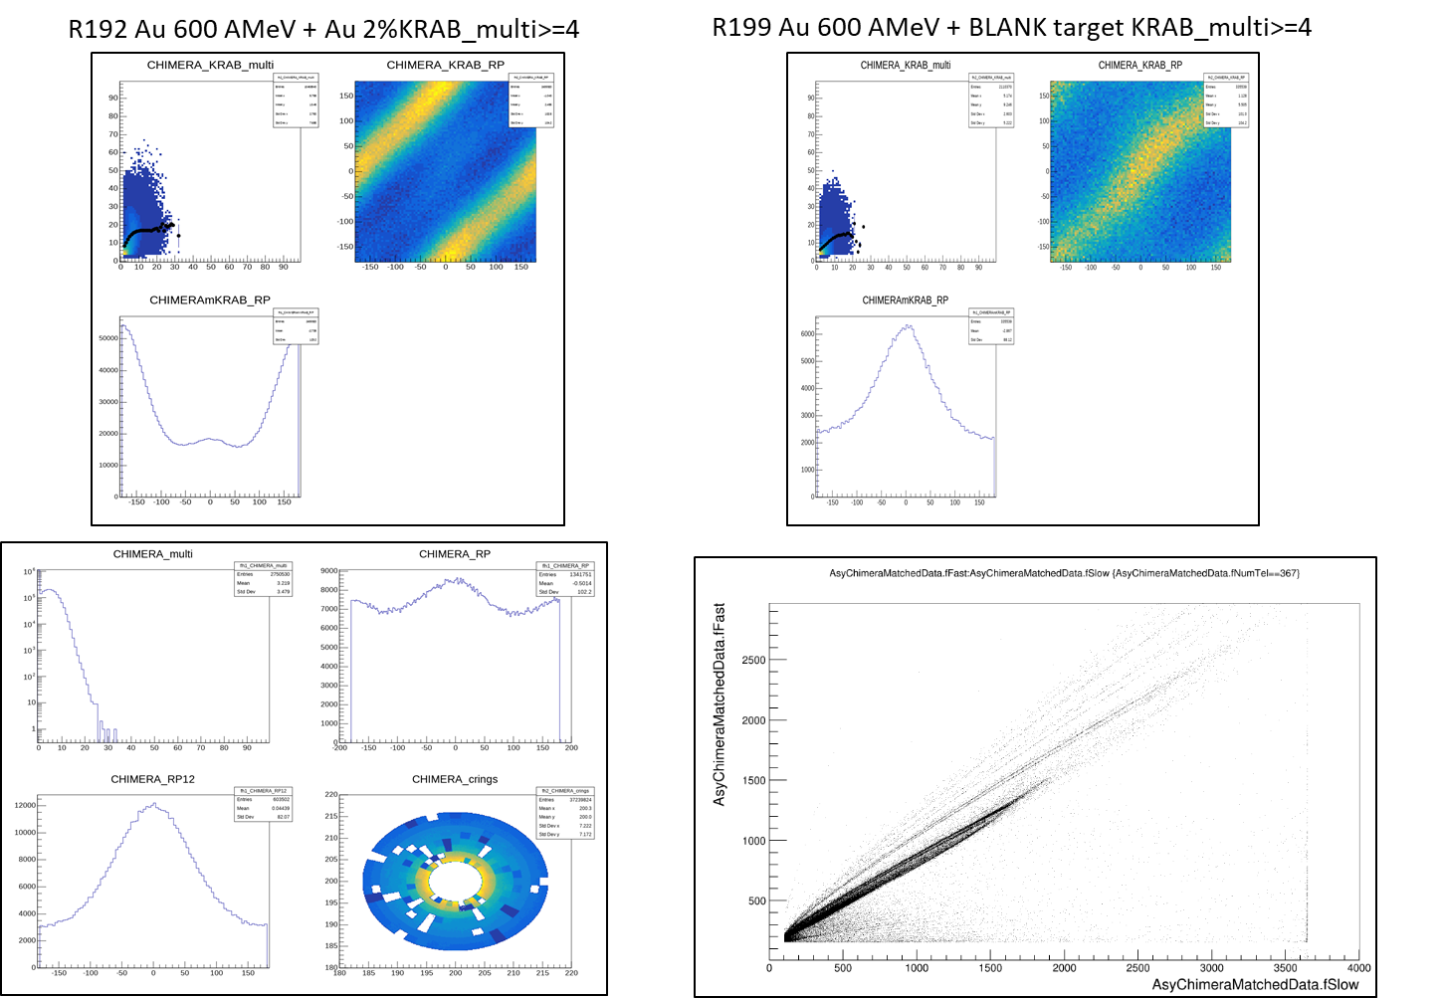
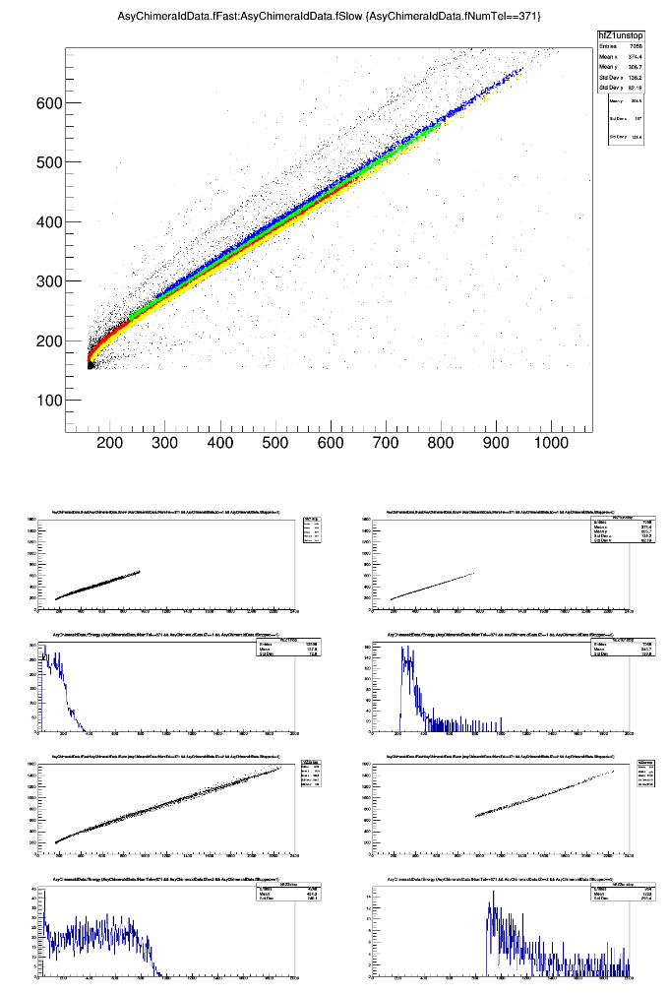
S122 (ASY-EOS II) - Symmetry energy at high densities from neutron/proton flow excitation functions (Mar 2025)

Slide 23
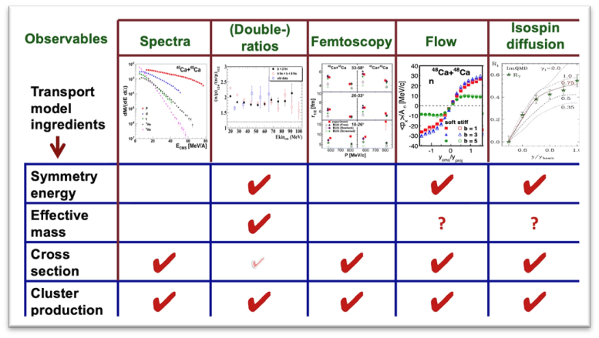
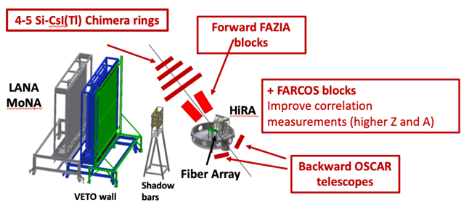
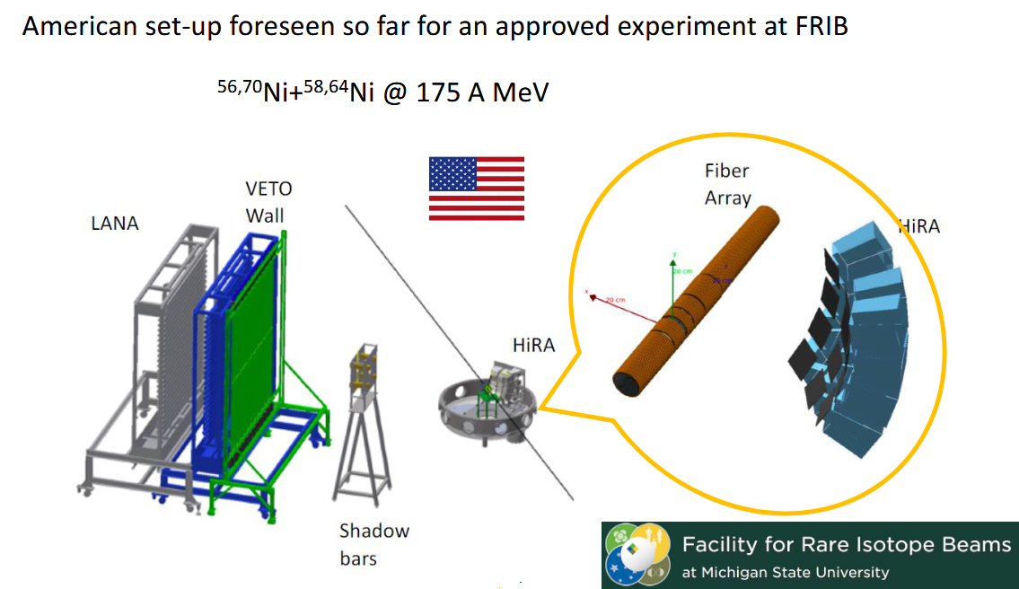
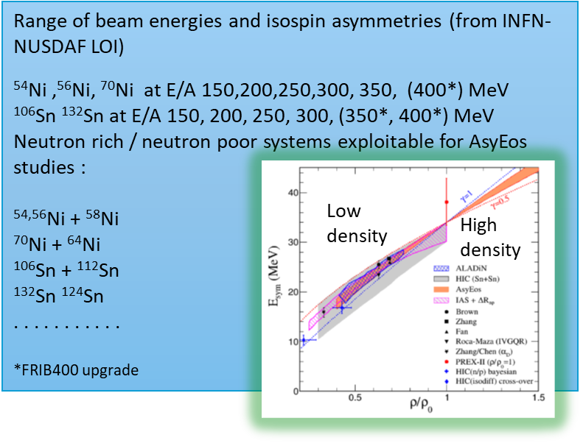
NUSDAF – Devices and beams at FRIB for SYMEOS (Symmetry energy and Equation of State)
From LOI at FRIB
Hypothetic setup at FRIB with INFN devices from LOI
1° NUSDAF collaboration meeting in October 2025 in Catania
In 2026 we foresee to take part in the already scheduled beamtime with some FARCOS telescopes and some NARCOS workhorses to probe the feasibility of coupling with the US setup and the MSU DAQ.

Slide 24
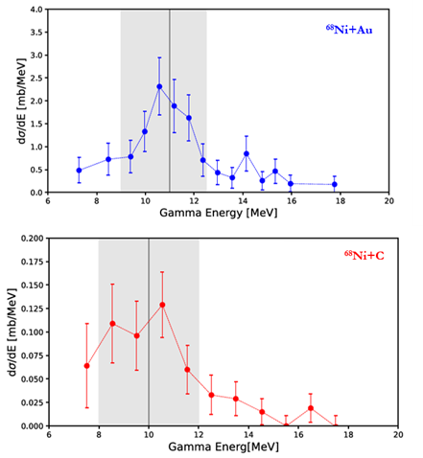
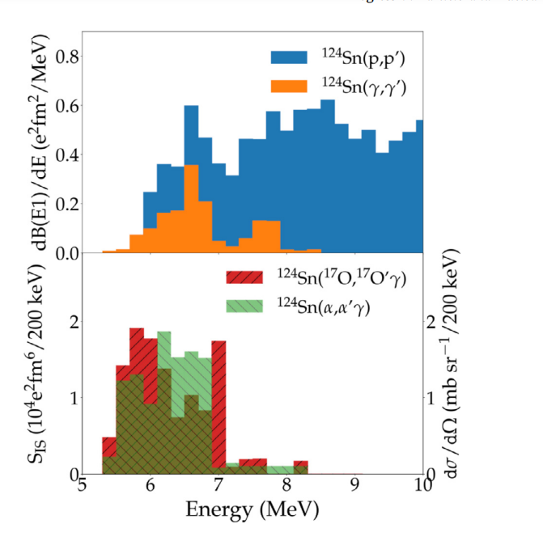
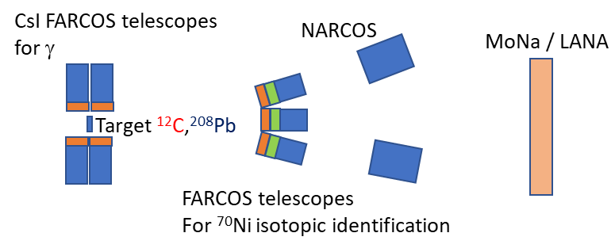
Investigations of Pygmy Dipole Resonances at FRIB & LNS
The pygmy dipole excitation has been studied in ⁶⁸Ni showing the possibility to excite it both with isovector (coulomb excitation GSI) and isoscalar probes (LNS Carbon target CHIMERA & FARCOS)
Differently from stable nuclei ( see for instance ¹²⁴Sn on the right) in which the Pygmy resonance is mostly visible at excitation energy lower than the particle decay threshold, very small differences from isovector and isoscalar excitation have been observed
We plan to extend the investigation to ⁷⁰Ni at FRIB
8 FARCOS telescopes at forward angles 1°-8° to detect and isotopically identify scattered 70Ni. Different configuration for isoscalar (2 stages 300 nd 1500 mm) and isovector (2 stages 1500-1500 mm)
12 FARCOS telescopes around the target for gamma ray detection

Slide 25
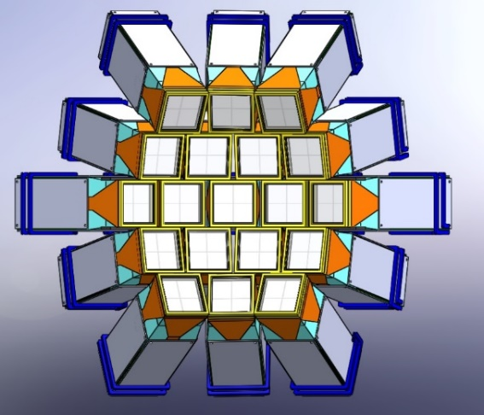
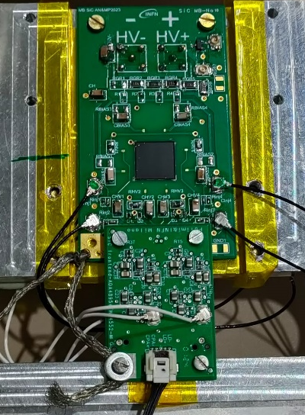
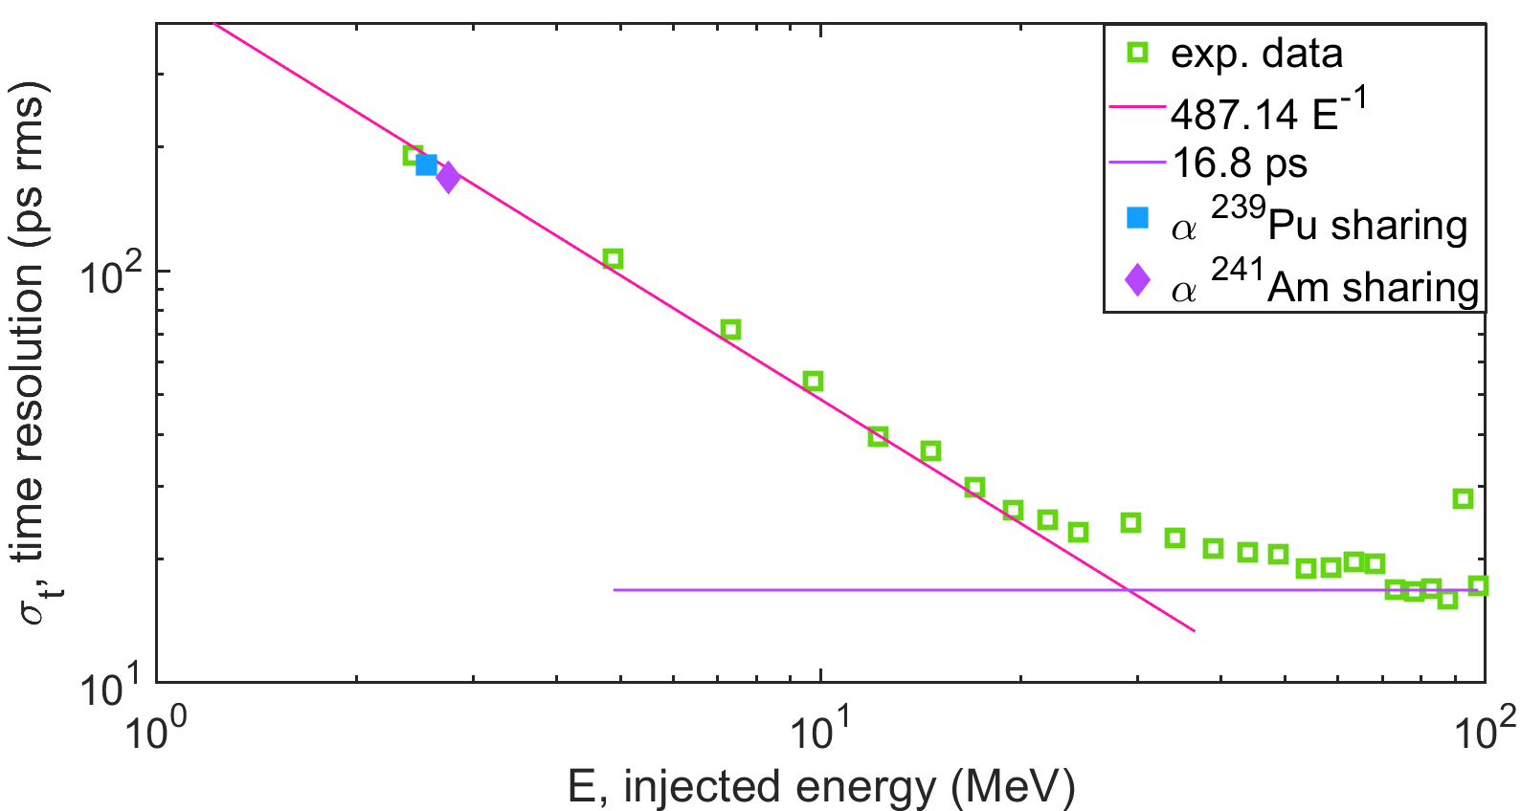
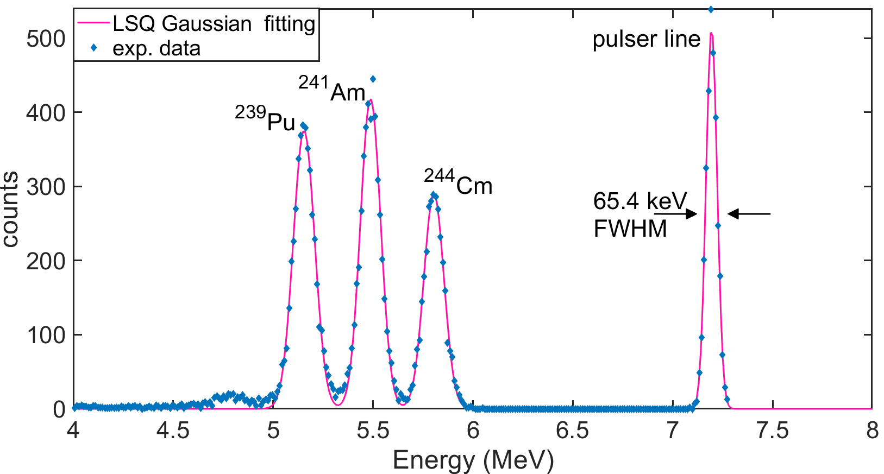
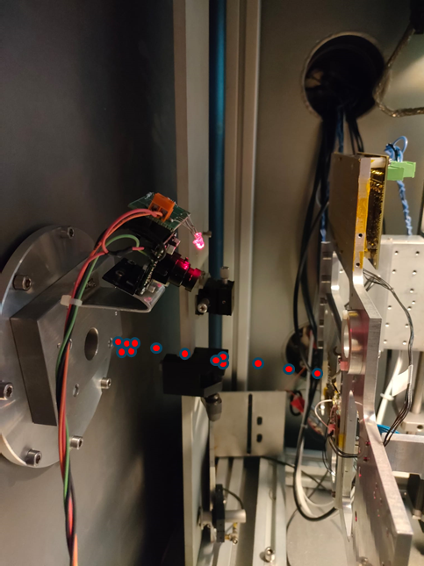
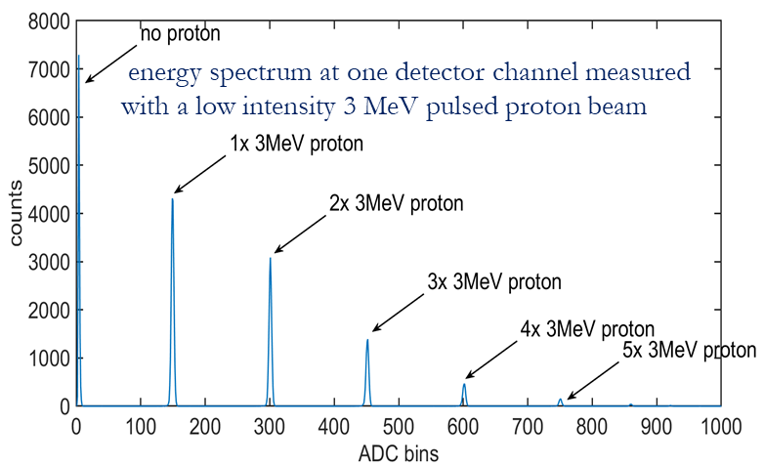
Da CHIRONE (2021-2025) a CHI-NEXT (2026-2028)
CHIRONE @ MILANO: main achievements
FARCOS array use at GSI
Prototype of a SiC based tagging system for RIBs
65 keV FWHM
< 20 ps rms
FARCOS used in the experiment at GSI
@ DEFEL – LABEC (INFN, Sesto Fiorentino - FI, Italy) - beamtime April 7-11, 2025
better than 100 keV FWHM energy resolution measured!
better than 100 ps time resolution measured!
design defined for the final large-format system assembly
NARCOS array
activity related to the PRIN ANCHISE (3 years project starting June 2022 cod. 2020H8YFRE - INFN-Unict-UniMe-PoliMI
@ HIL (Warsaw, Poland) T-INSIDE experiment, June 23-27, 2025

Slide 26
Da CHIRONE (2021-2025) a CHI-NEXT (2026-2028)
CHI-NEXT @ MILANO: plan of activity
Full development of the SiC based tagging system and qualification under beam in collaboration with CT and LNS
motherboard, powerboard, interconnections, flanges design
new detector prototypes qualification in the lab and with dedicated beam tests (LABEC, Madrid/HIL)
16/32 channels frontend boards design
individual component qualification and verification of the performance of the assembled prototype
full mounting within a spherical DN160 cross, qualification and commissioning in 2027 - 2028
R&D and upgrade activity for the NARCOS (Neutron Array for Correlation Studies) detection system
Upgrade of the readout of the EJ276 scintillator crystals to optimize the granularity of the readout channels in order to improve performance by reduction of the input capacitance
Exploitation of the readout granularity to increase the position resolution of the interaction vertex within the crystal
Implementation of Pulse Shape Analysis/position sensing algorithms in the firmware of the digitizer board (embedded FPGA)
Development of 1 prototype cluster with upgraded readout (2027-2028)

Slide 27
CHI-NEXT (2026-2028) - Richieste Finanziarie @ Milano
MISSIONI: 13.7 k€ + 1.8 k€ SJ
Spostamenti Responsabile Locale e riunioni di collaborazione 0.5 k€
Missione @INFN-CT/LNS per iniziative specifiche (SiC) (x 3 viaggi, x2 pp) 4.2 k€
Missione @Madrid o @HIL Varsavia per qualificazione rivelatori SiC con acceleratore 2.5 k€
Missione @Labec per qualificazione rivelatori SiC con protoni (x 1 viaggio, x2 pp) 1.8k€ SJ
Missione @INFN-CT/LNS per iniziative specifiche (NARCOS) (x 2 viaggi, x1 pp) 2.0 k€
Test NARCOS su fascio (x1 viaggio, x2 pp) 2.0 k€
Missione MSU per test NUSDAF FARCOS & NARCOS at FRIBS (x1 viaggio, x1 pp) 2.5 k€
CONSUMO: 10.0 k€
materiale specifico da laboratorio: filo bonding, colle, alcool isopropilico, thermal pads 4.0 k€
rinnovo cablatura 2.5 k€
materiale consumo per montaggi e test 3.0 k€
materiale stampante 3D 0.5 k€
COSTRUZIONE APPARATI: 19.5k€ + 1.5k€ SJ
PCB custom for SiC MB + mounting 4.5 k€
PCB frontend SiC + mounting 6.0 k€
componenti attivi e passivi 9.0 k€
meccanica SiC 1.5k€ SJ
INVENTARIO: 9.0k€
Alimentatore LV/HV per SiPM NARCOS @ MI & frontend 9.0k€
TRASPORTO: 1.5 k€​
Trasporti elettronica, flange/cavi da/per CT/LNS e per sedi misura 1.5 k€

Slide 28
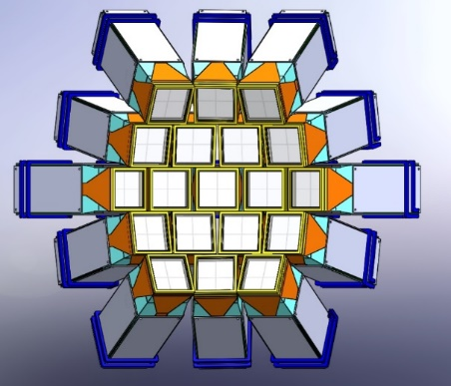

Da CHIRONE (2021-2025) a CHI-NEXT (2026-2028)
CHIRONE @ MILANO: main achievements
CHI-NEXT @ MILANO: plan of activity
FARCOS array in wall configuration
Full development of the SiC based tagging system for RIBs and qualification under beam in collaboration with CT and LNS
FARCOS frontend electronics fully developed and mounted
Advanced interconnections to preserve signal interity
Detectors used in the first experiments
motherboard, powerboard interconnections, flanges
16/32 channels frontend boards
mounting, qualification and commissioning
Prototype of a SiC based tagging system for RIBs
R&D and upgrade activity for the NARCOS detection system
Upgrade of the readout of the EJ276 scintillator crystals to optimize the granularity of the readout channels in order to improve performance by reduction of the input capacitance
better than 100 keV FWHM energy resolution measured!
better than 100 ps time resolution measured!
design defined for the final large-format system assembly

Slide 29
SIGLA | FTE | Meccanica mesi/uomo | Elettronica mesi/uomo | Missioni k€ | Consumo k€ | Inv. Appa. Etc … k€
CHI-NEXT | 4.6 | 1 | 1.5 | 13 | 10 | 21+9+1.5=31.5

Slide 30
GRUPPO 3 MILANO
LINEA 3
Struttura nucleare e dinamica di reazione
GAMMA
Studi di struttura nucleare con tecniche di spettroscopia GAMMA

Slide 31




GAMMA @ CSN3: studi di struttura nucleare con tecniche di spettroscopia GAMMA
RL: A. Giaz
RN: G. Benzoni (MI) e A. Gottardo (LNL)

Slide 32



















CAMPAGNE SPERIMENTALI COMPLEMENTARI
FASCI (stabili, instabili, neutroni) e APPARATI allo stato dell’arte, …
MARA
Separator
DUBNA
Oslo
JYFL
GANIL
Krakow
GSI
Orsay
Legnaro
ROSPHERE
ISOLDE
CERN
OSAKA
ILL
RIKEN
Bucharest
USA/CANADA
LNS
EXILL/FIPPS
TRIUMF
GALILEO Array at LNL
Working horse for

Slide 33




AGATA: Advanced Gamma Tracking Array based on segmented detectors
Campagna di Fisica: @ LNL 2021 ➔ 2028 - @ GANIL 2028 ➔ 2030
AGATA accoppiata a spettrometro PRISMA: campagna sperimentale ongoing
AGATA coupled with PRISMA: Current Configuratiuon
46 experiments performed:
2022-2024: ~7000 hours of beam on target !
2025: already 750 hours of beam on target
2026 AGATA zero degrees
2026: Spostamento verso nuova configurazione “stand-alone”
Progettazione camera di scattering + linea di fascio: ufficio progettazione @INFN-MI
Nuovo read-out scheme per rivelatori ancillari: S.Brambilla, C.Boiano, S.Capra
Integrazione con Scintillatori: F.Camera e A. Giaz
Servizi:
Elettronica ancillary silicio: servizio di elettronica
Supporto per installazione: Officina meccanica
supporto per campagna di presa dati e istallazione ~ 100 trasferte nel 2026
Presentazione di Proposal a spokes di UniMi e INFN-MI
Notes:
Collaborazione Italiana ha chiesto prolungamento della campagna in vista di SPES oltre al 2025, in discussion a Settembre
Si ringrazia Ufficio progettazione e Officina meccanica per supporto e realizzazione camera di scattering attualmente in uso
Si sottolinea forte impegno della sezione nel supporto alla campagna sperimentale con circa 60 trasferte nei primi 6 mesi dell’anno, anche grazie a ADR dedicato appena rinnovato
Attivita’ altamente formative anche per student e dottorandi coinvolti in varie tipologie di esperimenti
0° gradi 2026 –
Officina progettazione e verrà coinvolta nell’istallazione
Elettronica readout system ancillary al silicio
GANIL 2028-2030

Slide 34
AGATA: Advanced Gamma Tracking Array based on segmented detectors
Campagna di Fisica: @ LNL 2021 ➔ 2028 - @ GANIL 2028 ➔ 2030
AGATA accoppiata a spettrometro PRISMA: campagna sperimentale ongoing
AGATA coupled with PRISMA: Current Configuratiuon
46 experiments performed:
2022-2024: ~7000 hours of beam on target !
2025: already 750 hours of beam on target
MOU attivo fino a 2030 (2025 review just finished)
Richiesta per 2026: 575 k€ (IVA incl.)
OC 2026: 138 k€ (IVA incl.)
2026 AGATA zero degrees
2026: Spostamento verso nuova configurazione “stand-alone”
Progettazione camera di scattering + linea di fascio: ufficio progettazione @INFN-MI
Nuovo read-out scheme per rivelatori ancillari: S.Brambilla, C.Boiano, S.Capra
Integrazione con Scintillatori: F.Camera e A. Giaz
Servizi:
Elettronica ancillary silicio: servizio di elettronica
Supporto per installazione: Officina meccanica
supporto per campagna di presa dati e istallazione ~ 100 trasferte nel 2026
Presentazione di Proposal a spokes di UniMi e INFN-MI
Notes:
Collaborazione Italiana ha chiesto prolungamento della campagna in vista di SPES oltre al 2025, in discussion a Settembre
Si ringrazia Ufficio progettazione e Officina meccanica per supporto e realizzazione camera di scattering attualmente in uso
Si sottolinea forte impegno della sezione nel supporto alla campagna sperimentale con circa 60 trasferte nei primi 6 mesi dell’anno, anche grazie a ADR dedicato appena rinnovato
Attivita’ altamente formative anche per student e dottorandi coinvolti in varie tipologie di esperimenti
0° gradi 2026 –
Officina progettazione e verrà coinvolta nell’istallazione
Elettronica readout system ancillary al silicio
GANIL 2028-2030

Slide 35
AGATA: Advanced Gamma Tracking Array based on segmented detectors
Campagna di Fisica: @ LNL 2021 ➔ 2028 - @ GANIL 2028 ➔ 2030
AGATA accoppiata a spettrometro PRISMA: campagna sperimentale ongoing
AGATA coupled with PRISMA: Current Configuratiuon
AGATA(Ita)@ INFN → 2025 until 2028
GRAZIE @
Ufficio progettazione e Officina meccanica
per camera di scattering
INFN Milano 60 trasferte 2025 finora
Formativo anche per student e dottorandi nei esperimenti 0° gradi 2026
Officine verranno coinvolti nell’istallazione di campagne attuali e sviluppi futuri
46 experiments performed:
2022-2024: ~7000 hours of beam on target !
2025: already 750 hours of beam on target
2026 AGATA zero degrees
2026: Spostamento verso nuova configurazione “stand-alone”
Progettazione camera di scattering + linea di fascio: ufficio progettazione @INFN-MI
Nuovo read-out scheme per rivelatori ancillari: S.Brambilla, C.Boiano, S.Capra
Integrazione con Scintillatori: F.Camera e A. Giaz
Servizi:
Elettronica ancillary silicio: servizio di elettronica
Supporto per installazione: Officina meccanica
supporto per campagna di presa dati e istallazione ~ 100 trasferte nel 2026
Presentazione di Proposal a spokes di UniMi e INFN-MI
Notes:
Collaborazione Italiana ha chiesto prolungamento della campagna in vista di SPES oltre al 2025, in discussion a Settembre
Si ringrazia Ufficio progettazione e Officina meccanica per supporto e realizzazione camera di scattering attualmente in uso
Si sottolinea forte impegno della sezione nel supporto alla campagna sperimentale con circa 60 trasferte nei primi 6 mesi dell’anno, anche grazie a ADR dedicato appena rinnovato
Attivita’ altamente formative anche per student e dottorandi coinvolti in varie tipologie di esperimenti
0° gradi 2026 –
Officina progettazione e verrà coinvolta nell’istallazione
Elettronica readout system ancillary al silicio
GANIL 2028-2030

Slide 36






HIGHLIGHTS GAMMA 2025: Campaigns at International Labs.
Phase-0 Campaign @GSI on going towards FAIR commissioning
2026 One experiment Milano leadership
Experimental campaign in Osaka
IFJ-PAN Krakow campaigns
2025 PDR measurements in ⁶⁴Ni isotope experiment on going (Milano leadership)
2026 two proposals: PDR in Zn isotopes and GDR in ⁴⁰Ca
Experimental campaign in Bucharest
Studies of Pygmy Resonance states built on hot compound nucleus: First ever experimental measurement
ELIFANT-GG@IFIN Bucharest
11 3x3 inch LaBr₃:Ce
10 3x3 inch CeBr₃
Isospin mixing: A. Giaz et al., PLB, 868, 2025, 139653
Notes:
Continuano misure presso laboratori internazionali di punta, GSI epr studi di nuclei esotici, OSAKA e Bucharest per studi di risonanze giganti e Pygmy,
in particolare da sottolineare la misura per la prima volta della Pygmy Resonance costruita su un nucleo caldo
E infine proseguono le misure al reattore di ILL

Slide 37
HIGHLIGHTS GAMMA 2025: Campaigns at International Labs.
Phase-0 Campaign @GSI on going towards FAIR commissioning
2026 One experiment Milano leadership
Experimental campaign in Osaka
Continuano 2026 misure presso laboratori internazionali di punta, GSI per studi di nuclei esotici, OSAKA e Bucharest per studi di risonanze giganti, Pygmy e struttura nucleare,
in particolare da sottolineare la misura per la prima volta della Pygmy Resonance costruita su un nucleo caldo e a temperatura 0 a Krakow
E infine proseguono 2025 le misure al reattore di ILL(F)
IFJ-PAN Krakow campaigns
2025 PDR measurements in ⁶⁴Ni isotope experiment on going (Milano leadership)
2026 two proposals: PDR in Zn isotopes and GDR in ⁴⁰Ca
Experimental campaign in Bucharest
Studies of Pygmy Resonance states built on hot compound nucleus: First ever experimental measurement
ELIFANT-GG@IFIN Bucharest
11 3x3 inch LaBr₃:Ce
10 3x3 inch CeBr₃
Isospin mixing: A. Giaz et al., PLB, 868, 2025, 139653
Notes:
Continuano misure presso laboratori internazionali di punta, GSI epr studi di nuclei esotici, OSAKA e Bucharest per studi di risonanze giganti e Pygmy,
in particolare da sottolineare la misura per la prima volta della Pygmy Resonance costruita su un nucleo caldo
E infine proseguono le misure al reattore di ILL

Slide 38






First RIB delivered @ SPES
B-DS setup-up (developed by INFN Mi-Pg-Fi) to receive RIB by autumn 2025
Detectors Readout, DAQ, Analysis by GAMMA Pd-LNL-MI

Slide 39







Attivita’ di R&D di rivelatori / readout / DAQ
N3G:
Next Generation Germanium Gamma detectors
New activity on LaCl₃ / CLYC detectors for $γ$-n discrimination
Improvement of n-𝛾 discrimination algorithms
Neutron energy measurement
ToF-PSD
LCP discrimination
Test di tenuta della capsula contenente il rivelatore:
  nuove guarnizioni helicoflex → leak rate Q_{L} = 5∙10⁻¹⁰ mbar∙l / s
  attivazione getter e mantenimento livello di vuoto → 10⁻⁶ – 10⁻⁵
    mbar
Validazione della sequenza di montaggio del rivelatore e della sua connessione elettrica flessibile
SiPM readout for PARIS phoswich det.
➔ test sotto fascio @ AGATA
2˝x2˝x2˝ LaBr₃ (first part of the crystal)
2 inch sensL matrix, signal as a sum of 64 SiPM (6x6 mm)
Thermal compensation
Dedicated electronics
Test nuovi preamplificatori di carica integrati (tecnologia 350 nm, AMS)
Primi test orientati al montaggio dei preamplificatori integrati nei criostati di test disponibili presso la collaborazione
NEW n,γ discrimination
CLYC
LaCl₃
D Rigamonti et al 2025 Meas.
Sci. Technol. 36 015907
Notes:
In parallel e funzionali alle campagne sperimentali proseguono le misure di R&D di rivelatori, elettronica e new DAQ schemes.
Attivita’ svolta in collaborazione con Politecnico (Fiorini) e con prezioso aiuto del servizio di elettronica (Boaino e Brambilla)
Milano e’ capofila della collaborazione internazionale PARIS per la costruzione di array di Phoswich (LaBr+Nai) (Camera e Brambilla)
Una nuova attivita’ attorno a revelatory Clyc per la discriminazione dei neutroni viene proposta (A.Giaz)
Chiedere a Stefano e Giacomo qualcosa su N3G

Slide 40

Attivita’ di R&D di rivelatori / readout / DAQ
N3G:
Next Generation Germanium Gamma detectors
New activity on LaCl₃ / CLYC detectors for $γ$-n discrimination
Improvement of n-𝛾 discrimination algorithms
Neutron energy measurement
ToF-PSD
LCP discrimination
Test di tenuta della capsula contenente il rivelatore:
  nuove guarnizioni helicoflex → leak rate Q_{L} = 5∙10⁻¹⁰ mbar∙l / s
  attivazione getter e mantenimento livello di vuoto → 10⁻⁶ – 10⁻⁵
    mbar
Validazione della sequenza di montaggio del rivelatore e della sua connessione elettrica flessibile
Continuano
Collab. Politecnico (Fiorini) e con prezioso aiuto del servizio di elettronica (Boiano e Brambilla)
Milano e’ capofila della collaborazione internazionale PARIS per la costruzione di array di Phoswich (LaBr3:Ce+NaI) (Camera e Brambilla)
SiPM readout for PARIS phoswich det.
➔ test sotto fascio @ AGATA
2˝x2˝x2˝ LaBr₃ (first part of the crystal)
2 inch sensL matrix, signal as a sum of 64 SiPM (6x6 mm)
Thermal compensation
Dedicated electronics
Test nuovi preamplificatori di carica integrati (tecnologia 350 nm, AMS)
Primi test orientati al montaggio dei preamplificatori integrati nei criostati di test disponibili presso la collaborazione
NEW n,γ discrimination
CLYC
LaCl₃
D Rigamonti et al 2025 Meas.
Sci. Technol. 36 015907
Notes:
In parallel e funzionali alle campagne sperimentali proseguono le misure di R&D di rivelatori, elettronica e new DAQ schemes.
Attivita’ svolta in collaborazione con Politecnico (Fiorini) e con prezioso aiuto del servizio di elettronica (Boaino e Brambilla)
Milano e’ capofila della collaborazione internazionale PARIS per la costruzione di array di Phoswich (LaBr+Nai) (Camera e Brambilla)
Una nuova attivita’ attorno a revelatory Clyc per la discriminazione dei neutroni viene proposta (A.Giaz)
Chiedere a Stefano e Giacomo qualcosa su N3G

Slide 41


Consuntivi 2024:
Budget : 1363 KE
Researchers: 46.23 FTE (63 people)
Technologists: 5.80 FTE (14 people)
MI: 28 persone / 21.7 FTE
Budget Mi: 796 (+25 SJ) KE
76 publications (DOI indexed)
25 Thesis (BT/MT/PhD)
~150 talks to Conferences
Richieste economiche 2026:
Consumo* | 33k€
Trasporti | 0 k€
Inventariabile | 5 k€
SPServizi | 170 k€
Apparati** | 663 k€
Totale | 830 k€
Missioni | 125 k€
BORMIO
* 20k€ CALL CSNV (S. Capra)
** su APPARATI Milano: PARIS MoU (58 k€), GRIT MoU (30 k€), AGATA MoU (575 k€) 3π configuration in 10 years
VII TOPICAL WORKSHOP
ON MODERN ASPECTS
OF NUCLEAR STRUCTURE
3-8 Febbraio 2025
$\sim$150 partecipanti
Richieste di Servizi:
Officina meccanica: 12 mesi/uomo
Elettronica: 12 mesi/uomo (C.Boiano)
Contributo INFN: GRAZIE!!

Slide 42
SIGLA | FTE | Meccanica mesi/uomo | Elettronica mesi/uomo | Missioni k€ | Consumo k€ | Inv. Appa. Etc … k€
GAMMA | 19.6 | 12 | 12 | 125 | 33 | 663+170+5=838

Slide 43
GRUPPO 3 MILANO
LINEA 4
Astrofisica nucleare
LUNA3
Study charged-particle-induced nuclear reactions of astrophysical interest

Slide 44

LUNA
Responsabile nazionale: Alba Formicola (INFN Roma)
Responsabile Locale a Milano: Rosanna Depalo
Programma Scientifico della sigla:
Astrofisica nucleare
Misure di sezioni d’urto di reazioni nucleari di interesse astrofisico effettuate in un laboratorio sotterraneo a bassissimo fondo. Vengono studiate reazioni dei cicli di combustione dell’idrogeno e dell’elio e reazioni chiave per la nucleosintesi primordiale
Attività di ricerca e sviluppo della sigla:
Misure in corso presso gli acceleratori LUNA-400 kV e LUNA-MV
Laboratori per misure della sigla:
Italia: LNGS, LNL
Estero: HZDR e Felsenkeller Dresda (Germania)
Sigla Milano
Ricercatori:2
Tecnologi:0
Ass-Dott:1
FTE: 3
Sezioni coinvolte: BA, GE, LNGS, MI, NA, PD, RM1, TO

Slide 45
Pubblicazioni 2024 - 2025
Stöckel et al. Novel approach to infer the 2H(p,γ)3He angular distribution: Experimental results and comparison with theoretical calculations, PHYSICAL REVIEW C 110, L032801 (2024)
Csedreki et al. Status and future directions for direct cross section measurements of the 13C(a,n)16O reaction for astrophysics, J. Phys. G: Nucl. Part. Phys. 51 (2024) 105201
Takács, et al. Direct capture cross section and resonances in the 22Ne(p,γ)23Na reaction at low energy PHYSICAL REVIEW C 109, 064627 (2024)
Masha et al. A high energy resolution gas target setup to study selected NeNa cycle reactions, Eur. Phys. J. A (2025) 61:45
D. Rapagnani et al. Revision of the CNO cycle: Rate of 17O destruction in stars, PHYSICAL REVIEW C 111, 025805 (2025)
Skowronski et al. Improved S factor of the 13C(p, γ) 14N reaction at Ep = 330−740 keV and parameters of resonances at 448 keV and 551 keV, PHYSICAL REVIEW C 111, 064611 (2025)
Review papers:
Buompane et al. Nuclear Physics Mid Term Plan at LNGS, Eur. Phys. J. Plus (2024) 139:224
Acharya et al. Solar fusion III: New data and theory for hydrogen-burning stars. ACCEPTED ON REVIEWS OF MODERN PHYSICS

Slide 46


Attività at INFN-MI
LUNA – 400 kV
Coordinamento esperimento ¹⁶O(p,γ)¹⁷F, presa dati conclusa, pubblicazione risultati in corso (prossima slide)
Coordinamento studio della reazione ¹⁴N(p,γ)¹⁵O nell’ambito del
PRIN 2022 SOCIAL (Solar Composition Investigated At Luna). Presa dati conclusa, analisi in corso.
Bellotti Ion Beam Facility
Working group sulla calibrazione in energia dell’acceleratore
Misura sezione d’urto della reazione ¹²C+¹²C:
  Test di produzione bersagli di elevata resistenza sotto fascio
  Presa dati appena cominciata

Slide 47

Risultati ¹⁶O(p,γ)¹⁷F
Reazione cruciale per comprendere il rapporto isotopico ¹⁶O/¹⁷O misurato nelle stelle e nei meteoriti, e utilizzato per tracciare i moti convettivi nelle stelle.
MISURE A LUNA:
PROMPT GAMMA: 1 rivelatore HPGe + 2 rivelatori CeBr₃ a tre diversi angoli, per misura sezioni d’urto parziali di cattura allo stato fondamentale e primo eccitato, e distribuzione angolare
ATTIVAZIONE: Studio del decadimento del ¹⁷F
Coperto range energetico mai studiato prima.
Raccordo tra dati di letteratura preesistenti.
ASTRO ENERGIES

Slide 48
Richieste per il 2025
FTE 3: A. Guglielmetti (100%), R. Depalo (100%), G. Gosta (100%)
Richiesta Economica:
10 k€ inventario
5 k€ consumo
12 k€ per missioni

Slide 49
SIGLA | FTE | Meccanica mesi/uomo | Elettronica mesi/uomo | Missioni k€ | Consumo k€ | Inv. Appa. Etc … k€
LUNA3 | 3 | 0 | 0 | 12 | 5 | 10

Slide 50
GRUPPO 3 MILANO
LINEA 5
Simmetrie e interazioni fondamentali
FAMU
Measuring the Hyperfine
Splitting of Muonic Hydrogen in the Ground State
La sigla FAMU sarà presentata da S. Capra (via zoom)

Slide 51
FAMU experiment Overview and perspectives
S. Capra, A. Pullia, on behalf of the FAMU collaboration

Slide 52





Scientific goal:
Measuring the Hyperfine
Splitting of Muonic Hydrogen in the Ground State
Accelerator:
RAL (UK), ISIS protosynchrotron @ RIKEN muon facility
Experimental technique:
Muon spill
Population of the muonic hydrogen
After thermalization, injection of laser
beam
Detection of x-rays after laser injection
Muonic hydrogen spontaneously transfers the muon to oxygen, leading to an x-ray emission, but if laser is resonant with HFS transition, the muon transfer rate to oxygen increases.
Wrong laser wavelenght
Normalization is performed comparing x-ray spectra in presence and in absence of laser injection, taking into account muon fluence, target temperature and pressure
HFS Resonant laser wavelenght

Slide 53





Experimental setup:
Cryogenic target
with mixture of hydrogen and oxygen operated at 7 bar, 90 K
Detector array
with high solid angle coverage:
10 LaBr3:Ce 1’’ SiPM
6 LaBr3:Ce 1’’ PMT
6 LaBr3:Ce 1’’ SiPM
12 LaBr3:Ce 1’’ SiPM
a)
b)
c)
Tunable Laser Wavelength range 6800 ± 50 nm Energy output > 1 mJ
Linewidth < 0.07 nm Tunability steps 0.03 nm Pulses duration 10 ns Repetition rate 25 Hz
Difference frequency generation
Inputs: ≈70 mJ @ 1064 nm and
≈35 mJ @ 1262 nm
Output Wavelength: 6800 nm

Slide 54




2025 FAMU highlights
Unprecedented accuracy on HFS measurement
- Excellent wavelength stability and mode control
- Long time continuous working
- >3 mJ Record energy output
Wide spectral region explored

Slide 55
FAMU @ INFN-MI (2026)
Financial request @ INFN-MI
2 k€ for electronic components (CONSUMO)
  6 k€ for travel expenses (MISSIONI)
Personnel @ INFN-MI
Stefano Capra 0.1FTE (Resp. Loc.)
Alberto Pullia 0.1FTE

Slide 56
SIGLA | FTE | Meccanica mesi/uomo | Elettronica mesi/uomo | Missioni k€ | Consumo k€ | Inv. Appa. Etc … k€
FAMU | 0.2 | 0 | 0 | 6 | 2 | 0

Slide 57
GRUPPO 3 MILANO
LINEA 5
Simmetrie e interazioni fondamentali
LEA
Studio dell’antimateria e delle sue proprietà fisiche

Slide 58

Consiglio di Sezione - Luglio 2025
ALPHA (CERN) with anti-hydrogen
- BRESCIA/PAVIA
AEGIS (CERN) with anti-hydrogen
- TRENTO, MILANO, BRESCIA/PAVIA
ASACUSA (CERN) with anti-hydrogen
- BRESCIA/PAVIA, MILANO
PSYCO with positronium
- TRENTO
QUPLAS with positronium
- MILANO , FIRENZE, BRESCIA/PAVIA
Antimatter at low (sub-MeV) energy
CPT and Gravitation with Antimatter

Slide 59
A E G I S
At CERN
Recall: the AD/ELENA accelerator system at CERN provides for low-energy antiprotons
Main goal: inertial sensing and gravitation for anti-H
A complex detector system suitable also for other topics (e.g. Ps)
Recent relevant results
Accumulation of 10 millions antiprotons
Detection of H-bar formation
Ps studies and cooling
INFN responsibilities
R. Caravita (Trento) – Spokesman
G. Consolati (Milano) – Chair of the Institutional Board

Slide 60
Laser cooling result included (together with another group in Japan) in the top-10
Unprecedented real-time resolution for the detection of charged particles

Slide 61

A S A C U S A
At CERN
AIABE
Antiproton Interferometry and the Aharonov-Bohm Effect
Proposed by the Milano group
Measurement of the Ground State Hyperfine Splitting of anti-Hydrogen
(a CPT test)
and other Physics topics
System tuned up with hydrogen
(best result ever, after the one obtained with MASER technique)
Recent relevant results
Accumulation of 100 millions of anti-H
Beam of anti H formed and detected at the end of apparatus
Phys Rev Lett in preparation

Slide 62


Q U P L A S
Ps Gravitation proposed by the Milano-Como-Firenze groups
Positronium Gravitation
(a CPT test)
- Ps- formation study in development
- Photodetachment cavity almost completed
Photodetachment
Mach-Zehnder interferometer
M. Sacerdoti et al., Nucl. Instr. & Methods A 1071 (2025) 170068.
G. Vinelli et al., Classical and
Quantum Gravity 40 (2023) 205024.
In development in Como
In development in Firenze

Slide 63

We propose the use of the BriXSinO Injector for obtaining a suitable positron beam for QUPLAS
Possible with the Na-22 source but the optimal solution would be a LINAC
e⁻ beam → e⁺ beam → Ps⁻ beam → Ps beam → Ps interferometry
The possible use of a high-intensity electron beam (e.g. BriXSinO)
Ps ion (Ps-) intermediate state

Slide 64
LEA QUPLAS ASACUSA AEGIS
Castelli 80% 40% - 40%
Ferragut 90% 60% 30%
Bayo 100% 60% 40% (Dottorando)
Consolati 40% - - 40%
Giammarchi 90% 60% 30%
Maero 50% 20% 30%
Prelz 20% - - 20%
Romè 50% 20% 30%
Triggiani 100% 100% - (Assegnista)
Roncoli 100%. - 100%. (Dottorando)
LEA MILANO 2025 per 2026
LEA QUPLAS ASACUSA AEGIS
C. Apparati 70 50 10 10
Missioni 34.5 10 15 9.5
Richieste
(provvisorie, ma circa…)
per il 2026

Slide 65
SIGLA | FTE | Meccanica mesi/uomo | Elettronica mesi/uomo | Missioni k€ | Consumo k€ | Inv. Appa. Etc … k€
LEA | 7.2 | 0 | 0 | 34.5 |  | 70

Slide 66
GRUPPO 3 MILANO
LINEA 6
Applicazioni e benefici per la società
FOOT
sezioni d’urto per adroterapia e radioprotezione

Slide 67




FOOT (Fragmentation of Target)
Responsabile nazionale:
M. Villa (Bologna)
Responsabile Locale a Milano:
S. Muraro
Programma Scientifico della sigla:
misura delle sezioni d’urto differenziali di frammentazione del target e del proiettile per applicazioni in adroterapia e radioprotezione
Attività di ricerca e sviluppo della sigla: realizzazione di un esperimento “table top” in due modalità: emulsioni nucleari e apparato con spettrometro magnetico, misura di ToF e calorimetro per identificazione di Z, A, misura (E,$\vec{p}$) dei frammenti prodotti nelle interazioni di C,He,O con C,H,O nel range di energia 200-800 MeV/u
FOOT@CNAO Nov. 2024
Laboratori per misure della sigla: GSI, CNAO, Heidelberg
Sezioni INFN coinvolte:
Ba, BO, LNF, MI, NA, Pi, PG, RM1, RM2, TIFPA, TO
International partners:
GSI, IPHC Strasbourg, Nagoya Univ., Calicut University (New Entry!)
~100 partecipanti (60% staff)
Giugno 2025: Espressione di interesse da parte di un gruppo di Aarhus (Danimarca)

Slide 68
Attività svolta e in corso nel 2024-2025
Principali risultati dell’intera collaborazione da giugno 2024
Primo run di fisica con apparato completo al CNAO novembre 2024 + run emulsioni
In via di conclusione il Progetto MOFFIITS (MAECI): Oxygen fragmentation on Carbon (GSI). Purtroppo non è stato possibile avere il fascio di 16O al GSI quest’anno. Nell’ambito di questo progetto: insieme a Strasburgo: progetto nuovo Vertex detector basato su chip MIMOSIS
Continua l’attività dei 4 progetti PRIN sinergici con FOOT. Prolungati fino a Febbraio 2026. Milano nel PRIN TOFpRad (nuovo ToFWall).
E’ stata portata avanti l’analisi prevista delle campagne di presa dati GSI2021
FOOT ha risposto ad una call ESA per avere fascio al GSI nel 2026 ad energia di ~700 MeV/u, per misure di interesse per la radioprotezione nelle missioni spaziali. Si attende l’esito della call entro Settembre 2025
Principali attività del Gruppo di Milano da giugno 2024
Sviluppo software, analisi dati e simulazioni MC (upgrade sostanziale. E’ stato intensificato lo studio di fattibilità per misure ad energie superiori a 500 MeV/u per le attività d’interesse per la radioprotezione spaziale
Gestione e manutenzione camera a drift utilizzata per il Beam Monitor
Misure, simulazioni e analisi per l’attività TOFpRad
E’ attualmente in corso una tesi magistrale in ambito FOOT

Slide 69

Pubblicazioni 2024/25
Dong, Y. et al., The FLUKA Monte Carlo Simulation of the magnetic spectrometer of the FOOT experiment, Computer Physics Communications https://doi.org/10.1016/j.cpc.2024.109398
Galati, G. et al., Charge identification of fragments produced in 16O beam interactions at 200 MeV/n and 400 MeV/n on C and C_2H_4 targets, Frontiers in Physics, http://doi.org/10.3389/fphy.2023.1327202
Bartosik, N. et al., Development and Performance Assessment of the Calorimeter Module for the FOOT experiment, JINST, https://doi.org/10.1088/1748-0221/20/03/P03021
Ridolfi R. et al., Angular differential and elemental fragmentation cross sections of a 400 MeV/nucleon 16O beam on a graphite target with the FOOT experiment, Accepted in Phys. Rec. C
Mattei I. et al., Cross Section Measurements for Large Angle Fragments Production in the Interaction of Carbon with Thin Targets, Submitted to Phys. Rev. C
Galati, G. et al., Measurement of 200 MeV/n 16O nuclear reaction cross-section on carbon and polyethylene targets with the nuclear emulsion detector of the FOOT experiment, submitted to Phys. Rev. C

Slide 70
Attività da svolgere nel 2026
Run di fisica da effettuare al CNAO a 200 MeV/u e/o al GSI a 700 MeV/u (se approvata proposta ESA)
Realizzazione e test del nuovo Vertex detector sviluppato nell’ambito del progetto MOFFIITS (MAECI)
Gruppo di Milano:
¹²C
⁸Be
⁴He
⁴He
Attività di simulazione e partecipazione presa dati CNAO e/o GSI
Analisi dati: Milano attivo sul tema del clustering nei nuclei 𝛼-coniugati: ¹²C → 3 𝛼 ; ¹⁶O → 4 𝛼
e analisi sezioni d’urto di frammentazione isotopiche doppio differenziali
Attività di simulazione (MC), presa dati e analisi per il PRIN TOFpRad
Sviluppo software, ricostruzione dati detector MSD
⁴He
Richieste e Anagrafica Milano 2026
PRELIMINARI
A) Missioni (meeting e prese dati): 20 k€
B) Consumo (Gas e Materiale Informatico): 1.0 k€
C) Trasporti: 2.5 k€
 |  | %
S. Muraro | Ric. III Livello | 70 * 30% su PRIN_202293MEL9. Sigla sinergica a FOOT
I. Mattei | Ric. III Livello | 80
Y. Dong | AR | 95
S. Brambilla | Primo Tecnologo | 10
Richiesta servizi Milano:
eventuale assistenza su richiesta del Servizio Elettronica

Slide 71
SIGLA | FTE | Meccanica mesi/uomo | Elettronica mesi/uomo | Missioni k€ | Consumo k€ | Inv. Appa. Etc … k€
FOOT | 2.55 | 0 | 0.5? | 20 | 1 | 2.5

Slide 72
GRUPPO 3 MILANO
LINEA 6
Applicazioni e benefici per la società
SPES-MED
Production and Study of medical radionuclides

Slide 73



SPES-MED – MI unit

Slide 74
Nuclear xs measurements – MI unit
¹⁵⁹Tb(p,5n)¹⁵⁵Dy →¹⁵⁵Tb up to 70 MeV at SPES (LNL, Legnaro, PD), also in the framework of the PRIN PNRR 2022 entitled “APHRODITE-155” and focused on ¹⁵⁵Tb production;
^{nat}Eu(α,x)¹⁵⁵Tb in the energy range 10-30 MeV in collaboration with ARRONAX facility (Saint-Herblain, FR) and with Czech Nuclear Physics Institute CAS (Řež, CZ);
^{nat}Gd(p,x)^{152,149}Tb in the energy range 40-70 MeV at SPES and at energies up to 200 MeV in collaboration with i-Themba facility (Cape Town, ZA);
^{nat}Gd(α,x)^{152,155}Tb in the energy range 10-70 MeV in collaboration with ARRONAX facility and CAS.
 | 2025 |  |  |  | 2026 |  |  |  | 2027
 | M 3 | M 6 | M 9 | M 12 | M 15 | M 18 | M 21 | M 24 | M 27 | M 30 | M 33 | M 36
WP1 - Nuclear cross-section measurements
¹⁵⁹Tb(p,5n)¹⁵⁵Dy → ¹⁵⁵Tb up to 70 MeV at SPES → POSTICIPATA 26/27 | → |  |  | ●
^{nat}Eu(α,x)¹⁵⁵Tb at ARRONAX → CONCLUSA | → |  |  |  | ●
^{nat}Eu(α,x)¹⁵⁵Tb at Czech Nuclear Physics Institute CAS |  |  | → |  |  |  | ●
^{nat}Gd(α,x)^{152,155}Tb at ARRONAX → IN CONCLUSIONE |  |  | → |  |  |  | ●
^{nat}Gd(p,x)^{152,149}Tb in the energy range 40-70 MeV at SPES ARRONAX |  |  |  | → |  |  |  |  |  | ●
^{nat}Gd(p,x)^{152,149}Tb up to 200 MeV at i-Themba lab |  |  |  |  |  | → |  |  |  |  |  | ●
^{nat}Gd(α,x)^{152,155}Tb at Czech Nuclear Physics Institute CAS |  |  |  |  |  |  | → |  |  |  |  | ●
→ Activity started
● Milestone reached

Slide 75


^{nat}Eu(a,x)^{1xx}Tb
Le sezioni d’urto sono state misurate ad ARRONAX nel range 20-67 MeV.
Sono previste misure nel range 10-30 MeV presso il CAS di Praga a partire dal prossimo semestre;
È in fase di revisione interna una pubblicazione scientifica sul lavoro già concluso.

Slide 76

^{nat}Gd(a,x)^{1xx}Tb
Dal momento che gli irraggiamenti con p a SPES sono stati posticipati, le misure di xs per la reazione ^{nat}Gd(a,x)^{1xx}Tb sono state anticipate;
Le misure per alcuni radionuclidi sono ancora in corso;
8 luglio, irraggiamento ad ARRONAX per verificare lo schema di decadimento del ¹⁵⁴Tb che risulta particolarmente ostico nella sua quantificazione.

Slide 77
Descrizione |  | Richieste (k€)
Altri materiali tecnico-specialistici non sanitari | targets to be irradiated | 13
Rimborso per viaggio e trasloco | irradiation runs at (2) LNL, (2) ARRONAX, (1) CAS, (1) iThemba, 2 persons, 1 week | 23
Manutenzione ordinaria e riparazioni di attrezzature | Contribution for nitrogen and laboratory equipment maintenance | 2
Trasporti, traslochi e facchinaggio | Authorized transport to LASA (Segrate) of the irradiated targets from SPES, ARRONAX, and CAS Laboratories | 10.9
Inventariabile | modulo nim per HPGe | 7.5
Totale |  | 56.4

Slide 78
SIGLA | FTE | Meccanica mesi/uomo | Elettronica mesi/uomo | Missioni k€ | Consumo k€ | Inv. Appa. Etc … k€
SPESMED | 1.9 | 0 | 0 | 23 | 13 | 10.9+2=12.9

Slide 79
RESUME RICHIESTE e SERVIZI CSN3 MILANO
SIGLA | FTE | Meccanica mesi/uomo | Elettronica mesi/uomo | Missioni k€ | Consumo k€ | Inv. Appa. Etc … k€
KAONNIS | 3.5 | 0 | 0 | 8 | 20 | 2+2=4
CHI-NEXT | 4.6 | 1 | 1.5 | 13 | 10 | 21+9+1.5=31.5
GAMMA | 19.6 | 12 | 12 | 125 | 33 | 663+170+5=838
LUNA3 | 3 | 0 | 0 | 12 | 5 | 10
FAMU | 0.2 | 0 | 0 | 6 | 2 | 0
LEA | 7.2 | 0 | 0 | 34.5 |  | 70
FOOT | 2.55 | 0 | 0.5? | 20 | 1 | 2.5
SPESMED | 1.9 | 0 | 0 | 23 | 13 | 10.9+2=12.9
TOTALE | 42.55 | 13 | 14 | 207 | 84 | 898.9

Slide 80
Grazie per l’attenzione

