Slide 1


– KAONNIS –
KAOn Nucleon/Nuclei Interaction Studies
Giacomo Borghi
Local responsible @ INFN-MI section
Consiglio di sezione INFN-MI – July 15th, 2025

Slide 2
KAONNIS – KAOn-Nucleon/Nuclei Interaction Studies
Objectives and Organization
National Responsible: Catalina Oana Curceanu (LNF-INFN)
Research Line: Quark and Hadron Dynamics
INFN Sections: LNF-INFN and MI-INFN
Laboratories: Laboratori Nazionali di Frascati (LNF-INFN) and J-PARC Laboratories (Japan)
Goals of the Project: KAONNIS is an integrated initiative in the field of experimental low-energy kaon-nucleon/nuclei interaction studies. Under KAONNIS the following activities are performed:
kaonic atoms measurements by the SIDDHARTA-2 experiment
future kaonic atoms measurements program at the DAΦNE collider (EXKALIBUR)
kaon-nuclei interactions at low-energies (AMADEUS Collaboration)
kaonic atoms and kaon-nuclei interaction studies at J-PARC (Japan)

Slide 3
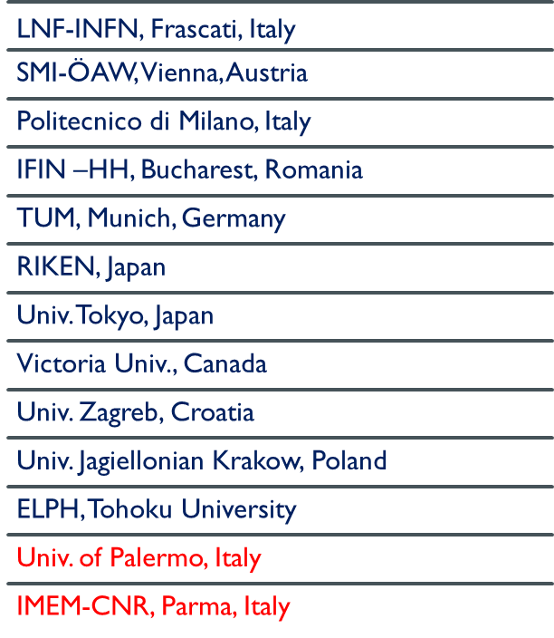






SIDDARTHA-2
The Collaboration
Silicon Drift Detectors for Hadronic Atom Research by Timing Application

Slide 4
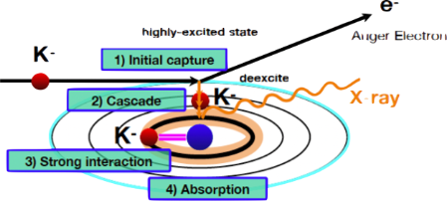
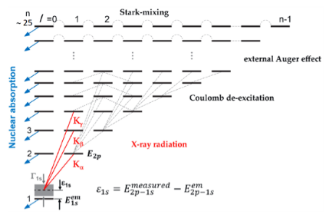

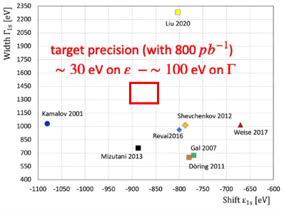
SIDDARTHA-2
Main Scientific Goal
Goal: first measurement ever of kaonic deuterium X-ray transition to the ground state (1s-level) such as to determine its shift and width induced by the presence of the strong interaction, providing unique data to investigate the QCD in the non-perturbative regime with strangeness.
Kaonic deuterium X-ray spectroscopy to measure the shift and width of 1s-level
Determine the kaonic deuterium scattering length through the “summed up” Deser-Truman like formula
Combined analysis of the kaonic deuterium and kaonic hydrogen measurements to determine the isospin-dependent K-N scattering lengths

Slide 5
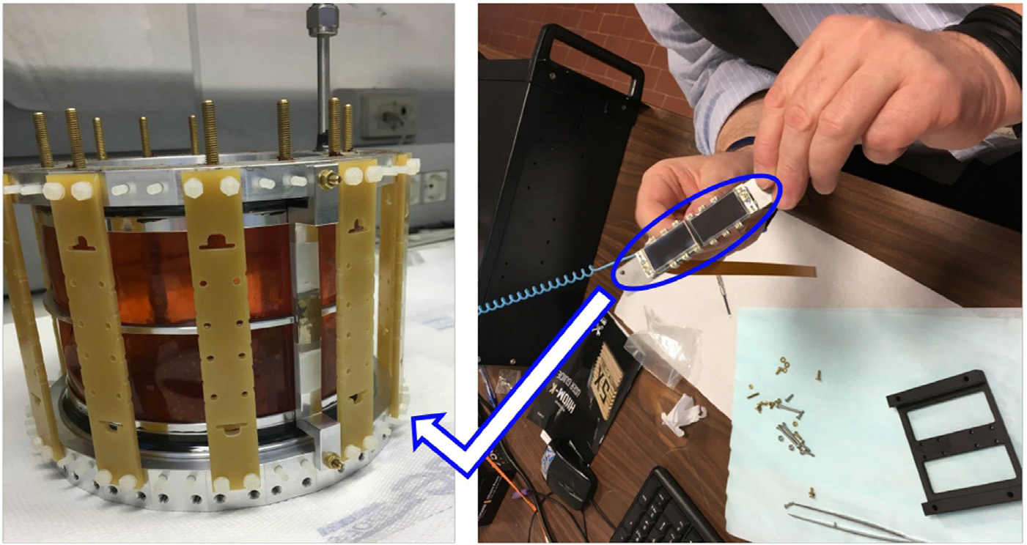
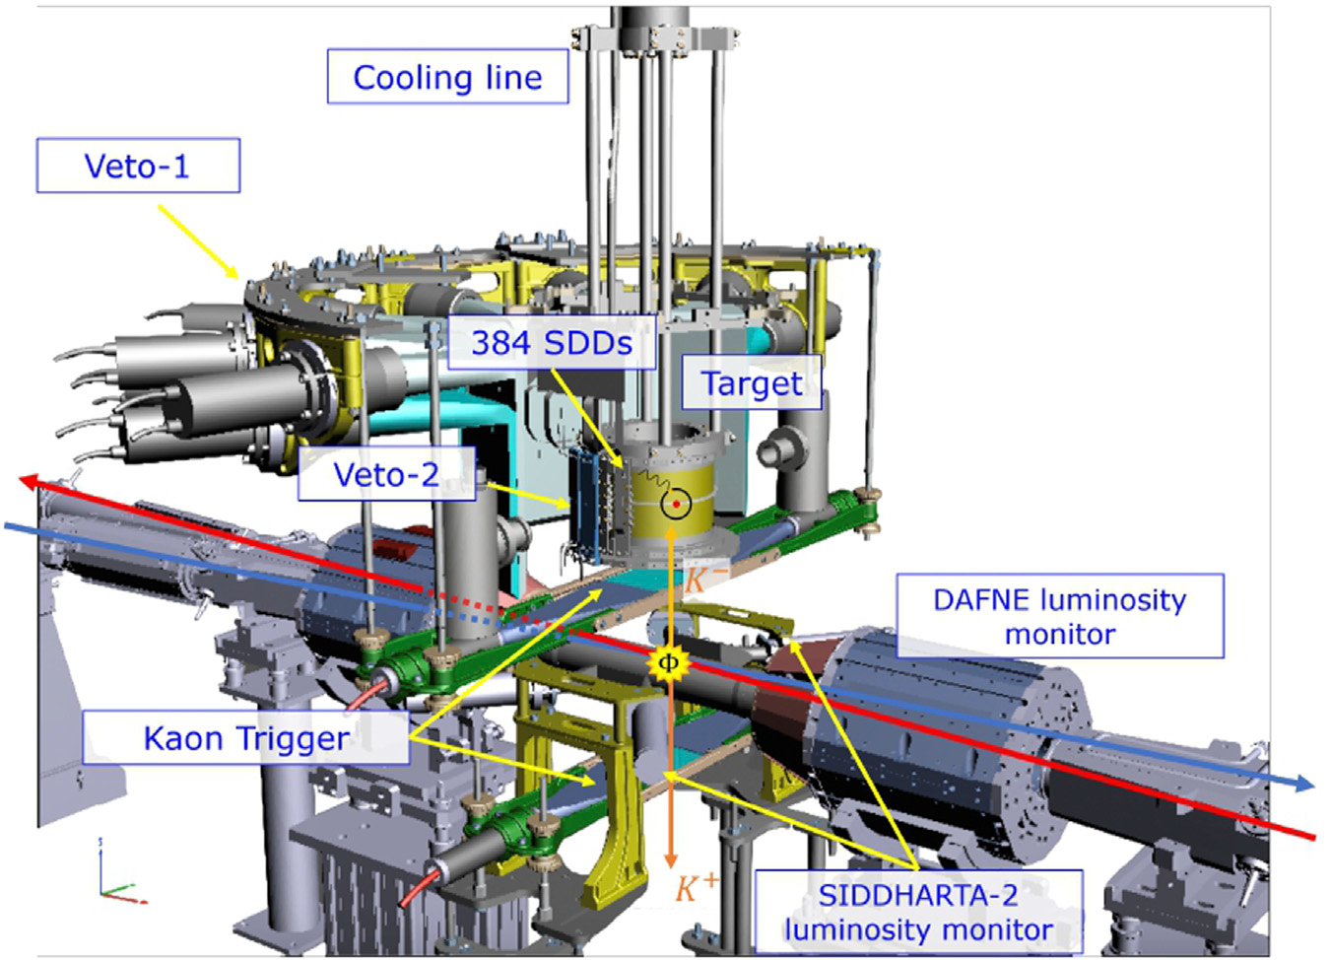
SIDDARTHA-2
The Apparatus
SIDDHARTA-2 apparatus is installed in the Interaction Region (IR) of the DAΦNE e⁺e⁻ collider at LNF-INFN. It is composed of:
cylindrical cell (Ø: 144 mm / H: 125 mm) filled with target gas in which kaonic atoms are formed
detector barrel composed of 48 monolithic SDD arrays
each array is composed of 2x4 SDD pixels
single pixel area: 0.64cm² (total area ~245 cm²)
450 μm thickness
readout electronics based on CUBE preamplifier and analog pulse processor (APP) ASIC chip called SFERA

Slide 6
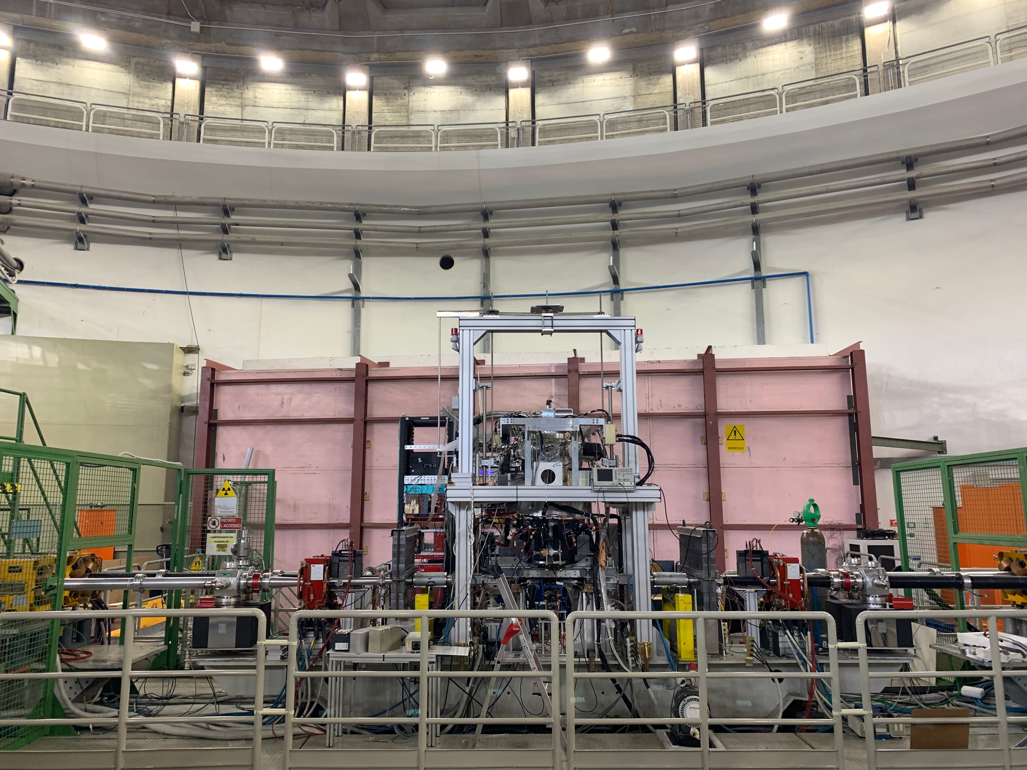
SIDDARTHA-2
Data Taking Summary
Kaonic neon: initial calibration and optimization of the setup, int. lumi 125 pb-1 (April 2023)
K-d Run-1: int. luminosity 164 pb-1 (May – July 2023)
Kaonic helium-4: final calibration of the setup , int. lumi 40 pb-1 (July 2023)
Kaonic neon: initial calibration of the setup, int. lumi 36 pb-1 (Sept 2023)
K-d Run-2: int. luminosity 276 pb-1 (October – December 2023)
Kaonic hydrogen: final calibration of the setup , int. lumi 26 pb-1 (Dec 2023)
Kaonic hydrogen: initial calibration of the setup, int. lumi 70 pb-1 (Jan 2024)
K-d Run-3: int. luminosity 375 pb-1 (February – April 2024)
Kaonic hydrogen: final calibration of the setup , int. lumi 150 pb-1 (April 2024)
Low density run: int. luminosity 185 pb-1 (May – July 2024)
Post Kd calibration run (July 2024) – 20 pb-1 with solid targets (B and F)
Total 1467 pb-1 of good data (April 2023 - July 2024; about 13 months):
K-d total integrated luminosity good for physics : 1000 pb-1
Other kaonic atoms: 467 pb-1

Slide 7
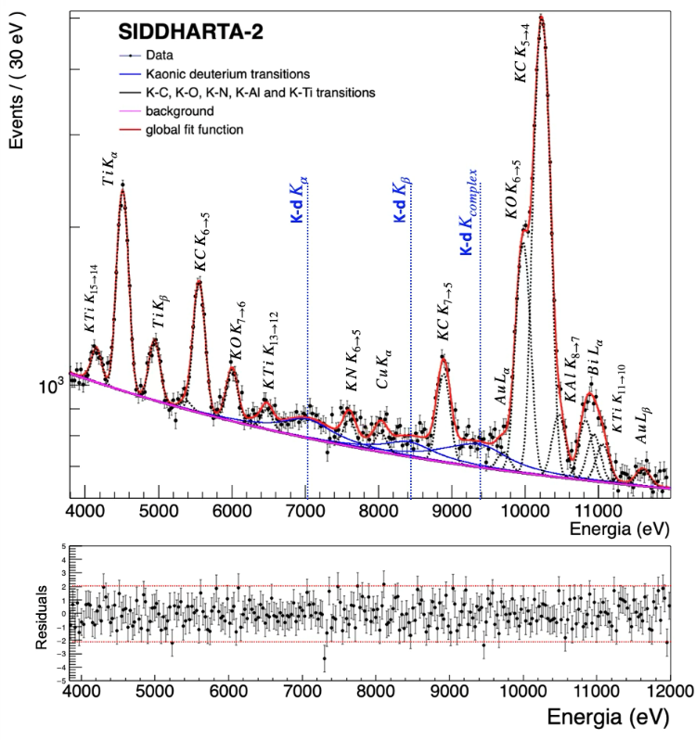
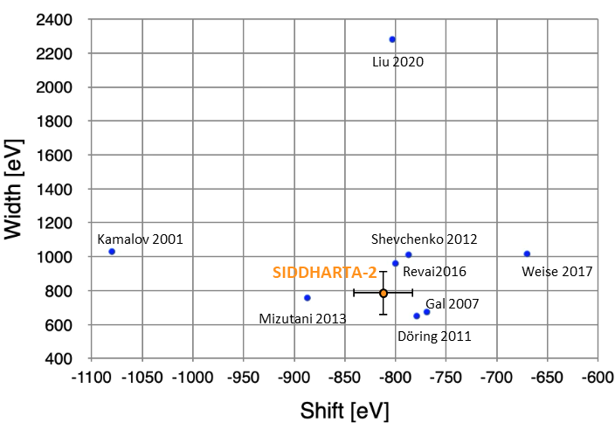
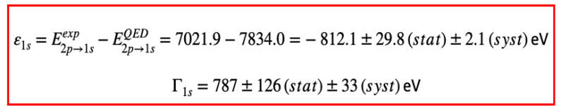
SIDDARTHA-2
Kaonic Deuterium Results
Measurement of the 2p→1s transitions in Kaonic Deuterium (KD): Target precision achieved!
→ paper in preparation: high-impact journal
Other kaonic atoms: KB, KS; KAl, KF in data analyses

Slide 8
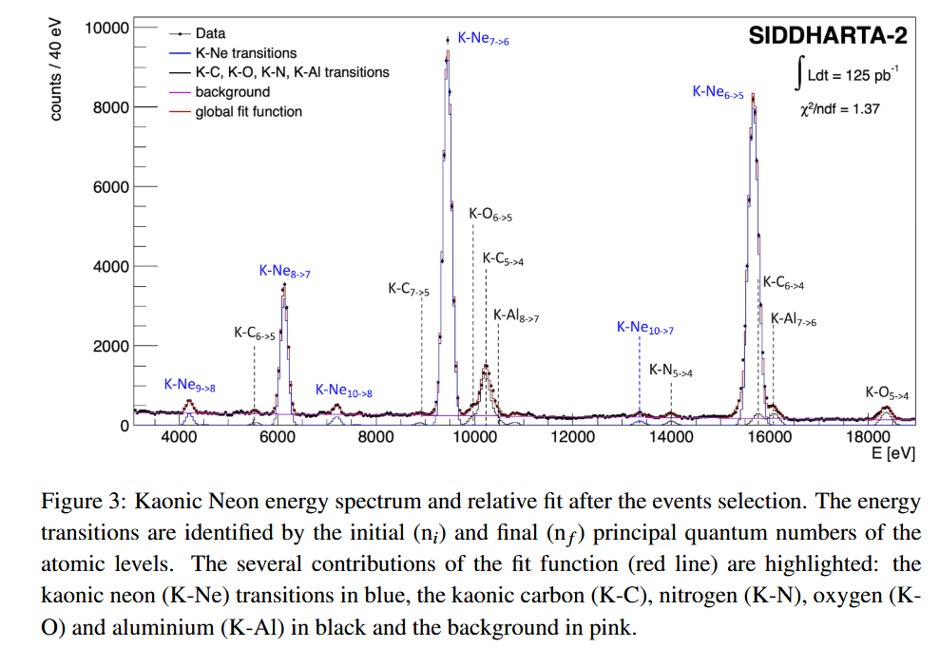
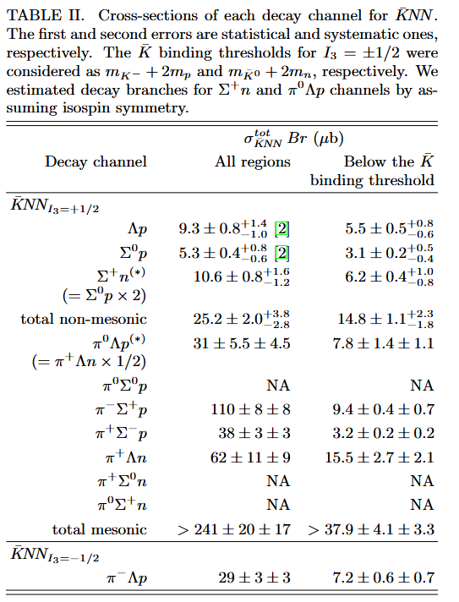
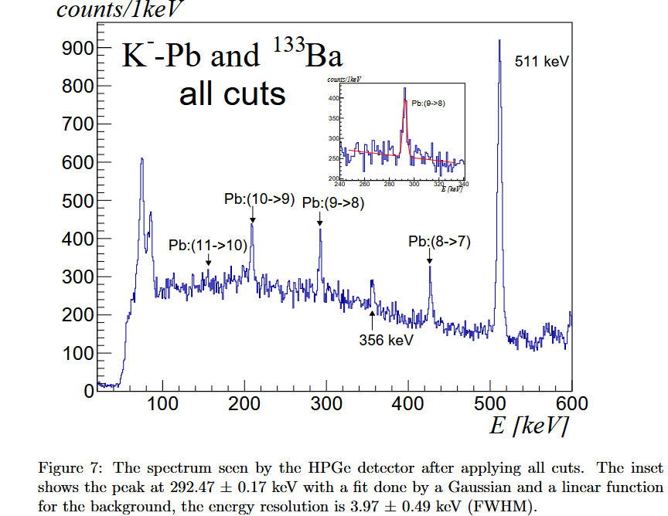
SIDDARTHA-2
Other Significant Results in 2024/2025
(1)
(1) High precision spectroscopy of kaonic neon (first meas. ever) → Phys.Lett.B 865 (2025) 139492
(2) Kaonic lead measurement with HPGe (kaon mass) → Nucl.Instrum.Meth.A 1069 (2024) 169966
First Stability Characterization for a CZT Detection System in an e+e− Collider Environment → Sensors 24 (2024) 23, 7562
(3) Measurement of the mesonic decay branch of the K¯NN quasibound state → Phys.Rev.C 110 (2024) 1, 014002
(3)
(2)

Slide 9
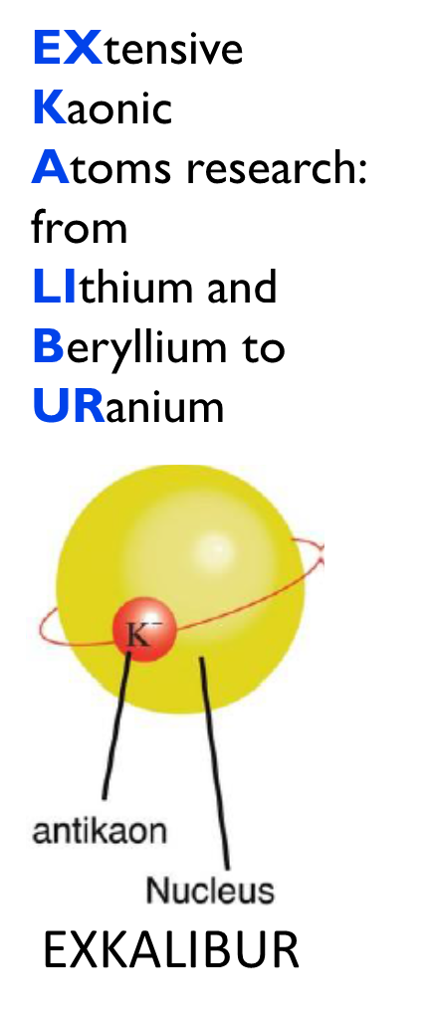
EXKALIBUR
EXtensive Kaonic Atoms research: from LIthium and Beryllium to URanium
Goal: proposal to perform fundamental physics at the strangeness frontier at DAFNE for a 3-years period (post-SIDDHARTA-2).
High precision kaonic neon measurement → extract charged kaon mass with a precision of about 5 keV (BSQED and Physics beyond Schwinger limit)
Light kaonic atoms (LHKA):
solid target Li, Be, B
integration of 1mm SDD
Intermediate kaonic atoms (IMKA):
dedicated runs for kaonic atoms (O, Al, S) with CdZnTe detectors
- 200 -300 pb-1 of integrated luminosity/target
Feasible with minimal modifications/addings of the already existent SIDDHARTA-2 setup:
New calibration system (0.2 eV accuracy) and new solid target system
New 1mm thick SDDs
New and improved CZT setup

Slide 10
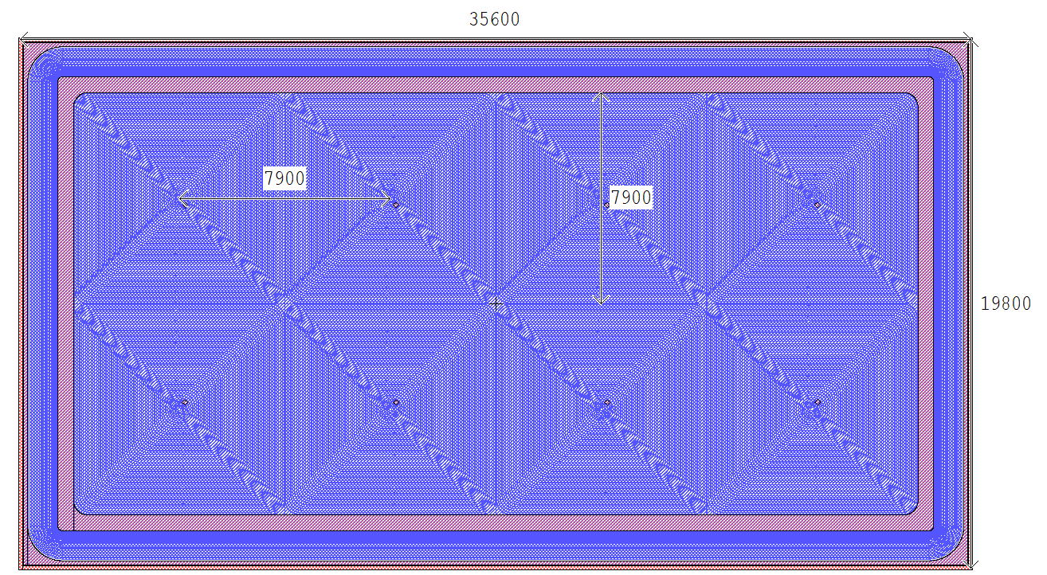
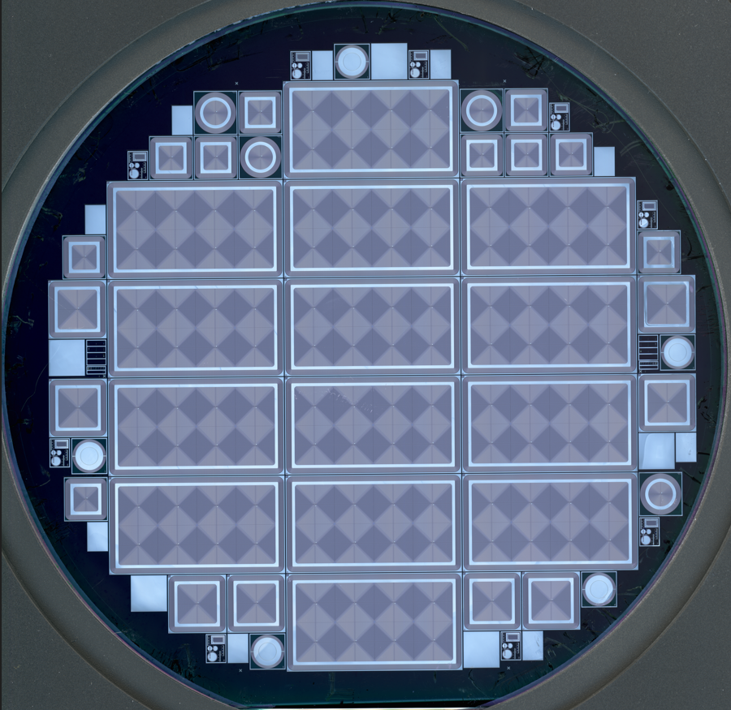
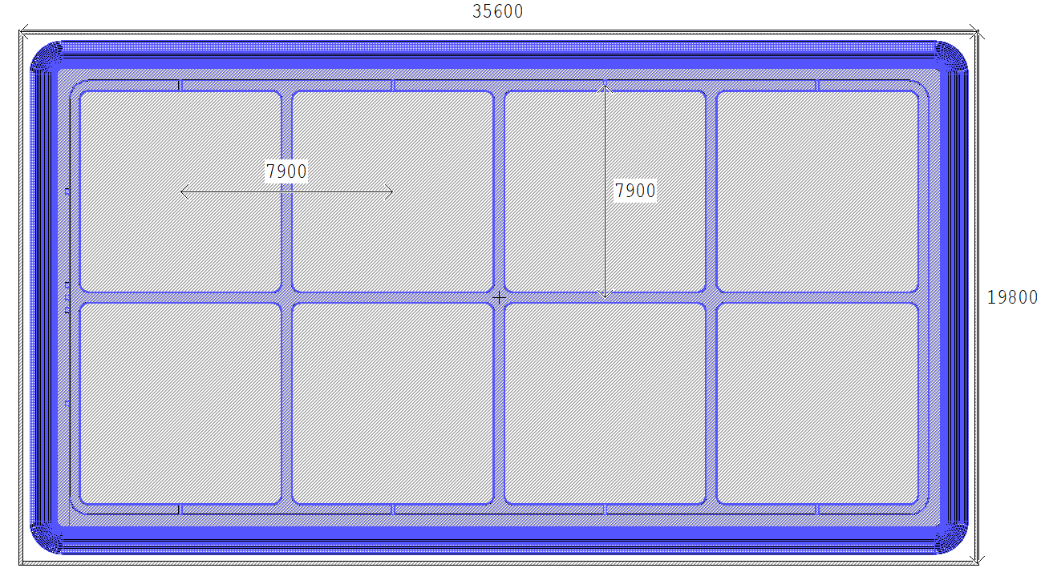
New 1 mm-Thick SDD Modules
Summary of the SDD Design and Production Results
New SDD modules produced at FBK:
Pixel dimensions: 7.9 mm X 7.9 mm
N. pixels: 2 X 4
Overall chip dimensions: 19.8 mm X 35.6 mm
Special features: new focusing electrode on the window to reduce charge sharing
Production process started in August 2021 and automatic tests finalized in June 2023
Very good Leakage Current Density @ 24°C:
1-mm-thick SDDs: ~ 0.5-2 nA/cm²
450-μm-thick SDDs: ~ 50-100 pA/cm²
Good production yield (~60%):
1-mm-thick SDDs: 93 arrays
450-μm-thick SDDs: 23 arrays
First sensors delivered in summer 2023

Slide 11
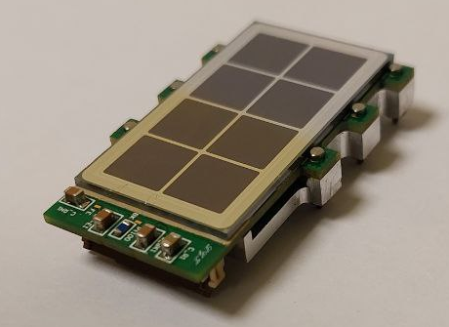
New 1 mm-Thick SDD Modules
The New Module Design
New detection module design developed for experiment upgrade. Main modifications w.r.t. current modules:
PCB dimensions enlarged to host a wider SDD chip (+1 mm on each side)
PCB material changed from ceramic to more standard material in order to move from a 2-layer structure to a 6-layer structure, to improve signal integrity
Element contamination tests and thermal cycles required to confirm the choice
New bias line introduced to provide independent voltage to the new focusing electrode on the window
New connector: from 20 to 30 pins to reduce noise and cross-talk problems

Slide 12
New 1 mm-Thick SDD Modules
Test of the First Assembled Prototypes
Five prototype modules assembled @ Polimi. All modules were functionally tested and characterized
Detailed spectroscopic measurements performed to characterize the prototype:
irradiation with an ⁵⁵Fe X-ray source;
detector temperature: -30° C;
spectra acquired with SFERA APP, shaping time 6 𝜇s;
L.G. Toscano et al. Development of high-efficiency X-ray detectors based on 1 mm thick monolithic SDD arrays 2024 JINST 19 P07039
DOI 10.1088/1748-0221/19/07/P07039

Slide 13
New 1 mm-Thick SDD Modules
Test of the First Assembled Prototypes
Five prototype modules assembled @ Polimi. All modules were functionally tested and characterized
Detailed spectroscopic measurements performed to characterize the prototype:
irradiation with an ⁵⁵Fe X-ray source;
detector temperature: -30° C;
spectra acquired with SFERA APP, shaping time 6 𝜇s;
Best energy resolution @5.9keV (Mn-K𝛼 peak ): ~140 eV
L.G. Toscano et al. Development of high-efficiency X-ray detectors based on 1 mm thick monolithic SDD arrays 2024 JINST 19 P07039
DOI 10.1088/1748-0221/19/07/P07039

Slide 14
New 1 mm-Thick SDD Modules
Test of the Focusing Electrode
Effect of focusing electrode studied in detail:
no mechanical collimation;
window voltage (𝑽_𝑾𝒊𝒏): -69.6 V;
voltage of focusing electrode (𝑽_𝑭𝑬):
-69.6V → -81.6V.
L.G. Toscano et al. Development of high-efficiency X-ray detectors based on 1 mm thick monolithic SDD arrays 2024 JINST 19 P07039
DOI 10.1088/1748-0221/19/07/P07039

Slide 15
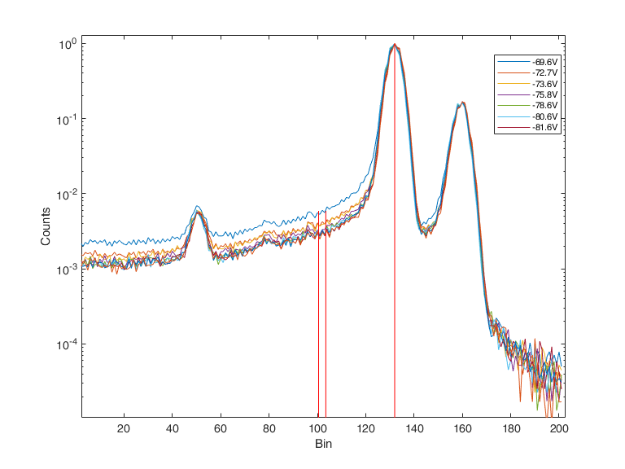

New 1 mm-Thick SDD Modules
Test of the Focusing Electrode
Effect of focusing electrode studied in detail:
no mechanical collimation;
window voltage (𝑽_𝑾𝒊𝒏): -69.6 V;
voltage of focusing electrode (𝑽_𝑭𝑬):
-69.6V → -81.6V.
Results on Peak-to-Tail (P/T) parameter:
𝑉_𝐹𝐸 = 𝑉_𝑊𝑖𝑛 → P/T = 180;
𝑉_𝐹𝐸 = 𝑉_𝑊𝑖𝑛 - 10V → P/T = 330.
Mn-K$α$
5,89keV
P/T
Normalized counts
5,32keV
5,26keV
Bin
L.G. Toscano et al. Development of high-efficiency X-ray detectors based on 1 mm thick monolithic SDD arrays 2024 JINST 19 P07039
DOI 10.1088/1748-0221/19/07/P07039

Slide 16
New 1 mm-Thick SDD Modules
Test of the Focusing Electrode
Effect of focusing electrode studied in detail:
no mechanical collimation;
window voltage (𝑽_𝑾𝒊𝒏): -69.6 V;
voltage of focusing electrode (𝑽_𝑭𝑬):
-69.6V → -81.6V.
Results on Peak-to-Tail (P/T) parameter:
𝑉_𝐹𝐸 = 𝑉_𝑊𝑖𝑛 → P/T = 180;
𝑉_𝐹𝐸 = 𝑉_𝑊𝑖𝑛 - 10V → P/T = 330.
Slight improvement of energy resolution (2-3 eV)
L.G. Toscano et al. Development of high-efficiency X-ray detectors based on 1 mm thick monolithic SDD arrays 2024 JINST 19 P07039
DOI 10.1088/1748-0221/19/07/P07039

Slide 17
“Mass” Production of SDD Modules
Assembly Process Transferred from Polimi to FBK
Assembly process transferred to FBK by Milano group for series production (60 modules). INFN-MI tasks:
Technical discussions and tests to transfer the process
Procurement of all the components needed to assemble the detector
Design, production and delivery to the partner of the electronic boards required to test the detectors
Pre-production finalized in May 2025:
12 modules fully assembled and preliminarily tested in FBK: yield ~100 %
2 modules already tested at cryo temp. @ LNF with good results

Slide 18
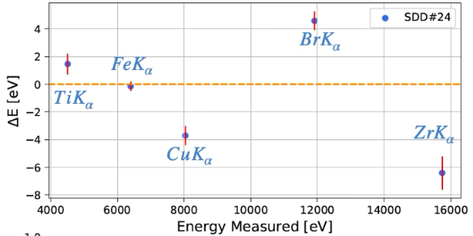
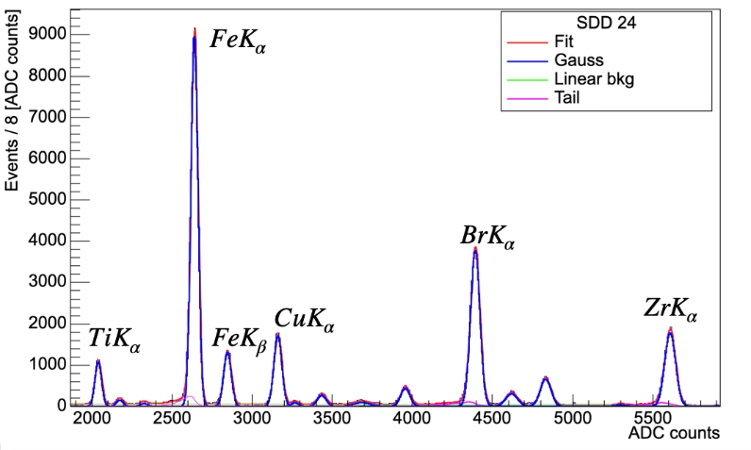
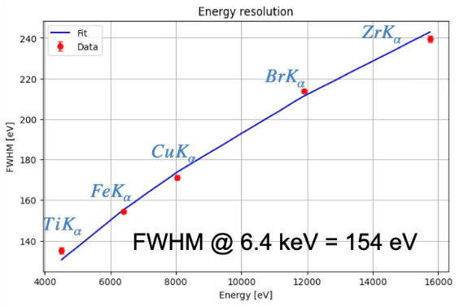
KAONNIS Detection Module with Single SDD
Test of the First Assembled Prototypes @ LNF
2 modules tested in BTF run (cryogenic conditions)
More tests performed with X-ray tube @LNF to optimize detector response
→ good energy resolution and linearity

Slide 19
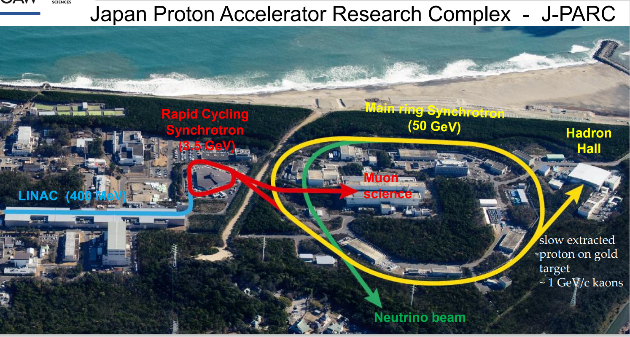
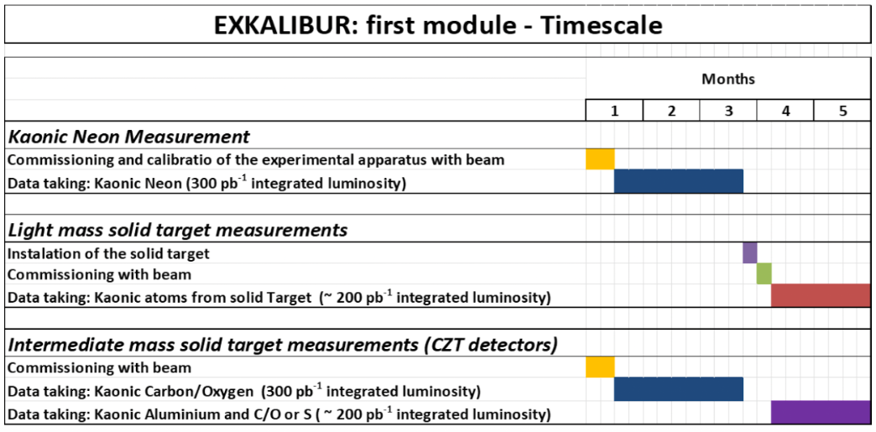
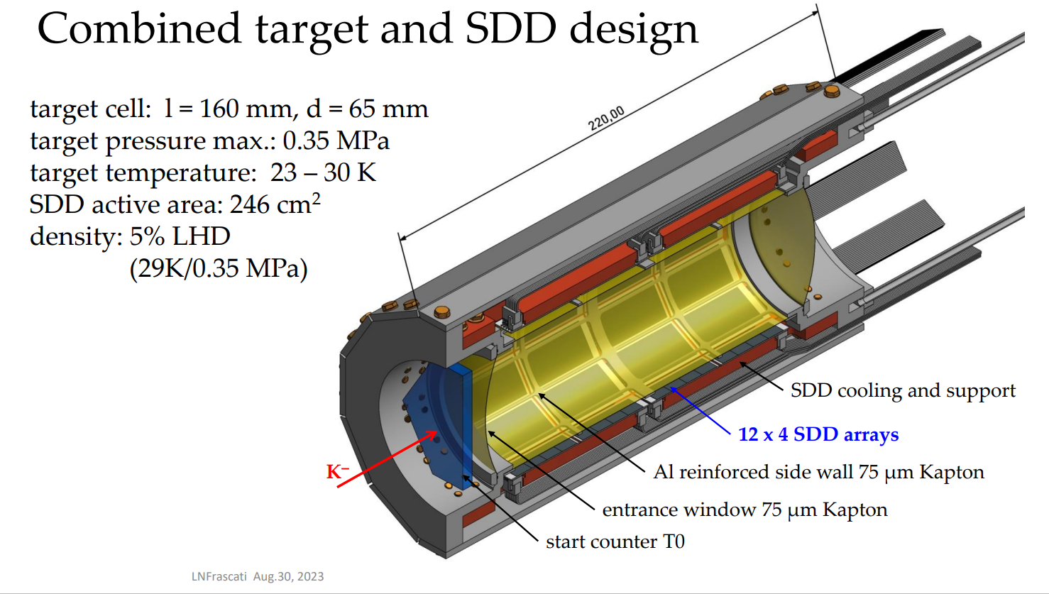
KAONNIS – EXKALIBUR
Future Measurements at DAΦNE and J-PARC Under Preparation
Measurements at DAΦNE:
New calibration system and 1mm thick SDDs financed by INFN Gr3
Requested luminosity: 300 pb-1 + 200 pb-1 (about 4 months in SIDDHARTA2-like condition)
Ongoing discussions to organize similar measurements at Japan Proton Accelerator Research Complex (J-PARC)

Slide 20
KAONNIS
Activities Planned for end 2025 and 2026
Analysis
Finalise the Kd data analysis (calibration and events selection of the entire data set)
Submission of an article on Kd shift and width in a very high-impact physics journal
Evaluation of the kaonic deuterium X-ray yields (high and low density runs)
Evaluation of the kaonic deuterium scattering length (in collaboration with theoreticians)
Combined analysis of kaonic hydrogen and deuterium to determine the isospin dependent antikaon-nucleon scattering lengths (in collaboration with theoreticians) and implication for theory
Kaonic Boron and Fluorine finalize data analyses
Data analyses for kaonic aluminium and fluorine with CZT setup completed
Experimental activities → EXKALIBUR first measurements module and J—PARC (E57)
realisation and test of refined calibration system ongoing: test in DAFNE (off)
1 mm SDD detector system: production of 3 buses and tests (in cryo gas)
CZT detector optimisations (Enrich COST Action)
If opportunity presents: ready to start as soon as possible: requested 300 pb⁻¹ + 200 pb⁻¹

Slide 21
Polimi Budget Requests and FTE
2026
Consumo: tot. 20.0 keuro
Produzione di ASIC per SDD a temperature criogeniche (J-PARC) 12.0k
Materiale per bonding 2.0k
Schede PCB e componenti per test rivelatori + assemblaggio esterno 4.5k
Materiale per stampe 3D componenti per moduli rivelazione e box di alloggiamento 1.5k
Manutenzione: tot 2.0 keuro
Riparazione oscilloscopio 2.0k
Licenze software: tot 2.0 keuro
Contributo per licenza Cadence (ASIC design) 2.0k
Missioni: tot 8.0 keuro
Missioni Italia 6.0k
Missioni Estero 2.0k
Totale Milano: 32.0keuro
FTE: tot. 3.5
Giacomo Borghi (responsabile locale) 0.5 FTE
Giacomo Ticchi 1.0 FTE
Pietro Barcella 1.0 FTE
Nassi Leonardo 1.0 FTE

Slide 22
Thank you!
Any questions?

Slide 23
1. Section
Title

