Slide 1
Analog Efficiency
For outer Layers of SuperB (L.4 & L.5)
Team: Luca Bombelli, Bayan Nasri, Carlo Fiorini, Paolo Trigilio

Slide 2
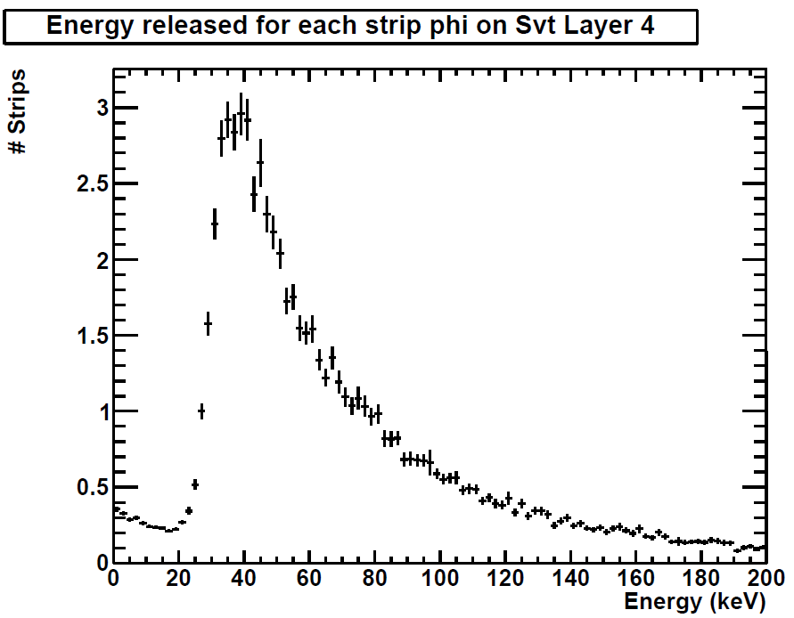
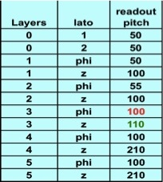
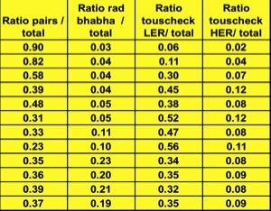
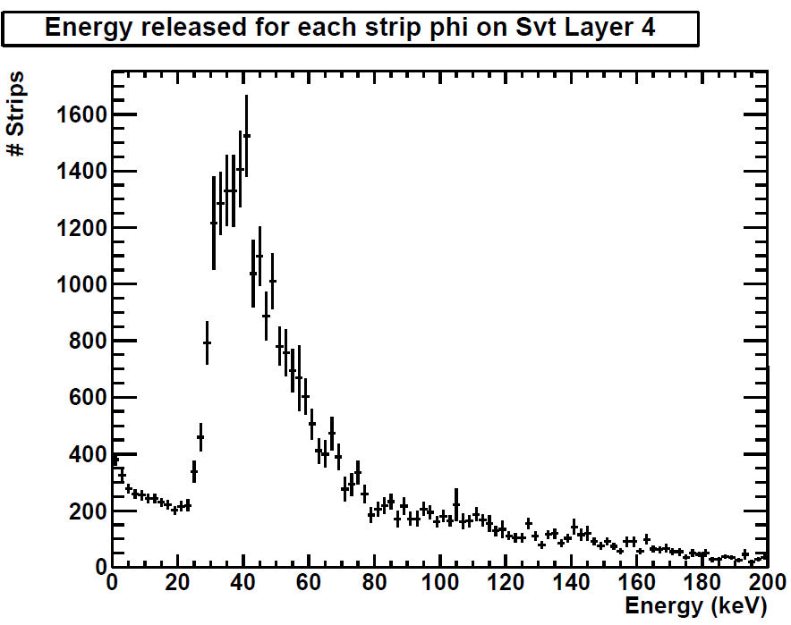
Efficiency simulation: background data used
Input Data:
Energy released for different background sources
Relative weights
Average hit-rate
Rad babha
Touscheck LER/HER
Pairs

Slide 3
Efficiency simulation: Pulse shape and calculation
Generation of random sequences
of pulses with given energy distribution.
3° order complex shaper, 500ns peaking-time
Efficiency:
$η=1− \frac{T.O.T}{T_{total}}$
Threshold: 0.25 MIP

Slide 4
Efficiency simulation for all layers shaper (RC)²-CR
Strip | Strip rate [KHz] | Peaking time [ns] | Efficiency (η)
L0 (side 1) | 1210 | 25 (real poles) | 95.7 %
L1 Phi | 724 | 100 (real poles) | 91.0%
L2 Phi | 525 | 100 (real poles) | 92.6%
L3 phi | 419 | 200 (real poles) | 82.4%
L4 phi | 90 | 500 (real poles) | 91.4 %
L5 phi | 54.4 | 1000 (real poles) | 89.6 %
Foreseen peaking-times
Strip | Strip rate [KHz] | Peaking time [ns] | Efficiency (η)
L0 (side 2) | 1210 | 25 (real poles) | 97.4%
L1 z | 473 | 100 (real poles) | 90.8%
L2 z | 454 | 100 (real poles) | 91.4%
L3 z | 270 | 200 (real poles) | 89.3%
L4 z | 47 | 500 (real poles) | 94.1 %
L5 z | 30.8 | 1000 (real poles) | 92.5 %

Slide 5
Efficiency simulation for the different peaking time
Available peaking-times
Strip | Strip rate [KHz] | Peaking time [ns] | Efficiency (η)
L4 phi | 90 | 250 | 96.1%
L4 phi | 90 | 375 | 94.2%
L4 phi | 90 | 500 | 92.3%
L4 phi | 90 | 500 (real poles) | 91.4%
L4 phi | 90 | 750 | 88.6%
Available peaking-times
Strip | Strip rate [KHz] | Peaking time [ns] | Efficiency (η)
L5 phi | 54.4 | 375 | 96.4%
L5 phi | 54.4 | 500 | 95.2%
L5 phi | 54.4 | 750 | 93.0%
L5 phi | 54.4 | 1000 | 90.7%
L5 phi | 54.4 | 1000 (real poles) | 89.6%

Slide 6
Efficiency simulation for the different peaking time
Available peaking-times
Strip | Strip rate [KHz] | Peaking time [ns] | Efficiency (η)
L4 z | 47 | 250 | 97.4%
L4 z | 47 | 375 | 96.1%
L4 z | 47 | 500 | 94.8%
L4 z | 47 | 500 (real poles) | 94.1%
L4 z | 47 | 750 | 92.4%
Available peaking-times
Strip | Strip rate [KHz] | Peaking time [ns] | Efficiency (η)
L5 z | 30.8 | 375 | 97.5%
L5 z | 30.8 | 500 | 96.7%
L5 z | 30.8 | 750 | 95.1%
L5 z | 30.8 | 1000 | 93.4%
L5 z | 30.8 | 1000 (real poles) | 92.5%

