Slide 1
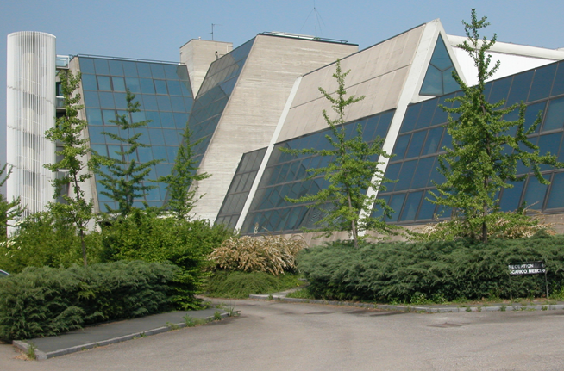

IRIS – WP4
Superconducting Magnet Lab
Carlo Santini – Enrico Beneduce
14/07/2025

Slide 2
New cryostats
Thermal design of the new service flanges for inner SOLEMI and Hilumi cryostats
  Final design of the gas-solid heat exchangers
  Final dimensions of the optimized current leads
Redefinition of technical requests for the new 20K / 55K GHe cooling system
  Calculations to support official communications with VS&S/CryoPride for supply details
SOLEMI 1 revamping:
  Cooldown in liquid nitrogen
  Power supply test
  Electrical insulation test
  Vacuum issues

Slide 4
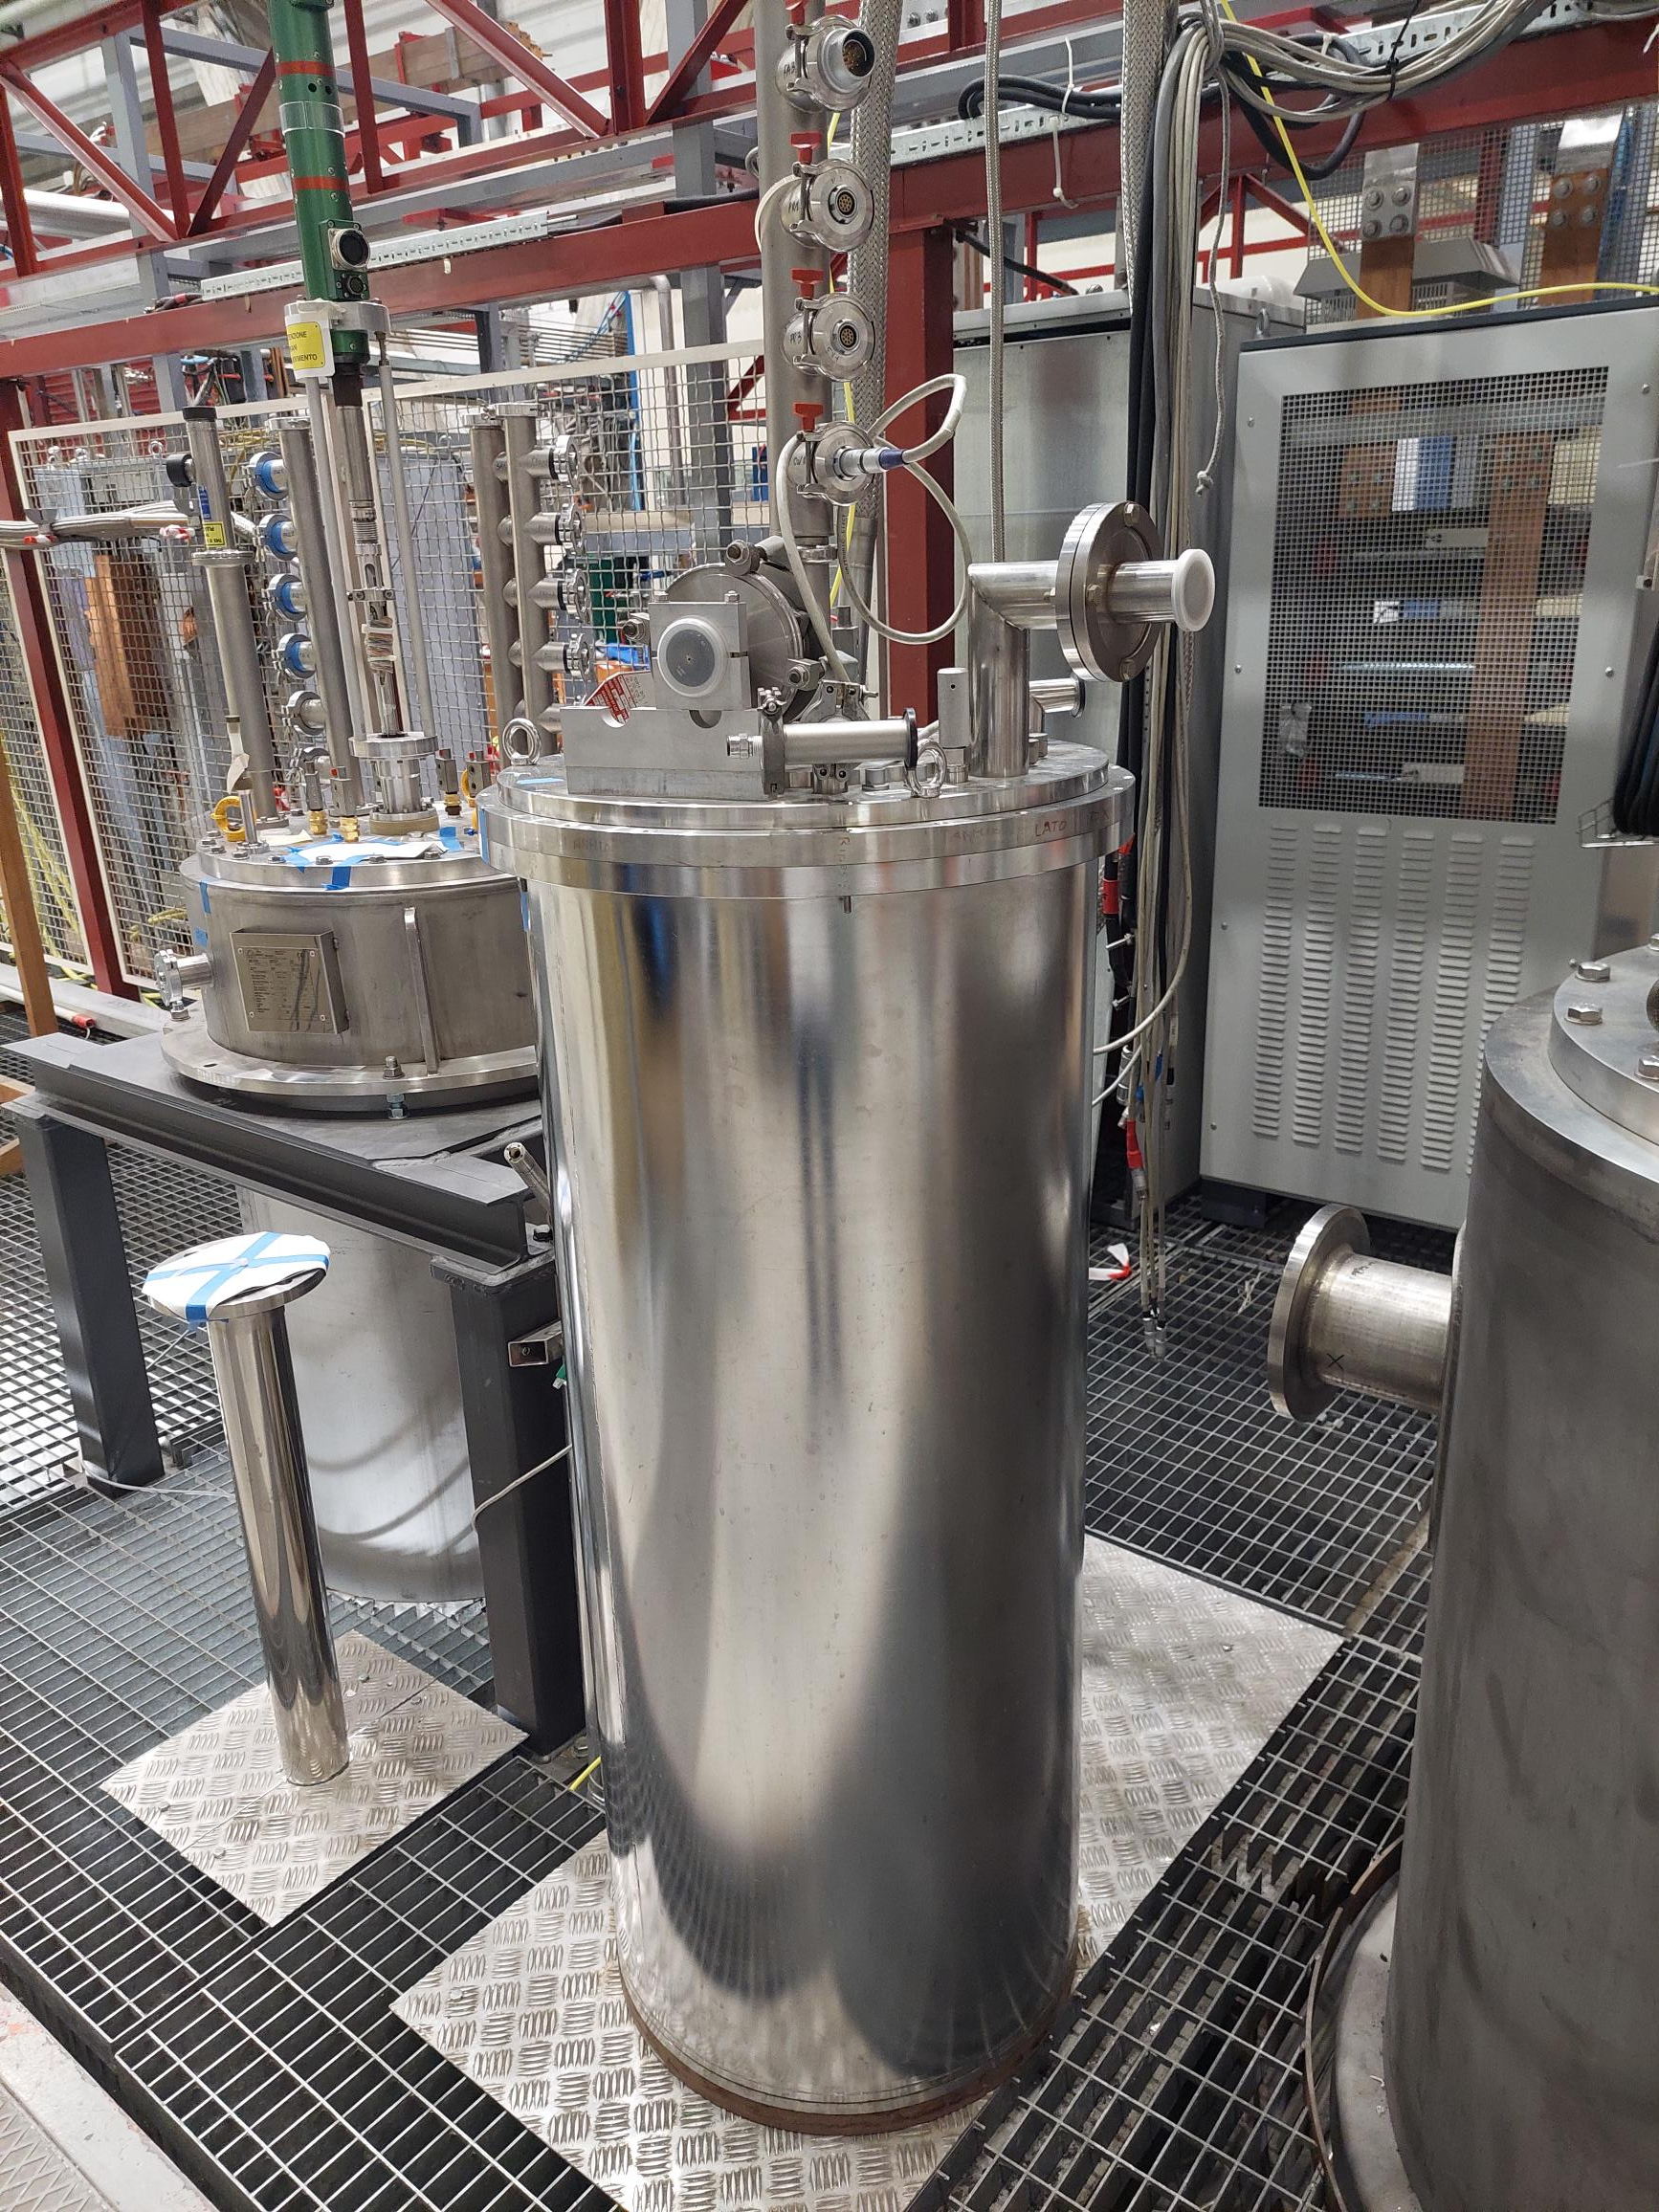
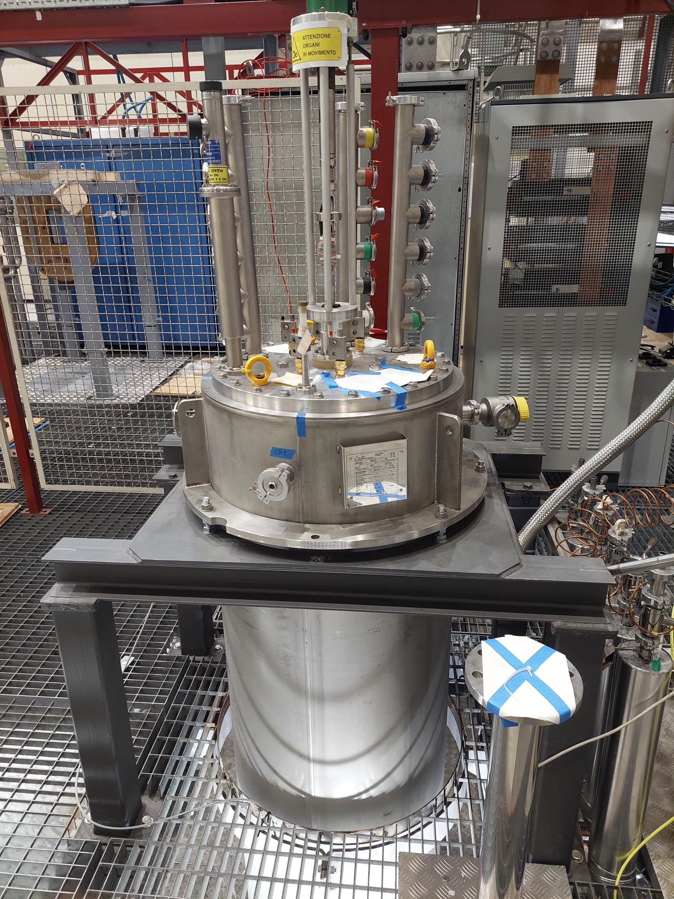
New service flanges for VT Test
Re-use of exhisting tanks with updated top flanges
Solemi insert cryostat
HiLumi cryostat

Slide 5
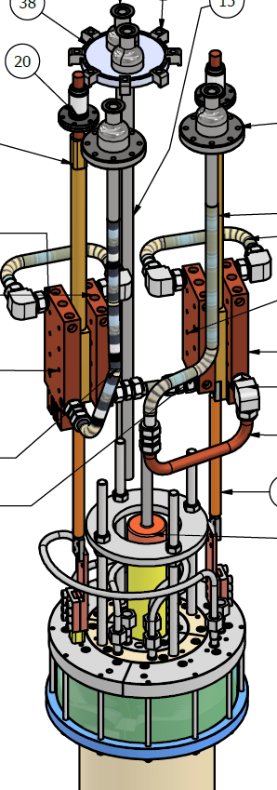
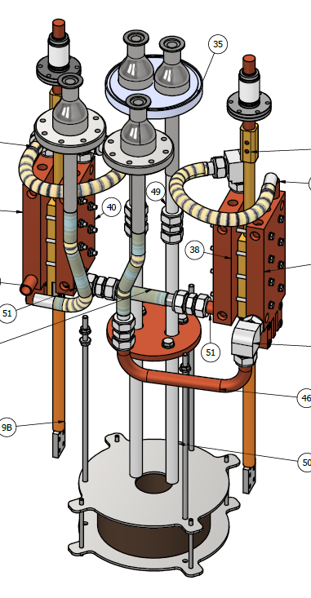
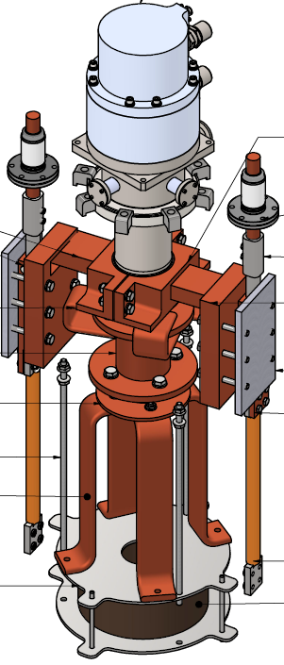
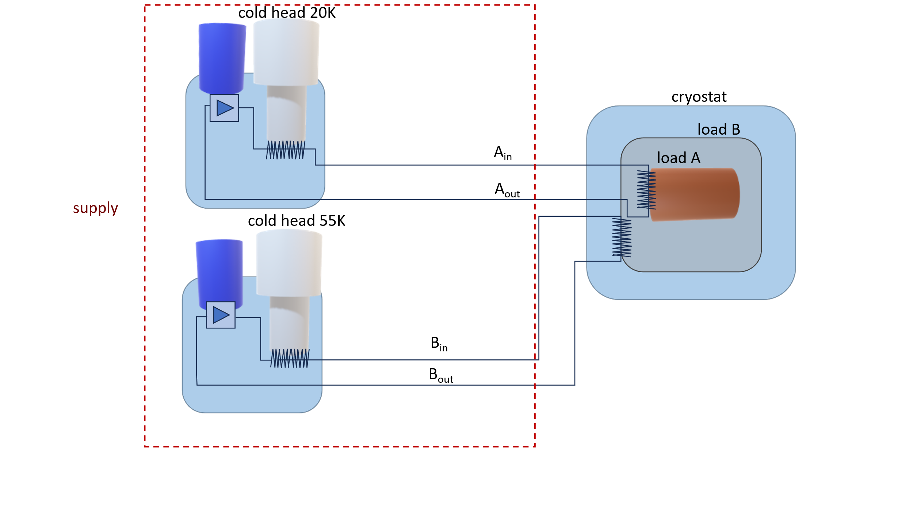
New service flanges for VT Test
GHe circulation system
SOLEMI GHe
SOLEMI cryocooler
HiLumi (GHe)

Slide 6


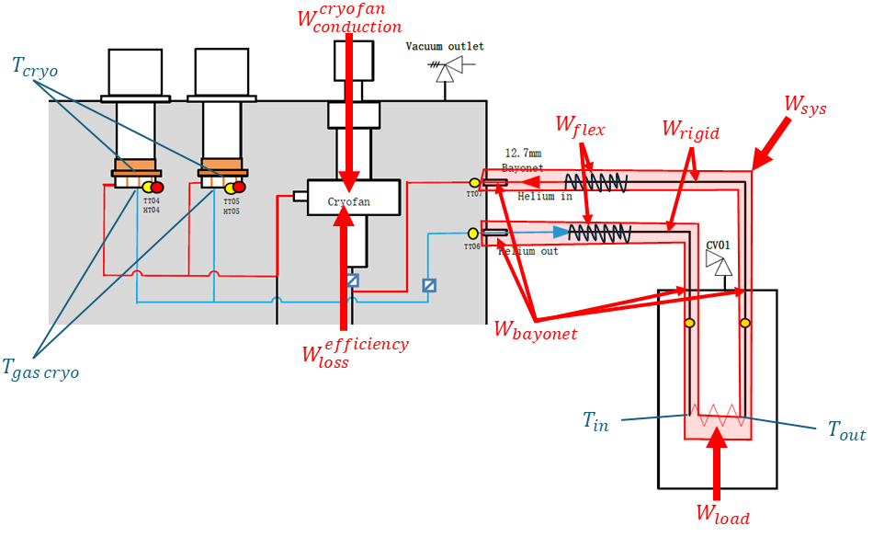
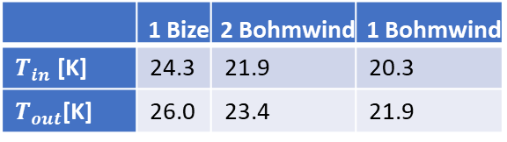
20K GHe cooling system
VS
Losses [W] | 1 Bize | 2 Bohmwind | 1 Bohmwind
From cryofan inefficiency | 33 | 14,3 | 8,7
From friction losses in the application | 3.8 | 6,3 | 2,7
Conduction inside the cryofan | 17 | 16 | 8
From transfer lines | 19 | 19 | 19
Application | 20 | 20 | 20
Total | 83,8 | 75,6 | 58,4
Accepted solution
 | 1 Bize | 2 Bohmwind | 1 Bohmwind
$T_{in}$ [K] | 24.3 | 21.9 | 20.3
$T_{out}$[K] | 26.0 | 23.4 | 21.9

Slide 7
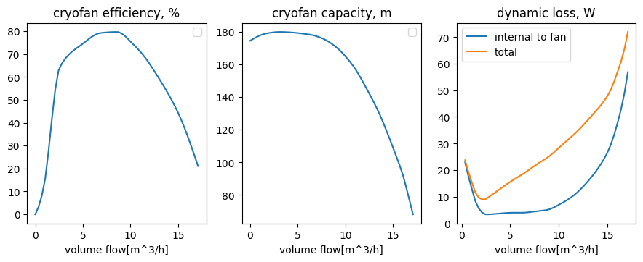
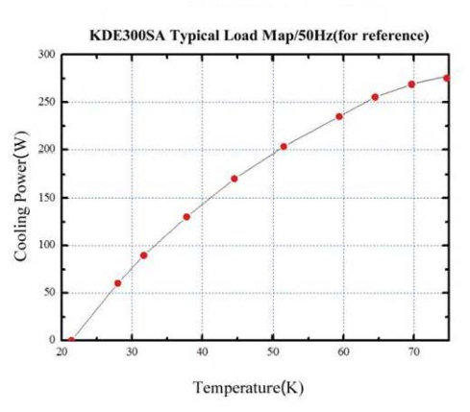
Gas temperature
With 52W /C.L. + 10 W load on the thermal shield, 4.3g/s flow:
T cryocooler [K] | T gas inlet [K] | T gas outlet [K]
30 | 31 | 36

Slide 8
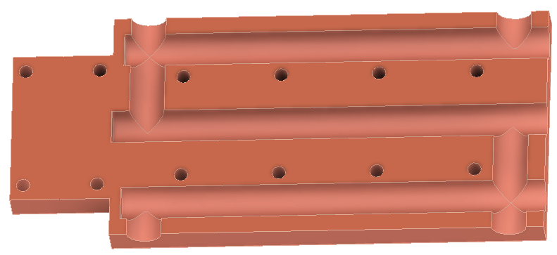
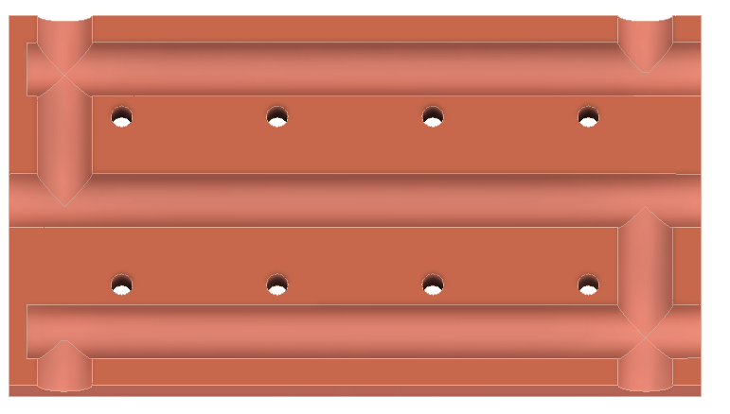
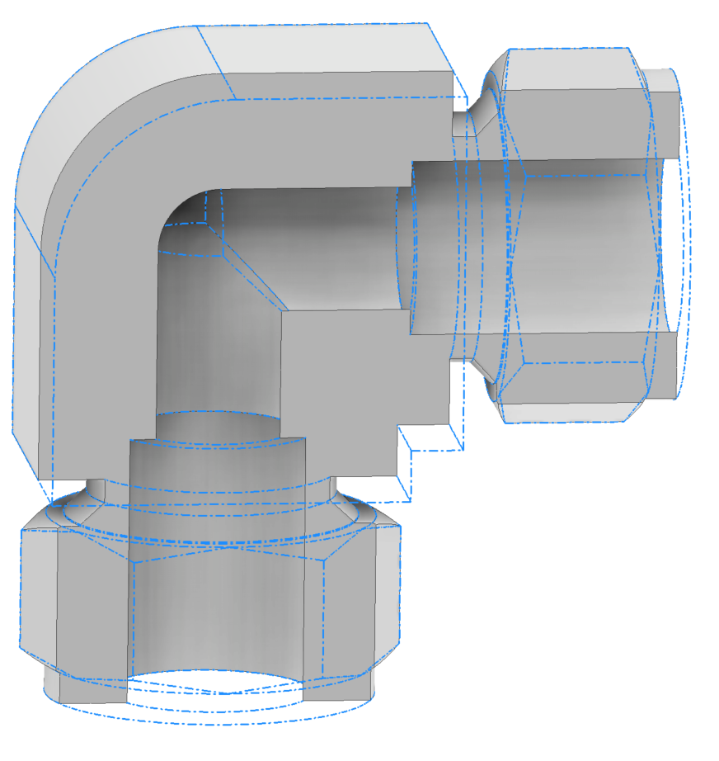
Heat exchange plates for CL
Outer side
GHe out
Heat load for one optimized current lead 300K-60K: 46W
Drill
Plug
GHe in
Inner side
Swagelock 90° mitre bend fitting
GHe in
Current leads are cooled in series
GHe in

Slide 9
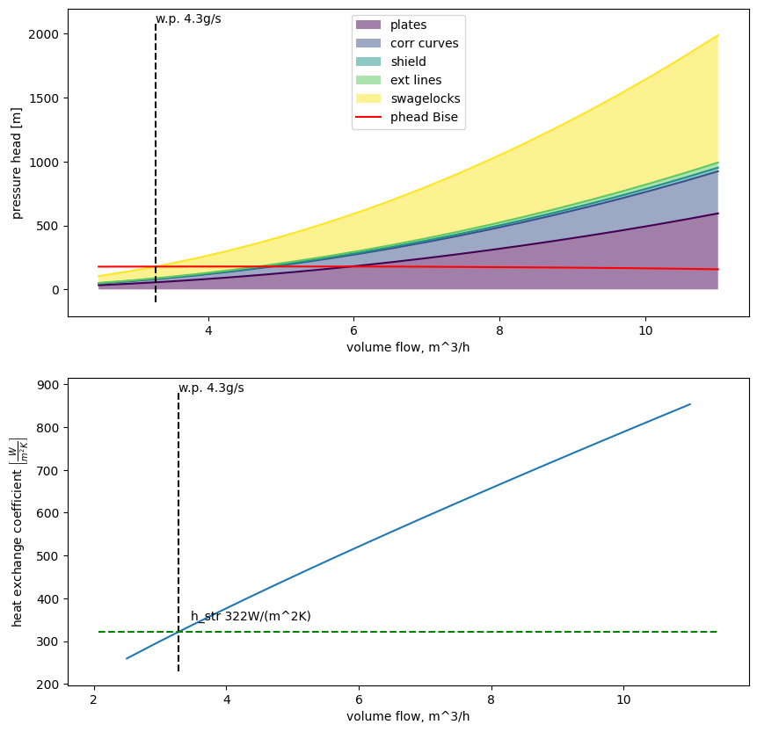
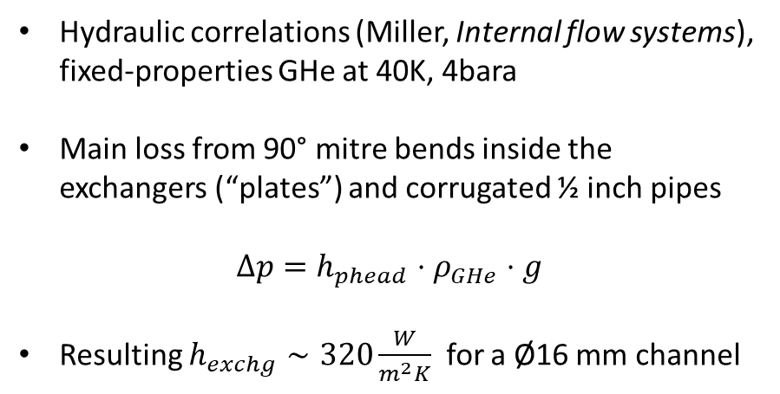
Friction losses VS cryofan capacity
Pressure drop
Hydraulic correlations (Miller, Internal flow systems), fixed-properties GHe at 40K, 4bara
Main loss from 90° mitre bends inside the exchangers (“plates”) and corrugated ½ inch pipes
$$Δp=h_{phead}⋅ρ_{GHe}⋅g$$
Resulting $h_{exchg}∼320\frac{W}{m^{2}K}$ for a Ø16 mm channel
Resulting heat exchange coefficient

Slide 10
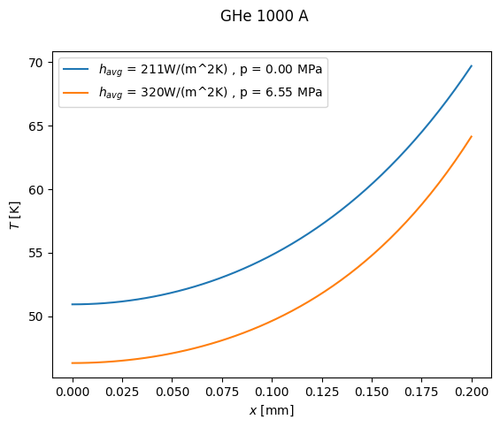

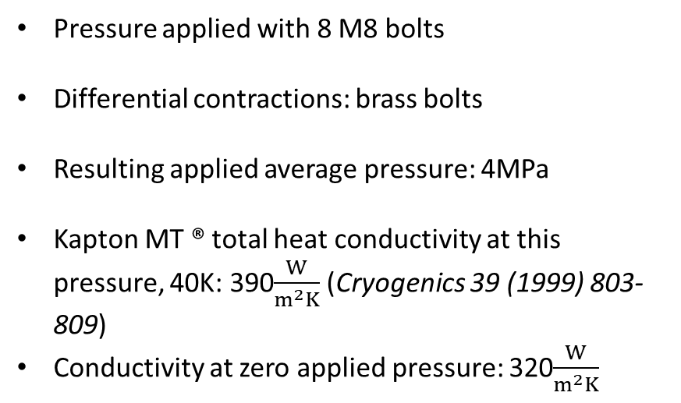
Current leads insulation
$76μm$Kapton MT ®
Pressure applied with 8 M8 bolts
Differential contractions: brass bolts
Resulting applied average pressure: 4MPa
Kapton MT ® total heat conductivity at this pressure, 40K: 390$\frac{W}{m^{2}K}$ (Cryogenics 39 (1999) 803-809)
Conductivity at zero applied pressure: 320$\frac{W}{m^{2}K}$
Current lead
Exchanger

Slide 11
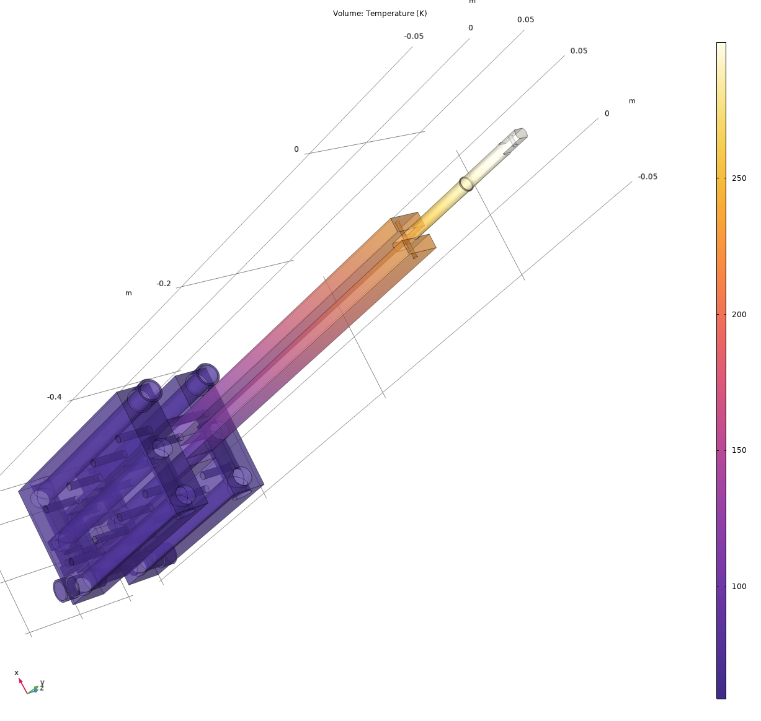




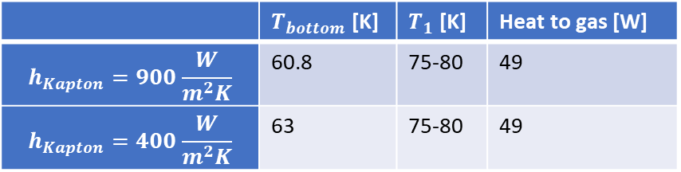
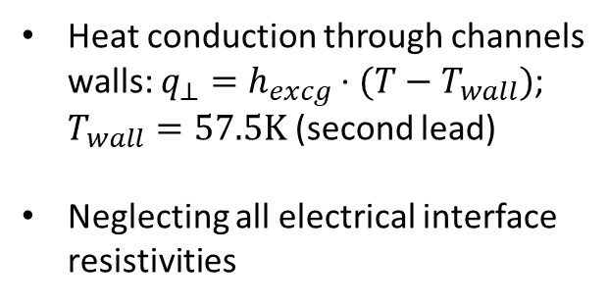
Simulations - GHe
OLD design! Illustration purpose only
$$T_{2}=300K$$
Heat conduction through channels walls: $q_{⊥}=h_{excg}⋅{(T−T}_{wall})$; $T_{wall}=57.5K$ (second lead)
Neglecting all electrical interface resistivities
Exchangers channels
$I$=1000 A
Electrical feedthrough
$$T_{1}$$
Optimized section
Main results (similar for SOLEMI and HiLumi):
Section for heat exchange
 | $T_{bottom}$ [K] | $T_{1}$ [K] | Heat to gas [W]
$$h_{Kapton}=900\frac{W}{m^{2}K}$$ | 60.8 | 75-80 | 49
$$h_{Kapton}=400\frac{W}{m^{2}K}$$ | 63 | 75-80 | 49
$$T_{bottom}$$
Kapton interfaces
Contact with HTS current lead (must be T<64K, target 60K)

Slide 12
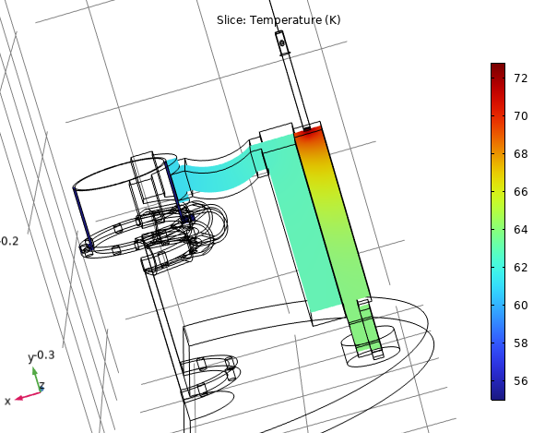
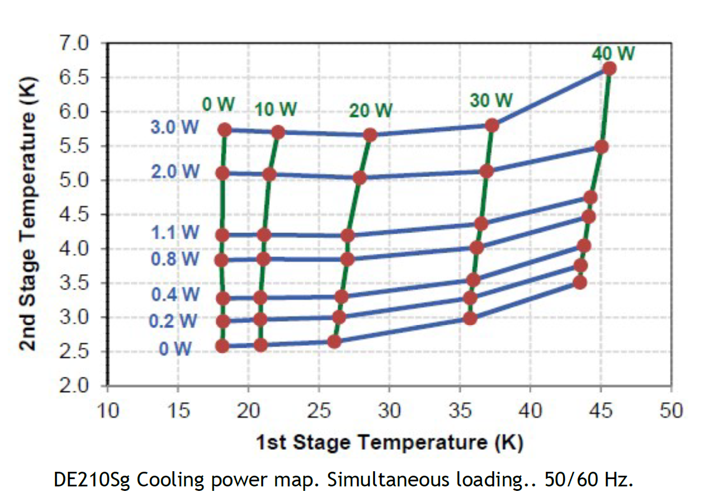





Simulations - Cryocooler
Cu-In-Cu
$$T_{2}=300K$$
60W?
$$T_{2}=55K$$
$I$=500 A
$$T_{1}$$
55K
Kapton interface
By reducing the current to 300 A (thermal load≈40W) temperatures may decrease by 10K!
$$T_{bottom}$$

Slide 13
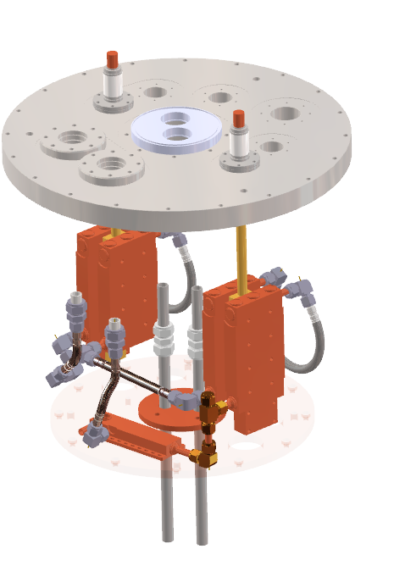
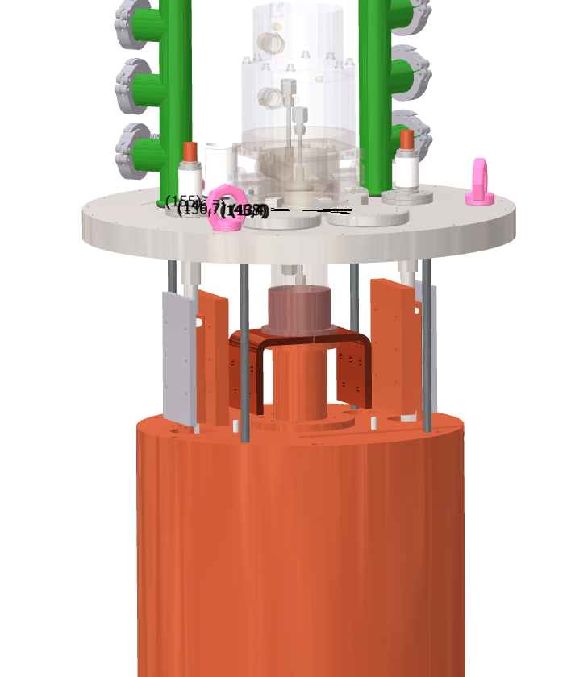
Last updates from suppliers’ requests
Thermal contact on the donward surface of the cryocooler
Commercial copper braids (not shown)
Swagelock pipes
Screw-on heat exchanger

Slide 14
Rescheduling
Final drawings INFN → SRV: officially on 31/01/2025
Original due delivery date: start production + 200gg = end of July 2025
Due to last changes, significant delay → end of semptember 2025, not sure.
Mitigations (tender objectives splitting) will be applied if necessary, similar to other tenders

Slide 15
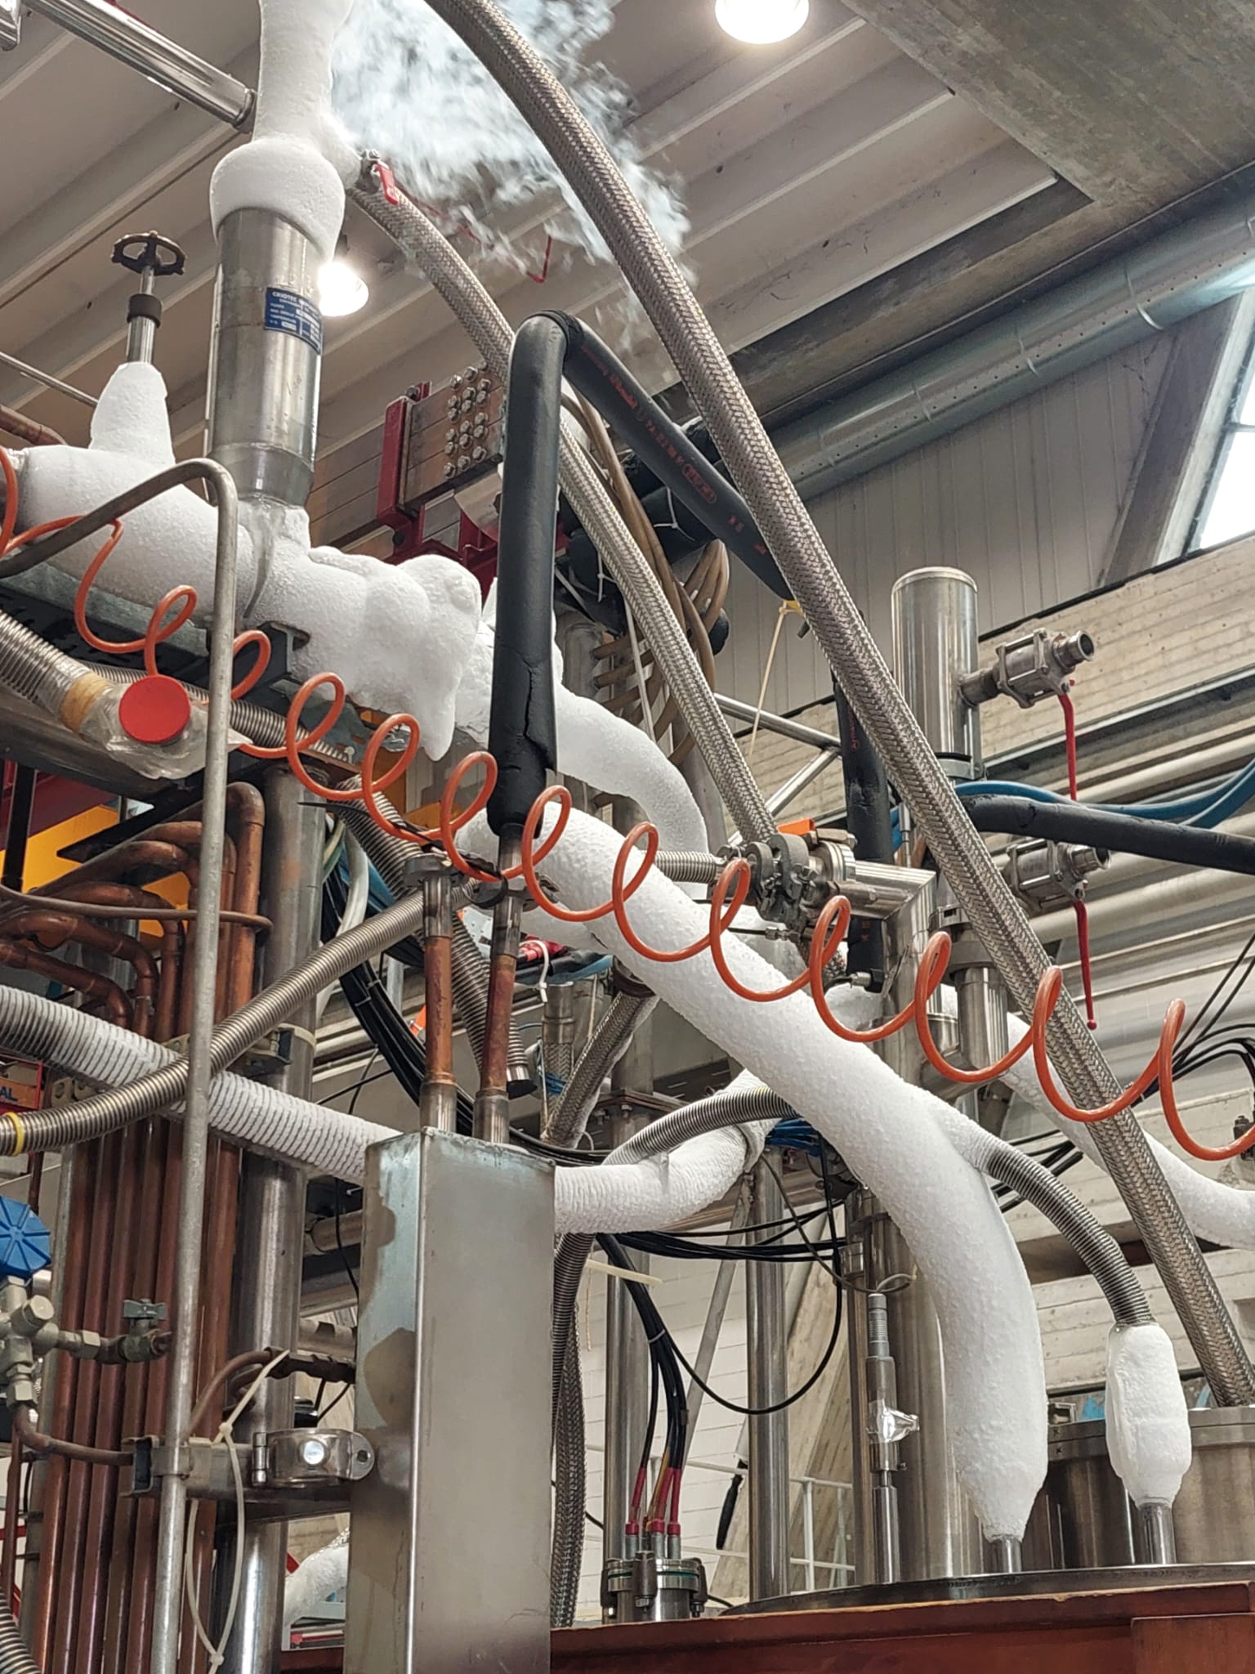
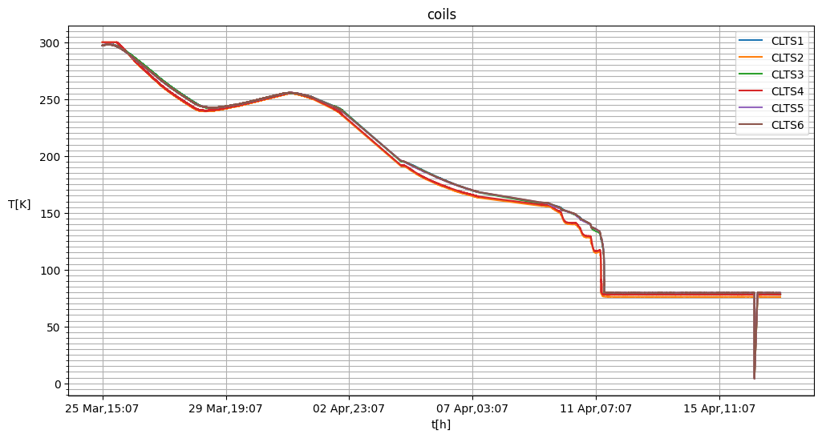
Solemi 1 - cooldown
~ 400h cooldown

Slide 16
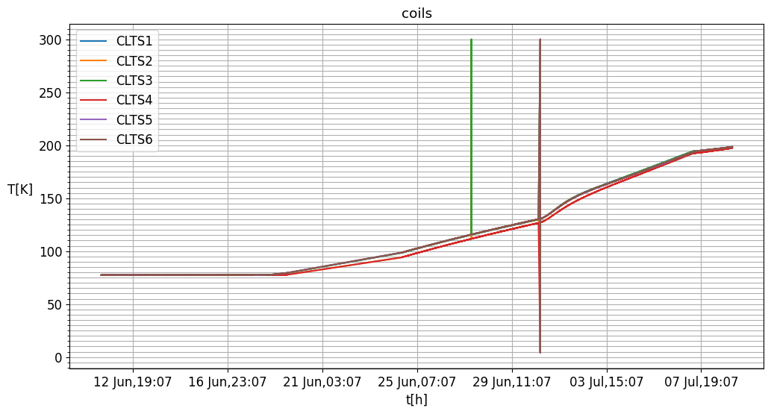
Temperature rise after stop cooling and vacuum leak
date time | frac day | hours | mbara | mbar/h | T [K]
30/06/2025 16:21 | 0 | 0 | 4,10E-03 |  | 120
01/07/2025 12:49 | 0,85 | 20 | 5,90E-03 | 8,79E-05
03/07/2025 10:32 | 2,75 | 66 | 1,20E-02 | 1,33E-04
04/07/2025 11:56 | 3,82 | 92 | 1,80E-02 | 2,36E-04 | 170

Slide 17
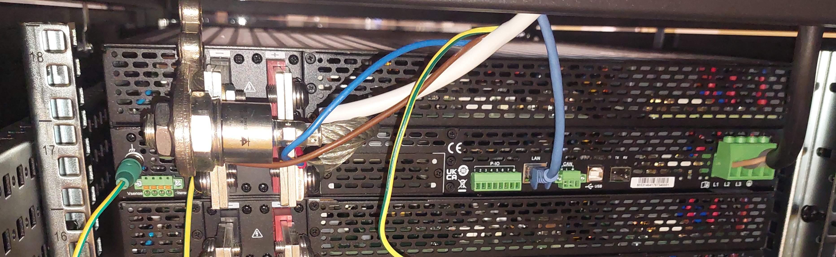
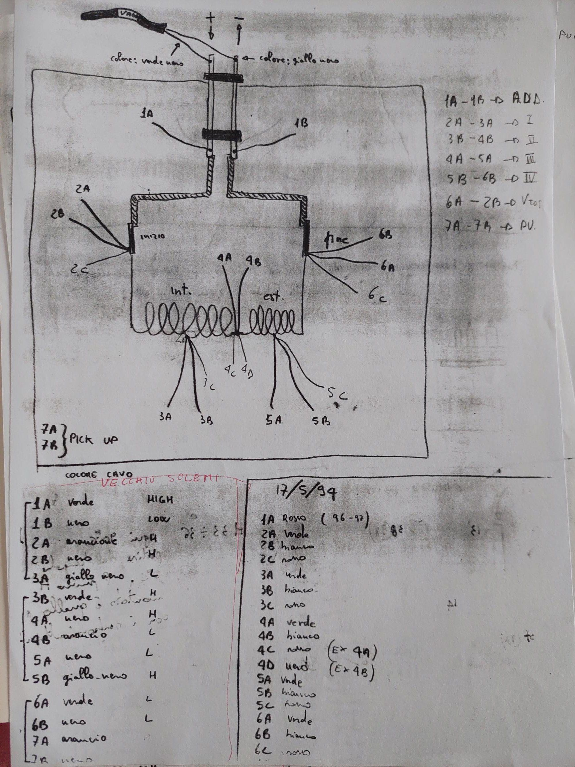
Power supply tests with ITECH 32V – 480A

Slide 18
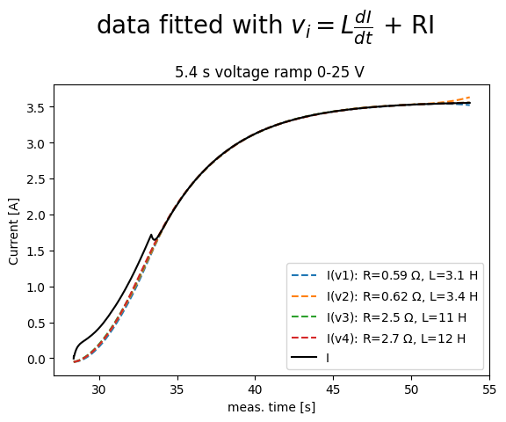
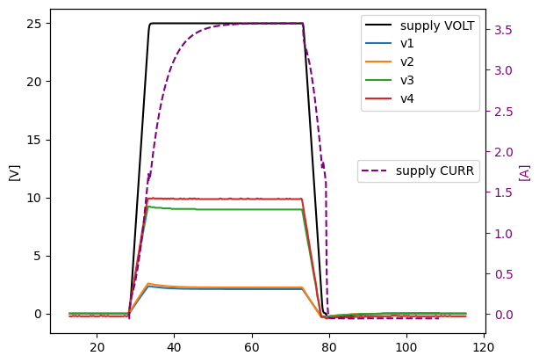
Power supply tests with ITECH 32V – 480A

Slide 19
Electrical insulation test
Duration [s] | Nom. Voltage [V] | Peak voltage [V] | Avg. Resistance [GΩ] | Avg. Current [nA]
30 | 25 | 34 | 2.426 | 14.1
30 | 50 | 58 | 2.58 | 22.8
30 | 75 | 83 | 2.66 | 31.4
Test with MEGGER. Insulation coils-to-ground.

Slide 20
Thank you for attention!

Slide 21
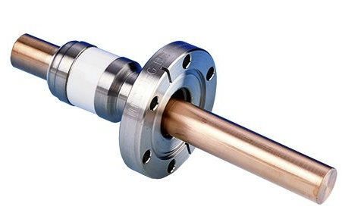
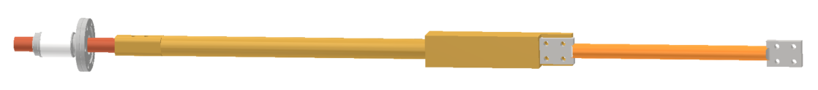
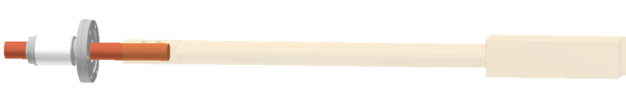




Final thermal design of the new service flanges for inner Solemi and Hilumi cryostats
MDC precision electrical feedthrough
$$d_{2}\text{19.1}\text{mm}$$
$d_{1}$?
$$\text{7}\text{4}\text{mm}\text{+85}\text{mm}$$
$$\text{x}\text{?}$$
200mm(GHe)
150mm (Cryocooler)

Slide 22
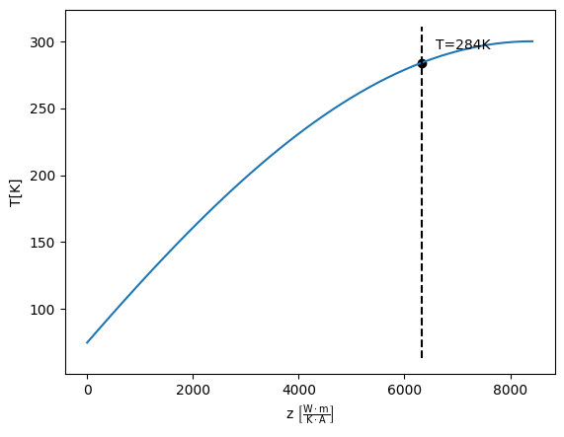
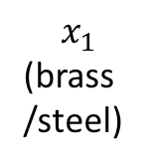
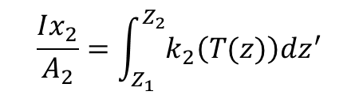

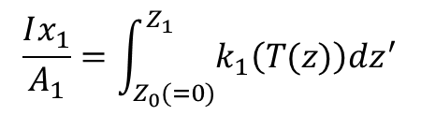

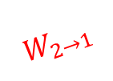


2-materials optimization
$$T_{2}=300K$$
Universal optimized solution
$$x_{2}$$
(Cu)
$$\frac{Ix_{2}}{A_{2}}=\int_{Z_{1}}^{Z_{2}}{k_{2}\left(T(z)\right)dz^{′}}$$
$$W_{2→1}$$
$$T_{1}$$
$$\frac{Ix_{1}}{A_{1}}=\int_{Z_{0}(=0)}^{Z_{1}}{k_{1}\left(T(z)\right)dz^{′}}$$
$$x_{1}$$
(brass /steel)
$$T_{0}=75K$$

