Slide 1
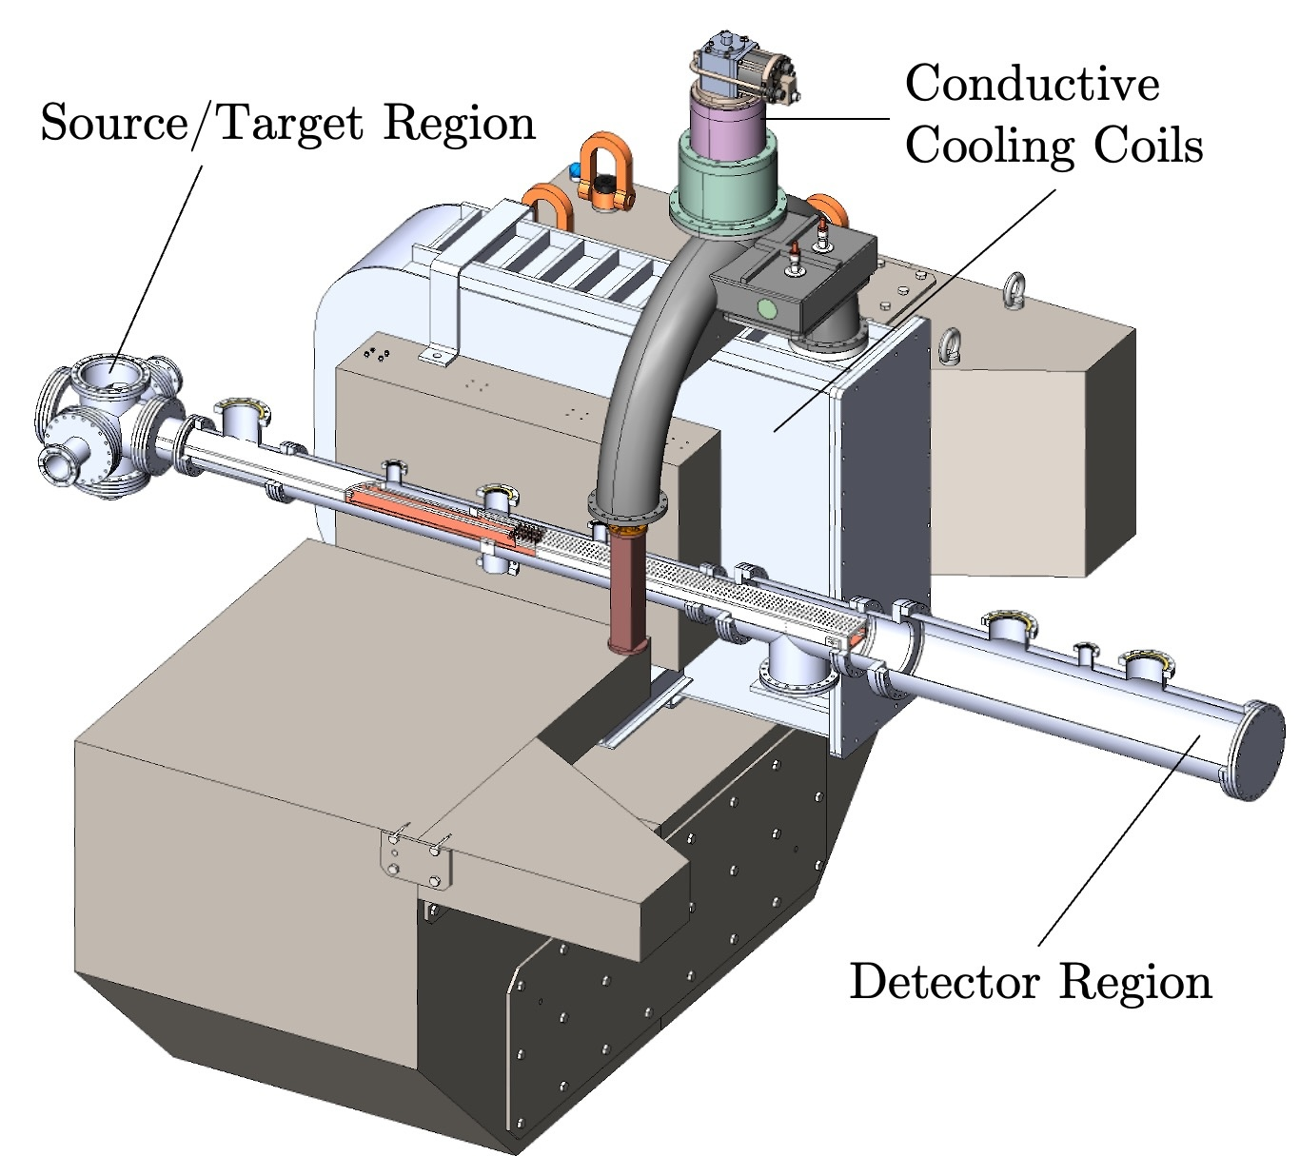
Relic neutrinos detection and mass measurement in the PTOLEMY project
R. Ammendola, C. Marin, G. Salina
Istituto Nazionale di Fisica Nucleare, Sezione di Roma Tor Vergata
V. Narcisi
Enea, Frascati

Slide 2
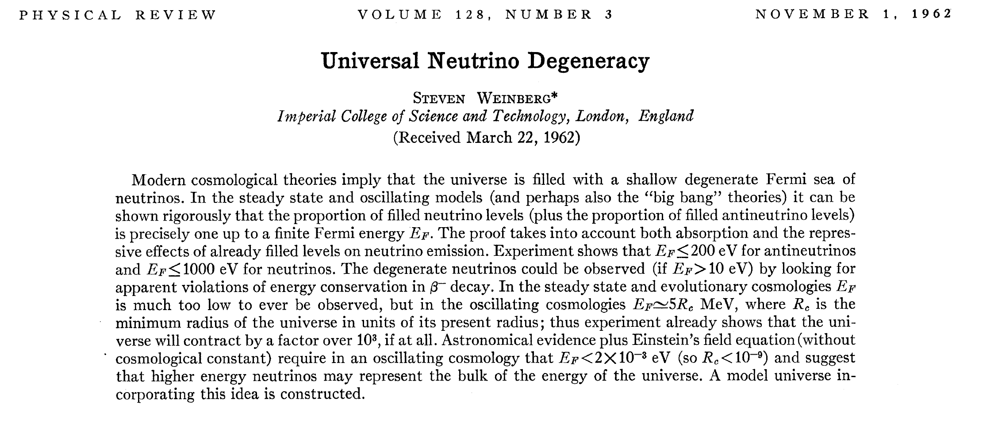
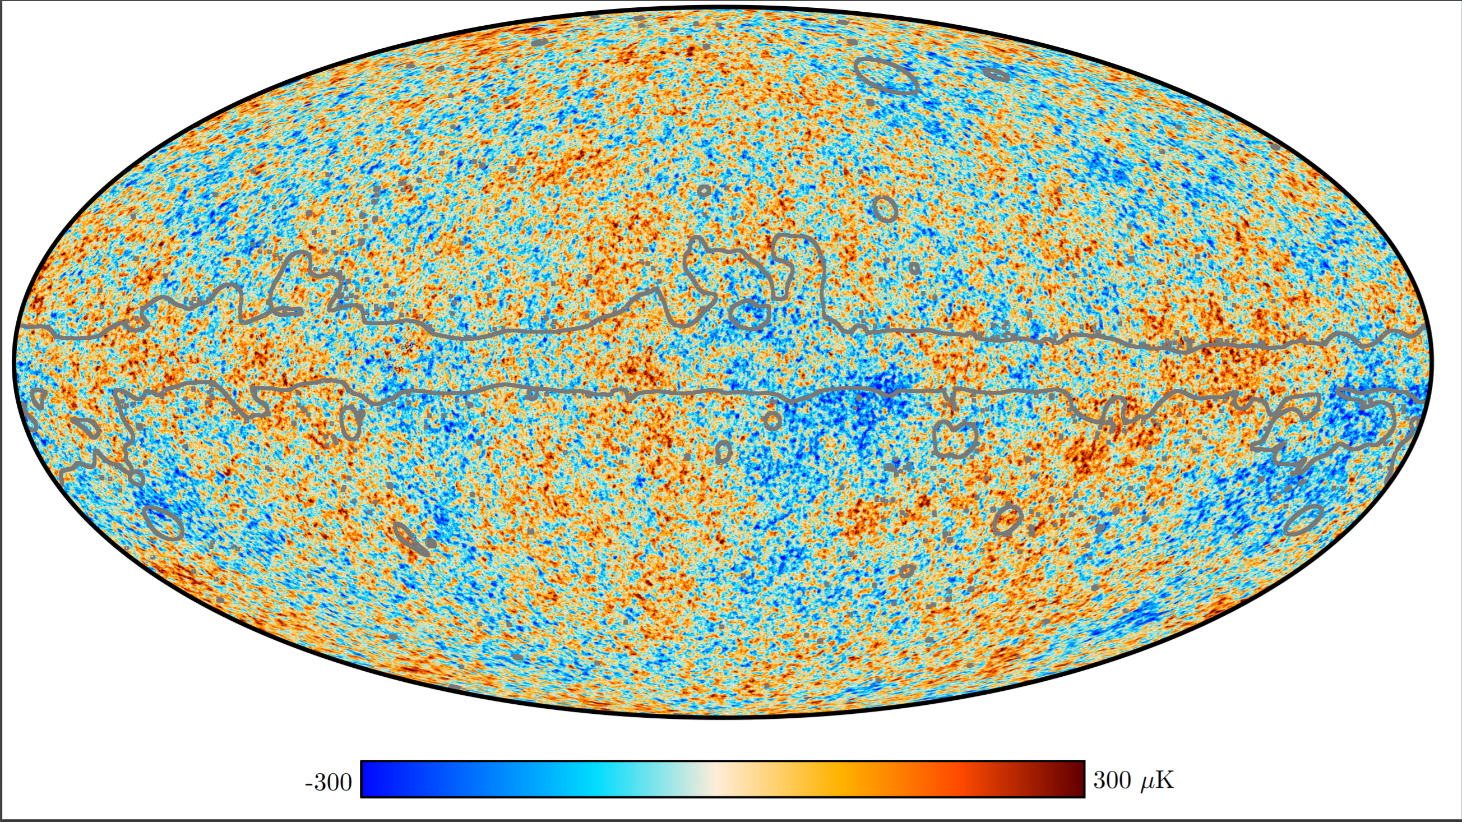
PTOLEMY project
Why believe Big Bang?
Expansion of Universe
Light element abundances
Cosmic Microwave Background
Cosmic Neutrino Background
$m_{ν}=0$
Cocco, Mangano, Messina calculated in 2007 the interaction cross session and the rate with $m_{υ}≠0$case
JCAP 0706:015,2007

Slide 3
PTOLEMY project

Slide 4
Signature of relic neutrinos
PTOLEMY project
$$e^{−}$$
$${\overline{ν}}_{e}$$
$$Q_{β}$$
$$(A,Z)$$
$$(A,Z+1)$$
T_{e}
m_{ν}
$$ν_{e}$$
$$e^{−}$$
$$(A,Z)$$
$$(A,Z+1)$$
$$Q_{β}$$
T_{e}
m_{ν}
m_{ν}

Slide 5
Detection concept: Neutrino Capture on 𝛽 unstable nuclei
Basic concept for relic neutrino detection rooted in a paper by Steven Weinberg in 1962 [Phys. Rev. 128:3, 1457]; applied for the first time, in case of massive neutrinos, to lay out a proposal for their direct experimental detection in 2007.
A.G.Cocco, G.Mangano and M.Messina. JCAP 06(2007)015
Gap (m_{ν}) constrained to
m_{ν} ≲ 200meV
from precision cosmology
Electron flavor expected with
m_{ν} ≳50meV
from neutrino oscillations
M.G. Betti et al JCAP 07(2019)047
PTOLEMY target resolution: ~ 50 meV

Slide 6
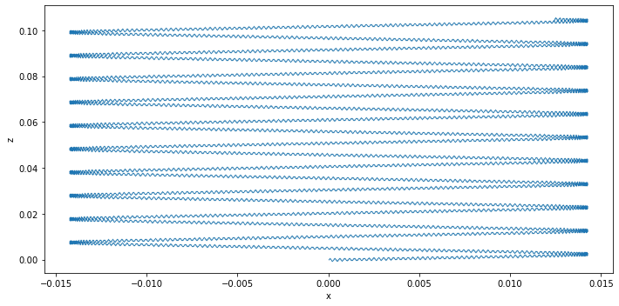
PTOLEMY detector schema
PonTecorvo / PrinceTon Observatory for Light Early-universe Massive-neutrino Yield
$$|B_{x}|$$
$$x$$
$$z$$
Target
RF-tracker
Transverse drift filter
TES µCal
$$ν$$
$$e^{−}$$
p
18.6 keV
© James Mead
$$E_{total}=q\left(V_{TES}−V_{target}\right)+E_{RF}+E_{cal}$$
6

Slide 7
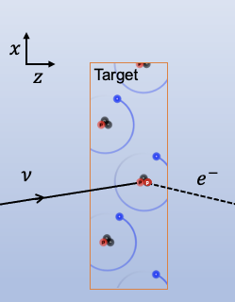
PTOLEMY detector schema
7

Slide 8
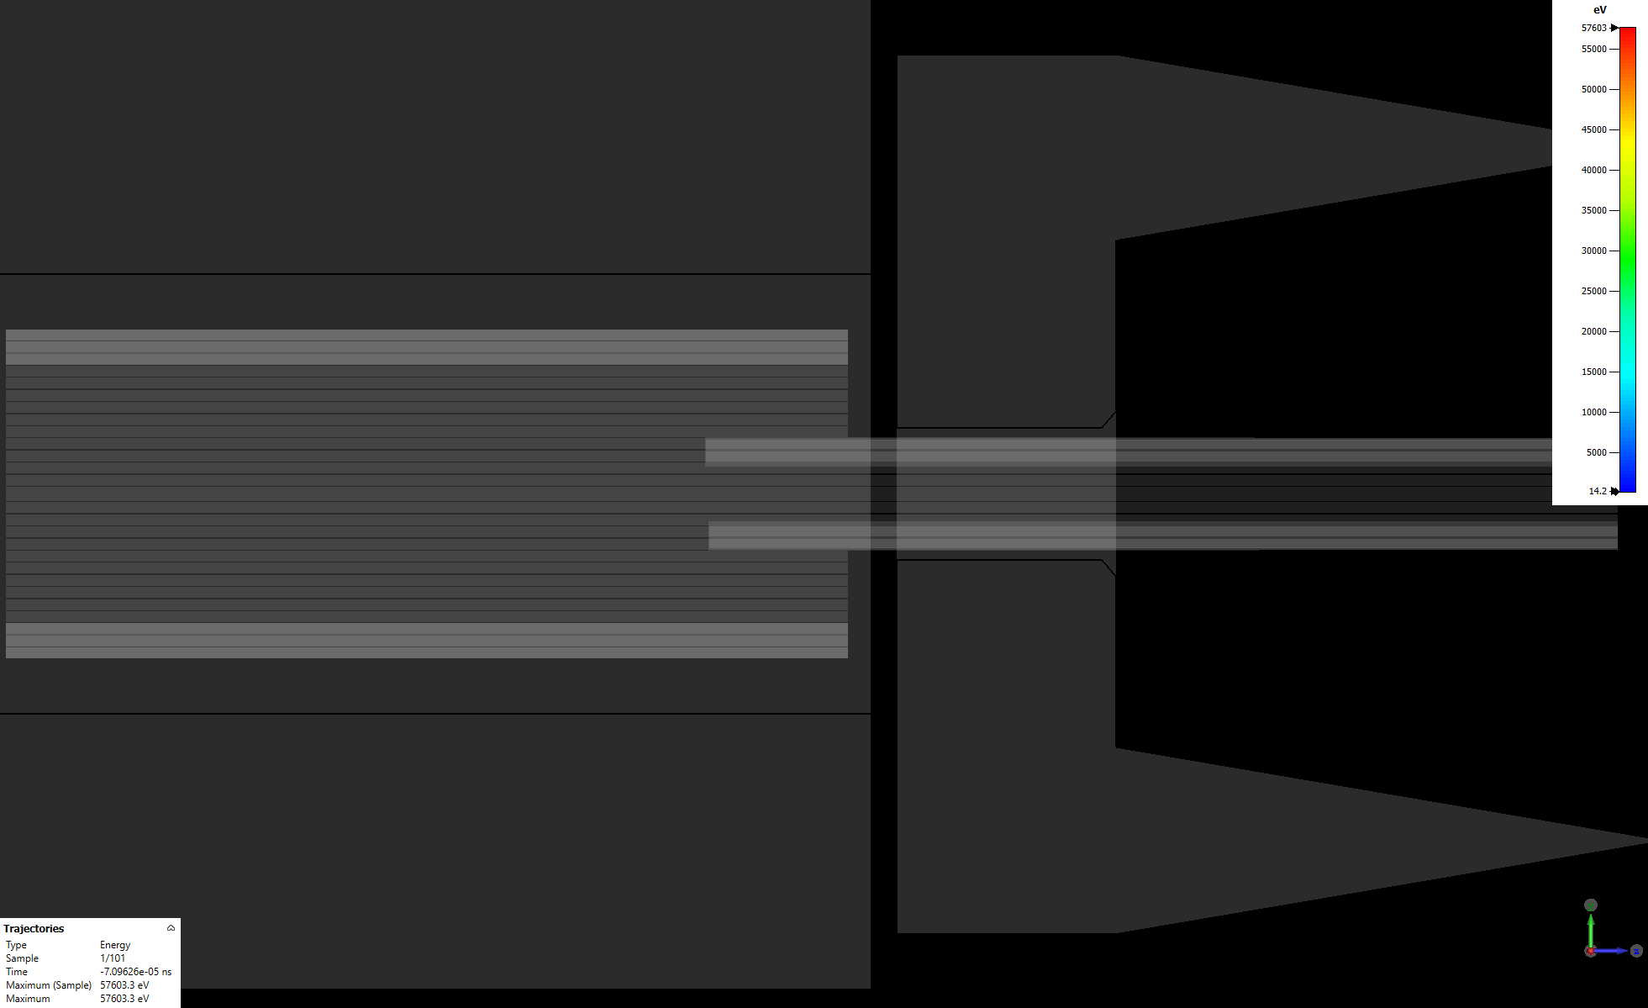
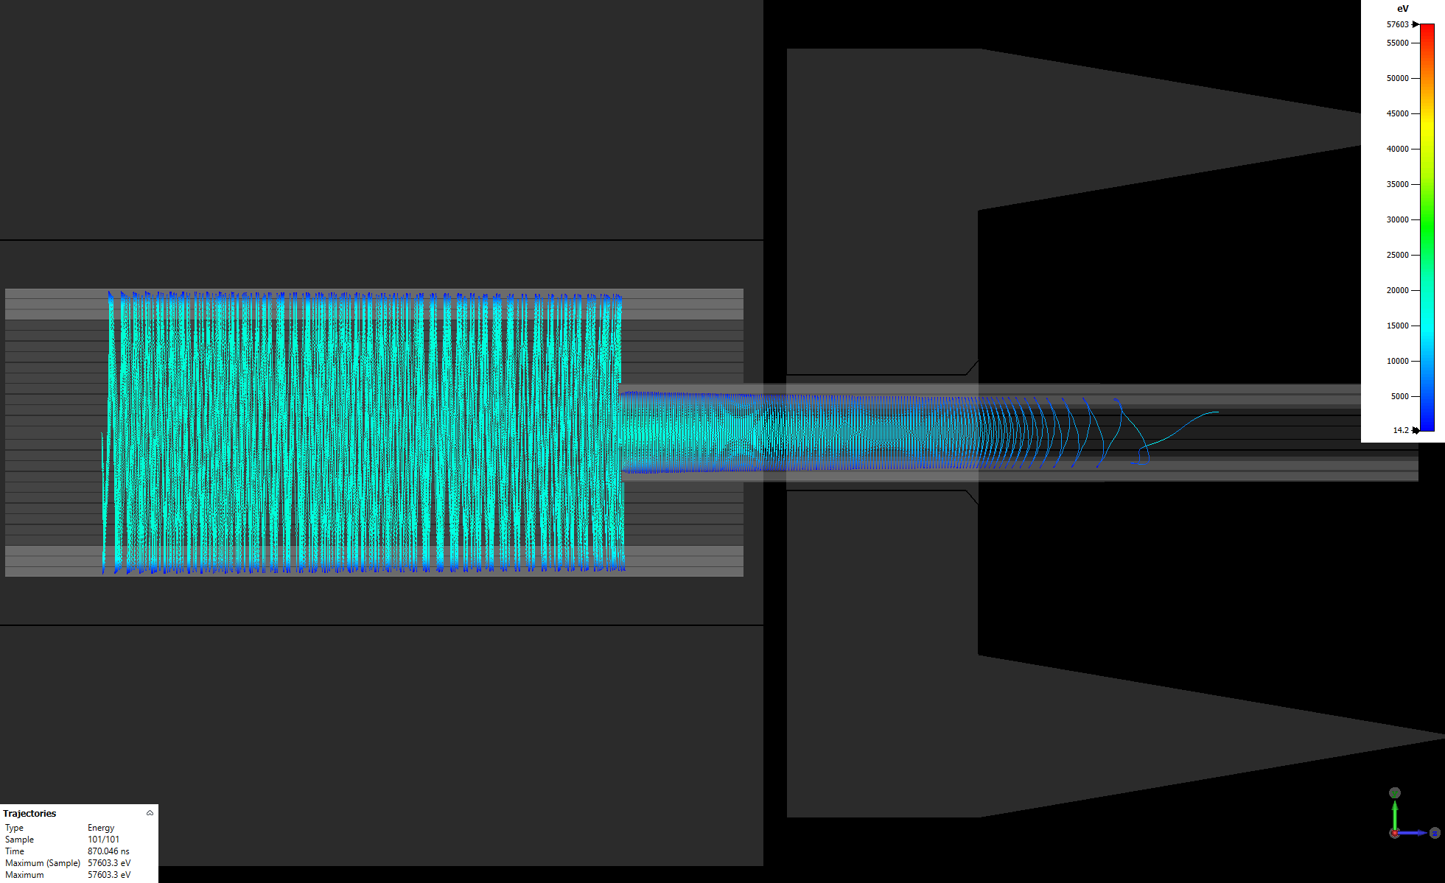
PTOLEMY detector schema
RF Antenna Region
Dynamic EM Filter Region
← Target
Calorimeter →
$$\vec{∇}|\vec{B}|$$
8

Slide 9
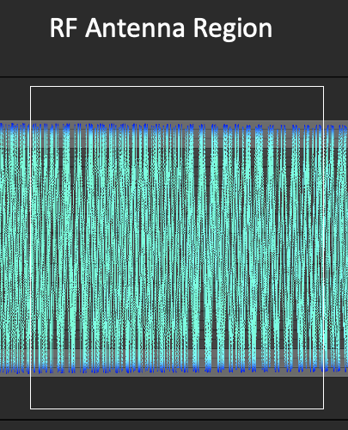
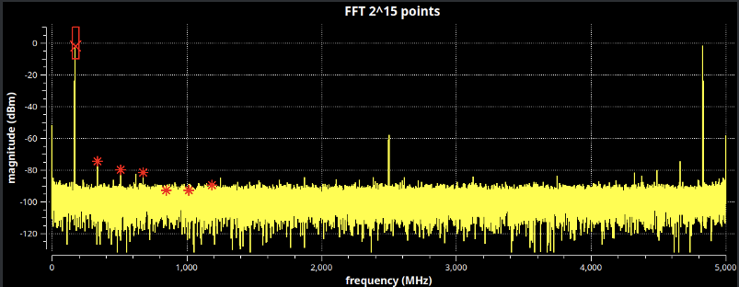
PTOLEMY detector schema
INFN Roma Tor Vergata
FPGA-based parallel FFT
design

Slide 10
Main Parallel FFT Algorithms
Cooley–Tukey: classic, highly parallel
Four-/Six-step: matrix reshape, memory-friendly
Split-radix: fewer operations, cluster-efficient
Prime Factor (PFA): non-power-of-2 sizes
Rader / Bluestein: prime & arbitrary lengths
Stockham: no bit-reversal, SIMD/GPU friendly
Pease / In-place: structured parallel shuffling
Multi-D FFTs: 2D/3D via MPI libraries
Pipelined / MDF: FPGA real-time streams
Auto-tuned libs: FFTW, VkFFT, AccFFT

Slide 11
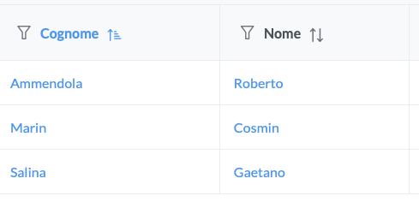
INFN Roma Tor Vergata
Anagrafica
+ V. Narcisi (30 %) Enea Frascati.
Richieste Finanziarie:
Missioni 3 Keuro per meeting e missioni LNGS

