Slide 1
WP5: user strategy and services
EuPRAXIA-PP
Technical Review Meeting
Emiliano Principi – Elettra-Sincrotrone Trieste S.C.p.A.
Francesco Stellato – Università Tor Vergata
15/07/2025

Slide 2
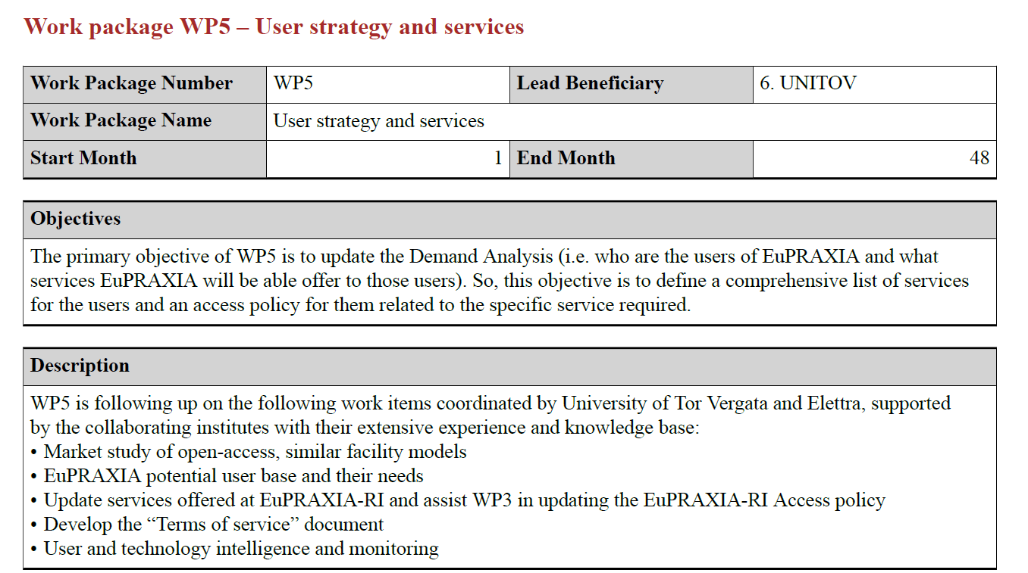
WP5 Overview

Slide 3
People
WP leaders
Emiliano Principi (Elettra)
Francesco Stellato (Uni ToV)
WP members
Davide Bleiner (EMPA)
Gianluca Sarri (Queen’s University Belfast)
EuPRAXIA-PP post-doctoral fellows
Emiliano De Santis (Uni ToV – from May 1st, 2024)
Zeinab Ebrahimpour (Elettra – from November 1st, 2024)

Slide 4
Connections
Connections with other WPs
WP2: Dissemination and Public Relations
WP3: Organization & Rules
WP6: Membership Extension Strategy
WP7: E-needs and Data Policy
WP11: Applications
WP15: TDR EuPRAXIA @SPARC_LAB (beam-driven plasma)

Slide 5
Milestones & Deliverables
WP 5 Milestones
WP 5 Deliverables

Slide 6
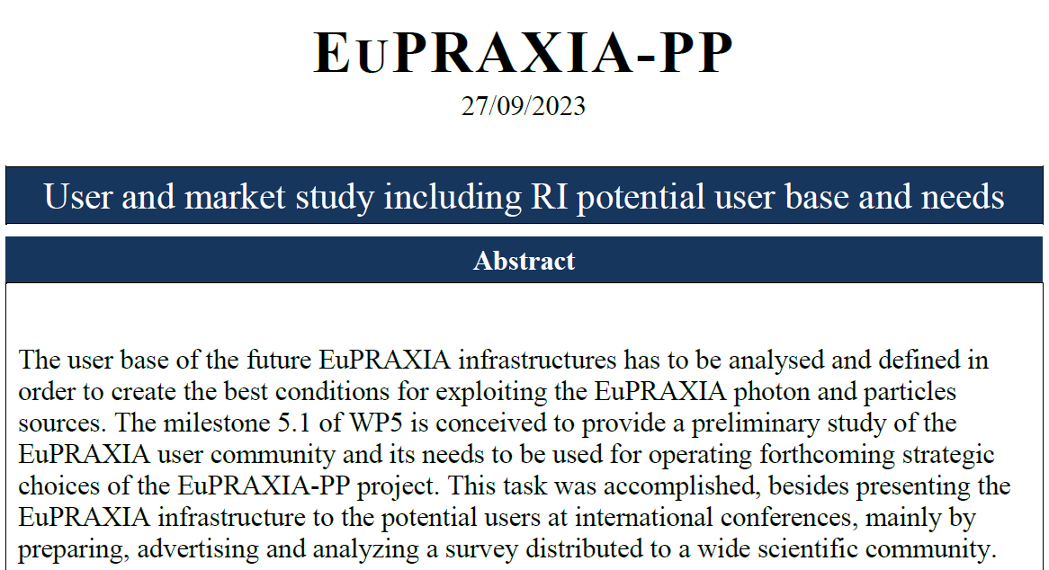
Milestone 5.1
WP5 focused on identifying the potential EuPRAXIA user base and their needs through the design, implementation, and promotion of a survey
Outreach efforts at international meetings and conferences helped raise awareness of EuPRAXIA and foster dialogue with prospective users to better understand their requirements and expectations.
WP5 complemented the survey analysis by examining user policies from similar European research infrastructures, allowing for the refinement of strategies and alignment with international best practices.

Slide 7
Milestone 5.2
Goal Develop a comprehensive user access policy for the EuPRAXIA infrastructure.
Motivation
Ensure transparent, inclusive, and effective user access.
Align policies with leading European light source facilities.
Methodology
Reviewed user policies from major EU research infrastructures.
Conducted a detailed web-based user survey.
Held in-person interviews with ESRF and EuXFEL user offices.
Engaged with scientific community through conferences and meetings.

Slide 8
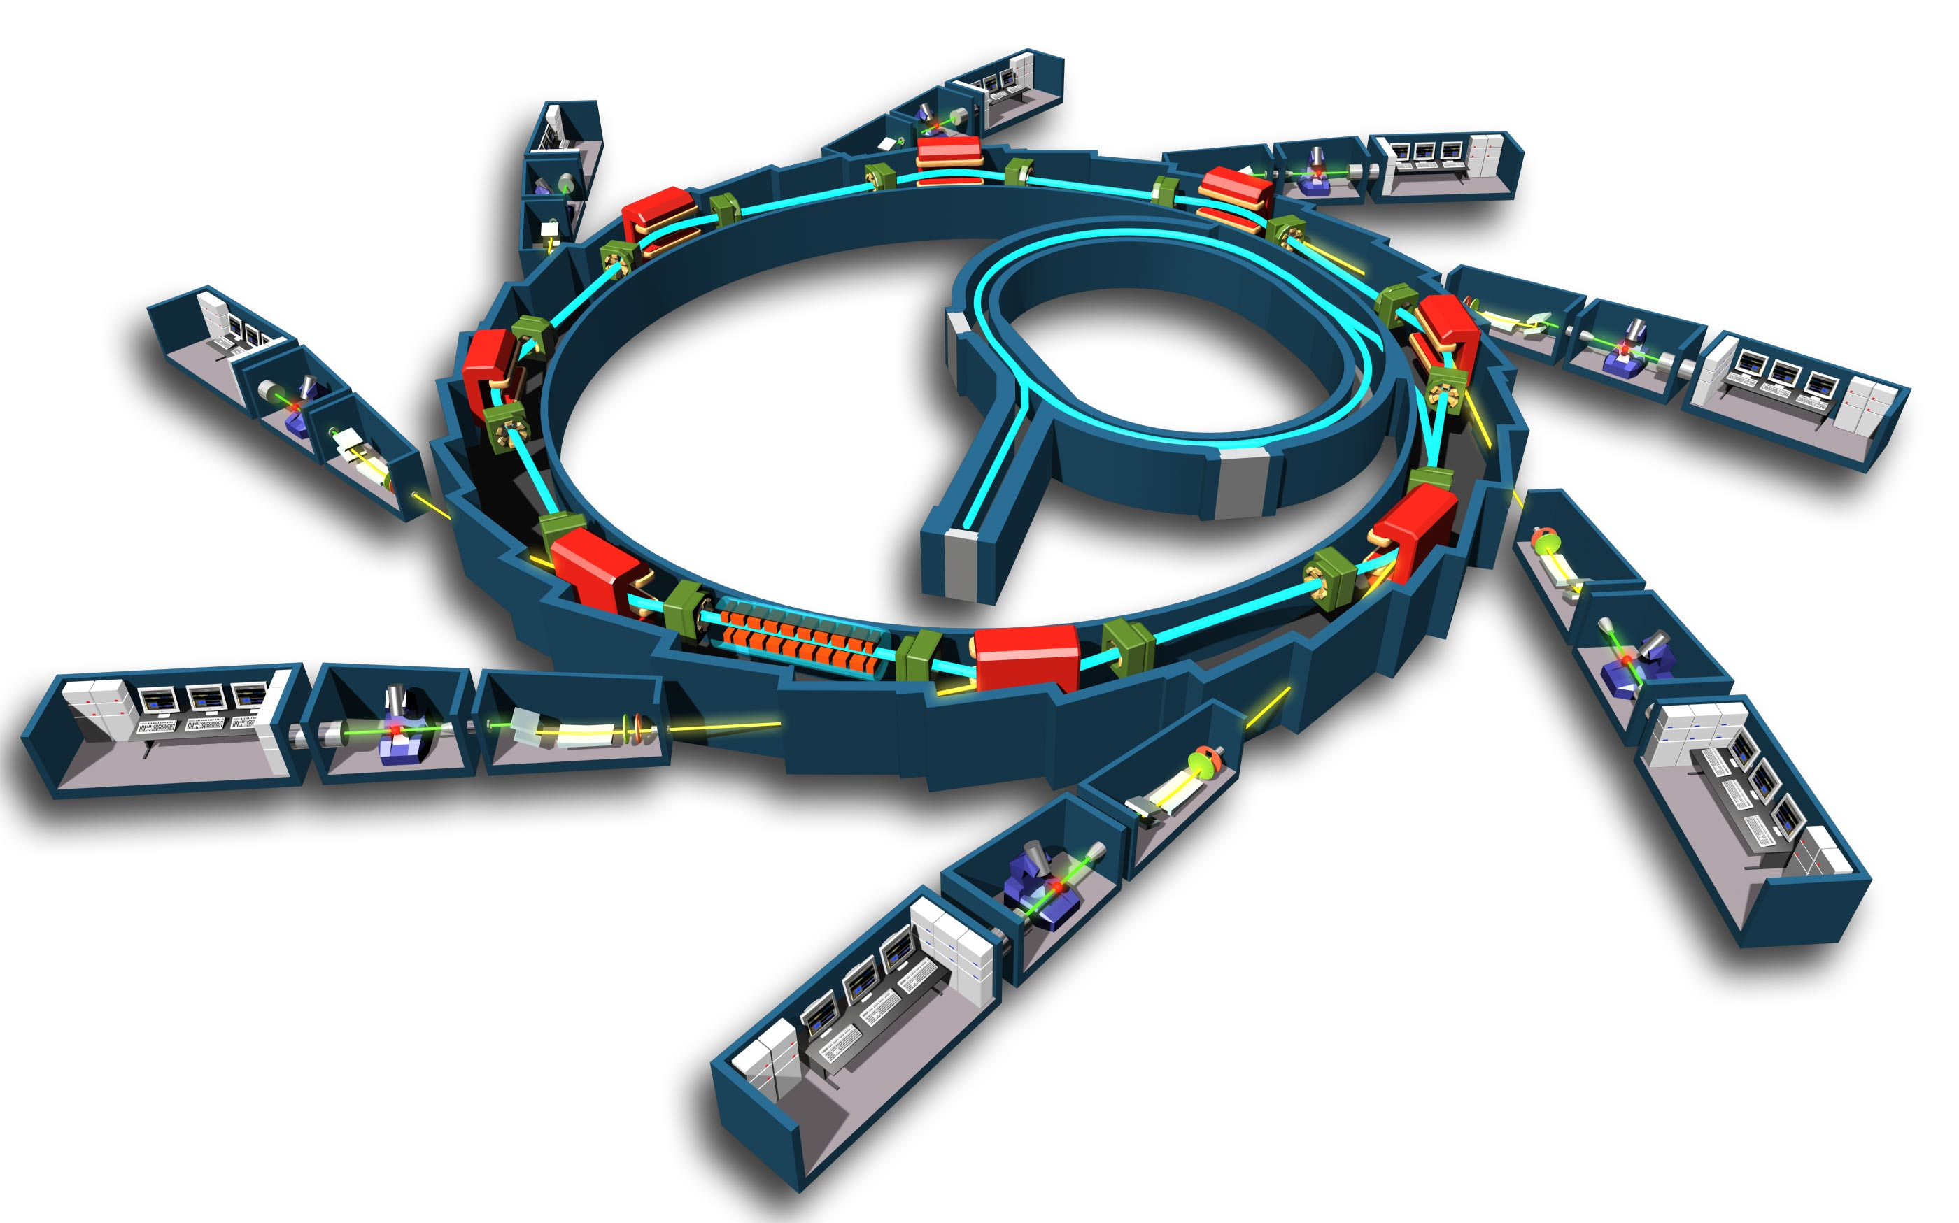
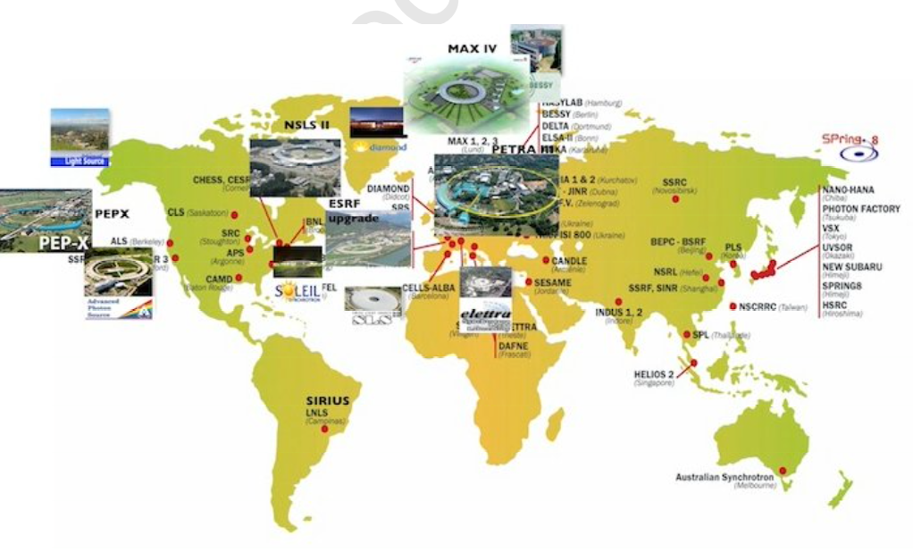
Milestone 5.2
‘Similar’ European (and not) RIs – Synchrotrons
🇫🇷
🇺🇸
🇬🇧
🇦🇺
🇹🇭
🇮🇹
🇩🇪
European Synchrotron Radiation Facility (ESRF, France)
Located in Grenoble, ESRF is one of the most powerful synchrotrons, providing high-energy X-rays for a broad range of scientific fields.
Advanced Photon Source (APS, USA)
Located at Argonne National Laboratory in Illinois, APS is a leading source of high-brightness X-rays for research in materials science, chemistry, and biology.
Diamond Light Source (UK)
Located in Oxfordshire, Diamond is the UK's national synchrotron facility and supports a wide range of scientific research with its versatile X-ray beamlines.
Australian Synchrotron (Australia)
Located in Melbourne, this facility provides a variety of X-ray techniques for research in materials
science, biology, and medicine.
Synchrotron Light Research Institute (SLRI, Thailand)
Based in Nakhon Ratchasima, this facility offers synchrotron radiation for research and industrial applications.
Elettra Sincrotrone Trieste (Italy)
Located in Trieste, Elettra is a cutting-edge research facility offering a range of synchrotron radiation techniques for studies in materials science, environmental science, and life sciences. It plays a key role in advancing scientific knowledge and industrial applications in Europe.
PETRA III (Germany) Located at DESY in Hamburg, PETRA III is one of the most brilliant X-ray sources worldwide. It supports a wide array of scientific disciplines, including physics, chemistry, biology, and nanotechnology, offering high-resolution imaging and structural analysis capabilities.

Slide 9
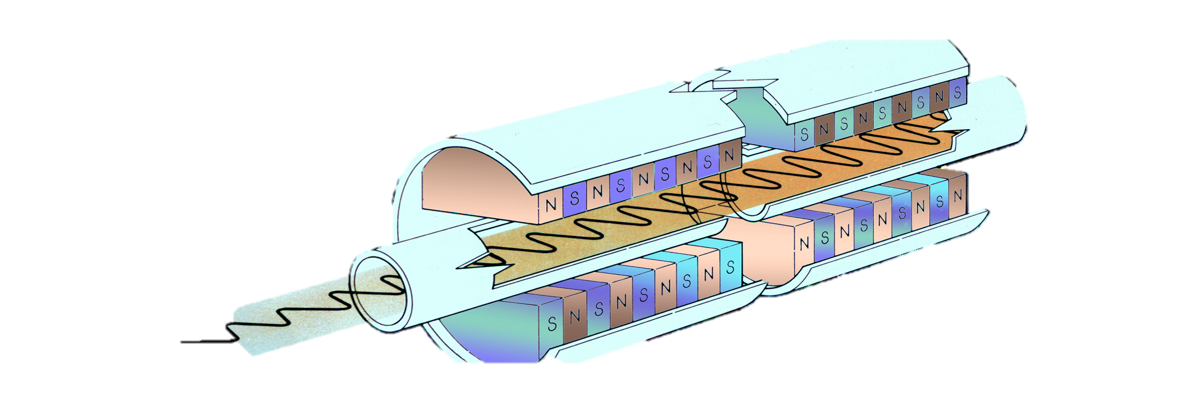
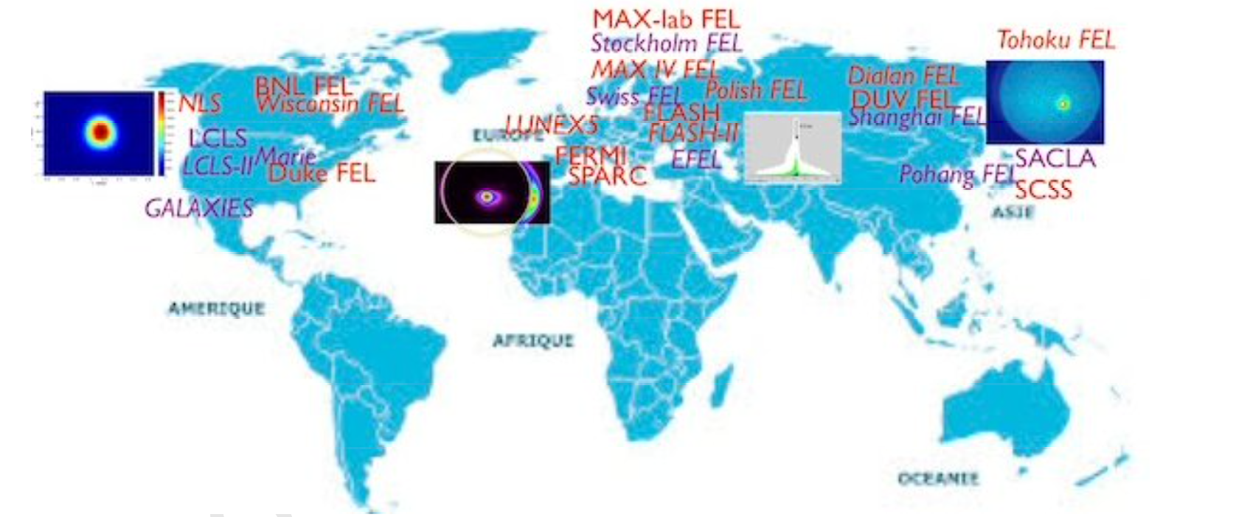
Milestone 5.2
‘Similar’ European (and not) RIs – Free Electon Lasers
🇩🇪
🇺🇸
🇨🇭
🇯🇵
🇩🇪
🇮🇹
🇰🇷
🇨🇳
European XFEL (Germany)
Located in Hamburg, the European XFEL is one of the most powerful X-ray lasers in the world, capable of generating extremely short and intense X-ray pulses.
Linac Coherent Light Source (LCLS, USA)
Located at SLAC National Accelerator Laboratory in California, LCLS was the first FEL to produce hard X-rays and is widely used for research in molecular and atomic physics.
SwissFEL (Switzerland)
Located at the Paul Scherrer Institute, SwissFEL is a cutting-edge facility that provides ultra-short X-ray pulses for a wide range of experiments.
SACLA (Japan)
Located in Harima, SACLA is one of the most compact XFELs in the world, producing
intense X-ray beams for high-resolution imaging and other applications.
FLASH (Germany)
Operated by DESY in Hamburg, FLASH is primarily used for soft X-ray and ultraviolet experiments.
FERMI (Italy)
Located in Trieste, FERMI is a state-of-the-art free electron laser facility specializing in soft X-rays and extreme ultraviolet light, offering advanced capabilities for ultrafast spectroscopy and imaging
Pohang Accelerator Laboratory X-ray Free Electron Laser (PAL-XFEL, South Korea) Located in Pohang, PAL-XFEL is a state-of-the-art facility providing hard and soft X-ray laser pulses for various scientific applications. It supports research in biology, chemistry, and materials science by offering ultrafast imaging capabilities.
Shanghai Coherent Light Facility (SCLF, China) Located in Shanghai, SCLF is a major free electron laser facility designed to produce high-brilliance X-rays for cutting-edge research. It aims to advance studies in physics, chemistry, and life sciences with its powerful and versatile X-ray beams.

Slide 10
Milestone 5.2
ESRF & Eu-XFEL policies
Why ESRF & Eu-XFEL ?
Both are multinational projects involving European countries that commit themselves in an intergovernmental convention.
Their collaboration and funding mechanisms involve a broad international community.
Other research infrastructures to look at: FERMI/Elettra , …

Slide 11
Milestone 5.2
Access policy - Questions
- Is there any official documentation about the "Access policy"
- How to get access to beamtime? - Scientific proposals selection: procedure, critical aspects, acceptance rate, calls per year - How many proposals received/accepted every year?
- Do users complain about limited access to the facility?
- Proposals review panels: composition, duration of the panel, budget for travels, in person sessions or ZOOM sessions
- Industrial users: how many, access policies, evaluation of industrial experimental proposals, access costs for industrial users

Slide 12
Milestone 5.2
User services - Questions
- Is there any official documentation about the offered «User services»?
- What is needed to operate a user office?
- Support offered to users: Canteen, Guest House, travel organization and/or reimbursement
- What are the most required services?
- Monitoring users' satisfaction (post-beamtime surveys, …)
- Annual budget for users services

Slide 13
Milestone 5.2
EuPRAXIA Report on access policy
Access Policy Highlights
Peer-reviewed Proposal System: Based on scientific merit, innovation, and feasibility.
Proposal Review Panel: Rotating experts; hybrid meetings to reduce travel.
Commissioning Phase Priority: In-house R&D and experiments suited to early-stage beam conditions.
Standard & Rolling Calls: Issued regularly; fast-access options planned.

Slide 14
Milestone 5.2
EuPRAXIA Report on access policy
User Support & Inclusivity
Financial/logistical support for travel, lodging, and meals.
Support services: Sample handling, data analysis tools, and training.
Reserved beamtime for early-career researchers, EU institutions, and internal R&D.
Portal Access:
Centralized user web portal for proposals, documentation, and support services.

Slide 15
Milestone 5.2
EuPRAXIA Report on access policy
Industrial Access
Fee-based, with simplified review for feasibility and commercial impact.
Programs to enhancing SME access to European research and technology infrastructures are being developed
https://www.esrf.fr/home/Industry/industry-news/content-news/esrf-news-list/enhancing-sme-access-to-european-research-and-technology-infrastructures.html

Slide 16
Deliverable 5.1
Report on EuPRAXIA-RI demand analysis
More than 2000 invitation emails sent, 300 responses (163 complete, 167 partial)
Participants: Mostly academic researchers 35–44 y/o
Awareness of EuPRAXIA:
48% partial knowledge
35% no prior knowledge
17% full knowledge
User web-survey to analyse expectations and requirements of the potential user community
https://surveys.infn.it/index.php/718177?lang=en

Slide 17
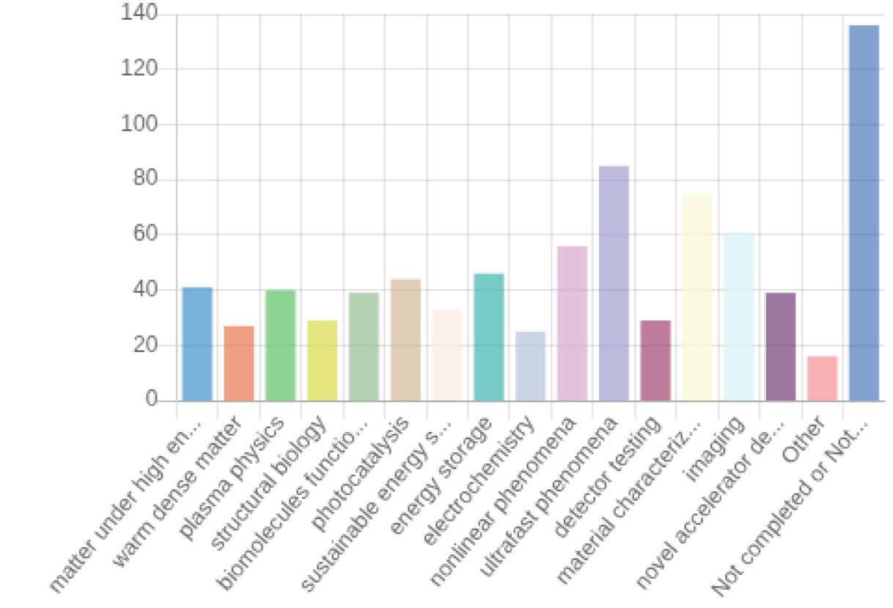
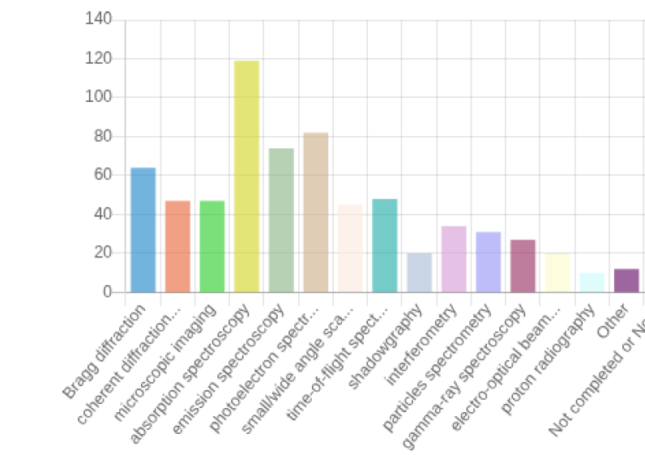
Deliverable 5.1
A few representative figures
Scientific area Experimental technique

Slide 18
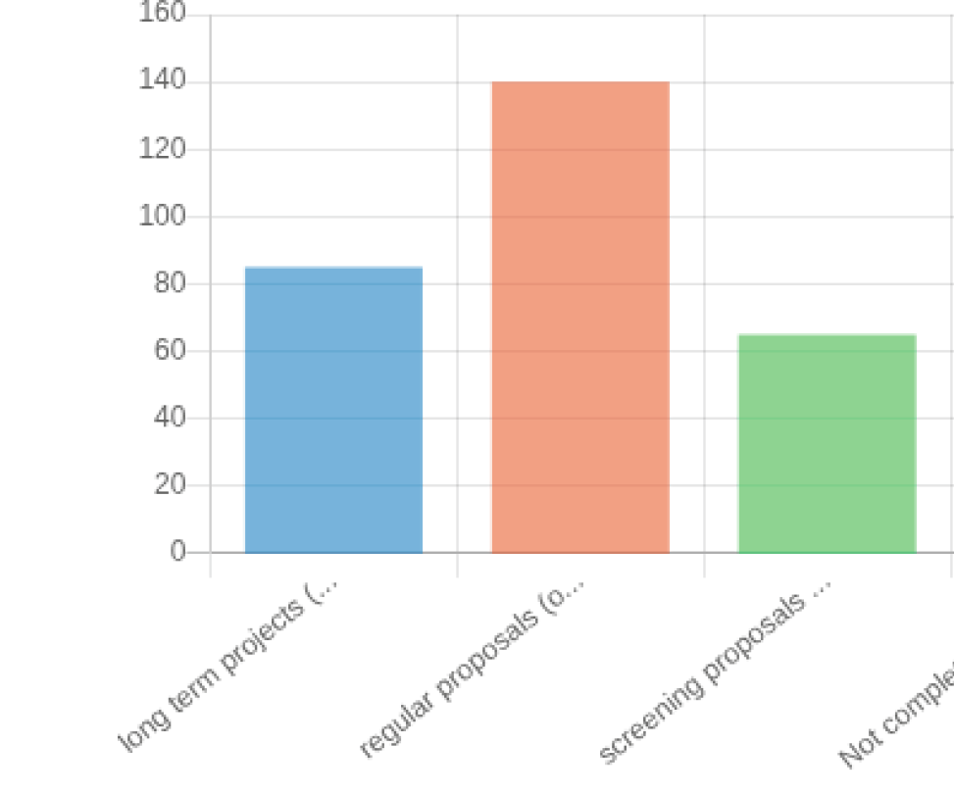
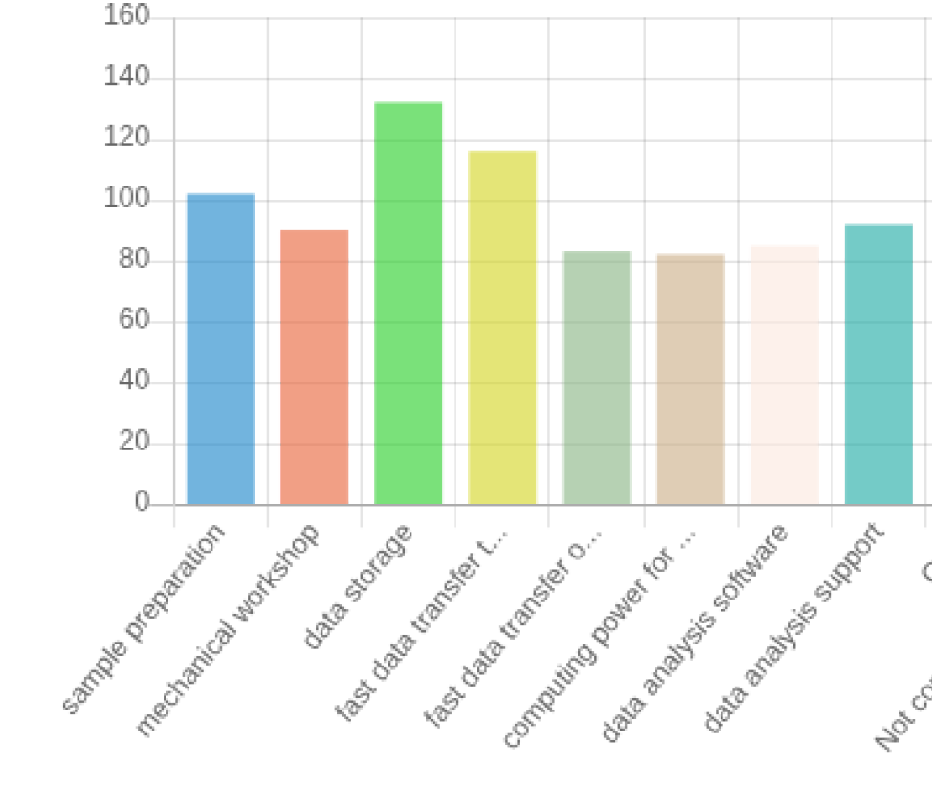
Deliverable 5.1
A few representative figures
Allocation Policy Requested support

Slide 19
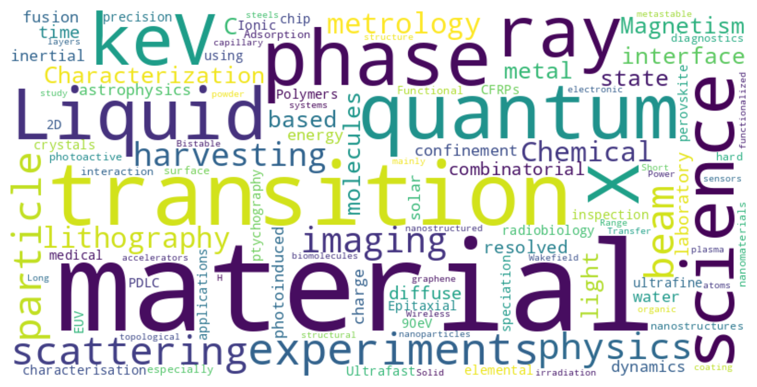
Deliverable 5.1
Report on EuPRAXIA-RI demand analysis
Key User Preferences
Photon Sources:
Soft X-rays (47%), EUV (33%), Hard X-rays (20%)
Other sources:
Electrons
Beam Parameters:
Repetition rate: 100–10,000 Hz
Pulse duration: 1–10 fs
Spot size: 1–5 µm
Support:
Demand for full experimental setups and detectors
Strong need for data storage and analysis services

Slide 20
Dissemination
Presentation of EuPRAXIA-PP at National and International conferences in various fields
←→ bidirectional interactions with the users’ community
EBSA 2023 - Stockholm (Biophysics)
EEAC2023 (Accelerators)
CMD-Fismat 2023 (Condensed matter physics)
Italian-Swedish workshop sponsored by the Italian Ministry of Foreign Affairs and International Cooperation (Bilateral cooperation → engagement of the Swedish community)
SILS 2023 & 2024 (Synchrotron radiation)
Big Science Business Forum 2024 (Industry)
XFEL users meeting 2023 & 2024 (FELs)
SIBPA 2024 (Biophysics)
LNF-INFN workshop (Physics)
Science@FELs 2024 (FELs)
EBSA 2025 (Biophysics)

Slide 21
Pubblications
F Galdenzi, MP Anania, A Balerna, RJ Bean, A Biagioni, C Bortolin, L Brombal, F Brun, M Coreno, G Costa, L Crincoli, A Curcio, M Del Giorno, E Di Pasquale, G di Raddo, V Dompè, S Donato, Z Ebrahimpour, A Falone, A Frazzitta, M Galletti, A Ghigo, S Lauciani, A Liedl, V Lollo, A Marcelli, E Principi, A R Rossi, F Stocchi, F Villa, M Zottola, A Cianchi, F Stellato, M Ferrario, “The EuAPS Betatron Radiation Source: Status Update and Photon Science Perspectives”, Condensed Matter, 2024
E De Santis, T Andrè, S Alleva, RJ Bean, M Ferrario, A Marcelli, V Minicozzi, E Principi, N Timneanu, C Caleman, F Stellato, “Biological Applications at the AQUA Beamline of the EuPRAXIA@SPARC LAB Free Electron Laser”, accepted in European Biophysical Journal, 2025

Slide 22
Summary
Building up the EuPRAXIA users’ community
Establishing connections with European Research Infrastructures
Collecting the needs of the users’ community and integrating them in the Demand Analysis
Merge users desiderata and existing RI policies to design the EuPRAXIA Access Policy

