Slide 1

General status on scientific advancement
Massimo Ferrario,
INFN-LNF
This project has received funding from the European Union´s Horizon Europe research and innovation program under grant agreement No. 101079773
EuPRAXIA-PP Technical Review Meeting
July 15, 2025

Slide 2
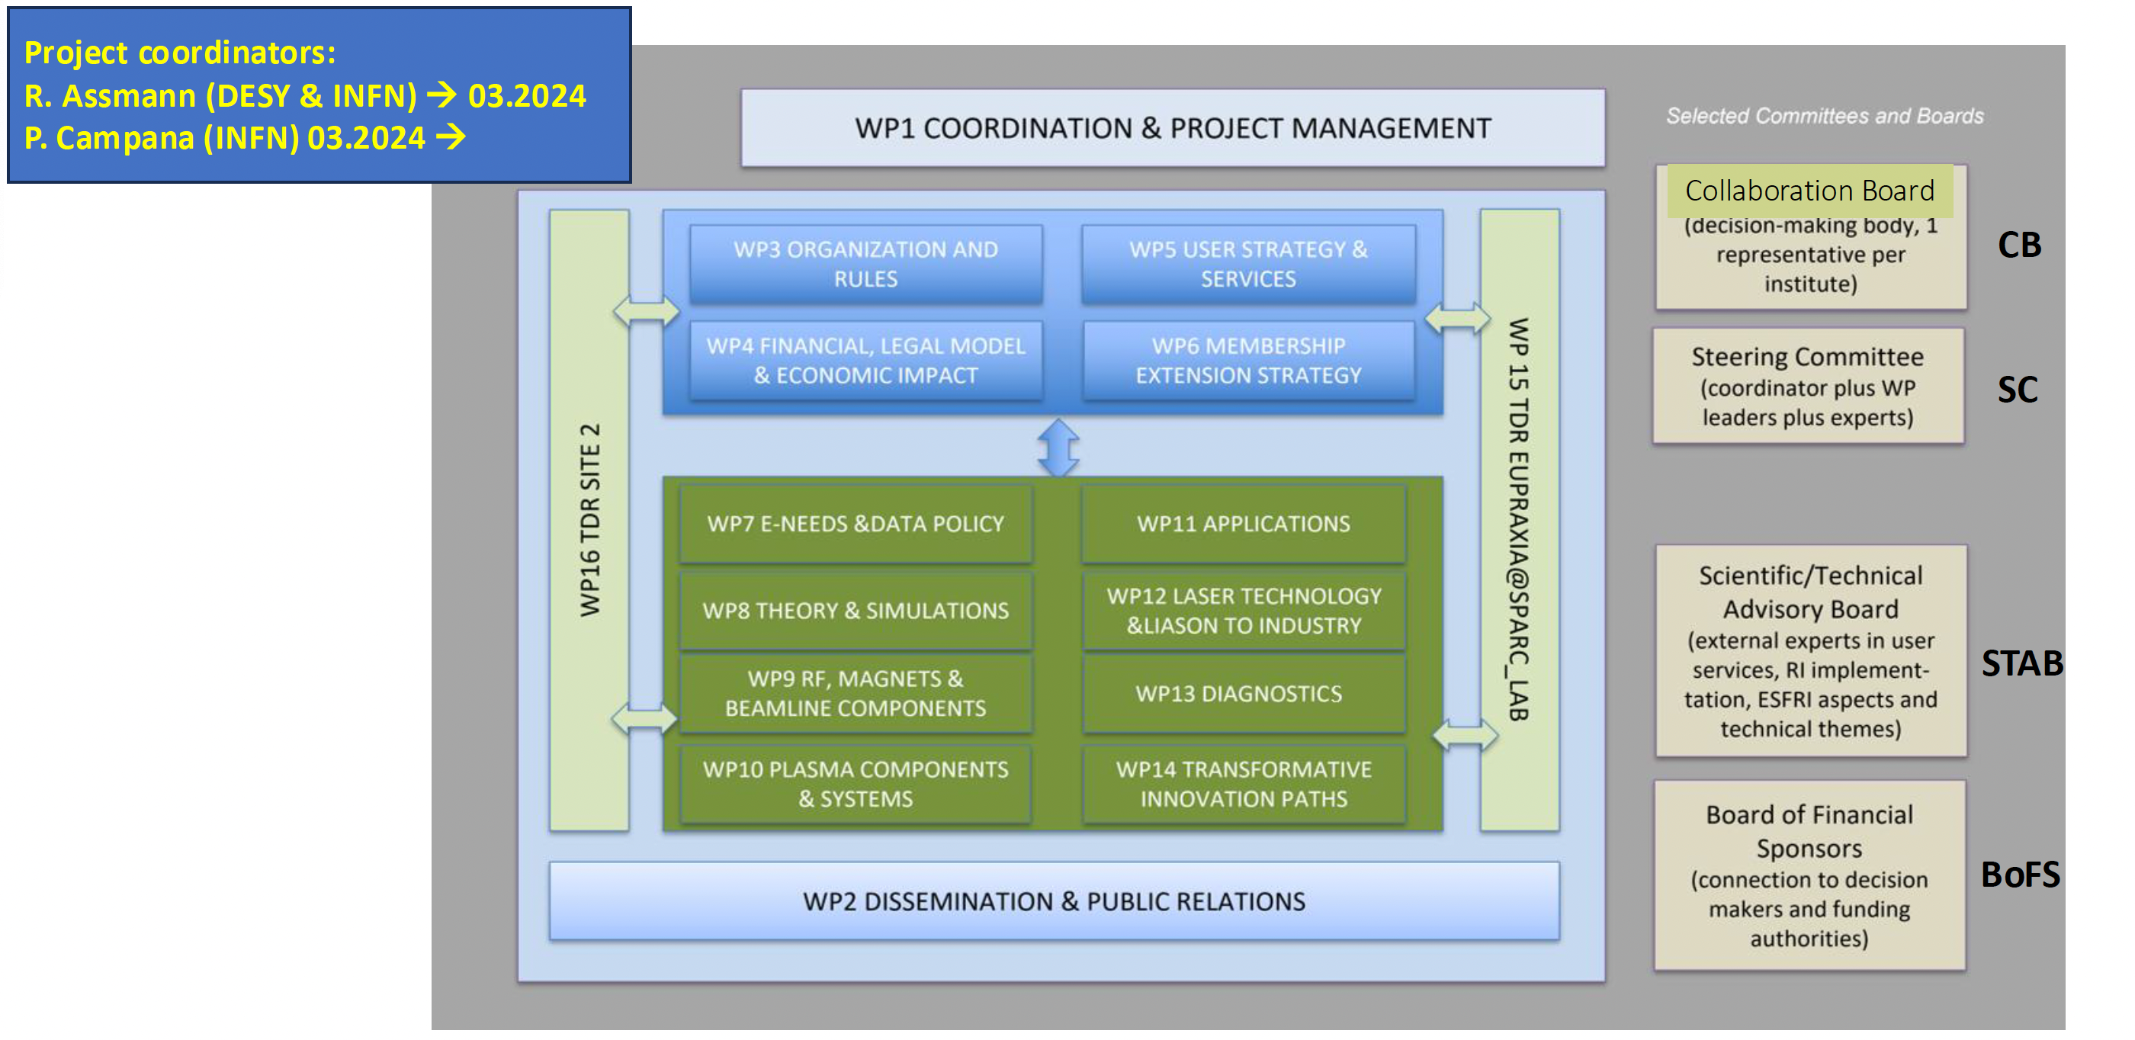
EuPRAXIA_PP Structure
Overall Mission: EuPRAXIA_PP advances the organizational, technical, legal, and financial maturity of EuPRAXIA project, preparing for its transition into a distributed Research Infrastructure (User Facility).

Slide 3
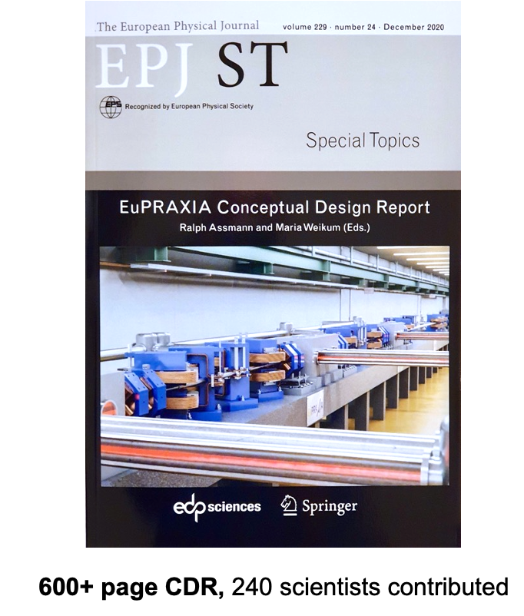
The Concept of User Facility in the EuPRAXIA Project
In the EuPRAXIA project, the user facility is conceived as a cutting-edge, distributed European research infrastructure that provides open access to advanced plasma-based accelerator technologies and associated beamlines. It is designed not only to serve the needs of the scientific community but also to act as a platform for innovation, integrating academia, industry, and technology developers. A distinctive element of the EuPRAXIA user facility is its commitment to open innovation, where collaboration between research institutions, industrial partners, and technology providers is central to the development and application of new accelerator concepts.
Mission | Serve a broad community of users in physics, material science, biology, medicine, and industrial applications through plasma-based electron beams and associated radiation sources.
Access | Open to external users (academic and industrial) through peer-reviewed proposals, ensuring scientific excellence and societal impact. Pilot user access is foreseen from 2031.
Distributed Model | EuPRAXIA is a distributed research infrastructure wich will operate through multiple nodes under a unified governance framework (AISBL) and coordinated access policy.
Beamlines & Instruments | Users will access beamlines including plasma-driven FELs, betatron and ICS X-ray sources, and ultrashort electron and positron beams.
Sustainability | Focus on energy efficiency (e.g., high-efficiency laser systems and RF modules), minimization of physical footprint through compact accelerator designs, and adherence to EU green transition objectives.
Data & Open Science | EuPRAXIA promotes open data policies and integration with the European Open Science Cloud (EOSC), enabling FAIR access to results and infrastructure services.

Slide 4


EuPRAXIA Scientific Goals
Funded by the European Union
  Free Electron Laser
Flagship Science Goal 1: EuPRAXIA will deliver free-electron laser (FEL) X rays with 10^9-10^13 photons per pulse to user areas, covering wavelengths of 0.2 nm to 36 nm. The EuPRAXIA FEL pulses are naturally short (down to 0.4 fs) and will therefore provide users with tools for investigating processes and structures in ultra-fast photon science at a reduced facility foot print.
Flagship Science Goal 2: EuPRAXIA will deliver betatron X rays with about 10^10 photons per pulse, up to 100 Hz repetition rate and an energy of 5-18 keV to users from the medical area. The much reduced longitudinal length of the X ray emission area (point-like emission) leads to an important improvement in image resolution compared to other techniques.
  Betatron Radiation Source
Flagship Science Goal 3: EuPRAXIA will deliver positron beams at energies from 0.5 MeV to 10 MeV and a repetition rate of 100 Hz for material science studies. Per pulse about 10^6 positrons will be produced in a time duration of 20-90 picoseconds on the sample, allowing time-resolved studies. EuPRAXIA will here advance the capabilities of existing positron sources in flux and time resolution.
  Positron Beams
Flagship Science Goal 4: EuPRAXIA will deliver electron and positron beams at energies from a few 100 MeV up to 5 GeV for high energy physics related R&D (detectors, linear collider topics). R&D goals include the demonstration of a linear collider stage, a "table top" HEP test beam and studies on positron transport and acceleration towards a linear collider.
  e+ / e- beams
  ICS Photon Beams
Flagship Science Goal 5: EuPRAXIA will deliver photons from an inverse Compton scattering (ICS) source. The photons of up to 600 MeV and with narrow-band spectrum will enable precision nuclear physics and highly penetrative radiography for users.
Flagship Science Goal 6: EuPRAXIA will provide access to a multi-stage, high-repetition rate plasma accelerator in the GeV range to users from accelerator science. This R&D platform will allow the testing of novel ideas and concepts, full optimisation of a plasma collider stage, certain fixed target experiments (also in combination with lasers) and performance studies of conventional versus novel accelerator technology.
  High Rep. Rate Laser
Flagship Science Goal 7: EuPRAXIA will provide access to cutting edge laser technology with short pulse length in combination with high energy photon pulses and short electron/positron bunches. Novel schemes of pump probe configurations and ultra-precise timing will be researched, feeding back into laser science.
  Laser Technology
www.eupraxia-facility.org

Slide 5
Scientific and Technical WPs Advancements
Area | Progress Highlights | Deliverables
(WP7) E-needs & Data Policy | Defined e-needs and proposed data policy for EuPRAXIA; benchmarked with existing infrastructures; initiated work on data management and European Open Science Cloud integration. | D7.2: Report on integration into European facility landscape and standards - M7.1: Benchmark within existing facilities on e-needs and data policy
(WP8) Theory & Simulation | Developed advanced laser injection models, 3D PIC simulations, and optimized plasma structures for high-rep-rate FEL-quality beams. | D8.2: Results in theory and simulations
(WP9) RF, Magnets, Beamlines Components | Designed compact RF/magnet components and assessed undulator technologies for FELs. | D9.2: Technical results on RF, magnets, beamlines
(WP10) Plasma Components | Published a technical report on plasma systems; held a workshop at DESY assessing readiness. | D10.2: Technical results on plasma components M10.1: Workshop on EuPRAXIA plasma concept
(WP11) Applications | Completed beamline concept surveys; demonstrated x-ray spectroscopy and positron beamline use cases. | M11.1: Survey of user facilities to test equipment and/or advanced beamlines
(WP12) Laser Technology & Liason to Industry | Specified high-rep-rate laser system for 2nd site; partnered with industry and EU projects (HOTSTACK, PACRI). | D12.2: Technical results on lasers - M12.2Design and project of transport beamlines
(WP13) Diagnostics | Workshop on Advanced beam/X-ray diagnostics; explored dielectric wakefield phase space shaping; promoted lab personnel exchange. | D13.2: Technical results on diagnostics
(WP14) Transformative Innovation Paths | Validated hybrid LWFA-PWFA beams; simulated plasma photocathode XFELs; launched P-MoPA experiments. | MG.1: Update of concepts for EuPRAXIA, systems status report
(WP15) TDR EuPRAXIA@SPARC_LAB | Completed draft TDR for EuPRAXIA@SPARC_LAB; final layout and simulations prepared. | D15.2: Mid-term report on TDR status M15.2: Workshop on upgrade and beamlines
(WP16) TDR Laser-driven Site | Selected ELI Beamlines (CZ) as second site; EPAC (UK) and CNR-INO (IT) designated as R&D nodes. | D16.1: Update on EuPRAXIA plans for selected site 2

Slide 6
WP.8 Theory and Simulations
Jorge Vieira (IST)
Henri Vincenti (CEA)
This project has received funding from the European Union´s Horizon Europe research and innovation program under grant agreement No. 101079773
EuPRAXIA-PP Technical Review Meeting
July 15, 2025

Slide 7
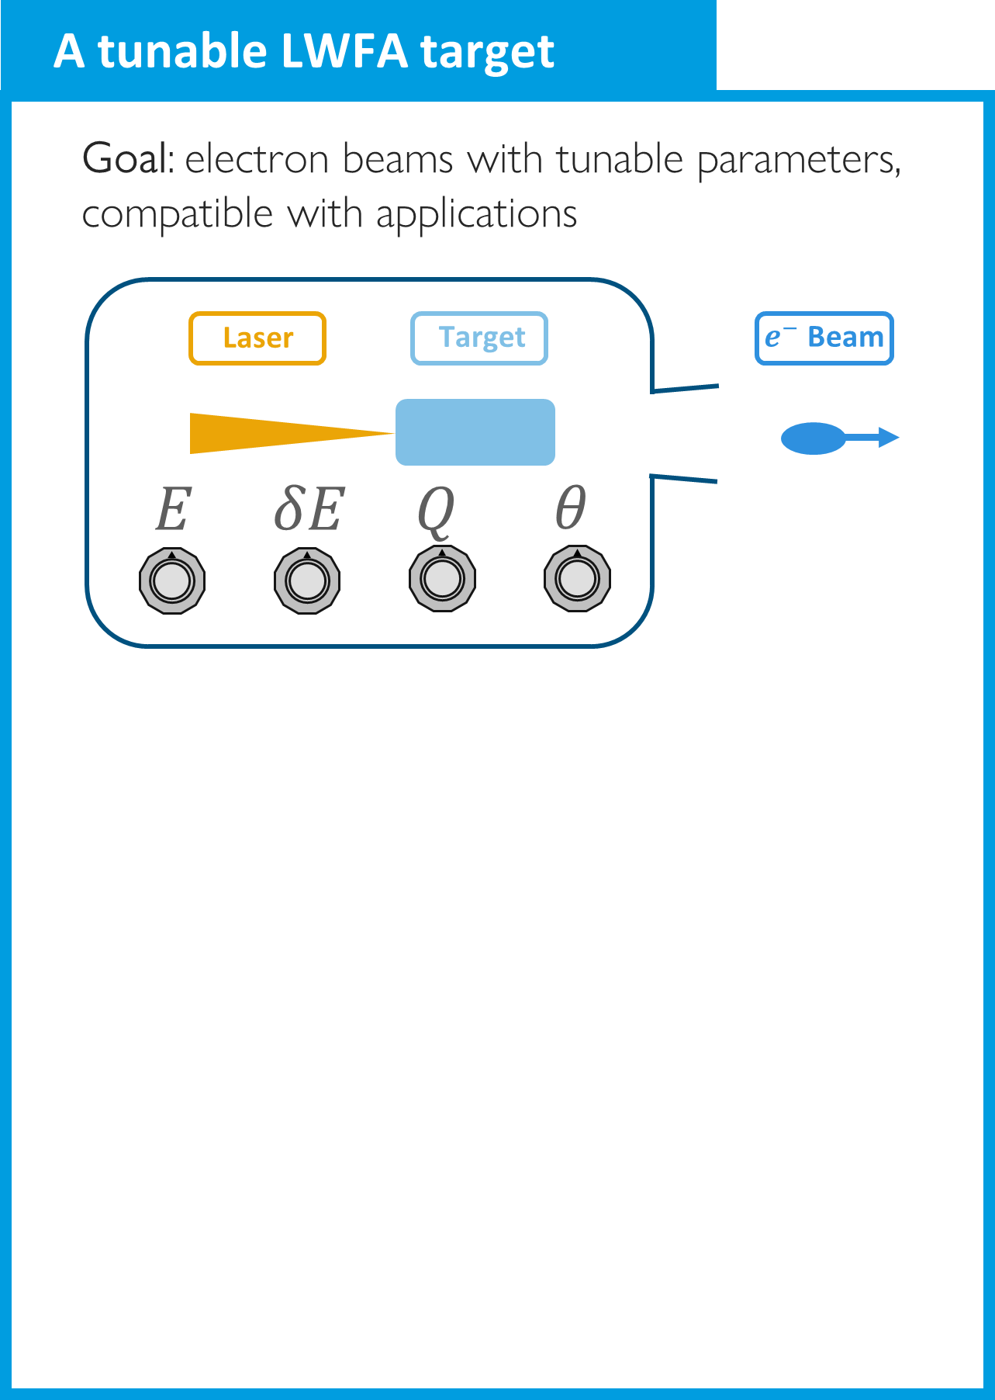
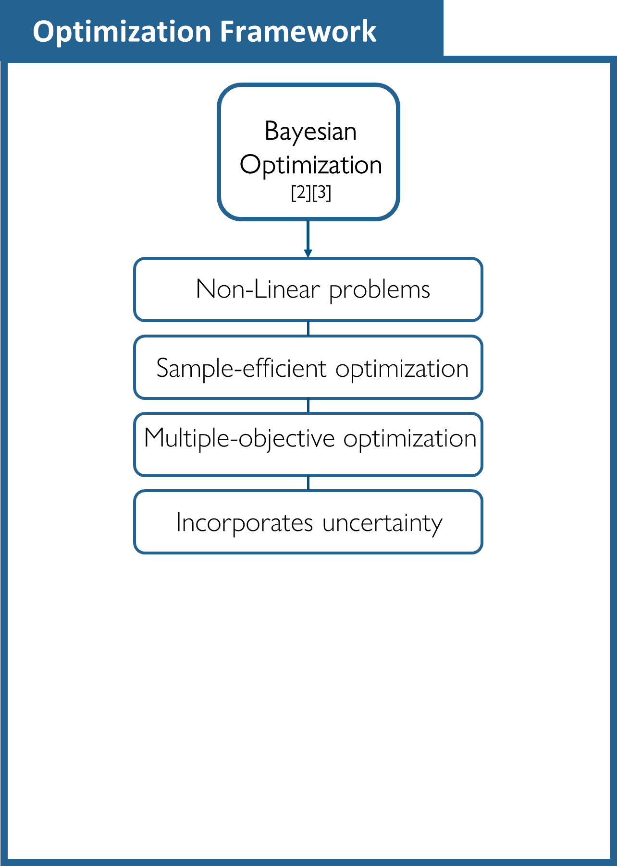

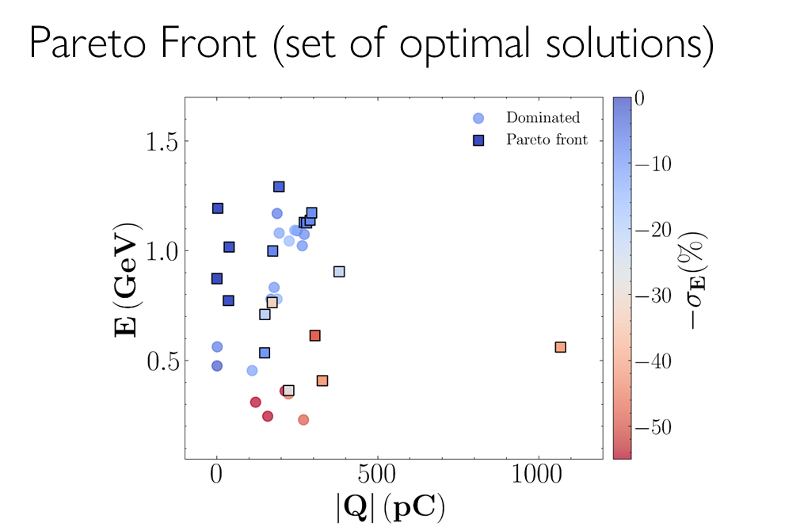

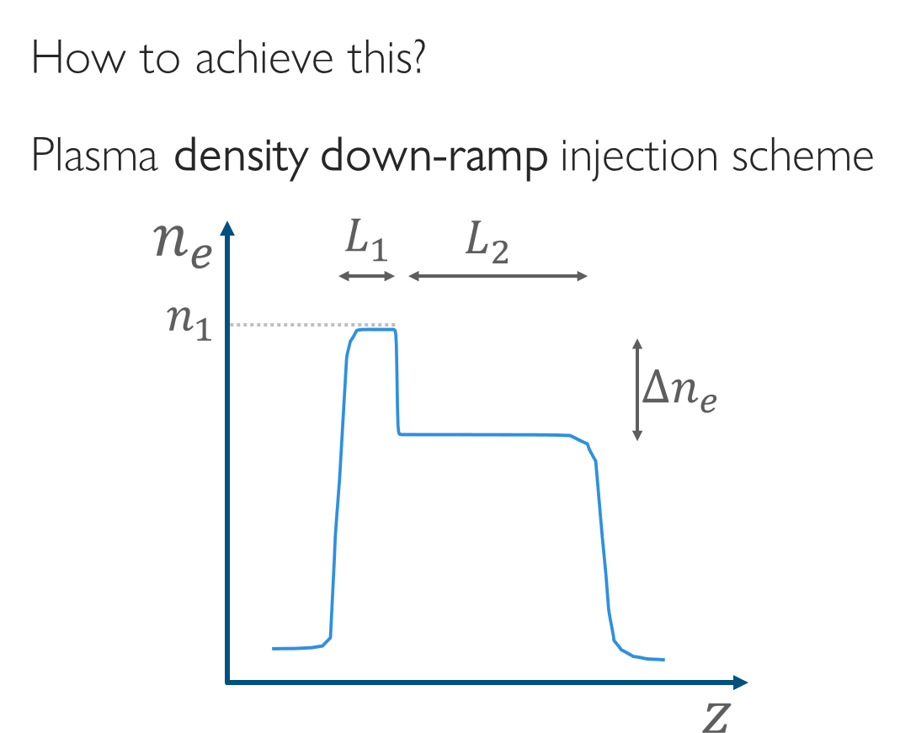
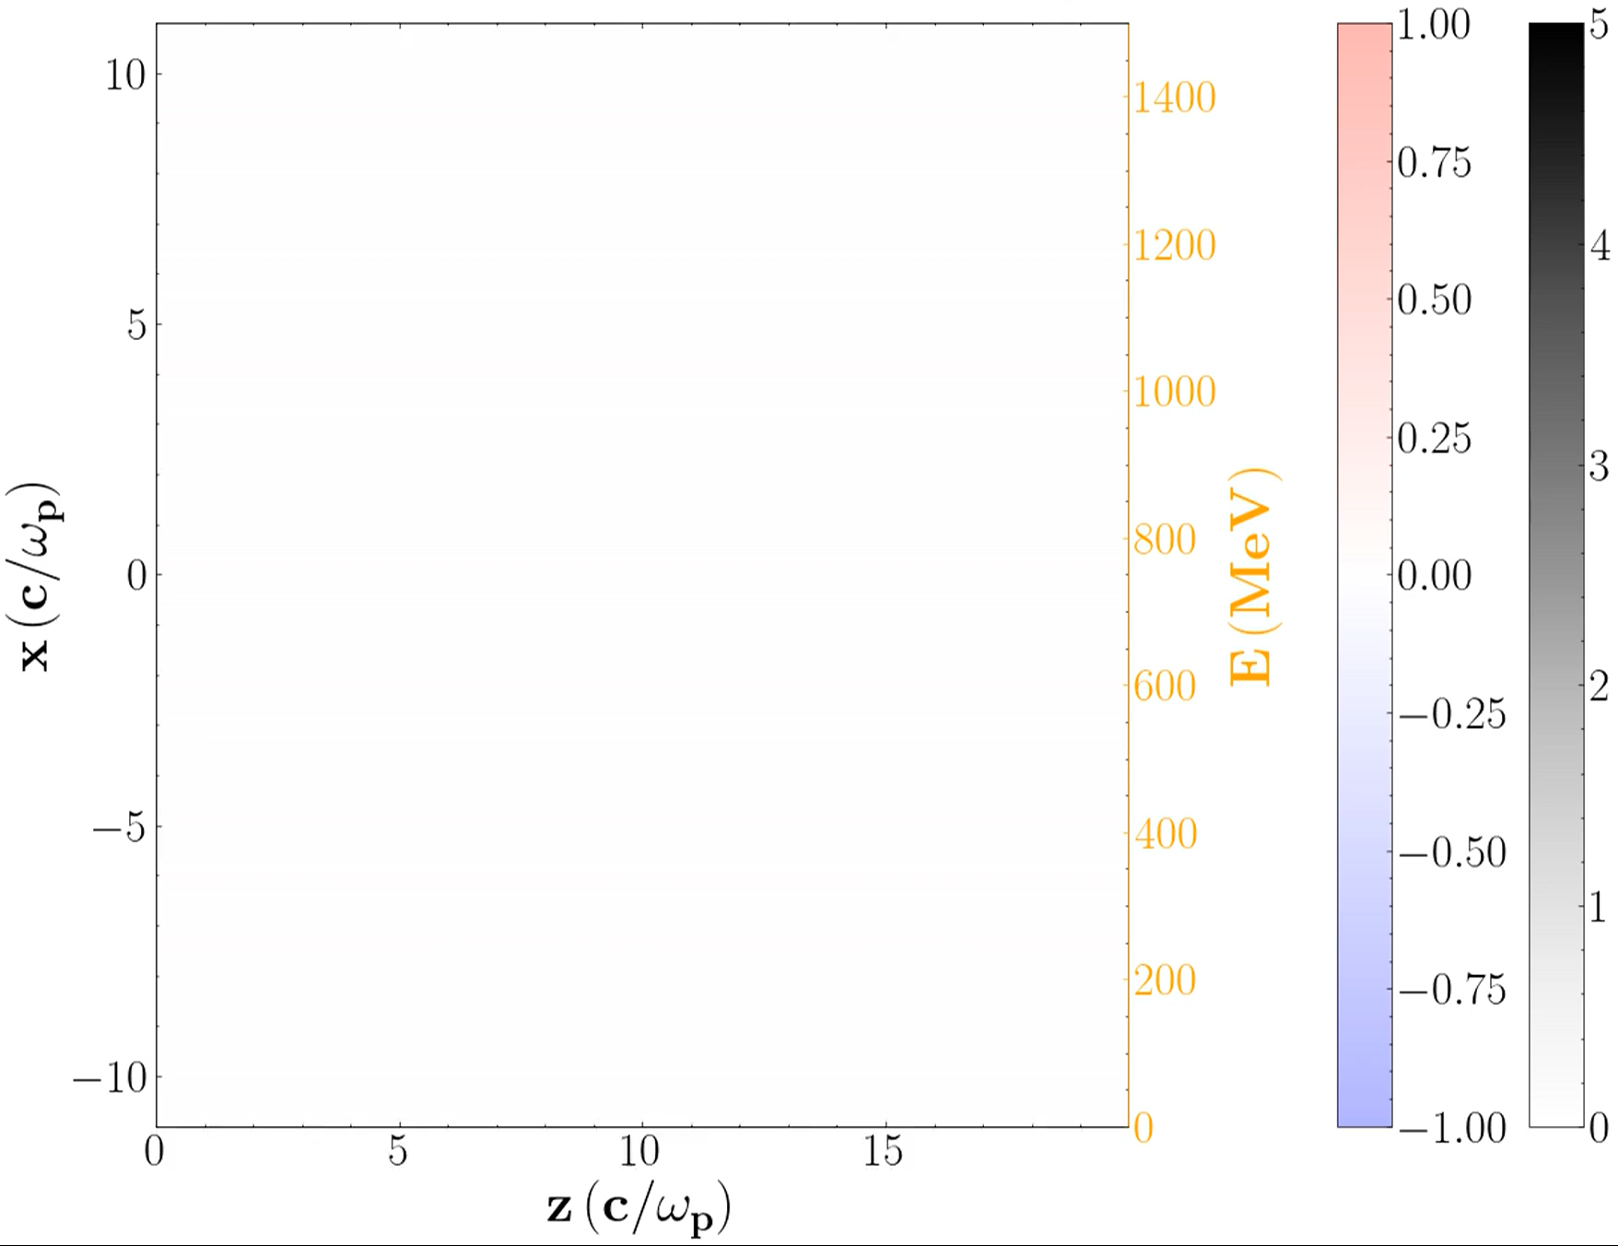
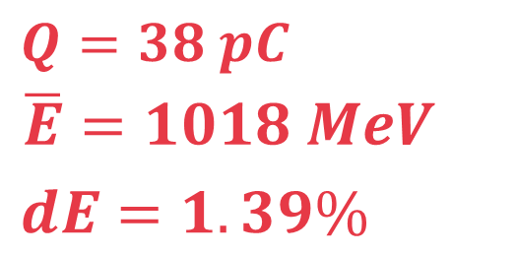
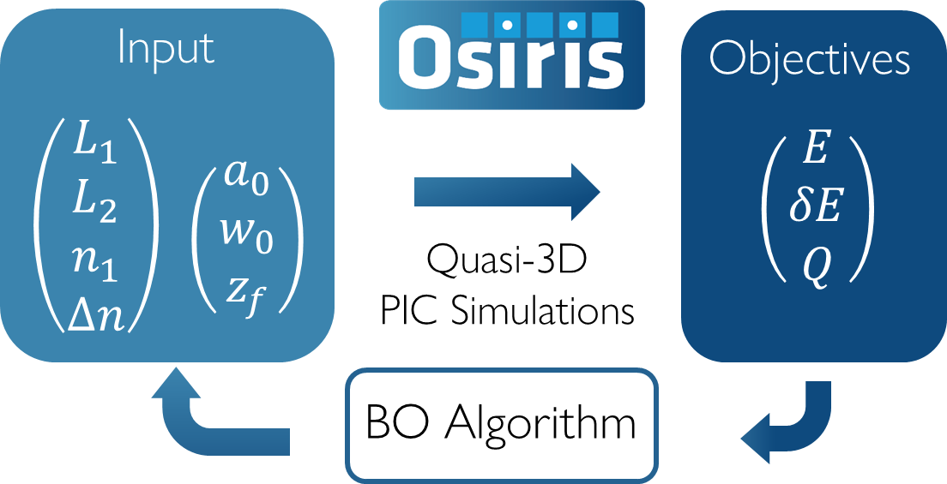
Down-ramp injection optimization (with ELI)
D. Lemos et al.

Slide 8
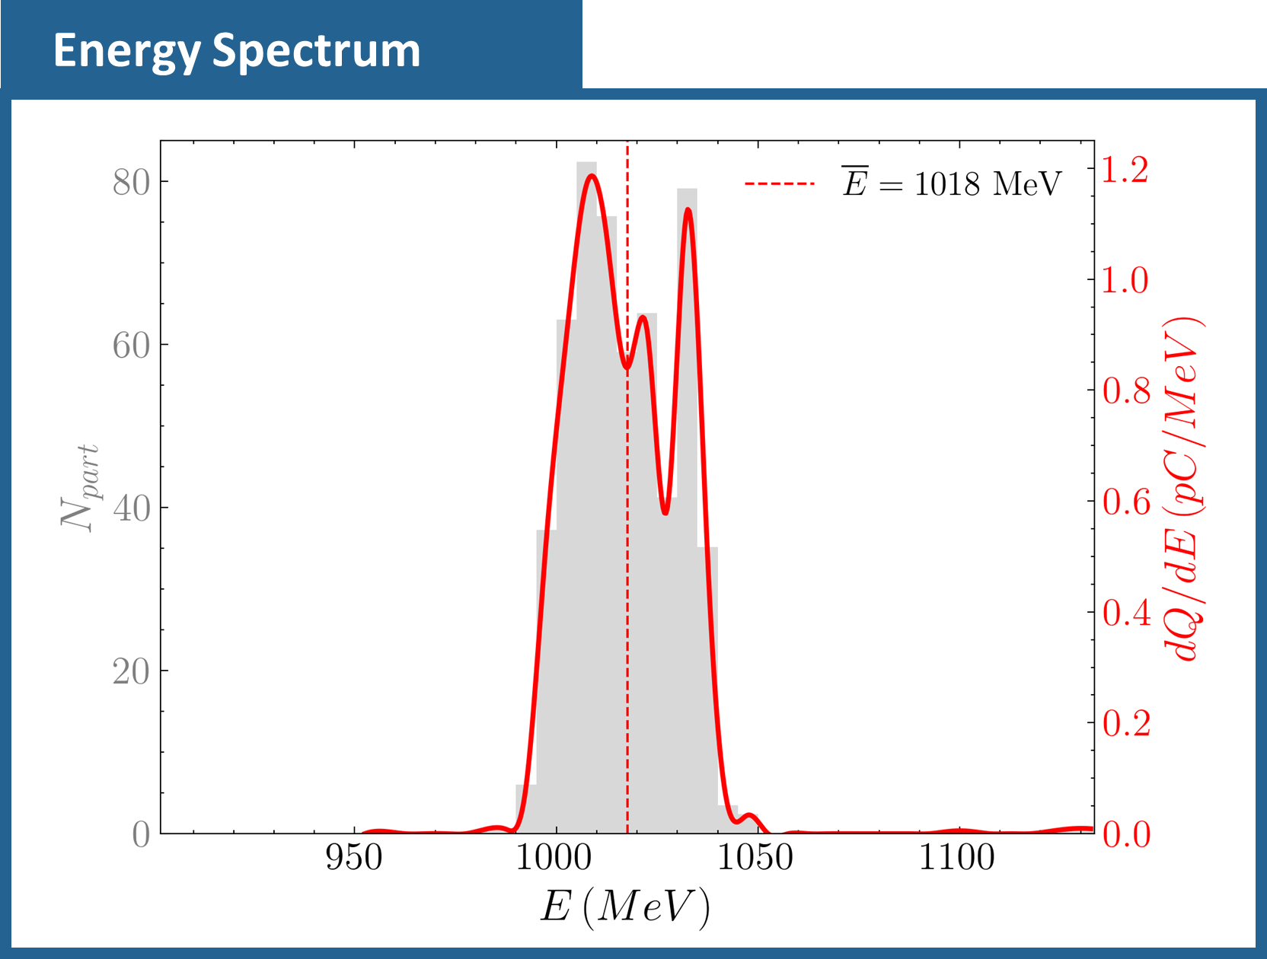
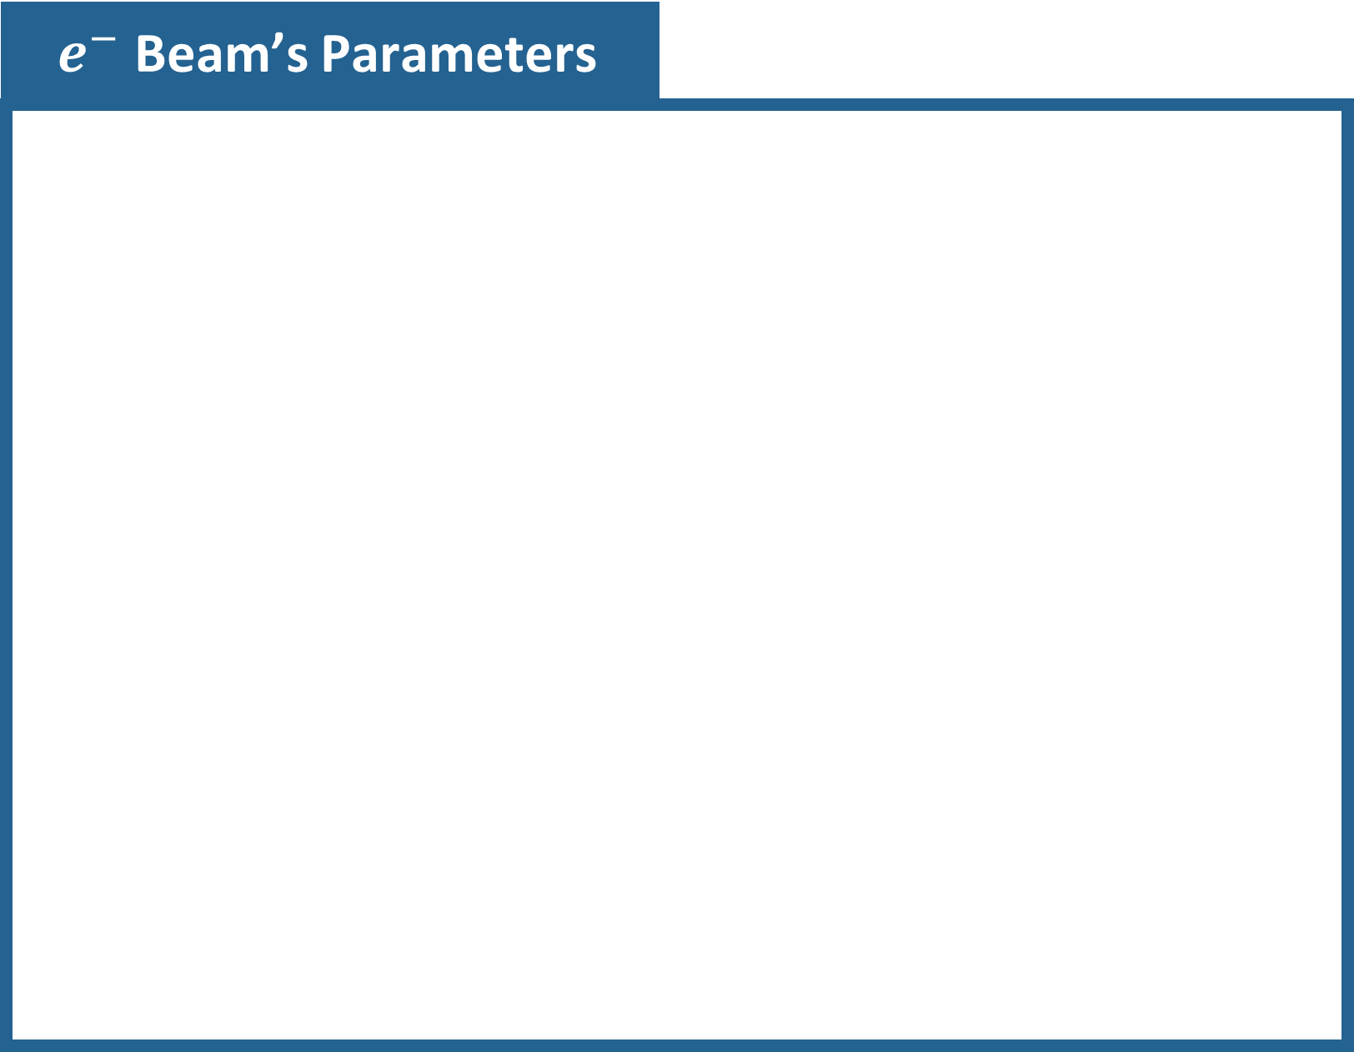
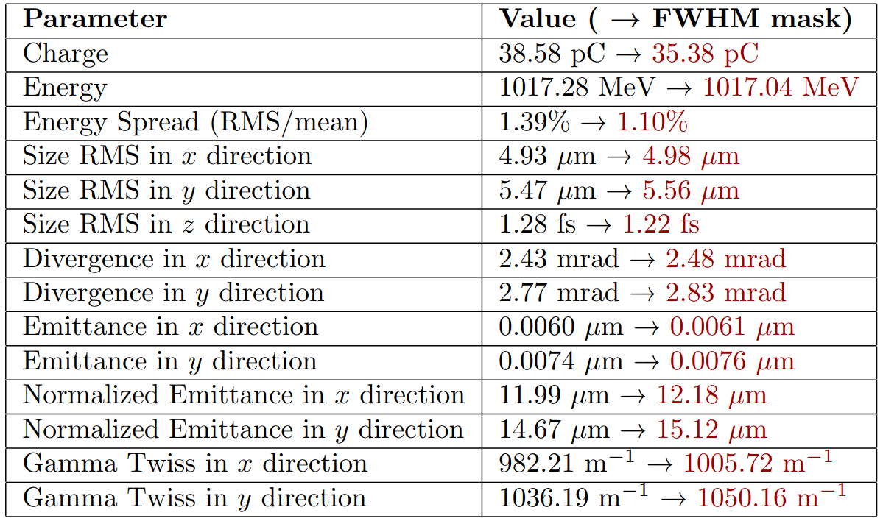

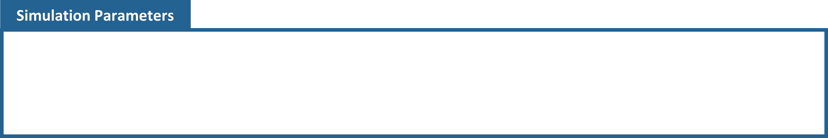
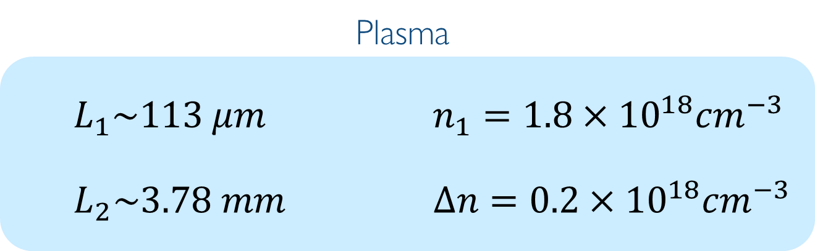
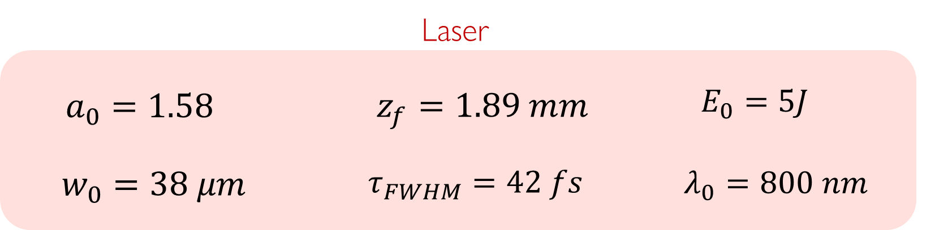
Optimized down-ramp injection: FEL-class bunches
Parameters relevant for ELI-EuPRAXIA Site 2

Slide 9
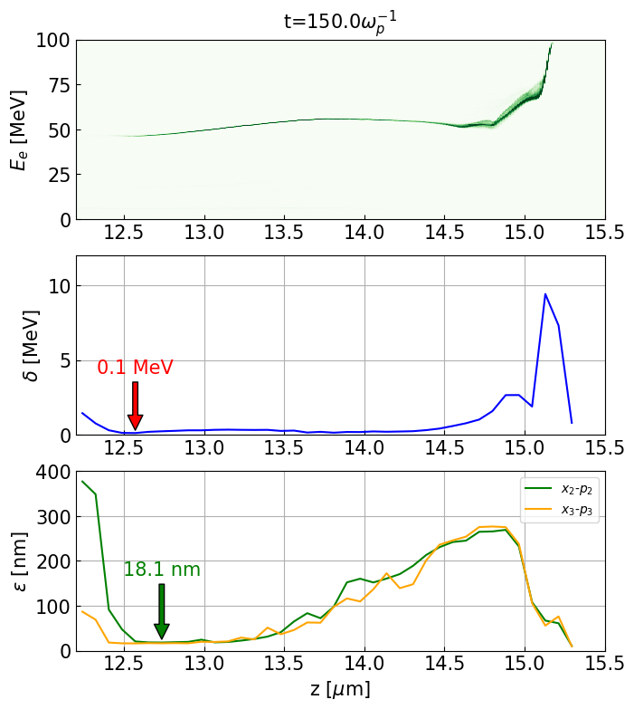
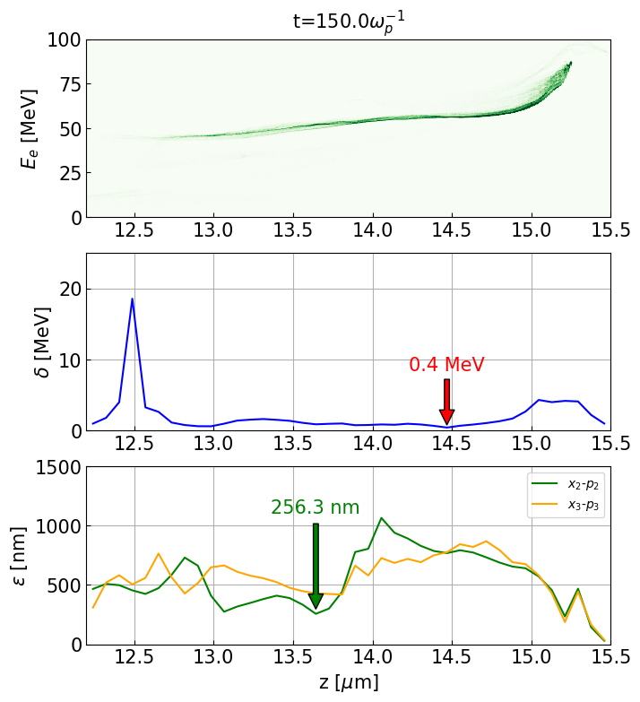
Down-ramp injection: role of laser aberration
No aberrations (Strehl ratio = 1)
With aberrations (Strehl ratio = 0.86)
Slice energy spread
Slice energy spread
Emittance
Emittance

Slide 10
WP.9 RF, Magnets & Beamline Components
Sergey Antipov (DESY)
Federico Nguyen (ENEA)
This project has received funding from the European Union´s Horizon Europe research and innovation program under grant agreement No. 101079773
EuPRAXIA-PP Technical Review Meeting
July 15, 2025

Slide 11
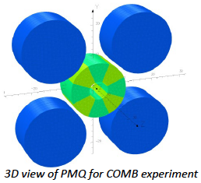
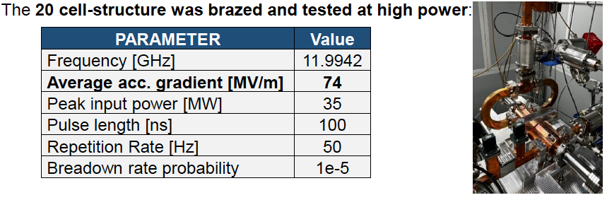
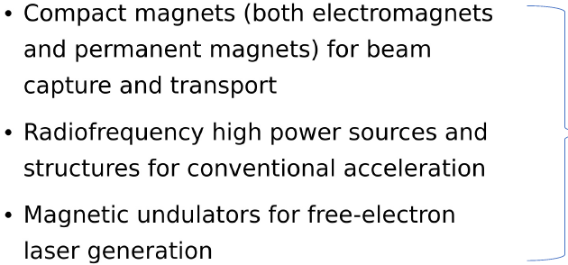
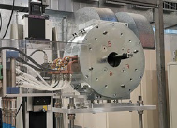
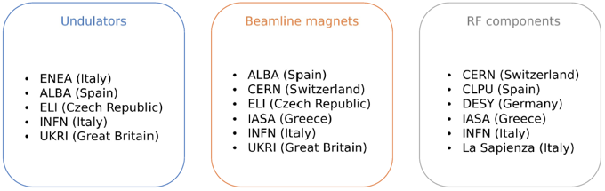
WP9
Magnet for
the gun
APPLE-X und.
cross section

Slide 12
WP.10 Plasma Components and Systems
Kevin Cassou (CNRS)
Rob Shalloo (DESY)
This project has received funding from the European Union´s Horizon Europe research and innovation program under grant agreement No. 101079773
EuPRAXIA-PP Technical Review Meeting
July 15, 2025

Slide 13
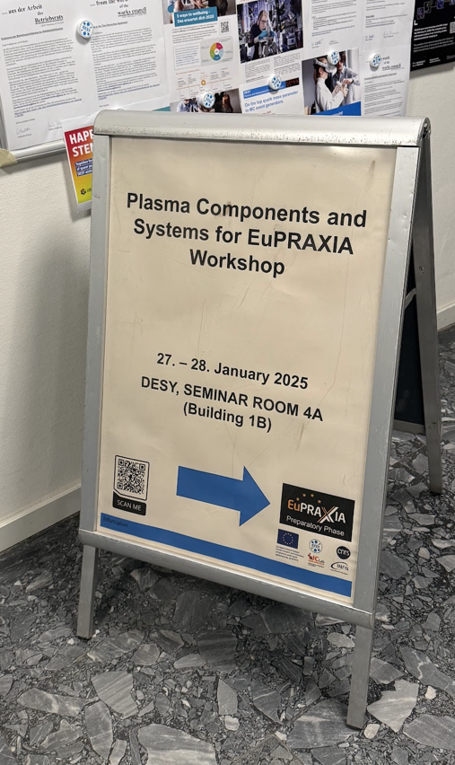
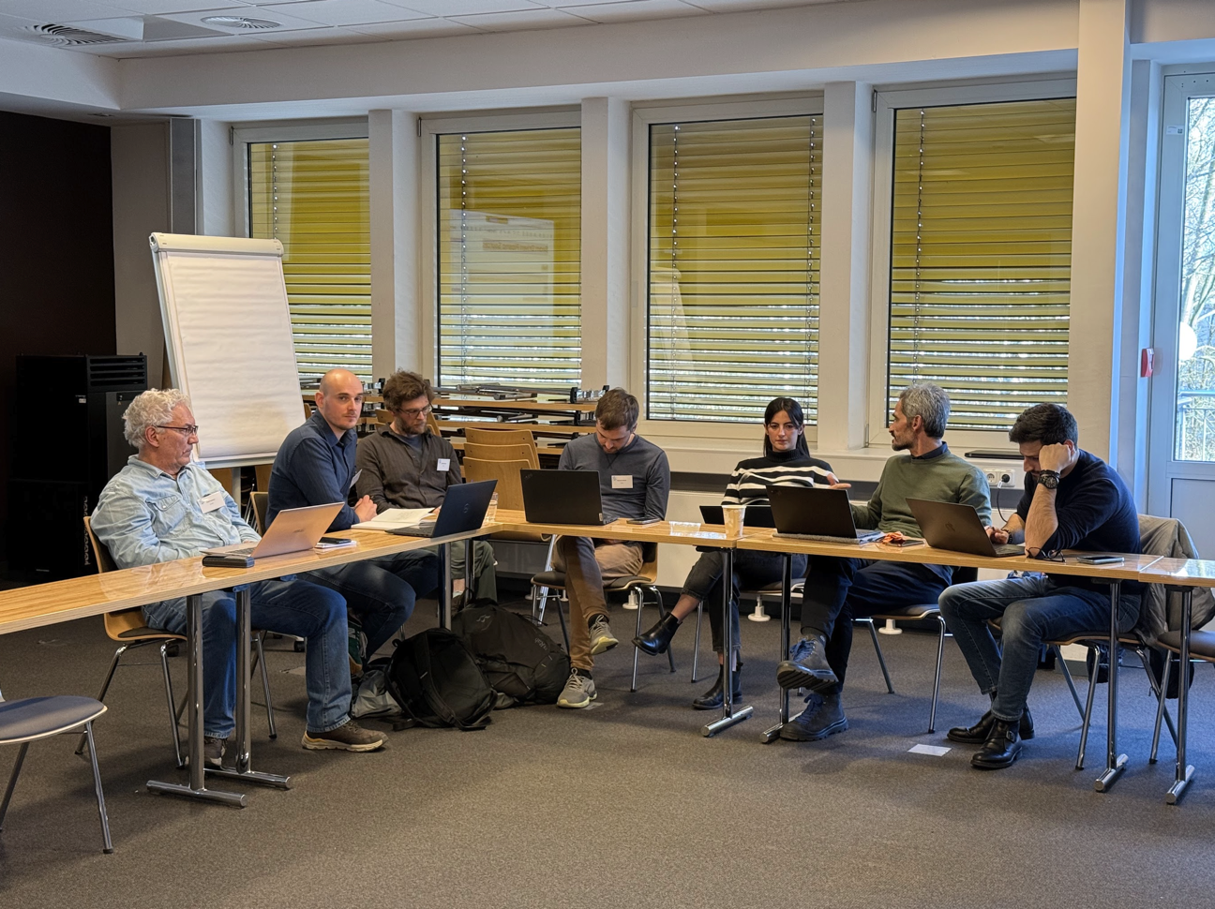
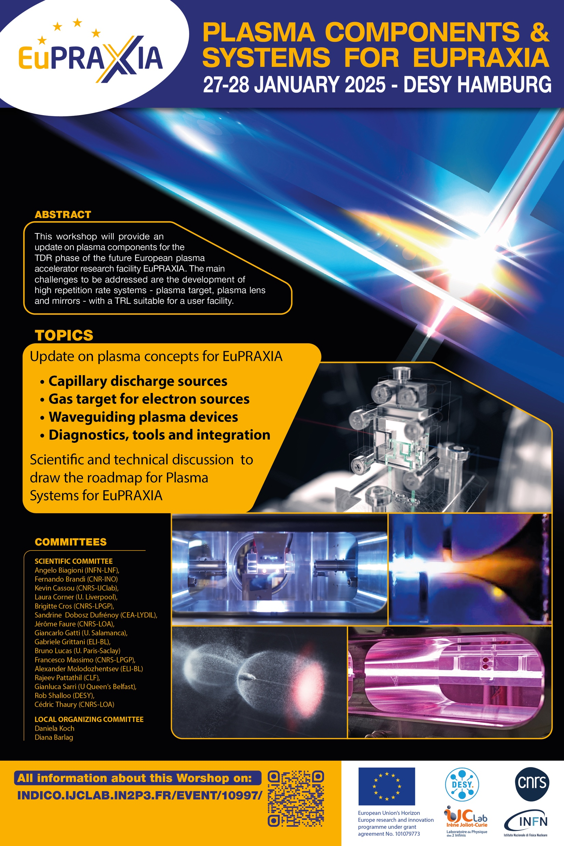
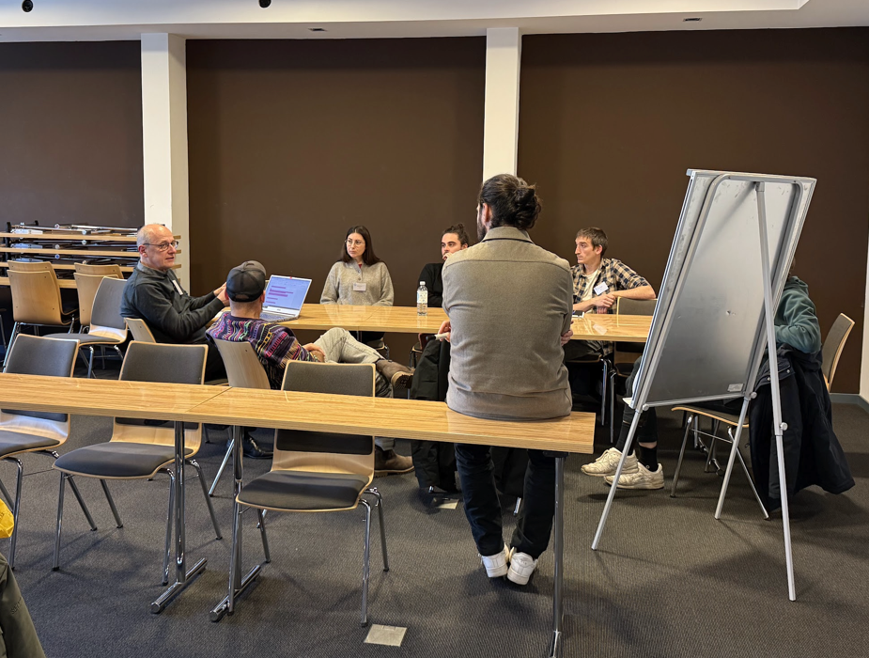
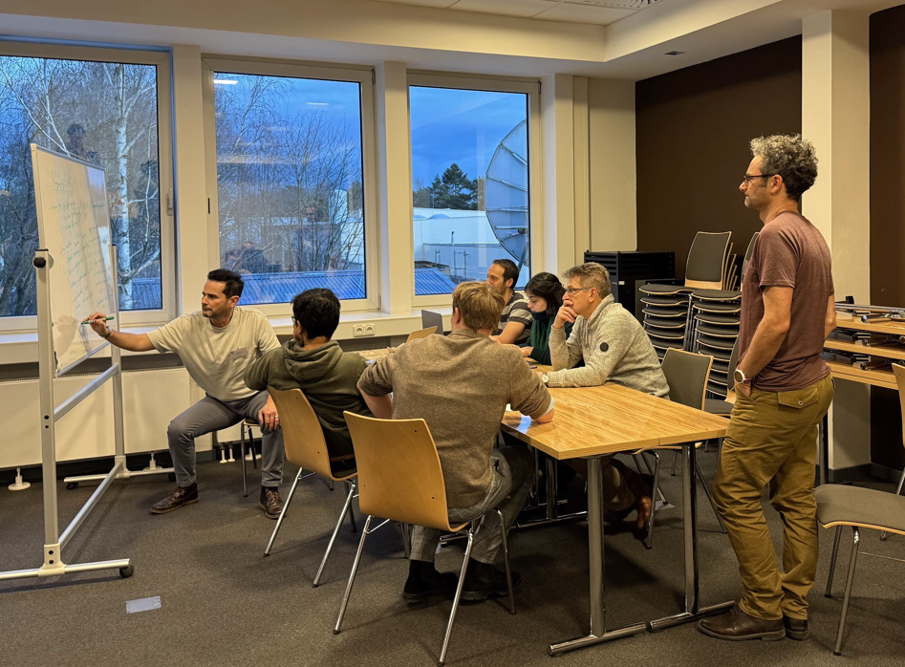
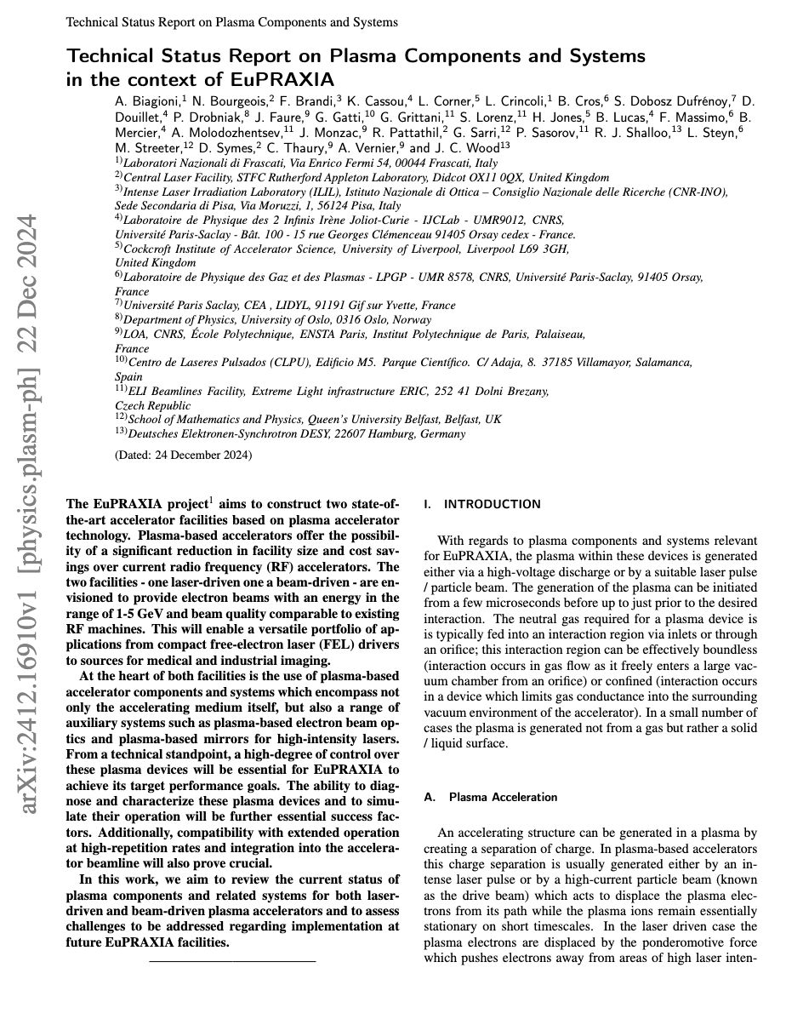

Last update on WP10 - plasma systems
Workshop on plasma system and components for EuPRAXIA 27-28/01/2025
25 attendees on-site and up to 6 online
Presentation of the WP10 review work
The discussion group tried to evaluate the TRL level of various plasma components for EuPRAXIA.
Technical Status Report on Plasma Components and Systems in the context of EuPRAXIA [1] has been submitted to PoP.
Milestone M10.1 has been delivered.
Last deliverable on TRL level of plasma component and system in preparation for the end of the year.
Activities slowly being merged with WP4 of PACRI INFRATECH
[1] https://arxiv.org/abs/2412.16910

Slide 14

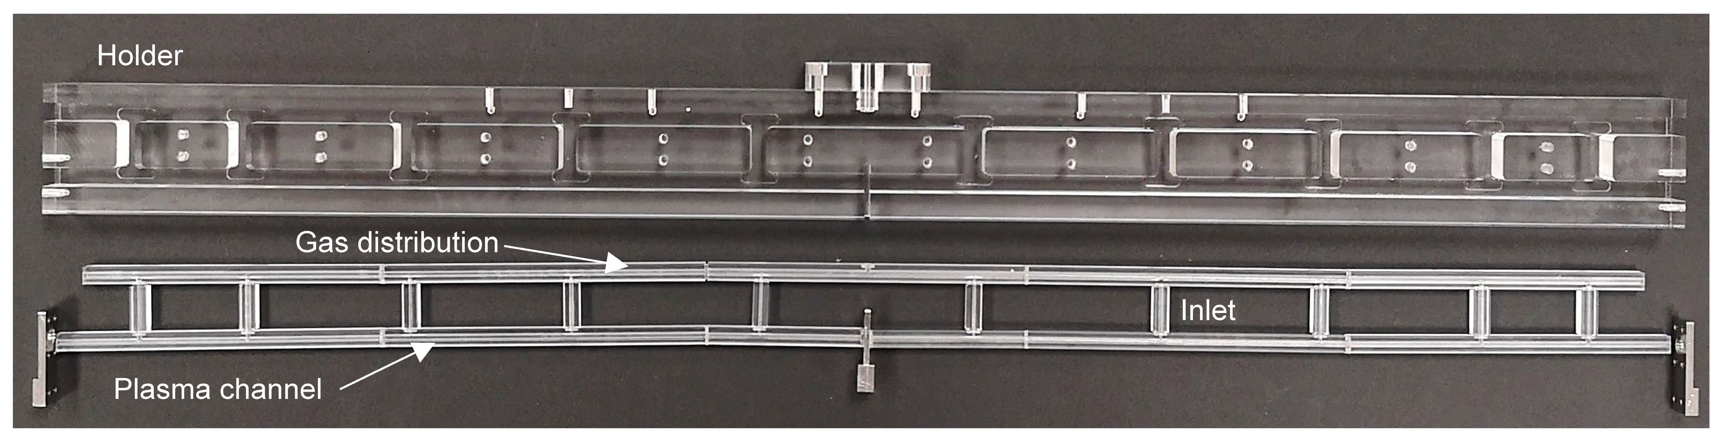
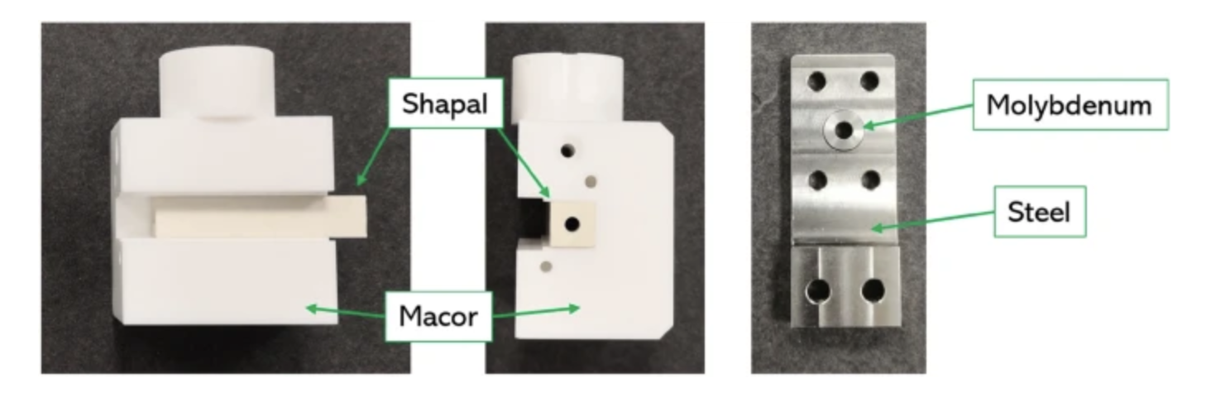
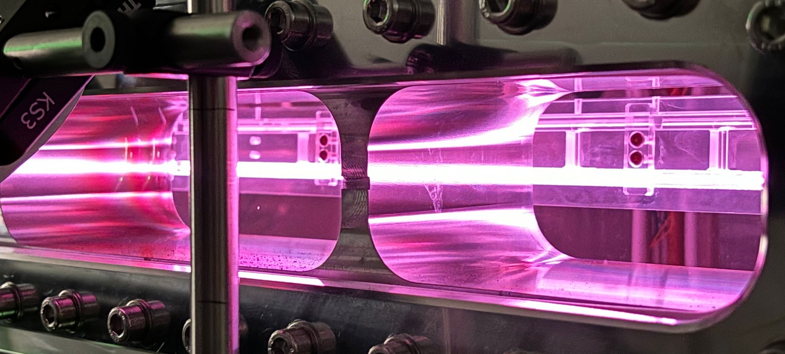
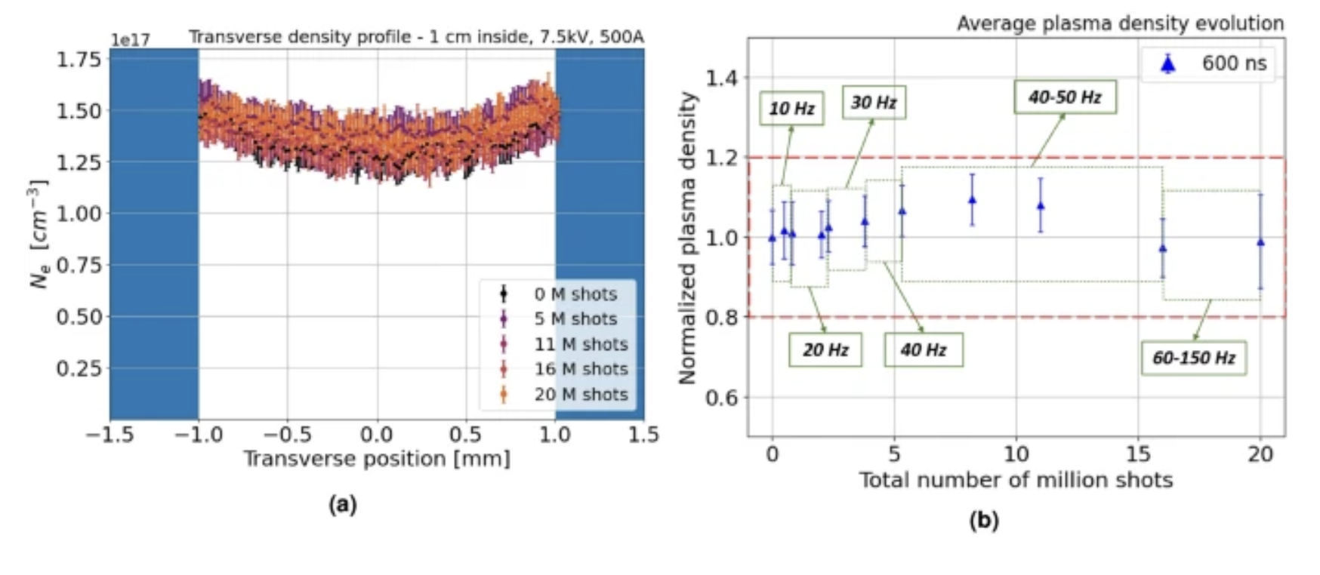
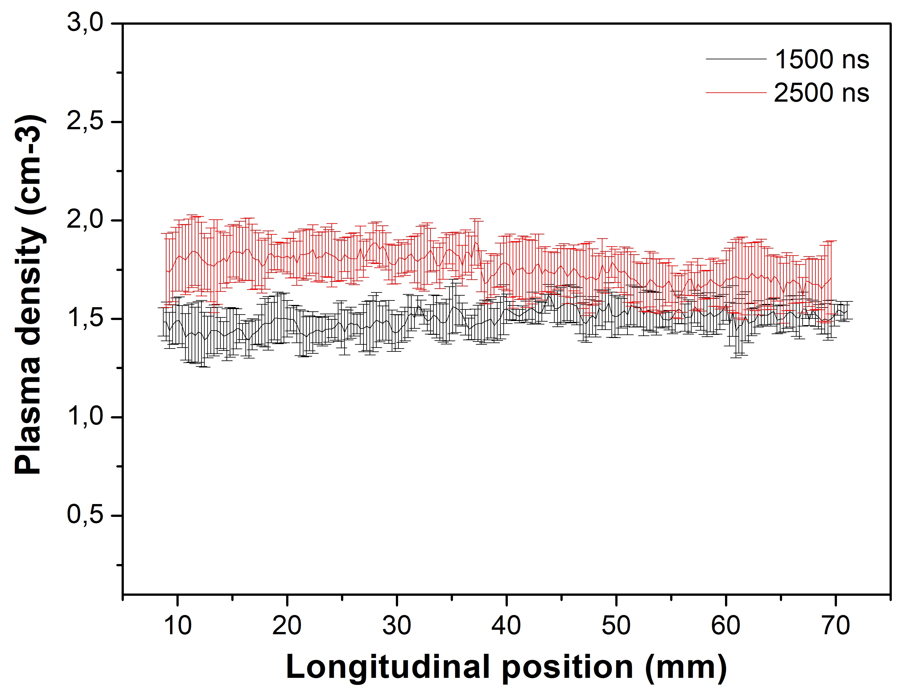
Beam driven plasma components
Test of meter-scale plasma discharge structure
Potentially ~ 1 GeV energy gain @ 10¹⁶ cm⁻³
Advanced short plasma discharge for high repetition rate
up to 150Hz using ceramic [1]
10¹⁷
[1] . L. Crincoli et al. Scientific Reports volume 15, 12456 (2025)

Slide 15



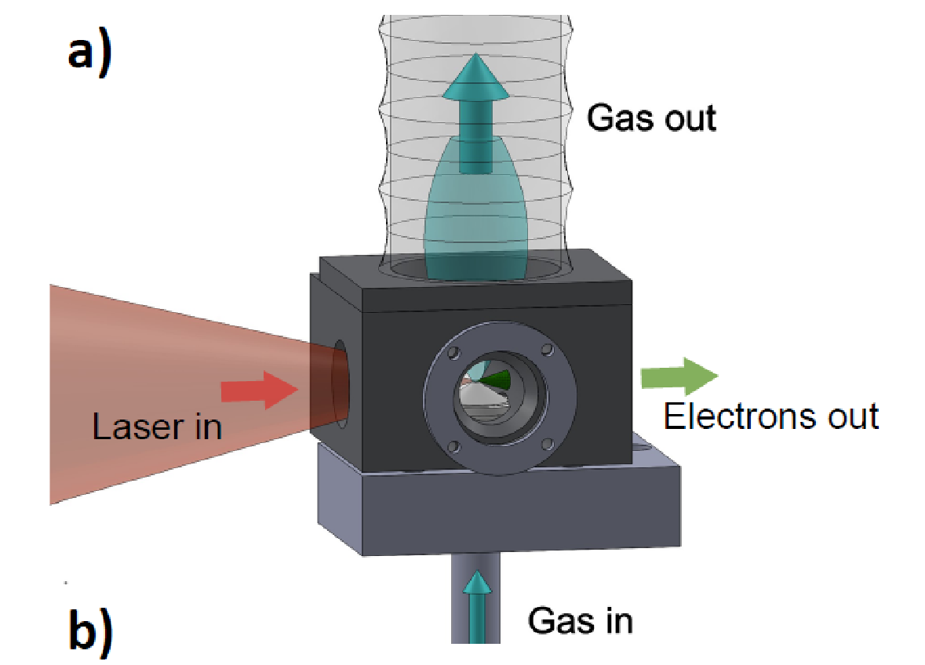
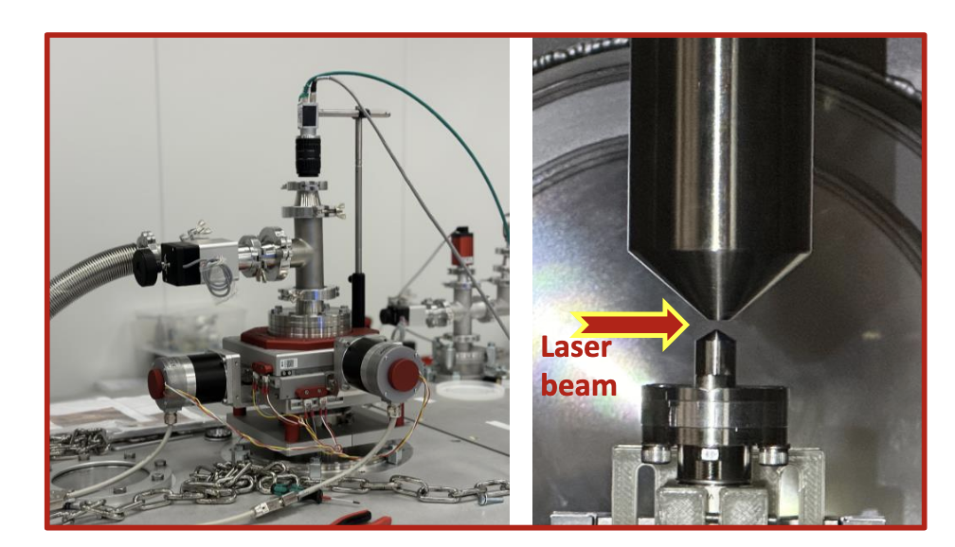
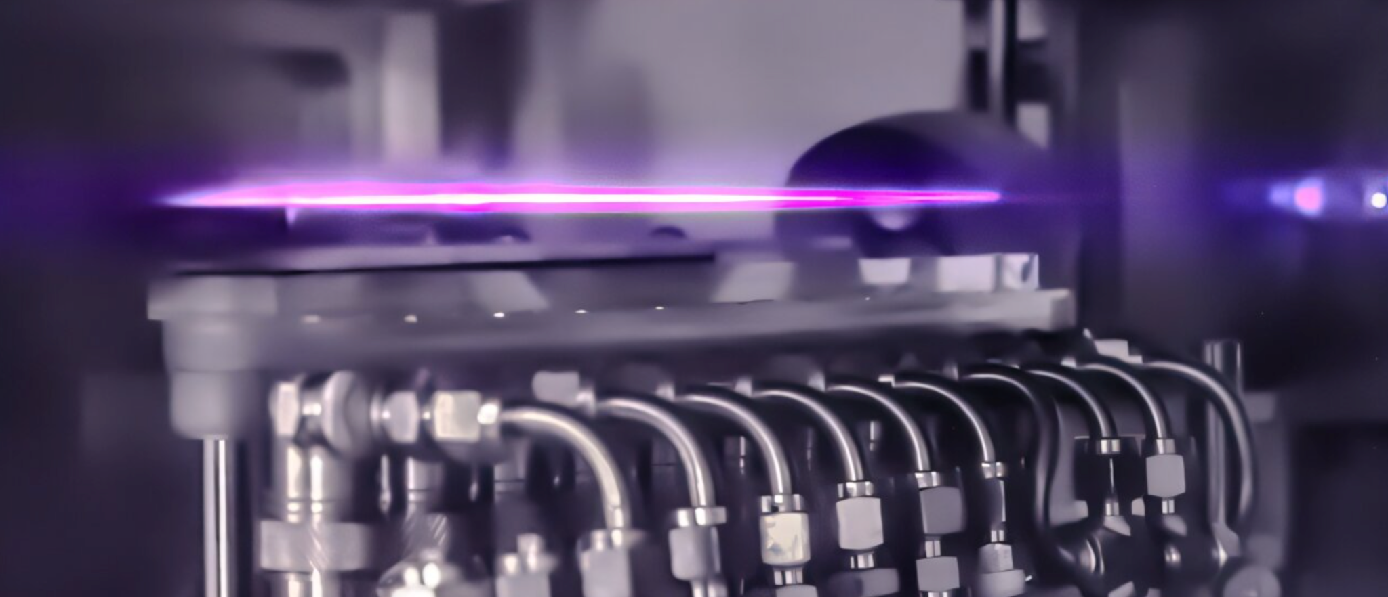
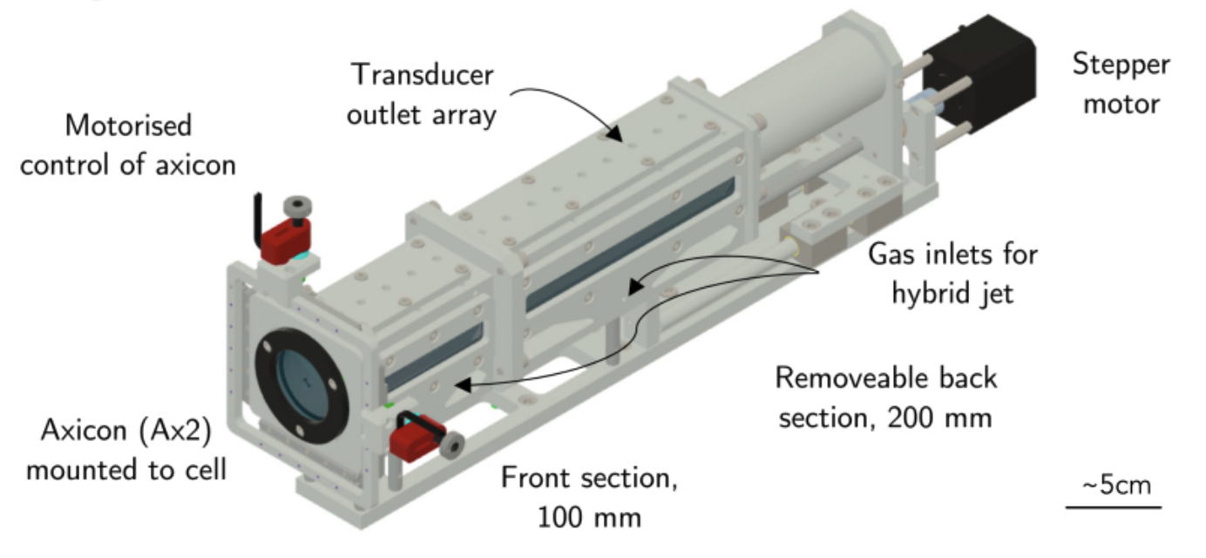
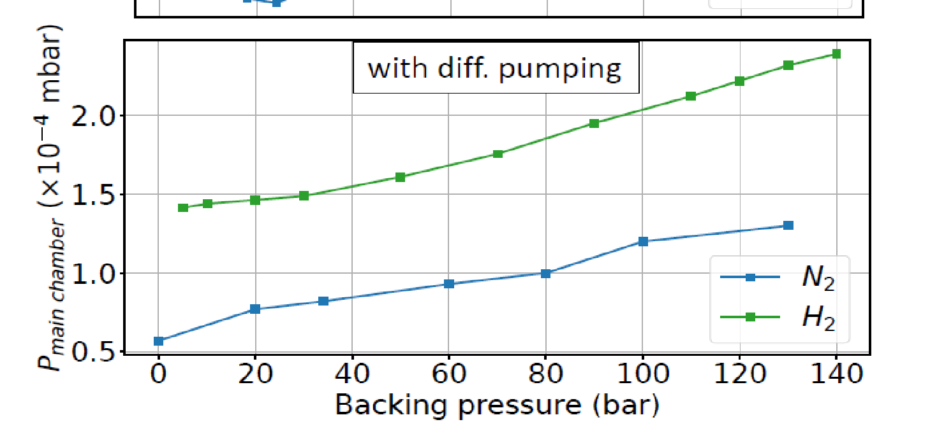
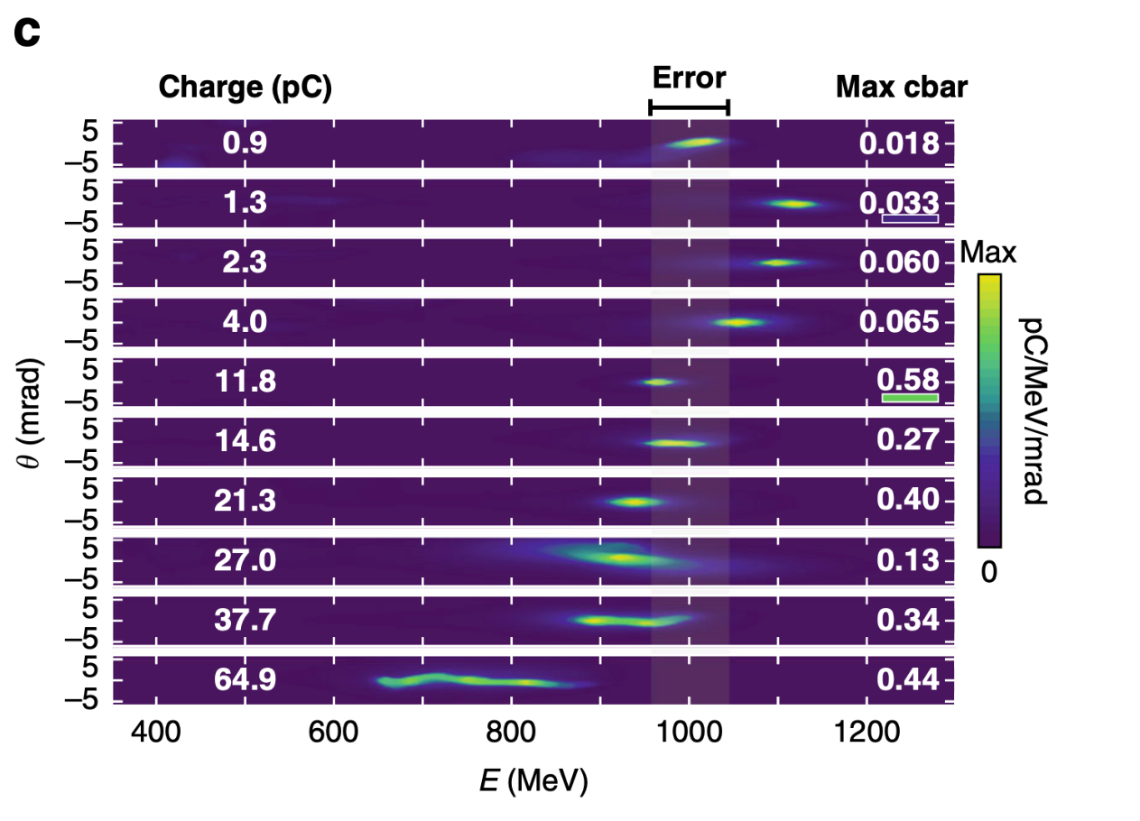
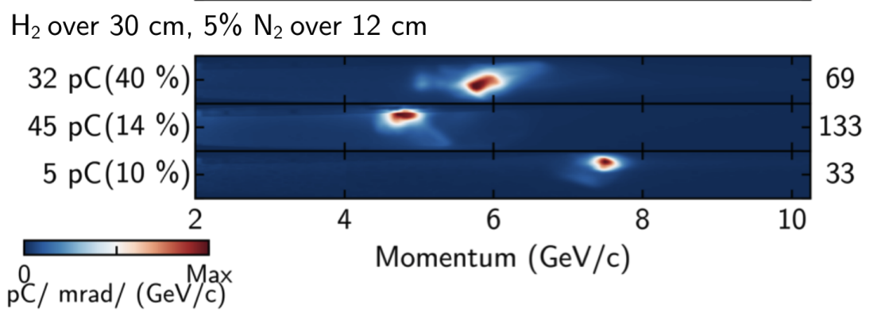
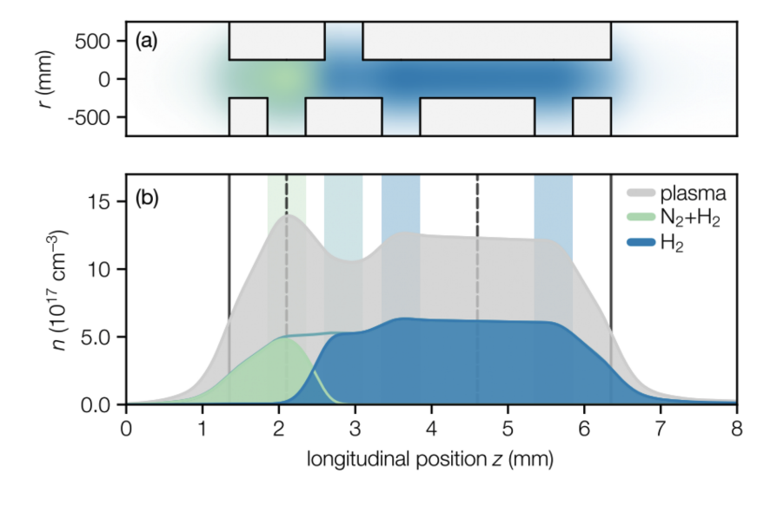
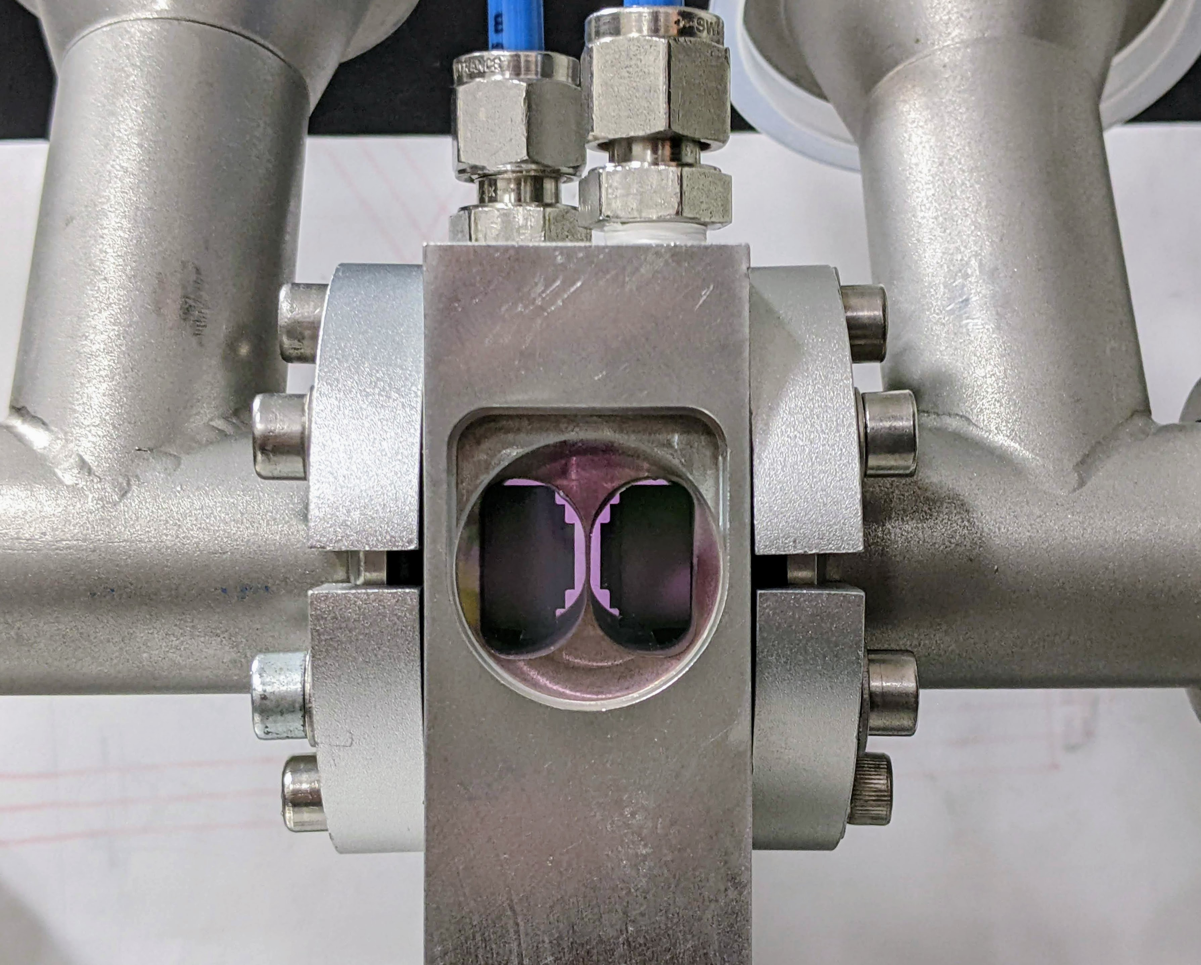
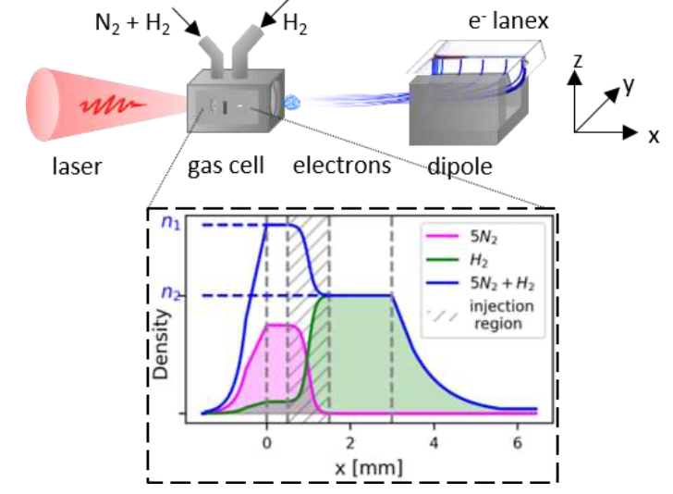
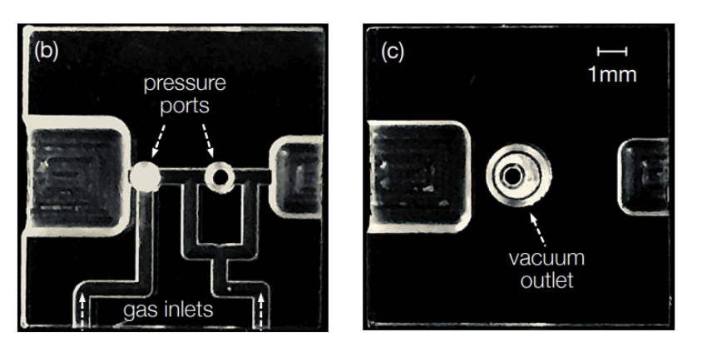
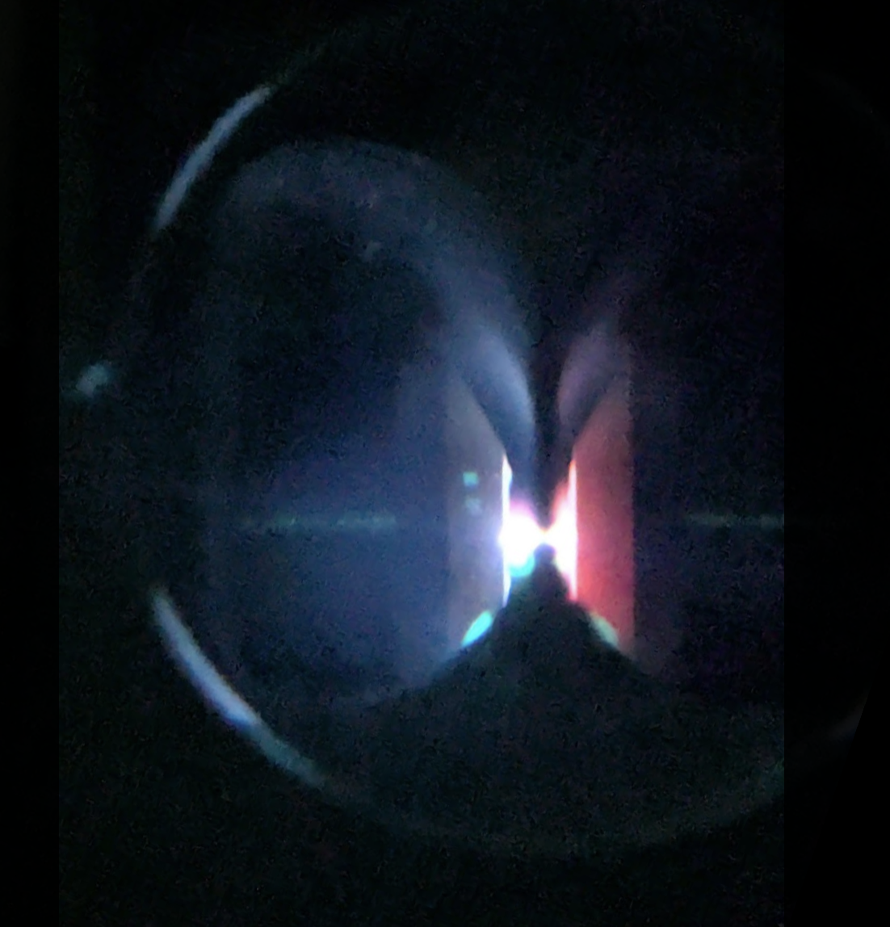
laser-driven plasma components
High repetition rate operation gas target
GeV laser-plasma injector scheme
Continuous gas flow jet of H₂ and N₂ [1,2]
HOFI plasma waveguide [6,]
[1] J. Monzac et al. Rev. Sci. Instrum. 96, 043302 (2025)
[2] S. Lorenz, ELI-BL LPAW2025
Pulsed and continuous gas flow gas cell target [3,4,5]
[6] R. J. Shalloo et al., PRAB 22, 041302 (2019
[7] B. Miao et al., PRX 12, 031038 (2022)
[8] K Oubrerie et al., Light Sci. Appl. 11, 180 (2022)
[9] A. Picksley et al., PRL 131, 245001 (2023)
[10] A. Picksley et al., arXiv:2408.00740 (2024)
[11] E. Rockafellow, et al. Phys. Plasmas 32, 053102 (2025)
[3] M. Kirchen, PhD Thesis University of Hamburg (2021)
M. Kirchen et al PRL 126, 174801 (2021) S. Jalas et al PRAB 26, 7, 071302 (2023)
[4] P. Drobniak et al. Rev. Sci. Instrum. 96, 033304 (2025)
[5] Tl. Steyn et al. arxiv:2506.18047v1 (2025)

Slide 16
WP.11 Applications
Gianluca Sarri (University of Belfast)
Enrica Chiadroni (Sapienza, University of Rome)
This project has received funding from the European Union´s Horizon Europe research and innovation program under grant agreement No. 101079773
EuPRAXIA-PP Technical Review Meeting
July 15, 2025

Slide 17
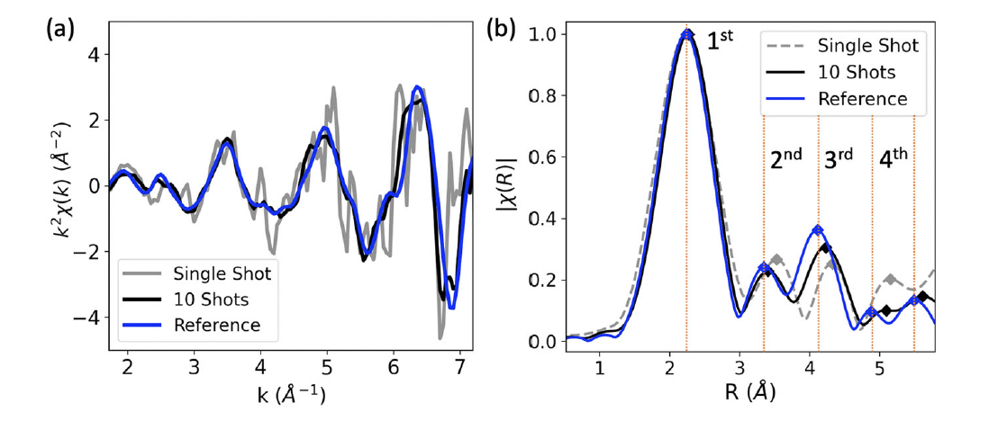
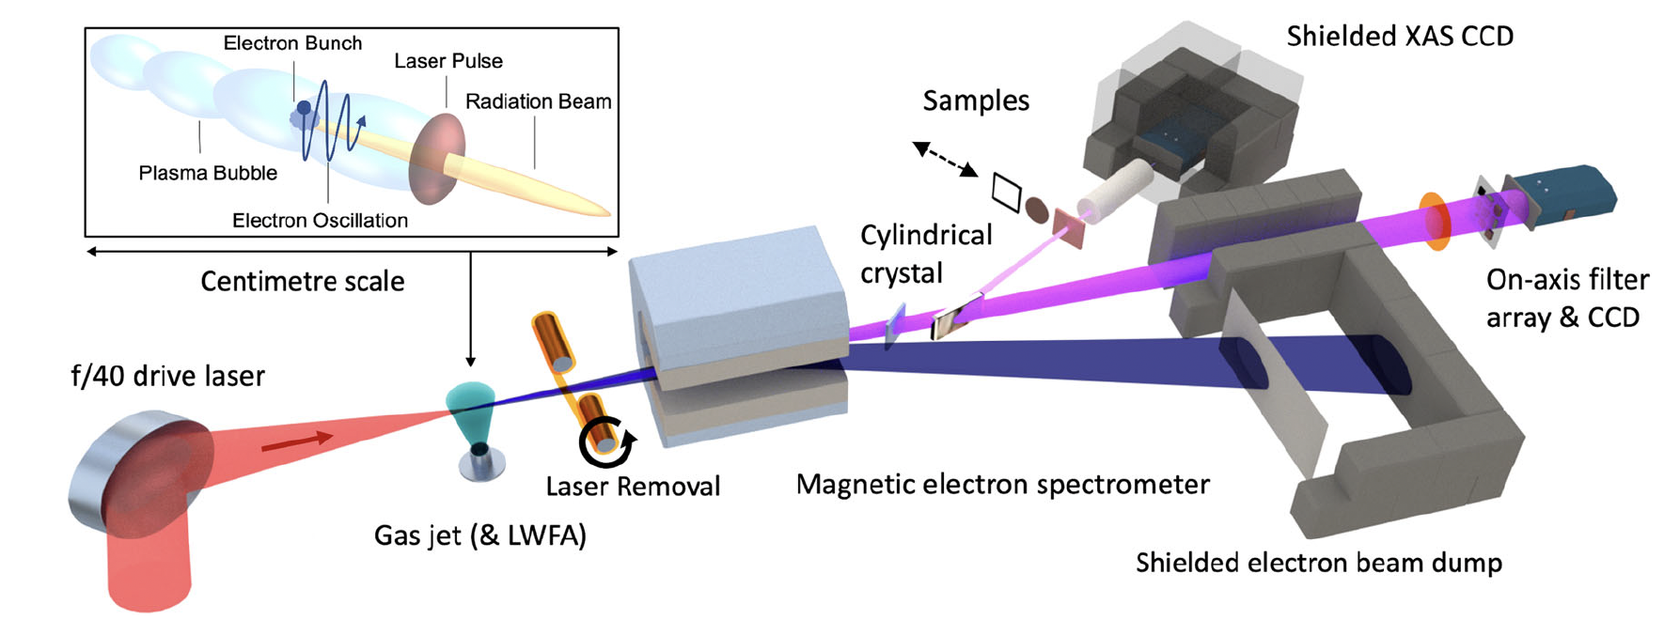
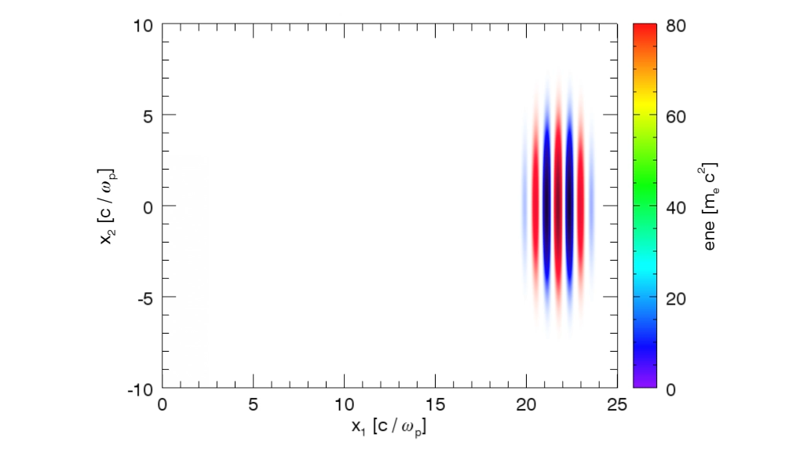
Betatron sources
Single-shot XANES and EXAFS have been demonstrated with a laser-driven betatron source
Careful consideration of the noise produced during the x-ray generation allows to dramatically increase the signal-to-noise at the detector.
XANES and EXAFS features on femtosecond timescales.
Pump-probe experiments in extreme conditions
B. Kettle et al., Comm. Phys. 2024
B. Kettle et al., Comm. Phys. 2024

Slide 18
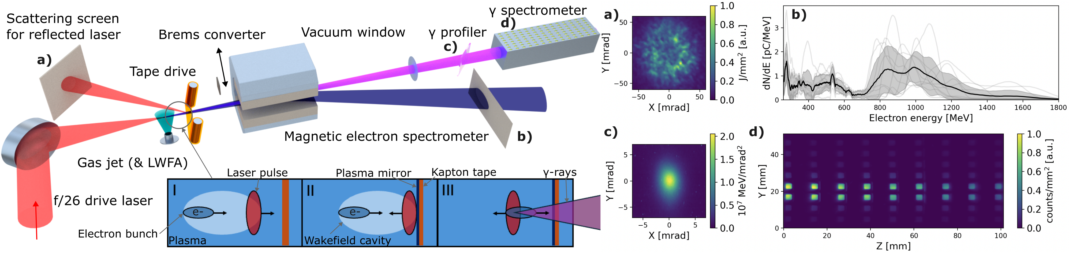
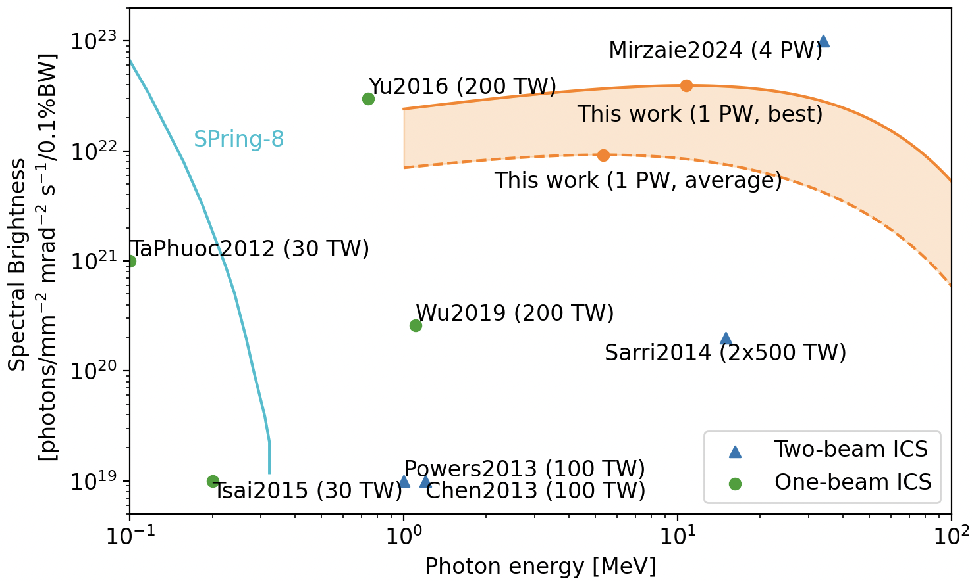
Compton sources
Self-aligned and synchronized ultra-high brilliance Compton sources have been demonstrated using a single laser beam
Easy to use and reproducible
High spectral brightness for multi-MeV energies, ideal for photonuclear applications
Strong scaling with laser power (results in the multi-PW regime also reported)
M. Mirzaie et al., Nat. Phot. (2024)
A. Matheron arXiv: 2412.19337 (2024)
E. Gerstmayr et al., submitted arXiv:2506.23718 (2025)

Slide 19


Positron beamline designed and simulated
Q2
Q3
Q3
Q2
High-energy positron beamline
(Flagship application)
Beamline designed for a 200 TW system
Suitable for beam-driven and laser-driven studies
First facility of this kind worldwide
Necessary stepping stone for plasma-based collider studies
Laser
Q1
Q1
Shielding
D1
D4
PL
GJ
Pb
BPM1
D2
D3
BPM3
BPM2
Positron energy: 460 ± 8% MeV
Positron charge: 2.1 pC
σ_{z}: 50 μm
σ_{x},σ_{y}: 20 μm

Slide 20

Novel radiobiology beyond FLASH
High-charge and broadband laser-wakefield electron beams can be used to study radiobiology in the femtosecond regime.
Novel regimes where Gy-scale doses can be delivered in a single shot, thus directly accessing the early stages of cellular response
C. McAnespie et al., accepted arXiv:2409.01717 (2025)

Slide 21




Proof-of-principle muon production
Demonstration of muons generated by 100s TW – PW lasers reported
SULF (CHINA)
BERKLEY (USA)
ELI-NP & QUB (Eu, UK)
F. Zhang et al., Nat. Phys. 2025
D. Terzani et al., Arxiv 2025
L. Calvin et al., Arxiv 2025
Beamline modelling indicates sizeable muon beams to be produced by PW-scale lasers (EPAC, EuPRAXIA)
Muon radiographies of extended objects achievable in 10s of s at Eupraxia.
L. Calvin et al., Front. Phys. 2023

Slide 22
WP.13 Diagnostics
Alessandro Cianchi (University of Rome "Tor Vergata")
Rasmus Ischebeck (EPFL)
This project has received funding from the European Union´s Horizon Europe research and innovation program under grant agreement No. 101079773
EuPRAXIA-PP Technical Review Meeting
July 15, 2025

Slide 23





Dielectric wakefield structure
When the beam travels through structure centre, the structure can
Decrease beam’s projected energy spread if the tail has higher energy than the head
Increase beam’s projected energy spread if the tail has lower energy than the head
Top: measured photon spectra for different structure gap settings
Bottom left: simulated longitudinal phase space of dechirped beam
Bottom right: photon spectra for
  beam with small energy spread
  beam with large energy spread
  beam with large energy spread + dielectric wakefield structure

Slide 24
WP.14 Transformative Innovation Paths
Bernhard Hidding (HHU)
Stefan Karsch (LMU)
This project has received funding from the European Union´s Horizon Europe research and innovation program under grant agreement No. 101079773
EuPRAXIA-PP Technical Review Meeting
July 15, 2025

Slide 25

Hybrid Laser-Electron-Beam Driven Acceleration
In the hybrid scheme, LWFA provides a compact injector, while PWFA offers precision beam shaping and acceleration, ideally producing beams with high current, low emittance, and narrow energy spread — suitable for X-ray FELs or collider R&D

Slide 26

Thanks for your attention

Slide 27
Publications
WP | # | Reference | PID
8 | 1 | Silva, T.; Vieira, J., Positron acceleration in plasma waves driven by non-neutral fireball beams, PHYSICAL REVIEW ACCELERATORS AND BEAMS | https://doi.org/10.1103/PhysRevAccelBeams.26.091301
8 | 2 | Romeo S. et al., Evaluation of the transfer matrix of a plasma ramp with squared cosine shape via an approximate solution of Mathieu differential equation PLASMA PHYSICS AND CONTROLLED FUSION | https://doi.org/10.1088/1361-6587/acfbf6
11 | 3 | Borghini, A. et al., FLASH Radiotherapy: Expectations, Challenges, and Current Knowledge INTERNATIONAL JOURNAL OF MOLECULAR SCIENCES | https://doi.org/10.3390/ijms25052546
15 | 4 | Pompili R. et al., Recovery of hydrogen plasma at the sub-nanosecond timescale in a plasma-wakefield accelerator COMMUNICATIONS PHYSICS | https://doi.org/10.1038/s42005-024-01739-x
11 | 5 | Galdenzi F. et al., The EuAPS Betatron Radiation Source: Status Update and Photon Science Perspectives CONDENSED MATTER | https://doi.org/10.3390/condmat9030030
8 | 6 | Romeo S. et al., Numerical studies for EuPRAXIA@SPARC LAB plasma beam driven working point IPAC23 PROCEEDINGS, Journal of Physics Conference Series | https://doi.org/10.1088/1742-6596/2687/4/042008
15 | 7 | Iovine P. et al., Study of the transfer and matching line for a PWFA-driven FEL IPAC23 PROCEEDINGS, Journal of Physics Conference Series | https://doi.org/10.1088/1742-6596/2687/4/042004
15 | 8 | Verra L. et al., IPAC23 PROCEEDINGS, Journal of Physics Conference Series | https://doi.org/10.1016/j.nima.2024.170157
15 | 9 | Crincoli L. et al., Advanced ceramic plasma discharge capillaries for high repetition rate operation SCIENTIFIC REPORTS | https://doi.org/10.1038/s41598-025-96882-y
12 | 10 | Fregosi A. et al., A study of cross-relaxation and temporal dynamics of lasing at 2 microns in Thulium doped ceramic HIGH POWER LASER SCIENCE AND ENGINEERING | https://doi.org/10.1016/j.nima.2025.170291
15 | 11 | Nguyen F. et al., FEL performance and tolerance studies of the EuPRAXIA@SPARC_LAB beamline AQUA NIM-A | https://doi.org/10.1016/j.nima.2025.170291

