Slide 1
Peeling commercial REBCO tapes: microscopic investigation and perspectives
Frascati – 27th June 2025
Angelo Vannozzi, Andrea Masi
ENEA CR Frascati
Laboratorio di Superconduttività

Slide 2
Background
REBCO film transfer by solder-and-peel technique
Copper
Copper
Copper
Solder
Solder
REBCO
REBCO
REBCO
Buffer stack
Buffer stack
Substrate removal
Hastelloy substrate
Hastelloy substrate
Buffer stack
Hastelloy substrate
2

Slide 3
Outline
Three commercial REBCO tapes investigated
Producer | Year | Tape width (mm) | I_{c} per cm width @77 K, s.f. (A)
Shanghai | 2022 | 10 | 500
SuperOx | 2022 | 12 | 475
Shanghai | 2025 | 12 | 625
3

Slide 4
Shanghai 2022 – 10 mm preliminary test
REBCO side
overview
detail
edge
Uniform REBCO surface exposed
Few small regions with detached REBCO and/or buffer residues (arrows)
Narrow defected strip at tape’s edges (ca. 1 mm width)
4

Slide 5
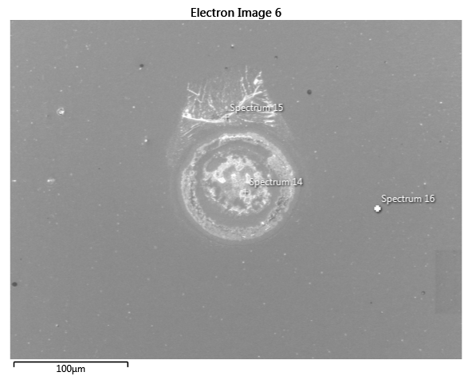
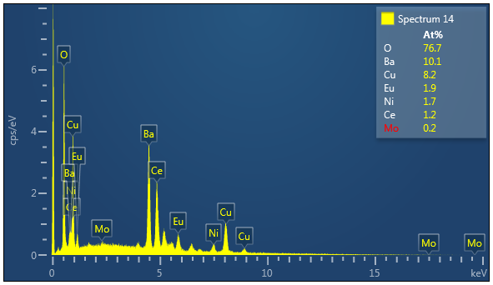
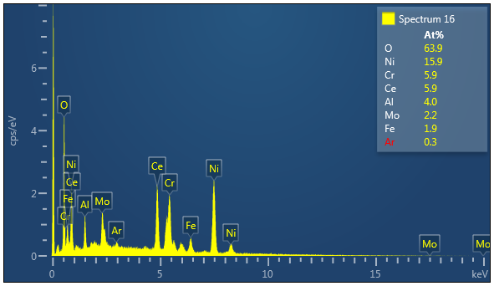
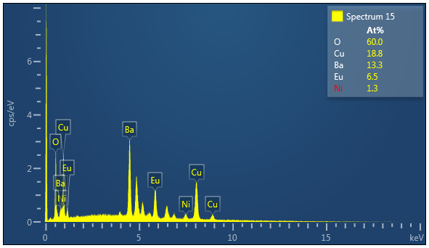
Shanghai 2022 – 10 mm preliminary test
Substrate side
REBCO residues
overview
Uniform buffer surface exposed
Few defected regions with detached REBCO and/or buffer residues (bright points)
No REBCO
5

Slide 6
SuperOx 2022 – 12 mm preliminary test
REBCO side Substrate side
overview
detail
overview
Patchwork-like microstructure
About 50% of REBCO surface exposed
Saw-tooth boundary due to points with higher film adhesion causing film break-up
REBCO
REBCO
Buffer
Buffer
6

Slide 7
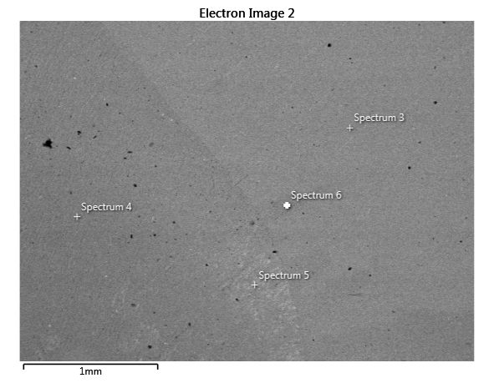
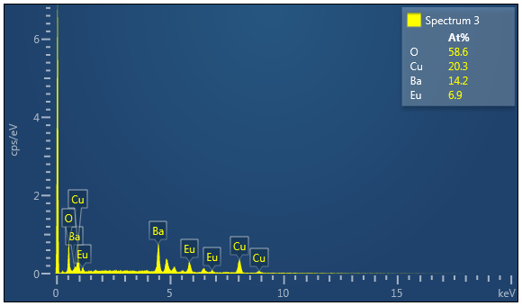
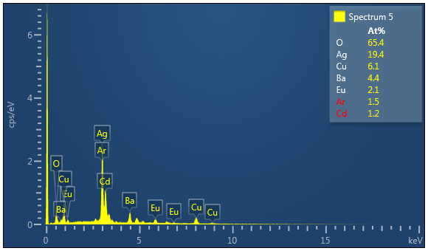
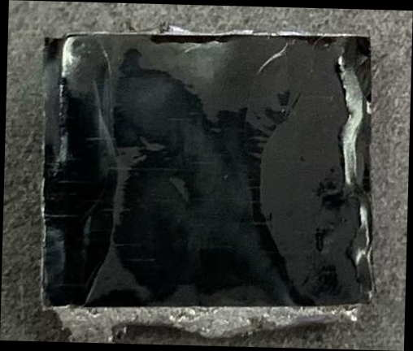
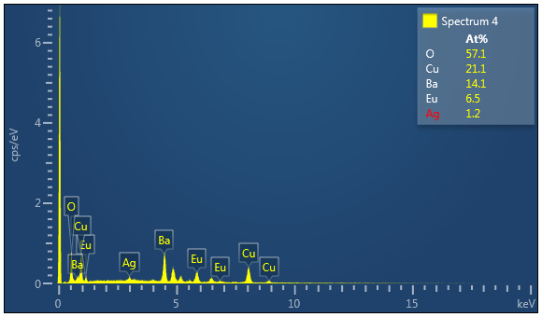

Shanghai 2025 – 12 mm
REBCO side
overview
detail
No buffer layer residues
Opaque regions with reduced REBCO film thickness
REBCO film internally delaminated
whole REBCO film thickness
reduced REBCO film thickness
7

Slide 8
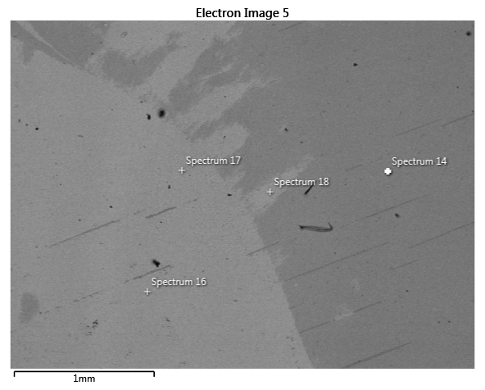
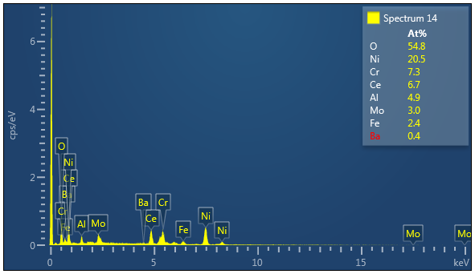
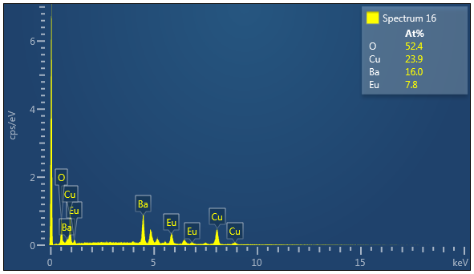
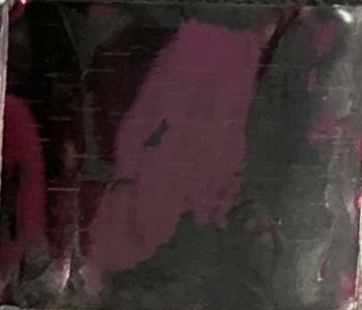

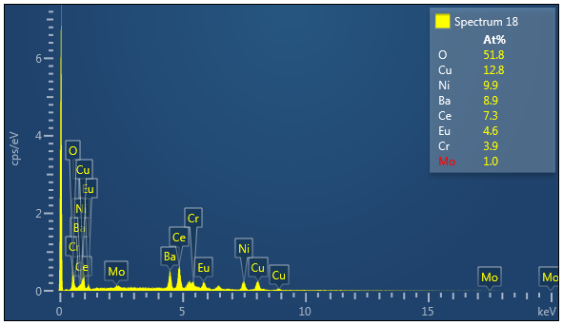
Shanghai 2025 – 12 mm
Substrate side
overview
detail
Incomplete REBCO film detachment
Black regions with REBCO film residues
No REBCO
REBCO film residue
8

Slide 9
Summary results
Different peeling behaviour depending on both producer and batch
Shanghai 2022
SuperOx 2022
Shanghai 2025
Copper
Copper
Copper
Solder
Solder
Solder
REBCO
REBCO
REBCO
Buffer
Buffer stack
stack
Buffer stack
Hastelloy substrate
Hastelloy substrate
Hastelloy substrate
9

Slide 10
Conclusion
Summary
Peeling behaviour dependent on both producer and batch
Previous Shanghai tape showed the best results for haloscope application because of the weak REBCO buffer layer interface, but tape width is 10 mm
SuperOx tape shows non-uniform tape peeling, with about 50% of the buffer layer remaining adherent to REBCO film; the influence of the residual buffer layer on haloscope performances needs to be investigated
New Shanghai tape shows a more robust architecture, which however might be detrimental for haloscope application, because REBCO film shows internal delamination, thus producing uneven superconducting film thickness for cavity coating
Samples of peeled Shanghai tape supplied to RM3: 4(2022) + 2(2025) and PoliTo: 2(2022) + 2(2025)

Slide 11
Conclusion
Work plan for 2026
Test further REBCO batches and tapes from other producers
Test different solders in order to investigate the possible effect of temperature
AFM analysis to evaluate REBCO film thickness variation in Shanghai 2025 tape
AFM analysis to evaluate the influence of film roughness on cavity performances
Residual 10-mm-wide Shanghai tape (2022) will be used for the cavity provided by LNF if tests with new Shanghai tape (2025) are below expectations

