Slide 1


Surface Technology and Superconductivity Service
INFN Legnaro National Laboratories
July 01, 2025
Collaboration meeting
Cristian Pira - Dorothea Fonnesu

Slide 2
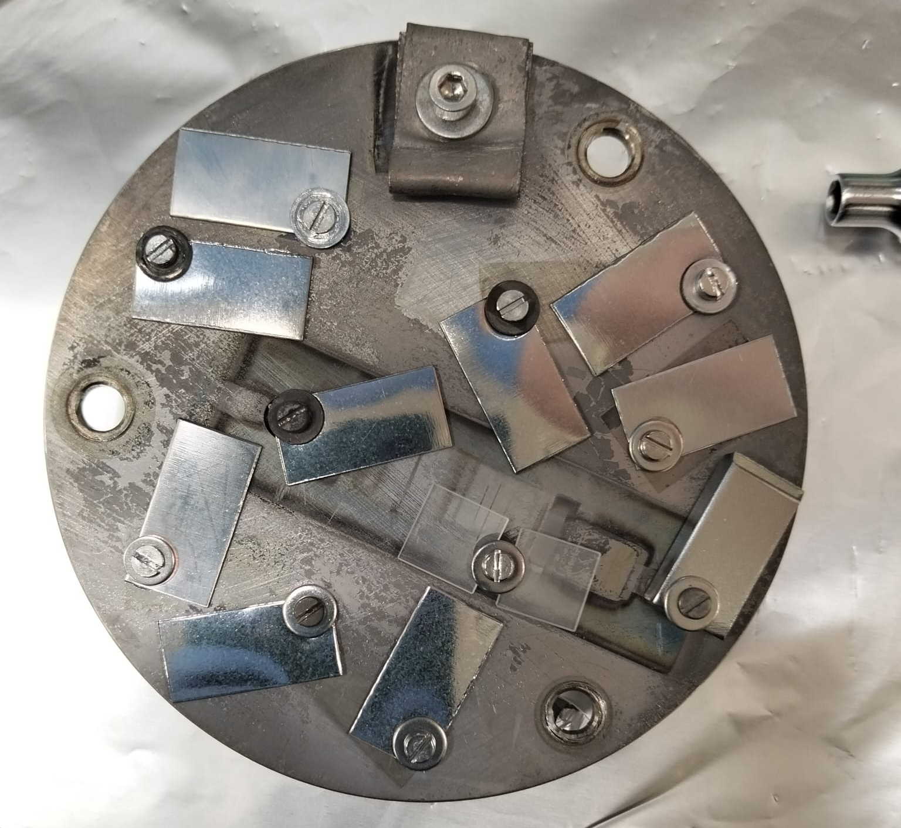
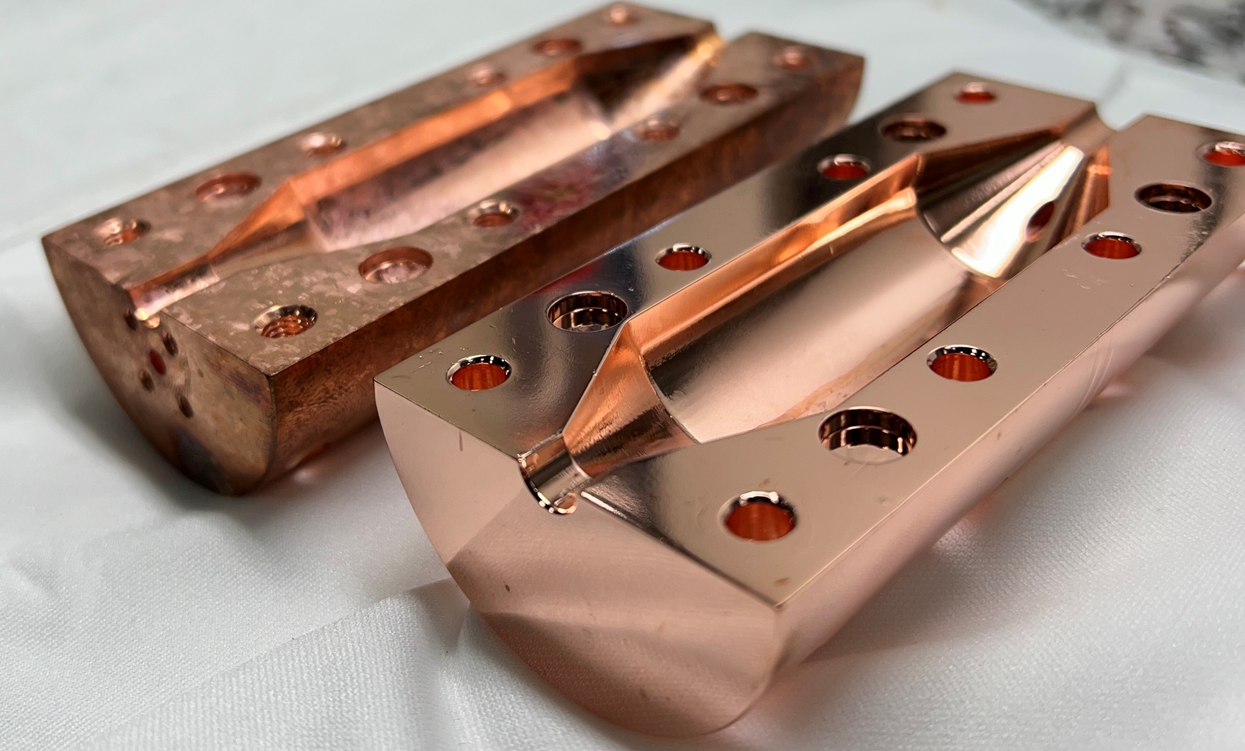
Outline
Nb₃Sn/Cu state of the art at LNL
Nb₃Sn activities for SuperMAD
New dedicated coating system
Currently ongoing
Next steps

Slide 3
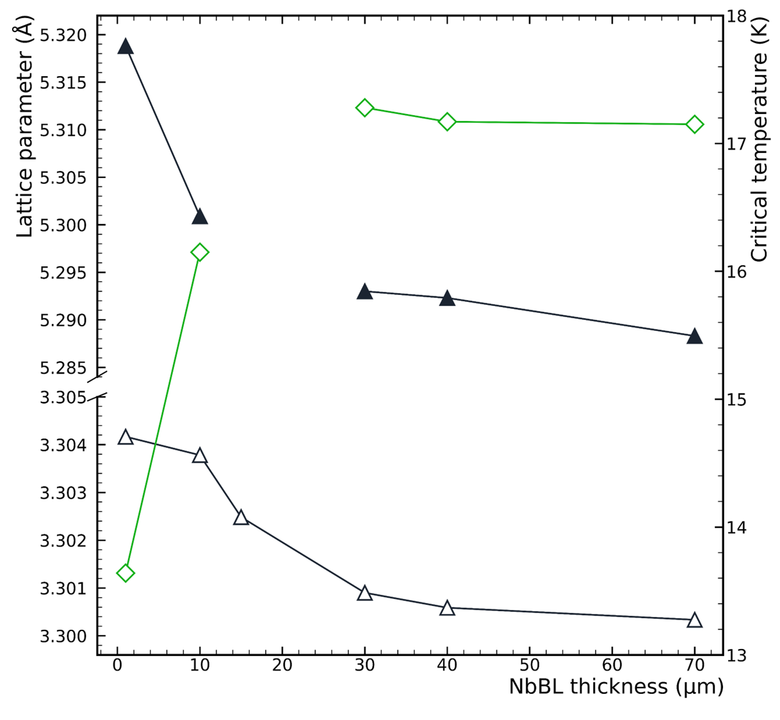
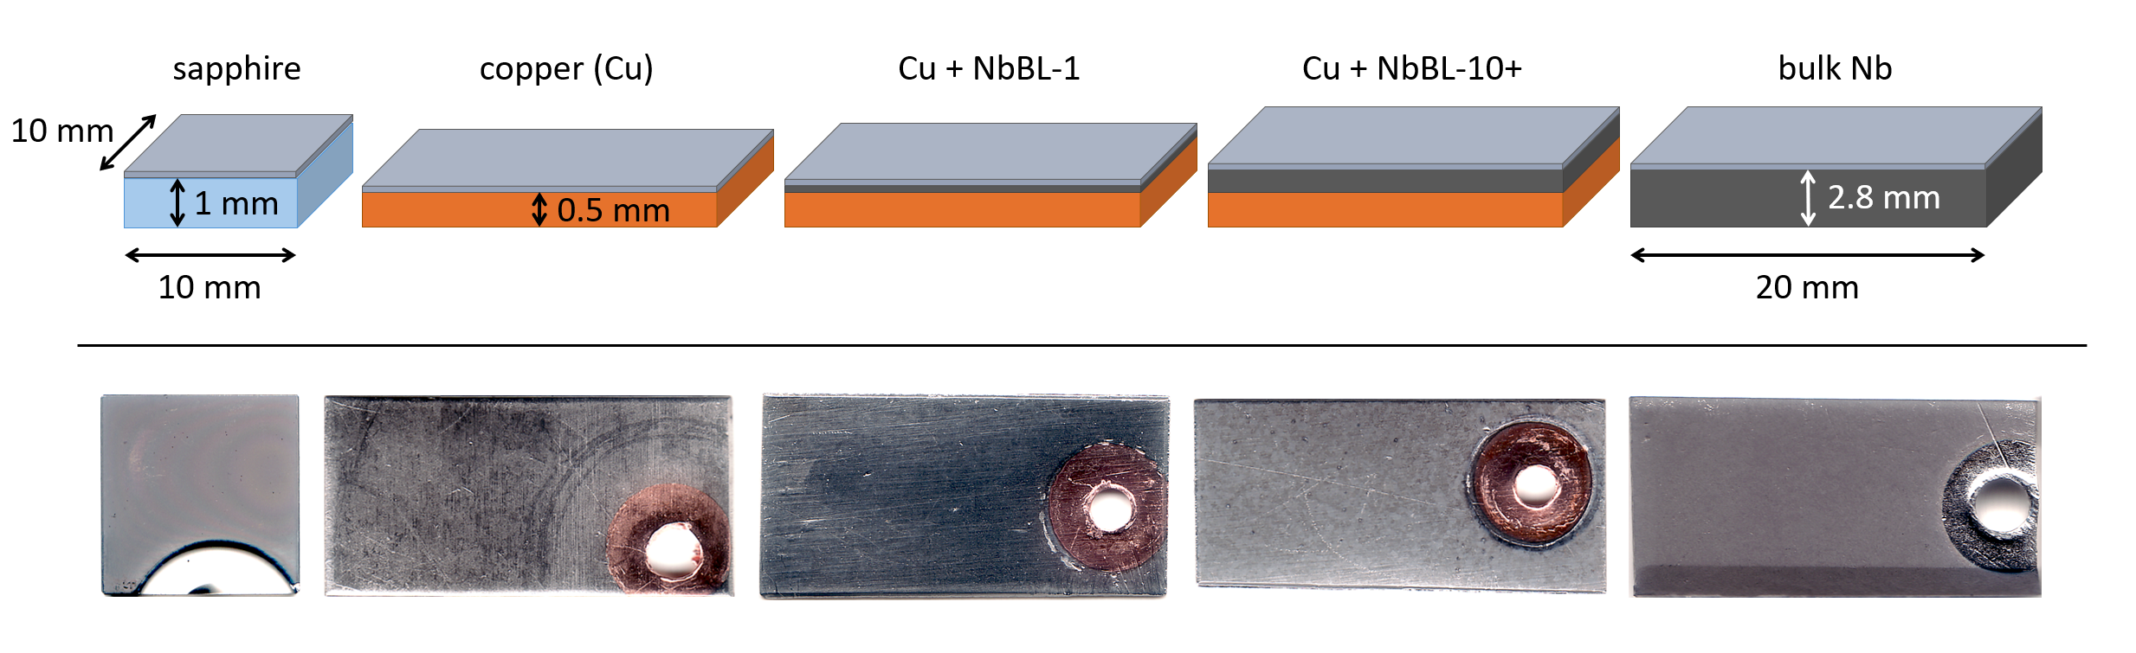

Nb₃Sn/Cu state of the art at LNL
Optimized recipe:
  Low cathode power < 20 W
  Deposition pressure 2 x 10⁻² mbar
  No annealing
  Deposition temperature 600 ºC – 650 ºC
  NbBL thickness = 30+ μm
NbBL thickness plays a major role:
  A thicker NbBL promotes the formation of the A15 phase (see T_{c}): accomodation effect
  30+ µm is the “saturation” thickness
650 °C
Nb₃Sn
NbBL
D. Ford

Slide 4
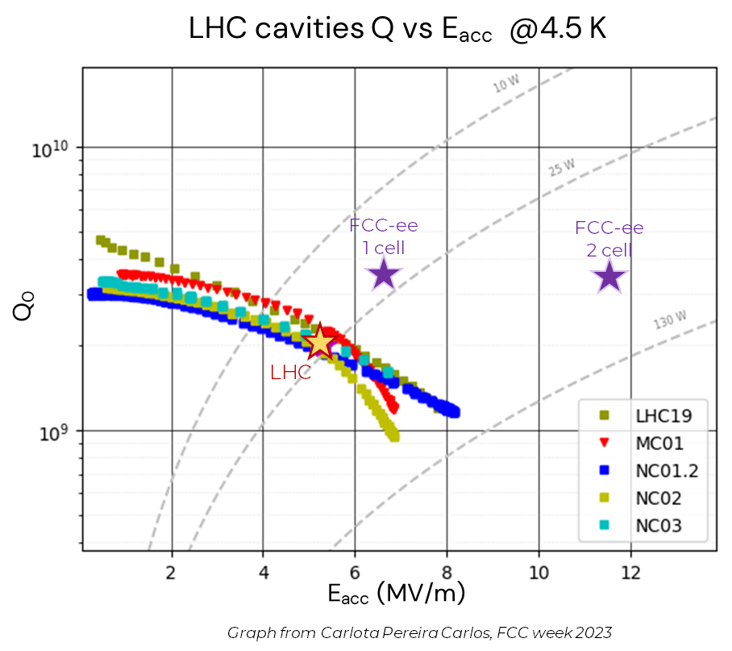

Nb₃Sn/Cu state of the art at LNL
Comparison to LHC baseline: Q₀ vs. E_{acc} @ 4.5 K
G = 216 Ω
QPR Nb₃Sn/Nb bulk
Equivalent to
Q₀ ~ 9 x 10⁹
@ 5 MV/m
@4.5 K
(O. Kugeler, S. Keckert)
Quadrupole Resonator (QPR)
test of Nb₃Sn/bulk Nb
coating according to optimized recipe
LHC cavities: Nb/Cu 400 MHz

Slide 5



Nb₃Sn activities for
WP1: Superconducting Materials
Conversion Power
DCMS deposition recipe with nominal T_{c} ready
and successfully RF tested (QPR)
Proceed with:
R&D on pulsed-MS deposition to improve material superconducting AC performances in high DC magnetic field
Parallel investigation of parameters toward improvement of current recipe, with goals: decreasing NbBL thickness, lowering T_{dep}
$$P_{aγ→γ}=g_{αγγ}^{2}\frac{ρ_{a}}{m_{a}}B^{2}ω_{0}VC\frac{Q_{a}Q_{c}}{{Q_{a}+Q}_{c}}$$
Reminder (Nb₃Sn):
Q and B
Medium Performances at Very High B field
V and C
Direct Deposition via PVD
Easy Scalable Technology
Technology Readiness Level
Medium-High: Cavity prototypes already made

Slide 6
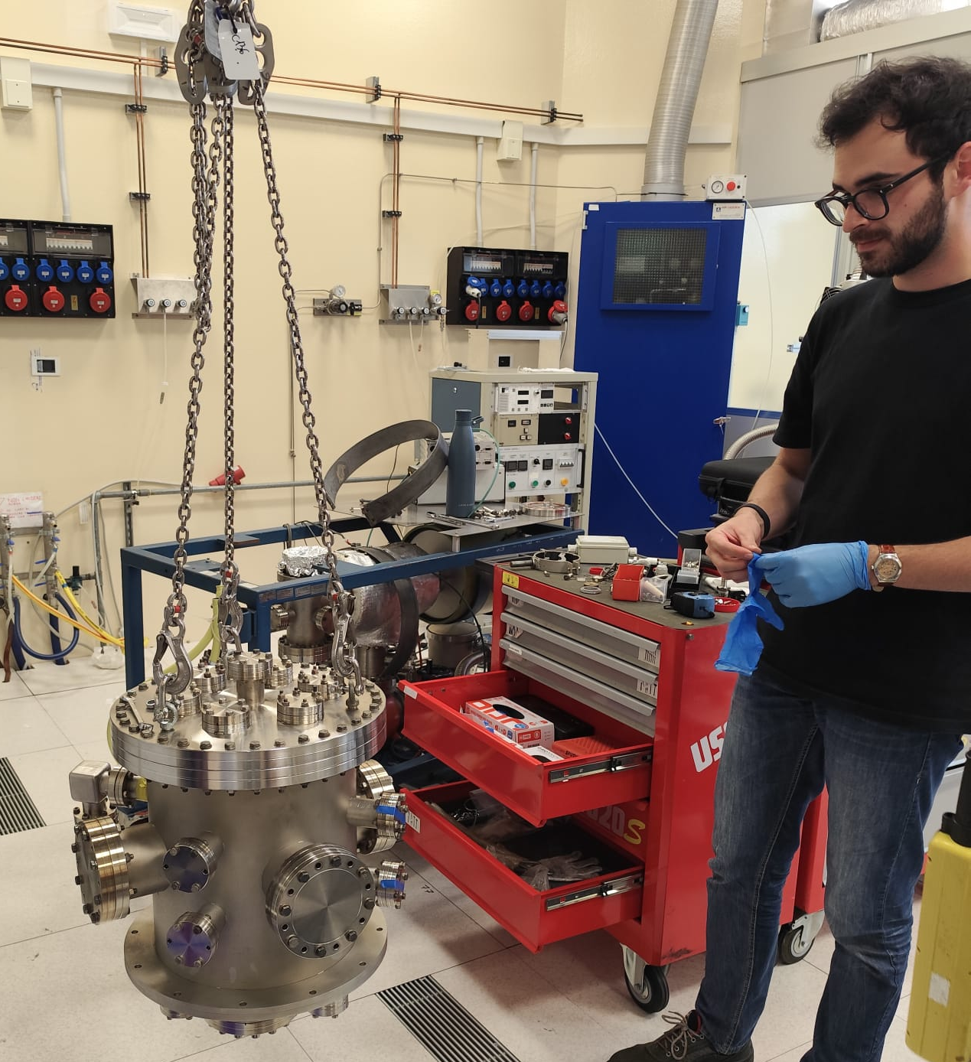
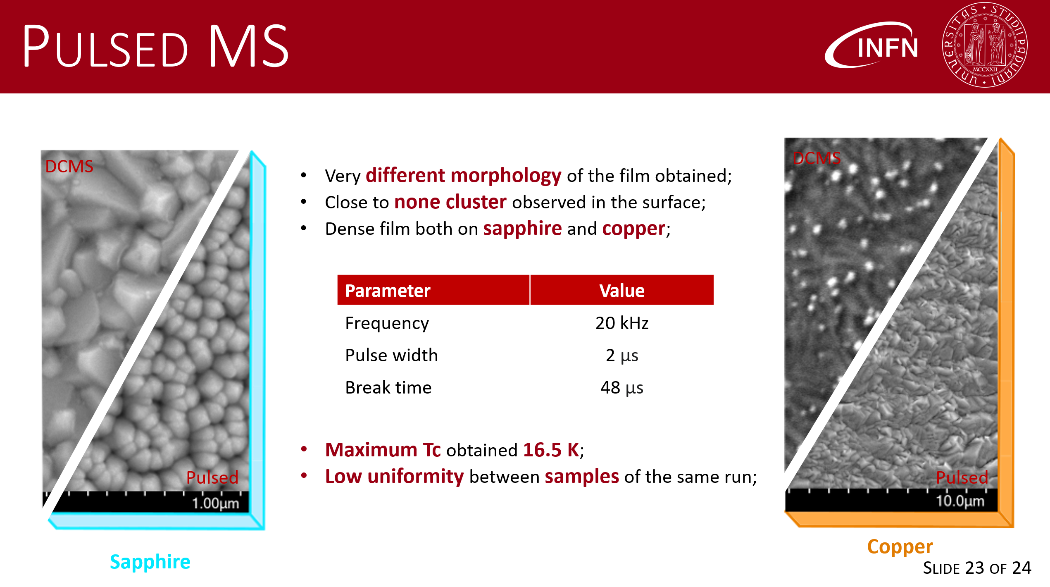
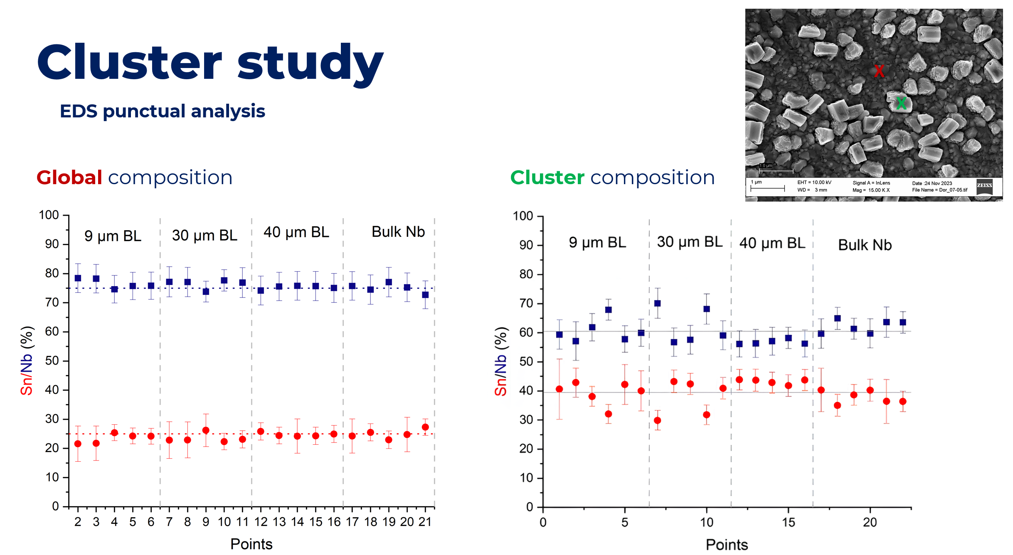
New dedicated coating system
New sputtering system:
fully dedicated to pulsed-MS depositions
2” magnetron with commercial stoichiometric single Nb₃Sn target
operated in DCMS: T_{c} = 17.5 K for Nb₃Sn/Al₃O₂ substrate (*)
→ demonstrates we have good control over system
→ demonstrates reproducibility of DCMS recipe (4” system)
More results:
*M. Lazzari’s MSc thesis
(*)
Sn-rich islands observed on DCMS samples

Slide 7
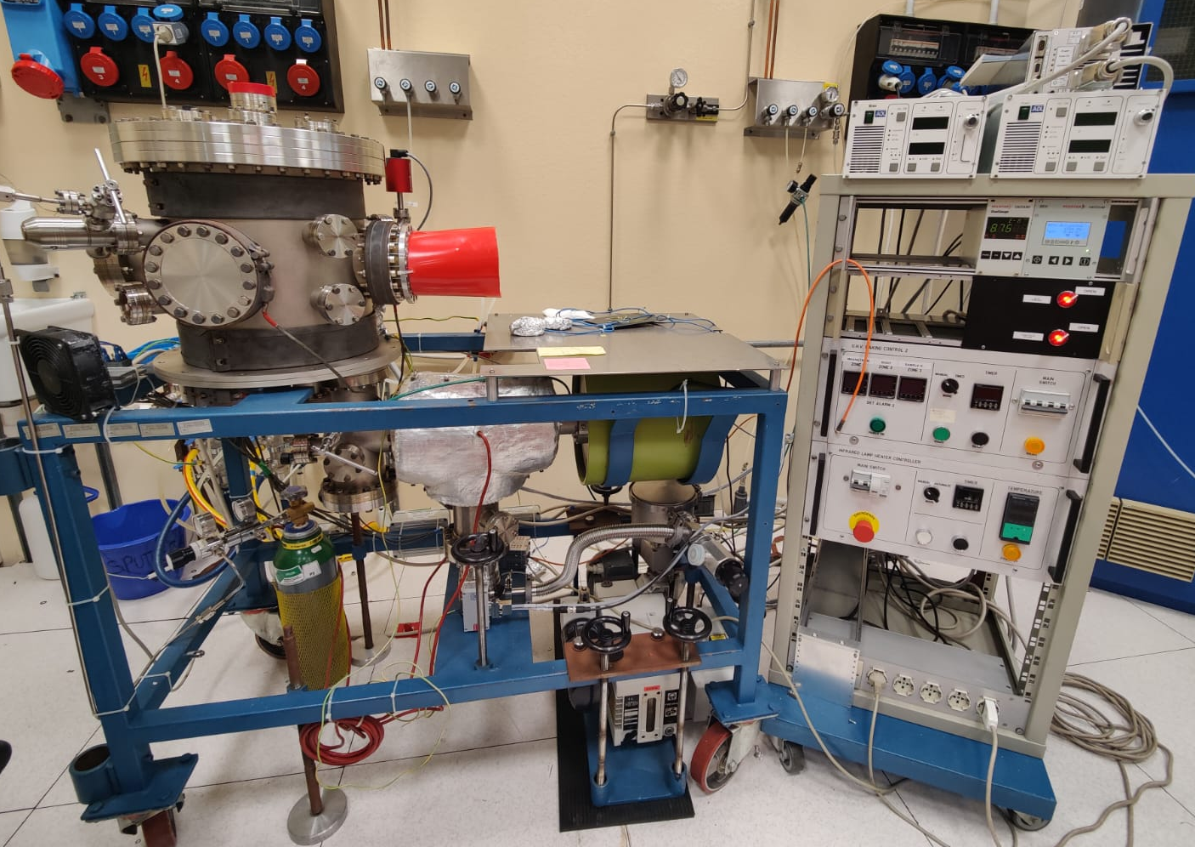

Currently ongoing
With new sputtering system being operational:
1x MSc student fully dedicated to it (E. Cremonesi)
deposition runs are resource- and time-consuming
  improve/assess pulsed-MS process robustness
  identify/confirm most influential parameters with
  minimal # of runs
  → T_{c} and a oriented DOE: 9 runs with T_{dep}, f, p, P
  (NbBL thickness is intrinsic)
preparation of first batches of NbBLs (2 μm, 16 μm, 30 μm)
first run prepared, baking done and deposition starting today 🤩
NbBL-2 (2)
NbBL-16 (1)
NbBL-30 (2)
NbBL-30 (1)
NbBL-2 (1)
NbBL-16 (2)
2x Al₂O₃
bulk Nb
NbBL-2 (3)
NbBL-16 (3)
NbBL-30 (3)

Slide 8
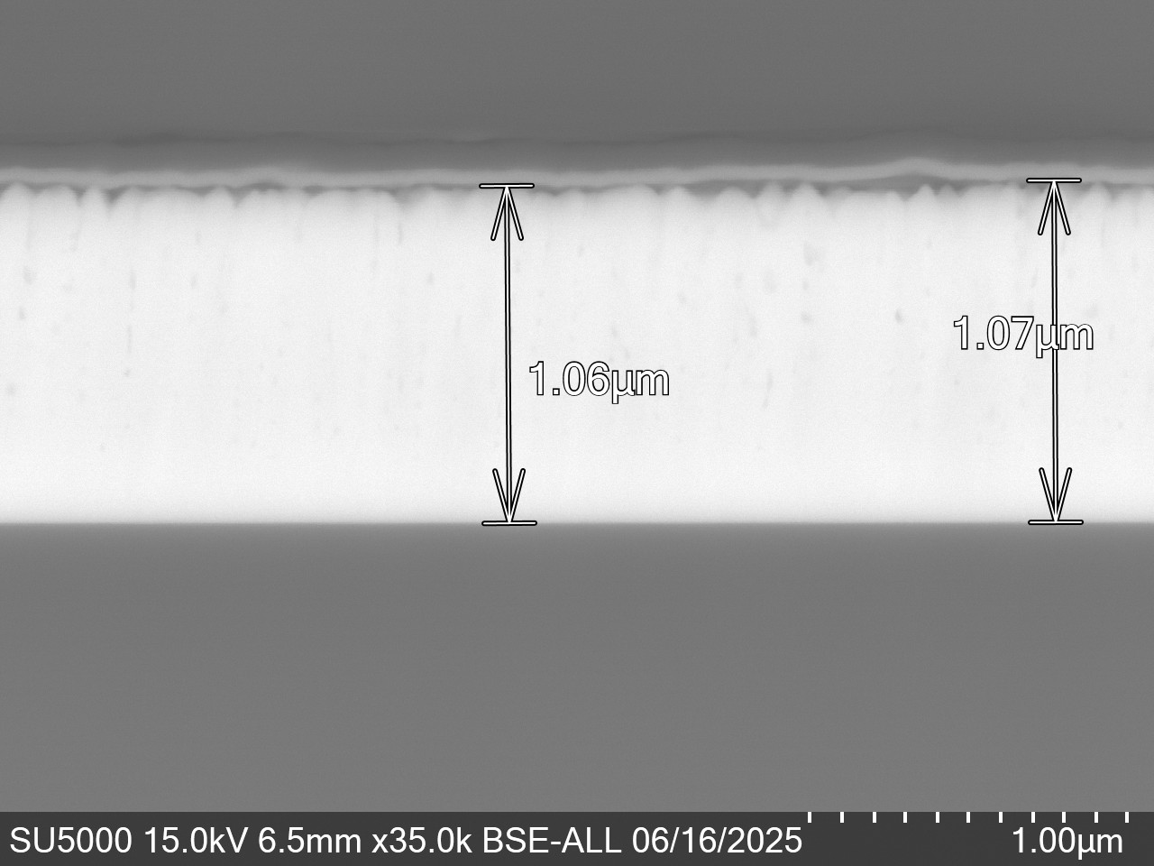
Currently ongoing (update)
4 run done
Tc around 14-15 K
Coating set-up must be improved
(several short cuts are limiting the productivity)
First coating presents lower film density
compared to DC (preliminar)
Ion milling installed + FE-SEM: cross section characterization possible!

Slide 9
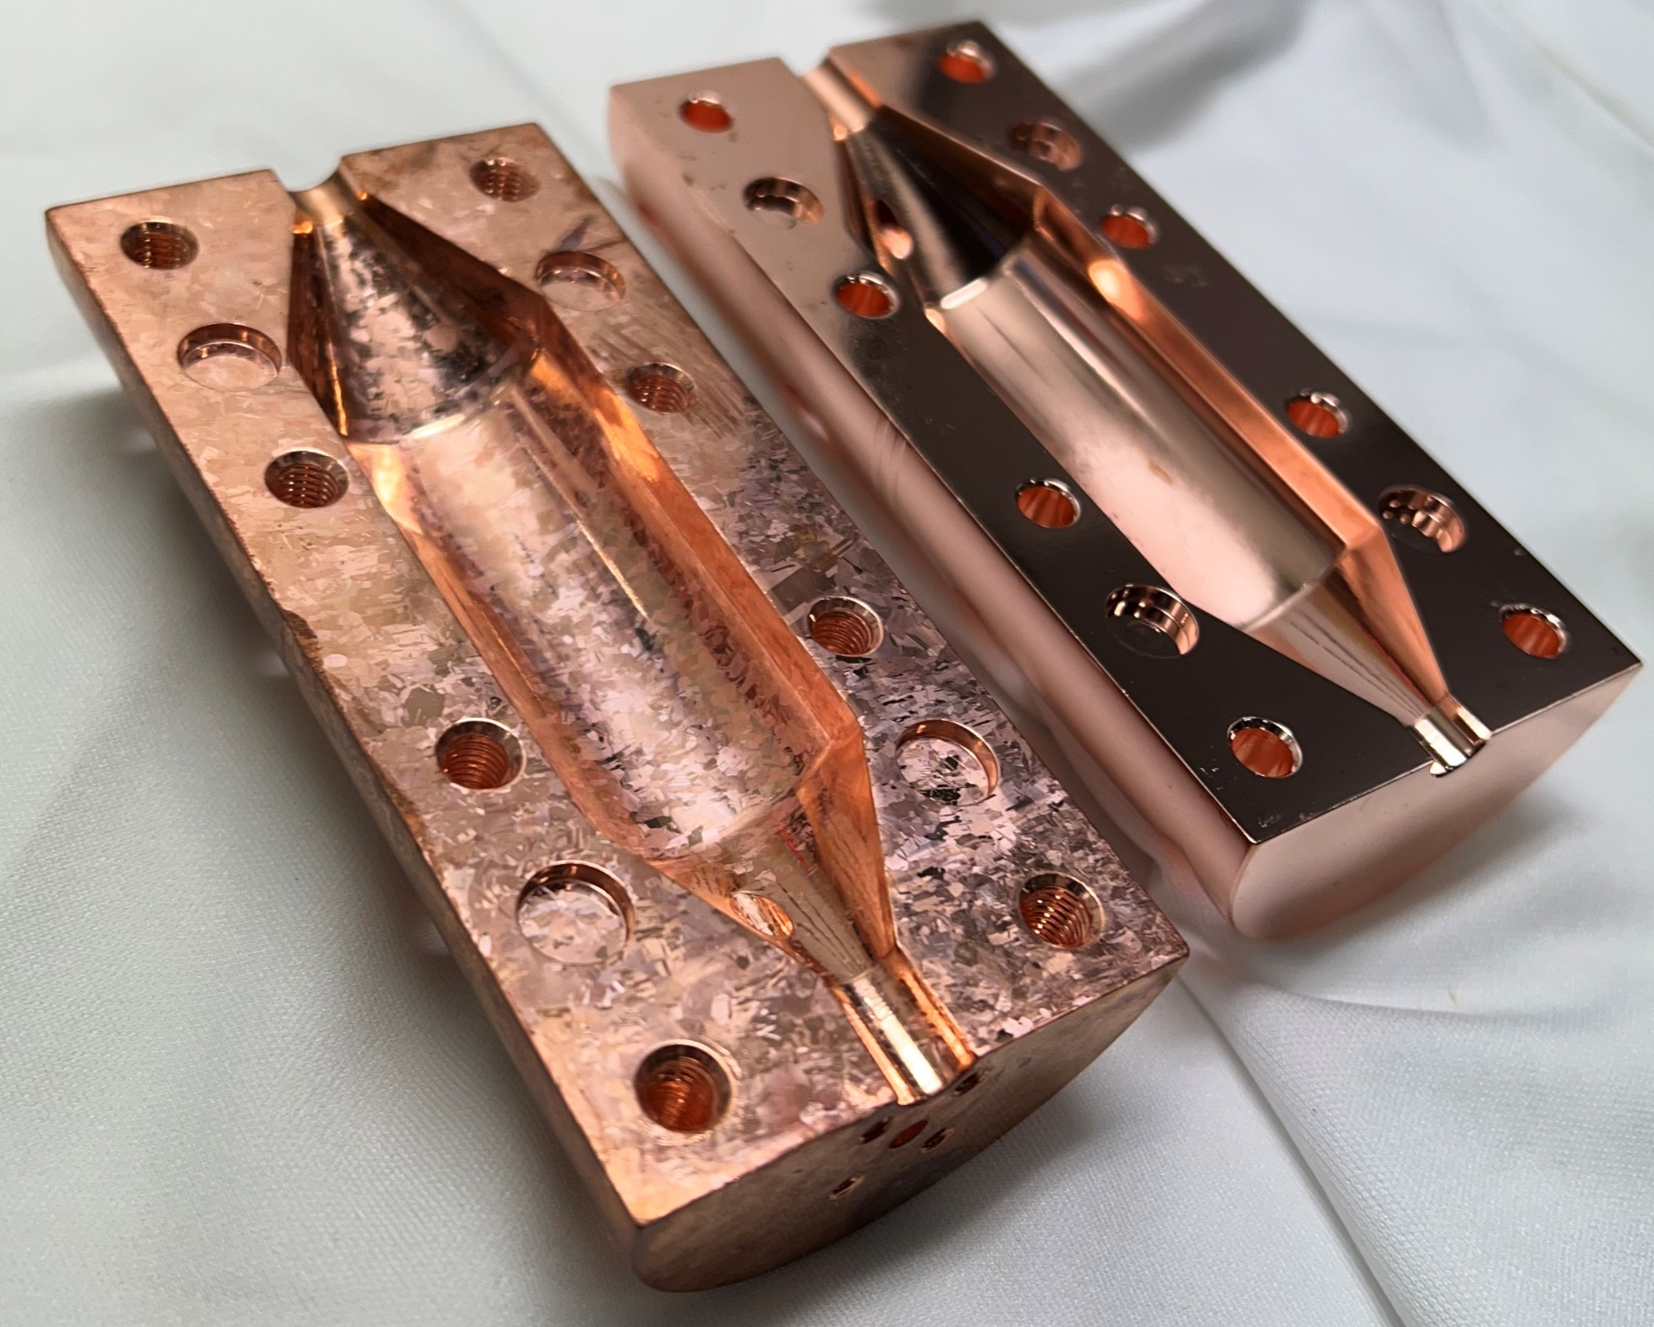
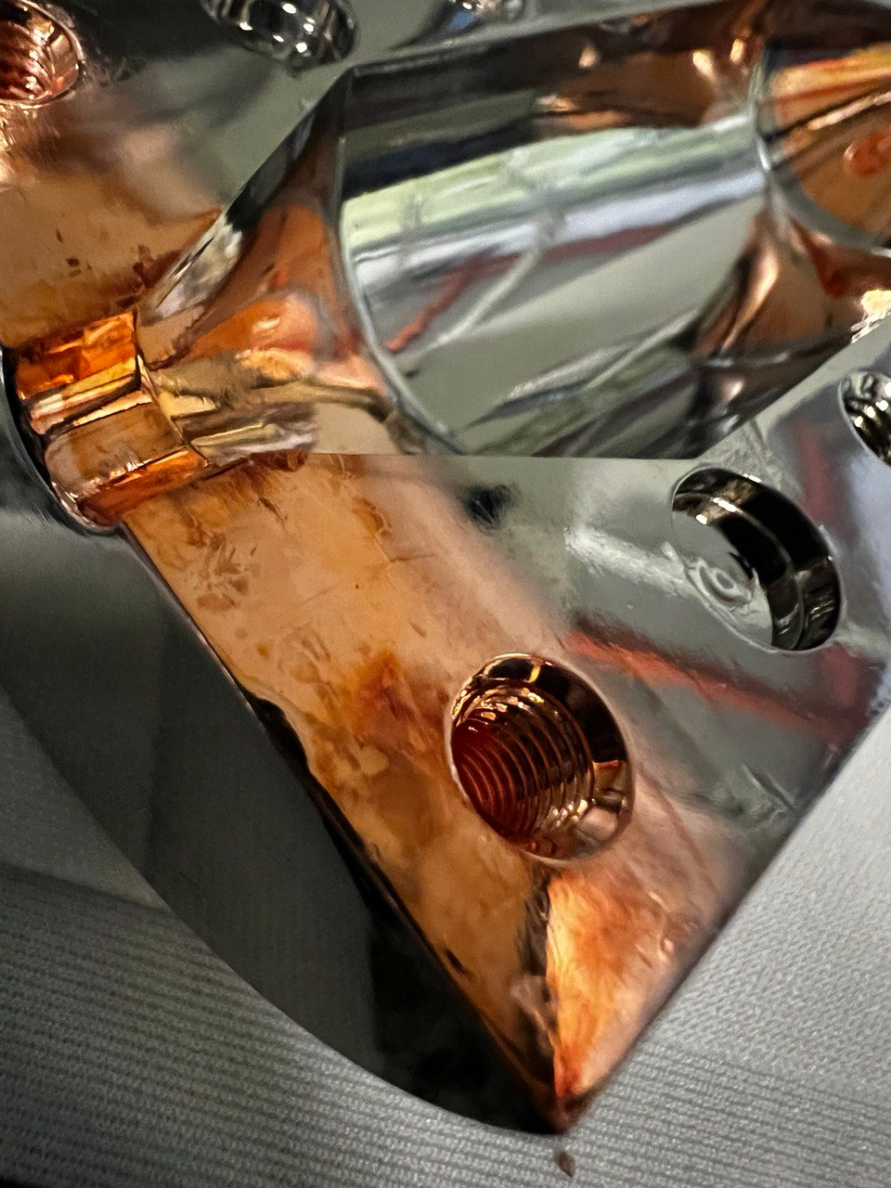

Next steps: 9 GHz haloscope
Workflow
Stripping of the SC layer
Persulphate etching
Plasma Electrolytic Polishing preparation
NbBL deposition
Nb₃Sn deposition
Measurements
E. Chyhyrynets
PEP
verified
Persulphate etched
Persulphate etched
PEP

Slide 10
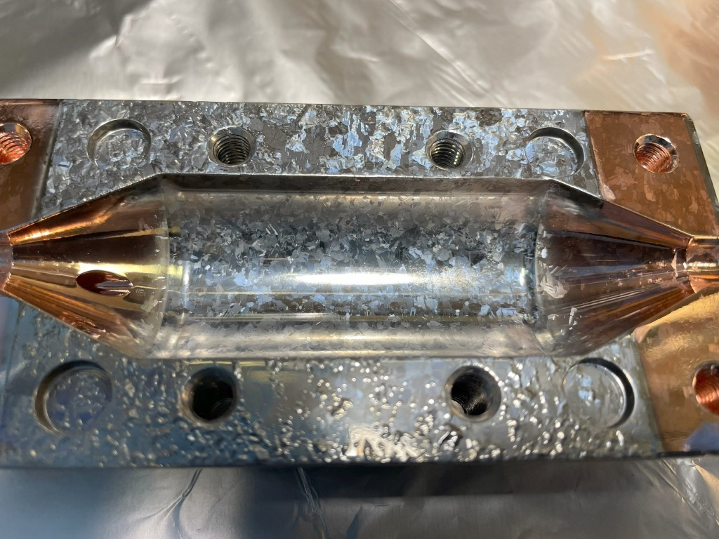
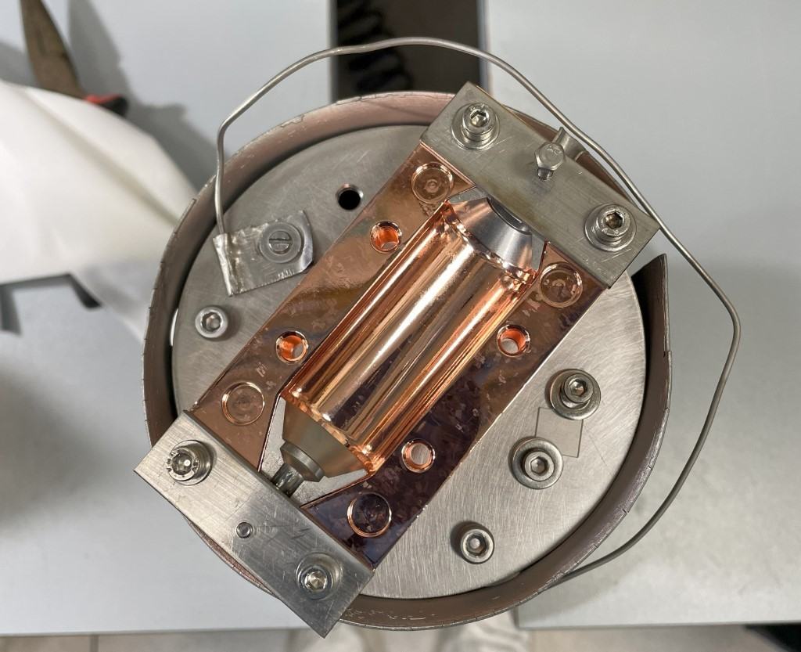
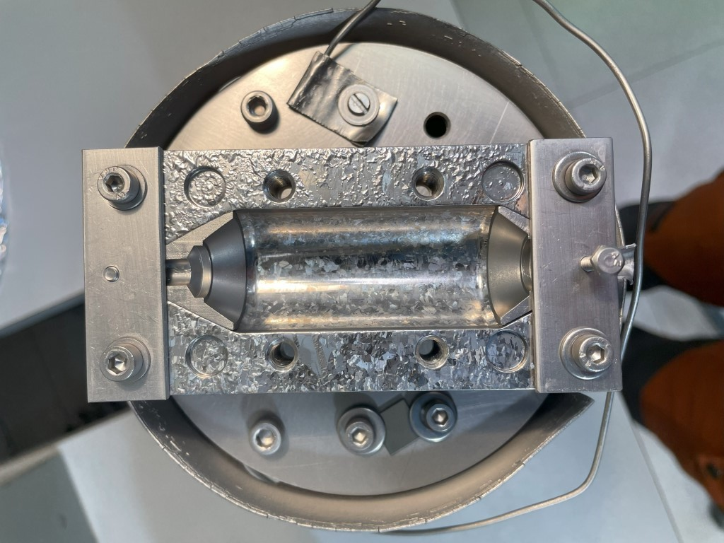
Next steps: 9 GHz haloscope (update)
Workflow
Stripping of the SC layer
Persulphate etching
Plasma Electrolytic Polishing preparation
NbBL deposition
Nb₃Sn deposition
Measurements
verified
Peel off on the upper part
The cavity coating resist to HPR

Slide 11
FLASH
Started a collaboration with FLASH group to define the Cu polishing of the large 100 MHz resonator
A small prototype in collaboration with University of Mainz will be built to test different solutions

Slide 12
2026 Activity
Continuation of the development of Nb₃Sn coatings via Pulsed MS
  Parameters explored: Pressure, Temperature, Pulse Frequency, Peak Power
Preparation of planar samples on sapphire for TO and RM3 and on Cu for RM3
Deposition of Nb₃Sn coating (DC-MS recipe) on 9 GHz haloscope cavity
Polishing of copper half-cells of reference cavity
First pulsed Nb₃Sn coating on reference cavity
Polishing test on FLASH cavity

Slide 13
FTE e Budget 2026
Budget per capitoli
Missioni | 1
Consumo | 2
Altri Cons | 2
Trasporti | 2
Manutenzione | 5
SPServizi | 3
Inventario | 25
TOTALE | 51
FTE
Nome | Qualifica | %
Cristian Pira | Primo Tecnologo | 30
Giorgio Keppel | Primo Tecnologo | 10
Eduard Chyhyrynets | Tecnologo | 30
Ezeaba Tochukwu Emmanuel | Dottorando | 40
Matteo Lazzari | Borsista | 50
Dal Ponte Matteo | Borsista | 70
Crnlovic Nikola | Borsista | 50
Stivanello Fabrizio | Tecnico | 65
TOTALE |  | 3,45 FTE
Dettaglio richieste
Capitolo | Descrizione | Richiesta
Missioni | Trasferte ditte esterne per la fabbricazione di cavità e componenti meccanici | 1
Missioni | Missioni a Frascati, Roma, e Torino per misure | 3
Missioni | Partecipazione Thin Film Workshop in UK | 3 (SJ)
Consumo | Acidi e soluzioni chimiche per pulizia Cu | 3
Consumo | Lampade IR x portacampioni riscaldato Nb e Nb3Sn | 3
Consumo | Gasket CF per UHV | 2
Altri Cons | Gas puri per sputtering (Ar) | 2
Trasporti | Spese spedizione cavità e campioni STFC, CERN, Jlab, Fermilab | 2
Manutenzione | Pompe turbo sistema da sputtering | 5
SPServizi | Lavorazioni meccaniche varie (adattatori prototipo cavità, portacampioni, etc.) | 3
Inventario | Contributo acquisto Diffrattometro | 25

Slide 14
Thank you!

