Slide 1



Cristian Pira
Trieste, CSN5 Meeting
9-9-2024

Slide 2





Involved Groups
Superconducting rf Materials for Axion Detectors
2 INFN National Laboratories
Cristian Pira
(National Responsible)
Giovanni Maccarrone
2 INFN Units
Nicola Pompeo
Gianluca Ghigo
1 External Research Centers
Giuseppe Celentano
Research Area: Accelerators
3 year Experiment: 2025-2027

Slide 3

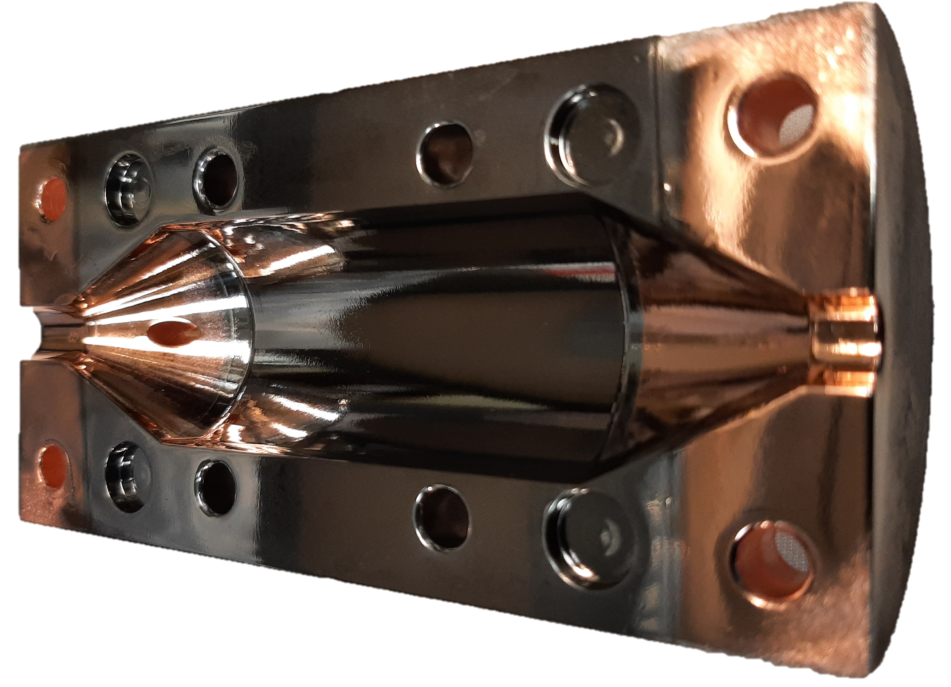

Goal
upholds the legacy of WP2
aims at developing and studying superconducting materials with different characteristics and different TRL (Technology Readiness Level), with the final scope of improving the state of the art in SC haloscope production for Dark Matter detectors

Slide 4
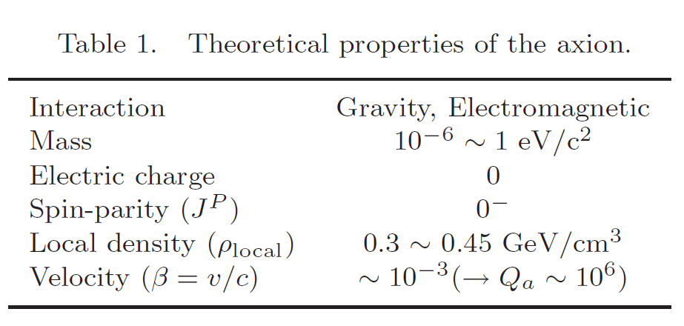
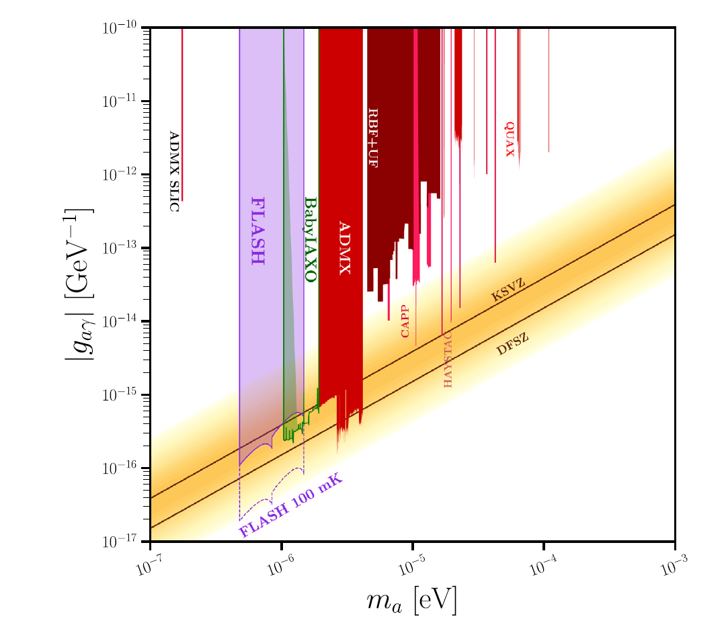
Axion Search
The axion is a highly-motivated elementary particle that could address two fundamental questions in physics: the strong charge-parity (CP) problem and the dark matter mystery
The most common experimental searches for axions rely on the EM interaction mediating the axion-photon coupling
S. Youn, «Axion Research at CAPP/IBS», International Journal of Modern Physics: Conference Series, vol. 43. p. 1660193, 2016.
Search with Haloscope
D. Alesini et al., Phys. Dark Universe, vol. 42, 2023,
Semertzidis and Youn, Sci. Adv. 8, eabm9928 (2022)

Slide 5

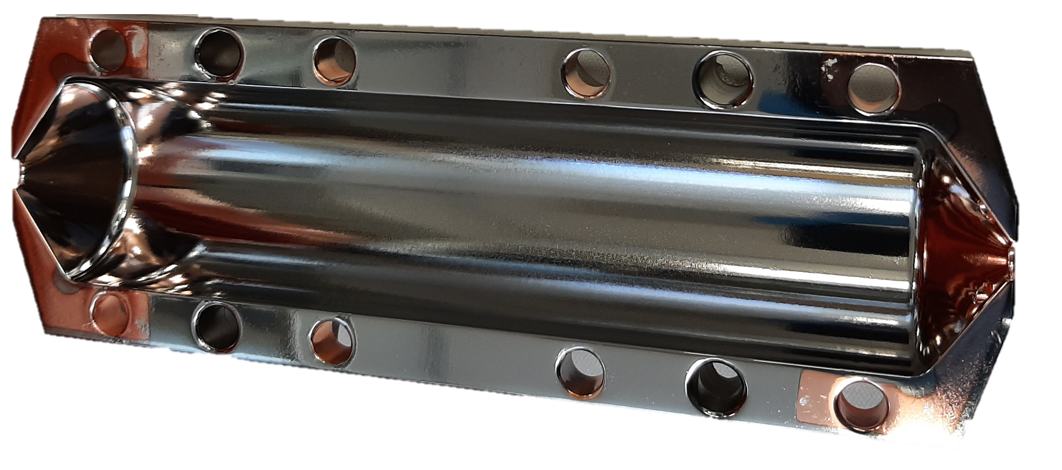
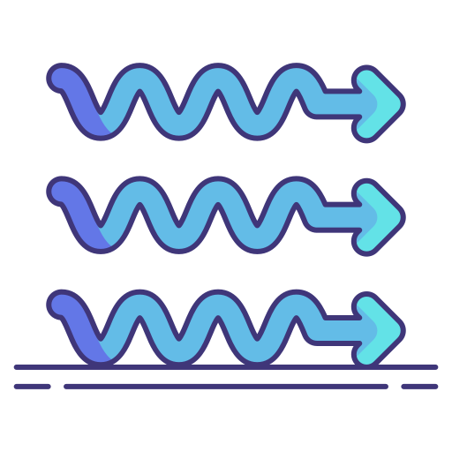

Basic Principle
SRF Axion Haloscopes
Coupling Constant
Dark Matter Axion Density
Volume
The axion haloscope was designed to scope microwave photon signals from the conversion of axions in our galactic halo
The signal power can be enhanced by the resonance effect that occurs when the axion mass matches the natural frequency of the detection system
Conversion Power
Cavity Quality Factor
$$P_{aγ→γ}=g_{αγγ}^{2}\frac{ρ_{a}}{m_{a}}B^{2}ω_{0}VC\frac{Q_{a}Q_{c}}{{Q_{a}+Q}_{c}}$$
Axion Mass
Magnetic Field
Resonant Frequency
Form Factor
Axion Quality Factor (10⁶)
D. Kim et al. JCAP03(2020)066
Q factor of Cu haloscope limited
by anomalous skin effect
Magnetic Field (B)
to improve Q
Photon (γ)
SRF in High Magnetic Field (Mixed State)
Virtual Photon (γ)
Axion (a)
Important parameters:
Q (10⁶-10⁷)
B, V, C (higher is better)

Slide 6
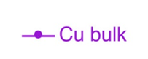
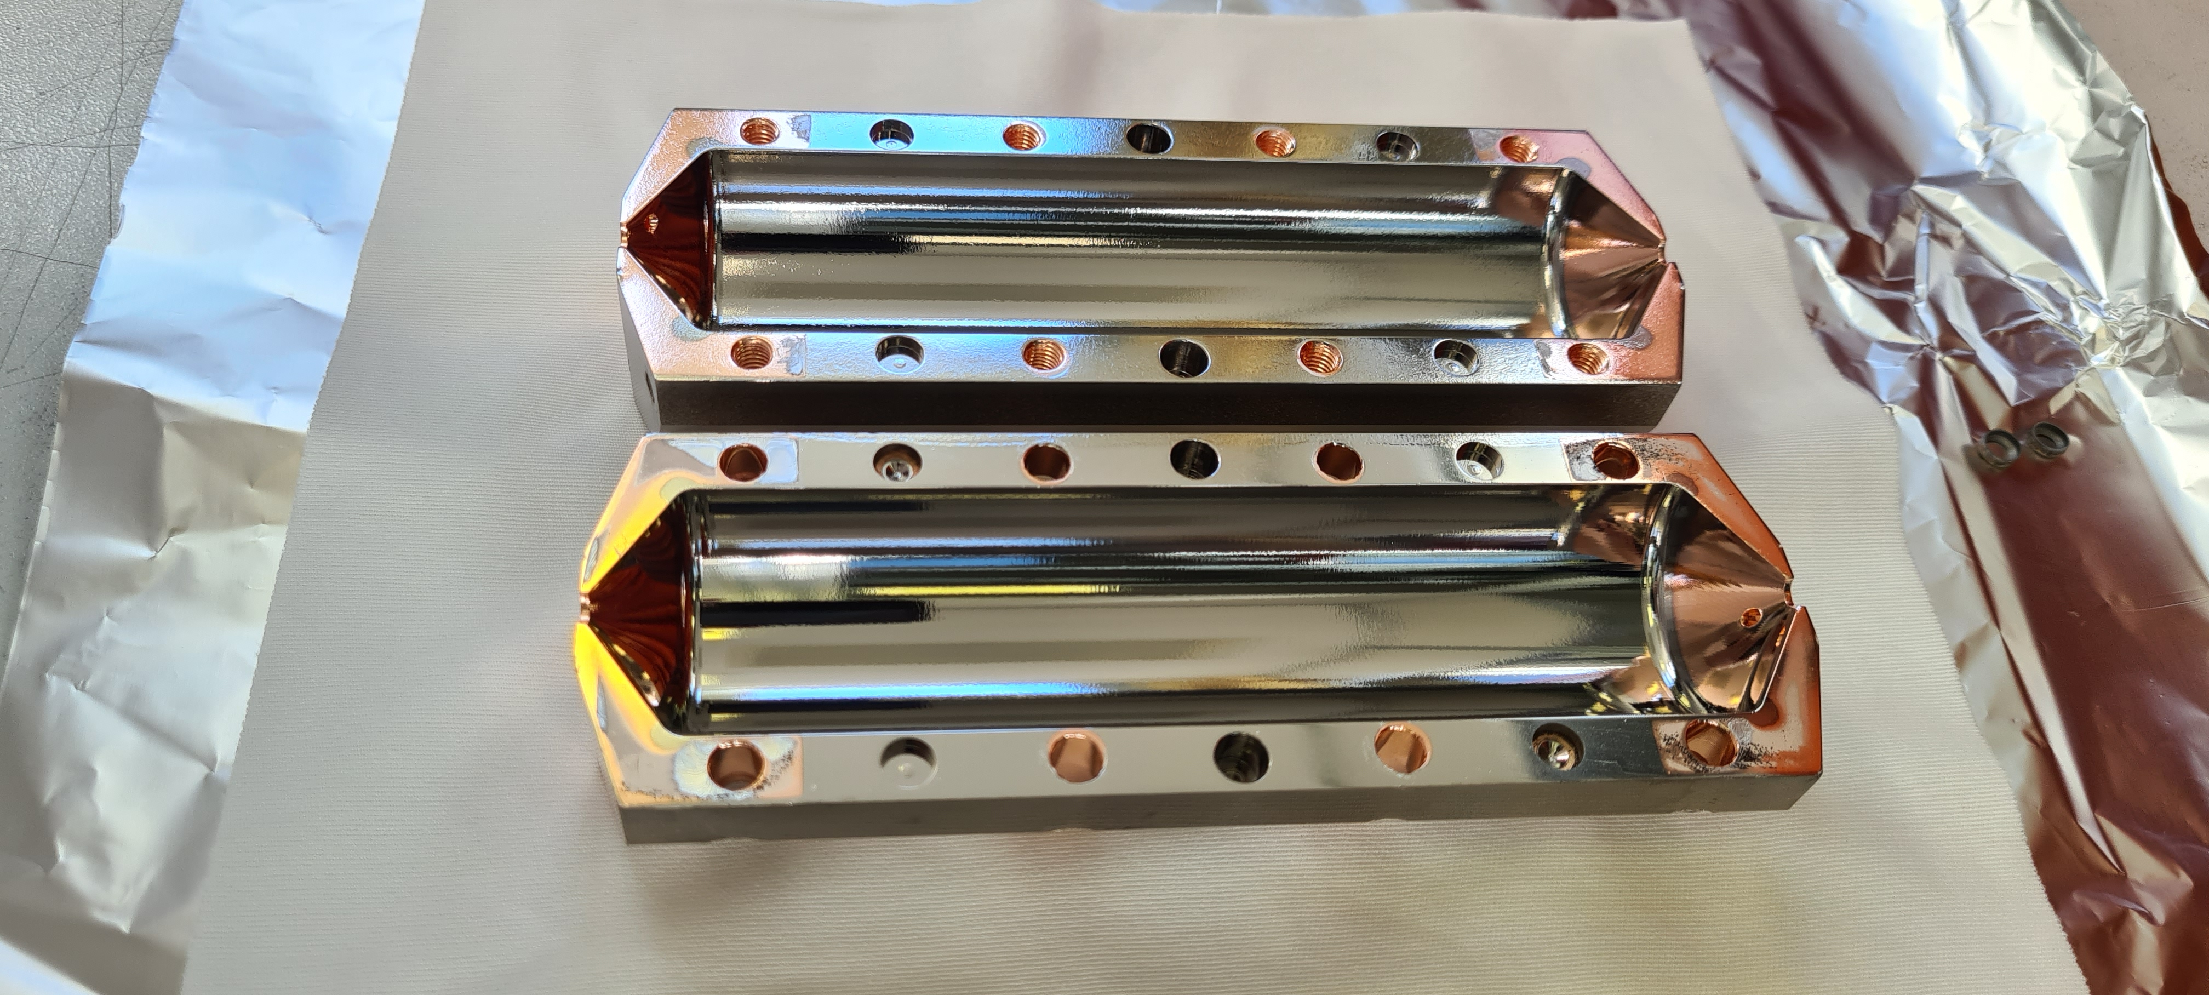
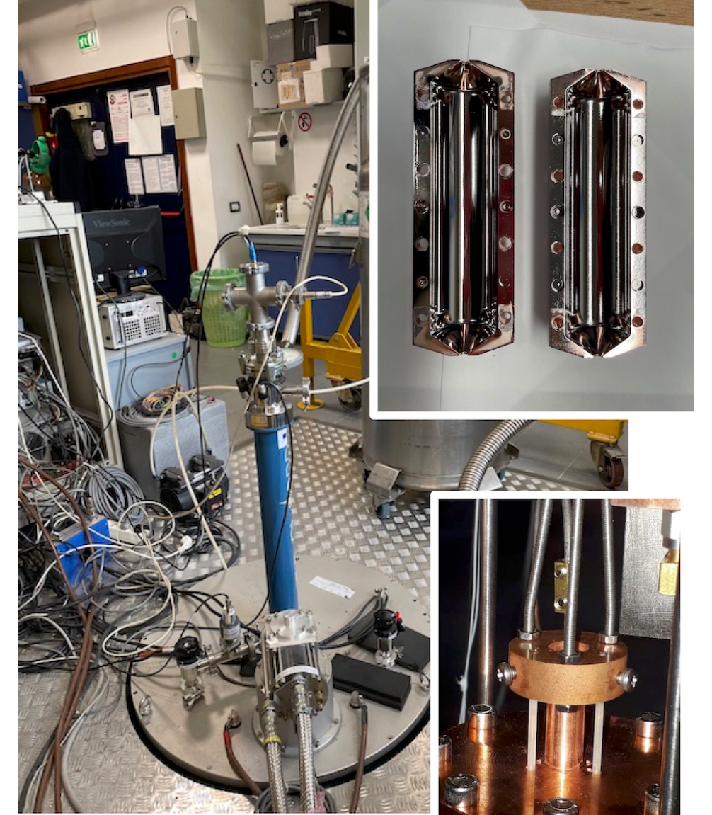
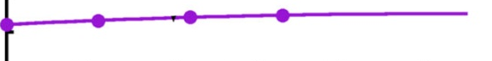
Best Results
QUAX 7 GHz cavity coated with NbTi
Q₀ ≈ Q₀ simulation → limited by Cu cones
Q₀ ≈ 9*10⁵ @ 2 T (T = 15 mK)
Q₀ _{NbTi} > 20*Q_{0 Cu} @ 15 mK, 2 T
Q₀ _{NbTi} > Q_{0 Cu} up to 9 T @ 4 K
15 mK
G. Marconato et al., IEEE Transactions on Applied Superconductivity, vol. 34, 2024, doi: 10.1109/TASC.2024.3416541
C. Braggio et al., arXiv:2403.02321

Slide 7
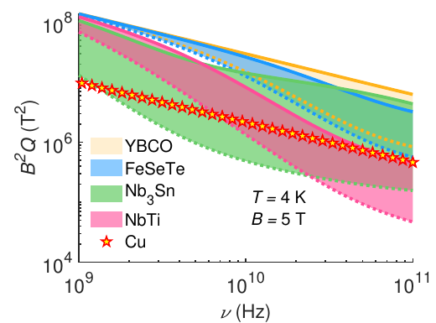
motivation
Computed B²Q factors for various SC
Within only BCS SC has been investigated
extends the study to High T_{c} SC
Perfect Superconductor does not exist
Best compromise among high Q, high B,
large V and optimized C
(strongly depends on the frequency)
A. Alimenti et al., Instruments, vol. 6, fasc. 1, 2022

Slide 8
Structure
3 Work Packages:
Superconducting Materials
Vortex dynamics studies
Haloscope Cavity

Slide 9
WP1 Superconducting Materials
WP Leader: Nicola Pompeo (RM3)

Slide 10

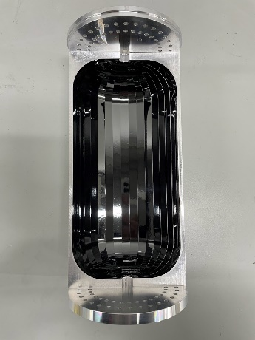


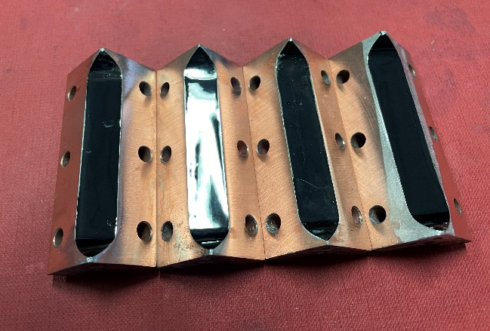
WP1 REBCO
State of the art
Q and B
Very High Performances at High B field
V and C
Direct Deposition not possible, glue is challenging
Technology Readiness Level
Tapes Commercially Available
Cavity prototypes already made
REBCO Cavity with Q = 1.5*10⁷ @ 8 T
Woohyun Chung, Quantum Technologies for Fundamental Physics Workshop, Erice, Italy, Sept 2023
Improve peeling process (minimizing defects)
Test different tapes available in the market
Study Soldering Process on Cu cavity
First REBCO cavity @ LNF-ENEA

Slide 11

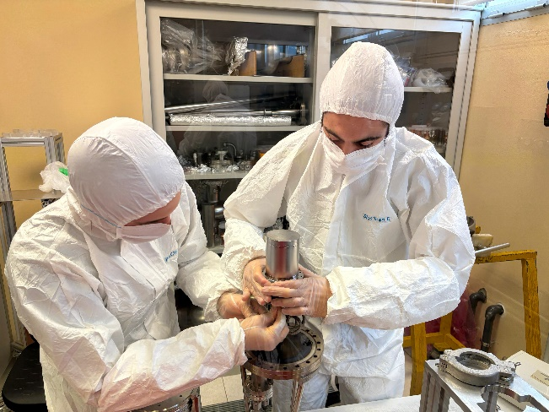
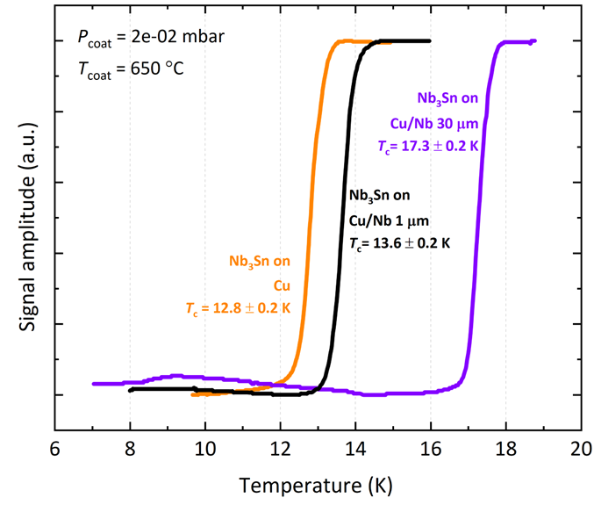
WP1 Nb₃Sn
Q and B
Medium Performances at Very High B field
V and C
Direct Deposition via PVD
Easy Scalable Technology
Technology Readiness Level
Medium-High: Cavity prototypes already made
Tc of Nb₃Sn by PVD on various substrates
QPR coated with Nb₃Sn @LNL
Magnetron Sputtering Recipe with nominal T_{c} ready
First test on cavity expected in SAMARA (end of 2024)
R&D on Pulsed Deposition to improve material performances (and reduce buffer layer thickness)

Slide 12
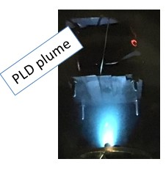


WP1 Fe(Se,Te)
Q and B
High Performances at High B field
V and C
Deposition on Pre-formed tapes (PLD)
Technology Readiness Level
Low: R&D on small planar samples
Mancini et al., https://doi.org/10.1109/TASC.2023.3338598
PLD – Pulsed Laser Deposition
R&D to improve thickness (at least 1 µm, 100-300 nm present state of the art)
R&D for large area scaling (tape: nichel based, SS, Cu?)

Slide 13
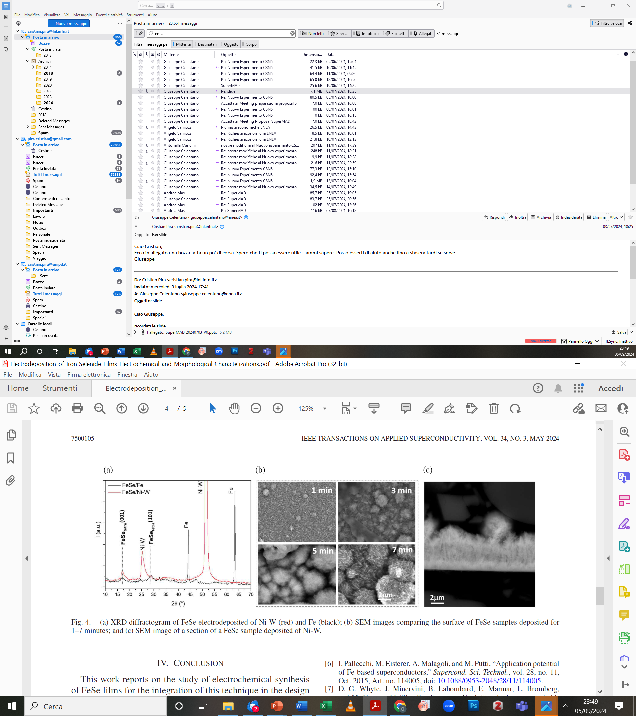
WP1 FeSe
Q and B
High Performances at High B field
V and C
Direct Deposition Possible (Electrodeposited)
Technology Readiness Level
Low: R&D on small planar samples
(a) XRD diffractogram of FeSe electrodeposited of Ni-W (red) and Fe (black); (b) SEM images comparing the surface of FeSe samples deposited for
1–7 minutes; and (c) SEM image of a section of a FeSe sample deposited of Ni-W.
Electrodeposition (aqueous solutions)
R&D to improve density, adhesion and reproducibility
R&D for large area scaling
Piperno et al. https://doi.org/10.1109/TASC.2023.3338592

Slide 14
NbTi: ready for a large experiment?
Q and B
Low Performances at Very High B field
V and C
Direct Deposition via PVD
Easy Scalable Technology
Technology Readiness Level
Medium-High: Cavity prototypes already made
D. Alesini et al., Phys. Dark Universe, vol. 42, 2023,
CSN2 proposal FLASH (Find a magnet for Light Axion SearcH)
Galactic axion search at 100 MHz (0.5-1.5 μeV)
1 T Magnet (2 m diameter, 2.5 m long)
In investigation on possible upgrade from Cu to SC haloscope
(Design Report on WP3)

Slide 15
WP2 Vortex dynamics studies
WP Leader: Gianluca Ghigo (TO)

Slide 16
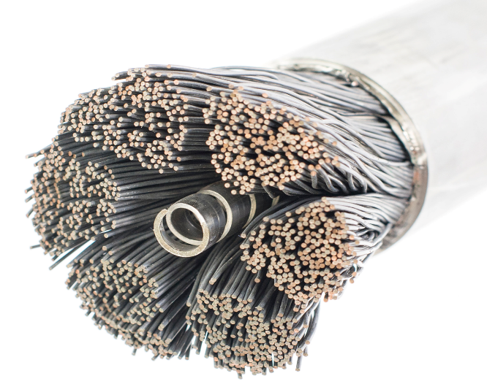
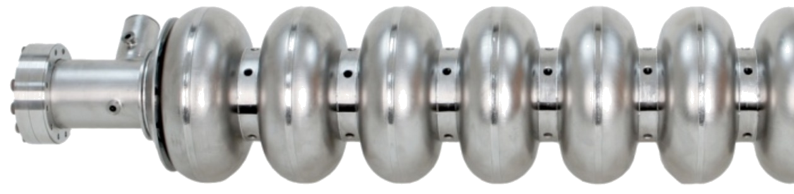
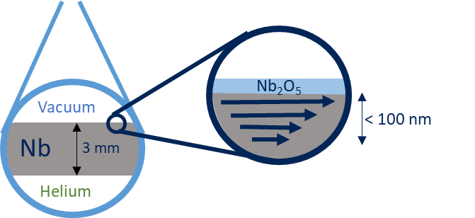
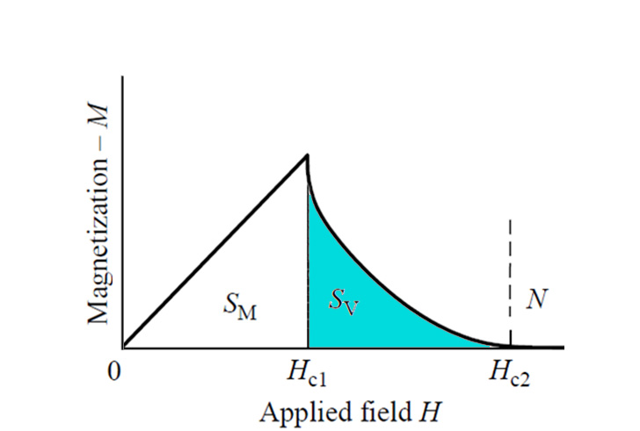
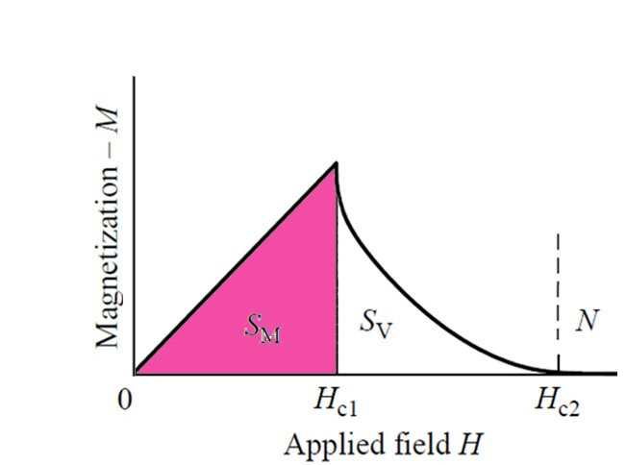
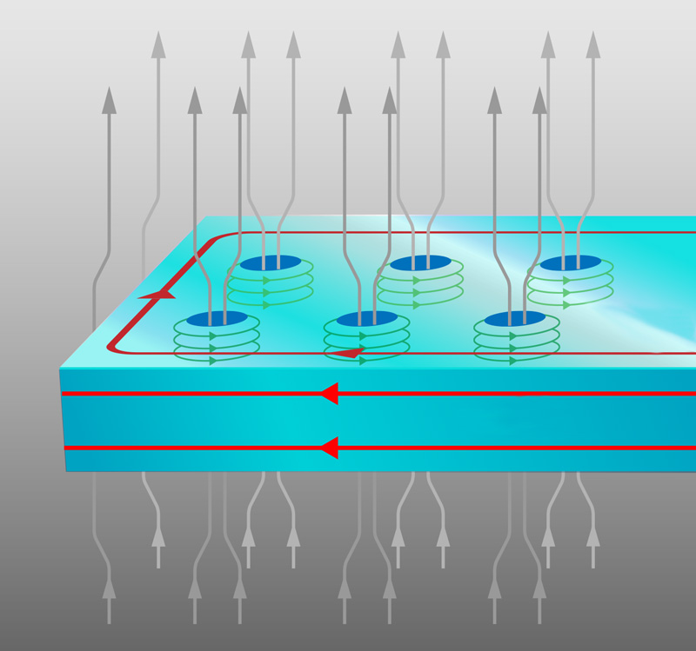
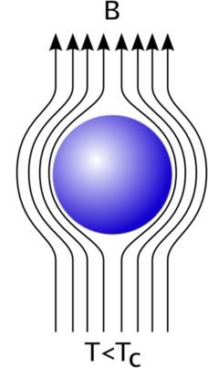
2 regimes in Superconductivity well explored
Cavities – RF
Magnets – DC
very high rf field with minimal dissipation (10-20 nΩ @1.3 GHz)
No dc field ↔ Meissner State
→ (oscillatory) motion of entrapped vortices increase dissipation
High current densities with zero resistance
DC field → Mixed State ↔ vortices
→ vortex (steady) motion determine dissipation
Complete
Flux Expulsion
Mixed State,
Vortex
Emphasis is placed on reducing the number of defects to avoid vortices entrapment and the related dissipation increase
Defects are voluntarily introduced to enhance dc pinning to reduce dissipation
SRF in high DC field is still to be explored
New paradigm: many vortices to be effectively pinned against (omnipresent) oscillatory motion

Slide 17
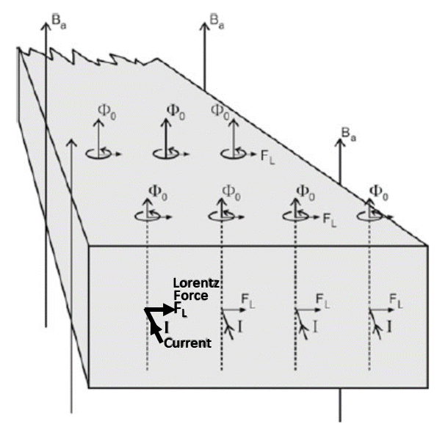
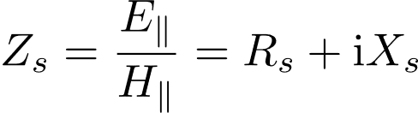
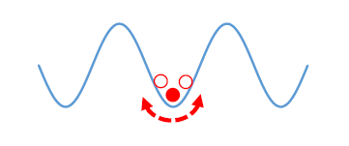
Flux dissipation
Maxwell
dissipation
Elastic &
reactive
energy
Q∝1/Rs
Pinning center
The motion of the rigid fluxon lattice
behaves as a harmonic damped oscillator
(neglecting thermal creep)
Depinning frequency fp
Unsafe zone
Fluxon viscosity
Pinning force
Safe zone
dissipation
Motion hindering
elastic energy
f < fp → pinned dominated (elastic) vortex motion
→ lower dissipation
f > fp → pin free (resistive) vortex motion
→ higher dissipation
Gittleman and Rosenblum: Phys Rev. Lett. 16, 734 (1966)
Calatroni and Vaglio, IEEE Trans. Appl. Supercond. 27 (2017) 3500506

Slide 18
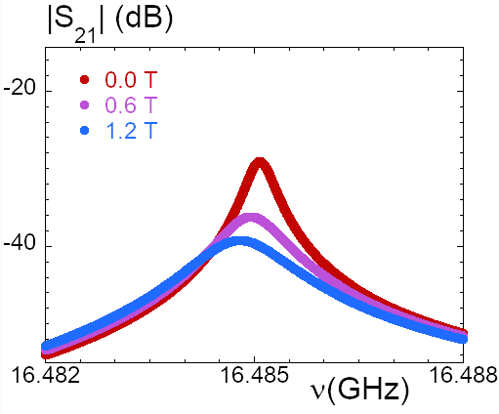
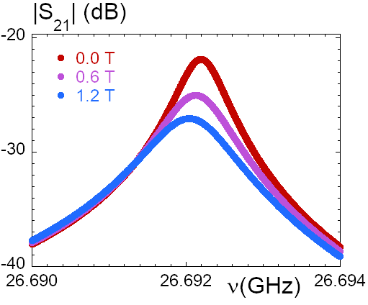
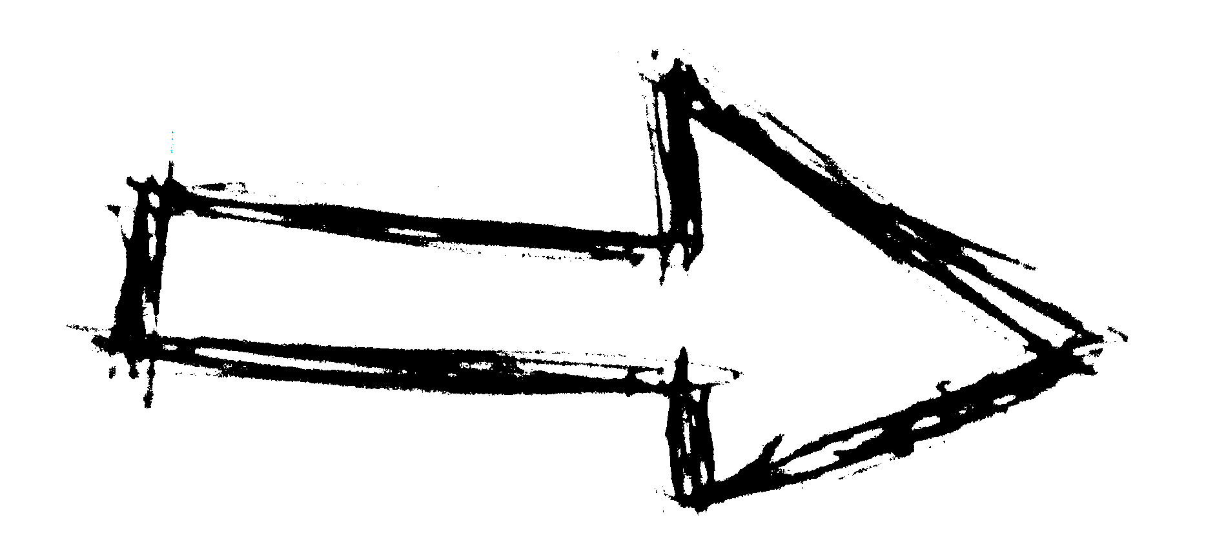

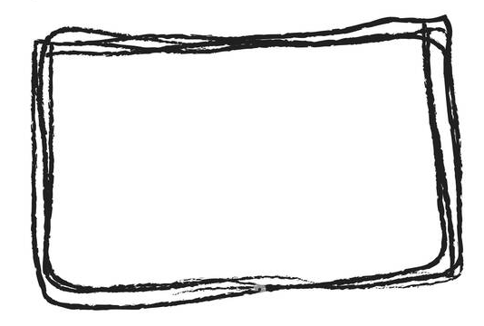
WP2 Measurement technique
(Part of) a microwave resonator made of superconducting material
-> Q and f_{res} depend on superconductor properties
Frequency
sweeps
TE011 mode
TE021 mode
Dual frequency
operation
fit
std. em
theory
bulk, thin film,
Intermediate
expressions
Vortex
motion
models
Q(T,H,θ)
fres(T,H,θ)
ΔRs(H,θ)
ΔXs(H,θ)
ρff , fp,
k , χ
ρvm(H, θ)
resonator
parameters
surface
impedance
shift
vortex
motion
resistivity
vortex
parameters

Slide 19
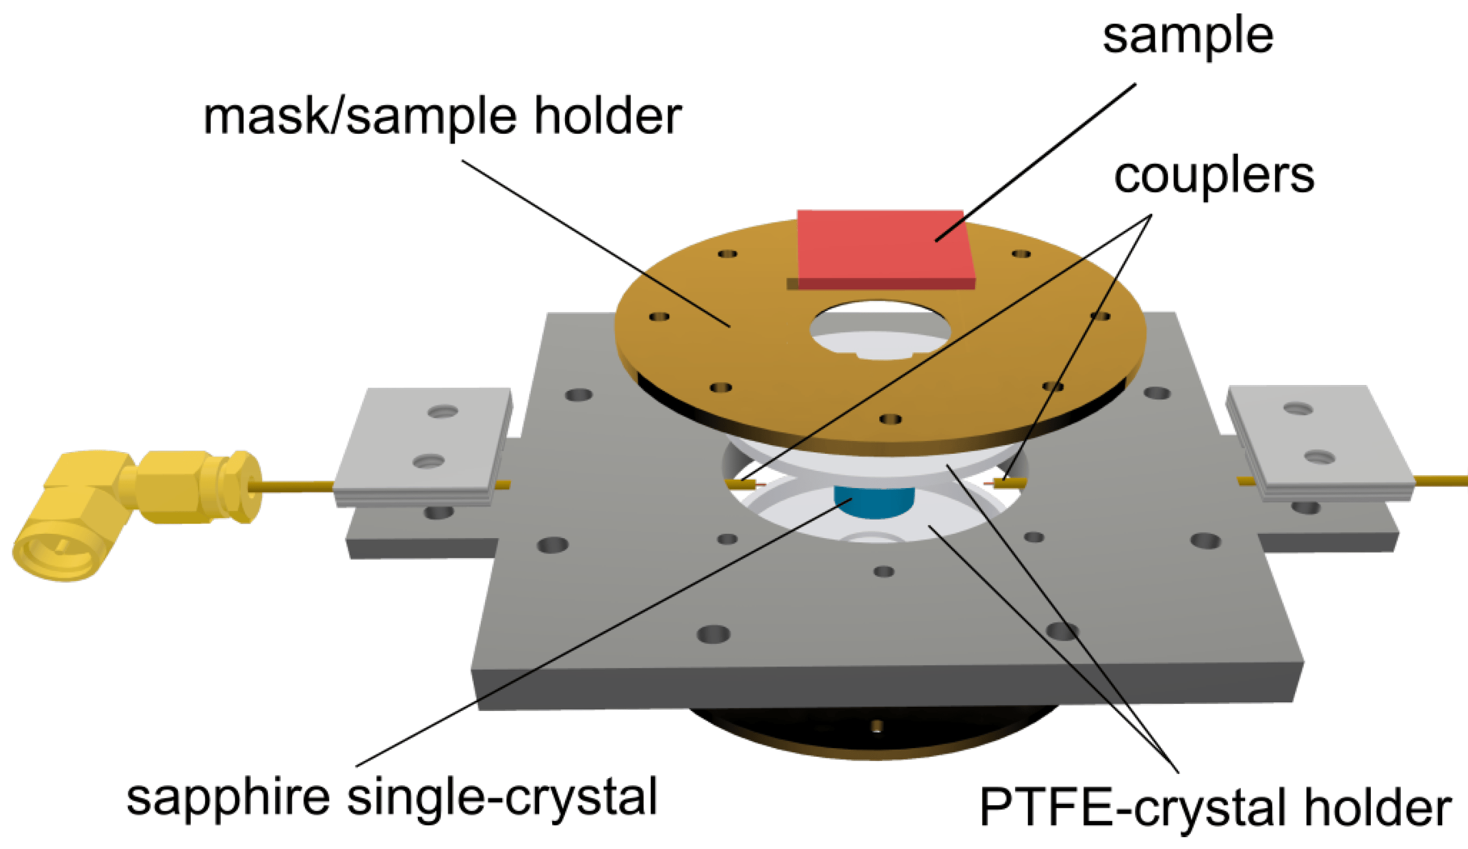
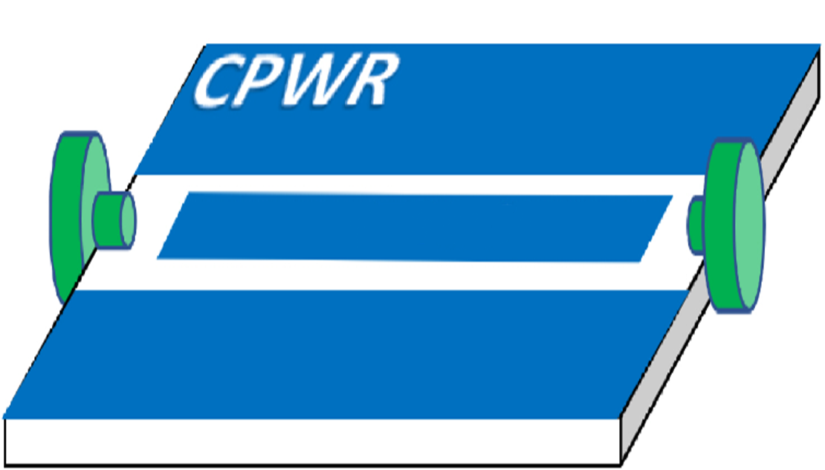
WP2 Impedance Measurements
Dielectric loaded resonators measurements
(On dielectric and metallic substrates)
Patterned coplanar waveguide resonators measurements
(Only on dielectric substrates)
A. Alimenti et al., Sensors, 2023
G. Ghigo et al., Materials, 2022
Other characterizations available: Magneto Optical Imaging, Scanning Hall Probe Magnetometry, Ion Irradiation, Multi-harmonic ac susceptibility, Inductive T_{c}, AFM, SEM, XRD
MAIN TASKS:
Vortex Modellization
Comparative assessment for SC materials for Haloscope Cavities
Open Database

Slide 20
WP3 Haloscope Cavity
WP Leader: Giovanni Maccarrone (LNF)

Slide 21


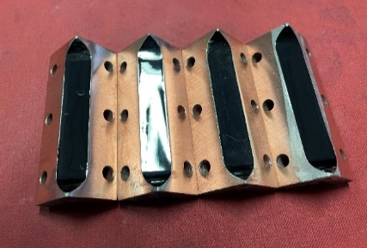

WP3 SC Haloscope Cavities
Design, modelling, building and Test Facility
Surface Preparation
SC coating Nb₃Sn and REBCO
LHe Cryostat (4 K) and Diluition Cryostat (mK)
New in SuperMAD:
10 slice cavity Test Stand
(Design, Drawing and Simulation of a Reference Cu Cavity
to test material performances on a cavity single slice)
First REBCO cavity @ LNF-ENEA

Slide 22
Scientific Impact
  New applications for SRF in high magnetic field are progressively appearing:
  Quantum Sensing Devices
  FCC-ee beam screen
  The development of superconducting materials carried out in SuperMAD is also of immediate interest for:
  SC Magnets community
  X-band accelerators

Slide 23
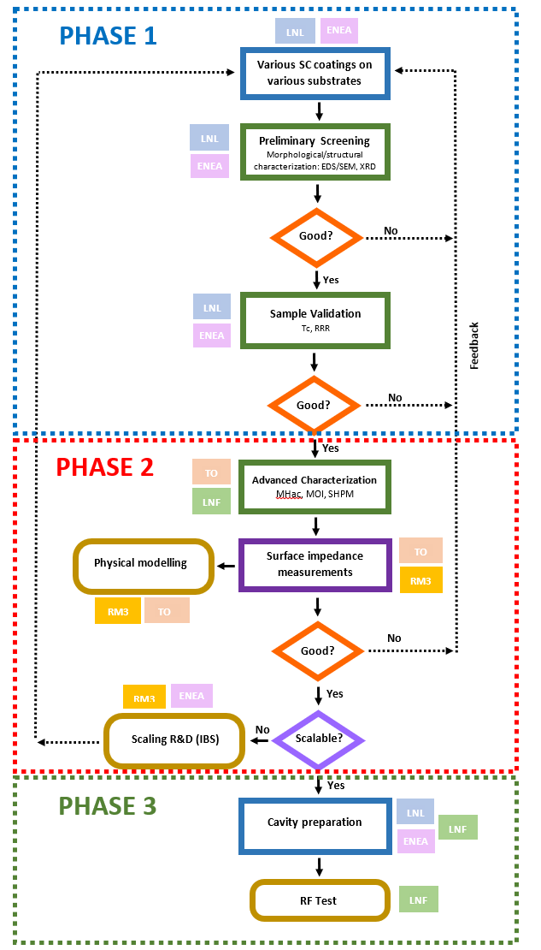
Project Organization
Project flow chart of SC materials development
Schematic project organization
WP | Task and sub-task description | Units involved
WP1 – Superconducting Materials | Task 1.1 - REBCO cladding
 | 1.1.1 Development of fixture methods (M1-M12) | LNF, ENEA, RM3
 | 1.1.2 Evaluation of REBCO exposure procedure (M2-M12) | LNF, ENEA, RM3
 | 1.1.3 Cladding of reference cavity for WP3, task 3.2 (M13-M18) | LNF, ENEA, RM3
 | 1.1.4 Optimization of cladding procedure on haloscope cavity for task 3.1 (M19-M34) | LNF, ENEA, RM3
 | 1.1.5 Planar Sample for WP2 (M3-M10) | LNF, ENEA, RM3
 | Task 1.2 - Nb3Sn coatings optimization
 | 1.2.1 Development of Pulsed Deposition (M1-M24) | LNL
 | 1.2.2 Planar Sample Coating for WP2 (M6-M22) | LNL
 | 1.2.3 Coating for reference cavity (WP3) (M23-M26) | LNL
 | 1.2.4 Cavity Coating for WP3 (M27-M29) | LNL
 | Task 1.3 – Iron Based SC
 | 1.3.1 Development of Fe(Se,Te) tape (M1-M12) | RM3, ENEA
 | 1.3.2 Development of Fe(Se,Te) tape: large area deposition (M13-M36) | RM3, ENEA
 | 1.3.3 Electrodeposition of FeSe films (M9-M36) | RM3, ENEA
 | 1.3.4 Planar Sample Fe(Se,Te) for WP2 (M13-M24) | RM3, ENEA
 | 1.3.5 Planar Sample FeSe for WP2 (M22-M36) | RM3, ENEA
WP2: Vortex dynamics studies | Task 2.1 Surface impedance and other measurements
 | 2.1.1 Z_{s}, MOI, SHPM characterizations of optimized Nb₃Sn films (M7-M24) | RM3, TO
 | 2.1.2 Z_{s}, MOI, SHPM characterizations of REBCO planar films on metal substrates (M3-M12) | RM3, TO
 | 2.1.3 Z_{s}, MOI, SHPM characterizations of Fe(Se,Te) films (M14-M24) | RM3, TO
 | 2.1.4 Z_{s}, MOI, SHPM characterizations of FeSe films (M23-M36) | RM3, TO
 | 2.1.5 Study of the effects of artificial defects introduced via ion irradiation (M10-M36) | RM3, TO
 | Task 2.2 Physical modelling
 | 2.2.1 Assessment of the applicability of the existing mean field models (M9-M24) | RM3, TO
 | 2.2.2 Identification of the pinning regimes and their correlation with the microstructure (M17-M36) | RM3, TO
 | 2.2.3 Modelization and investigation of vortex motion in the nominally zero Lorentz force configuration (with results from task 3.2) (M17-M36) | RM3, TO
 | Task 2.3 Surface Impedance Measurements Database feasibility study
 | 2.3.1 Surface Impedance Measurements Database feasibility study (M12-M24) | RM3, LNL, TO
WP3: Haloscope Cavity | Task 3.1 Haloscope Cavity
 | 3.1.1 RF design and test in static high magnetic field and low Temperature of cavity built using different SC materials: Nb3Sn, Cu-REBCO (M21-M36) | LNF
 | 3.1.2 Design and Construction of REBCO cavity (M13-M24) | LNF, ENEA
 | 3.1.3 Chemical/electrochemical Polishing of cavity substrates (M24-M26) | LNL
 | Task 3.2 Reference Cavity
 | 3.2.1 Design and simulation of Cu 10 slices reference cavity at 8.5 GHz (M1-M3) | LNF
 | 3.2.2 Construction of Cu 10 slices reference cavity at 8.5 GHz (M4-M10) | LNF
 | 3.2.3 Test RF with Different Materials (M13-M36) | LNF
 | Task 3.3 FLASH cavity SC Upgrade
 | 3.3.1 Design study of large 100 MHz SC cavity suitable for Flash experiment (M1-M12) | LNL, LNF

Slide 24
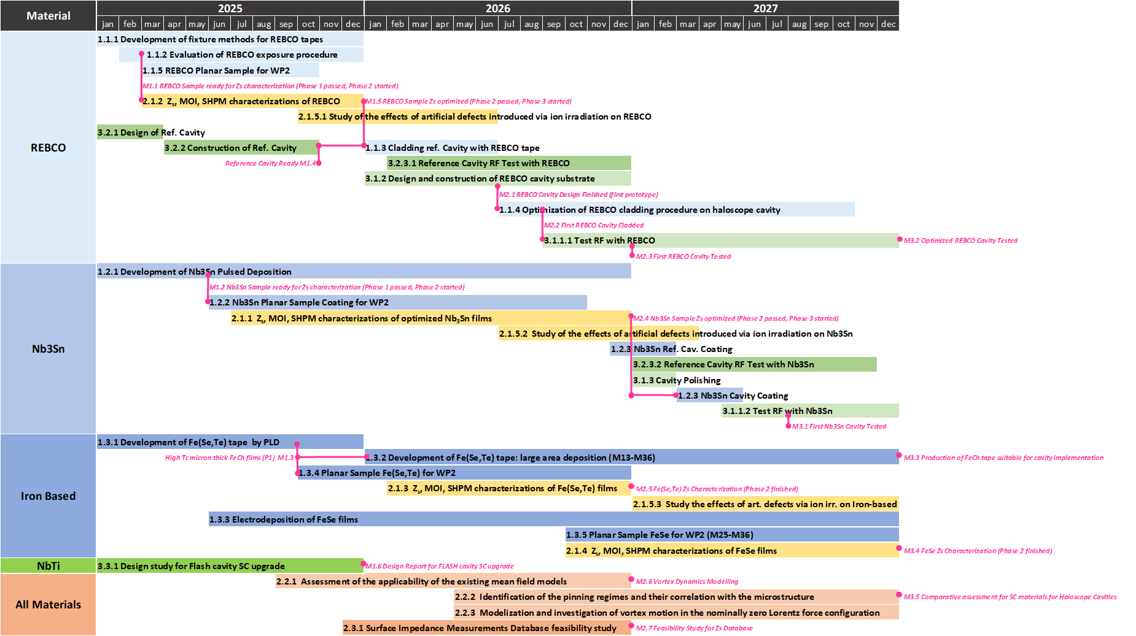
GANTT of the Proposal

Slide 25
Milestones
YEAR 1
M1.1 REBCO Sample ready for Z_{s} characterization (Phase 1 passed, Phase 2 started) [WP1, LNF-ENEA, Month 2]
M1.2 Nb3Sn Sample ready for Z_{s} characterization (Phase 1 passed, Phase 2 started) [WP1, LNL, Month 5]
M1.3 High T_{c} micron thick FeCh films (Phase 1 passed, Phase 2 started) [WP1, RM3-ENEA, Month 9]
M1.4 Reference Cavity Ready [WP3, RM3-ENEA, Month 10]
M1.5 REBCO Sample Z_{s} optimized (Phase 2 passed, Phase 3 started) [WP2, RM3-TO, Month 12]
M1.6 Design Report for FLASH cavity SC upgrade [WP3, LNL-LNF, Month 12]
YEAR 2
M2.1 REBCO Cavity Design Finished (first prototype) [WP3, LNF, Month 18]
M2.2 First REBCO Cavity Cladded [WP1, LNF-ENEA, Month 20]
M2.3 First REBCO Cavity Tested [WP3, LNF, Month 24]
M2.4 Nb₃Sn Sample Z_{s} optimized (Phase 2 passed, Phase 3 started) [WP2, RM3-TO, Month 24]
M2.5 Fe(Se,Te) Z_{s} Characterization (Phase 2 finished) [WP2, RM3-TO, Month 24]
M2.6 Vortex Dynamics Modelling [WP2, RM3-TO, Month 24]
M2.7 Feasibility Study for Z_{s} Database [WP2, RM3-TO, Month 24]
YEAR 3
M3.1 First Nb₃Sn Cavity Tested [WP3, LNF, Month 31]
M3.2 Optimized REBCO Cavity Tested [WP3, LNF, Month 36]
M3.3 Production of FeCh tape suitable for resonant cavity implementation [WP1, LNF-ENEA, Month 36]
M3.4 FeSe Z_{s} Characterization (Phase 2 finished) [WP2, RM3-TO, Month 36]
M3.5 Comparative assessment for SC materials for Haloscope Cavities [WP2, RM3-TO-LNL-LNF, Month 36]

Slide 26
Risk Mitigation Year 1
(Risk level: 1=low, 2=medium, 3=high)
MILESTONE | DESCRIPTION | BLOCKING | RISK | RISK MITIGATION
M1.1 | REBCO Sample ready for Zs characterization | Yes, for task 2.1.2 | 1 | Postpone task 2.1.2, switch with task 2.1.1 or 2.1.3. Bad scenario: use REBCO characterization time and resources for extra-characterizations of Nb3Sn and FeCh
M1.2 | Nb3Sn Sample ready for Zs characterization | Yes, for task 2.1.1 | 2 | Postpone task 2.1.1, switch with task 2.1.3. Bad scenario: use Nb3Sn characterization time and resources for extra-characterizations of REBCO and FeCh
M1.3 | High Tc micron thick FeCh films | Yes, for task 2.1.3 | 3 | Postpone task 2.1.3, switch with task 2.1.4. Bad scenario: use Fe(Se,Te) characterization time and resources for extra-characterizations of REBCO and Nb3Sn.
M1.4 | Reference Cavity Ready | Yes, for task 1.1.3 | 1 | 2 months of buffer already planned
M1.5 | REBCO Sample Zs optimized | Yes, for task 1.1.3 | 2 | Task 1.1.3 can be shifted by 5 months with a minor impact on other activities
M1.6 | Design Report for FLASH cavity SC upgrade | No | 1 | None

Slide 27
Risk Mitigation Year 2
(Risk level: 1=low, 2=medium, 3=high)
MILESTONE | DESCRIPTION | BLOCKING | RISK | RISK MITIGATION
M2.1 | REBCO Cavity Design Finished | Yes, for task 1.1.4 | 1 | Task 1.1.4 can be shifted by 2 months with a minor impact on other activities.
M2.2 | First REBCO Cavity Cladded | Yes, for task 3.1.1.1 | 2 | See M2.3 risk mitigation
M2.3 | First REBCO Cavity Tested | Yes, for Milestone M3.2 | 2 | Over a year dedicated to R&D for REBCO cavity optimization after first test
M2.4 | Nb3Sn Sample Zs optimized | Yes, for task 1.1.3 | 2 | 2 months of buffer already planned
M2.5 | Fe(Se,Te) Zs Characterization | No | 2 | M2.5 can be shifted by 12 months with a minor impact on other activities. The group at ENEA is large enough to work simultaneously on Fe(Se,Te) and FeSe
M2.6 | Vortex Dynamics Modelling | No | 3 | M2.6 can be shifted by 12 months with a minor impact on other activities
M2.7 | Feasibility Study for Zs Database | No | 1 | None

Slide 28
Risk Mitigation Year 3
(Risk level: 1=low, 2=medium, 3=high)
MILESTONE | DESCRIPTION | BLOCKING | RISK | RISK MITIGATION
M3.1 | First Nb3Sn Cavity Tested | No | 2 | 6 months of buffer already planned
M3.2 | Optimized REBCO Cavity Tested | No | 2 | Over a year dedicated to R&D for REBCO cavity optimization after first test
M3.3 | Production of FeCh tape suitable for resonant cavity implementation | No | 3 | 2 year of R&D fully dedicated to these milestone
M3.4 | FeSe Zs Characterization | No | 2 | Placed at the end of the project to increase the maturity level of the technology
M3.5 | Comparative assessment for SC materials for Haloscope Cavities | No | 1 | None

Slide 29



FTE SuperMAD
4.05 FTE
4.0 FTE
3.0 FTE + 0.4 FTE
0.5 FTE + 0.4 FTE
TOTAL 11.95 FTE

Slide 30
Budget SuperMAD
2025 Detailed Budget
General Budget
CAPITOLO | LNL | TO | RM3 | LNF
MISSIONI | 7 | 4 | 2 | 2
CONSUMO | 14.5 | 19.5 | 42 | 19
INVENTARIO | 15.5 | 9.5 | 0 | 0
SOFTWARE | 3.5 | 0 | 0 | 0
ALTRI CONS | 2 | 0 | 0 | 0
MANUTENZIONI | 2.5 | 0 | 0 | 0
TRASPORTI | 2 | 0 | 0 | 0
PUBBLICAZIONI | 0 | 3 | 0 | 0
TOTALE | 47 | 33 | 44 | 21
CAPITOLO | 2025 | 2026 | 2027
MISSIONI | 15 | 15 | 15
CONSUMO | 95 | 95 | 95
INVENTARIO | 25 | 13 | 13
SOFTWARE | 3.5 | 0 | 0
ALTRI CONS | 2 | 2 | 2
MANUTENZIONI | 2.5 | 3 | 3
TRASPORTI | 2 | 2 | 2
PUBBLICAZIONI | 3 | 0 | 0
TOTALE | 145 | 130 | 130

Slide 31
Conclusions
Experiment in continuity with SAMARA
  Collaboration well established
  Solid scientific base and interest
Important novelties:
  New external partner
  3 new materials investigated
  Cavity test bench developing
  Material Database
Strong Scientific Impact
  Results will have immediate impact for new generations Quantum Sensing Devices
  Interesting also for FCC-ee beam screen, X-band accelerators and magnet community
Possible application of the results to Large Experiments
  FLASH SC cavity Feasibility Study in the first year of SuperMAD

Slide 32
Trieste, CSN5 Meeting
9-9-2024
Thank you!
cristian.pira@lnl.infn.it

