Slide 1
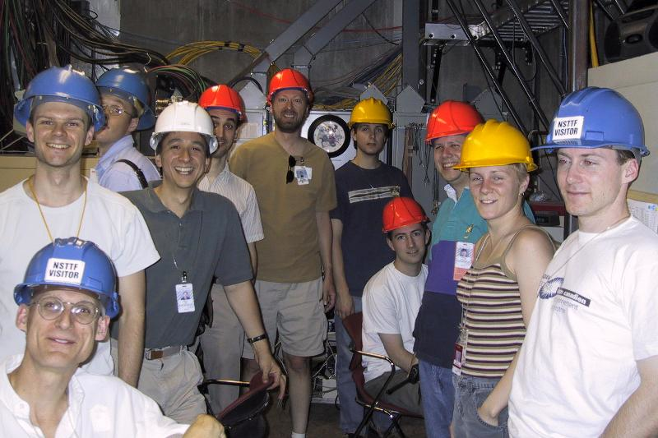
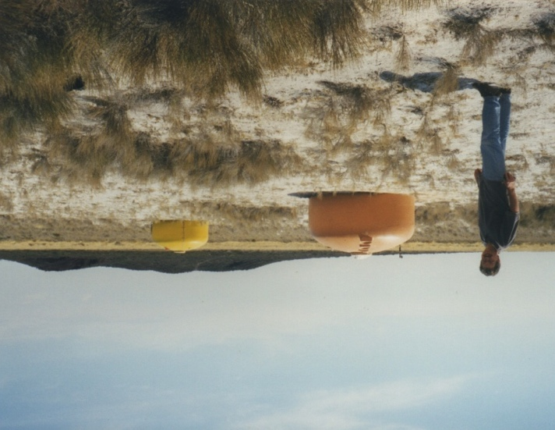
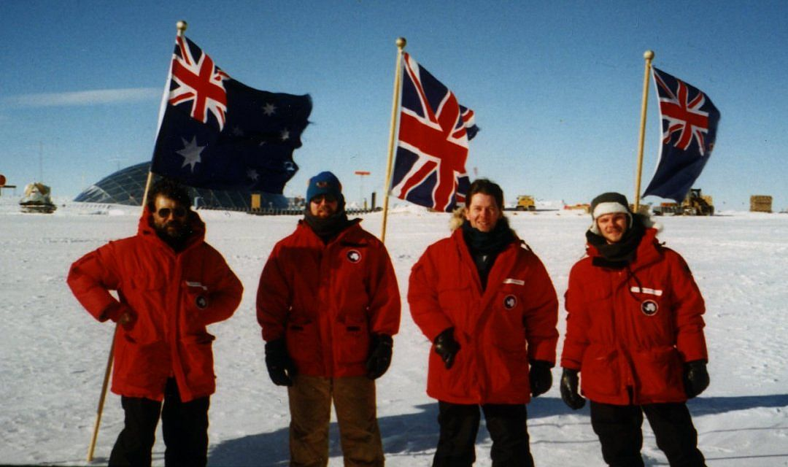
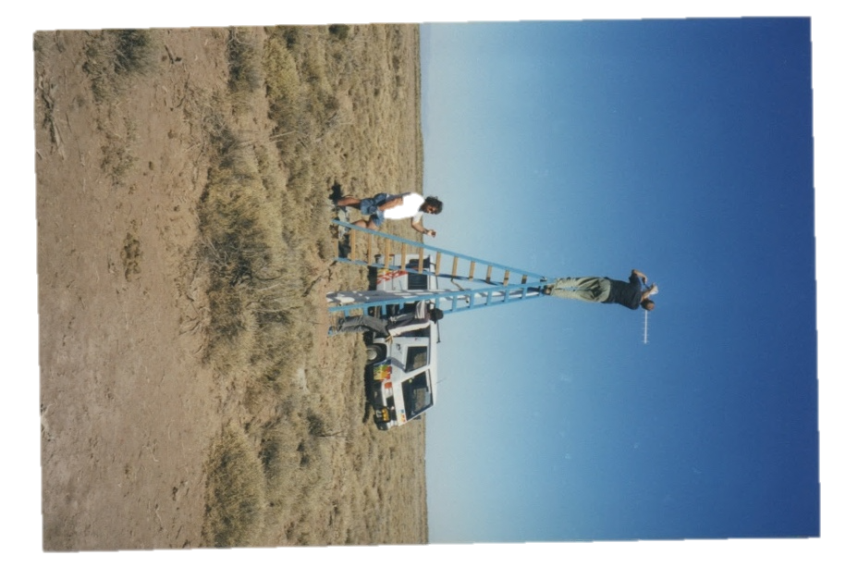
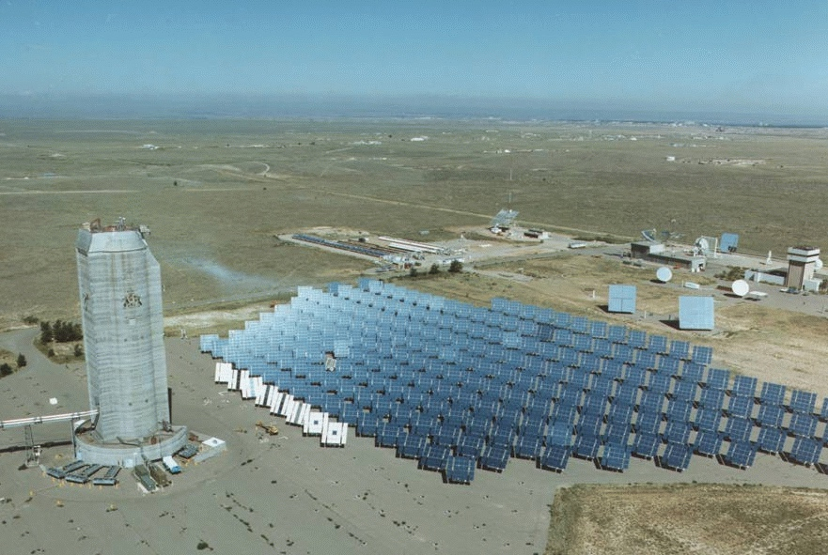

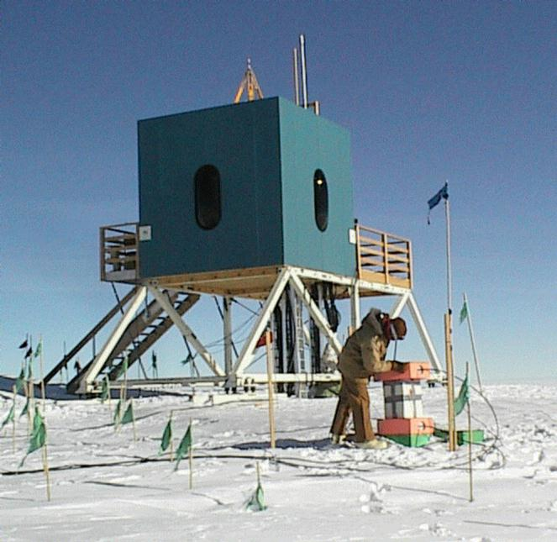
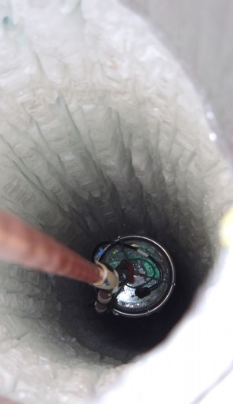
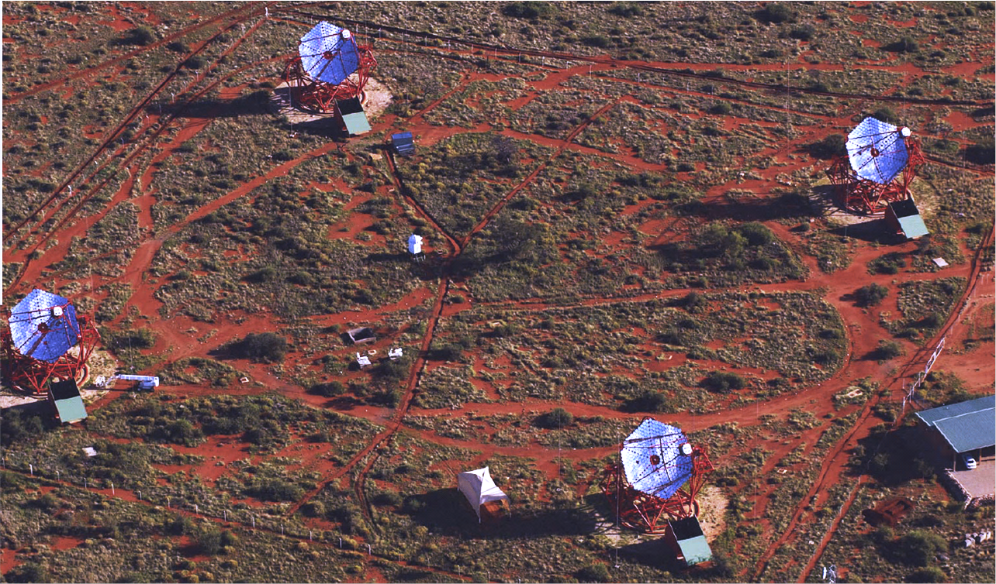
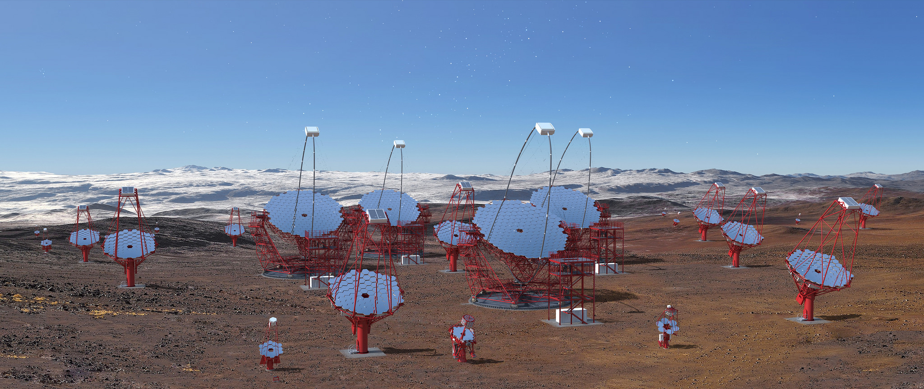
My Background

Slide 2
My Background
Jim

Slide 3
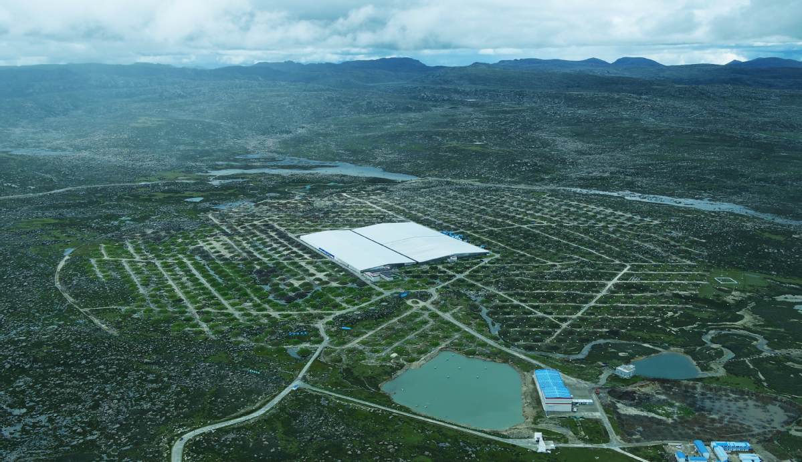
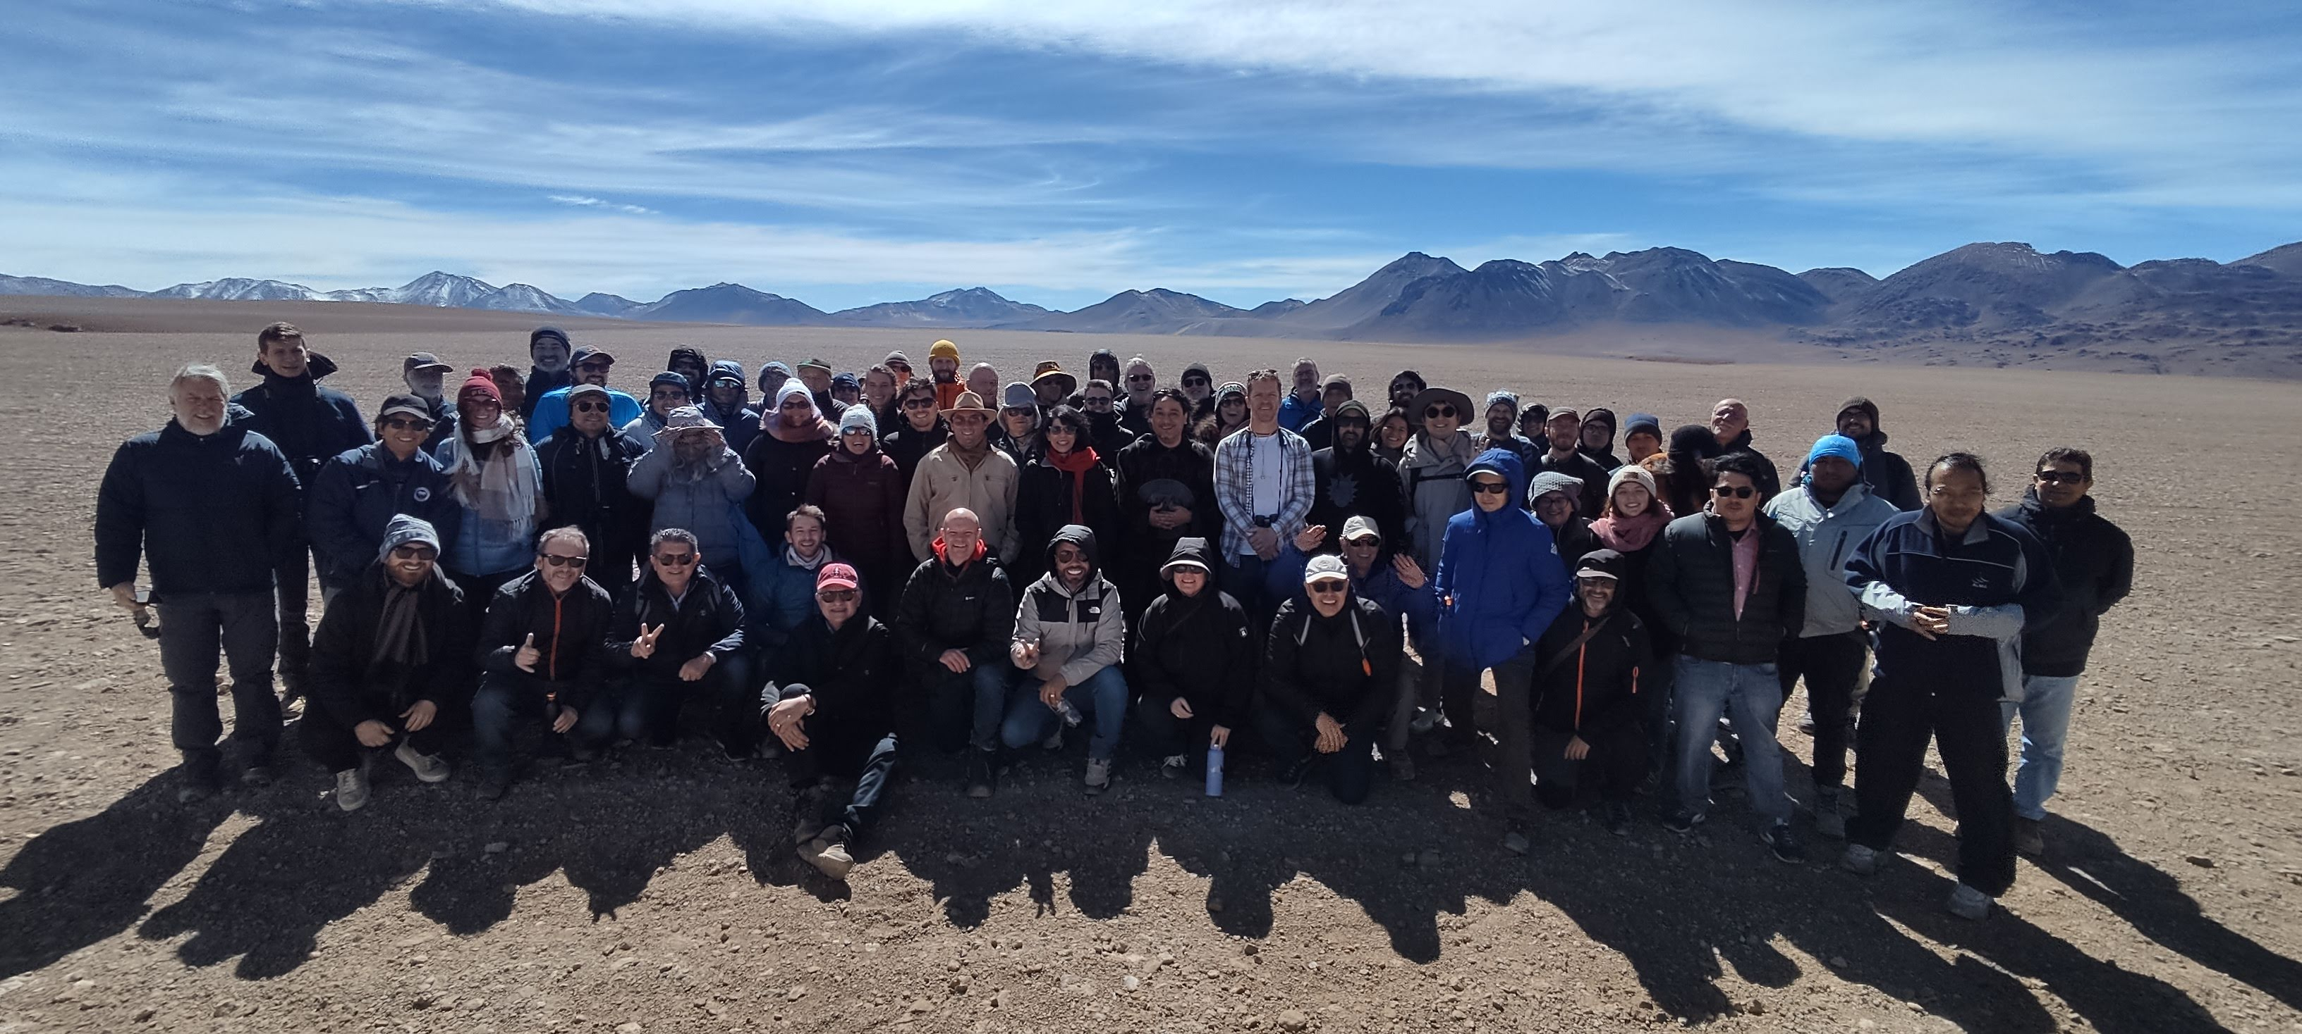


Extensive Air Shower Detector Science objectives and current status.
Observation of the Gamma Ray Sky from the ground:
the Air Shower array technique
Jim Hinton
1st July 2025

Slide 4
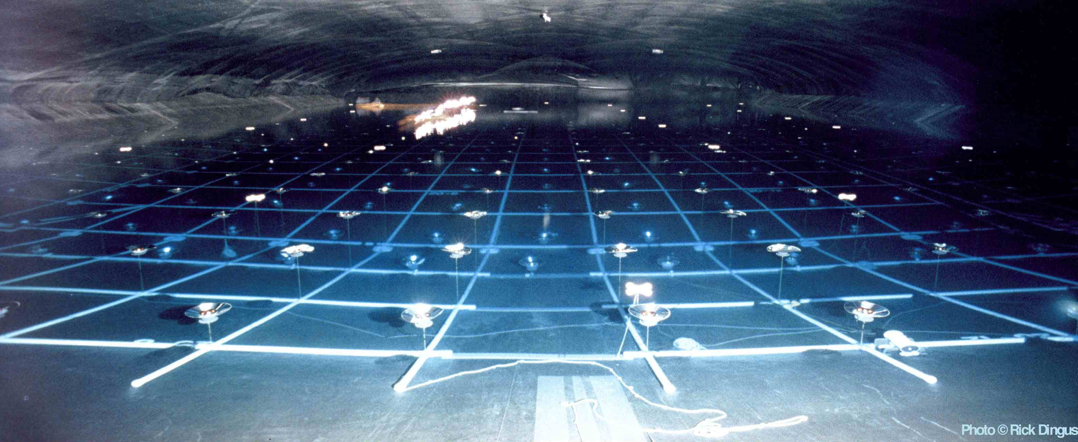
Shower Particle Detection
1 TeV γ-ray
Particle
Shower
Air-shower...
~ 120 m

Slide 5
Shower Particle Detection
1 TeV γ-ray
1st Interaction:
X₀ ~ 40 g/cm²
λ_{pair} = 9/7 X₀ ~ 50 g/cm²
X = X_{A} e ^{–h/h0} and X_{A}~10³ g/cm²
h_{pair} = h₀ ln(X_{A}/λ_{pair}) ☛ 20 km
Cascade:
For E=1 TeV (E_{C} ~ 80 MeV)
X_{max} ~ X₀ ln ( E/E_{C} ) / ln 2
h_{max} = h₀ ln(X_{A}/X_{max}) ☛ 5 km
Particle
Shower
~4 km
Need to be within a few X₀ of X_{max}
to detect particles directly
☛ typically >3 km alt.
Air-shower...
~ 120 m
Field of view 1-2 sr
100% Duty Cycle

Slide 6
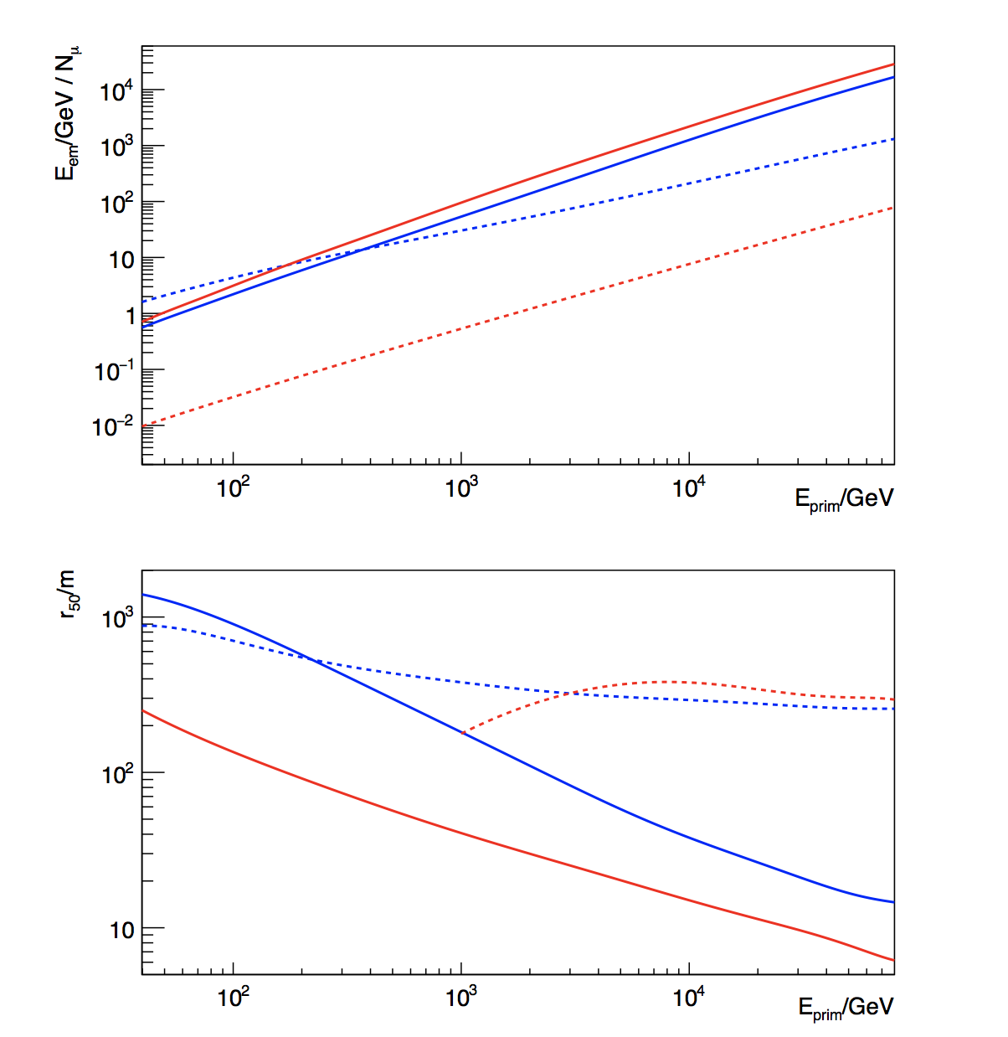
Ground-level Particles
Electromagnetic Energy
Gamma and proton initiated showers at 5km altitude
1 TeV gamma-ray brings 100 GeV of energy to the ground
  Typical electron energy ~10 MeV
1 TeV proton on average 50 GeV EM + 30 muons
  Typical energy of muons ~few GeV, with much bigger spread on ground
Number of muons
50% Encircled Energy Radius
Muons
EM

Slide 7
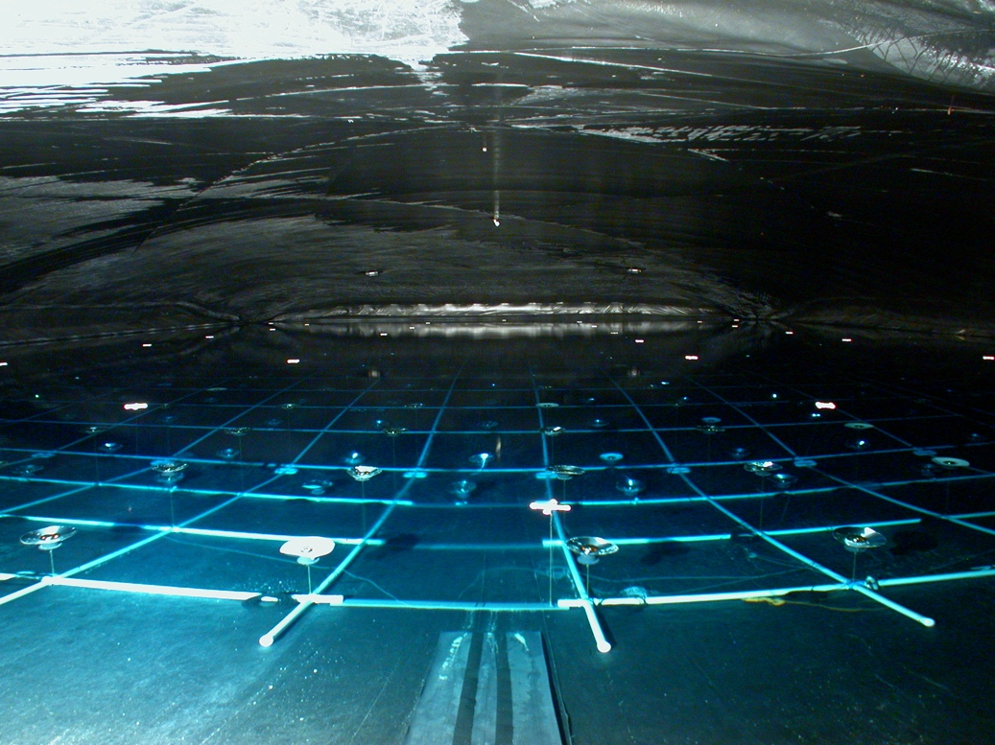
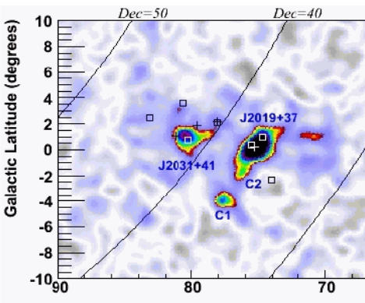
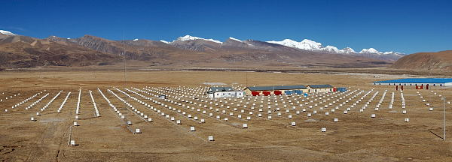
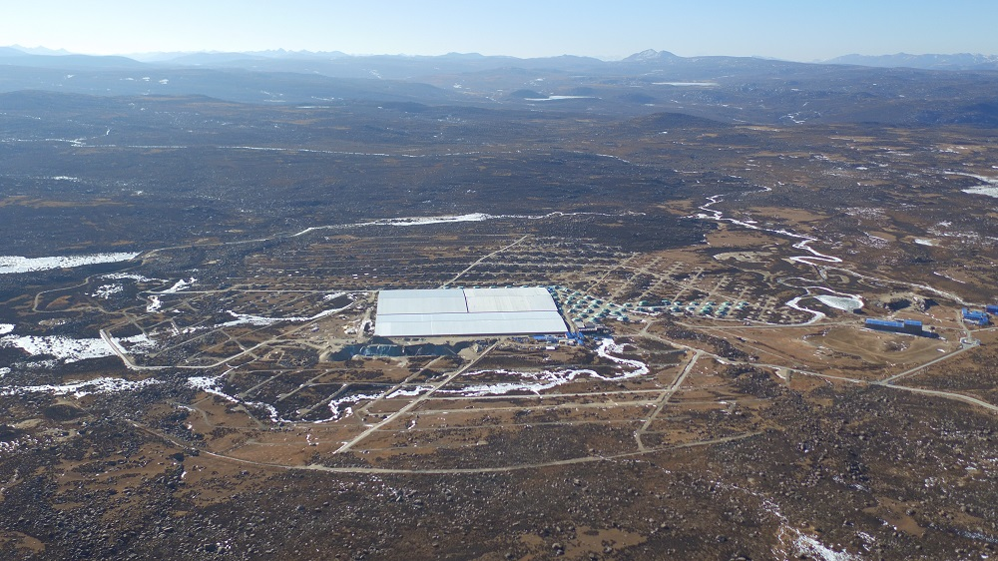
Ground-particle Detectors
MILAGRO: Cygnus Region
MILAGRO
MILAGRO – 2001-2008
HAWC – 2015 -
Tibet AS γ +ARGO – 1990s -
LHAASO – 2021 -
SWGO – 202X -
2.5 km
4.1 km
4.3 km
Tibet
4.4 km
4.8 km
Drivers of performance:
size, fill factor and altitude (move detector up to shower max)
Increase altitude: MILAGRO → HAWC → SWGO
Increase also fill-factor and size: Tibet → LHAASO & SWGO
LHAASO
+ muon detection

Slide 8
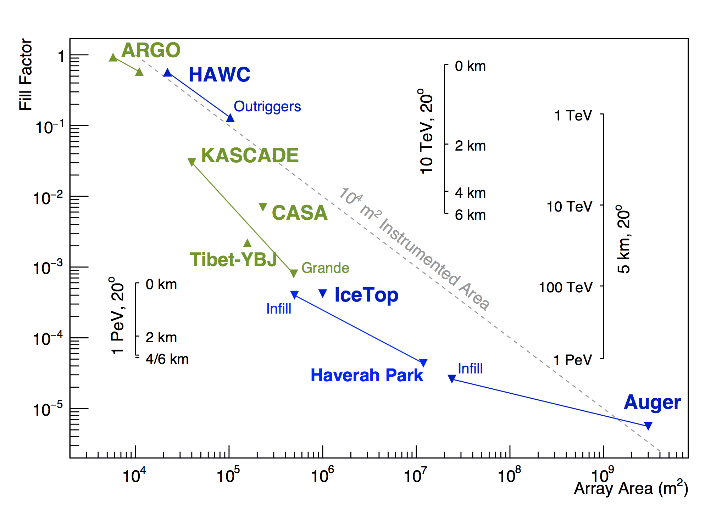
Total detector area
Higher Energies
Blue: Water Cherenkov Dets
Green: Other

Slide 9
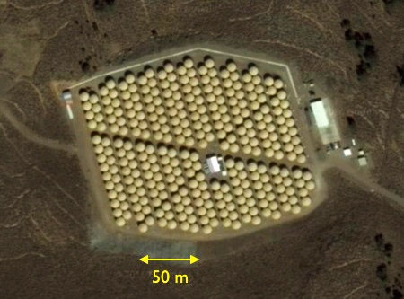
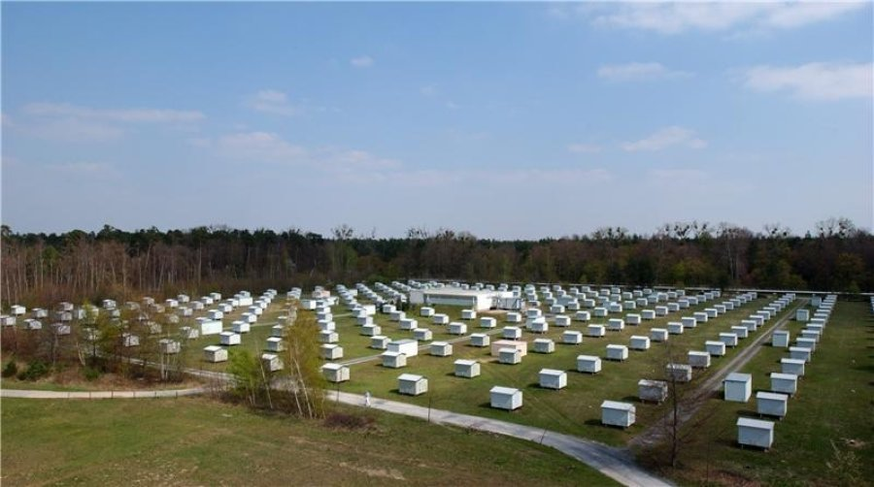
  2 x 10⁴ m²
  ~60% coverage
  4.1 km a.s.l.
  ~500 GeV threshold
▲ >3 km altitude
▾<3 km altitude
  4 x 10⁴ m²
  ~2% coverage
  100 m a.s.l.
  ~100 TeV threshold

Slide 10
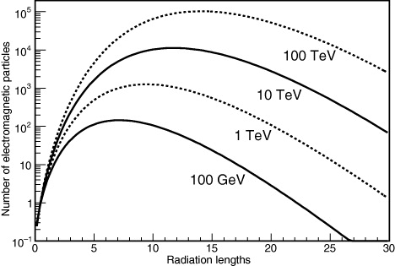
  2 x 10⁴ m²
  ~60% coverage
  4.1 km a.s.l.
  ~500 GeV threshold
▲ >3 km altitude
▾<3 km altitude
Exposure:
5 km² × 50 hours ~
2x10⁴ m² × 1 year
5 km² × 50 hours ~
2x10⁴ m² × 1 year
  4 x 10⁴ m²
  ~2% coverage
  100 m a.s.l.
  ~100 TeV threshold
Sinnis 2009

Slide 11

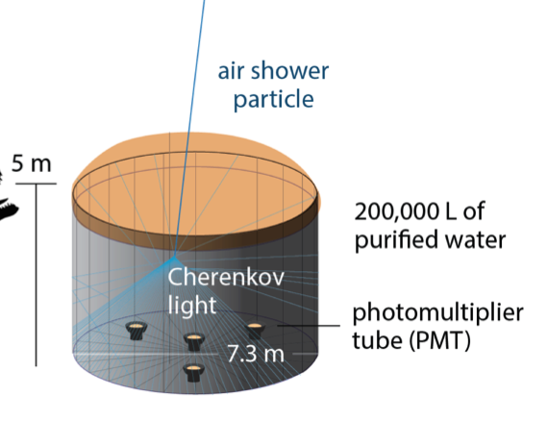
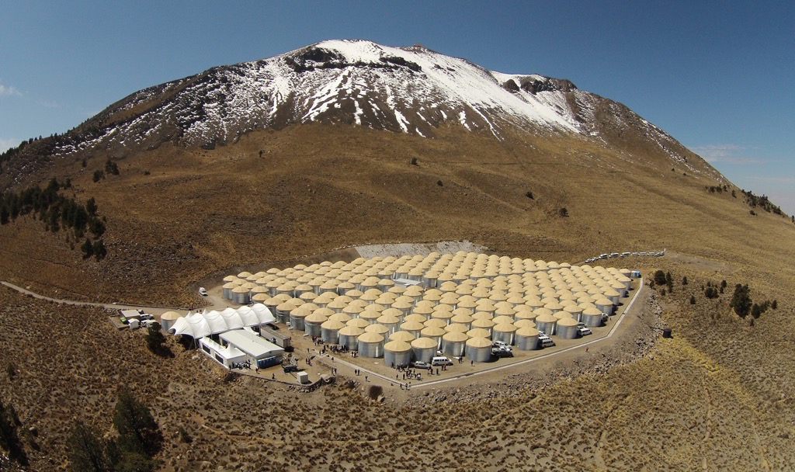
Pico de Orizaba (5636 m)
300 Detectors, 95% uptime since 2015, Area 22000m²
HAWC
(4100 m)

Slide 12
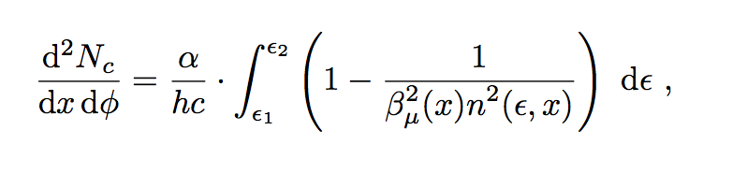
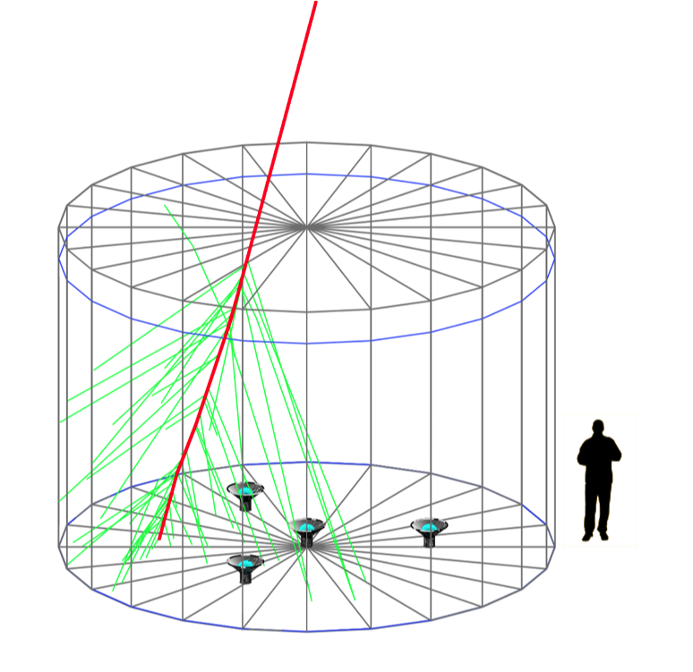
Detectors
5m tank → 12 radiation lengths (X₀ ~ 40 g/cm²)
  Gamma conversion
  EM showers near top of tank except for highest energy shower particles
Muons
  Pass through without interaction – long path length
Cherenkov light
  Angle: acos (1/n) ~ 41º
  Yield: (Δhν)2πα(1-1/n²)/hc → 300 photons / cm
0.01% photosensitive area
5m deep, 7.3 m diameter

Slide 13
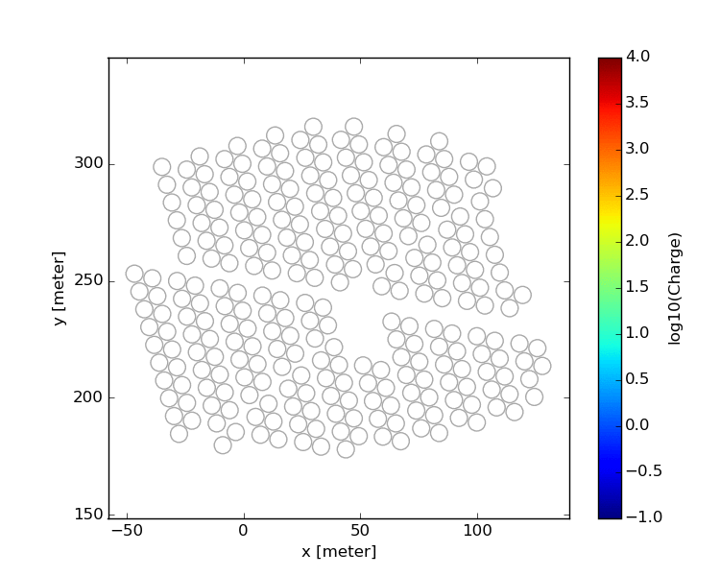
Events
Direction from arrival times
  time resolution ~ns over 100 m lever-arm → angular resolution ~(1 ns * c / 100 m) rad ~ 0.2º
Energy?
  More tricky – can measure ground-level size but big fluctuations doing to X_{max} differences / shower development
Hadron Rejection?

Slide 14
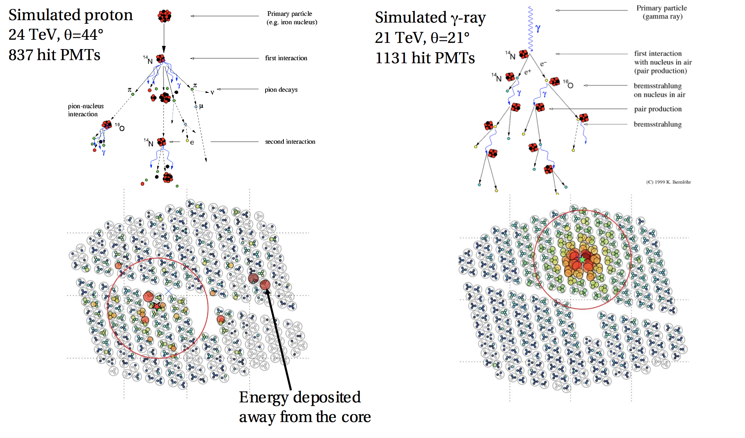
Gamma/Hadron Separation

Slide 15
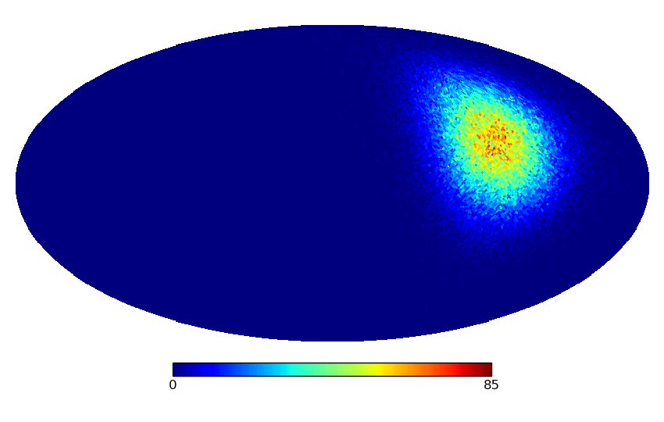
HAWC Events RA/Dec.
Typical IACT
Field of view
Notes:
This movie shows you the directions in right ascension and declination of events detected with HAWC, as a function of time – illustrate the large instantaneous field of view and the way in which over a sidereal day a large part of the sky can be observed. In contrast the few degree field of the imaging Cherenkov telescopes looks tiny, but of course they can point whereever they like

Slide 16
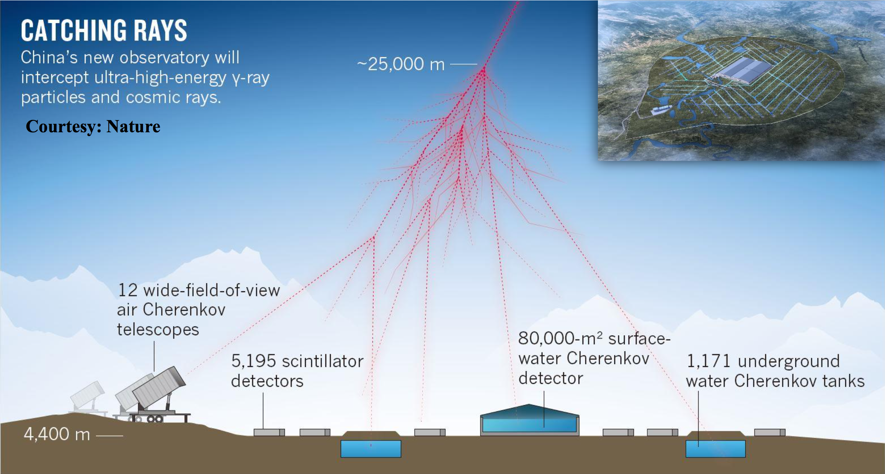
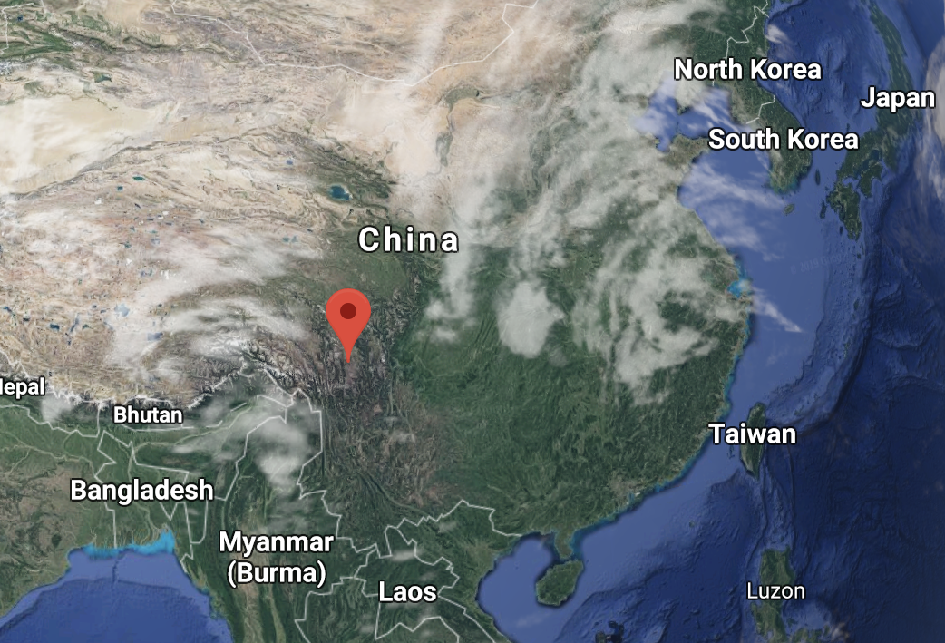
LHAASO
4.3 km altitude

Slide 17
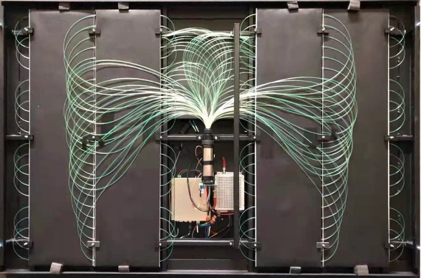
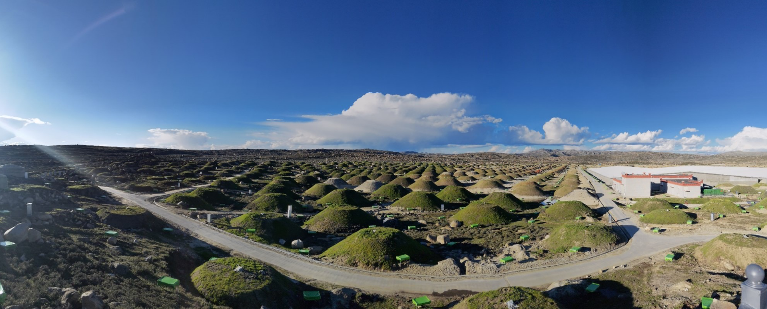
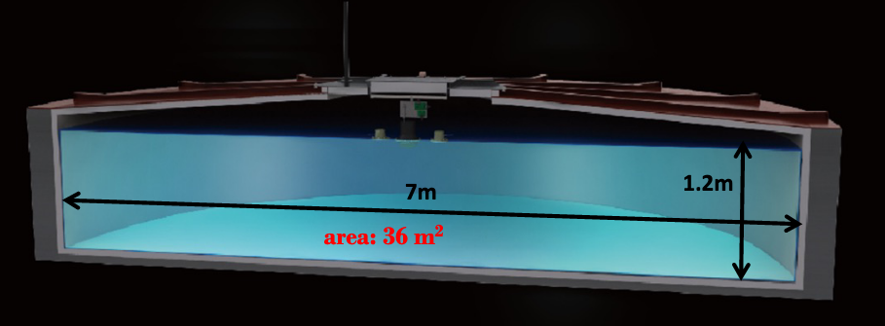
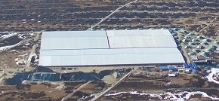
LHAASO
1 m² ED
Green Boxes Below
Completed 2021
  KM2A
    ED scintillators, MD buried muon dets
36 m² MD
3120x 25 m² WCD

Slide 18
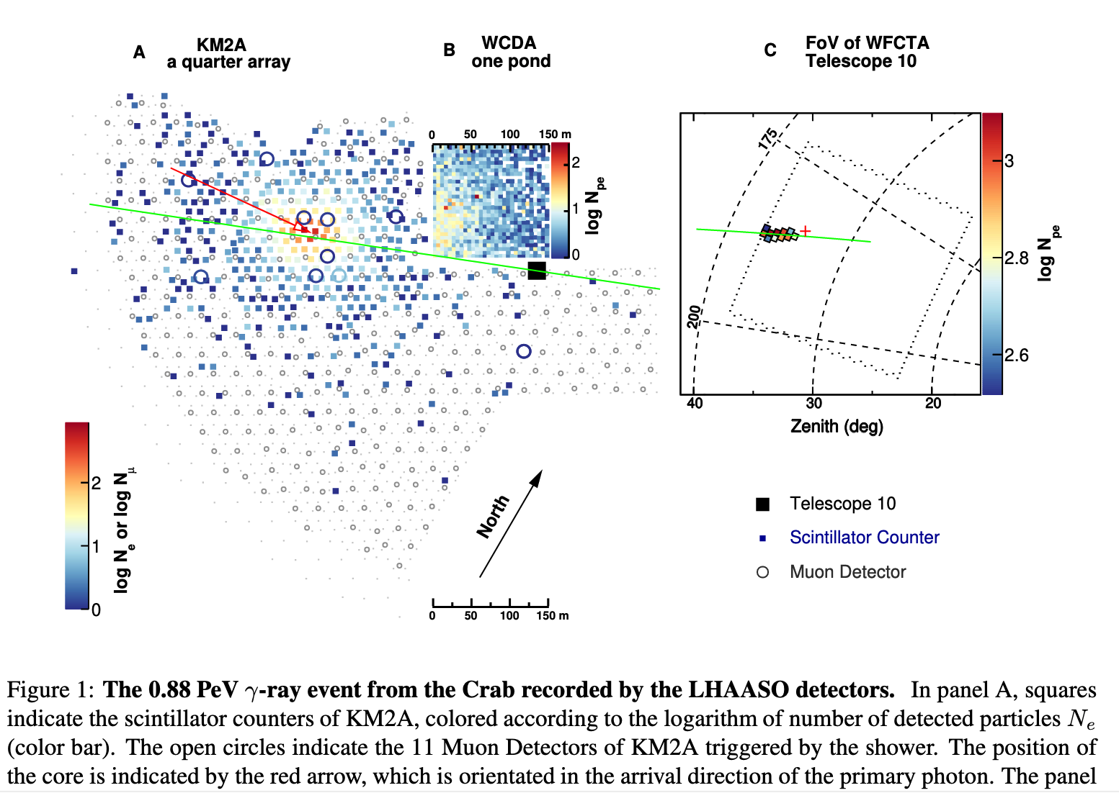
Cao 2022 – Science - arXiv 111.06545

Slide 19
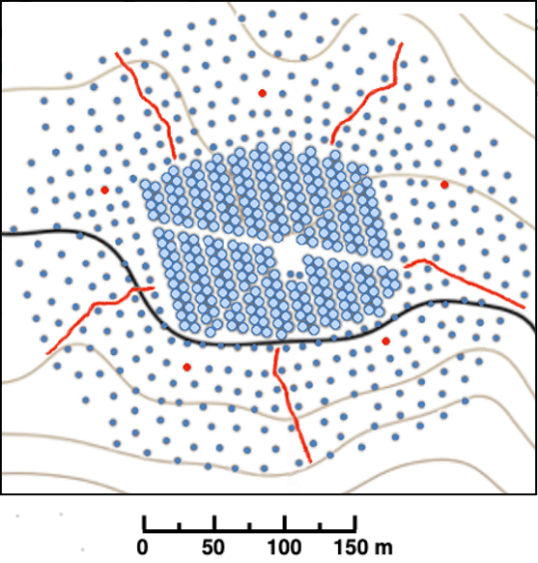
Cao 2022 – Science - arXiv 111.06545
HAWC

Slide 20
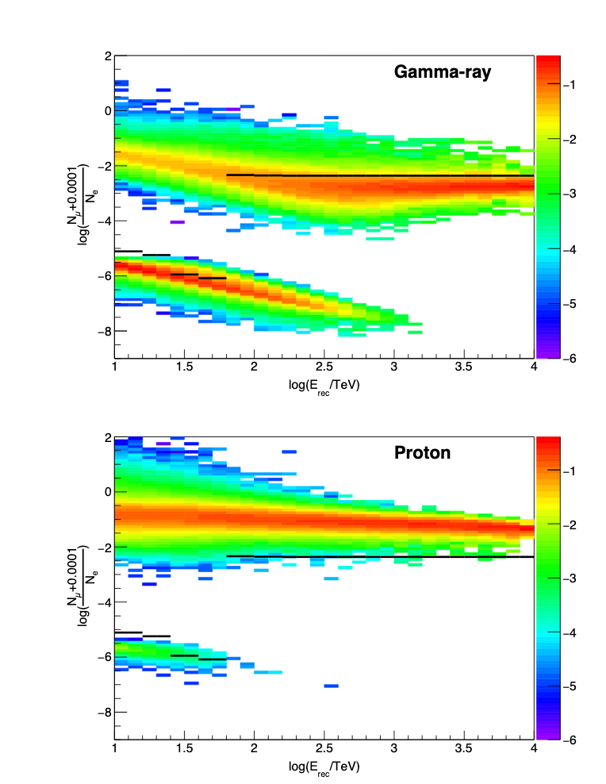
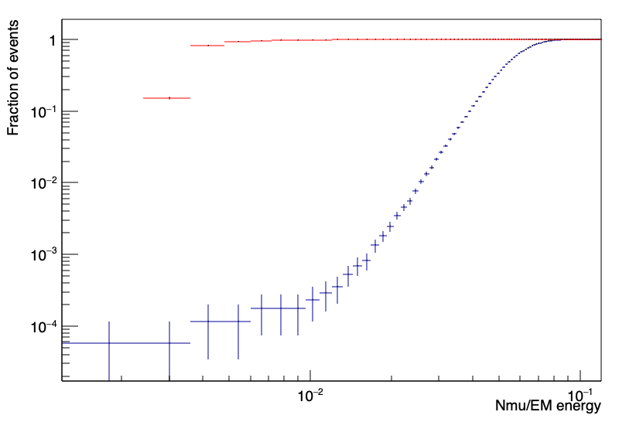
Muon Counting
At 1 PeV
Proton mode
gammas
1 PeV
protons
Zero muons
~80% gammas
10⁴ rejection
Cut factor 15-20 below mean
Jim
1 PeV
Zero muons
LHAASO

Slide 21
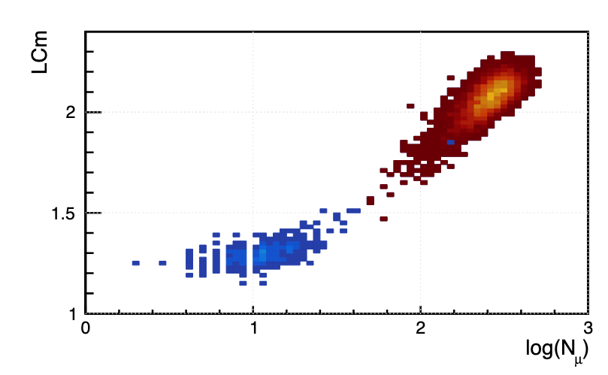
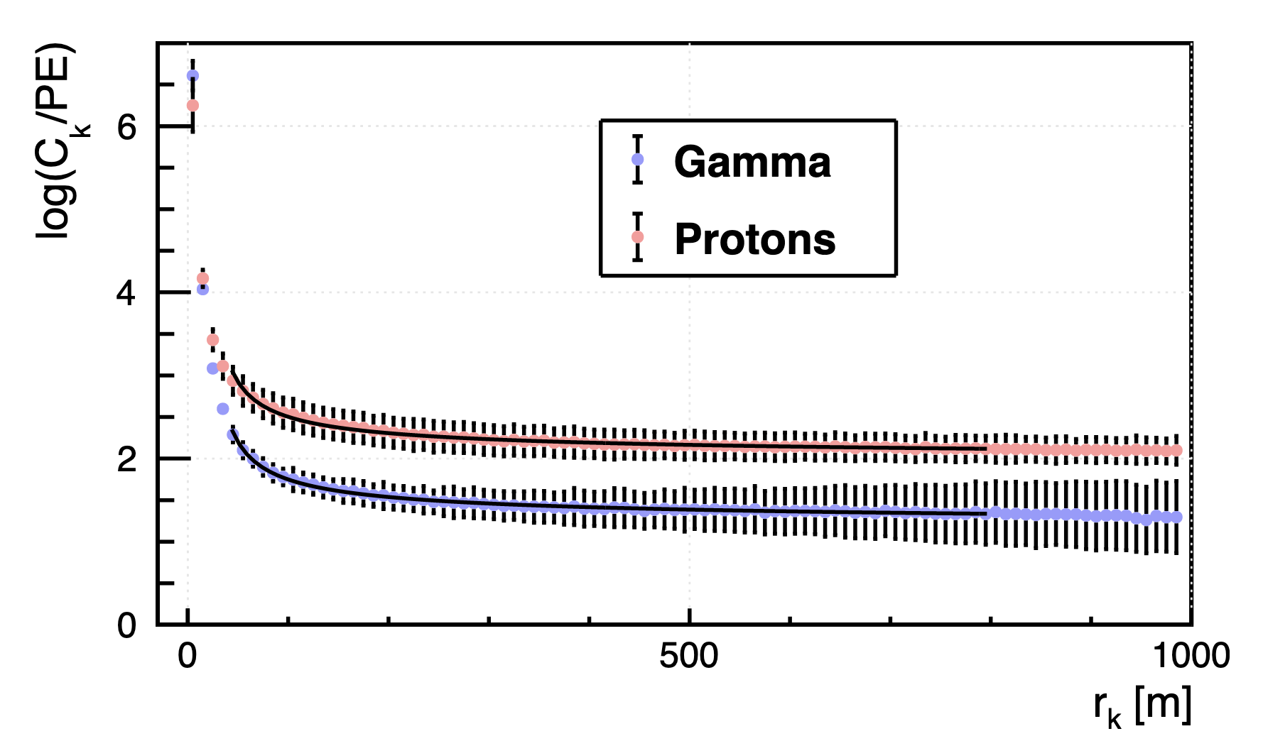
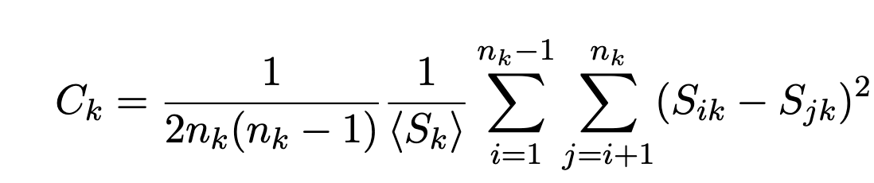
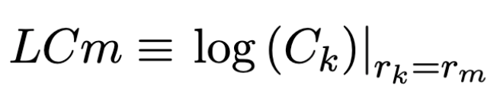
EM Fluctuations
Conceição et al arXiv 2204.12337
Protons
Gammas
LDF, sub-structure, azimuthal asymmetry
  Sub-showers in hadronic showers produce additional fluctuations, closely correlated with muon number – tail of very gamma-like protons

Slide 22
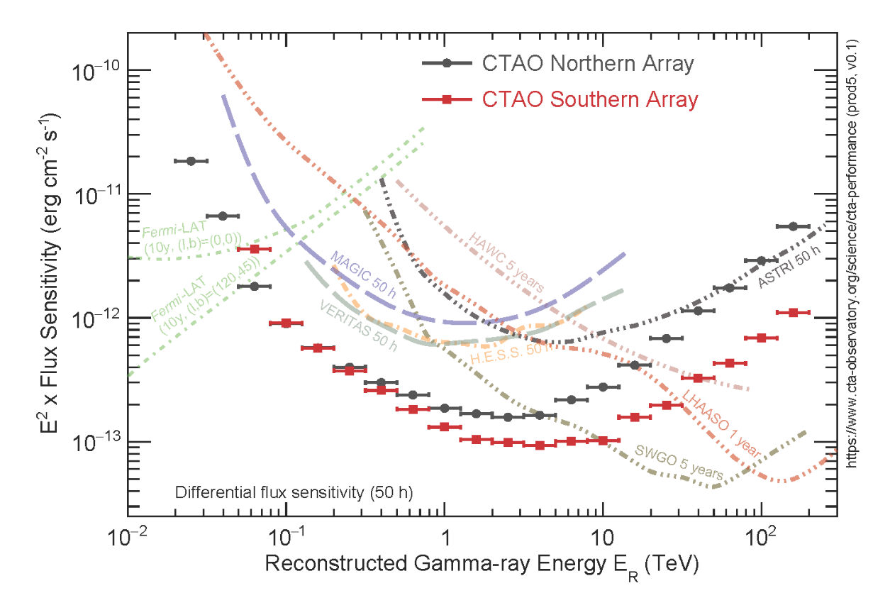
Sensitivity?
Point-like sources
50 hours
IACT Array
HESS-MAGIC-VERITAS
NSB Wall
Signal Limited
Background Limited

Slide 23
Sensitivity?
Current
IACTs
Fermi
WCD
HAWC 5y
KM2A
LHAASO 1y

Slide 24
Sensitivity?
IACTs Dominate
IACTs for resolution
Current
IACTs
Fermi
WCD
HAWC 5y
IACTs for variable emission
KM2A
LHAASO 1y

Slide 25
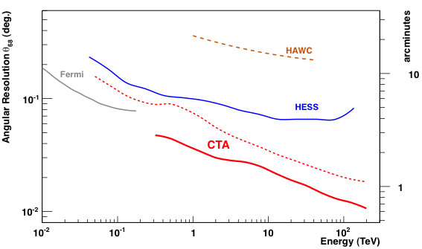
Resolution?
LHAASO KM2A
Current IACTs
o
Current WCDs
Fill factor is critical for resolution
LHAASO scintillators <1%
Very far from fundamental limits for both IACTs and ground particle arrays:
Huge scientific potential

Slide 26
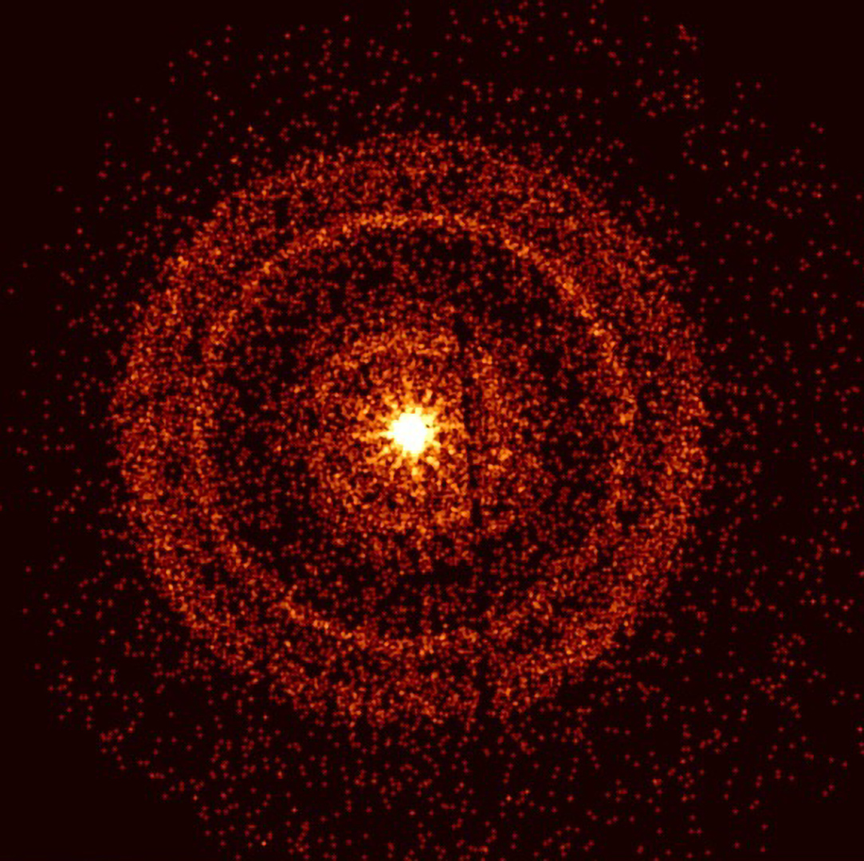
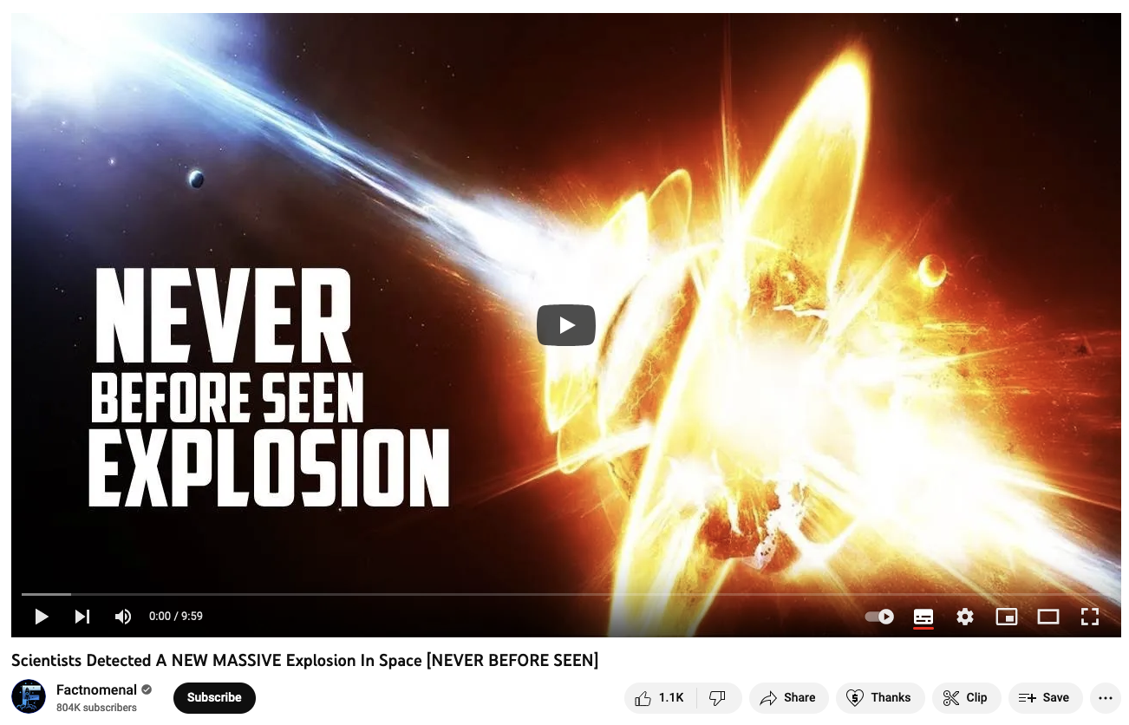
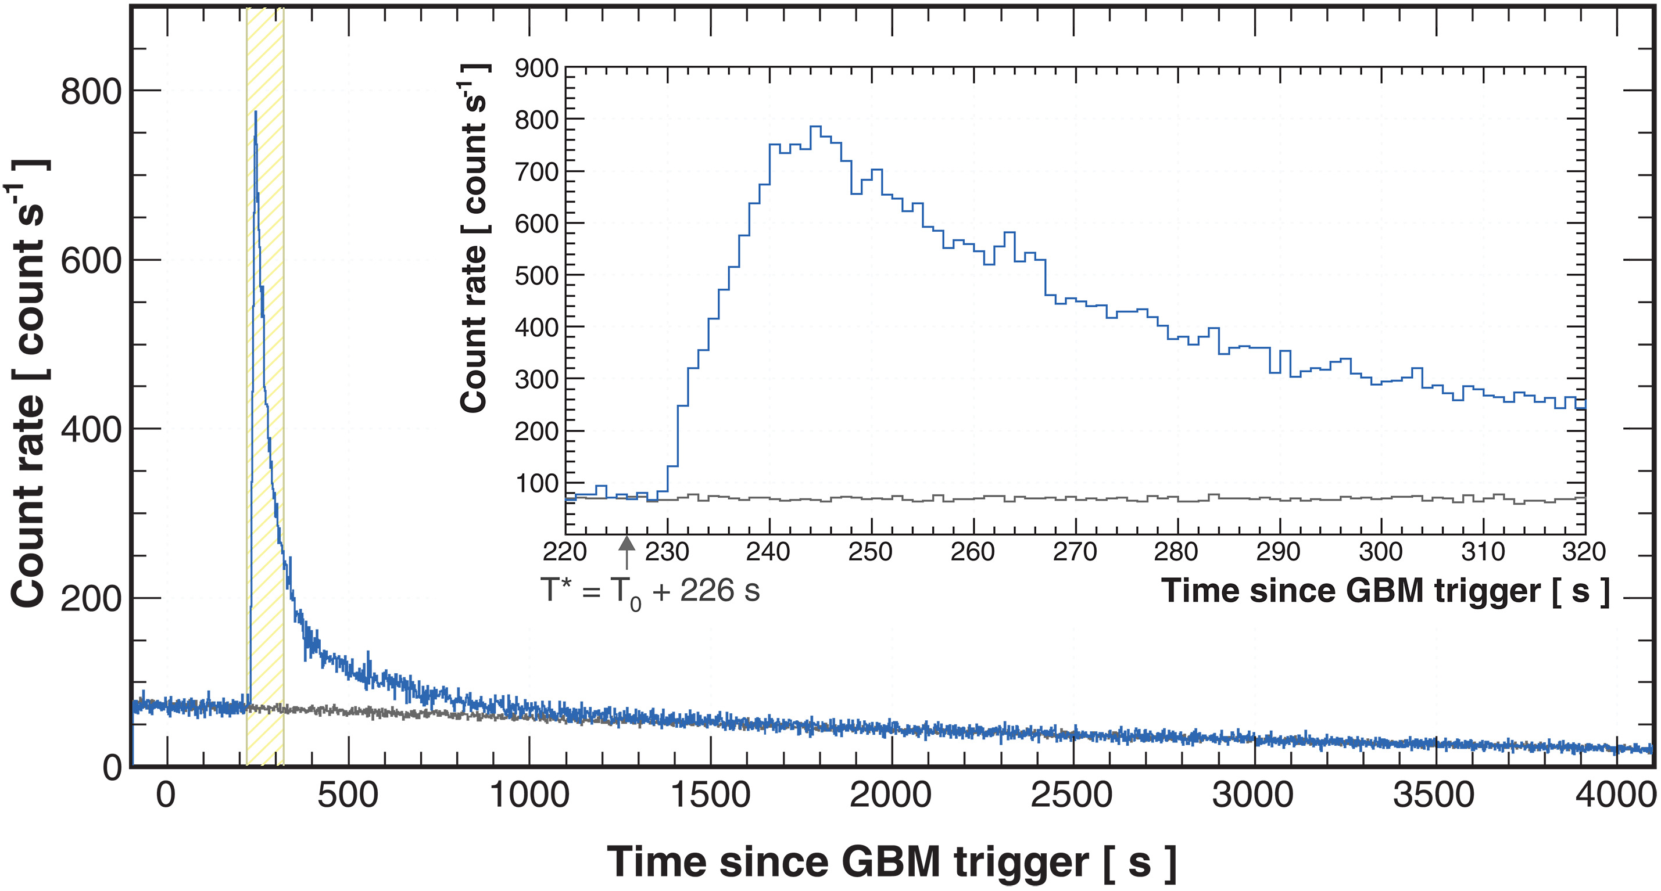
Discoveries?
e.g. GRB 221009A
Cao et al, Science 2023
z = 0.1505, photons up to (reconstructed) energy of 18 TeV

Slide 27
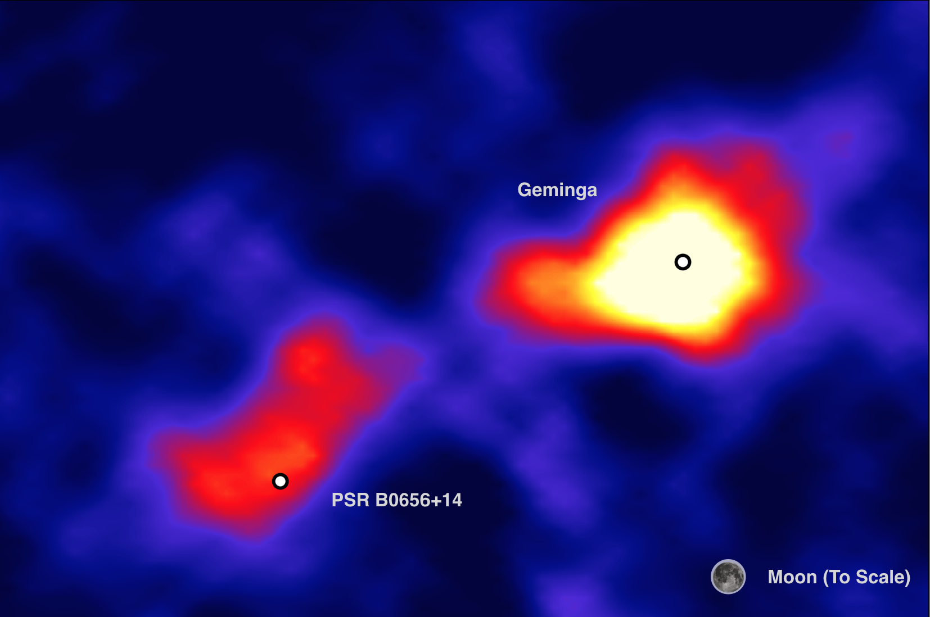
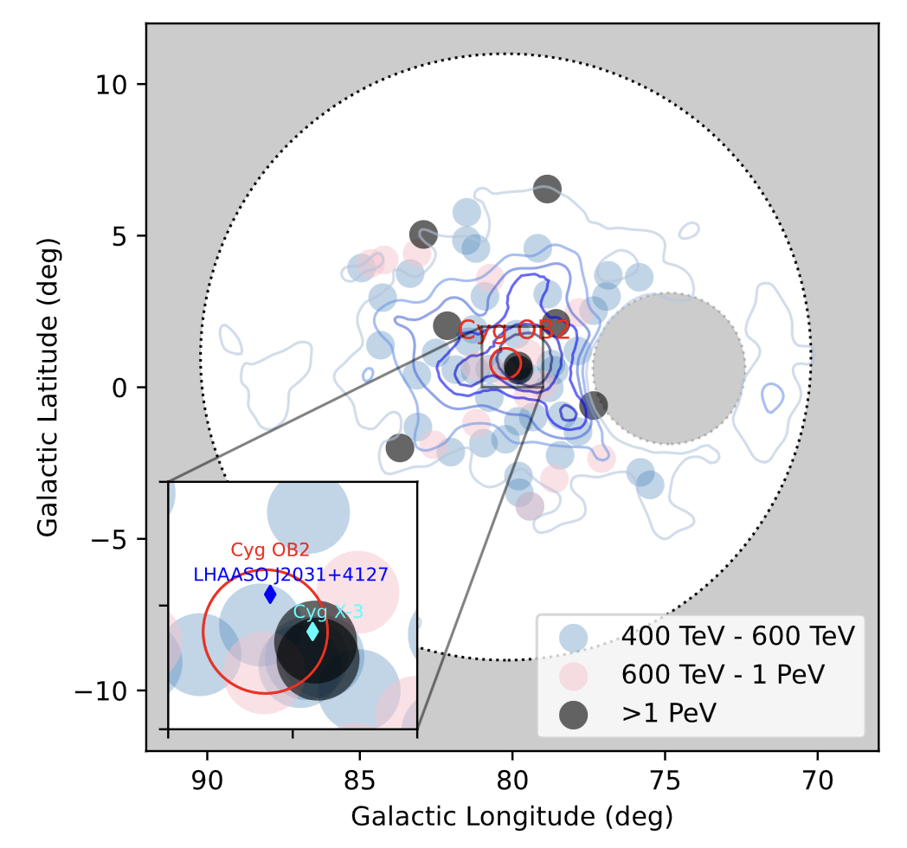
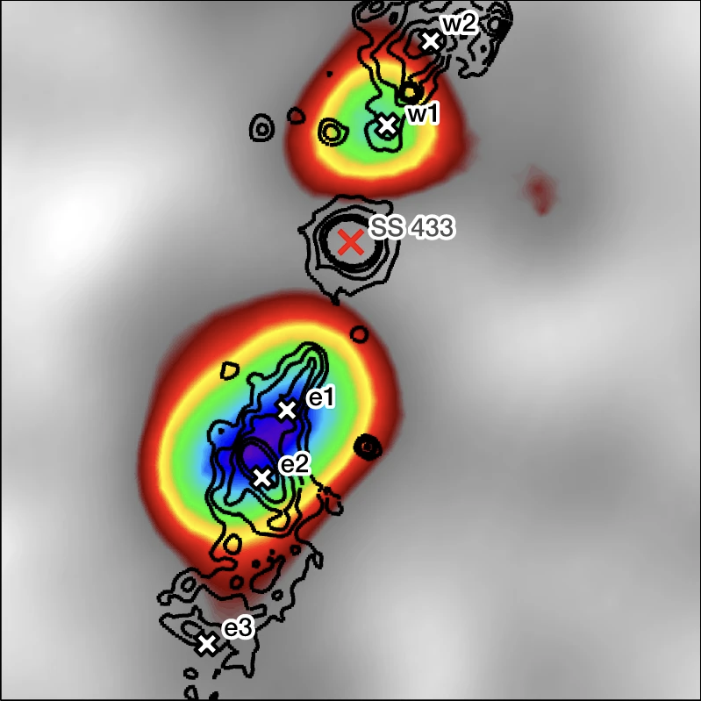

Discoveries?
Very large-scale sources
  e.g. The ‘halos’ of Geminga and Monogem
Emission in to a new energy domain – in particular with LHAASO
  PeV emission from Galactic Accelerators – e.g. Cygnus ‘bubble’
Very hard spectrum sources
  e.g. SS 433 ‘lobes’
Off-plane Galactic objects
  e.g. V4647 Sgr

Slide 28

A Tale of Two Hemispheres
LHAASO
+++
https://www.youtube.com/watch?v=vwZT1U4Tz9U

Slide 29








  Pass 5 prelim. Goodman Gamma2022
  Updated HESS GPS (Remy et al ICRC 2023)
  1st LHAASO Catalogue : KM2A

Slide 30


https://arxiv.org/pdf/2506.01786

Slide 31

The SWGO Collaboration

Slide 32


Slide 33




SWGO Status
Rapidly reaching end of R&D phase
  Aim for small # of WCDs on site early in 2026
    The Pathfinder
  Major funding applications submitted / in prep.
    Submitted: SWGO-A proposal to NSF
Narrowing down the phase space towards baseline:
  Zoned array: inner FF > 50%, outer to ~1 km² scale (“A4”)
  Inner array - dual layer WCD 5.2 m diameter, 4 m deep
  Outer array – WCD design still open
Excellent 𝛾/h separation from dual layer approach

Slide 34


SWGO
CTA
►Follow up of SWGO detected Galactic Sources
year+
Galactic Extended
Extragalactic
Extended
month
Galactic
Binaries
SWGO
Active
Galaxies
day
Timescale
CTA
hour
► Follow up of SWGO detected Flares
Gamma-ray Bursts (2)
CTA
GRBs
minute
SWGO
second
► Follow up of SWGO detected Transients
Distance
1 kpc
10 kpc
100 kpc
1 Mpc
10 Mpc
100 Mpc
1 Gpc

Slide 35


Transients: GRBs
Prompt phase observations
  SWGO+CTAO observations to cover full light-curve !
Alert distribution
CTAO slewing
Detection rate O(1 per year)

Slide 36

Dark Matter
WIMPs as a Thermal Relic of the Big Bank
  Still a strong DM candidate
Indirect detection with gammas reaching critical sensitivity for Gal. Centre
  SWGO advantages: wide field, BG systematics, higher energies
  Again CTAO+SWGO extremely powerful
CTAO

Slide 37
And a lot more…
Simulated Galactic Plane Observation with SWGO
  Use CTAO pop. Model
    499 CTA dets
    461 detections in SWGO FoV
    SWGO 5 years: 487
  Very similar source statistics
    Strong complementarity in terms of E-range and source scale
    CTAO resolution key to disentangle

Slide 38

Summary
Ground particle arrays are powerful tools for high energy astrophysics and astroparticle physics. Particular advantages:
  Large exposure and excellent background rejection at UHE
    Highest sensitivity at >100 TeV
  Very large-scale diffuse emission
    Very large Field-of-view
    Very low systematics from background subtraction
  Prompt observations of transients
    Observing the whole overhead sky all the time
Combination with IACT arrays very effective
Exciting progress towards SWGO!
  Joint CTAO/SWGO science very promising

Slide 39



Job Opportunities !
MPIK (in Heidelberg, Germany) is looking for new PhD Students and Post docs
  To work on CTAO and SWGO
Talk to me at the coffee break!

Slide 40
Questions?

Slide 41
SWGO Performance
Caveat – not fully realistic at low E (overlapping showers)

Slide 42

BG Rejection

Slide 43

Angular Resolution

