Slide 1




FLASH (FINUDA magnet for Light Axion SearcH): R&D for TDR
(FIsica NUcleare a DAΦNE)
(Double Annular Factory for Nice Experiments)
FLASH will be a new haloscope: a detector of axions and exotic particles composed of a resonant cavity immersed in a strong magnetic field
ISTITUTI PARTECIPANTI
Laboratori Nazionali di Frascati (LNF)
University of Camerino
Pisa University and INFN
Trento Institute for Fundamental Physics and Applications (TIFPA)
University of Bonn and University of Mainz
Technical University of Cartagena (UPCT) & IFIC (CSIC-University of Valencia) & IFAE-ICREA
University of Liverpool
Tsung-Dao Lee Institute (TDLI), Shanghai
University of Zaragoza
ALTRI PARTECIPANTI
ezSQUID
Technology Working Group of the Physics Beyond Collider@ CERN
Personale afferente 2025 in totale 10,9 FTE - 43 persone
Personale afferente 2025 al TIFPA 0,6 FTE - 2 persone
P. Falferi 30%, A. Vinante 30%
Durata esperimento 2 anni (R&D) (2025-2026)
Responsabile nazionale
Claudio Gatti (LNF)
Responsabile locale
Paolo Falferi (TIFPA)
Finanziamento (k€)
2025 richiesto 2025 assegnato
Totale 168 113
TIFPA 34 31

Slide 2
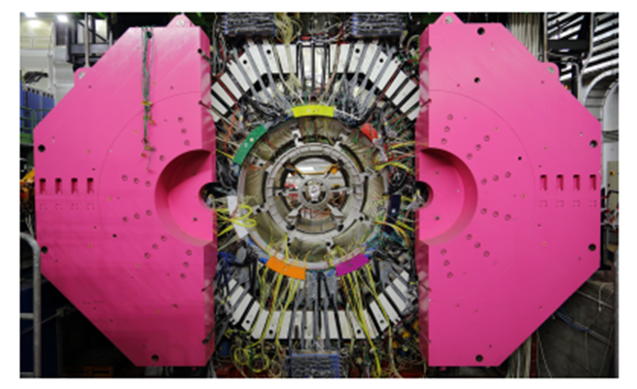
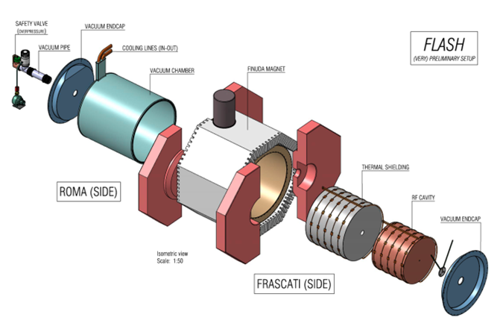
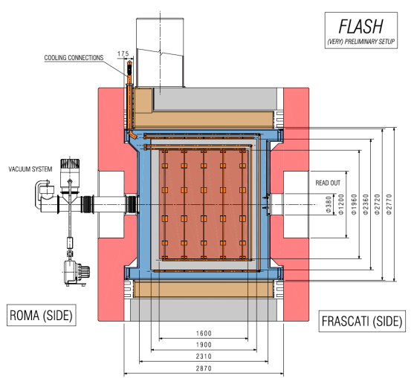
FINUDA was (data tacking stopped in 2007)
a non-focussing magnetic spectrometer
Idea: exploit FINUDA's cryogenic volume (≈6 m³) and superconducting magnet (1.1 T over 15 m³) to create a new haloscope @ LNF

Slide 3
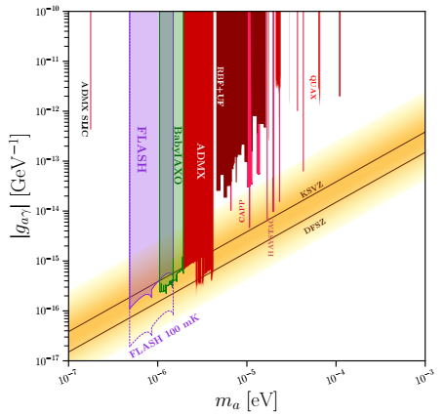
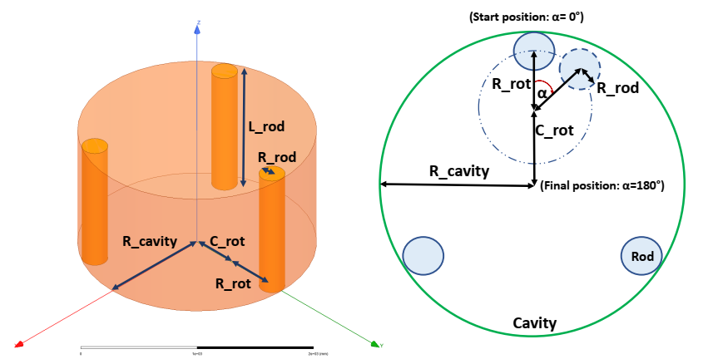
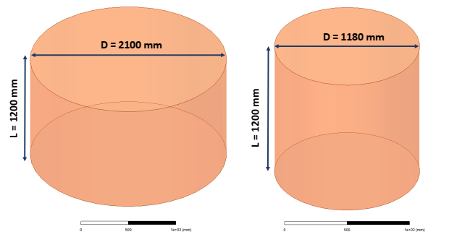
FLASH experiment: a new haloscope @ LNF to detect cosmic axions of masses around 10⁻⁶ eV, an unexplored mass window between the mass ranges of the experiments ADMX, BabyIAXO and DMRadio
The goal of the FLASH experiment is to cover the range 117-360 MHz by tuning with metallic movable rods the resonant frequency of the mode TM010 of two cavities.
117–206 MHz
206-360 MHz
V = 4156 L
V = 1312 L
Two cavities
Resonance tuning with movable rods

Slide 4
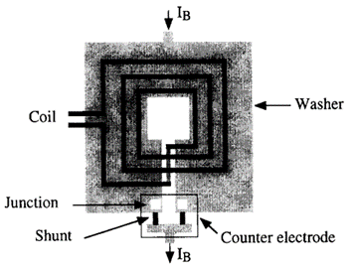
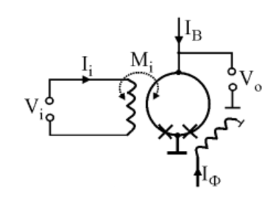
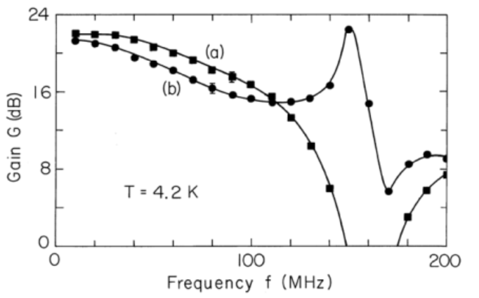
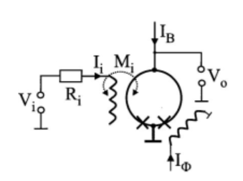
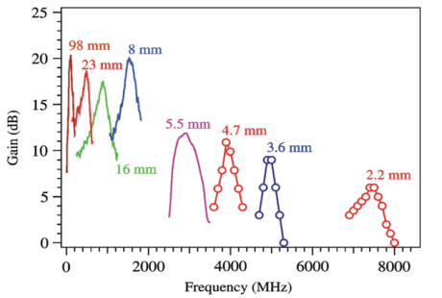
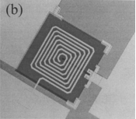
Given the operating frequency range the most suitable low noise amplifier is the MSA
Main differences between dc SQUID and Microstrip SQUID Amplifier (MSA)
«Standard» Square Washer SQUID
Input coil and SQUID washer form a capacitor in parallel to the input coil inductance -> Resonant circuit (typically ν₀ ≈ 40 MHz)
(a) negative and (b) positive V_{φ}
Microstrip SQUID Amplifier
The effect of the parasitic capacitance between input coil and SQUID washer can be exploited to operate the input coil as a transmission line resonator
Amplifiers based on this principle have shown gains of 20 dB at frequencies below 1 GHz and up to 10 dB at 5 GHz
Mück and McDermott, Supercond. Sci. Technol. 23 093001 (2010)

Slide 5
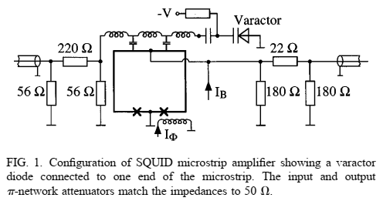
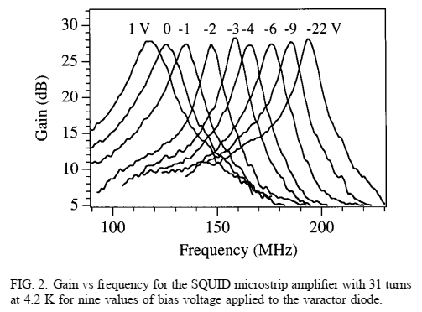
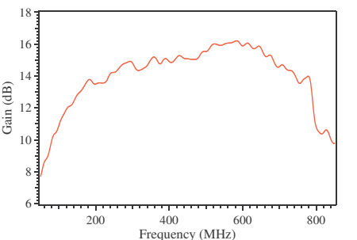
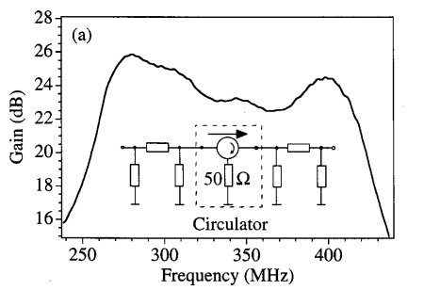
Matching the Flash cavity bandwidth (117–206 and 206-360 MHz)
Tuning the microstrip resonator with a varactor diode
It is possible to tune the resonant frequency of the MSA by terminating the microstrip resonator with a varactor diode.
The varactor doesn’t change the noise temperature of the MSA (here 0.9K @ 200 MHz, 4.2K)
Mück et al. Appl. Phys. Lett., 75, 3545,1999
Lower MSA resonator Q -> wider bandwidth (but lower gain)
Two cascaded MSA tuned to different resonant frequencies
A broad bandwidth can be obtained with a lower quality factor of the resonator but at the expense of a lower gain
A broad bandwidth can be obtained with a second MSA as a postamplifier. Here the resonance frequencies of the first and second amplifiers were about 280 and 400 MHz, respectively.

Slide 6
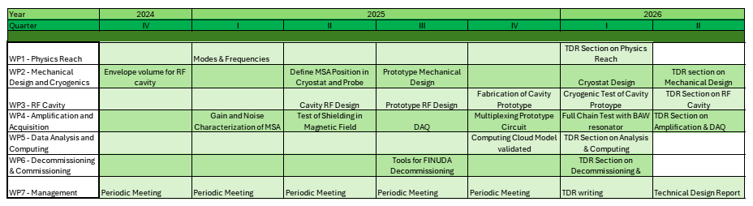
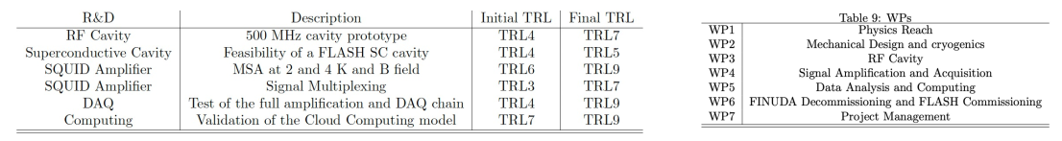
Gantt Chart for the FLASH-TDR preparation

Slide 7
Activity at TIFPA in 2025/2026 (WP4 Amplification and Acq)
Characterize a commercial MSA amplification system (SQUID + CryoAmp) in terms of gain, bandwidth and noise down to ultracriogenic temperatures
2025 status:
Purchase and distribution to Pisa and Camerino of 3 of the 5 MSA complete systems (SQUID + CryoAmp)
Test at room temperature of the low-noise semiconductor CryoAmp
TIFPA REQUESTS 2025/2026 (Dotazioni)
Capitolo di spesa | Descrizione | 2025 richiesta | 2025 assegnati | 2025 disponibili | 2026 richiesta
Inventario | 5 sistemi completi MSA (per Tn, Pi, LNF, Camerino) | 25 k€ | 25 k€ | 0.6 k€ | 0 k€
Consumo | Componenti RF e criogenici, liquidi criogenici | 7 k€ | 5 k€ | 5 k€ | 3 k€
Missioni | Run sperimentali | 2 k€ | 1 k€ | 0.4 k€ | 1 k€
 | Totale | 34 k€ | 31 k€ | 6 k€ | 4 k€

Slide 8
END

Slide 9
EXTRA MATERIALS

Slide 10
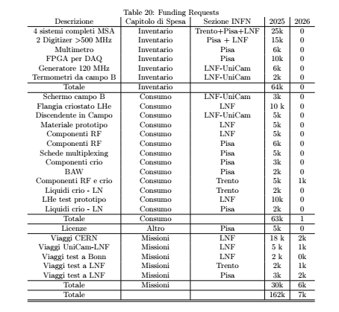

Slide 11
WP4 Signal Amplification and Acquisition
Participants: TIFPA/Trento, Pisa, Camerino, LNF, Bonn/Mainz
Coordinator: Paolo Falferi (MSA) (TIFPA/Trento), Gianluca Lamanna (Amplification/DAQ) (Pisa) WP
Objective: The objective of this WP is to acquire some complete commercial MSA amplification systems, characterize them in terms of gain, bandwidth and noise down to temperatures of the order of 300 mK and then operate them in conditions similar to those in Flash as far as concerns operating temperature, ambient magnetic field and resonating input load. It also includes the digitization and acquisition of the signal, and the definition of the calibration procedure.
Activity description
Task 4.1: MSA configurations Different MSA configurations will be considered and possibly tested: MSA with varactor diode for the tuning of its resonance frequency, MSA with lower resonance Q for a wider bandwidth, two cascaded MSA tuned to different resonant frequencies for a wider bandwidth. Gain, noise and bandwidth measurements will be carried out as a function of the operating temperature down to ultracryogenic temperatures. For a complete characterization of the noise, tests will be conducted with resonant loads at the input of the MSA.
Task 4.2: Stability High Q loads at the input of the MSA can lead to system instability. Cold damping networks will therefore be considered and possibly applied for the stabilization of the cavity/MSA system.
Task 4.3: Postamplifier If the MSA gain is not high enough to allow the use of a room temperature amplifier as postamplifier, low noise cryo amps capable of operating at 4K will be identified and tested.
Task 4.4: Magnetic shielding The MSA should operate in an environment with a low magnetic field (possibly << Gauss) and low vibrations so that the flux noise collected by the MSA SQUID loop remains << Φ0 . In Flash, where the magnetic field reaches 1.1 T, this condition can be satisfied by appropriately shielding the magnetic field around the MSA and/or by moving the MSA sufficiently away. To evaluate whether this is possible, superconductor/cryoperm composite magnetic shields will be realized and tested and in the design of the Flash cryostat we will try to
identify areas with a low residual magnetic field where the MSA can be safely housed. Tests of the shielded MSA in a 1.1 T magnetic field will be done.
Task 4.5: Multiplexing The possibility of operating two or more MSAs connected to the same antenna will be evaluated to simultaneously detect higher harmonics of the cavity but avoiding the MSAs interfering with each other.
Task 4.6: Replacement of the MSA In defining the design of the Flash cryostat and with prototype tests, the possibility of replacing the MSA without warming up the entire Flash cryostat to room temperature will be evaluated. In this way it would be possible to cover the entire range of Flash operating frequencies using some “bayonet design” MSAs optimized to operate on reduced frequency bandwidth.
Task 4.7: Secondary amplification and down conversion chain The RF amplification at room temperature will depend on the gain obtained in the cold stage and on the requirements of the digitization stage. Considering the non exceedingly high operating frequency (hundreds of MHz), the need for a potential down-conversion stage will be evaluated, based on noise control and acquisition bandwidth considerations.
Task 4.8: Digitization and data acquisition The Digitization and data acquisition stage will be defined according to the previous stage requirements. In addition, both commercial solutions (such as commercial fast FFT or a commercial digitizer) and custom-made solution based on RFSoc FPGA with high-end digitizer on board, will be considered. The second solution, although more complex, will offer greater flexibility and the possibility of applying data reduction and control algorithms directly in real-time.
Task 4.9: Full test of amplification chain with a BAW resonator Test of amplification and DAQ chain with a 100 MHz mode of a BAW in a cryogenic system to simulate the presence of the FLASH cavity. A full calibration procedure as in the real experiment will be implemented by measuring scattering parameters through ancillary lines and by means of calibrated thermal sources

Slide 12
Synergistic projects
• QUAX: QUAX is a CSN2 experiment looking for galactic axions with mass about 40 µeV. One ff the two haloscopes of the experiment is located in the COLD laboratory of LNF (https://coldlab.lnf.infn.it).
• BAUSCIA Project in Milano Bicocca with the objective of detecting HFGW with BAWs. Because of the strong synergies with the FLASH physics and involved technologies, the MiB team expressed a strong interest in collaborating with FLASH in the future, for searches at lower frequencies but also extending to the higher frequencies of FLASH.
• PNRR-NQSTI: The objective of the PNRR project NQSTI is the development of quantum technologies, including superconducting quantum devices. The LNF, Trento and Pisa teams are involved in this project.
• PNRR-ICSC: One of the objective of the PNRR project ICSC is to develop the infrastructure for scientific computing. The QUAX cloud computing is developed also within this project.
• Samara/SuperMad: The objective of this project in CSN5 are superconducting materials for axion cavities such as NbTi and Ybco. The LNF team is involved in this project. Solutions for sputtering the FLASH cavity with NbTi will be studied within SuperMAD if approved.
• Qubit/QUARTET: Superconducting devices. The LNF, Pisa and Trento teams are involved in this project.
• PRIN-2022bpjl2l (IRONMOON): The objective of the PRIN project IRONMOON is the study of superconducting materials for axion RF cavities. The LNF team is involved in this project.

Slide 13
Istituti personale FTE
LNF 10 2.6
Camerino 4 1.3
Pisa 12 2.3
TIFPA 2 0.6
Bonn/Mainz 5 2.1
Cartagena/Valencia 7 1.4
Shanghai 2 0.4
Zaragoza 1 0.2
TOT 43 10.9
Possible FLASH detection:
QCD axion
Axion-like particles
Scalar dark matter
Chameleons
Hidden (dark) photons
High frequency gravitational waves

Slide 14
Axion
An axion is a hypothetical elementary particle originally theorized in 1978 by Wilczek and Weinberg as a consequence of the Peccei–Quinn mechanism for solving the strong CP problem posed by quantum chromodynamics (QCD). If axions exist and have low mass within a specific range, they are of interest as a possible component of cold dark matter.
Strong CP problem
According to the current mathematical formulation of quantum chromodynamics, a violation of Charge Parity-symmetry in strong interactions could occur. However, no violation of the CP-symmetry has ever been seen in any experiment involving only the strong interaction. As there is no known reason in QCD for it to necessarily be conserved, this is a "fine tuning" problem known as the strong CP problem
Axion Models
Models in which the axion feebly couples to the Standard Model degrees of freedom:
Kim-Shifman-Vainshtein-Zakharov (KSVZ) model (1979/80)
Dine-Fischler-SrednickiZhitnitsky (DFSZ) model (1980/81)
These benchmark models belong to a larger class which is referred to as the “invisible” axion models.
Axion Experiments with haloscopes
Currently operating haloscopes: ADMX, HAYSTAC, ORGAN, CAPP-8T, CAPP-9T, CAPP-PACE, CAPP-18T, CAST-CAPP, CAPP-12TB, GrAHal, RADES, QUAX, and TASEH
Proposed haloscopes: FLASH, BabyIAXO/RADES, ABRACADABRA, DM-Radio, CADEx, MADMAX , ALPHA, WISPLC, DALI, BRASS, BREAD and SUPAX

Slide 15
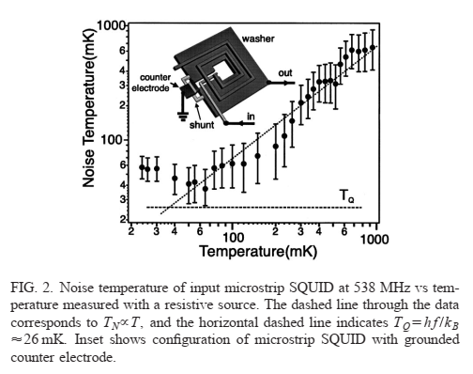
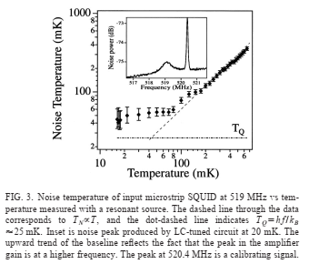
Mück et al., Appl. Phys. Lett. 78, 967 (2001)

Slide 16
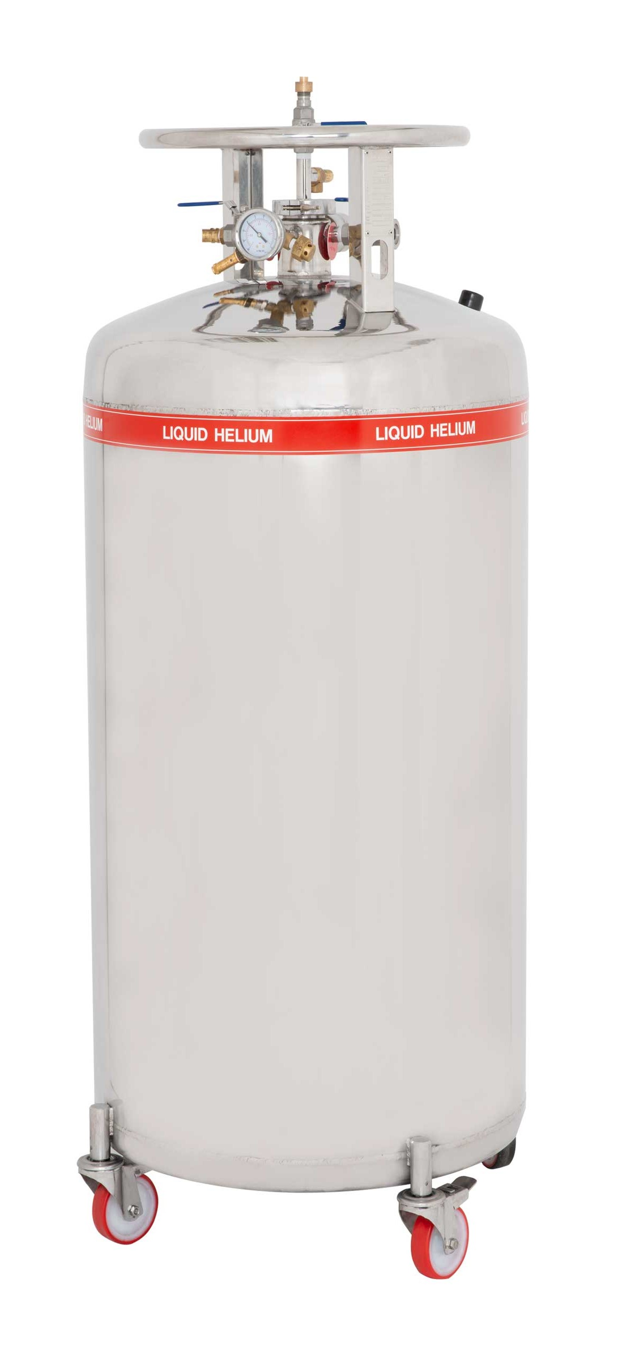
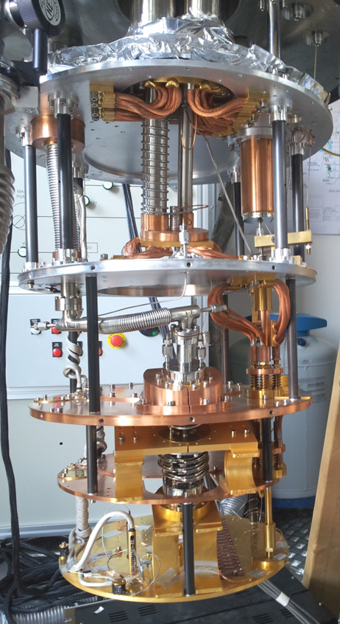
FLASH – Trento Activity
Equipment available
Dilution refrigerator -> MSA tests down to T_{base} = 20 mK
Liquid helium transport and lab dewars -> MSAs-antenna tests at 1-4.2K
Helium liquefier with gas recovery system -> liquid helium at affordable prices
Electronics (Signal generators, VNA, oscilloscope/spectrum analyzer 500 MHz)
FTE: Paolo Falferi 30%, Andrea Vinante 30%
Purchases
MSAs (4 k€ each)
Low noise cryogenic and room temperature RF amplifiers
Microwave-cryo-spares (filters, power splitters, cables, connectors...)
Liquid helium
Dilution Refrigerator
Helium liquifiers with gas recovery system

