Slide 1
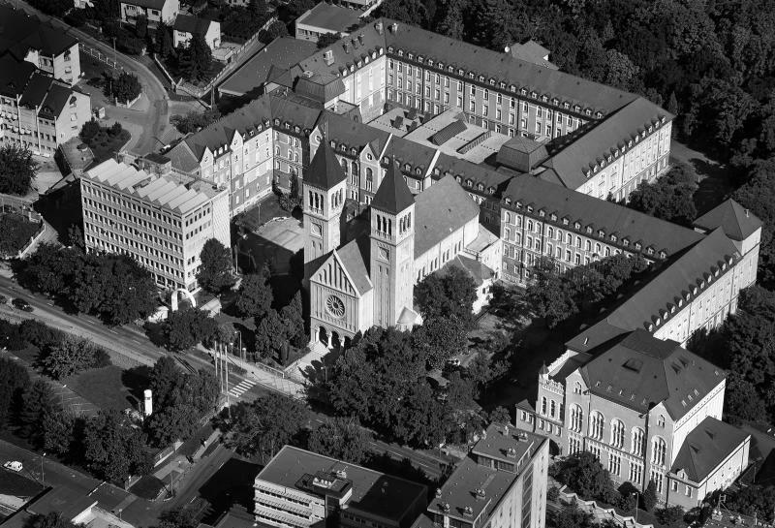



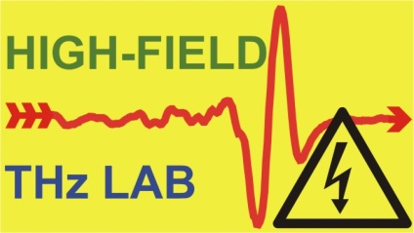


Prospects of Dielectric Terahertz-driven Accelerators in Medicine
Andrés Leiva Genre
University of Pécs
Szentágothai Research Center
EuPRAXIA-DN Camp III: Innovation
Supervisors: Dr. Szabolcs Turnár
Prof. Dr. Gábor Almási
Notes:
Good afternoon!
Today, I will speak about the PROSPECTS OF DIELECTRIC TERAHERTZ-DRIVEN ACCELERATORS IN MEDICINE.

Slide 2



OUTLINE
Dielectric Laser-driven Accelerator (DLA).
  Working principle.
  Advantages of operating in the THz range.
Applications in Medicine.
  Radiotherapy.
  Imaging.
  Others.
Conclusion
EuPRAXIA-DN Camp III – 06/10/2025
Notes:
Here’s the presentation’s outline.
First, I will BRIEFLY mention the basics of DLAs. After that, we will continue with the main part of the talk.

Slide 3
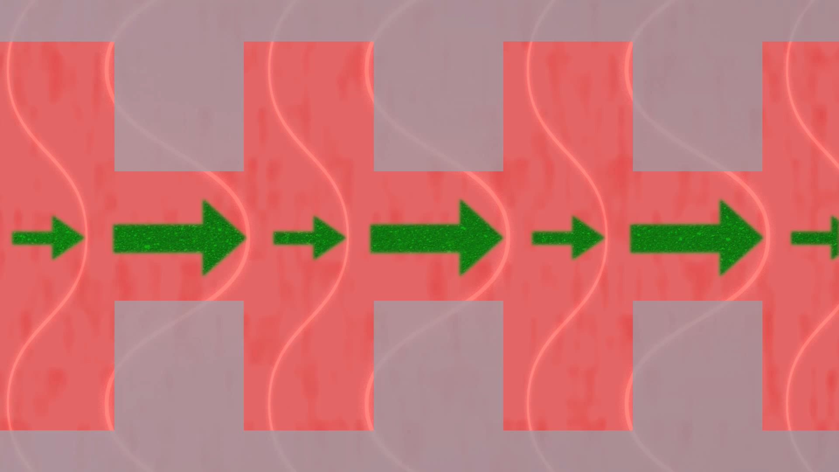
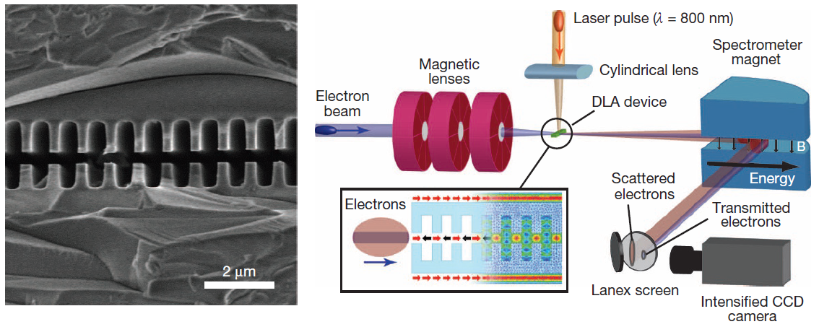
DLA: WORKING PRINCIPLE
Dielectric Laser-driven Acceleration Concept
Accelerator on a chip: How it works, SLAC National Accelerator Laboratory. Video from achip.standford.edu.
For a comprehensive DLA review:
England, R. Joel, et al. "Dielectric laser accelerators." Reviews of Modern Physics 86.4 (2014): 1337-1389.
Peralta, E. A., et al. "Demonstration of electron acceleration in a laser-driven dielectric microstructure." Nature 503.7474 (2013): 91-94.
EuPRAXIA-DN Camp III – 06/10/2025
Notes:
Thanks to today’s advance manufacturing techniques and laser technology, we can shape dielectric micron-scale structures to provide net acceleration. A nice visualization is provided by the video produced at SLAC.
A must-read review for people interested in DLA is provided by Joel Engalnd et. Al. 2014 on Dielectric Laser Accelerator.

Slide 4
DIELECTRIC TERAHERTZ-DRIVEN ACCELERATORS (DTA)
THz advantages:
  Shorter wavelengths than RF.
  Facilitates structure manufacturing and gaps dimensions, allowing greater bunch charges.
  Accurate timing (timing jitter).
  Can operates in the GV/m range.
  Beam manipulation.
Nanni, Emilio A., et al. "Terahertz-driven linear electron acceleration." Nature communications 6.1 (2015): 8486.
Wei, Y., et al. "Investigations into dual-grating THz-driven accelerators." Nuclear Instruments and Methods in Physics Research Section A: Accelerators, Spectrometers, Detectors and Associated Equipment 877 (2018): 173-177.
EuPRAXIA-DN Camp III – 06/10/2025
Notes:
Let’s ask ourselves this question: WHY we would like to accelerate particles using THz radiation?
First, THz radiation provides shorter wavelength than RF. Because the accelerator’s dimension is proportional to its operational wavelength, THz reduce the size of the particle accelerators.
Compared to optical DLAs, it softens some of the bunch parameters requirements, so that current technology is enough for the realization of these accelerators.
It supplies intrinsic synchronization and accurate timing as most of the high-intensity THz generation techniques are driven by a laser.
Lastly, it provides high acceleration gradients and it is well-suited for beam manipulation.

Slide 5
RADIOTHERAPY
EuPRAXIA-DN Camp III – 06/10/2025
Notes:
Now, let’s start with the radiotherapy applications of Dielectric Terahertz Accelerators.

Slide 6
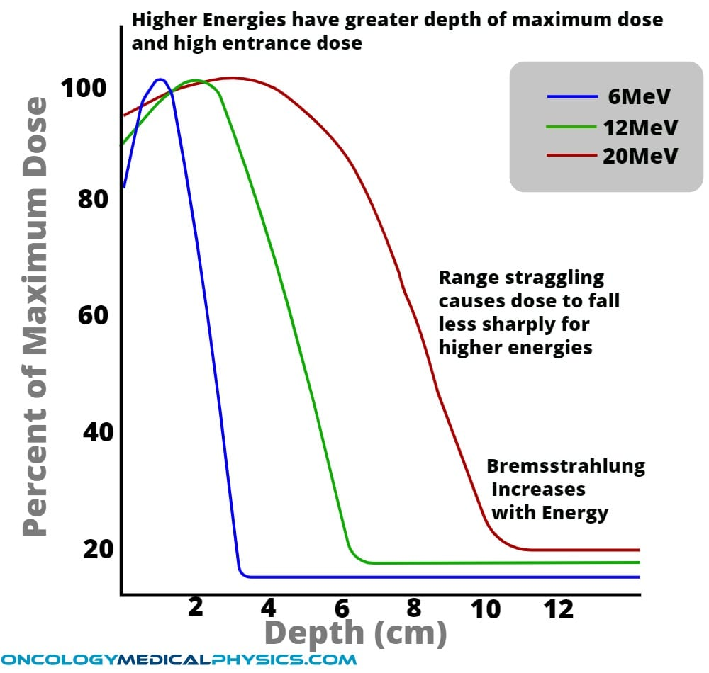
INTRA-OPERATIVE RADIATION THERAPY (IORT)
Electron depth-dose profile
EuPRAXIA-DN Camp III – 06/10/2025
Notes:
For radiotherapy, it is important to understand and study how particles deposit their energy along its path through a given media.
In this figure, we can observe how electrons deliver dose at different depths in a volume of water. Because electron beams with MeV energies do not travel more than a few centimeters, they are used for skin cancer and superficial treatments.

Slide 7
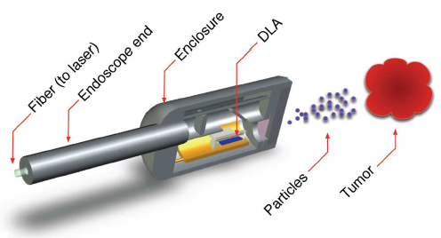
INTRA-OPERATIVE RADIATION THERAPY (IORT)
Estimated DTAs Acceleration Gradients around 1 GeV/m
  Full-dielectric accelerator -> Can be integrated on a chip
  Micrometer scale compact source
  Multi-MeV electron beam of mm-to-cm scale
  Attached at the end of an endoscope
Electron depth-dose profile
England, R. Joel, et al. "Dielectric laser accelerators." Reviews of Modern Physics 86.4 (2014): 1337-1389.
J. E. Clayton and P. A. Lovoi, “Laser Accelerator Driven Particle Brachytherapy Devices, Systems and Methods”. US Patent 9022914 B2. Filed 30 Sep. 2011, issued 5 May 2015.
EuPRAXIA-DN Camp III – 06/10/2025
Notes:
The high-gradient capabilities and compactness feature offered by DLA, we could overcome the main disadvantages of electron beams for radiotherapy.
Suppose we can fabricate a full-accelerator integrated on a chip which can accelerate electrons to multi-MeV energy on a mm-to-cm scale, we can attach the accelerator at the end of an endoscope and introduce the radiation source in the vicinity of tumorous tissue…

Slide 8
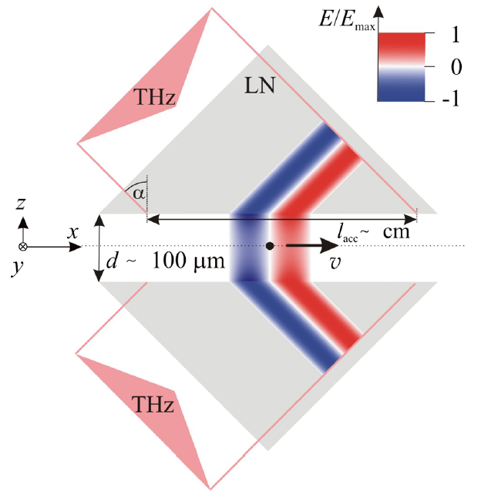
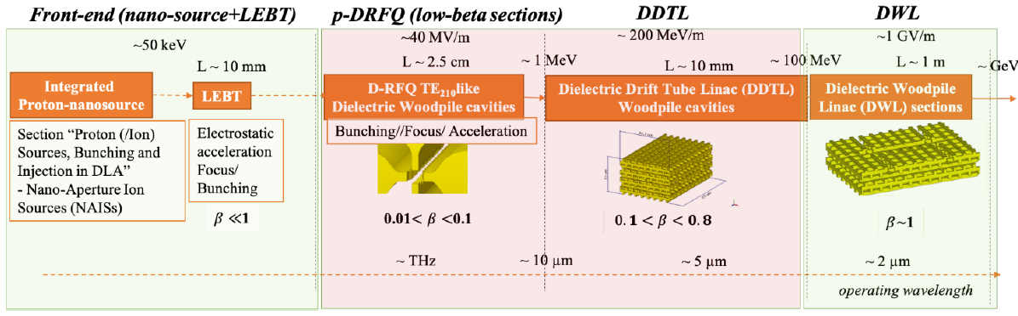
HADRONTHERAPY
Dielectric laser-driven acceleration mechanism allows for the acceleration of positively-charged particles
Evanescent-wave proton post-accelerator
Conceptual design of a p-DLA
Pálfalvi, László, et al. "Evanescent-wave proton postaccelerator driven by intense THz pulse." Physical Review Special Topics-Accelerators and Beams 17.3 (2014): 031301.
Torrisi, G., et al. "Feasibility Study and Perspectives of proton Dielectric Laser Accelerators (p-DLA): from nanosource to accelerator scheme." arXiv preprint arXiv:2106.13701 (2021).
EuPRAXIA-DN Camp III – 06/10/2025
Notes:
The acceleration concept of laser-driven structure-based accelerators permit acceleration of positively-charged particles. Therefore, DTAs could be employed for hadrontherapy systems thanks to their high acceleration gradients.
The first prototype was proposed here in Pecs by Laszlo Palfalvi, combining THz and prisms to accelerate particles via evanescent waves.
However, I must mention this is still a premature application of DTAs, and the community is still focused on the acceleration of electrons.

Slide 9
ADVANCE IMAGING
EuPRAXIA-DN Camp III – 06/10/2025

Slide 10
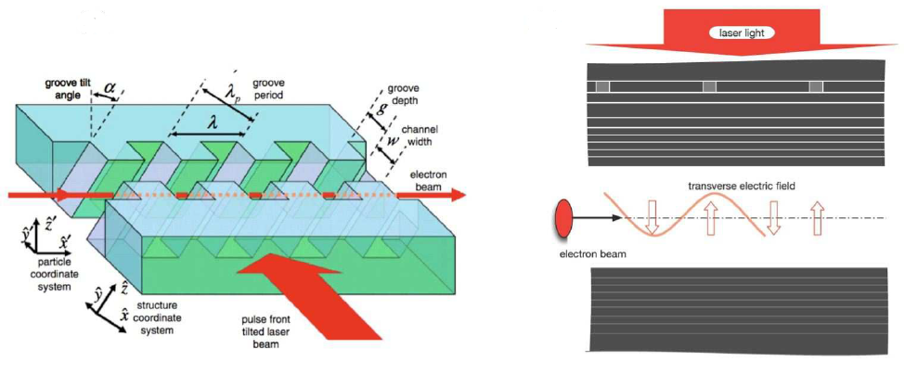
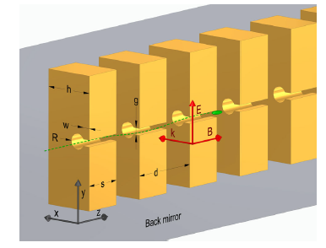
UNDULATOR LIGHT SOURCES
Laser Undulator for chip-scale XFEL
THz-driven Undulator
Dielectric-based microstructure laser-driven undulator (equivalent to a 4 T magnetic field)
Split ring resonator undulator
Plettner, T., and R. L. Byer. "Proposed dielectric-based microstructure laser-driven undulator." Physical Review Special Topics—Accelerators and Beams 11.3 (2008): 030704.
Travish, Gil, and Rodney B. Yoder. "Laser-powered dielectric-structures for the production of high-brightness electron and x-ray beams." Laser Acceleration of Electrons, Protons, and Ions; and Medical Applications of Laser-Generated Secondary Sources of Radiation and Particles. Vol. 8079. SPIE, 2011.
Rohrbach, D., et al. "THz-driven split ring resonator undulator." Physical review accelerators and beams 24.1 (2021): 010703.
EuPRAXIA-DN Camp III – 06/10/2025

Slide 11
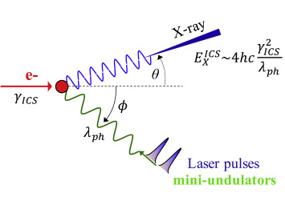
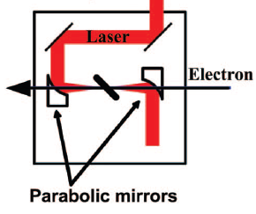
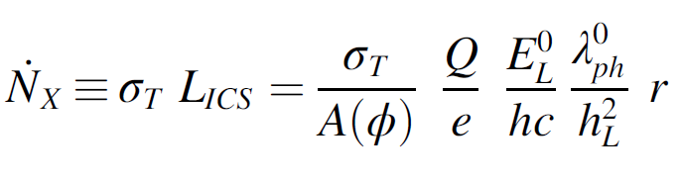
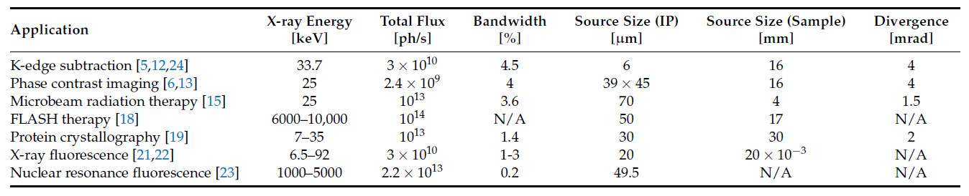
INVERSE COMPTON SCATTERING (ICS) SOURCES
Inverse Compton Scattering (ICS)
Interaction Chamber
Photon Flux
X-ray parameters required for ICS applications
England, R. Joel, et al. "Dielectric laser accelerators." Reviews of Modern Physics 86.4 (2014): 1337-1389.
Mușat, Vlad, Andrea Latina, and Gerardo D’Auria. "A high-energy and high-intensity inverse Compton scattering source based on CompactLight technology." Photonics. Vol. 9. No. 5. MDPI, 2022.
Bazzani, A., et al. "BoCXS: A compact multidisciplinary X-ray source." Physics Open 5 (2020): 100036.
EuPRAXIA-DN Camp III – 06/10/2025

Slide 12
DTA-BASED ICS X-RAY SOURCE
Possible layout for a compact DTA-based ICS X-ray source
Laser
Optical
HHG
DFG
UV
THz
Electron bunch
THz-driven Photogun
Interaction Chamber
X-rays
Compressor
DTA
Focus
e⁻
e⁻
Dump
EuPRAXIA-DN Camp III – 06/10/2025

Slide 13
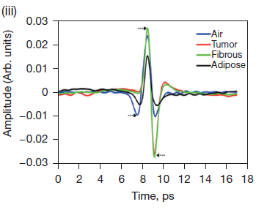
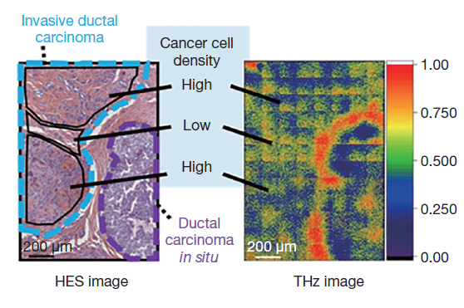
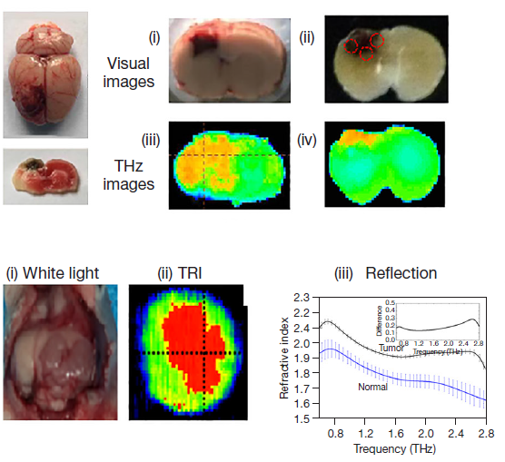
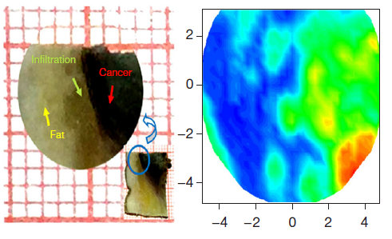
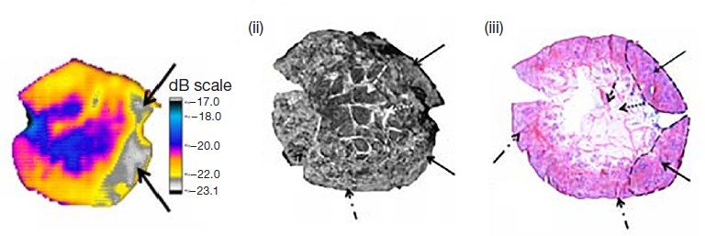
THZ TECHNOLOGY FOR IMAGING
THz Imaging Applications:
  Breast tissue
  Brain tissue
  Skin tissue
  Dentistry
Cong, Mengyang, et al. "Biomedical application of terahertz imaging technology: a narrative review." Quantitative Imaging in Medicine and Surgery 13.12 (2023): 8768.
EuPRAXIA-DN Camp III – 06/10/2025

Slide 14
OTHER APPLICATIONS
  Ultrafast Electron Diffraction
  Radiobiology
  Sterilization
Leiva Genre, A. “Unlocking Atomic motion: Dielectric Terahertz-driven Accelerators for Ultrafast Electron Diffraction”, EuPRAXIA-DN Camp II: Science, Instituto Superior Técnico, Lisbon, Portugal 13th-15th July 2025.
Koyama, Kazuyoshi, et al. "Development of a laser driven dielectric accelerator for radiobiology research." 8th Int. Particle Accelerator Conf.(IPAC'17), Copenhagen, Denmark, 14â 19 May, 2017. JACOW, Geneva, Switzerland, 2017.
McEvoy, Brian, et al. "Studies on the comparative effectiveness of X-rays, gamma rays and electron beams to inactivate microorganisms at different dose rates in industrial sterilization of medical devices." Radiation Physics and Chemistry 208 (2023): 110915.
EuPRAXIA-DN Camp III – 06/10/2025

Slide 15
CONCLUSION
EuPRAXIA-DN Camp III – 06/10/2025

Slide 16
CONCLUSION
  THz-driven structure-based accelerators have multiple applications in medicine.
  THz offers compactness and more cost-effective systems.
  Next-generation of medical equipment.
  New technologies can be implemented (IORT).
  Technological development is still needed for most of the applications.
EuPRAXIA-DN Camp III – 06/10/2025

Slide 17


Enjoy!
Project 101073480 – EuPRAXIA-DN
“Funded by the European Union. Views and opinions expressed are however those of the author(s) only and do not necessarily reflect those of the European Union or the European Research Executive Agency (REA). Neither the European Union nor the granting authority can be held responsible for them.”
The project has been supported by the TKP2021 funding scheme – (TKP2021 – EGA17)
andreslg@fizika.ttk.pte.hu

Slide 19




SPARE SLIDES

Slide 20
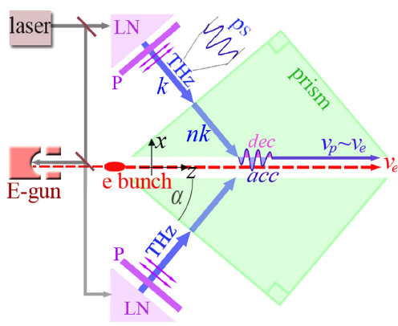
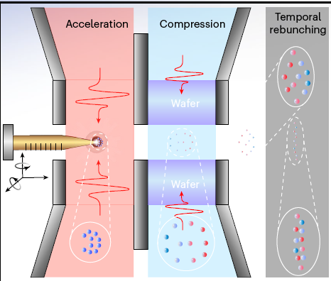
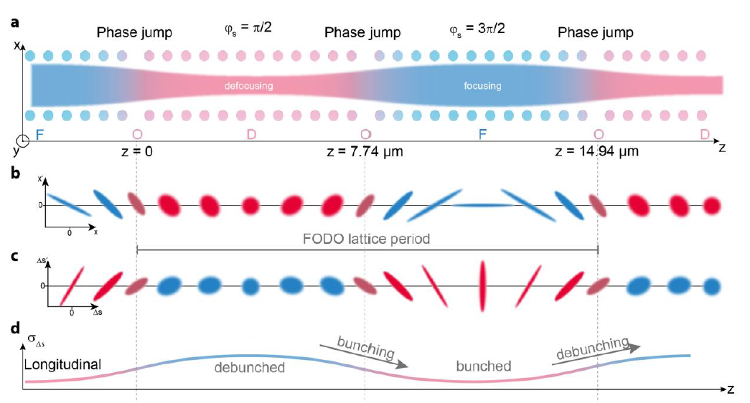
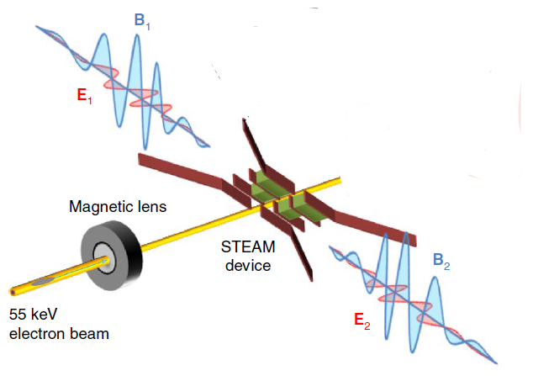
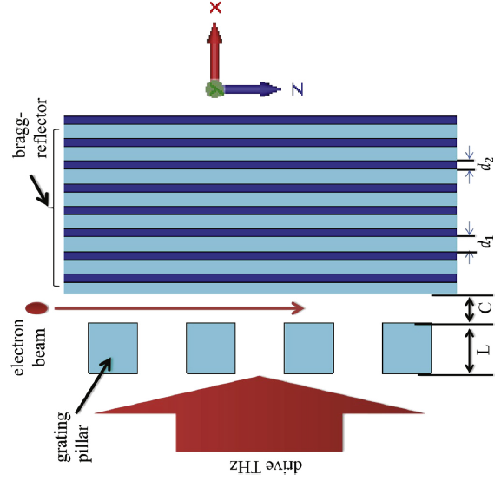
Oncological Treatment
Compact System:
  All-optical THz-driven sources (Synchronization)
  High-gradient linear electron acceleration (100-400 MeV/m)
  Practical THz manipulation of electrons
Transversal focusing
Source
Manipulation
Acceleration
Ying et. Al. (2024), Zhang et. Al (2018), Liu et. Al. (2021), Xiriai et. Al. (2019), Shiloh et. Al. (2021)
EuPRAXIA-DN Camp III – 06/10/2025
Notes:
Clinical LinAcs are used for oncological treatment of patients through external radiation. RF cavities are commonly included in Linacs systems to provide the acceleration of electrons which are impacted on anode to produce the photon flux needed for the treatment.
We could simply

Slide 21
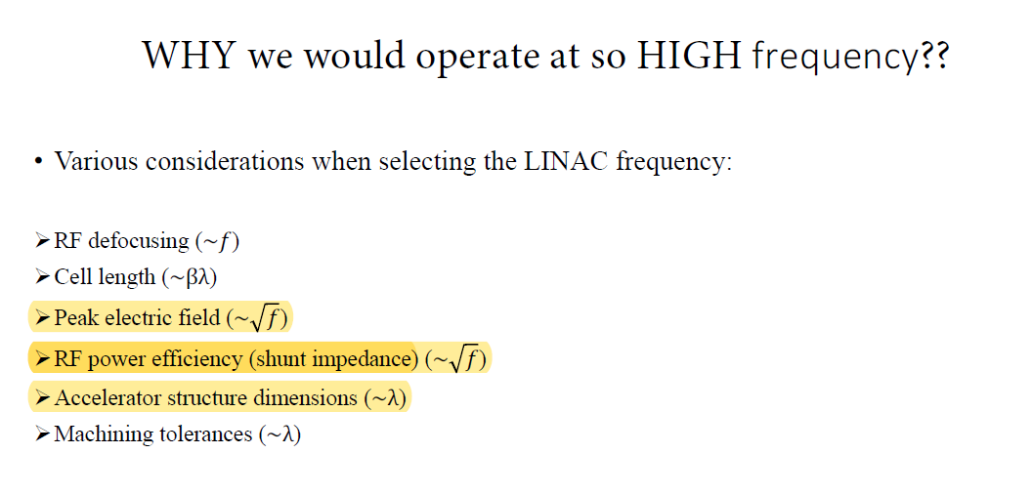
RF vs NIR and THZ
IDK Conference - 04/05/2024

