Slide 1





Development of a Marx Generator Discharge Circuit for High-Current Plasma Capillary Discharges
Romain Demitra - LNF INFN
On the behalf of EuPRAXIA@SPARC_Lab collaboration
EuPRAXIA-DN Camp III: Innovation
6 – 7 October 2025, Pécs, Hungary​

Slide 2
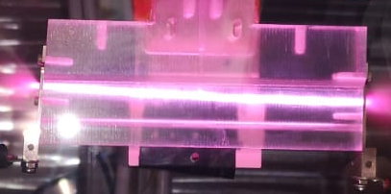
Plasma Capillary Optics: Why We Need High-Current Pulsers ?
Plasma capillaries discharges enable compact beam focusing and bending : Active Plasma Lens and Active Plasma Bending (kT/m gradients, cm-scale)
Achromatic transport demonstrated (reduced sensitivity to energy spread)
Applications: compact X-ray sources, FEL transport, collider beamlines
Cheap solution (capillary+discharge pulser)
Requirement: short, high-current pulses (>10 kA, <500 ns)
Magnetic Field (B_{φ}) vs Force on electrons (F)
APL
B_{φ}
F
-
-
-
-
-
-
-
-
-
-
-
-
e⁻ bunch
-
Current
+
APB
HV
Notes:
In plasma-based accelerators we are not only interested in acceleration, but also in compact beam optics. Plasma capillaries can act as lenses or bending devices, providing focusing gradients at the kT per meter level and bending fields strong enough to guide relativistic beams over centimeter scales. Recent experiments have demonstrated that relativistic beams can be guided and even bent in curved plasma channels while preserving emittance and transmission. One important advantage is the potential achromatic behavior, meaning the bending is far less sensitive to the beam’s energy spread compared to conventional dipoles. These properties make plasma optics highly attractive for EuPRAXIA, where compact X-ray sources for biology and chemistry, as well as future collider beamlines, demand both strong and compact beam manipulation

Slide 3
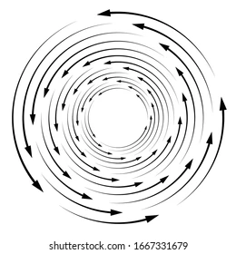
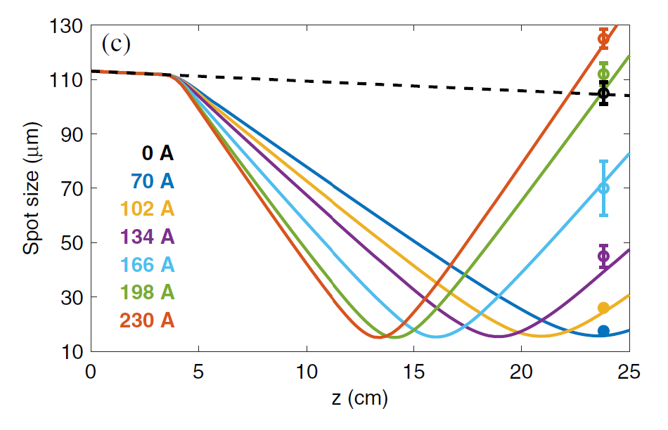
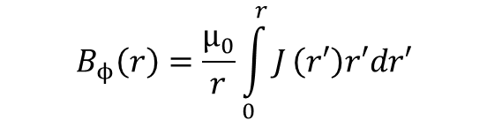
Active Plasma Lens
Active-Plasma Lens (APL): the focusing is produced by an electric discharge in a plasma-filled capillary
Magnetic field follows Ampere Law (current-carrying wire)
Weak chromaticity (like quadrupoles) → K~1/γ
Radially symmetric (like solenoids)
Compactness → kT/m magnetic field gradients
Not sensitive to beam distribution (as in passive-plasma lenses)
Active-Plasma Lens (APL): the focusing is produced by an electric discharge in a plasma-filled capillary
Magnetic field follows Ampere Law (current-carrying wire)
Weak chromaticity (like quadrupoles) → K~1/γ
Radially symmetric (like solenoids)
Compactness → kT/m magnetic field gradients
Not sensitive to beam distribution (as in passive-plasma lenses)
Great tunability by changing the current
$$B_{ϕ}\left(r\right)=\frac{μ_{0}}{r}\int_{0}^{r}{J}\left(r′\right)r′dr′$$
Beam energy = 127 MeV

Slide 4
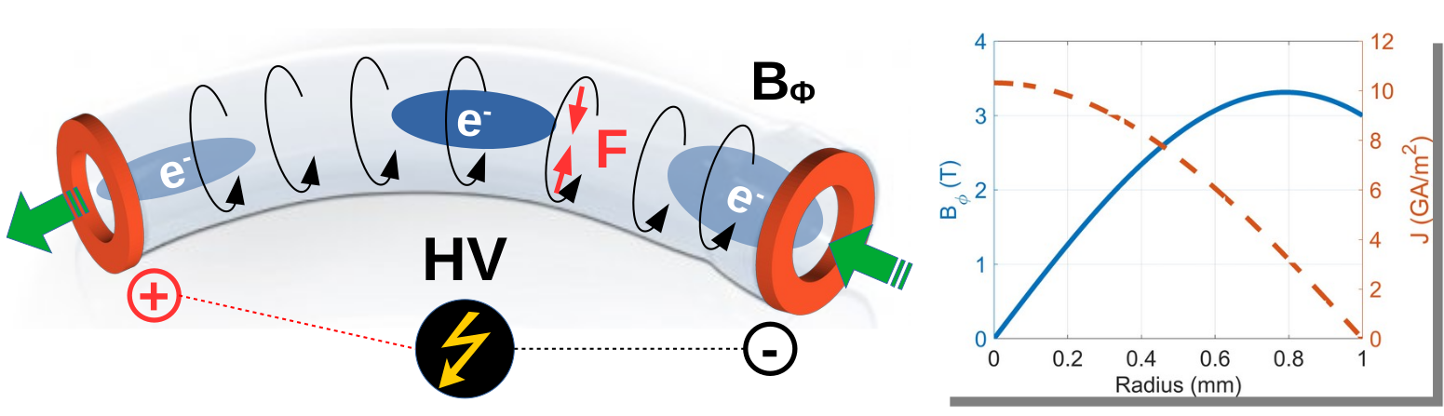
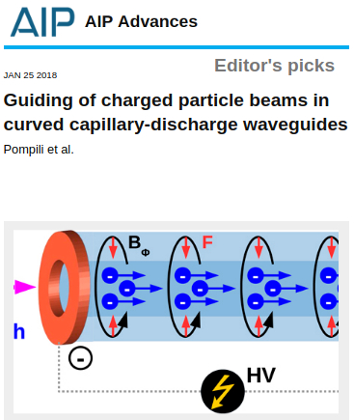
How Plasma Capillaries Guide and Bend Beams
Curved active-plasma lens: an alternative to classic bending magnets Plasma can sustain large currents, E.g., 15 kA currents produce ~4 T magnetic fields.
Compactness : Large deflection angles, no need of cryogenic systems
Tunability : The bending is tuned by adjusting the discharge-current
Cheap solution (capillary+discharge pulser)
Tunable dispersion (dispersion-free also possible) by changing the discharge current
Pompili, R., et al. "Guiding of charged particle beams in curved capillary-discharge waveguides." AIP Advances 8.1 (2018): 015326.

Slide 5
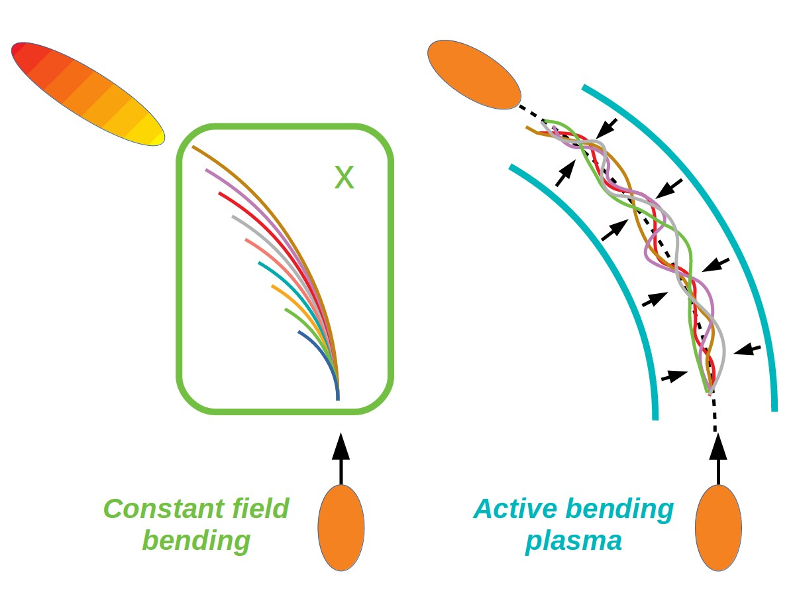
Bending mechanism
Particle motion in the ABP is different with respect to a classic bending magnet
Its magnetic field is radially increasing (not constant like in a planar bend)
Large energy particles → large offset with respect to the capillary axis → stronger deflection
Bunch elongation/dispersion can be made negligible even with large energy spreads
The ABP does not require any manipulation on the beam LPS as in the case of standard bending magnets!
No dispersion-matching optics (quads, sextupoles)!
Simple and affordable solution in view of futuristic compact machines.

Slide 6
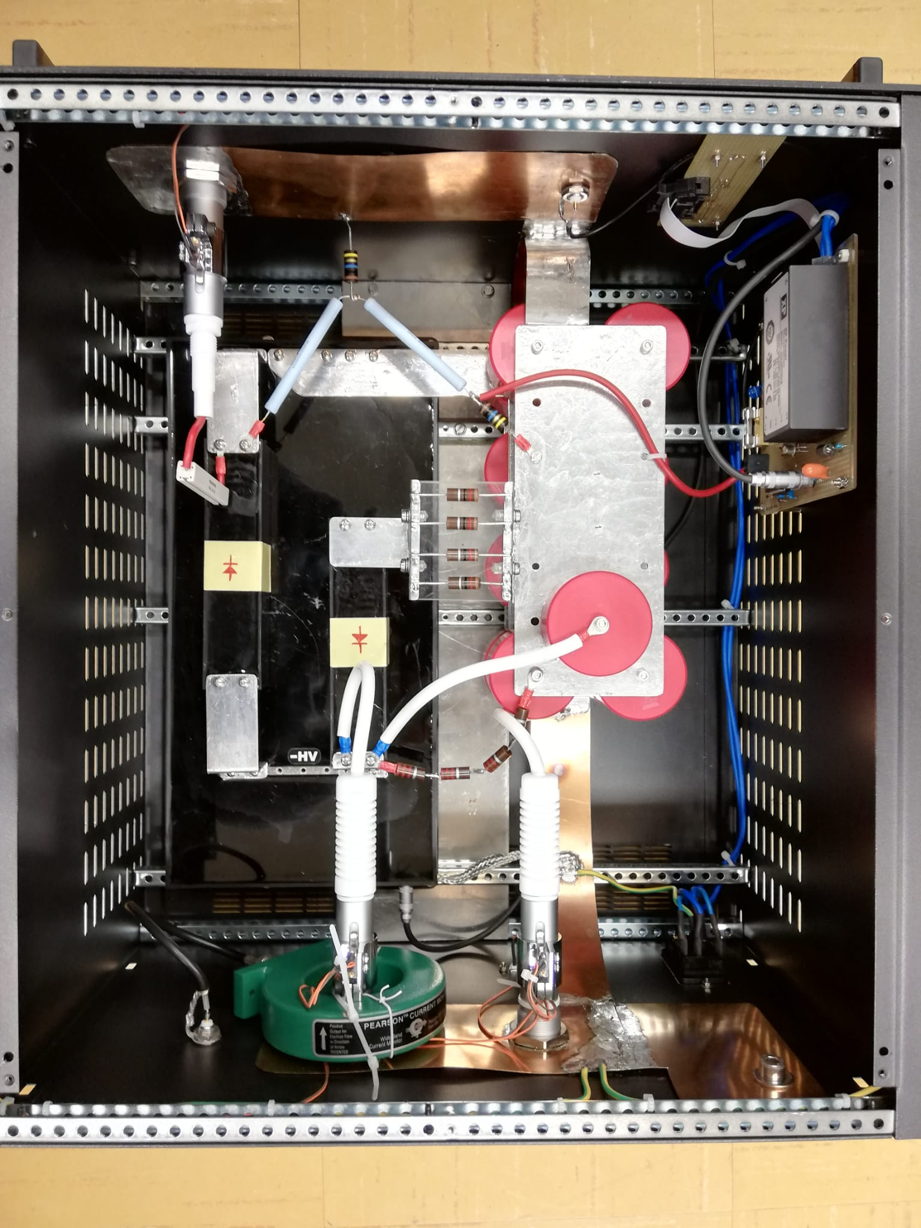
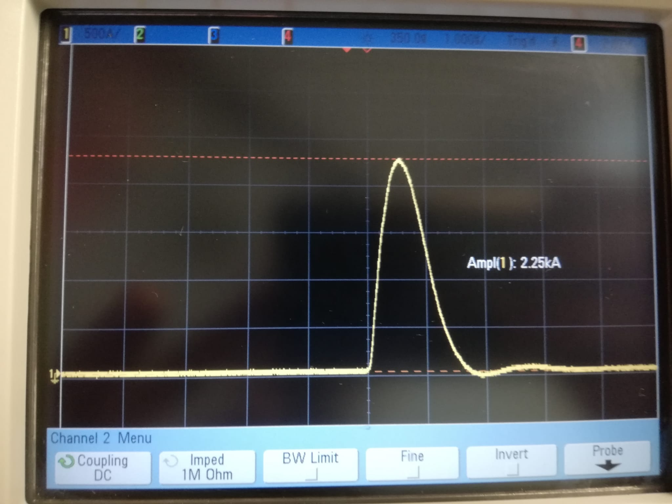
HV Pulser used for APB at SPAR_Lab
Thanks to
D. Pellegrini, T. De Nardis, G. Grilli
Classic RLC pulser
Vmax = 20 kV
Imax = 2.2 kA
HV pulser
First results @ 2.25 kA

Slide 7
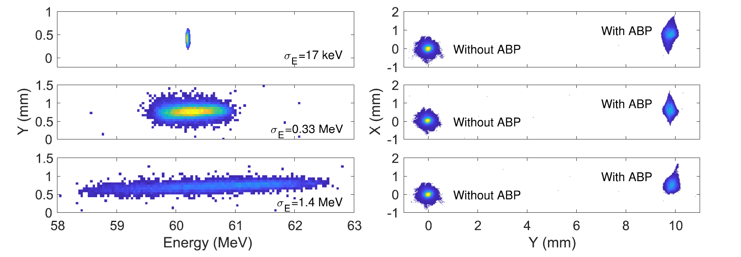
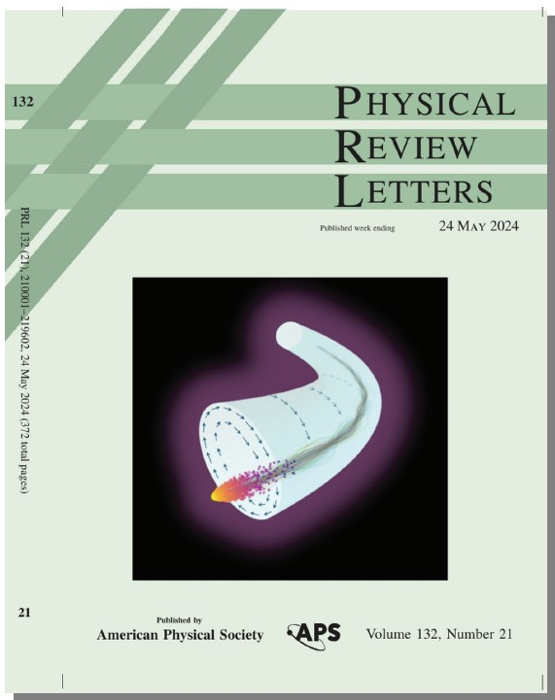
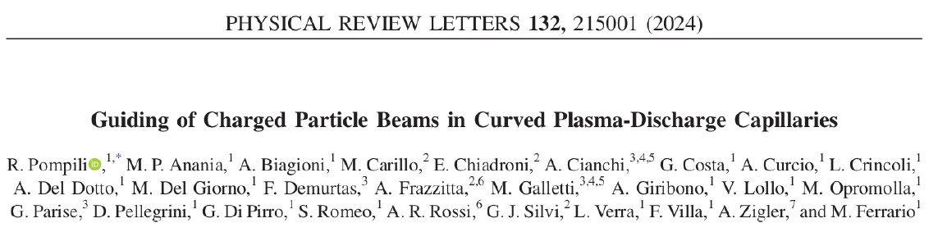
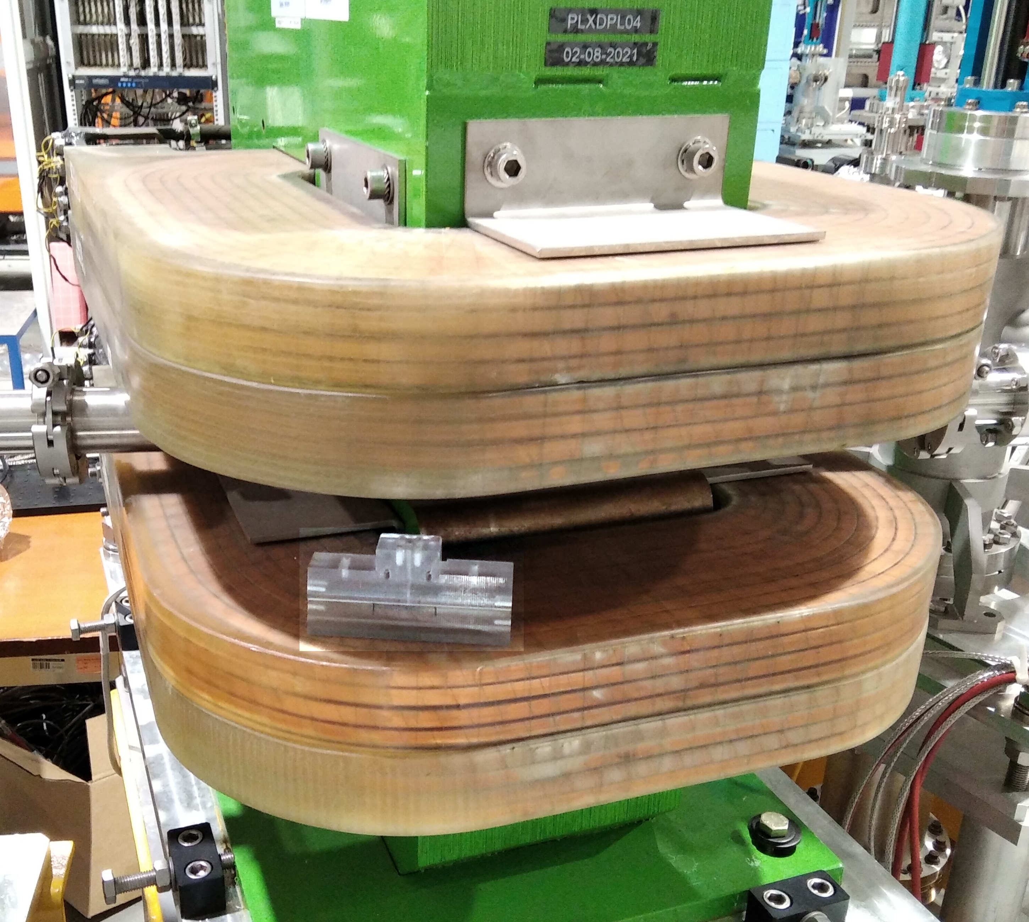
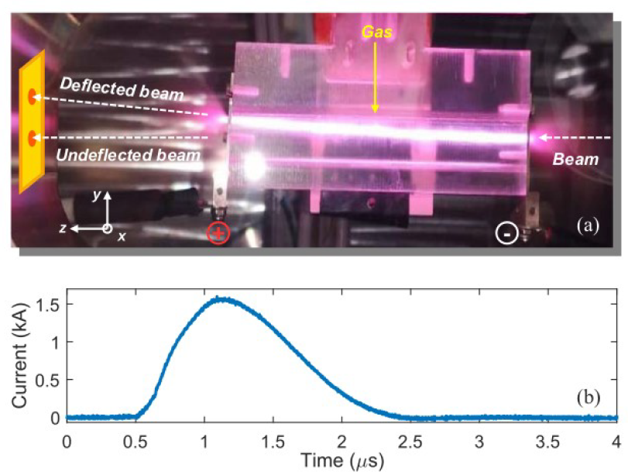
Active Plasma Bending Results at SPARC_Lab
Conventional
Bending
Magnet
By measuring the deflected beam spot size as a function of the input beam energy spread we can estimate how much the bending is affected by the beam chromaticity
The measured spot sizes are almost identical with each other. The plasma bending introduced a transverse focusing but not dispersion
Plasma bend

Slide 8
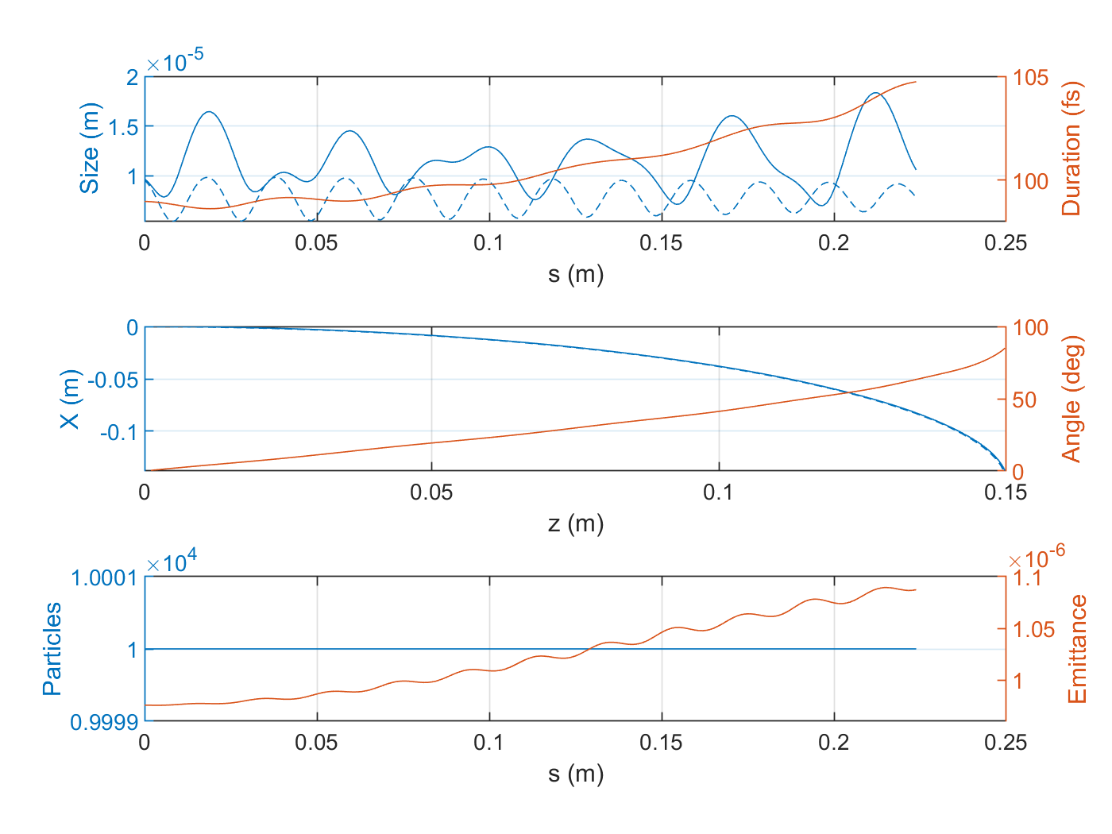
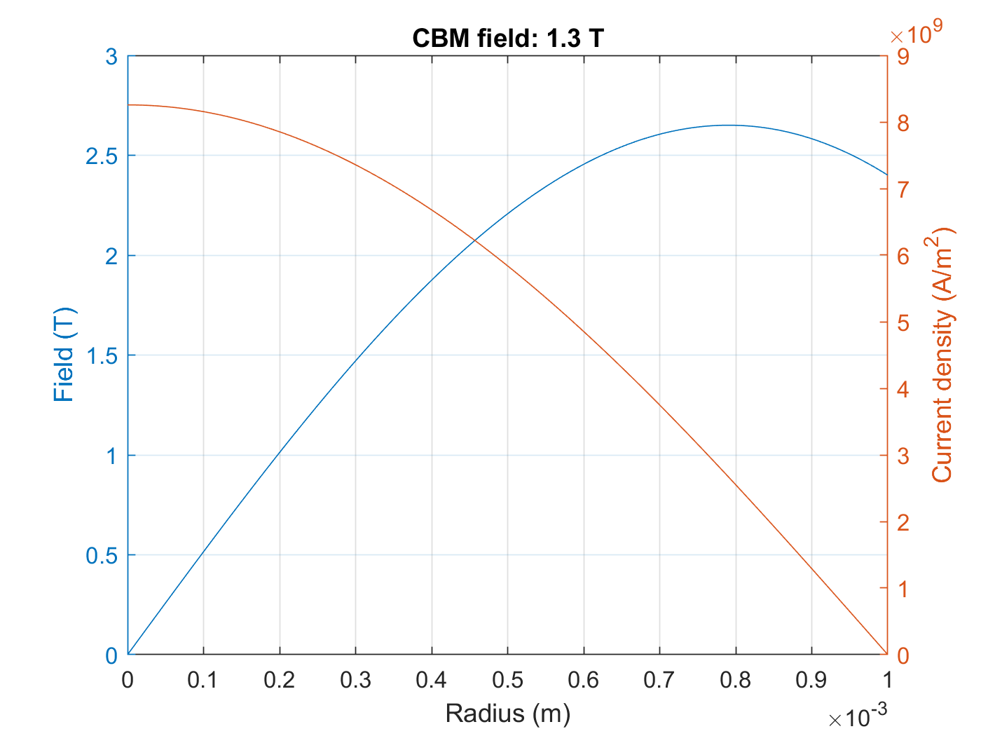
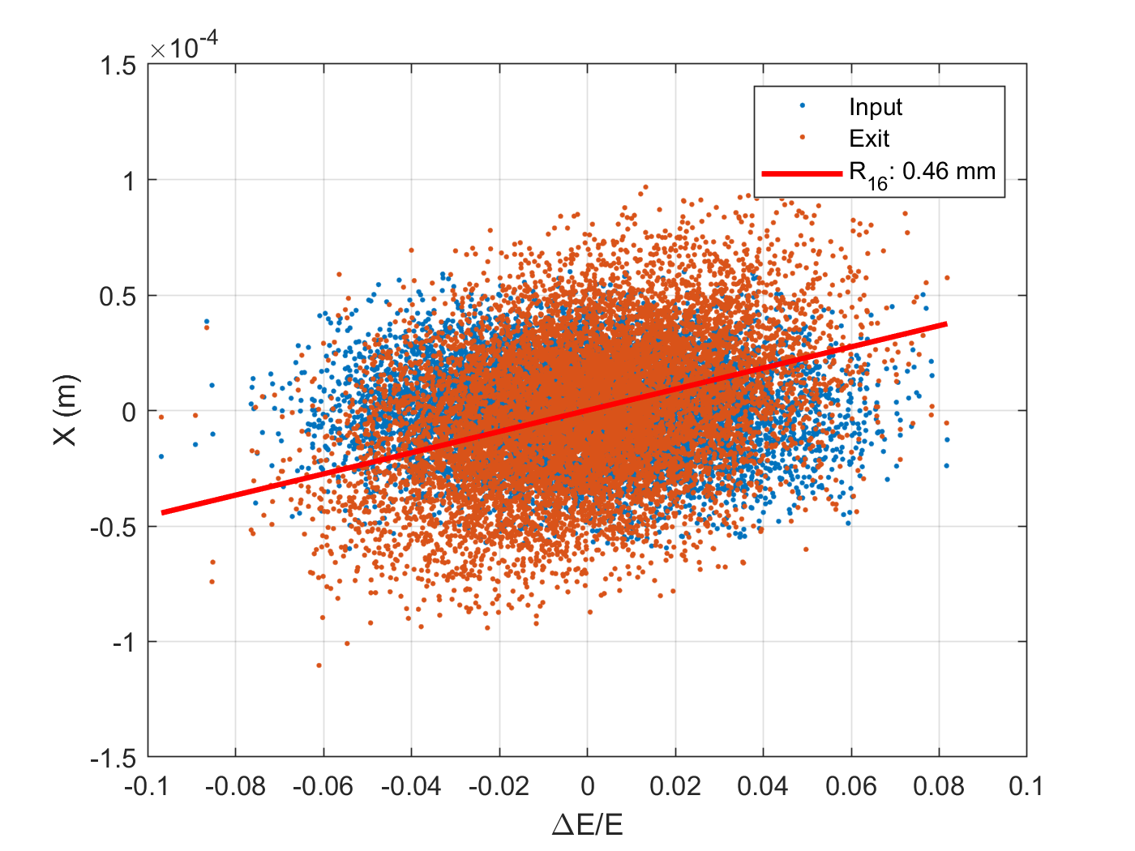
90° APB : Analytical studies
12
A discharge current of 12 kA generates an azimuthal magnetic field up to ~2.6 T inside the capillary
A weak energy–position correlation (dispersion) is observed at the exit, quantified by R₁₆ ≈ 0.46 mm
The 60 MeV electron bunch is bent by ≈90° over the 20 cm long curved plasma channel
Emittance growth remains limited (<10%) and charge transmission is 100%
12 kA NEEDED!!!
Filament on

Slide 9
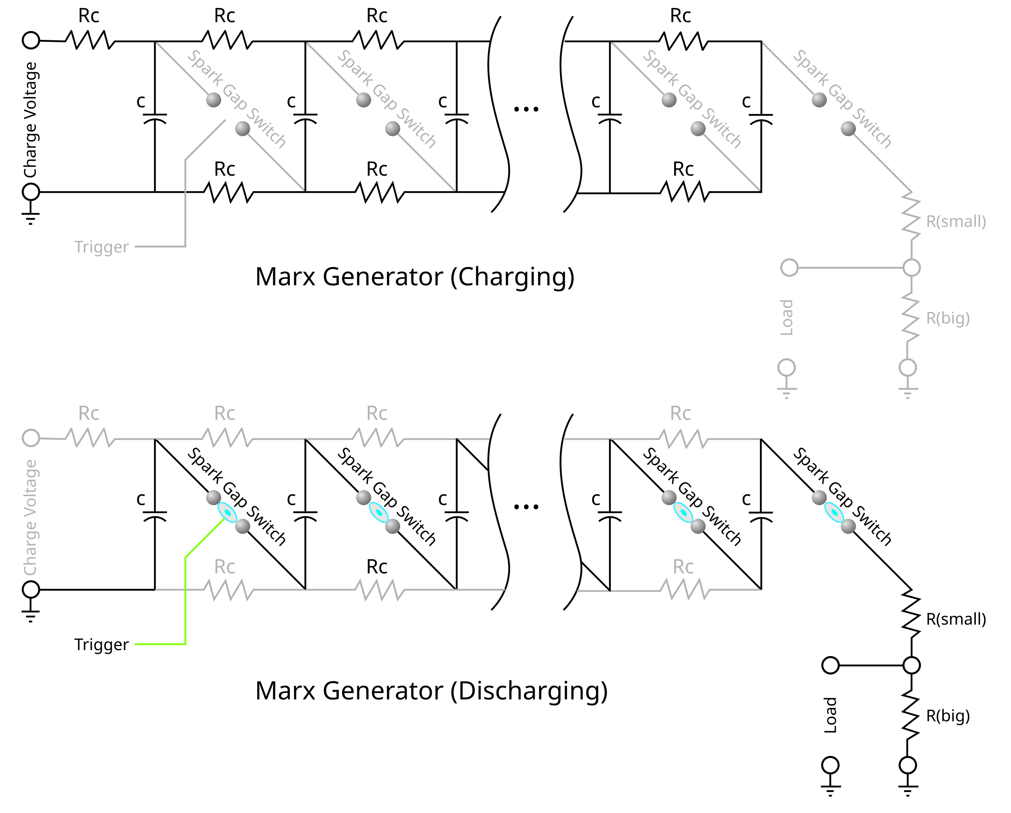
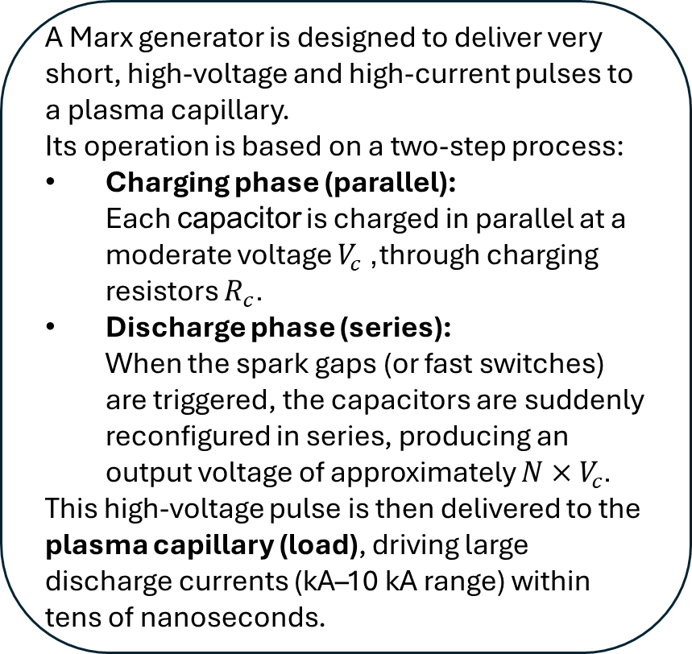
High Current Pulser : Marx Generator
A Marx generator is designed to deliver very short, high-voltage and high-current pulses to a plasma capillary. Its operation is based on a two-step process:
Charging phase (parallel): Each capacitor is charged in parallel at a moderate voltage $V_{c}$, through charging resistors $R_{c}$.
Discharge phase (series): When the spark gaps (or fast switches) are triggered, the capacitors are suddenly reconfigured in series, producing an output voltage of approximately $N×V_{c}$.
This high-voltage pulse is then delivered to the plasma capillary (load), driving large discharge currents (kA–10 kA range) within tens of nanoseconds.
Very short pulses (tens of ns)
Laser ignition for spark gaps : Jitter reduction from ns to ps

Slide 10
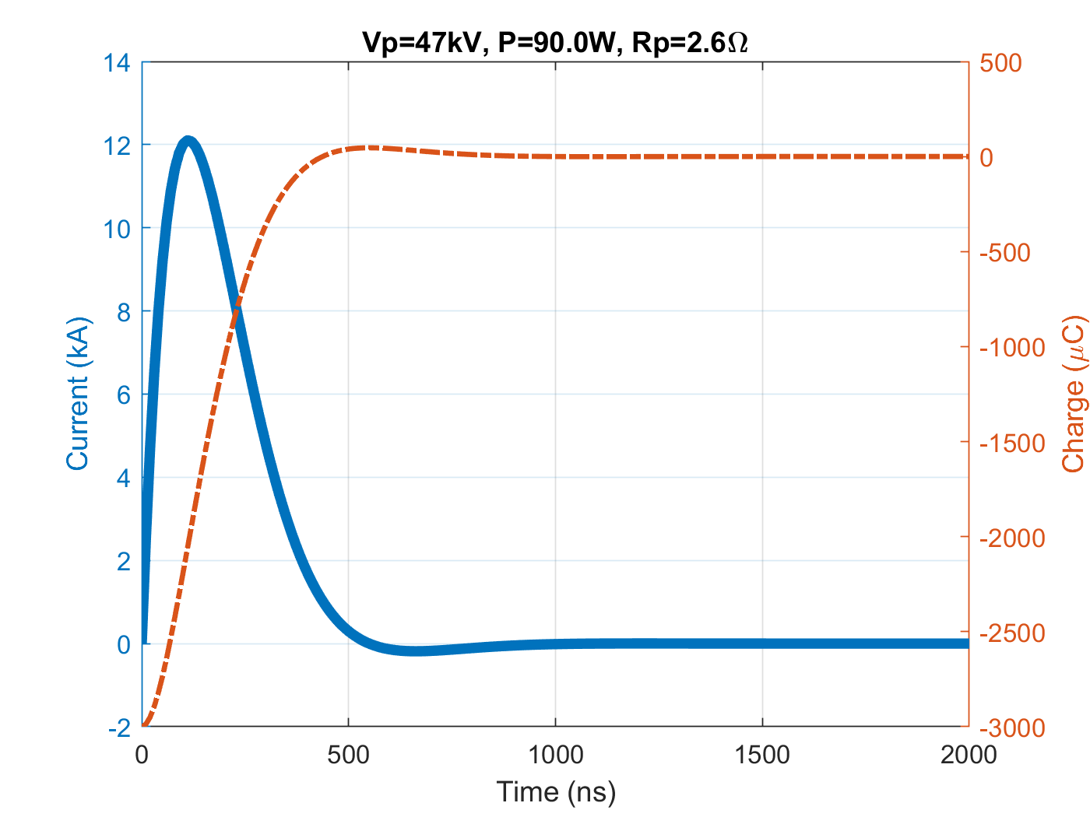

Marx Generator Simulations
Parameters | Value | Comments
Numbers of gaps (N) | 2 | Equivalent to 2 stages at 30 kV each
Output voltage (V) | 60 kV | From 2 × 30 kV
Capacitance per stage (Cᵢ) | 100 nF | Equivalent capacitance = 50 nF
Inductance per stage (Lᵢ) | 18 nH | Total inductance ≈ 36 nH + plasma contribution
Cable length | ~0.1 m | ≈0.05 m effective half-length per side
Capillary length | 20 cm | Radius = 1 mm
Effective resistance (R) | ~2.6 Ω | Approximated load (plasma) resistance
$$V_{\text{plasma}}=V_{\text{tot}}⋅\frac{R}{R_{\text{tot}}}=47 kV$$

Slide 11
Why a Marx Generator instead of a classical RLC pulser?
Marx generator:
Capacitors charged in parallel, discharged in series → voltage multiplication.
Produces short pulses (hundreds of ns and lower) with much faster rise times.
Higher peak current → stronger plasma density and magnetic fields.
Reduced energy per pulse → thermal management, enabling operation >400 Hz
Classical RLC pulser:
Single capacitor charged and discharged through a switch.
Pulse durations in the hundreds of ns to µs range.
Limited peak current (hundreds of A).
Higher energy per pulse → thermal stress at high repetition rates.

Slide 12
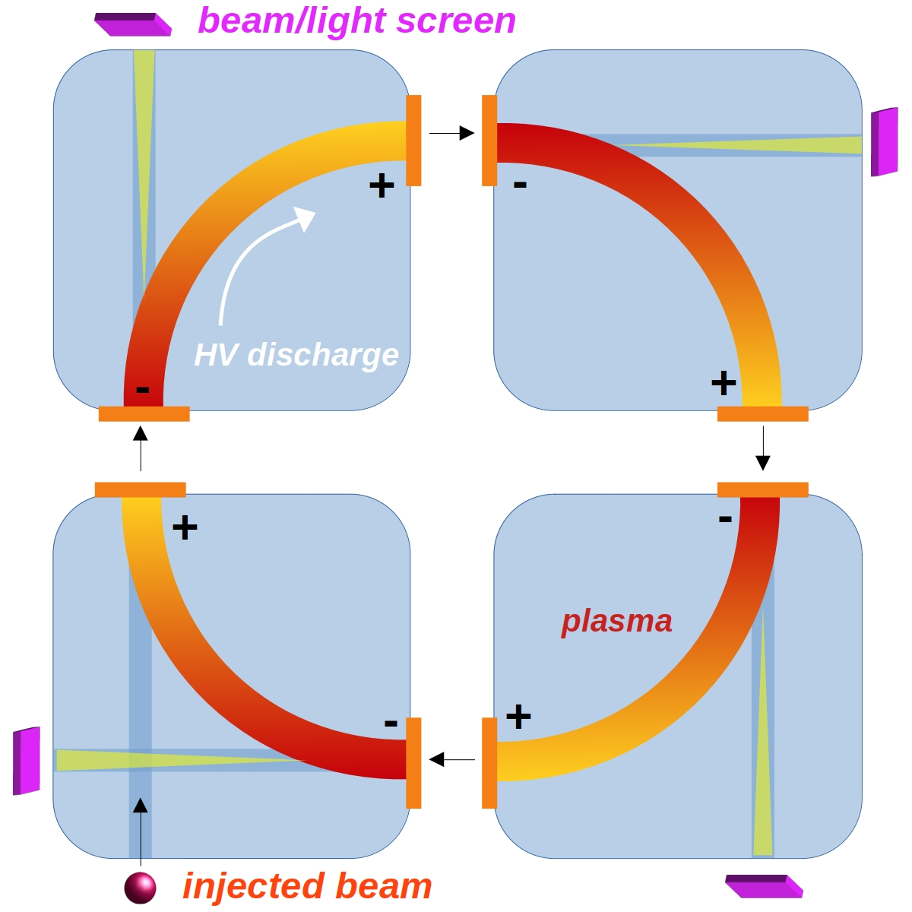
Applications : Table-top Synchrotron
Multiple achromatic plasma bends can be put together and “fired” to circulate an electron beam
Table-top synchrotron radiation source (SRS)
Light emission from ultra-short bunches (like FELs)
Ideally a light source with typical features of SRS (power spectrum, rep rate) and FELs (ultra-short, coherent pulses) can be envisioned

Slide 13
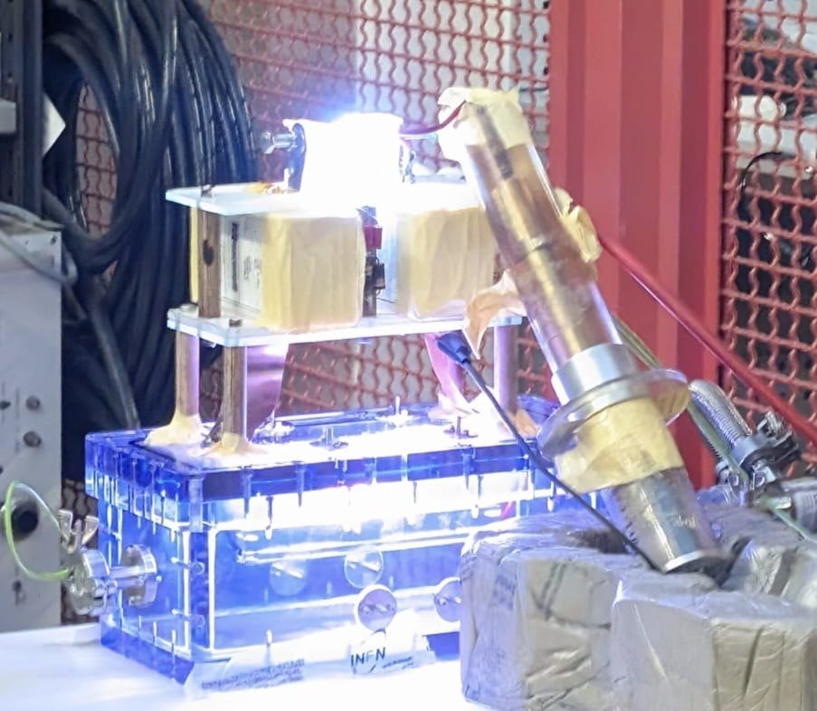
Ongoing and future Marx Activities
Preliminary tests of a first Marx prototype, designed as a plug-and-play beamline component: circuit directly attached to the vacuum chamber with a mounted capillary
New laboratory dedicated to HV discharge for the development of this circuit
Study of Plasma analytical model of the discharge and the current + beam-plasma simulations
Gas simulation for curved capillary
Measurements of plasma parameters (density, temperature)

Slide 14
Thanks !
QUESTIONS ?

