Slide 1
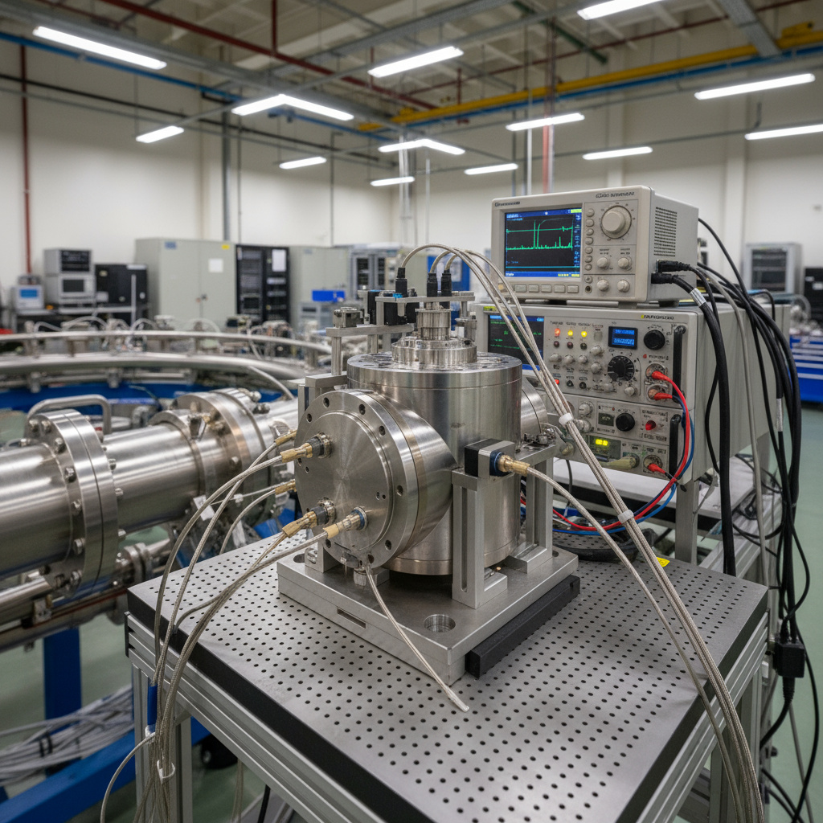






Simulation and Feasibility Analysis of a Compact, Non-invasive Re-entrant Cavity-based Bunch Charge Monitor
EuPRAXIA CAMP III, University of Pécs
Sruthy Chandran
06/10/2025

Slide 2

AEgIS experiment and why diagnostics are hard.
Basics of resonant cavities.
How the cavity Beam Current Monitors work.
Making them compact: the re-entrant approach.
Shrinking further with material loading.
Extracting femtowatt level signals.
In the EuPRAXIA context.
WHAT TO EXPECT

Slide 3
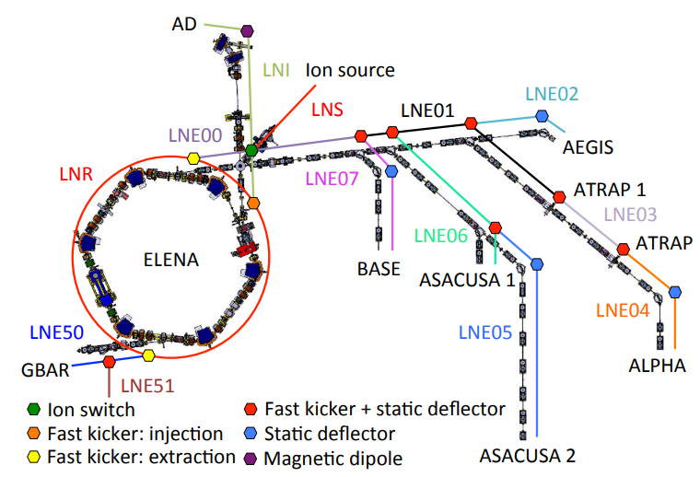
AEgIS
Antimatter Experiment: Gravity, Interferometry, Spectroscopy
AD
Verify Weak Equivalence Principle for antimatter.
Direct detection of g using antihydrogen atom, with 1% precision in Earth’s gravitational field.
Produced pulsed antihydrogen in 2018 for the first time.
First ever laser cooling of positronium (Physics World Top-10 breakthrough of 2024).
AEgIS
ELENA
Source: M. A. Fraser, 2015
Receives antiprotons of energy 100 keV (pC charge), ~75 ns bunch length from ELENA every 2 minutes.

Slide 4
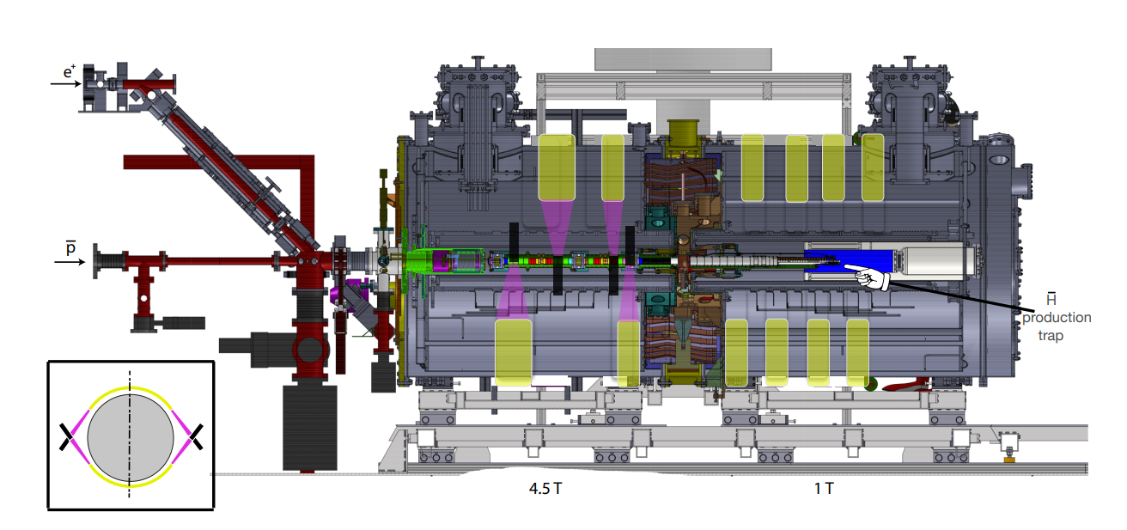
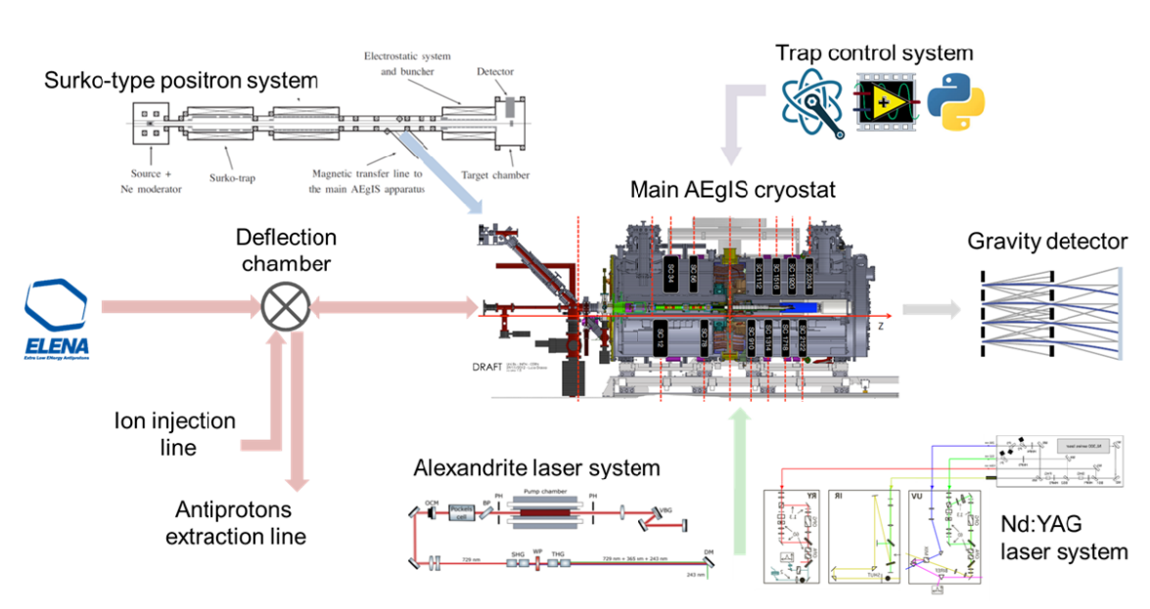
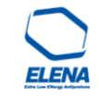
Diagnostic at AEgIS
MCP/Faraday Cup
100 keV antiprotons, ~75 ns, every 120s
Scintillators
5 T
1 T
Scintillators have a systematic uncertainty of 50% [R. Caravita et al., 2017].
Charge loss in Faraday Cup due to neutral particles created [B. S. Rawat et al., 2025].
Can we measure a few pC from one low-β bunch, non-invasively?

Slide 5
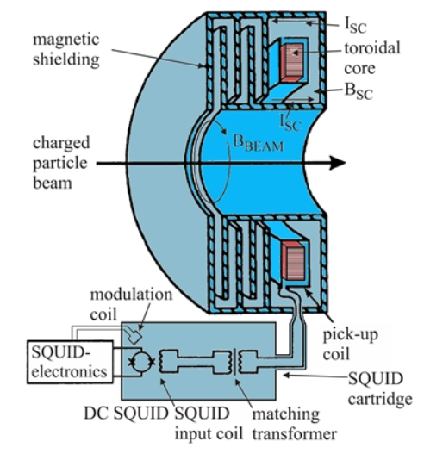
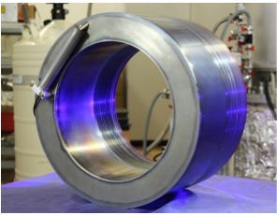
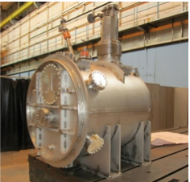
Diagnostic at AEgIS
AD has advanced diagnostics like Cryogenic Current Comparator (CCC).
Able to measure nA current of a single bunch using SQUID based technology.
Non-invasively measure bunch current of frequency DC to several kHz.
250 mm
Source: GSI, Darmstadt
1200 mm
Space limitation and high magnetic fields at AEgIS.
Niobium CCC
CCC at AD
Source: GSI, Darmstadt

Slide 6
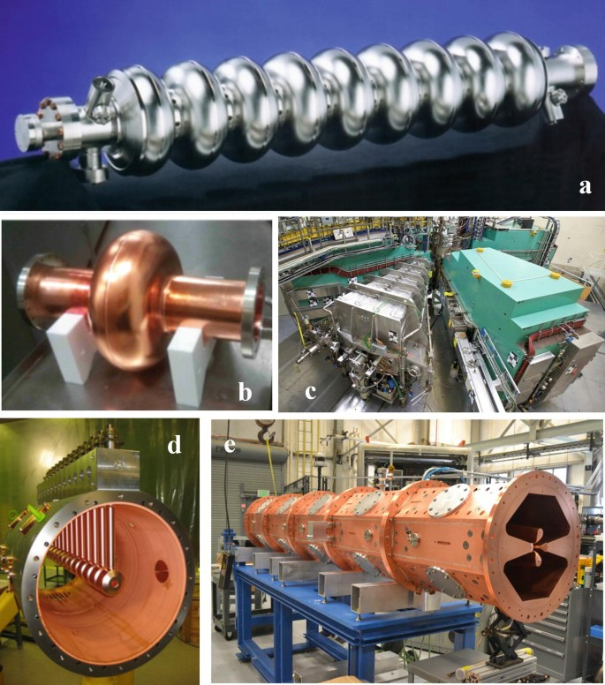
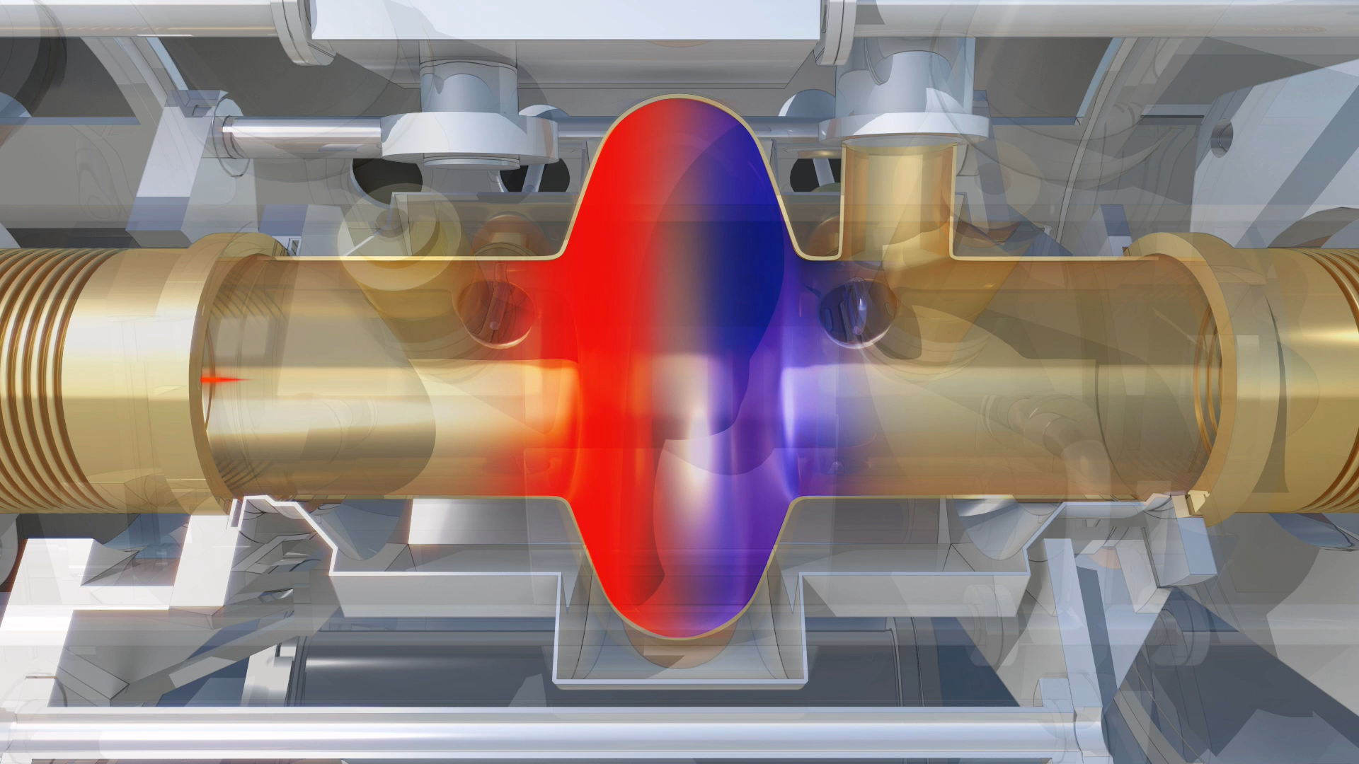
Resonant Cavities 101
Credits: CERN
Source: Simrock & Geng, 2022

Slide 7
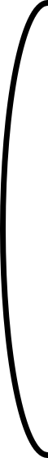



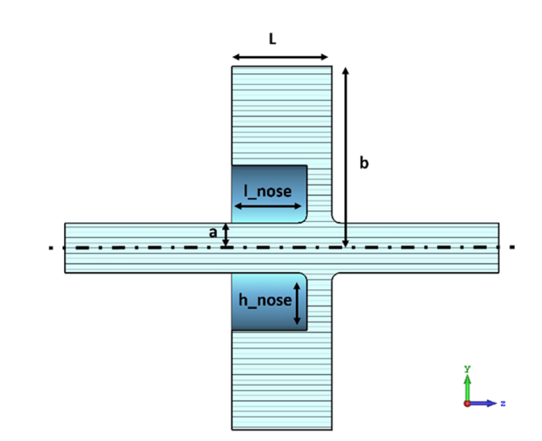
Cavity Beam Current Monitor
Any hollow metal cylinder in principle has infinite set of RF resonant modes defined by wall boundaries [T. R. Pusch et al., 2012].
Transverse Magnetic mode (TM mode) → electric field vector aligned in the longitudinal z axis.
⟹ TM mode couples to the beam.
TE modes: no E field on axis → do not couple efficiently to beam current.
_{B}
Eigen frequency is given by,
m, n, p → no. of half oscillations in each spatial dimension.
L, R → Length and radius of the cylinder.
j_{mn} → n^{th} root of m^{th} order Bessel function.
E
f_{mnp}
A passing charged beam excites the eigen mode of the cavity if it matches with the bunch frequency.
TM₀₁₀ – Lowest monopole mode is used for current measurements.

Slide 8
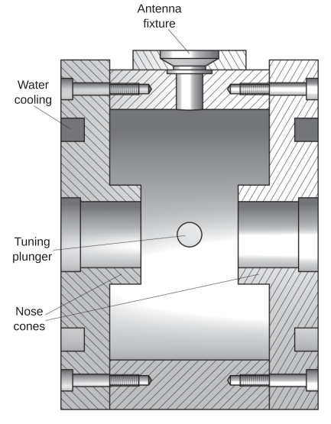
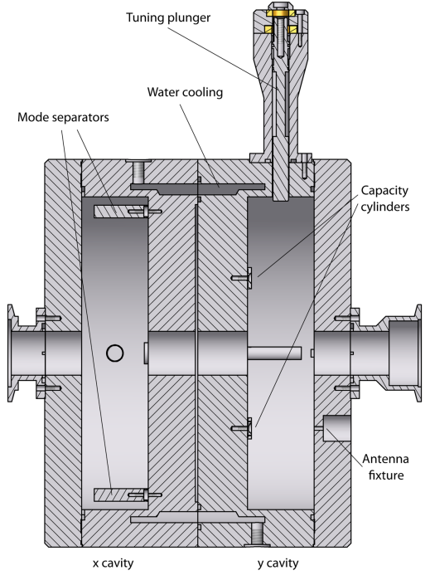
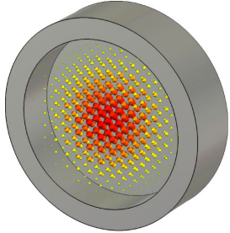
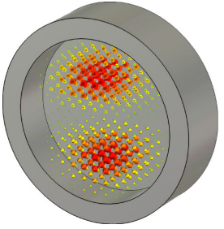
Cavity Beam Current Monitor
TM₀₁₀
TM₁₁₀
Beam Current Monitor
Beam Position Monitor
Source: T. R. Pusch et al., 2012

Slide 9
Cavity Beam Current Monitor
How does one choose the mode frequency, shape, and other parameters ?
For Quasi-CW beam,
f₀ = n f_{rep}
⟹ Integer multiple of the bunch repetition frequency.
Cavity damping time,
𝜏 = Q_{L}/ π f₀
Q_{L}⟹ Loaded quality factor for the mode frequency.
T = 1/ f_{rep} << 𝜏
⟹ Response from a bunch stays and is averaged out over different bunches.
T = 1/ f_{rep} >> 𝜏
⟹ Bunch arrives after damping time. Response from previous bunch is lost.
Is it possible to relate the frequency spectrum of a single bunch with cavity eigen mode?!
Will the single bunch response be strong enough to measure?!

Slide 10


Cavity Beam Current Monitor
The power of the signal coupled out of the cavity,
I → Beam Current,
B → Bunch factor,
R_{s} → Shunt impedance of the cavity,
κ → Coupling coefficient,
φ → Phase mismatch between cavity resonance and beam spectrum
Current (I) | Shunt impedance (R_{s}) | Power (P)
nA | kΩ | fW
nA | Ω | aW
Current (I) | Shunt impedance (R_{s}) | Power (P)
µA | kΩ | nW
µA | Ω | pW
For a gaussian bunch of length σ_{t},
Antiproton bunches from ELENA σ_{t} ~ 75 ns ⟹ for B to be maximum (=1), f₀ for TM₀₁₀ = 1 MHz or TM₀₂₀ = 2.29 MHz.
A regular pillbox cavity will need ~115 m!

Slide 11
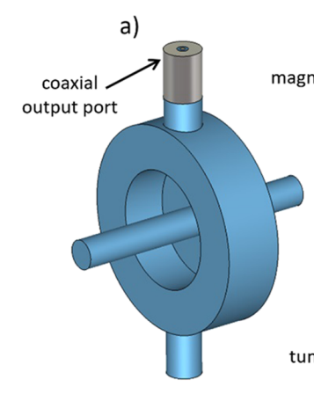
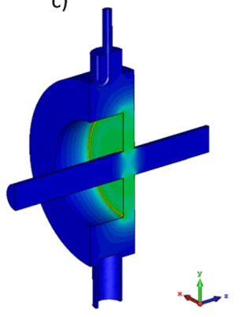
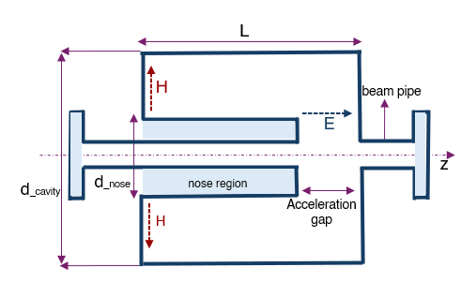
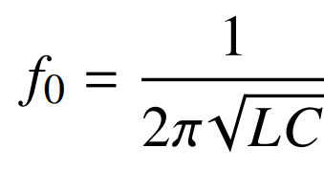
Re-entrant Cavity Beam Current Monitor
Source: F. Cardelli et al., 2021
Size will be reduced significantly.
But how much?!
Added nose cone separate and enhances capacitive and inductive regions.

Slide 12
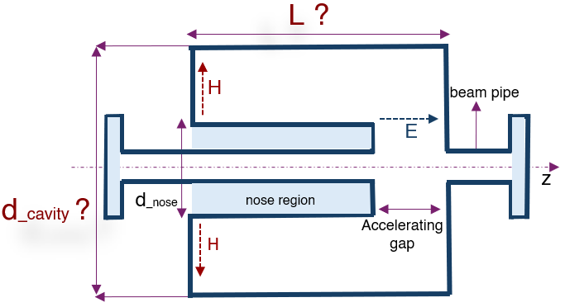
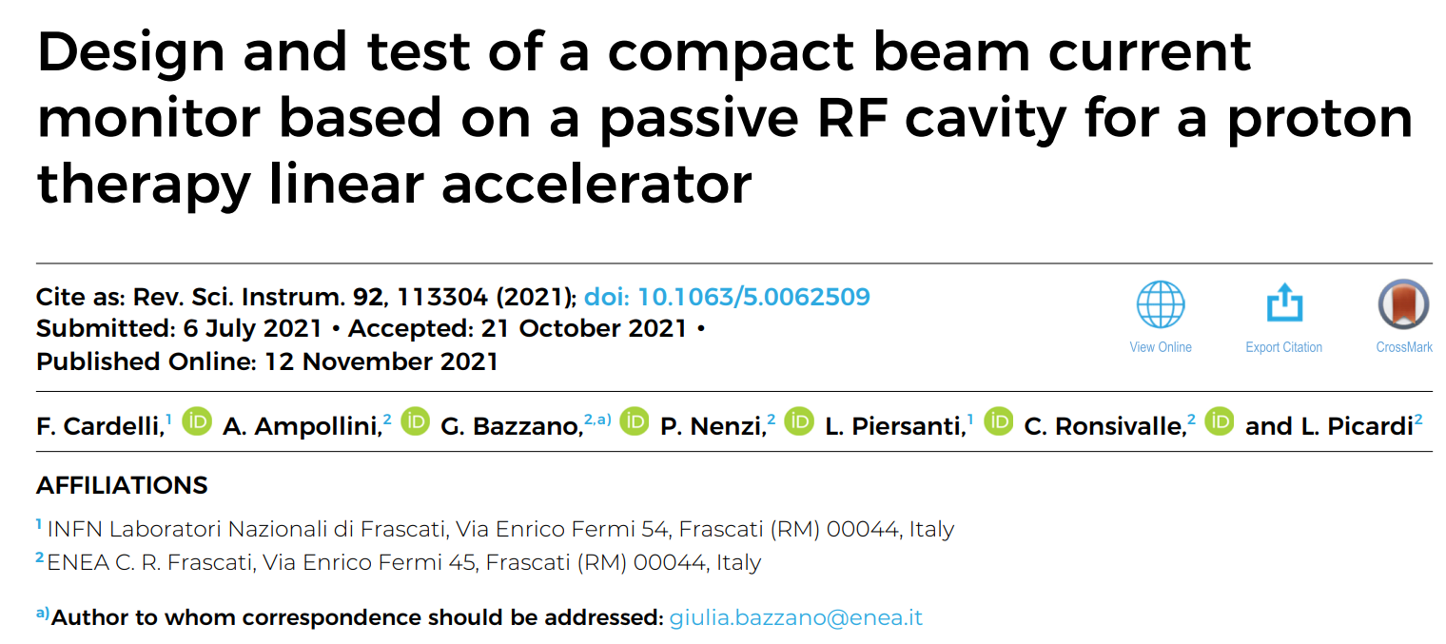
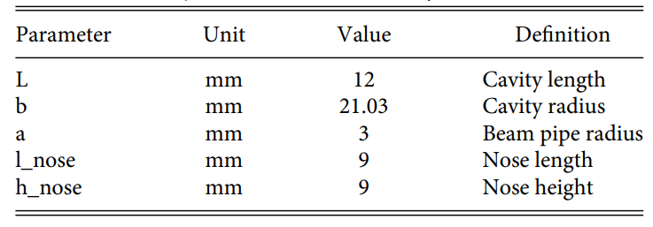
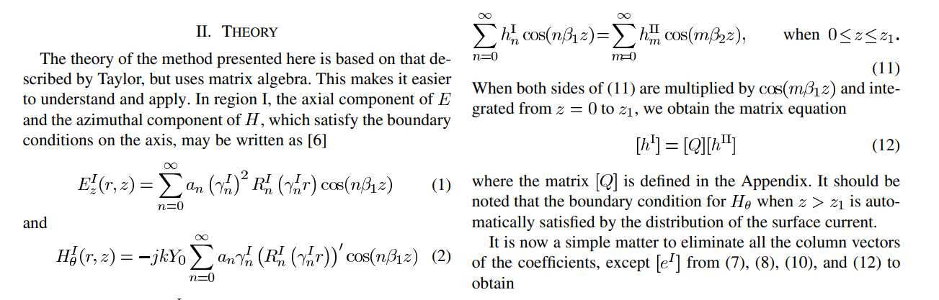

Re-entrant Cavity Beam Current Monitor
For f₀= 2.99 GHz
Source: Carter et al., IEEE TMTT 2007

Slide 13
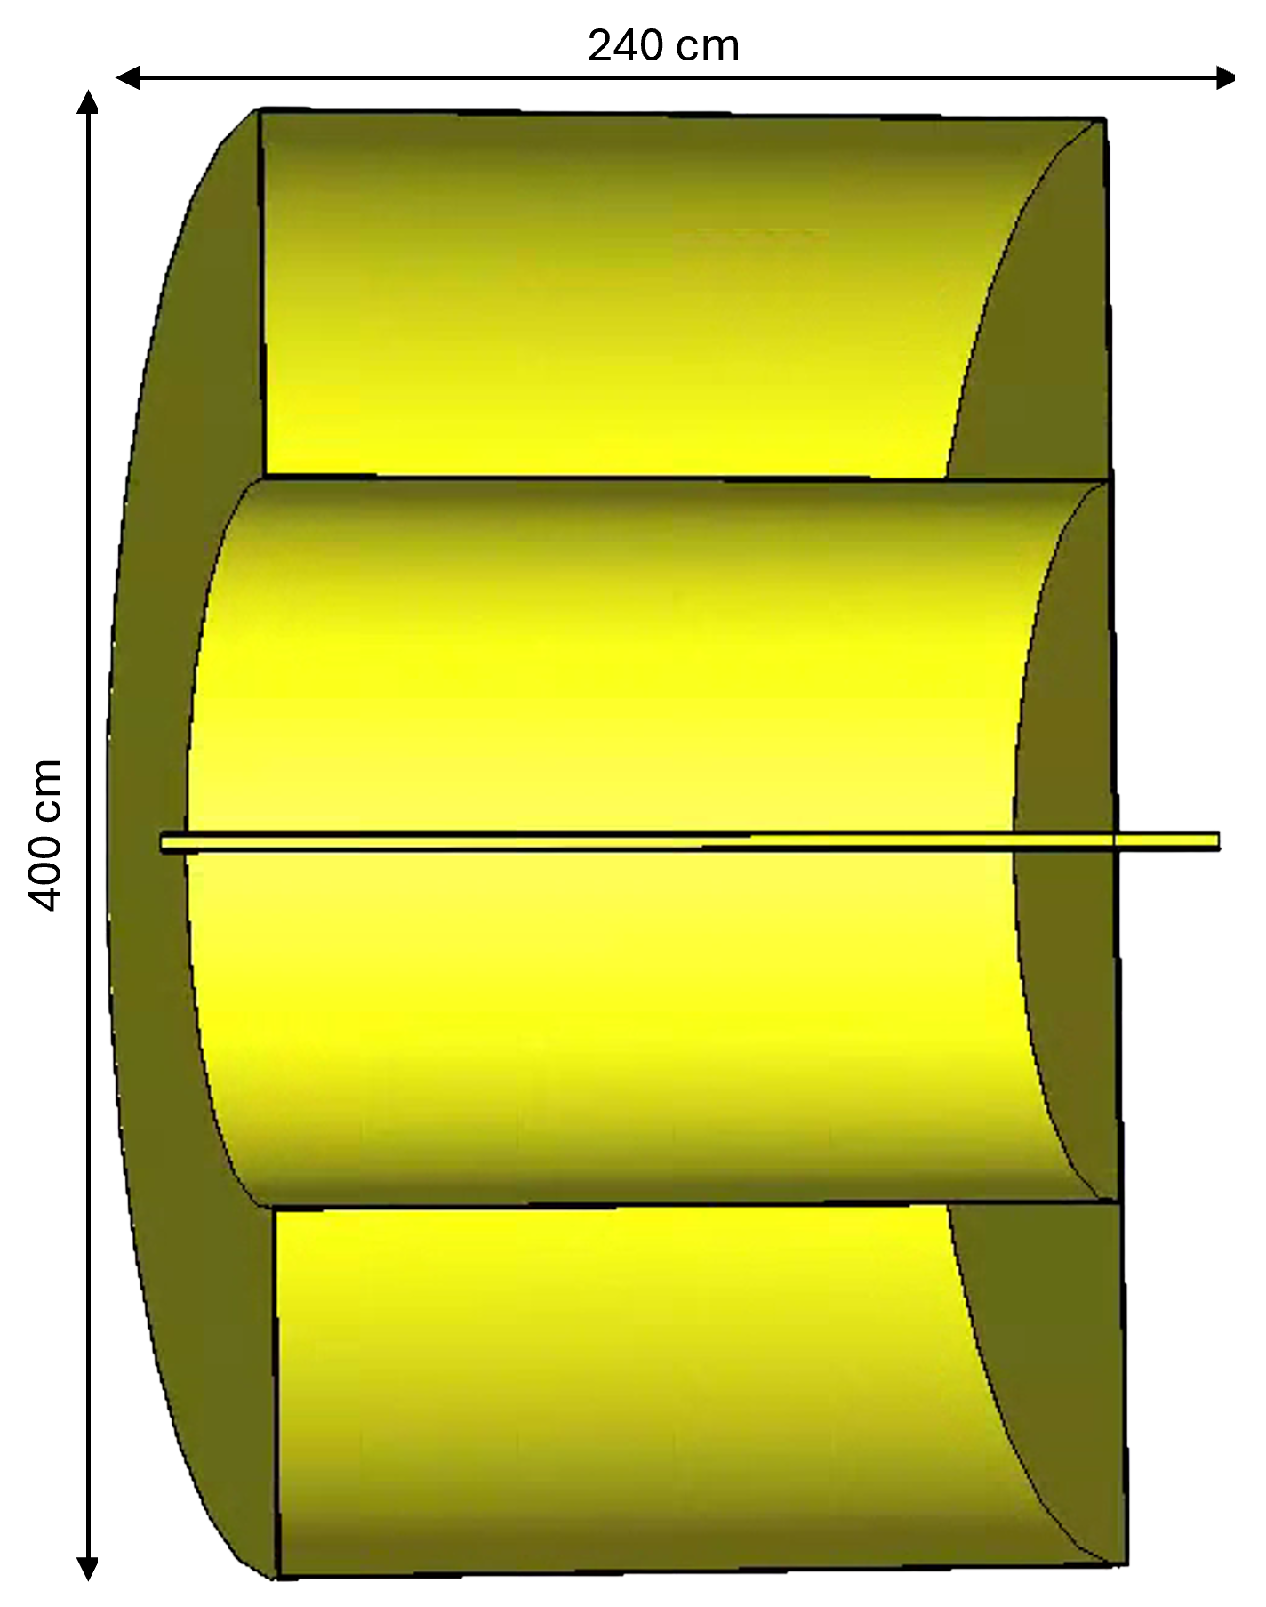
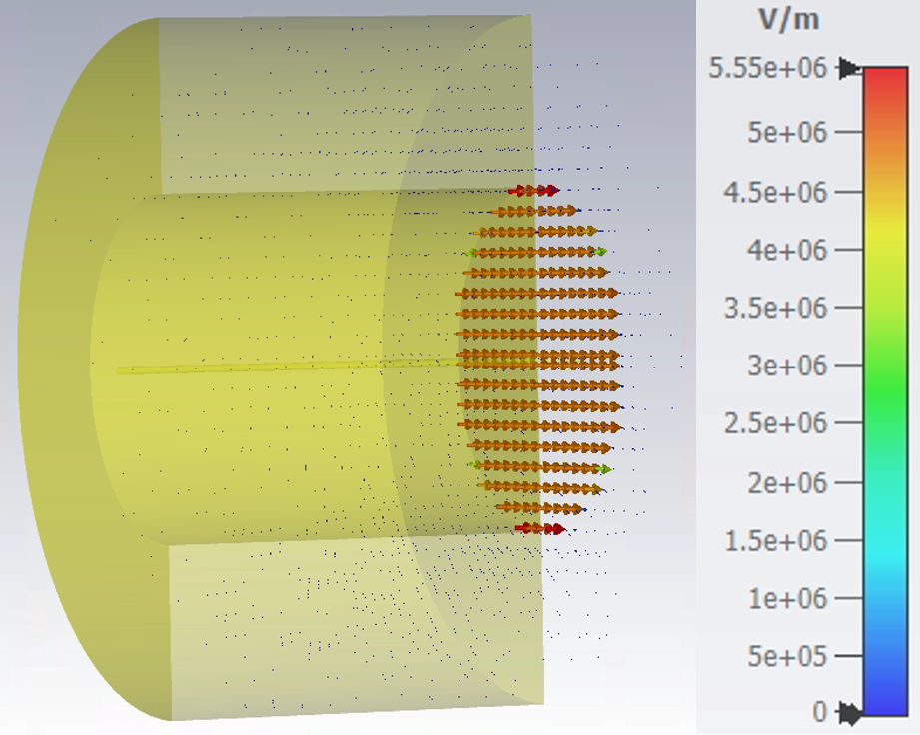
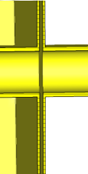
Simulation of Re-entrant Cavity Monitor
Antiproton bunches from ELENA σ_{t} ~ 75 ns ⟹ for B to be maximum (=1), f₀ for TM₀₁₀ = 1 MHz
or TM₀₂₀ = 2.29 MHz.
240 cm
400 cm
SN40
3 mm
y
y
x
z
x
z
4 m is still big!

Slide 14

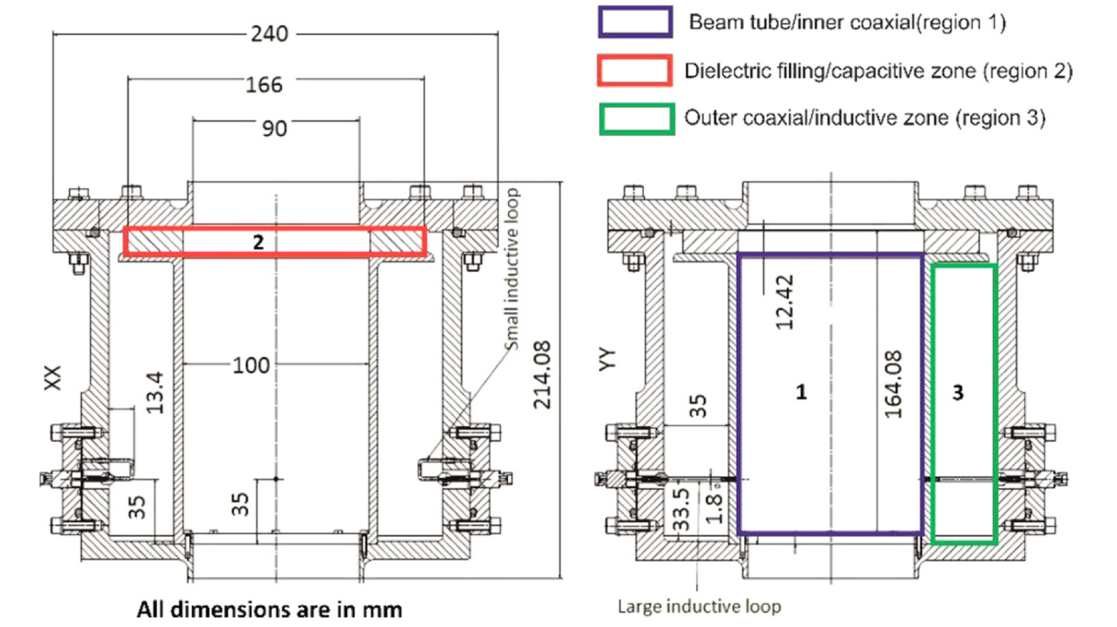
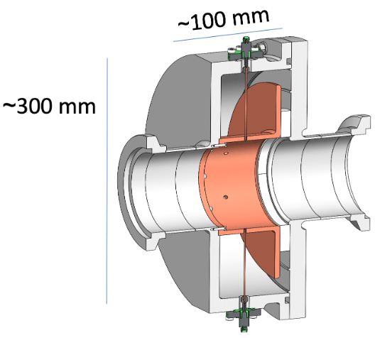
Material Loaded Re-entrant Cavity
Dielectric filling in the capacitive region can help reduce the size further.
But such cavities have very low shunt impedance as dielectric is lossy.
Works for bunches with high repetition rate as signal can be summed up.
30-175 MHz.
Source: Bergoz instrumentation.
Source: S. Srinivasan et al., 2020

Slide 15
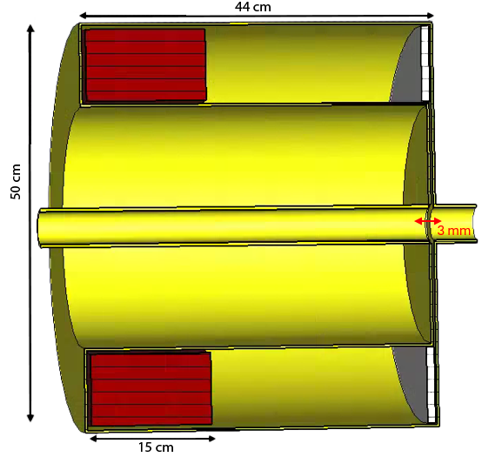
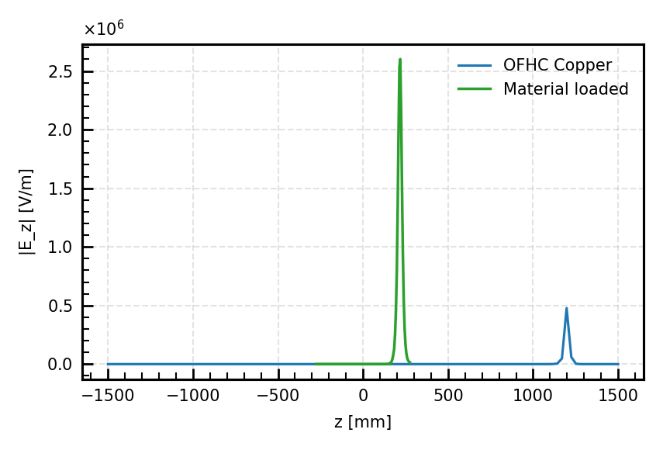
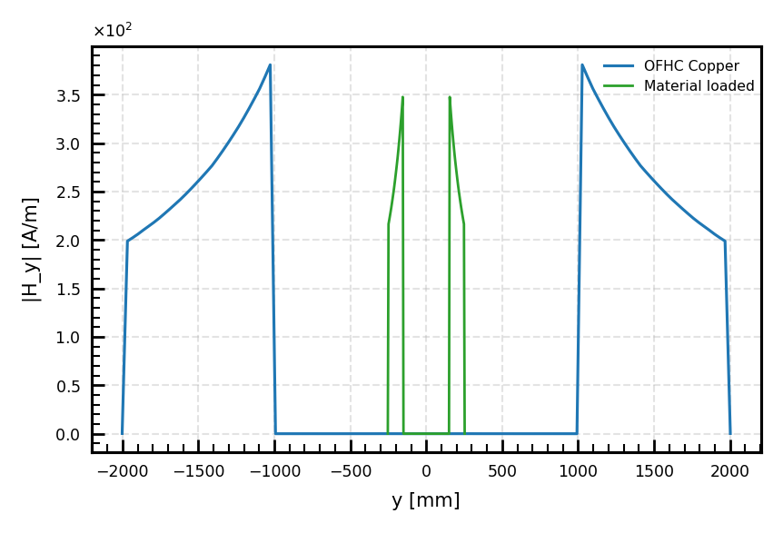
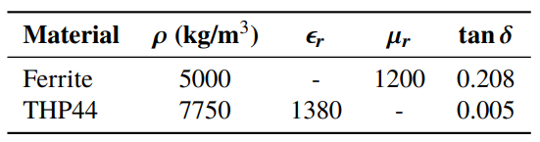
Simulation of Material Loaded Re-entrant Cavity
A gap introduced between the material and the cavity wall.
Dielectric thickness - 10 mm and ferrite thickness - 15 cm.
Unloaded Quality Factor = 409.
Shunt Impedance = 94 kΩ.
y
x
z
115 m → 4 m → 50 cm!

Slide 16
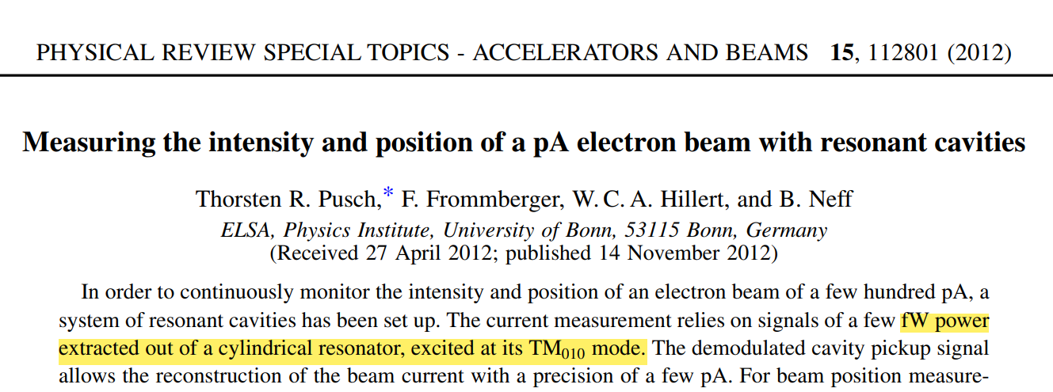
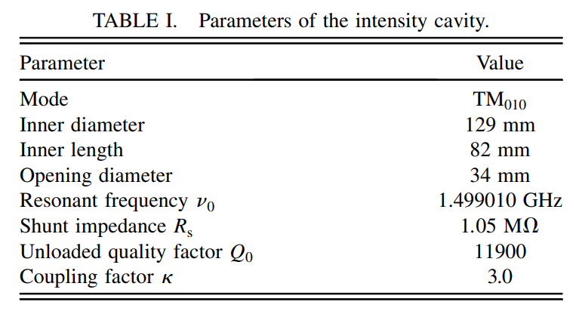
Signal Extraction
Signal at fW scale! Tough, but demonstrated.
~500 MHz, few e⁻ in a bunch – 200-800 pA current.
5-75 fW power β=3, -113…-101 dBm
RF LNA
+90 dB gain
RF band pass filter
Mixer with LO
|RF-LO| = 180 MHz
IF Band pass filter
Logarithmic detector
RF power to DC
Low pass filter
Opto-isolation
ADC→ PC
With pA resolution

Slide 17
What’s Next?
Mechanical practicality: Supports and fixtures to mount dielectric/ferrite.
Sensitivity: explore the geometry for a higher Q₀ and R_{S}.
Coupler to the external circuit: loop (H-field) or probe (E-field).
Optimise coupling constant β (=1,2,3..?) for optimum Q_{L}.
Ferrite heating is a possibility. Cooling system to be designed.
Ferrite and dielectric material exploration.
Readout choices: cryo-amplifier, double extraction etc.
Target: measure nA current with a resolution of pA.

Slide 18
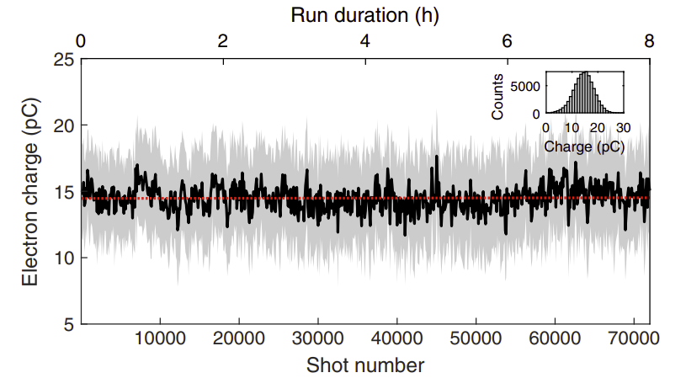
In Light of EuPRAXIA
AEgIS
Low-energy, non-relativistic (100 keV).
Bunch length: 75 ns (⟹ 1 MHz).
pC charge per bunch.
Repetition rate: 2 minutes.
Cannot average.
EuPRAXIA
Ultra-relativistic, high-energy (GeV).
Bunch length: few tens of fs (⟹ GHz-THz).
pC charge per bunch.
Repetition rate: 10-100 ms.
Shouldn’t average.
Shot-to-shot instability in EuPRAXIA or LPA:
Shot-to-shot jitter can be in charge, energy etc.
Cross-shot averaging can be misleading.
Dominant jitter parameter depends on the injection scheme.
Charge jitter, in cases when dominant, can reach ~26% rms.
Source: Bohlen et al., 2022

Slide 19
In Light of EuPRAXIA
Goal: stable, reproducible electron beams suitable for FEL, imaging etc.
Injection scheme still under optimisation [EuPRAXIA CDR, 2020].
Jitter mainly in energy, sensitive to plasma density and phase [S.Romeo et al., 2024].
Per-bunch charge measurement essential for calibration, feedback, user data.
Cavity-bunch spectrum relation allows single-bunch charge measurement (and more).
fs bunches → smaller GHz–THz cavities, often with higher RF performance.
Stronger, clearer signals possible for single-shot readout.

Slide 20
Conclusions
Feasibility:
compact, material-loaded re-entrant cavity BCM for long, low-energy bunches.
Key challenge:
single-shot signals below thermal noise- advanced extraction needed.
Impact:
non-invasive charge measurement for antimatter and precision physics.
Next steps:
optimize cavity geometry and coupling, address ferrite heating etc.

Slide 21
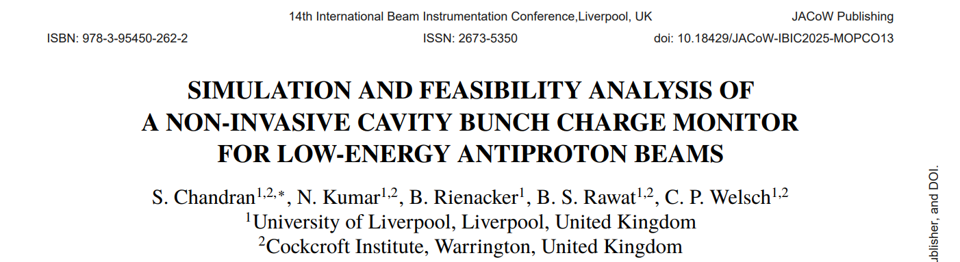



Acknowledgements
Narender Kumar, Benjamin Rienäcker, Bharat Singh Rawat, Carsten P Welsch

Slide 22
Backup slides

Slide 23
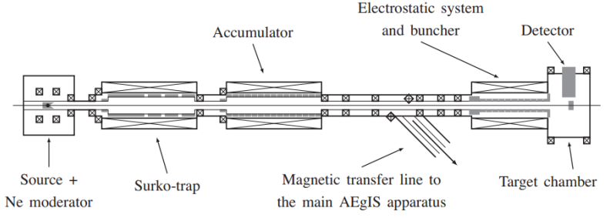
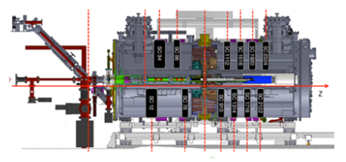
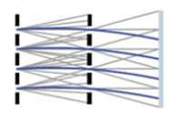

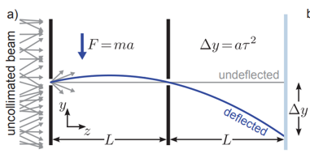
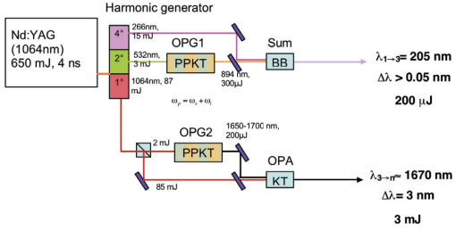
AEgIS- Schematic
AEḡIS cryostat
Moire deflectometer
100 keV
antiprotons
Ps
Ps*
Hbar
Antiprotons at 100 mK
Silicon target
1³S → 3³P
3³P → Rydberg excitation state

Slide 24
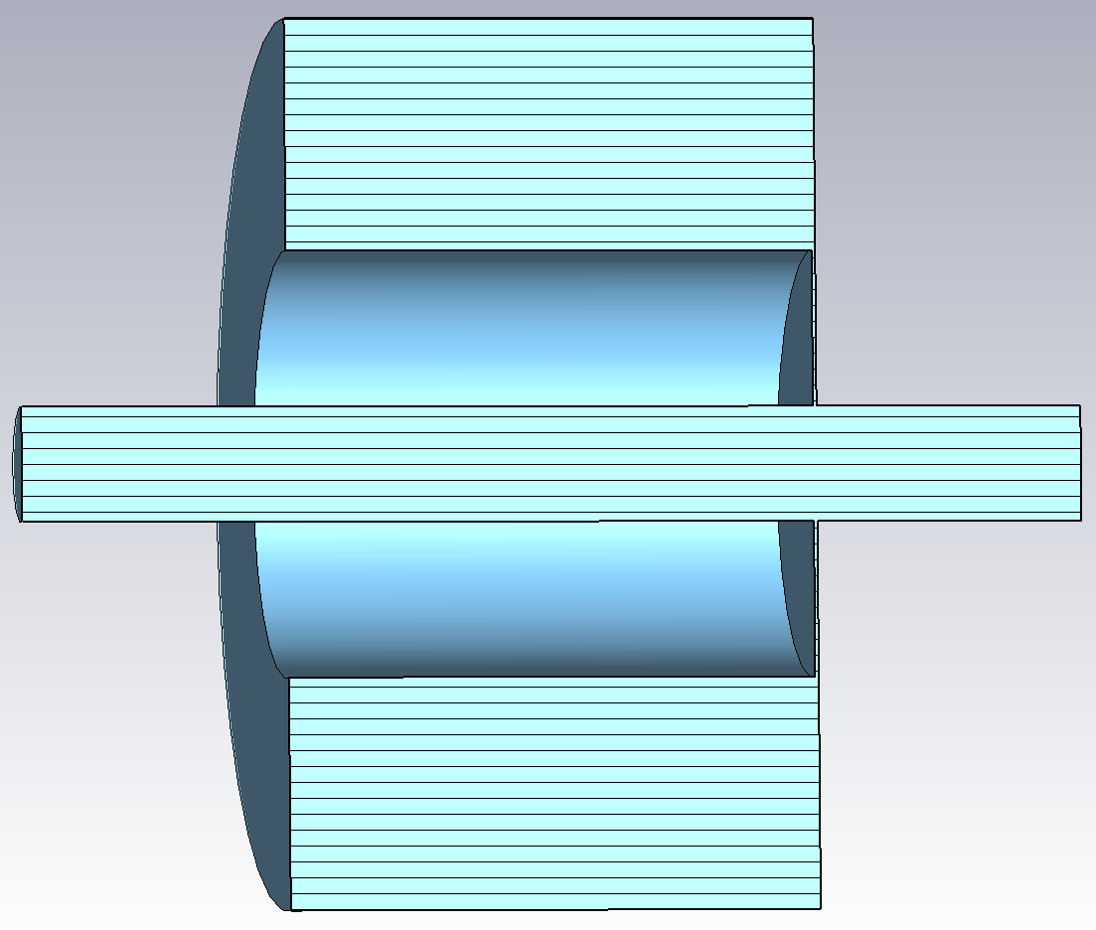
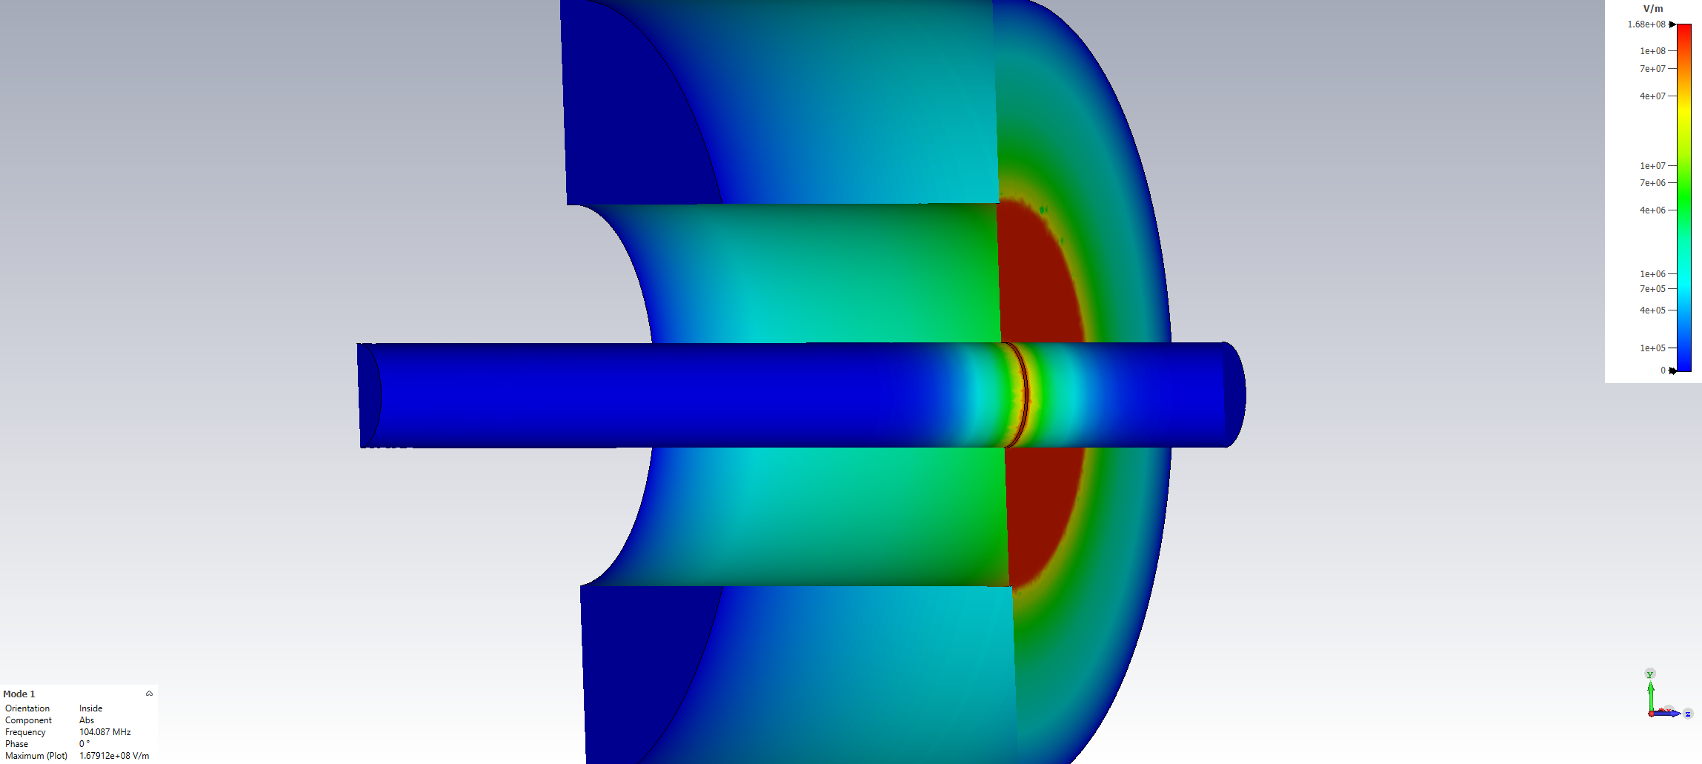
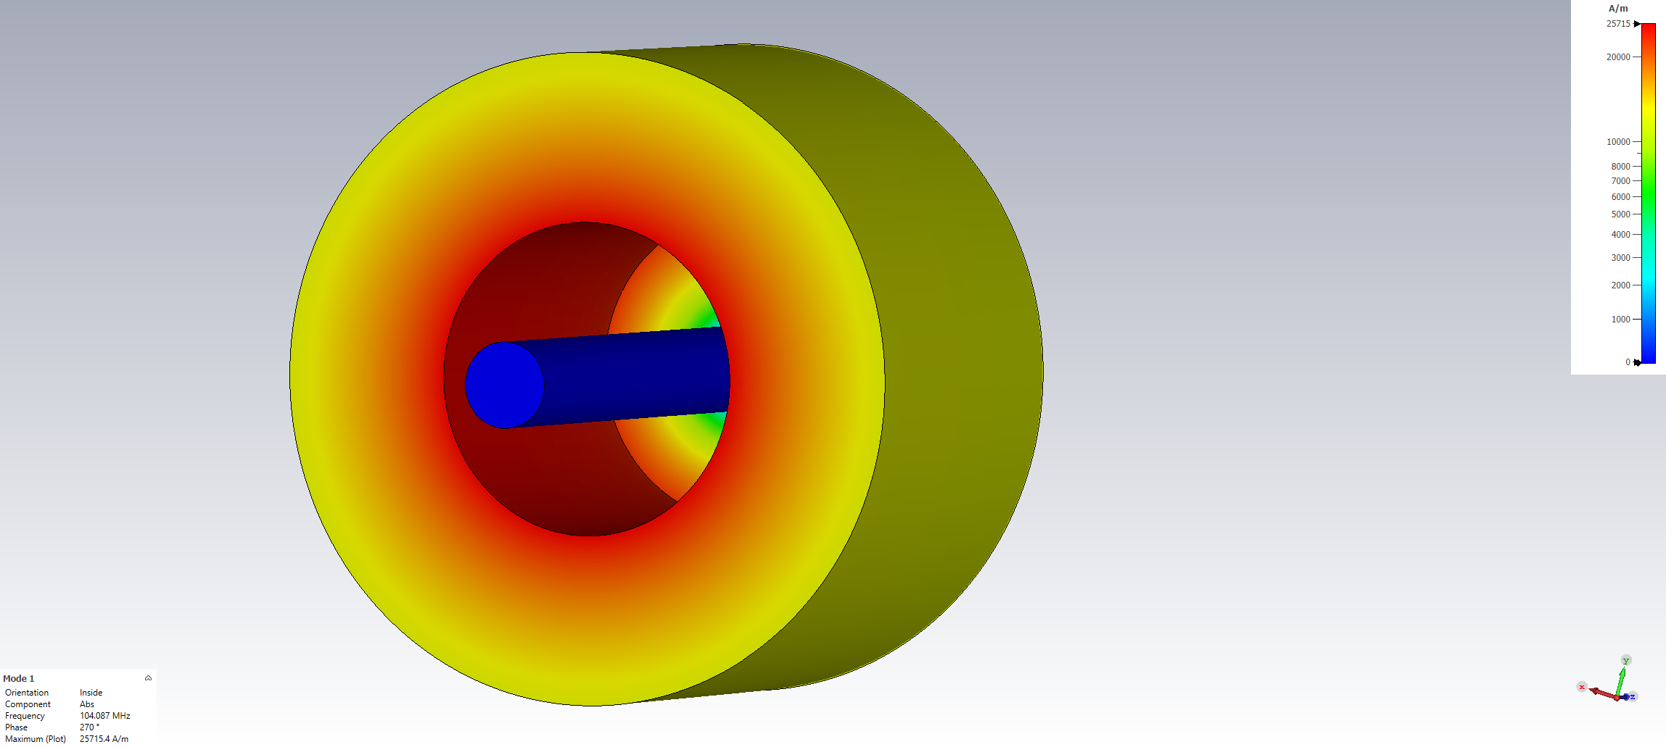
150 mm
250 mm
33 mm
1 mm accelerating gap

Slide 25
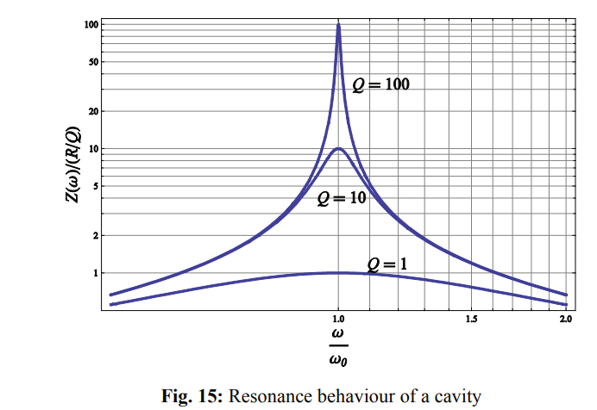
Source: Cavity basics, E. Jensen, CERN

