Slide 1



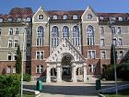
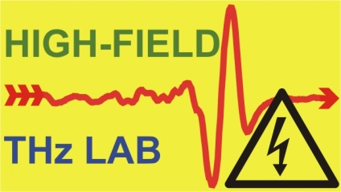
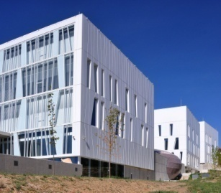

Terahertz driven electron acceleration using a parabolic mirror or a paraboloid ring
László Pálfalvi^{1,2}, Zerihun T. Godana^{1,3,4}, Szabolcs Turnár^{1,2}, Zoltán Tibai¹,
György Tóth^{1,3} and János Hebling^{1,2,3}
¹ Institute of Physics, University of Pécs, H-7624 Pécs, Hungary
² HUN-REN−PTE High-Field Terahertz Research Group, H-7624 Pécs, Hungary
³ Szentágothai Research Centre, University of Pécs, H-7624 Pécs, Hungary
⁴ Department of Physics, Dilla University, Dilla, Ethiopia
EuPRAXIA-DN Camp III: Innovation 2025. okt. 6–7. University of Pécs

Slide 2
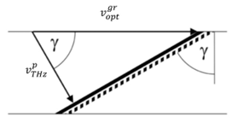
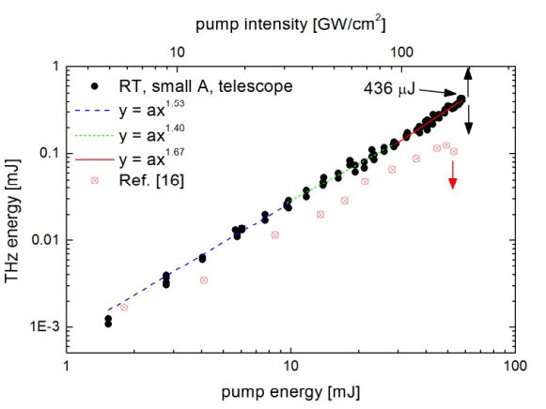
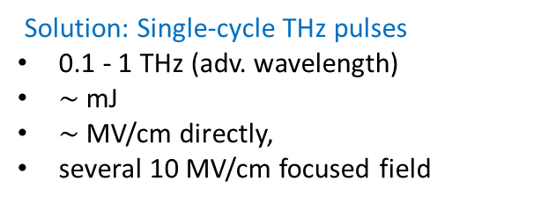

Motivation
Tightly focused radially polarized laser beam and THz pulses → strong longitudinal electric field + optimal spatial extension of the high-field region ⇒ particle acceleration applications [1].
Solution: Single-cycle THz pulses
0.1 - 1 THz (adv. wavelength)
$\sim$mJ
$\sim$MV/cm directly,
several 10 MV/cm focused field
OR + TPF excitation
$$v_{opt}^{gr}\cos{γ}=v_{THz}^{p}$$
J. Hebling et al. Optics Express 10, 1161 (2002)
LNs via TPFP setups used in the experiments
THz pulses with more than 0.4 mJ energy
1.0 mJ high energy THz pulse
J. A. Fülöp et al., Optics Express 22, 20155 (2014)
Scalable sources beyond LN: semiconductors (e.g. GaAs pumped by a CO₂ [2]), plasma.
[1] L. J. Wong et al., Optics Express 21, 9792-9806 (2013)
[2] G. Tóth et al., Scientific Reports 14, 999 (2024)

Slide 3
Motivation (cont.)
The usefulness of the THz pulses in particle acceleration is dual:
Satisfactorily long wavelength (two orders of magnitude longer than the visible/near IR) ⟶ large amount of charge (nC) is possible.
High energy single-cycle and multi-cycle THz pulses with good efficiency are available.
The parabolic mirror-based accelerator concepts, we are going to discus in this work require single-cycle THz pulses.
Two other practically implemented setup types for accelerating relativistic particles:
Waveguide accelerator driven by multi-cycle THz pulses [1,2].
Laser driven dielectric microstructure (Micro-fabricated dielectric laser accelerator) [DLA] [3], requiring multi-cycle laser pulses.
[1] E. A. Nanni et al., Nature communications 6, 8486, (2015).
[2] H. Tang et al., Phys. Rev. Lett. 127, 074801 (2021).
[3] E. A. Peralta et al., Nature 503, 91-94 (2013).

Slide 4
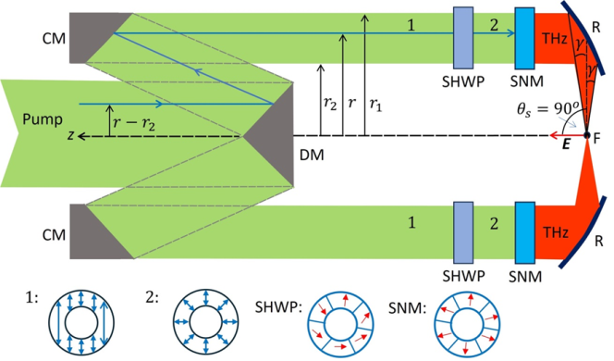
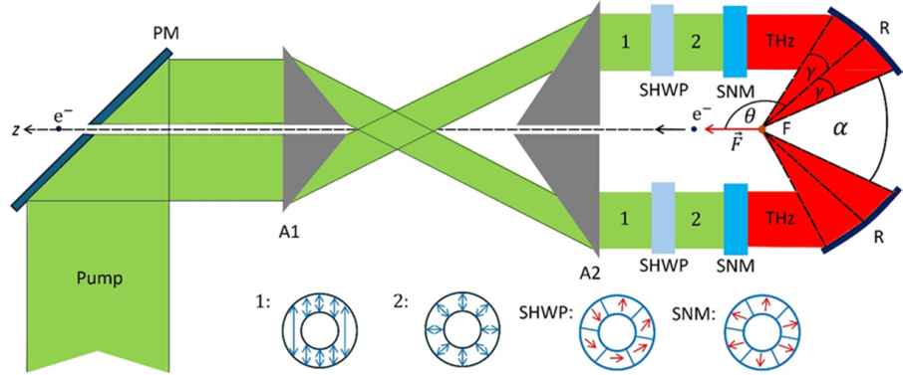
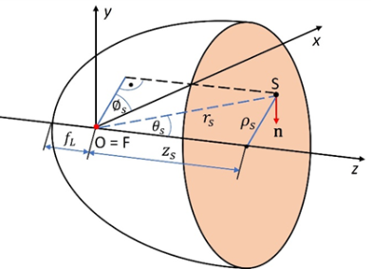
Outline
Goal: to find an optimal focusing geometry that provides an extremely strong longitudinal electric field for particle acceleration applications.
Calculation method and parametrization
Proposed setups
I) a „whole” on-axis parabolic mirror,
II) ring-like segment of on-axis parabolic mirror (annulus) in a perpendicular incident geometry, and
III) ring-like segment of on-axis parabolic mirror in an asymmetric (non perp.) incident geometry.
I) II) III)
Analyses: field characteristics, field-enhancement factor (h)
1. monochromatic radiation 2. THz pulses
Particle acceleration mechanism

Slide 5
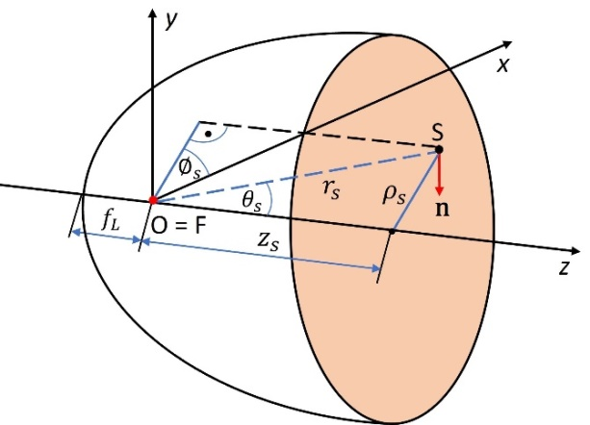
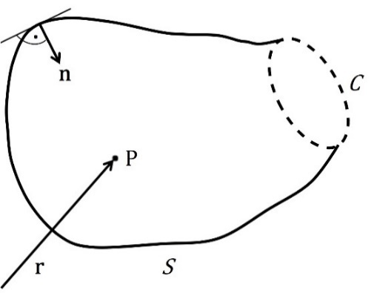


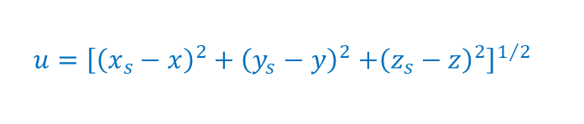
Calculation method
The characteristics of the electric field distribution in the focal region was determined by the Stratton−Chu vector diffraction method [3, 4, 5].
$$E\left(P\right)=\frac{1}{4π}\int_{S}{\left[ik\left(n×H\right)G+\left(n×E\right)×∇G+\left(n∙E\right)∇G\right]dA}+\frac{1}{4πik}\oint_{C}{∇G}\left(H∙ds\right),$$
w$ith, G\left(u\right)=\frac{exp⁡(iku)}{u},$
$$u={\left[{\left(x_{s}−x\right)}^{2}+{\left(y_{s}−y\right)}^{2}{+\left(z_{s}−z\right)}^{2}\right]}^{1/2}$$
$$E\left(ρ,z\right)=E_{S}\left(ρ,z\right)+E_{C}\left(ρ,z\right).$$
S is an open surface bounded by a contour, C.
on-axis parabolic mirror
[3] J. A. Stratton and L. Chu, Physical Review 56, 99 (1939)
[4] P. Varga and P. Török, JOSA A 17, 2081-2089 (2000)
[5] Z. T. Godana, et al., Photonics 10, 848 (2023)

Slide 6
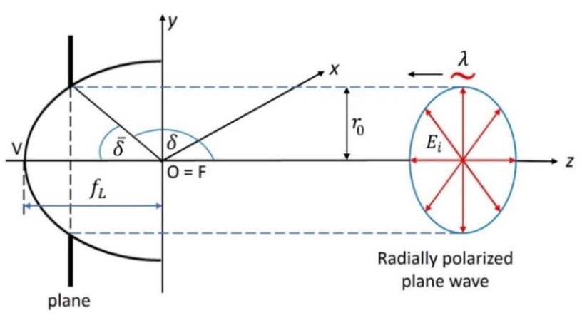
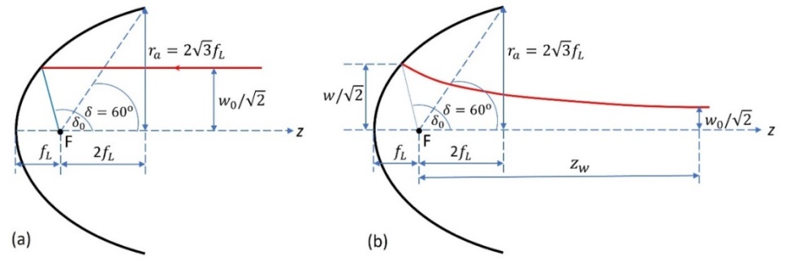
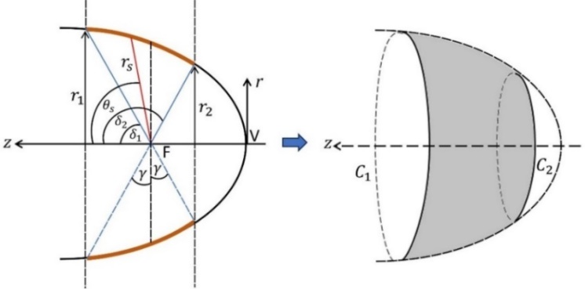


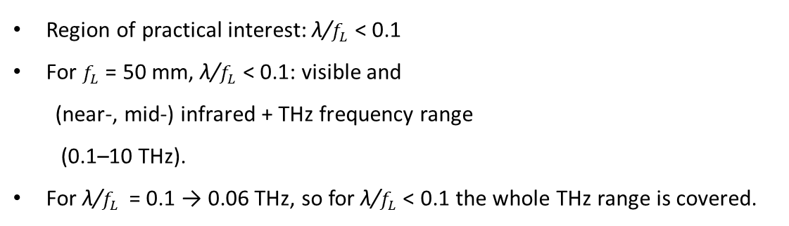

Calculation method and parametrization
For various focusing conditions → for different input beam profiles + whole on-axis parabolic mirror
→ for monochromatic radiation/THz pulses + paraboloid-ring cases
1. Monochromatic, flat-top beams +
whole on-axis parabolic mirror
2. Gaussian vector beams +
whole on-axis parabolic mirror
relative parameters: λ/$f_{L}$, $w_{0}/f_{L}$
L. Pálfalvi, et al., arXiv preprint, 2406.00795 (2024)
relative parameters: λ/$f_{L}$, r₀/$f_{L}$
3. monochromatic radiation/THz pulses + paraboloid-ring cases
Z. T. Godana, et al., Photonics, 10, 848 (2023)
Region of practical interest: λ/$f_{L}$ < 0.1
For $f_{L}$ = 50 mm, λ/$f_{L}$ < 0.1: visible and
(near-, mid-) infrared + THz frequency range
(0.1–10 THz).
For λ/$f_{L}$ = 0.1 → 0.06 THz, so for λ/$f_{L}$< 0.1 the whole THz range is covered.
relative parameters: λ/$f_{L}$, $r/f_{L},z/f_{L}$
L. Pálfalvi, et al., Opt. Laser Technol. 180, 111554 (2025)

Slide 7
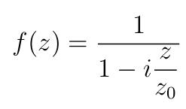
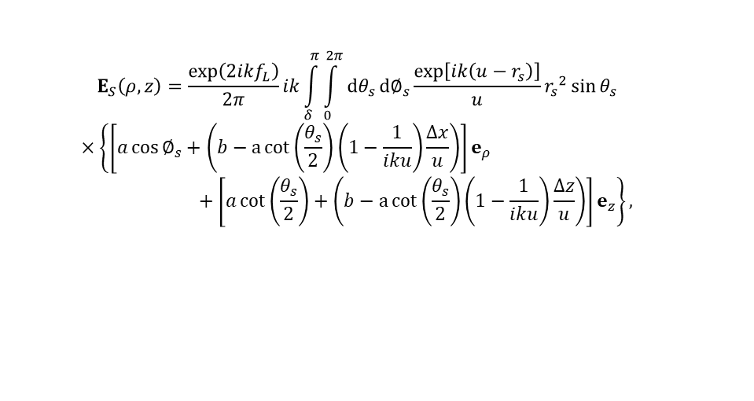
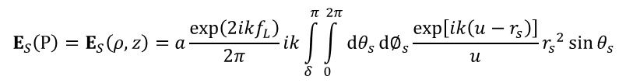

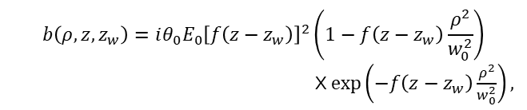
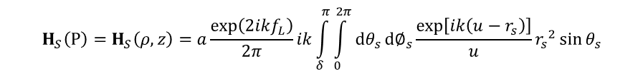


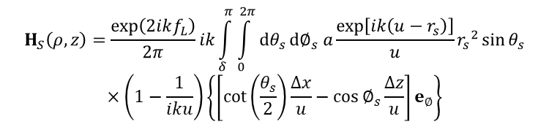
Derivation of spatial distribution of the electric and magnetic field strength of radially polarized beam
For 𝜆/ $f_{L}$≪1 (as it is fulfilled in the following discussion) the contribution of $E_{C}$can be neglected beside $E_{S}.$
Monochromatic, flat-top beams + whole on-axis parabolic mirror
$$E_{S}\left(P\right)=E_{S}\left(ρ,z\right)=a\frac{exp\left(2ikf_{L}\right)}{2π}ik\int_{δ}^{π}{\int_{0}^{2π}{dθ_{s}}}d∅_{s}\frac{exp\left[ik\left(u−r_{s}\right)\right]}{u}{r_{s}}^{2}\sin{θ_{s}}$$
$$×\left\{\left[\cos{∅_{s}}−\cot\left(\frac{θ_{s}}{2}\right)\left(1−\frac{1}{iku}\right)\frac{∆x}{u}\right]e_{ρ}+cot\left(\frac{θ_{s}}{2}\right)\left[1−\left(1−\frac{1}{iku}\right)\frac{∆z}{u}\right]e_{z}\right\}$$
$$H_{S}\left(P\right)=H_{S}\left(ρ,z\right)=a\frac{exp\left(2ikf_{L}\right)}{2π}ik\int_{δ}^{π}{\int_{0}^{2π}{dθ_{s}}}d∅_{s}\frac{exp\left[ik\left(u−r_{s}\right)\right]}{u}{r_{s}}^{2}\sin{θ_{s}}$$
Z. T. Godana, et al., Photonics, 10, 848 (2023)
$$×\left(1−\frac{1}{iku}\right)\left\{\left[\cot\left(\frac{θ_{s}}{2}\right)\frac{∆x}{u}−\cos{∅_{s}}\frac{∆z}{u}\right]e_{∅}\right\}$$
$a:$ amplitude of the incoming field.
Gaussian vector beams + Whole on-axis parabolic mirror
$$E_{S}\left(ρ,z\right)=\frac{exp\left(2ikf_{L}\right)}{2π}ik\int_{δ}^{π}{\int_{0}^{2π}{dθ_{s}}}d∅_{s}\frac{exp\left[ik\left(u−r_{s}\right)\right]}{u}{r_{s}}^{2}\sin{θ_{s}}$$
$$×\left\{\left[a\cos{∅_{s}}+\left(b−a\cot\left(\frac{θ_{s}}{2}\right)\left(1−\frac{1}{iku}\right)\frac{∆x}{u}\right)\right]e_{ρ}+\left[a\cot\left(\frac{θ_{s}}{2}\right)+\left(b−a\cot\left(\frac{θ_{s}}{2}\right)\left(1−\frac{1}{iku}\right)\frac{∆z}{u}\right)\right]e_{z}\right\},$$
$$a\left(ρ,z,z_{w}\right)=E_{0}\frac{ρ}{w_{0}}{\left[f\left(z−z_{w}\right)\right]}^{2}exp\left(−f\left(z−z_{w}\right)\frac{ρ^{2}}{w_{0}^{2}}\right),$$
$$b\left(ρ,z,z_{w}\right)=iθ_{0}E_{0}{\left[f\left(z−z_{w}\right)\right]}^{2}\left(1−f\left(z−z_{w}\right)\frac{ρ^{2}}{w_{0}^{2}}\right)$$
X $exp\left(−f\left(z−z_{w}\right)\frac{ρ^{2}}{w_{0}^{2}}\right),$
$$H_{S}\left(ρ,z\right)=\frac{exp\left(2ikf_{L}\right)}{2π}ik\int_{δ}^{π}{\int_{0}^{2π}{dθ_{s}}}d∅_{s} a\frac{exp\left[ik\left(u−r_{s}\right)\right]}{u}{r_{s}}^{2}\sin{θ_{s}}$$
$$×\left(1−\frac{1}{iku}\right)\left\{\left[\cot\left(\frac{θ_{s}}{2}\right)\frac{∆x}{u}−\cos{∅_{s}}\frac{∆z}{u}\right]e_{∅}\right\}$$
L. Pálfalvi, et al., arXiv preprint, 2406.00795 (2024)

Slide 8

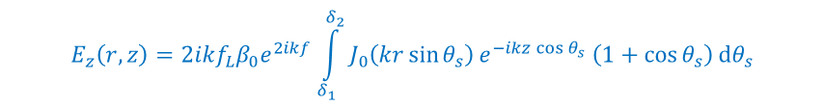
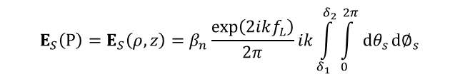
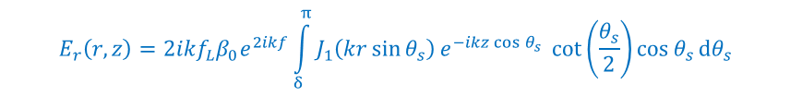
Derivation of spatial distribution of the electric and magnetic field strength of radially polarized beam
Optimized focusing → Focusing monochromatic radiation/THz pulses + paraboloid-ring
$${E_{S}\left(P\right)=E}_{S}\left(ρ,z\right)=β_{n}\frac{exp\left(2ikf_{L}\right)}{2π}ik\int_{δ_{1}}^{δ_{2}}{\int_{0}^{2π}{dθ_{s}}}d∅_{s}$$
$${\left(1−\frac{r_{2}}{r_{s}\left(θ_{s}\right)\sin{θ_{s}}}\right)}^{n}\frac{exp\left[ik\left(u−r_{s}\left(θ_{s}\right)\right)\right]}{u}{r_{s}}^{2}\sin{θ_{s}}$$
$$×\left\{\left[\cos{∅_{s}}−\cot\left(\frac{θ_{s}}{2}\right)\left(1−\frac{1}{iku}\right)\frac{∆x}{u}\right]e_{ρ}+cot\left(\frac{θ_{s}}{2}\right)\left[1−\left(1−\frac{1}{iku}\right)\frac{∆z}{u}\right]e_{z}\right\}$$
Furthermore, if 𝑟/ $f_{L}$, 𝑧/ $f_{L}$≪1 also holds (i.e., in the focal region).
The approximated $E_{z}$distribution (most important for particle acceleration ):
$$E_{z}\left(r,z\right)={2ikf_{L}β}_{0}e^{2ikf}\int_{δ_{1}}^{δ_{2}}{J_{0}\left(kr\sin{θ_{s}}\right)e^{−ikz\cos{θ_{s}}}\left(1+\cos{θ_{s}}\right)}dθ_{s}$$
The approximated $E_{r}$distribution:
$$E_{r}\left(r,z\right)={2ikf_{L}β}_{0}e^{2ikf}\int_{δ}^{π}{J_{1}\left(kr\sin{θ_{s}}\right)e^{−ikz\cos{θ_{s}}}{\cot\left(\frac{θ_{s}}{2}\right)\cos{θ_{s}}}}dθ_{s}$$
$J_{0}$and $J_{1} :$Bessel functions of the first kind, $β_{0}$is the amplitude at z = 0, r = 0.
L. Pálfalvi, et al., Opt. Laser Technol. 180, 111554 (2025)

Slide 9
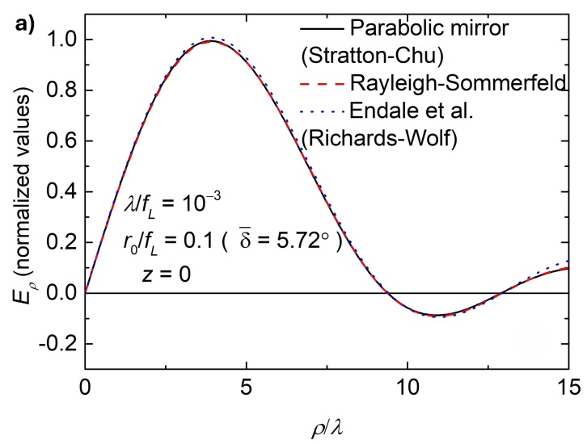
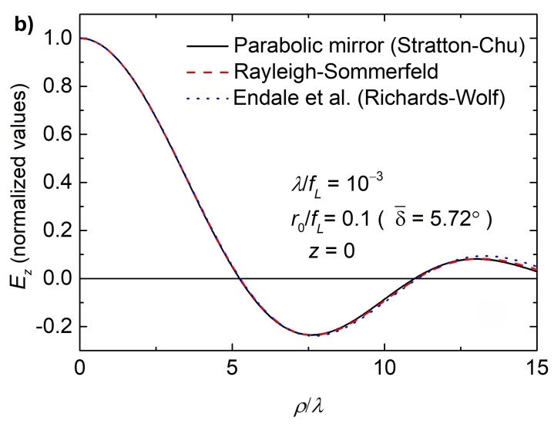
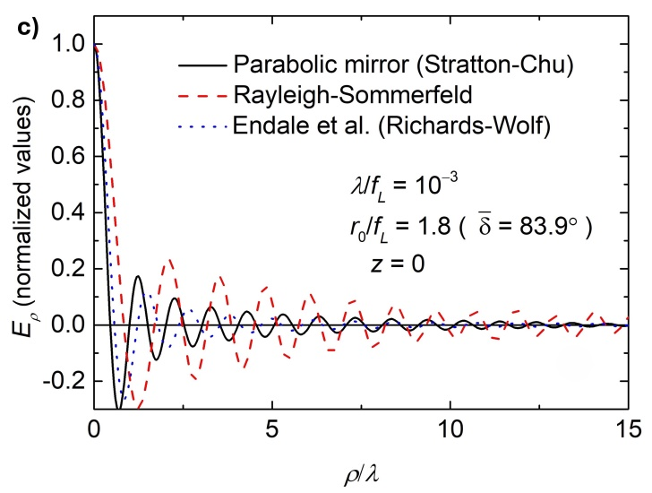
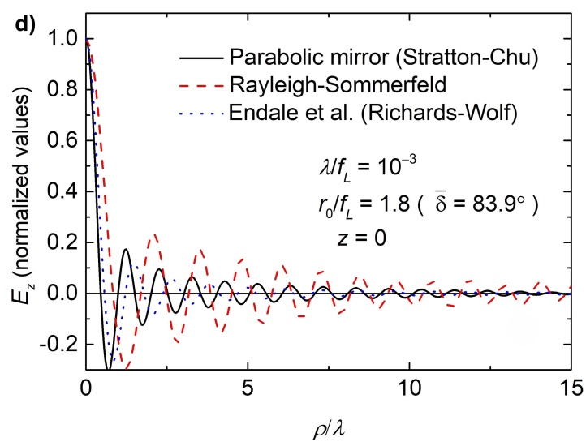
Validation of Calculation method
Monochromatic, flat-top beams + Whole on-axis parabolic mirror
Small NA
Large NA
Z. T. Godana, et al., Photonics, 10, 848 (2023)
G. Endale, et al., Optik, 253, 168586 (2022)

Slide 10
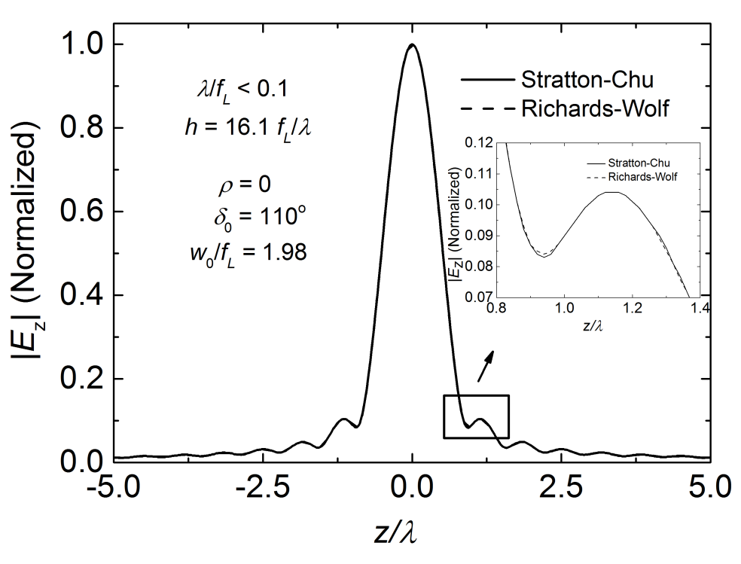
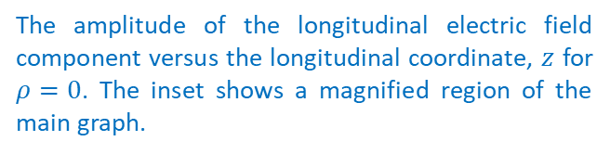
Validation of Calculation method (cont.)
Gaussian vector beams + Whole on-axis parabolic mirror
L. Pálfalvi, et al., arXiv preprint, 2406.00795 (2024)
H. Dehez, et al., Optics Express 20, 14891-14905 (2012)
The amplitude of the longitudinal electric field component versus the longitudinal coordinate, $z$ for $ρ=0$. The inset shows a magnified region of the main graph.
In the figure, the dashed curves from Richards–Wolf theory perfectly match the solid curves from Stratton–Chu theory.
Any distinction between them can only be seen through magnification, as shown in the inset.

Slide 11
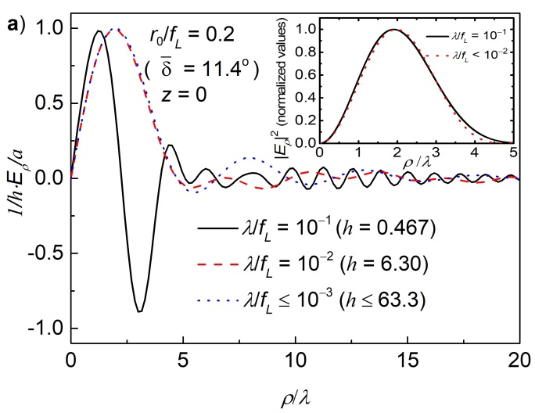
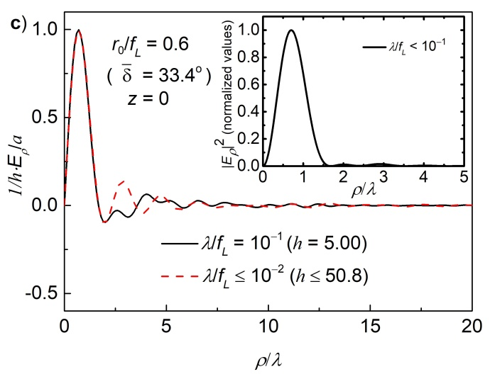
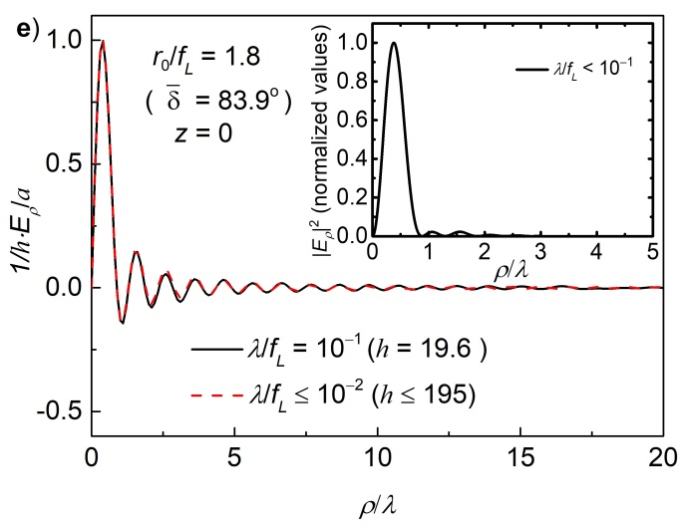
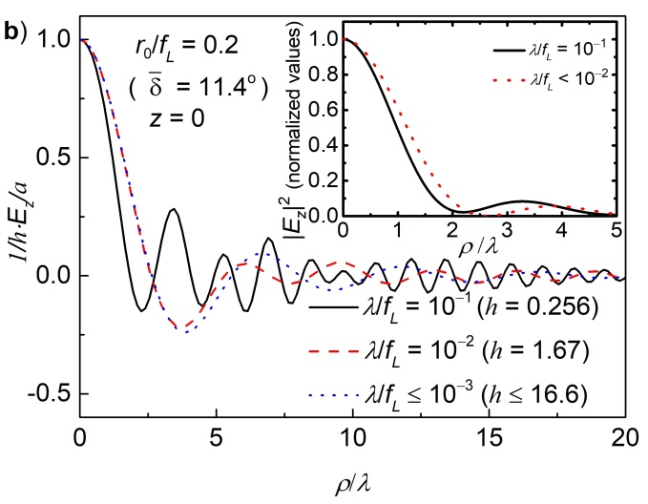
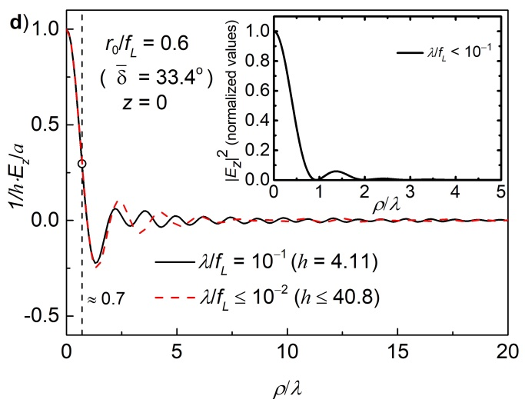
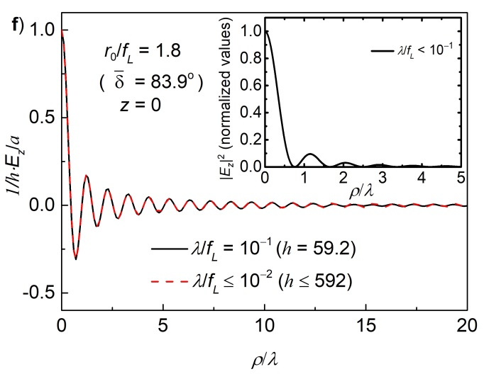
I) Monochromatic, flat-top beams + whole on-axis parabolic mirror (Radial distribution)
The field amplitude enhancement factors, ${h=|E}_{z}|/a$ increases with the NA.
The circle in Figure d.: an appropriate focusing geometry for in-coupling into the waveguide: Wong et al., Optics Express 21, 9792-9806 (2013)
Z. T. Godana, et al., Photonics, 10, 848 (2023)

Slide 12
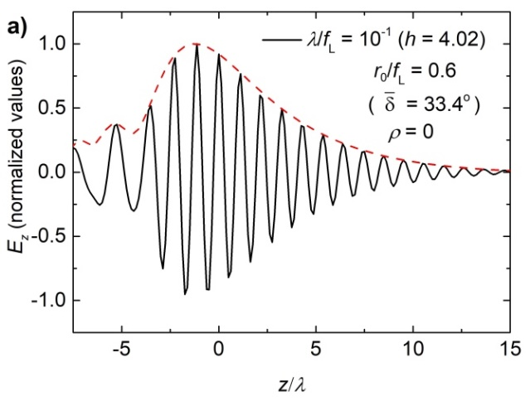
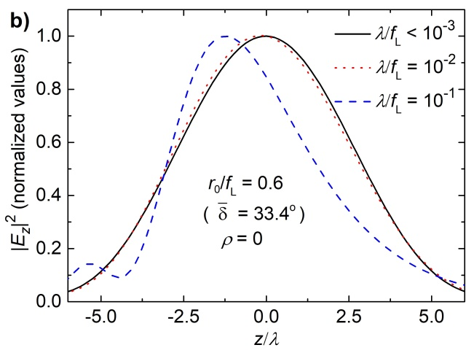
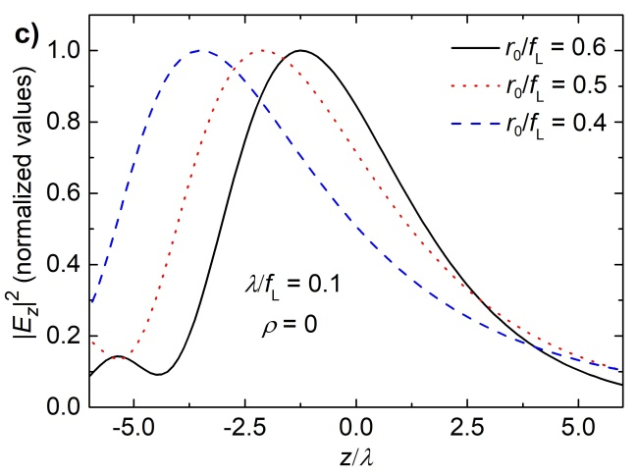
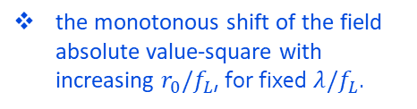
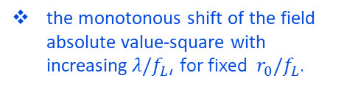

Monochromatic, flat-top beams + whole on-axis parabolic mirror (Axial distribution)
FWHM ̴ 4.5λ for $λ/f_{L}$= 0.1
FWHM ̴ 6λ for $λ/f_{L}$< 0.01
the peak of the curve is shifted from the focus towards the apex of the mirror.
the monotonous shift of the field absolute value-square with increasing$λ/f_{L}$, for fixed $r_{0}/f_{L}$.
the monotonous shift of the field absolute value-square with increasing $r_{0}/f_{L}$, for fixed $λ/f_{L}$.
Z. T. Godana, et al., Photonics, 10, 848 (2023)

Slide 13
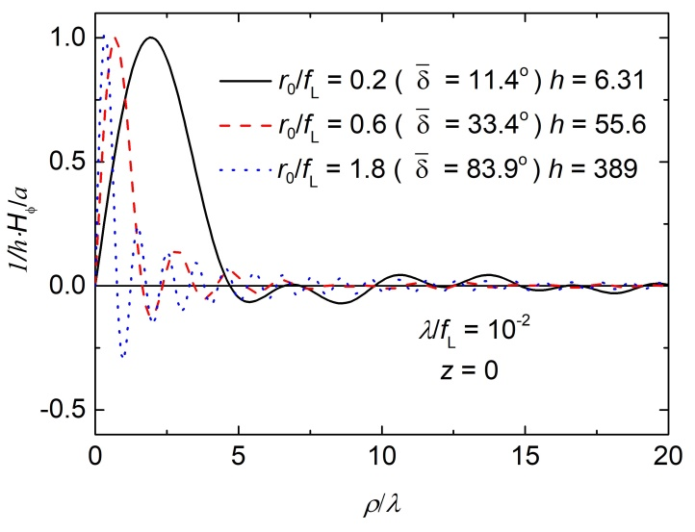
The transversal distribution of the azimuthal magnetic field + Monochromatic, flat-top beams + whole on-axis parabolic mirror
The oscillation period decreases with increasing numerical aperture.
The field enhancement factor, h obviously increases with the numerical aperture.

Slide 14
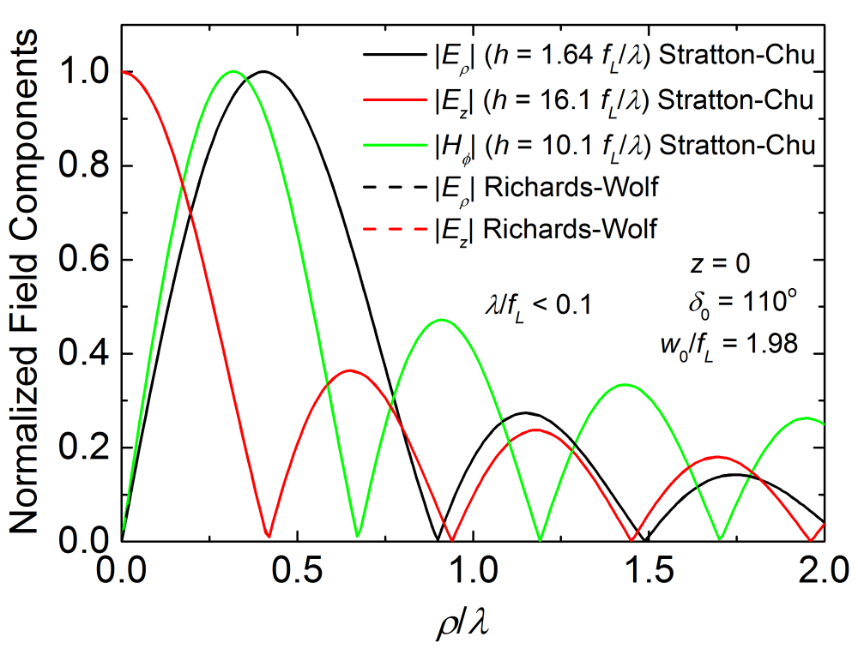
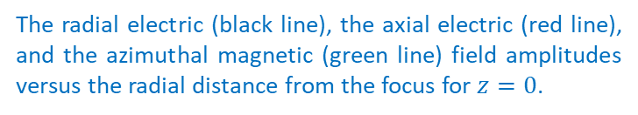
Gaussian vector beams + Whole on-axis parabolic mirror
The radial electric (black line), the axial electric (red line), and the azimuthal magnetic (green line) field amplitudes versus the radial distance from the focus for $z=0$.
The amplitude of the longitudinal electric field component versus the longitudinal coordinate, $z$ for $ρ=0$. The inset shows a magnified region of the main graph.
The information provided by the above Figures on the field characteristics and on the expansion of the high field region around the focus is interesting for specialists designing particle acceleration by tightly focused fields.
L. Pálfalvi, et al., arXiv preprint, 2406.00795 (2024)

Slide 15
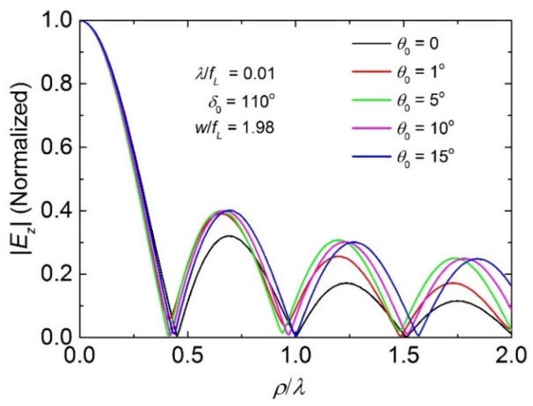
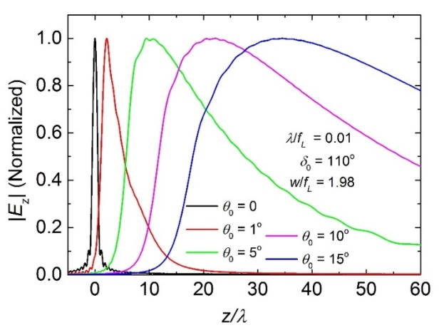
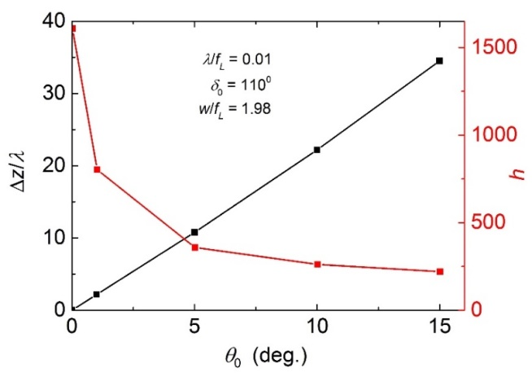

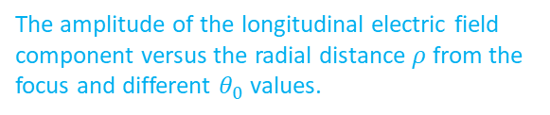

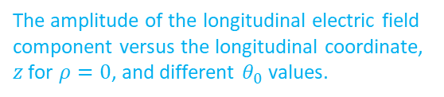

Gaussian vector beams + Whole on-axis parabolic mirror (The effect of the beam divergence)
The amplitude of the longitudinal electric field component versus the radial distance $ρ$from the focus and different $θ_{0}$ values.
The amplitude of the longitudinal electric field component versus the longitudinal coordinate, $z$ for $ρ=0$, and different $θ_{0}$ values.
$0<θ_{0}≤{15}^{o}$
→ the divergence of the THz beam originating from TPF sources falls in this range [1]
The $θ_{0}$ dependence is more significant in $ρ$ than in $z$.
focus shift
field enhancement factors (h) → a strong decrease with $θ_{0}$.
[1] C. Lombosi et al., New Journal of Physics 17, 083041 (2015).
The shift of the peak position, $Δz$ (normalized by the wavelength) and the field amplitude enhancement factor, $h$ versus the divergence angle $θ_{0}$

Slide 16

II) New setup and method for THz pulses + paraboloid ring
Ring-like segment of on-axis parabolic mirror (annulus) in a symmetric incident geometry
The setups consists of a reflaxicon for beam shaping to avoid power loss and
a paraboloid ring for tight focusing of the radially polarized THz pulse to reach strong accelerating electric field.
DM: (conical) Diverging Mirror,
CM: (conical) Converging Mirror,
SHWP: Segmented Half-Waveplate,
SNM: Segmented Nonlinear Material,
R: (paraboloid) Ring, F: Focus.
a pump beam with a flat-top intensity distribution is incident on DM
The SHWP converts the linear pump polarization to radial.
The radially polarized THz beam is generated in the SNM.
L. Pálfalvi, et al., Opt. Laser Technol. 180, 111554 (2025)

Slide 17





In the case of practical, optimized focusing → Focusing monochromatic radiation + paraboloid-ring
Field enhancement factor (amplitude factor):
${h=|E}_{z}|/β_{0}$ ~ 1000
(a) Radial distribution of the z electric field component at the focal region.
(b), (c) and (d) Axial distribution of the z electric field component at the focal region.
Radial FWHM diameter:$\sim$150 μm.
Axial FWHM length:$\sim 600$ μm for 𝛾=${20}^{o}$, for 𝛾=${40}^{o}$ it reduces by a factor of $\sim$2.
L. Pálfalvi, et al., Opt. Laser Technol. 180, 111554 (2025)

Slide 18



In the case of practical, optimized focusing → Focusing THz pulses + paraboloid-ring
The THz waveforms in front of ring (R) [a], and at the focal point [b]. The input and output normalized spectral intensity densities are shown in the insets.
E_{z} ∼ 100 MV/cm !!!
L. Pálfalvi, et al., Opt. Laser Technol. 180, 111554 (2025)
The radial (solid curves) and the axial (dashed curves) distribution of the accelerating electric field component at the focal region.

Slide 19



Particle acceleration mechanism
The temporal variation of the axial electric field component for several $z$
Simple calculation for $velectron ≈c$ → during its interaction with the cosine-like pulse.
Energy gain: of 0.28 MeV/0.23 MeV for 𝛾 $=$ $20$°, and 0.63 MeV/0.36 MeV for 𝛾 $=$ $40$° for same/opposite motion.
It is obvious from the graph, the highest field point sweeps into the $+z$ direction with velocity of $v_{s}≈2.9c$, for 𝛾 $=$ $20$°.
The field characteristics together with the moderating sweeping velocity $v_{s}≈1.6c$ of the accelerating field resulted in enhanced acceleration efficiency, for 𝛾 $=$ $40$°. (Advantages: higher field, more optimal spatial extension and moderate sweeping velocity).
L. Pálfalvi, et al., Opt. Laser Technol. 180, 111554 (2025)

Slide 20

III) The build-up of the paraboloid ring vacuum electron accelerator
Ring-like segment of on-axis parabolic mirror in an asymmetric incident geometry (optimized setup)
A modified setup using transmission axicon pairs, by the modification of the beam deflection angle 𝜃.
Examine the optimization of electron acceleration efficiency by a ring-shaped paraboloid vacuum accelerator.
PM: plane mirror,
A1-A2: transmissive axicon pair,
SHWP: segmented half-wave plate,
SNM: Segmented Nonlinear Material,
R: (paraboloid) Ring,
F: Focus.
L. Pálfalvi, et al., in preparation.
The way of in-coupling the pump through a PM,
Using A1, A2 for beam shaping and illuminate the R effectively, without any losses,
The SHWP converts the linear pump polarization to radial,
The radially polarized THz beam is generated in the SNM.
The holes on PM, A1 and A2 ensure the unobstructed transfer of the electrons through the whole setup along z.

Slide 21










Electric field characteristics in the focal region (optimized setup)
THz waveforms concerning the z electric field component at various z positions for $θ={90}^{o}$(a) and $θ={145}^{o}$(b) angles, respectively.
The sweeping velocity of the THz field in the focal region versus $θ$.
The z component of the electric field amplitude at the focus versus $θ$ for THz pulses.
The radial distribution (a), and the longitudinal distribution (b) of the z component of the electric field amplitude of the focused THz pulse at z = 0 for $θ={90}^{o}$and ${145}^{o}$ angles, respectively.
L. Pálfalvi, et al., in preparation.

Slide 22







Optimization of the acceleration efficiency with 𝜽
The energy gain of the electron during the interaction with the pulse versus $θ$. The $θ={145}^{o}$ is a practical choice (see the square in Figure).
The energy gain as the function of time for $θ={145}^{o}$. The same is shown in the inset for $θ={90}^{o}$.
The electric field experienced by the electron during the acceleration as a function of time for $θ={145}^{o}$. The same is shown in the inset for $θ={90}^{o}$.
The energy gain as a function of initial electron energy. The horizontal line concerns the electron having v ≈ c initial velocity.
L. Pálfalvi, et al., in preparation.

Slide 23
Conclusion
For focusing: whole parabolic mirror + paraboloid-ring for symmetric configuration.
Computation with the Stratton-Chu vector diffraction method.
Detailed analyses of the field distributions
Study of beam divergence
Particle accelaration simulations with a symmetric geometry (𝜃 = 90°) (axicon + ring) for 1 ps, 3 mJ THz pulses:
calculations predicted field enhancement factor ∼1000,
the calculations also predicted the electric field component can reach magnitudes of 100 MV/cm, which is excellently suitable for particle acceleration.
An energy gain of 0.28 MeV/0.23 MeV (𝛾=20°) by an electron moving at nearly the speed of light was obtained from the study of acceleration using a simple model.
With ptimized setup three times higher energy gain, reaching the MeV level is available at an optimal 𝜃.
This improvement results from an increased interaction length due to a sweeping velocity closer to c, and a longer focal range, which significantly overcompensates the reduced axial field amplitude.

Slide 24

Funding
The project has been supported by the
Development and Innovation Fund of Hungary, financed under the TKP2021‐EGA‐17 funding scheme
National Research, Development and Innovation Office (2018‐1.2.1‐NKP‐2018‐00010)
TWAC project, which is funded by the EIC Pathfinder Open 2021 of the Horizon Europe program under grant agreement 101046504.

