Slide 1



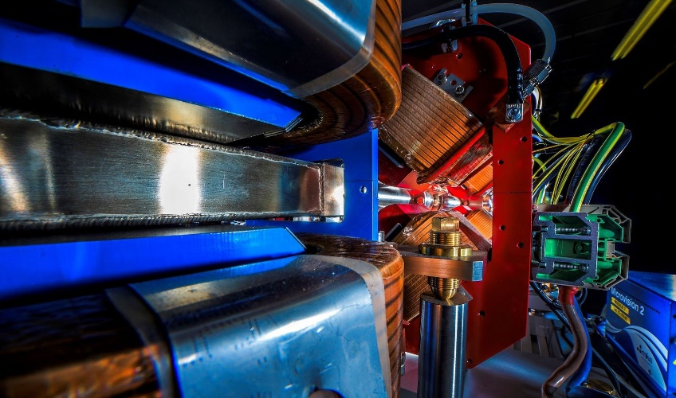


Making a brighter future through advanced accelerators
High Impact
Beamlines
for R&D Hubs
Dr. Thomas Pacey
ASTeC, STFC Daresbury Laboratory
and The Cockcroft Institute
EuPRAXIA-DN Camp III: Innovation
University of Pecs, 7/10/25
Notes:
Thank you very much for the opportunity
About 9 years ago I attended a similar event, end of LA3NET DN in paris, presenting as a student
Valuable events

Slide 2

What can beamlines do to help deliver plasma accelerators for applications?
Notes:
The abstract pattern can be removed or repositioned if required. Be careful to ‘Send to Back’ so that it does not obscure any important information.

Slide 3

Outline
Beamline design principles
Beamline tools
Challenges of laser plasma accelerators
Case Studies, CLARA & EPAC
Examples of other designs & builds
Notes:
Part lecture, part overview, part results

Slide 4
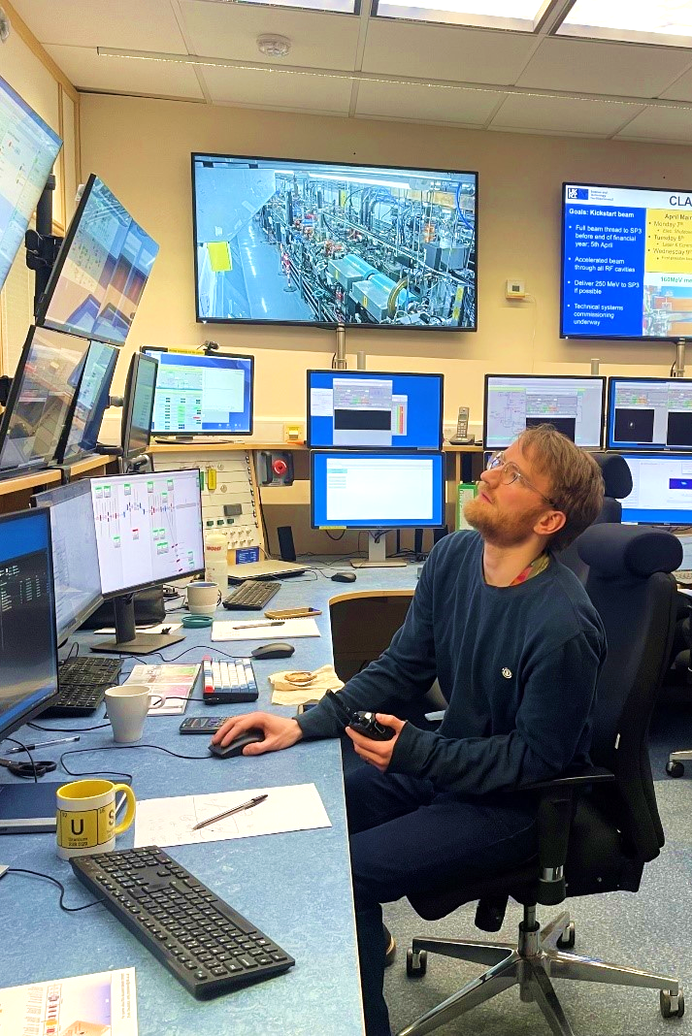
My background
PhD in novel acceleration: Dielectric Wakefield Accelerations
THz generation and bunch dechirping
Leading the commissioning at CLARA accelerator and preparing for novel acceleration R&D
Worked on electron beamline design for EPAC (LWFA) & RUEDI (ultrafast diffraction)
Novel + conventional accelerators
Design + Application & Exploitation
Notes:
Straddle the camps of 'novel' and 'conventional' accelerators
Work on both beamline 'design' and'application/exploitation'
I'm an electron person, so 95% of talk about electrons, but the principles apply equally to proton beamlines, if tools differ slightly
Important features of control room, screens, keyboards, paper coffee cups, radio!

Slide 5
Beamline design
Notes:
The abstract pattern can be removed or repositioned if required. Be careful to ‘Send to Back’ so that it does not obscure any important information.

Slide 6

Beamline Design
What is 'a beamline'?
A
B
e-
Source
Interaction
=
Application
Job done?

Slide 7
Beamline design
What does the beamline need to do?
Prepare beam for interaction
Preserve source beam properties we like
Correct the properties of the source beam we don’t like

Slide 8

Beamline design
Prepare the beam for interaction:
Align beam to target
May need to set a defined axis
Transverse focusing or defocusing
Set specific transverse optics
Longitudinal compression
or decompression
y
x
y
x
E
t

Slide 9
Beamline design
Preserve source beam properties we like
Limit beam losses
Avoid transverse clipping
Have sufficient energy acceptance
Prevent excessive emittance dilution
Sufficient beam pipe vacuum
Mitigation of higher order effects
Limit interfaces (windows, ‘plasma mirrors’)
Reduce impact of collective effects
y
x
x'
x
Notes:
No animation for the last one – we don't want that to change!

Slide 10
Beamline design
Correct the properties of the source beam we don’t like
Condition the beam, i.e. clean it up
Collimate, remove transverse halos and energy tails
Remove co-propagating radiation sources, e.g. lasers
Set particular energy or energy spread/chirp
Reduce energy spread, control energy-time correlations
y
x
E
t

Slide 11
Beamline tools
Notes:
So if it takes more than just a pipe and a vacuum pump, what tools do we use to do achieve those design goals?

Slide 12
Tools: Spatial properties
Aligning beam to target:
‘Humble’ corrector magnet
'Weak' EM dipole
Only ever want to make small corrections!
Want a well-aligned beamline!
Focusing of beam:
Quadrupoles
>=2 Needed for focus in both planes
Usually many more in beamline
Required for setting optics through other elements
x
s
x
s
x
s
Notes:
Why small corrections?
Dispersion!
Too much correction early on and lead to big issues later on
How do we avoid needing too much correction? Beam line alignment!

Slide 13
Tools: Longitudinal compression
Compress (or decompress)
Magnetic chicane or arc
Rect. dipoles introduce vertical focusing
Add quadrupoles…
Higher order effects especially when energy spread is large
Add sextupoles...
Velocity bunching
Drift bunch at “low energy”
Then accelerate again to 'freeze' in place
Requires chirp control + space + further acceleration
Velocity de-bunching can also occur
E
E
z
z

Slide 14
Tools: Collimation
Halo
x
Core
Transverse collimation
Can add transverse focusing for more control
Dispersive collimation
Will define energy spread & central energy exactly
But its lossy; not in energy acceptance = gone!
Can turn energy instability into charge instability
Can be designed to alter longitudinal compression or not (isochronous, R56 = 0, need some quads!)
s
E
E
z
z
Notes:
Collimation: using big pieces of metal to scatter or absorb particles we don't want in our beamline
NOT what laserist calls collimation

Slide 15

Tools: Collimation
The higher the energy the more material is needed
2mm Tungsten -> 1 GeV electrons scatter 17mrad
5 Gev <1 mrad
Beyond just 'scattering' out of beam, may want to “absorb”
250 MeV electrons: >10cm of lead
Generates additional radiation
Higher average power (energy x charge x rep rate) = more problems with activation
Implications for building ‘compact lab sources’
Jackson, Classical Electrodynamics,1975

Slide 16
Tools – Active energy spread control
Can be RF Cavities or a driven plasma
Can be done with net acceleration
Timing jitters will map to energy jitters
V
t
E
E
Cavity
t
t

Slide 17
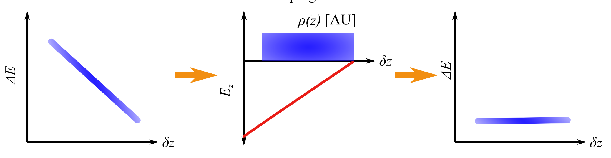
Tools – Passive Energy spread control
Passive dechirpers
Use beam wakefield: self synchronised !
Head slows down the tail
Field depends on bunch longitudinal profile and charge
Can have transverse effects: spoil beam in other dimensions!
B.H, Gonzalez,, et al. "Detailed simulation study of wakefield induced beam dynamics in the dielectric dechirper at CLARA." IPAC24 . JACoW, 2024.
R. D’Arcy et. Al Tunable Plasma-Based Energy Dechirper | Phys. Rev. Lett.

Slide 18

Tools – Energy jitter compensation
Map energy jitter onto time jitter
Active: RF cavities (or even plasma)
V
t
E
E
E
Cavity
t
t
t
Experimentally applied to LPA
P. Winkler et. Al., Active energy compression of a laser-plasma electron beam | Nature 2025
Note that 1deg of S-Band RF = ~1ps time delay
Notes:
Think of these as individual bunches, not just a chirp
Implications for further interactions, more RF or laser collisions etc etc

Slide 19
Interjection
Notes:
Legal obligation to emphasise the importance of diagnostics

Slide 20
Using the tools
How do we use the tools operationally?
Diagnostics!
Need to measure the output of our beamline ‘tools’ and tune appropriately
Ensure we have “set our beam” for the application
Lots of established systems…do they all work for plasma accelerators?

Slide 21
Tools – Diagnostics
Typical diagnostic tools for MeV – GeV electron beams
“Basic”:
Screens + cameras (scintillators, transition radiation)
Current transformers, Faraday Cups
Dipole + Screen (measure energy and energy spread)
“Advanced”:
Beam Position Monitors
Compression monitors (Coherent radiation generation)
Spectrometer beamline w/ dipole + quads (measure energy + energy spectrum precisely)
Transverse deflecting structures (RF cavities or passive wakefield)
i.e. straightforward to implement in laser lab context,
Limited total number of components
Notes:
Basic : straight forward to implement in a laser lab, limited total number of components

Slide 22
Diagnostics
R&D systems can also be applied
Does an ‘application’ want an experiment on an experiment?
More on diagnostics:
See Dr Joe Wolfenden's talk:
EuPRAXIA-DN School on Plasma Accelerators (22-26 April 2024): Beam Diagnostics for Plasma Accelerators · Agenda (Indico)
See Prof Alessandro Cianchi talk:
EuPRAXIA-DN Camp I: Technologies (7-8 April 2025): Diagnostics for beam and plasma · Agenda (Indico)

Slide 23

Beamline design - Tools
Transverse Collimators
Dispersive Collimators
Transverse focusing
Emittance preserving transport
Magnetic compressors
Energy spread compensation
"Basic" Diagnostics
"Advanced" Diagnostics

Slide 24
Challenges of plasma accelerators
(Break)
Notes:
Focus on mostly LWFA issues not PWFA
You will have heard a lot from PWFA from SPARC_LAB so won’t tread that back

Slide 25
Challenges of plasma accelerators
Characteristic
High energy spread
Pointing & Charge jitter
Ultrashort bunches driving collective effects
Beam halos, energy tails, undesired backgrounds
Desire for compactness
Source parameter uncertainty
Fundamental
Non-linearities & sensitivity to jitters
From high gradient & high frequency fields
Energy jitter
Small, divergent sources
Notes:
Fundamental = from laser plasma interaction
Characteristic = some things we see regularly but there are schemes to deal with some (not not all simultaneously)

Slide 26
Challenges - Fundamental
High gradients; >0.5Gv/m
Non-linear wakes have highest gradients
Non-linear -> more sensitivity to jitters
High frequency wakes; more sensitive to timing jitters
Operating at ~10THz
Dealing with energy jitter is a key challenge
Maybe best not approached as a job of the beamline but as a job of the source
Likely x10 bigger on plasma than RF beamline (RF run at <= 10^-4 stability)

Slide 27
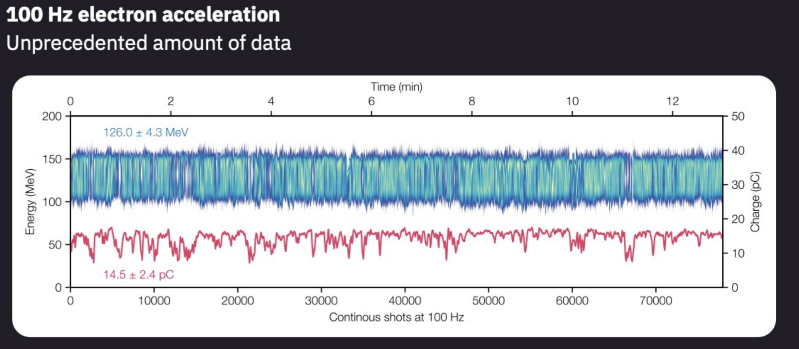

Progress in source energy & charge energy jitter
EAAC25: DESY, KALDERA laser, MAGMA source
7th European Advanced Accelerator Conference (21-27 September 2025): First Electron Beams from the High-Average-Power Laser-Plasma Accelerator KALDERA · Agenda (Indico)
Notes:
Strongly encourage everyone to look at these results

Slide 28
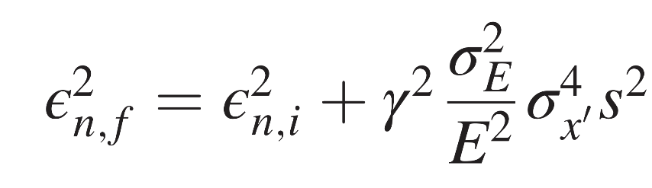
Challenges – Fundamental
Emittance growth in transport
Source is small, emittance is <= 1um, divergence is high ~5mrad
growth comes in transport; divergence dominates early in beamline
Start: ε_{n,i} = 0.1um, 500 MeV, 5% energy spread, 2.5 mrad divergence
After 1m: ε_{n,f} = 300 um (!)
Implication: Deal with source divergence early in beamline
Need strong focussing near the source
Can’t have just a vacuum pipe
First emittance measurement of the beam-driven plasma wakefield accelerated electron beam
Intrinsic normalized emittance growth in laser-driven electron accelerators | Phys. Rev. ST Accel. Beams

Slide 29
Challenges - Characteristic
}
High energy spread
Correlated can be adjusted
Uncorrelated is harder to solve
Jitters
Cannot be corrected for with feedbacks within beamline
Pointing (want it to go down beamline)
Energy jitter
Charge jitter
}
Correlated
E
Uncorrelated
t
Notes:
Remember with charge jitter, no beamline tool was suggested to resolve

Slide 30
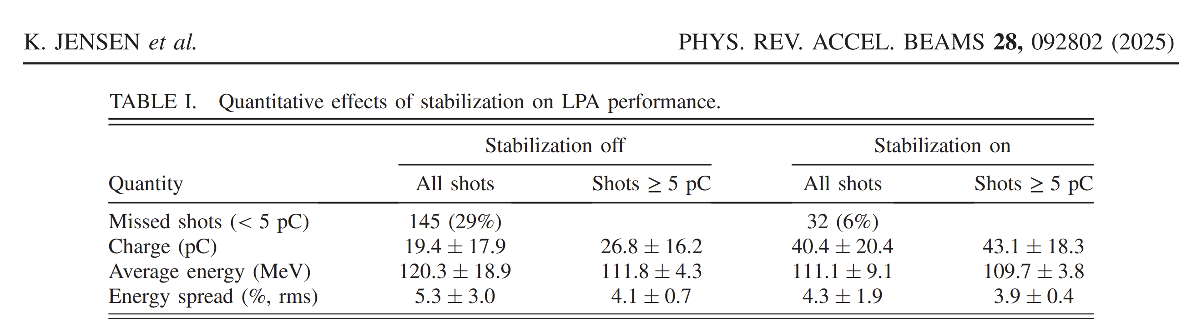

Charge jitters
Laser stabilisation and feedback can improve jitters and drifts
Still presence of large charge jitter
Improved laser-plasma accelerator stability via high-bandwidth longitudinal focal position stabilization of a 100 TW-class laser system | Phys. Rev. Accel. Beams
Notes:
Recent result, very exciting and scalable feedback system

Slide 31
Challenges - Characteristic
Ultra short bunches
with high peak current straight from source
<50fs bunches, >5kA peak currents
Need to be mindful of:
Coherent Synchrotron Radiation from bends
Will spoil projected emittance, can be mitigated with beamline design
Coherent Optical Transition Radiation
Can complicate beam imaging
Can also be used for advanced diagnostics!
Notes:
In normal electron accelerator we work very hard to achieve these parameters, but in doing so we are aware of multitude of issues

Slide 32
Challenges - Characteristic
Desire for Compactness
Use high gradient focusing systems
Permanent Magnet Quads: Be aware of field quality, narrow aperture etc.
Plasma lenses
EMQ 50 T/m, PMQ 500 T/m, Plasma lens 5 kT/m
If we want to preserve emittance, transport a large range of energies and have limits on our magnet strengths…
We will need many quads

Slide 33
Challenges - Characteristic
Desire for compactness
Laser based = RF free (in most cases)
RF systems put demand on lab infrastructure,
Hard to add post-hoc in small settings
Removes some of the ‘beamline tools’

Slide 34
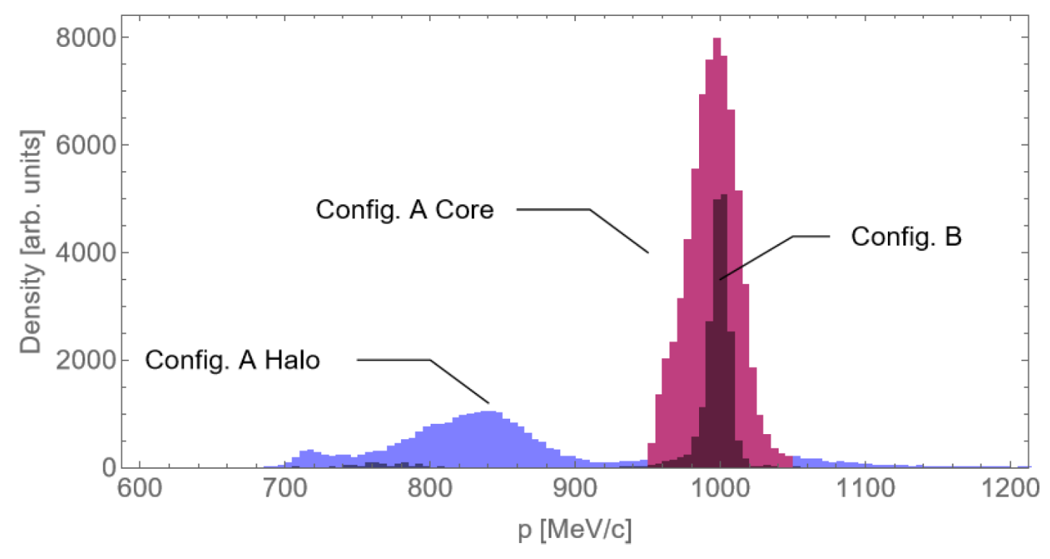
Challenges - Characteristic
Halos and energy tails
E.g EPAC FBPIC simulated beams:
Config core ‘A’ is bright
But it comes with a large trailing halo
Config ‘B’ is less bright
But no halo!
E.g. Low energy particles from solid targets
TNSA has many off energy particles +additional species
“Plasma detritus”
Sims. courtesy O. Finlay, pub. in review

Slide 35
Challenges – Characteristic
Source simulations and uncertainty of beam parameters:
How well is the high power laser drive behaviour known?
Even mature commercial technology will produce differences between spec. and delivery
Complex interplay between parameters : energy, charge, source exit size, and divergence
Much potential from just a gas jet and a ~ PW laser
E.g pC to nC of charge, <1um emittance, 0.5 GeV to 5 GeV
Can’t do all parameters at once!
More uncertainty and/or wider parameter space makes beamline design harder

Slide 36
Challenges – Measuring and tuning
Diagnostics are needed for
Feedbacks: stabilise interactions and account for drifts
These need to be non-invasive
Optimisation:
These need to single shot measurements; deal with jitters
Non-invasive and/or single shot diagnostic are the most challenging!
High energy systems >0.5 GeV
Diagnostic beamlines for rigid beams are not short

Slide 37

Challenges
Charge jitter
Energy Jitter
Energy Spread
Transverse halos
Off-energy halos or tails
Pointing jitter
Emittance growth
Source parameter uncertainties

Slide 38
Applications

Slide 39
Electron Beam Applications
Photon generation:
FEL
ICS
Bremsstrahlung
Betatron radiation
Direct use of beam:
Direct irradiation
Medical radiotherapy/radiobiology
Medical or industrial imaging, nuclear physics
Storage ring injector, further plasma acceleration
(e.g. staging for collider)
Generation of secondaries (positrons)

Slide 40
Applications – Betatron Radiation
Charge jitter
Energy Jitter
Energy Spread
Transverse halos
Off-energy halos or tails
Pointing jitter
Emittance growth
Source parameter uncertainties
Transverse Collimators
Dispersive Collimators
Transverse focusing
Emittance preserving transport
Magnetic compressors
Energy spread compensation
"Basic" Diagnostics
"Advanced" Diagnostics
Notes:
No beam line needed!

Slide 41
Applications – Bremmstrahlung
Charge jitter
Energy Jitter
Energy Spread
Transverse halos
Off-energy halos or tails
Pointing jitter
Emittance growth
Source parameter uncertainties
Transverse Collimators
Dispersive Collimators
Transverse focusing
Emittance preserving transport
Magnetic compressors
Energy spread compensation
"Basic" Diagnostics
"Advanced" Diagnostics
If you want a focus, energy jitter will be an issue
But, potentially not significant
Notes:
If you want some focusing onto a target these will be a problem and connected

Slide 42
Applications – Industrial Imaging
Charge jitter
Energy Jitter
Energy Spread
Transverse halos
Off-energy halos or tails
Pointing jitter
Emittance growth
Source parameter uncertainties
Transverse Collimators
Dispersive Collimators
Transverse focusing
Emittance preserving transport
Magnetic compressors
Energy spread compensation
"Basic" Diagnostics
"Advanced" Diagnostics
If one wants to illuminate a large area, focussing and jitters need to be addressed
Notes:
As long as we don’t care about charge jitter

Slide 43
Applications – Radiobiology/-therapy
Charge jitter
Energy Jitter
Energy Spread
Transverse halos
Off-energy halos or tails
Pointing jitter
Emittance growth
Source parameter uncertainties
{
Transverse Collimators
Dispersive Collimators
Transverse focusing
Emittance preserving transport
Magnetic compressors
Energy spread compensation
"Basic" Diagnostics
"Advanced" Diagnostics
}
Collimating to solve these problems could cause more charge jitter
Notes:
Remember FLASH – we want a lot of dose and we want to have it controlled to the sample in short intense shots

Slide 44
Applications – FEL
Charge jitter
Energy Jitter
Energy Spread
Transverse halos
Off-energy halos or tails
Pointing jitter
Emittance growth
Source parameter uncertainties
Transverse Collimators
Dispersive Collimators
Transverse focusing
Emittance preserving transport
Magnetic compressors
Energy spread compensation
"Basic" Diagnostics
"Advanced" Diagnostics
All the challenges need to be addressed
All the tools are needed
Notes:
Timeline one would design this over, want to pick ‘best possible future LWFA’
But is that proven? Is it certain?

Slide 45
Applications - FEL
More certainty on source parameters = more efficient design
Deploying all the tools from the toolbox results in not a “compact system”
Must also consider the length of the undulators
The better the beam, the shorter the undulators will be
The better you look after the beam, the shorter the undulators will be
Notes:
Certainty means both
numerical, spread on parameters
Confidence in the technology – state of art uncommissioned systems

Slide 46
Case Study:
CLARA
Notes:
Target timing here to be 45 minutes!

Slide 47
CLARA
Daresbury Laboratory’s Flagship accelerator
Medium energy user facility for accelerator R&D
250 MeV, 250pC, 100Hz
FEBE Experiment hutch and dedicated beamline
120 TW Laser: Amplitude Ti:Saph, 2.8J, 23fs, 5Hz
Key Science Themes:
Electron radiotherapy/radiobiology, Novel Accelerators, Laser-electron interactions, Advanced diagnostics, AI for accelerators
Not a “plasma beamline” a beamline for plasma accelerator R&D!

Slide 48
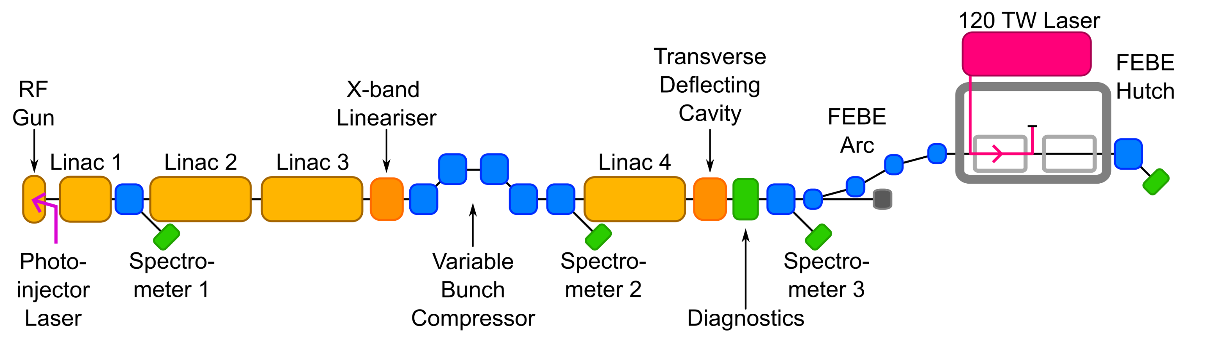
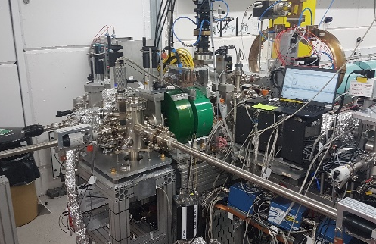
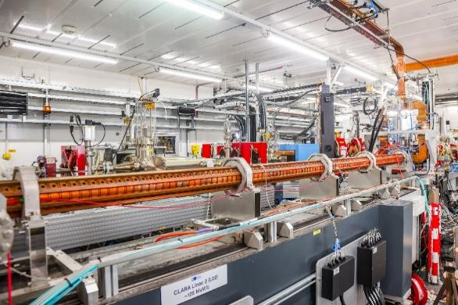
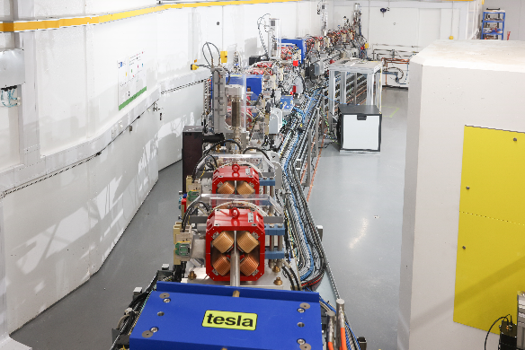
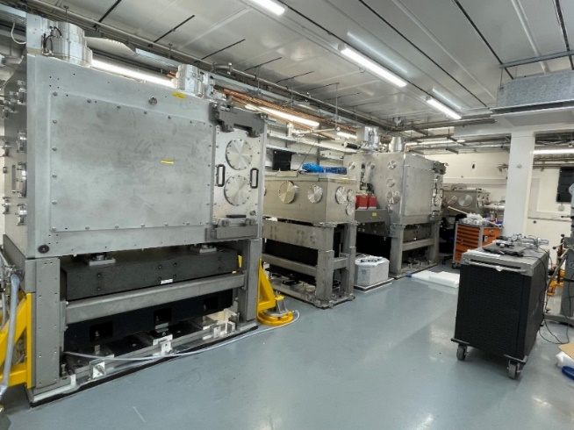
CLARA Layout
Total Length ~80m
e- beam direction
Generate
Accelerate & Manipulate
Measure
Experiment
CLARA Gun
RF Linac
Transfer arc to FEBE hutch
FEBE hutch
Notes:
Use an ‘edited’ new schematic or maybe do a morph from the old one?

Slide 49
CLARA in numbers
Example technical system | CLARA Front End | CLARA 250 MeV | CLARA + FEBE
RF Structures | 2 | 7 | 7
Magnets | 22 | 77 | 126
Diagnostic Systems | 13 | 65 | 94
Vac. Gauges + Pumps | 57 | 109 | 155
Notes:
Example systems only

Slide 50
CLARA in numbers
Example technical system | CLARA Front End | CLARA 250 MeV | CLARA + FEBE
RF Structures | 2 | 7 | 7
Magnets | 22 | 77 | 126
Diagnostic Systems | 13 | 65 | 94
Vac. Gauges + Pumps | 57 | 109 | 155

Slide 51
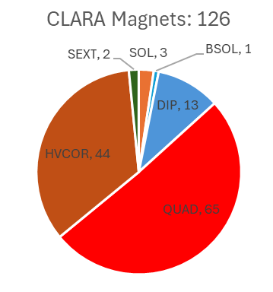
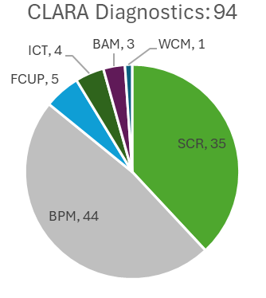
CLARA systems breakdown

Slide 52
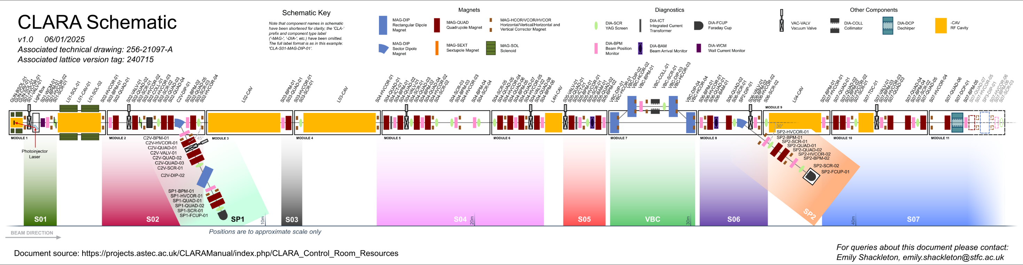
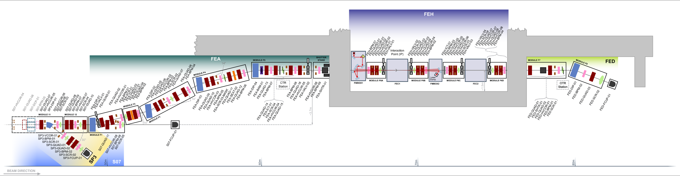
First Beam 17/3/25
Linac02 on , 28/3/25
Linac03 on , 2/4/25
Linac04 on , 2/4/25
e-
e-
Linac02 & 03 on 2/4/25
E=160 MeV
e-

Slide 53
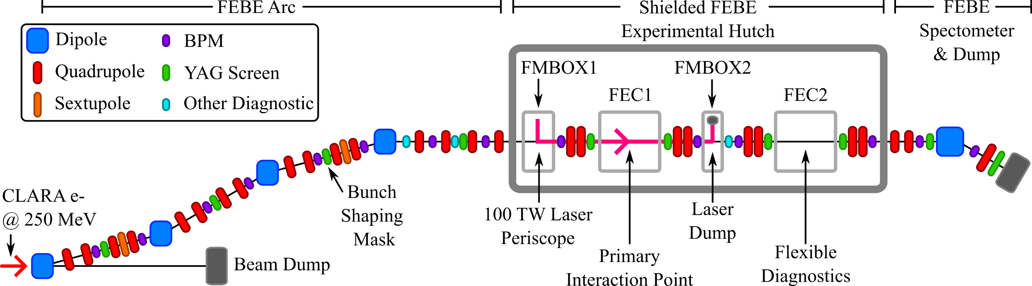
FEBE Beamline & Energy Sectors
Up to 250 MeV
250 – 600 MeV
Lots of components!
Performs manipulations needed for novel accelerator R&D
250 MeV – 2 GeV
Further detail on FEBE beamline design can be found in
Snedden, E. W., et al. "Specification and design for full energy beam exploitation of the compact linear accelerator for research and applications." PRAB 27.4 (2024): 041602.
https://doi.org/10.1103/PhysRevAccelBeams.27.041602
Notes:
This is the exploitation line. Here everything is post – source
Manipulations needed for plasma R&D

Slide 54
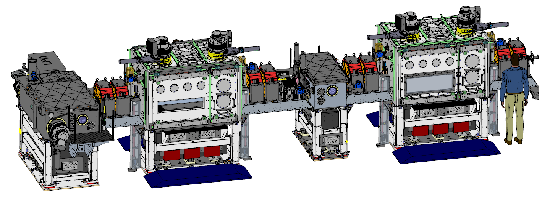
FEBE Hutch
Laser from roof
FEC1
IP2
IP1
CLARA
250 MeV e-

Slide 55
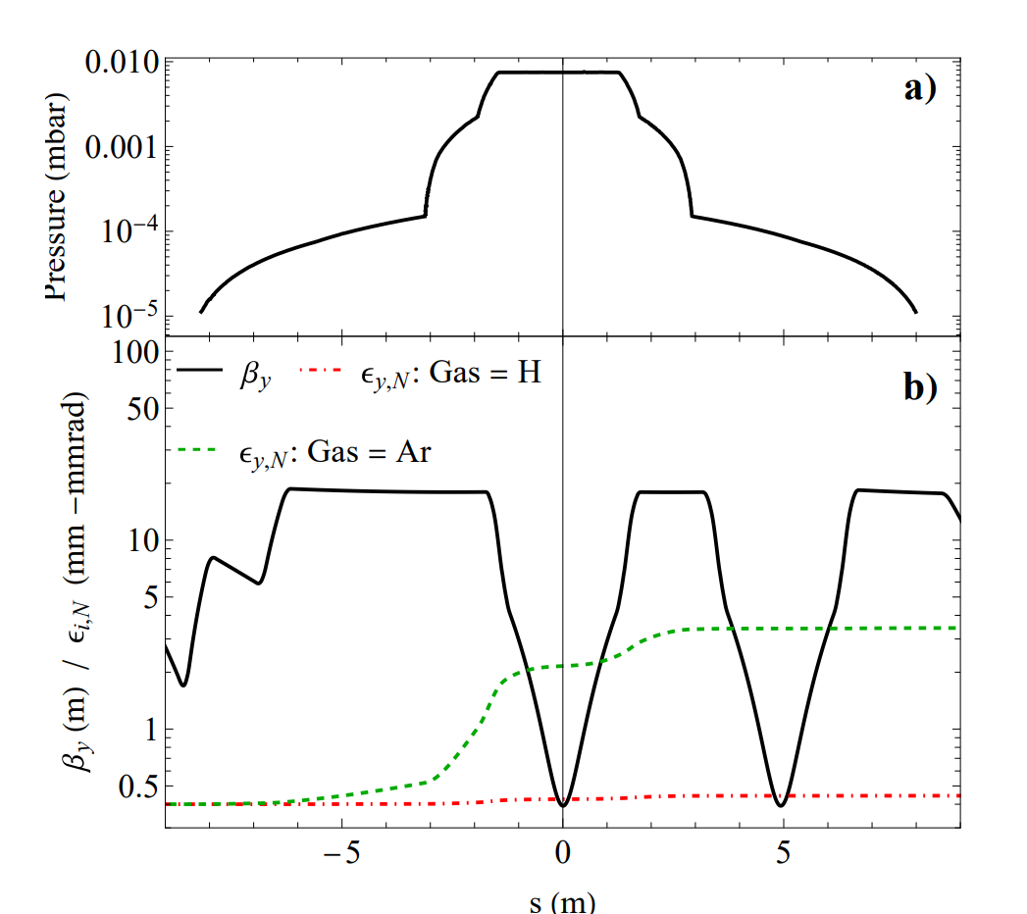
Gas Management
High power laser -> Large apertures
Gas load -> Small apertures
Invested in large volume turbos on experimental chambers & mirror boxes 6 at ~ 2000l/s
Upstream irises and apertures to reduce gas propagation in electron beamline
Don’t what large beta & high pressure at same places
Negligible modelled emittance growth for Hydrogen,
Limited growth for heavier species, e.g. Argon

Slide 56
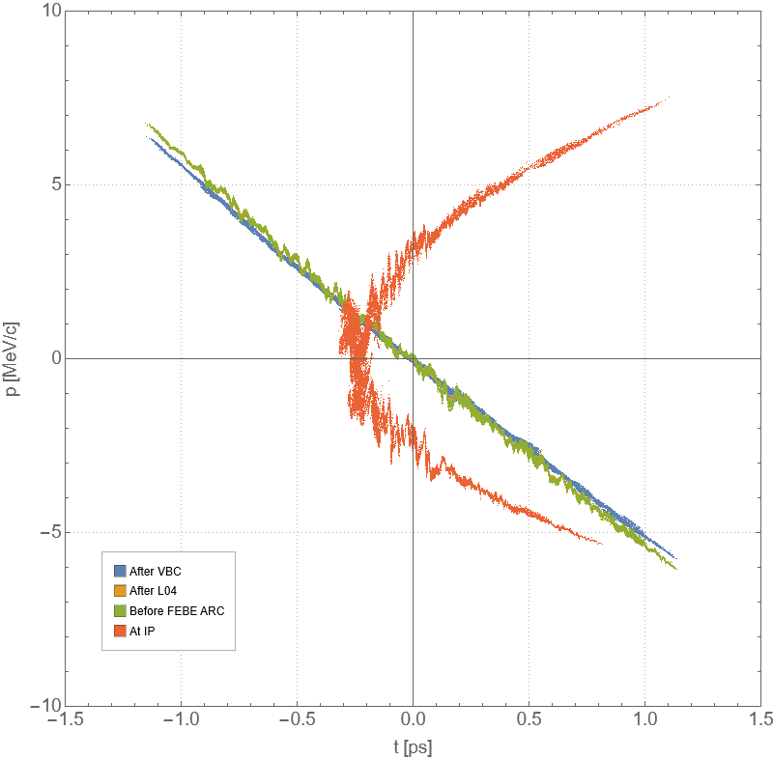
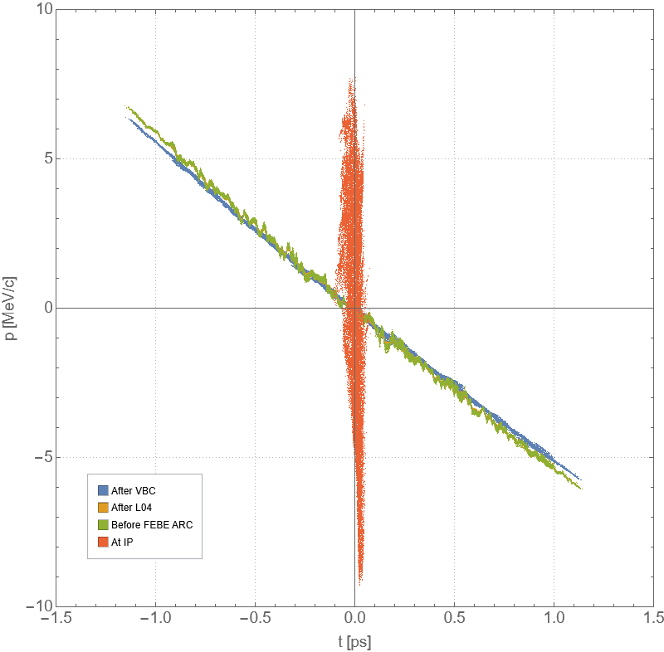
Mitigation of higher order terms
Needed an arc
Fixed displacement and length
Bunker size is fixed
High order aberations when energy spread is large (RMS ~1%!)
Energy spread is large when we want to compress
Need sextupoles to correct!
Before arc
At IP
Before arc
At IP
Without sextupoles
With sextupoles
Notes:
How often do we talk about building beamline in fixed existing bunkers?
This means you run into these problems

Slide 57
Case Study:
EPAC EA1
Notes:
The abstract pattern can be removed or repositioned if required. Be careful to ‘Send to Back’ so that it does not obscure any important information.

Slide 58
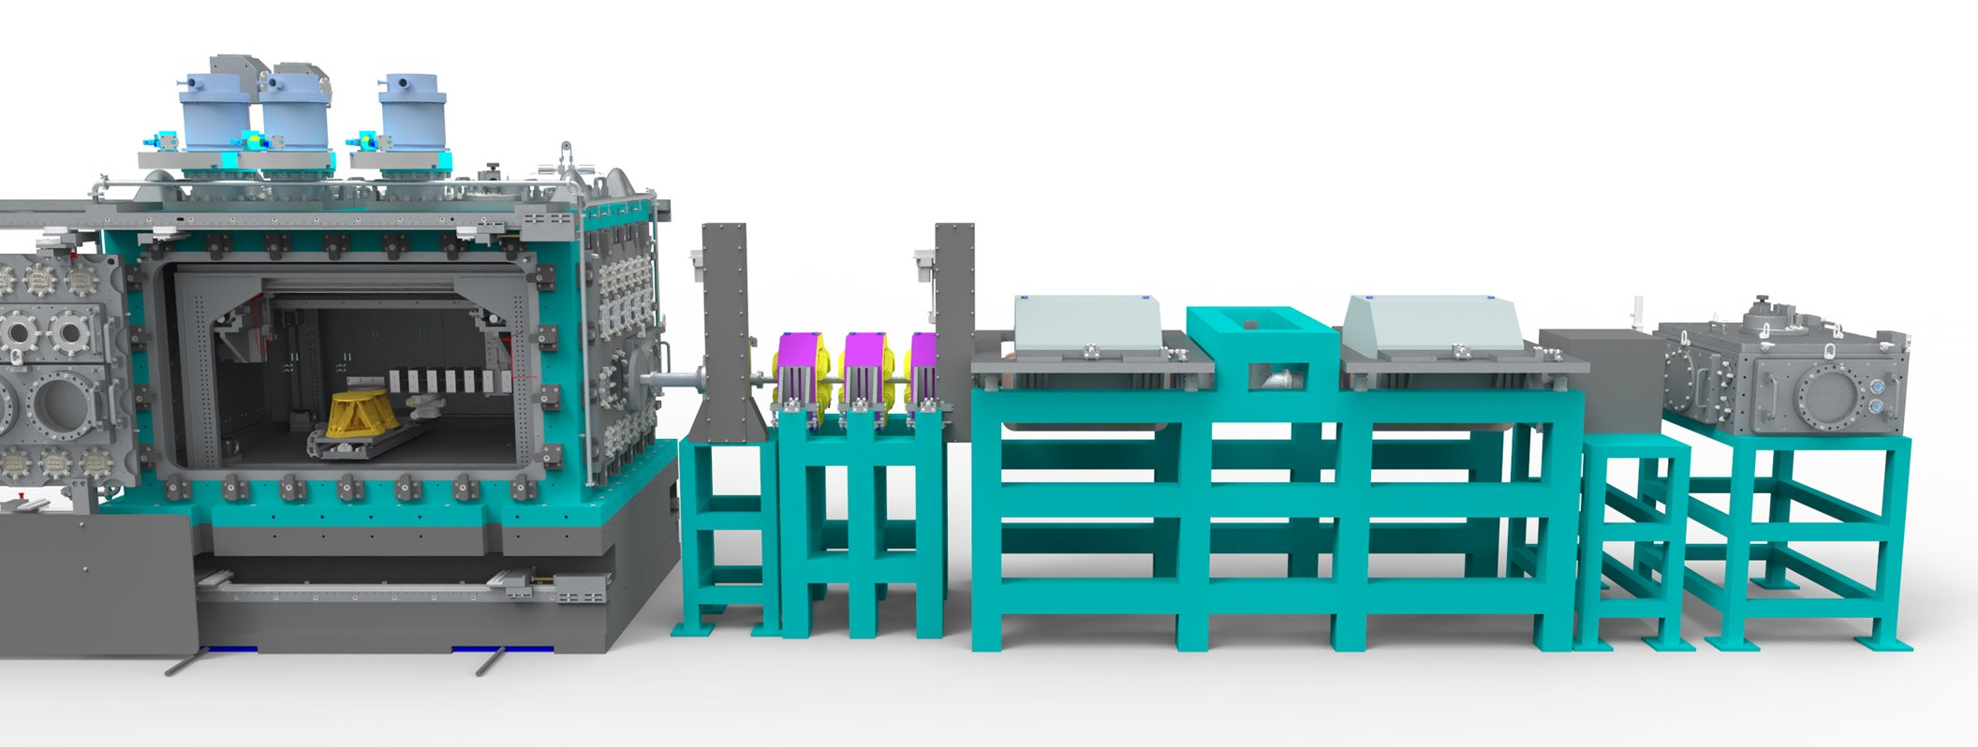
EPAC EA1 Electron beamline
EPAC is built, laser being commissioned, beamline components being installed
Laser: 1 PW, 10 Hz, 30 J, <30 fs
Electrons: 1-5 GeV, 0.1 – 1 nC, 1 – 25% energy spread
Example EA1 Configuration
laser
e-
PMQ Array
Spectrometer
Energy selector

Slide 59
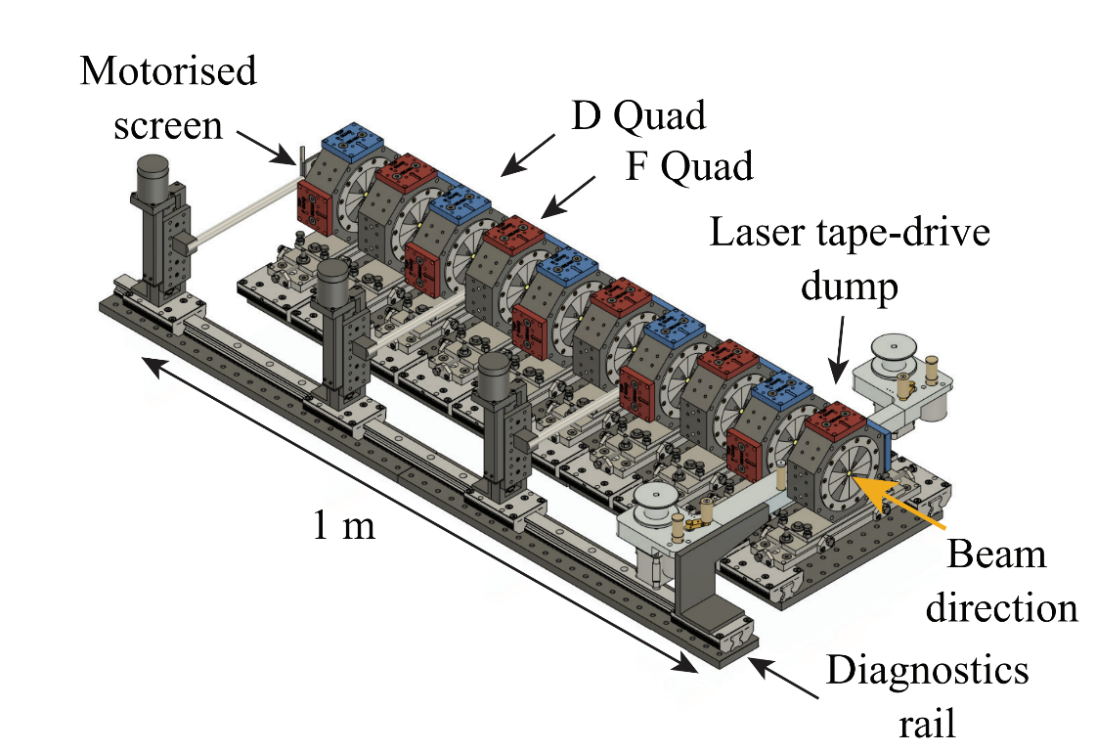
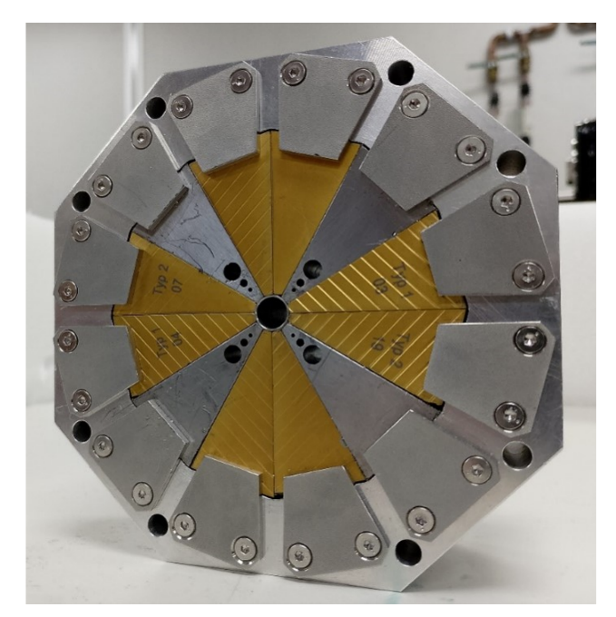
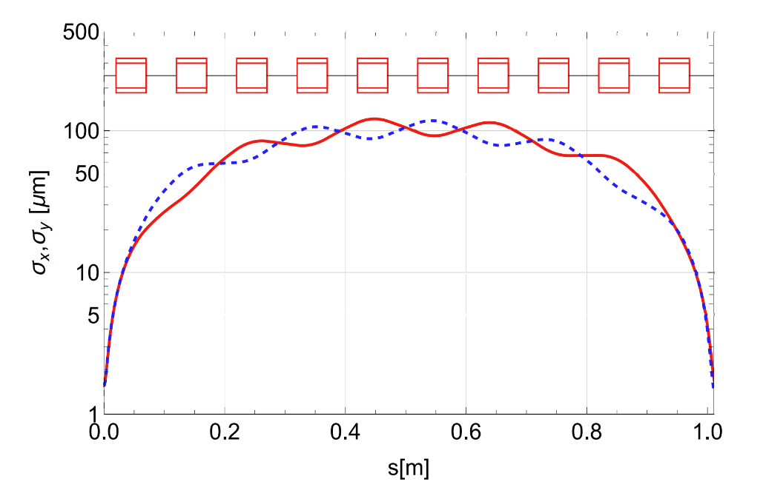
EPAC PMQ Array
~500 T/m Halbach quadrupoles, 5cm long, 5cm separation
Relays electron beam focus from source to application
Relatively robust to jitters in source terms
Paper on beamline design under review
Building these quadrupoles to specification has challenges:
Measurement and Simulation of Demagnetization in a Prototype Halbach Array Quadrupole

Slide 60
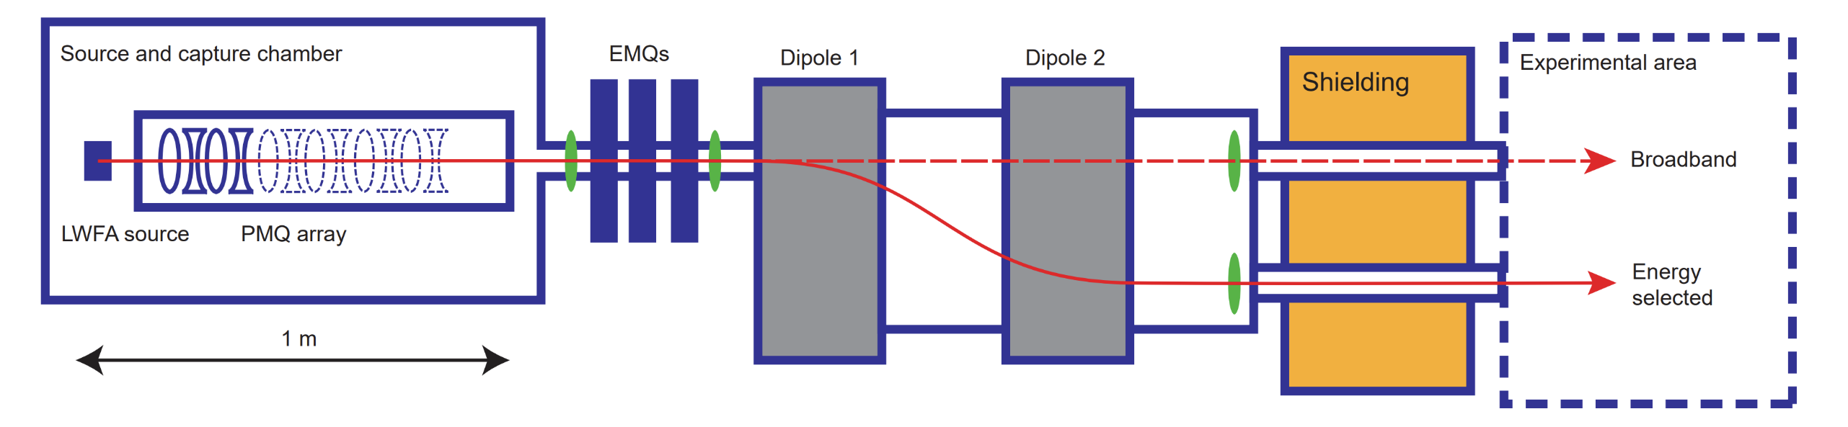
EPAC Spectrometer line
Energy spectrum measurement, up to 5 GeV
Energy selection and collimating to deliver to application
Large EM Dipoles have been procured
Requires high current DC power supplies & water cooling -> Integration challenges!

Slide 61
Other beamline designs and builds at Daresbury Lab
& Cockcroft Institute
Notes:
5minutes left check

Slide 62

RUEDI
CDR, TDR complete, now moving to final design & procurement
Diffraction line: 5 MeV, 50 fC, ~10fs resolution
Well known source -> design beamline line to compress & remove timing jitter
Small but not ‘simple’
Electron
gun
Magnetic
arc
Sample
chamber
Post-detector
diagnostics
Condensers
Projectors
TDC
Detector

Slide 63
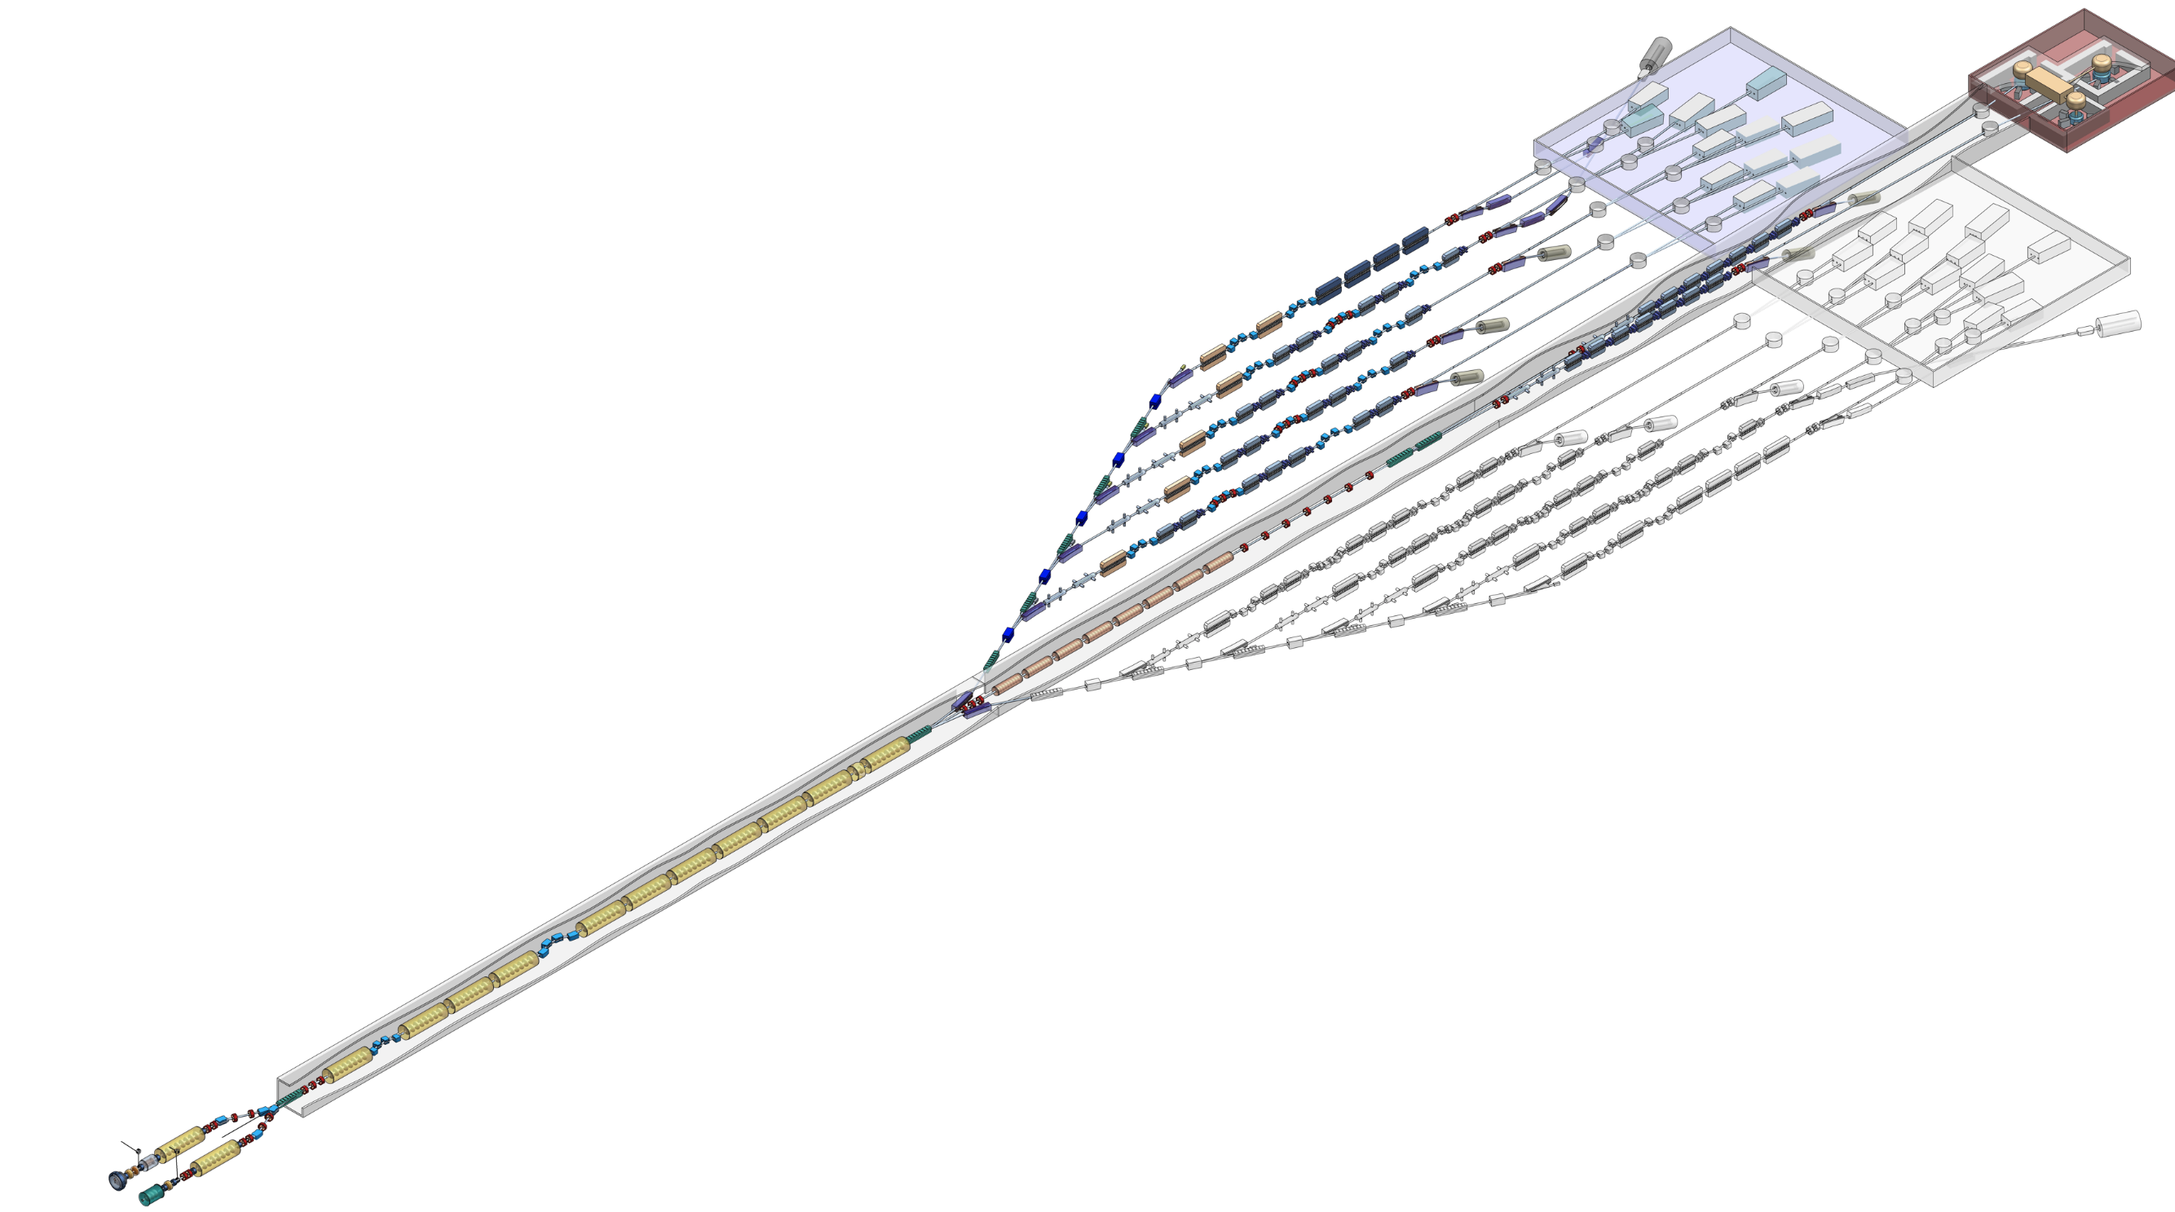
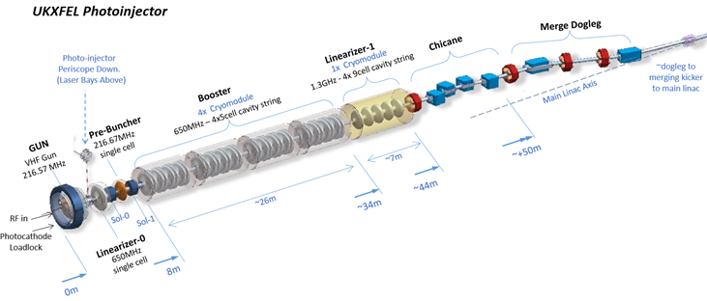
UKXFEL
Design study: CDR and Options Analysis complete
8 GeV SC FEL facility
Includes PWFA booster beamline
Includes work on X-ray beamlines + additional sources

Slide 64
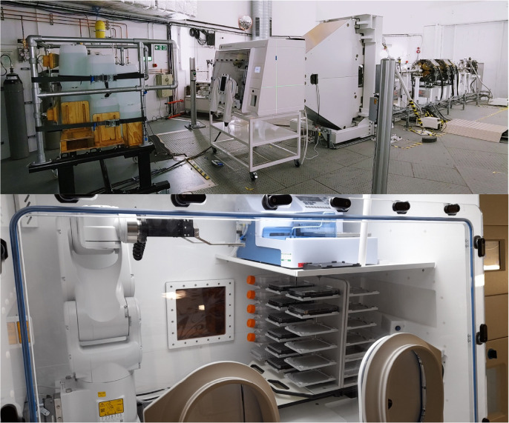

Christie Hospital Research Beamline
Proton therapy research beamline (cyclotron source)
At a cancer therapy hospital
Aiming at proton FLASH research
(cells now, in future small animals)
Conventional beamline, functionally independent from treatment beamlines
Cockcroft Institute: design
ASTeC: proton beam shaping in 3D for treatment
The proton therapy research beamline at the Christie NHS foundation trust - PubMed

Slide 65
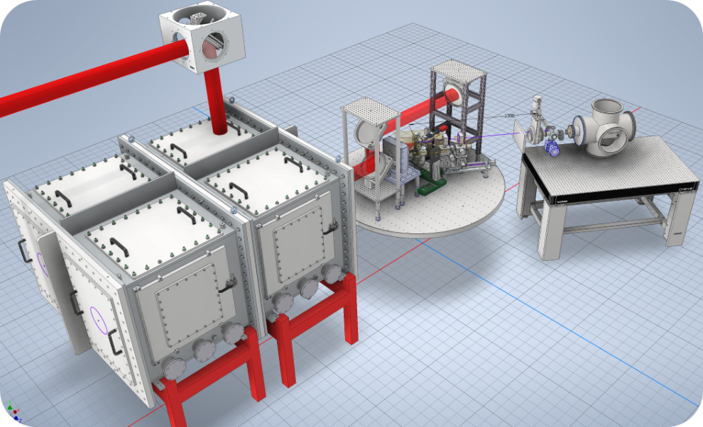
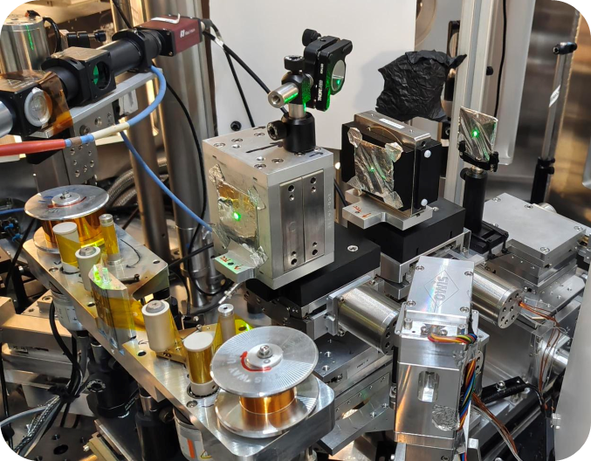

ITRF/LhARA & PoPLAR
LhARA:
Large collaboration across many partners; Plasma sources for Radiobiology
ITRF: Project to design dedicated facility for radiobiology
Beamline, infrastructure, + more
PoPLAR:
Proof of principle beamline @ SCAPA University of Strathclyde
Commissioned; >10 MeV TNSA for FLASH
PoPLAR Beamline, credit Dr. R. Gray
Notes:
Typical elements, 2 small PMQs, Kapton tape for laser removal etc

Slide 66
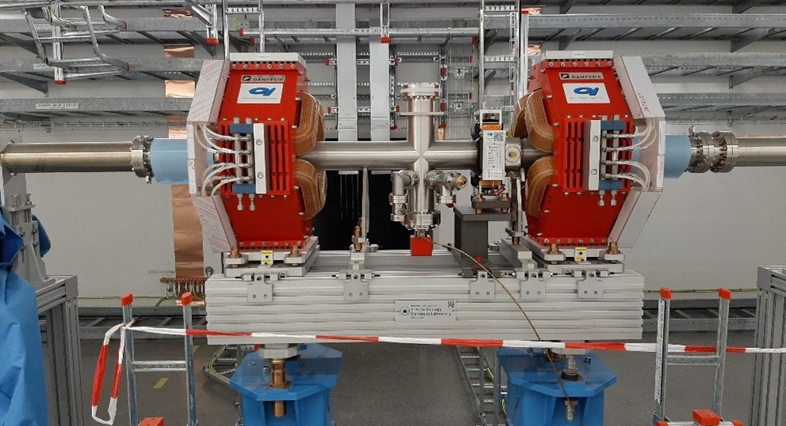
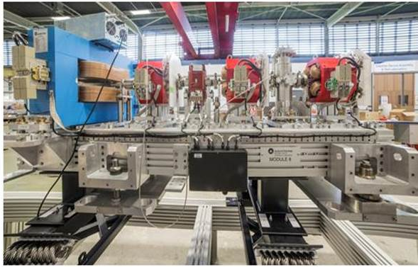
Other beamline builds completed at Daresbury Laboratory
ESS beam transport modules
74 built for SC linac cleanliness
BTM installed at ESS
Technology European Spallation Source: Beam Transport Modules (BTM)
ELI-NP electron beamline modules
35 modules, mechanical + controls
Ready for despatch to ELI-NP - The ingredients to generate gamma beams of unprecedented brilliance

Slide 67
Conclusion
Notes:
The abstract pattern can be removed or repositioned if required. Be careful to ‘Send to Back’ so that it does not obscure any important information.

Slide 68
Summary
Tools are availible to make LWFA beams suitable for applications
Invest effort now in diagnostics to support future advanced beamlines
Source charge jitter should be prioritised
Unlock more radiobio-/therapy applications
Complex applications will require complex beamlines
Means bigger facility footprints
Large experience at Daresbury Laboratory designing and building beamlines and working with novel plasma schemes

