Slide 1




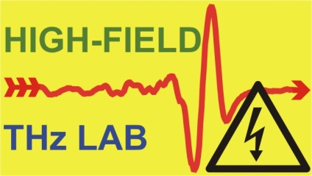

Terahertz pulse sources
Dr. Gergő Krizsán

Slide 2
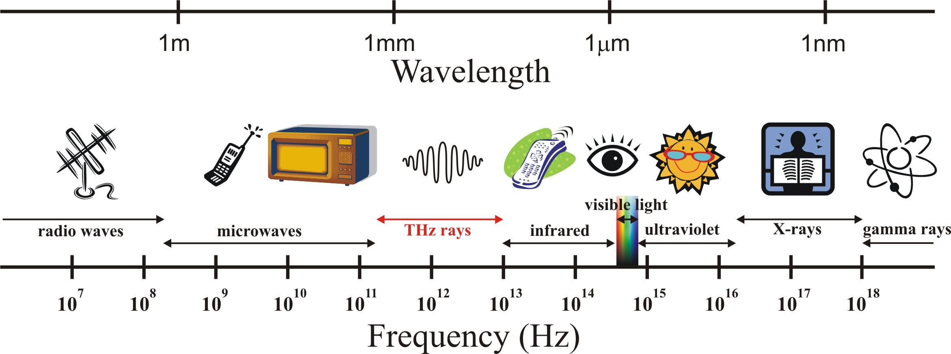





Terahertz radiation in the EM spectrum
$$v=0,1−10 THz$$
$$λ≈3−0,03 mm$$
$$T≈10 −0.1 ps$$
$$E=hν=0,41−41 meV$$
$$T=\frac{hν}{k_{b}}=4,8−480 K$$
2

Slide 3
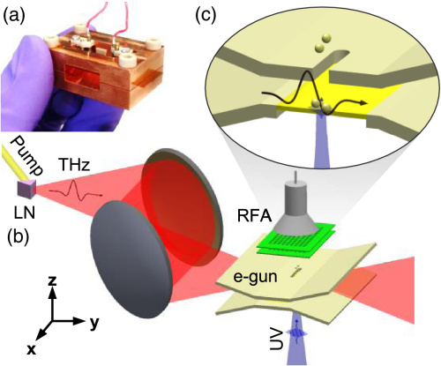
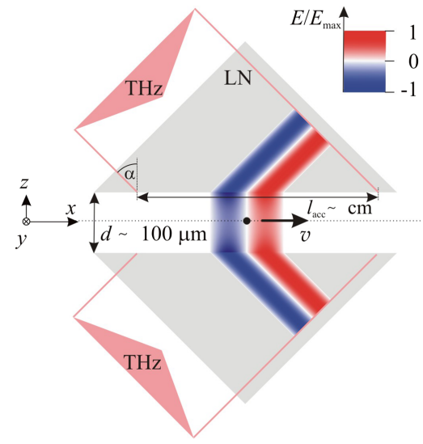
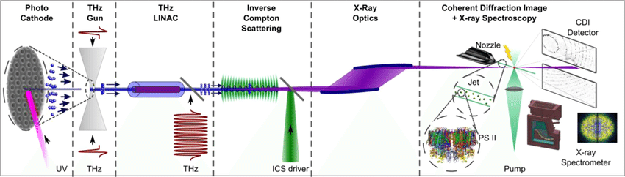
Motivation
Application possibilities of THz pulses with extremely high field strength (>> 1 MV/cm)
1., Enhancement of HH generation (for attosecond pulse generation)
E. Balogh et al.: Phys. Rev. B 84, 023806 (2011)
K. Kovács et al.: Phys. Rev. Lett. 108, 193905 (2012)
2., Field-free orientation of molecules
S. Fleischer et al.: Phys. Rev. Lett. 107, 163603 (2011)
K. N. Egodapitiya et al.: Phys. Rev. Lett. 112, 103002 (2014)
3., Acceleration (and other manipulations) of charged particles
J. Hebling et al.: arXiv 1109.6852 (2011)
L. Pálfalvi et al.: Phys. Rev. ST-AB 17, 031301 (2014)
Sz. Turnár et al.: Appl. Phys. B 127, 38 (2021)
Works of the Kaertner group
W. Ronny et al.: Optica 3, 1209 (2016)
E. A. Nanny et al.: Nature Comm. 6, 8486 (2015)
D. Zhang et al.: Nature Photonics (2018)
E. Curry et al.: Phys. Rev. Lett. 120, 094801 (2018), IFEL based manipulation of elect.
4., Carrier-envelop-phase (CEP) stable attosecond pulse generation
Gy. Tóth et al.: JOSA B 35, A103 (2018)
3

Slide 4
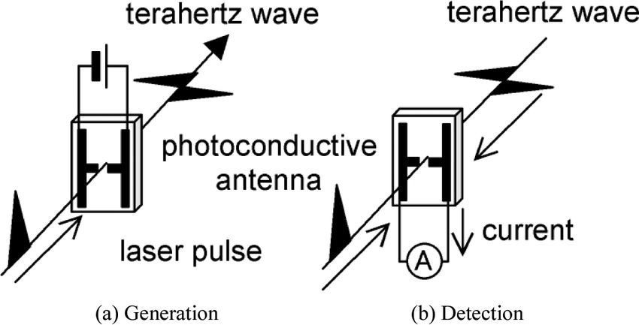
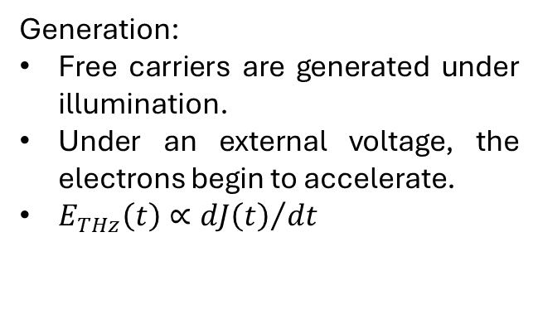
Photoconductive antenna
Generation:
Free carriers are generated under illumination.
Under an external voltage, the electrons begin to accelerate.
$E_{THz}\left(t\right)∝{dJ\left(t\right)}/{dt}$
Detection:
Instead of bias voltage, voltage meter.
The laser pulse generates free carriers.
The detected volatge will be proportional to the THz field.
Scaling:
Large-area photoconductive antennas
  Increase the distance between the electrode pairs
  Increase the number of electrode pairs
4

Slide 5
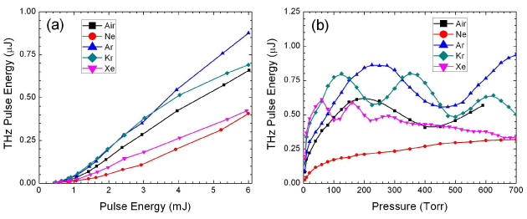
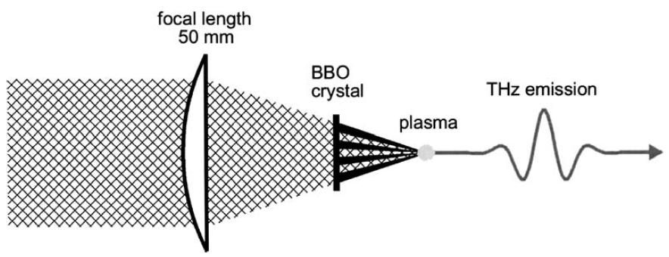
Plasma based THz sources
Generation:
The pump is focused onto a gas target using an optical element.
Second harmonic generation is achieved using a nonlinear crystal.
Plasma is generated.
The ponderomotive force induces a transient current, which in turn produces THz radiation.
Detection:
Use of a time-varying bias
Simultaneous focusing of the pump and the THz beam.
The generated second harmonic is proportional to the THz field.
Efficiency increase:
Three wavelength pumping
Use of longer pumping wavelengths
Koulouklidis A.D. et al., Nat. Commun. 11, 292 (2020)
Efficiency depends on:
Type of the used gas
Pressure
Relative phase of the pump and second harmonic
Pump energy
Bartel T. et al., Opt. Lett. 30, 2805 (2005)
5

Slide 6
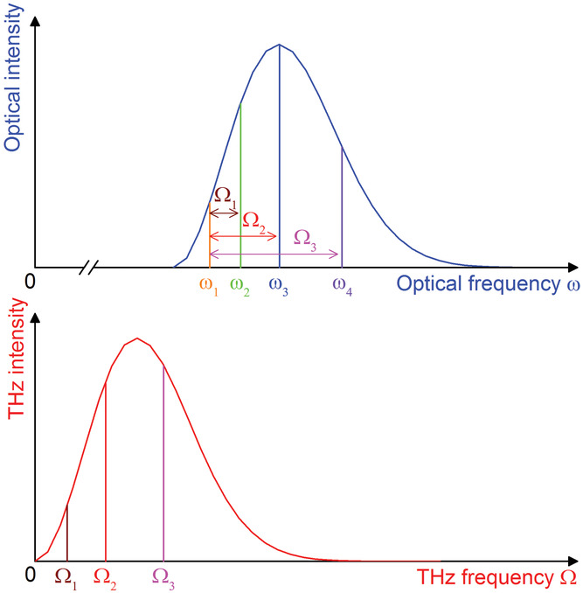
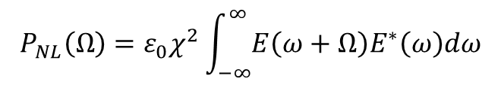
Optical rectification in nonlinear materials
Difference frequency generation within the frequency components of the pump pulse
Longer pump pulse duration-> narrow spectral bandwith -> low THz frequencies
Short pump pulse duration-> broad spectral bandwith -> higher THz frequencies too.
$$\begin{aligned}&P_{NL}\left(Ω\right)=ε_{0}χ^{2}\int_{−∞}^{∞}{E\left(ω+Ω\right)E^{∗}\left(ω\right)dω}\#\end{aligned}$$
Broad THz spectral bandwith
6

Slide 7
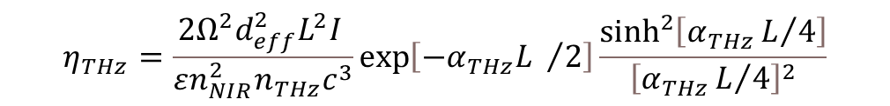

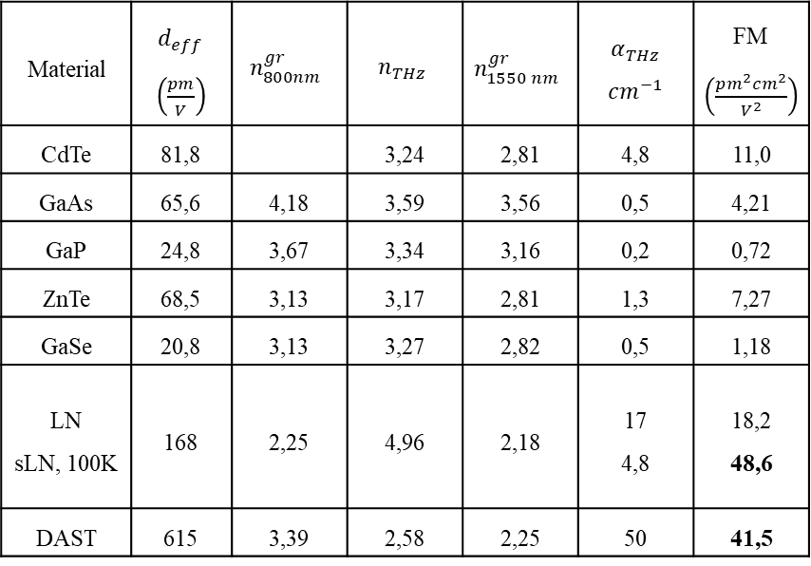

Often used nonlinear materials
Material | $d_{eff}$ $\left(\frac{pm}{V}\right)$ | $$n_{800nm}^{gr}$$ | $$n_{THz}$$ | $$n_{1550 nm}^{gr}$$ | $α_{THz}$ $cm^{−1}$ | FM $\left(\frac{pm^{2}cm^{2}}{V^{2}}\right)$
CdTe | 81,8 |  | 3,24 | 2,81 | 4,8 | 11,0
GaAs | 65,6 | 4,18 | 3,59 | 3,56 | 0,5 | 4,21
GaP | 24,8 | 3,67 | 3,34 | 3,16 | 0,2 | 0,72
ZnTe | 68,5 | 3,13 | 3,17 | 2,81 | 1,3 | 7,27
GaSe | 20,8 | 3,13 | 3,27 | 2,82 | 0,5 | 1,18
LN sLN, 100K | 168 | 2,25 | 4,96 | 2,18 | 17 4,8 | 18,2 48,6
DAST | 615 | 3,39 | 2,58 | 2,25 | 50 | 41,5
Phase matching condition(collinear case):
$$\begin{aligned}&Δk\left(Ω\right)=k\left(Ω\right)+k\left(ω\right)−k\left(ω+Ω\right)=0\end{aligned}$$
$$\begin{aligned}&Δk=\frac{\left[n\left(Ω\right)−n_{g}\left(ω_{0}\right)\right]Ω}{c}\#\end{aligned}$$
$$\begin{aligned}&v\left(Ω\right)=v_{g}\left(ω_{0}\right)\end{aligned}$$
Lithium niobate, semiconductors, organic materials
$$\begin{aligned}&η_{THz}=\frac{2Ω^{2}d_{eff}^{2}L^{2}I }{εn_{NIR}^{2}n_{THz}c^{3}}\exp\left[−α_{THz}L /2\right]\frac{\sinh^{2}\left[α_{THz}L/4\right]}{{\left[α_{THz}L/4\right]}^{2}}\#\end{aligned}$$
Y.-S. Lee, Principles of terahertz science and technology, vol. 170. Springer Science & Business Media, 2009.
$$\begin{aligned}&FM=\frac{4 d_{eff}^{2}}{n_{NIR}^{2}n_{THz}α_{THz}}\#\end{aligned}$$
7

Slide 8
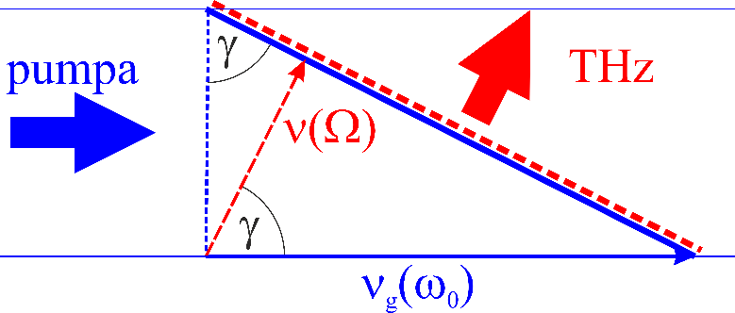
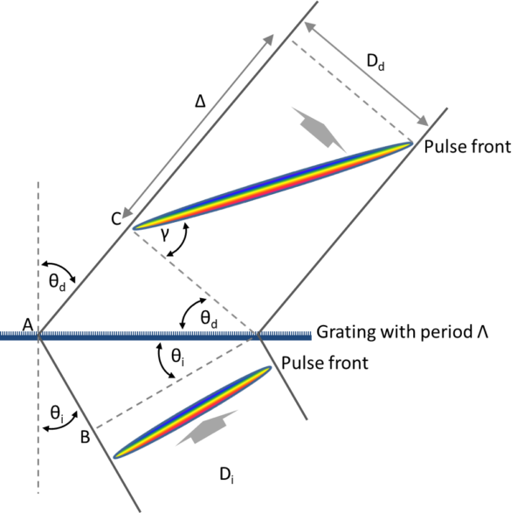


Tilted pulse front pumping
$$\begin{aligned}&ν\left(Ω\right)=ν_{g}\left(ω_{0}\right)\cos\left(γ\right)\end{aligned}$$
Relation between PFT and angular dispersion
$$\begin{aligned}\tan\left(γ_{r}\right)=\frac{n_{2}}{n_{g_{2}}}λ\frac{dθ_{d}}{dλ}\#\end{aligned}$$
$$\begin{aligned}n_{1}\sin\left(θ_{i}\right)+n_{2}\sin\left(θ_{d}\right)=\frac{λ}{d}\end{aligned}$$
$$\begin{aligned}&\tan\left(γ_{r}\right)=\frac{n_{g_{1}}\sin\left(θ_{i}\right)+n_{g_{2}}\sin\left(θ_{d}\right)}{n_{g_{2}}\cos\left(θ_{d}\right)}\end{aligned}$$
Grating equation
$$\begin{aligned}&\tan\left(γ_{r}\right)=\tan\left(γ\right)n_{g,NOA}N\#\end{aligned}$$
Impulzusfront dőlés változása nagyítás és anyagba lépés hatására
8
J. Hebling Derivation of the pulse front tilt caused by angular dispersion. Opt Quant Electron 28, 1759–1763 (1996)

Slide 9
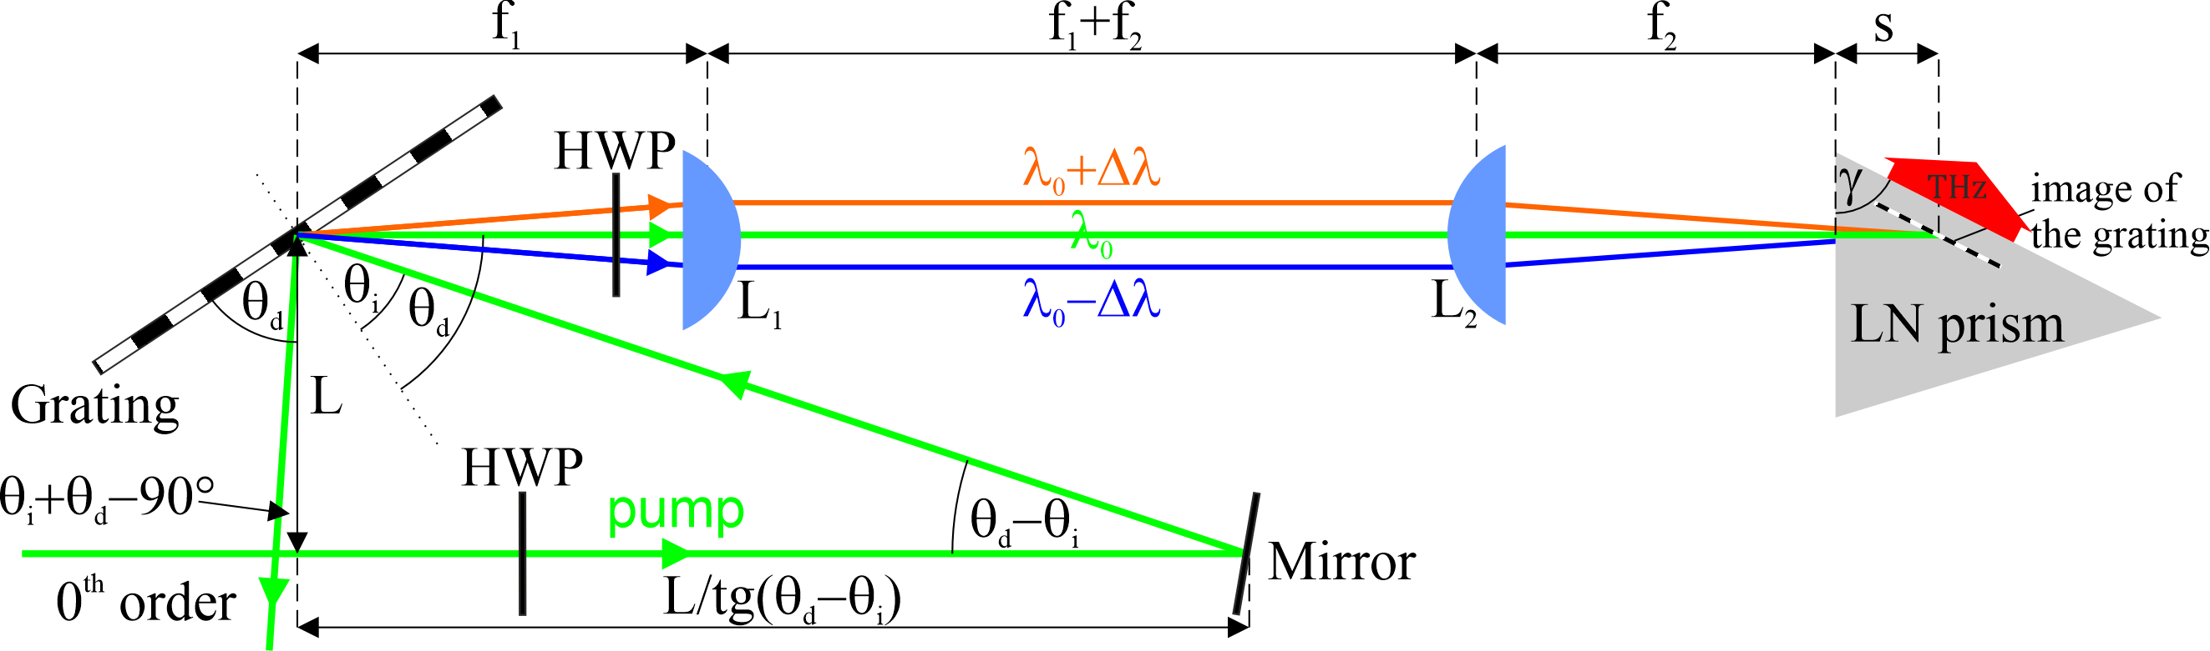
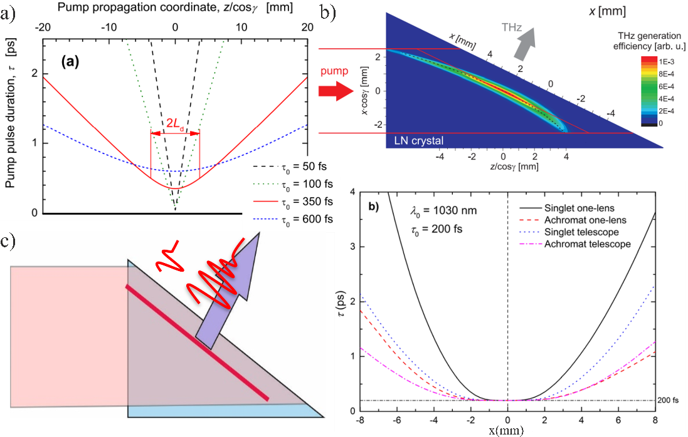
Conventional tilted pulse front pumped LN setup
I. Angular dispersion-> rapidly increasing pulse duration -> limited interaction length
J. A Fülöp et al., Opt. Express, 18, 12311 (2010)
II. Imaging -> curved pulse front and more rapidly increasing pulse duration at the sides of a wide pump beam
L. Tokodi et al.,J. Infrared Millim. Terahertz Waves, 38, 22 (2016)
III. Prism shaped crystal -> different propagation length whitin the crystal -> Varying THz waveform
G. Tóth et al., Opt. Express, 27, 7762 (2019)
9

Slide 10
Effect of PFT on THz energy and efficiency
Gy. Tóth et al., Light: Sci. & Appl. (2023)
10

Slide 11
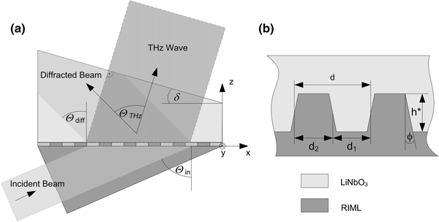
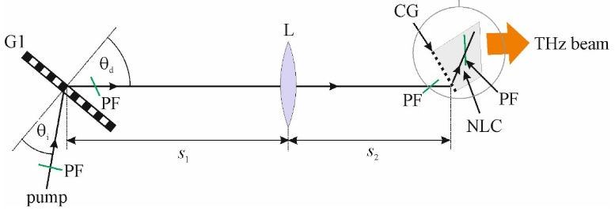
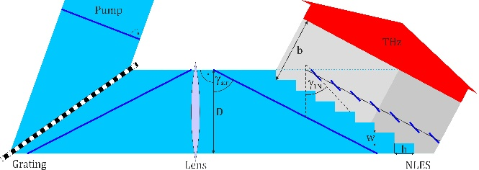
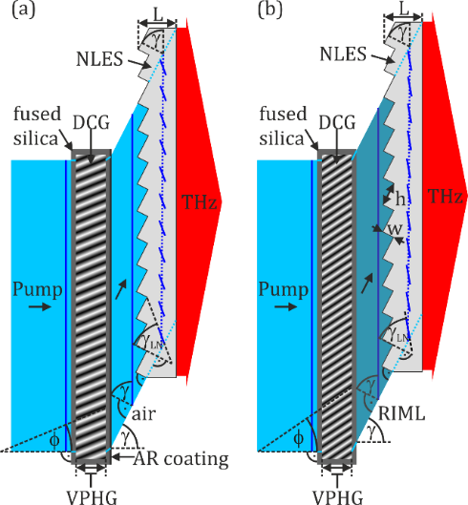
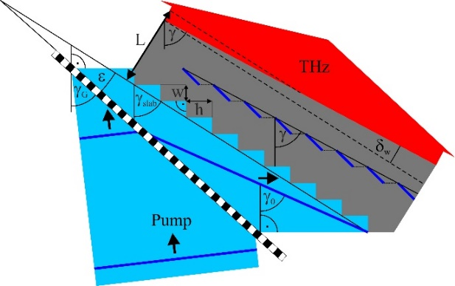
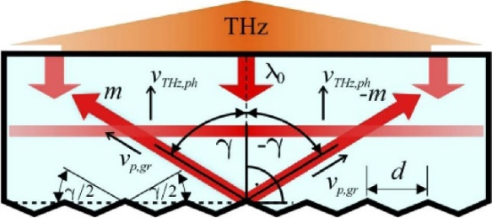
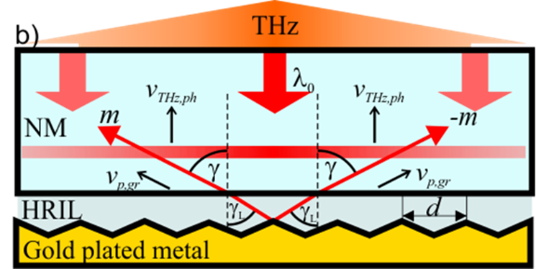
Microstructured LN THz sources
Contact grating ii., iii.
L. Pálfalvi et al., Appl. Phys. Lett. 92, 171107 (2008)
Z. Ollmann et al., Appl. Phys. B 108, 821 (2012)
M. Tsubouchi et al., Optics Lett. 39, 5439 (2014)
Hibrid contact grating TPFP ii., iii.
L. Pálfalvi et al., Opt. Express 24, 8156 (2016)
Nonlinear echelon slab with imaging i., ii., iii.
L. Pálfalvi et al., Opt. Express 25, 29560 (2017)
P. S. Nugraha et al., Opt. Lett. 44, 1023-1026 (2019)
NLES with volume phase holographic gratingi., ii., iii.
G. Krizsán et al., Opt. Express 30, 4434-4443 (2022)
G. Krizsán, et al., Opt. Lett. 50, 4250-4253 (2025)
Wedged NLES i., ii. iii.
G. Tóth et al., Opt. Express 27, 7762 (2019)
G. Krizsán et al., Opt. Lett. 48, 3777-3780 (2023)
Reflective nonlinear slab i., ii., iii.
G. Tóth et al., Opt. Express 27, 30681 (2019)
RNLS with external structured reflectori., ii., iii.
G. Krizsán et al., Opt. Express 28, 34320 (2020)
11

Slide 12
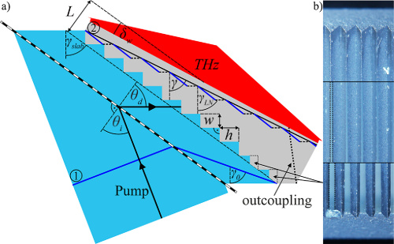
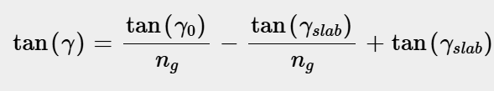
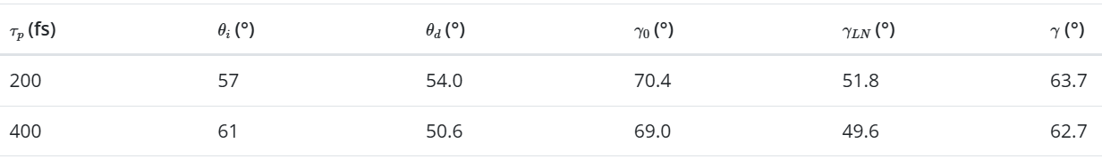
Demonstration of wedged NLES THz source
12

Slide 13
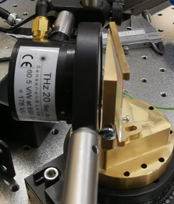
Wedged NLES THz source
13

Slide 14
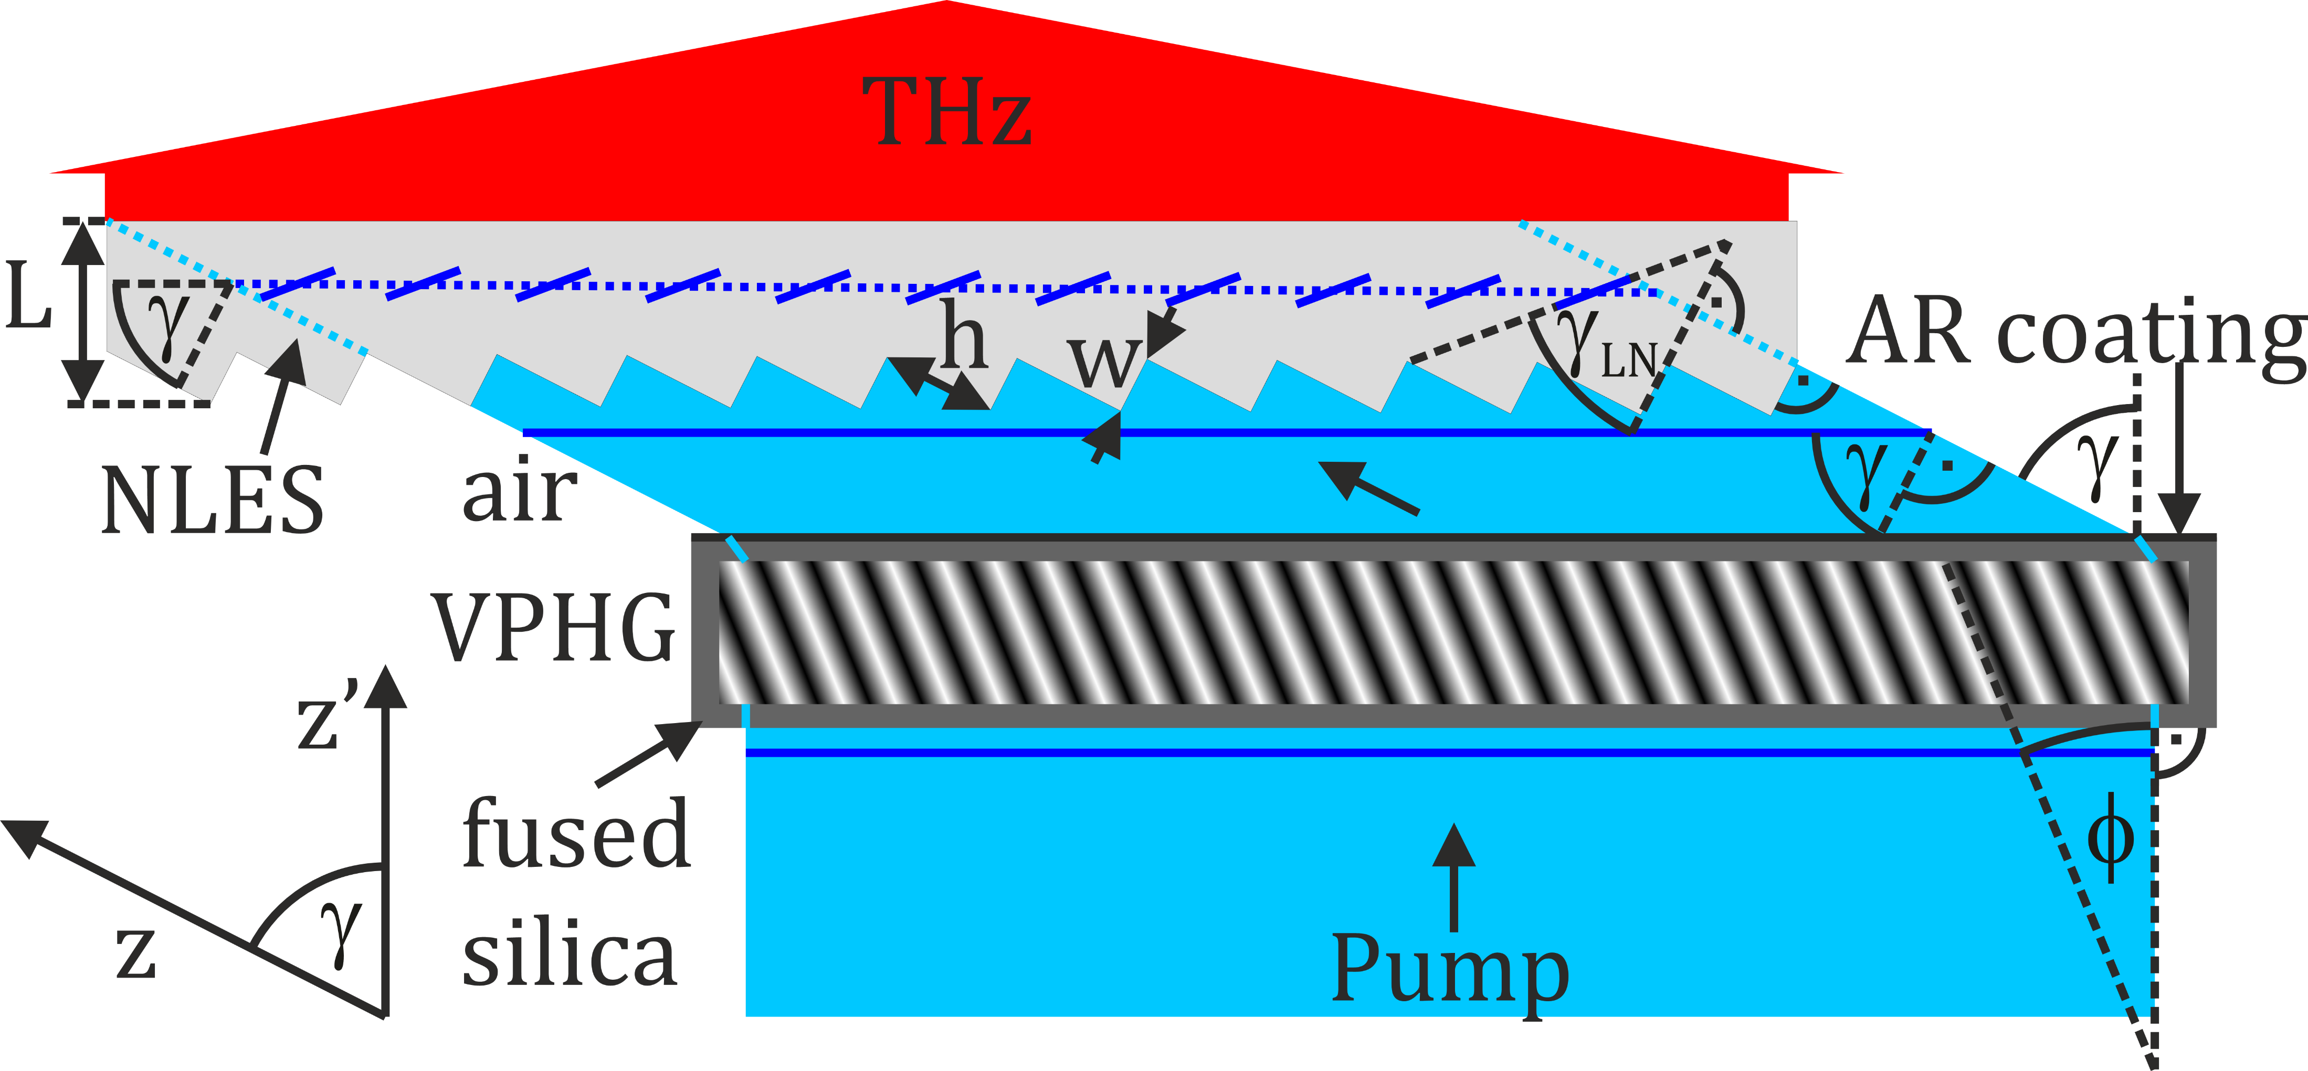
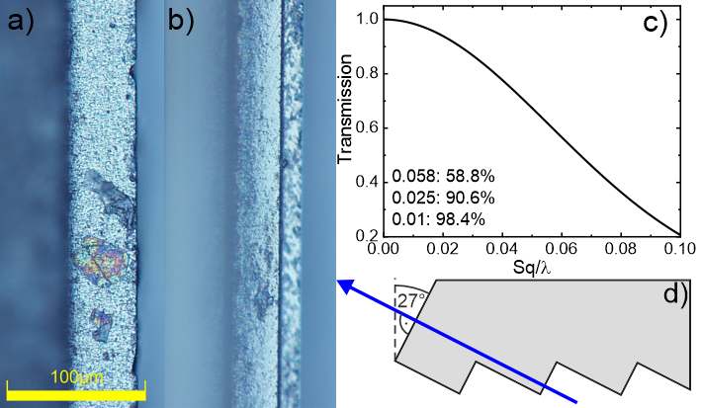
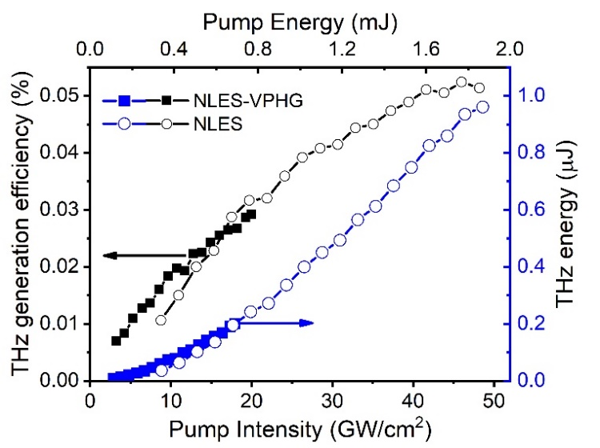
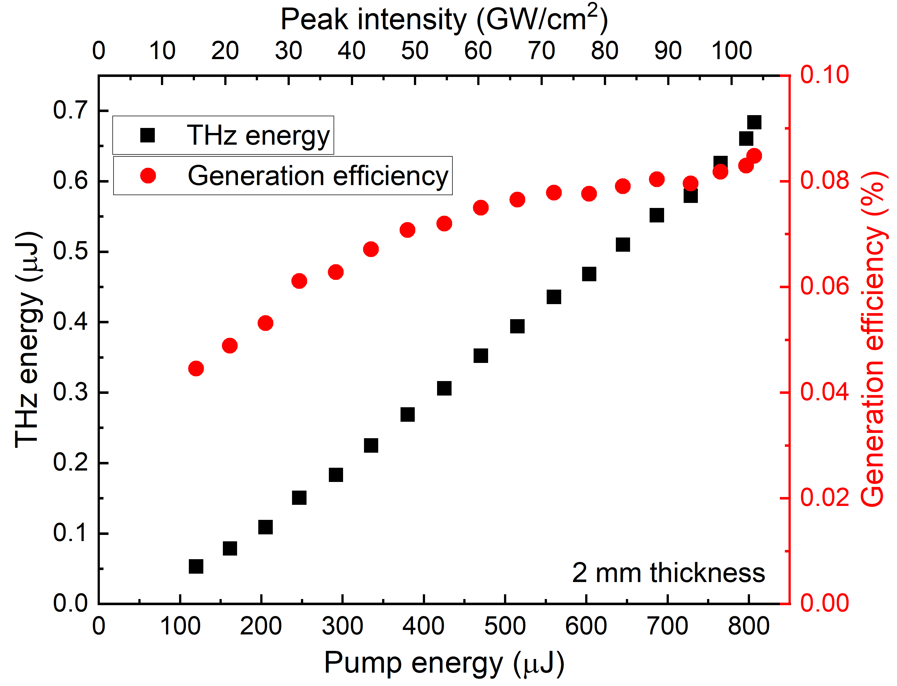
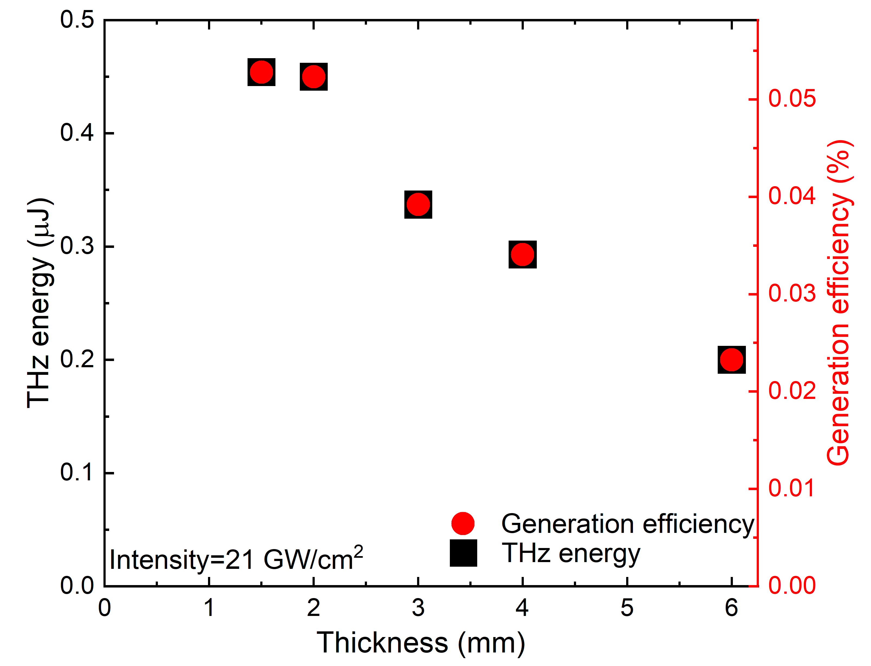
VPHG-NLES setup demonstration
14

Slide 15
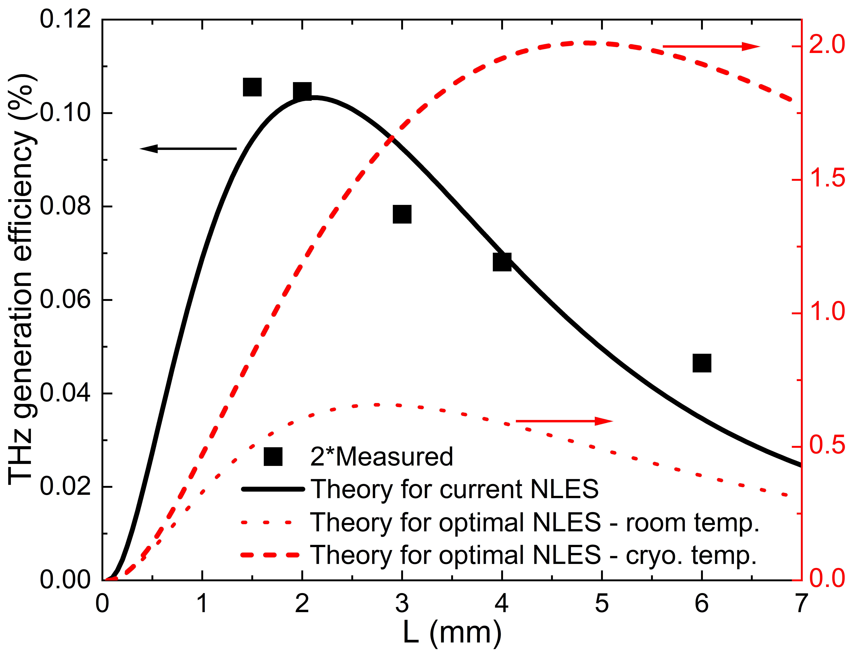
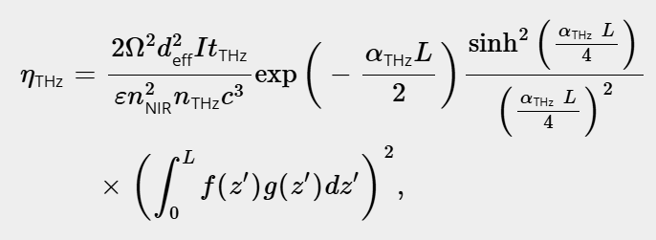



VPHG-NLES possible improvements
Pumping the current (optimal setup) with 64 mJ energy (20x30 mm, 200 fs, 150 GW/cm² ) could result in ~77 (416) µJ energy. Focusing it with a single 1 inch focal length parabolic mirror would result in an electric field as high as 4.5 (10) MV/cm.
Such a setup at large (wide) pump beam sizes can already be more efficient than the conventional one. With increased microstructured quality it could outperform the conventional source at small pump beam sizes too.
G. Krizsán, et al., Opt. Lett. 50, 4250-4253 (2025)
15

Slide 16
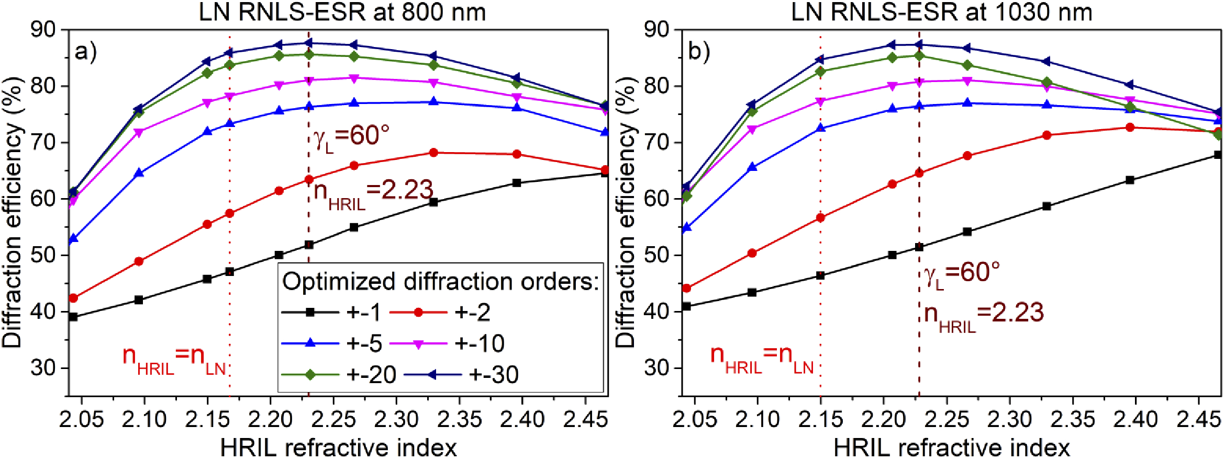
RNLS(-ESR)
Gy. Tóth et al., Opt. Express 27, 30681-30691 (2019)
Surface roughness is even more critical
G. Krizsán et al., Opt. Express 28, 34320-34327 (2020)
16

Slide 17
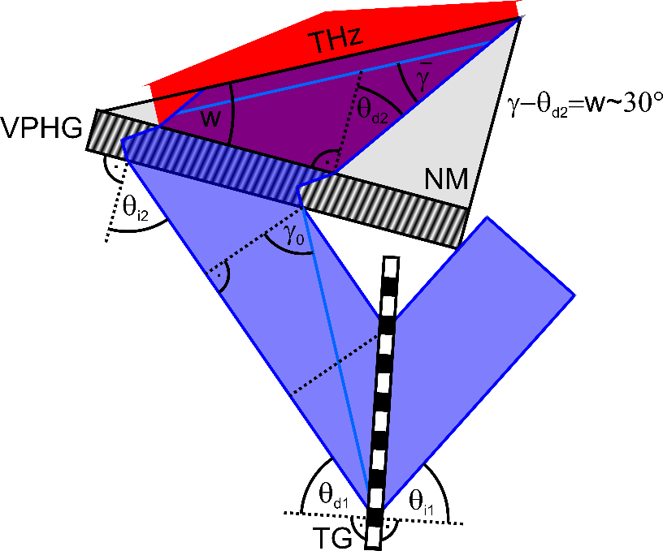



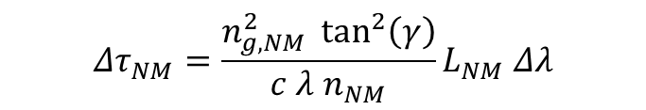
LN with a contact VPHG
No need for imaging if: $Δτ_{air}=Δτ_{NM}$
$$\begin{aligned}&Δτ_{air}=\frac{\tan^{2}\left(γ_{0}\right)}{c λ}L_{air} Δλ\end{aligned}$$
No need for microsturcturing
PFT angle can be easily tuned
$$\begin{aligned}&Δτ_{NM}=\frac{n_{g, NM}^{2} \tan^{2}\left(γ\right)}{c λ n_{NM}}L_{NM} Δλ\end{aligned}$$
~30° wedge angle
$$\begin{aligned}&L_{air}=D \left(\tan\left(θ_{d1}\right)+\tan\left(θ_{i2}\right)\right)\end{aligned}$$
$$\begin{aligned}&L_{NM}=\frac{D}{\cos\left(θ_{i2}\right)}\frac{\sin\left(γ−θ_{d2}\right)}{\cos\left(γ\right)}\end{aligned}$$
G. Krizsán et al., manuscript in preparation
3.7x wider crystal and 2.3x wider pump beam and higher pump energy than a conventional TPFP setup with same THz generation efficiency
17

Slide 18
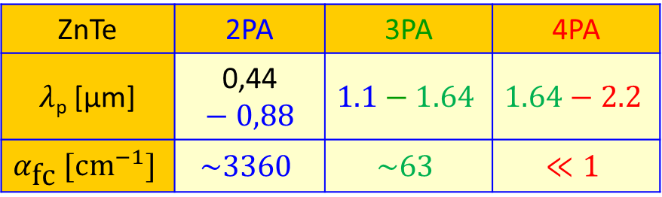
Reconsidering semiconductors for THz generation
Collinear phase matching at common pump laser wavelengths
Material | ZnTe | GaP | GaAs | LN
d_{eff} [pm/V] | 68.5 | 24.8 | 65.6 | 168
Small nonlinear coefficient
Strong two-photon absorption (2PA) at such pump
wavelengths
  Free carrier absorption of THz
  Limited useful pump intensity
  Low efficiency for THz generation
ZnTe | 2PA | 3PA | 4PA
$λ$_{p} [μm] | 0,44$−0,88$ | $$1.1−1.64$$ | $$1.64−2.2$$
$$α_{\text{fc}} [\text{c}{\text{m}}^{−1}]$$ | $$\sim 3360$$ | $$\sim 63$$ | $$≪1$$
Polónyi et al., Opt. Express, 2016 Blanchard et al., Appl. Phys. Lett.,2014 Fülöp et al., Opt. Express, 2010
18

Slide 19
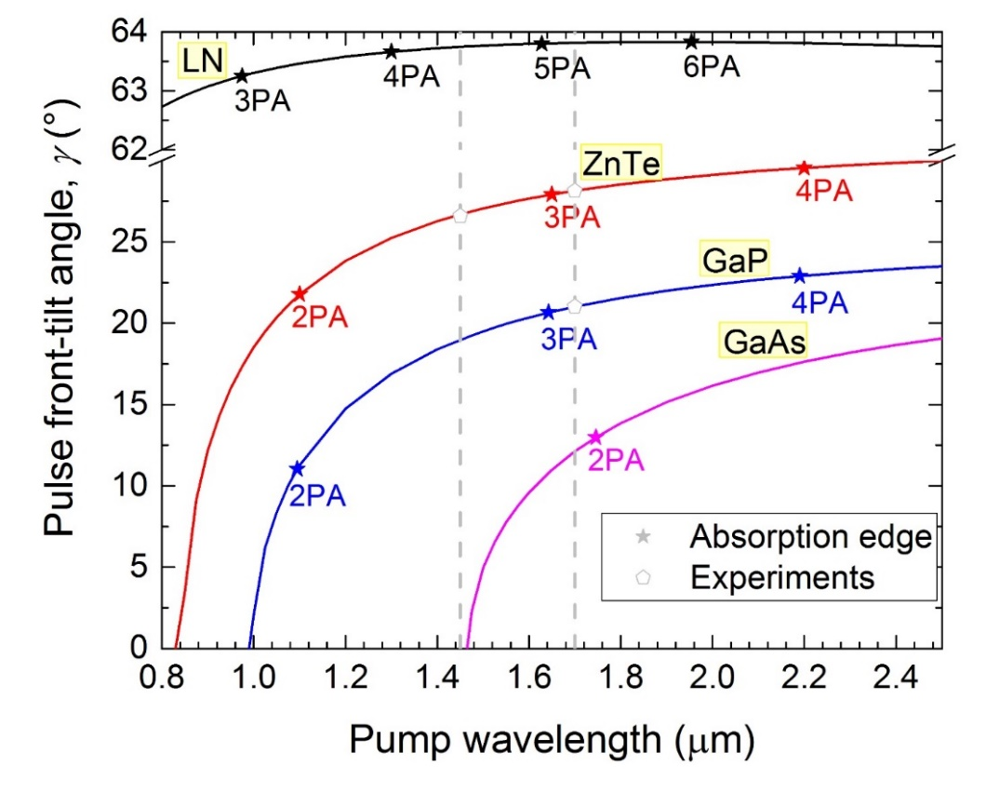
Reconsidering semiconductors for THz generation
Solution: longer pump wavelength
  Allows for higher pump intensity
  More efficient THz generation
Requires tilted-pulse-front pumping
The pulse front tilt angle is advantageously smaller
  Large interaction length for THz generation compensates for smaller nonlinear coefficient
  More uniform crystal length across the pumped area
19

Slide 20
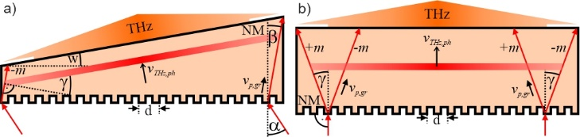
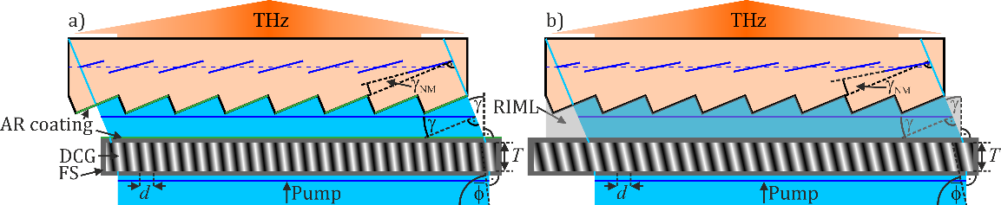
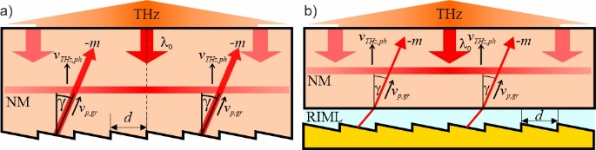
Microstructured semiconductor THz sources
Contact grating
Diffraction efficiency <75% (1.7-3.9 µm, 1-4 THz)
Wedge angle → limited size
Co-propagating ±1 orders → limited pumping intensity
J. A. Fülöp et al., Optica 3, 1075-1078 (2016)
Gy. Polónyi et al., IEEE 23, 1-8 (2017)
Hybrid VPHG – echelon grating (without imaging)
Diffraction efficiency ~80% (1.8 µm, 3 THz)
Pulse front segments tilt angle < Average PFT angle →
→ reduced THz generation efficiency
Reflective nonlinear slab (and with external structured reflector)
Z. Tibai et al.,Opt. Express 30, 45246-45258 (2022)
Diffraction efficiency ~70-95% (1.8 µm, 3 THz)
AR coating only for pump
Z. Tibai et al.,Opt. Express 30, 45246-45258 (2022)
20

Slide 21
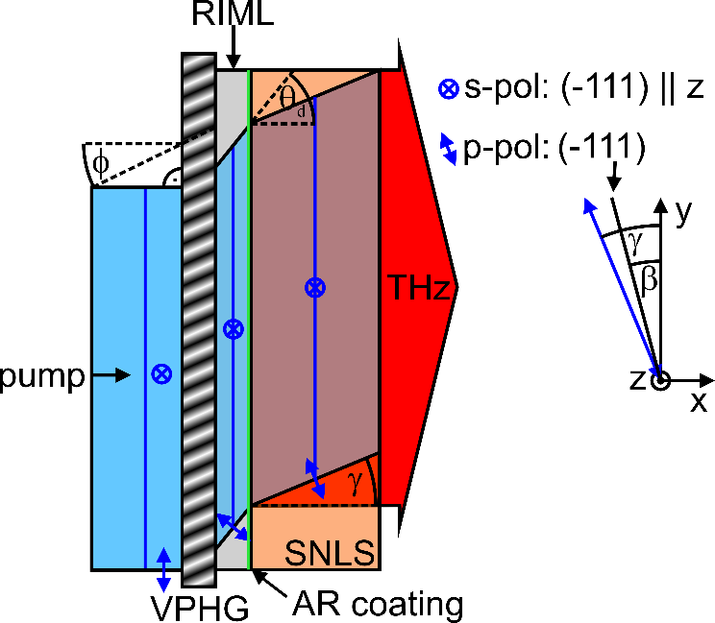
Semiconductor with VPHG
G. Krizsán et al., Opt. Express 32, 18909-18915 (2024)
Only one diffraction order
No limit on the pump beam size
No need for microsturcturing
Easily adaptable to different pump wavelengths and THz phase matching frequencies
High diffraction efficiencies
Usable up to 2.5 µm → 6 photon absorption
Fresnel loss can be high for large PFT-angles (20-30% for γ=21-25°)
AR coating at RIML-NM surface (1 layer TiO₂ <4%)
Pump polarization is in the dispersion plane (p-pol)
Differently oriented semiconductor
Smaller nonlinear polarization (but only ~5%)
Overall, 13-23% gain in the γ=21-25° range
21

Slide 22
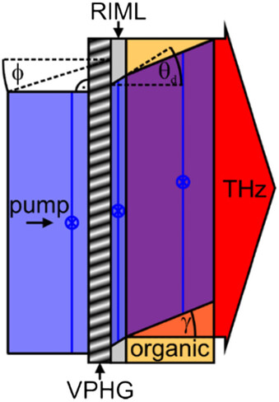
Organic material based THz sources
Numerical simulations demonstrated significant gains achievable with TPFP. Pumping DSTMS, DAST, BNA, and MNA crystals at 2050 nm with optimized tilt angles (19°, 22°, 27°, and 33°, respectively) resulted in conversion efficiency enhancements of 1.6x, 2.1x, 2.4x, and 6x compared to untilted pumping.
Gy. Polónyi et al. Advanced Photonics Research 6.6 (2025): 2400180.
Material | Dominant MPA order | PFT, γ [°] | VPHG line density, d [1 mm⁻¹] | Slant angle, φ [°] | Thickness [μm] | Diffraction efficiency [%] | Transmission (Fresnel losses + diff. eff.) [%] | Transmission w/o VPHG [%]
DAST | 4 | 22 | 385 | 15–20.2 | 5.4–7.2 | 96 | 89.6 | 87.3
DSTMS | 4 | 19 | 326 | 6.3–7.7 | 12–16.6 | 91 | 85.3 | 88.1
BNA | 7 | 27 | 392 | 16–21.9 | 5.4–7.1 | 96 | 91.5 | 92.3
MNA | 7 | 33 | 526 | 27.7–32.2 | 4.8–5.9 | 98 | 91.9 | 89.2
22

Slide 23
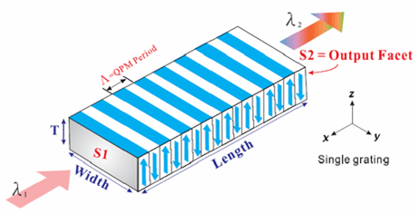
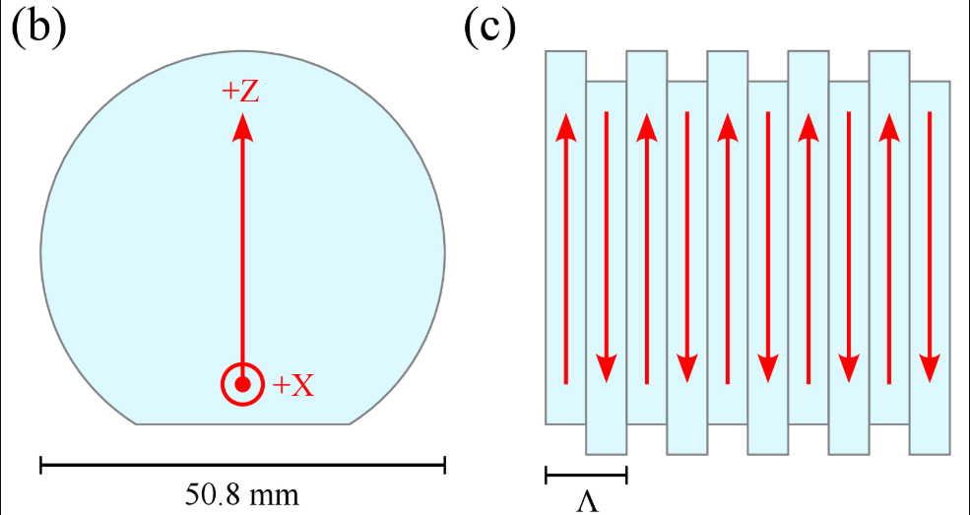
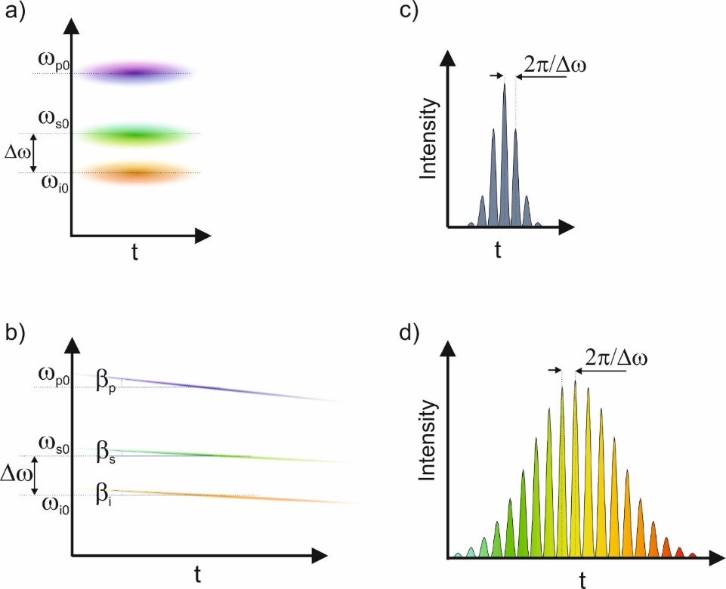
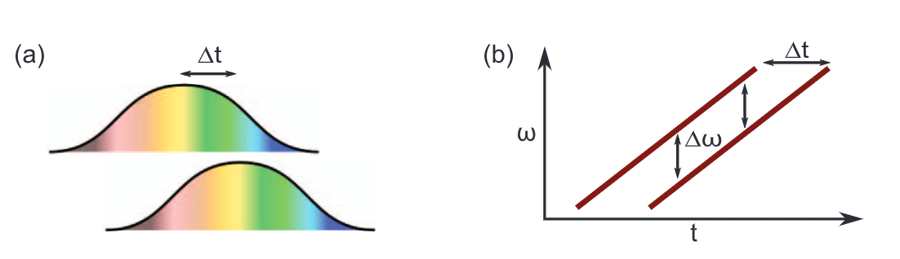
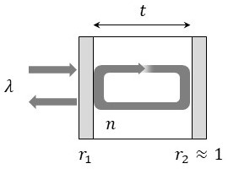
Multicycle THz sources
C. D. W. Mosley, Opt. Express 31, 4041-4054 (2023)
Intensity modulated pumping
Chirp and delay
L. Nasi, Opt. Continuum 4, 2176-2192 (2025)
F. Ahr Opt. Lett. 42, 2118-2121 (2017)
Multipulse pumping (GT etalon)
23

Slide 24
Thank you for your attention!

