Slide 1
An analytic model for plasma expansion into a vacuum
Imre Ferenc Barna¹, István Földes² and László Mátyás³
¹Wigner Research Centre for Physics Budapest, Hungary
²Energy Research Centre for Physics Budapest, Hungary
³Sapientia Hungarian University, Miercurea Ciuc, Romania
2025 okt 6 EuPRAXIA DN CAMP Pécs

Slide 2
Outline
Introduction personal, various PDEs, basic solutions, self-similar and travelling wave and other Anzätze, a nice example the diffusion equation
A simple plasma extension model and some perliminary solutions
Summary & Outlook possible generalizations future plans

Slide 3









Personal Introduction
dr. Barna Imre Ferenc Phd
was born in 1972,
stuff scientist at HUN-REN Wigner Research Centre for Physics,
Education: Technical University Budapest, eng-phys. 1991 - 97
Phd: Justus-Liebig Universität, Giessen in 2002, topic: ion-atom collision, ionisation
PostDoc:
2002 - 2004 Max Planck Institute for Physics of Complex Systems, Dresden
2004 - 2005 TU Vienna, Theoretical Phys. Departement
Permanent Positions:
2005 - 2013 Atomenergy Research Institute
2012 - 2019 ELI ALPS laser center, half position
2013 - till today HUN-REN Wigner Research Centre for Physics
2008 - till today german biophysics tutor at the Vetarinary University
Research fields: old: atomic physis, new: laser - matter interaction, matematical physics,
86 peer-revied publication, Google scholar: 1360 citation, Erdős number: 4 ☺
Webpage: http://www.kfki.hu/~barnai/
E-mail: barna.imre@wigner.hu Tel: 392-2222/3504

Slide 4
Some words about PDEs
What are the methods:
1) based on Lie symmetries, quite a worked out method,
my heavy personal problem that they never analyze the properties of
the solutions ☹☹
(I do not know the method, but it would be fine to know☹)
2) Ad-hoc variable transfomrations e.g. Hopf-Cole
U(x,t) = Exp[V(x,t)] in some cases transforms to a linear PDE
pl. Kardar-Parisi-Zwang surface gowth equation
3) Separation of variables, learn at Laplace-Poisson equation in university
4) Reduction of the original spatial x and temporal variable t
to a new one η(x,t) therefore PDE becomes an ODE
in many cases it has analytic solutions (this is our main topic)
5) Numericla methods, (I do not consder now)

Slide 5
The very basics of the idea
Initially: a (nonlinear) partial differential
equation (system) for u(x,t) is given
Ansatz: combination from space and time variable x,t
to a new variable η(x,t) so u(η) called reduction technics
Result: a (nonlinear) ordinary differential
equation (system) u’ (η)
+ with some tricks analytic solutions can be
found which depend on some free physical
parameter(s), general global properties can be studied
like: non-continous solutions, compact supports,
oscillations, asymptotic power-law behaviour etc. etc.

Slide 6
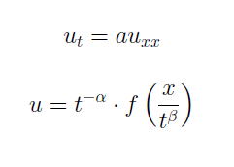
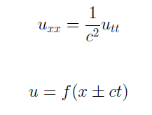
A way of interpretation
there are the two basic time-dependent linear PDEs
which describe propagation in space and time
each has it’s natural Ansatz with physical interpretation
we may attack any kind of non-linear PDE with
self-similar or traveling wave Ansatz ☺ asking
how diffusive/dissipative or how wave-like it is
(the connection between the two Ansätze is nontivial !! Sometimes can be seen)

Slide 7
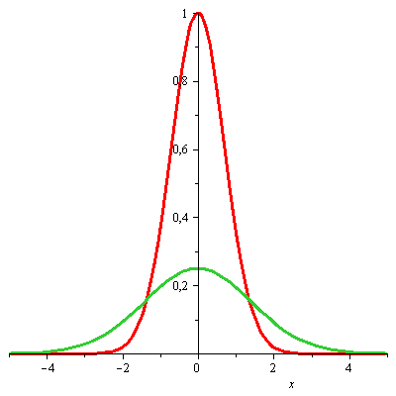

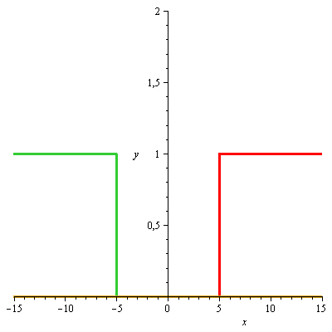
How these solutions look like
- Self-similar in 1D Sedov, Zeldovich, Barenblatt
- Traveling waves:
arbitrary wave fronts
u(x,t) ~ g(x-ct), g(x+ct)
Sedov, Zeldovich, Barenblatt
in Fourier heat-conduction the Gaussian

Slide 8

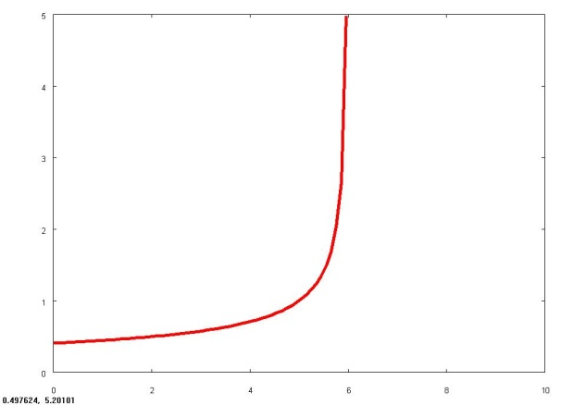


Additional relevant solutions for PDEs I
- generalised self-similar:
- one case: blow-up solution:
goes to infinity in finite time
other forms are available too
- generalized travelling waves,
exp-function method
He & Wu 2006

Slide 9

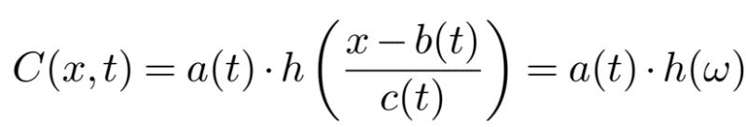


Additional relevant solutions for PDEs II
We go for diffusion now so u(x,t) is changed to C(x,t)
The „generalized self-similar Ansatz”
Traveling profile Ansatz interpolates between self-similar and traveling wave
It is also a kind of interpolating Ansatz
generalization with a finite
series (we applied to diffusion)
Clarkson-Kruskal 1989 a non-classical
symmetry, also a kind of generalization

Slide 10
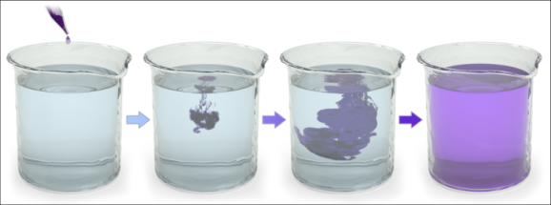
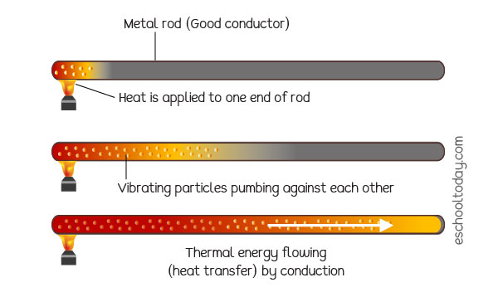

The linear diffusion/heat conduction equation (our former interest)
Physical processes: diffusion and heat conduction
the one dimensional corresponding PDE:
written in one Cartesian coordinate, diffusion/heat conduction coefficient is a positive real number D > 0, and independent of the concentration/temperature
(remark: the non-linear problem was investigated also)

Slide 11
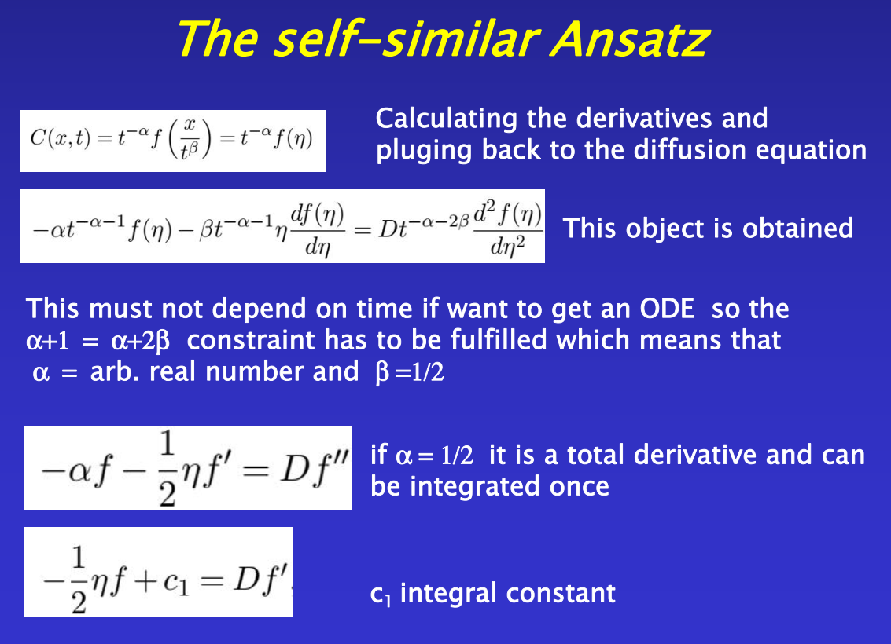
and we can get the Gaussian solution

Slide 12
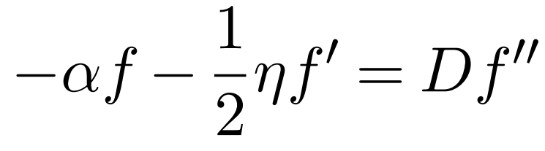
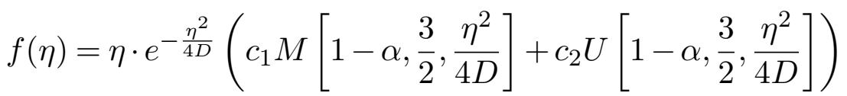


The general solution
What happens when a$≠$ ½ ? Not a well known case....
Solutions contain the Kummer’s M and Kummre’s U functions
Kummer’s M is defined with the hypergeometic series:
a_{n} are the Pochammer symbol, or rising factorial
The functions have very interesting solutions, we investigated in depth
I.F. Barna and L. Mátyás Universe 9, (2023) 26, Mathematics 10, (2022) 3281

Slide 13
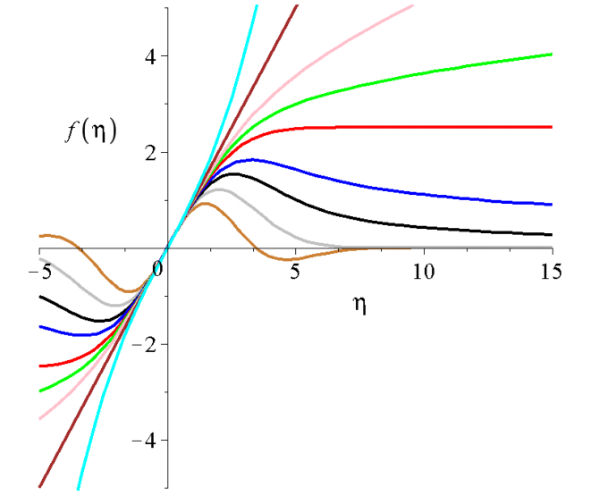
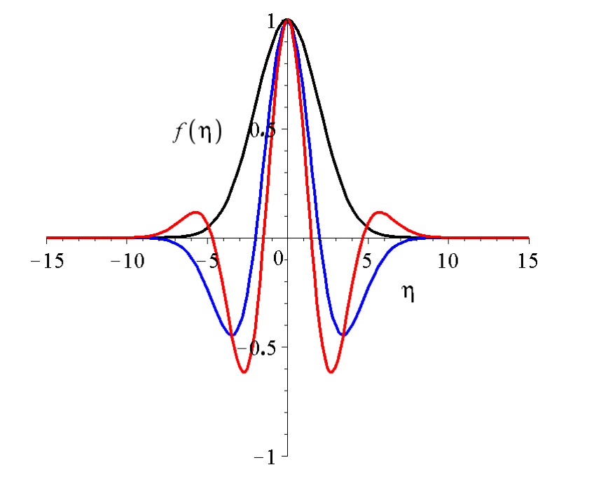
General properties of the solutions
Kummer’s M are odd solutions some Kummer’s U are even solutions
depending on the free self-similar exponent α
- it can diverge,
- can have assymptot or
- decay with oscillations
α = 1/2, 3/2, 5/2

Slide 14
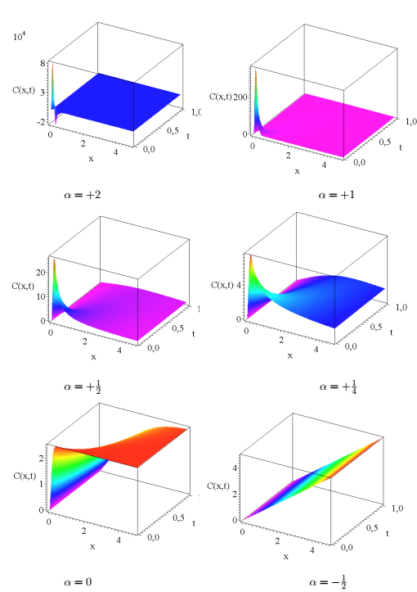
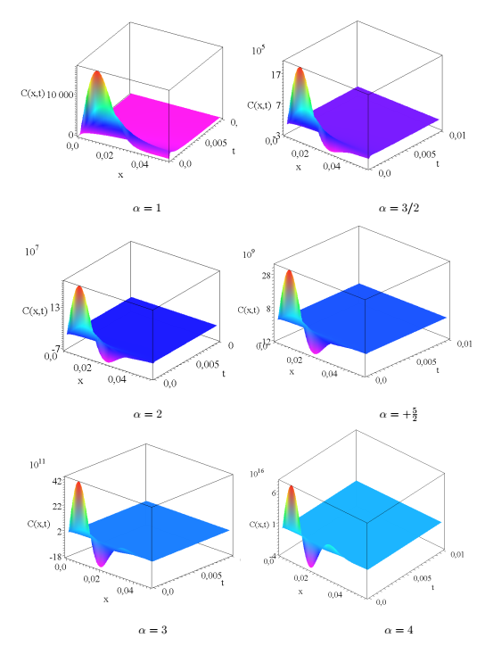
The C(x,t) solutions

Slide 15
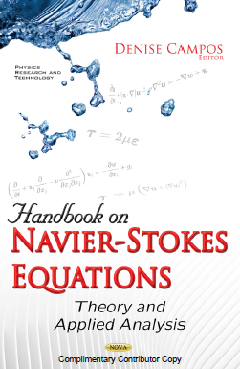
Additional remarks
- We apply the self-similar and the traveling-wave Ansätze almost a decade, which can easily be generalized for
PDE systems for 2 or 3 dimensions
- We investigated the: - usually various diffusion equations
        - Kardar-Parisi-Zwang surface growth equation
- Rayleigh- Bénard convection equations
- heated/non-newtonian boundary layer equtions
- various 3D Euler and Navier-Stokes equations
- Madelung equation (hydro view of Schrödinger eq.)
- non-linear Maxwell equations
- water waves,
- dark fluid to describe the Universe ☺
+ 2 book chapters in Nova Science books
More on www.kfki.hu/~barnai/publ.html

Slide 16
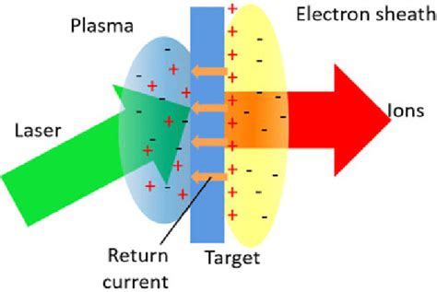
Our plasma extension model
based on the TNSA, ion accelerating model,
after the quick sharp laser pulse there is a charge separation on the metal surface
and the created electric field accelerates the ions out of the surface

Slide 17
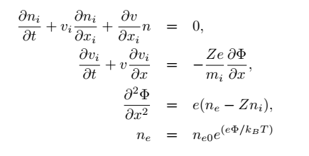

Our plasma extpansion model
it can be formulated with 1D Cartesian PDE system
coupled continuity, Euler and Poisson equations in one Cartesian direction
plus a Boltzmann distribution for the number of electrons
where n_{i},v_{i},Φ are the ion number, ion velocity, and electric field strength produced by the difference of the ion an electron numbers n_{e}, Z charge of the ion, e elementary charge, m_{i} mass of the ions
for solutions we take the self-similar Ansatz:
with the reduced variable of where, f,g,h are the shape functions,
and α,β,γ and δ are the real self-similar exponents

Slide 18
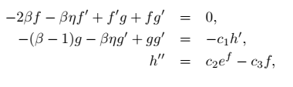

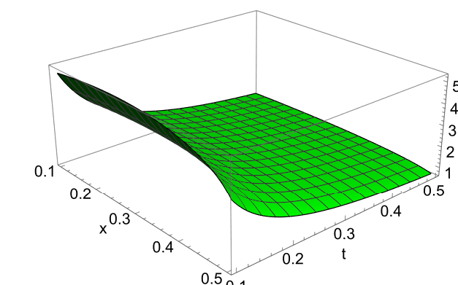
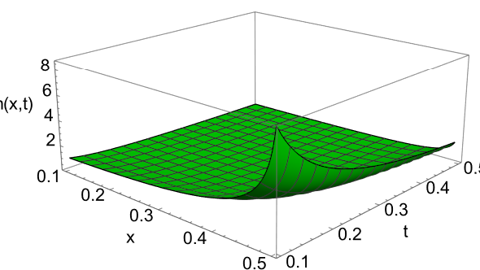
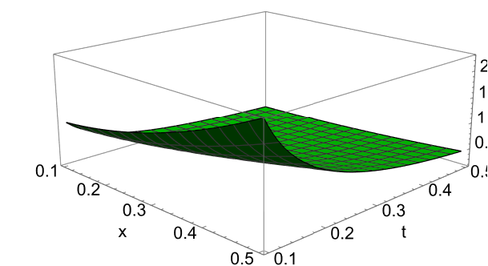
The reduced ODE and the exponents
after some algebra we get non-linear, non-autonomus ODE system
the constraint among the self-similar expoonents:
very sensitive to initial conditions and to the parameters:
Phi(x,t)
V(x,t)
n(x,t)

Slide 19
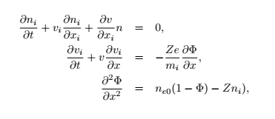

A reduced model
Using the Taylor expansion of the exp(φ(η)) function we get:
Applying the same Ansatz of
We arrive to the ODE with the exponents:

Slide 20
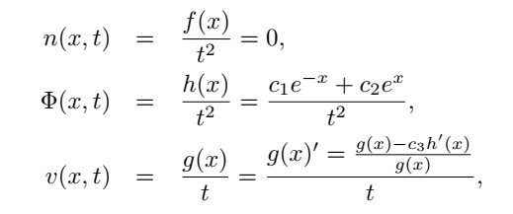
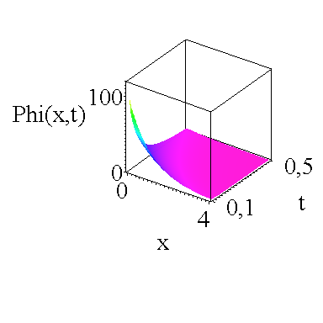
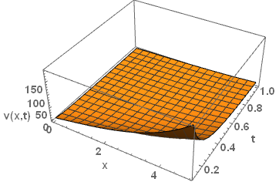
A results of the reduced model
Due to β = 0 the solutions are separable,
one solution is trivial all variables are constant
The second is:
the particle number is zero
the electric field is analytic
velocity field is implicit numerically given

Slide 21
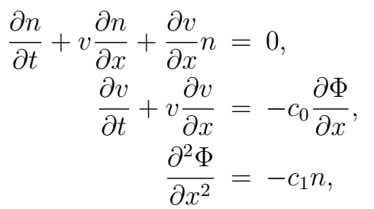
A neven more simplified model
coupled continuity, Euler and Poisson equations in one Cartesian direction:
No initial electrons, just ions
with the same Ansatz a reduction to an ODE system is possible
with the following self-similar exponents

Slide 22
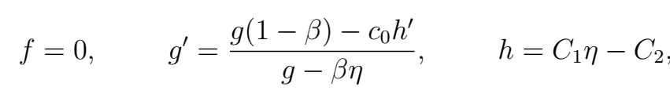

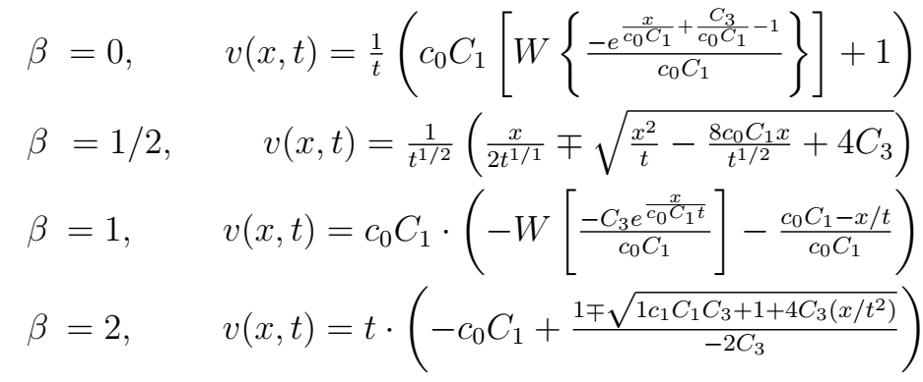
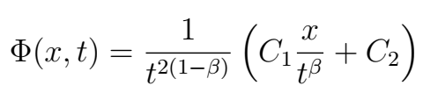

The solutions of the ODE system
Beyond the trivial solutions we have:
the general solution for the velocity shape function g(η) is:
The final solutions for different βs:
where W is the
Lambert function
defined as:

Slide 23
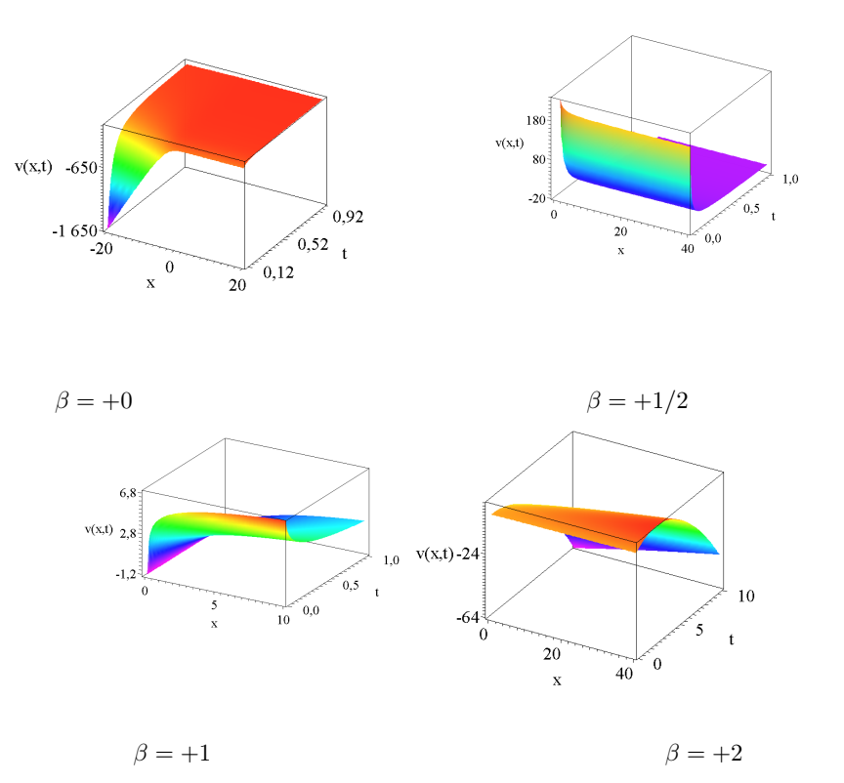
The velocity distributions
For different αs

Slide 24
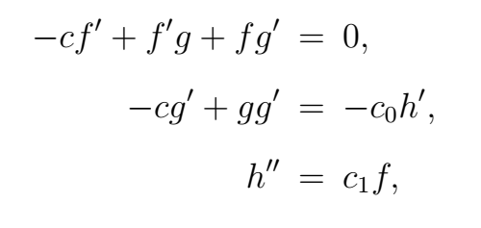
The traveling wave solution of the simplest model
Just apply the next Ansatz:
a much simpler coupled second-oreder non-linear non autonomus system
can be derived:

Slide 25
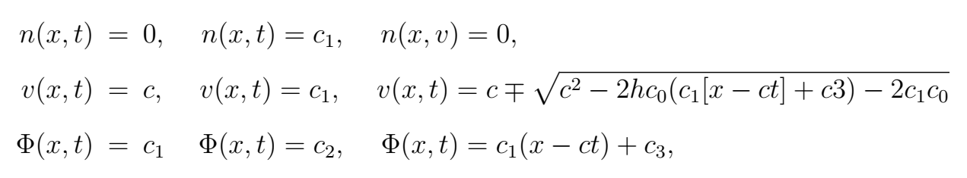
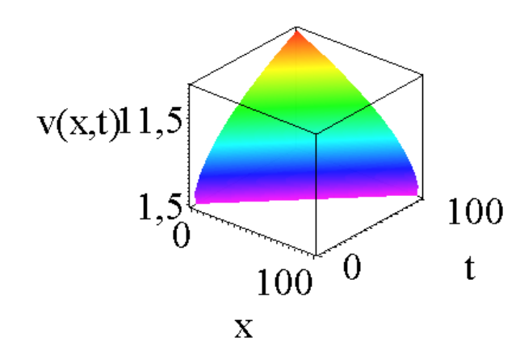
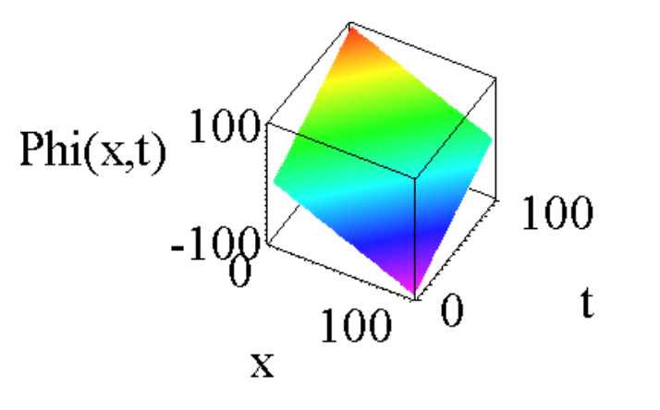
The traveling wave solution of the simplest model
there are three different solutions available, the first 2 of them are almost
Trivial only the third is remarkable
these are just „running fronts” in time and space

Slide 26
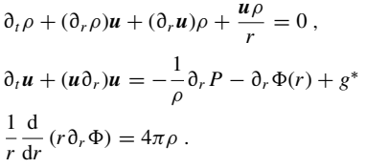
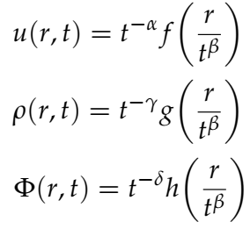
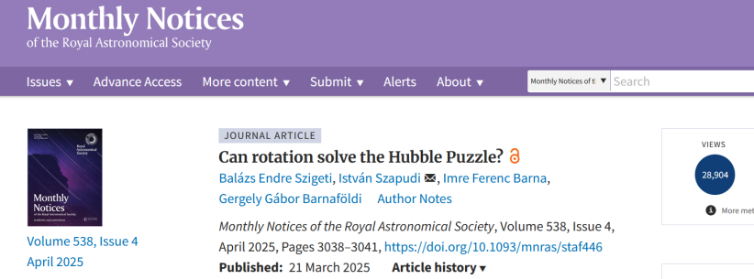
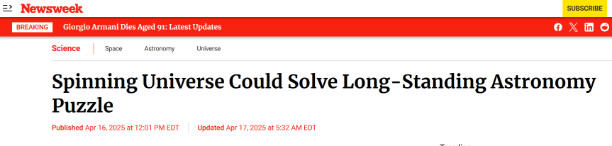
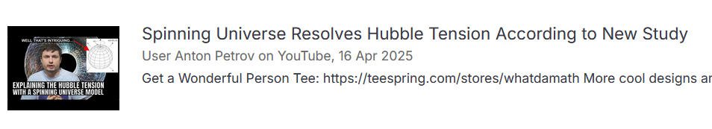
A stimulating slide at last
a very similar spherically symmeteric hydrodinamical model, applied to the dark fluid with additional rotation can solve the Hubble tension,
which means acceleration expansion of the Universe
So the Universe should rotate
Attracts remarkable attention:
approx. 29’000 downloads of the paper,
8 citations in 7 months
approx. 80 newspapers article world wide,
like Stern, der Standard, Newsweek, India Today,
Aljazeera
3 relevant youtube channels,
several hundred thousand followers
Anton Petrov, NASa Space News, Dr. Becky

Slide 27
Summary and outlook
- we gave an introduction to the reduction mechanism of PDEs
- as an example we presented the self-similar solutions of the diffusion equ.
- presented a hydrodinamical model for plasma acceleration of ions
- presented different kind of solutions
- as improvement we may include viscous effects, or source terms

Slide 28
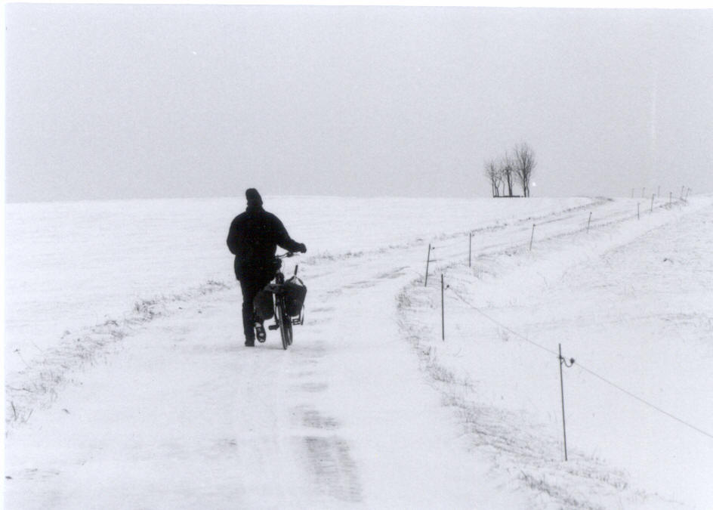
Thank you for your attention!
Questions, Remarks, Comments?…

