Slide 1
Medical Applications of Plasma Accelerators
Sonja Gerlach
October 6, 2025
Chair of Experimental Physics – Medical Physics
Laser-Ion Acceleration Group, Prof. Dr. Jörg Schreiber

Slide 2

What is medical physics?
Definition:
[…] physics principles, methods and techniques in practice and research for the prevention, diagnosis and treatment of human diseases with a specific goal of improving human health and well-being.
Fields:
        Imaging (ionizing & non-ionizing)
  Radiation therapy
  Nuclear physics
  Radiation protection
  …
This talk:
Ionizing radiation for imaging and cancer therapy
International organization of medical physics

Slide 3
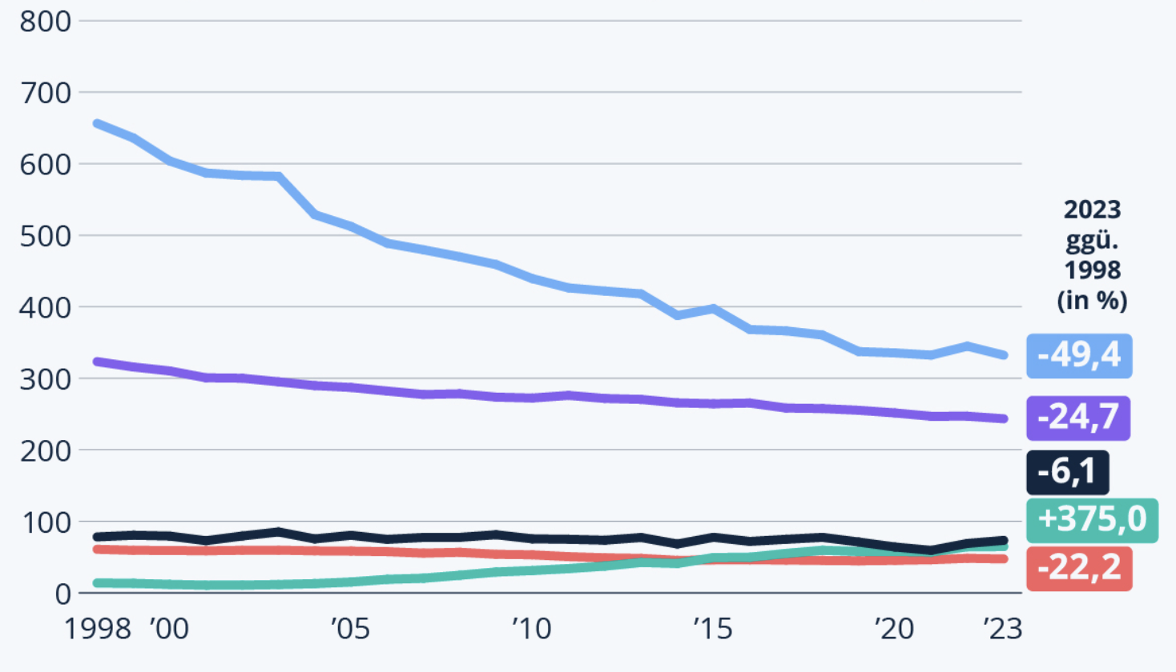
Cancer
Some numbers (Germany, rounded):
≈ 50% get cancer in the course of life
≈ 60% 5-year survival rate (1980: 50%)
Second likely cause for death
(Most likely: Cardiovascular disease)
Reason (USA):
Food (35%), Tobacco (30%), Infections (10%)
 | ♀ | ♂
Incidence | Breast Colorectum Lung | Prostate Lung Colorectum
Mortality | Breast Lung Colorectum | Lung Prostate Colorectum
Mortality per 100 000 inhabitants
Cardiovascular disease
Cancer
Respiratory disorder
Psychological diseases
Digestive system
Ref.: Health report German government

Slide 4
Cancer therapy
British study, treatment 2009:
 | All patients (N = 1,029,569) | Patients survived less than 5 years (N = 491,599) | Patient survived at least 5 years (N= 537,970)
Modality | % of patients | % of patients | % of patients
Surgery | 64% | 46% | 80%
Radiotherapy | 35% | 31% | 39%
Chemotherapy | 31% | 34% | 29%
Surgery and/or Radiotherapy and/or Chemotherapy | 79% | 66% | 90%
Other options: Immunotherapy, Hormon therapy, Laser therapy…
Mee et al, British Journal of Radiology, 2023

Slide 5
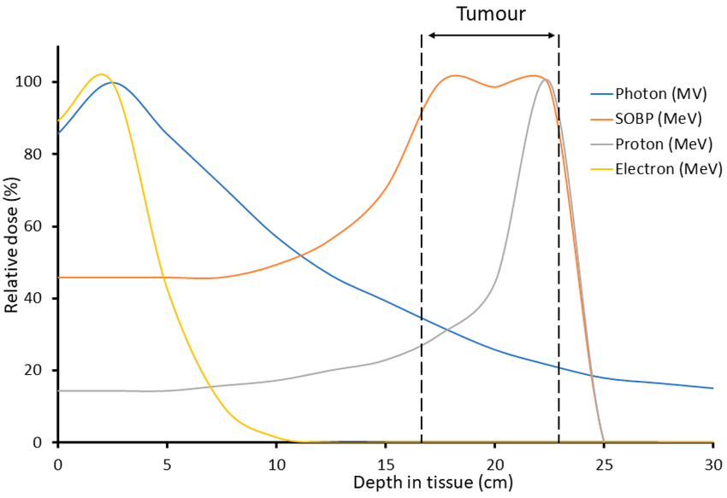
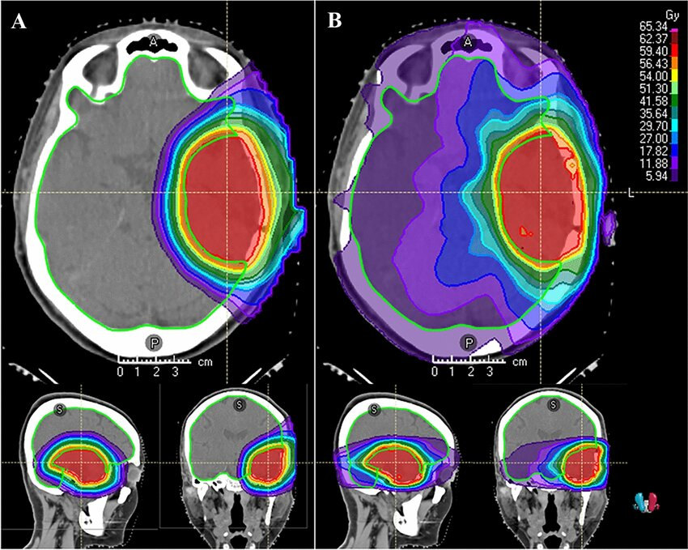
Radiation therapy
Options: X-rays, Ions, Electrons (Neutrons)
Comparison of depth dose curves:
Comparison of treatment plans:
A: Protons B: X-rays
Protons seem to have beneficial properties, but physical dose is not everything!
Hughes et al Int Journal of Molecular Science, 2020
Gal et al, Journal of Neuro-Oncology, 2024

Slide 6
Radiation therapy
Clinical practice:
X-rays dominant
Few % receive ion therapy:
Pediatric cases, skull base tumors,
spinal cord, pediatric…
Internal X-ray therapy: Brachytherapy
Drawbacks ions:
Expensive
Robustness to inhomogeneities & movements
Clinical evidence not always clear
Excursus FLASH:
The FLASH effect refers to the observation that delivering radiation at ultra-high dose rates (≥40 Gy/s, compared to ~0.03–0.1 Gy/s in conventional therapy) can spare normal tissues while still being equally effective (or more effective) at killing tumors
Current research topics:
Flash
Biological effectiveness
Motion control
Treatment verification
Mini/Micro beam therapy
---
Fig: Oh PFM 2019, adabed from PTCOG

Slide 7
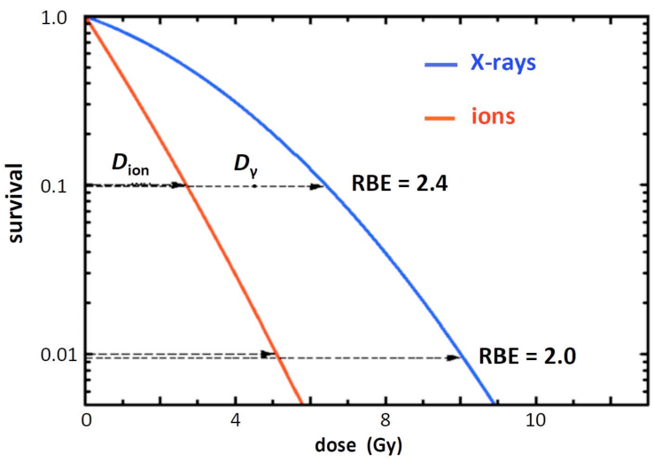
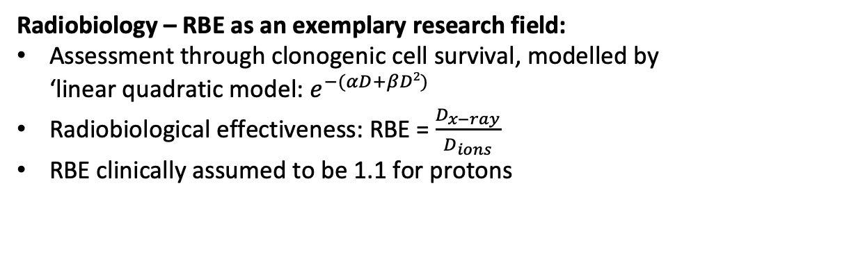
Radiation therapy
Radiobiology – RBE as an exemplary research field:
Assessment through clonogenic cell survival, modelled by
‘linear quadratic model: $e^{−(αD+βD2)}$
Radiobiological effectiveness: RBE = $\frac{D_{x−ray}}{D_{ions}}$
RBE clinically assumed to be 1.1 for protons
Fig: Amaldi et al, CERN reports, 2019

Slide 8
Medical physics & plasma based accelerators
Current research topics:
Laser-driven proton therapy
Laser-driven proton sources for isotope production
Laser-driven proton sources for preclinical research in radiobiology, including FLASH
Laser-driven electron therapy
Plasma based X-ray sources for imaging
This talk:
Laser-driven proton acceleration for therapy and research

Slide 9
Outline
Introduction to laser-driven proton acceleration
State of the art & limitations
Research at CALA in Munich
Three examples for medical physics with plasma-based accelerators

Slide 10
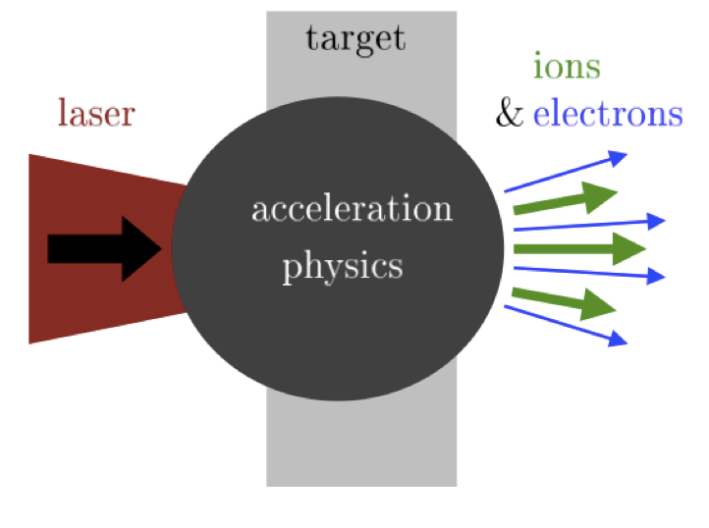
Laser-driven ion acceleration
Difference to Electron Acceleration:
Short focal length parabola
High sensitivity to laser contrast
Overcritical target (solid/liquid)
‘younger field’
…
Acceleration mechanism:
Target normal sheet acceleration (TNSA)
Radiation pressure acceleration (RPA)
More advanced concepts
(…)
Fig: Macchi, 2016

Slide 11


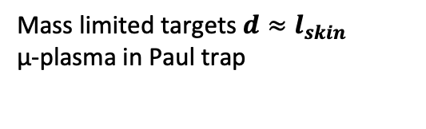
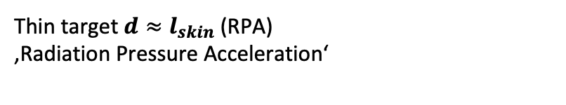
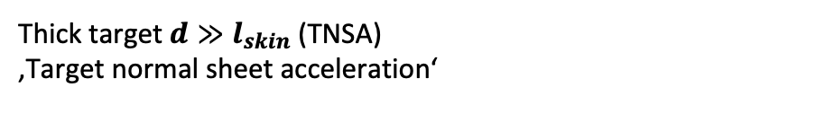
Laser-driven ion acceleration
Thick target$d≫l_{skin}$ (TNSA)
‚Target normal sheet acceleration‘
Thin target $d≈l_{skin}$ (RPA)
‚Radiation Pressure Acceleration‘
$$R$$
Mass limited targets $d≈l_{skin}$
µ-plasma in Paul trap
R
transverse confinement
$$r_{L}$$
Hilz+,
Nat Comm. 9, 423 (2018).
Optimization strategy during last 20 years: laser-pulse energy ­, pre-pulses ↓, target thickness (size) ↓, repetition rate ­, reproducibility ­

Slide 12
Laser-driven ion acceleration
Laser-plasma acceleration | Non-laser (Radio frequency, RF) acceleration
Single bunch every second (large particle number ≈10¹² per bunch) | Continuous beam (micro-bunch train)
Broad energy distribution (100%) yet short bunch (fs…ps…ns) | Mono-energetic (ns…µs bunches)
Spray (10° divergence) yet small source (µm) | Beam
Intrinsically synchronous to multiple radiation modalities | Non-trivial in sub-ns
Source and acceleration combined (high field, high temperature, high density)
New application possibilities
Topics in medical physics
Probing ultrafast processes
Research in nuclear astrophysics

Slide 13
Laser-driven ion acceleration
State of the art (rough numbers):
 | Laser-driven | Conventional
Energy | 150 MeV record, 70 MeV reproducible | 70-230 MeV
Energy spread | 100% without beamline | 0.1 %
Avg. Dose rate | 0.5 Gy/s | 0.1 Gy/s
Peak Dose rate | Up to 10⁹ | Continuous beam
Stability | Poor | Solved
Diagnostic | Challenging | Solved
Costs | $ 40M (1 PW) | $ 40M
Literature:
Schreiber et al: “Hands-on” laser driven ion acceleration: A primer for laser-driven source development and potential applications (2016)
Linz et al: What will it take for laser driven proton accelerators to be applied to tumor therapy? (2016)
Linz et al: Laser-driven ion accelerators for tumor therapy revisited (2016)
Notes:
Accelerator hardware: only around 20% of 40 Million

Slide 14
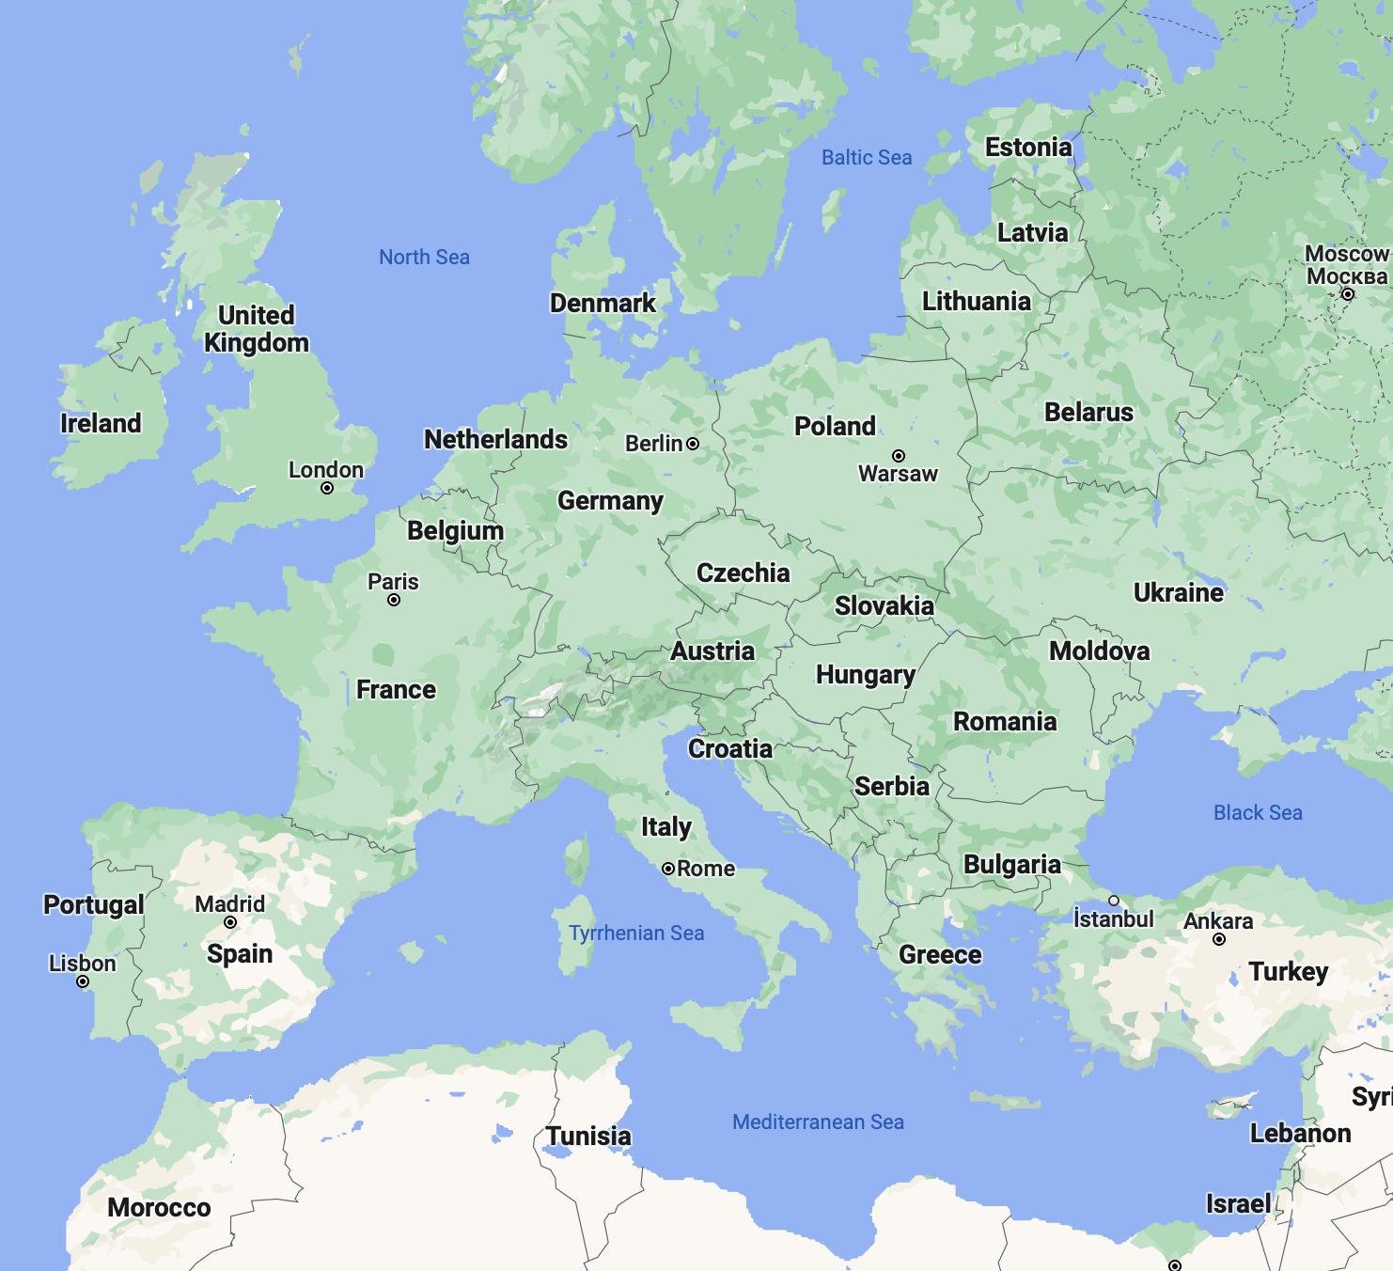
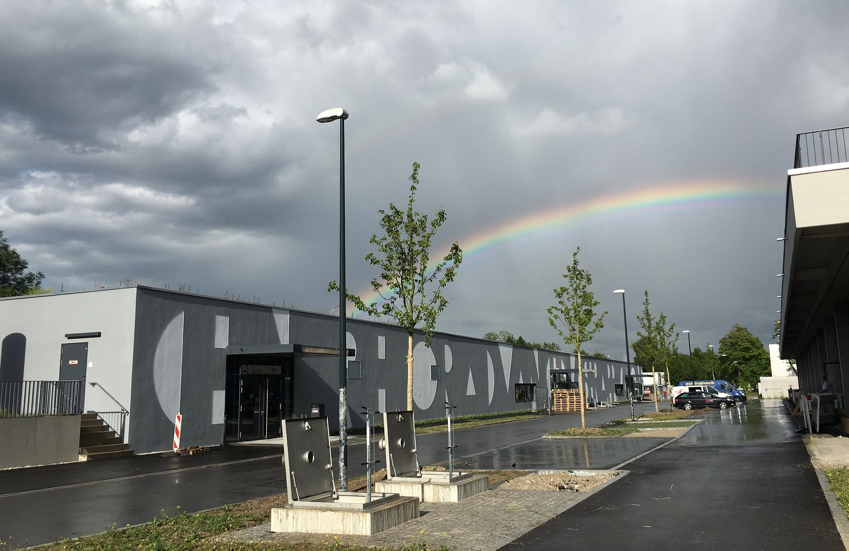
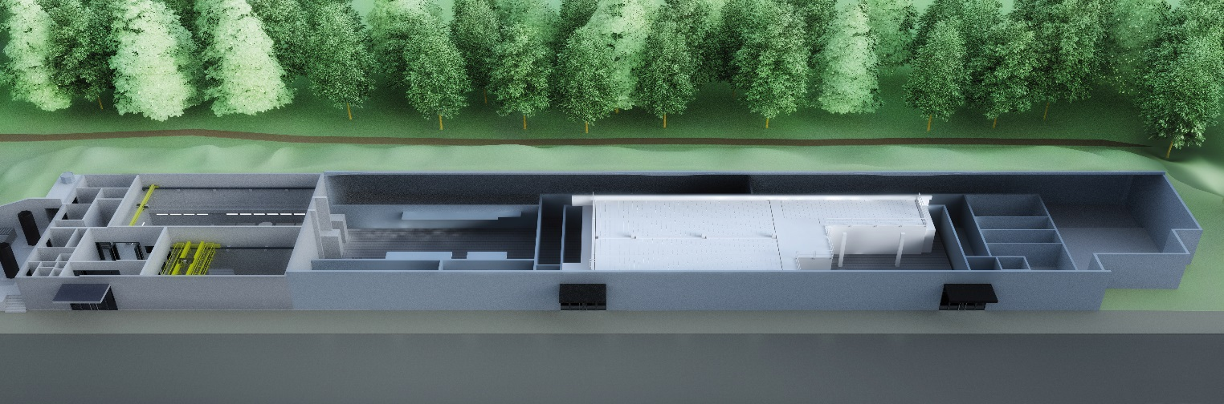
Centre for Advanced Laser Applications (CALA)
Fig: Google maps
ATLAS3000
Prot+carbons
Heavy ions
Broadband IR Diagnostics
ZEUS (R&D)
Light-Light scatter
PFS (kHz)
Electrons+xrays
https://www.pulse.physik.uni-muenchen.de/

Slide 15


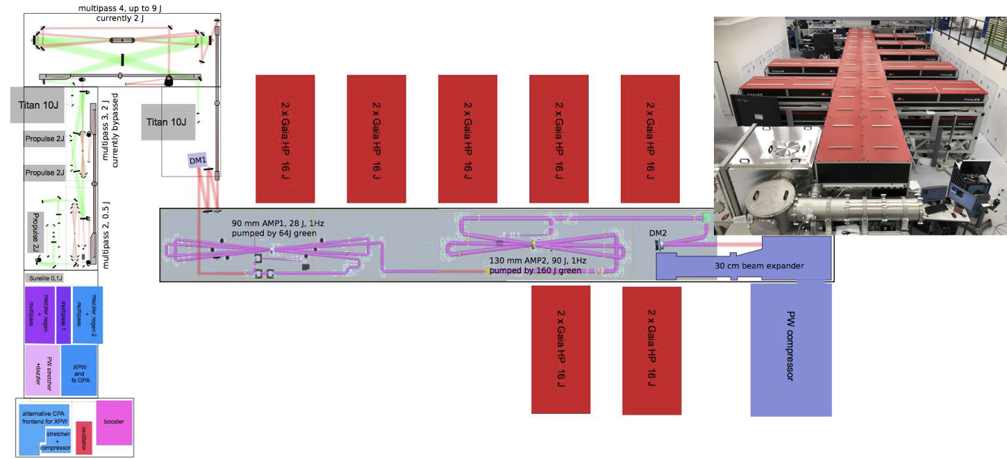
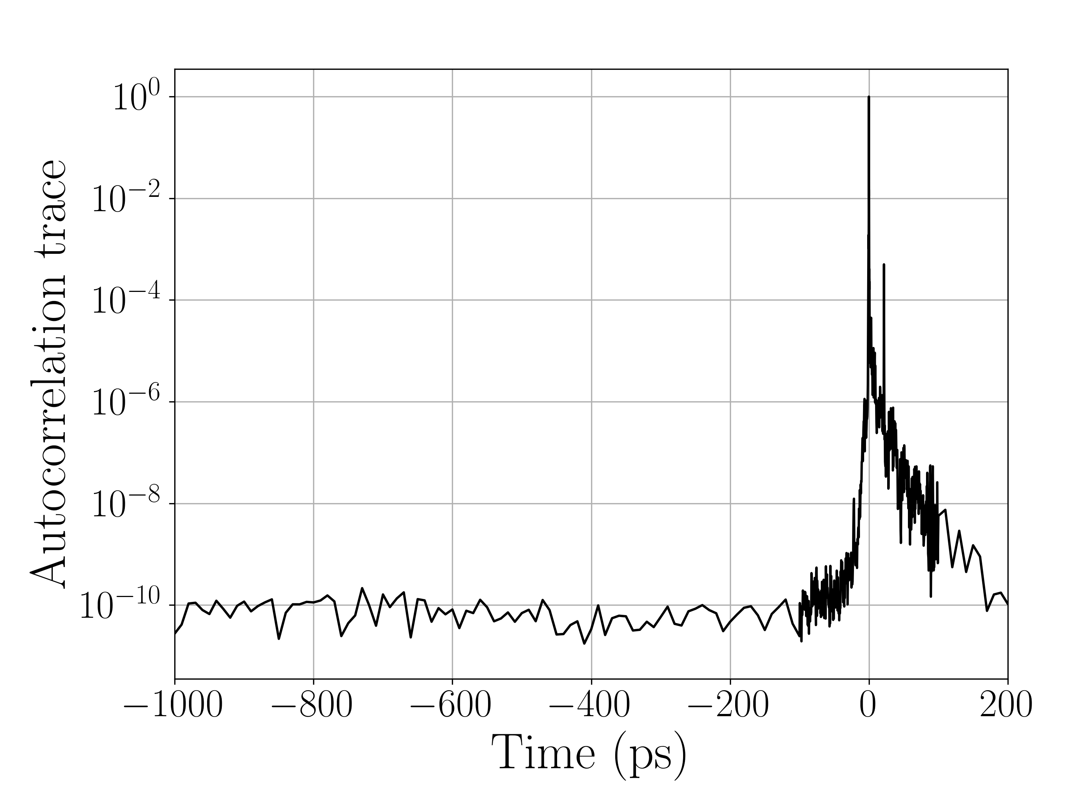


ATLAS 3000 Laser
Ti:Sa
Pulse length: 25 fs
Repetition rate: 1 Hz
Energy: 60 J (13 J)
3 Deformable mirrors
Focus size: 4.5 μm
Bachreflex Suppression via PC
Temporal Contrast:
Homebuilt frontend
Thales main amplifier
Experimental areas

Slide 16
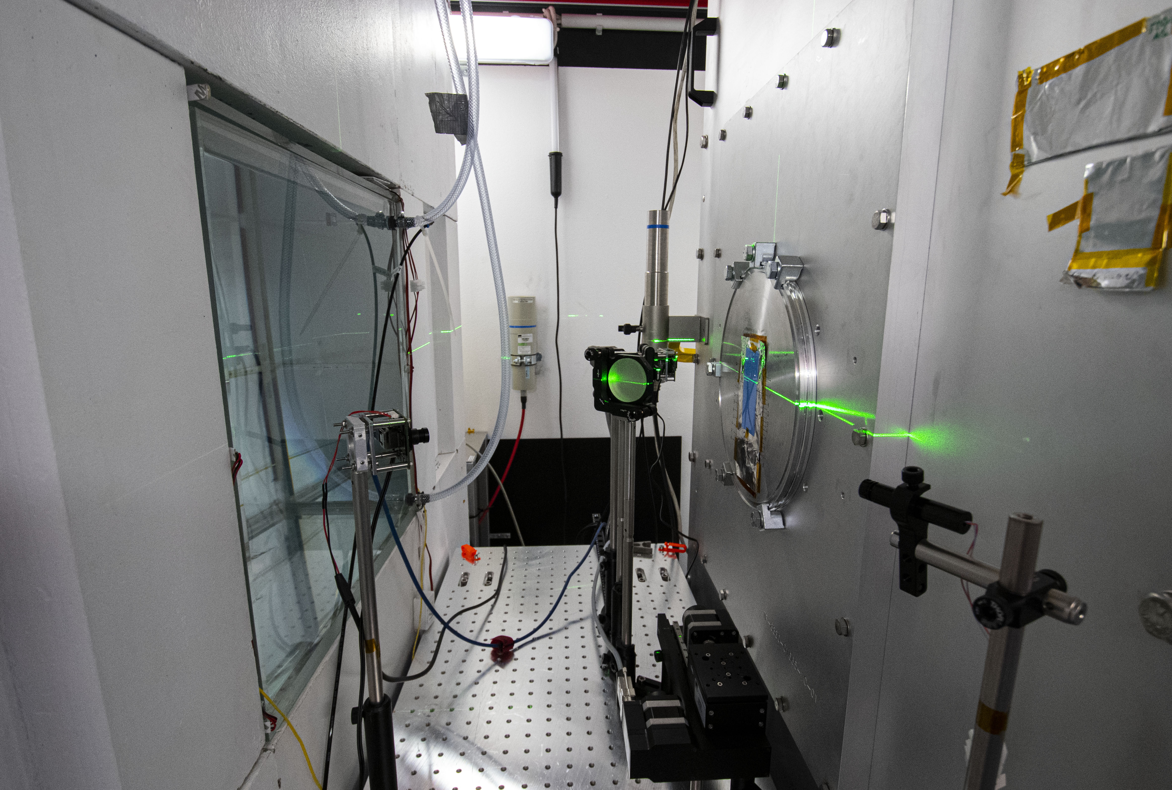
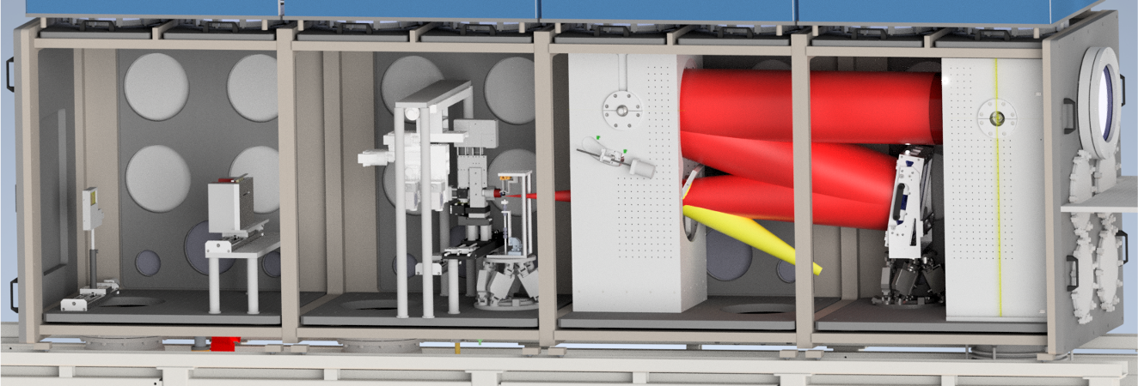
Laser-ION Acceleration (LION)
Laser
Target positioning system
f/5 off-axis
parabola
Wide angle spectrometer
Application plattform
Permanent magnet quadrupoles

Slide 17
Laser-ION Acceleration (LION)
Some specifics:
Extensive control system based on Tango
Water leaf target
Operation w/o beamline
---------------------------------------------
University based system!
Target positioning system
f/5 off-axis
parabola
Wide angle spectrometer
Application plattform
Permanent magnet quadrupoles

Slide 18
Laser-ION Acceleration (LION)
Current performance:
Typically 20 MeV
(42 MeV max)
With beamline:
≈ 1 mm lateral focus size,
≈ 5 % energy spread
1 Hz operation (mostly) possible
Online characterization of individual ion bunches
Target positioning system
f/5 off-axis
parabola
Wide angle spectrometer
Application plattform
Permanent magnet quadrupoles

Slide 19
Laser-ION Acceleration (LION)
Application plattform at LION
Subtitle:
From single shot experiments towards a machine
High repetition rate
Reproducibility
…
Protons
Goal:
Providing particle bunches with
reproducible & tunable parameters at 1 Hz
for various applications

Slide 20


Machine control via ‚Tango controls‘
Requirements:
Operation at 1 Hz
Correlation between laser- and ion-parameters
Intelligent feedback loops
Many device servers
available open source!
https://gitlab.lrz.de/
cala-public
User control
Scripted control
ATLAS-3000
Diagnostics (energy, spectrum, profile)
Dispersion manipulation (Dazzler)
Attenuator + filters
Experiment
Motion (Phytron, PI, Owis, Thorlabs, …)
Cameras (Basler, IDS, Grasshopper, …)
Diagnostics (Picoscope, …)
Others (Arduino, power supplies, …)
Weiße et al, HPLSE 2023

Slide 21
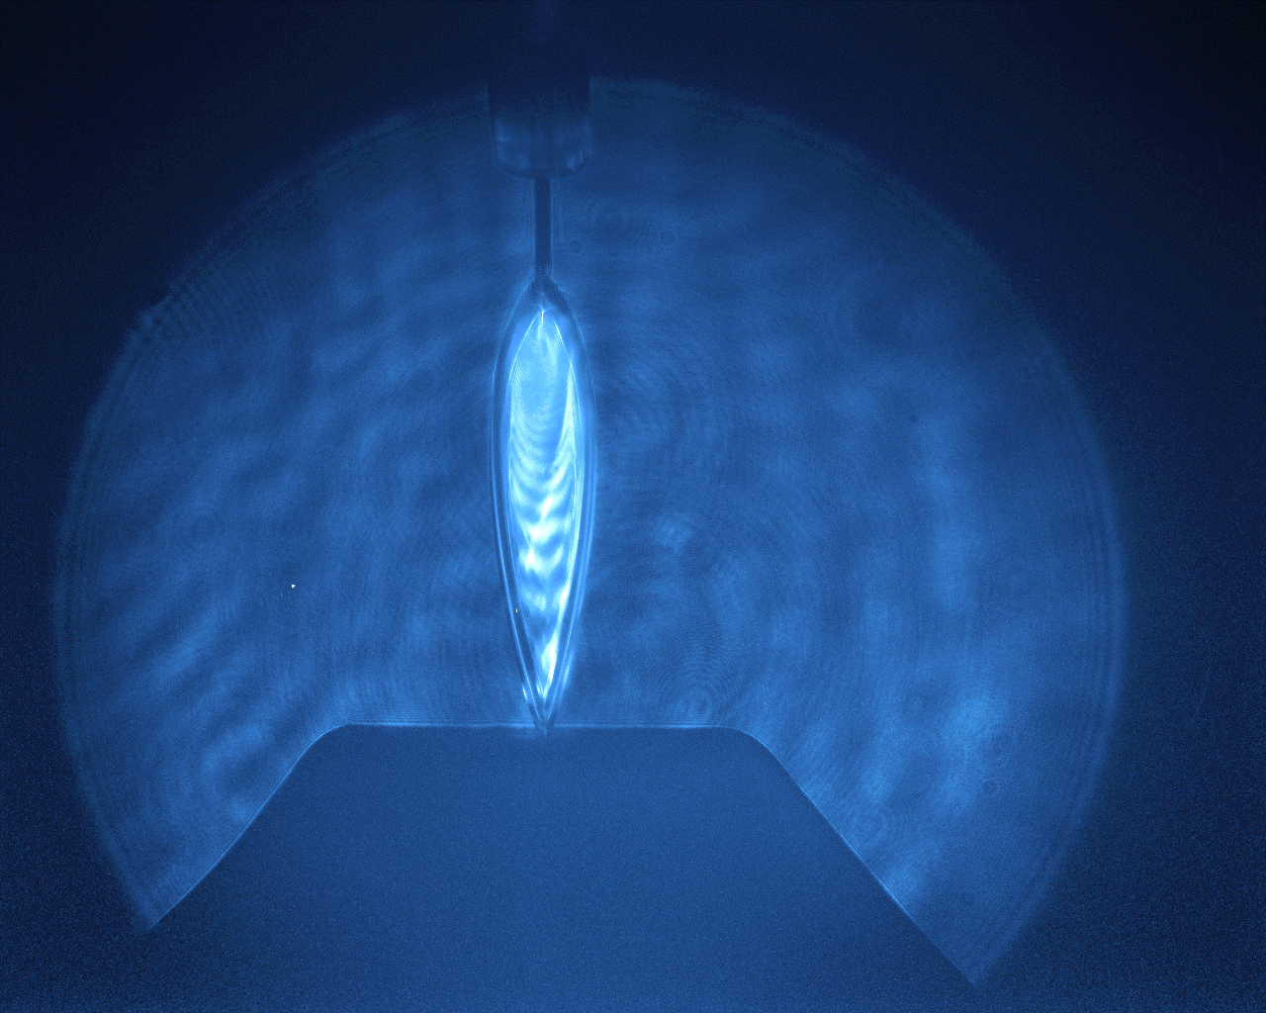
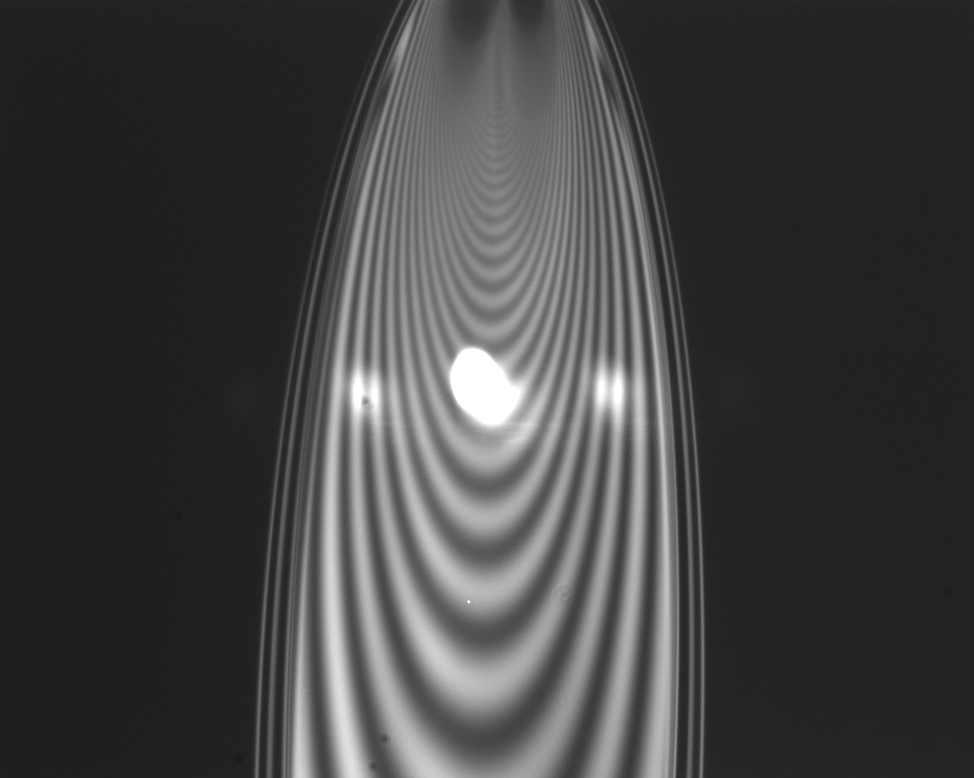
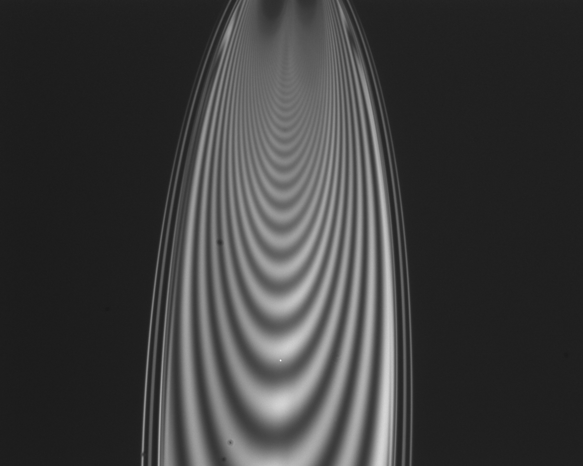
Liquid Leaf Target System
Setup:
FRONT VIEW
45° collision angle
fused silica nozzles:
50 and 25 µm
Ø1 mm catcher:
heated to approx. 110° C
1 mm

Slide 22
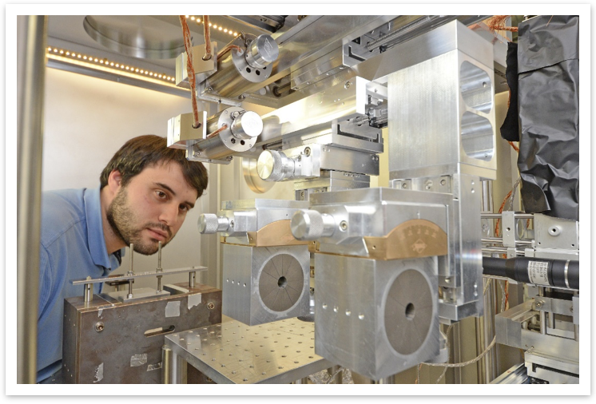
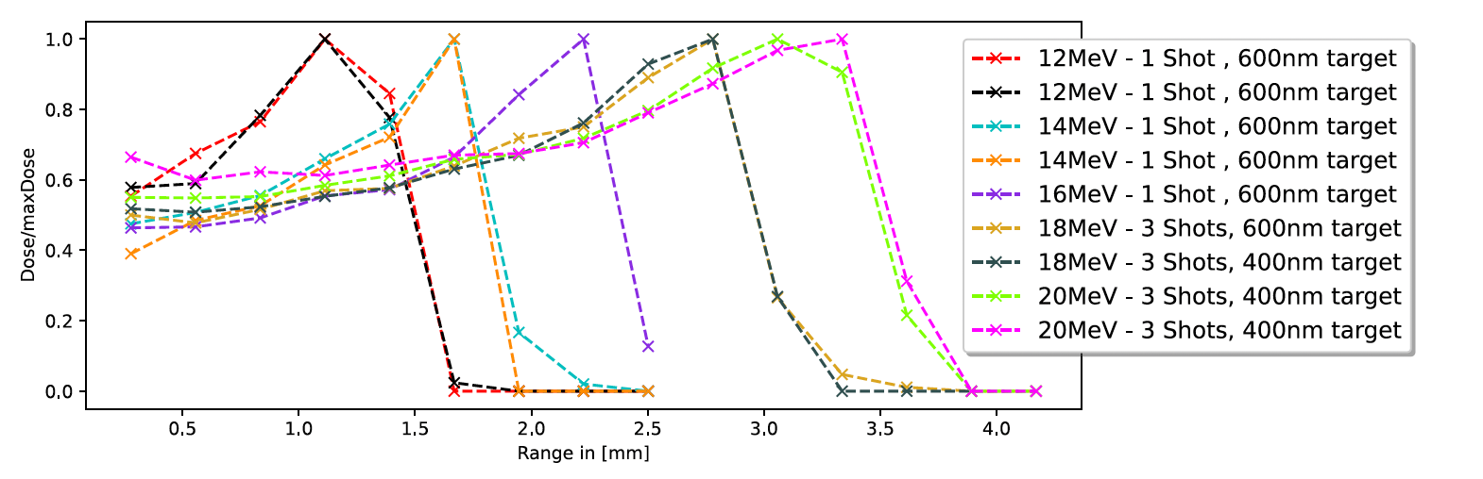
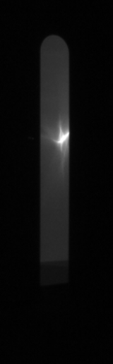
Chromatic focusing lens
Permanent magnet quadrupoles
Dublet / quadruplet available
Magnets motorized in x/y position & rotation
PMQ position defines transported proton energies
Lateral FWHM: ≈ 1 mm
Energy spread: ≈ 5 % (calculated & experimentally confirmed)
Target: liquid leaf
Normalized Dose (a.u.)
18 MeV
Target: formvar foils
1 cm
Range (mm)
Other options: Solenoids, plasma lens

Slide 23
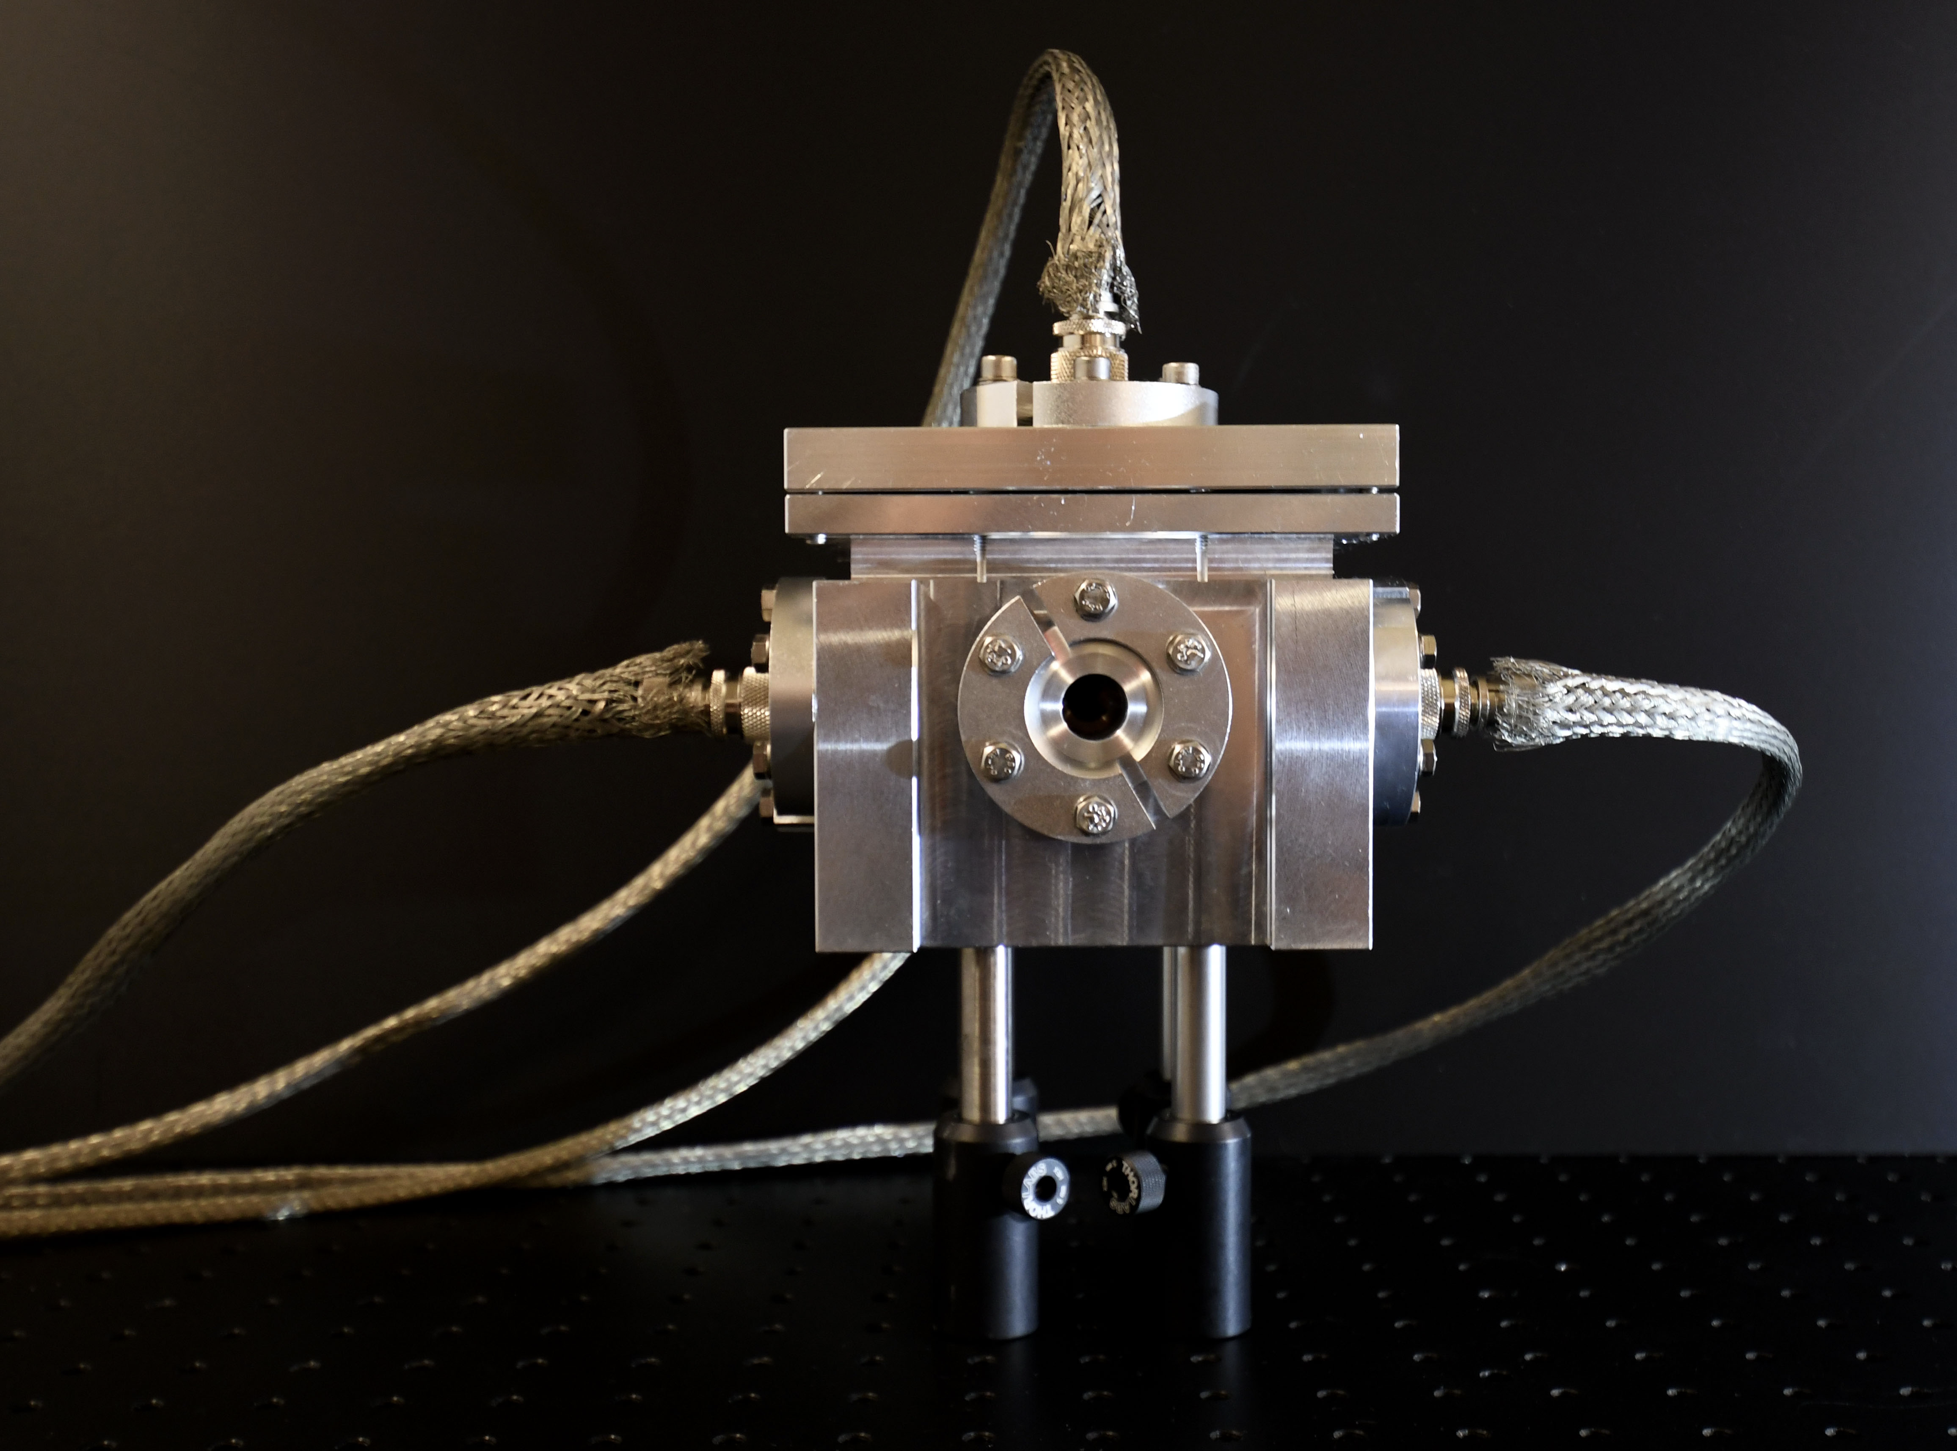
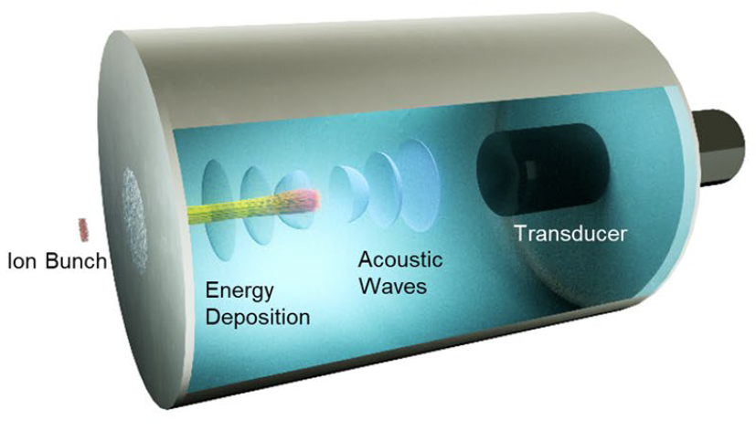
Particle Bunch Characterization @ 1Hz
I-BEAT 3D
Measures particle bunch properties such as energy, position & particle number at the ion focus
Electromagnetic pulse resistant & cheap
1 Hz compatible
Working Principle
Ions deposit their energy in a water reservoir
Energy deposition leads to localized heating
A pressure wave originates from gradients in thermal expansion
Ultrasonic signal is recorded by a transducer
Gerlach et al, 2023 & Haffa et al, 2019

Slide 24
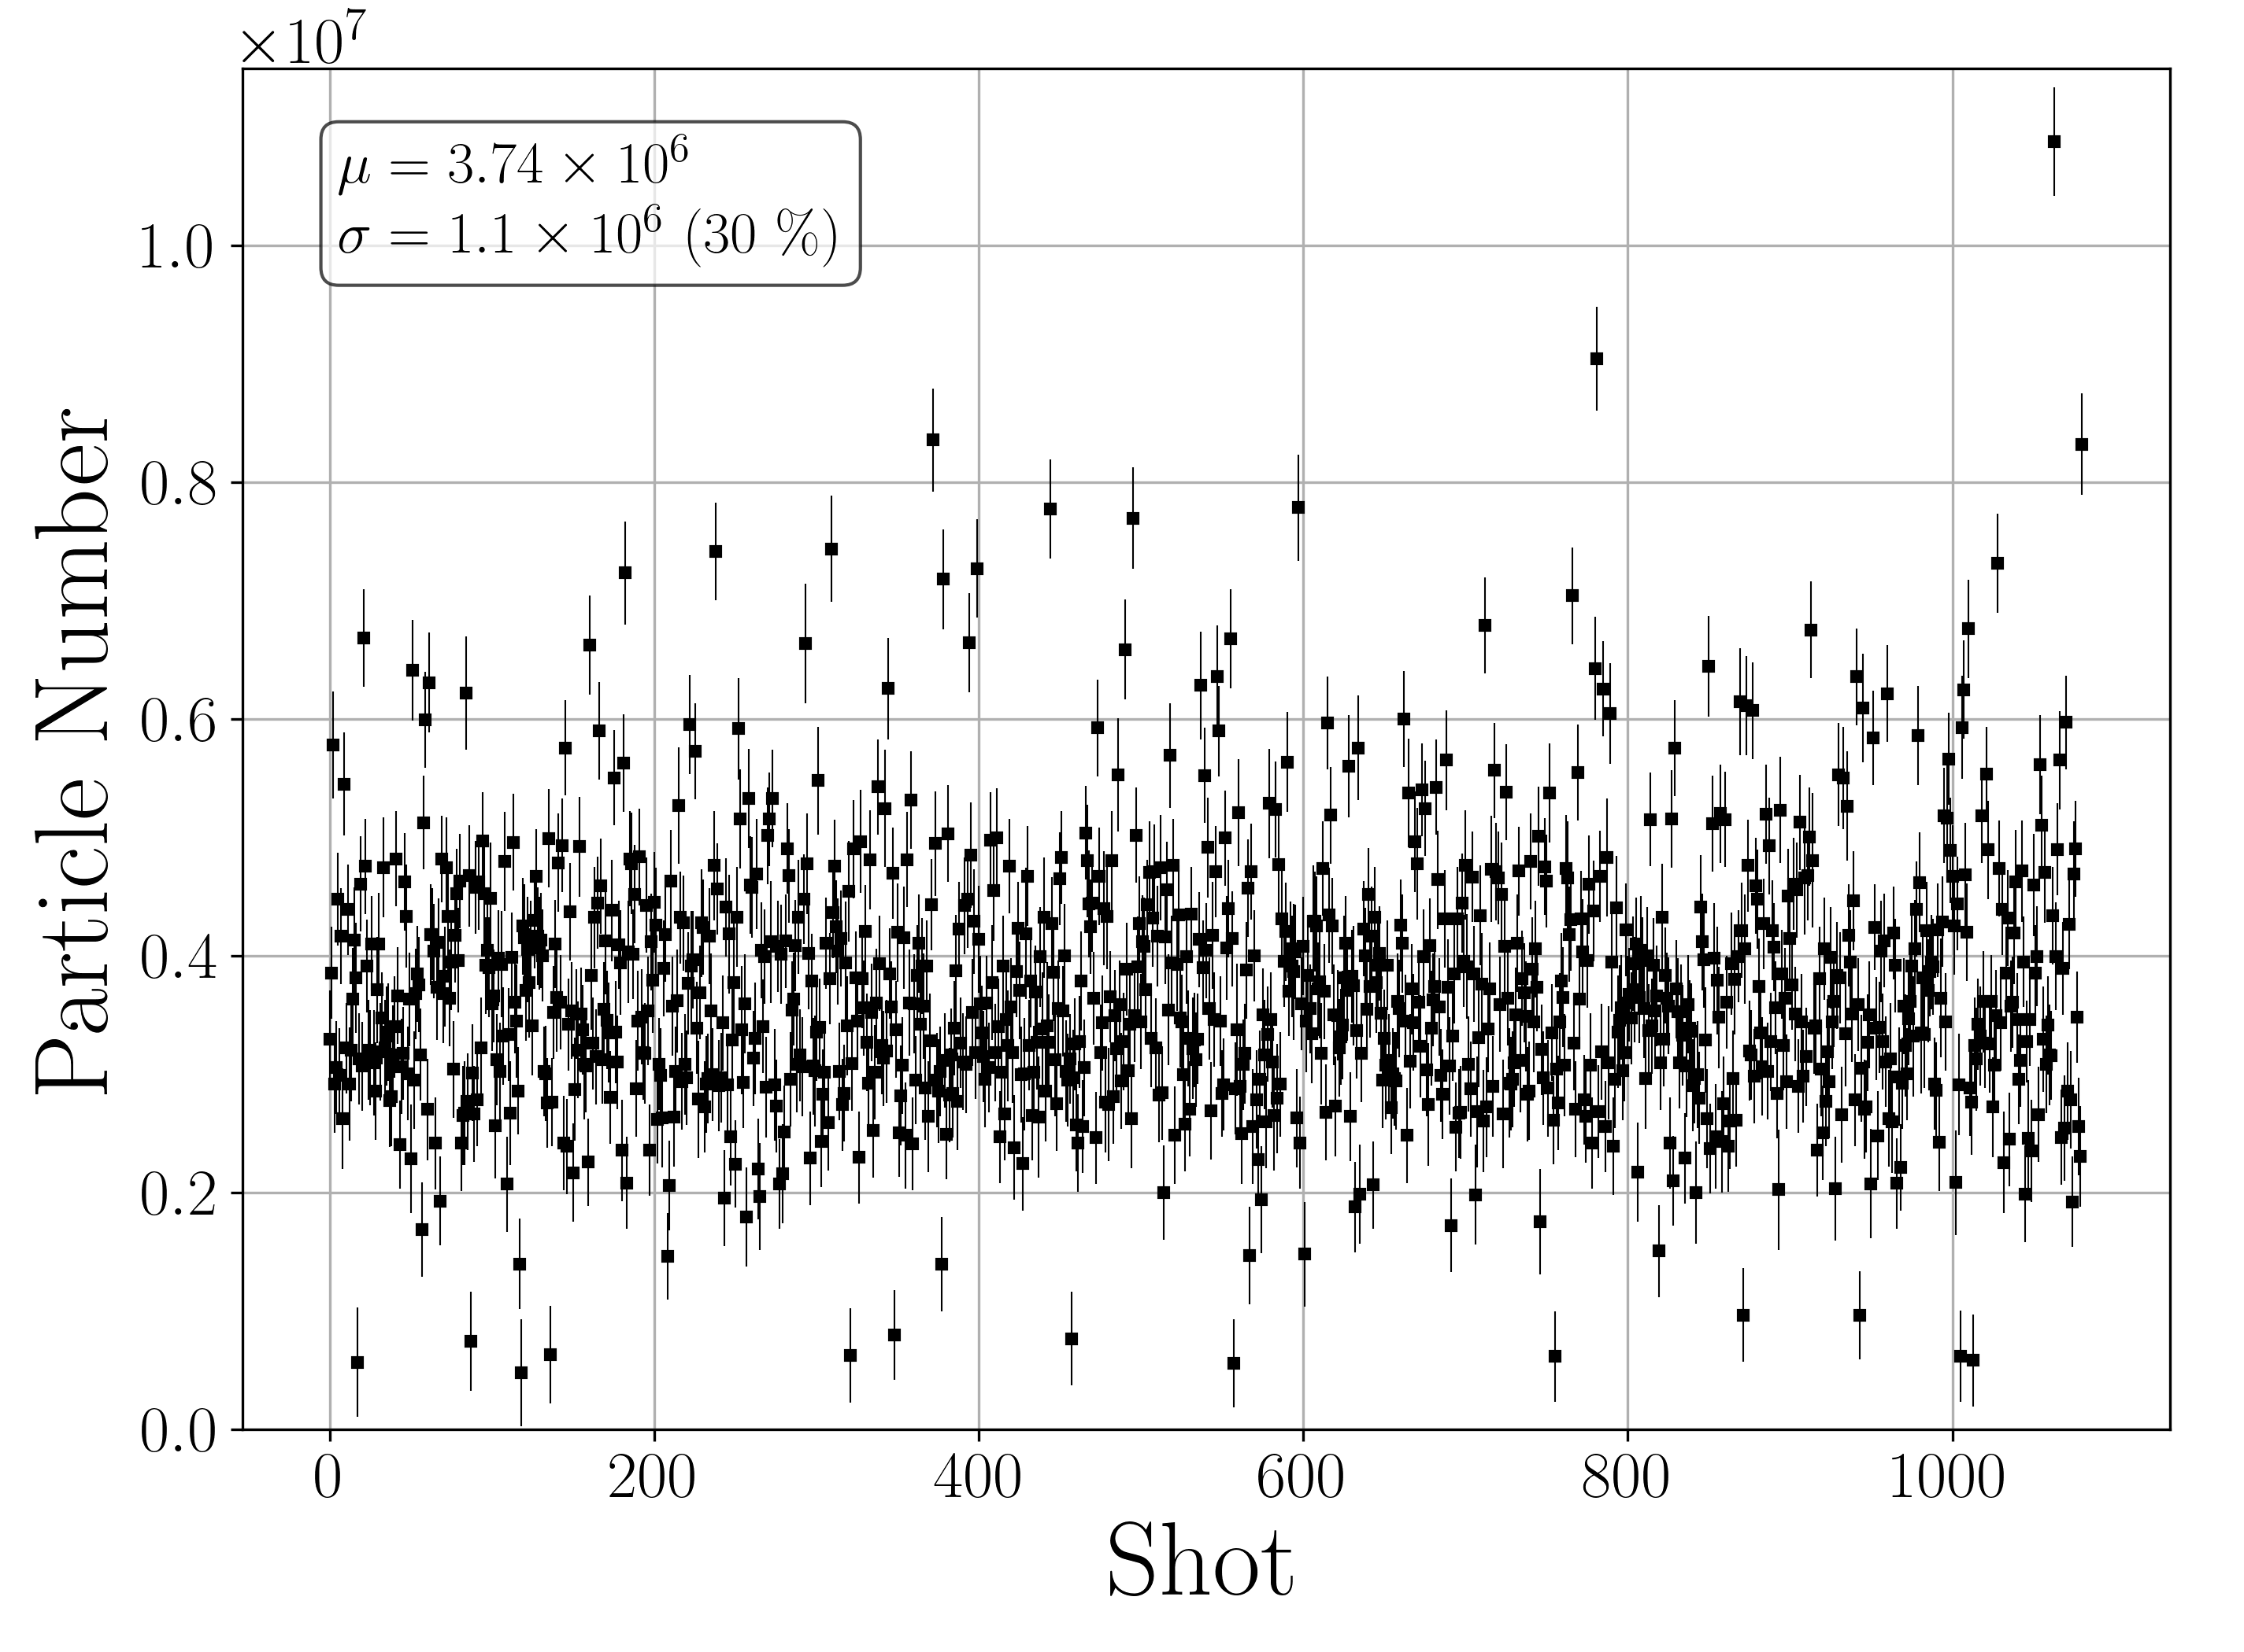
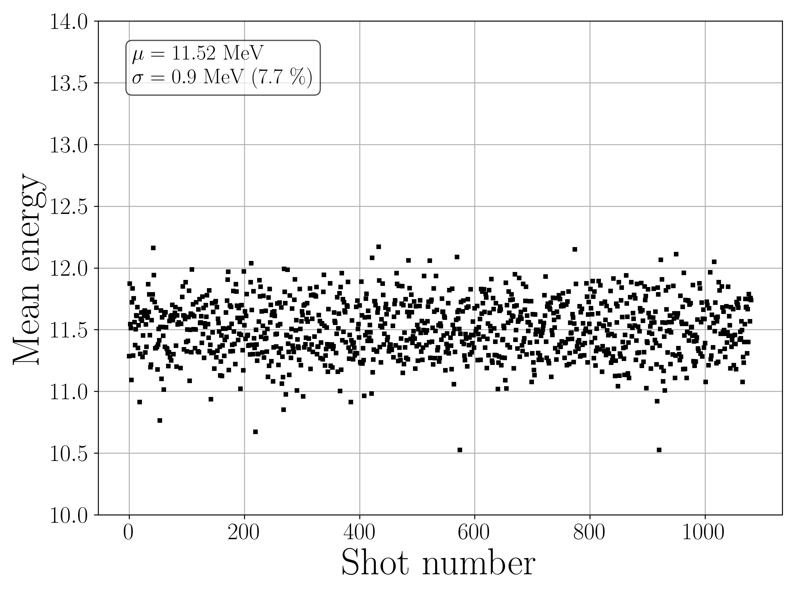
Particle Bunch Characterization @ 1Hz
Particle number & mean energy characterized at 1 Hz @ LION

Slide 25
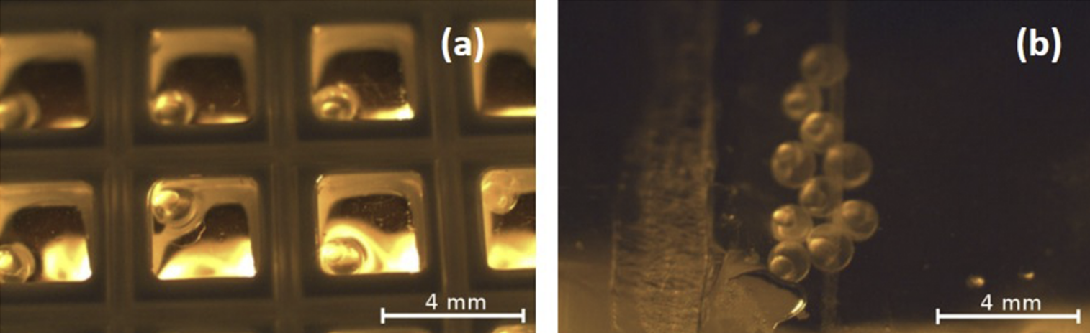
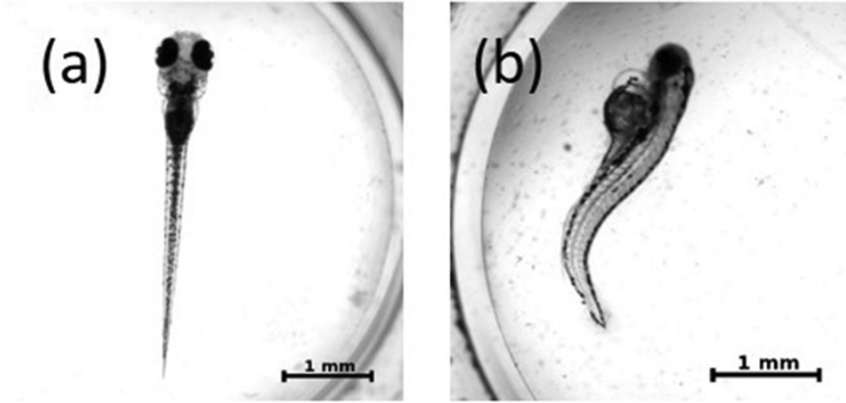
Example 1: First in-vivo studies
Zebrafish irradiation (CALA, Munich)
Feasibility of irradiating zebrafish embryos with
laser-driven proton bunches
Biologically relevant doses
(up to ~15 Gy photon-equivalent)
Challenges: dose inhomogeneity, precise dosimetry, and reproducibility
Rösch et al, Rev Sci Instrum, 2020

Slide 26
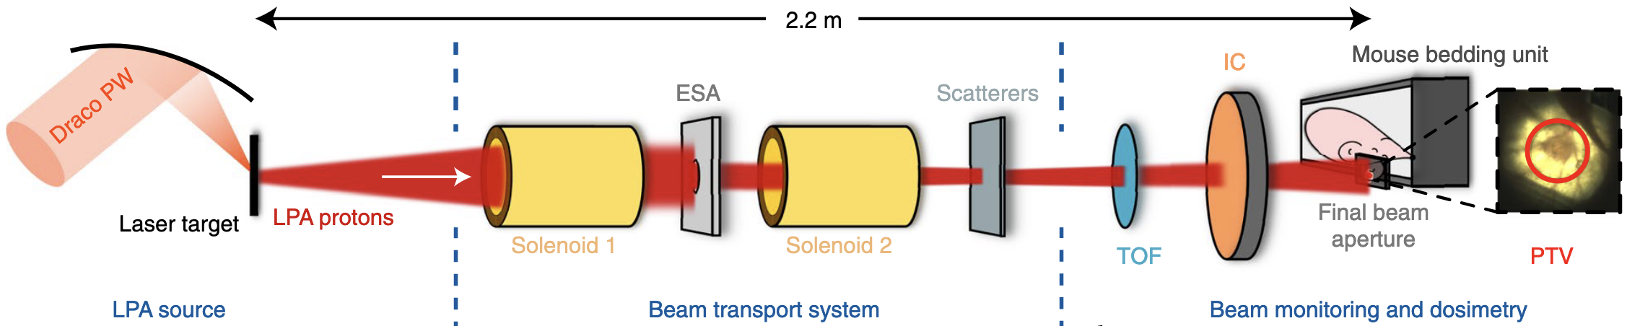
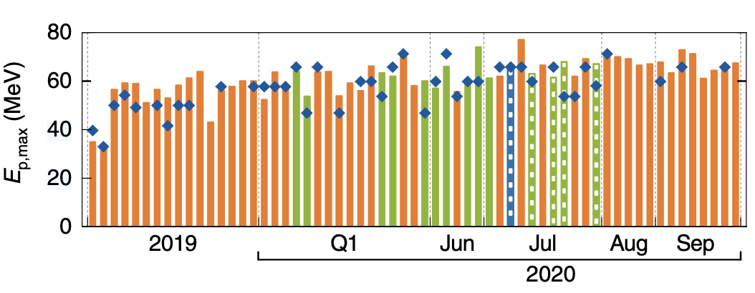
Example 2: First in-vivo studies
Mouse irradiation (HZDR, Dresden)
Demonstration of a laser-driven proton plattform delivering controlled, homogeneous tumour doses
Irradiated mouse ear tumours with 4 Gy &
ultrahigh dose rates (~10⁹ Gy/s)
Challenge: beam stability and precision for radiobiology studies
Kroll et al, Nat Phys, 2022

Slide 27
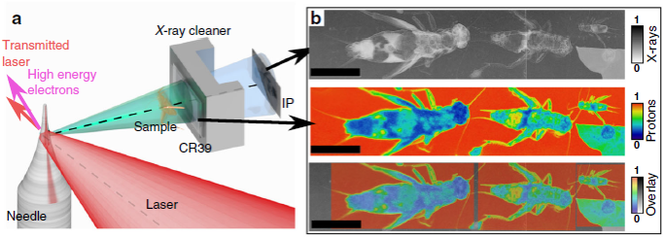
Example 3: Imaging
Bi-modal imaging: X-ray phase contrast & proton projection (Texas Petawatt Laser)
Co-emitted x-ray and proton micro-sources from micrometer tungsten needles.
Micrometer-scale source sizes and ultra-short proton and x-ray bunches (generation < ps)
Opens prospects for integrated imaging and irradiation in radiobiology and therapy.
Ostermayr et al, Nat Com, 2020

Slide 28
Summary
Conclusion
Medical physics is a broad yet specialized field with major impact
Plasma-based accelerators hold promise for addressing questions motivated mainly by imaging & radiotherapy
Technology is maturing, but improvements in stability and instrumentation remain crucial
First in-vitro & in-vivo studies are ongoing
Outlook: novel applications on the horizon?

Slide 29
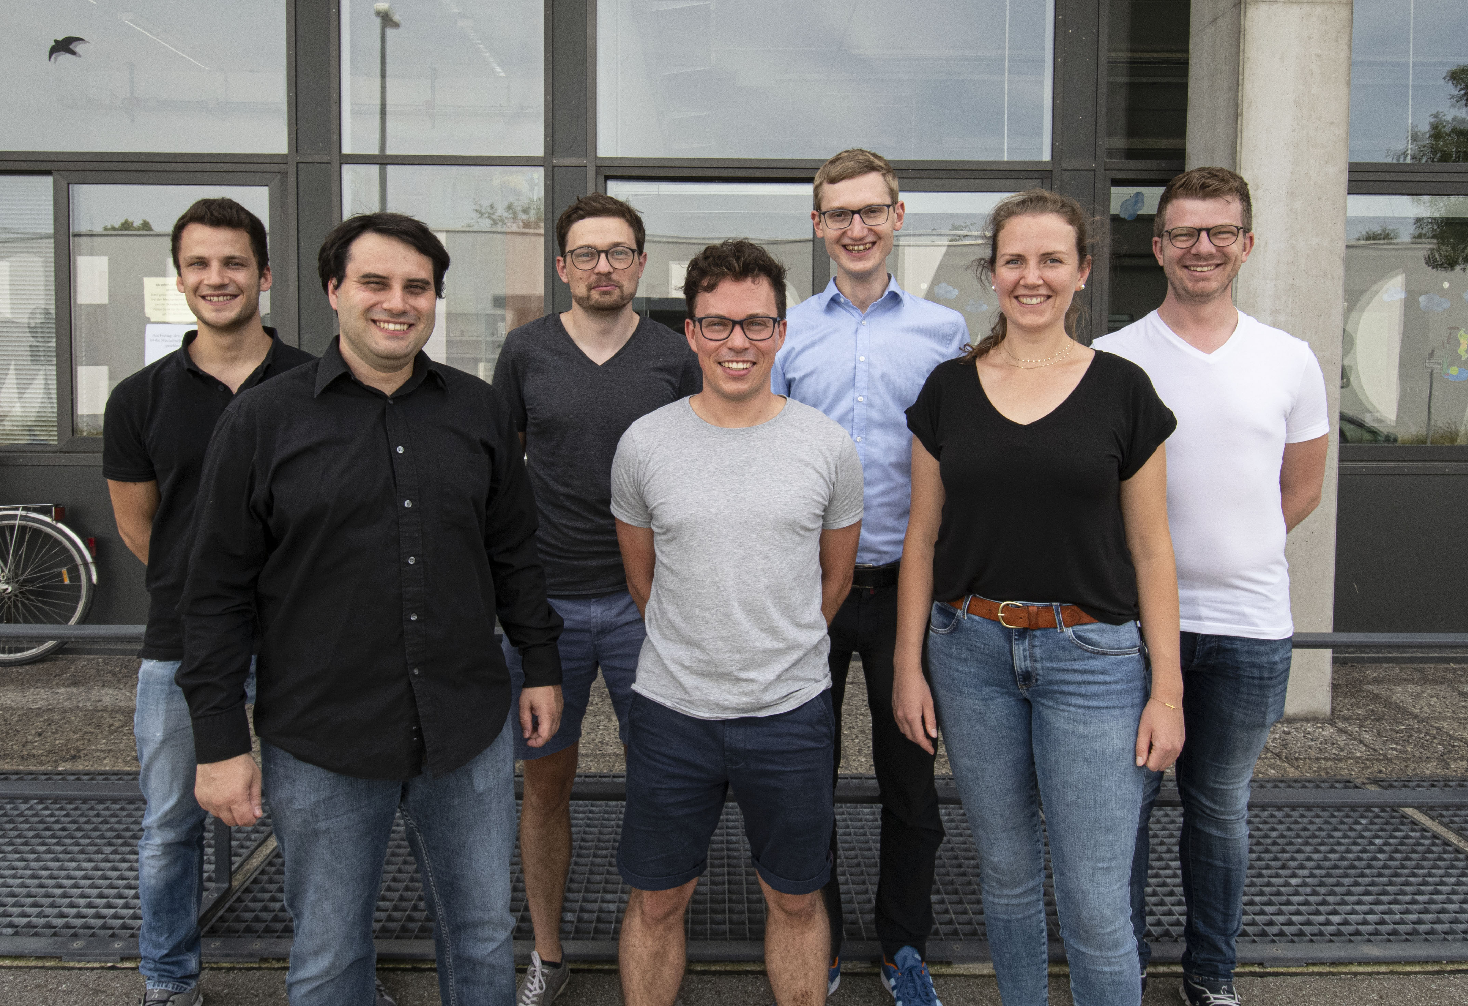
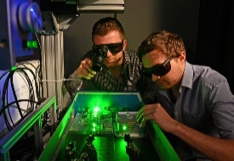
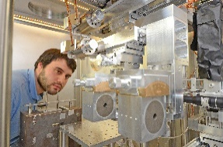
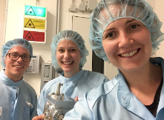
Acknowledgements
Ludwig Maximilians University Munich:
AG Schreiber, AG Karsch, AG Döpp, AG Thirolf
K. Parodi+, P.R. Bolton, J. Bortfeldt, G.Dedes, W. Assmann, F. Krausz+, H. Ruhl+, A. Friedl, M. Groß, J. Szerypo, H. Wirth, O. Gosau, N. Gjotev, F. Saran, G. Schilling
Tel Aviv University (Israel): I. Pomerantz+
Queens University Belfast (UK): B. Dromey+
GSI Darmstadt (Germany): B. Zielbauer, V. Bagnoud+
TU Darmstadt (Germany): M. Roth+, G. Schaumann,
HZDR Dresden (Germany): U. Schramm, M. Bussmann+
FSU Jena (Germany): M. Zepf, P. Hilz, +
Peking University (China): W. Ma+
SIOM (China): J. Bin
LBNL (US): T. Ostermayr
Funding: DFG, BMBF, Bavarian state

