Slide 1
Welcome!
EuPRAXIA Camp III - Innovation
Carsten P Welsch
INFN-LNF and U Liverpool/CI

Slide 2



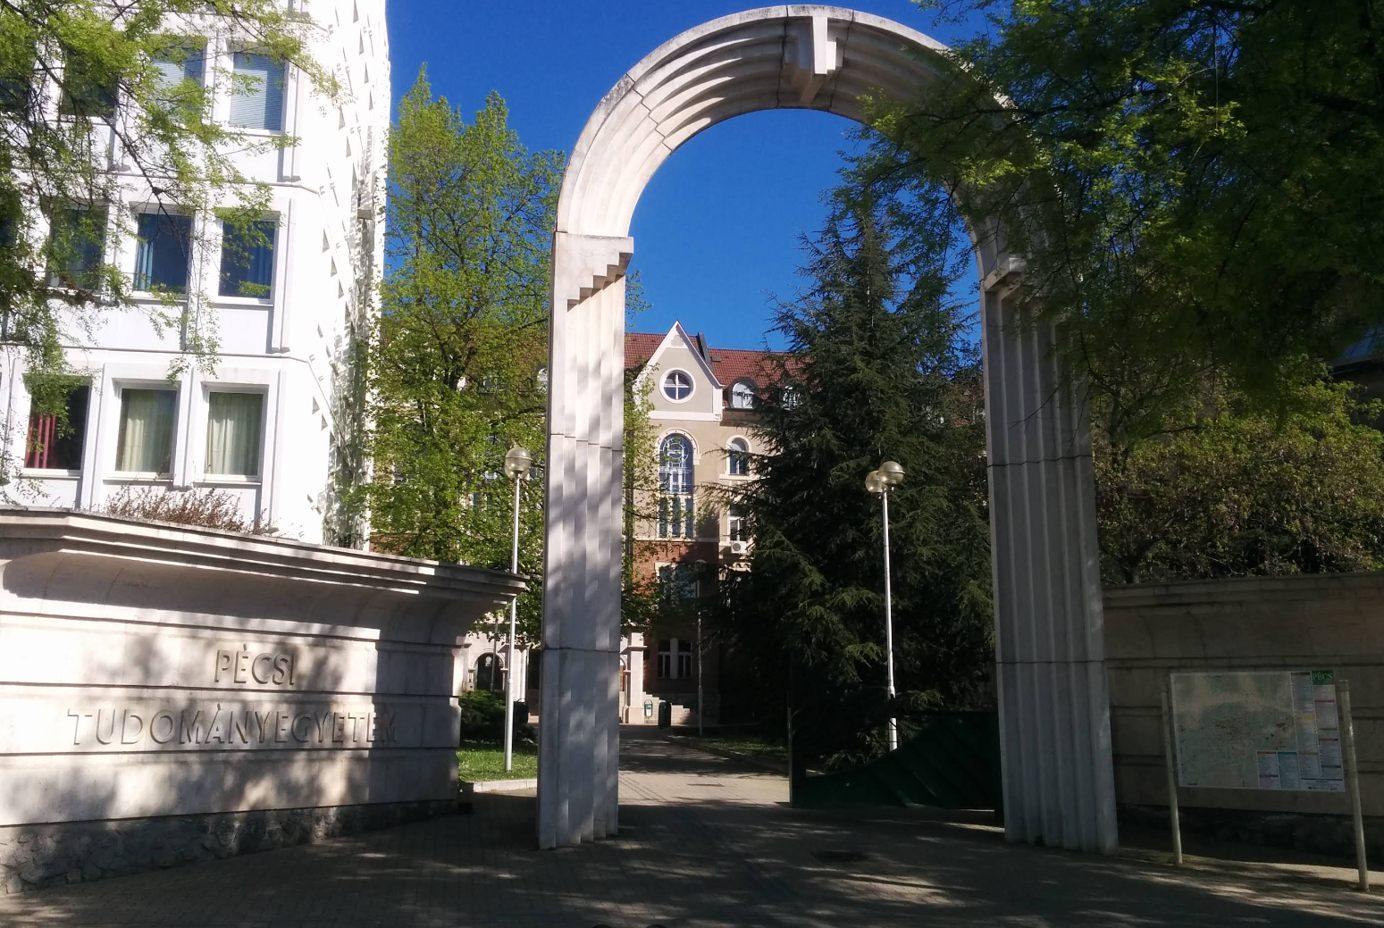


EuPRAXIA-DN Camp III: Innovation
6 – 7 October 2025, Pécs, Hungary
Meeting Venue
Overview of Activities
University of Pécs
Faculty of Sciences
Ifjúság útja,
7624 Pécs
Hungary
Entrance to the site
Sunday 5 October
Welcome Reception, Hotel Makar 18:00
Monday 6 October
Registration, U Pécs, Faculty of Science, 8:30
Camp start, U Pécs, Faculty of Science, 9:00
Lunch, Paulus Restaurant 12:30
Afternoon sessions, Szentagothai Research Centre 14:00
Dinner at Pécs TV Tower 19:00
Tuesday 7 October
Camp start, U Pécs, Faculty of Science, 9:00
Camp end, 16:30
Please see Indico for the full agenda.
This project has received funding from the European Union´s Horizon Europe research and innovation programme under grant agreement
no. 101073480 and the UKRI guarantee funds.

Slide 3
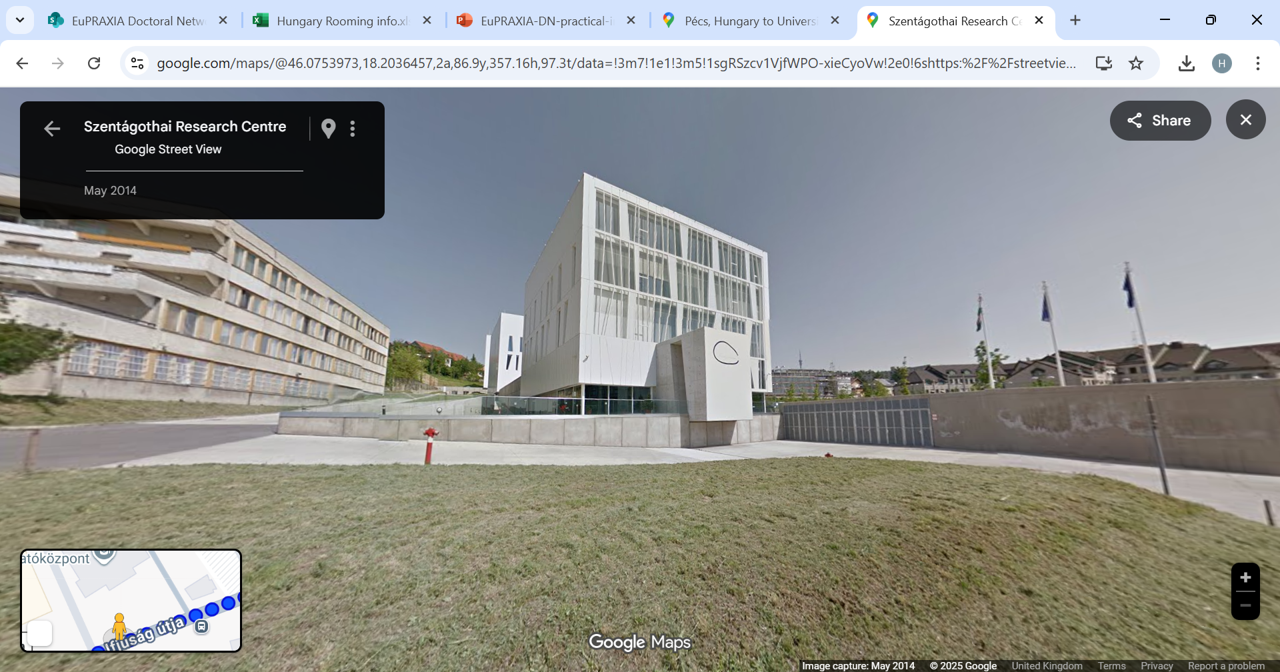
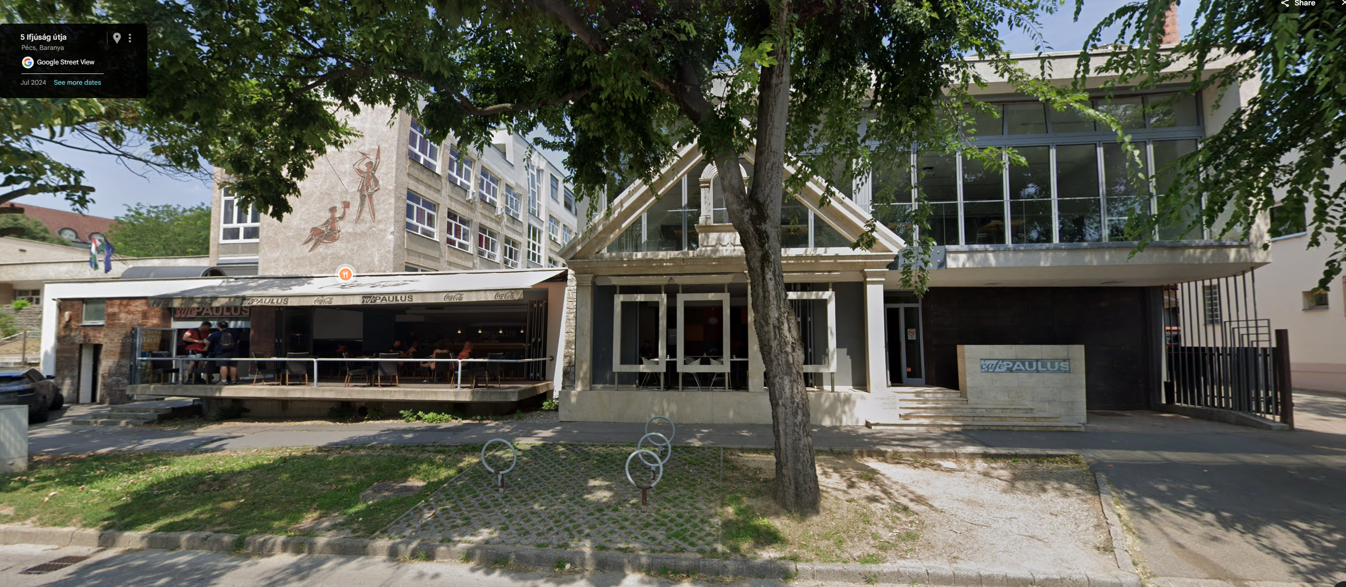
EuPRAXIA-DN Camp III: Innovation
6 – 7 October 2025, Pécs, Hungary
Key Locations
Please see below the entrance to Paulus Restaurant, where lunch will take place on Monday and Tuesday.
University of Pécs, Faculty of Science
Paulus Restaurant
Please see the next slide for an example walking route from Hotel Makar to the University of Pécs, Faculty of Science.
We would recommend walking to the university as it is just 9 minutes away from Hotel Makar.
Please use an app such as Google Maps for more precise directions or for routes from alternative locations.
The photo above shows Szentagothai Research Centre, where sessions will take place on Monday after the first session.
Szentagothai Research Centre
Please note that all venues are close together,
just a short walk from each other.
This project has received funding from the European Union´s Horizon Europe research and innovation programme under grant agreement
no. 101073480 and the UKRI guarantee funds.

Slide 4
EuPRAXIA-DN Camp III: Innovation
6 – 7 October 2025, Pécs, Hungary
WIFI @ University of Pécs
Dinner
A temporary guest network will be available, and you can join using the following details:
Wi-Fi: EupraxiaDN
Password: EupraxiaDN2025
The eduroam network is also available across the campus.
Monday 6 October, from 19:00
Pécs TV Tower
Bus transport will be provided to and from the dinner venue, departing from Szentagothai Research Centre at 18:40 following the poster session. The bus will take you back to Szentagothai Research Centre after the dinner.
This project has received funding from the European Union´s Horizon Europe research and innovation programme under grant agreement
no. 101073480 and the UKRI guarantee funds.

Slide 5
Overview
EuPRAXIA Doctoral Network
Carsten P Welsch
INFN-LNF and U Liverpool/CI

Slide 6






A bit of history…
  (Beam Diagnostics, Physics)
  4.2 M€, 22 Fellows, 32 partners
  (Laser Applications, Engineering)
  4.6 M€, 22 Fellows, 38 partners
  (Accelerator Optimization, Physics)
  6 M€, 23 Fellows, 35 partners
  (Medical Applications, Life Sciences)
  3.9 M€, 15 Fellows, 31 partners
  (Antimatter R&D, Physics)
  4.0 M€, 15 Fellows, 24 partners
  (Plasma AcceleratorR&D, Physics)
  3.2 M€, 12 Fellows, 23 partners
Largest portfolio of MSCA networks in any scientific area; around 25M€ of funding and more than 100 Fellows!
Also: Chair of STFC ETCC, member of UKRI TSAG and Director of two CDTs.

Slide 7
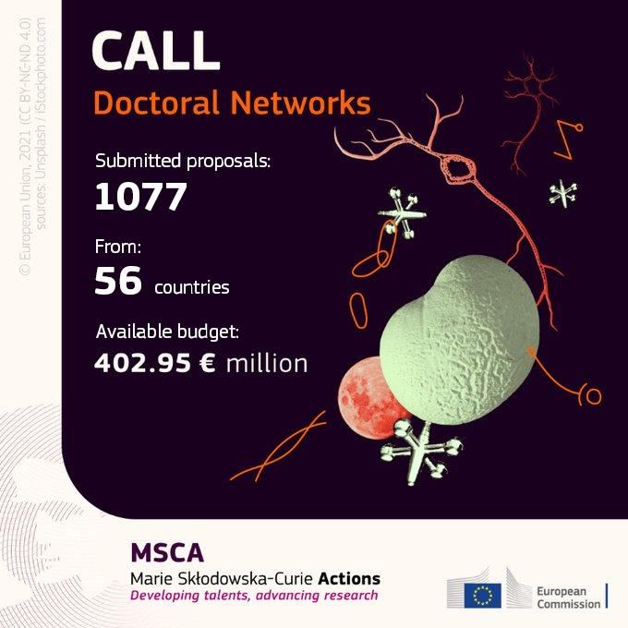
The 2021 MSCA-DN Call
897 proposals for standard doctoral networks
In PHY: 83 proposals – only 10 networks were selected! Success rate was only 12 %.
Complicated start…but we got there! (Brexit, visa issues,…)
With 3.2M€ EuPRAXIA-DN is one of the largest networks, training 12 Fellows.

Slide 8
What is EuPRAXIA-DN?
12 high-level Fellowships (10 Fellows are funded by the EU, another two by the UKRI Guarantee Funds);
Interdisciplinary and cross-sector plasma accelerator research and training program carried out between universities, research centres and industry;
Organizes a (large) number of international events for the wider community;
Recognized importance of plasma accelerator R&D at European level!

Slide 9









Beneficiaries

Slide 10













Partner Organizations

Slide 11



Research
Laser & Plasma
Facility Design & Optimization
Applications
The network's main scientific and technological objectives are split into three closely interlinked work packages.

Slide 12
Training & Events
International School on plasma accelerators;
EuPRAXIA Camps on focused research topics – always across the different project work packages.
Researcher skills trainings designed to prepare all Fellows for their future careers and make them attractive for employers in academia and industry;
Final conference and outreach symposium to present project results.
Events are open to all Fellows and wider community!

Slide 13
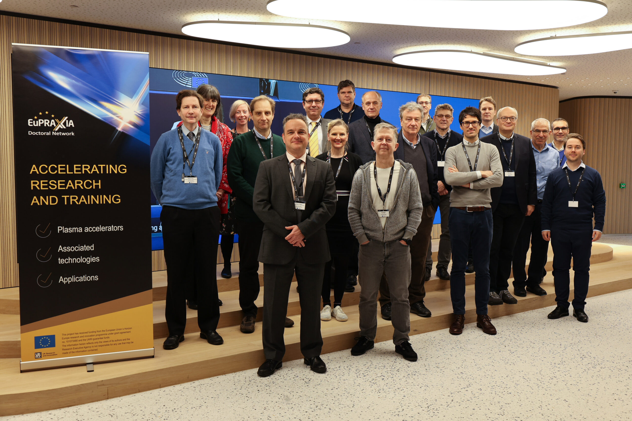
Kick-off Meeting
https://indico.cern.ch/event/1200106/

Slide 14

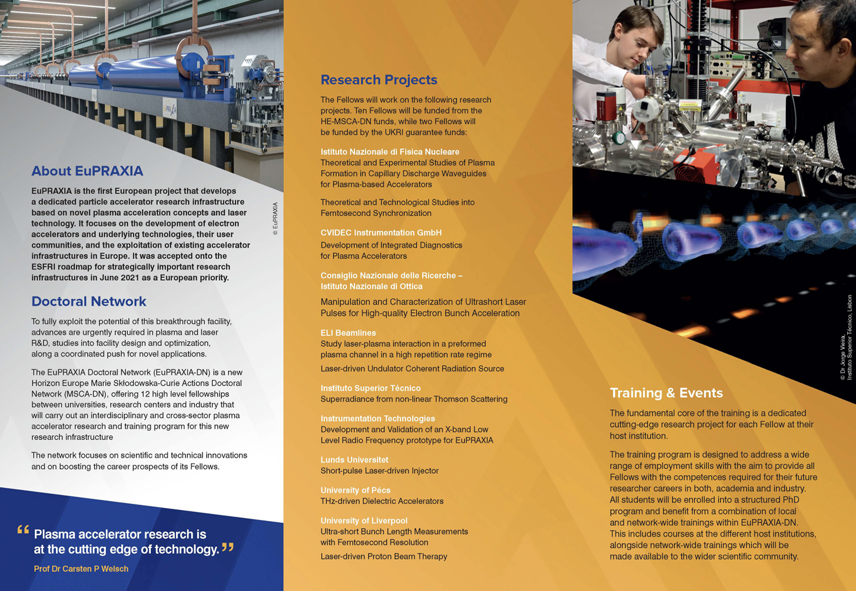
EuPRAXIA-DN Leaflet

Slide 15
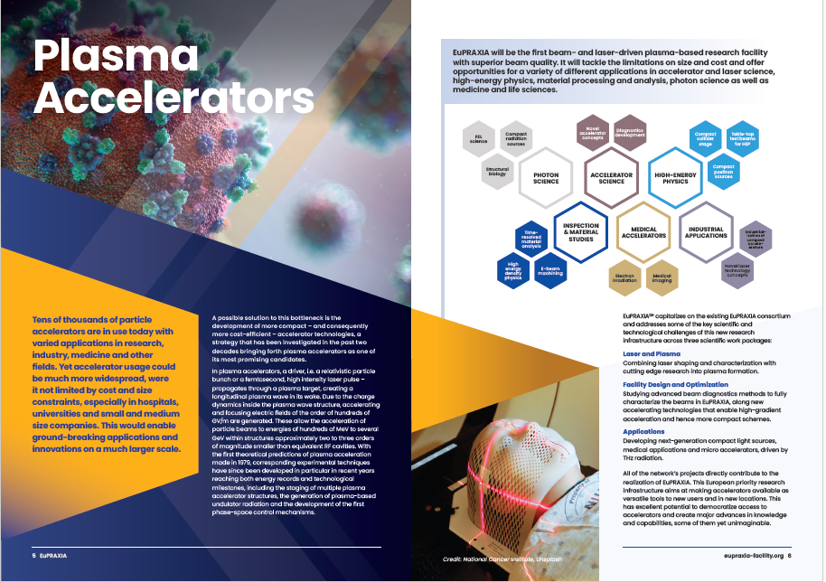
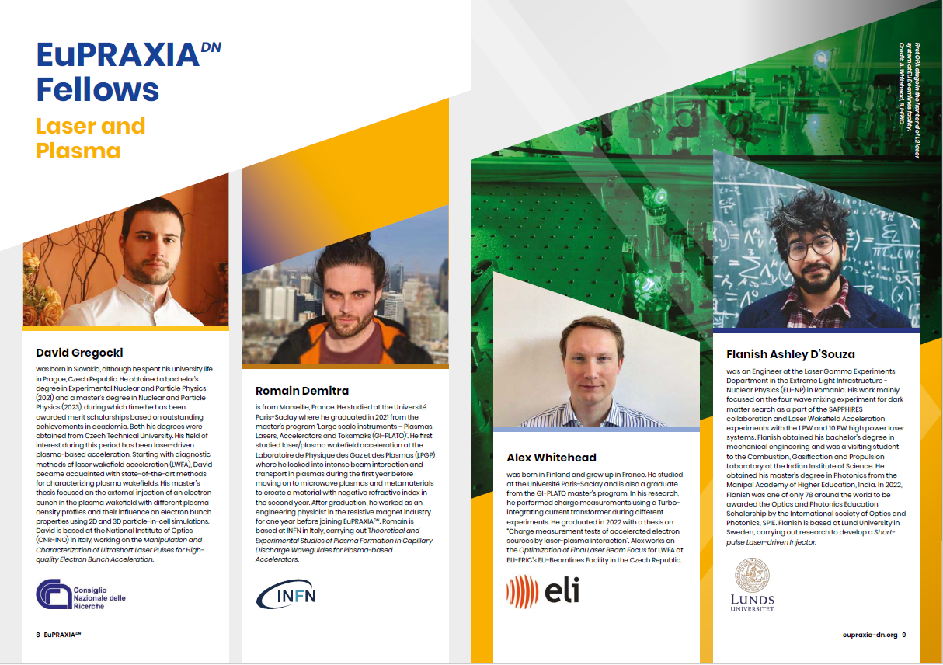
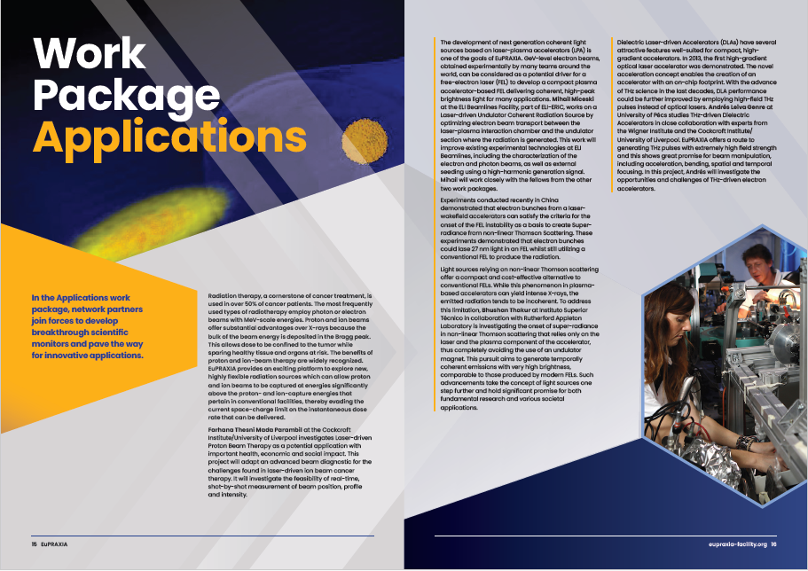
EuPRAXIA-DN Brochure

Slide 16
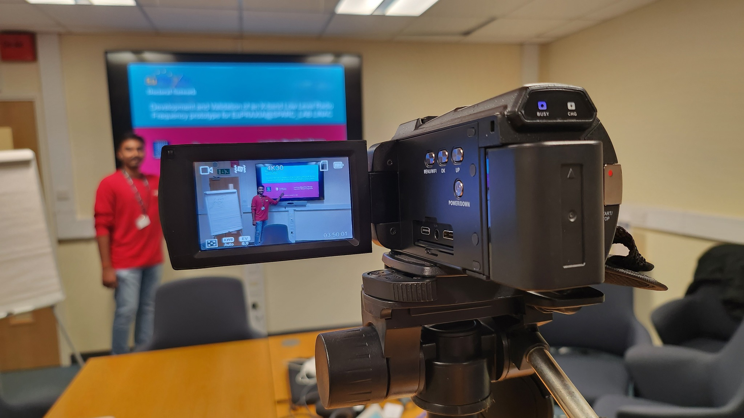
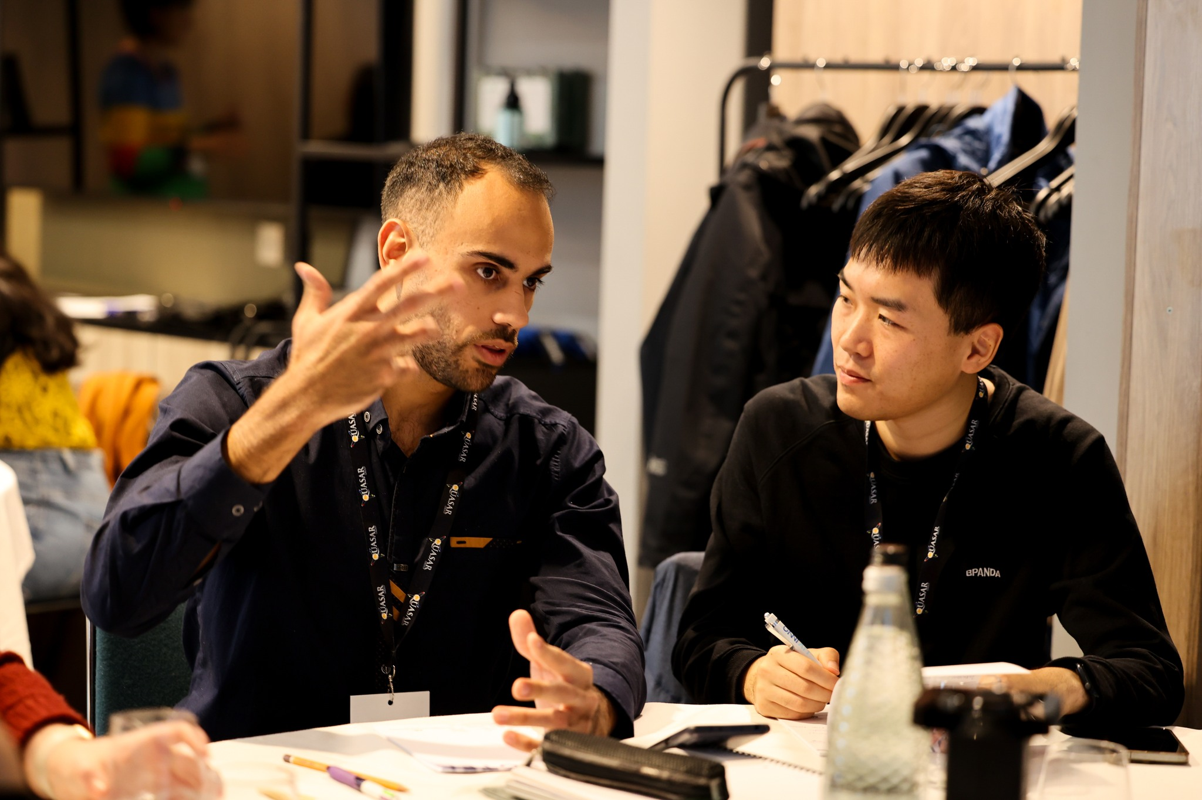
Skills School
PhD project-specific part
  Presentation skills
  Scientific writing
  Project management
Generic skills through outreach project
  Team working
  Proposal writing
  Peer review
  Working under (time) pressure
“I hadn’t really thought of myself
as a project manager until today!”

Slide 17
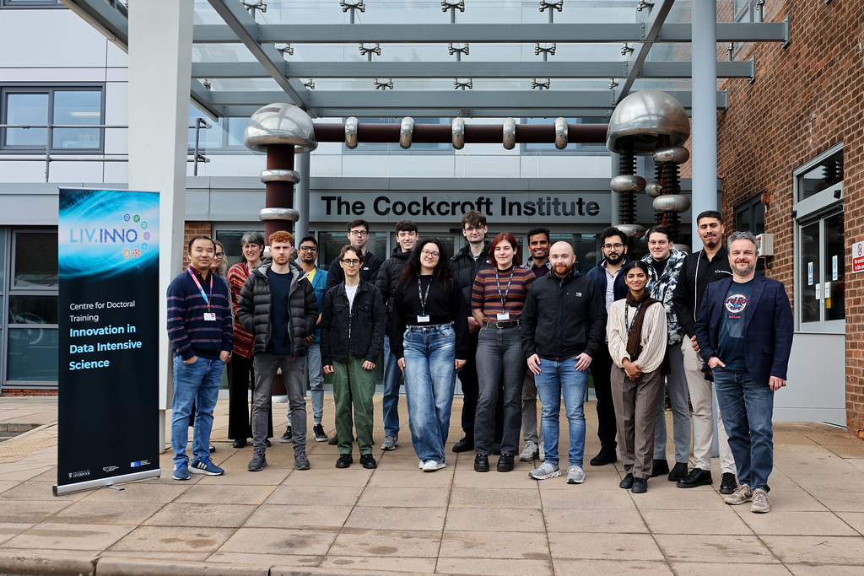
Skills School

Slide 18
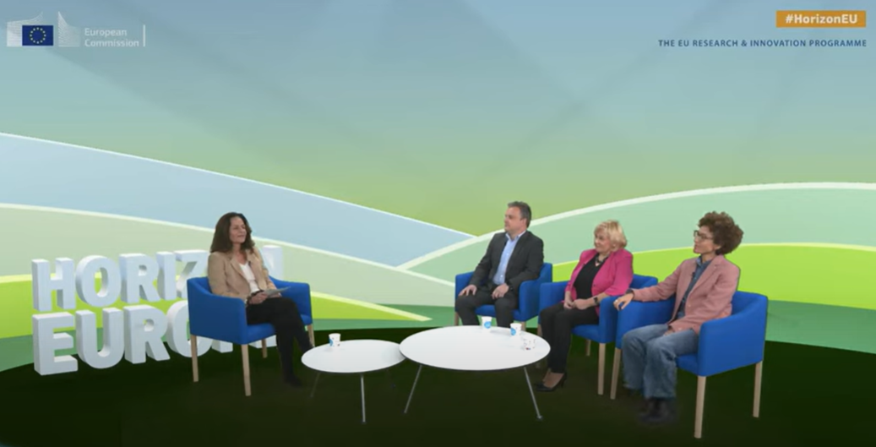
MSCA Info Day 2023
Brussels, 8/9 November 2023: Exemplary exploitation of synergies!

Slide 19

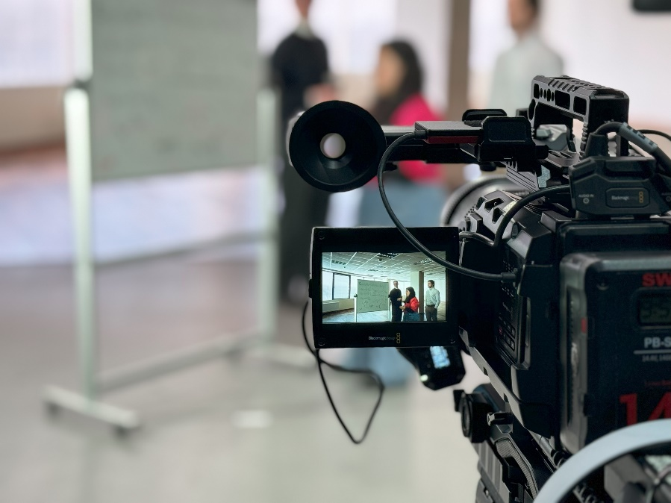
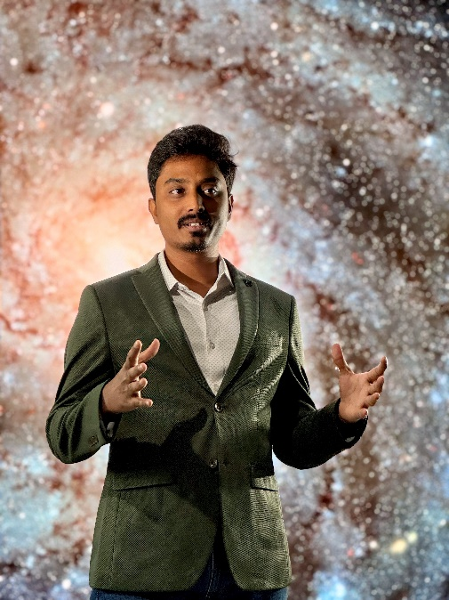
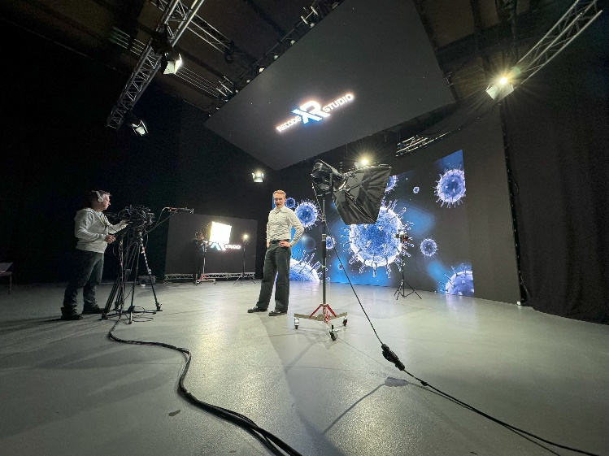
Media Skills School

Slide 20



EuPRAXIA-DN Film
Thus far ~20,000 views
Sustainable video production, use of AI, recognized as EU success story.
https://youtu.be/6NPgxCdffrE

Slide 21


Slide 22
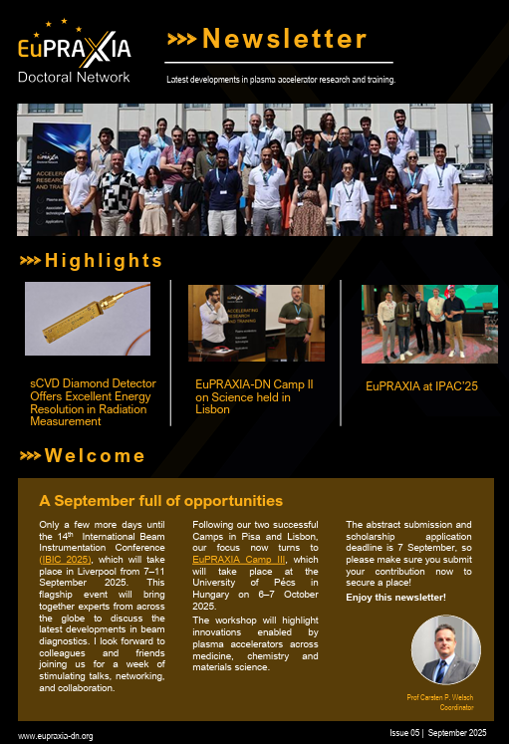
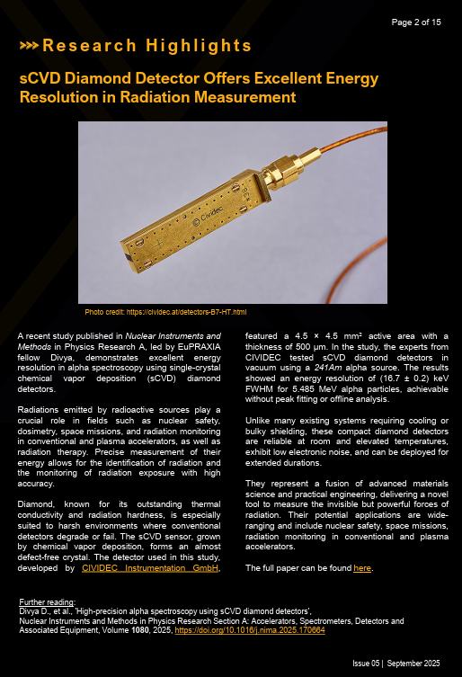
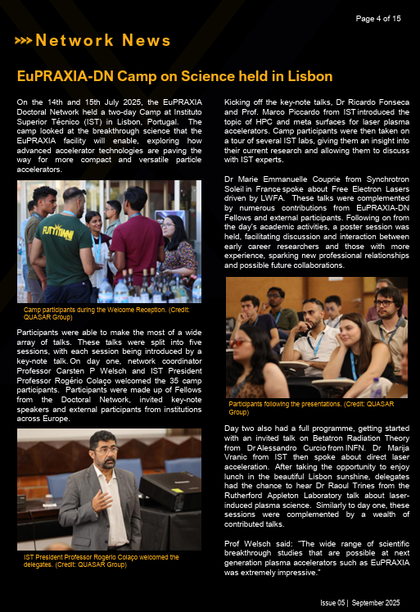
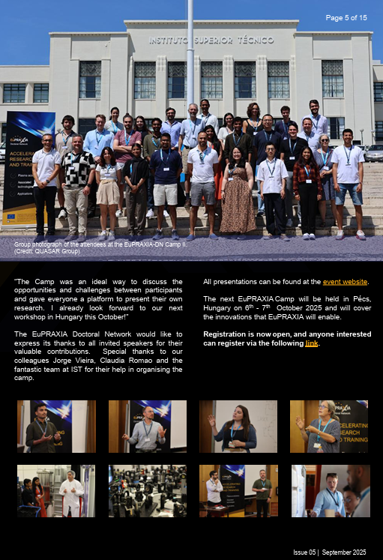
EuPRAXIA-DN Newsletter
https://www.eupraxia-dn.org/newsletter

Slide 23
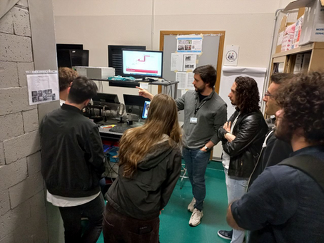
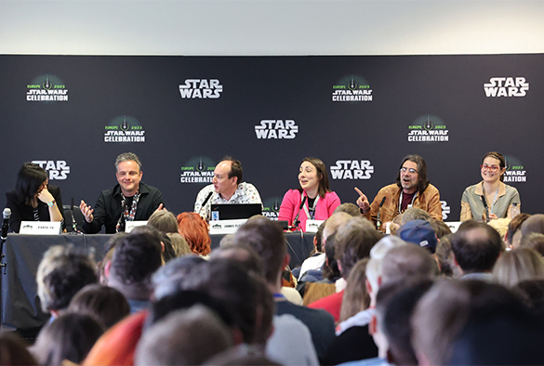

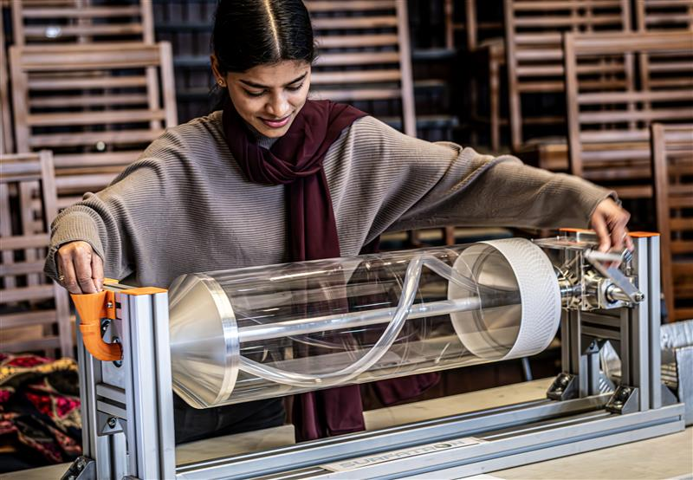

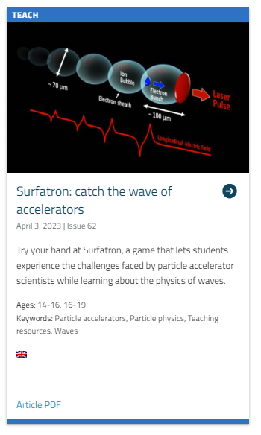
Outreach
International successes:
Physics of Star Wars
Surfatron

Slide 24



Social Media
All communication activities are supported by established social media channels:
    @TheQuasarGroup, @lnf.infn.it, @infn.lnf
    @quasar_6roup, @lnf_infn, @livuniphysics
    EuPRAXIA, QUASAR Group Project T.E.A.M

Slide 25
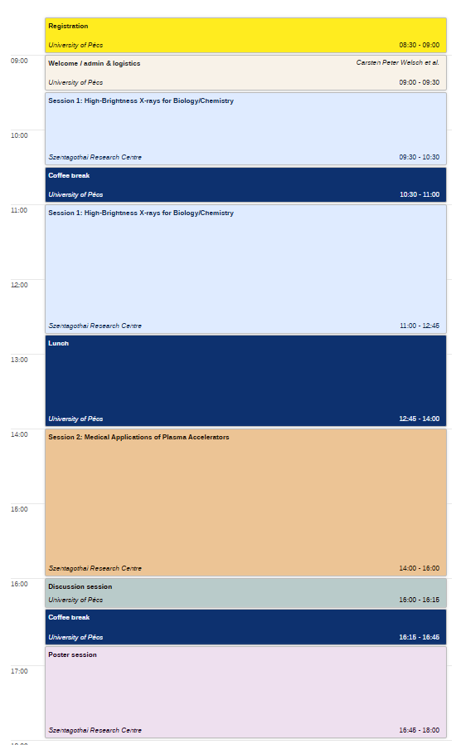
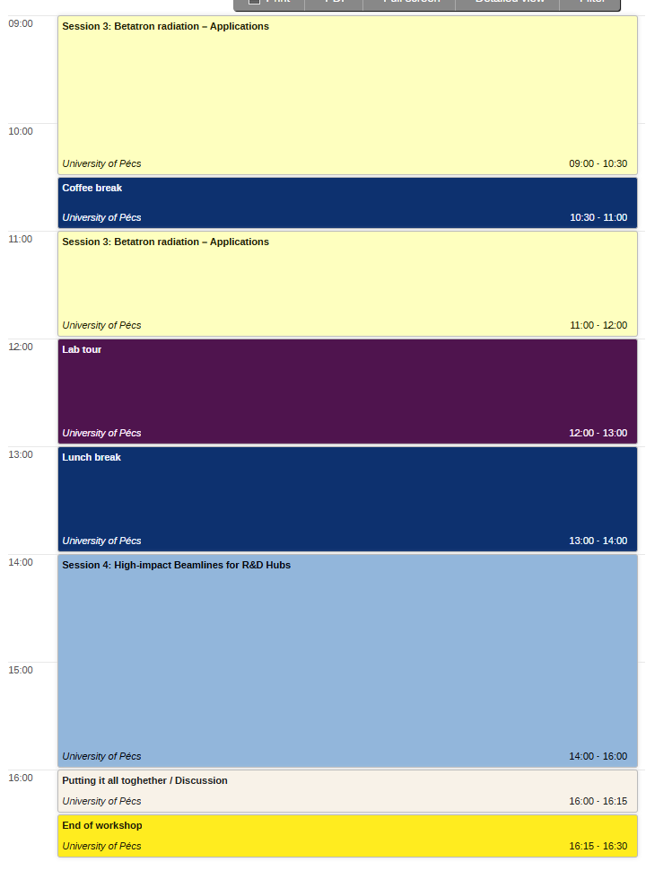

Workshop overview
Contact in case
of Emergency
Carsten
+44 79 73 24 79 82

Slide 26
Camp III – Overview
In this challenge-led workshop we will look into the innovations that are made possible by plasma accelerators.
There will be keynote talks in each session to “set the scene”
These will be followed by R&D talks about the latest research, with plenty of time for discussion. A small poster session in the afternoon will cover an even wider area.
Important: Get to know other participants – network and become part of the EuPRAXIA family. Also: Get out of your comfort zone!
Enjoy the Camp!

Slide 27



This project has received funding from the European Union´s Horizon Europe research and innovation programme under grant agreement no. 101073480.

