Slide 1

Preventivi 2025
Consiglio dei Laboratori
Roberto Cimino Responsabile Locale
Laboratori Nazionali di Frascati

Slide 2
Einstein Telescope - ITALIA @ LNF
GW detector Upgrade for High Sensitivity
Electrostatic charges induced noise
Thermal
noise
Electrostatic charges mitigation
Frost mitigation on Cryogenic Mirrors
Passive
Active
WP1
M. Angelucci (MaSSLab)
Active
Passive
Identification and Control
of charge sources
(Electrostatic screen)
Characterization of
materials vacuum properties
(Outgassing)
Charge mitigation
(Electron irradiation)
Frost Removal
(Electron desorption)
WP3
M. Angelucci (MaSSLab & Vacuum Group @ LNF
& EGO/Virgo & IFAE)
Cryogenic Environment
WP2
A. Liedl (Vacuum Group – Latino @ LNF
& MaSSLab & EGO/Virgo)
WP5 (2026)
M. Angelucci (MaSSLab)
Development of a
“Cold” electron gun
WP4 (2025)
T. Napolitano
Contribution to ETO engineering

Slide 3
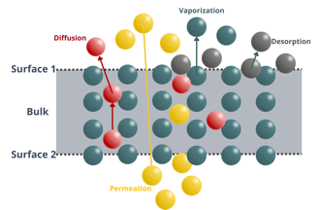
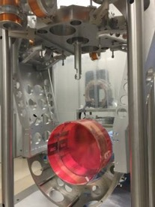
ET ITALIA @ LNF (Gr II)
Coatings, CRD – WP9.3
(E. Cesarini)
WP1: Frost mitigation and Electrostatic Charging – M. Angelucci (MaSSLab)
The final goal of this WP is to validate the use of low energy electrons as a mitigation method for frost formation and as a neutralization method for mirrors’ electrostatic charging.
WP2: Material Properties – A. Liedl (Vacuum Group – Latino @LNF in collaboration with MaSSLab and EGO/Virgo)
The aim of this WP is the characterization of the materials involved in the tower vacuum system containing the mirrors. The investigation of the outgassing properties will define the level and quality of vacuum surrounding the mirror surfaces.
WP3: Passive mitigation method for electrostatic charging – M. Angelucci
(MaSSLab in collaboration with the Vacuum Group @ LNF, EGO/Virgo & IFAE)
The aim of this WP is to carry out a R&D activity to develop a passive mitigation strategy for the electrostatic charging generated by low energy electrons coming from ion pumps, propagating along the beampipes and finally impinging on the test masses.

Slide 4
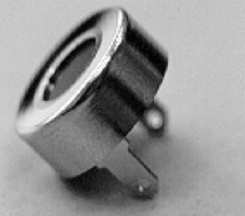
ET ITALIA @ LNF (Gr II)
ETO
WP4: ETO Engineering – T. Napolitano
The aim of this WP is to contribute to the ETO engineering office for the definition and integration of the ET design .
Vacuum, WPXX.1
(A. Grado)
WP5: Cold Electorn Gun – M. Angelucci (MaSSLab)
The aim of this WP is to propose and investigate a possible solution to the integration of an electron irradiation system compatible with the ultra-high cryogenic vacuum conditions that characterize the mirror towers.

Slide 5
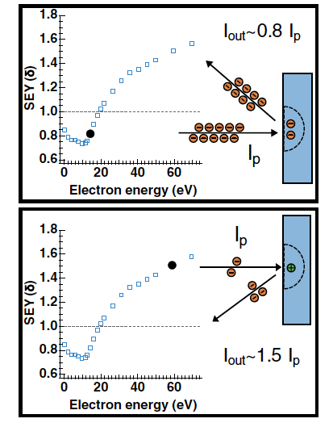
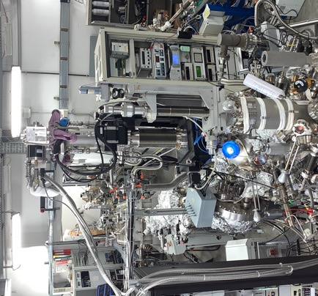
Cryogenic Vacuum Issues
WP1: Frost mitigation and Electrostatic Charging (MaSSLab)
Electrostatic charging
Mirror Temperature will define tower operating pressure since, at cryogenic temperature, residual gas will cryosorb on the mirror surface inducing detrimental effects on the optical properties
An active mitigation method is mandatory to remove the unavoidable frost formation on the optics
Both VIRGO and LIGO optics undergo to inhomogeneous electrostatic charging that may induce unwanted noise
The existing mitigation method cannot be applicable at cryogenic temperature since microns of N₂ will cryosorb on the surface
Proof of concept
At MassLab there two “state of the art” UHV set-ups equipped with cryogenic manipulators for hosting small samples (10x10mm²) at <20 K, electron guns, XPS, SEY, QMS and other spectroscopies to perform:
Surface studies of mirrors materials at RT and LT before and after cryosorption of gases and electrostatic charging.
Secondary Electron Yield (SEY or δ)
SEY=I_{out}/I_{p}
L. Spallino, et al., Phys. Rev. D, 105, 042003 (2022)

Slide 6
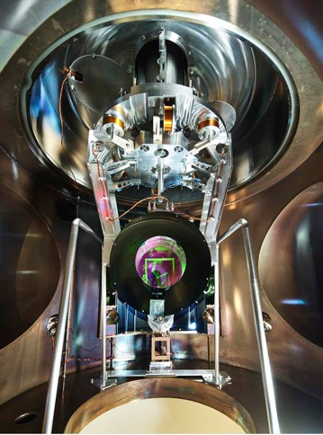
WP2: Material Properties
(Vacuum Group – Latino @ LNF in collaboration with MaSSLab & EGO/Virgo)
The main factor determining the vacuum level within the towers is the amount of gas released from the components installed inside the tower's chambers.
→ The choice of materials is critical to limit the traces of low-volatile organics, potentially cryosrobing onto optical surfaces and directly degrading ET performances.
Saturated vapour pressure from Honig and Hook (1960)
Test on materials and assemblies to assess their compatibility to the vacuum
Outgassing Measurements
Vacuum compatible Materials List (EGO-INFN-KIT MoA)

Slide 7
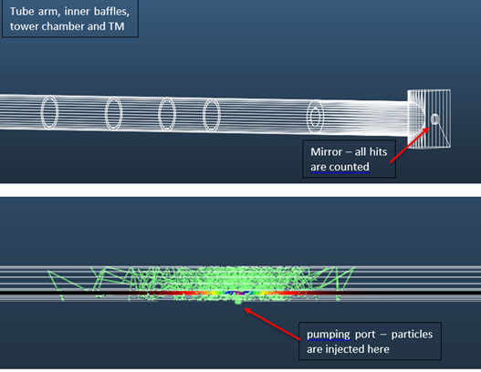
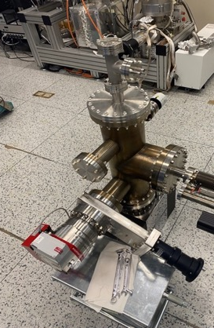
WP3: Passive mitigation method for electrostatic charging
(MaSSLab in collaboration with Vacuum Group @ LNF & EGO/Virgo & IFAE)
Electrostatic charges are generated by low energy electrons impinging on the test masses
Simulation by A. Pasqualetti et al., 2021 (not published data)
Careful evaluation of the distance of the ion pumps from the test mass
Electrostatic ring on baffle
R&D activity LNF-EGO/Virgo-IFAE to test the possibility of integrating an electrostatic ring on selected baffles to mitigate the charges’ flow from the beampipes to the mirrors’ chamber.
numerical simulation
electrostatic measurements
→ mock-up system design/realization for validation

Slide 8
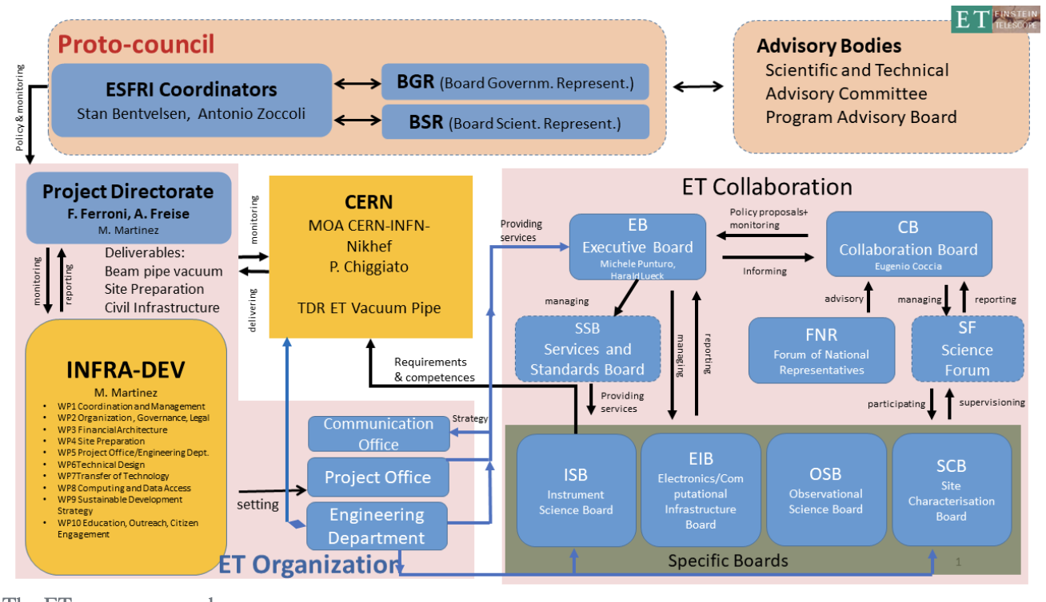
WP4: ETO Engineering – T. Napolitano
ETO, among others, has the mandate to produce an educated estimate on the Site independent costs.
They already produced a new and optimized optical design.
Their work implies meetings and represent the INFN contribution to ET Organization.

Slide 9
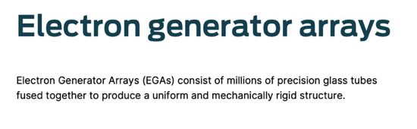
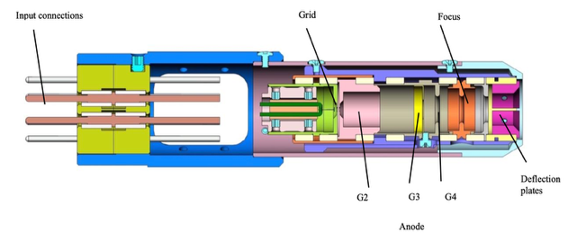
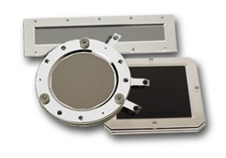
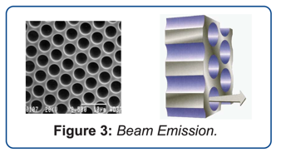
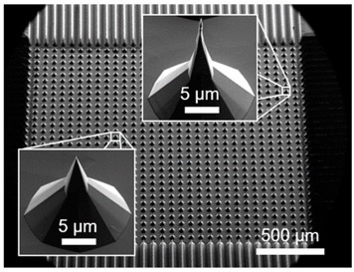

WP5: Cold Electorn Gun (MaSSLab)
Mandatory R&D plan
Cold electron source
Electrons
Hot Cathode
$$J=AT^{2}e^{−Φ/KT}$$
Kimball Physics ELG-2 Theory of Operation (Manual)
Field emission array
Disadvantages:
Refractory metal thermionic emitter
Strong temperature dependance
Material outgassing
To implement:
Characterization at ~10 K
Energy tuning
Deflection and Focusing
A. Schels et al., Micromachines 2023

Slide 10
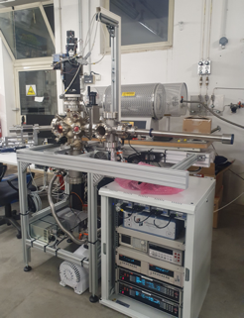
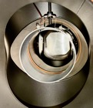
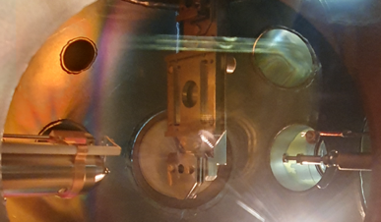
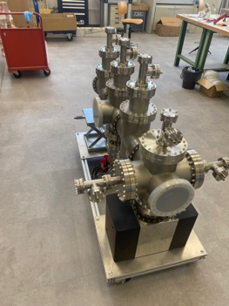
Einstein Telescope – ITALIA @ LNF
ET-Italia ,
LNF is a Research Unit in ET coll.
Characterization of the vacuum properties of components of the ET tower vacuum system
Risultati
Luglio 2025:
  Implementazione setup e software per misure di caricamento su campioni da 1 pollice
  Misure di caricamento e neutralizzazione a bassa temperatura
  Preparazione meeting per ISB-Vacuum&Cryo @ ELBA (Settembre 2025)
  Networking per studio della mitigazione di frost e charging sulle ottiche ottiche e del caricamento
  Upgrade sistema Latino e Prime misure di outgassing su campioni prototipo
  Misure di emissione di elettroni da pompa ionica
  Implementazione sistema per misure di propagazione di elettroni emessi da pompa ionica in tubi.
In corso:
  Misure SEY su campioni rappresentativi delle ottiche di ET a bassa temperatura
  Misure di Caricamento/Neutralizzazione su campioni rappresentativi delle ottiche di ET a bassa temperatura
  Test su camera per misure di emissione elettroni da pompa ionica
  Test di funzionamento sistema di misure su campioni da un pollice (1’’)
Conferenze:
  XIV ET Symposium (talk e poster)
  ET annual meeting
  SIF2025 (talks)
  ISB – Vacuum&Cryo @ Orsay (talk)
Pubblicazioni:
Kelvin probe
e- gun
Sample holder
L. Spallino, M. Angelucci, R. Cimino: Vacuum 233 (2025), 113969.

Slide 11

Einstein Telescope – ITALIA @ LNF
ET – Italia @ LNF
FTE 2026: tot 2.9 @ LNF.
  R. Cimino (80% Resp. Loc.), M. Angelucci (80%), R. Larciprete (80%), A. Liedl (30%), T. Napolitano (20%), L. Spallino (20%*).
Attività a LNF 2026:
  Caratterizzazioni materiali isolanti rappresentativi delle ottiche di ET a bassa temperatura.
  Upgrade camere sperimentali.
  Mitigazione di carica su campioni rappresentativi delle ottiche di ET da un pollice (1’’).
  Misure di Outgassing su diversi materiali candidati per l’utilizzo nelle torri in UHV.
  Identificazione e design sistema per mitigazione di carica tramite anelli elettrostatici.
  Acquisizione componenti per sviluppo cannone elettronico compatibile con bassa temperatura
Richieste CSNII 2025: Tot. 97 k€
  32 k€ missioni
    10 k€ annual and collaboration meetings,
    16 k€ national and international WP and ETO meetings,
    6 k€ travel to other laboratories.
  19 k€ consumo (gasket, manutenzioni, componenti da vuoto)
  46 k€ inventario (criostato, electron generator array, alimentatori)
Richieste LNF 2025: 5 mesi/uomo LLDSU
Fondi Esterni: mur (virgo_miur)

