Slide 1
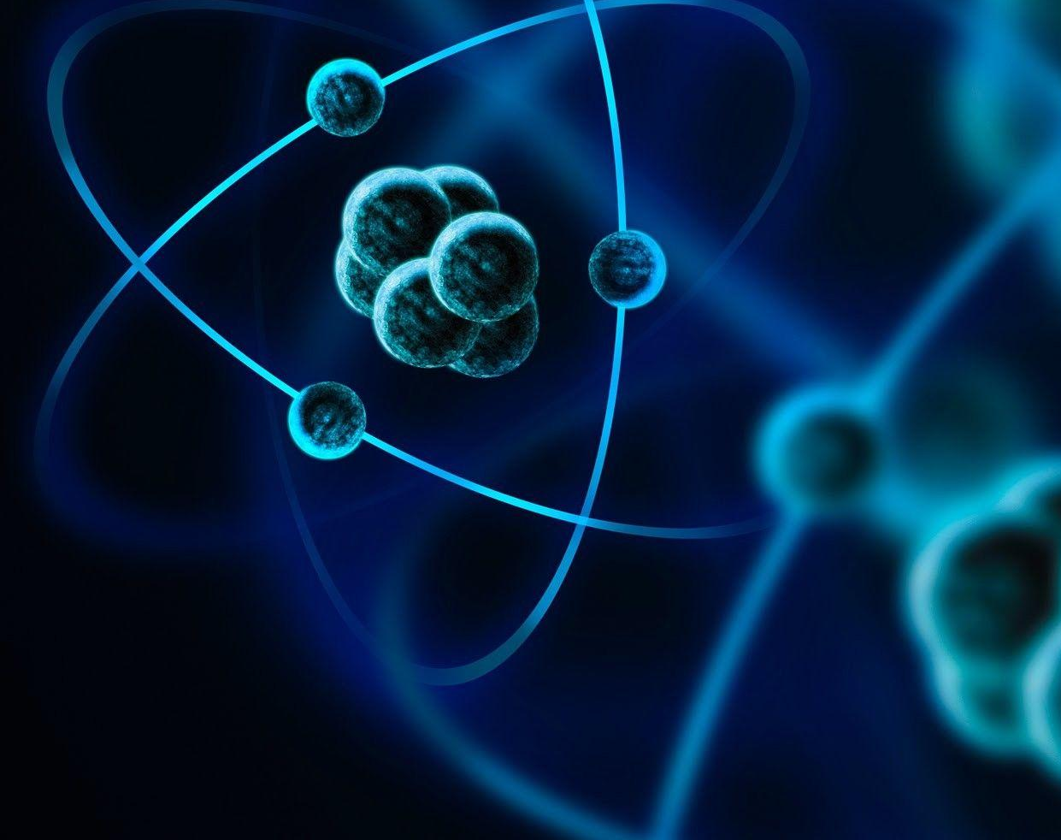


Commissione Scientifica Nazionale 3
Applications and societal benefits
Maria Giuseppina Bisogni
Università di Pisa e INFN Pisa

Slide 2
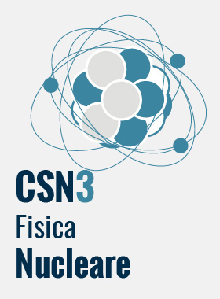

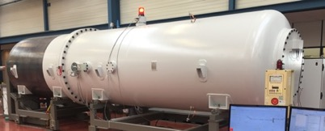
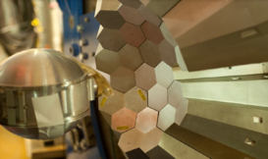
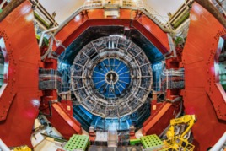
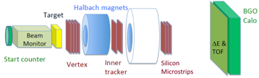
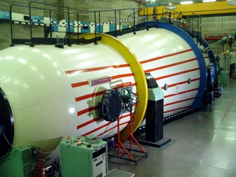
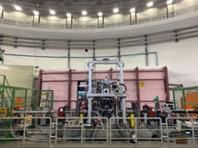
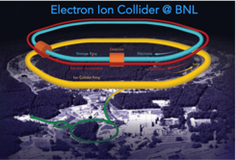
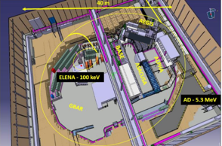
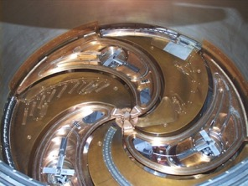
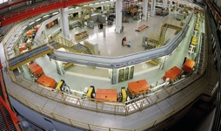
Commissione Scientifica Nazionale 3
Presidente: Paolo Giubellino
N_TOF, LUNA, ERNA
GAMMA/AGATA
FOOT
ALICE
JLAB
Energy
keV
MeV
GeV
TeV
JEDI
SIDDHARTA
EIC
LEA
NUMEN, ASFIN2,NUCLEX, CHIRONE, FORTE
https://web.infn.it/csn3/index.php/it/

Slide 3
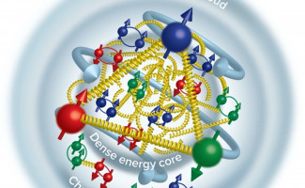
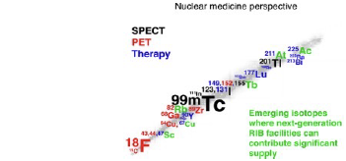

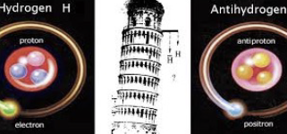
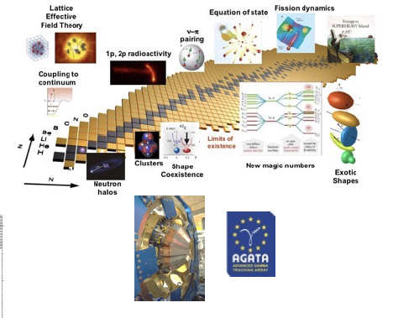
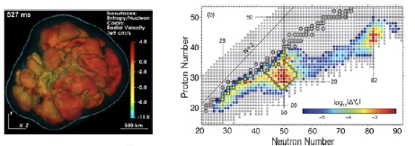
Linee di ricerca
CSN3
1: QUARKS AND HADRON DYNAMICS
KAONNIS (LNF), JLAB12 (JLAB), MAMBO (JPARC), EIC (BNL)
3: NUCLEAR STRUCTURE AND REACTION MECHANISM
FORTE, GAMMA, CHIRONE, NUC-EX, NUMEN_GR3, (LNS, LNL, GANIL, RIKEN….)
4: NUCLEAR ASTROPHYSICS
ASFIN, ERNA, LUNA ,n_TOF, PANDORA (LNS, LNL, LNGS, CIRCE , CERN…)
2: PHASE TRANSITION IN HADRONIC MATTER
ALICE (CERN) , NA60+(CERN)
5: FUNDAMENTAL INTERACTIONS
LEA (CERN), JEDI (Bonn),VIP (LNGS), FAMU (RAL)
6: Applications and societal benefits
FOOT (GSI,CNAO,TIFPA, HIT) SPES_MED (LNL, Arronax)

Slide 4
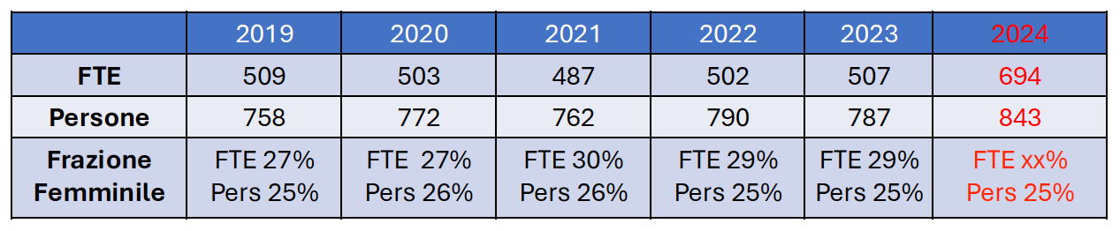
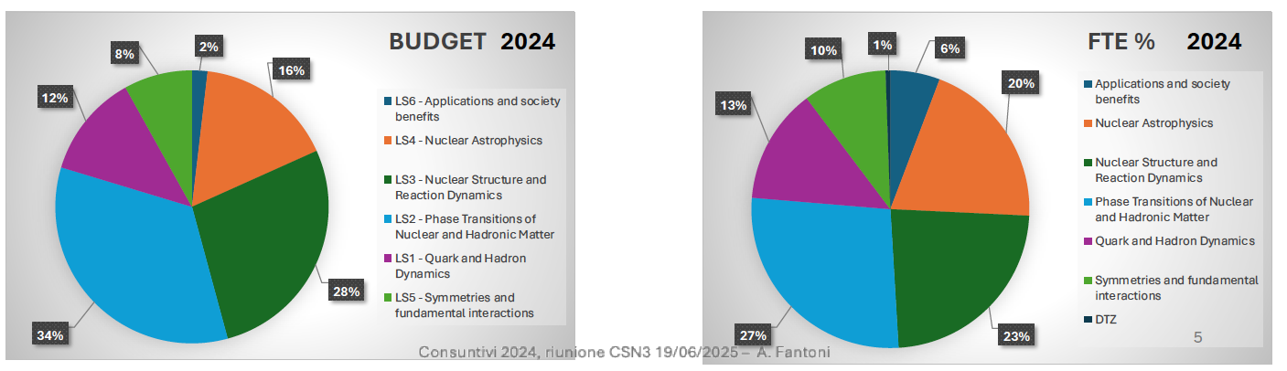
9%
11%
3%
17%
BUDGET %
13%
10% 1%
6%
20%
FTE %
29%
31%
27%
Consuntivi 2023, riunione CSN3 18/09/2024 – A. Fantoni
23%
Fonte Dati: Consuntivi INFN 2024, Analisi di A. Fantoni, S.Palmerini, S.Piantelli per GLV

Slide 5
Linee di ricerca
CSN3
1: QUARKS AND HADRON DYNAMICS
KAONNIS (LNF), JLAB12 (JLAB), MAMBO (JPARC), EIC (BNL)
3: NUCLEAR STRUCTURE AND REACTION MECHANISM
FORTE, GAMMA, CHIRONE, NUC-EX, NUMEN_GR3, (LNS, LNL, GANIL, RIKEN….)
4: NUCLEAR ASTROPHYSICS
ASFIN, ERNA, LUNA ,n_TOF, PANDORA (LNS, LNL, LNGS, CIRCE , CERN…)
2: PHASE TRANSITION IN HADRONIC MATTER
ALICE (CERN) , NA60+(CERN)
5: FUNDAMENTAL INTERACTIONS
LEA (CERN), JEDI (Bonn),VIP (LNGS), FAMU (RAL)
6: Applications and societal benefits
FOOT (GSI,CNAO,TIFPA, HIT) SPES_MED (LNL, Arronax)

Slide 6

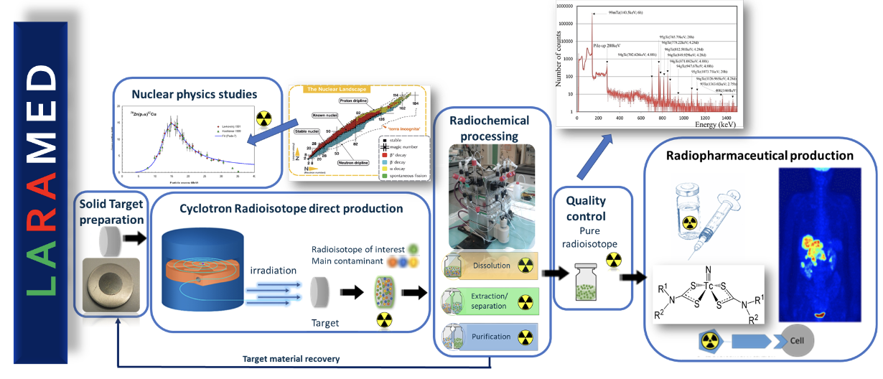
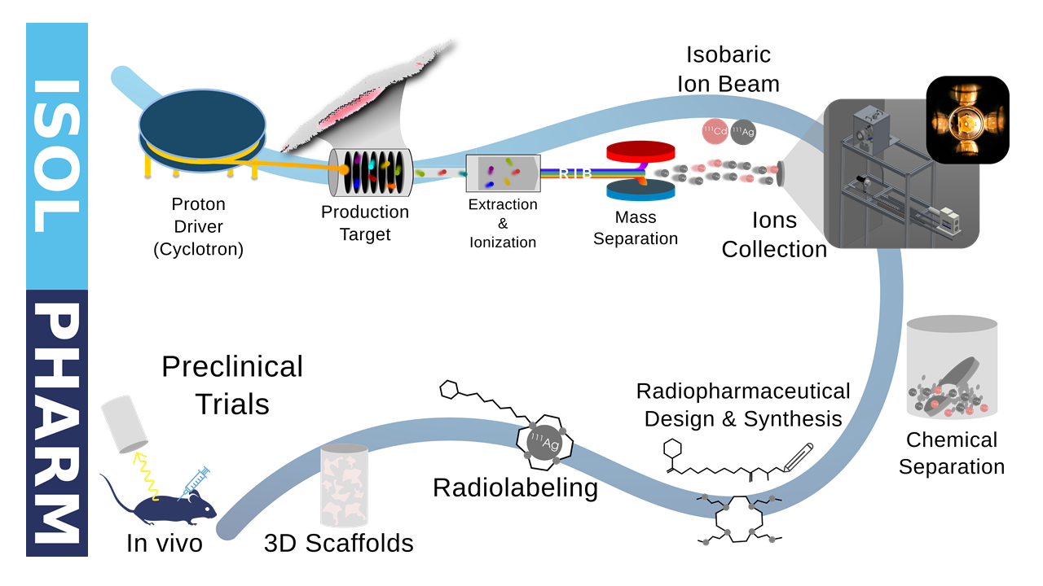
Resp. Nazionale: E. Mariotti (INFN Pi); 5 Sezioni INFN:LNL, Pisa, Milano, Padova, Pavia; 32 ricercatori/12.2 FTE; Status: in costruzione (approvato da CSN3 per 2025-2027)
INFN LNL
Obiettivi
Misurare sezioni d'urto nucleari finalizzate all'ottimizzazione della produzione di radionuclidi medicali (⁴⁷Sc, ^{64,67}Cu and ^{149,152,155}Tb) e contaminanti;
Fornire una misura precisa degli yield di produzione ISOL da target di SiC (²⁸Mg) e TiC (⁴³K, ⁵¹Cr) e da UC (¹¹¹Ag);
Simulare la produzione di radionuclidi ad alta purezza per applicazioni mediche attraverso reazioni nucleari ed esaminare diversi modelli per l'analisi dei meccanismi di reazione nucleare.
Notes:
ISOL Isotope Separation On-Line (ISOL) technique
Selective Production of Exotic Species
rispetto al metodo di produzione ai reattori→ altissima purezza
si producono isobari e quindi piu’ facili da separare chimicamente
attenzione alla risoluzione in massa di +- una massa nucleare

Slide 7

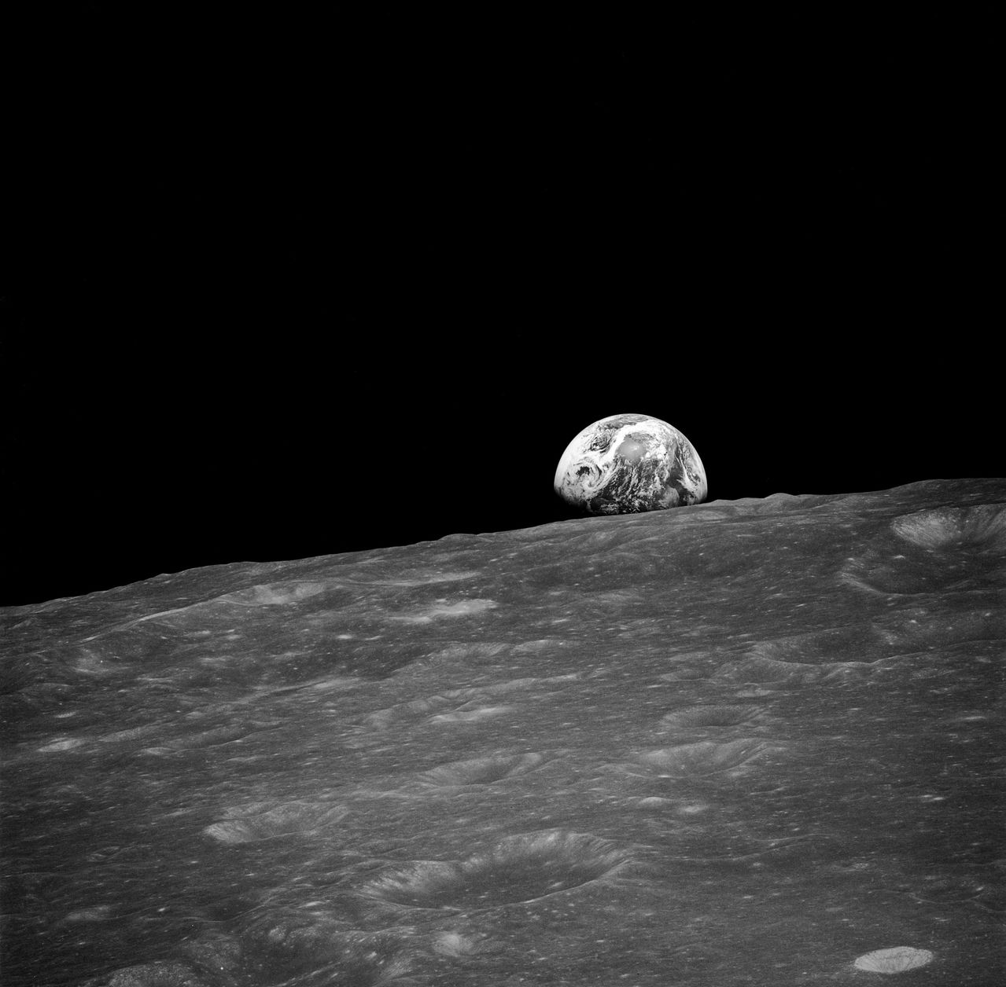
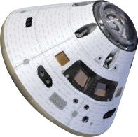
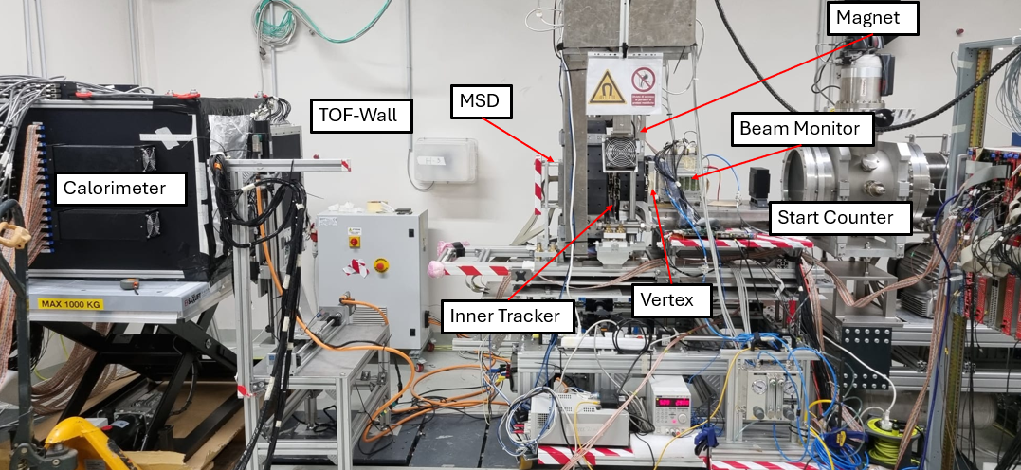
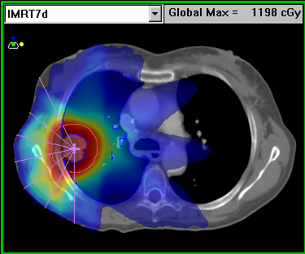
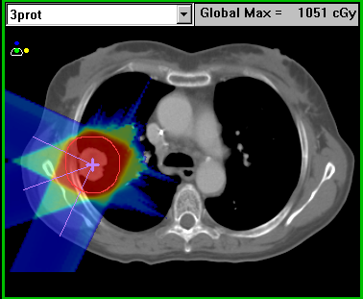
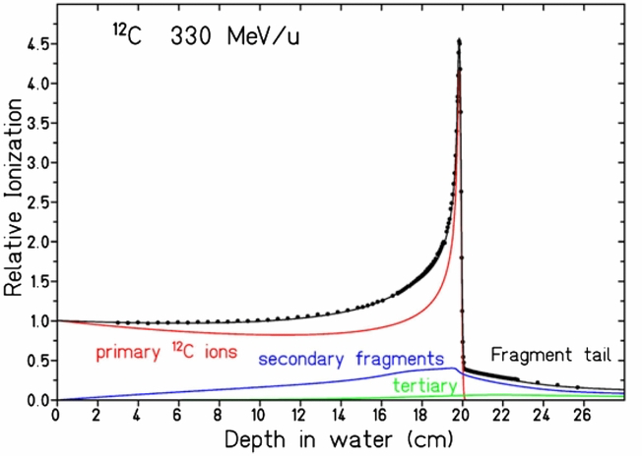
FOOT (FragmentatiOn Of Target)
Resp. Nazionale Mauro Villa INFN Bo; 11 Sezioni INFN: BA, BO, LNF, MI, NA, PG, PI, RM1, RM2, TIFPA, TO ;
79/28.85 ricercatori/FTE
Status: running
Humans to Mars!
Obiettivi misurare la sezione d’urto nei processi di frammentazione rilevanti per la definizione dei piani di trattamento nella terapia con particelle e per la radioprotezione degli astronauti nelle missioni spaziali a lungo termine.
Apparato sperimentale due apparati dedicati alla rivelazione i frammenti nucleari prodotti in bersagli composti da materiali di interesse biologico da proiettili ionici leggeri (protoni e ioni fino ad ¹⁶0) a diverse energie (100-800 MeV/u).
Laboratori GSI Darmstadt (Germania), CNAO Pavia, INFN LNS Catania, Centro Protonterapia APSS Trento, HIT Hidelberg (Germania)
Notes:
L’esperimento FOOT (FragmentatiOn Of Target) partito nel 2017 ha due obiettivi principali:- vuole dapprima migliorare la conoscenza della frammentazione in alcune reazioni per fasci (p, C, O) ed energie (50-250 MeV/n di energia cinetica) rilevanti nell’ambito della adroterapia. Ad energie maggiori (400-1000 MeV/n) gli stessi processi sono di interesse per la radioprotezione da raggi cosmici nello spazio profondo, particolarmente rilevante per la progettazione delle missioni umane verso Marte.
Gli obiettivi concreti riguardano la determinazione delle sezioni d'urto differenziali per produzione di frammenti nucleari in funzione della carica, dell'angolo di produzione e dell'energia cinetica di produzione. Si misureranno le sezioni d'urto su carbonio e su polietilene e per differenza si avranno anche le sezioni d'urto per bersaglio di idrogeno. Tramite tecnica della cinematica inversa risalire alla sezione d'urto di un fascio di protoni che incide su nuclei di carbonio o di ossigeno.
Il fenomeno fisico studiato e' la frammentazione nucleare nei processi a) p-> C, p -> O a 200 MeV/nucleone, b) C -> C , O-> C, C -> O , O -> O da 200 a 800 MeV/nucleone, c) He->C,O da 200 a 800 MeV/nucleone, I processi a) b) e c) ( questi ultimi limitatamente al range di energie 200-400 MeV/nucleone) sono di interesse per il miglioramento della qualita' dei trattamenti sdroterapici. I processi b) e c) a piu' alta energia sono di interesse per la valutazione della dose integrata dagli astronauti dovuta alla frammentazione dei raggi cosmici sugli schermi di radiazioni delle astronavi

Slide 8
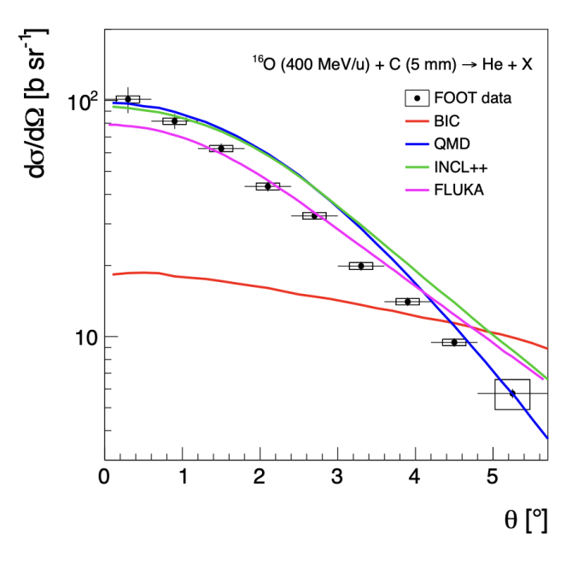
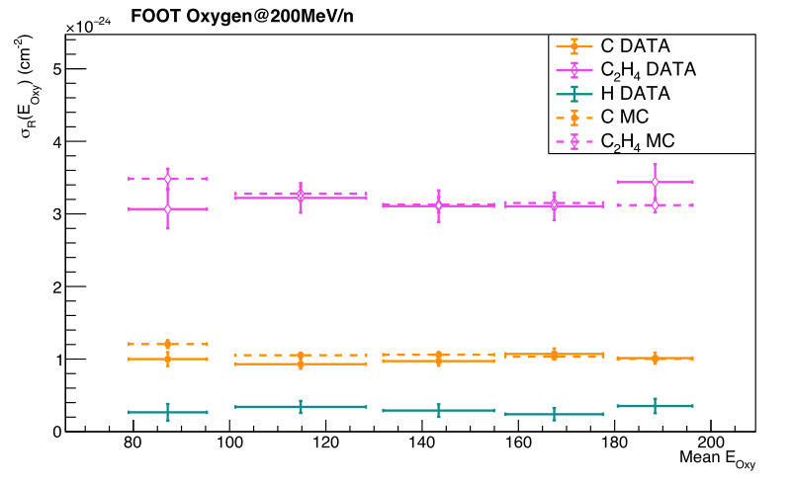
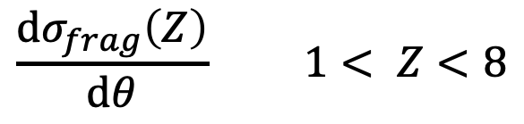
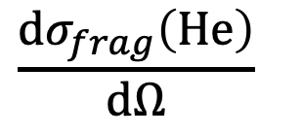
Fragmentation cross sections measurements
for hadrontherapy and space radioprotection
Electronic apparatus
Emulsions
¹⁶O on ^{nat}C at 400 MeV/N kinetic energy
16O on two emulsions bricks (carbon and polyethilen targets) at 200 MeV/n kinetic energy
$$\frac{dσ_{frag}\left(Z\right)}{dθ} 1< Z<8$$
$$\frac{dσ_{frag}\left(He\right)}{dΩ}$$
Published on PRC (may 25)
Paper ready to be submitted to PRC
Notes:
These are some of the results of the beam fragmentation cross section of Oxygen on a Carbon and a Polietilene target, measuread at GSI with the FOOT electronic apparatus with an energy of 400 MeV/N. we measuread for the first time the differential production cross section and the total production cross sections for all elements up to Nitrogen. On the left the measured fragmentation cross section for a carbon target and for Helium production, compared with fragmentation models. These results have been published on PRC.
Using standard emulsions, we measured at GSI fragmentation cross sections of 16O at 200 MeV/N kinetic energy on two bricks of emulsions, one with a carbon target, the other with the polyethilen target.
It was possible to measure the total reaction cross sections for Carbon, Polyethilen and (by difference) Hydrogen on the right. Since the beam slows down in the emulsion bricks before having an interaction, it is possible to measure these cross sections at different Oxygen kinetic energies. The analysis is describeld in a paper that is going to be submitted to PRC
These results are missing from literature and are relevant both in the field of hadrontherapy studies and in space radioprotection evaluations.

Slide 9
TOFpRad: Time Of Flight Proton RADiography with plastic scintillators
PI: Matteo Morrocchi (UNIPI)
CO-PI: Giacomo Traini (INFN – Sezione di Roma)
The research is funded by the grant PRIN: PROGETTI DI RICERCA DI RILEVANTE INTERESSE NAZIONALE - Bando 2022 “TOFpRad: Time Of Flight Proton RADiography with plastic scintillators” grant nr. 202293MEL9, CUP I53D23000970001. The work has been supported by the INFN CSN3 FOOT experiment.

Slide 10
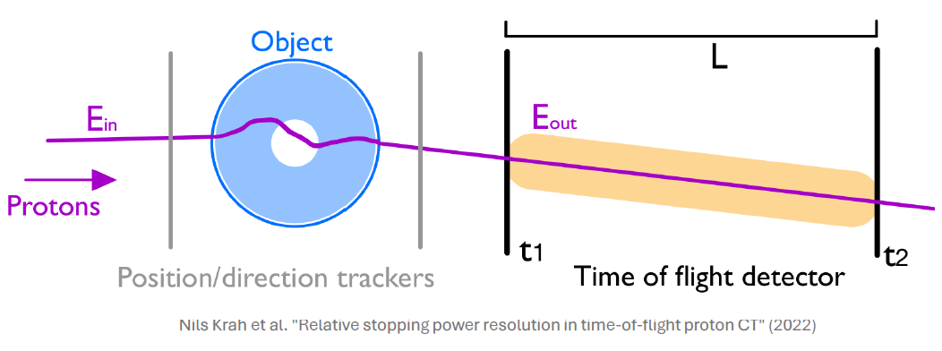
Time of Flight for proton radiography
Proton radiography (pRad) and proton computed tomography (pCT) are being investigated for both diagnostic and verification purposes.
Direct measurement of stopping power
Higher density and soft tissue contrast
Compared to calorimeters, Time-of-Flight-based proton radiography has the advantages of:
Better energy resolution (depending on the distance between the two TOF detectors)
Easier calibration, less bulky (easier application to the clinical context)
In this context, plastic scintillators are particularly appealing:
Excellent time resolution
High-rate capability
Cost-effective
Possibility to cover large areas

Slide 11
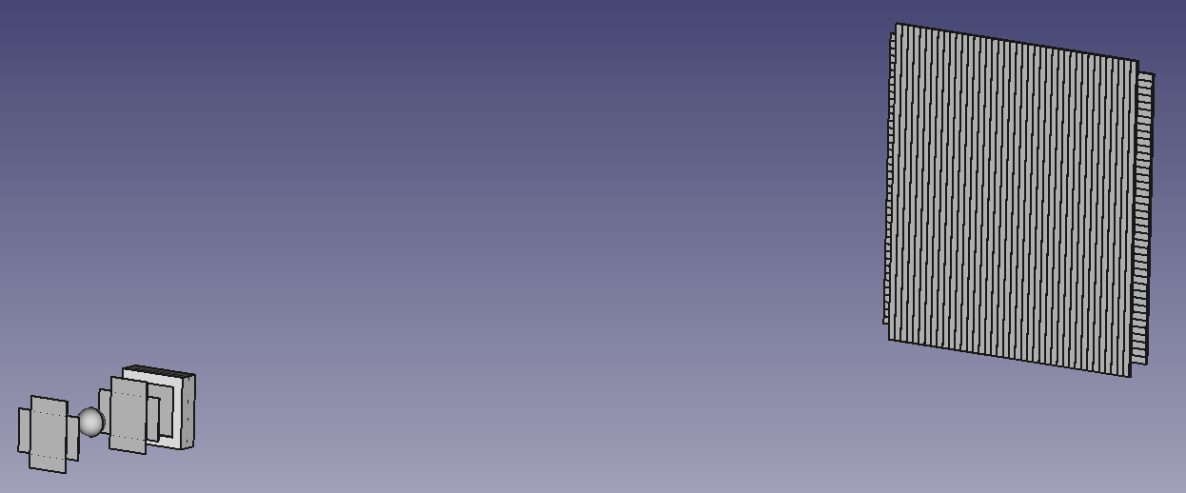
Goal 1
Investigate the TOF technique for the development of innovative proton radiography systems to support ion beam therapy treatments. Development of a plastic scintillator-based TOF prototype for the reconstruction of water equivalent path length maps, thus obtaining a proton radiography of the patient (two-dimensional).
SCINTILLATING FIBER LAYERS
For the monitoring of the entrance and exit position of the proton from the phantom (in the future, additional layers may be included after the phantom to reconstruct also the final direction of the proton)
T1 – START DETECTOR
Thin layer of plastic scintillator readout by silicon photomultipliers
T2 – STOP DETECTOR
Arrays of plastic scintillating bars readout by silicon photomultipliers (a larger area must be covered by this detector compared to the T1 detector)

Slide 12
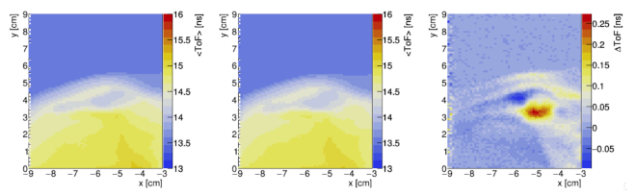
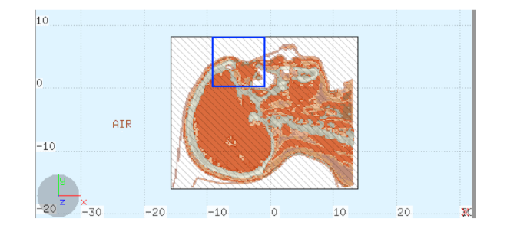
Goal 2
Investigate the TOF technique for a fast and easy verification of the treatment before its delivery with a reduced amount of dose (range probing).
Example of how a variation in the patient anatomy between hadrontherapy sessions can be detected with a pre-irradiation TOF proton radiography.
Average ToF 2D map obtained using the CT1 (left) and the control scan CT2 (center). Difference of the average TOF (right) obtained with 0.2 mGy dose to the patient

Slide 13
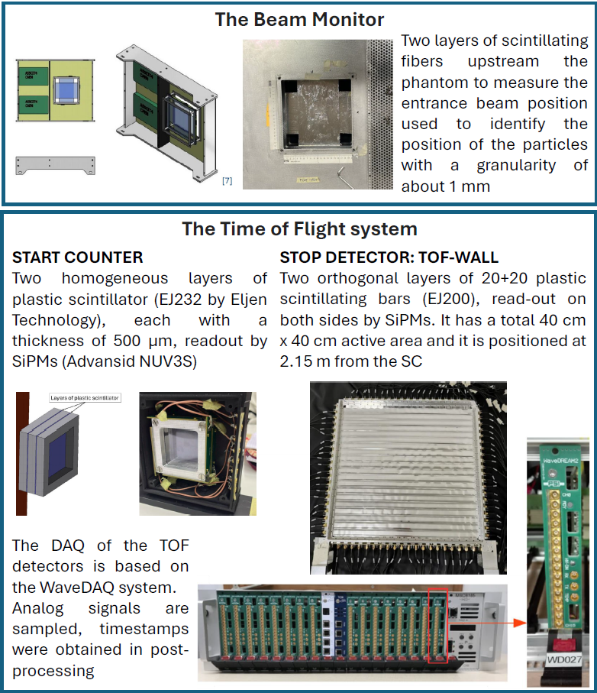
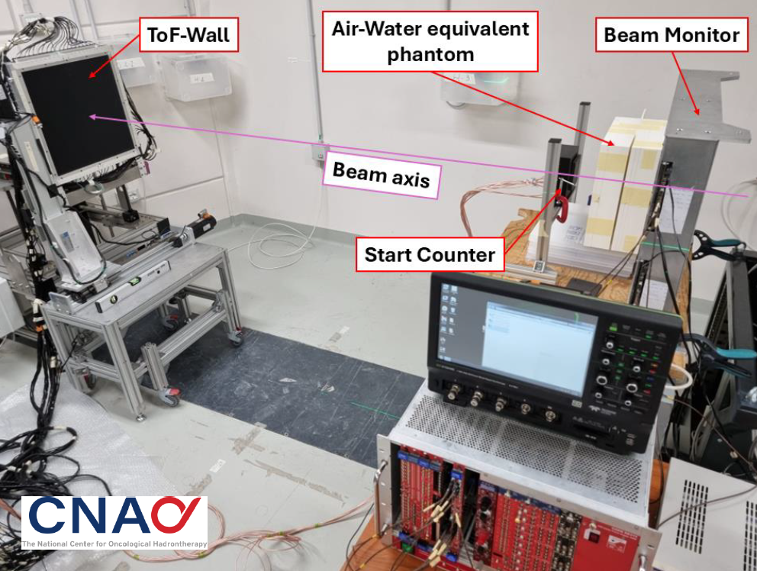
Some preliminary results
Preliminary tests performed at CNAO using existing detectors (from FOOT and other experiments) using 230 MeV proton beams.

Slide 14
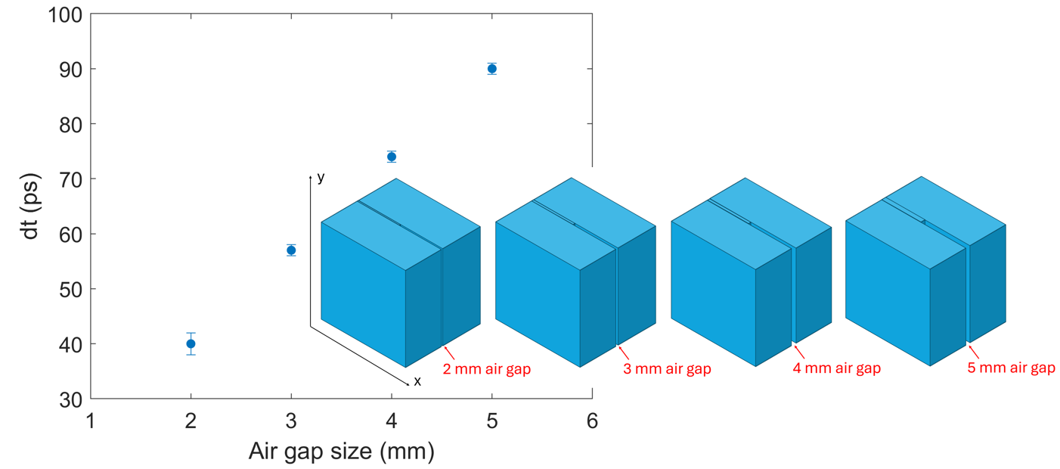
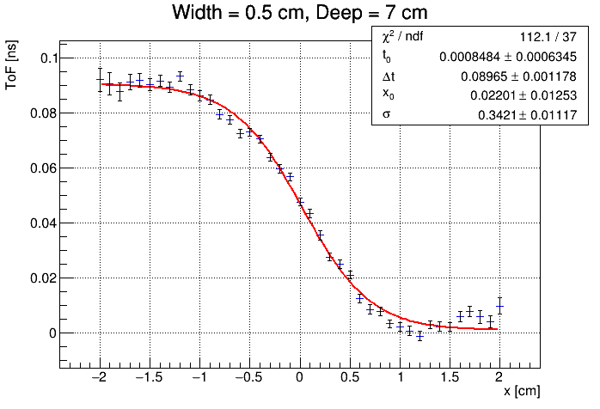
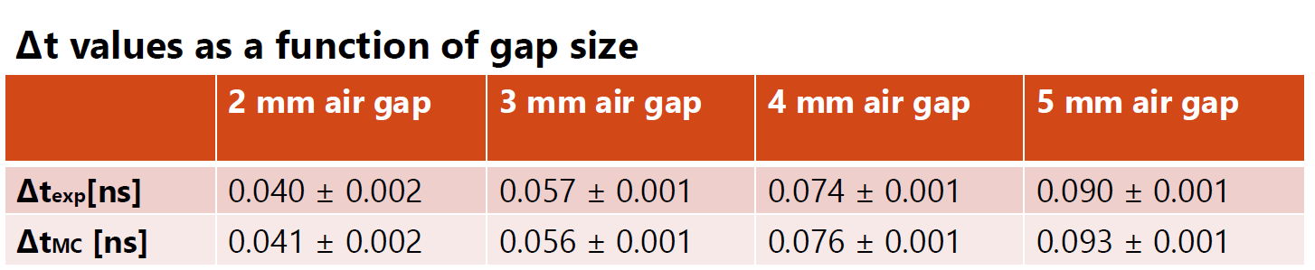
Some preliminary results
Irradiation of a water-equivalent phantom with an air gap of variable size covering half the transversal phantom size (i.e., forming an edge at x = 0).
Good agreement with what expected from the FLUKA simulations, still some work to do on the spatial resolution

Slide 15
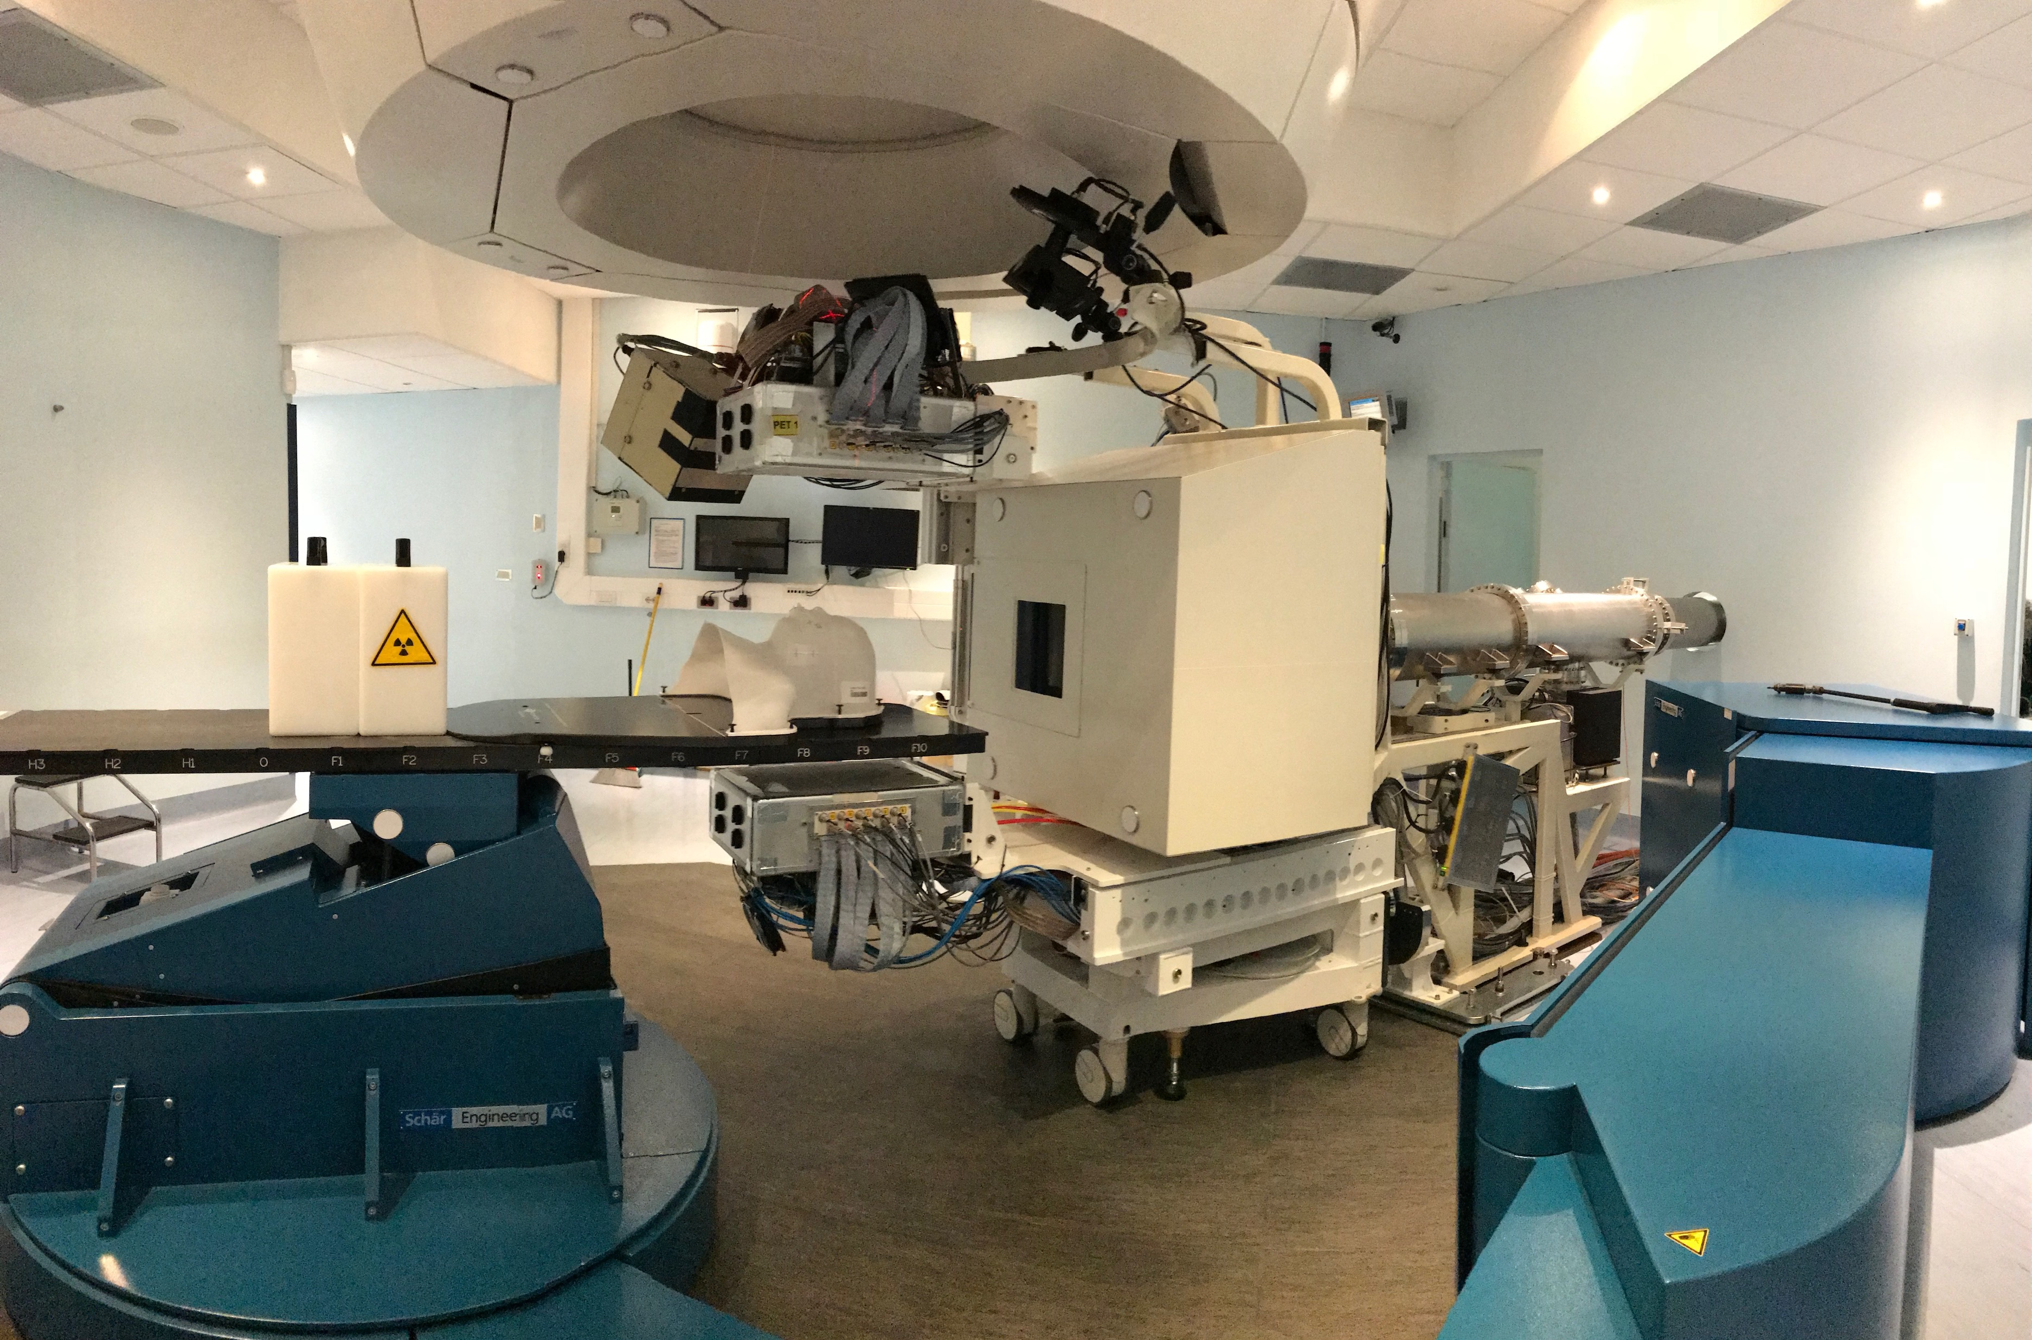



A Multimodal Imaging System For In Vivo Range Verification In Particle Therapy
M. G. BISOGNI^{1,2}
On behalf of the INSIDE Collaboration
¹University of Pisa, ²INFN Pisa

Slide 16
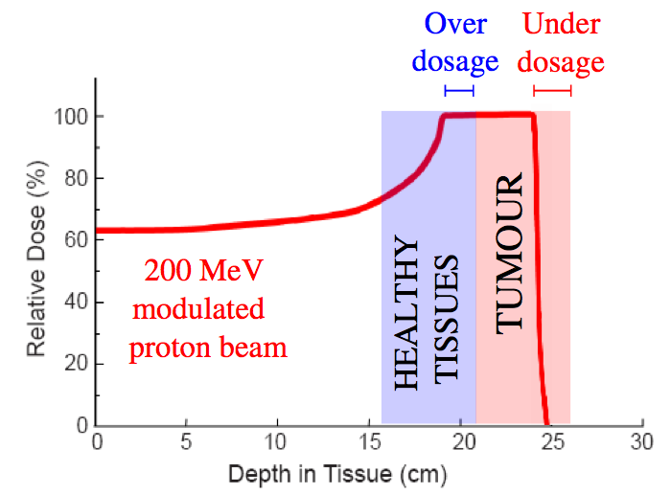
Range uncertainties
Zhu X, Fakhri GE. Theranostics. 2013;3(10):731-740.
safety margins → 2.5-3% + 1-3 mm
Notes:
being a precision technique PT is highly sensitive to range uncertainties
Large Safety margins to take into account range uncertintis (1-3% of the range +1-3 mm)
Margin reduction may be obtained improving the precision/accuracy of the treatment planning
In vivo range verification, if not able to reduce the safety margings, is useful to check/improve the accuracy of beam delivery
In order to fully utilize the potential advantage when using particles, their range in patients needs to be predicted as accurate as possible in the treatment planning and delivery process. An improper quantification of safety margins can have more severe consequences than in photon therapy . Margins underestimating uncertaintis in photon therapy may cause under-dosage of the tumor. In particle therapy underestimation may cause part of the tumor not receiving any dose due to a potential shift of the sharp dose distal fall-off.
It would be good, if we could monitor the range of the protons!

Slide 17
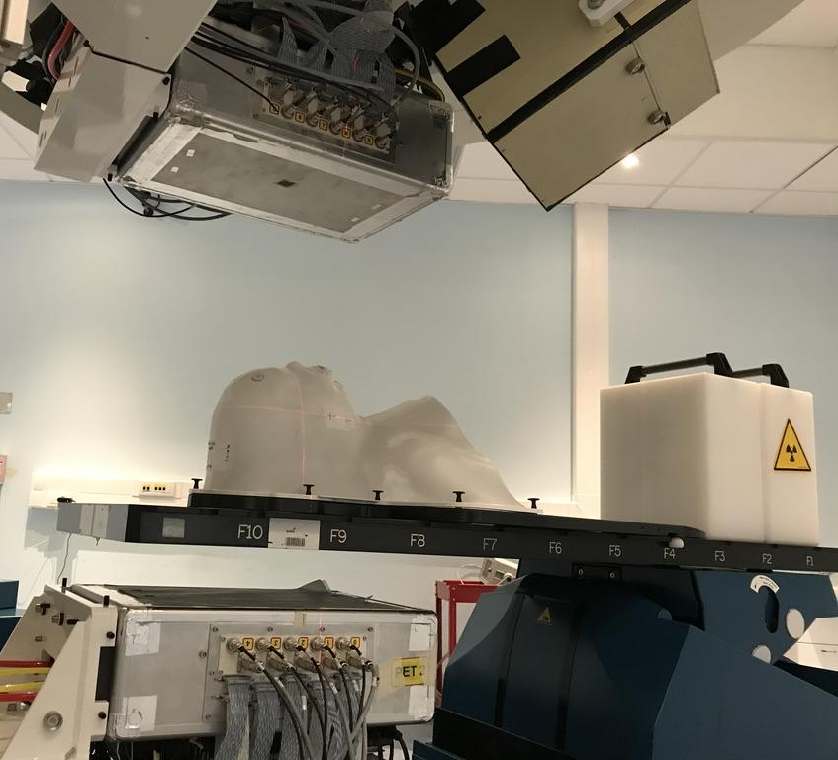
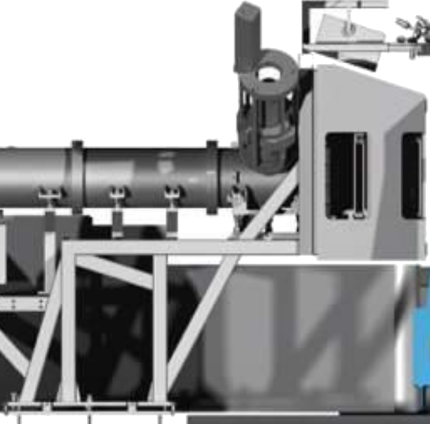




INSIDE BI-MODAL IN-VIVO RANGE VERIFICATION SYSTEM
Passive signals
Charged particles
𝛄 511 keV
𝛄 511 keV
INnovative Solutions for In-beam DosimEtry in Hadrontherapy
Notes:
Inside pioneered since 2013 the bi-modal approach with synergistic combination of PET e charged fragment detection
In beam PET has been long studied and applied in clinics
Charged fragments production is an high cross section process in the interactions of He, C and O beams and is hence particularly suited for monitoring applications of those beams.
¹¹C (T_{1/2}≈ 20.3 min)
¹⁰C (T_{1/2} ≈ 19.3 s)
¹⁵O (T_{1/2} ≈ 2.0 min)
¹³N (T_{1/2}≈ 10.0 min)

Slide 18

Dose profiler
PET
Notes:
Inside pioneered since 2013 the bi-modal approach with synergistic combination of PET e charged fragment detection
In beam PET has been long studied and applied in clinics
Is more accurate and suitable with protons
Charged fragments production is an high cross section process in the interactions of He, C and O beams and is hence particularly suited for monitoring applications of those beams.
¹¹C (T_{1/2}≈ 20.3 min)
¹⁰C (T_{1/2} ≈ 19.3 s)
¹⁵O (T_{1/2} ≈ 2.0 min)
¹³N (T_{1/2}≈ 10.0 min)

Slide 19
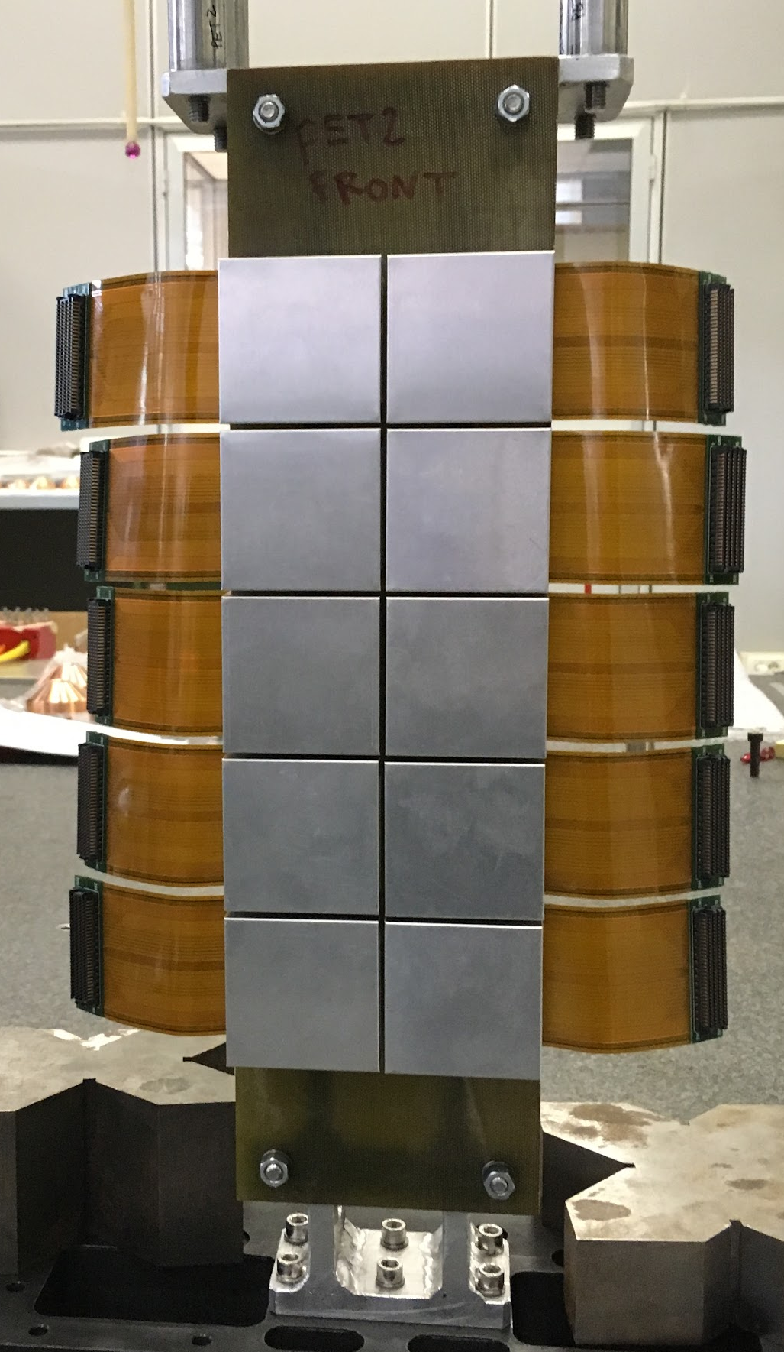
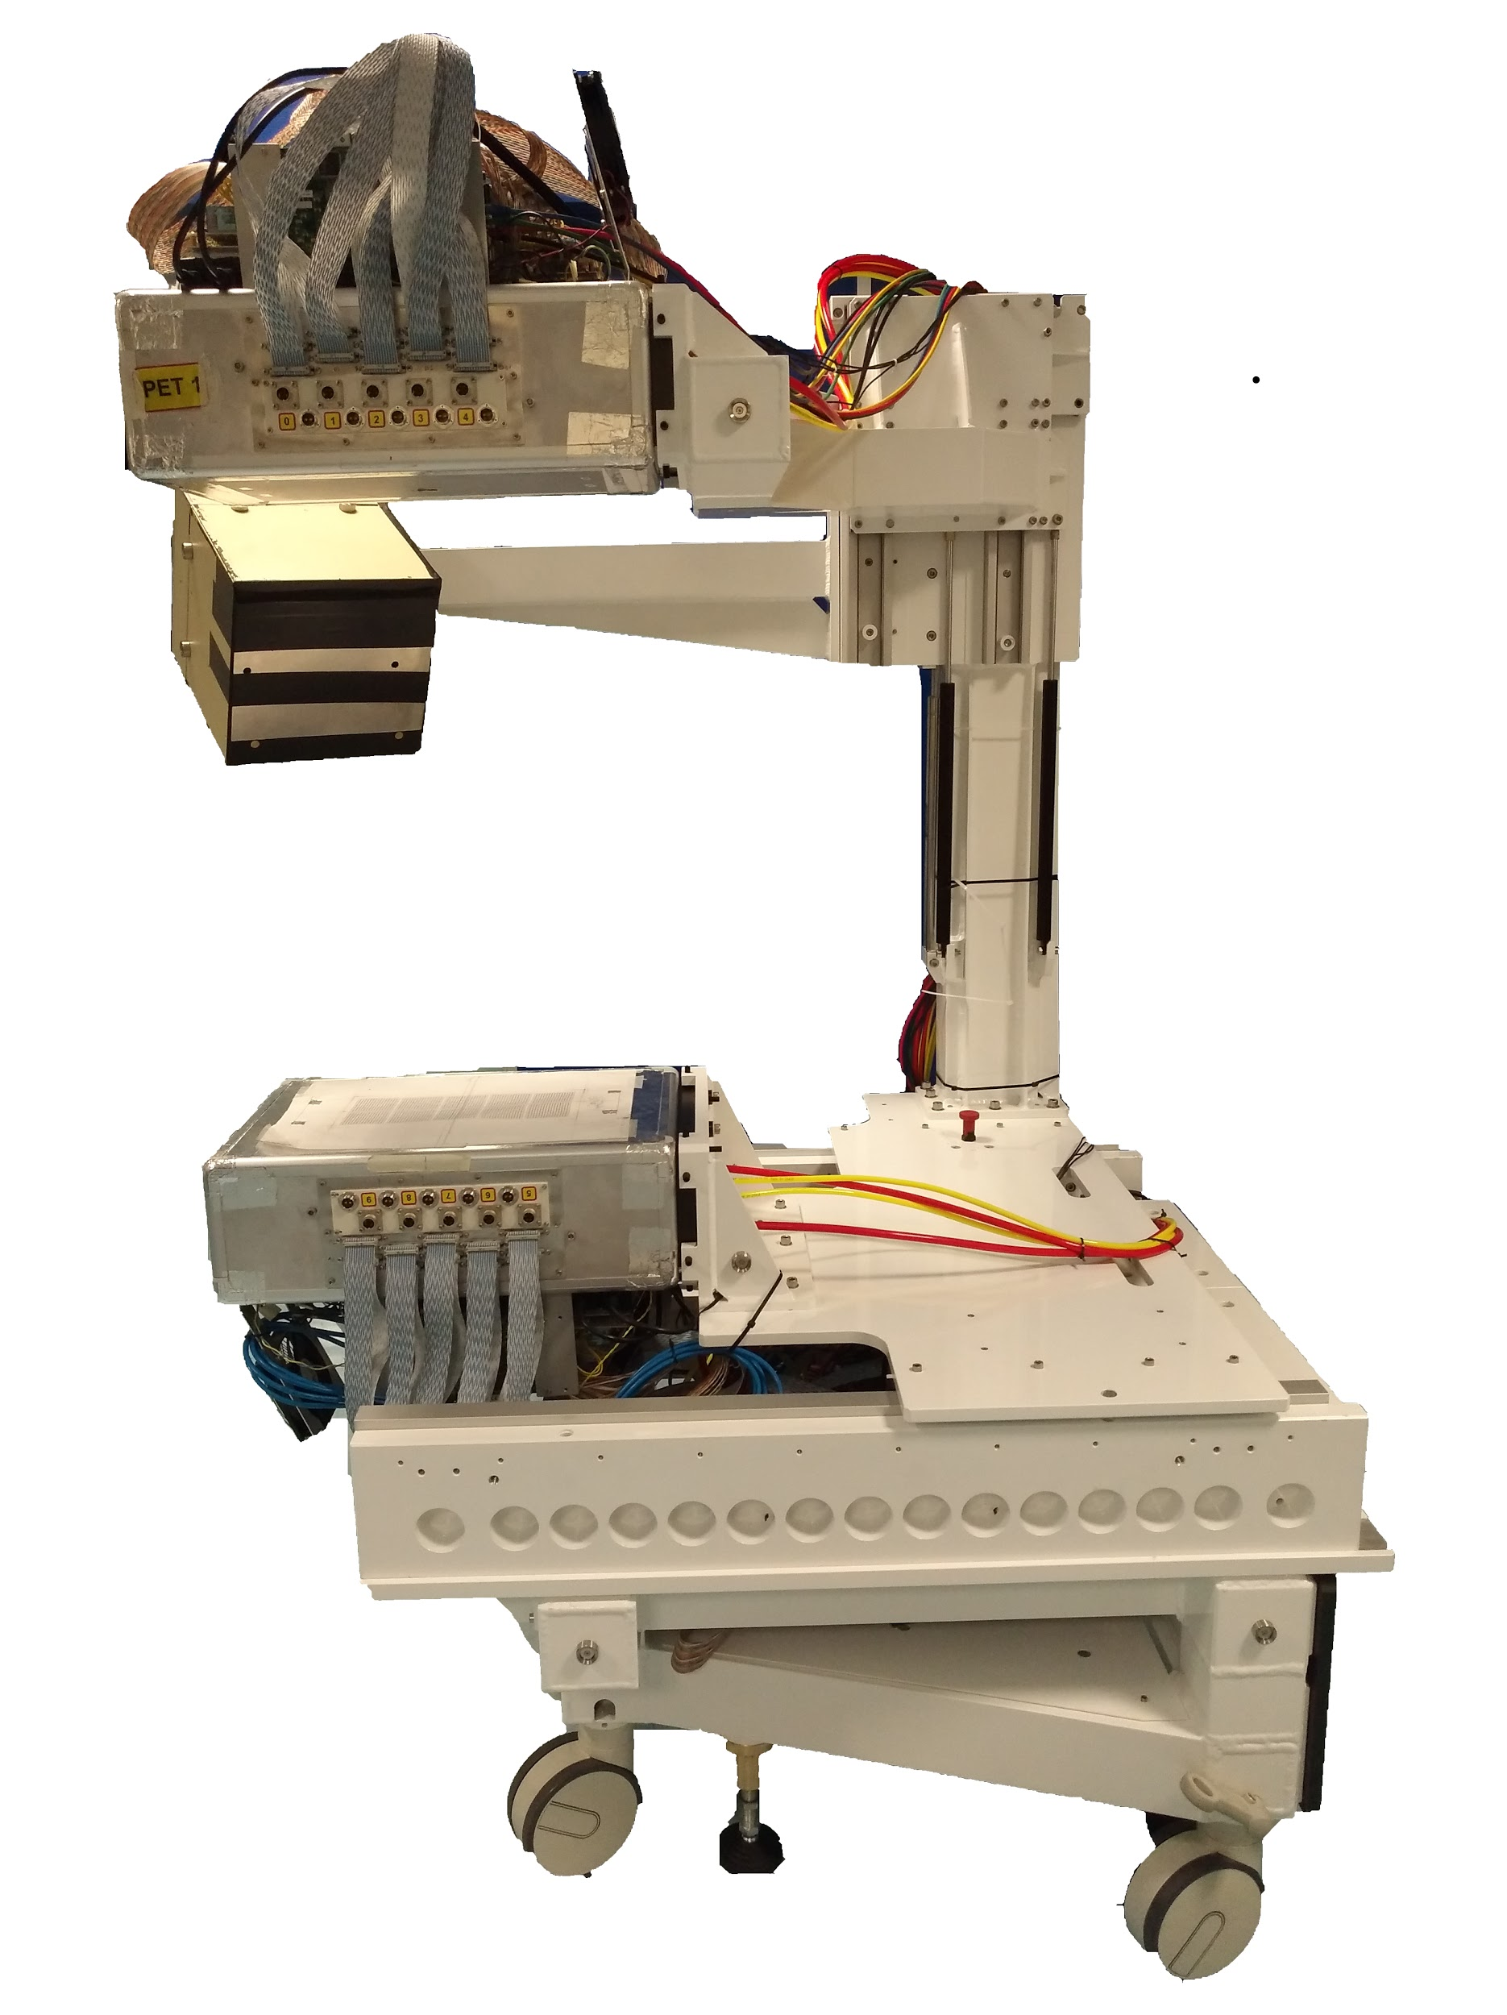
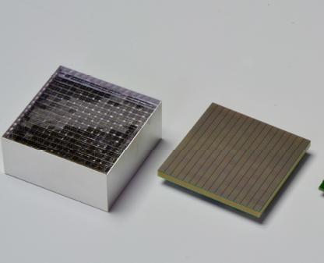
IN-BEAM PET
PET modules
256 Luthetium Fine Scintillating
(LFS) pixel crystals (3 x 3 x 20mm³) coupled to SiPMs
PET panel
2x5 modules
active area = 10 x 25 cm² @ 30
cm from the isocenter
Main features
coincidence window = 2 ns
CTR (Ge68) = 1.2 ns FWHM
Avg energy resolution = 13%
image reconstruction method: MLEM
M.G. Bisogni, et al.,
Journal of Medical Imaging 4(1), 2017
Notes:
8 XY planes with 2 cm spacing. Each plane made of 2 stereo layers of 192 (384) 0.5x0.5 mm² square scintillating fibers
2x0.5 mm squared fibers read out by Hamamatsu 1mm² SiPM : S12571-050P
32 SiPM feed a 32 ch ASIC BASIC32
10 x 25 x 2 cm³
2560 acq chns/head
Distance from the
isocenter=30 cm

Slide 20
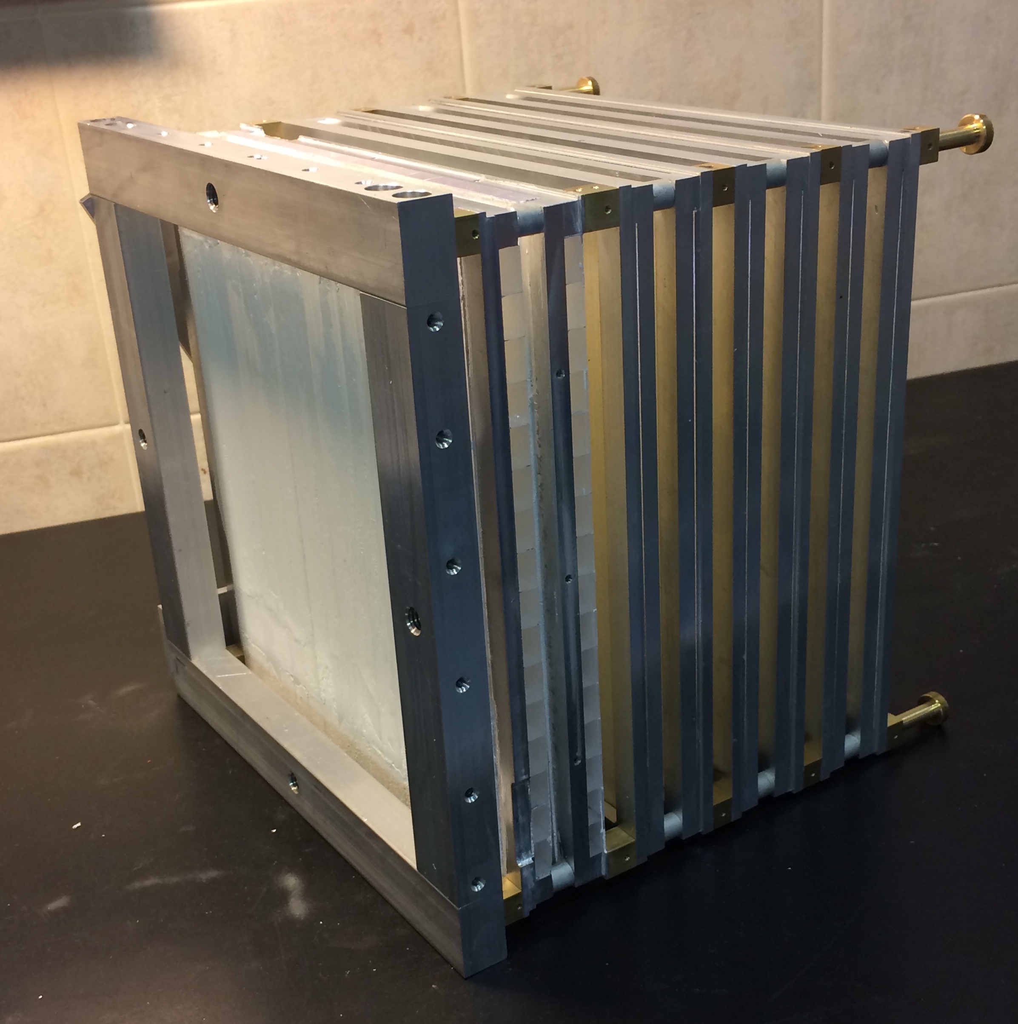
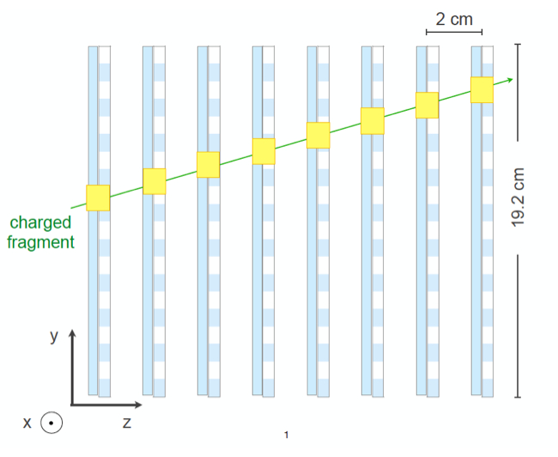
DOSE PROFILER
DP planes
orthogonal BCF-12 square
scintillating fibres (0.5 x 0.5 x 192 mm³)
read out by SiPMs (1 x 1 mm²)
DP box
8 planes
entrance window = 19.2 x 19.2 cm²
@ 60° wrt the beam direction
@ 50 cm from the isocenter
Traini G, et al.,
Physica Medica 2019
Main features
Synchronization with Dose Delivery System signal
Image reconstruction method: backtracking with Hough Transform and Point Of Closest Approach
Notes:
8 XY planes with 2 cm spacing. Each plane made of 2 stereo layers of 192 (384) 0.5x0.5 mm² square scintillating fibers
2x0.5 mm squared fibers read out by Hamamatsu 1mm² SiPM : S12571-050P
32 SiPM feed a 32 ch ASIC BASIC32
10 x 25 x 2 cm³
2560 acq chns/head
Distance from the
isocenter=30 cm
The 1D emission spatial distribution along the beam axis (z in the reference frame) is built for each PB delivered in the treatment
A statistical comparison between single PB spectra would be too sensible to fluctuations (~300 tracks per PB). PBs belonging from the same target volume of 1cm x 1cm x 0.6 cm have been summed up in order to create Super Pencil Beams (SPB).

Slide 21
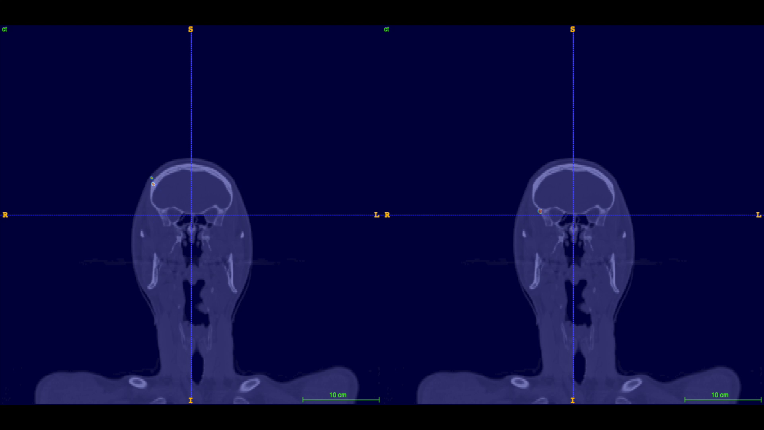
INSIDE: in-beam PET
Carcinoma of the lacrimal gland
3.7 10¹⁰ protons
[66.3, 144.4] MeV/u (28-29)/30 fractions, 2.2 GyE
Vertex field
240 s treatment + 30 s after-treatment of data acquisition
DAY 1
DAY 2
V. Ferrero et al., “Online proton therapy monitoring: clinical test of a Silicon-photodetector-based in-beam PET”
Scientific Reports, (2018) 8:4100
compare
E. Fiorina et al,
Front. Phys. 2021
F. Pennazio et al. :Phys.Med. Biol.63 2018
Notes:
Carcinoma of the lacrimal gland
3.7 10¹⁰ protons
[66.3, 144.4] MeV/u
(28-29)/30 fractions, 2.2 GyE
Vertex field
240 s treatment + 30 s after-treatment of data acquisition

Slide 22




Observational clinical trial
Inter-Fractional
comparison
Day 2
day 3
day 1
Day 3
day 2
day 3
First 20 patients
2019-2020
21
ClinicalTrial.gov id: NCT03662373
day N
21

Slide 23



in-beam PET
ACC (adenocortical carcinoma ) patient
range detection methods compared for patient subject to small anatomical changes (BEV, MLS)
E. Fiorina et al,
Front. Phys. 2021
M. Moglioni et al,
Frontiers in Oncology 2022

Slide 24


Dose profiler
v1
Production points of the fragments obtained as Points of Closest Approach (PCA) of the reconstructed track with the nominal incoming beam direction
PCA
r_{min}
Beam
v2
Carbon beam
Fragment emission distribution
Dose
0
0
¹²C beam
5
5
10
10
y (cm)
y (cm)
15
15
M. Fischietti et. a., Inter-fractional monitoring of ¹²C ions treatments: results from a clinical trial at the CNAO facility, Scientific Reports 10, 20735 (2020)
20
20
25
25
30
courtesy of M. Fischetti
30
0 5 10 15 20
0 5 10 15 20
z (cm)
z (cm)

Slide 25








SYNCT
AI-driven synthetic imaging for PET monitoring in hadron-therapy
Bando Finanziamenti per l'alta formazione con l'attivazione di assegni di ricerca 2021
Regione Toscana
PI: Giancarlo Sportelli, UNIPI e INFN Pisa

Slide 26


Correlazione fra immagini PET e cambiamenti morfologici
Esempio di immagini PET in-beam e CT acquisite durante la 2ª e 34ª frazione. L'immagine PET a destra mostra una code più lunga nella direzione del fascio dovuta al cambiamento morfologico.
Schema a blocchi semplificato della prima architettura di generazione di una CT sintetica (a destra) a partire dalla CT di controllo (in basso a sinistra) e di una PET in-beam (in alto a sinistra)

Slide 27

Architettura di seconda generazione: visual transformers
L’immagine viene spezzata in più patch e ciascuna patch viene passata attraverso un encoder di tipo transformer
L'architettura è analoga a quella usata nei modelli LLM (tipo ChatGPT) per la generazione di testo

Slide 28



Risultati preliminari ottenuti con visual transformers su dati simulati
CT pianificazione
CT predetta
CT controllo
Slice non vista in addestramento. Paziente non visto in addestramento. SSIM: 0.952
Notes:
indice di similarita strutturale

