Slide 1
The Astro-particle Physics experiments at LNS covers a wide range physics goals in a long-range programme of science
Members of CSN-2 at LNS are constantly growing in number and responsibilities
Role of LNS in international experiments is solid and respected
Lownoiser- HEU
Geoinquire - HEU
Dark Matter
DarkSide /ReD
FOCUS - ERC
ReD+ -PRIN
Dives - PRIN
Melite -NATO
ITINERIS-PNRR
NATURE-PN IR
NAUTILUS – PN IR
ETIC-PNRR
PN IR
KM3NeXT – IR Sicilia
KM3NeT4RR-PNRR
Infradev 2 – HEU
Alica - PRIN
Cosmic Neutrinos
KM3NeT
Gravitational Waves
Einstein Telescope

Slide 2
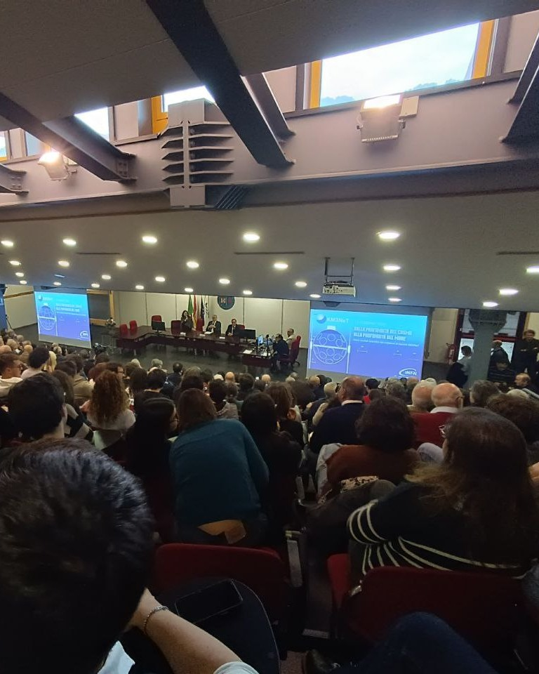
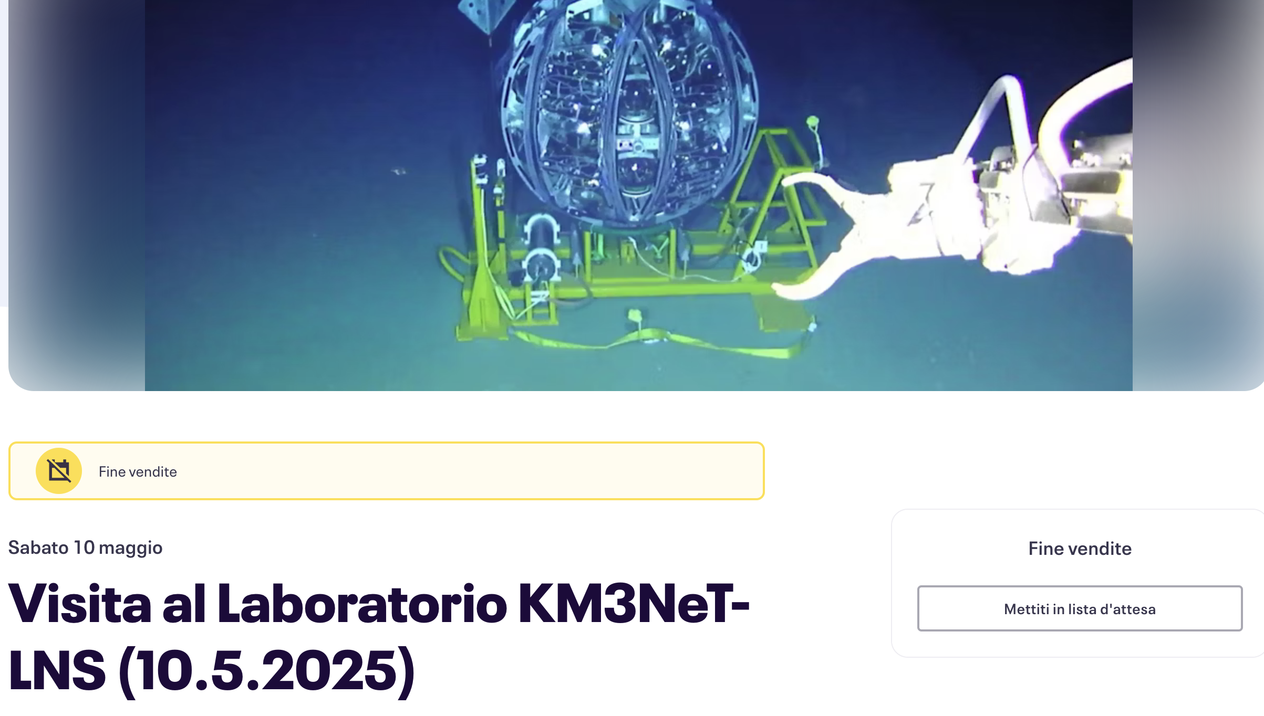
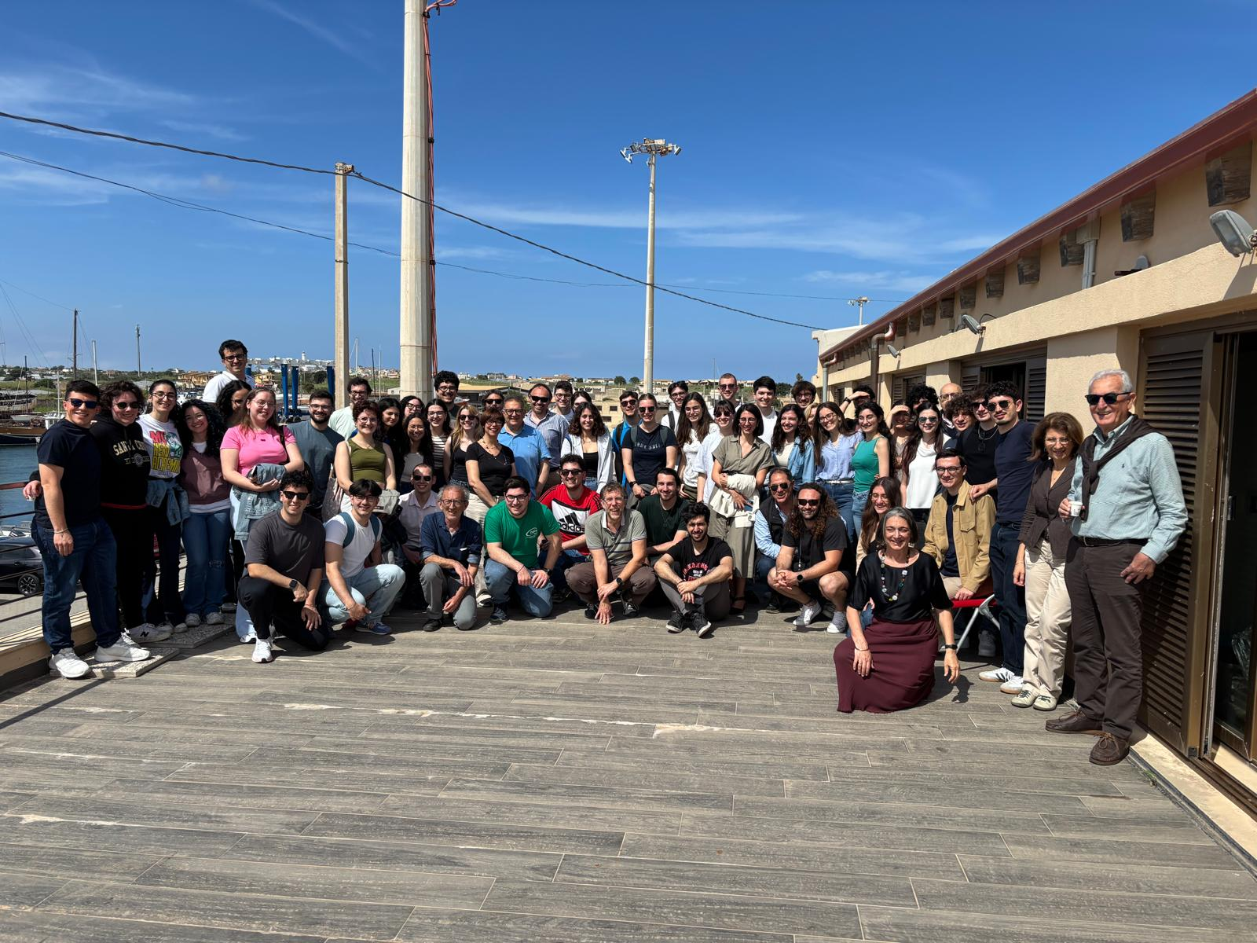
Gruppo 2- DFA Strengthening Collaboration
Dalle profondità del cosmo alle profondità del Mediterraneo
mercoledì 12 feb 2025, 16:15
Visit the ARCA Shore Station:
50 Students from the Dept. of Physics and Astronomy
University of Catania

Slide 3
INFN Gruppo 2 – Education/Training
Theses (completed in 2025):
Karim Hesahm
Maria Rita Torrisi
Visiting Erasmus
Carlos Quiroz (IFIC) 01-04 2025
Mathilde le Pape (Univ. Brest, DFA) 06-09 2025
Borse CSN2:
2024 – 1 Darkside, 1 KM3NeT (positioning) sep 2025
2024 – 1 Darkside, 1 KM3NeT (positioning) sep 2025

Slide 4
Astro Particle Physics at LNS
2020
2025
2030
2035
KM3NeT
Actual Phase: Construction, operation, data analysis
Main science cases: neutrino astronomy (multimessenger),neutrino fundamental physics
Large increase with PNRR
Science on Stage!
ET
Actual Phase: R&D
main science cases: Gravitational waves detection (multimessenger)
LNS plays a major role in civil works
Scientific component from LNS stable
DarkSide (ReD)
Actual Phase: Transition from R&D to Construction
Main science case: Dark Matter detection (multimessenger)
39 Persons
25.1 FTE
42 Persons
29.1 FTE
TBD
2024
2025
2026

Slide 5
KM3NeT cross disciplinary spin-offs
Marine Hazard (S. Biagi & A. Orlando)
Seismic Station @Capo Passero infrastructure
Since 2025 part of the INGV seismic network.
Connected to CFT2, 1 beacon used also for the Capo Passero LBL
Impact for LNS: negligible. The only interface is KM3NeT
FOCUS-ERC (M-A Gutscher Univ. Brest PI, G. Riccobene INFN PI) ends in 2025 – data harvesting continues
Monitoring of seismic phenomena with Brillouin Optical time reflectometry using the fibers of the subsea cable of the Port of Catania Test Site
approx. 2 papers/year published
First Bruillon OTDR permanently connected in Med Sea.
1 Post Doc hired at LNS (Didac). Overheads to LNS Director
Impact for LNS: 20k€ overheads
LNS must ensure proper quality of services in Catania Test Site (power, proper room for DAQ, air conditioning, access to cable end)
ECCSEL-ERIC: IPANEMA (A. Orlando & S. Viola) – ends in 2025 – data harvesting continues
Monitoring of CO2 with acoustic antennas and chemical sensors
two stations: Panarea (20 m depth- in operation), Catania (2100 m depth, Sep 2024)
Acoustic data now in the Italian Integrated Ocean Sound Subsystem (ITINERIS)
2 post docs hired (Letizia- now CSFNSM, Abdel)
Impact for LNS: Ensure proper quality of services in Catania Test Site (power, proper room for DAQ, air conditioning, access to cable end)

Slide 6
KM3NeT cross disciplinary spin-offs
EMSO-JRU (G Riccobene & S. Viola, INFN Reps)
INFN in the EMSO-ERIC
Major player in the context of marine scientific policy in Italy
Impact for LNS: + 40k€ funding / year (increasing). Ensure access to INGV personnel (admin) and DAQ systems at port of Catania (IT)
JRU General assembly at LNS (2025)
PNRR-ITINERIS (G. Pappalrdo CNR PI, G. Riccobene PI INFN) ends in 2025
Seafloor data “e-highway” in Capo Passero; access for the new EMSO cable in Catania
Ocean Sound Sub System: LNS is the developer and organiser of the Italian marine sound data network
1 JB
2 TDs ( Simone, Danilo)
Impact for LNS: admin tendering, access to INGV at the port of Catania new building (ITINERIS EMSO MEOC)
Training Course at Capo Passero (2024)
PNIR- NATURE(G. Pappalrdo PI CNR, G. Riccobene PI INFN), if approved 2026-2029
EMSO platform in Capo Passero and Access to industries, improvement of the IT-OSSS
10 days sea operations
computing resources improvement in Catania, Capo Passero and LNS
1 Seafloor multidisciplinary observatory (CTD, ADCP)
1 TD to be hired
Impact for LNS: IT services, admin (tendering)

Slide 7
KM3NeT cross disciplinary spin-offs
Geo-Inquire EU (K. Fleming PI, GFZ, G. Riccobene PI INFN) – Ends in 2026
Transnational access activity to use optical fibers of the subsea cable at the port of Catania for seismic and volcanic monitoring
DAS digital twin
1 post-doc hired (Giuseppe)
Impact for LNS: + 20k€ overheads + 1 TA September port of Catania (IFERMER Brest+ASN)
Geoinquire School October 2025
Lownoiser (Marine Tech PI, G. Riccobene PI INFN) – Ends in 2028
Use of DAS to measure/mitigate underwater radiated noise from vessels
DAS connected to the Capo Passero MEOC. Already in operation. First DAS dedicated to Marine traffic Monitoring worldwide
1 TD to be hired
1 post doc hired (Giuseppe)
Impact for LNS: admin (minimal) and IT services. Main interface is KM3NeT
Synergic projects with CSFNSM:
Vongola PNRR-NCBF (with Univ. of Palermo)
Use of DAS to detect baleen whales and study effect of shipping noise on cetaceans
DAS connected to the Capo Passero MEOC. Already in operation
Impact for LNS:
LNS must ensure proper quality of services in Catania Test Site (power, proper room for DAQ, air conditioning, access to cable end)
Sound PNRR-INEST (with OGS and Univ. of Trieste)

Slide 8
KM3NeT Anagrafica
Sigla | Name | % | Sinergy | End | Notes
INGV Porto |  |  |  | 2025 | From 2026 only tech staff
 | Riccobene |  | KM3NeT
 | Larosa |  | KM3NeT
FOCUS |  |  |  | 09/2025
 | Larosa |  | KM3NeT
 | Cocimano |  | KM3NeT
 | Riccobene |  | KM3NeT
Lownoiser |  |  |  | 2028
 | Pulvirenti |  | KM3NeT
 | Giorgio |  | KM3NeT
 | Viola |  | KM3NeT
 | Riccobene |  | KM3NeT

Slide 9
KM3NeT Spese
Sostanzialmente solo acquistì MAC in convenzione
Per Il 2026 vi richiedero’ Programmazione stretta
Missioni: Va fatto un Booking!

Slide 10
KM3NeT cross disciplinary spin-offs
LNS manages the largest marine acoustic infrastructure in Europe
Directly and indirectly operates
hydrophones arrays in Catania and in Capo Passero
1 BOTDR in Catania
1(+1) DAS in Catania and Capo Passero
AIS network (Catania, Capo Passero, Reggio Calabria)
Develops new Techniques
Acoustic Detection of UHE neutrinos

