Slide 1

QuTe FDS
Quantum Teleportation induced
Frequency Dependent Squeezing
Grant Giovani Ricercatori
Responsabile
Andrea Grimaldi
Sede Ospitante
INFN Padova

Slide 2
Project analysis slide 2
Breve introduzione
Einstein Telescope
The new Generation of Gravitational Wave Detectors is aiming to Higher Sensitivity at Low Frequency 8~20Hz.
Improving different aspect of the interferometer:
Suspension, Coating, Vacuum, …
New Detector Configuration: Detuned interferometer
Core collapse supernovae
heavier
systems
Earlier Detection 1 and 20 hours before the merger
warning for
electromagnetic/neutrino
follow-up

Slide 3
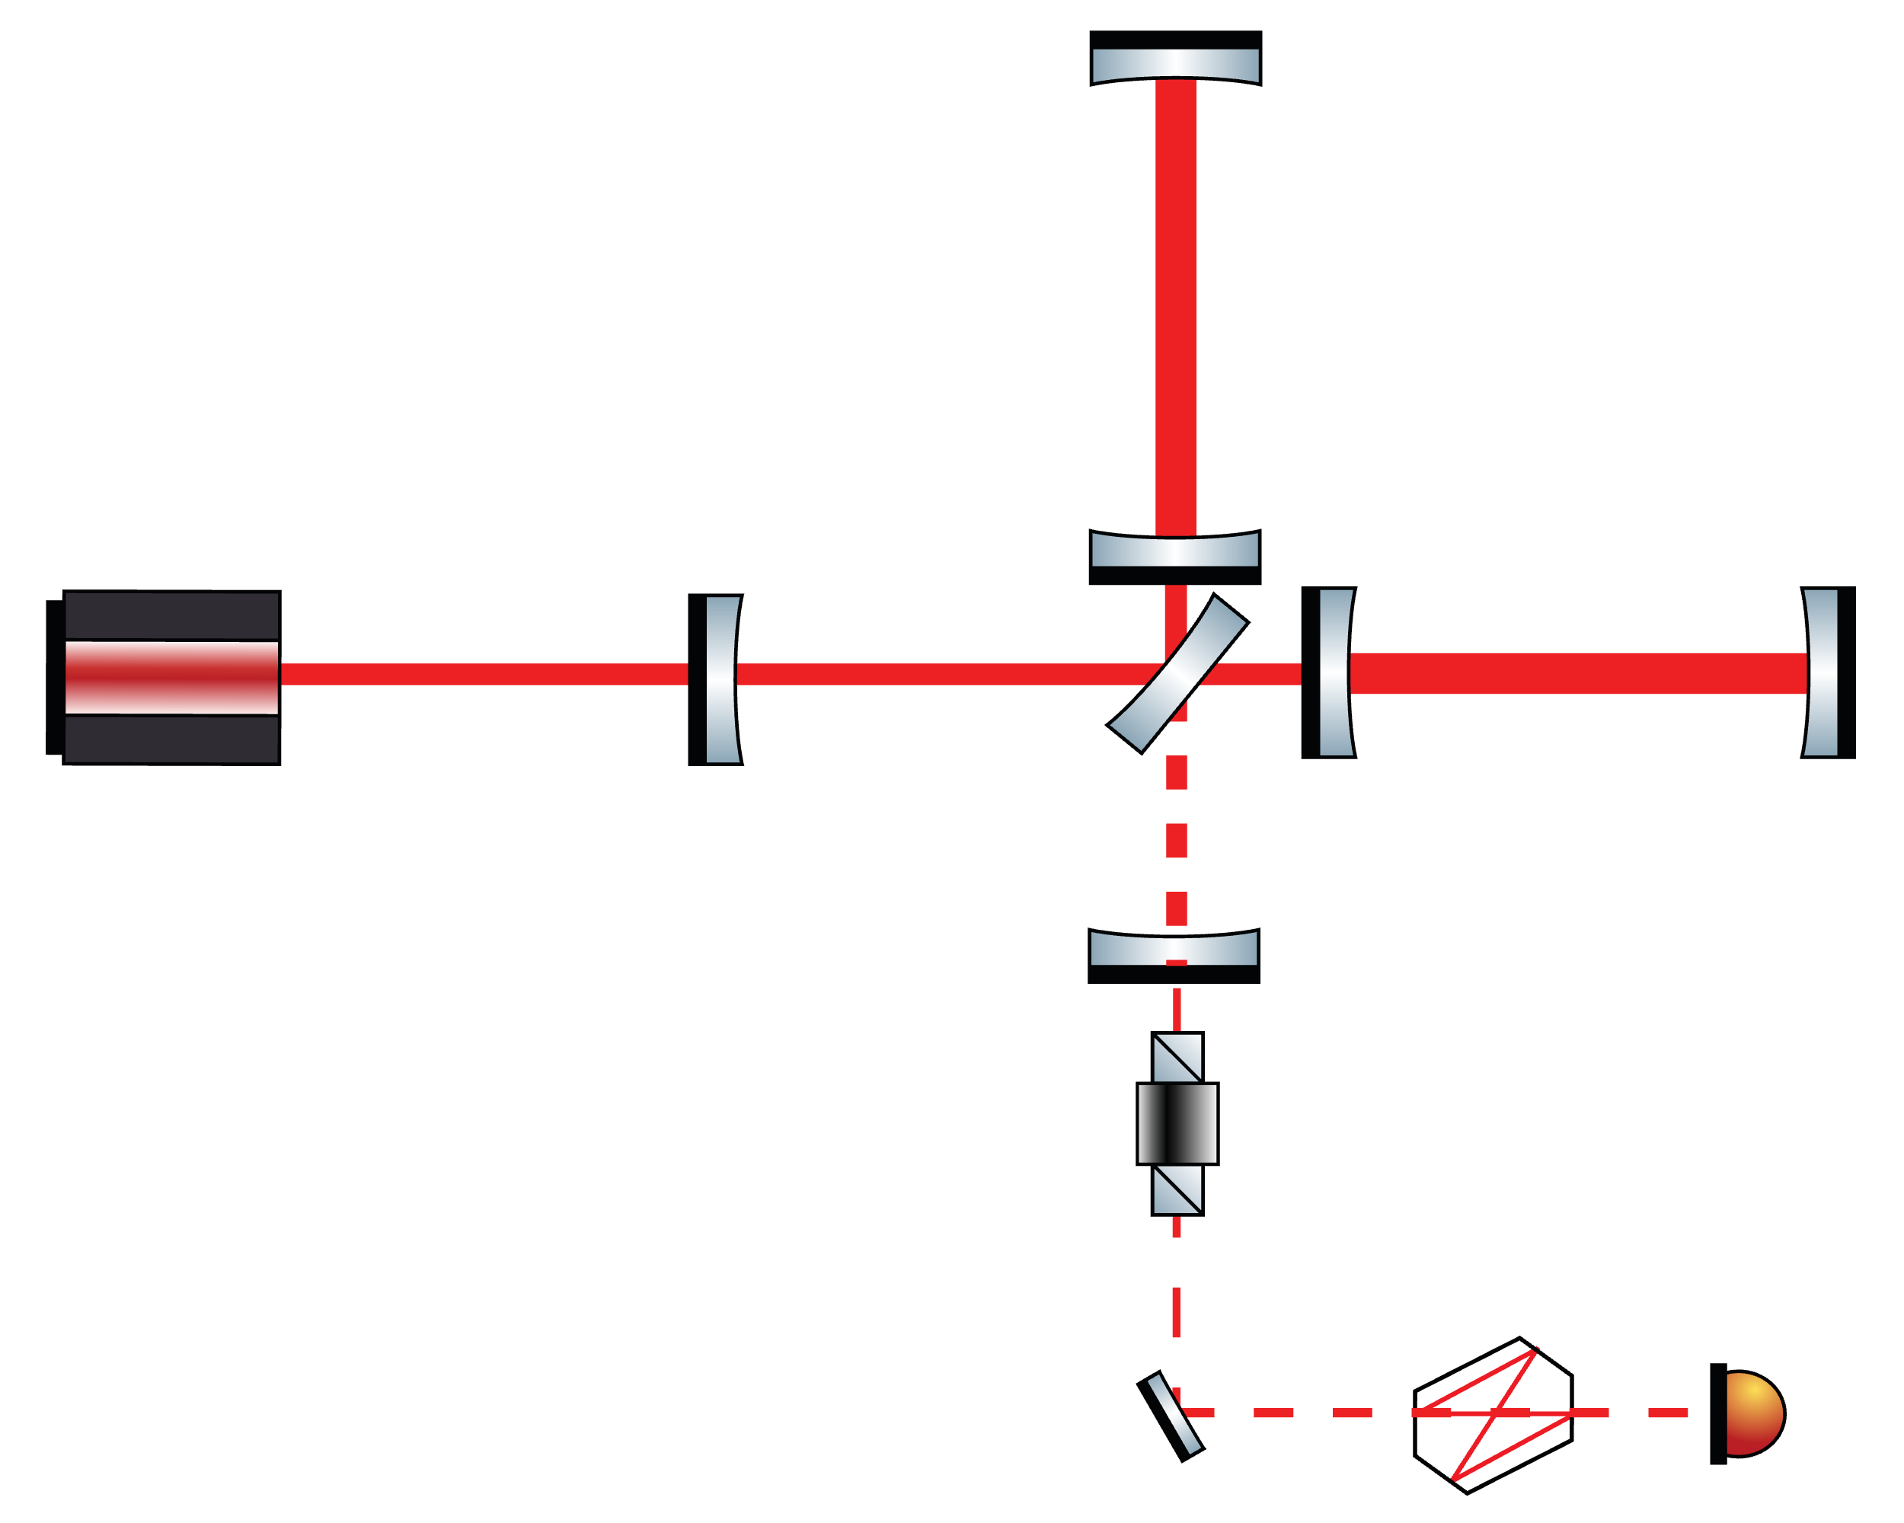
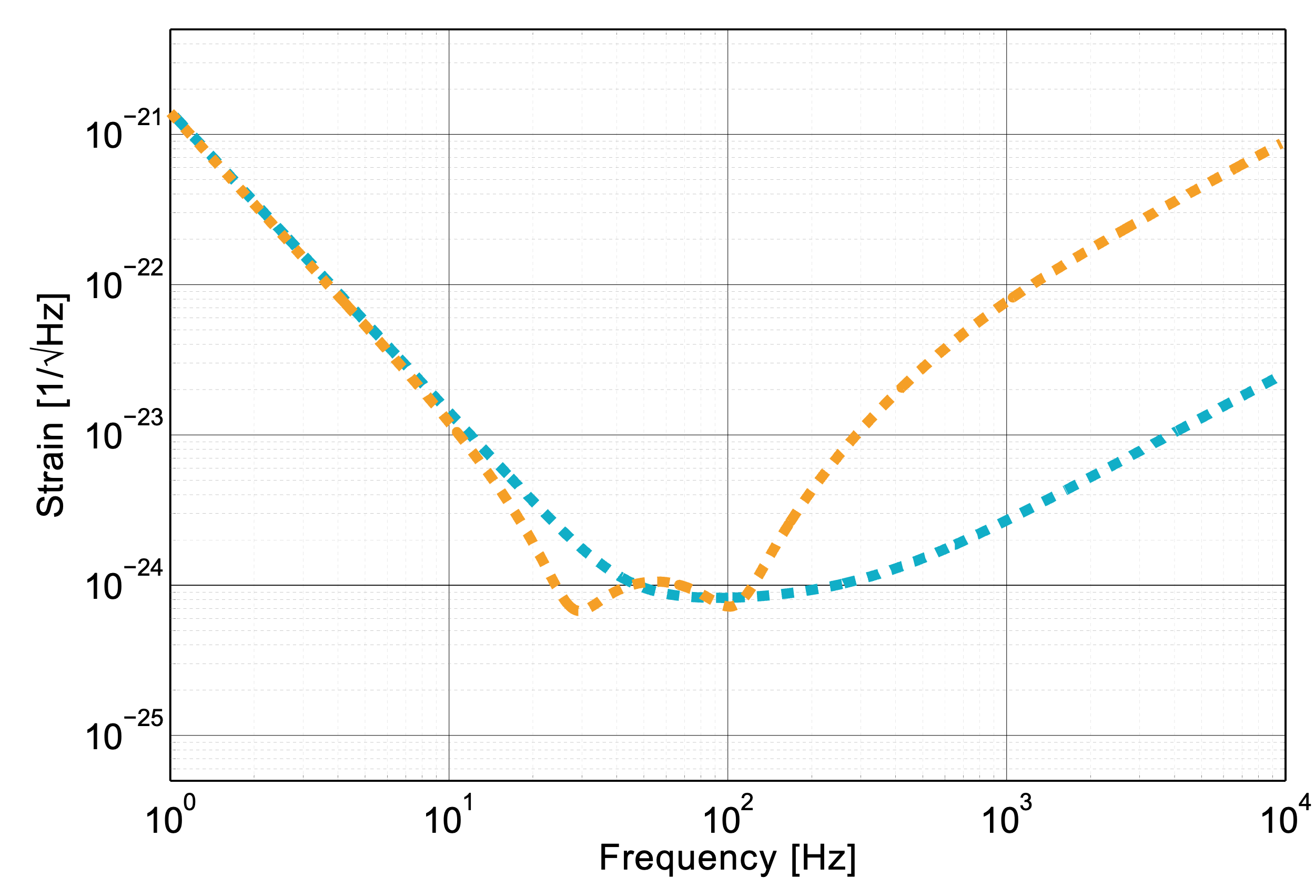
Project analysis slide 2
Breve introduzione
Quantum Noise Reduction
Detuned Configuration
The Signal Recycling Cavity is detuned to enhance Low-Frequency Response
Signal
Recycling
Cavity
Detuned scheme
Tuned scheme
Extra Gain
Complex response
To
Quantum Noise

Slide 4
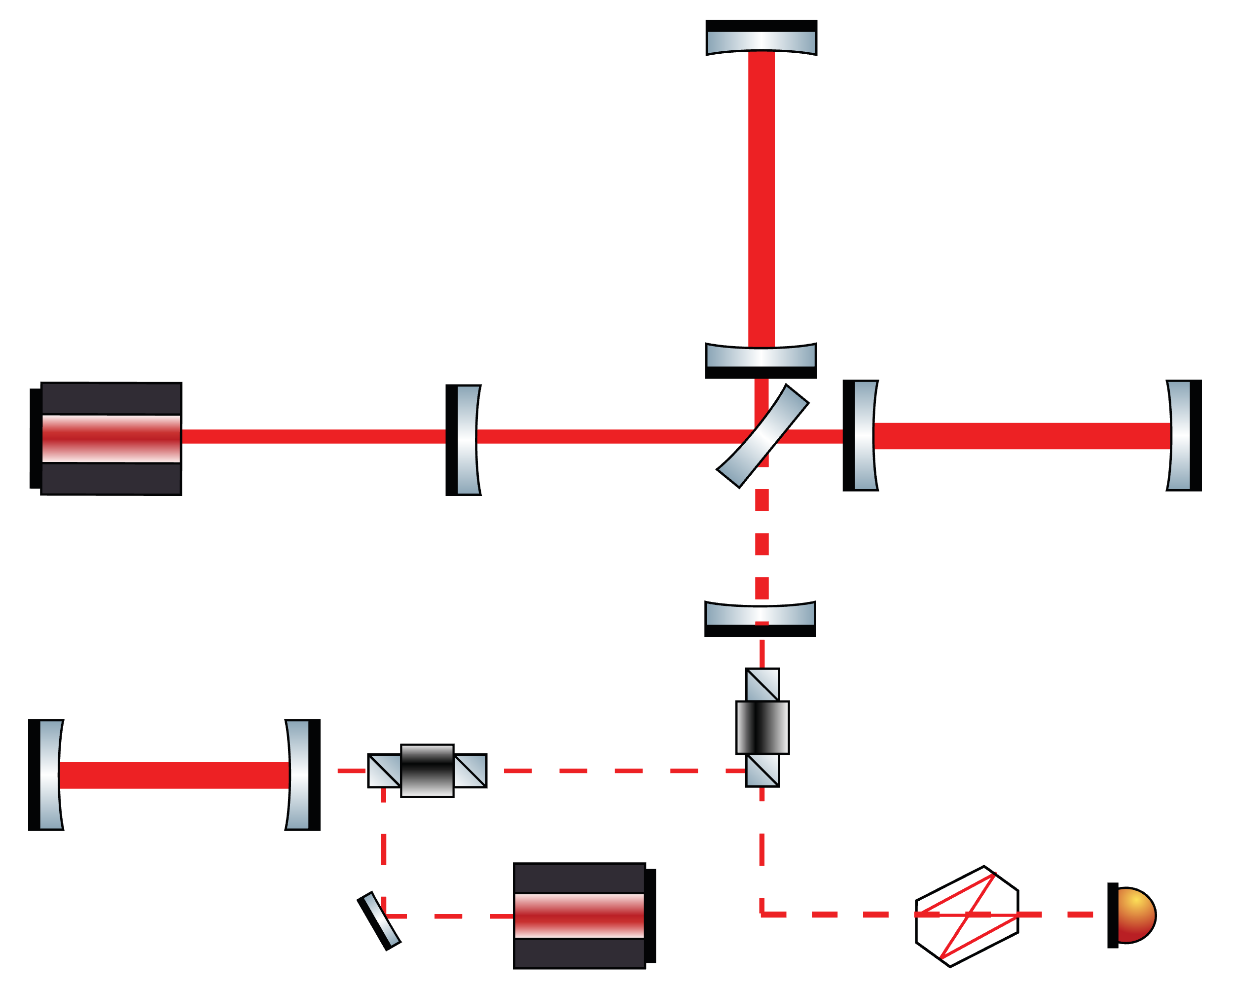
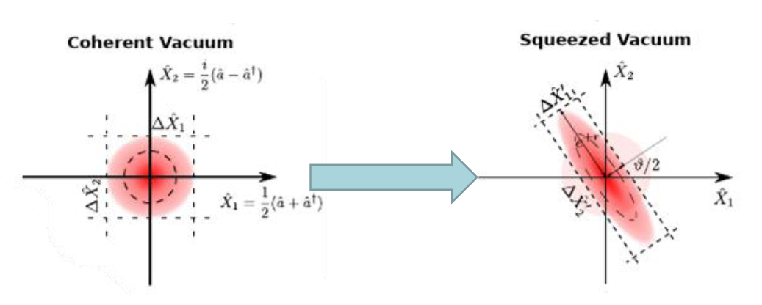
Project analysis slide 2
Breve introduzione
Quantum Noise Reduction
Squeezed Vacuum Injection
Replace the vacuum with
Frequency Dependent Squeezed Vacuum
Squeezed
Vacuum

Slide 5
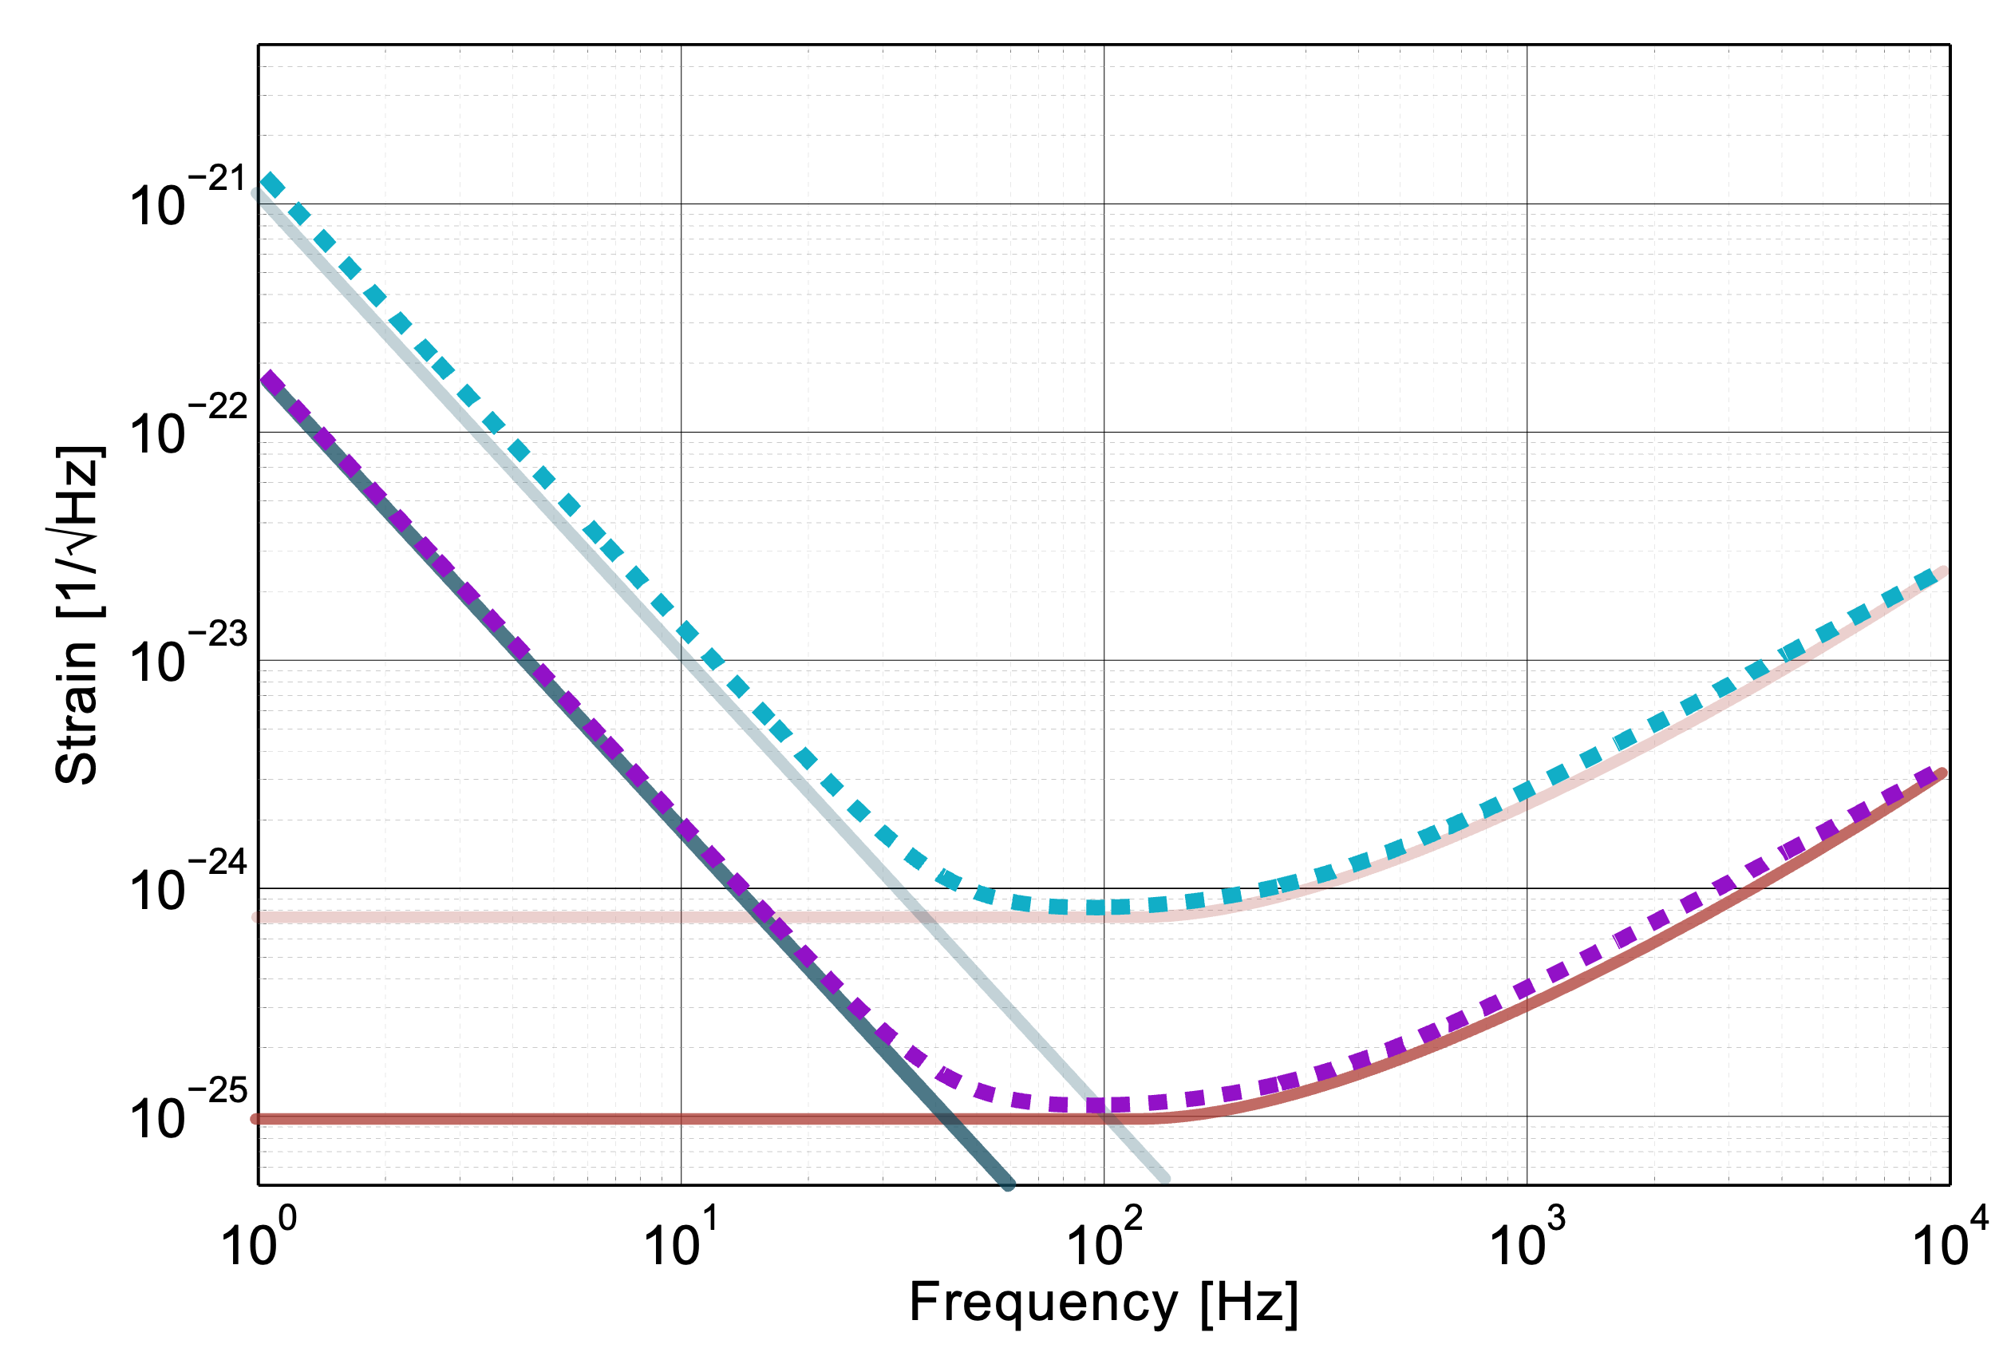
Project analysis slide 2
Breve introduzione
Quantum Noise Reduction
Squeezed Vacuum Injection
Replace the vacuum with
Frequency Dependent Squeezed Vacuum
Tuned scheme
Amplitude Squeezing
Phase Squeezing

Slide 6
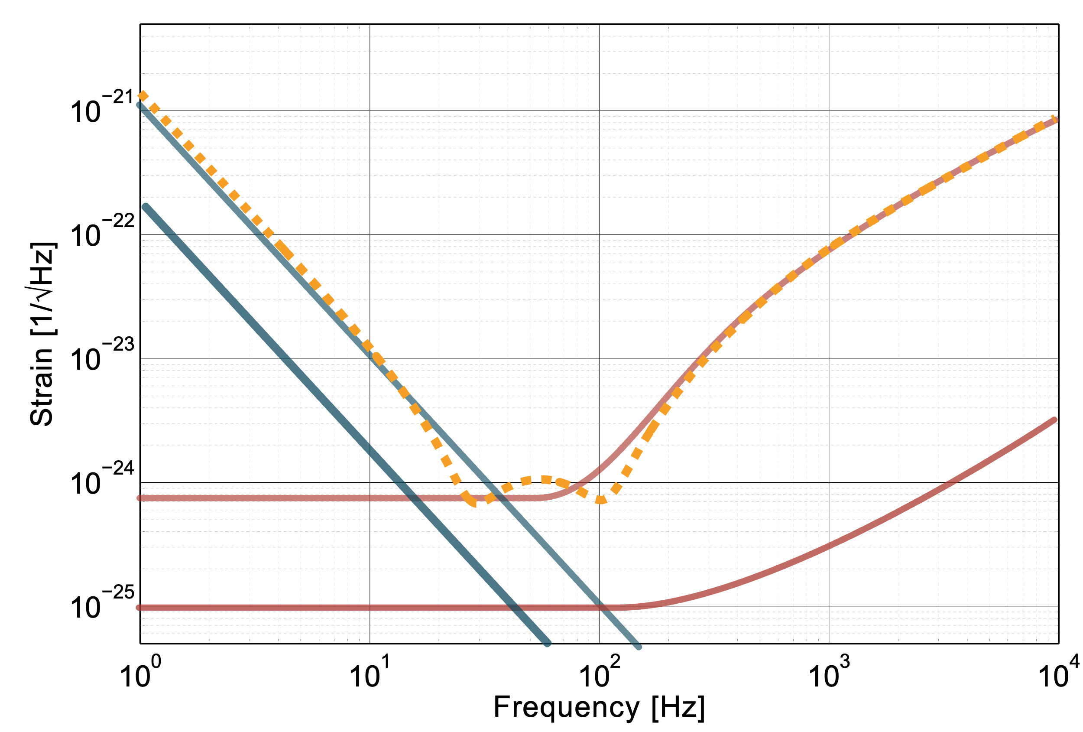
Project analysis slide 2
Breve introduzione
For the Science
Squeezed Vacuum Injection
Replace the vacuum with
Frequency Dependent Squeezed Vacuum
Amplitude Squeezing
Phase Squeezing

Slide 7
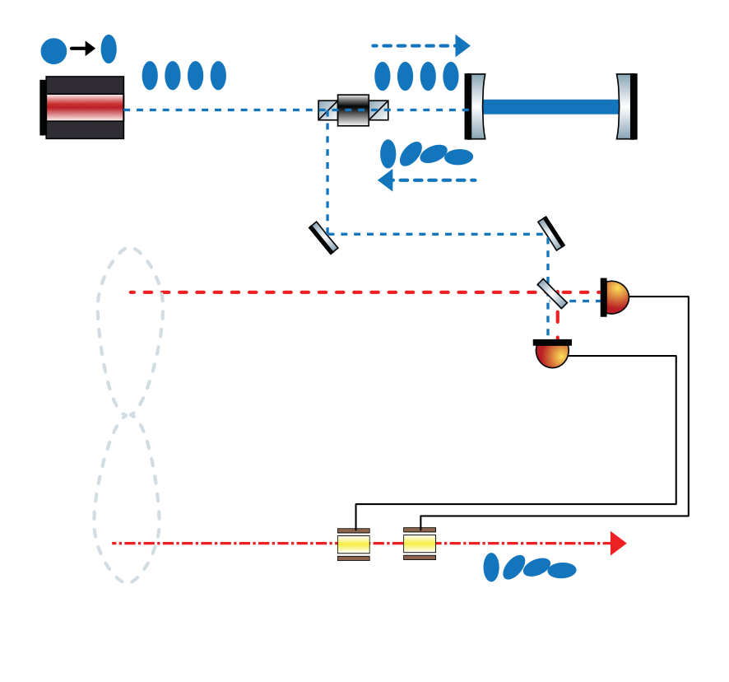
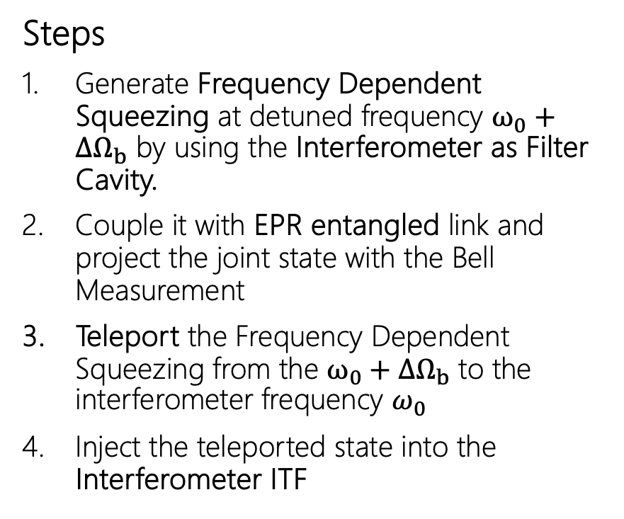


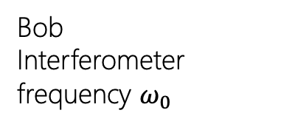
Project analysis slide 2
Breve introduzione
Qute_FDS
Victor
“ITF” as Filter Cavity
Steps
Generate Frequency Dependent Squeezing at detuned frequency $ω_{0}+{ΔΩ}_{b}$ by using the Interferometer as Filter Cavity.
Couple it with EPR entangled link and project the joint state with the Bell Measurement
Teleport the Frequency Dependent Squeezing from the $ω_{0}+{ΔΩ}_{b}$ to the interferometer frequency $ω_{0}$
Inject the teleported state into the Interferometer ITF
$$ω_{0}+{ΔΩ}_{b}$$
Squeezing
Source
Bell State
Measurement
Alice
$$ω_{0}+{ΔΩ}_{a}/2$$
EPR entangled
“ITF” as Filter Cavity
ITF
Bob
Interferometer frequency $ω_{0}$
Notes:
4:22

Slide 8
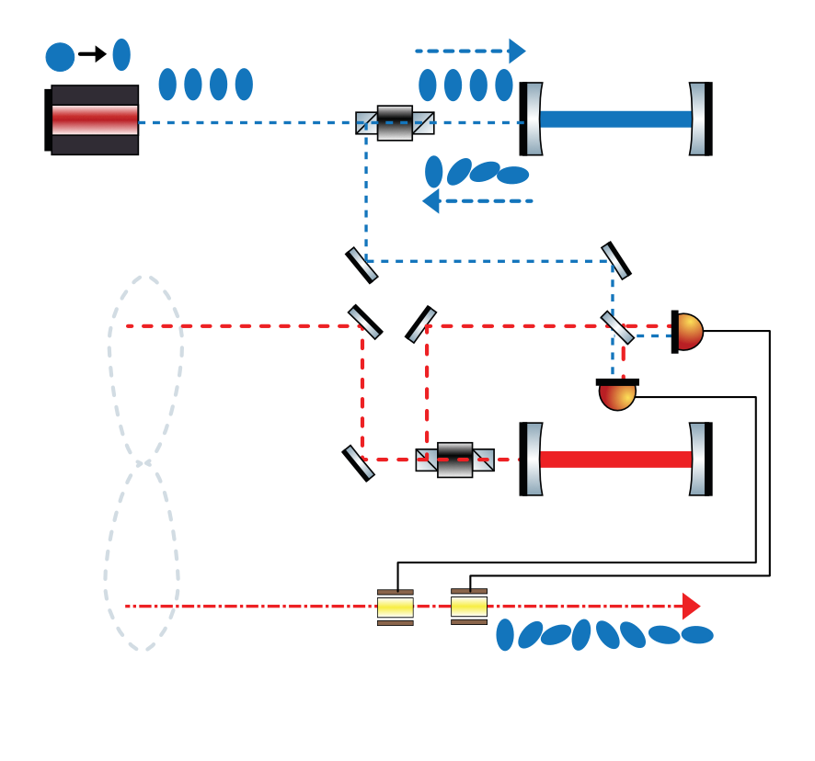
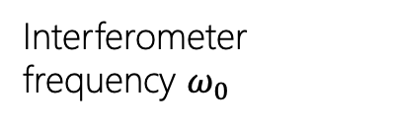

Project analysis slide 2
Breve introduzione
Qute_FDS
$$ω_{0}+{ΔΩ}_{b}$$
“ITF” as Filter Cavity
Table-Top Experiment
Interferometer replaced by a Linear Cavity
Phase Rotations around 1MHz
Double Rotation measured by Tomography of the final state
Squeezing
Source
Bell State
Measurement
EPR entangled
Interferometer frequency $ω_{0}$

Slide 9





Project analysis slide 7
Breve introduzione
2025
2026
2027
2025
1 | 2 | 3 | 4 | 5 | 6 | 7 | 8 | 9 | 10 | 11 | 12 | 13 | 14 | 15 | 16 | 17 | 18 | 19 | 20
M1 |  |  |  |  | M2 |  |  | M3.1 |  |  | M3.2 |  |  | M4.1 |  |  | M4.2 |  | M4.3
EPR SQUEEZING SOURCE
MULTILMODE SQUEEZING
TELEPORTATION
Milestones
M1 Final design of the optical setup and place the order for the custom optics.
M2 Measurement of two-mode squeezing
M3.1 Measurement of single mode squeezing
M3.2 Measurement of the benchmark defined in M2 and M3.1 simultaneously.
M4.x Measurement of Frequency-Dependent Squeezing

Slide 10
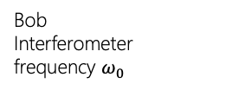


Project analysis slide 7
Stato attività
Simulations and Desing
Victor
2025
Simulate and design the optical setup.
The WP1 is dedicated to:
T1.1 Re-adapt the protocol presented to a tabletop experiment.
$$ω_{0}+{ΔΩ}_{v}$$
1 | 2
M1
Alice
$$ω_{0}+{ΔΩ}_{a}/2$$
Bob
Interferometer
frequency $ω_{0}$

Slide 11

Project analysis slide 7
Stato attività
Simulations and Desing
Victor
2025
Simulate and design the optical setup.
The WP1 is dedicated to:
T1.1 Re-adapt the protocol presented to a tabletop experiment.
  Optical frequencies are defined. ${(ΔΩ}_{v}=0.5 MHZ; {ΔΩ}_{a}={OPO}_{fsr}−1.5 MHZ; {OPO}_{fsr}≃800MHz)$
  Requirement on Test Cavity are defined ($losses<150\frac{ppm}{m};HWHM<500 kHz;FSR≃50MHZ$)
$$ω_{0}+{ΔΩ}_{v}$$
1 | 2
M1
Alice
$$ω_{0}+{ΔΩ}_{a}/2$$
Bob
Interferometer
frequency $ω_{0}$

Slide 12
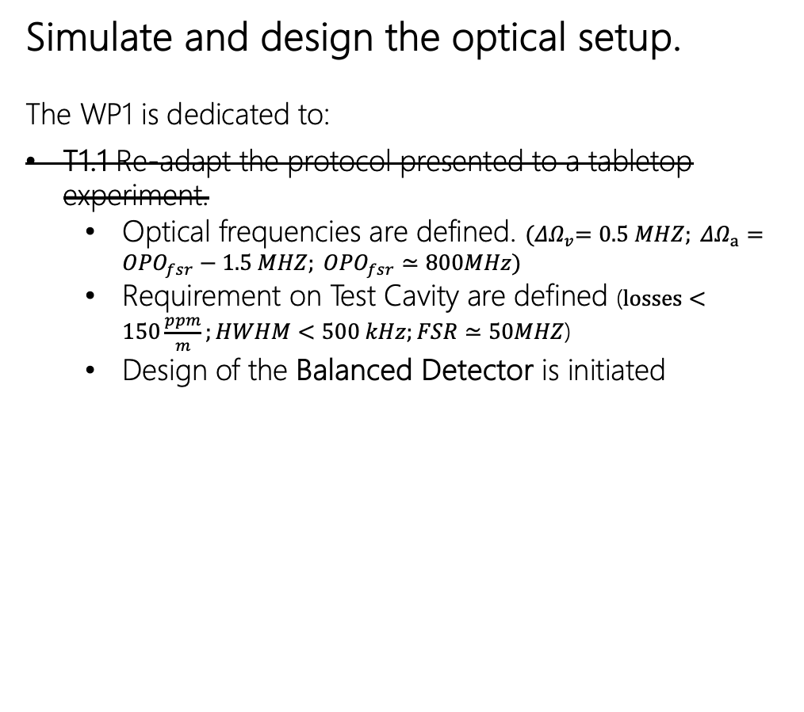
Project analysis slide 7
Stato attività
Simulations and Desing
Victor
2025
Simulate and design the optical setup.
The WP1 is dedicated to:
T1.1 Re-adapt the protocol presented to a tabletop experiment.
  Optical frequencies are defined. ${(ΔΩ}_{v}=0.5 MHZ; {ΔΩ}_{a}={OPO}_{fsr}−1.5 MHZ; {OPO}_{fsr}≃800MHz)$
  Requirement on Test Cavity are defined ($losses<150\frac{ppm}{m};HWHM<500 kHz;FSR≃50MHZ$)
  Design of the Balanced Detector is initiated
$$ω_{0}+{ΔΩ}_{v}$$
1 | 2
M1
Alice
$$ω_{0}+{ΔΩ}_{a}/2$$
Bob
Interferometer
frequency $ω_{0}$

Slide 13
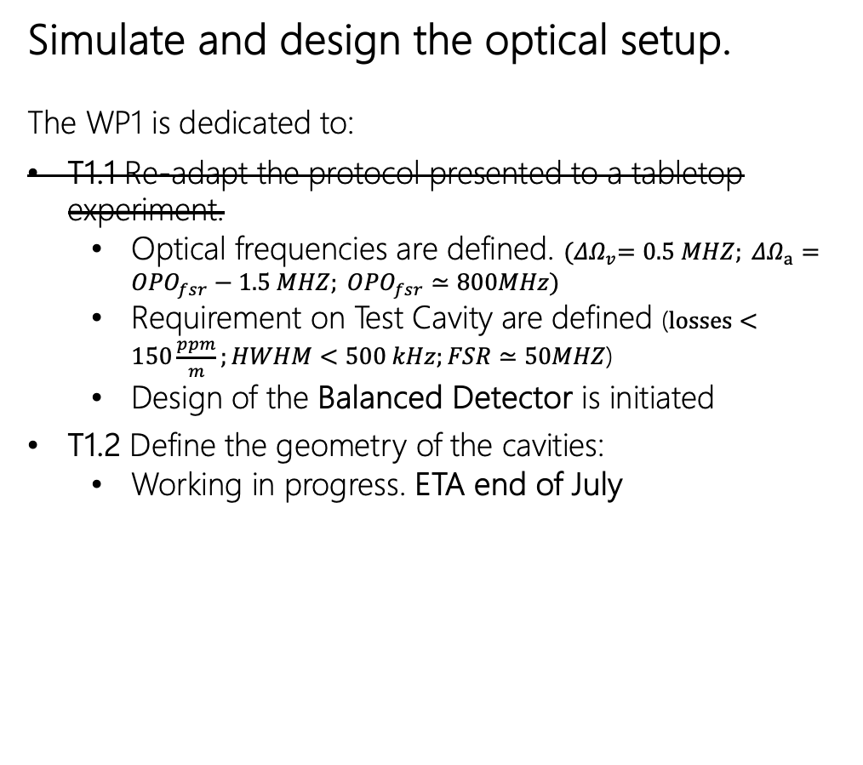
Project analysis slide 7
Stato attività
Simulations and Desing
Victor
2025
Simulate and design the optical setup.
The WP1 is dedicated to:
T1.1 Re-adapt the protocol presented to a tabletop experiment.
  Optical frequencies are defined. ${(ΔΩ}_{v}=0.5 MHZ; {ΔΩ}_{a}={OPO}_{fsr}−1.5 MHZ; {OPO}_{fsr}≃800MHz)$
  Requirement on Test Cavity are defined ($losses<150\frac{ppm}{m};HWHM<500 kHz;FSR≃50MHZ$)
  Design of the Balanced Detector is initiated
T1.2 Define the geometry of the cavities:
  Working in progress. ETA end of July
$$ω_{0}+{ΔΩ}_{v}$$
1 | 2
M1
Alice
$$ω_{0}+{ΔΩ}_{a}/2$$
Bob
Interferometer
frequency $ω_{0}$

Slide 14
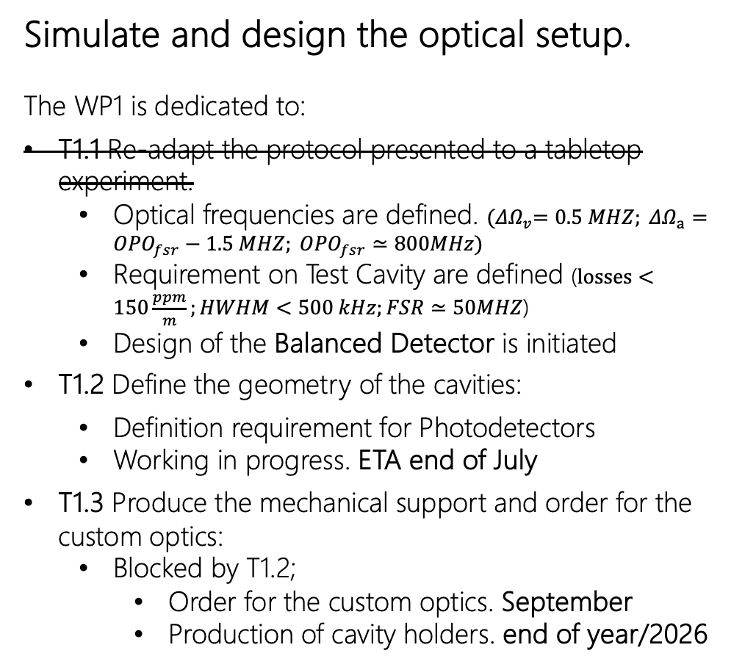
Project analysis slide 7
Stato attività
Simulations and Desing
Victor
2025
Simulate and design the optical setup.
The WP1 is dedicated to:
T1.1 Re-adapt the protocol presented to a tabletop experiment.
  Optical frequencies are defined. ${(ΔΩ}_{v}=0.5 MHZ; {ΔΩ}_{a}={OPO}_{fsr}−1.5 MHZ; {OPO}_{fsr}≃800MHz)$
  Requirement on Test Cavity are defined ($losses<150\frac{ppm}{m};HWHM<500 kHz;FSR≃50MHZ$)
  Design of the Balanced Detector is initiated
T1.2 Define the geometry of the cavities:
  Definition requirement for Photodetectors
  Working in progress. ETA end of July
T1.3 Produce the mechanical support and order for the custom optics:
  Blocked by T1.2;
    Order for the custom optics. September
    Production of cavity holders. end of year/2026
$$ω_{0}+{ΔΩ}_{v}$$
1 | 2
M1
Alice
$$ω_{0}+{ΔΩ}_{a}/2$$
Bob
Interferometer
frequency $ω_{0}$

Slide 15
Project analysis slide 7
Attività previste
Installation and Characterization
2026
1 | 2
M1
3 | 4 | 5 | 6 | 7 | 8 | 9 | 10 | 11 | 12 | 13 | 14
 |  |  | M2 |  |  | M3.1 |  |  | M3.2
EPR SQUEEZING SOURCE
MULTILMODE SQUEEZING

Slide 16
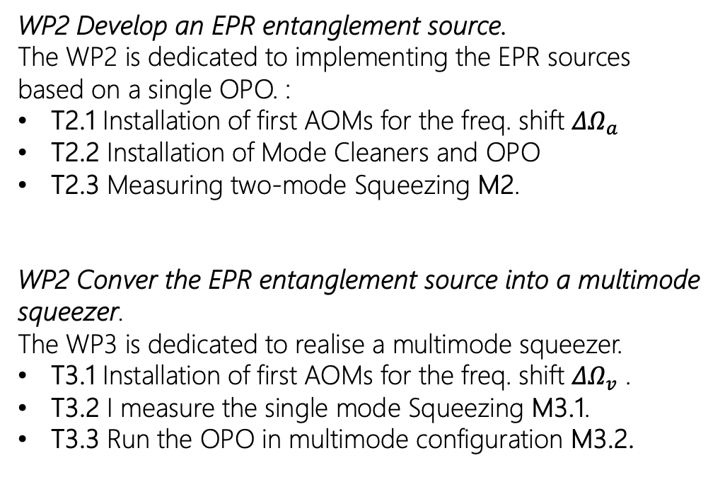
Project analysis slide 7
Attività previste
Richieste Finanziarie
WP2 Develop an EPR entanglement source.
The WP2 is dedicated to implementing the EPR sources based on a single OPO. :
T2.1 Installation of first AOMs for the freq. shift ${ΔΩ}_{a}$
T2.2 Installation of Mode Cleaners and OPO
T2.3 Measuring two-mode Squeezing M2.
WP2 Conver the EPR entanglement source into a multimode squeezer.
The WP3 is dedicated to realise a multimode squeezer.
T3.1 Installation of first AOMs for the freq. shift ${ΔΩ}_{v}$ .
T3.2 I measure the single mode Squeezing M3.1.
T3.3 Run the OPO in multimode configuration M3.2.
Name | Task | Inventariabile | Costo Parziale (IVA inclusa)
Piezo actuator | T2.2 | No | 8.17 k€
FPGA controller | T2.1/T3.1 | No | 5.12 k€
Temperature Controller | T2.2 | Yes | 1.34 k€
Cavity mirrors | T2.2 | No | 25.03 k€
PPKTP crystal | T2.2 | No | 9.98 k€
Low Losses Optics | T2.2 | No | 23.06 k€
Faraday Isolators 1550nm | T2.2 | Yes | 2.65 k€
 |  | Total | 75 k€

Slide 17
Project analysis slide 7
Attività previste
Richieste Servizi
WP2 Develop an EPR entanglement source.
The WP2 is dedicated to implementing the EPR sources based on a single OPO. :
T2.1 Installation of first AOMs for the freq. shift ${ΔΩ}_{a}$
T2.2 Installation of Mode Cleaners and OPO
T2.3 Measuring two-mode Squeezing M2.
WP2 Conver the EPR entanglement source into a multimode squeezer.
The WP3 is dedicated to realise a multimode squeezer.
T3.1 Installation of first AOMs for the freq. shift ${ΔΩ}_{v}$ .
T3.2 I measure the single mode Squeezing M3.1.
T3.3 Run the OPO in multimode configuration M3.2.
Servizi | Task | Costo Mesi/Uomo
Electronical Workshop | Photodiode Detectors | 3
Mechanical Workshop | Cavity Holders. | 4

Slide 18
Project analysis slide 2
WHO?
Official Team
Contributions
  A. Grimaldi: Everything
  Prof. M. Bazzan: Design and characterization of non-linear crystal
  Dott. JP. Zendri: Opto-Electronics (Balance Detector, Photodetector for cavity lock); RF electronics for phase control
  Marco Toffano: design and characterisation of the Balance Detectors
  Simone Marchetti: Installation and characterisation of the squeezing source.
Name
Role
FTE
A. Grimaldi
Assegnista
.9
Prof. M. Bazzan
Prof. Associato
.1
Dott. JP. Zendri
Ricercatore INFN
.1
Marco Toffano
PHD
.2
Simone Marchetti
PhD
.2
Total FTE
150%

