Slide 1
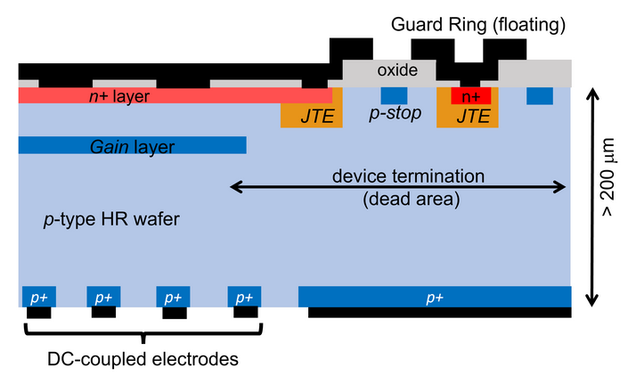
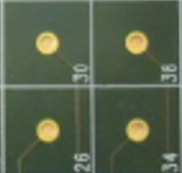
Avalanche Diodes Array – ADA-5D
G.Collazuol
M.Mattiazzi
2025/6/25
University of Pisa & INFN Pisa / University of Siena & INFN Pisa
University of Padova & INFN Padova / University of Pavia & INFN Pavia
University of Trento & TIFPA / Fondazione Bruno Kessler FBK (Trento)
Development thick LGADs and related large dynamic range electronics
- large pixels (3mm x 3mm)
- sensor thickness 200-300 um
Example of thick LGAD implementation
mini-TILE (2.4cm x 2.4 cm):
16 FE = 8 x 8 LGADs
Each FE chip, connected to 4 LGADS, implements:
- double gain linear range to cover > 1000 m.i.p.
- internal ADC
- internal TAC + ADC conversion
- Track & Hold
FE chip
Notes:
1

Slide 2
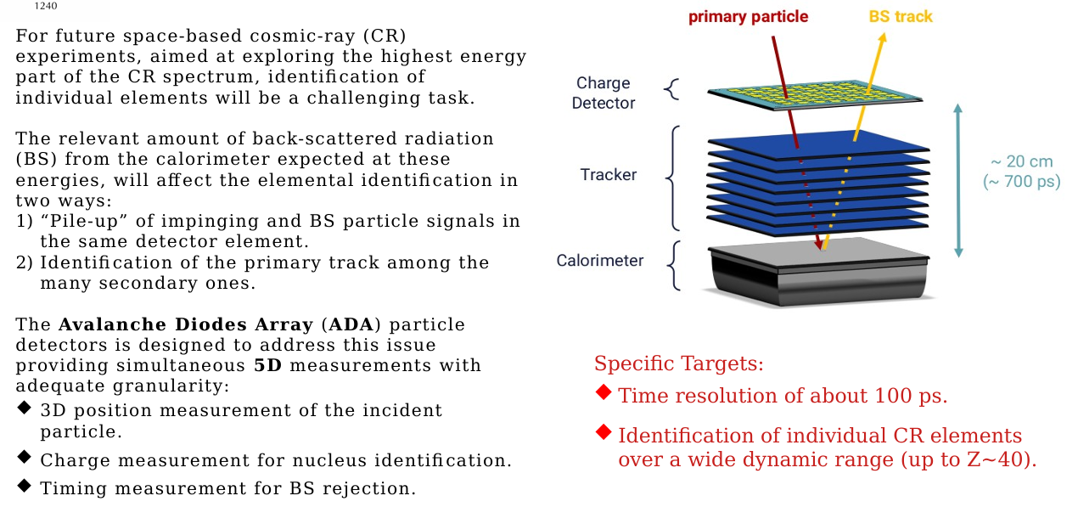
ADA-5D motivation and context
ADA-5D

Slide 3
Position, Charge & Timing detector (5D)
ADA-5D
Charge measurement:
- large dynamic range > 1000 m.i.p.
- charge resolution for proton < 0.1 => 200-300 μm sensors for primary ionization
Timing measurement:
- sub-ns resolution (e.g., for 10 – 20 cm flight path → 100 ps)
Space resolution and granularity:
- modest granularity (3mm x 3mm pixels) to cover large O(m²) sensitive area
- an independent TRACKER is in charge of the fine spatial resolution
Power budget:
- VERY challenging < 150 W/m²
Radiation hardness:
- modest problem for space experiments < 10¹¹ 1 MeV neq (TID ~100 krad)

Slide 4
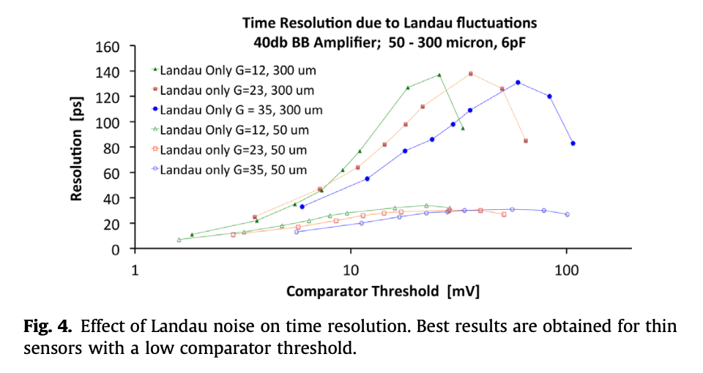
Gain and Time resolution
ADA-5D
with G ~ 10-20 dominant term in time resol. is the Landau tails jitter
~ 100ps feasible with a low threshold (ok as S/N>30 for 1 m.i.p)
e.g.: 100 ps resolution with:
300 um thickness
G=23
threshold ~ 20 – 30 mV
z
Nuclear Instruments and Methods in Physics Research A 845 (2017) 47–51

Slide 5
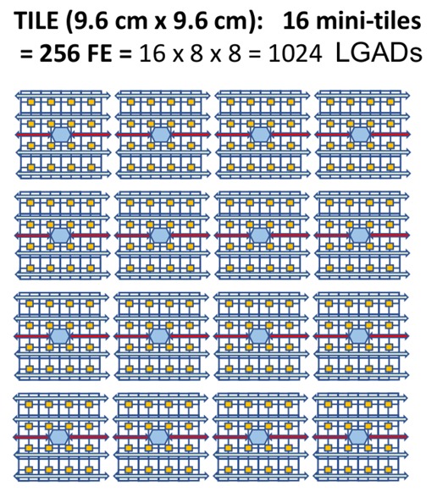
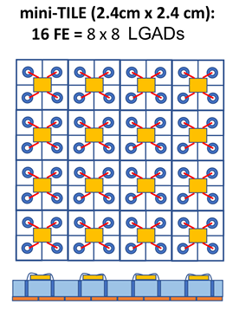
Detector concept
ADA-5D
Courtesy Paolo Brogi -- TREDI 2025 workshop

Slide 6
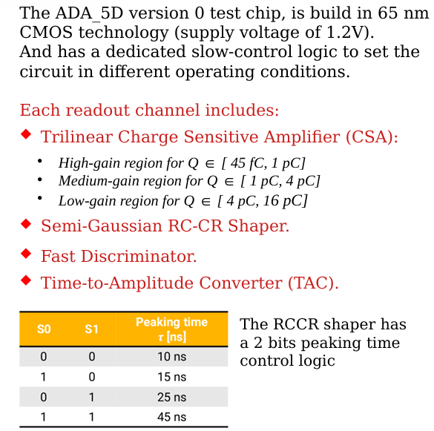
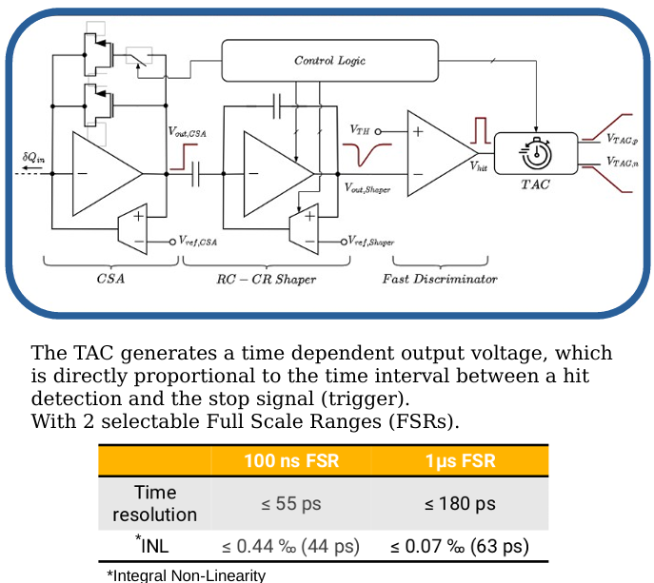
Dedicated Chip Front-End
ADA-5D
Courtesy S. Giroletti

Slide 7
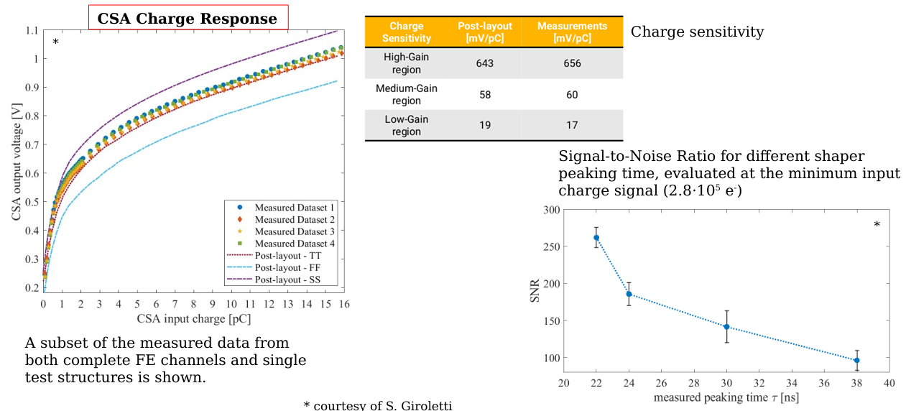
Chip Front-End
ADA-5D
Courtesy S. Giroletti

Slide 8
Sensors tested in 2024
ADA-5D

Slide 9
Test Beam 2024 Nov. – SPS Pb ion beam
ADA-5D

Slide 10
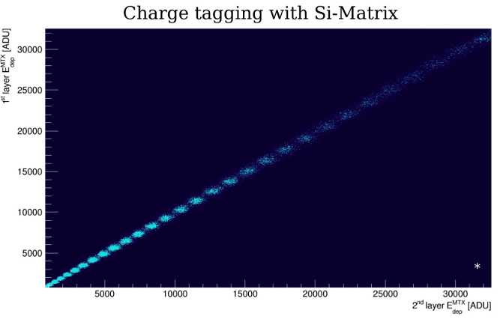
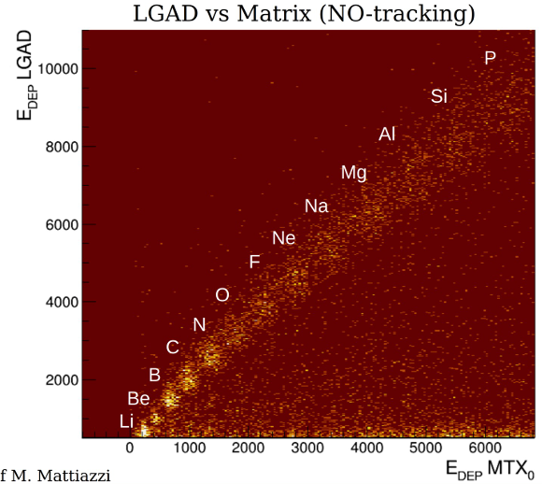
Test Beam 2024 Nov. – SPS Pb ion beam
ADA-5D
Charge Analysis by Marco Mattiazzi – INFN PD and DFA

Slide 11
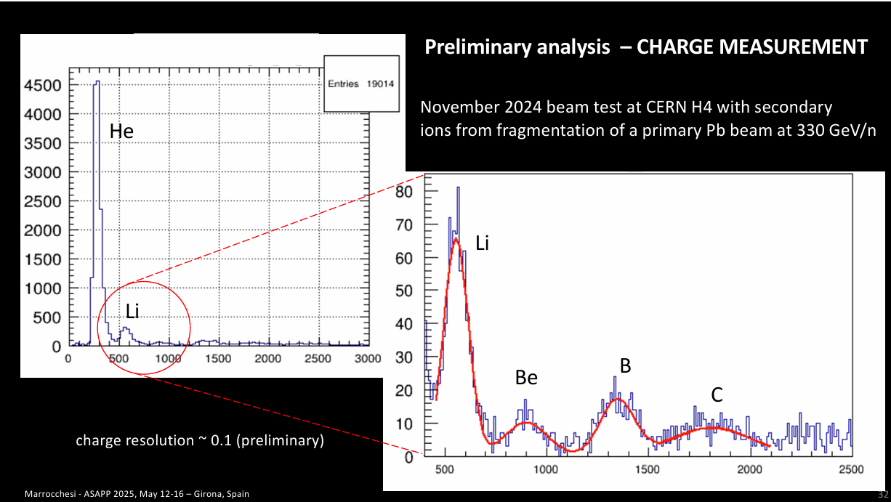
Test Beam 2024 Nov. – SPS Pb ion beam
ADA-5D

Slide 12
ADA-5D
Activities in 2025
TIFPA - caratterizzazione laser IR di campioni LGAD FBK con spessore 275um
Pavia – nuova versione del ASIC con on-chip ADC e interfaccia digitale per R/O
FBK - secondo batch di LGAD
Pisa & Padova
Digital readout system and DAQ integration
Charaterization and selection sensors
Setup telescope for Test Beam @ SPS ions => November 2025
Request CSN5 for 1 year Extension
Activities in 2026
Last batch of thick sensors → characterization
Demonstrator layer
Digital readout system and DAQ integration
Setup telescope for Test Beam @ SPS ions => Fall 2026

Slide 13
ADA-5D
Resources @ INFN Padova
FTE Padova 2026
- G.Collazuol 10 %
- M.Mattiazzi 60%
Preventivi 2026
Consumo per circa 10kEuro
Missioni (CERN) per 5kEuro
Richieste 2026 in Sezione PD
Servizio Elettronica
programmazione FPGA TimePix4 + SiPixels (collab. con INFN FE) ~ 3m.p.
Servizi Tecnici ed Elettronici
elettronica ancillare TimePix4 ~ 1m.p.
Servizio Progettazione Meccanica
disegno setup telescopio (collaborazione con Stefano Levorato) ~ 1m.p.
Servizio Officina Meccanica
meccanica telescopio ~ 1m.p.

Slide 14
Additional material ADA-5D

Slide 15
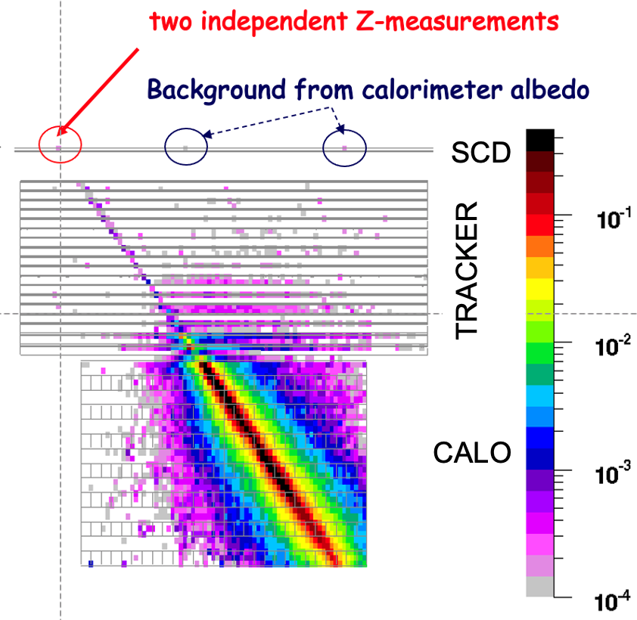
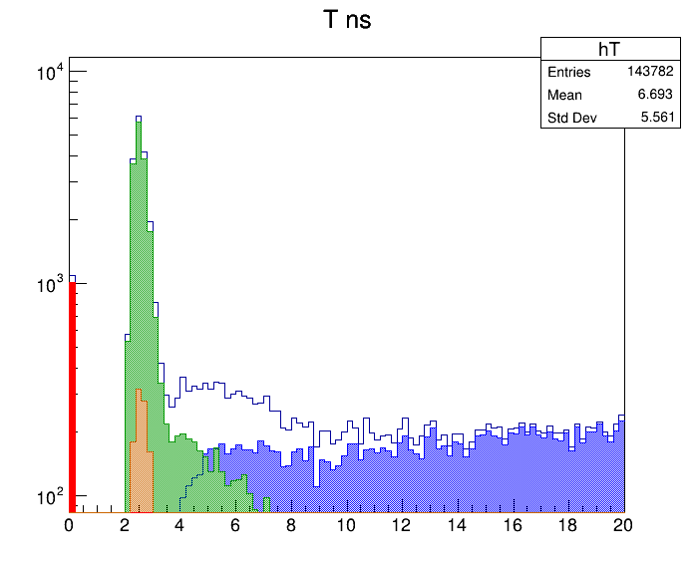
ADA_5D
Charge & Timing 5D detector (x,y,z, charge, time) based on LGAD sensors for the next generation of multi-TeV calorimetric experiments in space
CHARGE IDENTIFICATION of cosmic-ray ions
with charge 1 ≤ Z ≤ 30 via multiple dE/dx ∝ Z²
in a pixelated sub-ns Charge-ToF detector (SCD)
Backscattering (BSC) from calorimeter generates fake hits in SCD and tracker, degrading charge-ID as energy increases.
FLUKA simulation of 1 TeV incident carbon nucleus
Arrival time (ns) of BSC from calorimeter on SCD:
a GEANT4 simulation with 30cm flight path
ADA_5D concept: BSC rejection with a
high resolution ToF measurement
secondaries from BSC photons interacting in SCD
BSC electrons
- large dynamic range > 1000 m.i.p
- 100 ps time resolution (e.g. for 20 cm flight path)
- large pixels (3mm x 3mm) to cover large O(m²) sensitive area
- indipendent TRACKER for fine track resolution
- challenging power budget < 150 W/m²
- modest Rad Hardness required in space < 10¹¹ 1 MeV neq
BSC All
BSC neutrons
incident protons at t=0

