Slide 1
ASPIDES
G.Collazuol
INFN Padova Gr5 2025/6/25
Acronym: ASPIDES - A CMOS SPAD and Digital SiPM Platform for High Energy Physics Project duration: 3 years (2025, 2026, 2027) Research area: rivelatori ed elettronica Principal Investigator: Lodovico Ratti (Universita` e INFN Sezione di Pavia)
Participating Units: Pavia(PV), Bari (BA), Bologna (BO), Milano (MI), Napoli (NA),
Padova (PD), Torino (TO), Trento (TIFPA)
Ambito: DRD4 - WG1 (dSiPM) / WP1 CMOS SPAD
Aims: development technology platform for the design, production and commissioning of digital silicon photomultipliers (dSiPMs) => detectors with single-photon sensitivity and embedded functionalities
Applications:
Scintillation and Cherenkov light detection in dual-readout calorimetry
Scintillation det. (e.g. SciFi / Water Based L.Sci.) and TPC optical RO for Hyper-Kamiokande Near detector => involvement Padova
Gruppo Padova
Staff: G.Collazuol, R.Stroili
Post-Doc: M.Feltre Dottorandi: C.Forza
Notes:
1

Slide 2
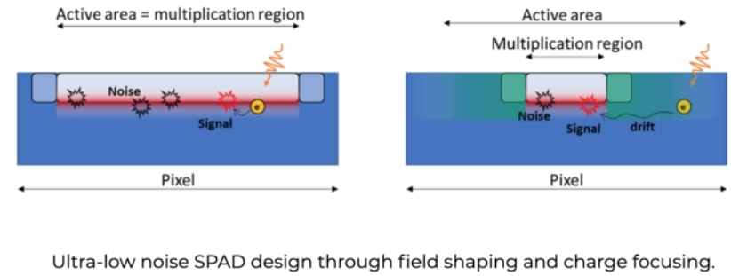
ASPIDES will deliver 2D CMOS monolithic sensors
ASPIDES
Target technology
110 nm CMOS image sensor process
Main features
Noise mitigation
- Optimization for ultra-low noise spad cell
- Single SPAD control (on/off)
- threshold adjustment capabilities for noise rejection (output validation)
Photons counting
- fully digital output, obtained through a completely digital processing chain
or through analog, Q/V or I/V transformation and final A/D conversion
- asynchronous counting with wide O(1000) dynamic range of simultaneous photons
Timing features
- time of arrival of the first photon
- photon pulse duration (width)
w/ 100ps resolution
- … additional features available
to measure accurately
shape of photon pulse evolution)
Notes:
2

Slide 3
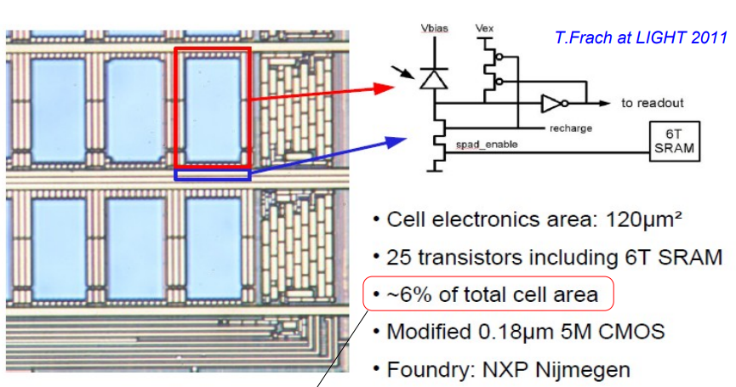
ASPIDES will deliver 2D CMOS monolithic sensors
ASPIDES
The technology offers SPADs with a DCR of around 100 kHz/mm2 , a PDP close to 50% at 450 nm and excess voltage of 6 V and a sufficient integration density to pack all the needed functions in the available area without unacceptably degrading the sensor PDE
Notes:
3

Slide 4
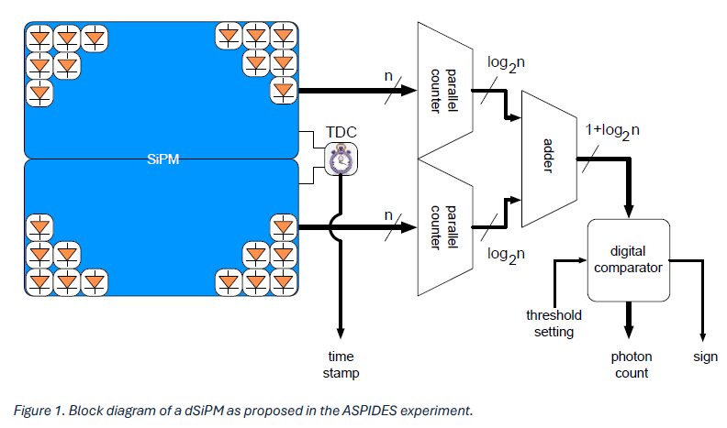
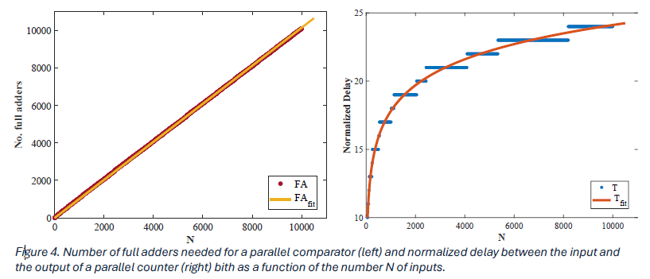
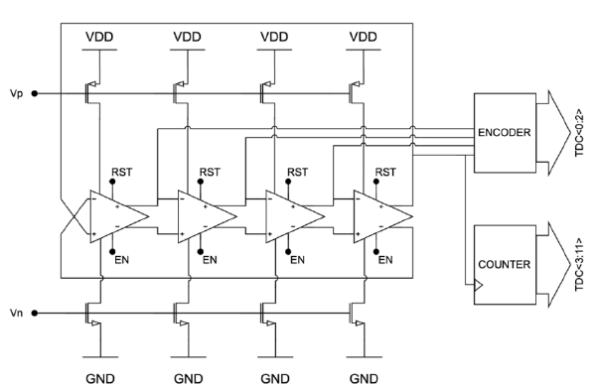
ASPIDES will deliver 2D CMOS monolithic sensors
ASPIDES
Photon counting might be performed through a parallel counter based on adder trees, usually employed in digital multipliers to perform the sum of partial products (digital compressors as they reduce n bits into ⌈𝑙𝑜𝑔2𝑛⌉ bits)
Possible alternative is mixed analog and digital approach
based on I/V or Q/V conversion, followed by an ADC
(current steering circuit integrated in each individual micro-cell
to summing node when the micro-cell is hit and a trans-resistance amplifier or a charge preamplifier provides a measurement of the overall signal)
The time of arrival of the first photon will be measured by means of a time to digital converter (TDC) triggered by the first hit micro-cell through an OR-tree (or by a transition of one of the bits at the parallel counter output).
Block diagram of a 12-bit ring-oscillator-based TDC
Notes:
4

Slide 5
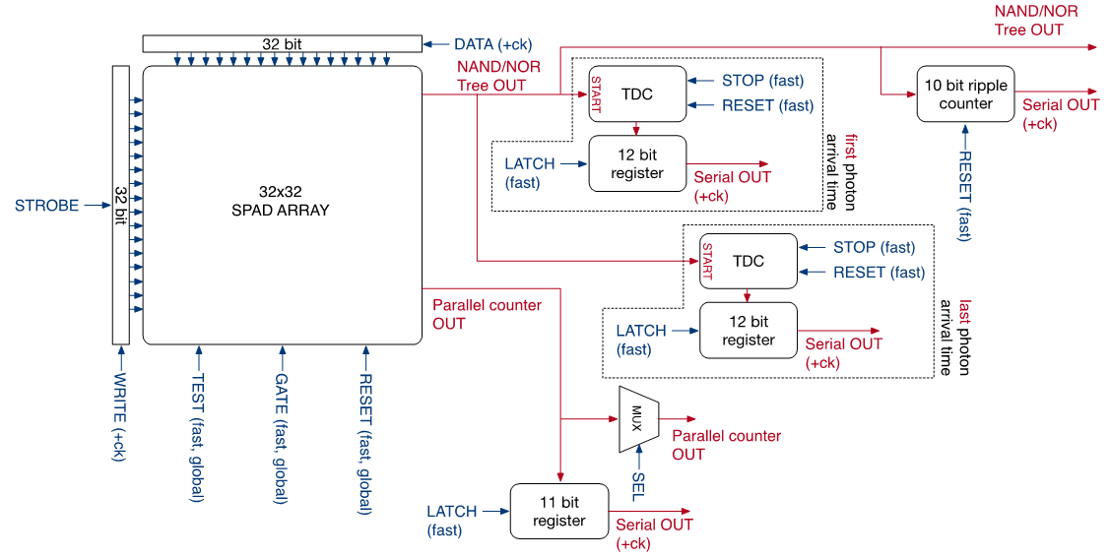
ASPIDES Demonstrator – first version
Technology & Architecture:
110 nm CMOS image sensor process.
1024 micro-cells with a 30 µm pitch and 50% fill factor.
Key Features:
Parallel counter for real-time digital readout of hit pixels, delivering results within ns after the last photon arrival.
Fast NAND/NOR tree with optimized symmetry minimizing fixed-pattern jitter achieving <10 ps timing uncertainty for the first photon.
Noise Mitigation:
Individual micro-cell disablement to suppress hot pixels.
Threshold-based triggering to reduce false events in timing circuitry
ASPIDES
Notes:
5

Slide 6
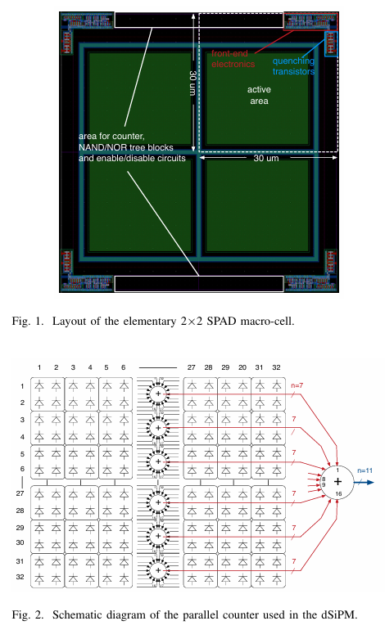
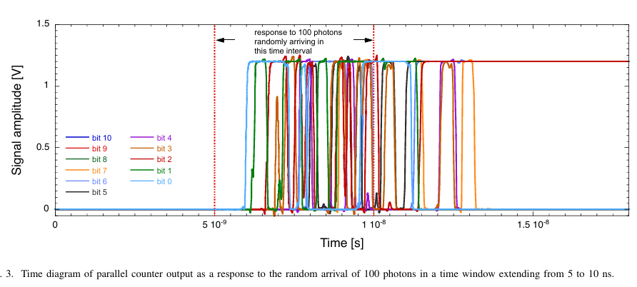
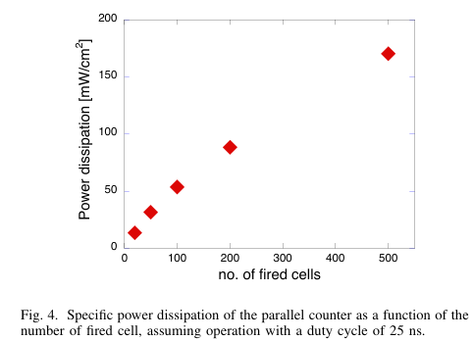
ASPIDES Demonstrator – first version
Technology & Architecture:
110 nm CMOS image sensor process.
1024 micro-cells with a 30 µm pitch and 50% fill factor.
Key Features:
Parallel counter for real-time digital readout of hit pixels, delivering results within ns after the last photon arrival.
Fast NAND/NOR tree with optimized symmetry minimizing fixed-pattern jitter achieving <10 ps timing uncertainty for the first photon.
Noise Mitigation:
Individual micro-cell disablement to suppress hot pixels.
Threshold-based triggering to reduce false events in timing circuitry
ASPIDES
Notes:
6

Slide 7
ASPIDES will deliver 2D CMOS monolithic sensors
ASPIDES
Project Deliverables
A prototype chip, including structures such as mini-SiPMs with O(1000) micro-cells with different pitch and single electronic blocks (e.g., TDC/QTC) for characterization purposes
A final demonstrator, with full scale SiPMs and optimized fill factor for dual-readout calorimetry
Involvement in Padova 2026
1) Characterization
Investigation of radiation tolerance both to ionization and displacement damage
Study device operation in cryogenic conditions or high pressure and different radiators
PDE to light from 200nm to 1000nm
2) Applications
Scintillation applications (HYPER-K ND)
Focussed / Imaging
Optical Readout for STP Gas TPC (HYPER-K ND) for High Pressure TPC (DRD1 / WP8)
Eager to move our PhotoDet.
activities from LNL to new Lab. “dell’Universo” in via Luzzatti
Notes:
7

Slide 8
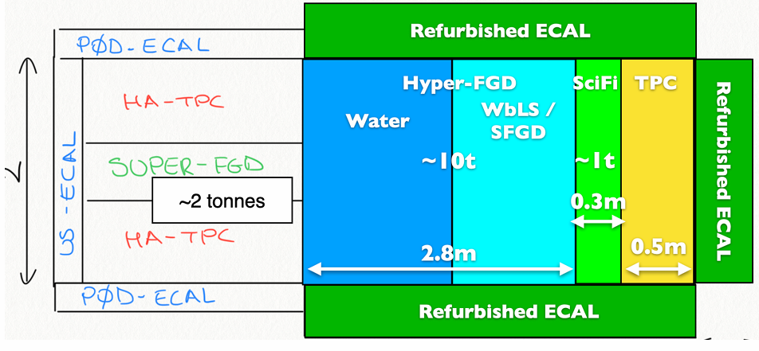
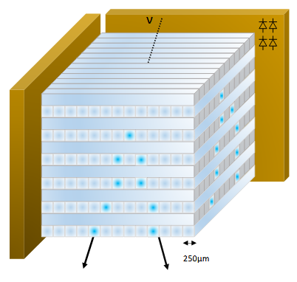
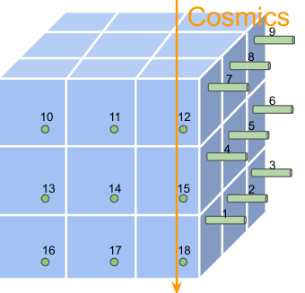
Further upgrade Hyper-Kamiokande Near Detector (2030)
Development TPC Optical Readout
Synergy → DRD1/4 / INFN Gr5 TIMEPIX4
1. Downstream TCP under study
- Optical readout of avalanche gas multiplication
- Extended drift regions - Transparent conductive anodes - Advanced timing solutions
2. “Thin” top and bottom TCPs under evaluation
Development new Digital-SiPM
Synergy → DRD4 / INFN Gr5 ASPIDES
Development new Back Side illuminated SiPM
Synergy → DRD4 / INFN Gr5 IBIS-Next (C.Forza - PhD)
→ Optical Readout of TPC
Readout of Water-based liquid scintillator
SiPM => low noise & high PDE
← Readout of very fine grained sci-fi detector

Slide 9
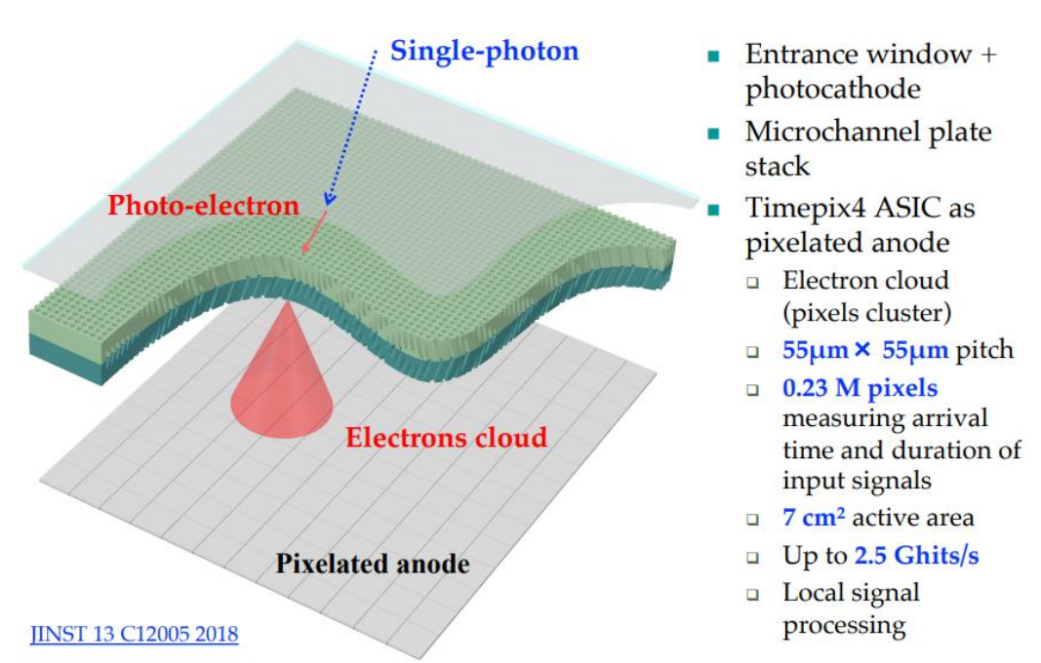
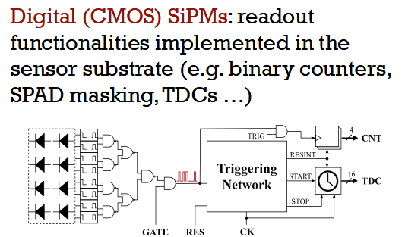
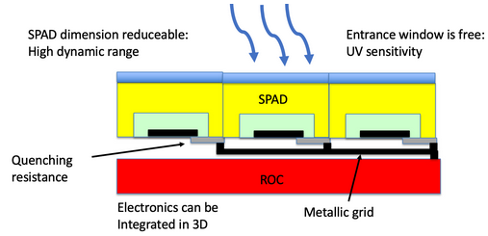
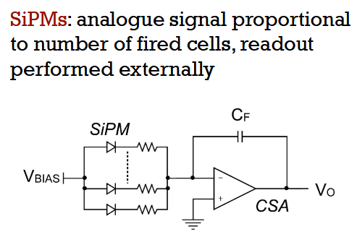
Further upgrade HK Near Detector
Development TPC Optical Readout
Synergy → DRD1/4 / INFN Gr5 TIMEPIX4
Requests to ASPIDES: optical instrumentation & parts
for Photo-detector characterization
Requests to TIMEPIX4: gas multiplier structures
DTZ-Gr1 Padova: provided FPGAs for Readout systems
Requests to HK for R&D = optical parts for imaging anode
(Lenses, Mirrors, Quartz windows …) needed also for TPC laser data taking Request → O(15kE) including MM structures (prev. slide)
Development new Digital-SiPM
Synergy → DRD4 / INFN Gr5 ASPIDES
Development new Back Side illuminated SiPM
Synergy → DRD4 / INFN Gr5 IBIS-Next (C.Forza - PhD)

Slide 10
Courtesy
E.Radicioni G.Catanesi

Slide 11
ASPIDES
Resources @ INFN Padova
FTE Padova 2025/7 => 40%
G.Collazuol 10%
R.Strolili 10%
M.Feltre 20%
Preventivi 2026
Consumo per circa 10kEuro
Missioni (Italia) per 4kEuro
Richieste 2026 in Sezione PD
Servizio Elettronica
Servizi Tecnici ed Elettronici
Servizio Progettazione Meccanica
Servizio Officina Meccanica
parts for a small volume prototype high pressure TPC – 1 m.p.

Slide 12
Additional material

Slide 13
ASPIDES Demonstrator – first version
A monolithic silicon photo-multiplier, including 1024 micro-cells with a 30~$\upmu$m pitch and a fill-factor of 50\%, has been designed in a 110 nm CMOS image sensor technology. The SiPM takes advantage of a parallel counter to compute the number of hit pixels, providing the count in digital form with a latency time of a few ns from the time of arrival of the last photon. Careful design of a fast NAND/NOR tree, preserving as much as possible the signal path symmetry, minimizes fixed-pattern related jitter so to ensure uncertainties in the time of arrival of the first photon below 10 ps. Noise mitigation is accomplished both by individually disabling hot micro-cells and by setting a threshold for the signal triggering the event timing circuitry.
ASPIDES
Notes:
13

Slide 14
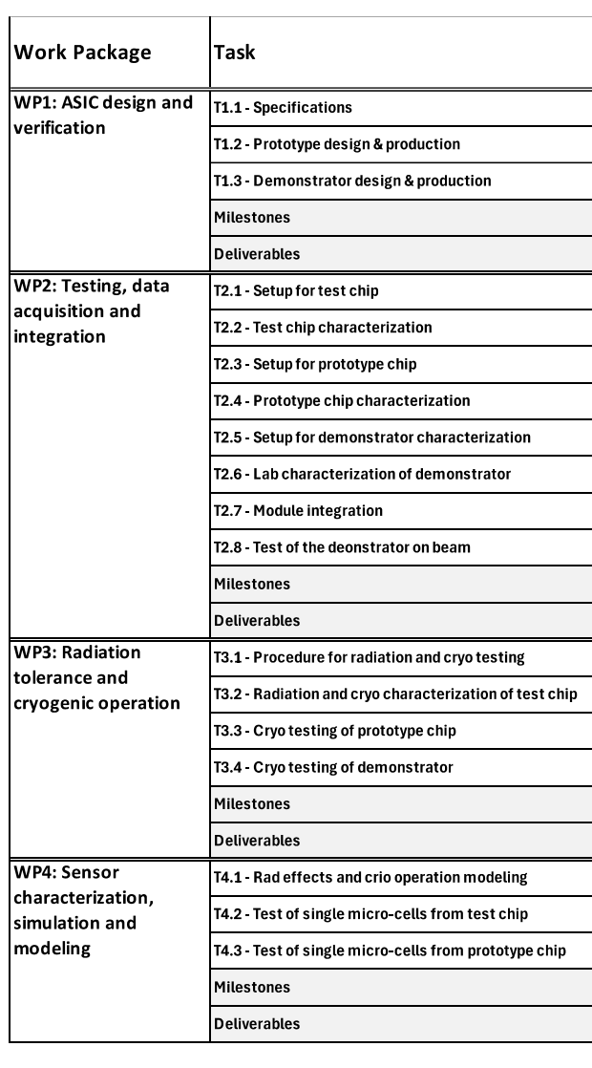
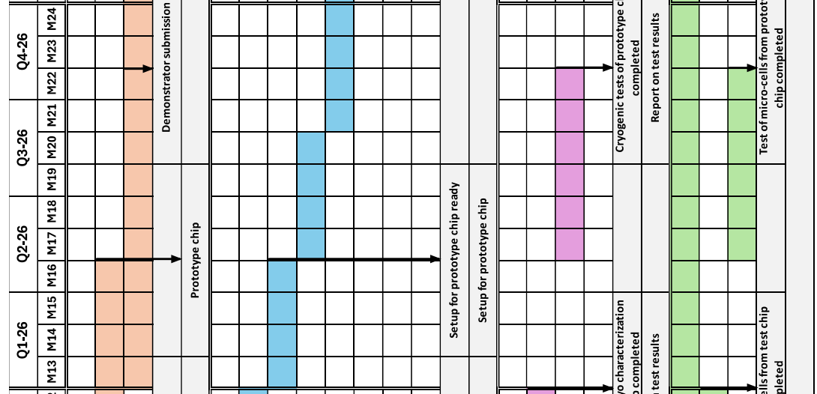
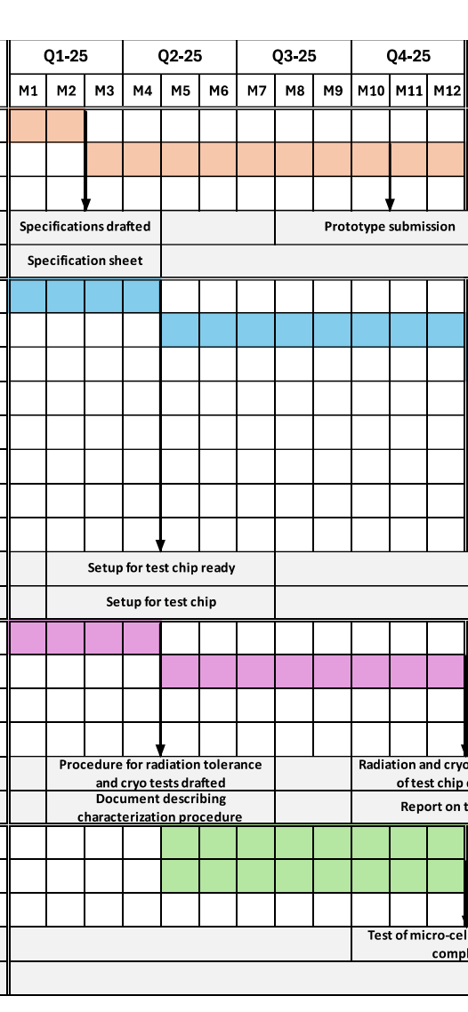
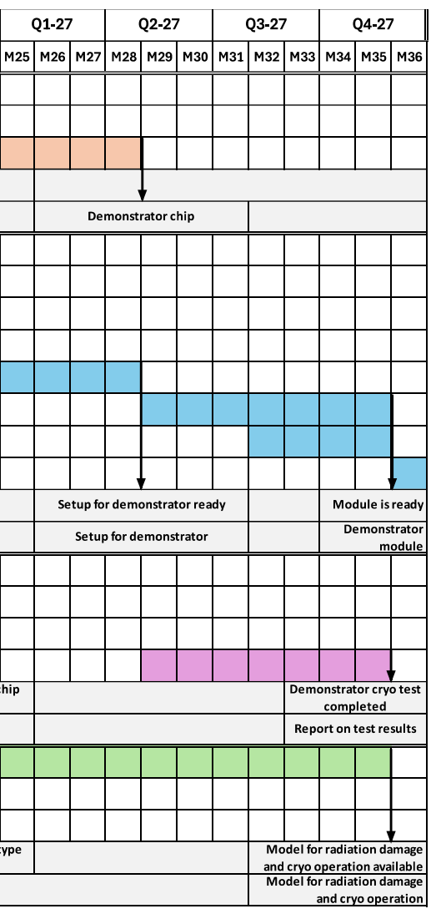
ASPIDES timleine
ASPIDES
Notes:
14

