Slide 1
TIMEPIX4
Acronym: TIMEPIX4 Project duration: 3 years (2025, 2026, 2027) Research area: Interdisciplinary / Detectors Principal Investigator: Massimiliano Fiorini (INFN Sezione di Ferrara) Participating Units: Ferrara, Laboratori Nazionali del Sud, Napoli, Padova, Pisa, Trieste Ambito: DRD4 - WG1 (Gaseous) / WP2 (Vacuum Based)
Sinergia: HYPER-K (CNS1) per charge & optical readout in gaseous detectors
Aims: exploiting TIMEPIX4 chip => to develop detector systems beyond State-of-the-Art
Applications:
Ultra-fast, high granularity MCP based photon detector => HEP
X-ray, gamma ray and particle imaging w/ semiconductors => Medical Physics
Photons detection and Tracking w/ gas detectors => Padova proposal
Staff: G.Collazuol, S.Levorato
Post-Doc: M.Feltre
G.Collazuol
INFN Padova Gr5 2025/6/25
Notes:
1

Slide 2
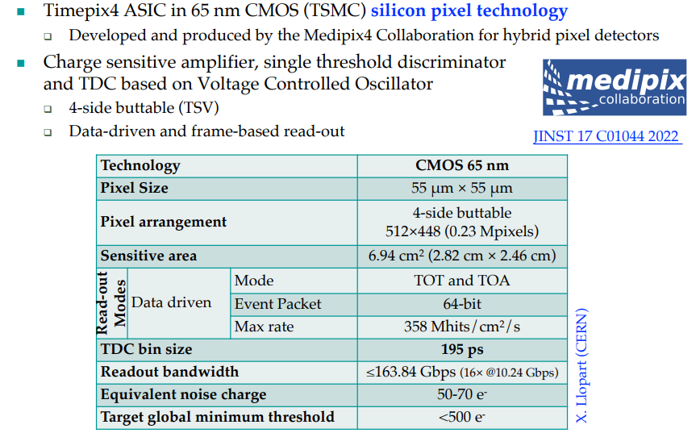
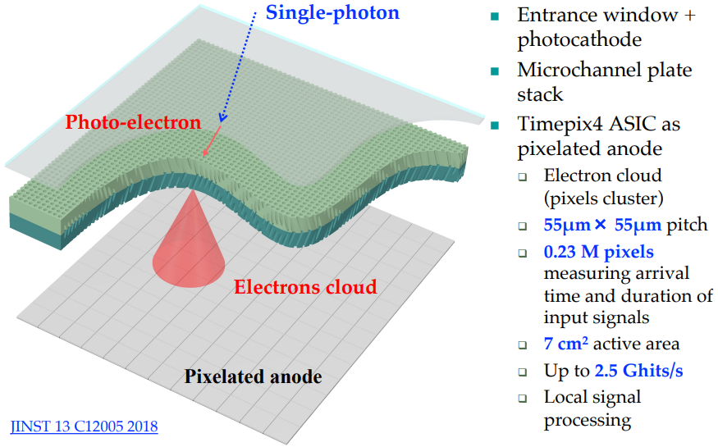
Hybrid vacuum photon detector - MCP / TIMEPIX4
TIMEPIX4

Slide 3
TIMEPIX4 gas detector – WP2 rimodulated
TIMEPIX4
Aim
Proof of principle of coupling gas multiplication gap to TIMEPIX4 chip in a simple way
Target applications high-resolution & low material budget tracking detectors with PID capabilities for charged particles down to very low momenta
Method
building MicroMegas Resistive Embedded Anode gap by standard technique at CERN
(stainless steel mesh supported by pillars on DLC resistive layer on Kapton)
to be tensioned and over-imposed on top of TIMEPIX4
Gas multiplication gap
128 um gap with SD45/18
woven stainless steel mesh
DLC resistive layer
on 50 um of Kapton
TIMEPIX4 chip
Chip Support and gap tensioning system

Slide 4
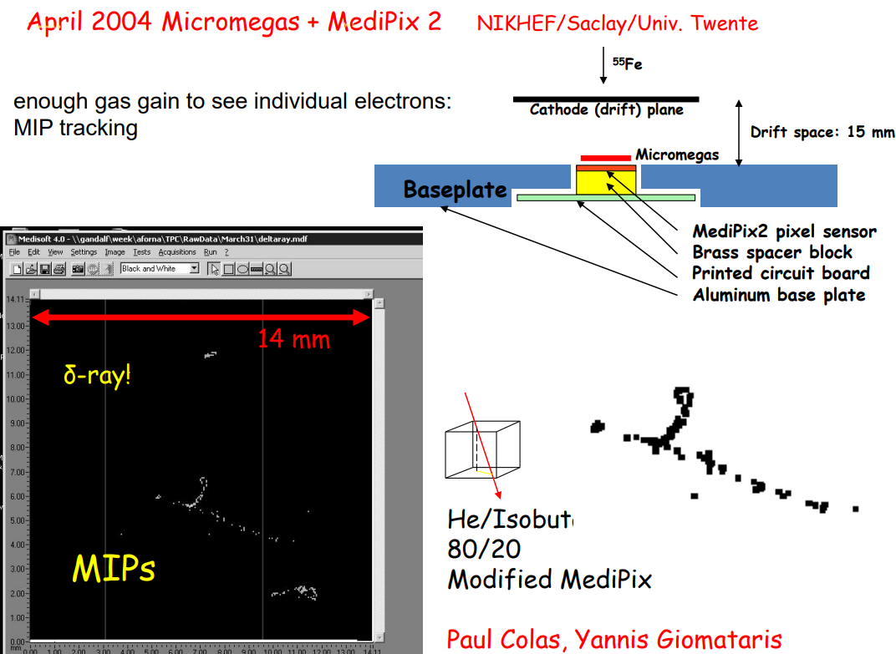
History of TIMEPIX gas detectors

Slide 5
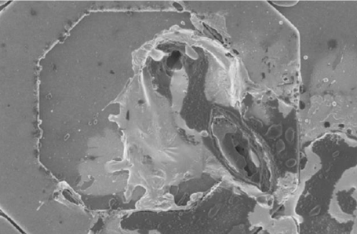
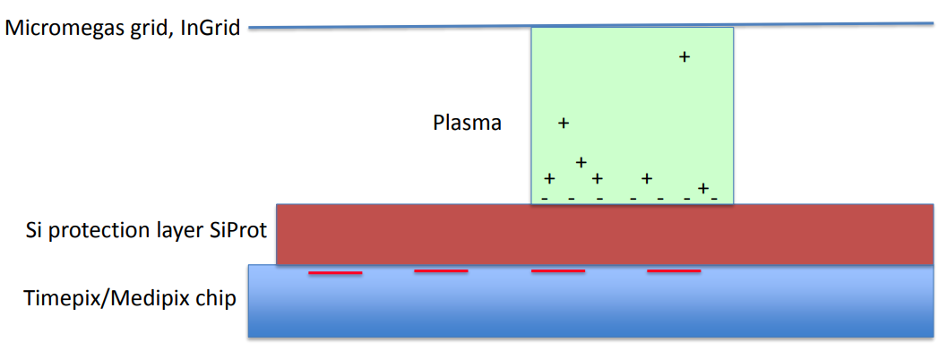
TIMEPIX gas detectors – issue #1 = discharges
Protection layer
High resistivity

Slide 6
TIMEPIX gas detectors – issue #2 = alignment
When the Timepix chip was used with a Micromegas the grid was first stretched over the chip surface and set on top of the chip using pillars
The grid holes were not aligned to the chip pads/pixels
and the distance between the chip and the grid was
not constant along the surface
This misalignment resulted in spatial inefficiency
and gain variations with patterns resembling
Moiré optical effect
To solve this issue a 1um thick Al grid was integrated on top of the TIMEPIX3 chip (InGrid)
The grid was perfectly aligned to the TIMEPIX3 pads thanks to lithographic based technique carried on during the chip post-processing phase

Slide 7
A much simpler approach based on ERAMs
(Encapsulated Resistive Anode Modules)
development for the T2K Near Detector TPCs

Slide 8
Charge spread on low resistivity foil
Charge Spreading 2D telegraph eqn. solution
in O(RC) time scale
Gaussian spread
Final ERAM layout choice for series production:
Considering pads of 11x10 mm² parameters
400 kΩ/□ DLC resistivity – low resistivity
150 μm thickness glue – C_{dlc-pad/gnd} ~ O(20pF)
Trade-off optimal charge spread VS spark protection
Gain not affected by resistivity
(transparency to induced signals is guaranteed)
RC ~ O(100ns/mm² )

Slide 9
Coupling ERAM gaps to TIMEPIX4 chip => ERAMPIX
Proof of principle of simple coupling of TIMEPIX4 with ERAM-like multiplication gap
1) DLC (Diamond-like-Carbon) resistive layer = chip protection against discharges
2) DLC layer with low resistivity = charge spread against efficiency non uniformity
3) Micromegas principle allowing low ion feedback
128 um gap with SD45/18
woven stainless steel mesh
GAP
DLC resistive layer
on 50 um of Kapton
TIMEPIX4 chip
Chip Support and gap tensioning system
Note
A) need (simple) system for tensioning the gap and to lay down it on the chip
B) must tune DLC resistivity to avoid charge spread too much (all over chip !)
=> easy development at CERN MPGD lab. – agreement with Rui de Oliveira
C) testing GAP coupling to chip by simple contact (no gluing) has advantages
- does not affect induced signal
- does allow testing on the same chip various GAPs with different
configurations (mesh geom, DLC resistivity, gap distance mesh to DLC, …)

Slide 10
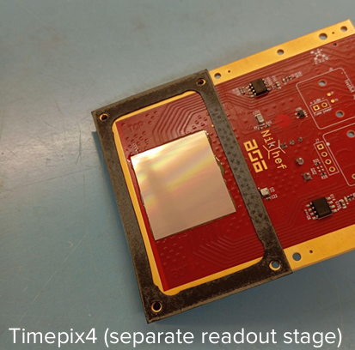
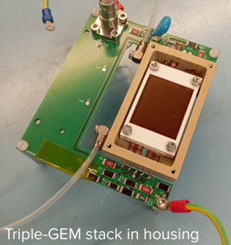
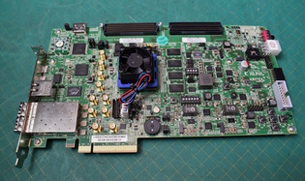
Coupling ERAM gaps to TIMEPIX4 chip => ERAMPIX
Proof of principle of simple coupling of TIMEPIX4 with ERAM-like multiplication gap
1) DLC (Diamond-like-Carbon) resistive layer = chip protection against discharges
2) DLC layer with low resistivity = charge spread against efficiency non uniformity
3) Micromegas principle allowing low ion feedback
128 um gap with SD45/18
woven stainless steel mesh
GAP
DLC resistive layer
on 50 um of Kapton
TIMEPIX4 chip
Chip Support and gap tensioning system
TIMEPIX4 on NIKHEF carrier board
Readout based on FPGA
Xilinx AMD Kintex UltraScale KCU105-G

Slide 11
Developments 2024/25 at CERN
TIMEPIX4

Slide 12
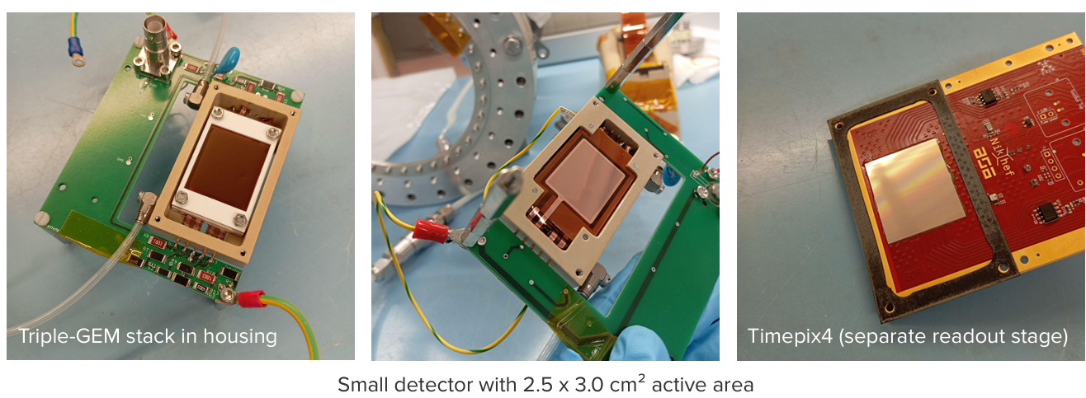
Developments 2024/25 at CERN
TIMEPIX4

Slide 13
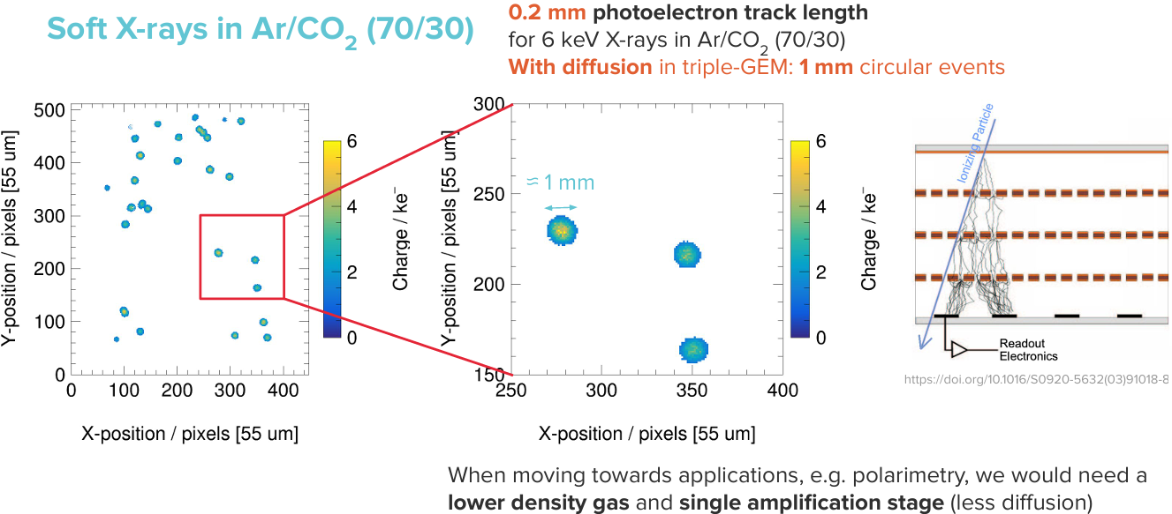
Developments 2024/25 at CERN
TIMEPIX4

Slide 14
Developments 2024/25 at CERN
TIMEPIX4

Slide 15
Developments 2024/25 at CERN
TIMEPIX4

Slide 16
Activities 2025
TIMEPIX4
Acquired RO system and start development of TIMEPIX4 readout (based on INFN FE FW)
Production of ERAMPIX structures fror simple coupling with TIMEPIX4
Xilinx AMD Kintex UltraScale FPGA KCU105 thanks to INFN-PD-Dtz1
Resistive Micromegas detector - Panel of 4 detector (2 guaranteed): production Panel P2 (330X254) Thickness 200um - 77mm x 97 mm (Based on DFS 3192 uRwell layout but adapted to MM) - 25mm x 41mm active area, 150um gap amplification (Dynamask) - DLC resistivity from 5 to 10M Ohm - 2 external connexions for Mesh and DLC
Eager to move our “gas detector”
activities from LNL to new Lab. “dell’Universo” in via Luzzatti
Activities 2026
Development TIMEPIX4 readout fast links
Production and test of ERAMPIX structure to embed with TIMEPIX4
Development of gas photon-multiplier layer for TPC optical readout

Slide 17
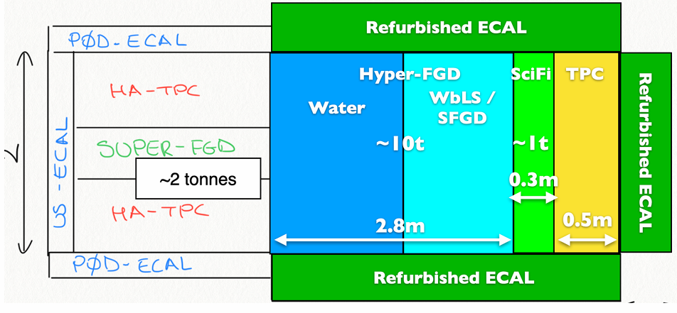
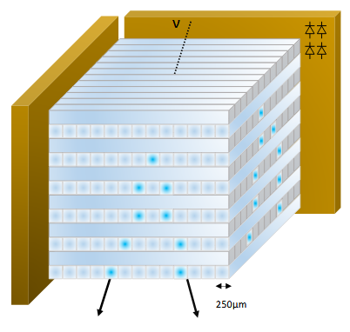
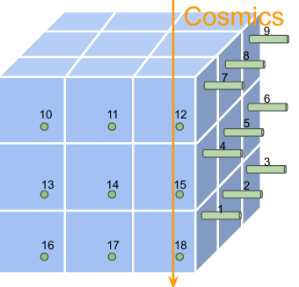
Further upgrade Hyper-Kamiokande Near Detector (2030)
Development TPC Optical Readout
Synergy → DRD1/4 / INFN Gr5 TIMEPIX4
1. Downstream TCP under study
- Optical readout of avalanche gas multiplication
- Extended drift regions - Transparent conductive anodes - Advanced timing solutions
2. “Thin” top and bottom TCPs under evaluation
Development new Digital-SiPM
Synergy → DRD4 / INFN Gr5 ASPIDES
Development new Back Side illuminated SiPM
Synergy → DRD4 / INFN Gr5 IBIS-Next (C.Forza - PhD)
→ Optical Readout of TPC
Readout of Water-based liquid scintillator
SiPM => low noise & high PDE
← Readout of very fine grained sci-fi detector

Slide 18
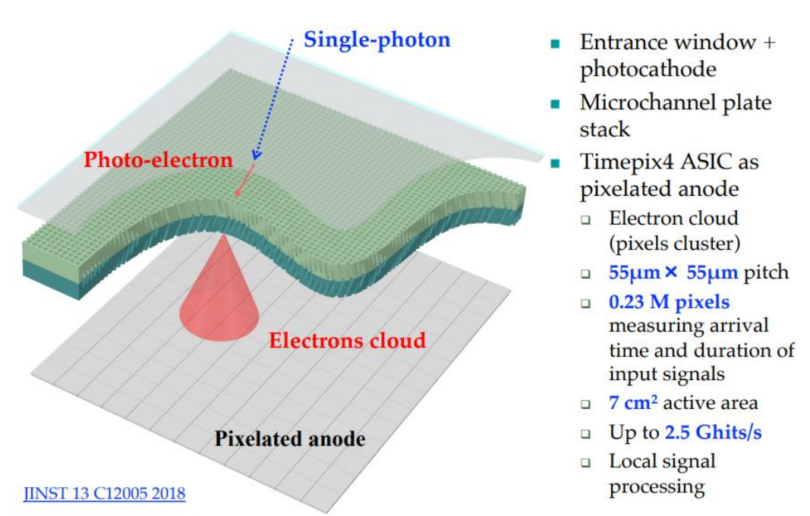
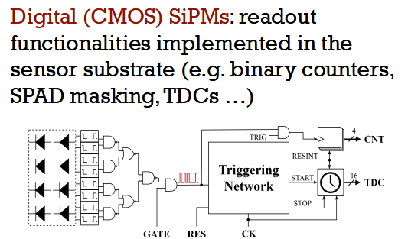
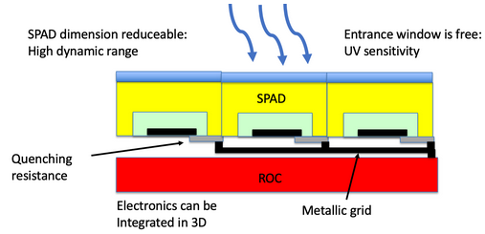
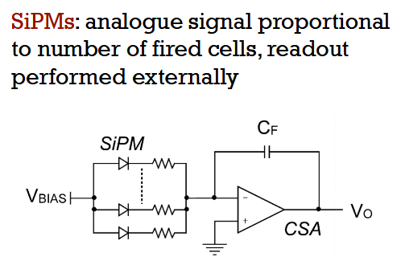
Further upgrade HK Near Detector
Development TPC Optical Readout
Synergy → DRD1/4 / INFN Gr5 TIMEPIX4
Requests to ASPIDES: optical instrumentation & parts
for Photo-detector characterization
Requests to TIMEPIX4: gas multiplier structures
DTZ-Gr1 Padova: provided FPGAs for Readout systems
Requests to HK for R&D = optical parts for imaging anode
(Lenses, Mirrors, Quartz windows …) needed also for TPC laser data taking Request → O(15kE) including MM structures (prev. slide)
Development new Digital-SiPM
Synergy → DRD4 / INFN Gr5 ASPIDES
Development new Back Side illuminated SiPM
Synergy → DRD4 / INFN Gr5 IBIS-Next (C.Forza - PhD)

Slide 19
Courtesy
E.Radicioni G.Catanesi

Slide 20
Resources @ INFN Padova
TIMEPIX4
FTE Padova 2025/7 => 40%
G.Collazuol 10 %
S.Levorato 10 %
M.Feltre 20%
Preventivi 2026
Consumo (new ERAM structures) per circa 10kEuro
Missioni (CERN) per 4kEuro
Richieste 2026 in Sezione PD
Servizio Elettronica
programmazione FPGA TimePix4 (collaborazione con INFN FE) ~ 3m.p.
(overlap – con richiesta ADA-5D)
Servizi Tecnici ed Elettronici
Servizio Progettazione Meccanica
Servizio Officina Meccanica

Slide 21
TIMEPIX4
Additional Material

Slide 22
Courtesy
E.Radicioni G.Catanesi

Slide 23
Padova Interests & contribution
TIMEPIX4
Aim
Implementation of Optical and Charge readouts of gas multiplication structures
based on resistive and capacitive micro-pattern gas detectors (MPGD)
Target sensitivity - for optical readout => VUV and DUV light
- for primary charge readout => single electron
Methods
Coupling Embedded Resistive Anode MicroMegas (ERAM) with TIMEPIX4 (DLC for resistive layer)
Coupling nano-diamond / DLC photo-cathodes to ERAM (later stage)
Applications
Imaging detectors exploiting charge and light
Robust x-ray & VUV & DUV gas-based detector

Slide 24
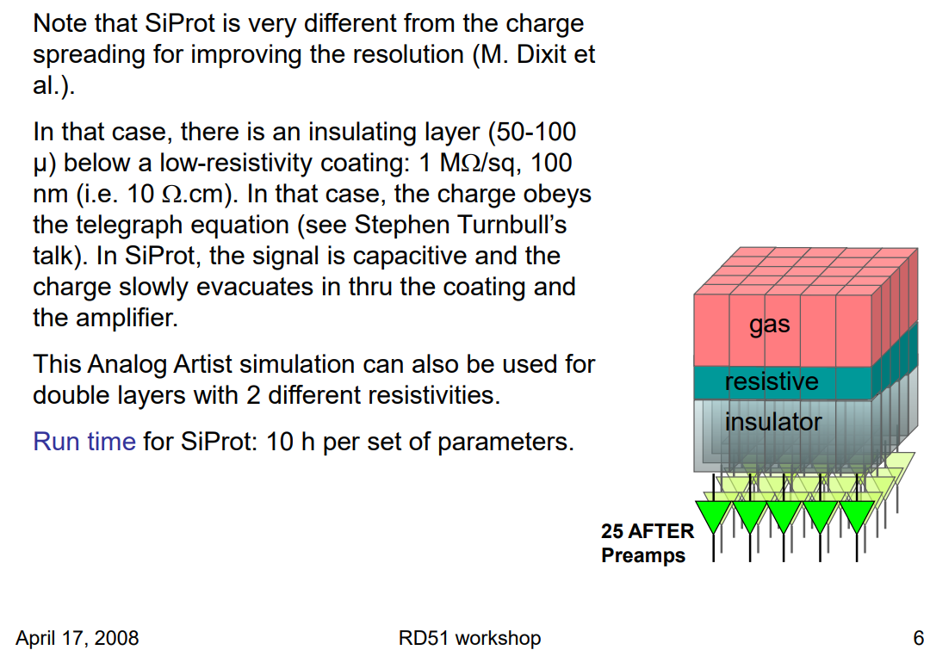
TIMEPIX gas detectors – issue #1 = discharges

Slide 26
History of TIMEPIX gas detectors

Slide 27
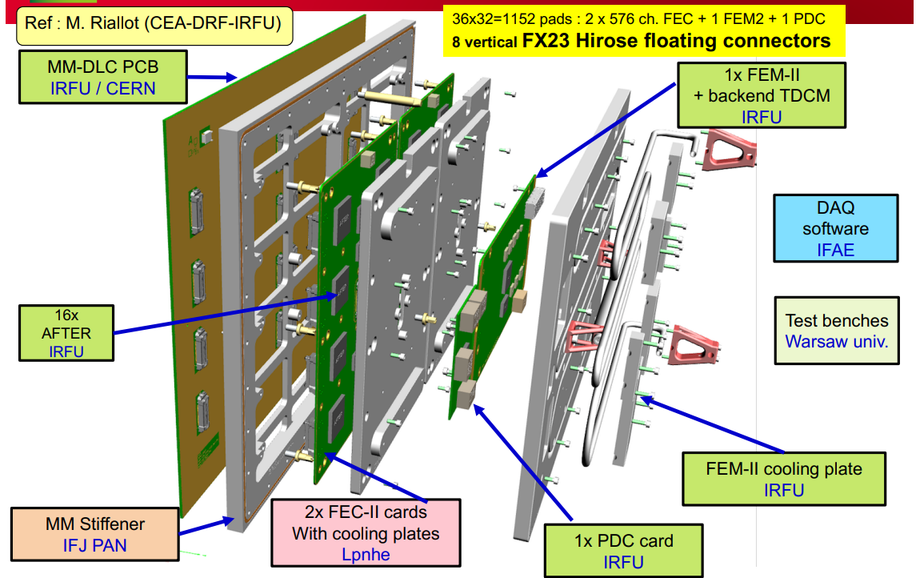
ERAM module for T2K TPCs
8 + 8 ERAMs per HATPC
Very compact electronics
ERAMs used for the new TPC of T2K
ERAMs are built at CERN MPGD Lab

Slide 28
ERAMs used for the new TPC of T2K
ERAMs are built at CERN MPGD Lab
TIMEPIX4

Slide 29
TIMEPIX4

Slide 30
TIMEPIX4

Slide 31
TIMEPIX4

Slide 32
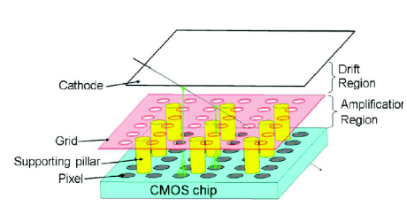
Coupling ERAMs + TIMEPIX4 chip
Applications
very fine grained tracker
and X ray detector
Resistive layer (DLC)
Insulating layer
Key points addressed (simulation and measurements) by TIMEPIX4
Choice of Diamond-Like-Carbon (DLC) resistivity
and thickness of insulator layer (between pads and DLC)
R x C => charge spread velocity
Geometry and dimension of grid/mesh with respect to pad
Geometry in order to avoid Moire`- like effect
➔ Build prototype
TIMEPIX4

Slide 36
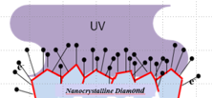
Coupling H-ND cathode + ERAMs + TIMEPIX4 chip
Applications
very fine grained photo-det
VUV-DUV imaging
Photo
Cathode
Resistive layer (DLC)
Insulating layer
Key points addressed (simulation and measurements) by TIMEPIX4
behavior of the hydrog. nano-diamond photo-cathode withT2K gas
study HV configuration and detector geometry for optimizing photo-electron collection and drift
➔ Build prototype
TIMEPIX4

Slide 37
TIMEPIX4 – WP2 timeline and milestones
TIMEPIX4

