Slide 1
RD MUCOL
M. Romagnoni rmgmrc@unife.it

Slide 2
Colliders high energy frontier
The evolution of high energy collider have exploited electron (positron), proton (anti-proton)
Electron/positron:
Circular Collider: limit on maximum energy (FCCee, CCC)
Linear Collider: single pass acceleration and single collision (ILC, CLIC)
Hadron :
Particle Internal structure: E_{cm} divided between partons (LHC,FCC-hh)
Using heavier fundamental particles such as Muon can overcome limitations of both e-/e+ and hadronic machines

Slide 3
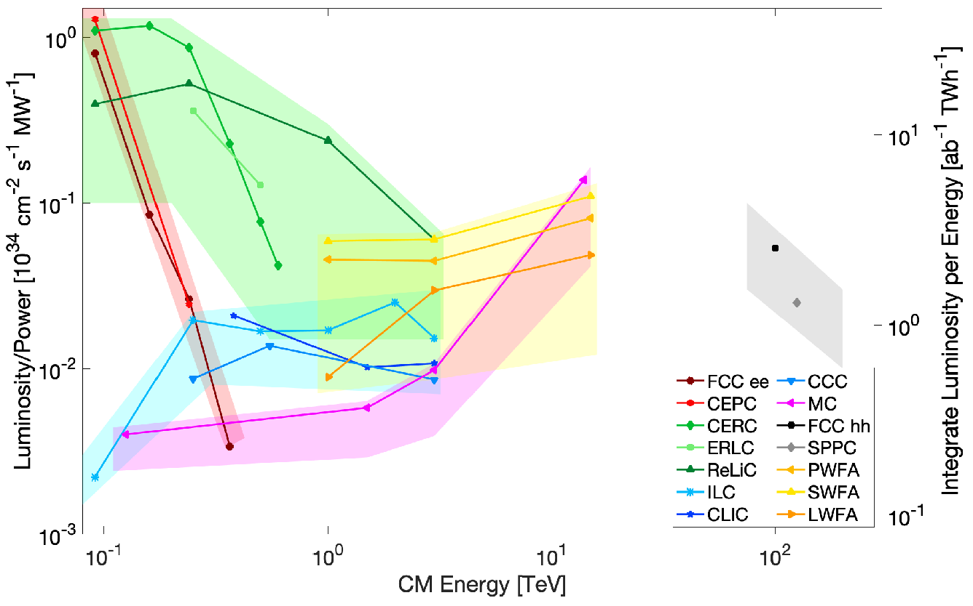
Muon Collider
Being more massive than electrons (positrons) radiation losses are reduced by a factor 10⁹
Being fundamental particle, all E_{cm} energy available in collision
High potential for physics studies and efficient luminosity vs energy scaling
More compact collider wrt hadron and e+/e- case
Thomas Roser et al., Report of the Snowmass 2021 Collider Implementation Task Force

Slide 4
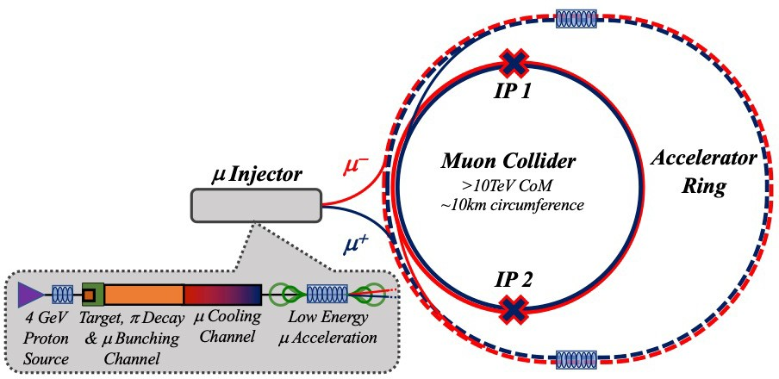
Muon Collider Schematic
First stage at E_{cm}= 3TeV, followed by a scale up to E_{cm}=10TeV (only collider ring not re-usable)
Footprint ~30km circumference

Slide 5
Beam Collimation with bent crystals
Bent crystal are powerful tool to deflect high energy particles
Test at LHC proved effectiveness at TeV scale for positive particles
Can muon in a future muon collider be efficiently deflected by bent crystal?
NEW CHALLENGE: STEERING OF NEGATIVE PARTICLE

Slide 6
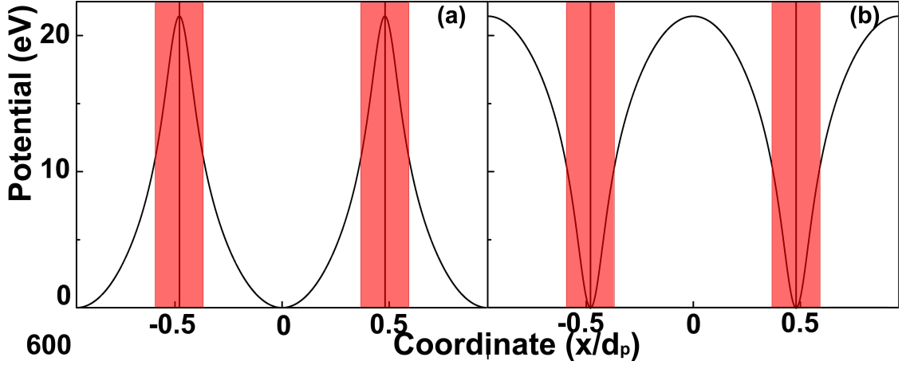
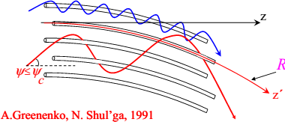
Negative particle steering
May 29, 2024 Laura Bandiera, INFN Ferrara
9
Planar channeling is significantly less efficient for negative particles, as incoherent scattering with atomic nuclei is enhanced instead of being suppressed.
Axial Stochastic Deflection was first proposed by А.А. Greenenko and N.F. Shul’ga in 1991
Experimentally observed by H8-RD22/UA9 collaboration at CERN in 2008 for protons and in 2009 for π– mesons
The mechanism involve over-barrier motion: particles scattering converge stochastically along the axis direction. Efficient for both positive and negative particles

Slide 7
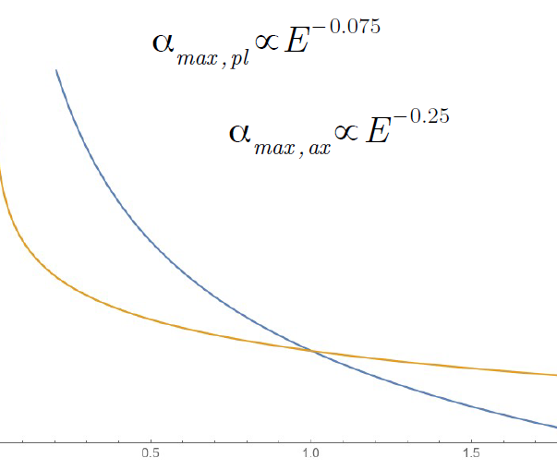
Axial Stochastic Deflection and Planar channeling
Negative particles in planar channeling exploit weaker potential and more incoherent nuclear scattering wrt positive case
Stochastic axial deflection has the potential to steer efficiently both negative and positive particles
Maximum deflection angle scale with different power law: E^{-0.075} (planar) vs E^{-0.25} (axial)

Slide 8
Comparison of planar and axial stochastic deflection at 1 TeV
A large simulation campaign has been carried out with both muon and anti-muon of 1 TeV/c momentum
Optimal radius of curvature has been obtained for deflection angles from 2 μrad up to 200 μrad
Cases for 200μrad, 50μrad are presented as example in this work

Slide 9
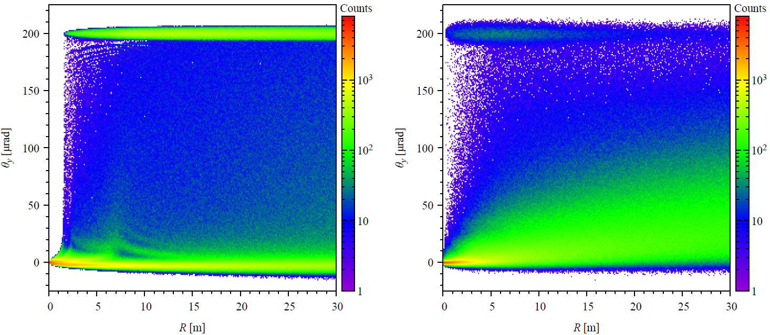
Large angle deflection μ- (200μrad)
(111) plane
<110> axis
Courtesy of I. Kyryllin
Better single pass efficiency with planar channeling
Optimal radius of curvature for R ~6-7m

Slide 10
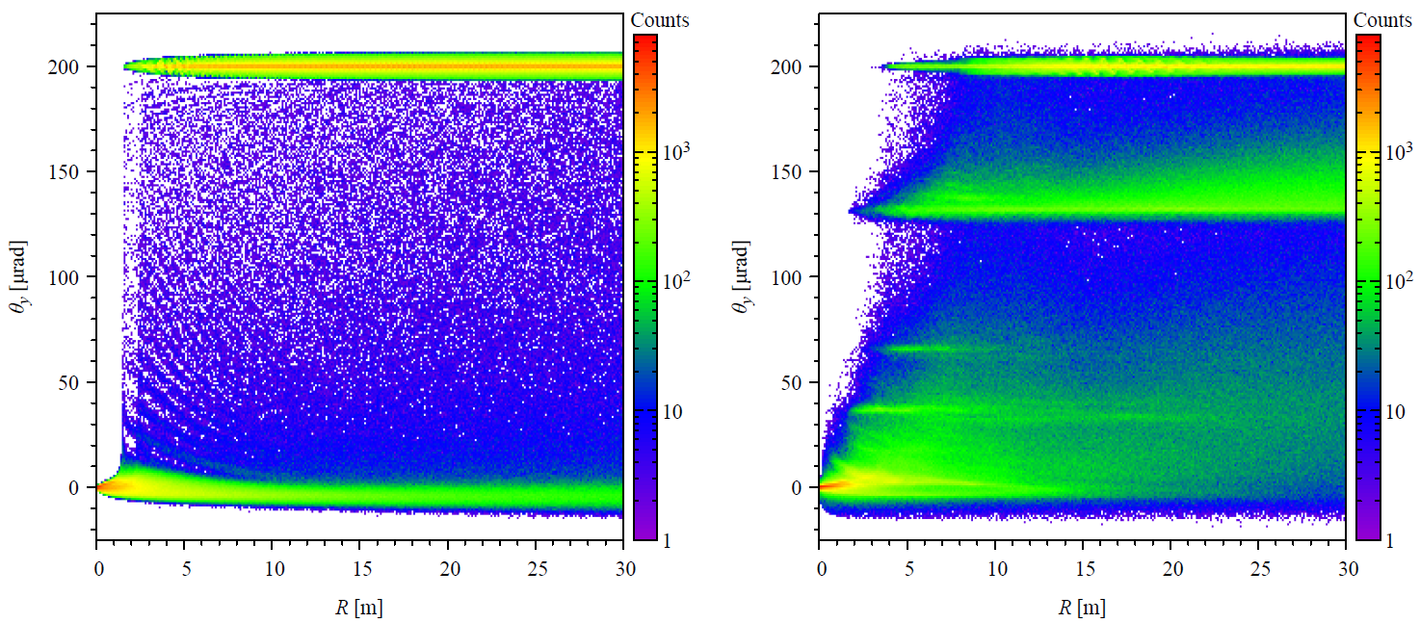
Large angle deflection μ+ (200μrad)
(111) plane
<110> axis
Courtesy of I. Kyryllin
Better single pass efficiency with planar channeling
Optimal R between 15-20m

Slide 11
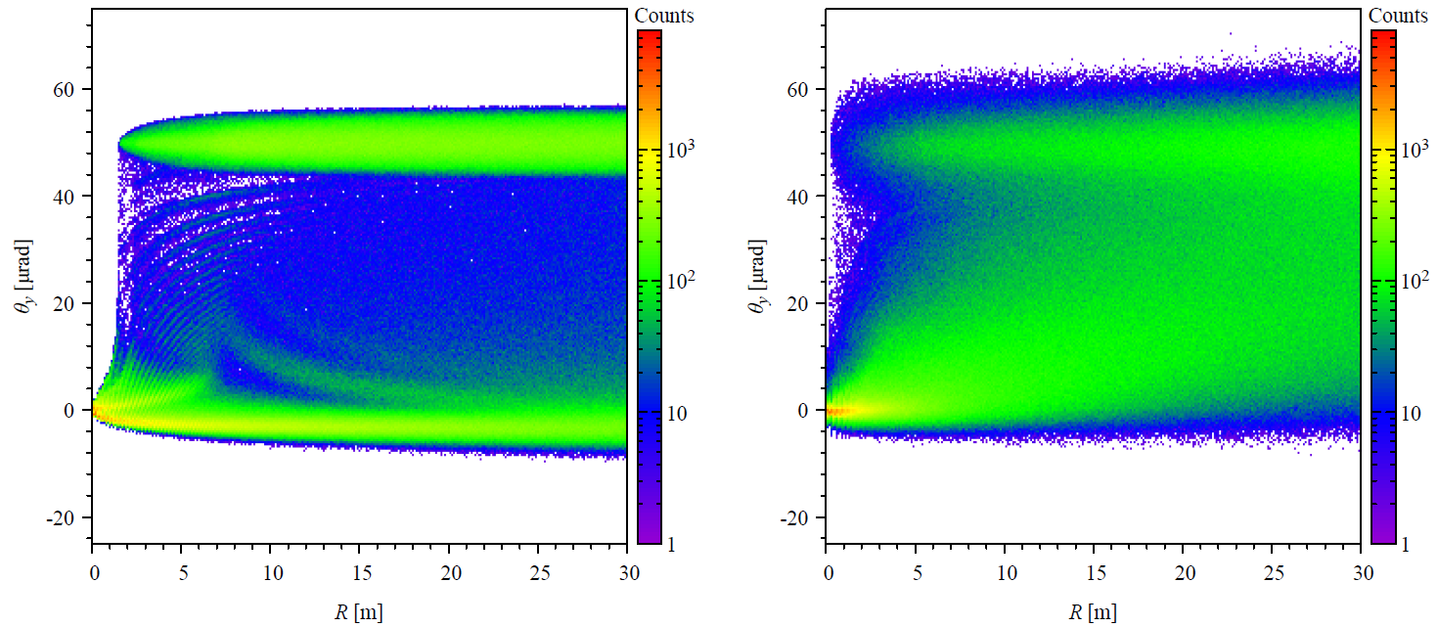
Small angle deflection μ- (50μrad)
(111) plane
<110> axis
Courtesy of I. Kyryllin
Better single pass efficiency with planar channeling
Optimal R between 20-25m

Slide 12
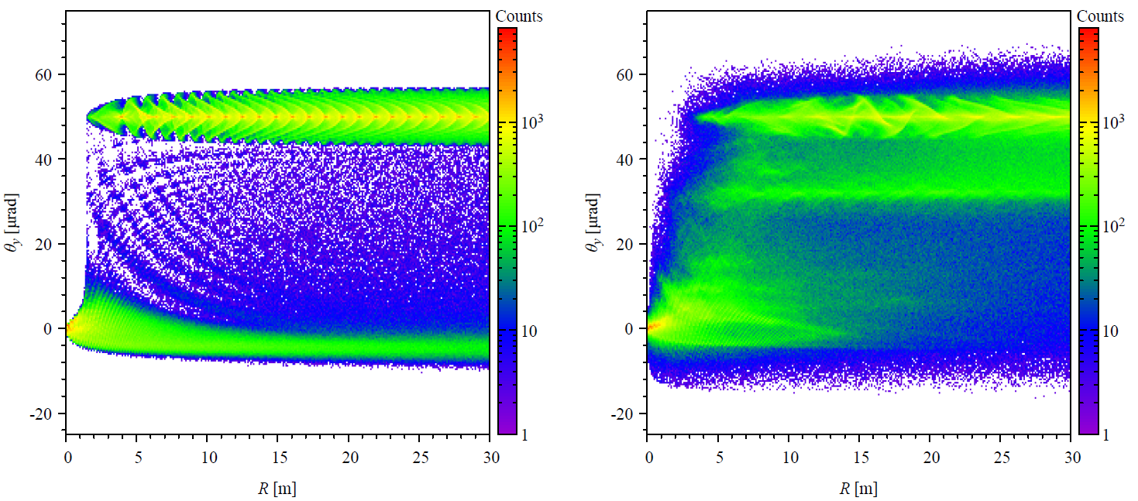
Small angle deflection μ+ (50μrad)
(111) plane
<110> axis
Courtesy of I. Kyryllin
Better single pass efficiency with planar channeling
Optimal R between 15-20m

Slide 13
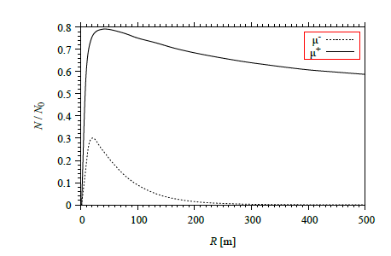
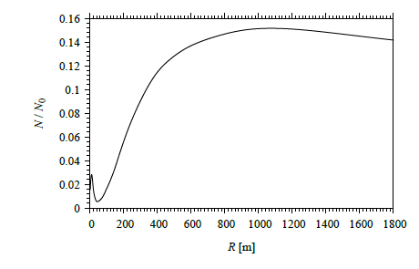
Planar vs Axial
PLANAR CASE
AXIAL CASE
https://doi.org/10.1016/j.nima.2025.170385

Slide 14
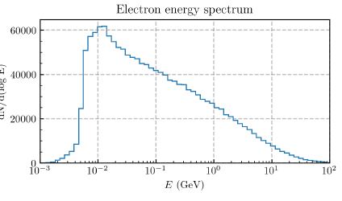
Next year
Study on other coherent effect for primary beam AND beam induced background (incoherent pairs)
Collaboration with testbeam of other groups (sj)
No services required

