Slide 1
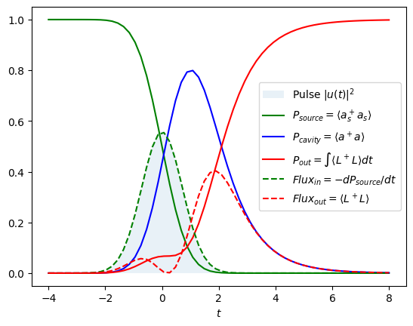
Source + Cavity (no qubit)
$$H=i\frac{\sqrt{k}}{2}\left(a_{in}^{+}a−a_{in}a^{+}\right) \\ L=\sqrt{k}a+g\left(t\right)a_{in}$$
$${dρ}/{dt}=−i\left[H,ρ\right]+LρL^{+}−\frac{1}{2}\{L^{+}L,ρ\}$$
$$u\left(t\right)=\frac{e^{−\frac{1}{2}t^{2}}}{\sqrt[4]{π}}$$
$$g\left(t\right)={u\left(t\right)}/{\sqrt{1−\int_{−∞}^{t}{dt^{′}{\left|u\left(t^{′}\right)\right|}^{2}}}}$$
Density matrix

Slide 2
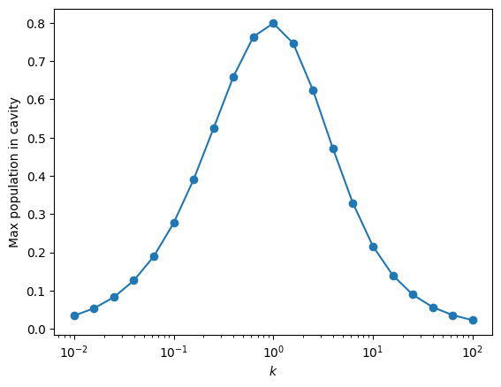
Source + Cavity (no qubit) – optimal transfer
Maximum transfer for $k=1$ (suboptimal with gaussian pulse, around 0.8)

Slide 3
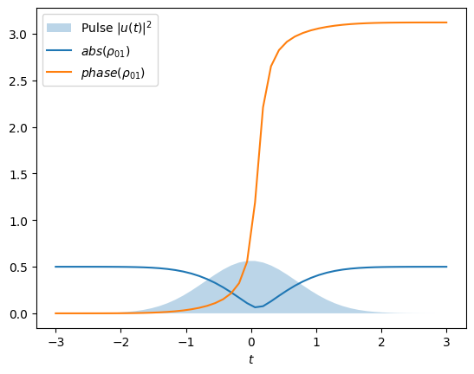
Source + Cavity + Single qubit
$$H=i\frac{\sqrt{k}}{2}\left(a_{in}^{+}a−a_{in}a^{+}\right) −\frac{χ}{2} a^{+}a σ_{z} \\ L=\sqrt{k}a+g\left(t\right)a_{in}$$
$${dρ}/{dt}=−i\left[H,ρ\right]+LρL^{+}−\frac{1}{2}\{L^{+}L,ρ\}$$
$$u\left(t\right)=\frac{e^{−\frac{1}{2}t^{2}}}{\sqrt[4]{π}}$$
$$g\left(t\right)={u\left(t\right)}/{\sqrt{1−\int_{−∞}^{t}{dt^{′}{\left|u\left(t^{′}\right)\right|}^{2}}}}$$
k=10, $χ=k$
Source and cavity traced off

Slide 4
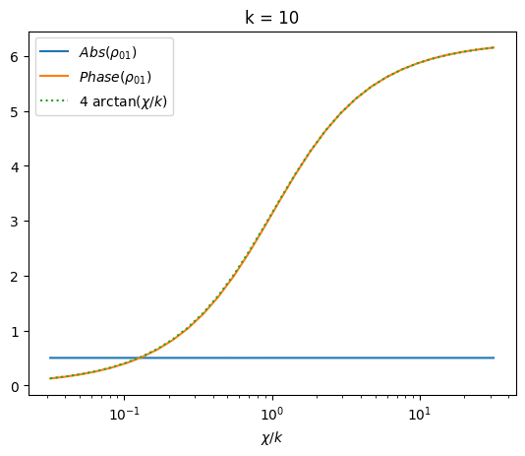
Source + Cavity + Single qubit – Sweep on $χ/k$
Empirical curve:
$$phase\left(ρ_{01}\right)=4\arctan\left(\frac{χ}{k}\right)$$

Slide 5
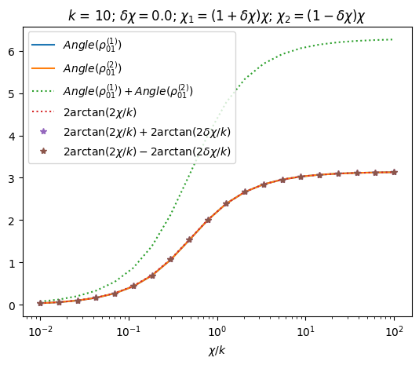
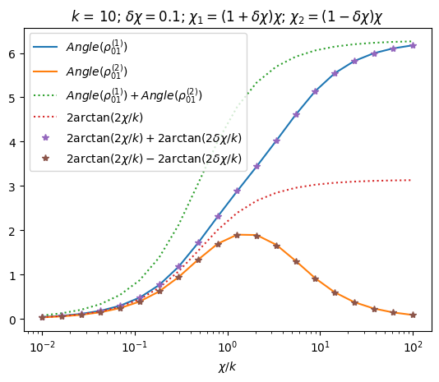
Source + Cavity + Two qubits – Sweep on $χ/k$
Empirical curves:
$$phase\left(ρ_{01}^{A}\right)=2\arctan\left({2χ}/k\right)+2\arctan\left({2δχ}/k\right)$$
$$phase\left(ρ_{01}^{B}\right)=2\arctan\left({2χ}/k\right)−2\arctan\left({2δχ}/k\right)$$
$$χ=\frac{χ_{1}+χ_{2}}{2}$$
$$δχ=\frac{χ_{1}−χ_{2}}{2χ}$$

Slide 6
Source + Cavity + Single qubit – Density matrix evolution

Slide 7
Source + Cavity + Single qubit – Bell state – Density matrix evolution

