Slide 1
ASPIDES meeting 5
Tommaso Floris
05/06/2025

Slide 2
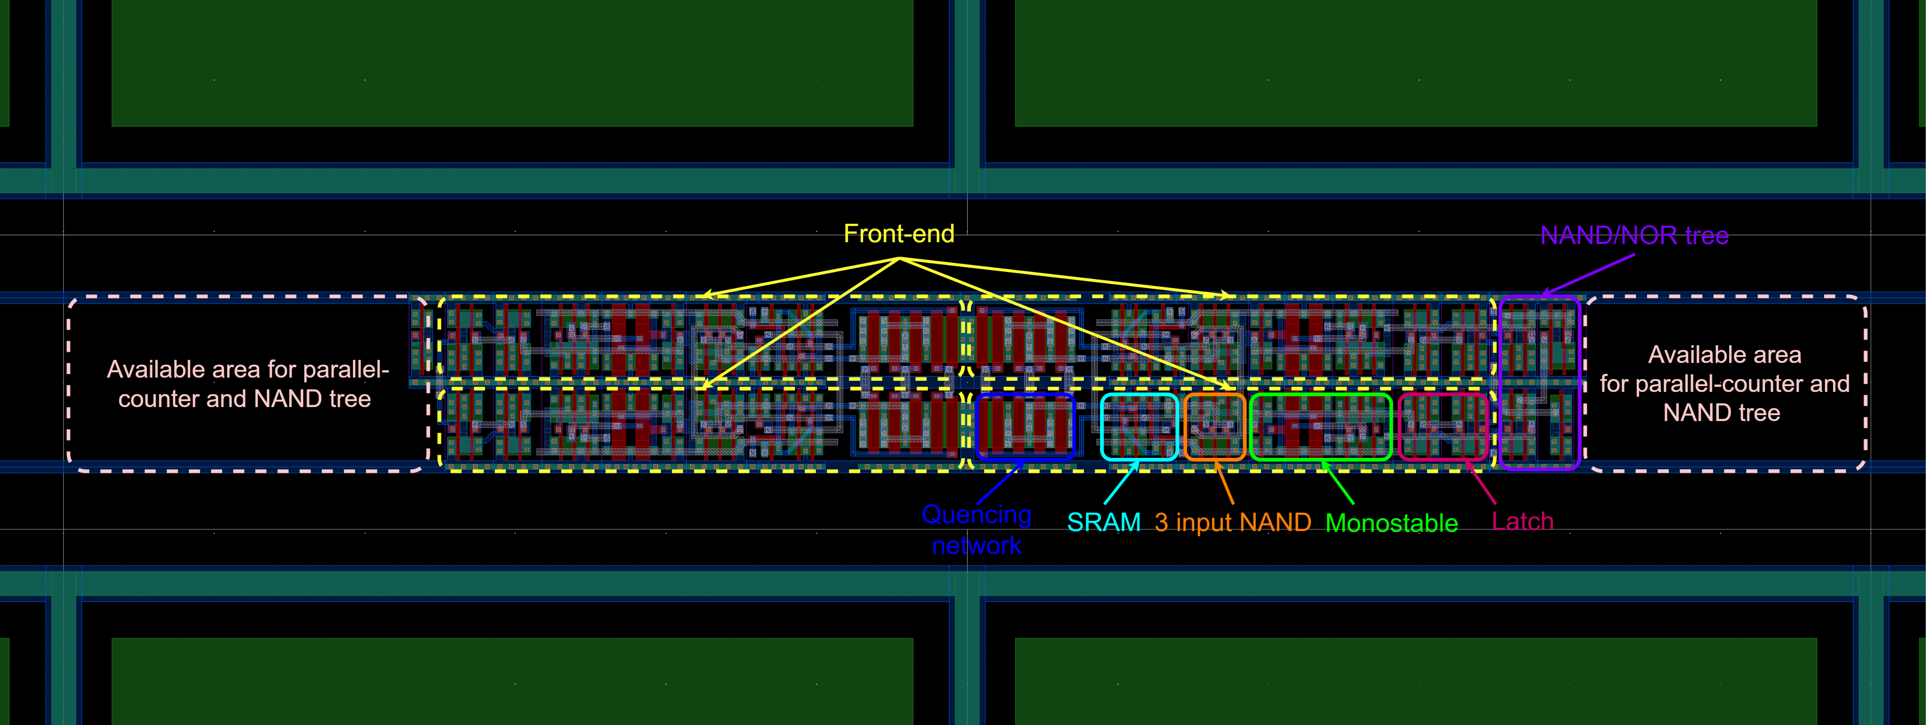
Front-end electronics

Slide 3
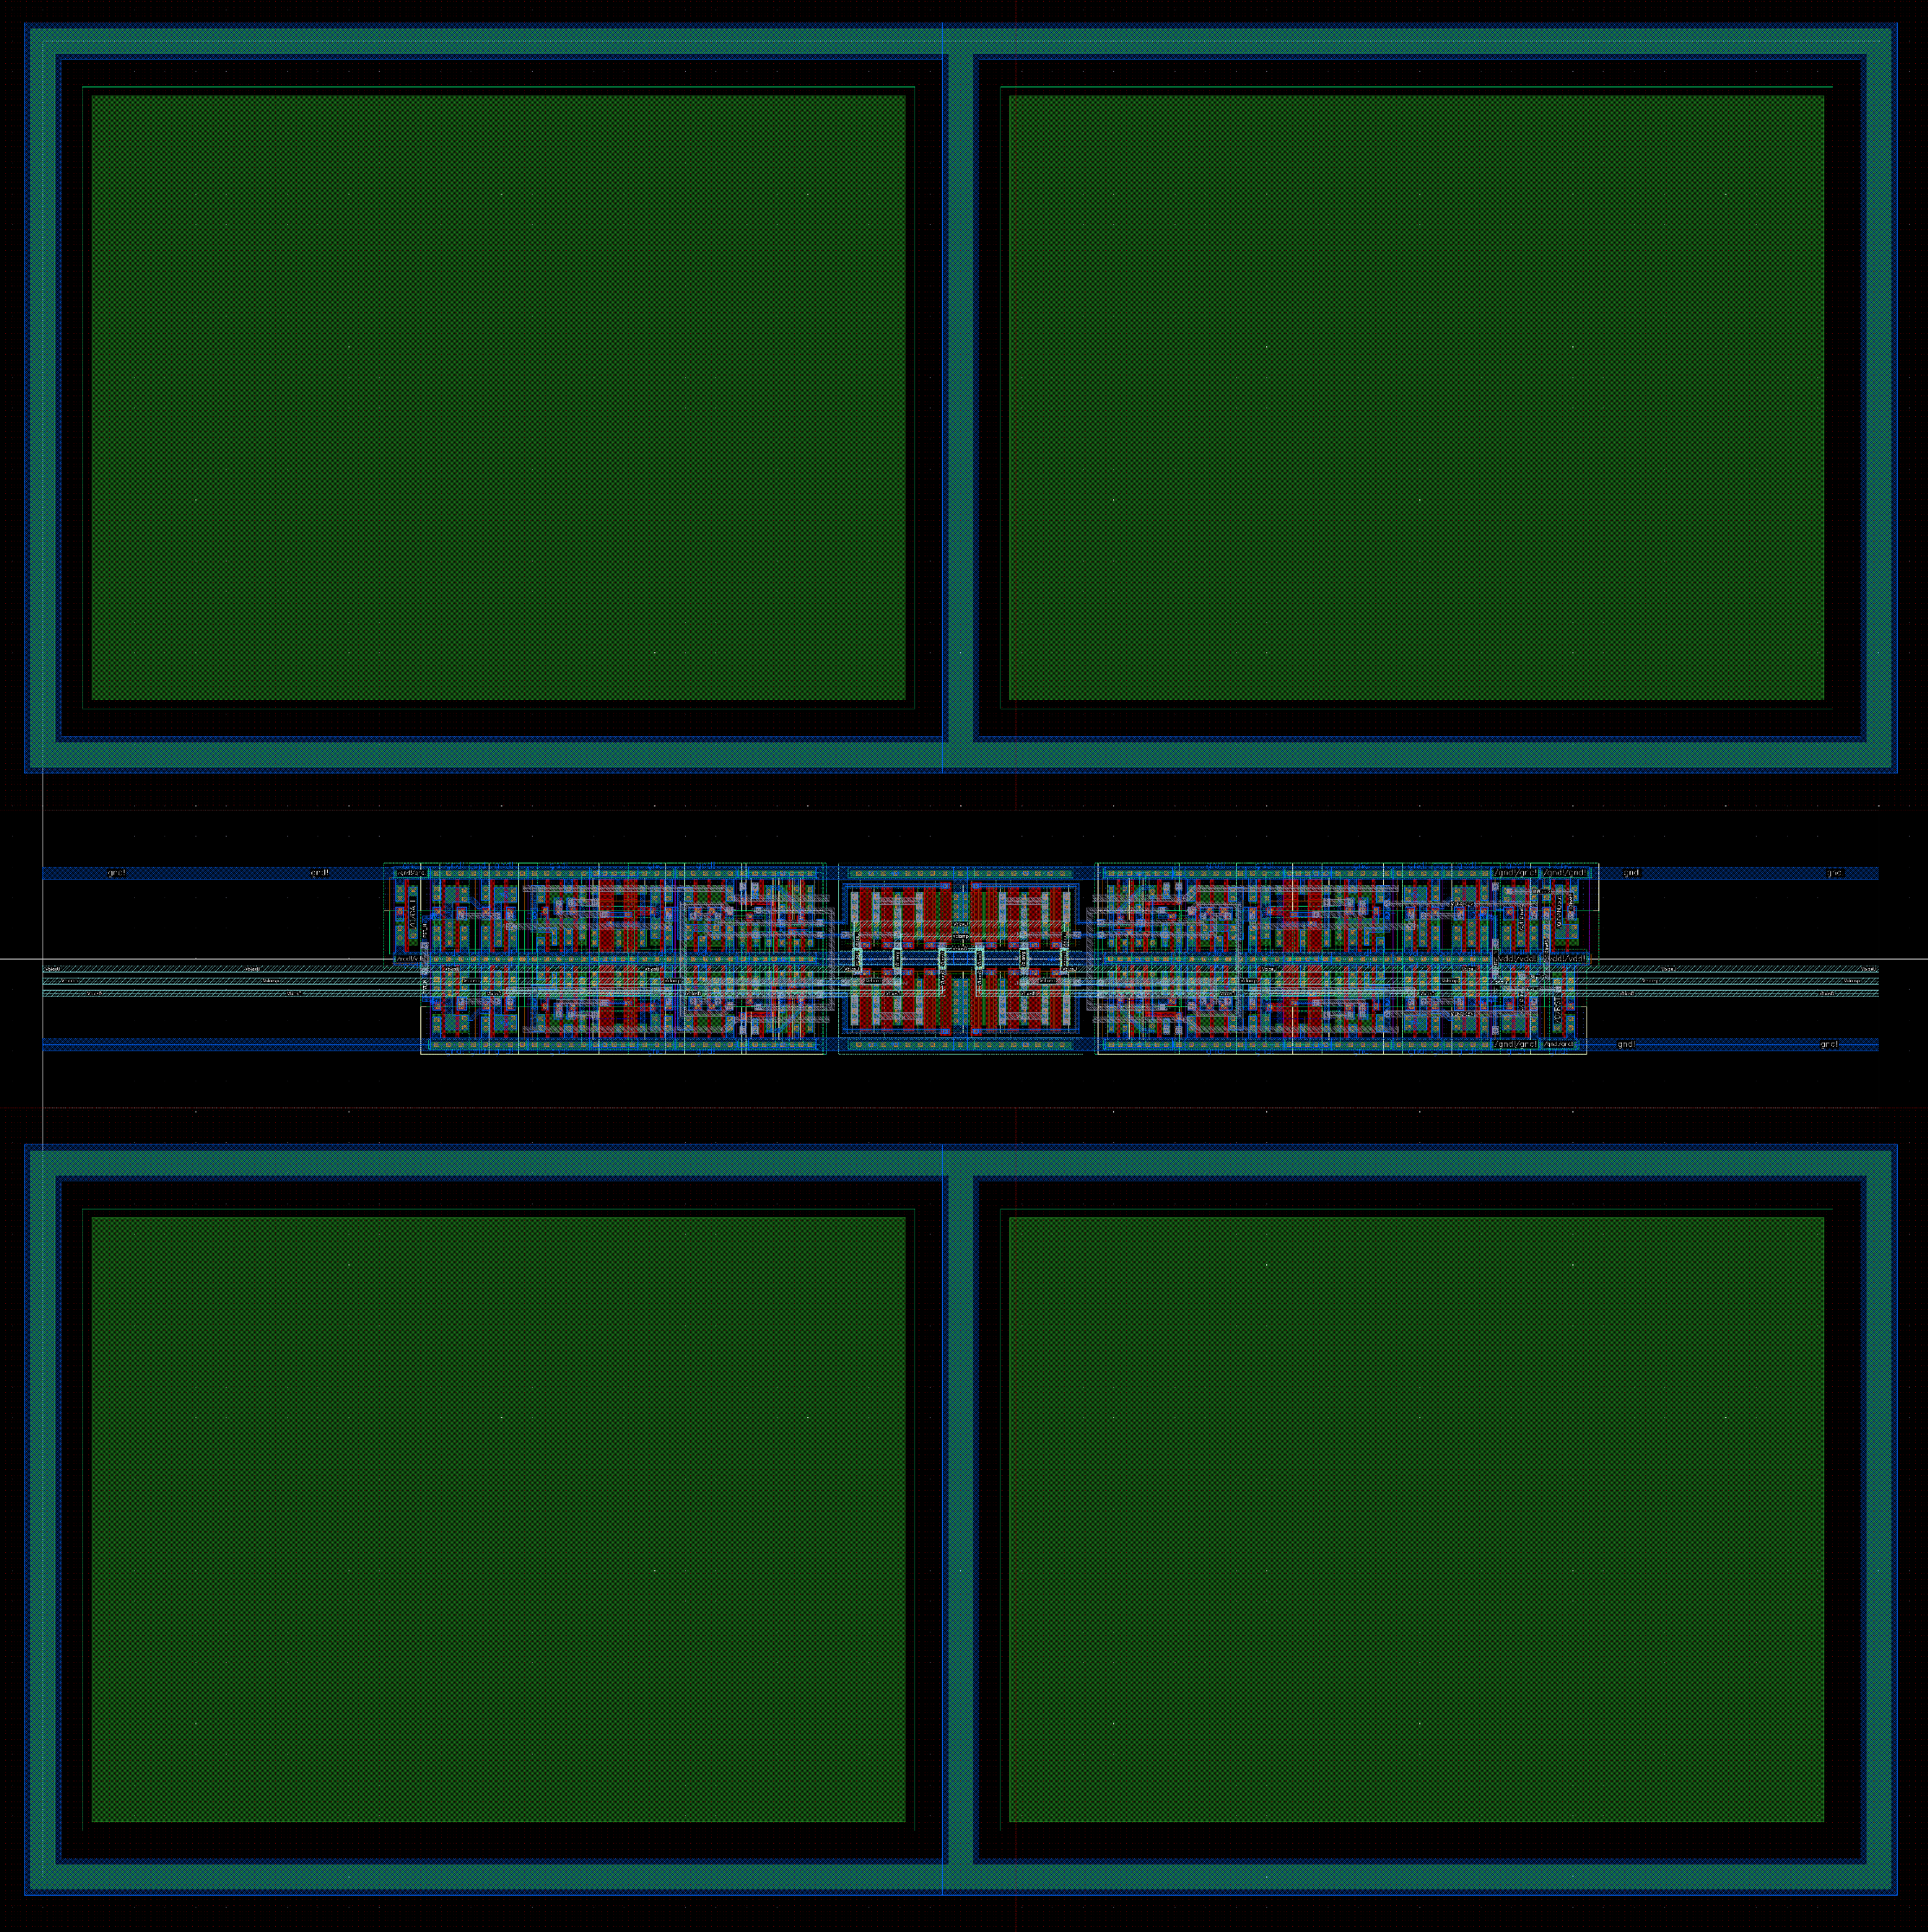
Pixel 2x2 cluster
FF = 58 %
FF = 48 %

Slide 4
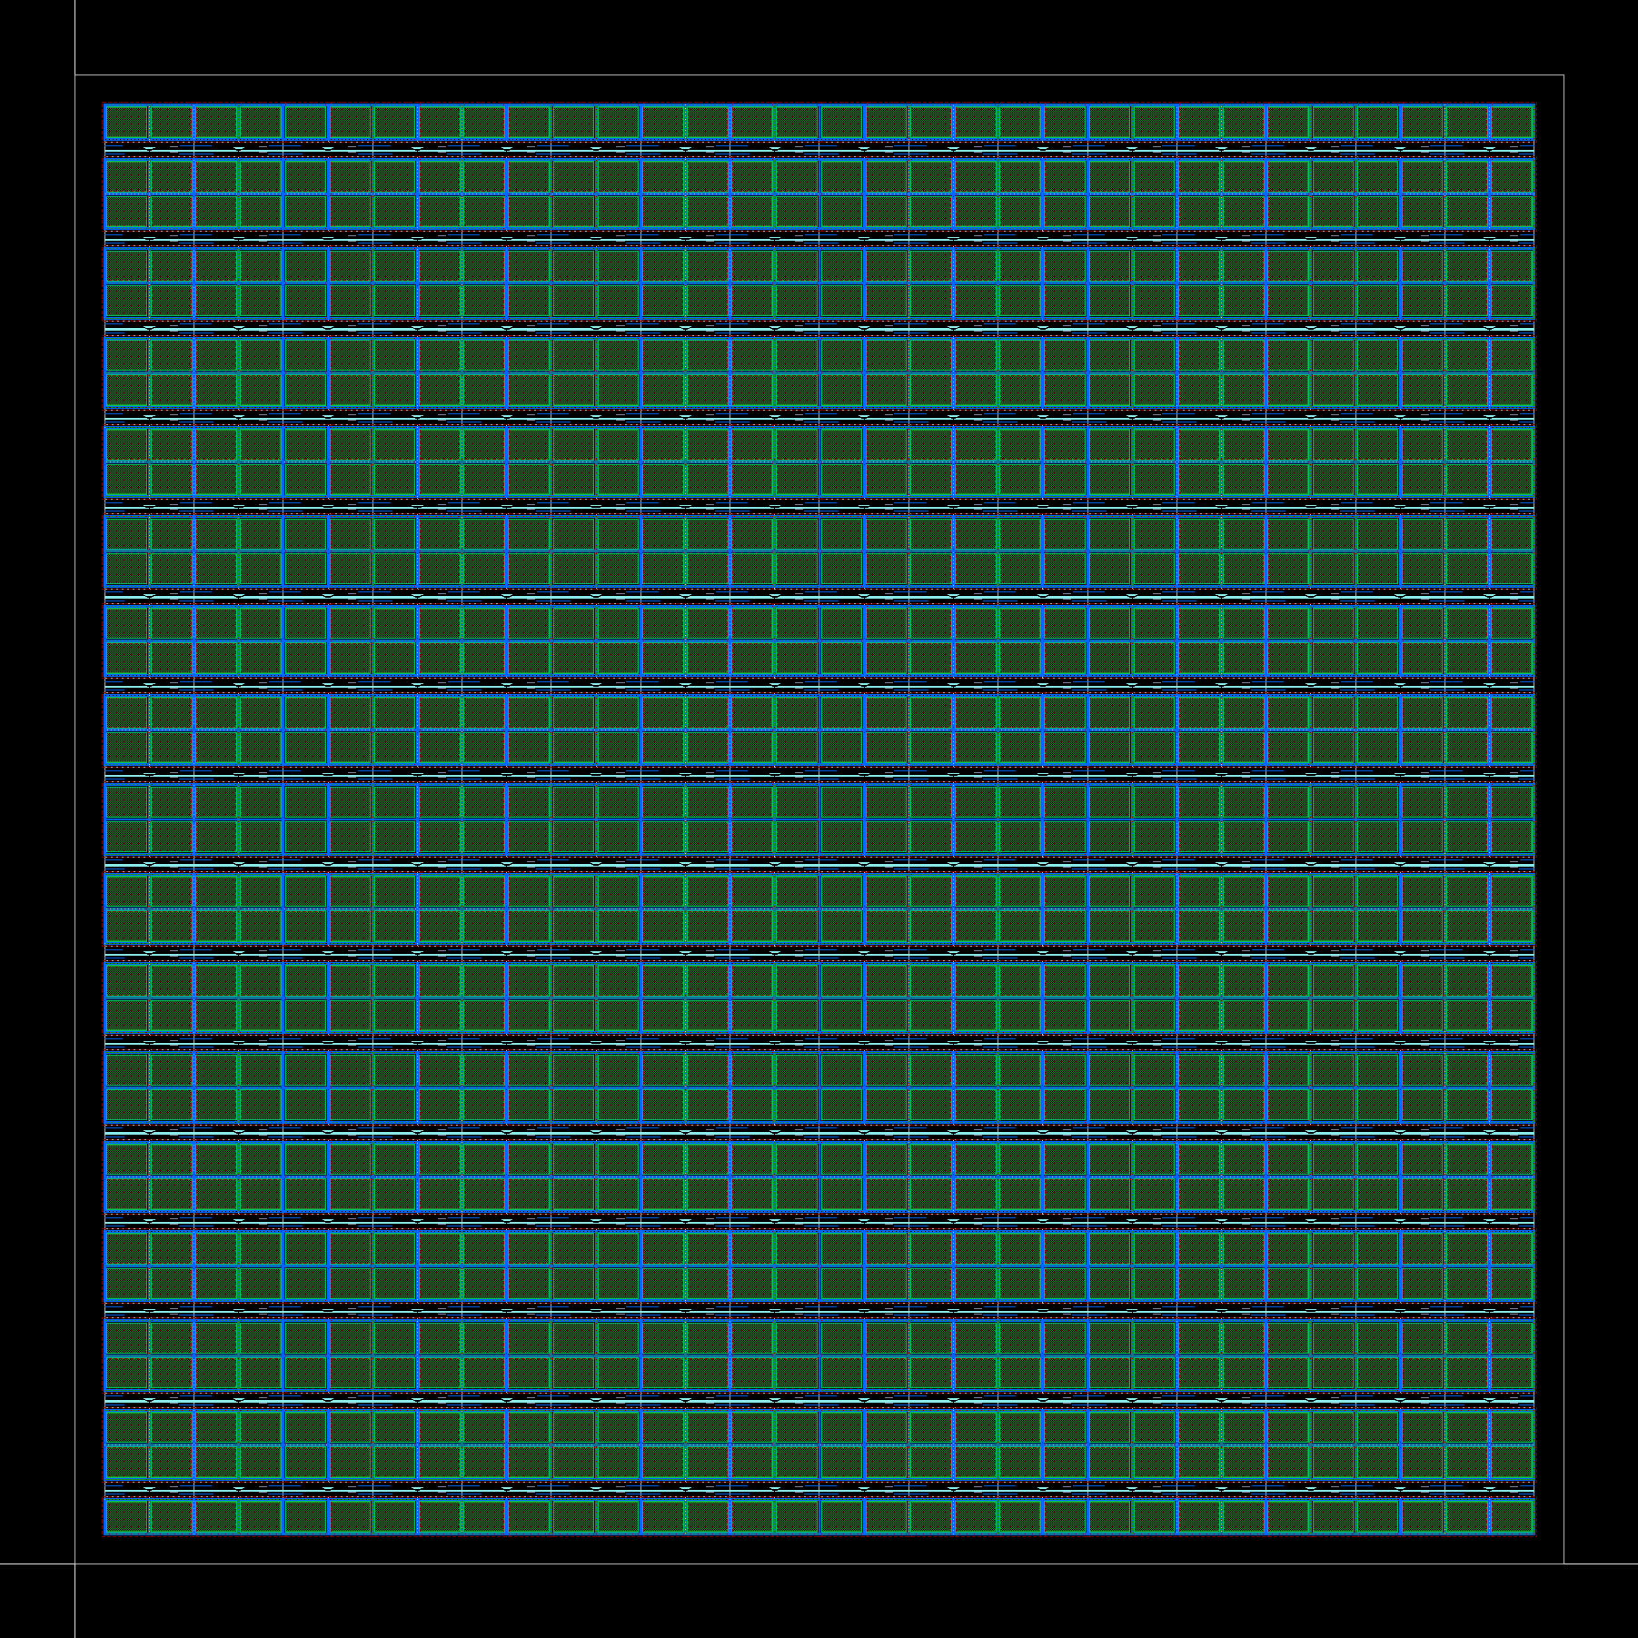
Preview of the 32x32 pixel array

Slide 5
Detail of the array

Slide 6
ASPIDES meeting 5
Tommaso Floris
05/06/2025

