Slide 1
R&D activities @ LNGS
Davide Fiorina – GSSI & INFN LNGS

Slide 2
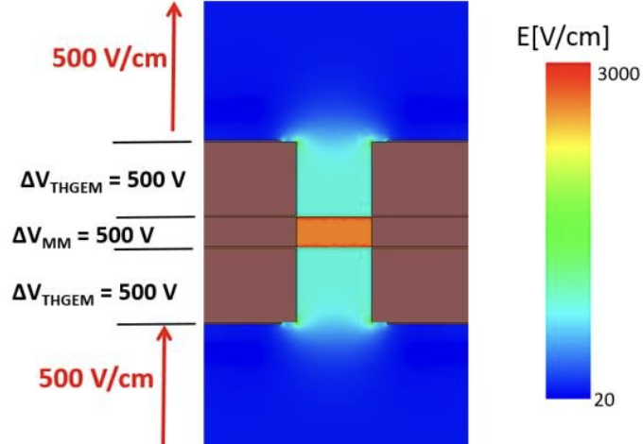
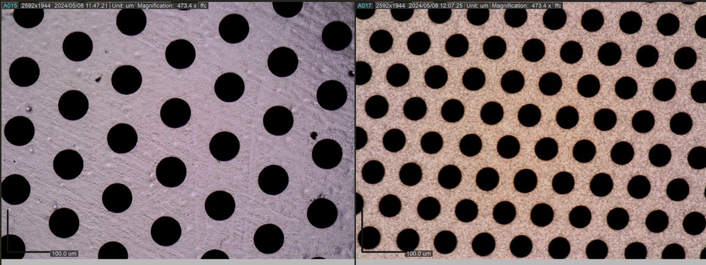
Tests foreseen
Check Primary Scintillation light with PMT instead of camera
  Through the camera hole removing the GEM
  Easy test to crescheck and thest the feasibility
CYGNO04 optimization
  Absolute saturation measurement
  Fields optimization
  Fine pitch GEMs
NID
  Fine-pitch GEMs to crosscheck diffusion behviour
  Better alpha alogment and repetibility
  MMThGEM
Polarimetry
  Incredibly promising result, ready for grant proposal
  Overview of R&D

Slide 3
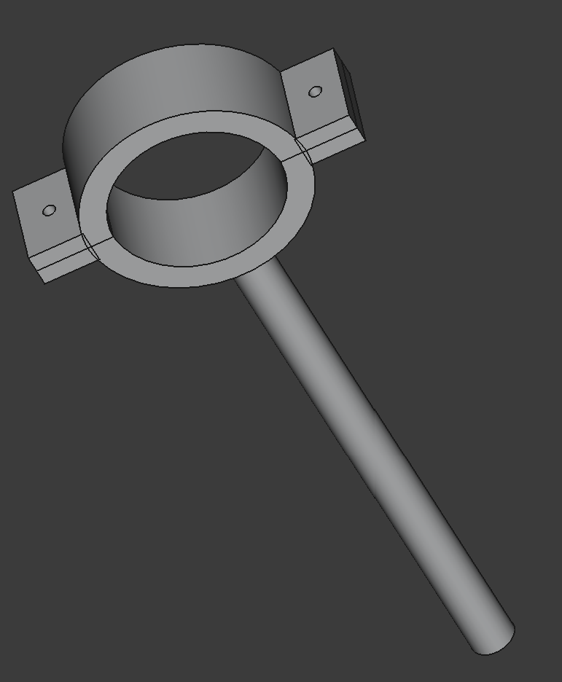
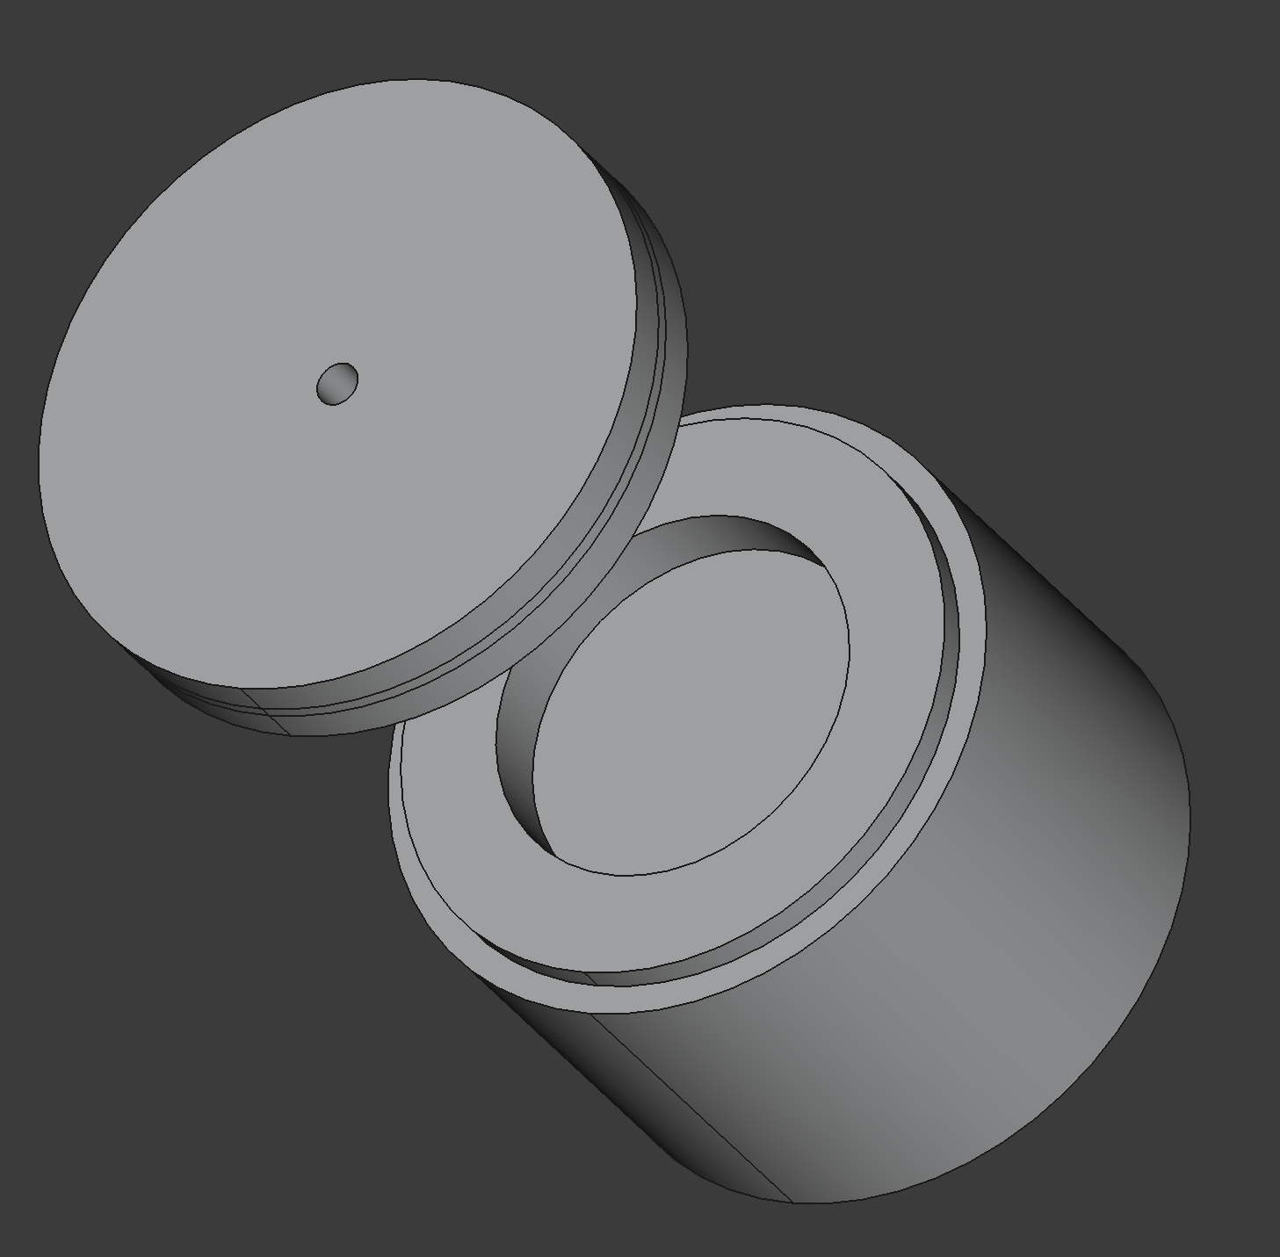
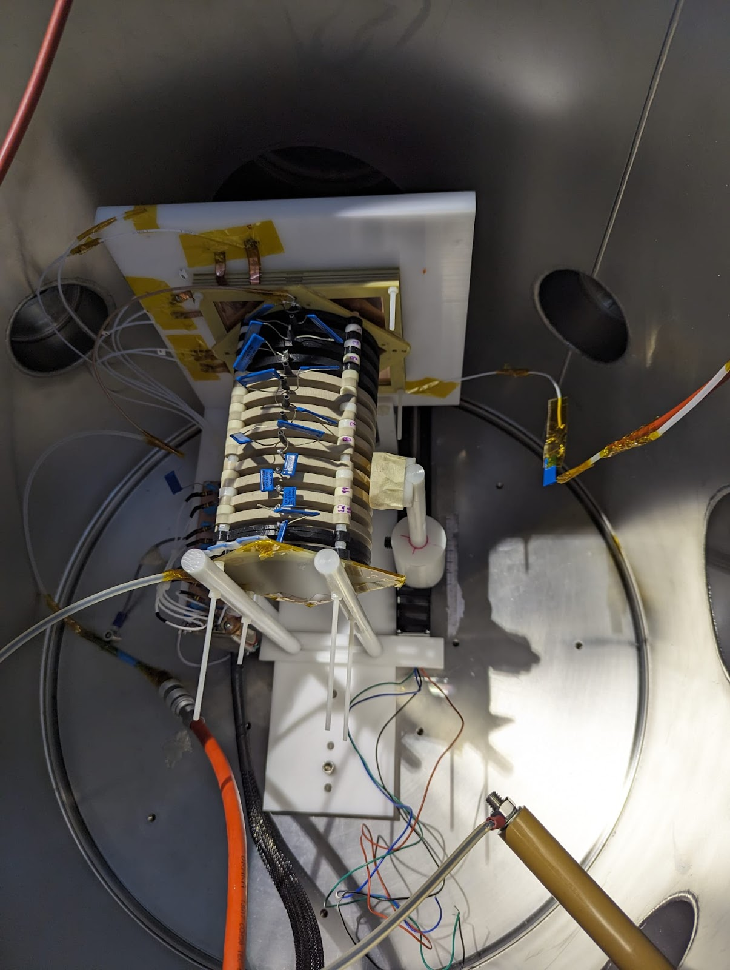
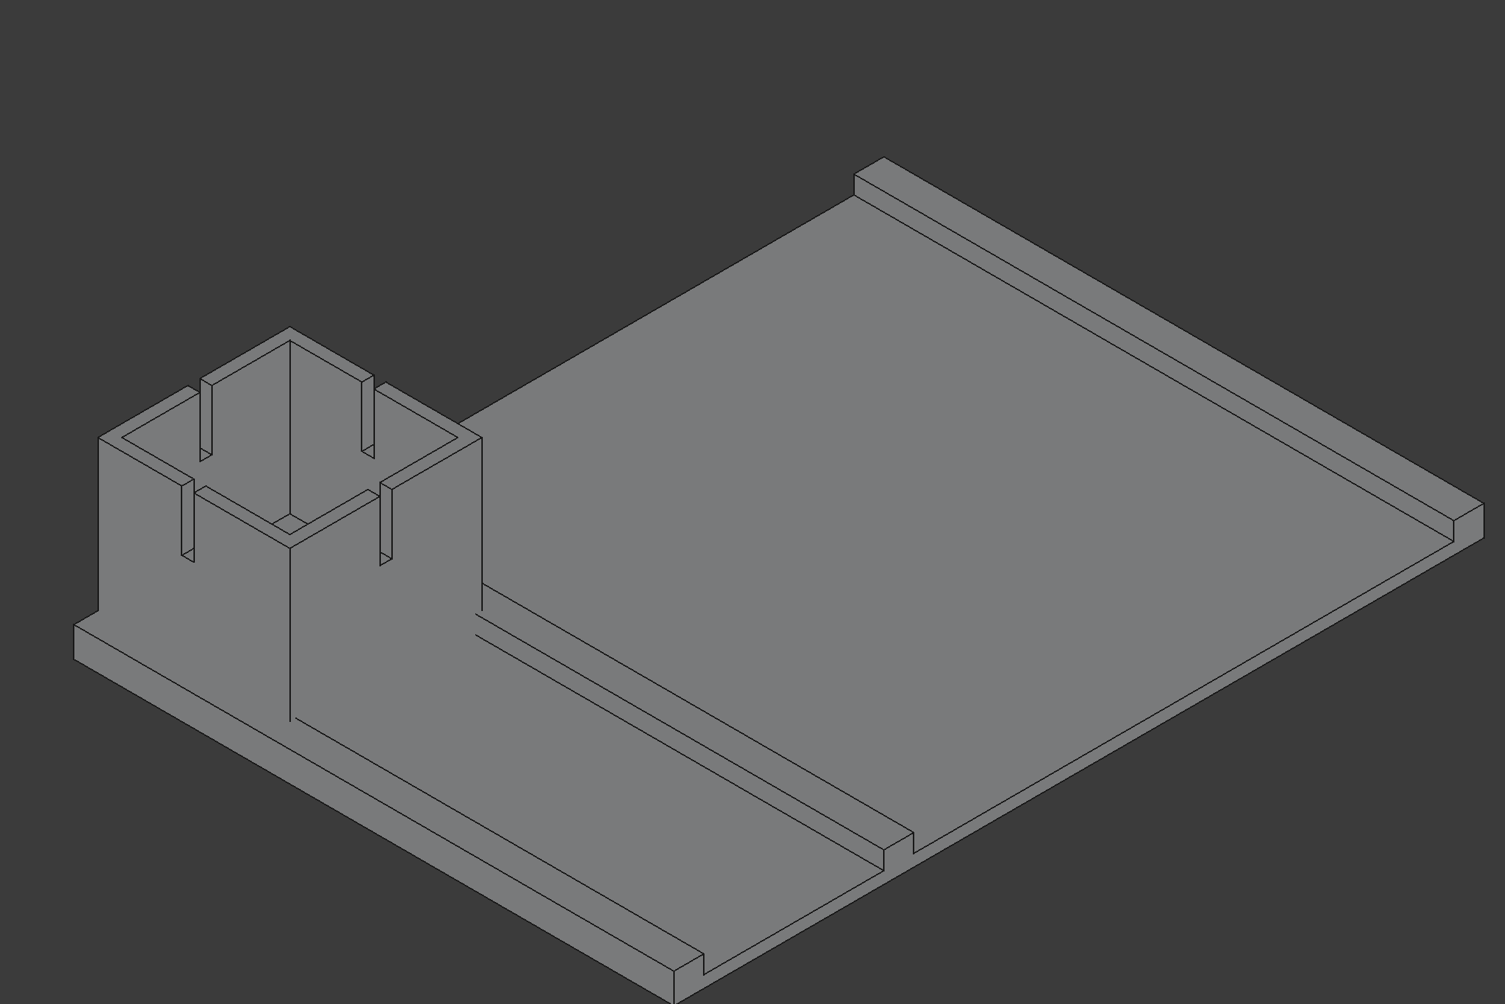
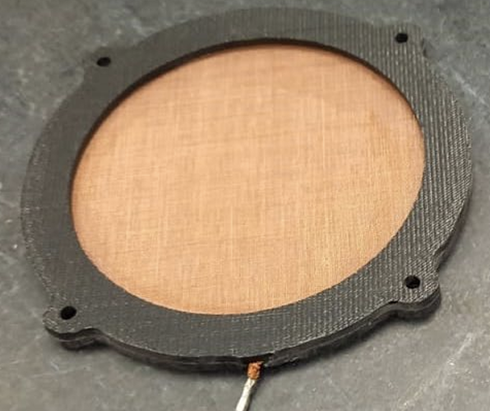
NID alignement
Lack of alignement ~mm
Lack of repetibility (placement by hand)
3D printed base for detector and actuator aligment ~100um
Alpha collimation as much as we want
Trasparent catode (mesh)
Gain space for 1 additional hole
Try to see primary scintillation with SiPM
Shoot alpha perpendicular to GEM
Actuator
Detector space
Source holder
Detector space
Actuator

Slide 4
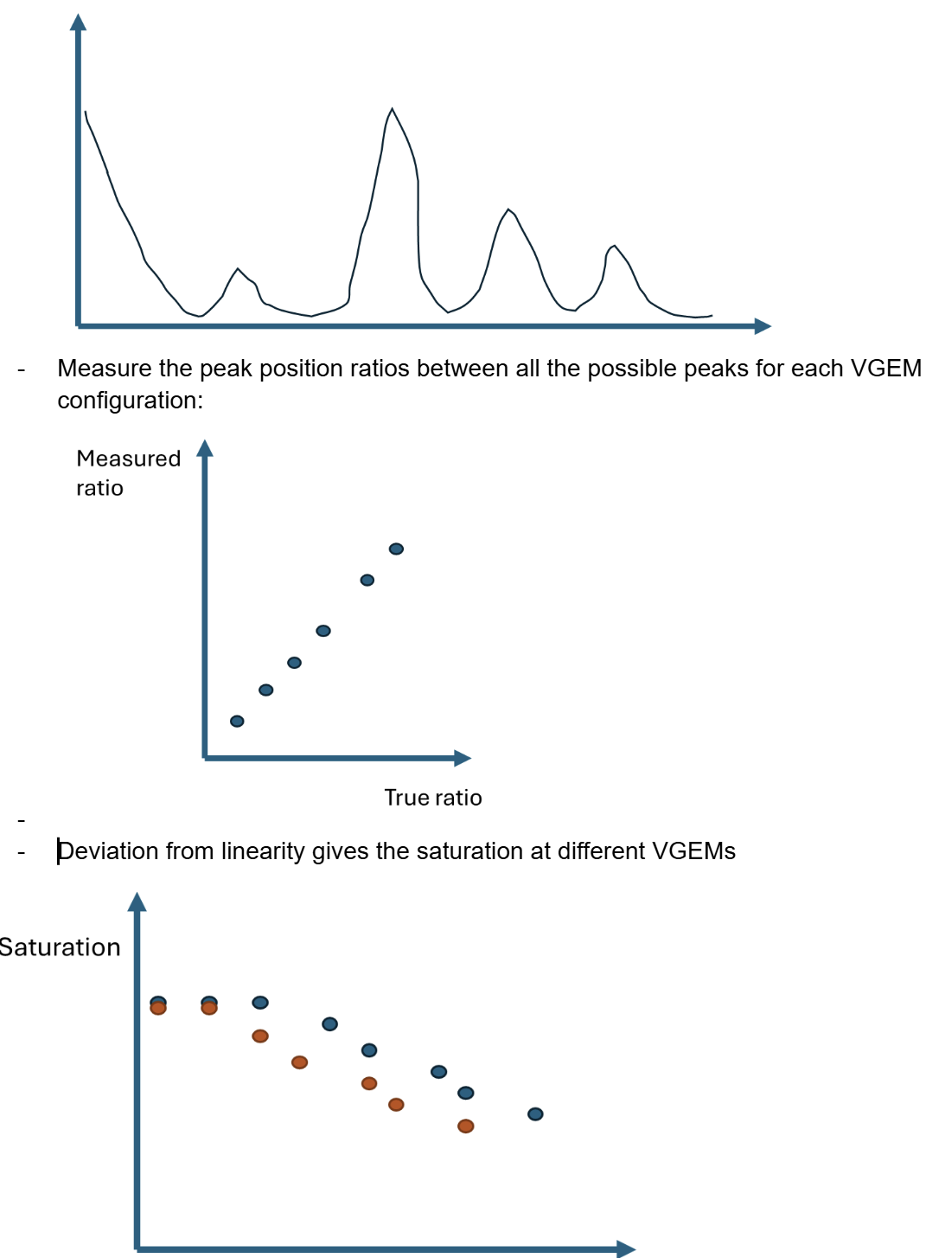
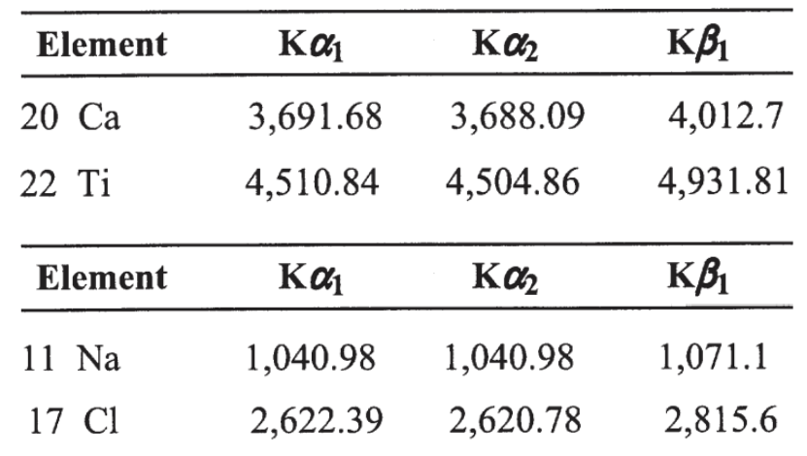
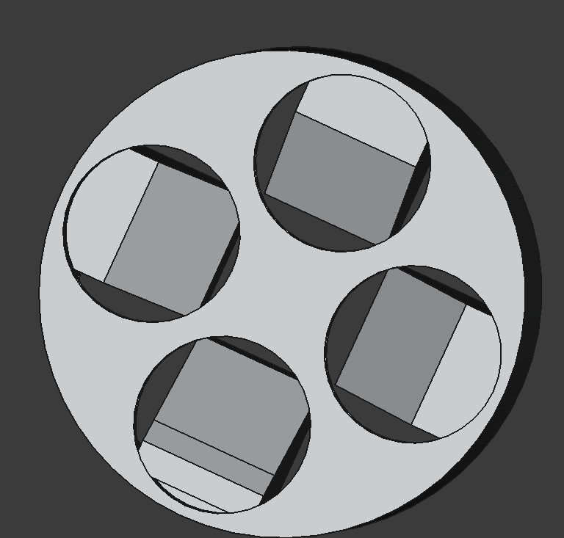
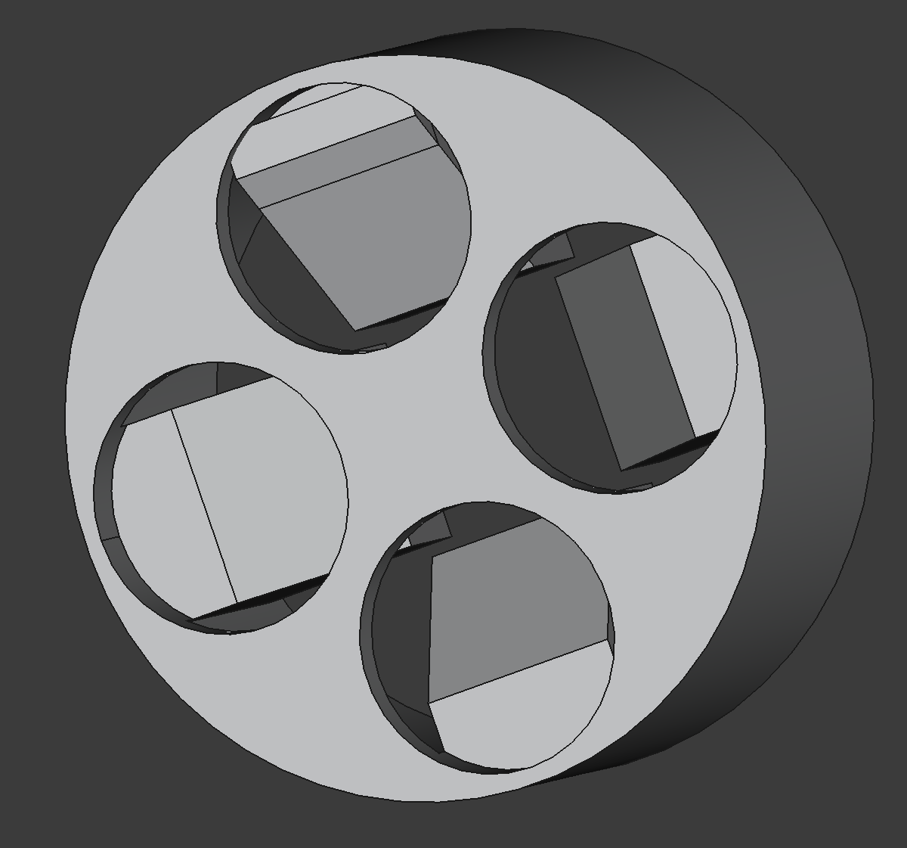
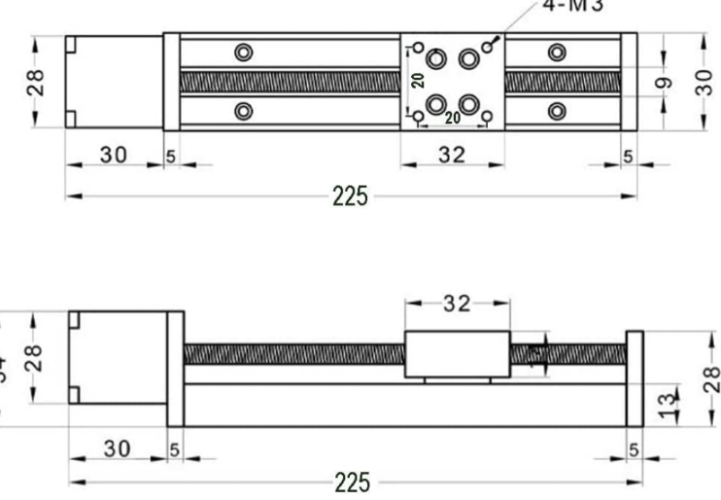
Saturation
Direct measurement of absolute saturation
Low energy X-rays peaks spectrum (charge+light)
Peak positions wrt real ratios gives the Absolute saturation
Alpha source shooting to a 45° inclined target emitting fluorecence
Rotating holder already printed and integrated in MANGO DAQ
Target procured!
Only testing is needed ;)
target
alpha
fiorotto8/LinearMovementArduino

Slide 5

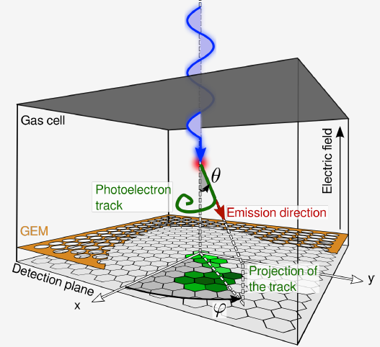
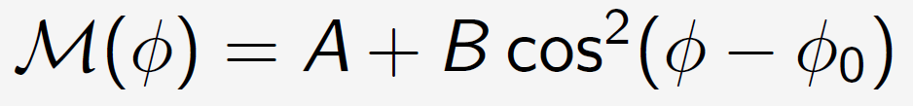

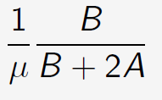
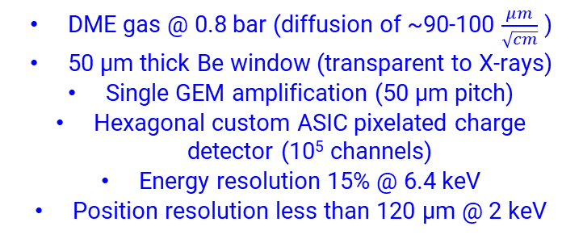
Polarimetry
The Imaging X-ray Polarimetry Explorer (IXPE) was launched in December 2021
3 Photoelectric detectors (GPD) in the optics of 3 mirror telescopes (reduces background, focuses sources)
Onboard calibration system with polarized and unpolarized sources
Polarization Angle
B
DME gas @ 0.8 bar (diffusion of ~90-100 $\frac{μm}{\sqrt{cm}}$ )
50 µm thick Be window (transparent to X-rays)
Single GEM amplification (50 µm pitch)
Hexagonal custom ASIC pixelated charge detector (10⁵ channels)
Energy resolution 15% @ 6.4 keV
Position resolution less than 120 µm @ 2 keV
A
Polarization Degree
Modulation Factor

Slide 6
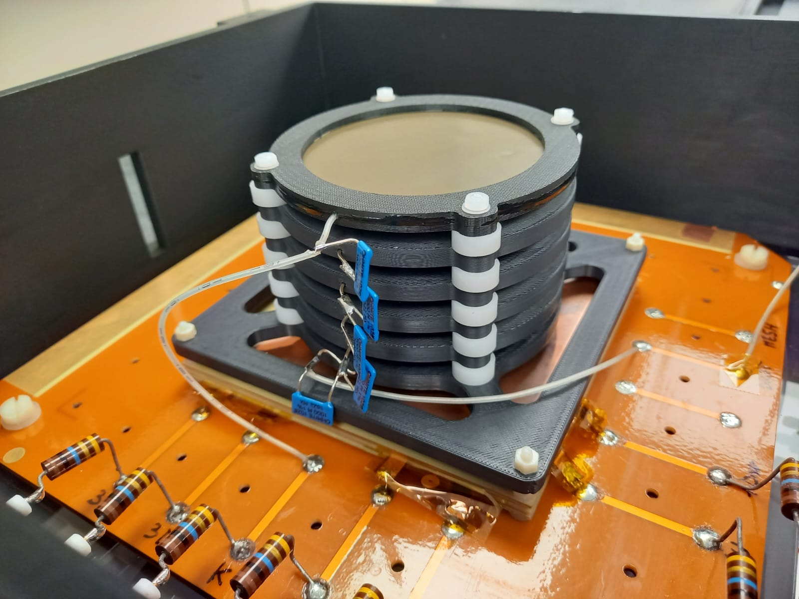
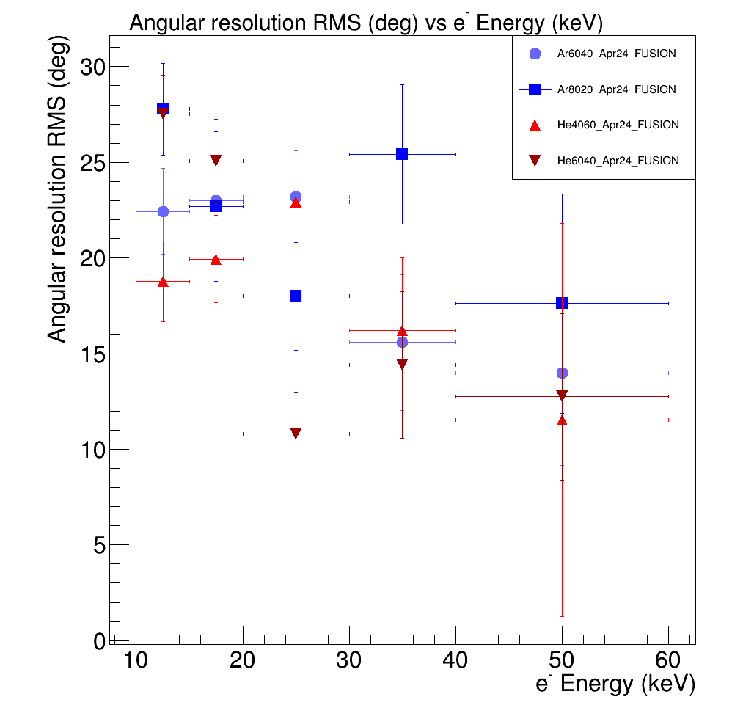
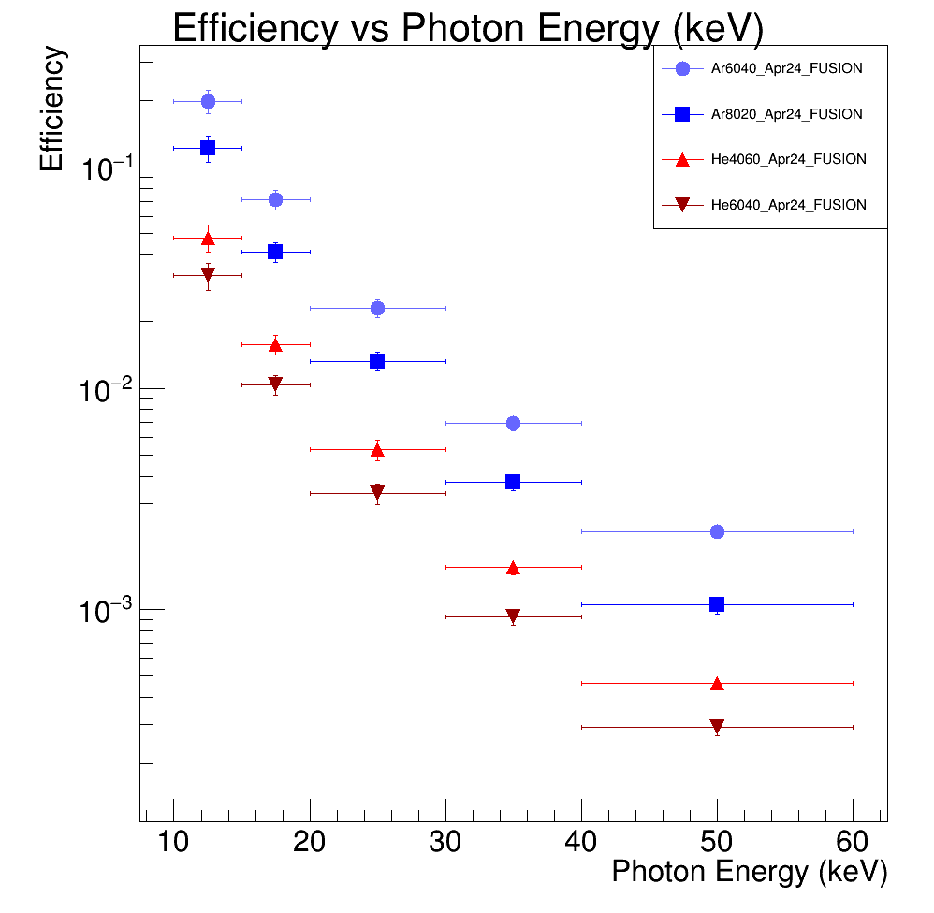
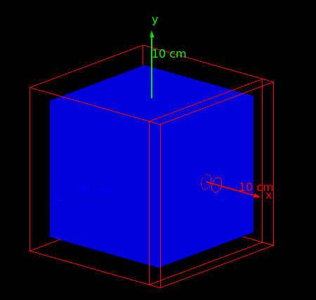
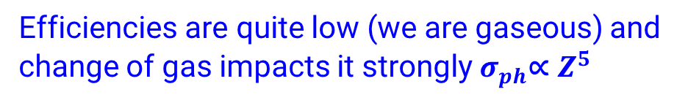
Angular resolution to electrons
‘MIMAC-like’ measurement
Electrons emitted parallel to the GEM
Angular resolution from 30° to 10°
No strong dependence on the gas used
→ Upper limit for angular resolution!!!
Geant4 simulation to estimate the efficiency to photons
→ Fully contained photoelectron in a 10 cm side cube
Efficiencies are quite low (we are gaseous) and change of gas impacts it strongly $σ_{ph}\text{∝} Z^{5}$

Slide 7
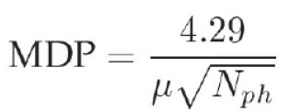
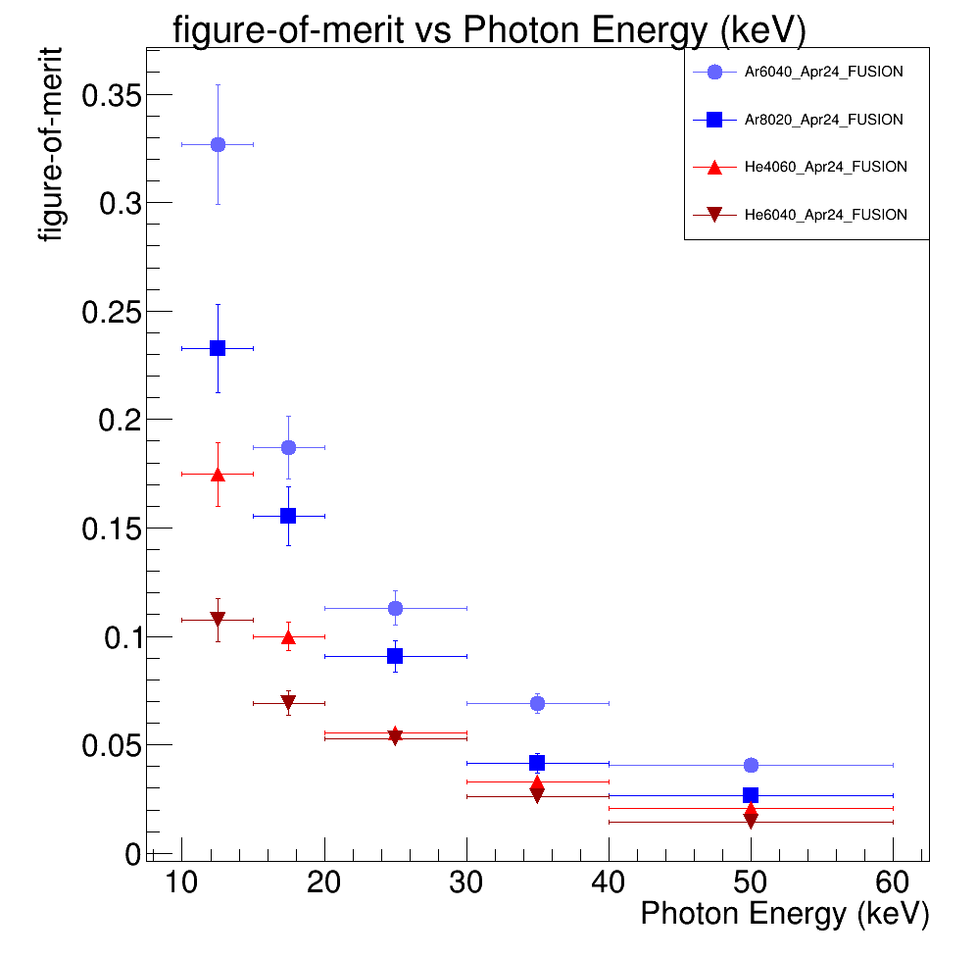
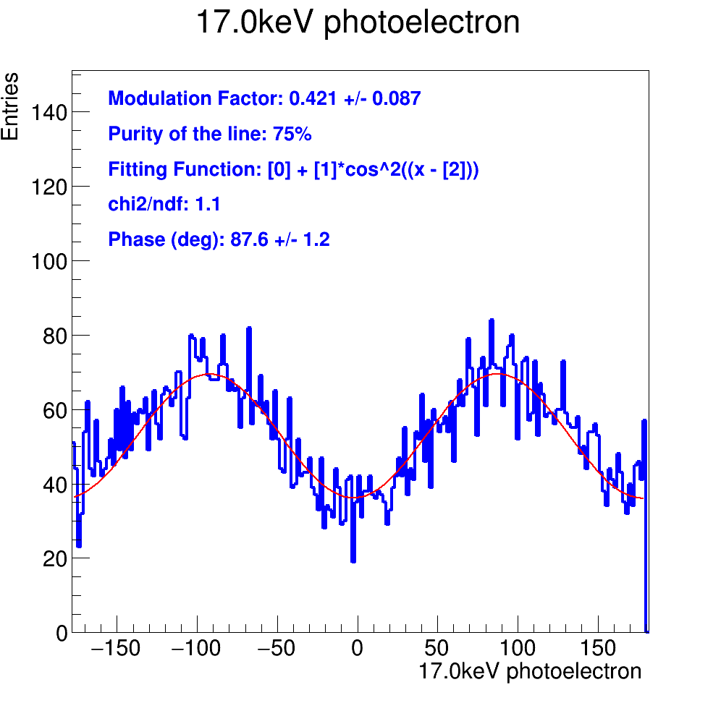
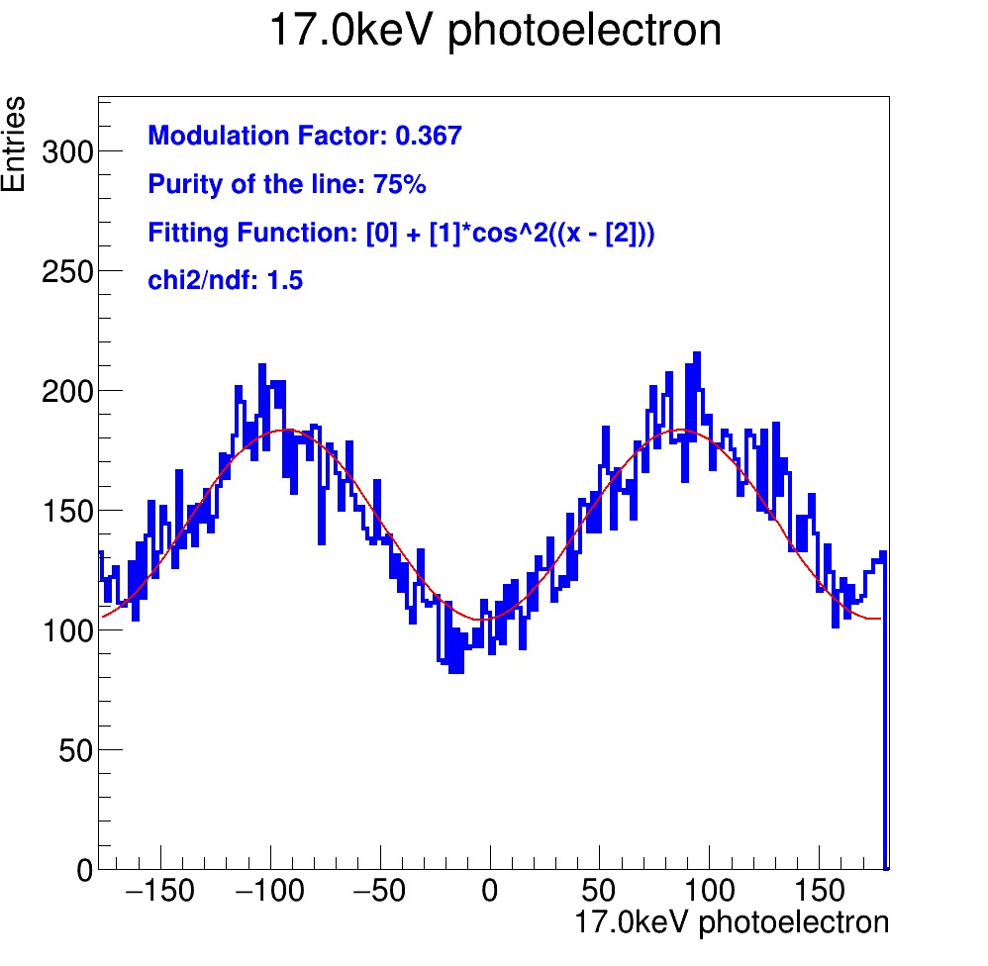
Polarimeter quality factor
𝝁√𝜺
Upper limits!!
IXPE values:
0.11 @ 2.6 keV
0.074 @6.4 keV
He/CF₄ 60/40
ORCA Fusion
200ms
@ 17keV
ε≈1%
𝝁√𝜺≈3.7%
Ar/CF₄ 60/40
ORCA Quest2
10ms
@ 17keV
ε≈8%
𝝁√𝜺≈12%

Slide 8
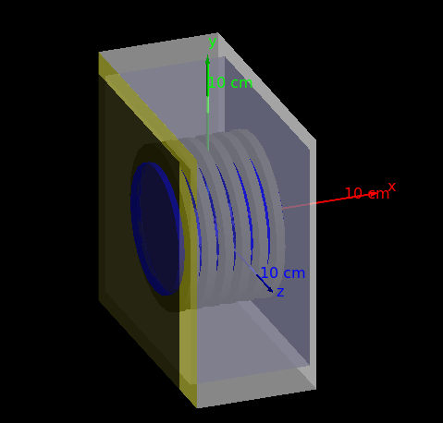
Next steps
New Geant4 to study and tune digitized signals
Reproduce measured modulation factor
  Need CYGNO infrastructure and expertice (I know a certain Melba who is expert in this)
Plug fluxes and background from space to estimate sensitivites to sources
New detector Prototype (sealed)
3 month-person request to LNGS
Play with gases and higher pressures
Play with different amplification structures
  GEM+MM
  >3 GEMs or <3 GEMs
Garfield simulation to optimize the amplification structure and WP
Money+People! The idea is to submit for a CSN5 mini-grant
N.B. Every development for electron tracking is a step forward for a neutrino observatory ;)

Slide 9
BACKUP

