Slide 1
CYGNO04
Technical Coordinator Report
Davide Fiorina – GSSI & INFN LNGS

Slide 2
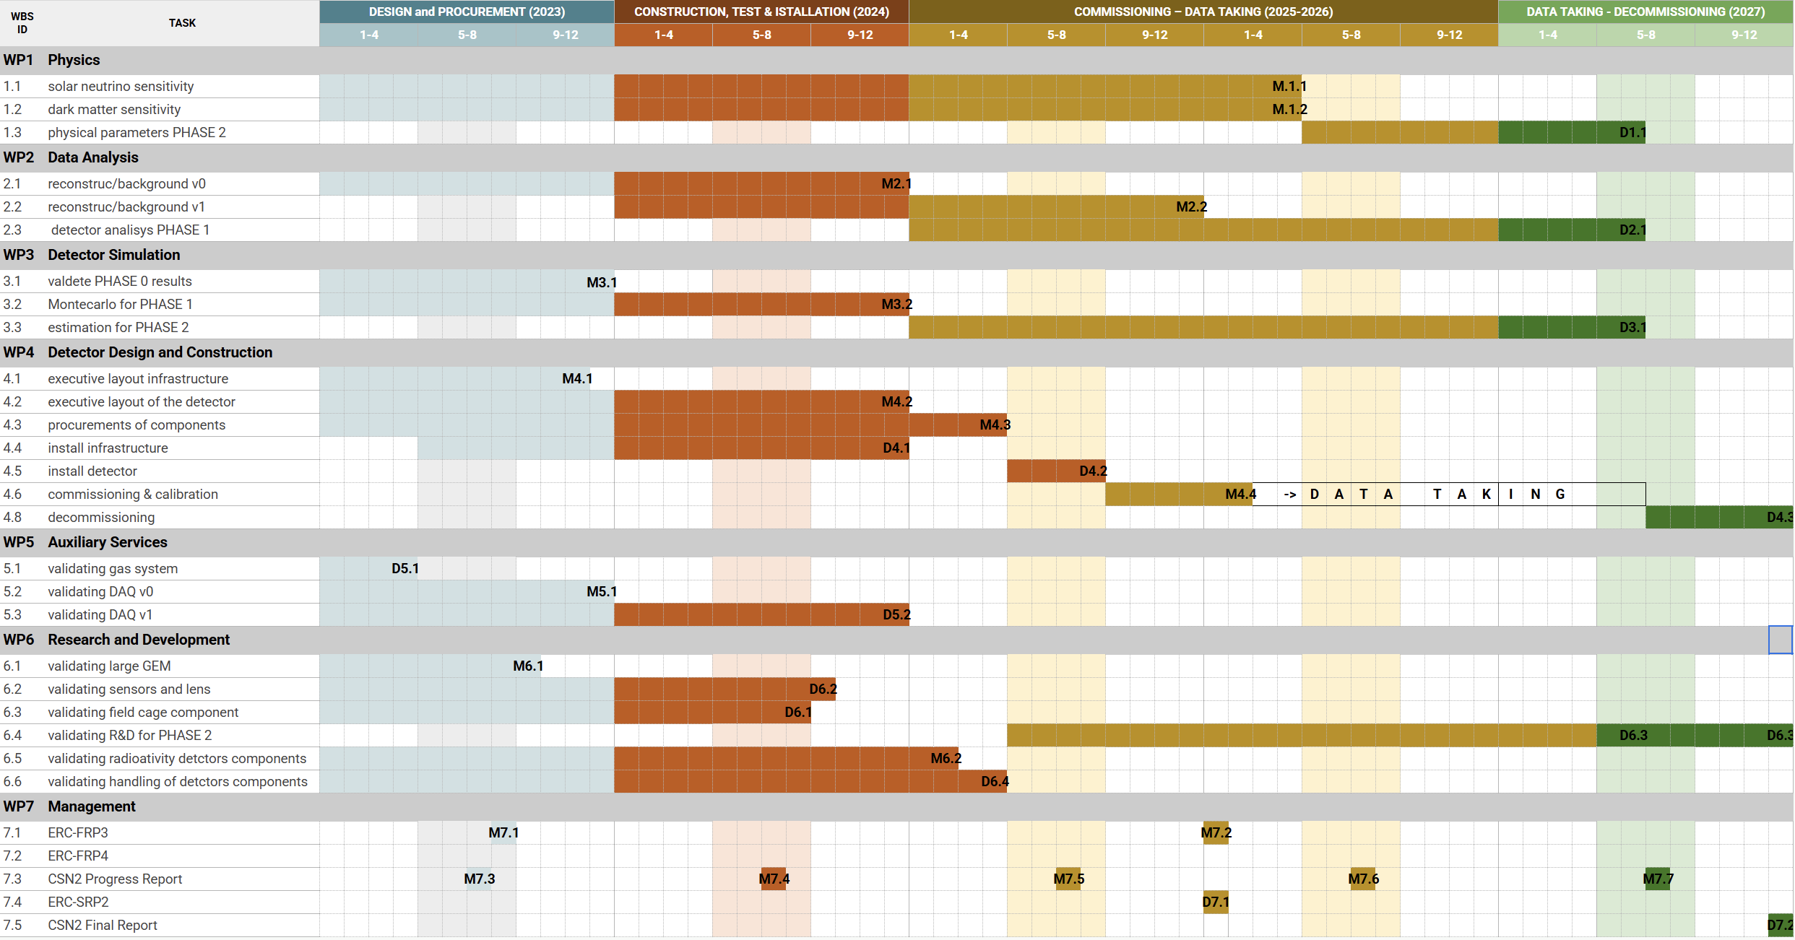
CYGNO04 Gantt
Start on first trimester of 2026 and decommisisoing end of 2027 as requested by CSN2
An average delay of 6 months accumulated mostly because of detector design
Start of 1 year Datataking
Collateral delay

Slide 3
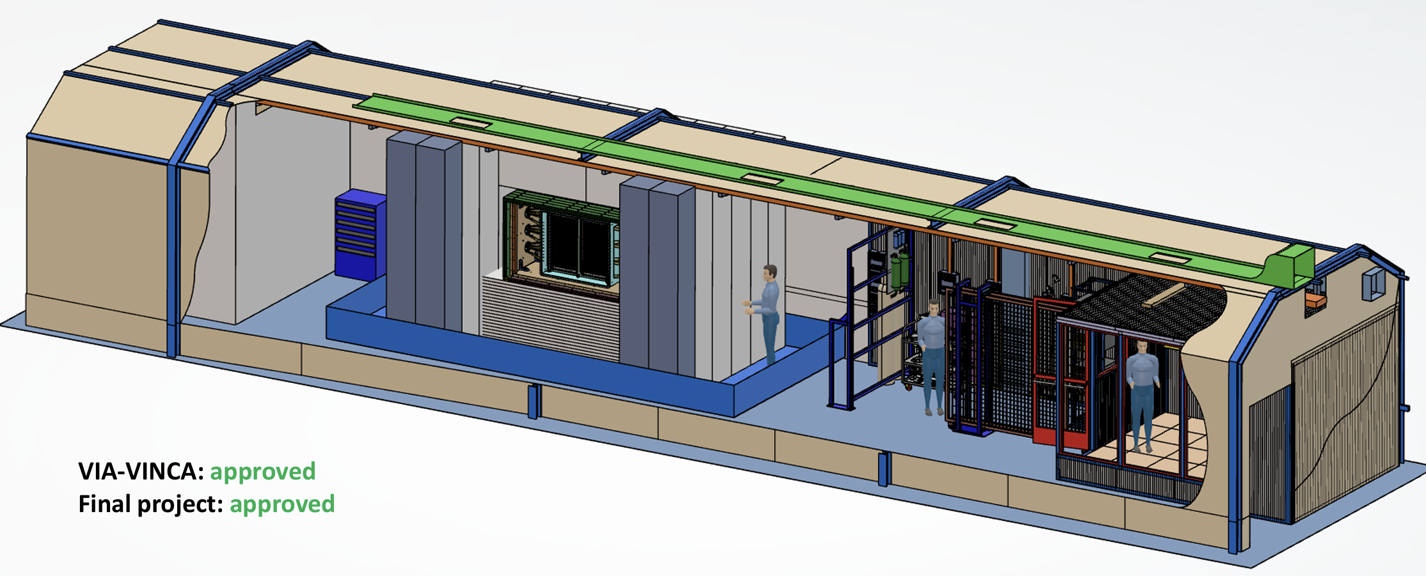
HallF Infrastructure

Slide 4
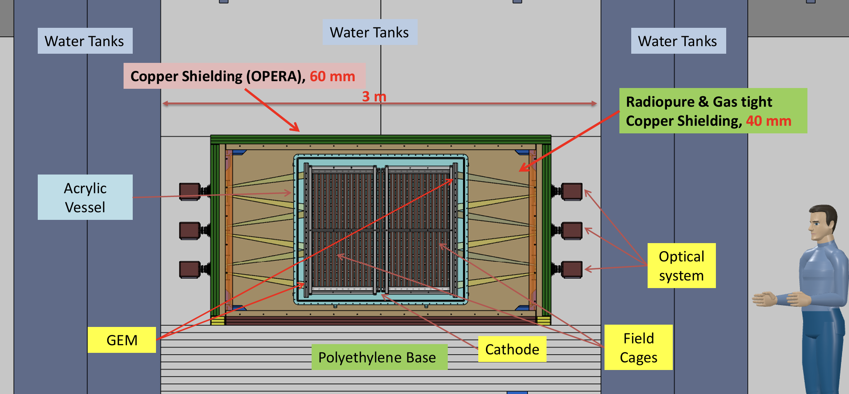
Mechanical Layout
Tirreno Side
Adriatico Side

Slide 5
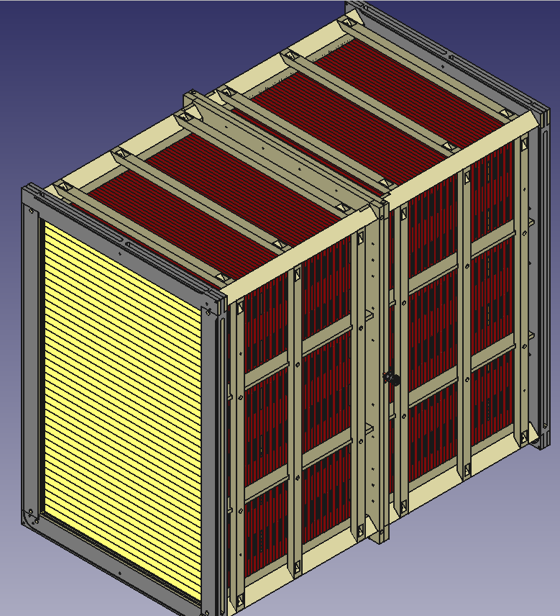
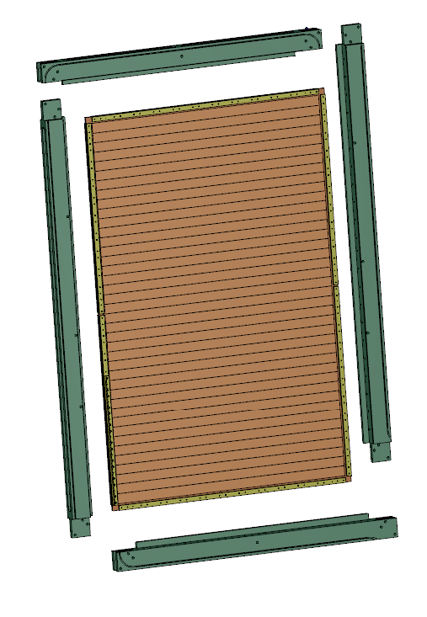
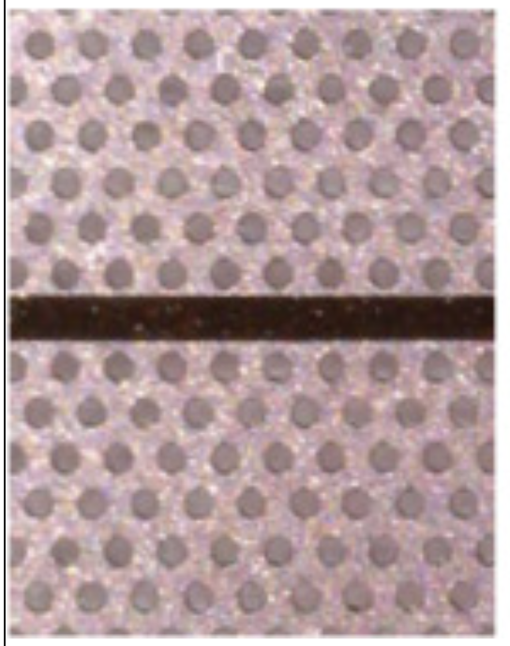
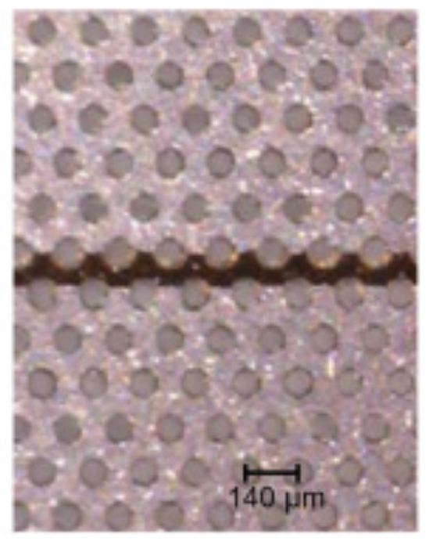
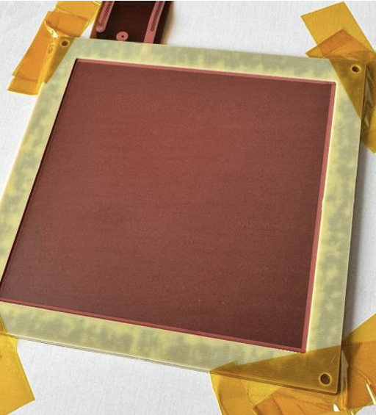

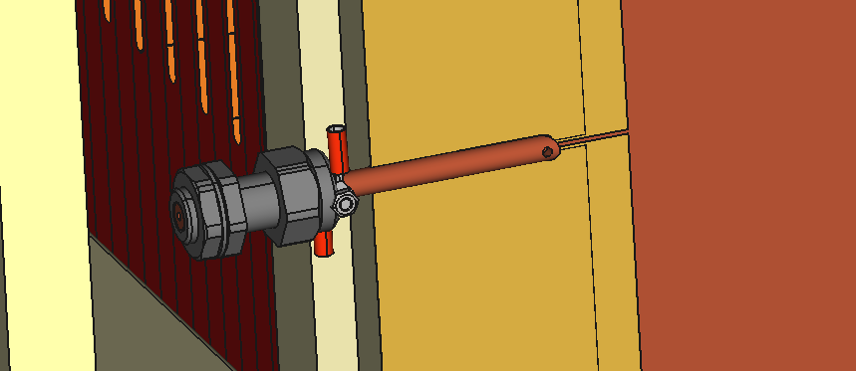
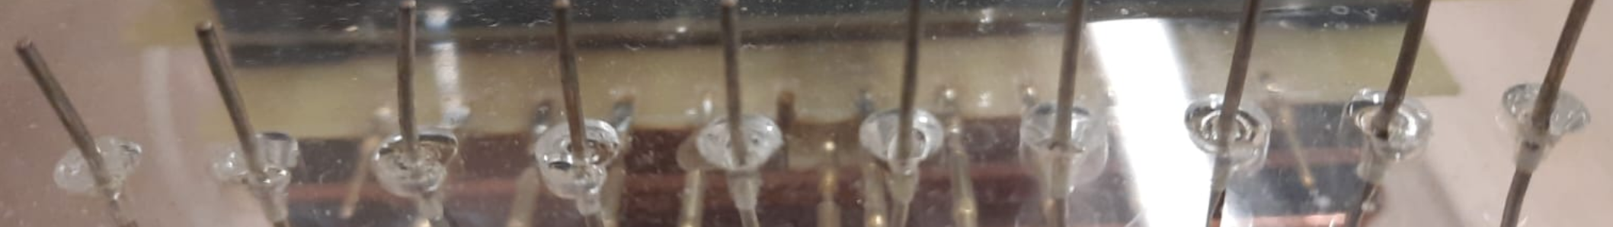
Inner Detector
CYGNO needs 6 GEM foils, we bought 8 foils
4 foils with random segmentation (one is oxidized)
4 foils with standard segmentation (one is oxidized)
Additonaly GEMs to have 3x stack of random segmented GEM

Slide 6
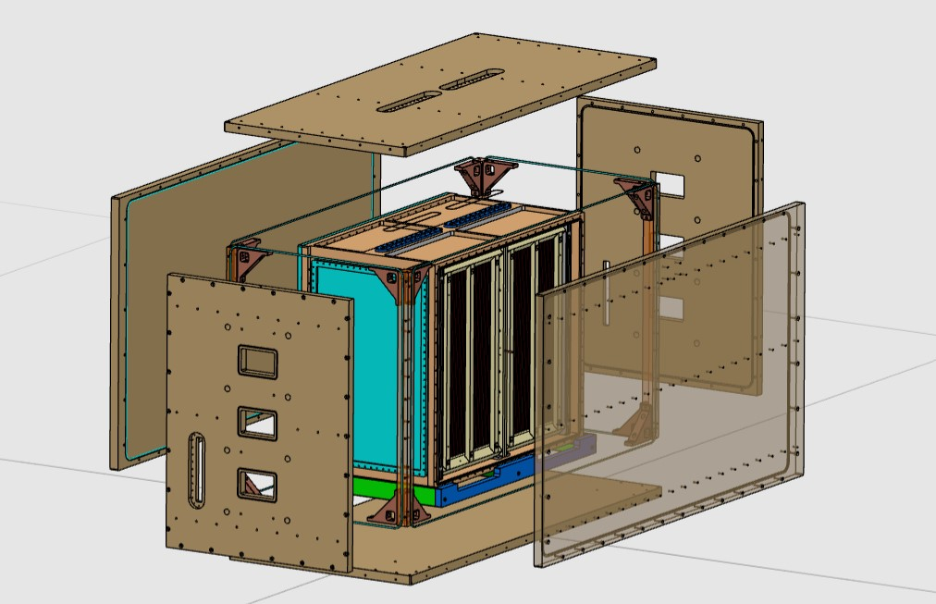
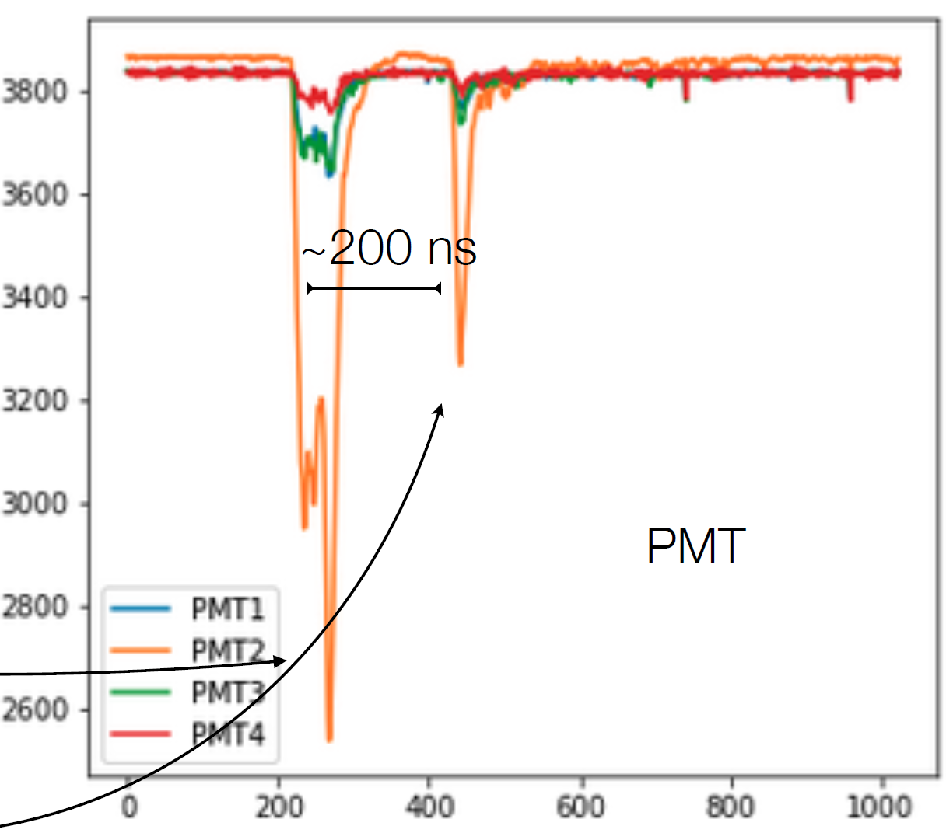
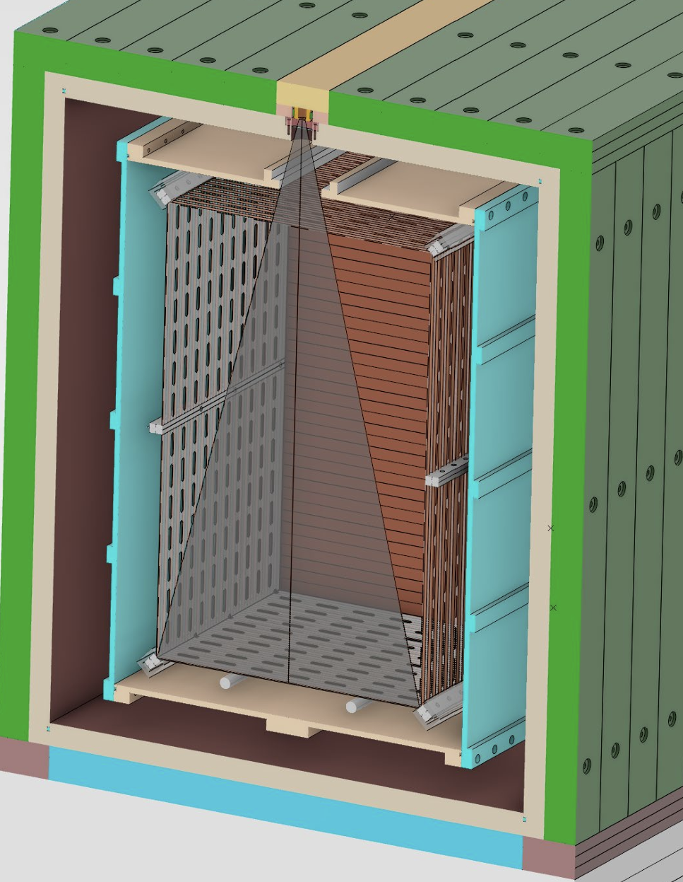
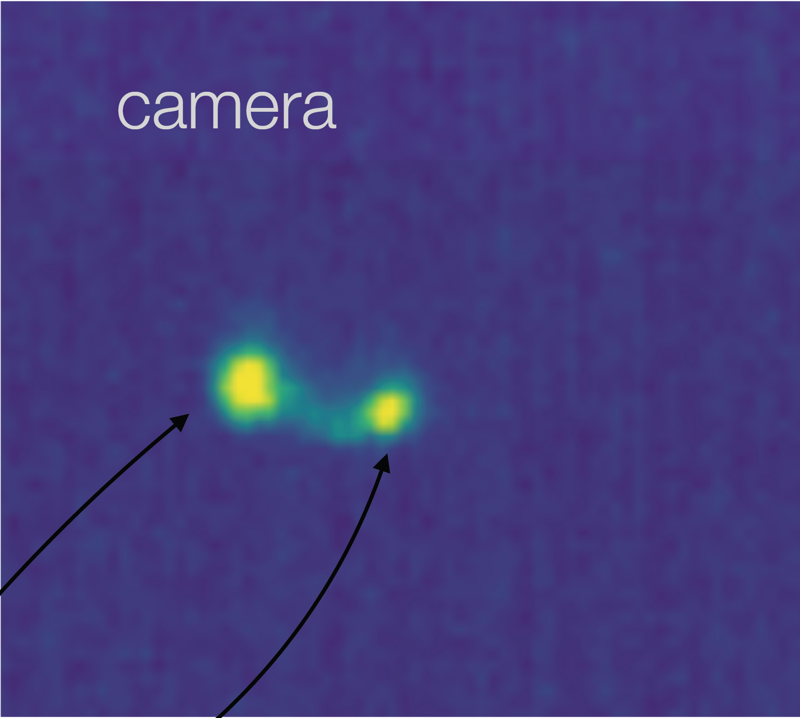
Copper Vessel
Source flange
83Kr for whole detector response (monthly)
55Fe for z response (daily)
HV gas flange
Camera flange
PMT flange

Slide 7
Gas distribution
Out PMMA
N2
IN Vessel
OUT PMMA
Capillary
Capillary
He/CF4
Liquid nitrogen dewar in HallB with gasificator and
Cathode
GEM
GEM
N2
OUT Vessel
6mm

Slide 8
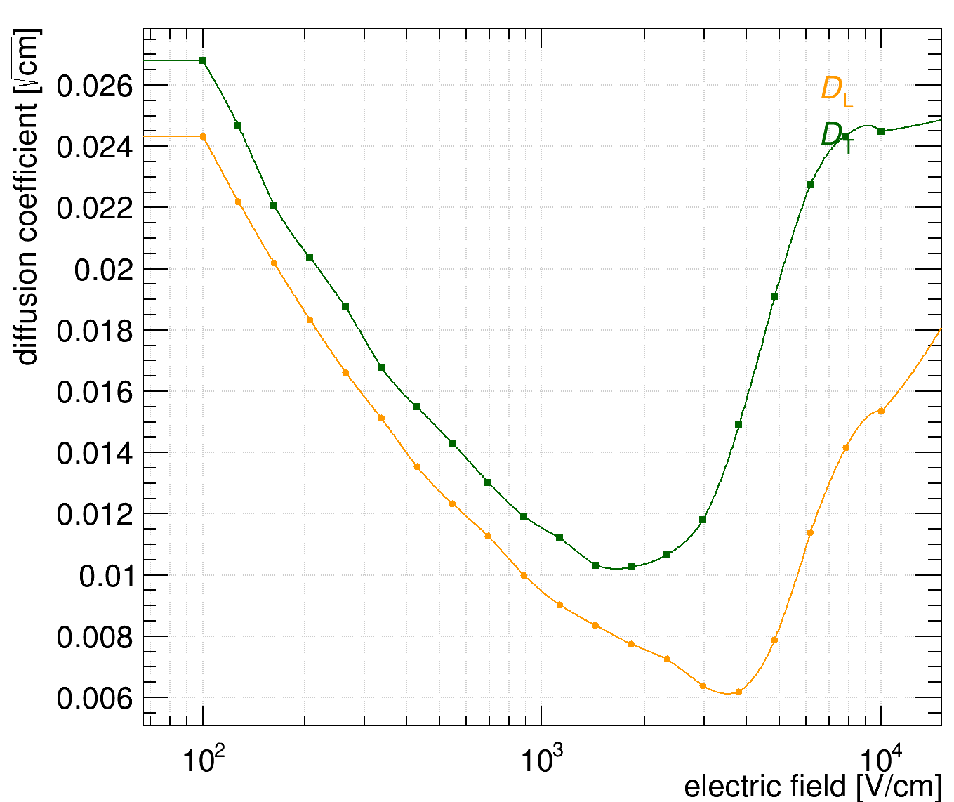
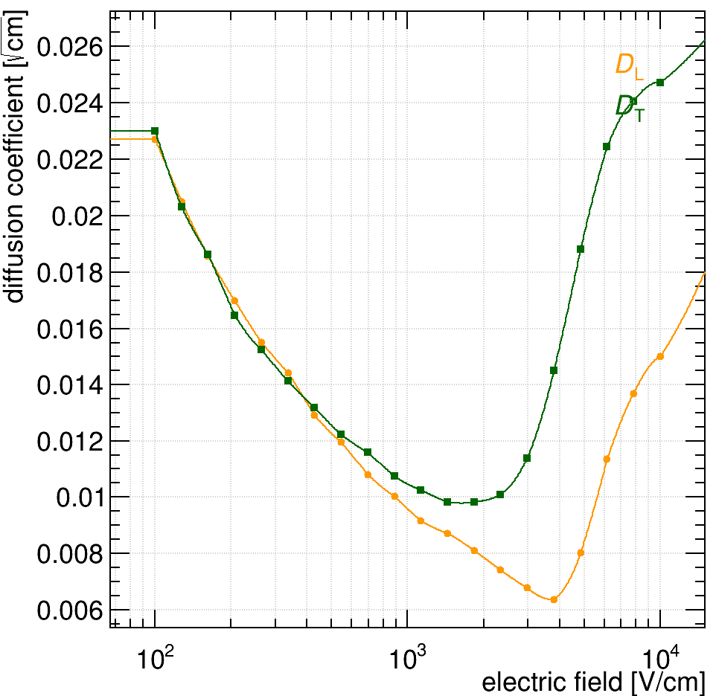
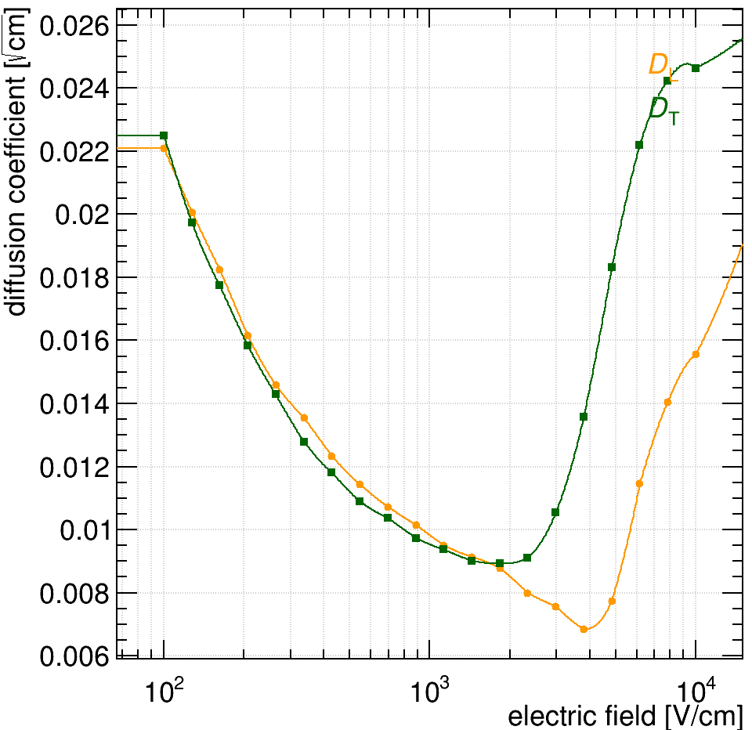
CYGNO04++
List of possible upgrades and possible ‘costs’:
Low cost i.e. no touching the detector
H-rich gas (H, iC4H10 or CH4)
  New flammable gas system (~100k€)
  Or just add water (2.6% volume is 100RH at 900mbar 20°C)
2x Larger Drift field
  New PS (~20k€)
Fine pitch opaque GEMs (~10k€ before assembly otherwise in medium)
Medium cost i.e. changing the inner detector (~100k€)
ITO for light enhancement
  Large custom quartz+ITO window (~50k€)
  Several 10k€ for electronics if strip readout
  New PS (~10k€ )
Larger gas pressure
High cost i.e. changing a lot more (several 100k€)
Primary scintillation detection
  Not sure if possible
  Thousands of SiPM channels in between field cage rings
GEM signal readout
  New HV distribution and readout
DISCLAIMER
End of September Start of CYGNO04 precommissioning in LNF
End of the year detector installation underground
Beginning of 2026 start of commissioning
Pure gas
400ppm O2
2.6% H2O (sature)

Slide 9
CYGNO04++
List of possible upgrades and possible ‘costs’:
Low cost i.e. no touching the detector
H-rich gas (H, iC4H10 or CH4)
  New flammable gas system (~100k€)
  Or just add water (2.6% volume is 100RH at 900mbar 20°C)
2x Larger Drift field
  New PS (~20k€)
Fine pitch opaque GEMs (~10k€ before assembly otherwise in medium)
Medium cost i.e. changing the inner detector (~100k€)
ITO for light enhancement
  Large custom quartz+ITO window (~50k€)
  Several 10k€ for electronics if strip readout
  New PS (~10k€ )
Larger gas pressure
High cost i.e. changing a lot more (several 100k€)
Primary scintillation detection
  Not sure if possible
  Thousands of SiPM channels in between field cage rings
GEM signal readout
  New HV distribution and readout
Pure gas
400ppm O2
2.6% H2O (sature)

Slide 10
BACKUP

