Slide 1
Neutrino physics at low energy (0,2 – 5.0 GeV)
M.G. Catanesi, INFN Bari
RD_MUCOL , 5 Dicembre 2024

Slide 2
The Demonstrator will produce a large number of muons/neutrinos of 200 MeV or less
Great advantage respect to a traditional neutrino beam but to match the physics goal it requires:
Muons from 200 MeV => 1 -1,5 GeV (acceleration phase (linear ?)
A decay tunnel (100 m )
A limited space to host the detector (compact design)
Location :An existing tunnel can be used at CERN ? (< 1km tunnel)
1+2
3
Concept for a neutrino X-sec measurement

Slide 3
Future Neutrino Oscillation Experiments
HyperK
La sensibilita’ dei futuri esperimenti di oscillazione di neutrino dipende fortemente dalla capacita’ di ridurre l’impatto degli errori sistematici nell’ordine del %.
Le incertezze nelle misure delle sezioni d’urto a bassa energia (0.2-5 GeV/c) e nei modelli montecarlo incidono nell’estrapolazione dei flussi dai Near Detector (ND) ai Far Detector (FD) , limitandone la precisione dei risultati

Slide 4
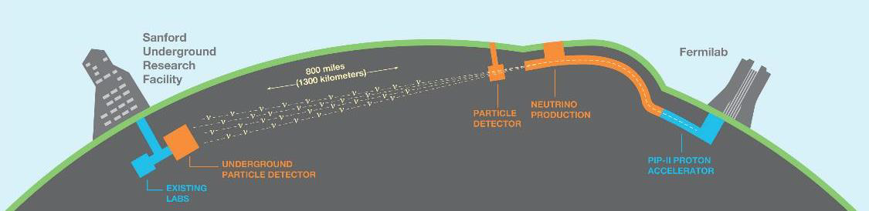
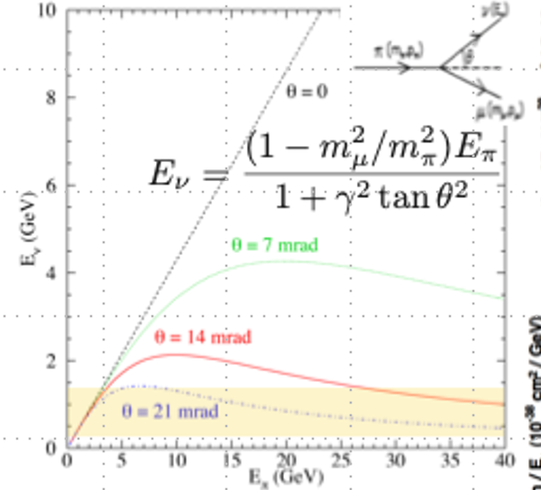
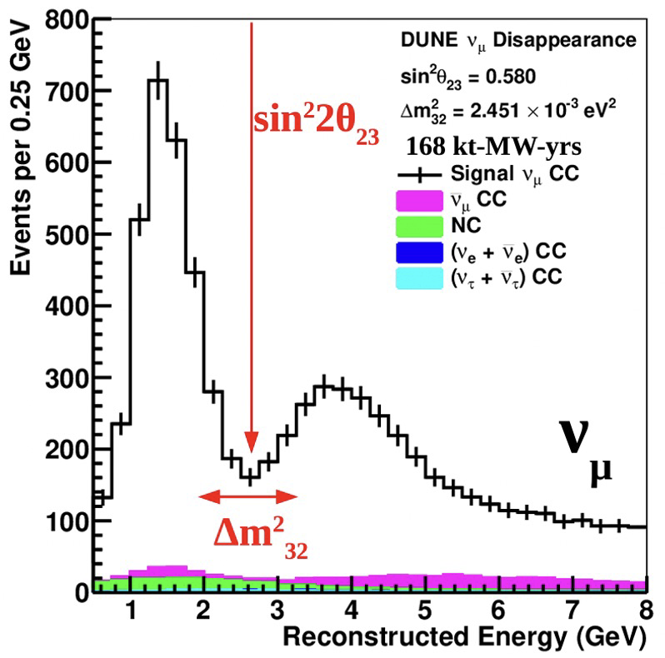
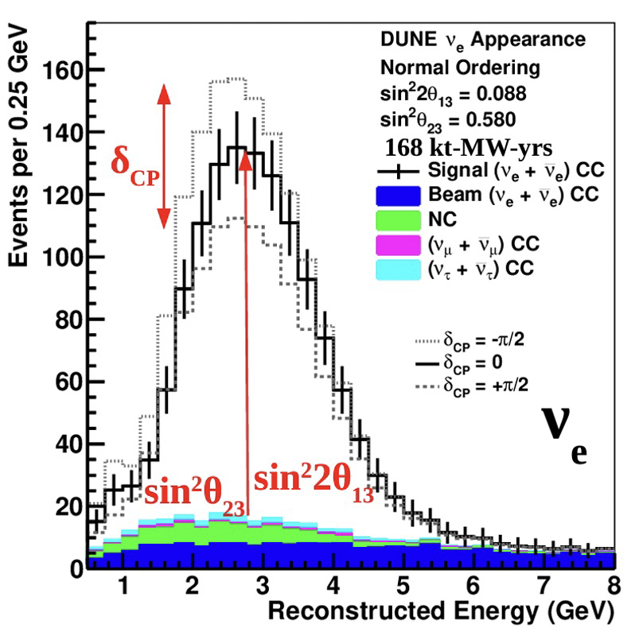
Neutrino Beams (0.2-5.0 GeV)
T2K/Hyper-K
Dune
60-120 GeV protons
L=1300 Km
E_{peak} = 2-4 GeV/c
Wide on Axis
30 GeV protons
L=300 Km
E_{peak} = 600 MeV/c
Off-axis

Slide 5
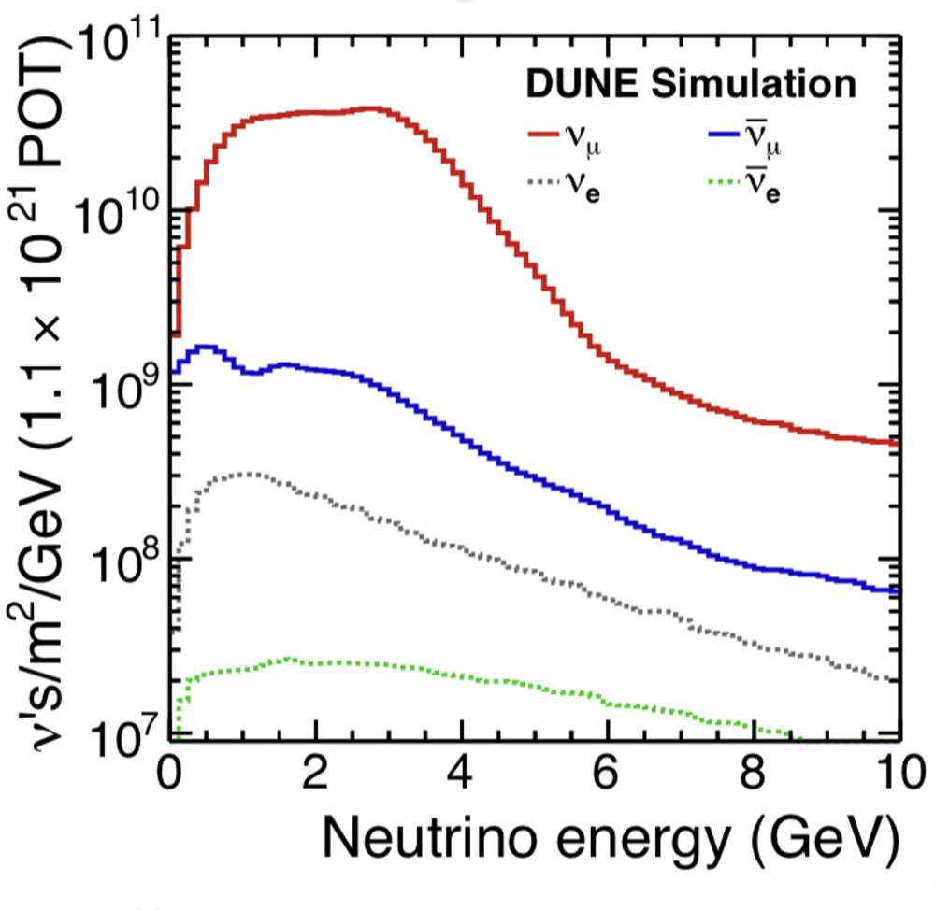
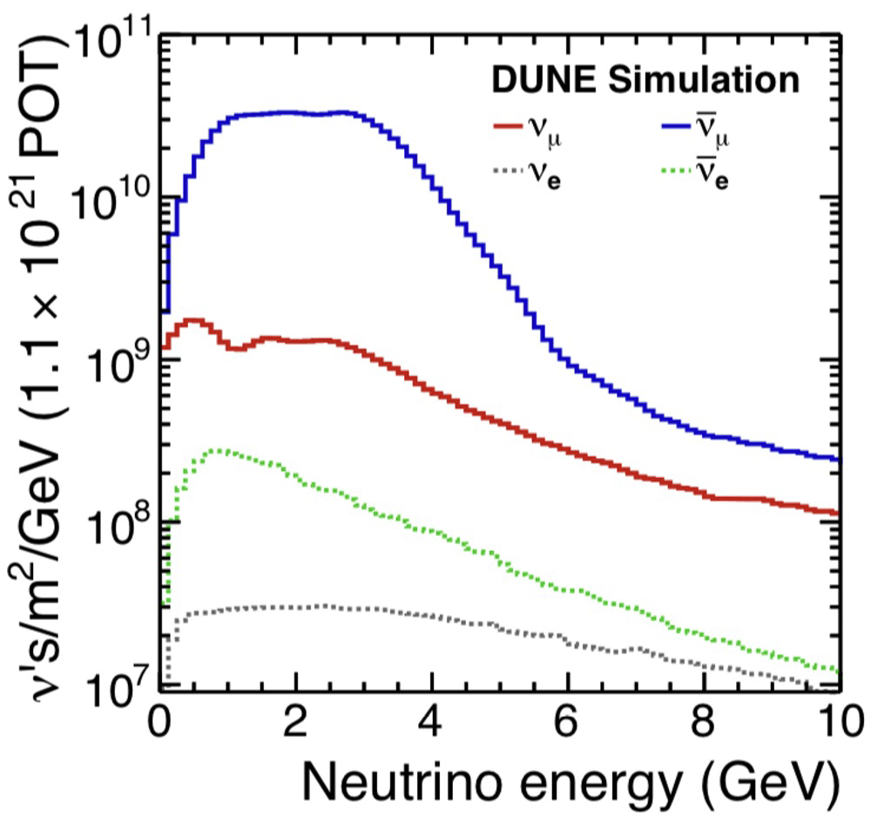


X-Sections
Hyper-K
DUNE
$0.68×{10}^{21}$ POT / year
$2.03×{10}^{21}$ POT / year

Slide 8
ν_{e} X-section
ν_{e} Tag (E> 2GeV )

Slide 9
Cosa bisogna misurare?

Slide 10
Why we need good models ?
S. Bolognesi –Jennifer Meeting

Slide 11
What do we need to measure?

Slide 12
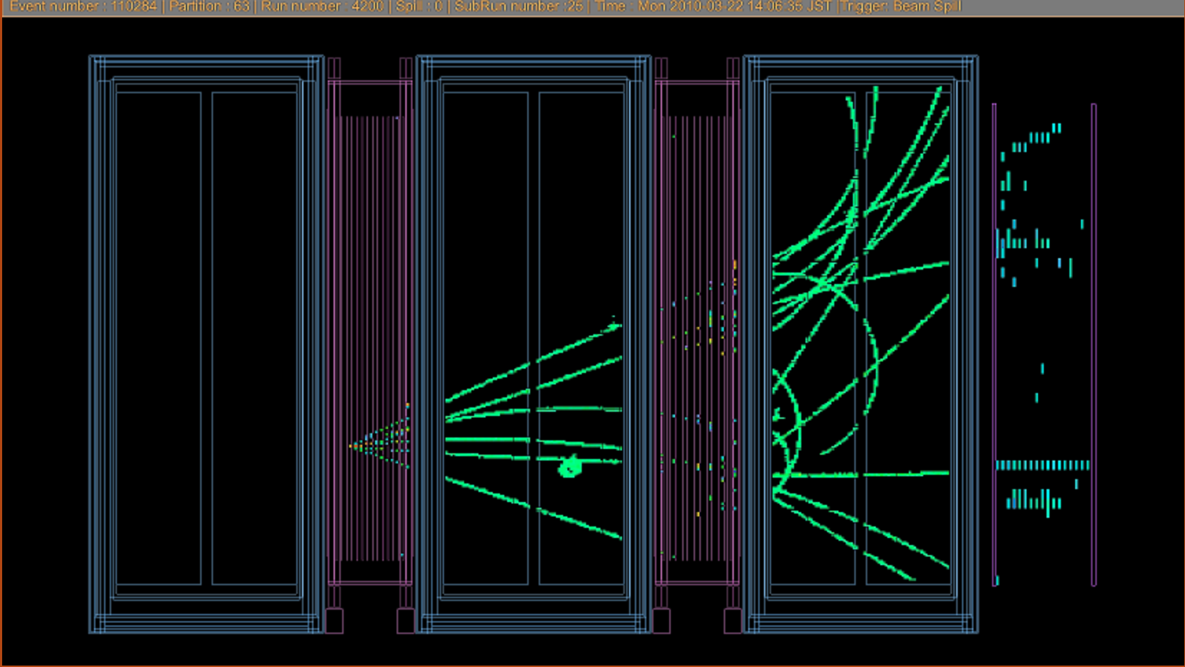
Why a HP-TPC with optical readout as neutrino detector at low energy (below 1GeV)
Target = detector
3D reconstruction capabilities.
Possibility to exchange targets changing gas
low density → low thresholds
excellent PID capabilities.
Almost uniform 4π acceptance.
low number of interactions → requires high pressure and large volume.
requires in addition a magnet to measure momentum and to distinguish between neutrinos and anti-neutrinos
Very large volumes require low cost per readout channel (pixel)
A neutrino interaction in the T2K near detector
The flow of neutrinos at low energy produced by a demonstrator at CERN can fit very well the requirements for a neutrino’s X-sec experiments
Differences within models are at low KE and are below the threshold of a liquid argon device

Slide 13
HPTPC with optical readout
(a possible “great” improvement)
Primary ionisations in the drift region are guided to the amplification region by an electric field
Amplification produces electrons and photons
Cameras image the amplification region and record a 2D projection of the electroluminescence photon
Highly segmented readout (∼ 100 × 100 μm²) at low cost per pixel possible
Current CCD cameras do not allow to access the longitudinal coordinate due to their slow readout speed
The goal is to combine optical and charge readout ➔Full 3D tracking information (since the longitudinal coordinate can be reconstructed from charge signals ) ➔ (TimePix or SIPM array)
NB: optical readout is also of great interest for for the beam instrumentation case:
1) reduction of the budget material along the beam line
2) readout optimization ➔ low gas amplification factor ➔ high density of tracks

Slide 14
Different Gas mixtures for neutrino scattering experiments
New ν-hydrogen scattering measurements are much desired for flux constraints and nucleon cross section (input for Oscillation Analysis)
Hydrogen rich gas mixtures in a high pressure TPC could provide new data of ν-H scattering
T2K experience + MC simulations tell us that in a HP-TPC 95 % purity for the extraction of ν-H interactions could be achieved with He-CH4 (50-50)or He-C2H6 (50-50)
Research needed to find the ideal mixture, which still allows for safe and stable operation of a TPC
Bubbles chambers data

Slide 15
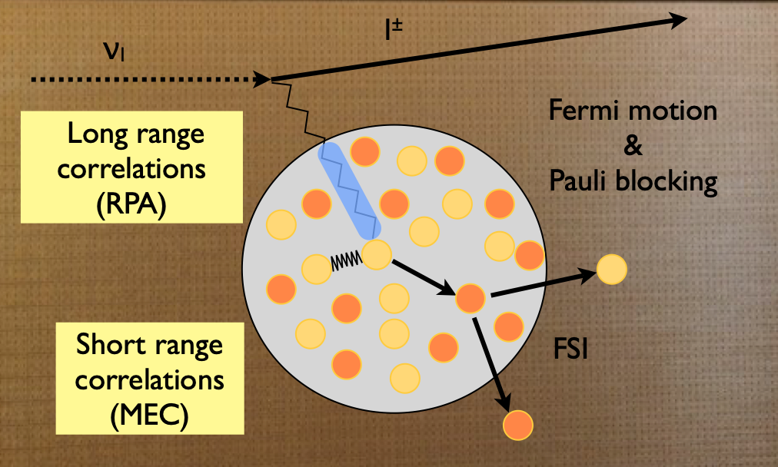
Number of events (example)
As a cross-section experiment, HP-TPC allows to change the nuclear target addressing nuclear uncertainties systematics.

Slide 16
The Demonstrator will produce a large number of muons/neutrinos of 200 MeV or less
Great advantage respect to a traditional neutrino beam but to match the physics goal it requires:
Muons from 200 MeV => 1 -1,5 GeV (acceleration phase (linear ?)
A decay tunnel (100 m )
A limited space to host the detector (compact design)
Location :An existing tunnel can be used at CERN ? (< 1km tunnel)
1+2
3
Concept for a neutrino X-sec measurement

Slide 17
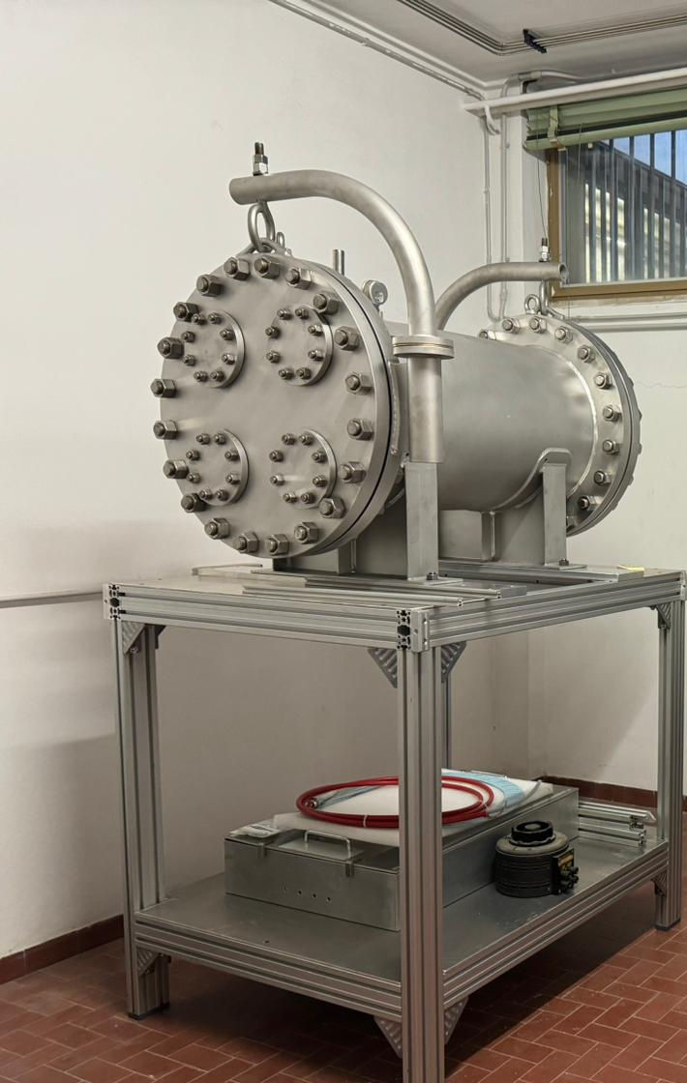
Conclusioni
La realizzazione del dimostratore apre per la prima volta la possibilita’ di misurare eventi di neutrino generati dal decadimento di muoni focalizzati (il sogno di tutti i fisici del neutrino)
Gia solo la misura di alcuni di questi eventi rappresenterebbe una novita’ importante
Se fosse possibile aumentare anche solo di un fattore 2 o 3 l’energia dei muoni prodotti dal dimostratore sarebbe possibile ottenere dei risultati di fisica dei neutrini di tutto rispetto, utilizzando un detector relativamente compatto.
Se fosse possibile trovare una “location” al CERN per ospitare una linea di fascio che contenesse oltre il dimostratore , un piccolo acceleratore lineare e il tunnel di decadimento dei muoni) sarebbe un plus.
A questo punto se vogliamo provare a studiare seriamente questa ipotesi e’ importante passare a una fase piu quantitativa che ci permetta di ottimizzare caratteristiche del fascio e del detector. La collaborazione con i colleghi della macchina e’ fondamentale
Il 23-24 gennaio 2025 e’ previsto un workshop al CERN su futuri esperimenti neutrino al CERN. https://indico.cern.ch/event/1460367/overview che riguarda proposte per fasci di neutrino al CERN . Al momento (a parte Nustorm) non c’e’ nulla di collegato al muon collider
Prototipo di HP-TPC

