Slide 1

Radiation environment on mars

Slide 2
Simulazione Marte con Corsika 8
Modello a bassa energia UrQMD con transizione a 𝐸_{kin,lab} =63.1 GeV al modello ad alta energia Sibyll2.3d
Interazioni E.m simulate con PROPOSAL.
Marte non ha campo magnetico e un’atmosfera descritta da un modello a due strati con diversa densità
Composizione dell’atmosfera di Marte è mantenuta al 78% azoto e al 22% ossigeno.
Energia di cutoﬀ per le particelle <0.3GeV.
Shower prodotti da protoni con energie di 10 GeV, 100 GeV, 1 TeV, 10 TeV e 100 TeV
Nevent = 1000

Slide 3
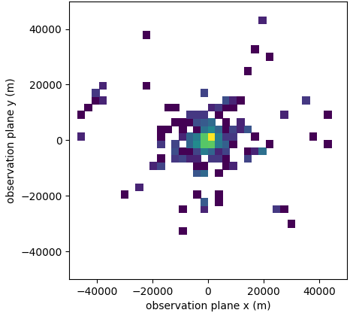
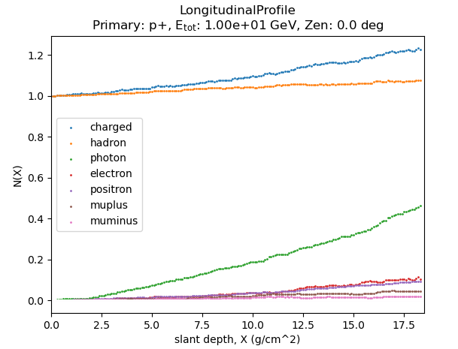
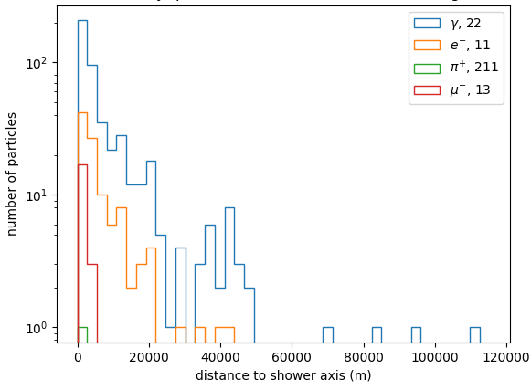
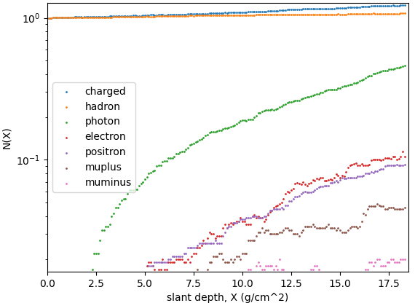
Notes:
On the top lateral particle number distributions on ground level are shown, while on the bottom this
isshown for longitudinal profiles.

Slide 4
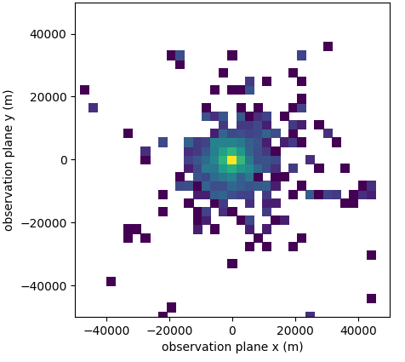
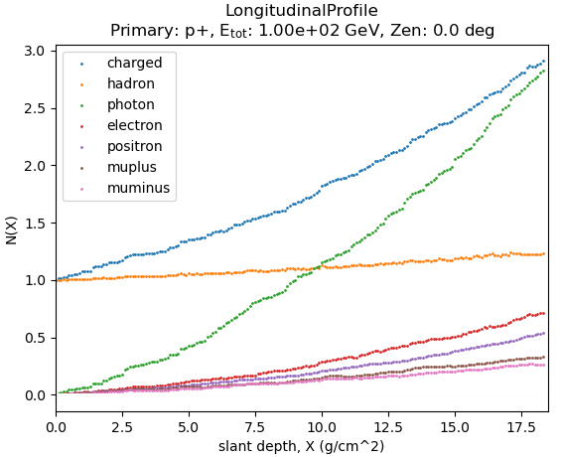
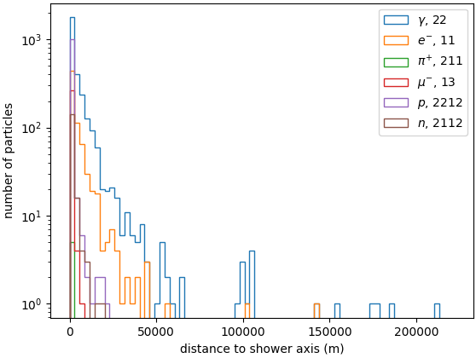

Slide 5
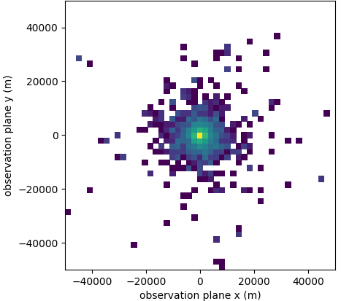
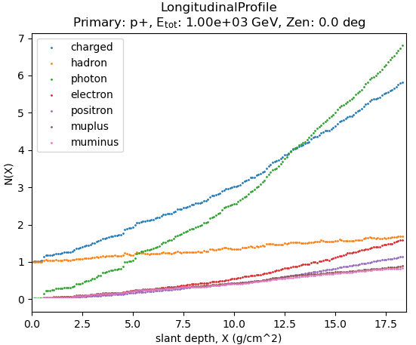
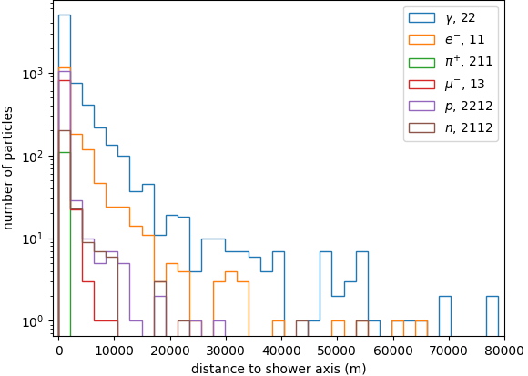

Slide 6
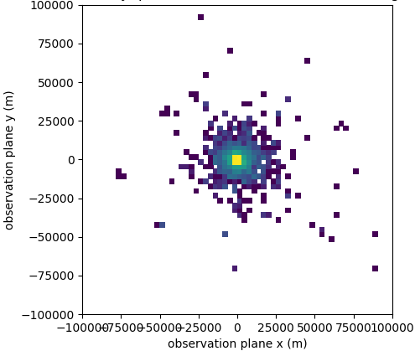
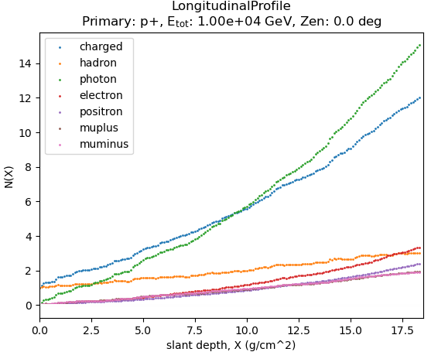
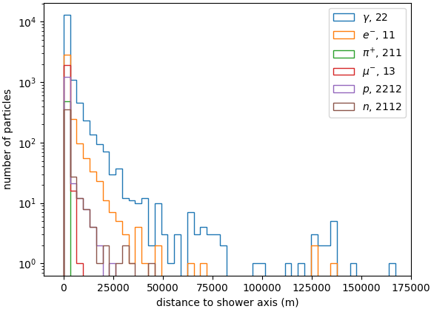

Slide 7
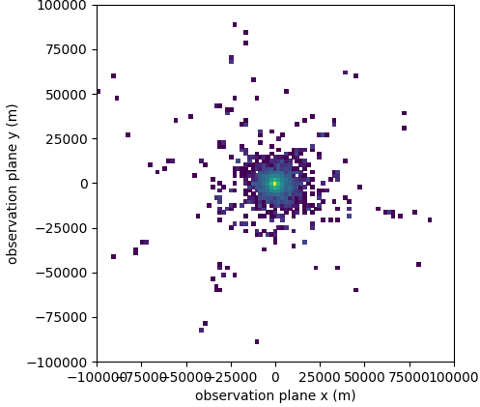
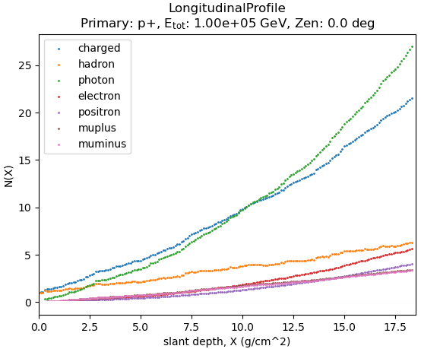
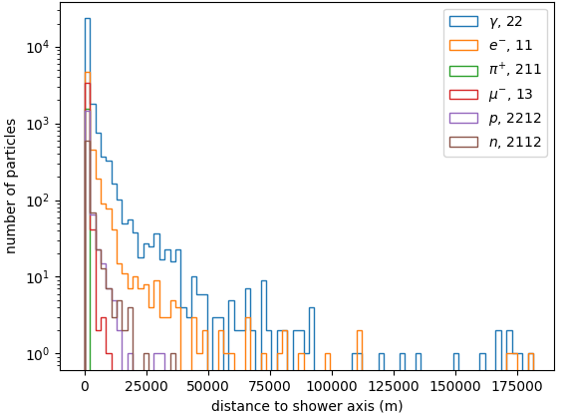

Slide 8
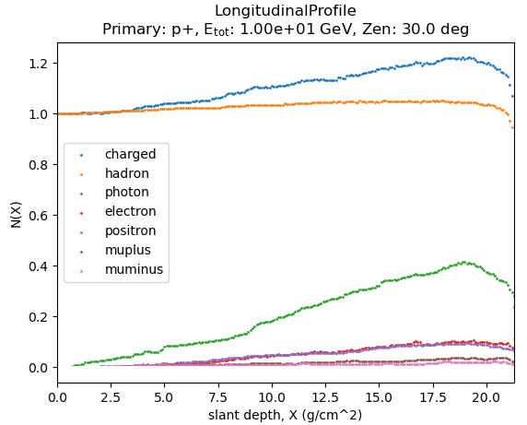
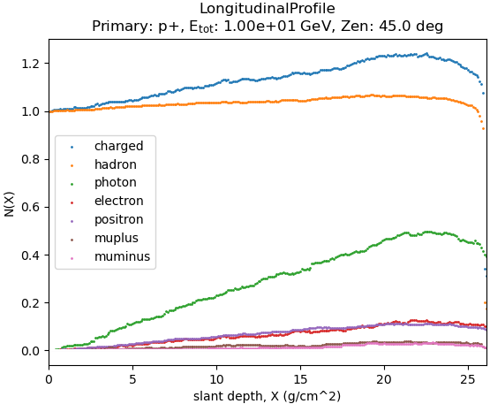

Slide 9
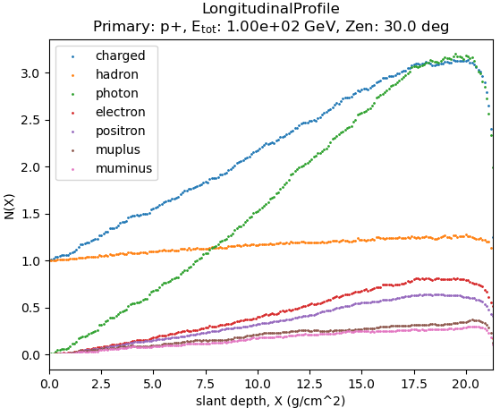
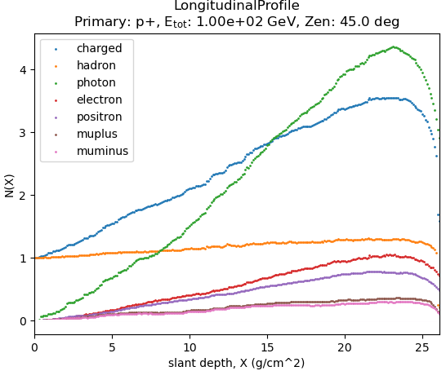

Slide 10
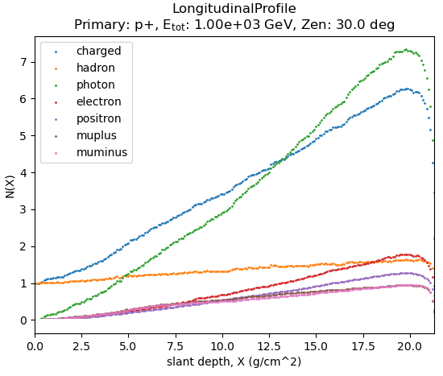
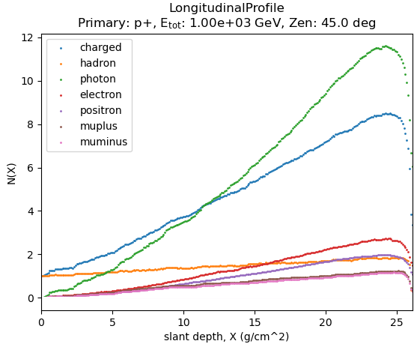

Slide 11
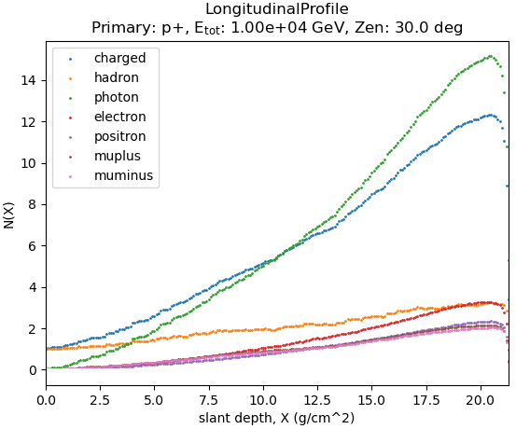
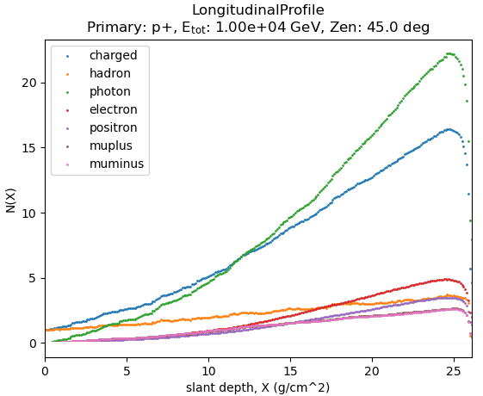

Slide 12
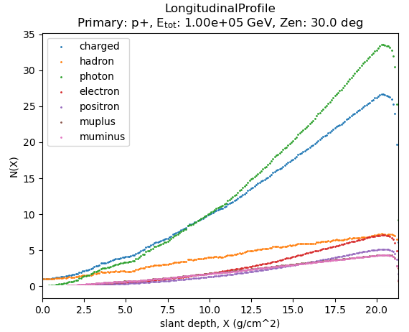
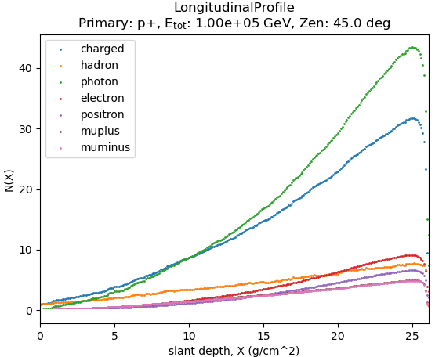

Slide 13
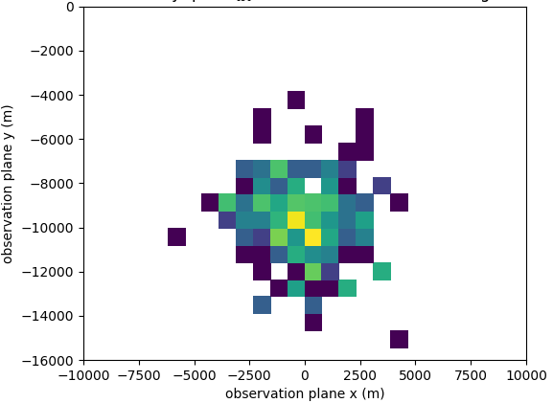
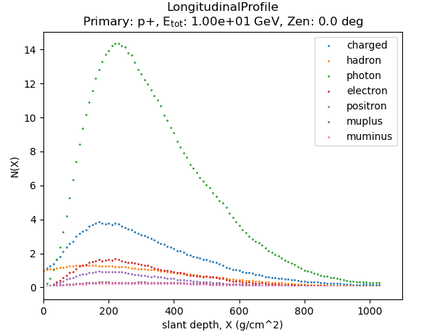
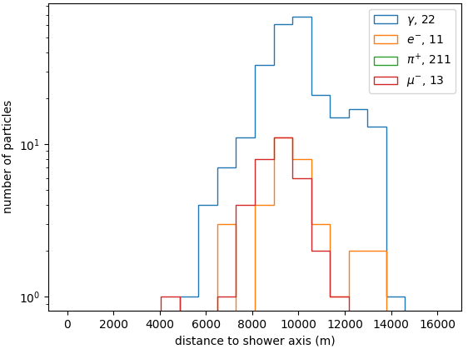
Earth

Slide 14
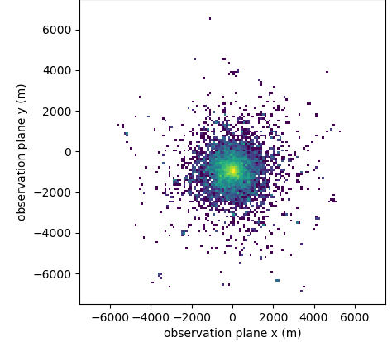
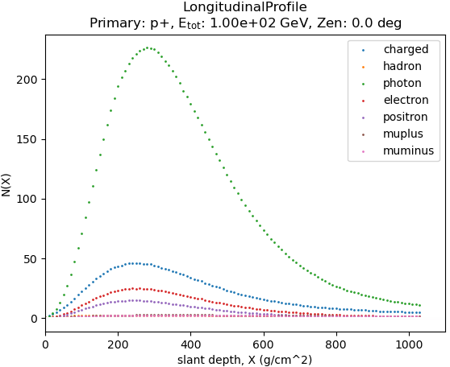
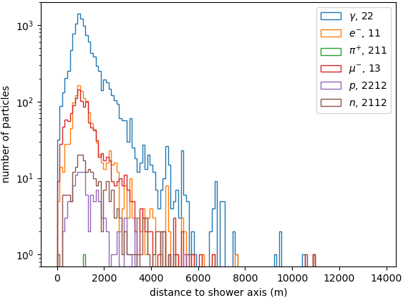
Earth

Slide 15
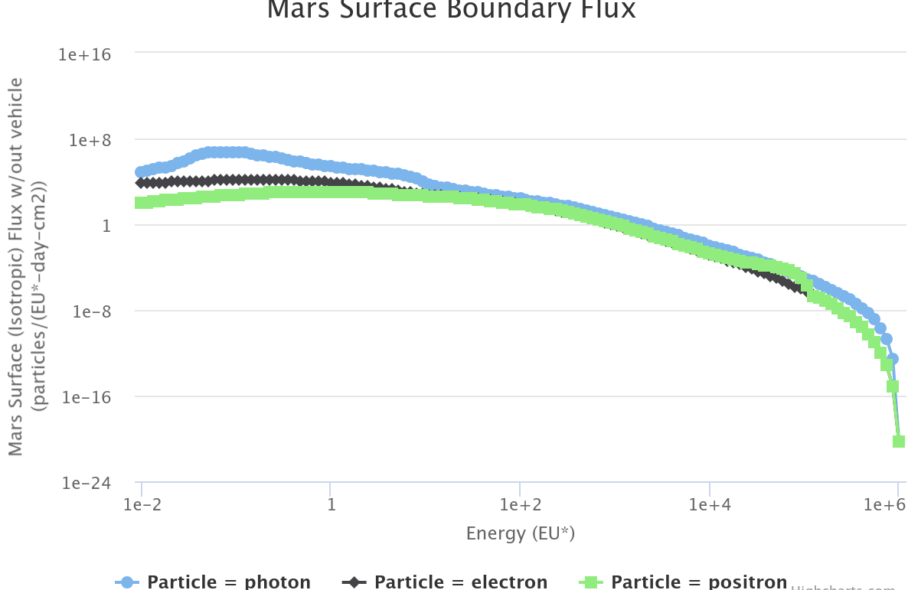
Oltaris: On-Line Tool for the Assessment of Radiation In Space
È un tool online che permette di studiare gli effetti della radiazione nello spazio basato sul codice HZETRN (High Charge and Energy Transport) della NASA.
Modello Raggi Cosmici Galattici: Badhwar-O'Neill (BO-20)
Date: January 1, 2022 to January 1, 2023
Durata Missione: 365.0 days
Modello Atmosfera: MarsGram (MGRAM)
Altitudine = 0.0 km
Energy unit (EU*) is MeV for photon, electron, and positron; EU* is MeV/amu for all other particles.
Notes:
HZETRN space radiation transport code. It is a deterministic radiation transport code capable of calculating the transport of the large variety and broad energy spectra of particles found in the space environment through shielding materials.
This GCR model is based on fitting the
existing balloon and satellite measured energy spectra
from 1954 to 1992 and more recent measurements from
the Advanced Composition Explorer satellite from 1997 to
2002 with the stationary Fokker–Planck equation. This fit
solves the diffusion, convection, and energy loss boundary
value problem and obtains an estimate of the appropriate
diffusion coefficient.

Slide 16
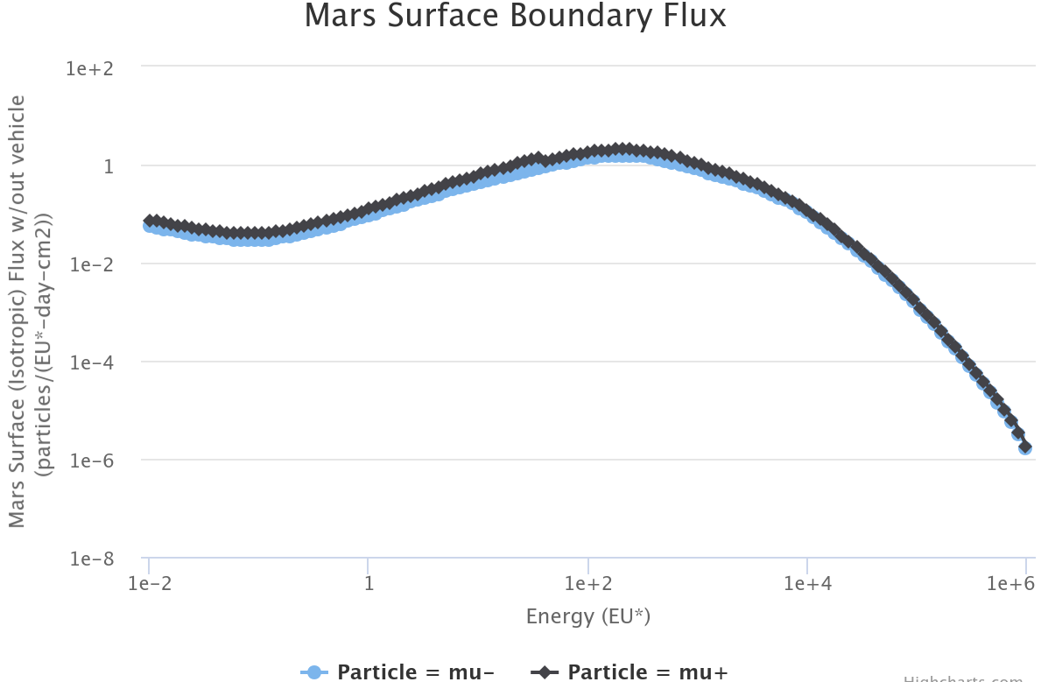
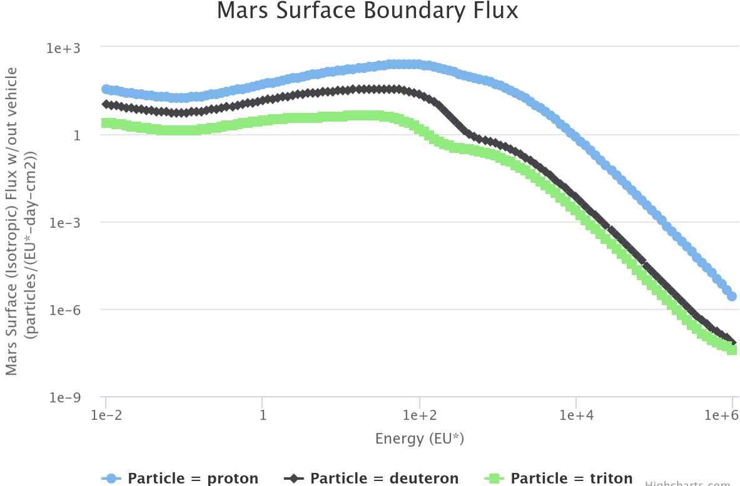
Energy unit (EU*) is MeV for photon, electron, and positron; EU* is MeV/amu for all other particles.
Notes:
HZETRN space radiation transport code. It is a deterministic radiation transport code capable of calculating the transport of the large variety and broad energy spectra of particles found in the space environment through shielding materials.

Slide 17
PLANETOCOSMICS/SPENVIS
Limitazioni dovute al fatto che attualmente il software è utilizzabile soltanto attraverso il server SPENVIS.
Difficoltà di interpretazione dell’output della simulazione
Notes:
Mars-GRAM 2001 is based on topography from the Mars Orbiter Laser Altimeter (MOLA) and includes new MGCM data at the topographic surface. A new auxiliary program allows Mars-GRAM output to be used to compute shortwave (solar) and longwave (thermal) radiation at the surface and top of atmosphere..
The Mars Global Reference Atmospheric Model (Mars-GRAM) is an engineering- oriented model that provides this critical information based on data tables derived from output results from the NASA Ames Mars General Circulation Model (MGCM), and the University of Michigan Mars Thermospheric General Circulation Model (MTGCM). Mars-GRAM is designed to offer mission planners the flexibility to select input parameters such as time, latitude, longitude, and dust level. Mars-GRAM outputs mean values for atmospheric density, temperature, pressure, winds, and constituents along a user defined path. Mars-GRAM also provides winds and density dispersions.

Slide 18
GRAZIE PER L’ATTENZIONE!

