Slide 1

Radiation environment on mars

Slide 2
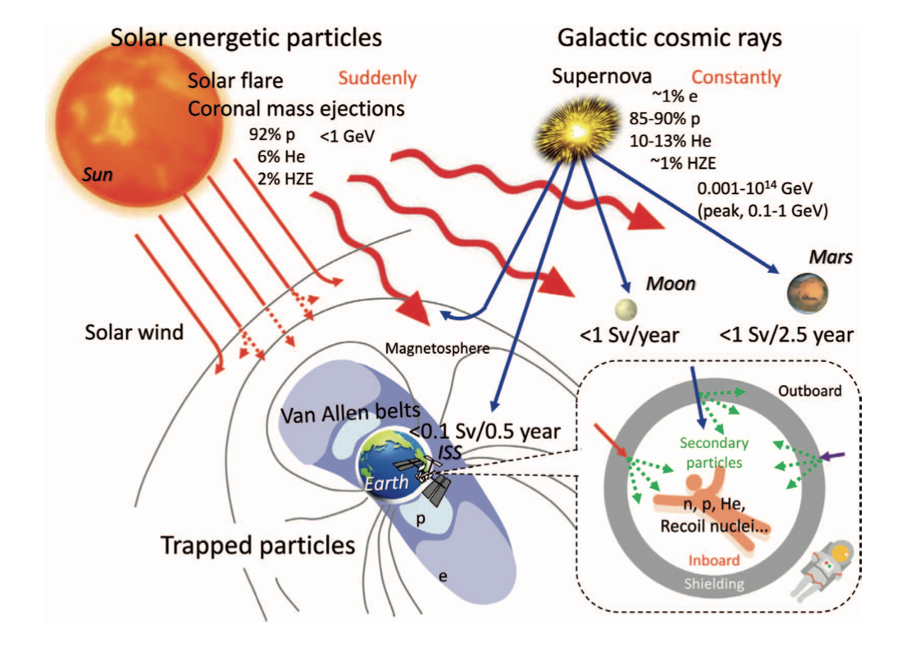
Space Radiation Environment
Sources of ionizing radiation:
Solar Energetic particles (SPEs) events
Galactic cosmic rays (GCRs)
GCRs are:
high energy particles (10 MeV/nuc to >10 GeV/nuc)
modulated by the heliosphere
anti-correlated with solar activity
composed of proton (85-90%), helium ions (~10-13%), electrons (~1%), and heavier nuclei (~ 1%) (varies depending on solar modulation)
SEP events are:
produced in the solar corona by high energy processes associated with flares, coronal mass ejections (CMEs) and their corresponding shocks
sporadic and difficult to predict
are typically dominated by protons, but composition can vary substantially. Fluxes can vary by by several orders of magnitude.
Components of the space radation environment

Slide 3
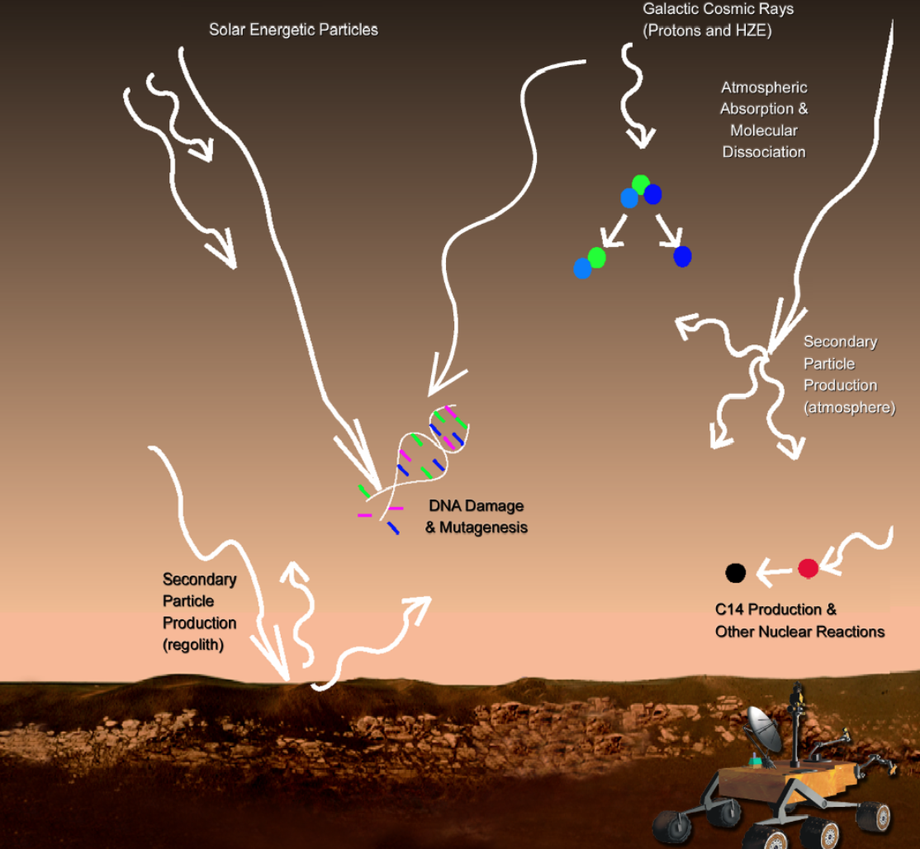
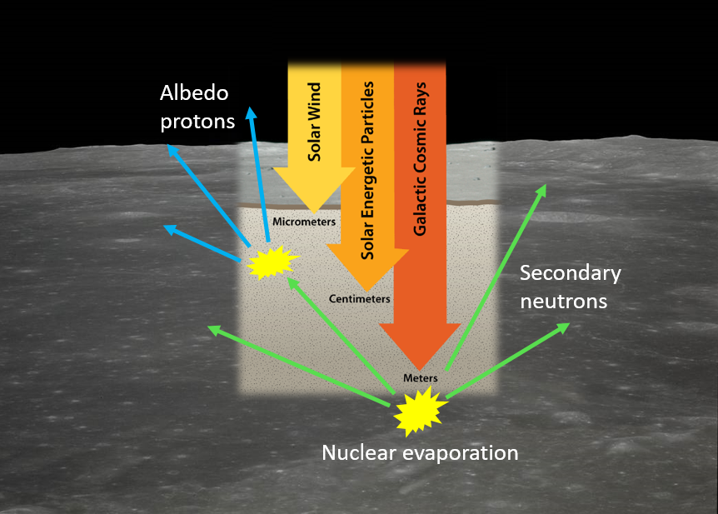
Radiation Environment on Mars
Harsh radiation exposure on the surface of Mars:
Mars lacks a global magnetic field to deflect energetic charged particles
The atmosphere is very thin (∼1-3% as thick as Earth’s one) providing little shielding against incident high energy particles.
SEPs and GCRs interact with the atmosphere and, if energetic enough, penetrate the Martian soil where they produce secondary particles (including neutrons and γ-rays).
Majority of GCRs fully penetrate the Martian atmosphere.
During sporadic and intense solar events, SEPs can dominate the radiation environment on short time scales (few hours to days). Only SEPs with energies > 150 MeV/nuc can penetrate the Martian surface.
Surface radiation environment (GCRS and secondary particles) modulated over time by:
The seasonal atmospheric pressure cycle which changes the amount of atmosphere GCRs have to travel through to reach the surface
Daily-recurring thermal tides that cause diurnal variations in the atmospheric pressure
the heliospheric modulation of the GCR flux during the 11-year solar cycle
Notes:
In general, the Martian surface radiation environment is dominated by the influence of GCRs.
Majority of GCRs have ranges sufficient to fully penetrate the Martian atmosphere. Ions propagating through the atmosphere to the surface can furthermore produce secondary (charged and neutral) particles by interactions with the nuclei in the atmosphere and ground.
Modulation of the interstellar GCR spectrum is energy- and species-dependent owing, at least to first order, to the mass-to-charge (A/Z) dependence of magnetic rigidity. Ions with lower energy or lower mass-to-charge ratios (such as protons, with A/Z =1) are more suppressed by higher modulation values, while the high-energy component changes less strongly. In all events, secondary neutrons produced by SEPs in the atmosphere can reach the surface.
The main factor affecting long-term radiation variability is solar modulation:
During solar maximum, increased solar activity causes stronger attenuation of GCRs, leading to lower surface radiation levels.
During solar minimum, the Sun's reduced activity allows more GCRs to reach the Martian surface, resulting in higher radiation exposure.
Mars’ thin atmosphere provides some shielding against incoming cosmic rays.
The daily thermal tide alters atmospheric mass:
Afternoon: Atmosphere expands → Pressure drops → Less shielding → Radiation increases.
Early morning: Atmosphere contracts → Pressure rises → More shielding → Radiation decreases.
For every 50 Pa increase in pressure, dose rate decreases by ~6.5%.
Seasonal variations (~25% change in pressure) affect long-term dose rates.Higher radiation exposure in southern hemisphere summer due to lower atmospheric pressure.

Slide 4
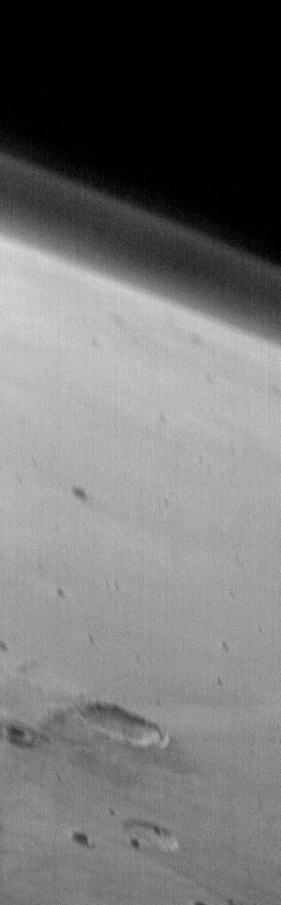
Martian atmosphere
Composition:
95.32% carbon dioxide
2.7% nitrogen
1.6% argon
0.13% oxygen
Pressure at the surface 6.35 mbar (over 100 times less Earth’s).
Typical column depths of the Martian atmosphere at Gale Crater are on the order of 20 g/cm².
Changes over a day because the ground gets extremely cold at night (∼ -160°C).
The seasonal variation changes the global air pressure, and which gases are in the air
Air pressure can change globally by ±8%, depending on the season.
UV Sunlight breaks down CO₂ and H₂O molecules that are free to react in new ways, changing the abundance of carbon monoxide (CO), oxygen (O₂), ozone (O3), and other trace species.
Notes:
Pressione atmosferica media 8.4 mbar
At such cold temperatures (-160 °C), both major and minor constituents of the atmosphere might either condense (snow, frost) or just stick to the soil grains a lot more than they do at warmer temperatures. Because of differing condensation temperatures and "stickiness", the composition can change significantly with the temperature.
During the day, the gases are released from the soil at varying rates as the ground warms, until the next night. It stands to reason that similar processes happen seasonally, as the water (H2O) and carbon dioxide (CO2) condense as frost and snow at the winter pole in large quantities while sublimating (evaporating directly from solid to gas) at the summer pole.
It gets complicated because it can take quite a while for gas released at one pole to reach the other. Many species may be more sticky to soil grains than to ice of the same material, so for those chemicals, the diurnal change could be more significant than the seasonal change. The seasonal variation changes the global air pressure on Mars and changes which gases are in the air

Slide 5
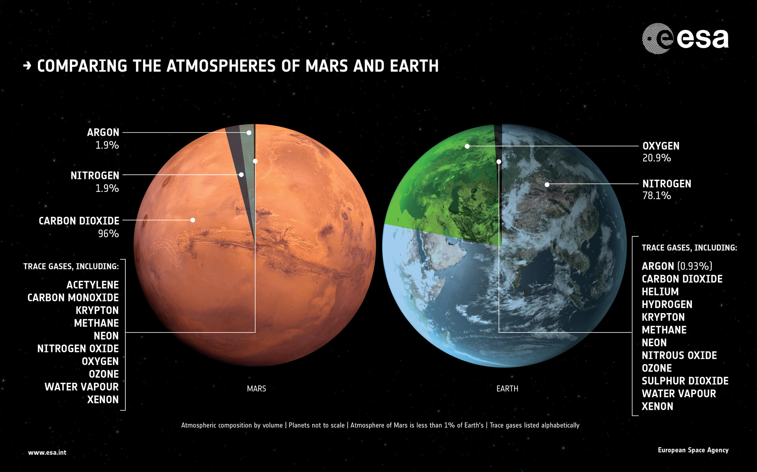

Slide 6
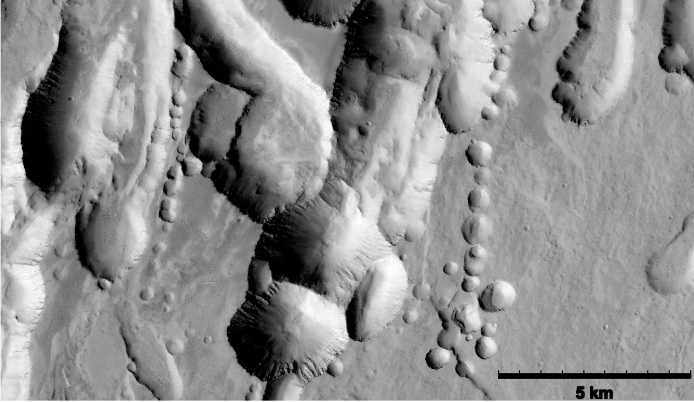
Lava Tubes on Mars
Subsurface voids formed by volcanic processes
Presence inferred from surface collapse chains and skylights detected through remote sensing
Hundreds of potential skylights identified in regions like «Arsia Mons, Olympus Mons, and Hadriaca Patera».
Uncertain presence of intact tubes, but morphological analogies with Earth suggest their existence.
1 to 3 orders of magnitude larger than their Earth counterparts
Intermediate in size between Earth and the Moon.
Widths of (40-400) m meters have been estimated from collapse features
May experience more collapses due to gravity and environmental factors
Complex terrain of collapse structures on the lower flanks
of Arsia Mons, Mars likely contains lava tubes and caves in the sub-surface (Kedar et al. 2013).
Notes:
A lava tube is a natural underground tunnel formed by flowing lava that cools and solidifies on the surface while
molten lava continues to flow beneath. These tubes, found on Earth, Moon, and Mars, can be large and structurally stable, potentially offering natural protection for future exploration and habitation. On the contrary, a skylight is a partial collapse of a section of a lava tube's roof that creates an opening to the
surface revealing the underground void. Such features are normally sub-circular and present overhanging roofs. They are therefore access points to subsurface environments, making them valuable targets for scientific exploration and planetary habitat development.

Slide 7
Corsika 8
New framework in C++ for Monte Carlo simulations of high energy cascades in matter.
The central loop involves a stack used for temporary storage of particles, a geometric transport routines and a list of processes that can lead to secondary particle production or absorption.
Main characteristics:
Modularity (Each physics process is provided as a module, with clear scope and having all necessary assumptions and parameters configurable)
Flexibility
Completeness (not just oﬀer a single reference implementation but at best all solutions available)
Robustness
Performance (Built-in support for multi-core CPU, parallelization, and hardware accelerators)
Support arbitrary geometries, environments, and mixed media with showers propagating in user-defined 3D space.

Slide 8
Corsika 8
Main building blocks and workflow steps of Corsika 8
Engel+2018

Slide 9
Corsika 8: Processes
Processes get given information about the current particle, track, medium, etc.
Can be completely passive or change the state.
There are no special processes or internal code. All of the core physics modules are regular user processes.
Users can choose to use any combination of these processes, none are required
Setting up the simulation, users provide a “physics list” that configures the physics of the simulation.
Discrete processes:
Collisions
Decays
Interactions
Continuous processes:
Energy losses
Cherenkov, radio emission
Boundary crossing processes:
Observation level
Transition radiation
Cascade equations process

Slide 10
Corsika 8 : Modules
Avaliable physics models:
High energy models:
  Sibyll 2.3d, QGSJetII, EPOS
Low energy models (below ∼100 GeV)
  UrQMD, Hillas-Splitting, FLUKA
Decays:
  PYTHIA 8, Sibyll 2.3d, TAUOLA
Electromagnetic interactions
  PROPOSAL,ZHS
Magnetic deflections, dE/dX, particle history,
CONEX profiles (→Xmax), geometry and multi-media
Novel type of HPC-friendly random number generators
Output format: combination of file-system, parquet, YAML
  Flexibility, read/analysis performance
  Easy to handle and to use: excellent python support.
Secondary emission models implemented as regular processes.
• The radio emission model available in all standard installations.
• Two independently developed optical emission modules for Cherenkov and fluorescence
Notes:
Hadronic models can be switched between per particle using energy, PID, location, interaction, etc., or based on any other user-provided "selection condition"
PROPOSAL implements most, but not all, of the EM processes provided by EGS4. As of the time of writing, photo-electric effects, potentially important at low energies, and some photo-hadronic processes, are currently missing.
These can all be included and configured from CORSIKA 8, with the exception of the LPM effect that, while present in PROPOSAL, is not yet available in C8.

Slide 11
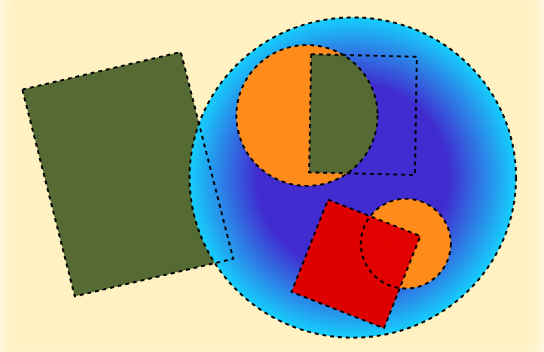
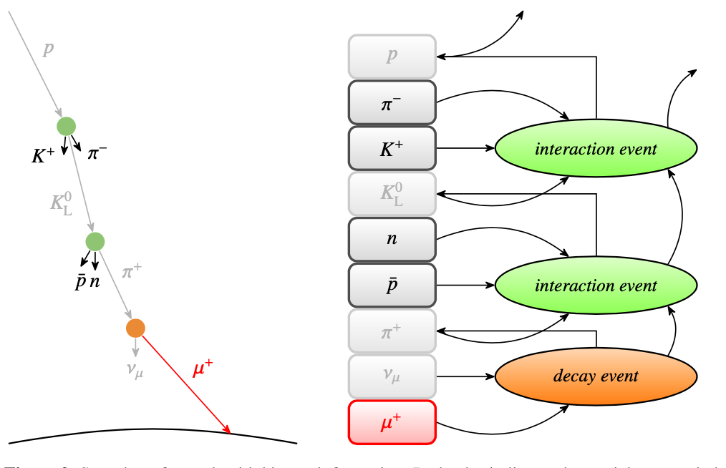
Corsika 8: Environment, Geometry and Particle Tracking
Environment and geometry:
Composed of simple geometric primitives (spheres, cuboid, cones)
Each geometry object can provide own physical property models
Material properties can depend on the location of the particle within each primitive
Easy exchange of atmospheric models
No support for «detector simulations»
Composition and media is provided to processes at each step
Full cascade history:
Optionally storing the entire generation history of particles (not the full shower, just particles that are “selected “).
Full parent tree, including intermediate particles, locations, and interactions.
Powerful tool to investigate i.e. muon production
Notes:
Only in memory during runtime and not saved to disk (storage limitation)
Muon histories allowing for studying the relative contribution of different particles to the observed muon flux at the ground.
Full particle histories enable a plethora of studies of the processes that contribute to observations (i.e. the muon excess) or as training data for supervised learning or analyses.

Slide 12
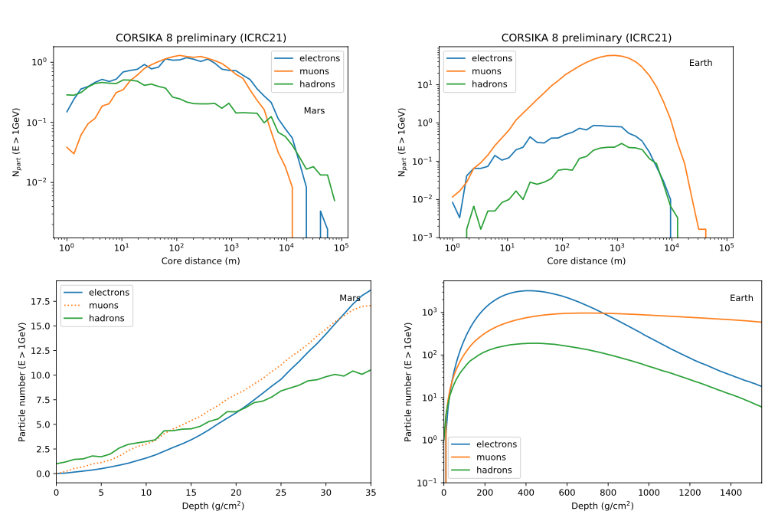
Corsika 8: example of simulation on Mars and Earth
Ulrich et al. ICRC2021
Implementation of a two-layer Mars atmosphere and simulation of inclined (𝜃=60°) proton showers on Earth and on Mars with a <1GeV particle cutoﬀ.
The low energy model is UrQMD with a transition at 𝐸_{kin,lab} =63.1 GeV to the high energy model Sibyll2.3d.
E.m. interactions are fully simulated with PROPOSAL.
Earth has a magnetic field strength of 50𝜇𝑇 and a standard Linsley atmosphere,
Mars has no magnetic field and a two-layer density model provided by NASA.
The atmosphere composition of Mars is kept as 78% nitrogen and 22% oxygen instead of almost pure CO₂.
Summary (average over 600 showers) of 100TeV proton induced showers on Mars (left) and Earth (right) at 60◦ of zenith angle. On the top lateral particle number distributions on ground level are shown, while on the bottom this is shown for longitudinal profiles. Secondary particles with kinetic energy above 1 GeV are shown.

Slide 13
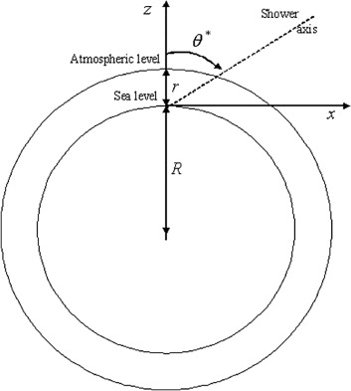

Example of Monte-Carlo simulation of atmospheric muon production on Mars (Tanaka 2007)
Monte Carlo simulation to analyse how cosmic ray showers develop in the Martian atmosphere and the production of secondary particles (mesons, neutrons, and muons) and their transport to surface.
Cartesian system with origin at sea level, taken as a spherical surface of volumetric mean radius and R= 3390637 m centered at the planet’s center.
Zenith angle θ∗ = the straight line that passes by the intersection point between the sea level and the vertical axis (z).
Azimuth angle φ = angle between the horizontal projection of the shower axis and the horizontal axis (x).
Atmospheric path length of particles (L_{path}) :
$$L_{path}={[{(R^{2} \cos^{2}{θ^{∗}} + 2Rr + r^{2})}^{1/2} − R\cos{θ^{∗}}]}/r$$
where R is the planet’s radius and r is the atmospheric thickness around the planet in vertical
Was assumed that the primary spectrum on Mars is the same as that on Earth.
Notes:
Muons are sensitive to atmospheric density and depth.
Muon showers begin deeper in the atmosphere, closer to the surface because martian atmosphere is thin.
Monte Carlo simulations to analyse how cosmic ray showers develop in the Martian atmosphere and evaluate the nuclide production rate in the martian regolith.
The study accounts for proton and neutron energy loss, particle decay, and muon range in the atmosphere.
The simulations model the production of:
Muons (charged particles from cosmic ray interactions).
Neutrons (important for cosmogenic nuclide production).
Protons (primary cosmic ray components).
Understanding muon flux variations over time can provide insights into Mars’ climate history.
at the atmospheric depth is 7 hPa, which corresponds to the Martian surface, the proton flux is⇠ 200 times stronger than the muon flux. The pion flux is only 5% of the muon flux, but it is much higher than the ratio observed on Earth’s surface (<0.1 %)
the vertical flux of these particles at atmospheric depths of 100 and 200 hPa, which correspond to the total thickness of the atmosphere that the muons traverse horizontally (85and 89 from zenith). The ratio between the proton and the muon flux is 25 and 7 at 100 hPa and 200 hPa, respectively. These non-muonic charged particles raining down on the Martian surface will produce an additional source of unwanted background noise as compared to Earth.
For non-vertical showers starting at the top of atmosphere, the thickness of the atmospheric layer is measured in terms of the slant depth evaluated at ground level. The plane surface approximation can give inaccurate estimation for large zenith angles, and it is divergent for θ∗= 90◦.

Slide 14
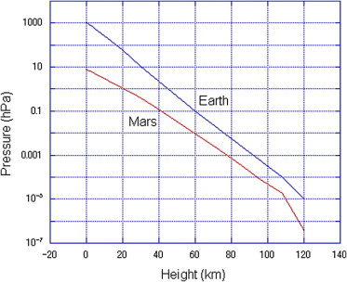

The Martian atmosphere is:
divided into five layers, with density and pressure based on Viking mission data.
$\text{Altitude} h_{l}\left(hl+1\right) where h1 = 0 \text{for} \text{l}\text{= 1,...,5 (}\text{layer}\text{)}$.
Vertical atmospheric depth $d= a + be^{{−h}/c}$ for each layer
Assumed with the same composition (95% CO₂, 5% N₂) and structure at all longitudes and latitudes, for all the regions of 0 < h < 90 km.
The pressure:
varied from 10⁻⁷ to 10⁻¹ hPa between 120 and 28 km above the surface ;
varied from 7.6 to 5.2 hPa between 4.5 and 0.0 km
The AIRES (AIR shower Extended Simulation) was used.
High-energy hadronic interactions were simulated using SIBYLL 2.1.
For photonuclear interactions and nuclear fragmentation was used the EHSA model.
Compton and photoelectric effects, Bremsstrahlung and pair production, emission of knock-on electrons, positron annihilation, LPM (Landau–Pomeranchuk–Migdal) effect and dielectric suppression, photonuclear reaction, and particle decay processes were taken into account
Incident primary energy region between 1 GeV and 5 TeV was considered and divided into two parts (1-20 GeV and 20 GeV - 5 TeV)
Notes:
Linsley’s atmospheric model (US standard atmosphere) (US standard atmosphere, National Aerospace Administration (NASA), National Oceanic and Atmospheric Administration (NOAA) and US Air Force 1976). This is a widely used model based on ex-perimental data, which describes vertical atmospheric temperature, pressure, and density.
The coefficients a, b, and c are adjusted to fit the corresponding experimental data or model.

Slide 15
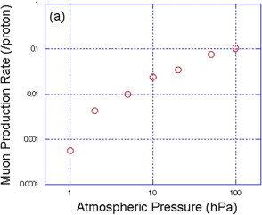
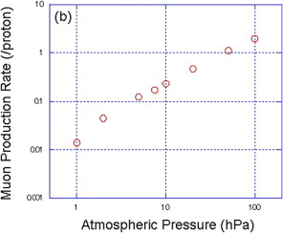

Increased atmospheric thickness enhances muon production by creating more secondary cosmic rays.
Once muons are produced, it can reach the planet surface before decays with high probabilities
Empiric relation between the muon generation rate N_{μ} the atmospheric thickness D (hPa) for incident protons between 1 and 20 GeV:
$N_{μ}=k(D^{0.8271})$ k = 0.0027863
Thicker atmospheres lead to greater muon flux at deeper depths in the Martian regolith.
Proton flux decreases with increasing atmospheric density, but muon flux increases significantly.
Estimation of muon production rate on Mars per incident proton, integrating over the zenith from – 90° to 90°, at Martian surface as a function of the atmospheric thickness for primaries between 1 and 20 GeV (a) and between 20 GeV and 5 TeV (b). For muons between 20 GeV and 5 TeV the production rate is over 10 times greater at all pressures.
Notes:
the steep power law dependence in the early stages of the shower cascade suggests that the meson flux and thus the muon flux will be strongly dependent on the atmospheric pressure, zenith angle and muon energy
The primary cosmic-ray flux on Mars is ~200× stronger than the muon flux at the surface​.Muon flux decreases with depth, but high-energy muons (>5 TeV) can still penetrate hundreds of meters into rock.
When cosmic ray protons interact with nuclei in the atmosphere they produce a shower of energetic particles, including charged mesons, which can undergo further interactions, producing other mesons. If the atmosphere is thin, charged mesons can decay before further interacting. The mean time to interaction varies inversely with density. Once muons are produced, it can reach the planet surface before decays with high probabilities. For example, Eμ ∼ 3 GeV muons travel around 20 km in the present martian atmosphere.
Usually, the muon generation rate increases with increasing incident primary energies. The average muon production rate by primaries between 20 GeV and 5 TeV is only 10 times higher than that by primaries between 1 and 20 GeV while the difference in the integrated primary intensity between these two energy regions is 3000.
Because the martian atmospheric thickness is much thinner than the terrestrial one, we have to consider the effect of the modulation in low energy primaries to the flux of the secondary particles at the martian surface. The GCR flux incident on planetary atmosphere is modulated by three processes: (a) variations of the solar wind within the heliosphere (on 10–1000 yr timescales, and possibly longer), (b) variations of planetary magnetic field, and (c) variations of the interstellar flux outside the heliosphere. While the martian magnetic field indicates that the ferromagnetic rock on the surface, the magnetic flux had not been strong enough to affect high energy cosmic rays for the past 10 million years, and thus the process (c) is not taken into account in the present discussion. The 140 Myr crossing period of the Solar System with the spiral arms of the Milky Way and nearby supernovae rate are long enough for the time scale of interest, so that we can neglect this effect for our present discussion. The GCR flux over these different timescales varies by between 15% during the 11 yr solar cycle, to as much as a factor 2 increase during periods of low geomagnetic field and low solar activity. increase in muon intensity with increasing atmospheric thickness is more extreme than that in primaries with decreasing the solar magnetic field. Thus, in this paper, the contribution of the solar modulation to the cosmic ray flux is not considered.

Slide 16
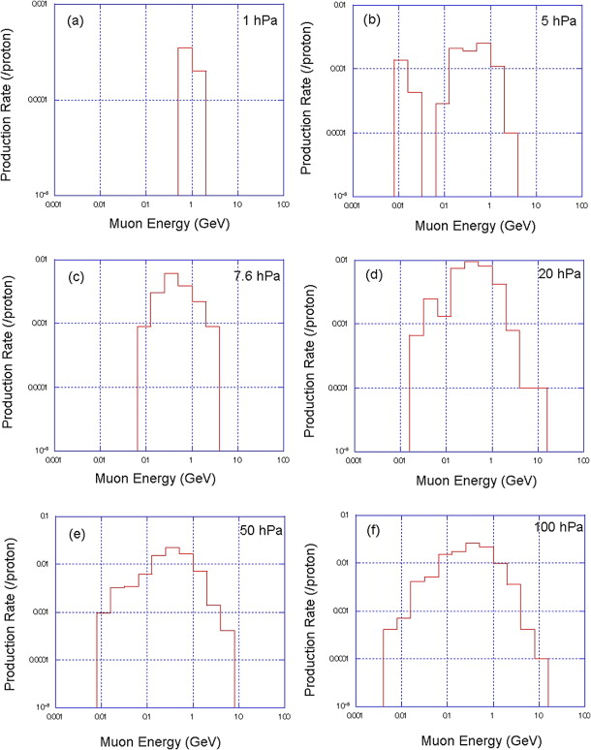
Muon energy spectrum at the martian surface for various atmospheric thicknesses, for incident protons between 1 and 20 GeV.
The peak (at ∼ 500 MeV) of the spectrum shifts to an order of magnitude lower energies than for the spectrum at sea level on Earth (peak at ∼ 2 GeV).
The range of muons with energy of 2 GeV is 5 m in rock while that with 500 MeV is 1 m
Notes:
The spectrum having a peak at relatively low energy region indicates that the amount of the muogenic nuclides is larger on Mars than on Earth and their flux profile has a peak at relatively shallow depth.
The peak muon energy on Mars (~500 MeV) is lower than Earth (~2 GeV) due to the thinner atmosphere.
Muons can penetrate deeper (~5-10 meters) into the Martian subsurface than neutrons or protons.
The muon energy spectrum varies based on past atmospheric thickness changes.

Slide 17
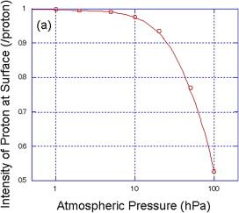
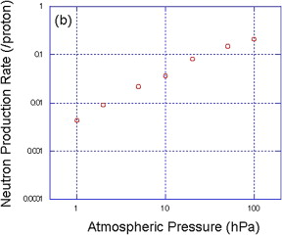
Intensity of protons (a), and energetic neutrons (b) at the martian surface as a function of the atmospheric thickness for primaries between 1 and 20 GeV (values obtained integrating over the angle region from θ∗= −90◦ to 90◦).
As the thickness of the atmosphere increases, more primary interactions occur, the proton flux decreases and the neutron flux increases.
Secondary production rate more sensitive to the atmospheric thickness than the proton reduction rate.
Notes:
The spectrum having a peak at relatively low energy region indicates that the amount of the muogenic nuclides is larger on Mars than on Earth and their flux profile has a peak at relatively shallow depth.

Slide 18
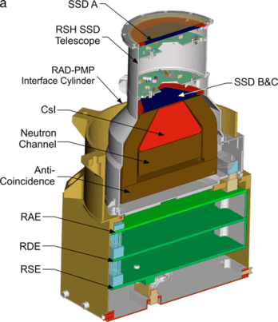
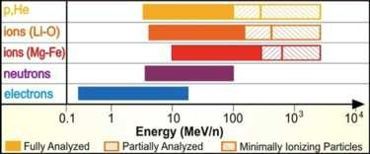
The Mars Science Laboratory Radiation Assessment Detector (MSL/RAD)
Cross section cartoon view of RAD showing the charged particle and neutral particle channels and electronic board layouts
First-ever radiation measurements on the Martian surface
Has been measuring almost continuously since the landing of the Curiosity rover in Gale crater (6 August 2012).
Has a wide dynamic range for charged particles and is able to measure all ion species that contribute to the radiation exposure
Consists of the RAD Sensor Head (RSH) and the RAD Electronics Box (REB) integrated together in a small, compact volume.
The REB contains three circuit boards
RAD energy range and coverage by particle type.
Hassler+2012
Notes:
RAD energy range and coverage by particle type.
Stopping particle energy ranges for charged particles are shown in solid colors
The REB contains three circuit boards , one with a novel mixed-signal ASIC for processing analog signals and an associated control FPGA, another with a second FPGA to communicate with the rover and perform onboard analysis of science data, and a third board with power supplies and power cycling or “sleep”-control electronics. The latter enables autonomous operation, independent of commands from the rover.
RAD provides differential fluxes in limited energy ranges, about 10–100 MeV/nuc for protons and helium, and integral fluxes of ions with higher energies. The dE/dx resolution of RAD is sufficient to distinguish between major particle species. RAD measures dE/dx in silicon, but these measurements can also be related to Linear Energy Transfer (LET) in water. (By LET we mean LET in water, i.e., the energy lost in an infinite volume.) The RAD dynamic range covers the LET range from 0.2 to approximately 1000 keV/µm. RAD also measures neutrons and γ -rays with energies from∼5 to 100 MeV using an approach similar to that discussed b

Slide 19
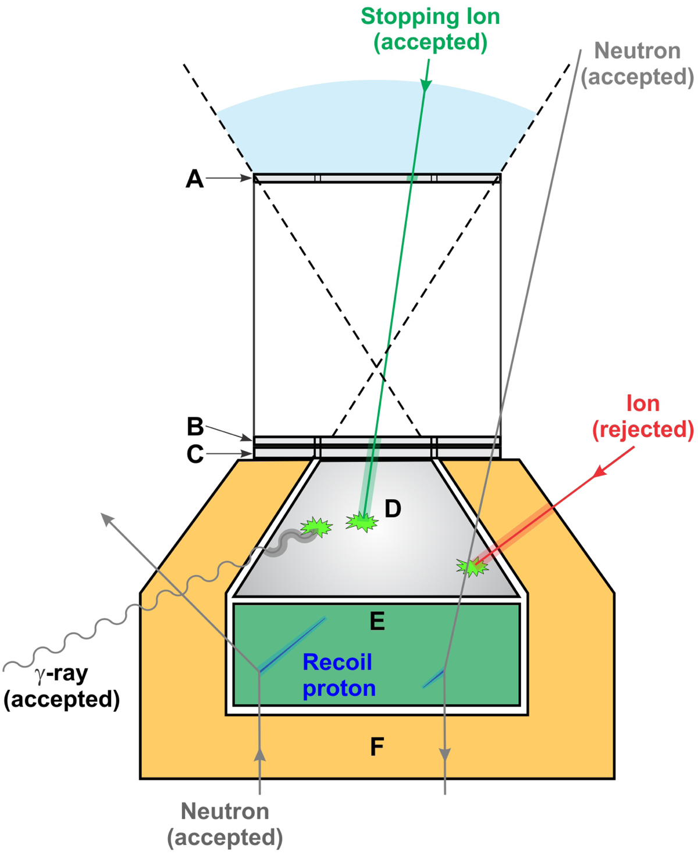
The RAD sensor head (RSH)
Si detector
The RAD sensor head (RSH) contains detectors for charged and neutral particle measurements
Neutral particles are measured in D and E
Separate spectra for γ-rays and neutrons are derived
To detect charged particle all detectors are used
The analysis distinguishes between particles penetrating the RSH and those that stop in one of detectors (B, C, D, E).
RAD measures the absorbed radiation dose in B and E
CsI scintillator
Plastic scintillator
Köhler+2014
Schematic of the RAD sensor head (from Köhler et al. 2014).
Notes:
The RSH contains a solid-state detector telescope with three silicon PIN diodes for charged particle detection, a thallium doped Cesium Iodide scintillator, plastic scintillators for neutron detection and anti-coincidence shielding, and the front-end electronics.
C and F act as anticoincidence against charged particles
A and B act as a telescope defining the acceptance cone for incoming charged particles.
Stopping particles can be resolved as energy- and particle-type-dependent spectra, while integral fluxes are derived for the different species of penetrating particles. The full opening angle for stopping particles is ~60° from the upper hemisphere, while particles penetrating the RSH have a full acceptance angle of 36° from both upper and lower hemisphere, although the fraction of penetrating particles coming from the lower half, the Martian soil, is estimated to be almost negligibly small

Slide 20
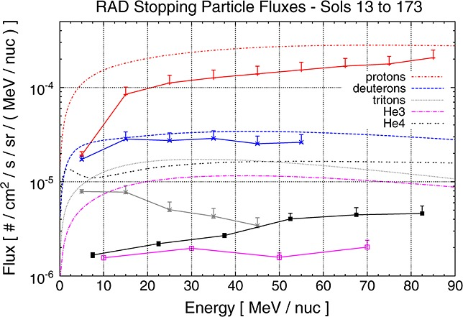
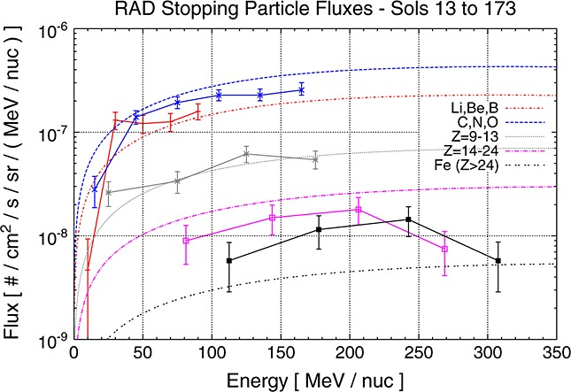
Charged particle spectra
Ehresmann+2014
Charged particle spectra obtained with the Mars Science Laboratory Radiation Assessment Detector (MSL/RAD) on the surface of Mars
Notes:
charged particle fluxes as measured with RAD averaged over a time period of 160 sols from sol13 to sol173 (18August2012 to 30January 2013). During that time the average atmospheric column depth above the rover was∼21–22g/cm2 and the average solar modulation parameter was Φ ≈577MV.
The On- Line Tool for the Assessment of Radiation in Space. OLTARIS is an integrated tool set utilizing HZETRN (High Charge and Energy Transport). These tools are intended to help scientists and engineers study the effects of space radiation on shielding materials, electronics, and biological systems. HZETRN radiation transport code. It is a deterministic radiation transport code capable of calculating the transport of the large variety and broad energy spectra of particles found in the space environment through shielding materials.
Stopping particle fluxes measured by RAD in Gale crater on Mars, during the time period from sol 13 to 173. The solid lines show the measurement results for ion species and isotopes with charges Z = 1 and 2. The dashed and dotted lines show predictions from the OLTARIS model, run with a solar modulation parameter Φ = 577 MV, and an atmospheric column depth of 21 g/cm2.
The solid lines show the measurement results for ion species group with charges Z = 3 to 26 and higher. The shown particle species are Li,Be,B (red); C,N,O (blue); ions with Z = 9–13 (grey); ions with Z = 14–24 (magenta); and ions with Z>24 (black).

Slide 21
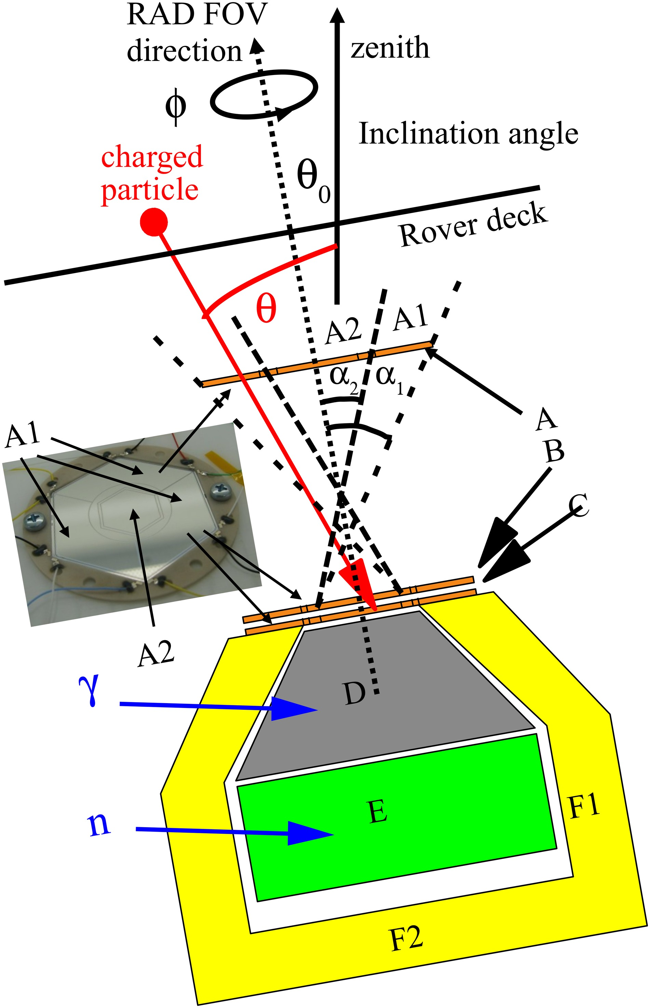
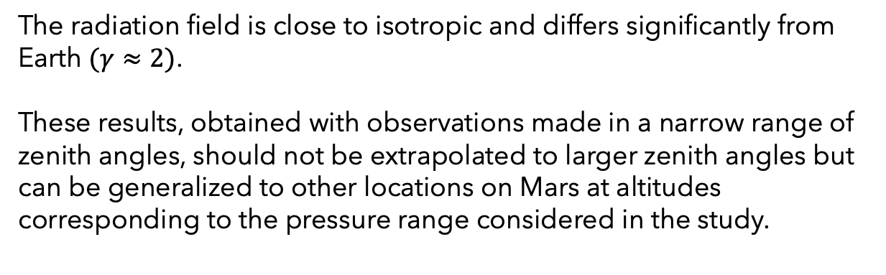


Zenith angle dependence of the Martian radiation environment
Data collected between Sol 525 and Sol 806 (281 Martian days).
The rover’s inclination varied between 0° and 15°, affecting the angle at which radiation entered the detector.
Environmental factors like pressure and temperature were accounted for, to isolate the zenith angle dependence.
Pressure varied between approximately 680Pa to about 930 Pa over the period of study.
$${J\left(θ\right)∝cos{(θ)}}^{γ}$$
$$γ ≈1.18 ±0.07$$
The radiation field is close to isotropic and differs significantly from Earth $(γ≈2)$.
These results, obtained with observations made in a narrow range of zenith angles, should not be extrapolated to larger zenith angles but can be generalized to other locations on Mars at altitudes corresponding to the pressure range considered in the study.
Wimmer-Schweingruber
+2015
Notes:
**Effects of Altitude & Surface Pressure:**
- Higher altitudes (e.g., Olympus Mons, **82 Pa surface pressure**) experience **higher radiation levels** due to thinner atmospheric shielding.
- Low-altitude craters (e.g., Hellas Planitia, **1,200 Pa surface pressure**) offer **better natural radiation protection** due to the thicker atmosphere.
- **Neutron Contribution to Radiation:**
- Increased atmospheric and regolith shielding **reduces heavy ion radiation** but **increases secondary neutron production**, particularly at ~30 cm depth.
- **Optimal Shielding Depth for Habitats:**
- To maintain an annual effective dose below **100 mSv**, the required regolith depth varies:
- **1.0 to 1.6 meters**, depending on surface pressure.
- Less shielding is needed at low-altitude sites with higher atmospheric pressure.
- **Variations in Radiation with Solar Activity:**
- Radiation levels fluctuate with **solar modulation conditions** (i.e., different phases of the solar cycle affect cosmic ray intensity).

Slide 22
The Atmospheric Radiation Interaction Simulator (AtRIS)
GEANT4-based Monte Carlo transport code for radiation interaction modeling in planetary atmospheres and regolith
GEANT4, which tracks particle interactions step by step through a 3D spherical model of a planet, uses Physics Lists to determine interaction models (default FTFP_BERT_HP)
Main features:
The planet specification format (PSF) used to describe the planet model (atmospheres, planetary surfaces)
Output in the form of atmospheric response matrices (ARMs), which quantify the relation between primary energy and altitude-dependent ionization as well as equivalent/absorbed dose rate.
The spectrum folding procedure used to calculate net quantities by implementing a convolution of a measured spectrum and the ARMs.
An interface for the Mars climate database (MCD), a database of meteorological fields derived numerical simulations of the Martian atmosphere and validated using available observational data, has been implemented.
Atmosphere is modeled as concentric spherical shells with varying density and composition.
Can calculate ion and electron pair production rates, secondary particle distributions (as a function of energy, directionality, planet altitude)
Tracking of charged particles through magnetic fields is not implemented
Notes:
enables parametric studies of ion pair production rates, essential for atmospheric chemistry models and habitability assessments.Unlike previous models, AtRIS also allows direct computation of absorbed and equivalent dose rates in human tissue or water-equivalent materials.
default FTFP_BERT_HP) for hadronic physics and high-precision neutron tracking.
After a primary is generated by sampling its energy, position, and direction from the corresponding probability density functions (PDFs), it is propagated through the matter in a step-by-step process. In each step, the simulation code evaluates the probabilities for the various possible physical processes by considering the relevant PDFs and applies the effect thereof after the step is completed. This is continued so long the particle has a nonzero kinetic energy or it leaves the atmosphere or enters the core. The same is also true
for all secondary particles. Useful information are accumulated and stored in varying degrees of verbosity
The advantage of ARMs is that it decouples simulation of primary particles from specific radiation flux models, allowing for faster parametric studies. Enables researchers to test different cosmic ray flux conditions without rerunning simulations.
The MCD includes complementary post-processing schemes such as high spatial resolution interpolation of environmental data and means of reconstructing the variability thereof.
The MCD provides mean values and statistics of the main meteorological variables (atmospheric temperature, density, pressure and winds) as well as atmospheric composition (including dust and water vapor and ice content), as the GCM from which the datasets are obtained includes water cycle [4,5], chemistry [6], and ionosphere [7,8] models. The database extends up to and including the thermosphere [9,10] (~350km). Since the influence of Extreme Ultra Violet (EUV) input from the sun is significant in the
latter, 3 EUV scenarios (solar minimum, average and maximum inputs) account for the impact of the various states of the solar cycle.

Slide 23
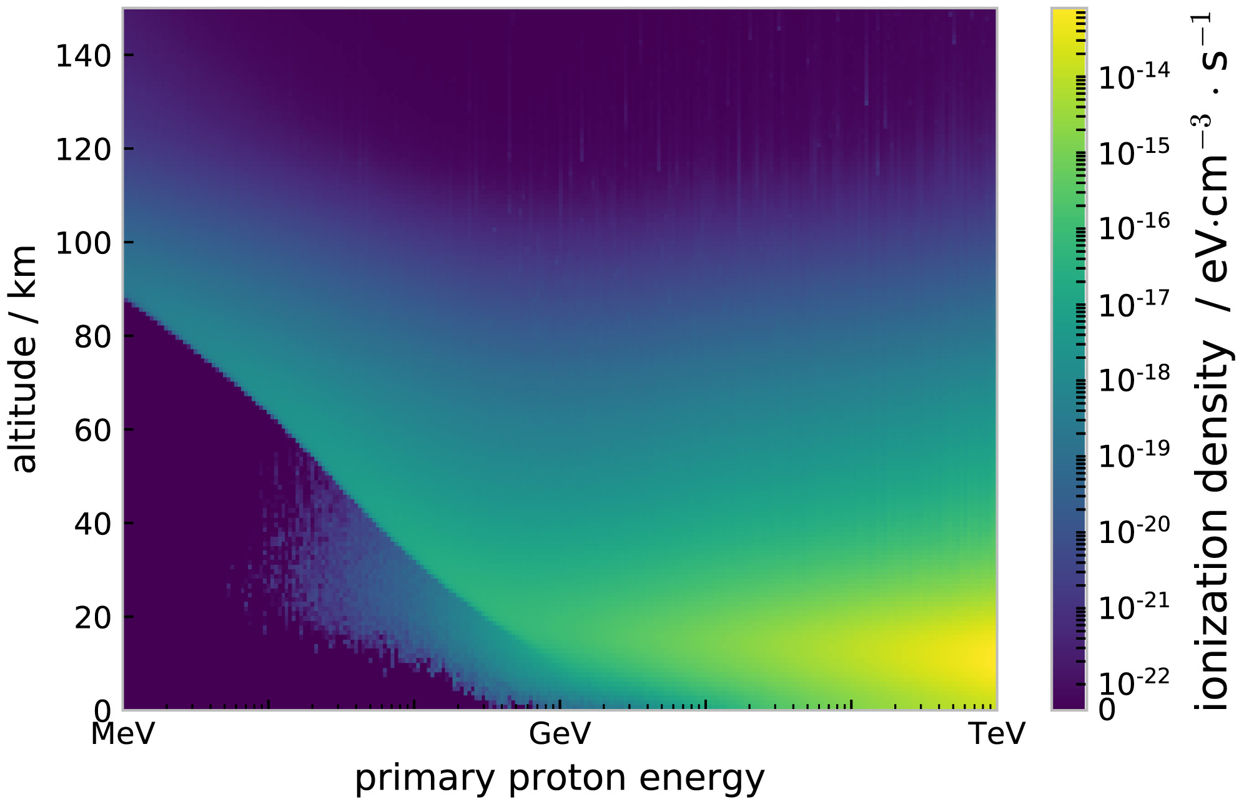
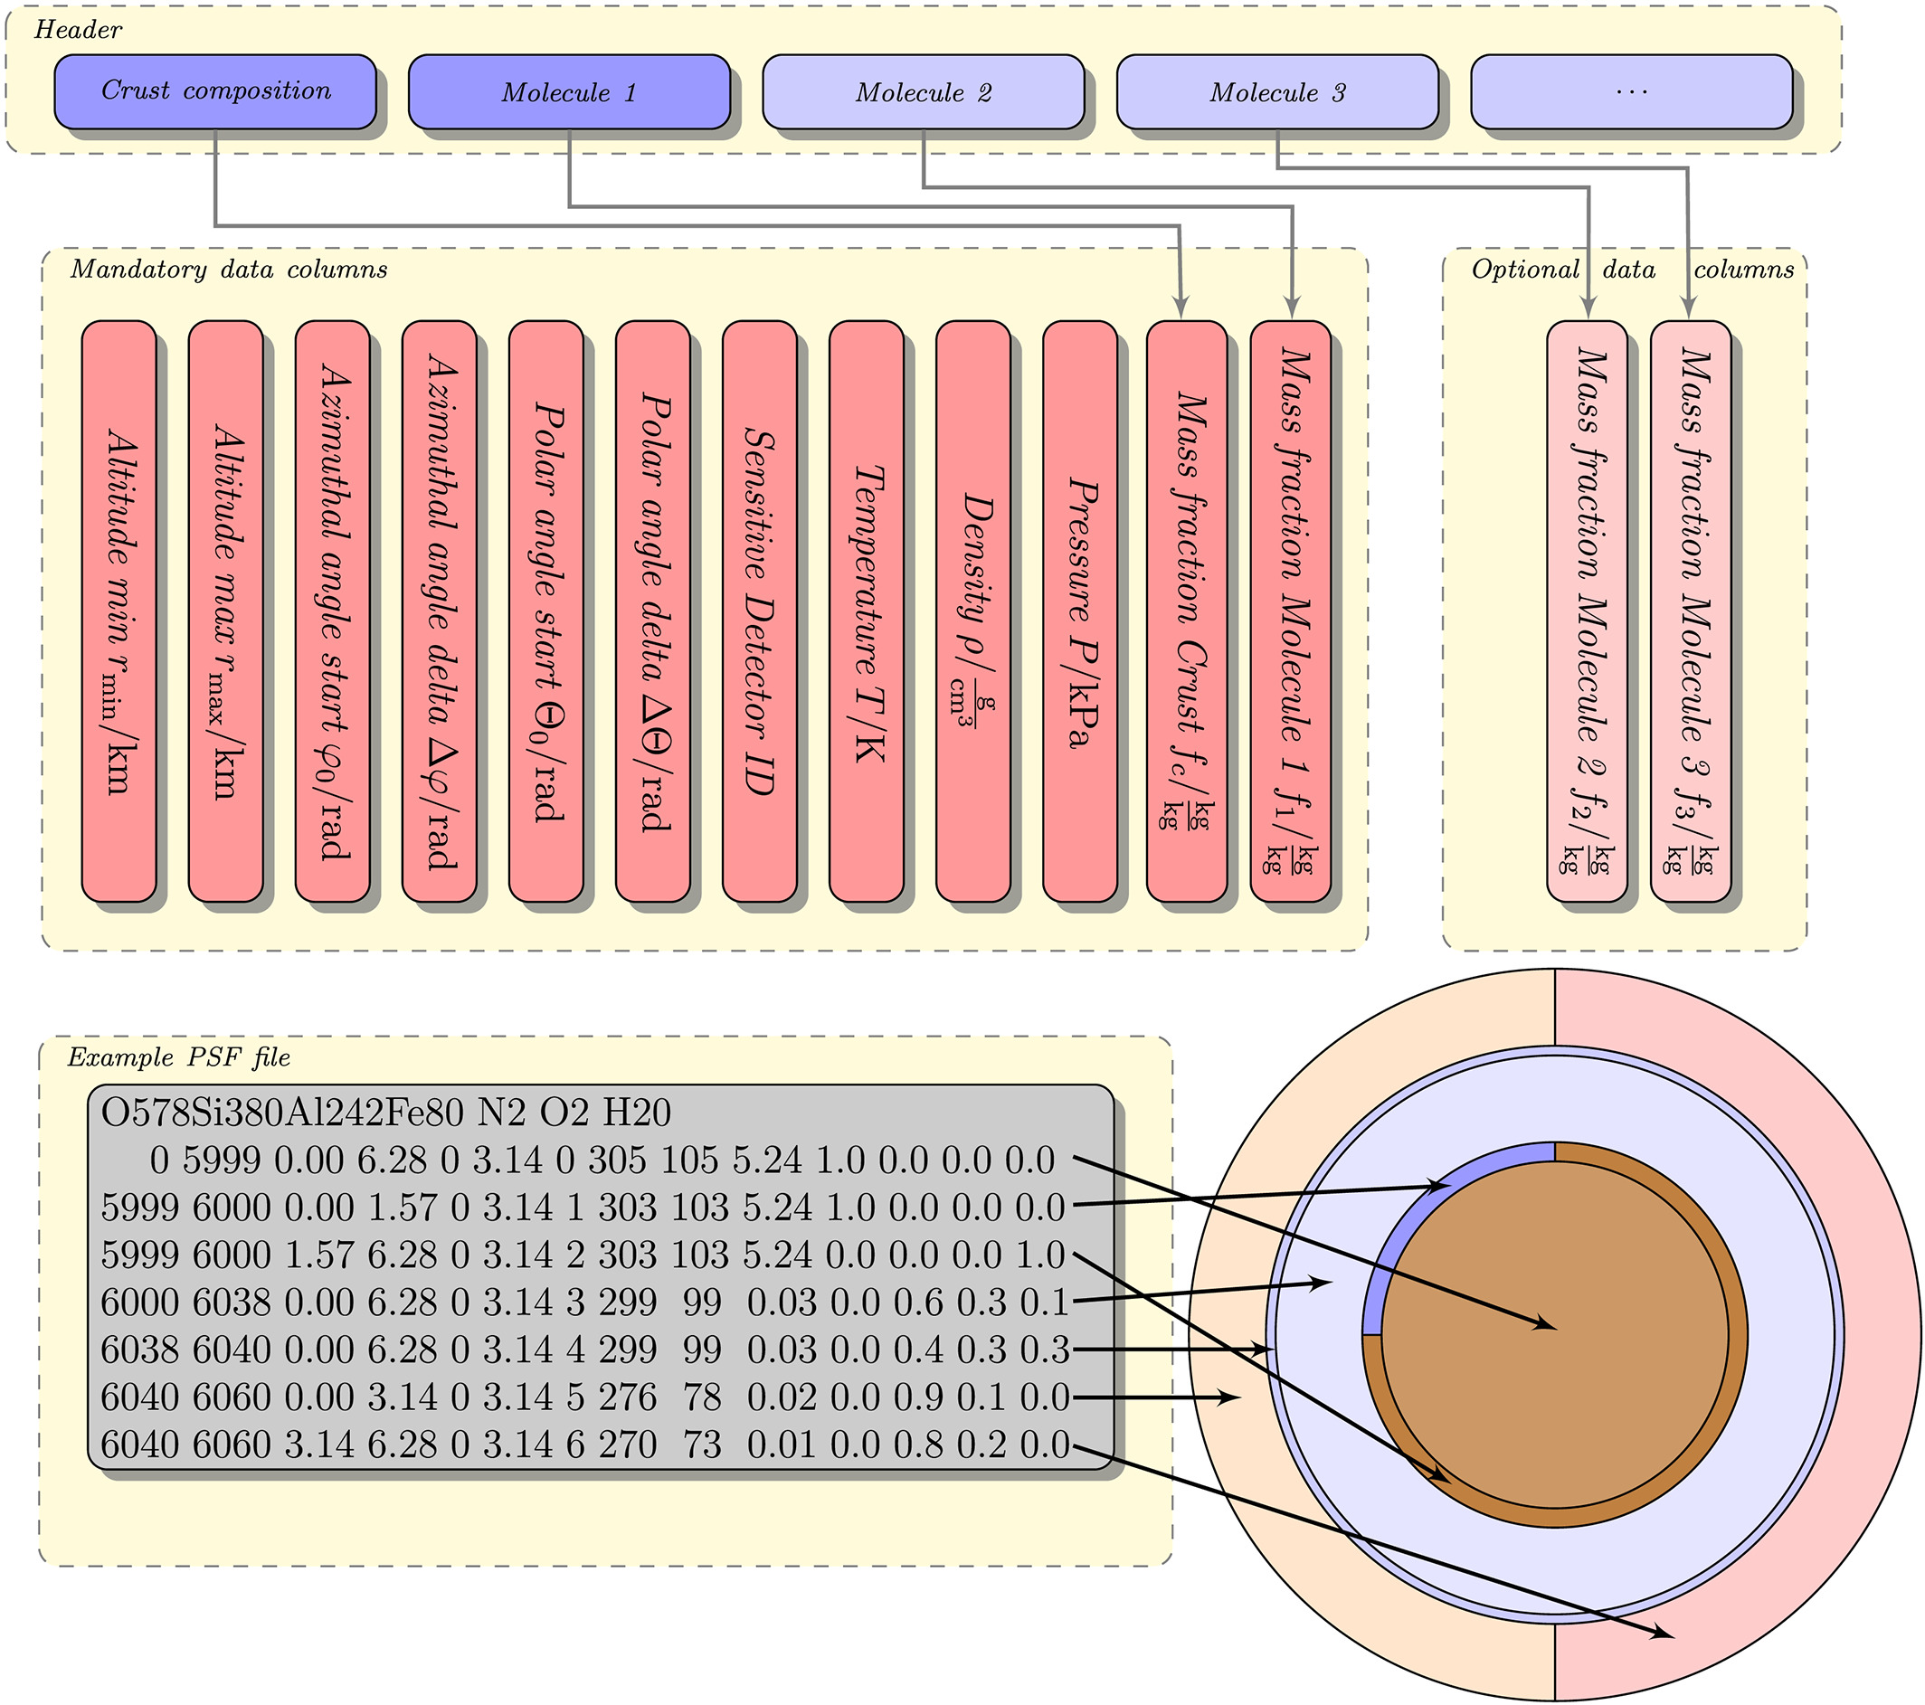
The atmospheric response matrix describes the relation between primary particle energy and the resulting average altitude‐dependent ionization. At energies of ≈1–10 MeV, we observe the primary Bragg peak. Above 10 MeV, a secondary peak due to pair production and pion‐muon production appears. Secondaries due to primary particles with energies above 700 MeV can penetrate down to the surface.
The planet specification format enables the specification of arbitrary atmospheres: The first six columns specify the geometry of the volume element; the next column provides the sensitive detector ID. After the three columns specifying the macroscopic properties of the volume elements, the last columns describe the composition.

Slide 24
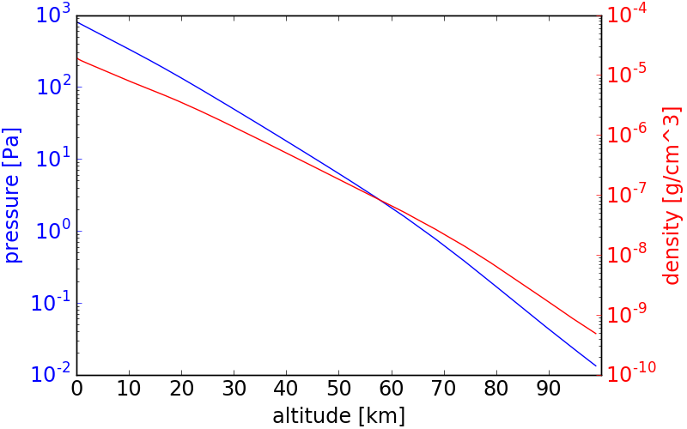
Sphere with a radius of 3390 km representing Mars
The soil composition is approximated as 50% Si, 40% O, and 10% Fe (mass fractions) and the crust sheet is 100 m thick
The Martian atmosphere from the MCD model is simulated as a 100 km thick shell divided into 500 m thick layers. The column depth at the surface is about 22 g cm⁻² corresponding to a surface pressure of 830 Pa
The study compares four different GEANT4 physics lists (QGSP_BIC_HP, QGSP_BERT_HP, FTFP_BERT_HP, FTFP_INCLXX_HP).
Use of Badhwar-O’Neill 2010 (BON10) GCR spectrum model.
The interaction of primary protons with the Martian atmosphere has been modeled and ARMs have been constructed for different secondary types (Hydrogen isotopes (proton, deuteron and triton) and ³He and ⁴He. Each secondary type is differentiated as downward and upward-directed with the respective matrix.
Simulated results are validated against Radiation Assessment Detector (RAD) on board Curiosity rover.
Good agreement with MSL/RAD measurements for protons and helium ions.
The FTFP_INCLXX_HP physics list provides the best match, especially for deuterium, tritium, and ³He..
Martian surface spectra of H and He isotopes induced by primary GCR proton and ⁴He particles modeled via four different physics lists. The spectra are averaged within 36° of downward zenith angle corresponding to the RAD view cone.
Martian atmospheric structure at Gale Crater implemented in the simulations as imported from the MCD model.
Notes:
The Badhwar-O’Neill (BON) model numerically solves the Fokker-Planck (FP) equation that takes into account diﬀusion, convection, and adiabatic deceleration within the heliosphere. The solution to the FP equation as implemented in the BON model is the flux of GCR particles of a given charge, Z, as a function of energy. The solution is obtained under the assumptions of a quasi-steady state and a spherically symmetric interplanetary medium
construct the “response function” of the Martian atmosphere based on simulated particle spectra from AtRIS. We can describe the statistical transformation of the atomic and nuclear interaction process for a particle spectrum (of particle type i as a function of energy E0) above the Martian atmosphere resulting in a particle spectrum (of particle type j as a function of energy E) on the Martian surface in a matrix Mij(E0, E). As particles could also interact with the Martian atmosphere and regolith and produce albedo particles contributing to the upward fluxes, we have also considered the generation of such upward particles in our simulations. Since the energy spectra of upward- and downward-traveling particles are dissimilar, we have separately constructed the upward and downward directed matrices for each primary– secondary case. Once such a matrix is constructed, it can be folded with any incoming SEP or GCR spectra within the energy range of the simulated particles for calculating the surface spectra without rerunning the particle transport simulations. The upward and downward secondary particle spectra generated by different types of primary particles can be combined. The following steps are used for constructing the matrix and folding it with a given incoming spectra to obtain the surface spectra:

Slide 25
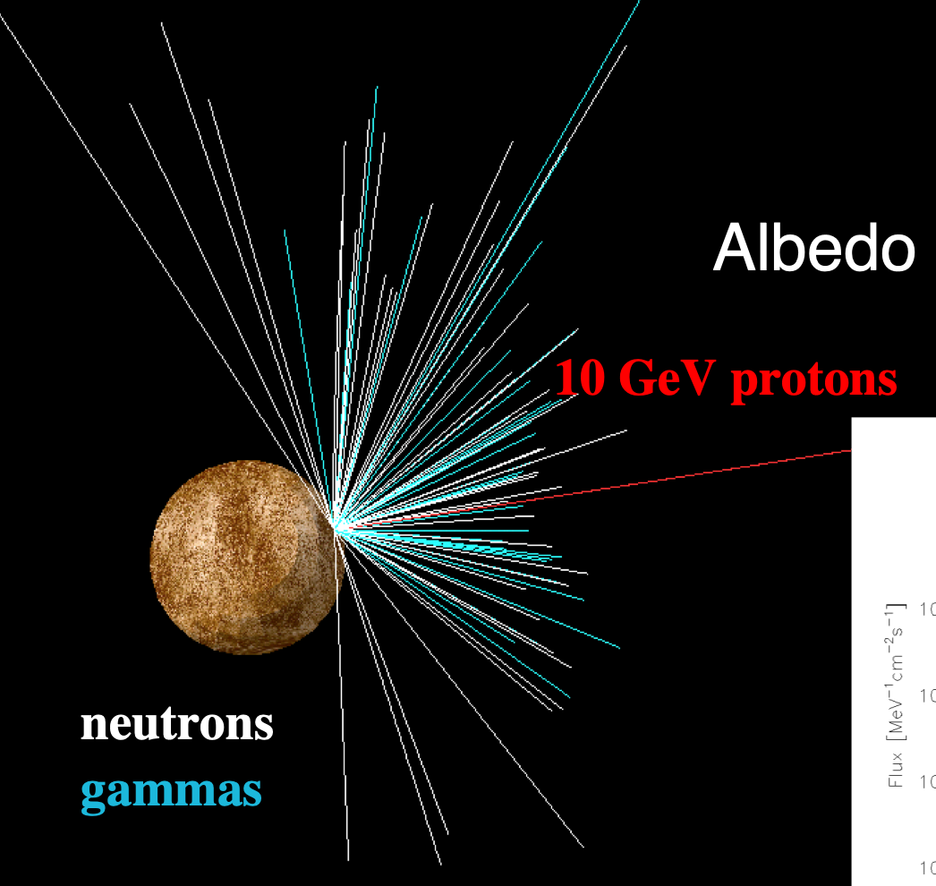
PLANETOCOSMICS
Geant4 based tool simulating cosmic rays interaction with planetary atmosphere, soil and magnetic field for Mercury, Earth and Mars.
Computes the energy deposition by energetic particles following a Monte Carlo scheme and using the physical processes provided by Geant4 (default physics lists QGSP_BIC_HP and StandardEM).
Fluxes of secondary particles and energy deposited at user defined altitudes, atmospheric depths, and soil depths
Visualisation of particle trajectories and field lines
Python Interface to MarsGRAM2001
Soil model of different layers, each one with a defined density, composition and thickness
Notes:
Mars-GRAM 2001 is based on topography from the Mars Orbiter Laser Altimeter (MOLA) and includes new MGCM data at the topographic surface. A new auxiliary program allows Mars-GRAM output to be used to compute shortwave (solar) and longwave (thermal) radiation at the surface and top of atmosphere..
The Mars Global Reference Atmospheric Model (Mars-GRAM) is an engineering- oriented model that provides this critical information based on data tables derived from output results from the NASA Ames Mars General Circulation Model (MGCM), and the University of Michigan Mars Thermospheric General Circulation Model (MTGCM). Mars-GRAM is designed to offer mission planners the flexibility to select input parameters such as time, latitude, longitude, and dust level. Mars-GRAM outputs mean values for atmospheric density, temperature, pressure, winds, and constituents along a user defined path. Mars-GRAM also provides winds and density dispersions.

Slide 26
Example of simulation on Mars with PLANETOCOSMICS
The physics lists FTFP_INCLXX_HP and emstandard_opt3 were used.
As the external source to the simulation, nuclei from the primary galactic cosmic radiation with atomic numbers from Z = 1 to 28 (H to Νi). The energy spectra were described applying a simplified version of the GCR ISO- model (ISO, 2004) with only one free parameter, for the period between November 15, 2015, and January 15, 2016.
The simulation geometry was a box with side length of 10⁴ km and in vertical direction consisted of 90 km atmosphere and 10 km of regolith (density 1.7 g/cm²).
Atmosphere divided in 196 different layers using atmospheric composition based on the Mars Global Reference Atmospheric Model 2001 (MarsGram-2001)
Ground altitude selected such that the vertical column density was 23 g/cm²
Simulated GCR particles enter isotropically, and secondary radiation flux is recorded at various altitudes and surface locations
Dose contributions are calculated for neutrons, protons, deuterons, tritons, ³He, ⁴He, electrons, positrons, muons, pions, and heavy ions.
The simulated dose rates agree well with RAD observations and small discrepancies arise due to uncertainties in atmospheric pressure fluctuations.
Notes:
The primary particles were shot into the geometry at the center point on top of the atmosphere with a cosine distribution to describe the isotropic in flux of GCR particles. Double differential (in energy and
zenith angle) secondary particle spectra were recorded at several altitudes in the atmosphere and on the ground. The particle flux was calculated from the number of particles crossing a horizontal plane extended over the full geometry at a given altitude and weighted by the inverse cosine of the zenith angle. In combination with the point source
on top of the atmosphere, this is identical to the number of secondary particles crossing a sphere, i.e. particle flux, at the given altitude for an isotropic incidence of GCR primaries on top of the atmosphere. Integrating the secondary particle spectra over different zenith angle ranges allowed to calculate the particle fluxes for different solid angle ranges: downward, upward, all angles and the RAD view cone

Slide 27
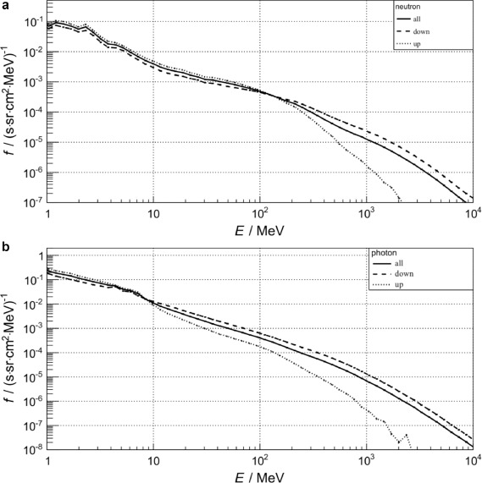
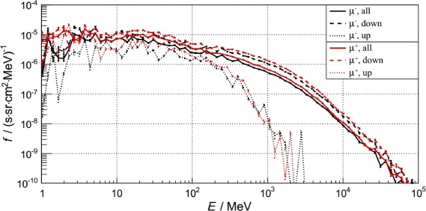
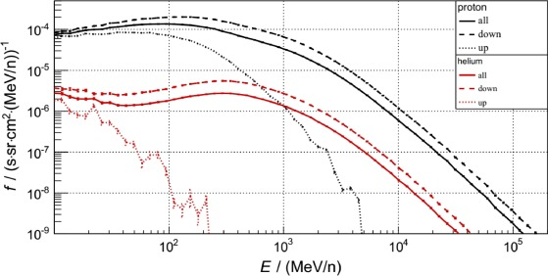
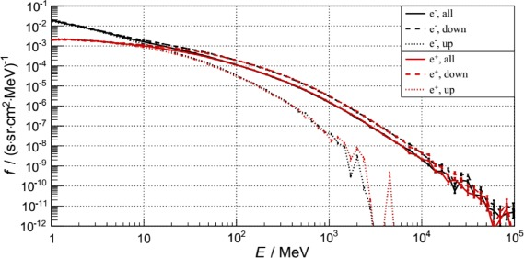
PLANETOCOSMICS
Calculated muon spectra at the Martian surface. Downward (dashed lines), upward (dotted lines) and average (solid lines) are shown separately.
Calculated neutron (a) and photon (b) spectra at the Martian surface. Downward (dashed lines), upward (dotted lines) and average (solid lines) are shown separately.
Calculated proton and helium spectra at the Martian surface. Downward (dashed lines), upward (dotted lines) and average (solid lines) are shown separately.
Calculated electron and positron spectra at the Martian surface. Downward (dashed lines), upward (dashed lines) and average (solid lines) are shown separately.

Slide 28
GRAZIE PER L’ATTENZIONE!

