Slide 1

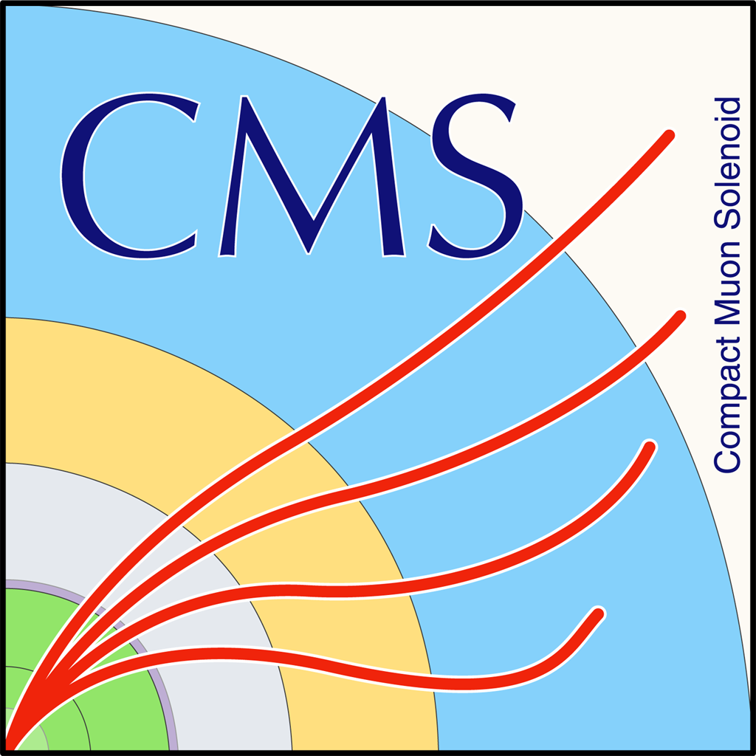


Studies for the Measurement of Quantum Correlations in Top Quark Pair Production with cms run 2 data
IMAPP Master Thesis Presentation
29/09/2025
Angelo Arisi

Slide 2
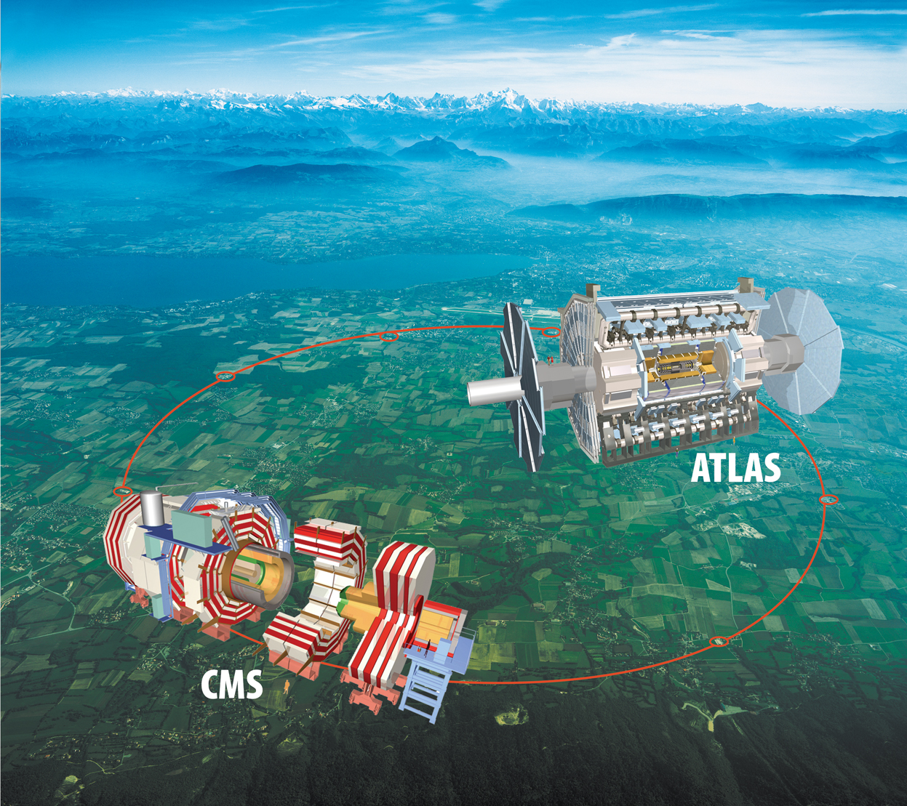
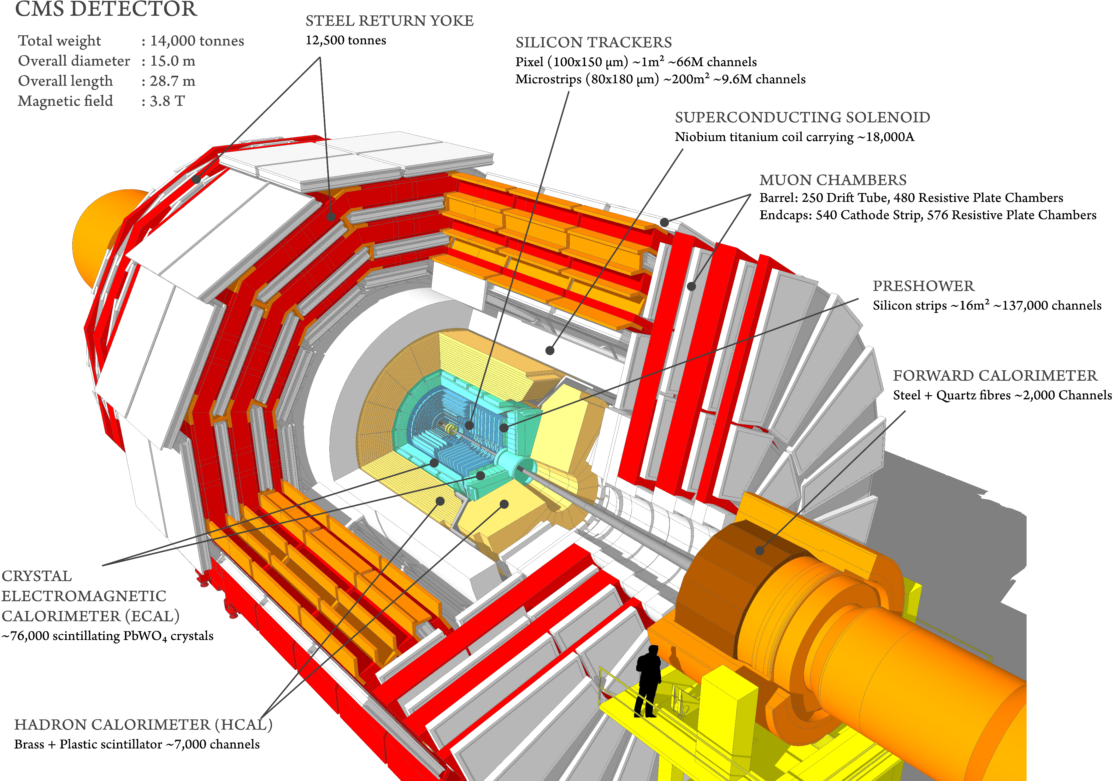
The LHC and cms

Slide 3
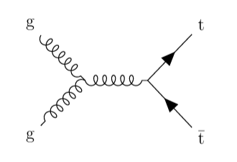
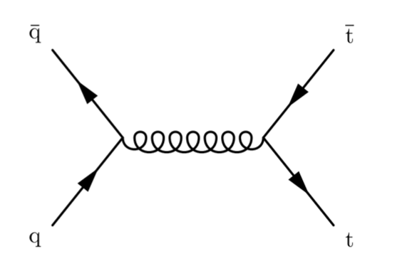
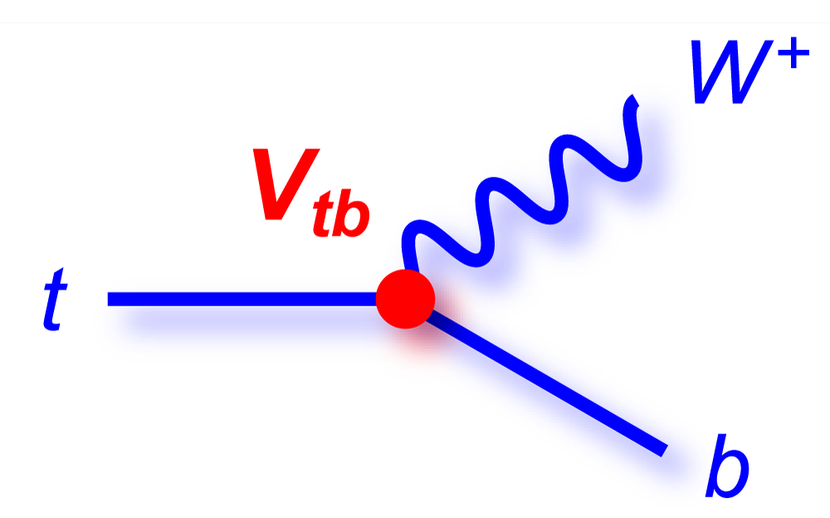
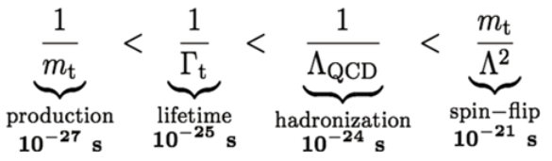
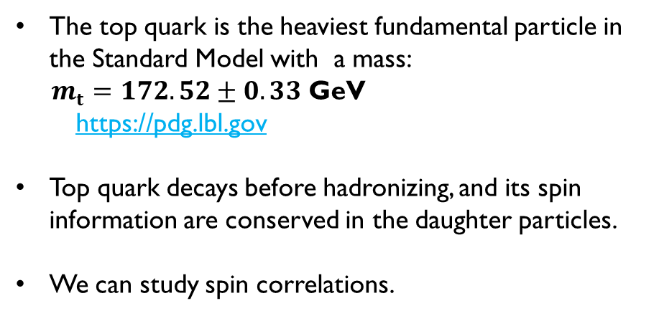
Top Quark at LHC
The top quark is the heaviest fundamental particle in the Standard Model with a mass:
$m_{t}=172.52±0.33$ GeV
https://pdg.lbl.gov
Top quark decays before hadronizing, and its spin information are conserved in the daughter particles.
We can study spin correlations.
Production:
Gluon fusion
Quark annihilation
Decay:

Slide 4
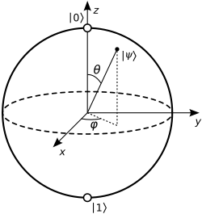
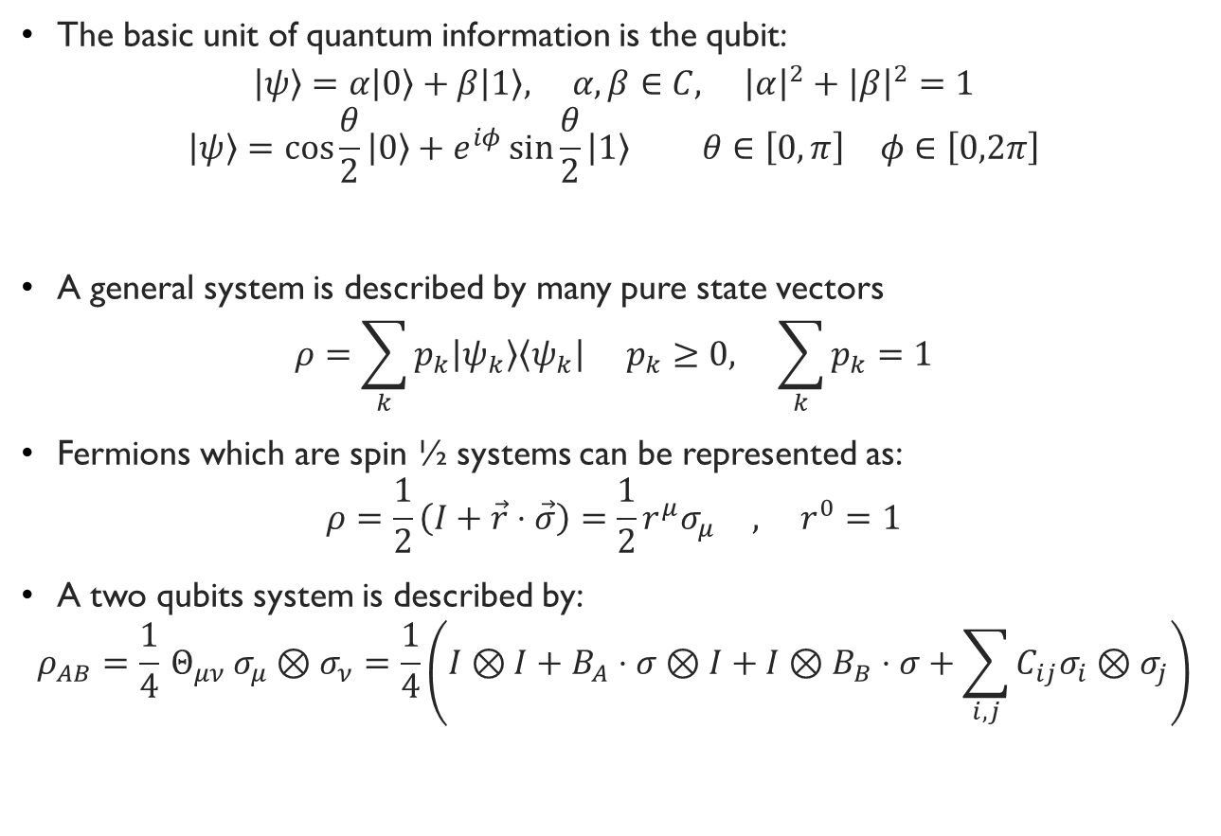
QUANTUM INFORMATION
The basic unit of quantum information is the qubit:
$$\left|ψ\right\rangle =α\left|0\right\rangle +β\left|1\right\rangle , α,β∈C, {\left|α\right|}^{2}+{\left|β\right|}^{2}=1$$
$$\left|ψ\right\rangle =\cos{\frac{θ}{2}}\left|0\right\rangle +e^{iφ}\sin{\frac{θ}{2}}\left|1\right\rangle θ∈\left[0,π\right] φ∈\left[0,2π\right]$$
A general system is described by many pure state vectors
$$ρ=\sum_{k}{p_{k}\left|ψ_{k}\right\rangle \left\langle ψ_{k}\right|} p_{k}≥0, \sum_{k}{p_{k}}=1$$
Fermions which are spin ½ systems can be represented as:
$$ρ=\frac{1}{2}\left(I+\vec{r}⋅\vec{σ}\right)=\frac{1}{2}r^{μ}σ_{μ} , r^{0}=1$$
A two qubits system is described by:
$$ρ_{AB}=\frac{1}{4} Θ_{μν} σ_{μ}⊗σ_{ν}=\frac{1}{4}\left(I⊗I+B_{A}⋅σ⊗I+I⊗B_{B}⋅σ+\sum_{i,j}{C_{ij}σ_{i}}⊗σ_{j}\right)$$

Slide 5
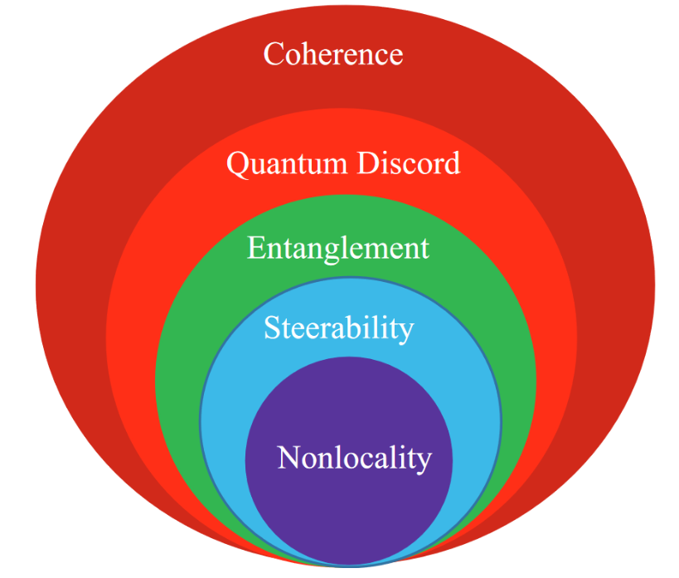
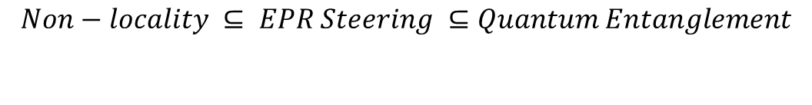
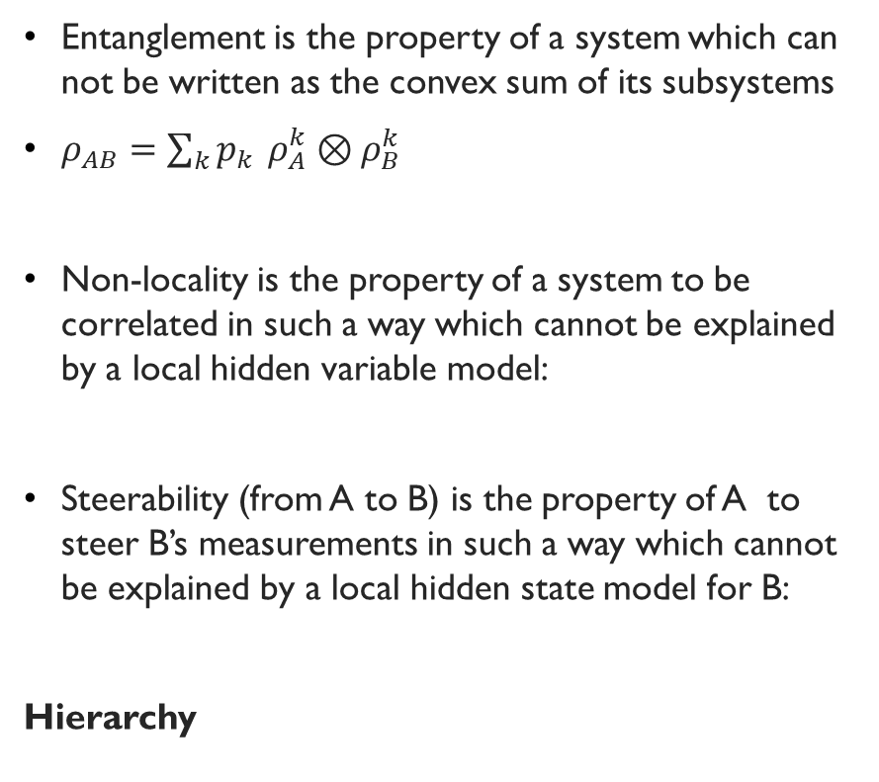
Hierarchy of QUANTUM correlations for 2 qubits
Entanglement is the property of a system which can not be written as the convex sum of its subsystems
$ρ_{AB}=\sum_{k}{p_{k}} ρ_{A}^{k}⊗ρ_{B}^{k}$
Non-locality is the property of a system to be correlated in such a way which cannot be explained by a local hidden variable model:
Steerability (from A to B) is the property of A to steer B’s measurements in such a way which cannot be explained by a local hidden state model for B:
Hierarchy
$$Non−locality ⊆ EPR Steering ⊆Quantum Entanglement$$

Slide 6
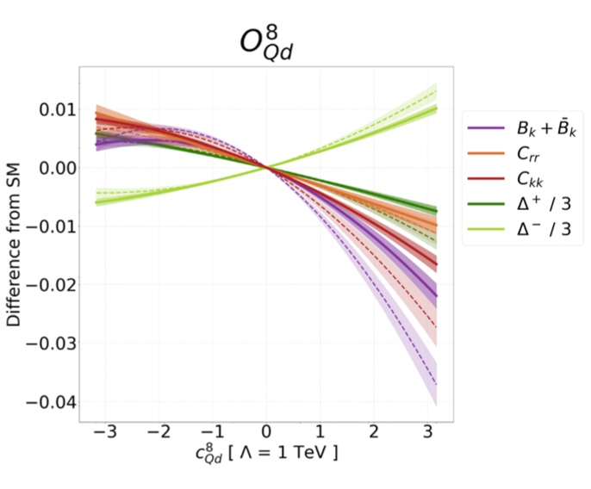
WHy do we measure quantum correlations?
Probing fundamental properties of quantum information theory (QIT) and quantum mechanics at the highest energies ever reached.
Applications between QIT and HEP.
Sensitivity to higher order SM corrections.
Sensitivity to BSM physics.
Limits on Effective Field Theories (EFT) dimension six operators.
JHEP 01 (2023) 148 [2210.09330]

Slide 7
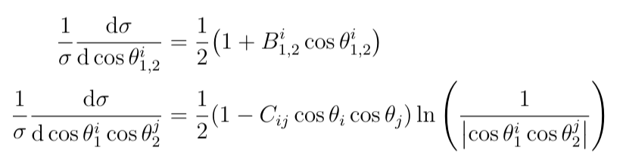

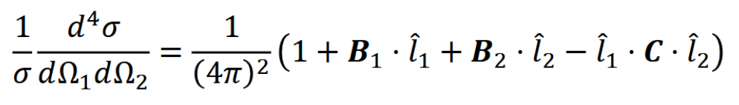
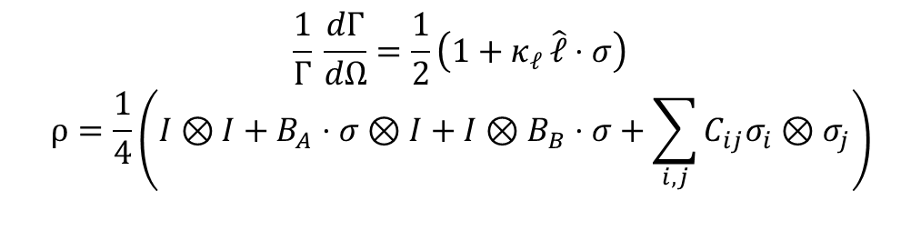

Quantum tomography
Top quark pairs are produced:
In a spin triplet state through quark annihilation.
In a spin singlet state and spin triplet state through gluon fusion.
Total state is a statistically mixed state.
By integrating over the azimuthal angles and then one polar angle we obtain 1D distributions.
We focus on the dilepton decay channel:
$t\overline{t}→{b^{+}b^{−}l}^{+}l^{−}ν\overline{ν}$.
All spin density matrix coefficients can then be extracted from 1D cross section distributions.
$$\frac{1}{Γ} \frac{dΓ}{dΩ}=\frac{1}{2}\left(1+κ_{ℓ} \hat{ℓ}⋅σ\right)$$
$$ρ=\frac{1}{4}\left(I⊗I+B_{A}⋅σ⊗I+I⊗B_{B}⋅σ+\sum_{i,j}{C_{ij}σ_{i}}⊗σ_{j}\right)$$
Quantum tomography
We can reconstruct the quantum state by measuring B and C expectation values through the distribution of kinematic observables of the final state leptons in the parent top quark reference frame.
The four angular cross section:

Slide 8
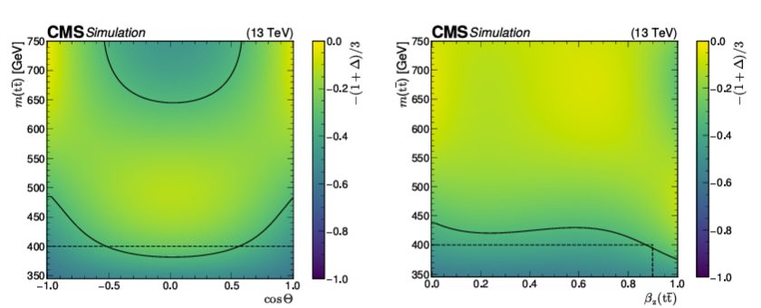
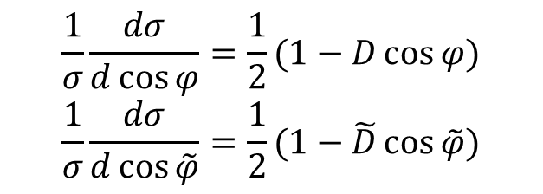

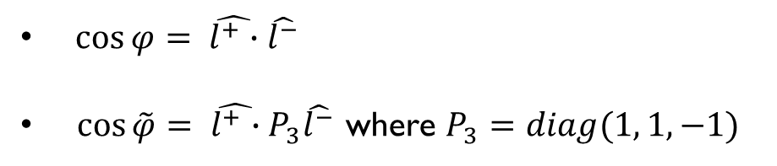
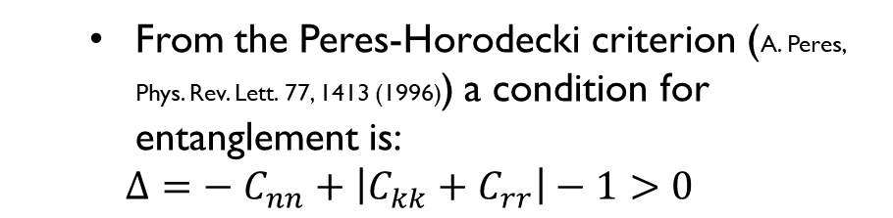

Entanglement measurement
  From the Peres-Horodecki criterion (A. Peres, Phys. Rev. Lett. 77, 1413 (1996)) a condition for entanglement is:
  $$Δ={− C}_{nn}+\left|C_{kk}+C_{rr}\right|−1>0$$
Threshold region:
$D=\frac{1}{3}\left(C_{kk}+C_{rr}+C_{nn}\right)<−\frac{1}{3}$ $→$ entangled
Boosted region:
The CMS Collaboration 2024 Rep. Prog.Phys. 87 117801 DOI 10.1088/1361-6633/ad7e4d ​
$\tilde{D}=\frac{1}{3}\left(C_{kk}+C_{rr} − C_{nn}\right)> \frac{1}{3}→$entangled
$$\frac{1}{σ}\frac{dσ}{d\cos{φ}}=\frac{1}{2}(1−D\cos{φ})$$
$$\frac{1}{σ}\frac{dσ}{d\cos{\tilde{φ}}}=\frac{1}{2}(1−\tilde{D}\cos{\tilde{φ}})$$
$\cos{φ}= \hat{l^{+}∙}\hat{l^{−}}$
$\cos{\tilde{φ}}= \hat{l^{+}∙}P_{3}\hat{l^{−}}$ where $P_{3}=diag(1, 1, −1)$

Slide 9
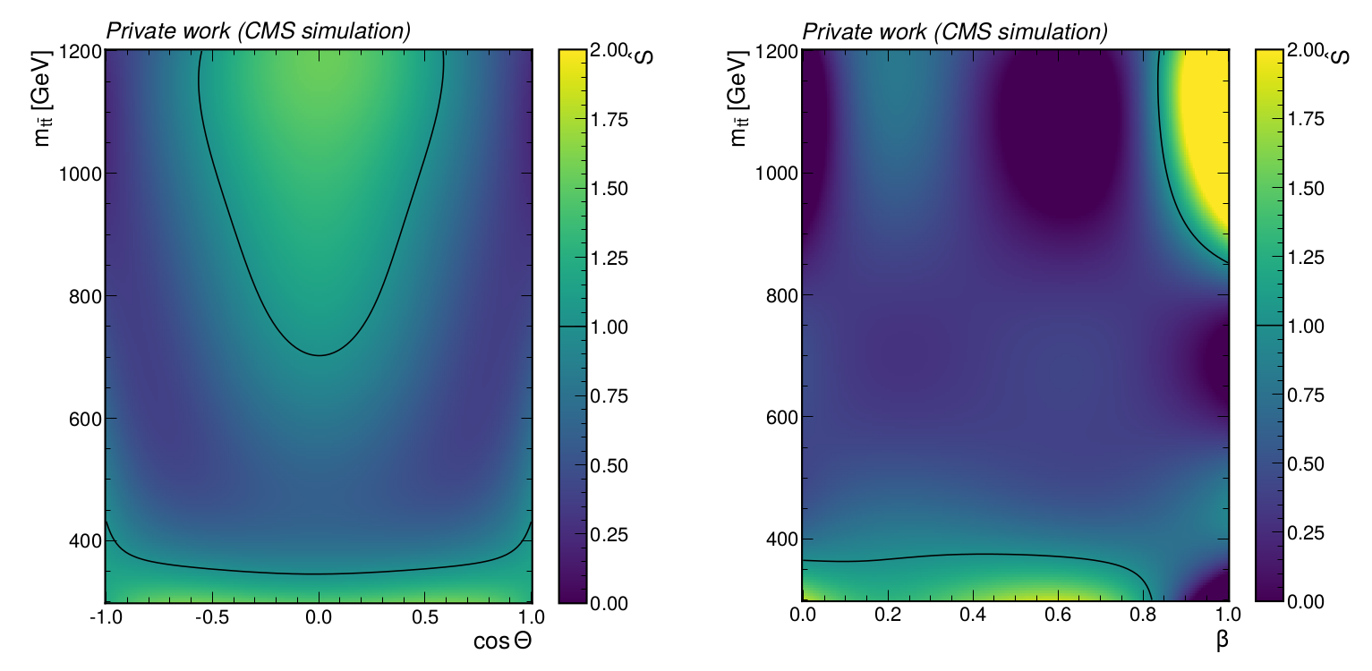
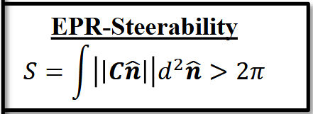
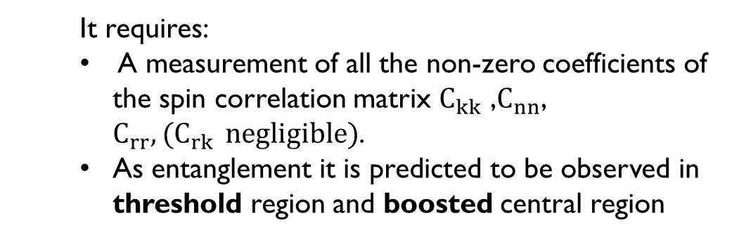
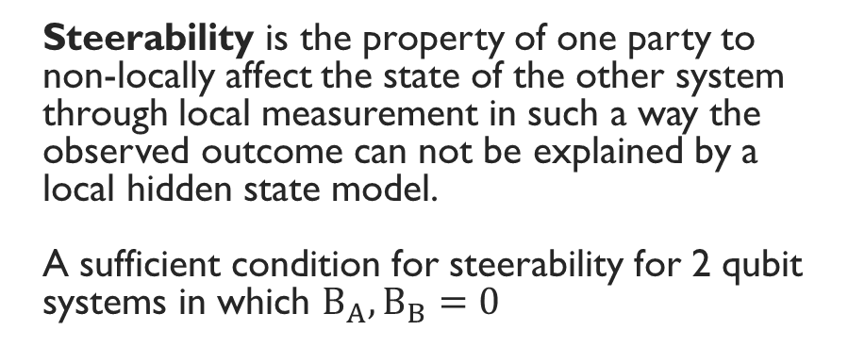
steerability measurement
Steerability is the property of one party to non-locally affect the state of the other system through local measurement in such a way the observed outcome can not be explained by a local hidden state model.
A sufficient condition for steerability for 2 qubit systems in which $B_{A},B_{B}=0$
Steerability condition reference
It requires:
A measurement of all the non-zero coefficients of the spin correlation matrix $C_{kk}$ ,$C_{nn}$, $C_{rr}{,(C}_{rk} negligible)$.
As entanglement it is predicted to be observed in threshold region and boosted central region

Slide 10
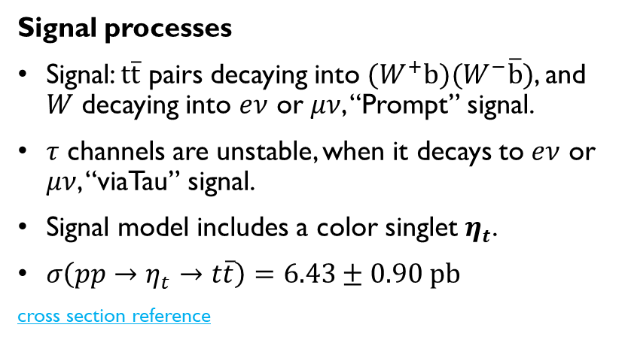
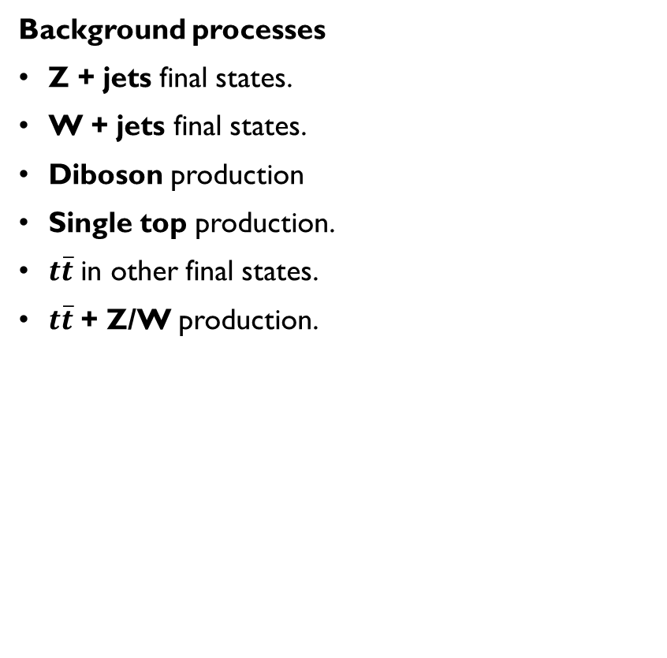
Signal and background processes
Signal processes
Signal: $t\overline{t}$ pairs decaying into $(W^{+}b)(W^{−}\overline{b})$, and $W$ decaying into $eν$ or $μν$, “Prompt” signal.
$τ$ channels are unstable, when it decays to $eν$ or $μν$, “viaTau” signal.
Signal model includes a color singlet $η_{t}$.
$σ\left(pp→η_{t}→t\overline{t}\right)=6.43±0.90 pb$
cross section reference
Background processes
Z + jets final states.
W + jets final states.
Diboson production
Single top production.
$t\overline{t}$ in other final states.
$t\overline{t}$ + Z/W production.

Slide 11
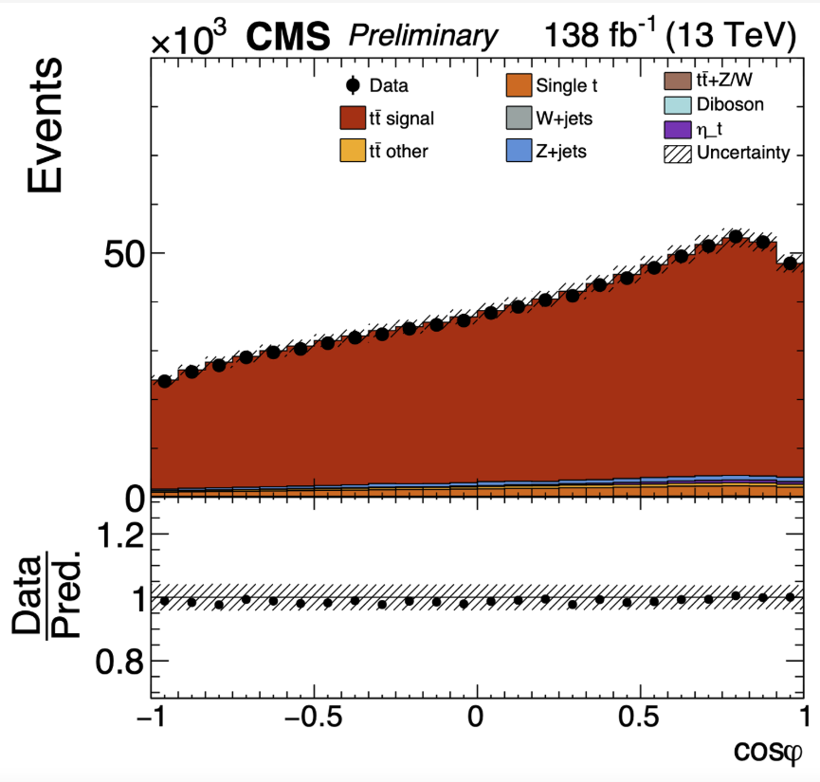

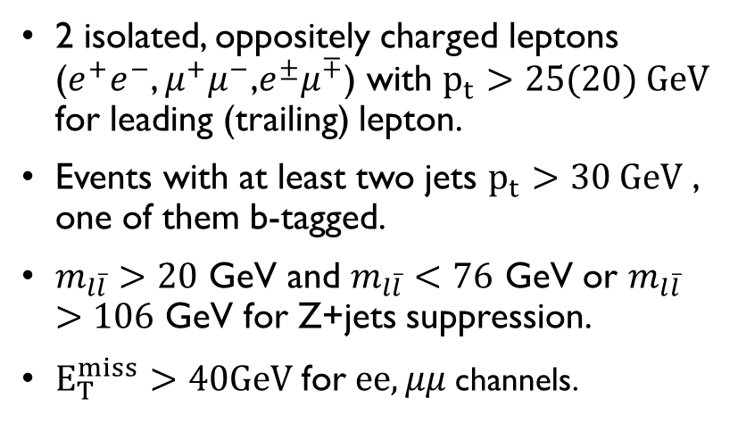
Event selection and reconstruction
Selection:
MC agreement with data:
2 isolated, oppositely charged leptons ($e^{+}e^{−}$, $μ^{+}μ^{−}$,$e^{±}μ^{∓}$) with $p_{t}>25(20) GeV$ for leading (trailing) lepton.
Events with at least two jets $p_{t}>30 GeV$ , one of them b-tagged.
$m_{l\overline{l}}>20$ GeV and $m_{l\overline{l}}<76$ GeV or $m_{l\overline{l}}>106$ GeV for Z+jets suppression.
$E_{T}^{miss}>40GeV$for$ee,μμ$ channels.
Top reconstruction algorithm
Assumes missing transverse energy coming from neutrino only and constraints on $m_{t},m_{W},m_{ν}$.
Solve analytical on-shell equations for each interaction vertex. Events with no solution are rejected.

Slide 12
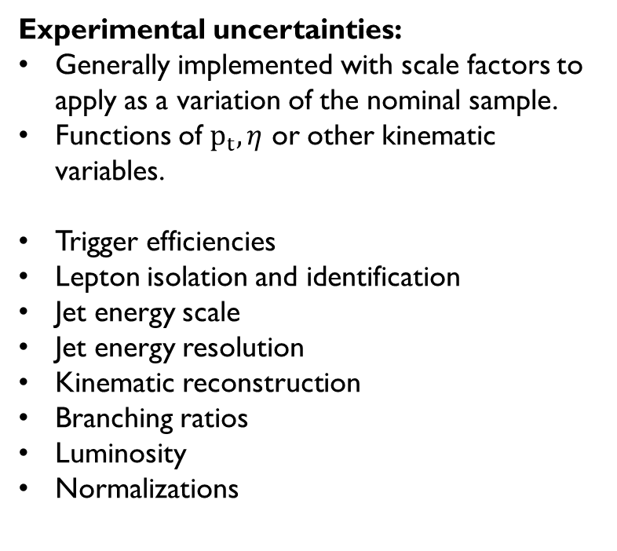
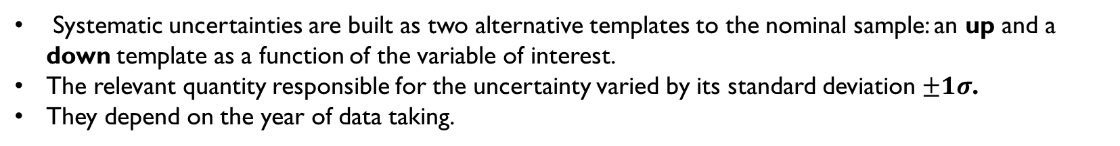
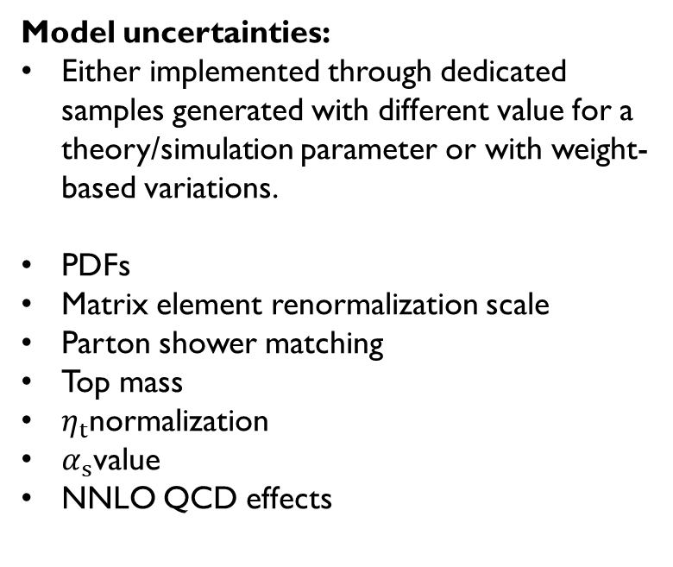
Systematic uncertainties
Systematic uncertainties are built as two alternative templates to the nominal sample: an up and a down template as a function of the variable of interest.
The relevant quantity responsible for the uncertainty varied by its standard deviation $±1σ$.
They depend on the year of data taking.
Experimental uncertainties:
Generally implemented with scale factors to apply as a variation of the nominal sample.
Functions of $p_{t},η$ or other kinematic variables.
Trigger efficiencies
Lepton isolation and identification
Jet energy scale
Jet energy resolution
Kinematic reconstruction
Branching ratios
Luminosity
Normalizations
Model uncertainties:
Either implemented through dedicated samples generated with different value for a theory/simulation parameter or with weight- based variations.
PDFs
Matrix element renormalization scale
Parton shower matching
Top mass
$η_{t}$normalization
$α_{s}$value
NNLO QCD effects

Slide 13
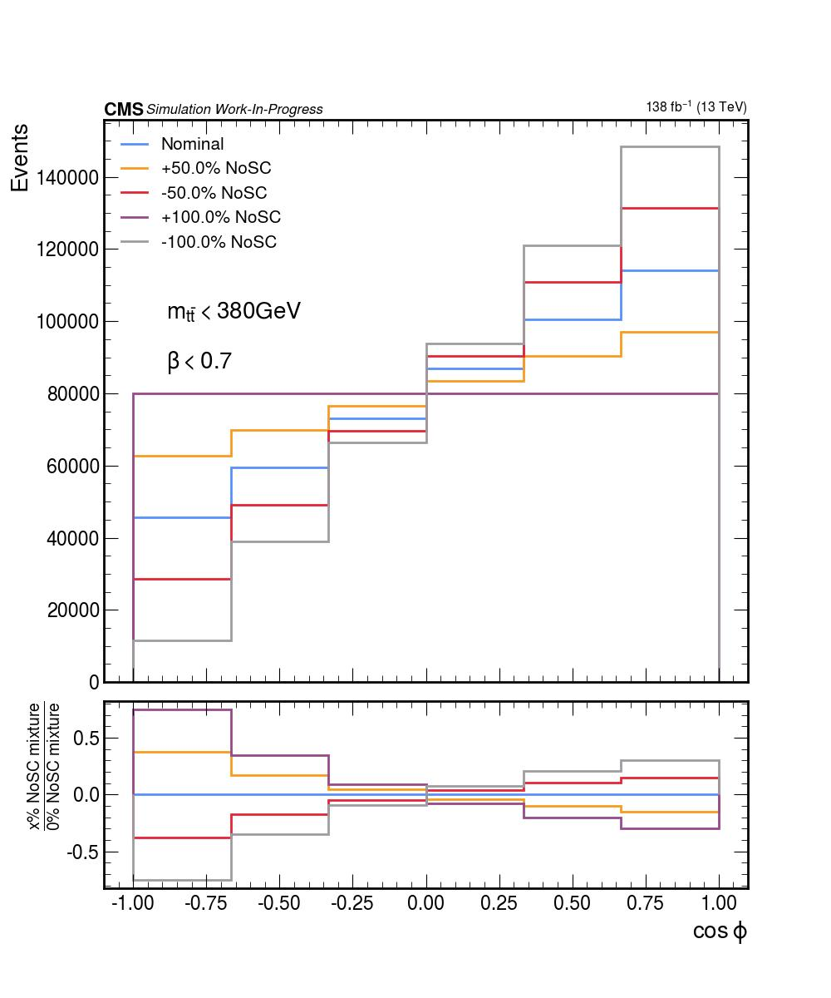
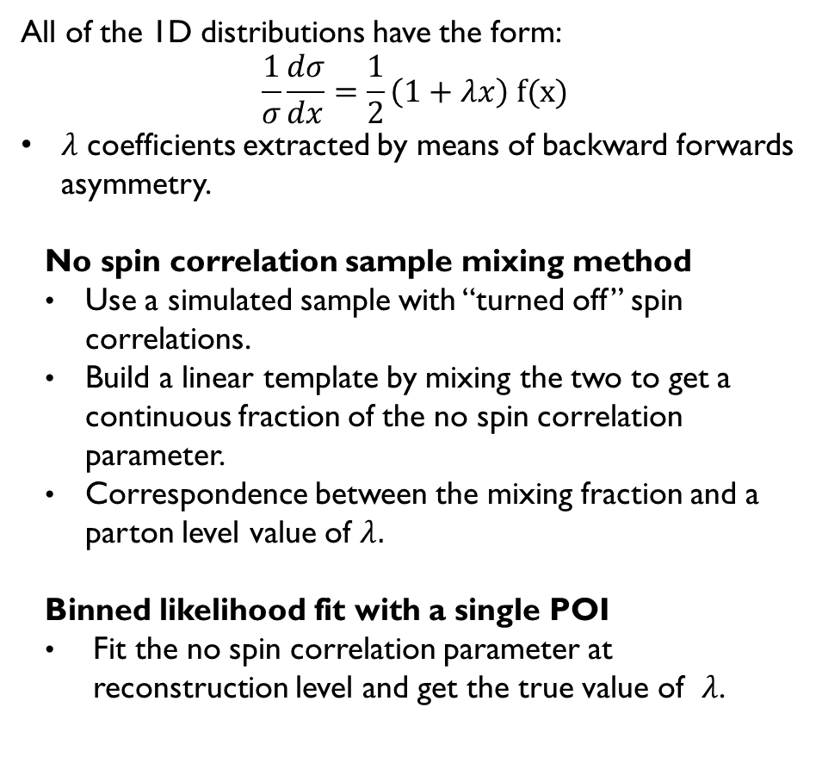
Measurement method
All of the 1D distributions have the form:
$$\frac{1}{σ}\frac{dσ}{dx}=\frac{1}{2}\left(1+λx\right) f(x)$$
$λ$ coefficients extracted by means of backward forwards asymmetry.
No spin correlation sample mixing method
Use a simulated sample with “turned off” spin correlations.
Build a linear template by mixing the two to get a continuous fraction of the no spin correlation parameter.
Correspondence between the mixing fraction and a parton level value of $λ.$
Binned likelihood fit with a single POI
Fit the no spin correlation parameter at reconstruction level and get the true value of $λ$.

Slide 14
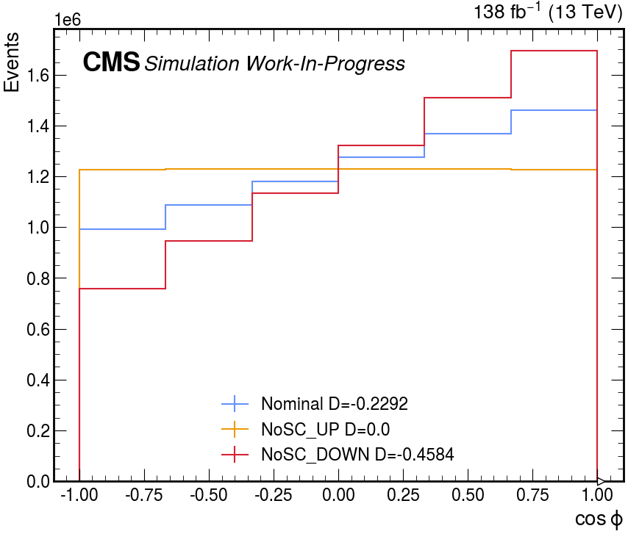
Reweighting method
Method to mimic no spin correlations in the 1D distributions by reweighting the nominal distribution.
$$\frac{1}{σ}\frac{dσ}{dx}=\frac{1}{2}\left(1+λx\right) f(x) w_{NoSC}\left(x\right)= \frac{1+x(1−NoSC\%)}{1+λx}$$
Used for the toponium sample for which we don’t have a no spin correlation sample at MC level.
Useful to test the whole analysis pipeline without relying on dedicated MC samples.

Slide 15
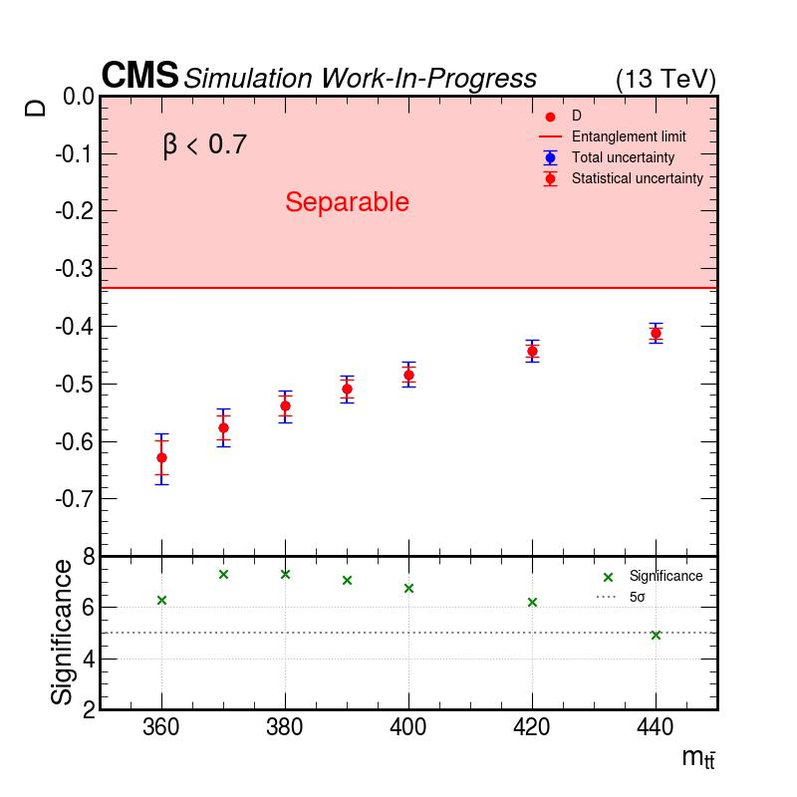
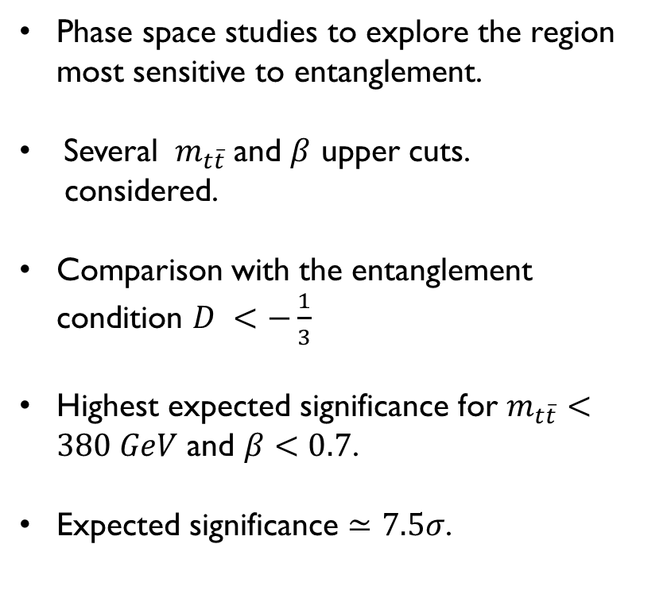
entanglement Sensitivity studies
Threshold region:
Phase space studies to explore the region most sensitive to entanglement.
Several ${ m}_{t\overline{t}}$and $β$ upper cuts.
considered.
Comparison with the entanglement condition $D <−\frac{1}{3}$
Highest expected significance for $m_{t\overline{t}}<380 GeV$ and $β<0.7$.
Expected significance $≃7.5σ$.

Slide 16
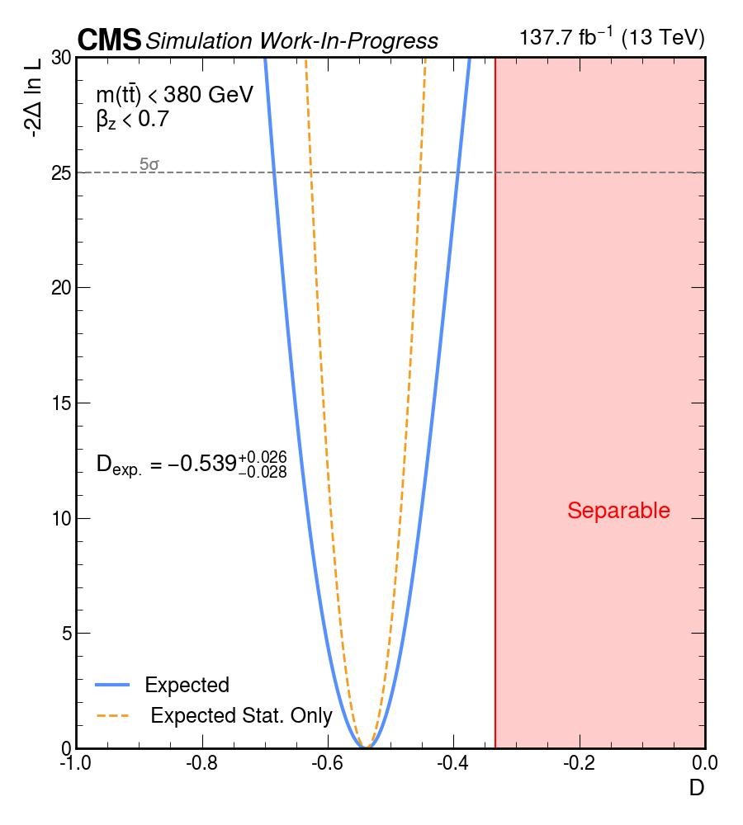
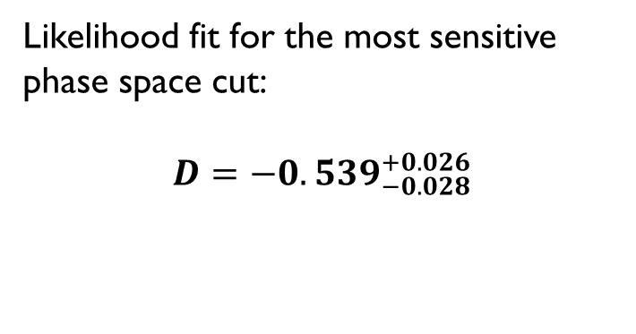
entanglement Sensitivity studies
Threshold region:
Likelihood fit for the most sensitive phase space cut:
$$D={−0.539}_{−0.028}^{+0.026}$$

Slide 17
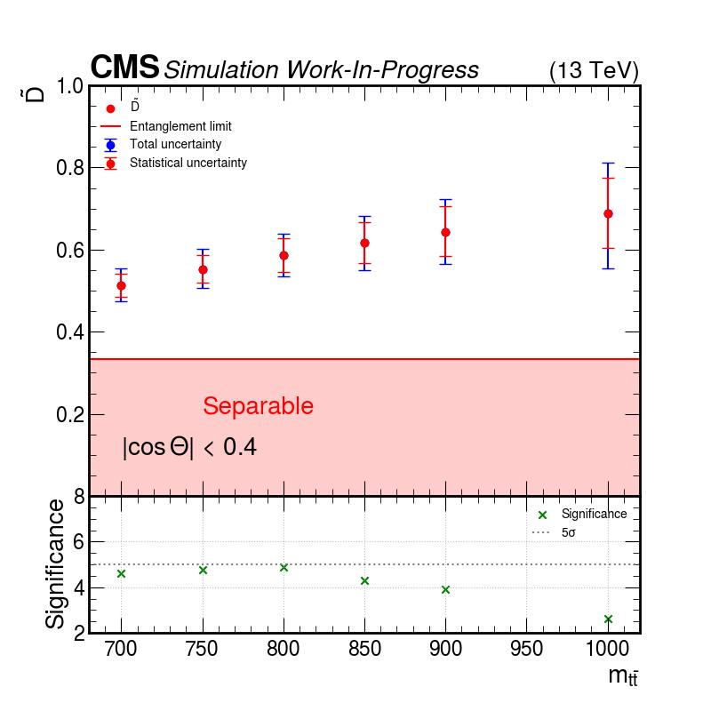
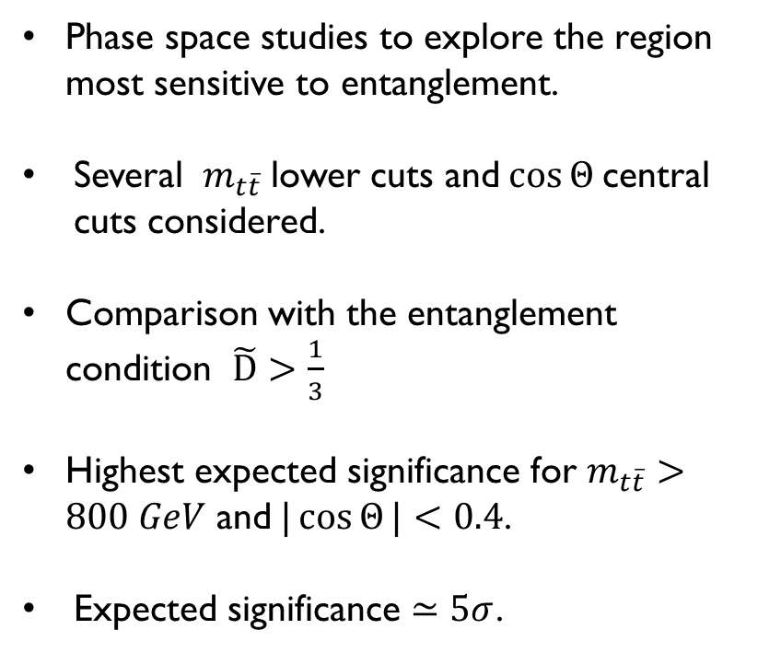
entanglement Sensitivity studies
Boosted region:
Phase space studies to explore the region most sensitive to entanglement.
Several ${ m}_{t\overline{t}}$lower cuts and$\cos{Θ }$central cuts considered.
Comparison with the entanglement condition $\tilde{D}>\frac{1}{3}$
Highest expected significance for $m_{t\overline{t}}>800 GeV$ and$|\cos{Θ}|<0.4$.
Expected significance $≃5σ$.

Slide 18
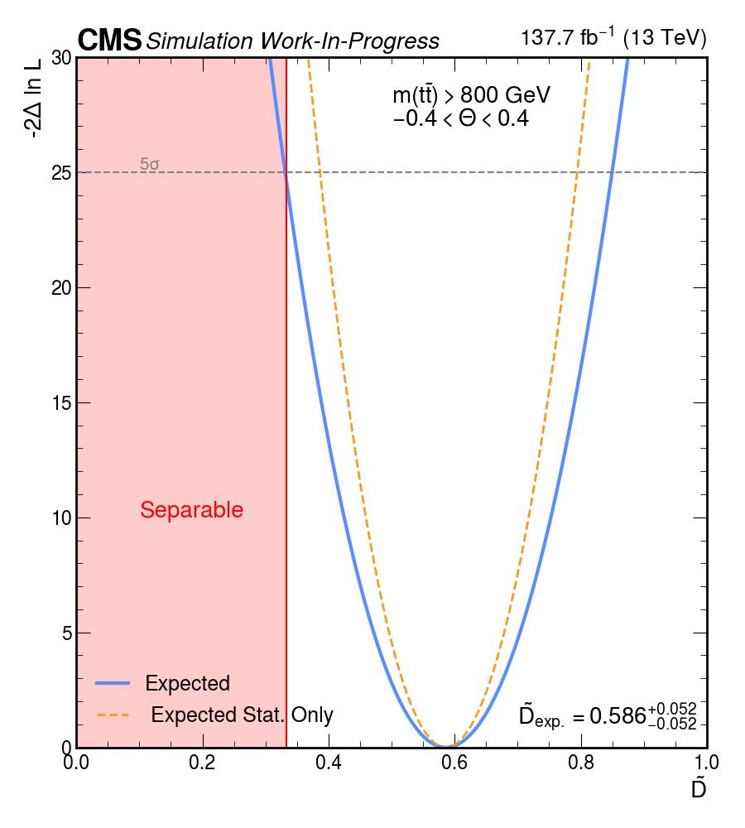
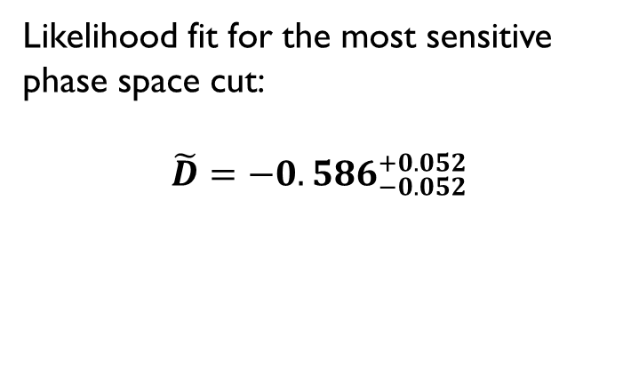
entanglement Sensitivity studies
Boosted region:
Likelihood fit for the most sensitive phase space cut:
$$\tilde{D}={−0.586}_{−0.052}^{+0.052}$$

Slide 19
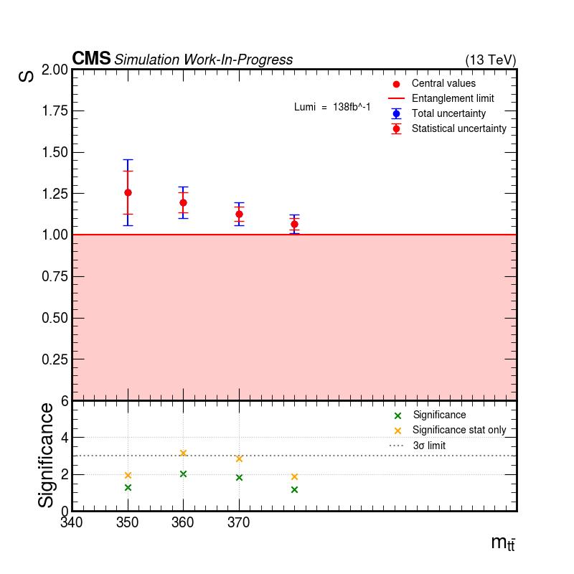
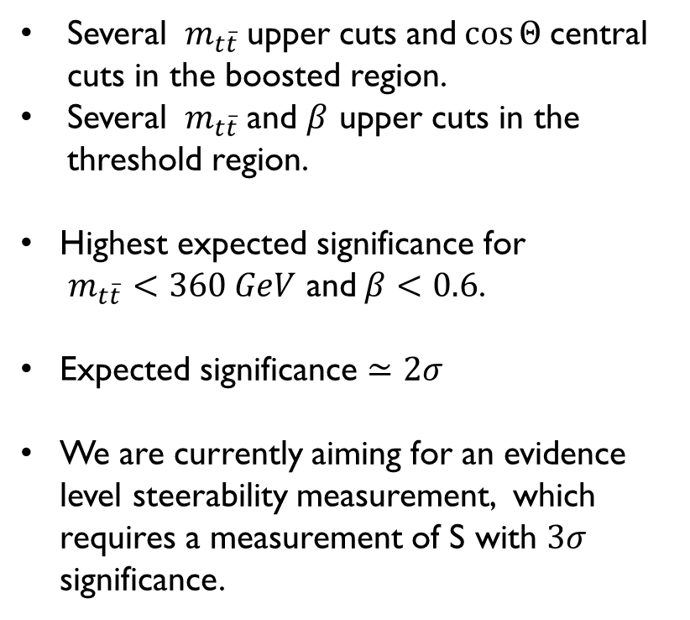
Steerability sensitivity studies
Threshold and Boosted region:
Several ${ m}_{t\overline{t}}$upper cuts and$\cos{Θ }$central cuts in the boosted region.
Several ${ m}_{t\overline{t}}$and $β$ upper cuts in the threshold region.
Highest expected significance for
$m_{t\overline{t}}<360 GeV$ and$β<0.6$.
Expected significance $≃2σ$
We are currently aiming for an evidence level steerability measurement, which requires a measurement of S with $3σ$ significance.

Slide 20
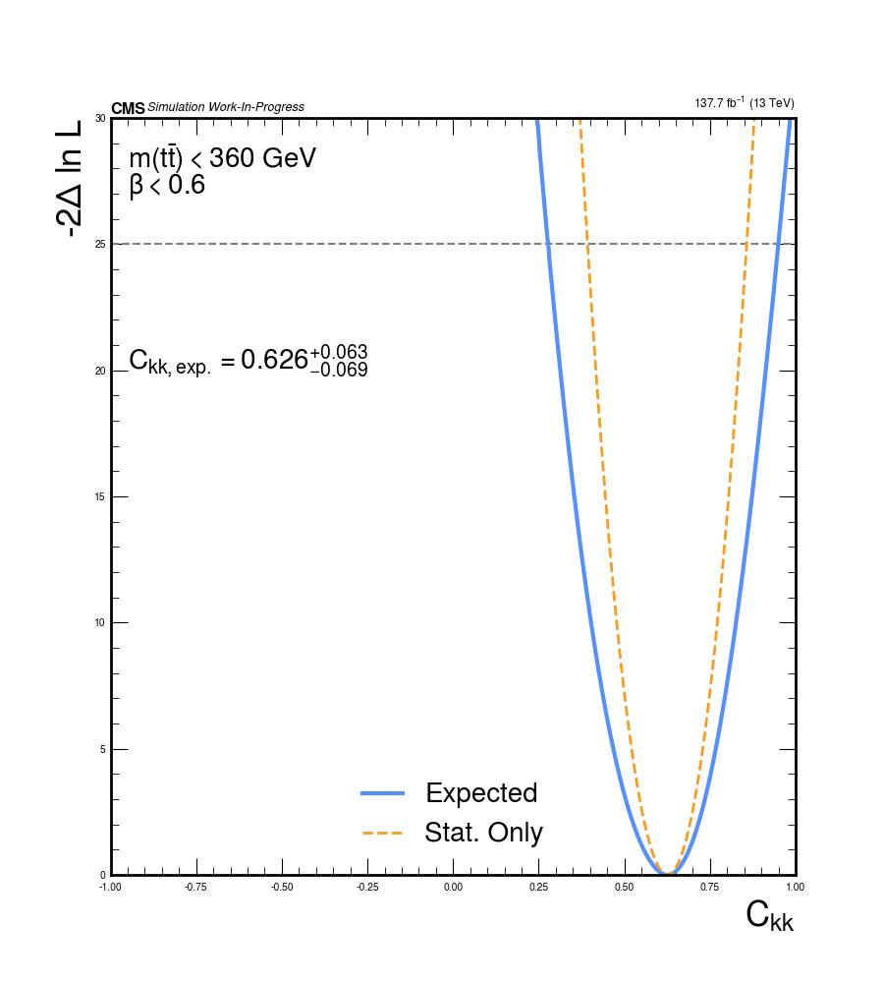
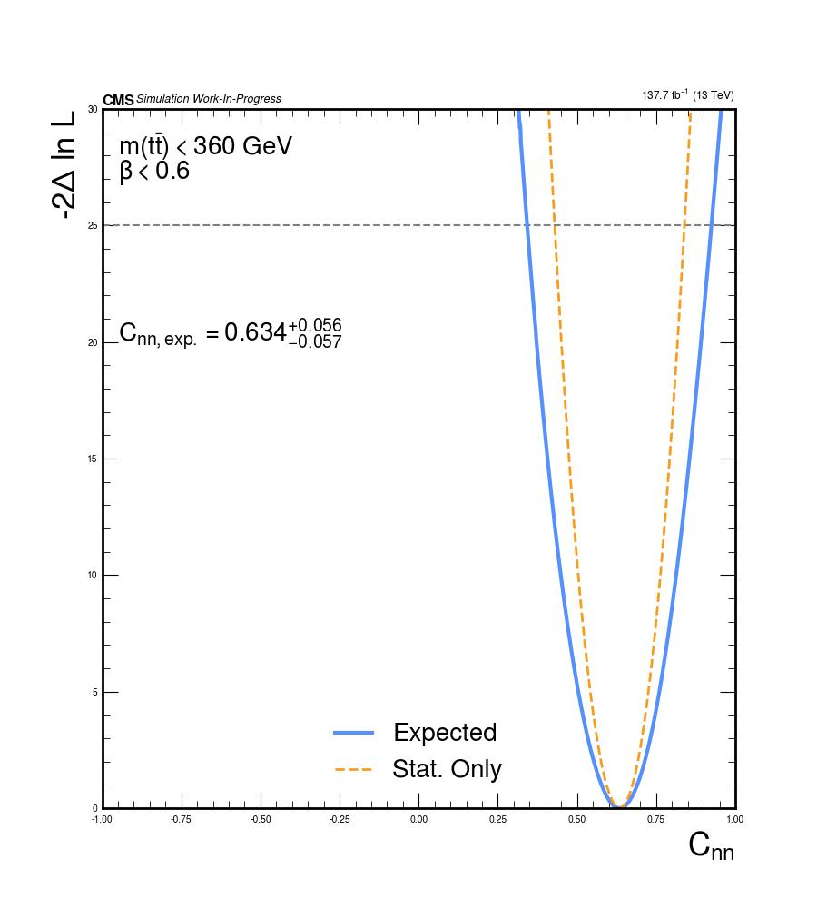
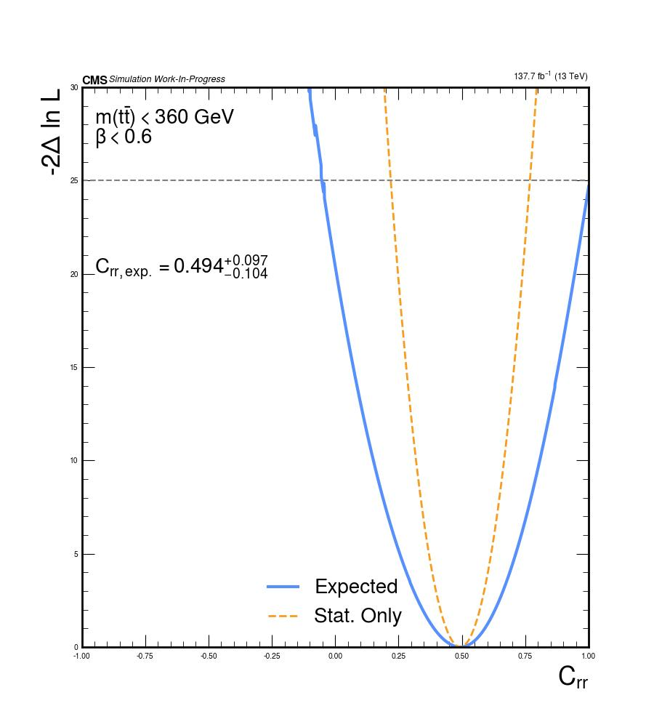
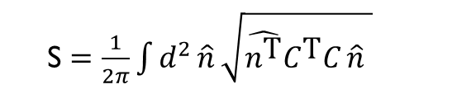
steerability Sensitivity studies
S $=\frac{1}{2π}\int{d^{2}}\hat{n} \sqrt{\hat{n^{\text{T}}}C^{\text{T}}C \hat{n} }$
Likelihood fit for the most sensitive phase space cut:
$$S =1.194±0.096$$

Slide 21


The Steering ellipsoid
The density matrix of a 2qubit state:
$ρ=\frac{1}{4} Θ_{μν} σ_{μ}⊗σ_{ν},$ $Θ_{μν}$= $\left(\begin{matrix}1 & B_{A}^{\text{T}} \\ B_{B} & C\end{matrix}\right)$
If a measurement $\hat{E}=\frac{1}{2}\sum_{μ=0}^{3}{X_{μ}}σ_{μ}$ on B is performed:
$$ρ_{A}=Tr_{B}\left(ρ\left(I⊗E\right)\right)$$
$$x=c_{A}+\tilde{C_{A}} \hat{n}$$
The Bloch sphere of allowed states for A becomes an ellipsoid:
$$c_{A}=\frac{B_{A}−C B_{B}}{1−B_{B}^{2}}$$
$$\tilde{C_{A}}=γ^{2}\left(C−B_{A}B_{B}^{\text{T}}\right)\left(I_{𝟚}+\frac{γ−1}{B_{B}^{2}} B_{B}B_{B}^{\text{T}}\right)$$
$$γ=\frac{1}{\sqrt{1−B_{B}^{2}}}$$
The ellipsoid equation is ${\left(x−c\right)}^{⊤}{\tilde{C}}^{−1}{\tilde{C}}^{−1T}\left(x−c\right)=1$
Steering ellipsoid reference

Slide 22


The Steering ellipsoid
Entanglement dependent on center, volume and orientation of the ellipsoid
  Tetrahedron condition: A state is separable only if its steering ellipsoid fits inside a tetrahedron which fits inside the unit sphere.
  Algebraic condition:
  $c^{4}−2c^{2}(1−Tr(Q)+2{\hat{c}}^{T}Q\hat{c})+h\left(Q\right)<0$
  where $Q={\tilde{C} }^{T}\tilde{C}$
  $h\left(Q\right)=1−8\sqrt{\det{Q}}+2Tr\left(Q^{2}\right)−{\left(Tr\left(Q\right)\right)}^{2}−2Tr\left(Q\right)$
Steerability is related to the surface:
  Steerability condition:
  $\hat{S}=\frac{1}{2π}\int{d^{2}}\hat{n} \sqrt{\hat{n^{\text{T}}}C^{\text{T}}C \hat{n}}>1$

Slide 23



Reconstruction method
Strategy:
Use the conditional angular distribution after a measurement on the lepton direction:
$$p\left(\hat{ℓ_{±}} ∣ \hat{ℓ_{∓}}=∓\hat{n}\right)=\frac{p\left(\hat{ℓ_{±}},\hat{ℓ_{∓}}=∓\hat{n}\right)}{p\left(\hat{ℓ_{∓}}=∓\hat{n}\right)}=\frac{1±B_{\hat{n}}^{±}⋅\hat{ℓ_{±}}}{4π}=\frac{1±\sum_{i}{B_{i\hat{n}}^{±}}⋅\hat{ℓ_{i}}±}{4π}$$
Sample the events in small bins of solid angle (2D bins in $θ,φ$) of the $\hat{ℓ_{−}}(\hat{ℓ_{+}})$direction.
For each bin compute the asymmetries of
$$\frac{1}{σ}\frac{dσ}{d\cos{θ_{i}^{1(2)}}}=\frac{1}{2}\left(1+B_{i}\cos{θ_{i}^{1(2)}}\right)$$
Construct the steering ellipsoid of the $t(\overline{t})$ quark.
Fit to an ellipsoid to get the matrix $\tilde{C}$to test the sensitivity to quantum correlations.
In these preliminary studies only the generator level MC dataset for ttbar dileptonic has been used, and statistical uncertainty only have been considered

Slide 24



Fit method
The points of the ellipsoid surface are defined by the equation:
$${\left(x−c\right)}^{⊤}A \left(x−c\right)=1$$
The steering ellipsoid equation in terms of $\tilde{C}$ is:
$${\left(x−c\right)}^{⊤}{\tilde{C}}^{−1}{\tilde{C}}^{−1T}\left(x−c\right)=1$$
Non-linear least square method has been applied to minimize the function:
$$\min{\sum_{i}{\left|r_{i}\right|}}$$
$$r_{i}=w_{i}\left[{\left(x−c\right)}^{⊤}{\tilde{C}}^{−1}{\tilde{C}}^{−1T}\left(x−c\right)−1 \right]$$
$$w_{i}=\frac{1}{4\left[{\tilde{C}}^{−1}{\tilde{C}}^{−1T}\left(x−c\right)W{\tilde{C}}^{−1}{\tilde{C}}^{−1T}\left(x−c\right)\right]}$$
Goodness of the fit estimated with:
$${\tilde{χ}}^{2}=\frac{1}{N−9}\sum_{i}{\frac{d_{i}^{2}}{ε_{i}}}$$
Once $\tilde{C}$is obtained:
  The eigenvalues of $\tilde{C}$determine the semiaxes of the ellipsoid
  The eigenvectors the orientation.

Slide 25




entanglement
We considered two phase space cuts sensitive to entanglement and steerability.
Threshold region cut:
$m_{t\overline{t}}<360 GeV$ and $β<0.8$
Boosted region cut:
$m_{t\overline{t}}>900 GeV$ and$|\cos{Θ}|<0.4$

Slide 26






entanglement
We considered two phase space cuts sensitive to entanglement and steerability.
Threshold region cut:${ m}_{t\overline{t}}<360 GeV$ and $β<0.8$
Boosted region cut: $m_{t\overline{t}}>900 GeV$ and$|\cos{Θ}|<0.4$
$V_{t,ε}$= 2.336 $±$0.003 $≫V_{t,max} ≈ 0.15$
$V_{t,ε}$= 3.49$±$0.01 $≫V_{t,max} ≈ 0.15$
More the bins the more the direction measurement of $\hat{ℓ_{±}}$ precise
Ellipsoid is better sampled
Asymptotic fit to get an estimate of the volume.
Compared to the entanglement condition
$$V_{t,ε}>V_{t,max}=\frac{4}{81}π$$

Slide 27





steerability
We considered two phase space cuts sensitive to entanglement and steerability.
Threshold region cut: $m_{t\overline{t}}<360 GeV$ and $β<0.8$
Boosted region cut: $m_{t\overline{t}}>900 GeV$ and$|\cos{Θ}|<0.4$
$S$= 1.1262 $±$ 0.0004 $> 1$
$S=1.291 ±0.002$ $> 1$
For states where B=0, $\tilde{C}=C$
S can be calculated with our $\tilde{C}$ obtained from the fit.
Asymptotic fit to get an estimate of S.
Compared to the steerability condition
$$S>1$$

Slide 28

Conclusions and future perspectives
Quantum tomography
  Expected improvement the precision of the measurement of $D$ at threshold.
  Expected observation of entanglement in the high mass region through $\tilde{D}$.
  Obtain evidence for steerability.
Steering ellipsoid
  Extend these studies to test the sensitivity of the ellipsoid to EFT coefficients.
  Develop a feasible method to measure the ellipsoid with all systematics uncertainties.

Slide 29
BACK UP

Slide 30




The helicity basis
The measurement are performed in the helicity basis ($\hat{k},\hat{n},\hat{r}$) where:
$\hat{k}$ is the direction of motion of the top quark,
$\hat{p}$ is the direction of the incoming parton,
$\hat{n }=sign\left(\cos{Θ}\right)\frac{\hat{p}×\hat{k}}{\sin{Θ}}$
$\hat{r}=sign\left(\cos{Θ}\right)\frac{\hat{p}−\hat{k}cos{Θ}}{\sin{Θ}}$
The four angular cross section:
$\hat{l_{i}}$ are the direction of the leptons.
$Ω_{1,2}$ are the lepton solid angle in the parent top rest frame.
All spin density matrix coefficient can then be extracted from 1D distributions.
Quantum tomography of the state.

Slide 31


Hierarchy of QUANTUM correlations for 2 qubits
Entanglement is the property of a system which can not be written as the convex sum of its subsystems
$ρ_{AB}=\sum_{k}{p_{k}} ρ_{A}^{k}⊗ρ_{B}^{k}$
Non-locality is the property of a system to be correlated in such a way which cannot be explained by a local hidden variable model:
Alice & Bob systems are untrusted
QM incomplete
Steerability (from A to B) is the property of A to steer B’s measurements in such a way which cannot be explained by a local hidden state model for B:
Bob measurement system is trusted
QM complete only for localized isolated systems
$$Non−locality ⊆ EPR Steering ⊆Quantum Entanglement$$

Slide 32




Spin density matrix and quantum tomography
We focus on the dilepton channel $t\overline{t}→ l^{+}l^{−}ν\overline{ν}$.
The matrix element of the process is the following:
The spin density $ρ= \frac{R}{Tr[R]}$ has the form:
B are the polarization vectors.
C is the spin correlation matrix.
Quantum tomography: Reconstruction of the full spin density matrix of the $t\overline{t}$ state by extracting all the polarization and spin correlation.

Slide 33





Quantum Discord
Quantum discord is the difference between the total mutual information and classical mutual information: $D_{A}=I\left(ρ_{AB}\right)−J_{A}\left(ρ_{AB}\right)$.
Can be non zero for separable states.
Asymmetric quantity.
For helicity basis (event dependent) non-trivial because of fictitious states: see [2412.21158]
Measurement should be conducted in the beam basis.
Decay method gives low sensitivity

Slide 34




NON locality
Non-locality: A quantum system is non-local if its measurement cannot be explained by any local hidden variable model.
A sufficient condition for a 2 qbit quantum system is to violate CHSH inequality:
For top pair production in the helicity basis two proxies can be:
[2305.07075]

Slide 35


Helicity amplitudes and spin states

Slide 36




toponium
Toponium
Non relativistic QCD predicts enhancements at the ttbar production threshold region due to a bound state called “toponium”.
Excess of cross-section at threshold observed by ATLAS and CMS.
Mainly a color singlet contribution coming from the gg spin singlet state.
Modeled through a pseudo scalar $η_{t}$
$σ\left(pp→η_{t}→t\overline{t}\right)=6.43±0.90 pb$
Produces maximally entangled state which influence the spin correlation observables.
Non negligible for this analysis.
The CMS Collaboration 2024 Rep. Prog.Phys. 87 117801
DOI 10.1088/1361-6633/ad7e4d ​
CMS Collaboration / CERN . Image from the CMS public news page on the near-threshold $t\overset{ˉ}{t}$ excess.

Slide 37


reweighting
$$\frac{1}{σ}\frac{dσ}{dx}=\frac{1}{2}\left(1+λx\right)f\left(x\right)$$
$$w_{NoSC}\left(x\right)= \frac{1+x(1−NoSC\%)}{1+λx}$$

Slide 38



Measurement method
Generator level distribution of $\cos{φ}$
Detector level distribution of $\cos{φ}$

Slide 39









Measurement method
Generator level distributions:
$$\cos{θ_{k}^{1}\cos{θ_{k}^{2}}}$$
$$\cos{θ_{n}^{1}\cos{θ_{n}^{2}}}$$
$$\cos{θ_{r}^{1}\cos{θ_{r}^{2}}}$$
$$\cos{θ_{r}^{1}\cos{θ_{k}^{2}}}$$
$C_{rk}$ << $C_{kk},C_{nn},C_{rr}$.
Impact of $C_{rk}$ in the S integral is < 1% for all region considered in the sensitivity studies.
Only diagonal coefficients included.

Slide 40


entanglement Sensitivity studies
Likelihood fit
Systematics impacts
$$D={−0.539}_{−0.028}^{+0.026}$$

Slide 41


entanglement Sensitivity studies
Likelihood fit
Systematics impacts
$$\tilde{D}={−0.586}_{−0.052}^{+0.052}$$

Slide 42

Framework optimization
I implemented techniques of columnar analysis and parallelization for:
  Histogram generation.
  Input templates for combine fitting.
Permitted rapidly perform very thorough sensitivity studies in multidimensional phase spaces.
Fundamental to quickly perform studies for many different distributions and observables.

Slide 43

entanglement Sensitivity studies
Likelihood fit
$$D={−0.539}_{−0.028}^{+0.026}$$
CMS entanglement observation with 2016 Run 2 data at: $m_{t\overline{t}}<400 GeV$ and $β<0.9$
Expected
$$D ={\text{−}\text{0}\text{.}\text{467}}_{−0.017}^{+0.016}{(stat)}_{−0.024}^{+0.021}(syst)$$
Observed
$D={\text{−}\text{0.4}80}_{−0.017}^{+0.016}{\left(stat\right)}_{−0.024}^{+0.021}\left(syst\right)$
Full Run 2: $m_{t\overline{t}}<400 GeV$ and $β<0.9$
Expected
$$D ={\text{−}\text{0}\text{.}\text{467}}_{−0.010}^{+0.010}{(stat)}_{−0.020}^{+0.021}(syst)$$

Slide 44

Run3 prospect

Slide 45

Entanglement Observation
Entanglement was observed (significance $>5σ$) by CMS in 2024 in the dilepton channel using Run2 2016 data with an integrated luminosity of $36,3{fb}^{−1}$.
Agreement with data improved including $η_{t}$ in the signal.
The CMS Collaboration 2024 Rep. Prog.Phys. 87 117801
DOI 10.1088/1361-6633/ad7e4d ​

Slide 46

conditional angular distributions
When a measurement $|\left.\hat{n}\right\rangle$ is performed on qubit with a probability $p_{\hat{n}}$ the conditional state of the second qubit is: $ρ_{\hat{n}}=\frac{1+B_{\hat{n}}^{+}⋅σ}{2}, B_{\hat{n}}^{+}=\frac{B^{+}+C⋅\hat{n}}{1+\hat{n}⋅B^{−}}, p_{\hat{n}}=\frac{1+\hat{n}⋅B^{−}}{2}$
For $t\overline{t}$ in dileptonic final states the angular distributions are given by:
$p\left(\hat{ℓ_{+}},\hat{ℓ_{−}}\right)=\frac{1+B^{+}⋅\hat{ℓ_{+}}−B^{−}⋅\hat{ℓ_{−}}−\hat{ℓ_{+}}⋅C⋅\hat{ℓ_{−}}}{{\left(4π\right)}^{2}}$
And the conditional reduced distribution for$\hat{{ ℓ}_{±}}$ after $\hat{{ ℓ}_{∓}}$ is measured in the direction $\hat{n}$is :
$p\left(\hat{ℓ_{±}} ∣ \hat{ℓ_{∓}}=∓\hat{n}\right)=\frac{p\left(\hat{ℓ_{±}},\hat{ℓ_{∓}}=∓\hat{n}\right)}{p\left(\hat{ℓ_{∓}}=∓\hat{n}\right)}=\frac{1±B_{\hat{n}}^{±}⋅\hat{ℓ_{±}}}{4π}=\frac{1±\sum_{i}{B_{i\hat{n}}^{±}}⋅\hat{ℓ_{i}}±}{4π}$
We can retrieve the $B_{\hat{n}}^{±}$ by the backwards-forwards asymmetry of the angular distributions of $\hat{ℓ_{+}}$ of the ensemble of events where $\hat{ℓ_{+}}$= $\hat{n}$.

Slide 47



Ellipsoid rings

Slide 48



Error propagation
$\min{f(c, Q)= min\sum_{i}{\left|r_{i}\right|}}$
$r_{i}=w_{i}\left[{\left(x_{i}−c\right)}^{⊤}{\tilde{C}}^{−1}{\tilde{C}}^{−1T}\left(x_{i}−c\right)−1 \right]$
$w_{i}=\frac{1}{∇_{i}f}=\frac{1}{4\left[{\tilde{C}}^{−1}{\tilde{C}}^{−1T}\left(x−c\right)W{\tilde{C}}^{−1}{\tilde{C}}^{−1T}\left(x−c\right)\right]}$
$Cov=(J^{T}WJ)σ_{r}$ where $σ_{r}=\sum_{i}{\frac{r_{i}^{2}}{dof}} , J=\frac{∂f}{∂x_{i}}$
W = diagonal matrix of the variances for each point.
Once $\tilde{C}$is obtained:
  Error propagation to the eigenvalues performed by assuming a gaussian multivariate distribution on the 9 parameter and calculating the eigenvalues on 10^6 toys samples.
  Take the standard deviation as the error on the eigenvalue.

Slide 49

Volume calculation
The volume of the ellipsoid is determined by
$V_{ε}=\frac{4}{3}πλ_{1}λ_{2}λ_{3}=\frac{4}{3}πdet\left(\tilde{C}\right)$
The tetrahedron which circumscribes the ellipsoid is given by applying the same affine transformation that transforms the unit sphere into the ellipsoid, to the tetrahedron which circumscribes the unit sphere.
$y_{t,ε}=c+\tilde{C} y_{t,unit}$
Its volume then is
$V_{t,ε}=V_{t,unit}\frac{4}{3}πdet\left(\tilde{C}\right)$

Slide 50



Bell non-locality
Threshold region cut: $m_{t\overline{t}}>1000 GeV$ $\text{and} |\cos{Θ}|<0.2$
$c_{1}^{2}+c_{2}^{2}$= 1.234 $±$ 0.015
Asympotic fit to get an estimate of $c_{1}^{2}+c_{2}^{2}$.
Compared to the condition
$$c_{1}^{2}+c_{2}^{2} >1$$

Slide 51

determinant

Slide 52

Entanglement Observation
The CMS Collaboration 2024 Rep. Prog.Phys. 87 117801
DOI 10.1088/1361-6633/ad7e4d ​

