Slide 1
Laboratori Nazionali di Legnaro – INFN
WP2: current status of the activities
Alberto Arzenton
June 5th, 2025

Slide 2
Gantt diagram
2025 2026 2027
MS2.1 █████▒▒▒▒▒ 50%
Tape system: done. IRIS: work in progress. Report from D. Chen’s PhD thesis or papers*.
MS2.4 █▒▒▒▒▒▒▒▒▒ 10%
Giulia Persi BSc thesis (supervisors: S. Moretto, A. Leso) will develop an online spectral analysis tool on the ISOLPHARM website with the help of L. Zangrando.
*D. Chen, S. Corradetti, D. Serafini, A. Leso, M. G. Martello, A. Arzenton, M. Ballan, A. Donzella, A. Monetti, M. Lunardon, E. Mariotti, A. Andrighetto. SPES low-energy beamline status and development of ISOLPHARM Radionuclide Implantation Station (IRIS), NIMA, under review.
*A. Arzenton, D. Chen, M. Lunardon, S. Moretto, G. S. Valli, A. Andrighetto, S. Corradetti, A. Leso, M. G. Martello, D. Serafini, E. Mariotti. The SPES-ISOLPHARM beamline for the production of medical radionuclides at INFN-LNL, HIAT Conference Proceedings, under review.
Notes:
2

Slide 3
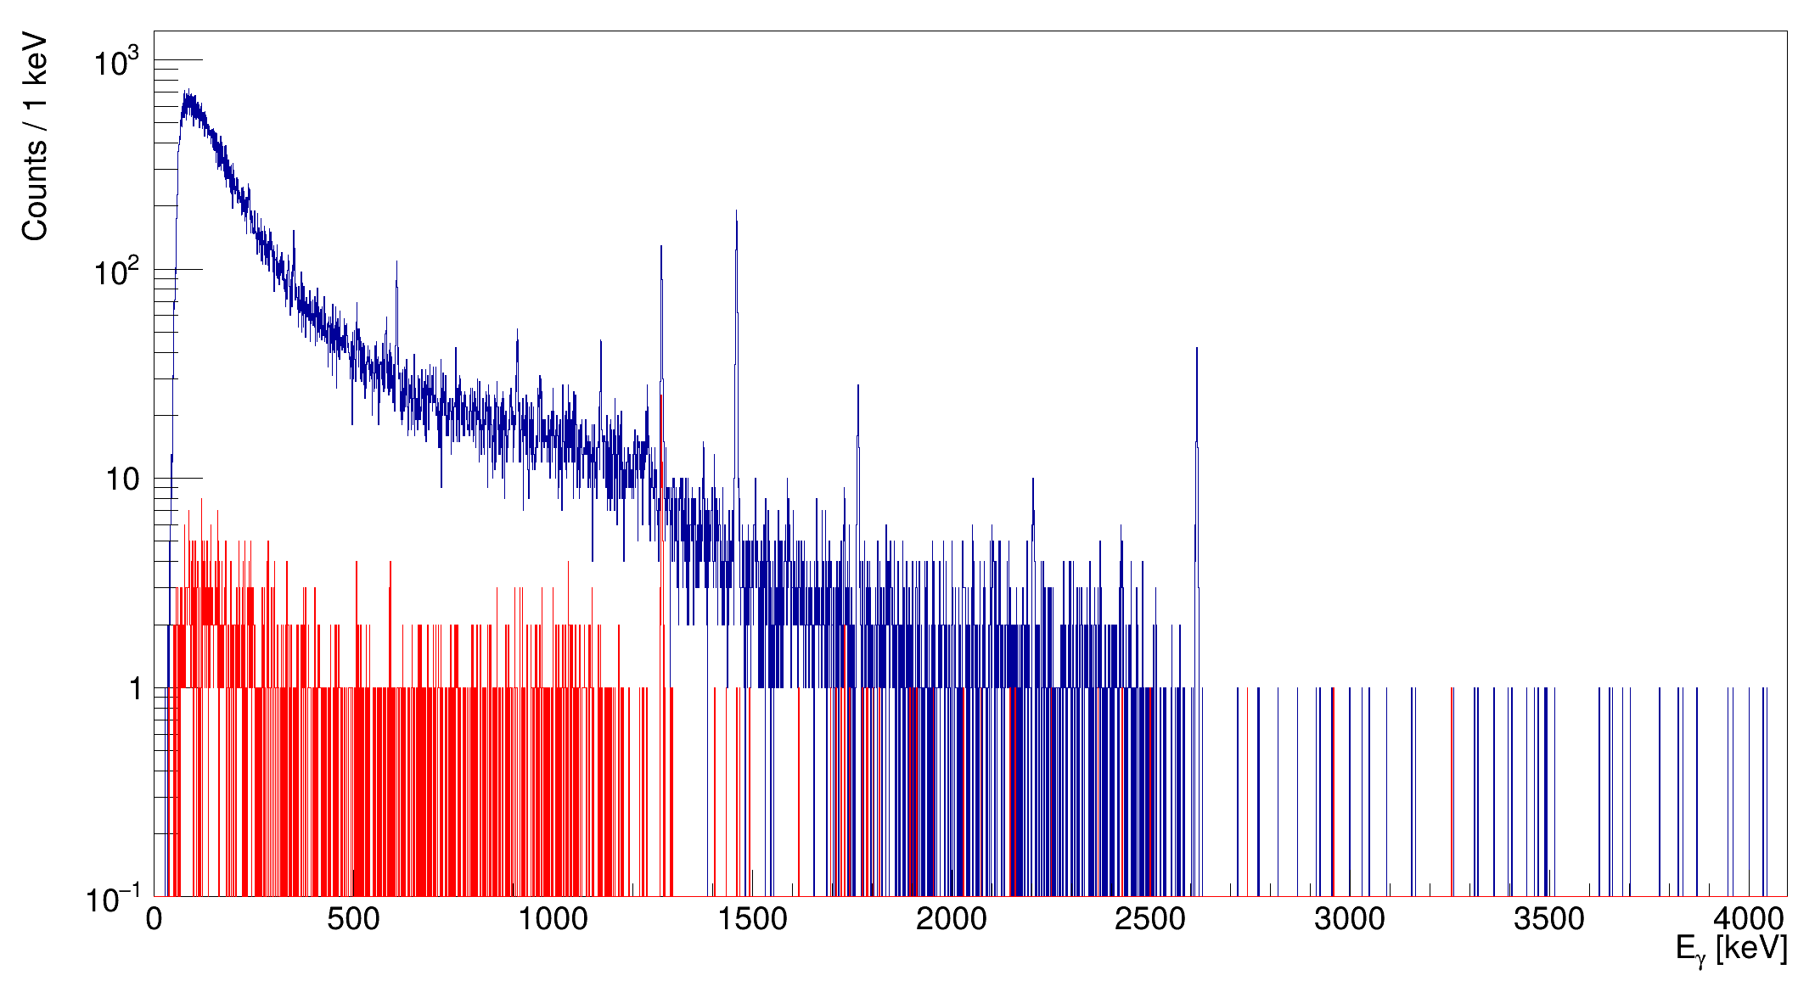
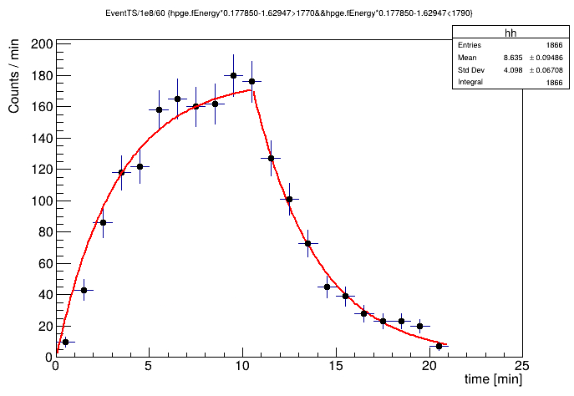
Tape system commissioning
A 40 MeV, ~5 µA proton beam was shot onto a SiC target with temperature ranging from 1600 to 1800 °C and γ spectra with mass numbers from 27 to 30 were acquired (April). Each irradiation cycle lasted 10 to 20 min.
γ spectrum with mass 29 (βγ coincidences in red)
Activity of ²⁸Al during a cycle with mass 28
Notes:
3

Slide 4
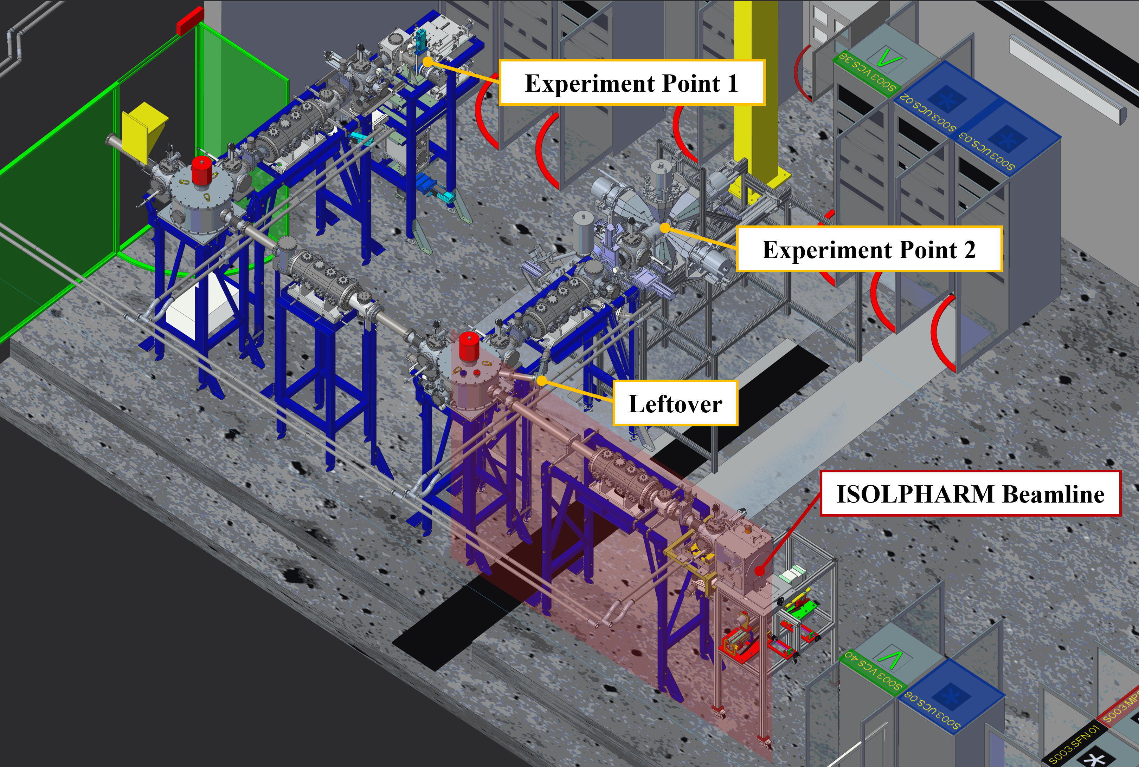
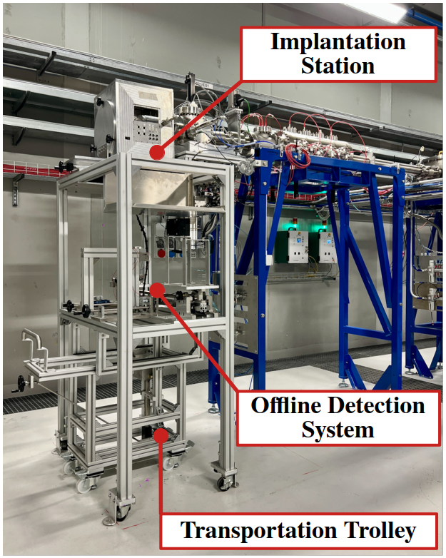
IRIS status
Test of the beamline by the end of the year!
Notes:
4

Slide 5
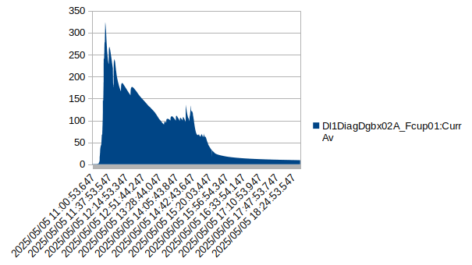
Transport and ionization efficiency
MS2.2 █████████▒ 90%​*
Efficiency test with stable Mg mass marker (nominal mass 200 µg) performed online on 5th May.
Plasma (FEBIAD) ion source used at SPES.
Result: 0.3%, probably underestimated due to Mg evaporation during tape system commissioning.
* new data could maybe come from
further offline tests; otherwise,
this experiment will be reported
Ion current [nA]
Notes:
5

Slide 6
Thank you!
Notes:
6

