Slide 1
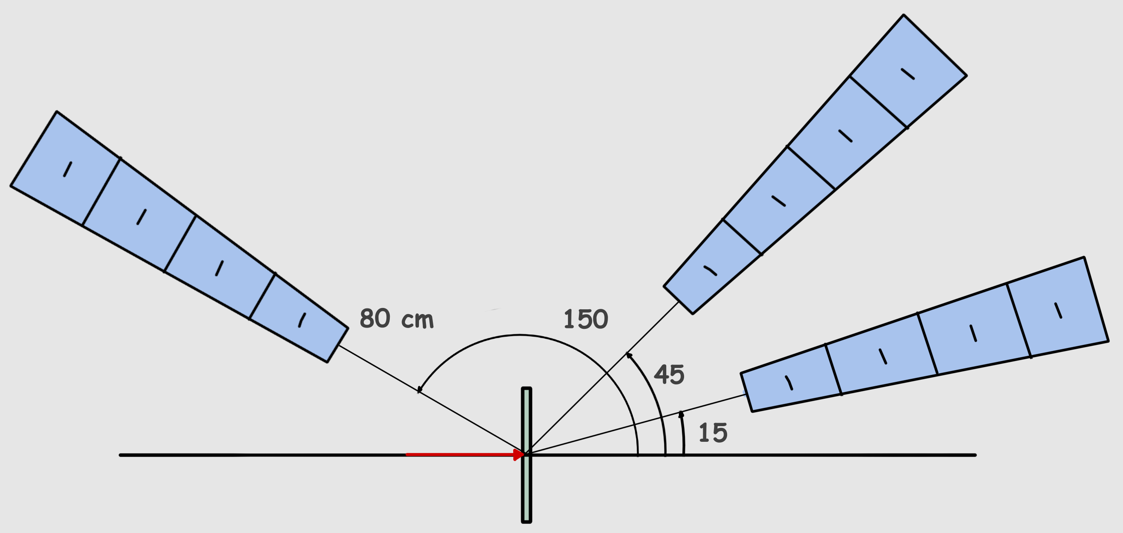
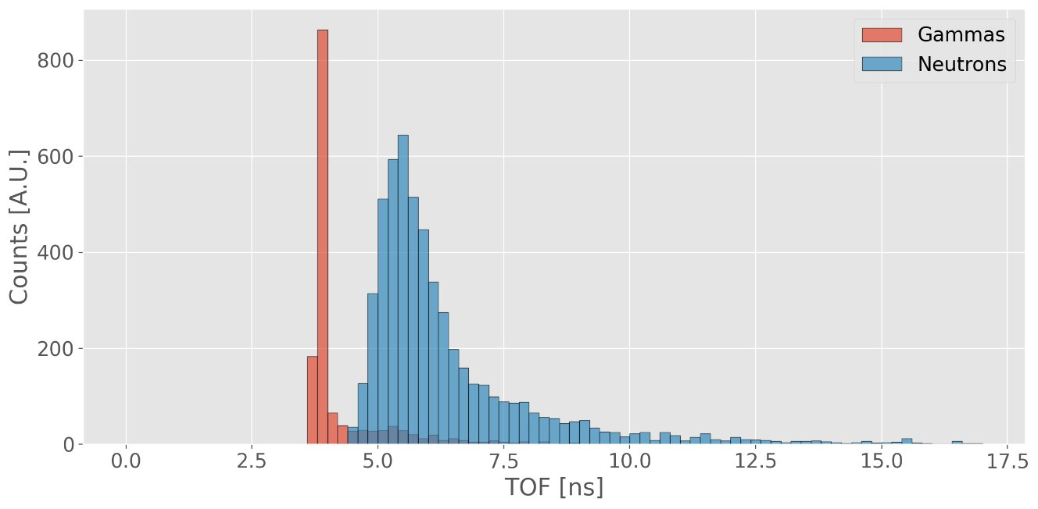
NeuProX - Neutron Production Cross Sections (Young Researcher Grant Proposal)
Goal: Assess the feasibility and reliability of measuring double differential neutron production cross-sections using a dedicated TOF multi-detector system
TOF = t_{d} - t₀
Methodology:
1. TOF from single particle data acquisition.
2. Combinatorial background rejection.
3. Neutron TOF distributions.
4. Neutron kinetic energy spectra.
5. Incoming neutrons per kinetic energy and angular direction.
t_{d}
t₀
Beam
Iram B. Rivas Ortiz (irambarbaro.rivasortiz@to.infn.it)

Slide 2
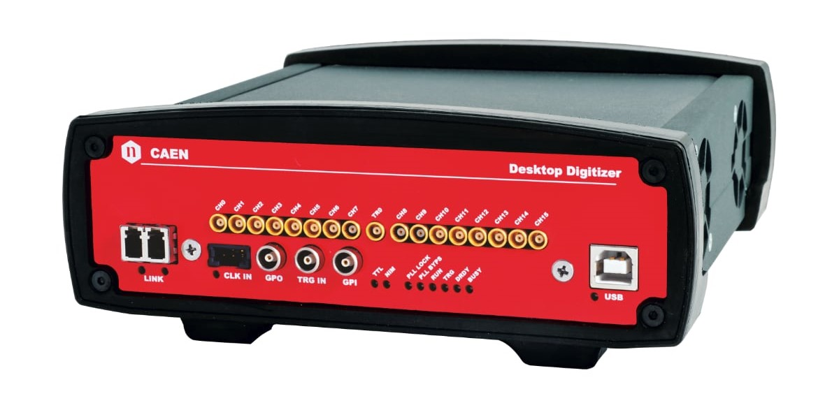
NeuProX - Neutron Production Cross Sections (Young Researcher Grant Proposal)
NeuProX - Neutron Production Cross Sections (Young Researcher Grant Proposal)
Beam Monitor Sensors
Beam sensor
Secondary Detectors
Veto plastic scintillators
Secondary Detectors
Beam
8-strip silicon detector, FBK
(Time Resolution: 50 ps)
LaBr3:Ce + SiPM, Luxium
(Time Resolution: < 200ps)
Conceptual Design (WP1) activities:
- Define appropriate materials and layout of crystal scintillators, veto plastic scintillators, target thickness and beam sensor for optimal TOF resolution (M1 - M6).
Mechanical and Electronic Assembly (WP2) activities:
- Design and build a system for rotating and/or translating the detectors for data acquisition at different angles and distance from the target (M6 - M16).
- Assemble scintillators with photodetectors and connect to readout electronics (M6 - M16).
DAQ
Signal read-out by a DT5742 digitizer (16 channels) by CAEN at a sampling frequency of 2.5 GHz
Iram B. Rivas Ortiz (irambarbaro.rivasortiz@to.infn.it)

