Slide 1
4DSHARE – INFN CSN5
DC-coupled resistive readout in silicon sensors with internal gain:
signal sharing for future 4D tracking
Coordinatore: Roberta Arcidiacono Iniziato nel: Gennaio 2023 (3 anni)
Anagrafica indicativa (frazione di FTE) in 2025
INFN - Sezione di Torino: R. Arcidiacono 0.3 - N. Cartiglia 0.3 - M. Ferrero 0.2 – L. Menzio 0.5 – F. Siviero 0.2
INFN - Sezione di Perugia: A. Morozzi 0.4 - D. Passeri 0.3 - F. Moscatelli 0.2 – T. Croci 0.1
TIPFA : M. Centis Vignali 0.4 - M. Boscardin 0.1 - G. Pepponi 0.1 - S. Ronchin 0.1 - O. Hammad Ali 0.3
Obiettivo del progetto: migliorare il disegno dei “resistive AC-LGAD” (prestazioni e scalabilità per dispositivi di grandi dimensioni)
Punti chiave:
ottenere un “signal sharing”controllato;
drenare la “leakage corrente” in ogni pixel

Slide 2
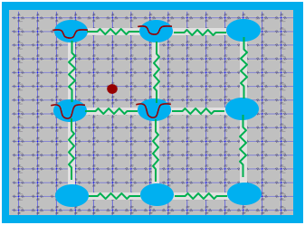
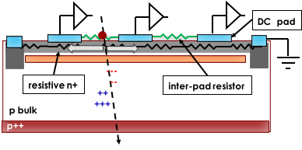
Obiettivi
Thin LGAD with a resistive DC-coupled read-out. Signals are DC-coupled, unipolar and contained within a grid of resistors.
DC-RSD
Main objectives of the 4DShare project
Finalize the concept of DC-coupled resistive read-out sensors via simulations to drive the design
Design and produce the first “proof-of-concept” prototype run, exploring multiple technological options and electrodes layouts
Perform full characterization of the production, with static and dynamic measurements in the laboratory (new/irradiated devices), and detailed performance measurements of most promising DC-RSD layouts
Develop in parallel analytical reconstruction code for estimating the position and time of the hit
Iterate the simulation process for an optimized DC-RSD design
Produce a second prototype run of DC-RSD, followed by a similarly detailed characterization of the production (if time permits)
Siamo qui!
ongoing…

Slide 3
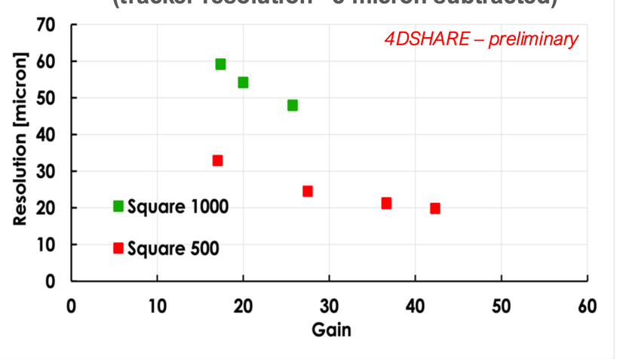
Attività dell’ultimo anno
completed the definition of mask layout/process split table and manufactured the first prototype run of DC-RSD
performed the full on-wafer characterization of the prototype run
pre-tested a small subset of sensors in the laboratory to be studied with an electrons test beam, using high resolution tracking station (DESY- December 2024 and March 2025).
detailed analysis of testbeam data ongoing
Optimization of the analysis codes (analytic method and ML technique method) for extracting the position and time resolution of DC-RSD devices, ongoing.
detailed studies of all designs ongoing in the LAB with TCT setup.
At higher gains (higher reverse bias voltage), we obtained:
500-micron pitch: 𝝈𝒙,𝒚~ 𝟐𝟎 𝝁𝒎
1000-micron pitch: 𝝈𝒙,𝒚~ 𝟒𝟖 𝝁𝒎

Slide 4
Sinergie con PRIN 4D-Share
PRIN 2022 4D-Share protocollo 2022KLK4LB
Coordinator: Roberta Arcidiacono
Team: due unità
UPO e INFN (Firenze/Torino - RL: Lorenzo Viliani)
PRIN finanziato con 209 kEuro in PE2 – Iniziato a Settembre 2023 – fine a 02/2026
Overlap con il programma 4DSHARE gr V (per i primi due anni):
nel PRIN e’ data piu’ enfasi alla parte di software di ricostruzione (con Machine Learning) per cui si richiede anche un contratto di ricerca (INFN – Firenze)

