Slide 1

111Ag-Mediated Intracellular Radiation for Targeted Breast Cancer Therapy
Cristiana Alberghina, Ph.D.
Institute of Bioimaging and Complex Biological Systems - National Research Council (IBSBC-CNR)
6th October 2025

Slide 2


Theranostics
Theranostics integrates therapy and diagnostics into a single platform, using the same or similar agents to both treat and monitor tumor progression
Silver-111 (¹¹¹Ag) is a radioisotope with attractive properties as a theranostic agent
Half-life: 7.45 days
β⁻ Radiation
350 keV avg energy/1037 keV max energy
Cytotoxic radiation suitable for therapeutic purposes
γ-rays
342 keV (~6–7% intensity)/245 keV (~1–1.3% intensity)
Emission allowing SPECT imaging for diagnostic evaluation
This dual property makes ¹¹¹Ag a theranostic radionuclide, allowing simultaneous tumor treatment and monitoring
¹¹¹Ag is a promising but still underexplored candidate for personalized radionuclide therapy

Slide 3

Aims
Radiation biophysics experiments investigate for the first time the impact of ¹¹¹Ag on the survival of cancer cells
Geant4 Monte Carlo simulations permit the investigation of cellular dosimetry and behaviour of cell populations after radiopharmaceuticals-derived internal radiation
Evaluation of cell in-take of different ¹¹¹Ag activities on human breast cancer cell lines, through γ-counter detector
Investigation on human breast cancer cell lines exposed to different ¹¹¹Ag activities of single cell released emission, via RGB CMOS sensors featured on the Raspberry Pi Camera 3
Analysis on human breast cancer cells viability, proliferation and colony formation capability after increasing doses of ¹¹¹Ag (0/0.5/1/2/4 Gy) administration, through Clonogenic assay

Slide 4
In-take Results
γ-counter detector measurement
Human Breast cell lines:
MCF-10 → non-tumorigenic epithelial cell line
MDA-MB-231 → Highly aggressive triple-negative breast cancer cell line
Administrated activity: 50 KBq
Timepoints: 1hr/24hrs/72hrs

Slide 5
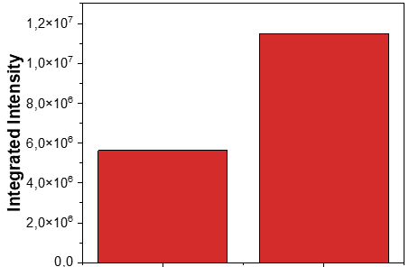
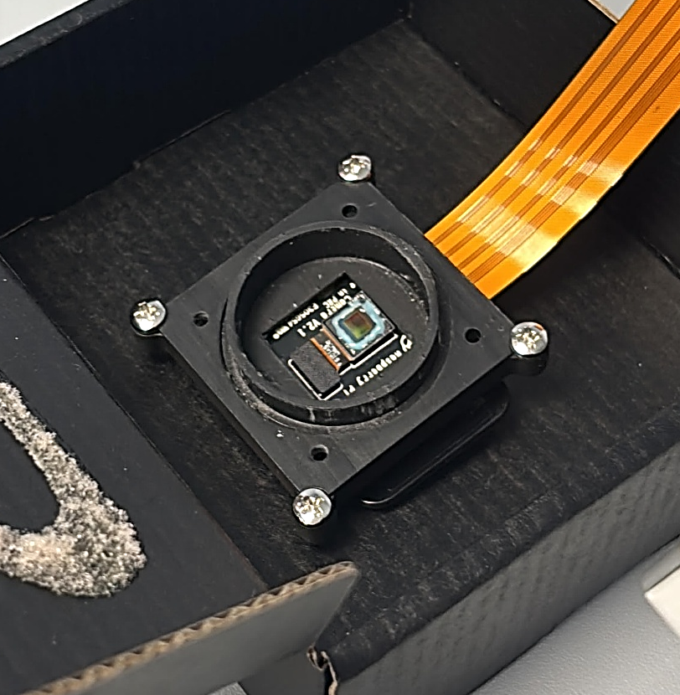
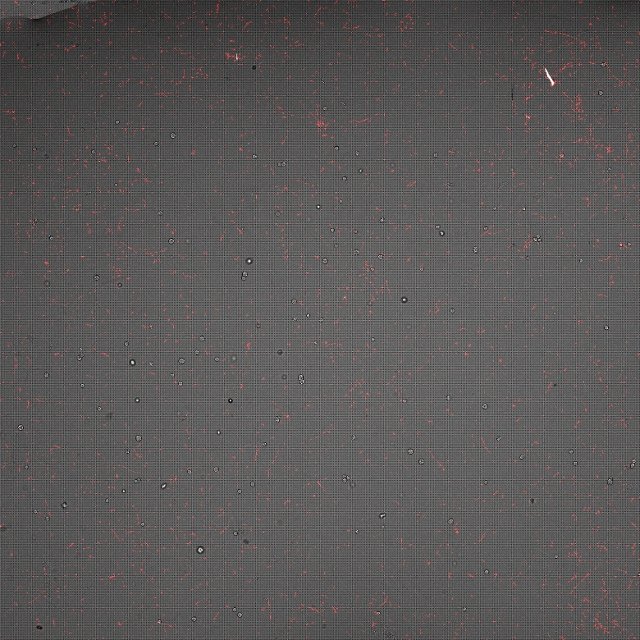
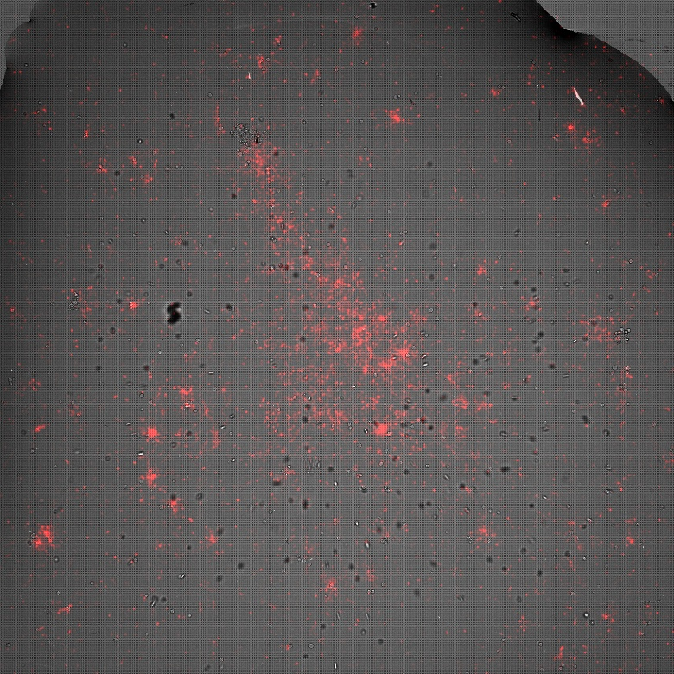
Single-Cell Results
RGB CMOS sensors analysis
Timepoint: 24hrs
Administrated activity: 800 KBq
MCF-10
MDA-MB-231
Zoom-in
Zoom-in
MCF-10
MDA-MB-231
10 µm
10 µm
Camera FOV
Camera FOV
β- accumulation
RGB CMOS sensors featured on the Raspberry Pi Camera 3

Slide 6
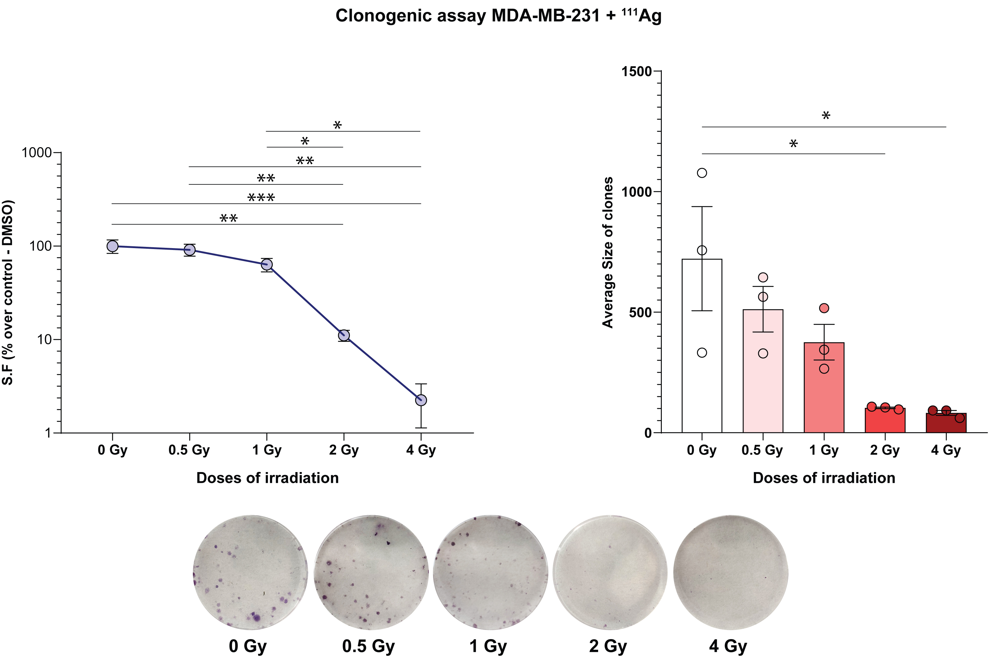

Clonogenic assay Results
Colony formation capability
Human Breast cancer cell line: MDA-MB-231
¹¹¹Ag activity exposure: 4 days treatment
Administrated doses: 0/0.5/1/2/4 Gy
Geant4 Monte Carlo simulations allow probabilistic estimation of energy deposition patterns, focusing on the related tumor adsorbed dose, impact of particle type and LET on DNA structure and cross-fire effects.
Monte Carlo dosimetry calculations at cellular level to assess the therapeutic potential of 111Ag are explained following:

Slide 7





Conclusions
¹¹¹Ag, in its cationic form of ¹¹¹Ag+, was effectively in-taken by MDA-MB-231 breast cancer cell line, probably by endocytosis processes. Otherwise, the in-take percentage of ¹¹¹Ag+ in non-tumorigenic MCF-10 cell line was negligible
MDA-MB-231 clonogenic capability and the related clones size resulted compromised in a ¹¹¹Ag dose-dependent manner
Future perspectives
Optimization of the experimental protocols, thus labelling a selective breast cancer target to ¹¹¹Ag radioisotope
Deeper investigation of intracellular-related alterations, thus analysing DNA damage and apoptotic and necrotic processes
Parallel comparative analysis between the Internal ¹¹¹Ag radiation treatment vs External X-ray radiation treatment effects
In vivo evaluation of internal ¹¹¹Ag radiation treatment on murine models, coupled by preclinical SPECT Imaging and Cerenckov Luminescence Imaging (CLI)

Slide 8
























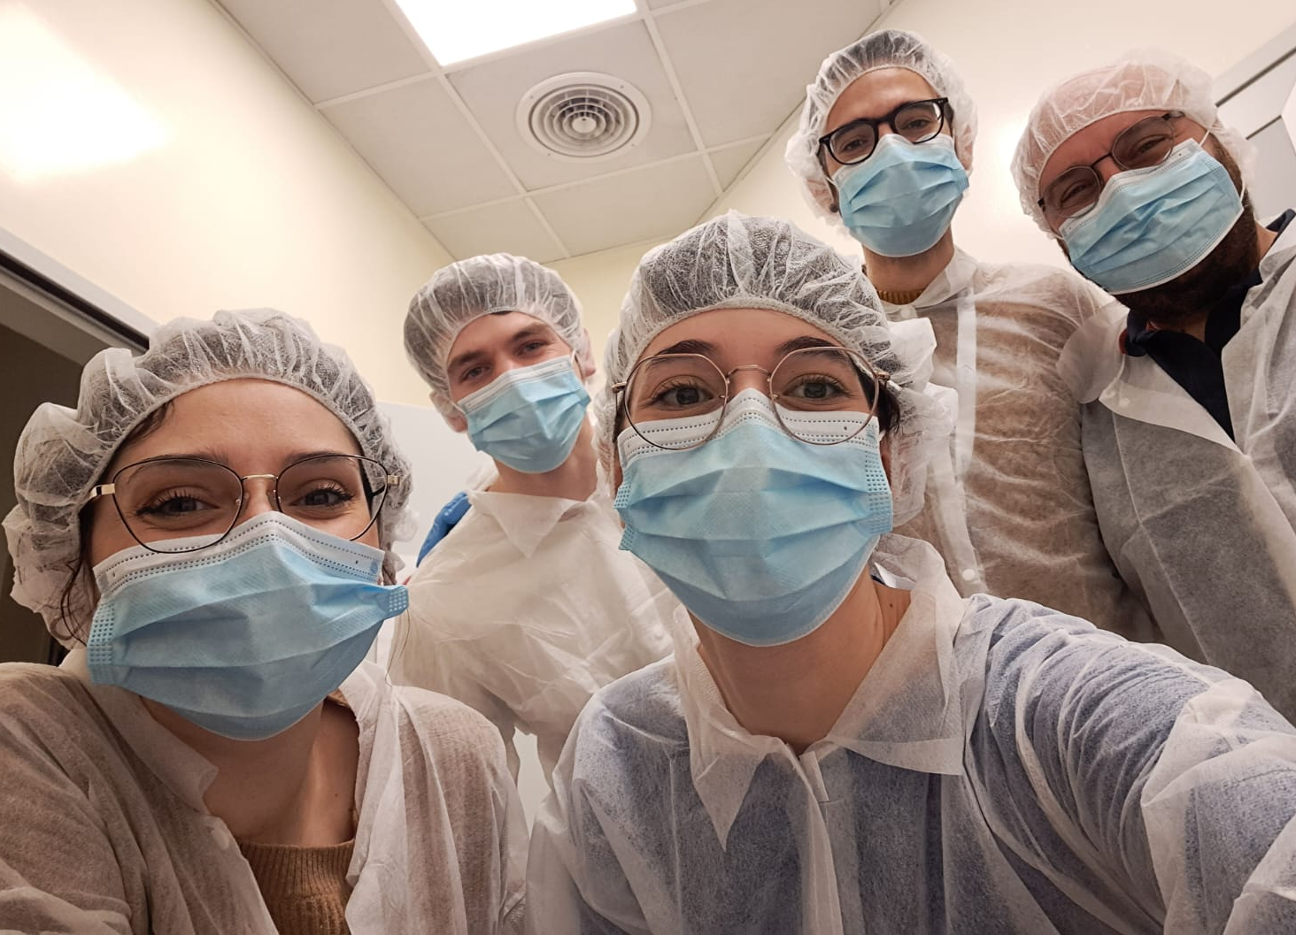
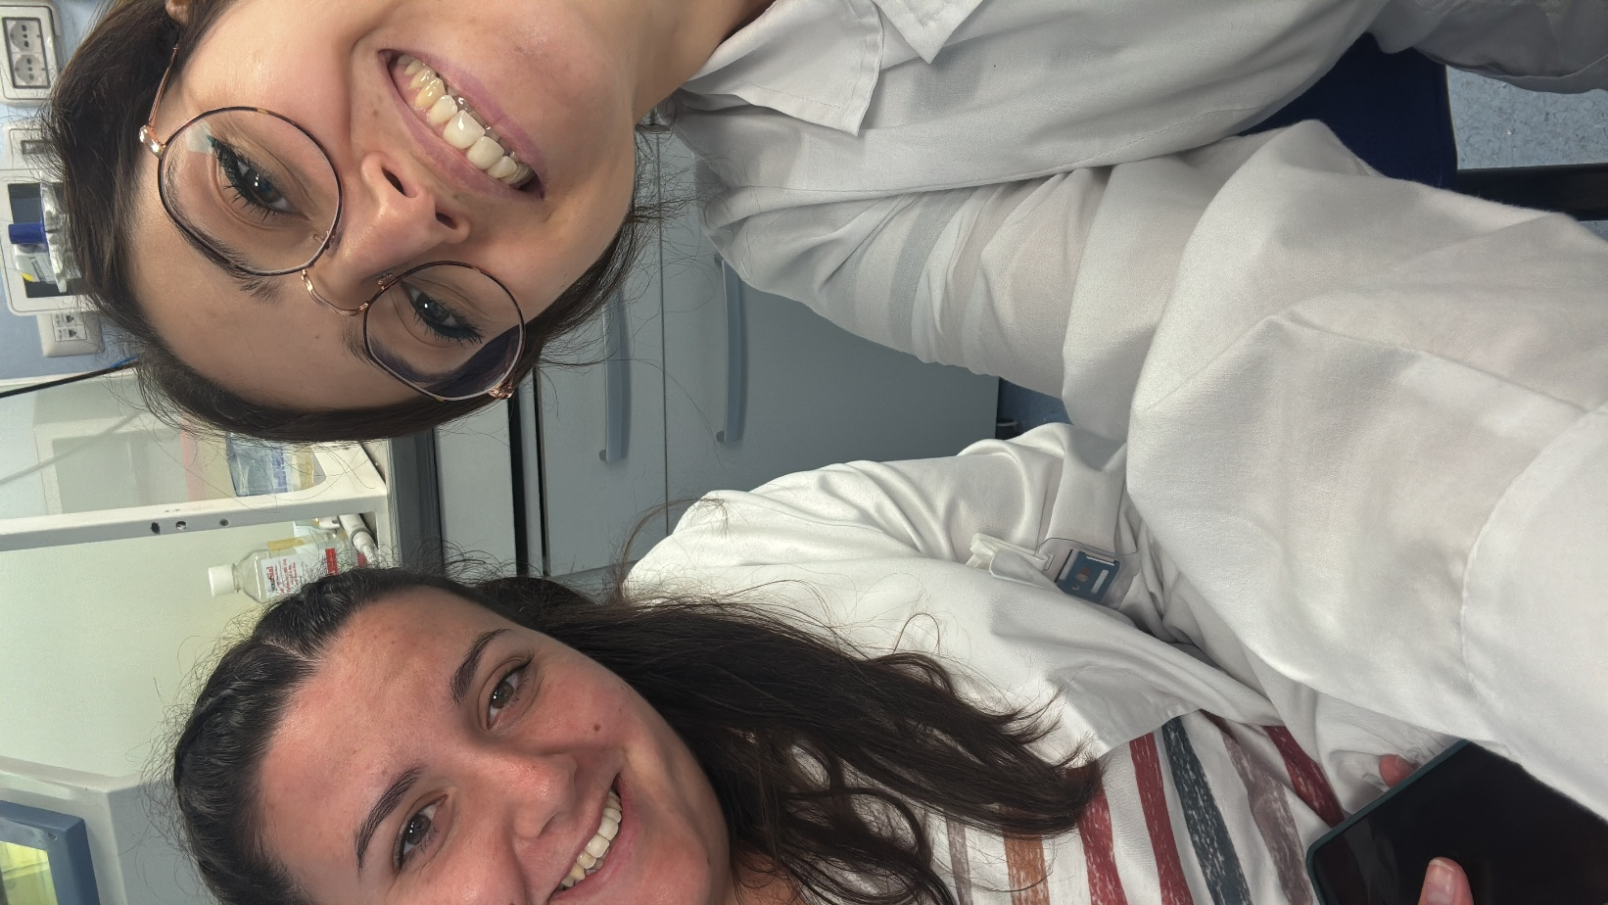

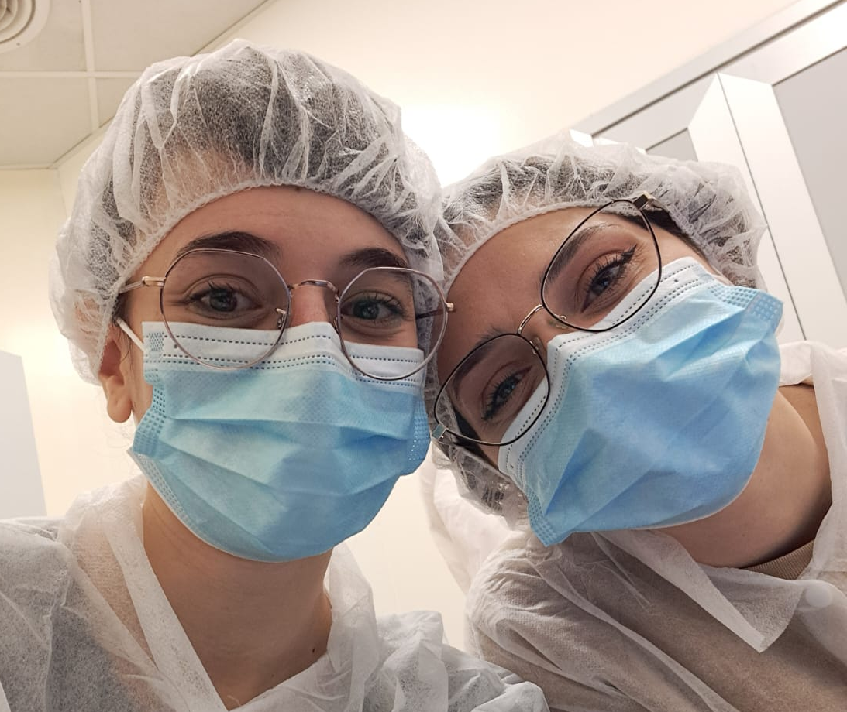

Slide 9


Introduction
Diagnosis
γ rays (High-energy photons, electromagnetic radiation)
Tissue penetration: Very long (several cm)
LET: Very low (~0.2 keV/µm)
β⁺ (positron and neutrin)
Tissue penetration: Long (few mm)
LET: Low to intermediate (~0.2–1 keV/µm)
β⁻ (electron and antineutrin)
Tissue penetration: Long (~1–10 mm)
LET: Low to intermediate (~0.2–1 keV/µm)
α particles: (2 protons + 2 neutrons - He²⁺ nucleus)
Tissue penetration: Very short (~50–100 µm)
LET: High (~50–230 keV/µm)
Auger electrons (Low-energy electrons)
Tissue penetration: Extremely short (<1 µm)
LET: Very high locally (>4–25 keV/µm)
SPECT IMAGING
γ
PET IMAGING
γ
β+
γ
β-
α
Auger
electrons
Therapy

