Slide 1





SIRR International Day 2025: Simulation and Biological Modeling
Radiation biophysical modeling and understanding
of ultra-high dose rate response:
present status & challenges
Emanuele Scifoni
Bio-Medical Radiation Physics
Research Team in Trento

Slide 2
Outline
The UHDR response understanding challenge
and the role of modeling
Track structure based models (TRAXCHEM)
  from Hetero- to Homo-geneous Radiation Chemistry
  Impact of medium, oxygenation, LET
Stochastic based models (MSGSM2)
Outlook: Biological Treatment Planning for FLASH

Slide 3
Why we need models in radiation biology/oncology?
To make predictions on different radiation effects on cells/tissue
To implement in Treatment Planning
To understand and explain phenomena on physics bases (computational microscopy)
Mechanistic better
AI better
Courtesy from A.Attili

Slide 4
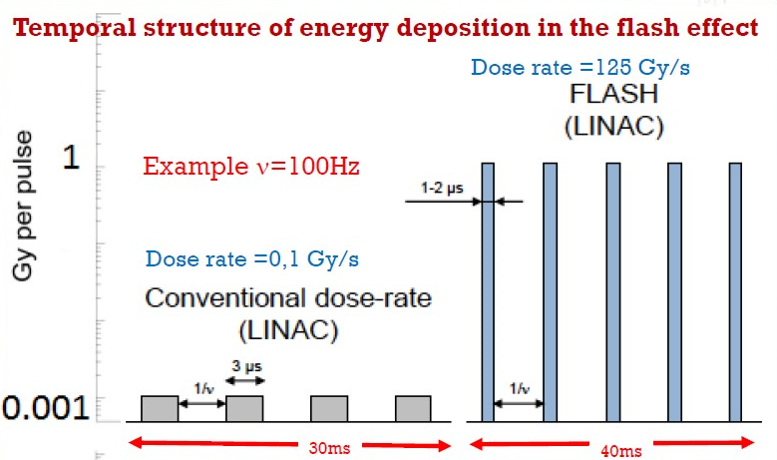

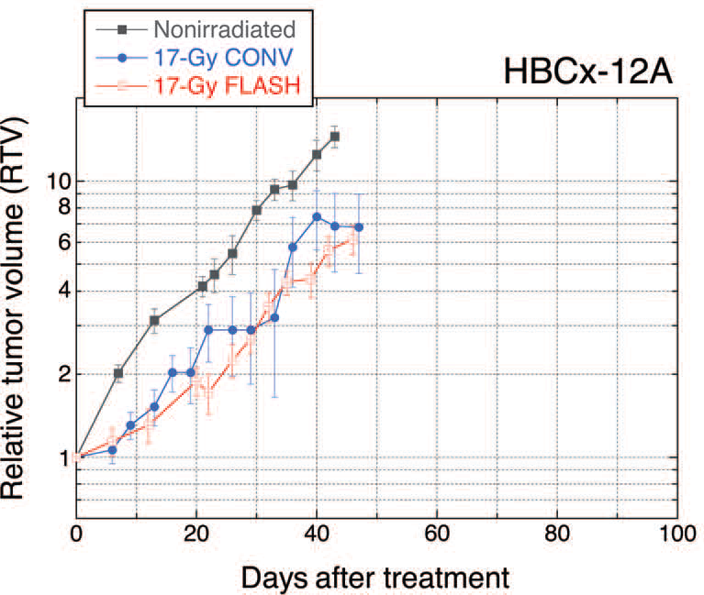
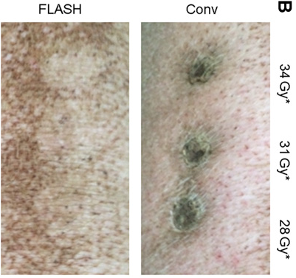
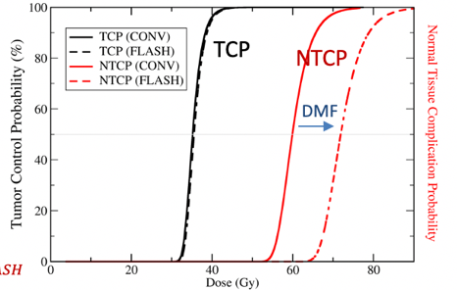
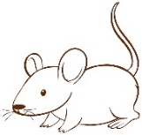
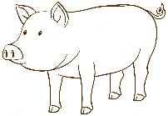
The FLASH effect
Unchanged tumor effectiveness
Higher sparing of normal tissue
V. Favaudon
DREF^{T}~1
DREF^{NT}
V. Favaudon et al., Sci. Transl. Med. (2014)
M. C. Vozenin et al., Clin. Canc. Res. (2019)
4

Slide 5
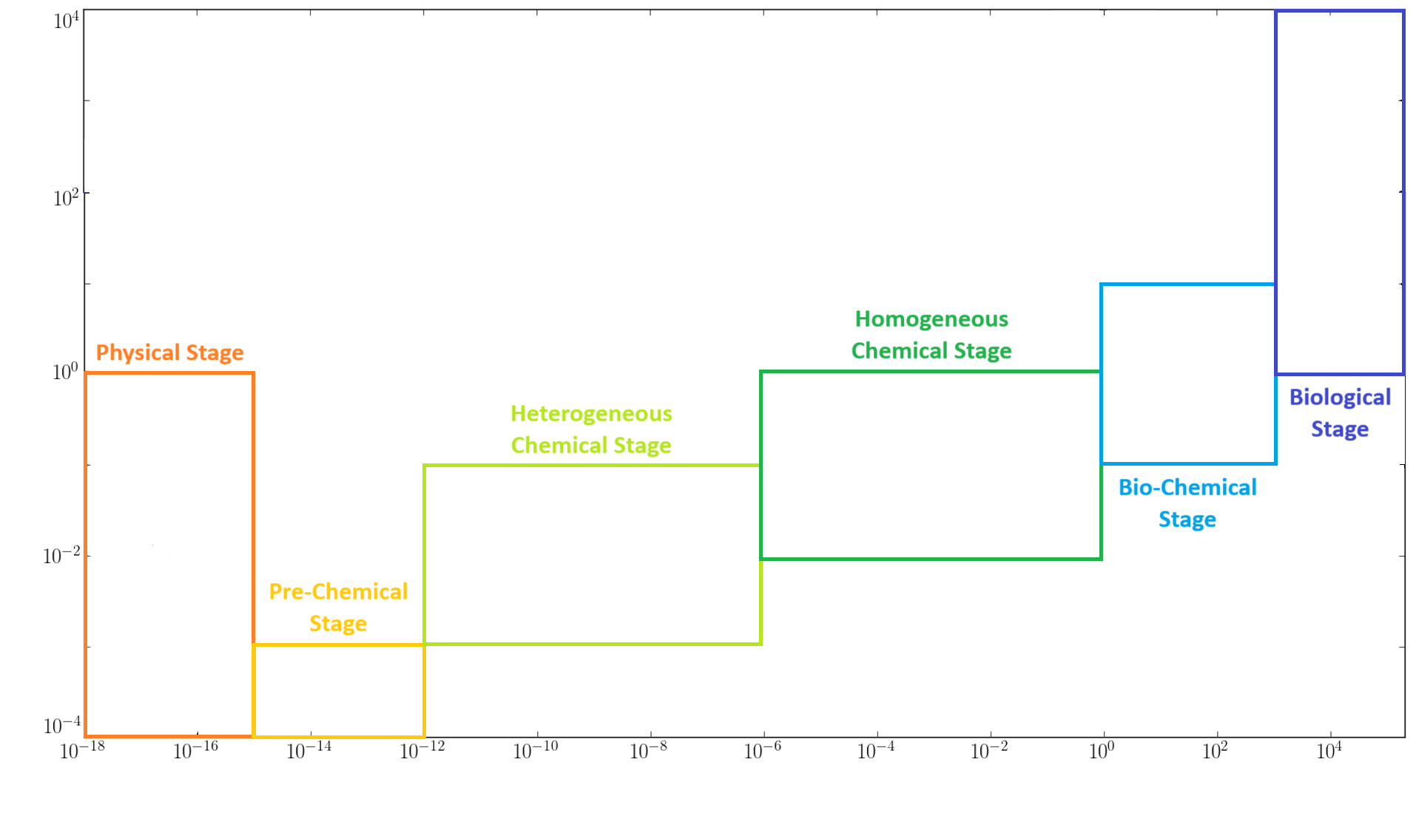
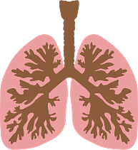
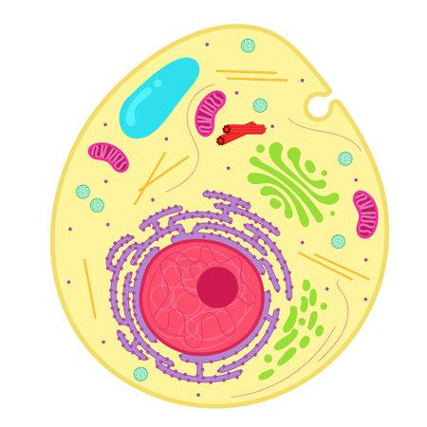
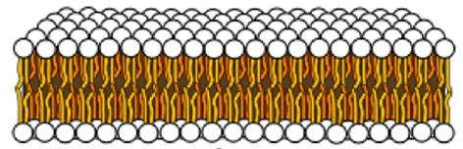
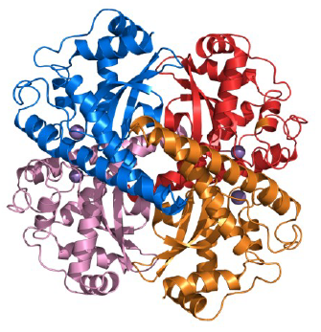

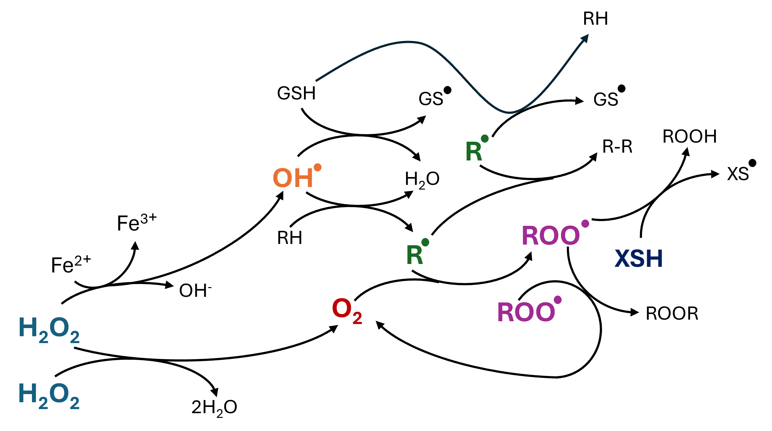
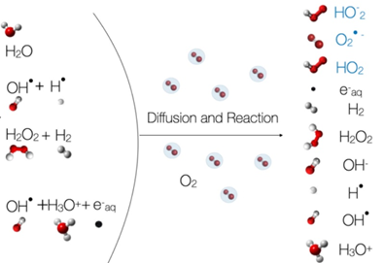
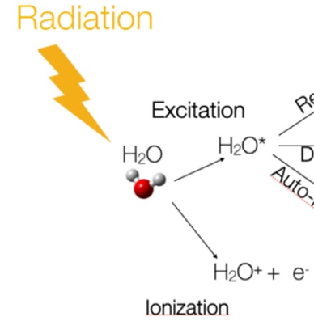
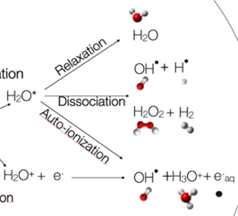
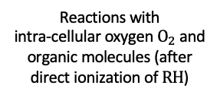
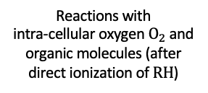
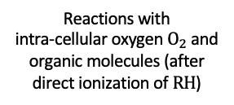
Spatio-temporal scales of radiation damage
Response of macroscopic biological systems
Response of macroscopic biological systems
Response of macroscopic biological systems
Response of macroscopic biological systems
Response of macroscopic biological systems
Response of macroscopic biological systems
Reactions with
intra-cellular oxygen $O_{2}$ and organic molecules (after direct ionization of $RH$)
Reactions with
intra-cellular oxygen $O_{2}$ and organic molecules (after direct ionization of $RH$)
Reactions with
intra-cellular oxygen $O_{2}$ and organic molecules (after direct ionization of $RH$)
Reactions with
intra-cellular oxygen $O_{2}$ and organic molecules (after direct ionization of $RH$)
Reactions with
intra-cellular oxygen $O_{2}$ and organic molecules (after direct ionization of $RH$)
Reactions with
intra-cellular oxygen $O_{2}$ and organic molecules (after direct ionization of $RH$)
Elementary electromagnetic interactions
Elementary electromagnetic interactions
Elementary electromagnetic interactions
Elementary electromagnetic interactions
Elementary electromagnetic interactions
Elementary electromagnetic interactions
Reaction and diffusion of chemical species
Reaction and diffusion of chemical species
Reaction and diffusion of chemical species
Reaction and diffusion of chemical species
Reaction and diffusion of chemical species
Reaction and diffusion of chemical species
Space (µm)
Space (µm)
Space (µm)
Space (µm)
Space (µm)
Space (µm)
Local generation of new species
Local generation of new species
Local generation of new species
Local generation of new species
Local generation of new species
Local generation of new species
Disruption of protein signaling networks, membrane rupture, enzymatic repair processes, etc.
Disruption of protein signaling networks, membrane rupture, enzymatic repair processes, etc.
Disruption of protein signaling networks, membrane rupture, enzymatic repair processes, etc.
Disruption of protein signaling networks, membrane rupture, enzymatic repair processes, etc.
Disruption of protein signaling networks, membrane rupture, enzymatic repair processes, etc.
Disruption of protein signaling networks, membrane rupture, enzymatic repair processes, etc.
Time (s)
Time (s)
Time (s)
Time (s)
Time (s)
Modified starting from U. Weber, E. Scifoni, M. Durante, Med. Phys. (2022)
Time (s)
Marco Battestini PjD Thesis
5

Slide 6


Crucial stages and mechanistic hypotheses of FLASH effect
10 Gy Conv
10 Gy UHDR
Space (µm)
Modified starting from U. Weber, E. Scifoni, M. Durante, Med. Phys. (2022)
Time (s)
Marco Battestini PjD Thesis
6

Slide 7
Crucial stages and mechanistic hypotheses of FLASH effect
10 Gy Conv
10 Gy UHDR
Organic Radical Recombination (ORR)
Space (µm)
Inter-Track (IT)
Radiolytic Oxygen Depletion (ROD)
Modified starting from U. Weber, E. Scifoni, M. Durante, Med. Phys. (2022)
Time (s)
Marco Battestini PjD Thesis
7
Notes:
One of the main proposed hypotheses is the Inter-Track effects, which involve early interactions between physico-chemical tracks that may enhance the biological response to UHDR radiation. However, it has been challenged by several investigations. The second main hypothesis is Oxygen Depletion, which proposes that the protective effect is triggered by an induced hypoxic environment under the UHDR regime. However, it has been challenged due to the extremely high dose required to achieve significant oxygen depletion. The third main hypothesis is Organic Radical Recombination, which suggests that UHDR radiation reduces cellular toxicity. This project focused on this mechanism.

Slide 8
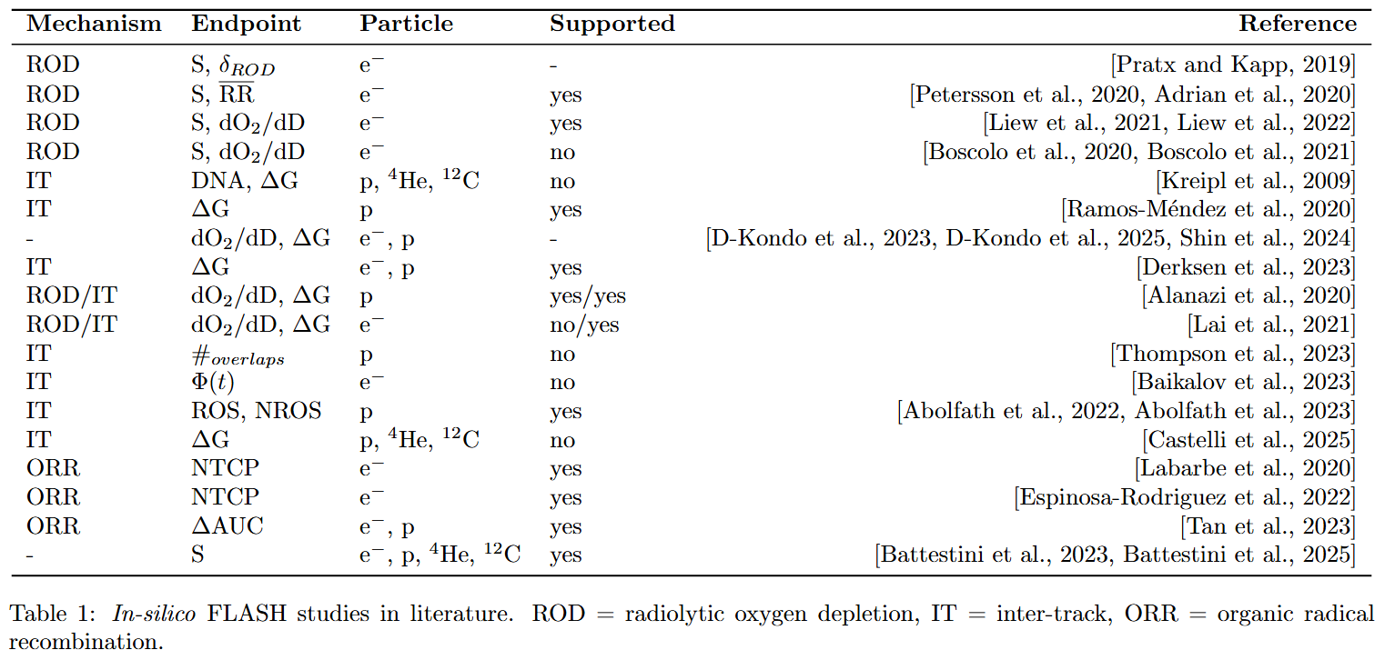
FLASH/UHDR Modeling Studies
M. Battestini PhD Thesis Univ of Trento 2025

Slide 9
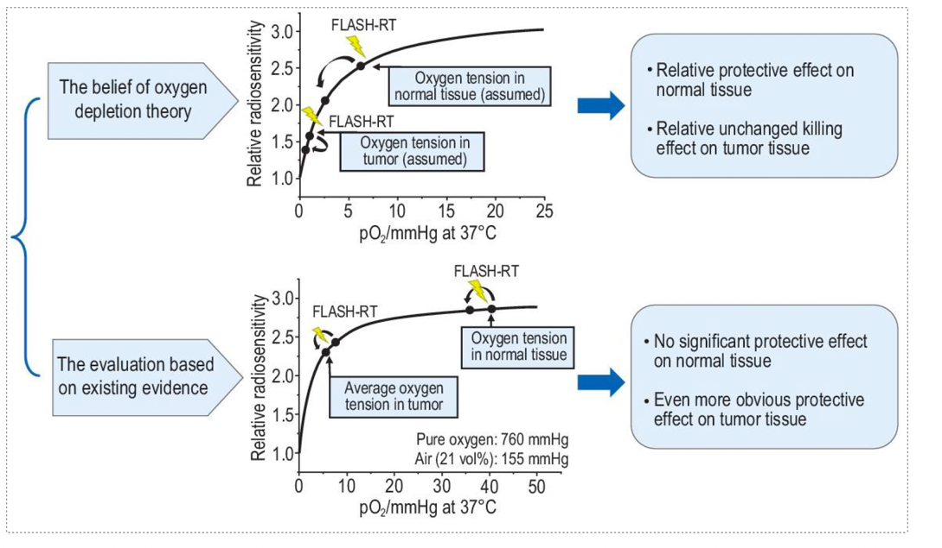
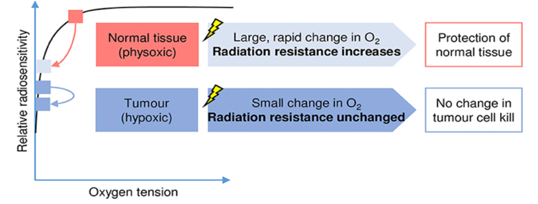
The Oxygen Depletion Hypothesis (ROD)
Ma et al. 2024
Wilson J. Et al. (2020) Front. Oncol
redrawn from Pratx et al.2019.
Ultrahigh dose rate:
Oxygen consuption too quick for redifussion to restore initial levels
Transient hypoxia generated -> induced radioresistabce
Already suggested in Hall&Brenner 1991
Zhou Med Phys 2020

Slide 10
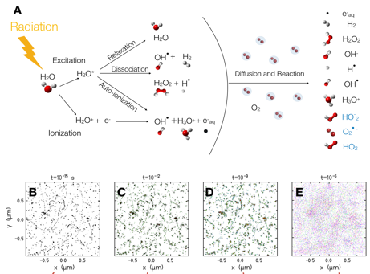
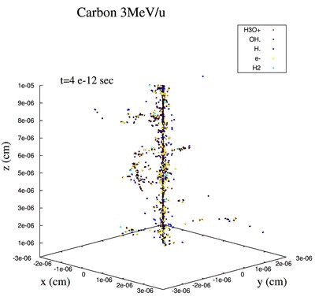
Monte Carlo Track structure Codes for exploring
FLASH Chemistry
Heterogeneous stage (and slightly beyond…)
TRAX-CHEM (Boscolo et al. 2020)
TOPASnBIO (Ramos et al. 2020)
gMicroMC (Lai et al. 2021)
Geant4-DNA (Tran et al. 2021)
IONLYS-IRT (Alanazi et al. 2021)
NASIC (Zhou et al.2021)
Boscolo et al. 2021 u.r.

Slide 11

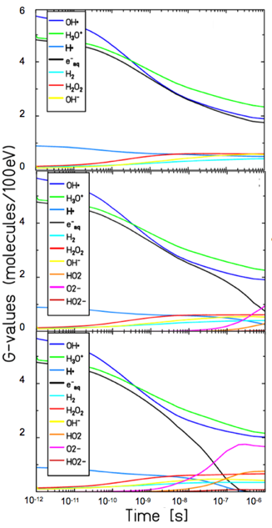
O₂ impact on the nanoscale

Slide 12
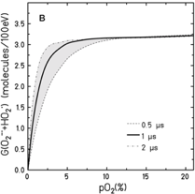
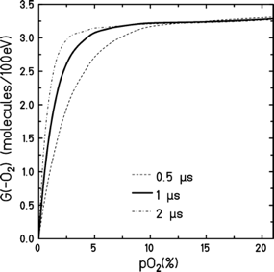

TRAX-CHEM predicted oxygen depletion in water
low-LET electrons
+
3.28 mol./ 100eV =
0.33 µM/Gy
=2.4%/100Gy
O₂ consumption
Boscolo et al. 2020
Boscolo et alIJMS 2020; RO 2021

Slide 13
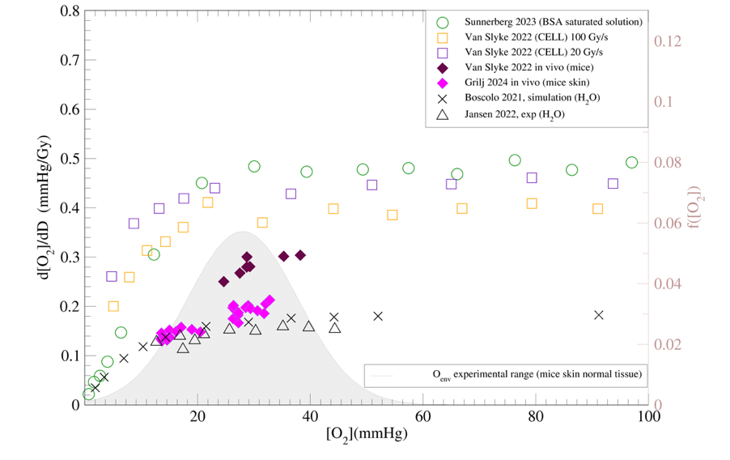
Summary depletion studies
Necessary depletion rate ( )
and initial oxygenation ( )
to justify ROD
Medium
CONV
In vitro
Water
FLASH
In vivo
Scifoni, Vozenin. Cordoni. Fuss, Seco, Radiother Oncol 2025

Slide 14
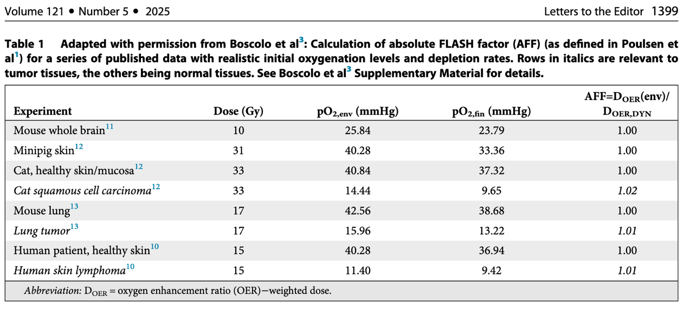
Summary depletion studies in vivo
Scifoni, Vozenin. Cordoni. Fuss, Seco, Radiother Oncol 2025

Slide 15
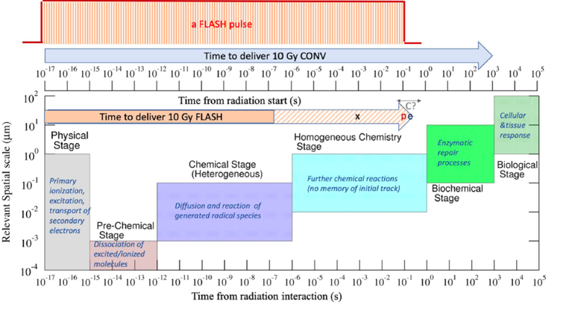
The challenge of reaching longer time scales:
Weber, Scifoni, Durante 2021
MS-GSM2
Battestini 2023
TRAX
Kraemer 1994
TRAXCHEM
Boscolo 2018-2022
TRAXCHEM-xt
Camazzola 2023

Slide 16
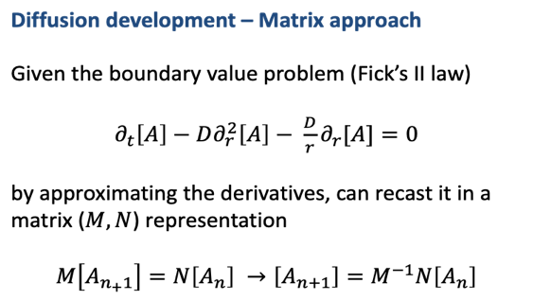
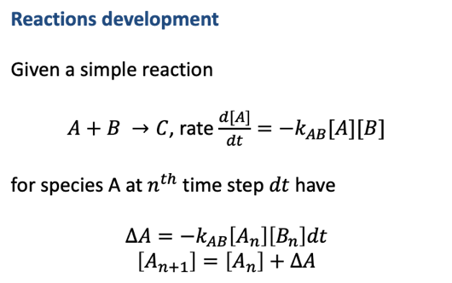
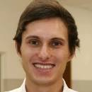
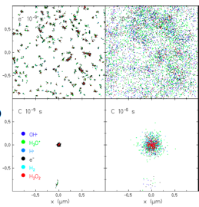
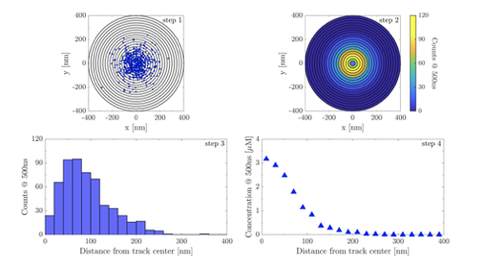
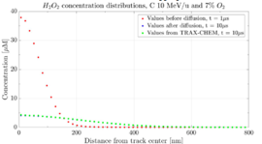
TRAXCHEMxt:
Radial Concentrations of Chemical species
G. Camazzola et al. 2023
Phase 2 Transition: New R-D Concentration based model

Slide 17
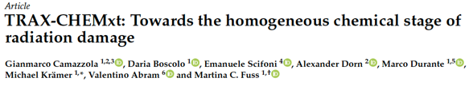
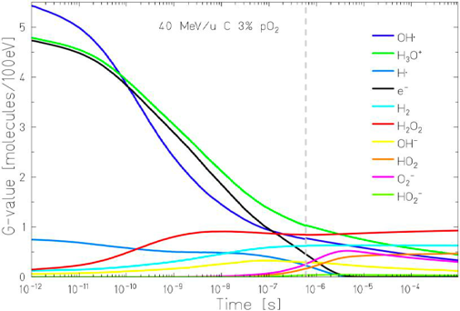
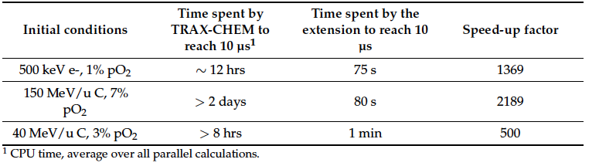
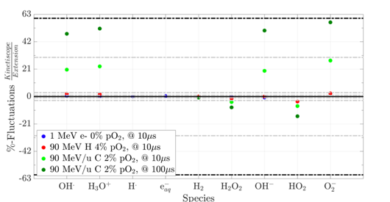
From Hetero to Homogeneous radiation chemistry
Cfr. wIth fully homogeneous (Kinetiscope) matches at low LET, deviates at high

Slide 18
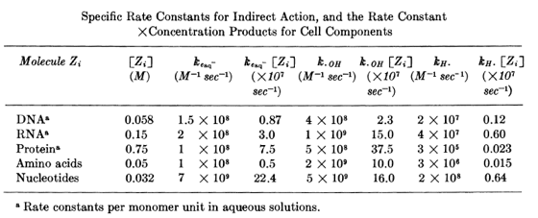
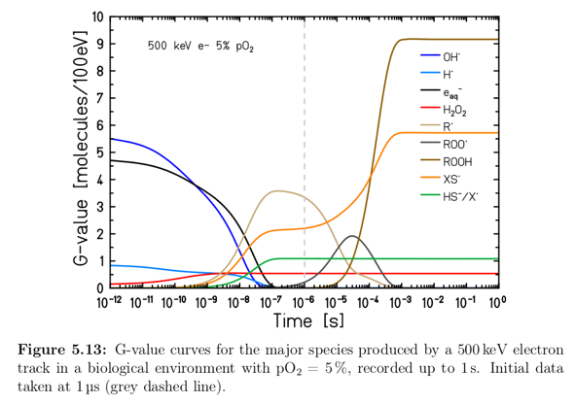
Impact of Medium
Inserting a RH molecule according to an average k of the DNA/protein components
RH molecule as a second Continuum
Species (scavenger) , treated as O2
Michaels&Hunt 1978
R.
Camazzola et al.
PhD Thesis 2024, submitted to PMB

Slide 19
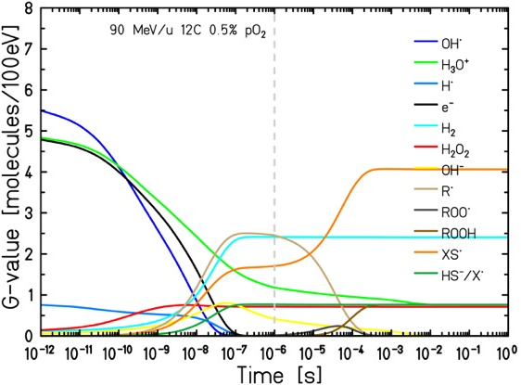
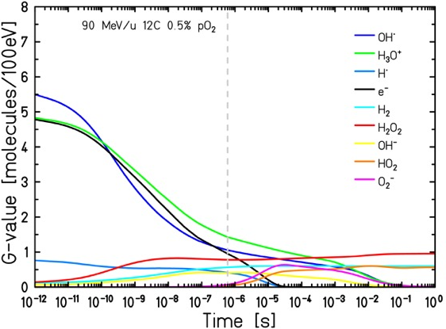
G-values comparison – H₂O+O₂ vs. biological environment
Camazzola et al.
PhD Thesis 2024, submitted to PMB
G-value: number of radicals/molecules produced per 100 eV of energy deposited
H₂O+O₂+RH+XSH
H₂O+O₂
R• & XS• production
OH•, H• & e_{aq}⁻ fully consumed
→ Biological environment already in
Monte Carlo!
Long-lasting reactions, ROOH production
Long-lasting reactions
3. Results

Slide 20
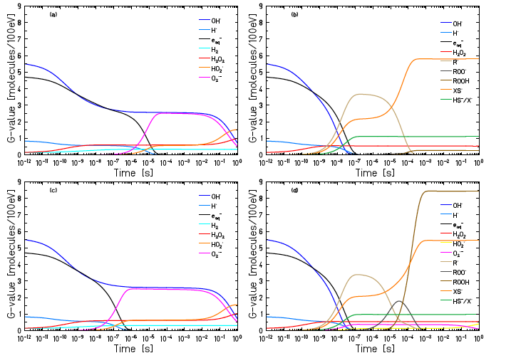
Medium impact for different oxygenation
Interplay O₂ and medium
Camazzola et al., submitted to PMB
O₂
0.5%
21%

Slide 21
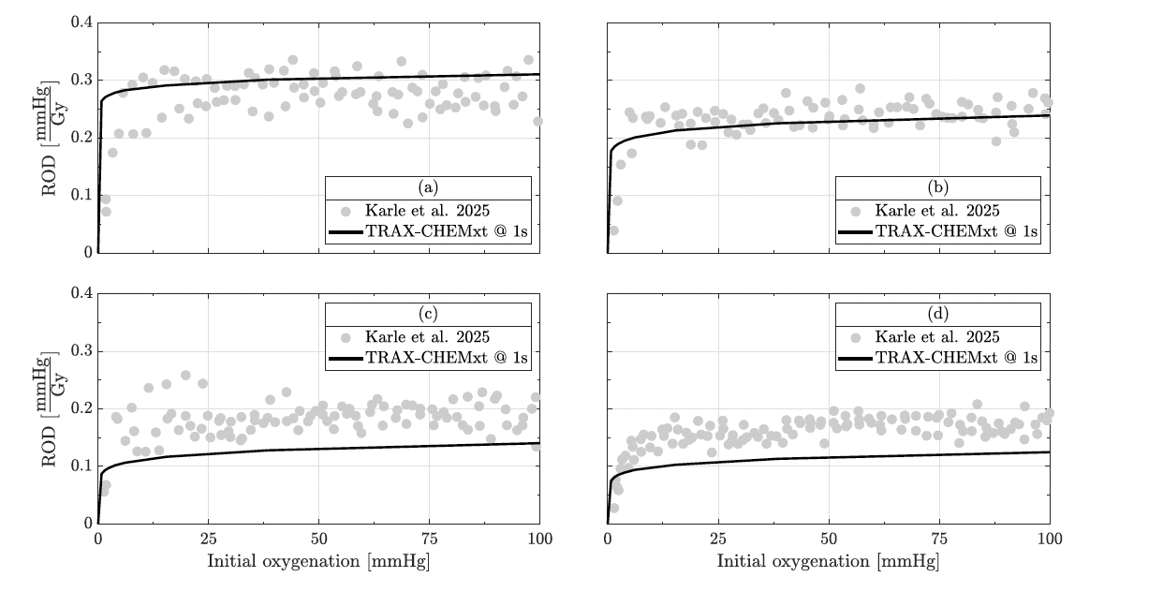
O₂ Depletion versus LET (in medium)
p, 5.4 keV/μm
He, 14.4 keV/μm
Camazzola et al., submitted to PMB
C, 65.0 keV/μm
O, 100.3 keV/μm

Slide 22
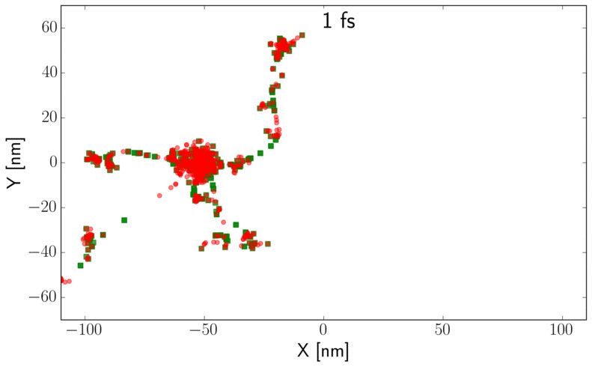
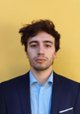
INTERTRACK phenomena
2 Projectile Δx = 100 nm and Δt = 1 ns
Castelli IJMS 2025
2

Slide 23
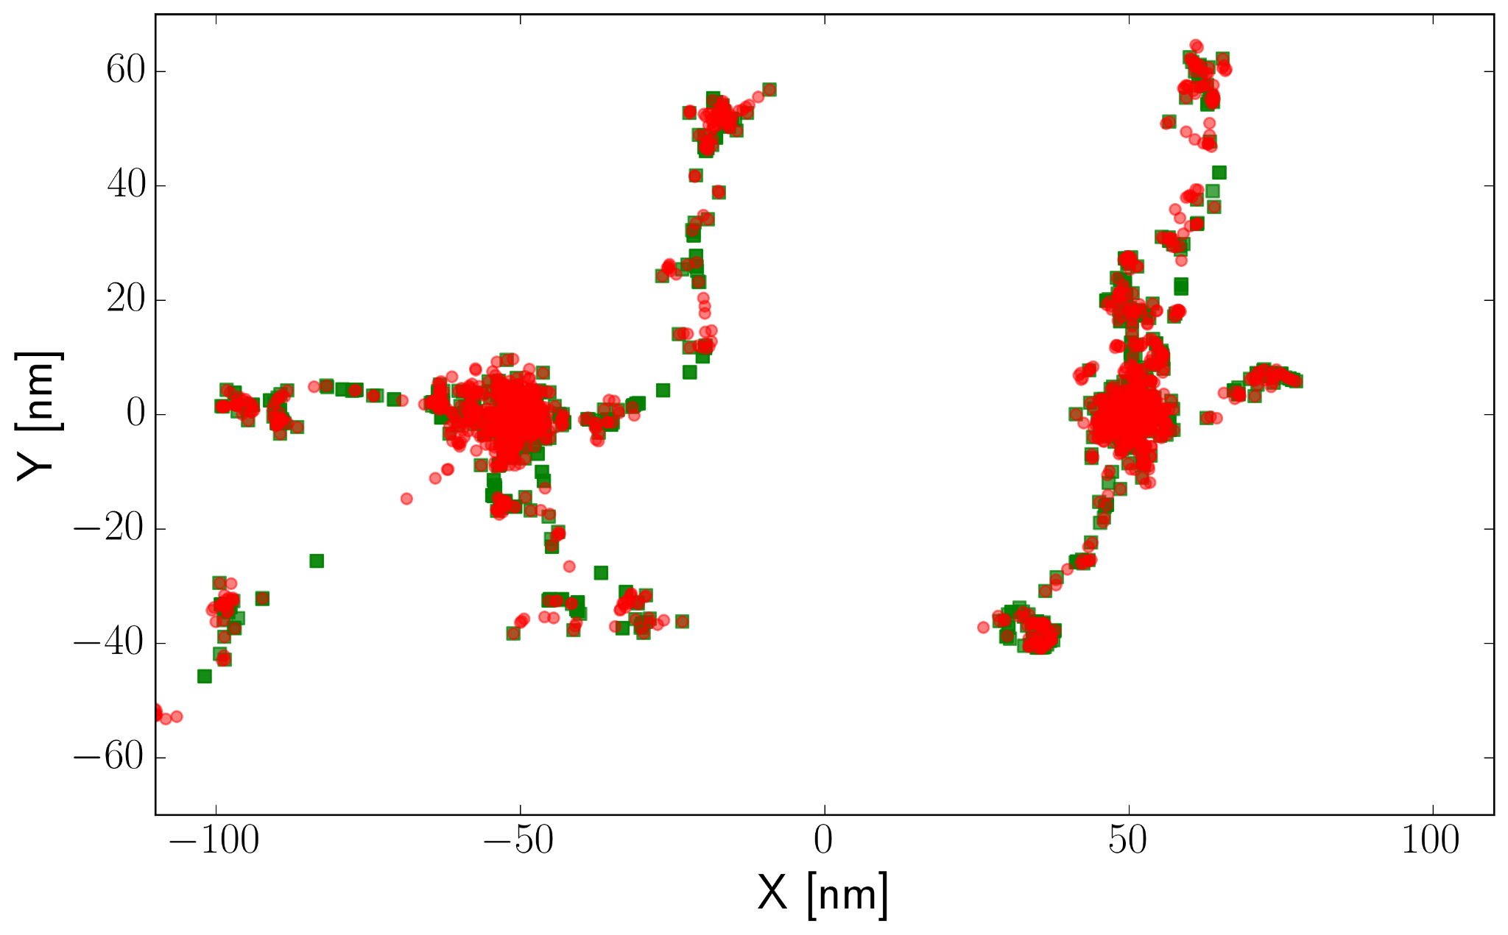
Implementation and study of Intertrack interaction
INTERTRACK
1st
2nd
Example: 2 Proj. Δx = 100 nm ; Δt = 1 ns
Phys
Phys
fs
ps
ps+Δt
μs
μs+Δt
Lorenzo Castelli (39th cycle)
3rd Year Admission Seminar
8

Slide 24
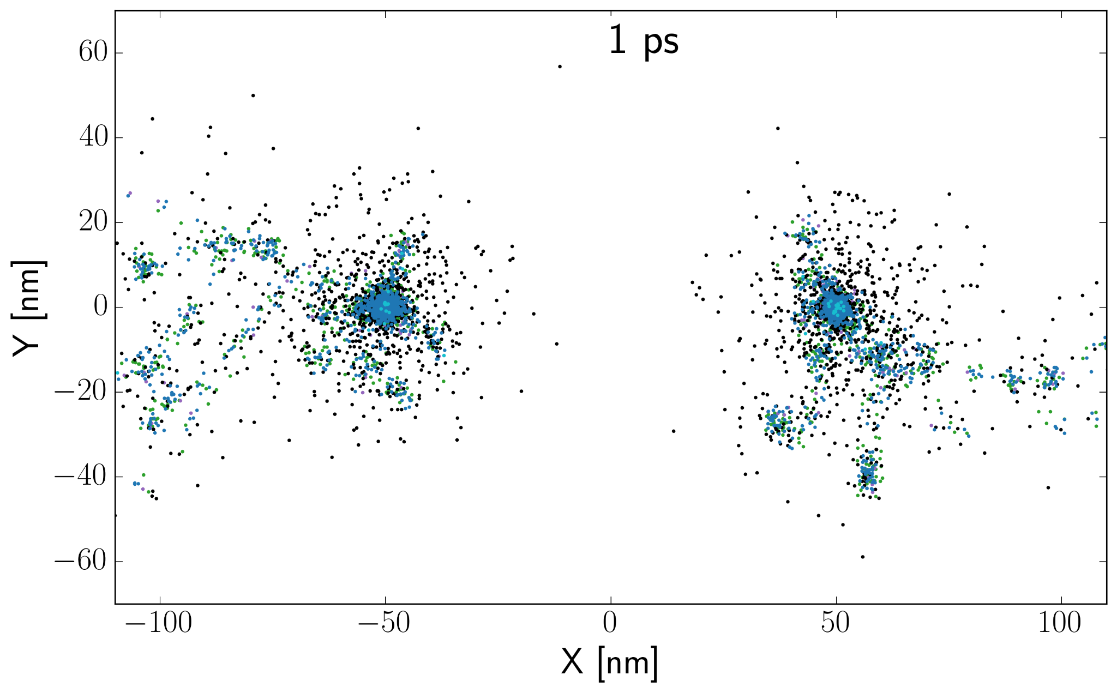
Implementation and study of Intertrack interaction
INTERTRACK
1st
2nd
Example: 2 Proj. Δx = 100 nm ; Δt = 1 ns
Phys
Phys
fs
Pre-Chem
Pre-Chem
ps
ps+Δt
μs
μs+Δt
Lorenzo Castelli (39th cycle)
3rd Year Admission Seminar
8

Slide 25
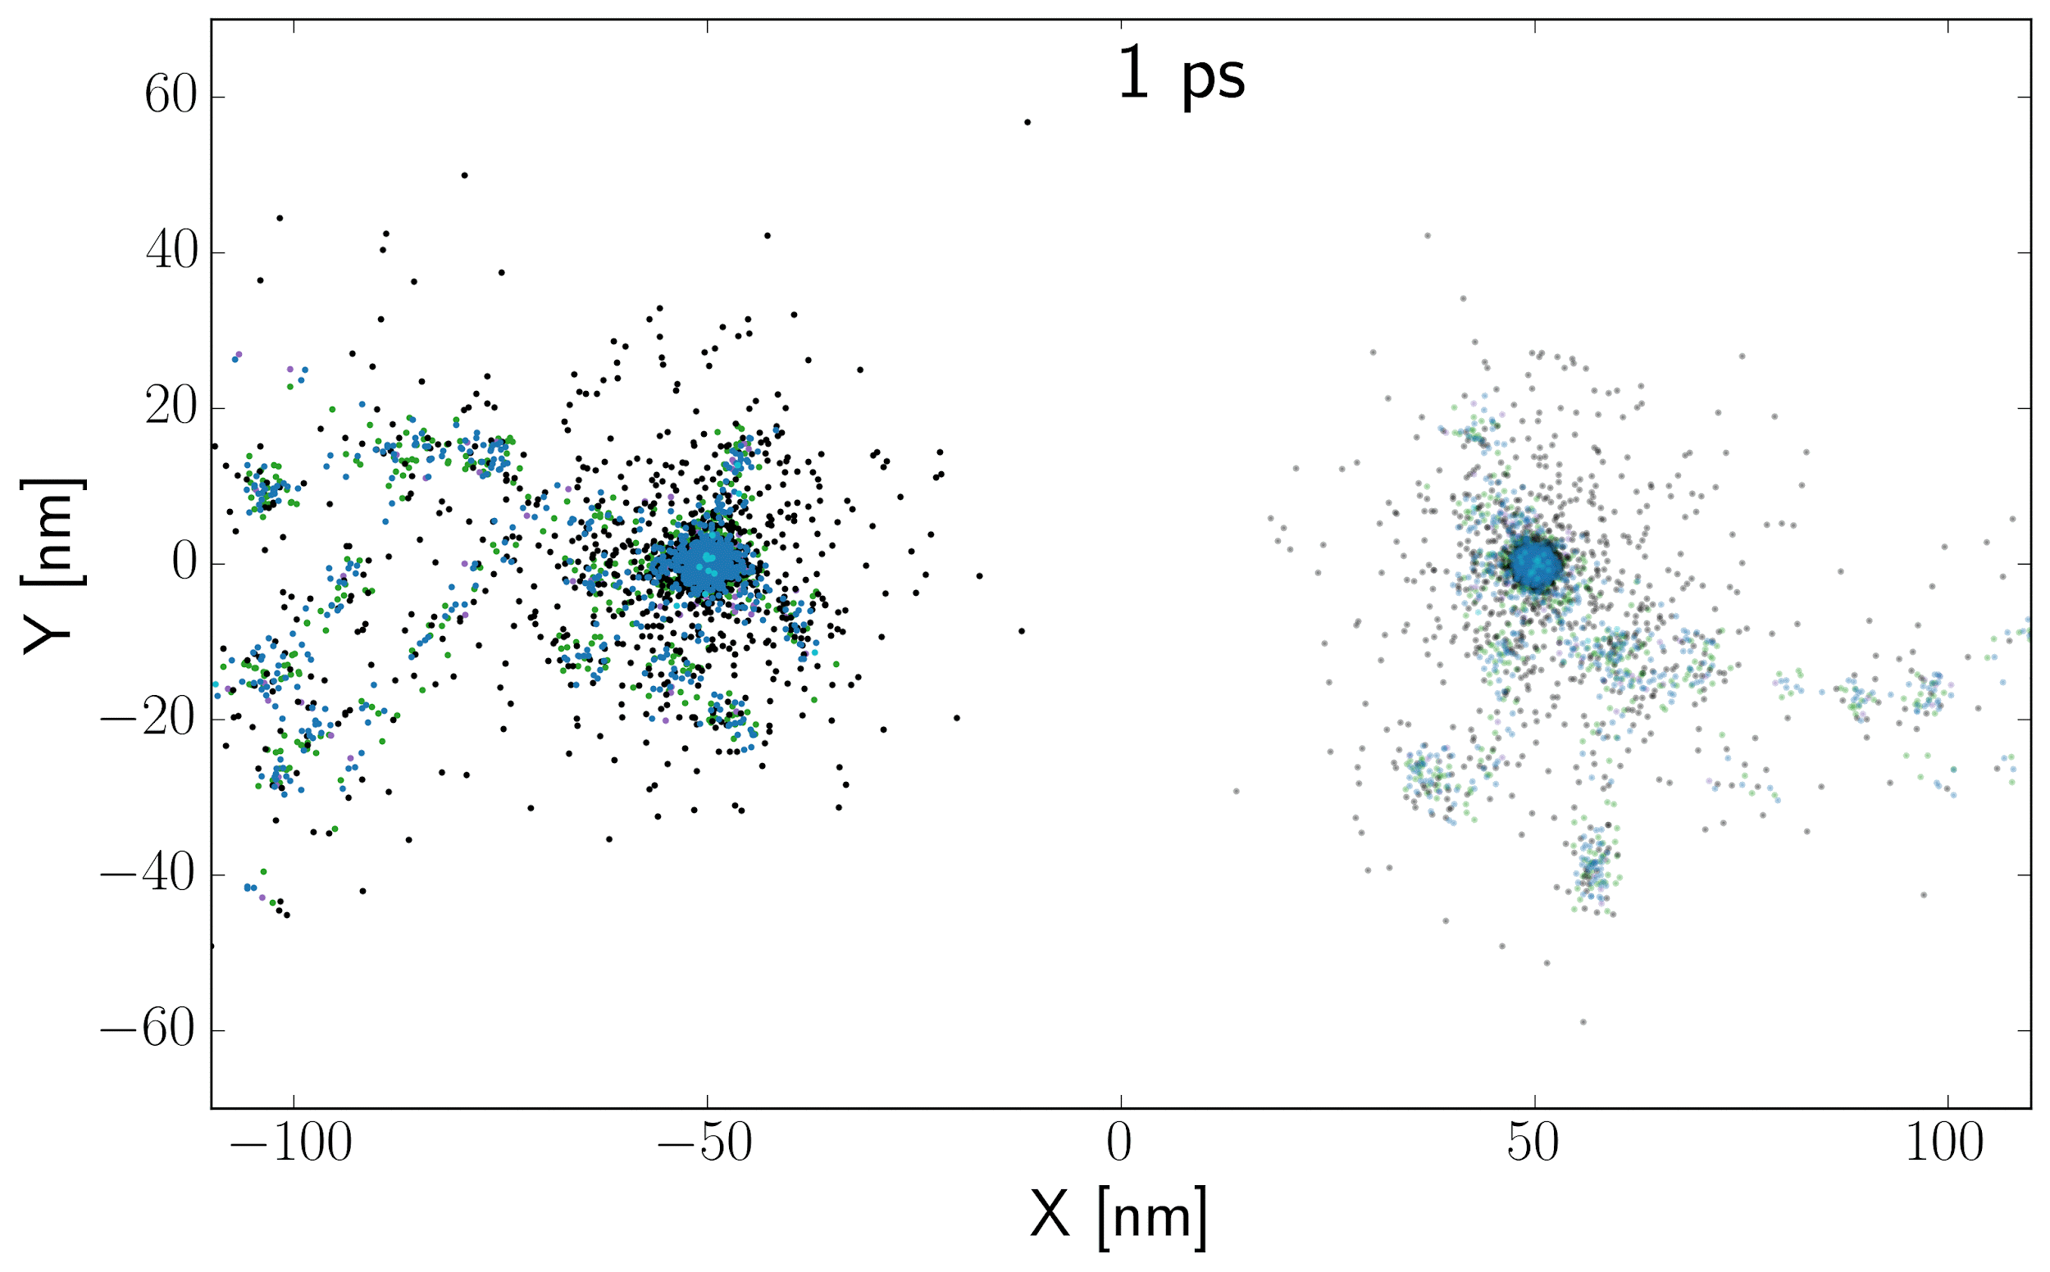
Implementation and study of Intertrack interaction
INTERTRACK:
2 Proj. Δx = 100 nm ; Δt = 1 ns
1st
2nd
Example: 2 Proj. Δx = 100 nm ; Δt = 1 ns
Phys
Phys
fs
Pre-Chem
Pre-Chem
ps
Hetero-Chem
(track freeze)
ps+Δt
μs
μs+Δt
Lorenzo Castelli (39th cycle)
3rd Year Admission Seminar
8

Slide 26

Implementation and study of Intertrack interaction
INTERTRACK
1st
2nd
Example: 2 Proj. Δx = 100 nm ; Δt = 1 ns
Phys
Phys
fs
Pre-Chem
Pre-Chem
ps
Hetero-Chem
(track freeze)
ps+Δt
μs
Hetero-Chem
μs+Δt
Lorenzo Castelli (39th cycle)
3rd Year Admission Seminar
8

Slide 27


Implementation and study of Intertrack interaction
INTERTRACK
Example: 2 Proj. Δx = 100 nm ; Δt = 1 ns
1st
2nd
Phys
Phys
fs
Pre-Chem
Pre-Chem
ps
Hetero-Chem
(track freeze)
ps+Δt
μs
Hetero-Chem
μs+Δt
N(t)
G-value(t) =
E(t)[100eV]
Lorenzo Castelli (39th cycle)
3rd Year Admission Seminar
8

Slide 28



Implementation and study of Intertrack interaction
INTERTRACK:
Proton 20 MeV (LET = 2.25 keV/μm)
Helium 5 MeV/u (LET = 30 keV/μm)
2 Projectile, with several Δx and Δt
Castelli et al.,IJMS, 2025
N(t)
G-value(t) =
E(t)[100eV]
8
Lorenzo Castelli (39th cycle)
3rd Year Admission Seminar
9

Slide 29




Impact of Oxygenation on Intertrack
Castelli at al. in prep

Slide 30

FLASH and Spatio-temporal Scales of Radiation Damage
Weber, Scifoni, Durante 2021
MS-GSM2
Battestini 2023
TRAX
Kraemer 1994
TRAXCHEM
Boscolo 2018-2022
TRAXCHEM-xt
Camazzola 2023

Slide 31


Organic radical recombination (ORR) hypothesis
Homogeneous chemistry
Modification of the chemical environment induced by recombination of organic peroxyl radicals ${ROO}^{⋅}$ at UHDR regime
Cellular damage
Antioxidants (XSH)
Toxic
Chemical species that protect the biomolecule by scavenging reactive species and preserving it against redox damage. E.g. vitamin E, glutathione (GSH), etc.
Protection against redox damage
R. Labarbe et al., Radiother. Oncol. (2020)

Slide 32







Organic radical recombination (ORR) hypothesis
Reaction rates of 9 species: system of Ordinary Differential Equations (ODEs)
Reactions
Production
$$\left\{\begin{aligned}\frac{dD\left(t\right)}{dt}=\dot{D}, t≤T_{irr} \\ &\frac{dD\left(t\right)}{dt}=0, T_{irr}<t≤T_{sim}\end{aligned}\right.$$
$$\frac{d\left[\overline{ξ}\right]}{dt}=f\left(ξ\right)+{ρG}_{\overline{ξ}}\frac{dD\left(t\right)}{dt}$$
$$k_{ij}∙{\left[\overline{ξ}\right]}_{i}∙{\left[\overline{ξ}\right]}_{j}$$
$$\left[\frac{\# molecules}{100 eV absorbed}\right]$$
R. Labarbe et al., Radiother. Oncol. (2020)
Low AUC
UHDR
Area under the curve (AUC)
High AUC
$${AUC}_{{ROO}^{⋅}}=\int_{0}^{T_{sim}}{\left[{ROO}^{⋅}\right]\left(t\right)dt}$$
Quantification of reduced cellular toxicity due to ORR
Conv

Slide 33







The workflow of the MS-GSM²
Dose rate
(iv) Biological stage
(i) Physical stage
(iii) Bio-chemical stage
FLASH assumption:
reduction of indirect DNA damages at UHDR regime via organic radical recombination
(ii) Chemical stage
The MultiScale - Generalized Stochastic Microdosimetric Model (MS-GSM²)
M. Battestini et al., Front. Phys. (2023)
M. Battestini et al., Radiother. Oncol. (2025)

Slide 34



The workflow of the MS-GSM²
Dose rate
$$\dot{d}$$
Physical stage
Biological stage
Radial dose
Nucleus domain
$$z$$
Bio-chemical stage
Energy deposited in a single event
Spatial and temporal
dose deposition:
Different dose delivery time structures and radiation qualities ($LET$)
Chemical stage
M. Battestini et al., Front. Phys. (2023)
M. Battestini et al., Radiother. Oncol. (2025)

Slide 35

The workflow of the MS-GSM²
Physical stage
Biological stage
Bio-chemical stage
Chemical stage
Optimized chemical network
Antioxidants:
Modulation of the FLASH sparing effect
Fast chemical reaction kinetics:
Toxic
System of ODEs
Cellular damage
$$\frac{d[ξ]}{dt}=f\left(ξ\right)+ρG_{ξ}\dot{z}$$
M. Battestini et al., Front. Phys. (2023)
M. Battestini et al., Radiother. Oncol. (2025)
Reactions
Production

Slide 36






The workflow of the MS-GSM²
Physical stage
Biological stage
Bio-chemical stage
Chemical stage
$$k_{D}$$
$$LET$$
$$k_{I}$$
Damage formation:
Reduction of indirect DNA damage yield $k_{I}$ at UHDR regime
Dependence on $LET, O_{2}, XSH,{ROO}^{⋅}\left(t\right)$
$$D, \dot{D}$$
M. Battestini et al., Front. Phys. (2023)
M. Battestini et al., Radiother. Oncol. (2025)

Slide 37







The workflow of the MS-GSM²
Physical stage
Biological stage
Direct damage
$$r$$
Cell survival
Bio-chemical stage
$$b$$
$$a$$
Chemical stage
Indirect damage
GSM²: a stochastic radiobiological model
F. G. Cordoni et al., Phys. Rev. E (2021), F. G. Cordoni et al., Rad. Res. (2022),
F. G. Cordoni et al., Int. J. Radiat. Biol. (2023)
M. Battestini et al., Front. Phys. (2023)
M. Battestini et al., Radiother. Oncol. (2025)

Slide 38

MS-GSM²: induction and evolution of lesions
System of jump-type Stochastic Differential Equations (SDEs) + Ordinary Differential Equations (ODEs)
Biology: Formation and evolution of sub-lethal and lethal lesions
Number of induced direct lesions
Modulation due to dose rate effects
Physics:
energy deposition
Number of induced indirect lesions
Chemistry:
fast chemical reaction kinetics
Production of chemical species
Joint evolution of the slow biological processes and the fast chemical processes, where both depend on physics
M. Battestini et al., Front. Phys. (2023)
M. Battestini et al., Radiother. Oncol. (2025)

Slide 39








The main idea of MS-GSM² for FLASH studies
Damage formation
$$D$$
1 Gy
30 Gy
3
higher peak concentration
4
jagged behavior due to radiation stochasticity
Low Dose
Conv DR
High Dose
Conv DR
1
2
rise in shorter time
1
2
Low Dose
UHDR
High Dose
UHDR
3
4
$$\dot{D}$$
Direct DNA damage
Indirect DNA damage
$$LET$$
M. Battestini et al., Front. Phys. (2023)
M. Battestini et al., Radiother. Oncol. (2025)

Slide 40

Comparison with in vitro experiments
Electrons (10 MeV)
MS-GSM²
Biological endpoint
FLASH
sparing effect
$$S \left(LET, D, \dot{D}, O_{2}\right)$$
a, b, r
fitted
Conv
OER effect
Exp: Adrian et al., Br. J. Radiol. (2020)
DU145 cell line
18.0 Gy
14 Gy/min (Conv), 600 Gy/s (FLASH)
1.6%, 2.7%, 4.4%, 8.3%, 20% O₂
M. Battestini et al., Radiother. Oncol. (2025)
Notes:
The selection of experiments was made as follows: (i) we only chose modern experimental data, i.e. after the birth of FLASH definition (2014), to avoid potential issues with dosimetry as reported in the original publication; (ii) we only considered experiments that present additional oxygenations besides normoxia to be able to perform a benchmark of model predictions at lower oxygenations which are relevant for realistic in-vivo systems; (iii) in the case of irradiation with ions, we only selected experiments using the beam in the entrance channel to avoid possible modeling issues with the Spread-Out Bragg-Peak (SOBP) irradiation, which is characterized by a complex mixed radiation field.

Slide 41




Validation with in vitro UHDR experiments
Electrons (10 MeV)
Helium ions (56 MeV/u)
Carbon ions (280 MeV/u)
FLASH effect
FLASH effect
OER effect
OER effect
Exp: Adrian et al., Br. J. Radiol. (2020)
Exp: Tessonnier et al., Int. J. Radiation Oncol. Biol. Phys. (2022)
Exp: Tinganelli et al., Int. J. Radiation Oncol. Biol. Phys. (2022)
M. Battestini et al., under review (2024)

Slide 42





Investigation of the FLASH differential effect
3 Gy
- e⁻
Tumor
Antioxidant rate $\left[s^{−1}\right]$
$$\frac{\ln{S_{Conv} −\ln{S_{FLASH}}}}{\ln{S_{Conv}}}$$
$$k_{XSH,{ROO}^{.}}∙\left[XSH\right]$$
Healthy tissue
M. Battestini et al., Radiother. Oncol. (2025)

Slide 43
Investigation of the FLASH differential effect
- e⁻
Differential selectivity effect
The antioxidant activity modulates the FLASH effect
$$\frac{\ln{S_{Conv} −\ln{S_{FLASH}}}}{\ln{S_{Conv}}}$$
Sparing effect
In vitro
M. Battestini et al., Radiother. Oncol. (2025)
Notes:
This scavenging action may involve a more macroscopic regulation of the redox environment in-vivo compared to in-vitro. A higher scavenger capacity with higher antioxidant levels, typical of tumor tissue, can prevent the radical-radical recombination that we hypothesize to be at the origin of the FLASH effect, yielding an overall unvaried biological effect independently of the dose rate.

Slide 44










The GSM² -based NTCP model
Functional sub-units (FSUs)
response
GSM² surviving probability
$$P_{ij}\left({LET}_{ij},D_{ij},{\left[O_{2}\right]}_{ij}\right)=\prod_{k=1}^{N_{c}}{\left(1−S_{k}\left(z_{n}^{k},{LET}^{k},X^{k},Y^{k} | {LET}_{ij},D_{ij},{\left[O_{2}\right]}_{ij}\right)\right)}$$
beam
probability FSU dies
$$m$$
$$P_{ij}$$
FSU
$$n$$
GSM²
FSU
$$P_{ij}$$
$$S_{k}$$
Normal Tissue Complication Probability (NTCP)
$$NTCP=\prod_{j=1}^{n}{\left[1−\prod_{i=1}^{m}{\left(1−P_{ij}\left({LET}_{ij},D_{ij},{\left[O_{2}\right]}_{ij}\right)\right)}\right]}$$
cell nucleus
DNA damages
Kallman, P. et.al. Int. J. Radiat. Biol. (1992)

Slide 45



Comparison with experiments: Conventional
Rat spinal cord
Conv irradiation
¹²C, ⁴He, p
18, 6, 2, 1 fractions
M. Battestini et al., in prep.
a, b, r
fitted
Exp: Saager et al., Radiother. Oncol. (2018),
Hintz et al., Radiother. Oncol. (2022),
Karger et al., Int. J. Radiation Oncology Biol. Phys. (2006)
predicted
predicted

Slide 46


NTCP model for UHDR
Dose rate
Chemical environment
Fractionation scheme
Oxygenation level
Radiation quality
Cell line
MS-GSM²
Dose prescription
Tissue architecture
$$NTCP=\prod_{j=1}^{n}{\left[1−\prod_{i=1}^{m}{\left(1−P_{ij}\left({LET}_{ij},D_{ij},{\dot{D}}_{ij},{\left[O_{2}\right]}_{ij},{\left[XSH\right]}_{ij}\right)\right)}\right]}$$
10/07/2025
Marco Battestini
46

Slide 47


First comparison with in vivo UHDR experiment
Mouse skin
Moist desquamation
Conv/UHDR irradiations
p
1 fraction
Exp: Sørensen et al., Radiother. Oncol. (2022)
$$FMF\sim 1.5$$
GSH = 2.12 mM*
pO₂ = 4%
a, b, r
fitted
Complex macroscopic biological system.
Huge reduction of DNA damage yield at UHDR.
Not only DNA damage? Lipids?
preliminary results

Slide 48


Towards FLASH Biological Treatment Planning

Slide 49
Conclusions
FLASH RT mechanism remains a fundamental challenge
Multiscale modeling allows to provide several insights in the mechanism
The heterogeneous stage is accurately described by TRAXCHEM, depicting the chemical evolution of tracks at different conditions allowing to explore impact of oxygenation and LET up to ms time scale. The mulltitrack feature evidences a clear range in time and space where intertrack may occur, which is extremely limited in typical FLASH experiments
Multiscale-GSM2 is provides a comprehensive description of the phenomenon, allowing to return a consistent picture of the overall process and to reproduce experimental in vitro data.
Further extensions of the code approach the in vivo level
The way to FLASH biological TPS is open but requires still a lot of multidisciplinary research

Slide 50











Acknowledgments
Bio-Medical Radiation Physics Research Team in Trento
F. Tommasino
G. Bordieri
J. Morand
Taffelli
E. Verroi
E. Fogazzi
A.Fasolini
F. Cordoni
M. Battestini
G.Camazzola
D.Boscolo
M.Fuss
W. Tinganelli
O. Sokol
U. Weber
M. Durante
M.Kraemer
M.Missiaggia
Lorenzo Castelli
Valentina Tozzini
Igor Biodrenkio
Andrea Attili
Till Boehlen.
Rafael Moeckli
C. La Tessa
Rudi Labarbe
Lucien Houtou
FRIDA CSN5
RM3
02-02-2023

Slide 51



Thanks for your Attention!
Pavel Vitek,
Petra Trnkova
Anna Jelinek Michaelidesova
Pavel Blaha
Marie-Catherine Vozenin
Emanuele Scifoni
Francesco Romano
OC:

Slide 52


FLASH WORKSHOP 2026
The Physics and Chemistry of FLASH Radiation Therapy
-Trento 1-3 July 2026….to be confirmed
Previous workshops
-2023 Stockholm
-2024 Heidelberg
-2025 Heidelberg

Slide 53

Discussion Slides

Slide 54



Radicals Plots interpretation
Castelli IJMS 2025
G-value_{inter}(μs) - G-value_{NI}(μs)
ΔG-value_{μs} =
G-value_{NI}(μs)
ΔG-value_{μs} (Δt; Δx)= (1.26-1.36)/1.36 = -7.4 %
6
Notes:
Deve esserci feedback tra la figura in alto a destra e quello che compare nella tabella
parlare della scelta dei Dx e Dt
parlare di come si dimensiona il volume di irraggiamento e la statistica scelta
non sarebbe male far comparire un video di cio che succede aumentando la statistica per un evento (tipo un plot con con tnat e G-value in blue chiaro e la Gvalue media in rosso), interessante sarebbe anche vedere come cambia tra intertrack e No-inter.

Slide 55



Intertrack effect characterization for H₂O₂
Castelli IJMS 2025
9
Notes:
Devo cambiare il plot sia dei bin e mettere gli ultimi fatti e anche mettere i plot radiali cercando di farli bassi per quanto possibile visto che comunque devo scrivere i risultati che si vedono…

Slide 56


Intertrack effect characterization for H₂O₂
Castelli IJMS 2025
9
Notes:
Devo cambiare il plot sia dei bin e mettere gli ultimi fatti e anche mettere i plot radiali cercando di farli bassi per quanto possibile visto che comunque devo scrivere i risultati che si vedono…

Slide 57
Intertrack effect characterization for H₂O₂
H₂O₂ + e⁻ → OH⁻ + OH•
Castelli IJMS 2025
9
Notes:
Devo cambiare il plot sia dei bin e mettere gli ultimi fatti e anche mettere i plot radiali cercando di farli bassi per quanto possibile visto che comunque devo scrivere i risultati che si vedono…

Slide 58






Inter-track quencing hypothesis
Courtesy oi
Jan Schumann / Jose Ramos
Study effects on
G-values for inter-track effects
Pulses:
1 ns, 1 µs, 10 µs
Larger effect
for low LET
protons
Ramos-Méndez et al. Radiat. Res. 2020
TOPAS-nBio implementation with multiple tracks

Slide 59

Simulation Set-Up
2 Projectile (Δx ; Δt)
Different radiation quality (proj.) and energy
LET 🠒 Depth
(track segment condition)
Δt from 1 ps to 1 μs
Δx from 0 to 1 μm
Projectile | Energy [MeV/u] | LET [keV/μm] | Depth [μm]
Proton | 20 | 2.25 | 2.5
Carbon | 240 | 16.1 | 2.0
Helium | 5 | 33.5 | 1.5
4
Notes:
Probabilmente i dettagli sulla statistica sono da backup, forse togliere la colonna e dire quanti MeV son depositati
Deve esserci feedback tra la figura in alto a destra e quello che compare nella tabella
parlare della scelta dei Dx e Dt
parlare di come si dimensiona il volume di irraggiamento e la statistica scelta
non sarebbe male far comparire un video di cio che succede aumentando la statistica per un evento (tipo un plot con con tnat e G-value in blue chiaro e la Gvalue media in rosso), interessante sarebbe anche vedere come cambia tra intertrack e No-inter.

Slide 60

INTERTRACK: Quantities and their time evolution
Castelli IJMS 2025
N(t)
G-value(t) =
E(t)[100eV]
N₁
N₂
N₁ + N₂
G-value =
+
G-value =
E₁
E₂
E₁ + E₂
5
Notes:
La gif di intertrack ha convert -delay 80 (potrei fare il video con una piccola pausa a 1 ns)
Deve esserci feedback tra la figura in alto a destra e quello che compare nella tabella
parlare della scelta dei Dx e Dt
parlare di come si dimensiona il volume di irraggiamento e la statistica scelta
non sarebbe male far comparire un video di cio che succede aumentando la statistica per un evento (tipo un plot con con tnat e G-value in blue chiaro e la Gvalue media in rosso), interessante sarebbe anche vedere come cambia tra intertrack e No-inter.

Slide 61


INTERTRACK: Quantities and their time evolution
Castelli IJMS 2025
N(t)
G-value(t) =
E(t)[100eV]
N₁ + N₂
G-value =
E₁ + E₂
5
Notes:
La gif di intertrack ha convert -delay 80 (potrei fare il video con una piccola pausa a 1 ns)
Deve esserci feedback tra la figura in alto a destra e quello che compare nella tabella
parlare della scelta dei Dx e Dt
parlare di come si dimensiona il volume di irraggiamento e la statistica scelta
non sarebbe male far comparire un video di cio che succede aumentando la statistica per un evento (tipo un plot con con tnat e G-value in blue chiaro e la Gvalue media in rosso), interessante sarebbe anche vedere come cambia tra intertrack e No-inter.

Slide 62
Radicals Plots interpretation
6
Notes:
Deve esserci feedback tra la figura in alto a destra e quello che compare nella tabella
parlare della scelta dei Dx e Dt
parlare di come si dimensiona il volume di irraggiamento e la statistica scelta
non sarebbe male far comparire un video di cio che succede aumentando la statistica per un evento (tipo un plot con con tnat e G-value in blue chiaro e la Gvalue media in rosso), interessante sarebbe anche vedere come cambia tra intertrack e No-inter.

Slide 63
Radicals Plots interpretation
G-value_{inter}(μs) - G-value_{NI}(μs)
ΔG-value_{μs} =
G-value_{NI}(μs)
Castelli IJMS 2025
6
Notes:
Deve esserci feedback tra la figura in alto a destra e quello che compare nella tabella
parlare della scelta dei Dx e Dt
parlare di come si dimensiona il volume di irraggiamento e la statistica scelta
non sarebbe male far comparire un video di cio che succede aumentando la statistica per un evento (tipo un plot con con tnat e G-value in blue chiaro e la Gvalue media in rosso), interessante sarebbe anche vedere come cambia tra intertrack e No-inter.

Slide 64
Radicals Plots interpretation
G-value_{inter}(μs) - G-value_{NI}(μs)
ΔG-value_{μs} =
G-value_{NI}(μs)
ΔG-value_{μs} (Δt; Δx)= (1.26-1.36)/1.36 = -7.4 %
Castelli IJMS 2025
6
Notes:
Deve esserci feedback tra la figura in alto a destra e quello che compare nella tabella
parlare della scelta dei Dx e Dt
parlare di come si dimensiona il volume di irraggiamento e la statistica scelta
non sarebbe male far comparire un video di cio che succede aumentando la statistica per un evento (tipo un plot con con tnat e G-value in blue chiaro e la Gvalue media in rosso), interessante sarebbe anche vedere come cambia tra intertrack e No-inter.

Slide 65


Intertrack effect characterization for H₂O₂
9
Notes:
Devo cambiare il plot sia dei bin e mettere gli ultimi fatti e anche mettere i plot radiali cercando di farli bassi per quanto possibile visto che comunque devo scrivere i risultati che si vedono…

Slide 66


Towards UHDR: the MS-GSM² -based NTCP
MS-GSM² - LookUp Table
FLASH extension
$$NTCP=\prod_{j=1}^{n}{\left[1−\prod_{i=1}^{m}{\left(1−P_{ij}\left({LET}_{ij},D_{ij},{\dot{D}}_{ij},{\left[O_{2}\right]}_{ij},{\left[XSH\right]}_{ij}\right)\right)}\right]}$$
Probability calculated based on the DNA damage yield of the LUT
NTCP model seems to work fine, but it is slow.
Can Artificial Intelligence help us?
FRPT 2024
M. Battestini, FRPT 3-MINUTES PRESENTATIONS COMPETITION,
Preliminary results

Slide 67


O2 impact at longer times
Camazzola et al. 2023
On overall yields evolution

Slide 68


Ultrahigh Dose Rate Response and FLASH
$$DREF={\left.\frac{D(\dot{D})}{D({\dot{D}}_{ref})}\right\rceil }_{same effect}$$
DREF
Dose-Rate Effectiveness Factor
Durante et al. Br J Radiol 2019
DREF^{T}~1
DREF^{NT}
This we understand
(sublethal damage repair etc..) e.g.:
Despite plenty of accumulating exp evidence….
This we presently DON’T understand

Slide 69



    Comparison of in vitro trends/ par. dependence to in vivo
In-vivo
T. Boehlen in prep.
FMF in vitro and in vivo have
similar thresholds /trends
In-vitro
“quasi in vivo” (ZFE)

Slide 70



    Comparison of in vitro trends/ par. dependence to in vivo
T. Boehlen et al. in prep.

Slide 71



The role of the redox environment
pO₂ = 0.5%
Healthy tissue
pO₂ = 7%
Tumor
pO₂ = 4%
Battestini, Cordoni et al . In prep

Slide 72

The FLASH effect: in vivo evidence
UHDR beams
Photons Electrons Protons Helium ions Carbon ions
Gao et al. (2022)
Diffenderfer et al. (2021)
Almeida et al. (2024)
Iturri et al. (2023)
Eggold et al. (2022)
Ruan et al (2021)
Zhang et al. (2020)
Mouse muscle
Tinganelli et al. (2022)
Tinganelli et al. (2024)
Zhang et al. (2023)
Sorensen et al. (2024)
Saade et al. (2023)
Ghannam et al. (2023)
Modified starting from C. Limoli, M. C. Vozenin, Annu. Rev. Cancer Biol. (2023)

Slide 73




The “FLASH-like” sparing effect: in vitro evidence
UHDR beams
Photons Electrons Protons Helium ions Carbon ions
Clonogenic cell survival
DNA damage
Senescence
DU145 - Adrian et al. (2020)
Cancer cell lines - Adrian et al. (2021)
H454 - Montay-Gruel et al. (2019)
NS1 - Liljedahl et al. (2022)
IMR90 - Buonanno et al. (2019)
A549, H1437 - Tessonnier et al. (2021)
CHO-K1 - Tinganelli et al. (2021)
MRC5, IMR90 - Fouillade et al. (2020)
PBL (ex vivo) - Cooper et al. (2022)
IMR90 - Buonanno et al. (2019)
A549, H1437 - Tessonnier et al. (2021)
IMR90 - Buonanno et al. (2019)
Plasmid DNA damage
Spheroids
pUC19 – Sforza et al. (2024)
pBR322 - Wanstall et al. (2024)
A549 - Khan et al. (2021)
Increased sparing effect for both cancer and healthy cell lines
Notes:
Because of the challenges of comparing experiments conducted under varying irradiation conditions, it is impossible to draw definitive conclusions about the underlying mechanism of this effect. Therefore, we strongly emphasize the significance of in-vitro experiments and recommend that, in the future, they will be carried out systematically to assess the role of physical parameters of irradiation, as well as chemical and biological environmental conditions, in the emergence of the sparing effect for the UHDR irradiation.

Slide 74




The mystery of the H₂O₂ yield or: Can we understand complex phenomena (FLASH) if we still don’t get the simple ones?
CONV
FLASH
FLASH
CONV
Blain et al. 2022 (exp)
Kondo et al. 2023
Opposite D/t effect found in several experiments and most simulations (already in simple water environment)
Kacem et al. 2023 (exp)

Slide 75

RESULTS: Intertrack effect for Carbon OH•
Why does it change along Δx?
7
Notes:
Devo cambiare il plot sia dei bin e mettere gli ultimi fatti e anche mettere i plot radiali cercando di farli bassi per quanto possibile visto che comunque devo scrivere i risultati che si vedono…

Slide 76

Intertrack effect for Carbon OH•
Why does it change along Δx?
R₈₀ = 62 nm
80% of all chem. species are in R₈₀
7
Notes:
Devo cambiare il plot sia dei bin e mettere gli ultimi fatti e anche mettere i plot radiali cercando di farli bassi per quanto possibile visto che comunque devo scrivere i risultati che si vedono…

Slide 77

Intertrack effect for Carbon OH•
Why does it change along Δx?
R₈₀ = 62 nm
7
Notes:
Devo cambiare il plot sia dei bin e mettere gli ultimi fatti e anche mettere i plot radiali cercando di farli bassi per quanto possibile visto che comunque devo scrivere i risultati che si vedono…

Slide 78

Intertrack effect for Carbon OH•
Why does it change along Δx?
R₈₀ = 62 nm
Castelli IJMS 2025
7
Notes:
Devo cambiare il plot sia dei bin e mettere gli ultimi fatti e anche mettere i plot radiali cercando di farli bassi per quanto possibile visto che comunque devo scrivere i risultati che si vedono…

Slide 79

Intertrack effect for Carbon OH•
Why does it change along Δx?
R₈₀ = 62 nm
Castelli IJMS 2025
7
Notes:
Devo cambiare il plot sia dei bin e mettere gli ultimi fatti e anche mettere i plot radiali cercando di farli bassi per quanto possibile visto che comunque devo scrivere i risultati che si vedono…

Slide 80

Intertrack effect for Carbon OH•
Why does it change along Δx?
R₈₀ = 62 nm
Castelli IJMS 2025
7
Notes:
Devo cambiare il plot sia dei bin e mettere gli ultimi fatti e anche mettere i plot radiali cercando di farli bassi per quanto possibile visto che comunque devo scrivere i risultati che si vedono…

Slide 81
Intertrack effect for Carbon OH•
Δx determine track overlap, closer means higher density of chemical species
R₈₀ = 62 nm
Castelli IJMS 2025
7
Notes:
Devo cambiare il plot sia dei bin e mettere gli ultimi fatti e anche mettere i plot radiali cercando di farli bassi per quanto possibile visto che comunque devo scrivere i risultati che si vedono…

Slide 82
Intertrack effect for Carbon OH•
Δx determine track overlap, closer means higher density of chemical species
Why does it change with Δt?
Castelli IJMS 2025
7
Notes:
Devo cambiare il plot sia dei bin e mettere gli ultimi fatti e anche mettere i plot radiali cercando di farli bassi per quanto possibile visto che comunque devo scrivere i risultati che si vedono…

Slide 83

Intertrack effect for Carbon OH•
Δx determine track overlap, closer means higher density of chemical species
Why does it change with Δt?
7
Notes:
Devo cambiare il plot sia dei bin e mettere gli ultimi fatti e anche mettere i plot radiali cercando di farli bassi per quanto possibile visto che comunque devo scrivere i risultati che si vedono…

Slide 84
Intertrack effect for Carbon OH•
Δx determine track overlap, closer means higher density of chemical species
Δt impact the number of available species because of intratrack reactions
7
Notes:
Spatiotemporal considerations:
low Δt and x 🠂 high impact
high Δt 🠂 less available chemical species
high Δx 🠂 less overlap between the tracks

Slide 85





Intertrack effect on OH• at different Radiation Qualities
8
Notes:
Devo cambiare il plot sia dei bin e mettere gli ultimi fatti e anche mettere i plot radiali cercando di farli bassi per quanto possibile visto che comunque devo scrivere i risultati che si vedono…

Slide 86




Intertrack effect on OH• at different Radiation Qualities
LET considerations:
increase LET 🠂 higher track density but quick consumption
Are there similarities with LET effect?
Is this behaviour observed for other chemical species?
8
Notes:
Devo cambiare il plot sia dei bin e mettere gli ultimi fatti e anche mettere i plot radiali cercando di farli bassi per quanto possibile visto che comunque devo scrivere i risultati che si vedono…

Slide 87




A stochastic approach for modeling the ROO. effect
Particles arrive before chemical reactions finish (temporal proximity)
Dose rate
$$\dot{D}>\overline{\dot{D}}$$
Particles arrive close enough to interact (spatial proximity)
Dose
$$D>\overline{D}$$
Different concentration between tumor and normal tissue (differential selectivity)
Chemistry
$$\left[{ROO}^{⋅}\right]\left(t\right)$$
Battestini, Cordoni et al. 2024,2025

Slide 88























The MultiScale-Generalized Stochastic Microdosimetric Model
Battestini et al. 2023 .
MS-GSM²: a multi-stage tool
Fast chemical reaction kinetics
Battestini et al., Front. Phys. (2023)
Spatial and temporal dose deposition
cell nucleus
$$DR$$
single particle track hitting
+
energy deposition
+
elapsed time
cell
nucleus
Mod. From Labarbe 2020
$$X$$
$$Y$$
domain
$$r$$
$$b$$
system of ordinary differential equations
$$a$$
track dose distribution
resolution in each domain
Damage formation
$$∅$$
$$Y$$
DNA damage yield $k$
$$Y$$
Damage evolution and cell survival
direct term
indirect term
$$k_{d}$$
$$LET$$
$$k_{i}\left(\left[{ROO}^{.}\right]\left(t\right)\right)$$
$X$: sub-lethal lesions
$Y$: lethal lesions
conventionally considered constant

Slide 89


Including a chemical network
Reaction network Modified from Labarbe 2020

Slide 90




Results: $\left[{ROO}^{⋅}\right]$ time evolution
Only the combined effect of high dose and high dose rate leads to a different temporal evolution of the organic peroxyl radical.
p 18.6 MeV (2.8 keV/μm)
continuous irradiation
1 Gy
30 Gy
jagged behavior
higher peak concentration
rise in shorter time
In a specific cell domain
Battestini et al., Front. Phys. (2024)

Slide 91





Results: relative reduction in indirect damage
The magnitude of the damage reduction depends on the absorbed dose.
The overall pattern in the indirect damage yield reduction depends on the radiation quality.
p 18.6 MeV (2.8 keV/μm)
C 149 MeV/u (19.6 keV/μm)
per unit Gy
per unit Gy
Hirayama et al., Radiat. Res. (2009)
$\sim$ 12 %
DNA damage yield
$\sim$ 30 %
10 – 50 Gy/s
direct term
indirect term
Battestini et al., Front. Phys. (2024

Slide 92
The basic Idea of Physics based modeling of (radiation induced) Biological effects
Ignore as much as possible Biology
(too complicate for dummy physicists)
Spot the differences in Physics
Work on them as relative factors
Courtesy from A.Attili

Slide 93




Dissolved oxygen in the target
    oxygen concentration [molecule/ liter]
Dissolved oxygen implemented as a continuum
Probability of not interacting with oxygen
Probability of interact with oxygen in a time
Boscolo et al. IJMS 2020;
    oxygen concentration [molecule/ liter]

Slide 94




Particle beam biophysics
Radiation biophysics attempts to explain on the basis of the pattern of fundamental
interactions, relative factors of radiation induced biologic effectiveness, e.g.:
Different Particle type/radiation field : RBE
Different medium, environment, oxygenation: OER
Impact of Radisensitizer/radioprotector substance: DEF
Different dose delivery method (dose rate): DREF
$$RBE={\left.\frac{D(ref=Xrays)}{D(Particle Field)}\right\rceil }_{same effect}$$
$$OER={\left.\frac{D(pO2)}{D(21\%)}\right\rceil }_{same effect}$$
$$DEF={\left.\frac{D([C=0])}{D([C])}\right\rceil }_{same effect}$$
$$DREF={\left.\frac{D(\dot{D})}{D({\dot{D}}_{ref})}\right\rceil }_{same effect}$$

