Slide 1



For a safer hadrontherapy: modeling and prediction of side effects
Mario Carante^{1,2}
¹University of Pavia
²INFN Pavia
SIRR International Day – Catania, 6 October 2025

Slide 2

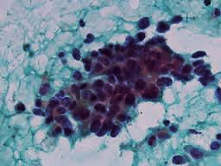
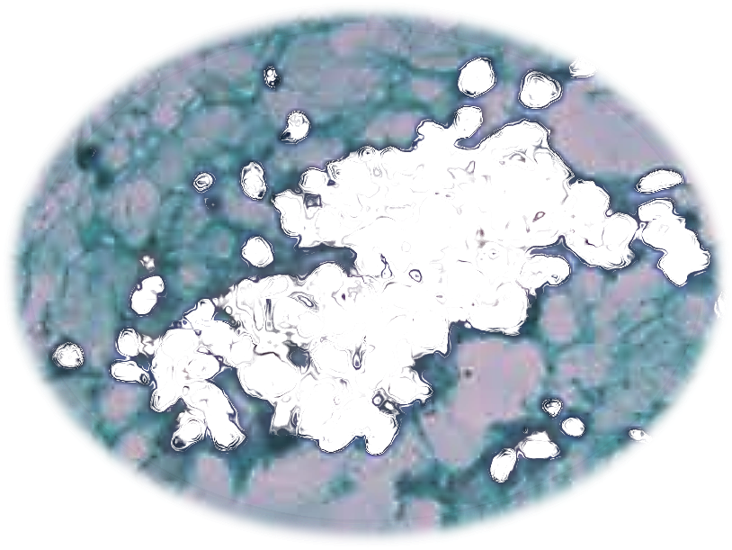
Radiotherapy
Aim:
kill tumor cells
Problem:
preserve healthy cells!

Slide 3




Volume definition
OAR
PTV
CTV
GTV
These definitions allow to define the treatment planning, that is how much dose should be released in each region

Slide 4
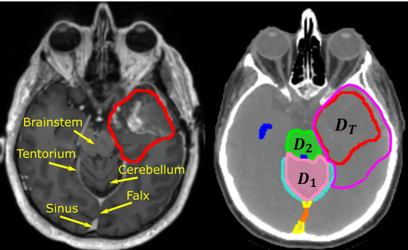
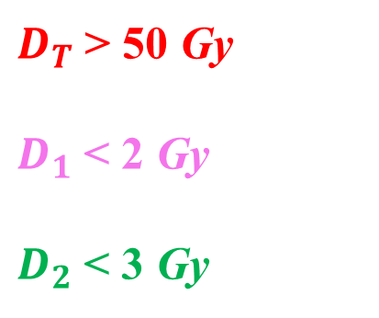
Treatment planning
[Image credit: The Cancer Imaging Archive]
$D_{T}$ > 50 Gy
$D_{1}$ < 2 Gy
$D_{2}$ < 3 Gy
How to consider the biological outcome of this dose delivery?

Slide 5
Efficiency indices
Tumor Control Probability (TCP)
No evidence of tumor recurrence in the treated region
Mainly due to clonogenic death of tumor cells
Normal Tissue Complication Probability (NTCP)
An adverse effect, associated to the use of radiotherapy
Due to the death of many healthy cells (tissue reactions) or to mutations in heatlhy cells (stochastic effetcs)

Slide 6

Tolerance dose
The higher the dose, the higher the probability of tumor control. If this was the only goal, it would be sufficient to indefinitely increase the dose. However, also the probability of complications increases
Tolerance dose = maximum acceptable dose (acceptable probability of complications)
Normal tissue complication:
few percents
(as low as possible)
Tumor control:
80% - 90%
(as high as possible)

Slide 7
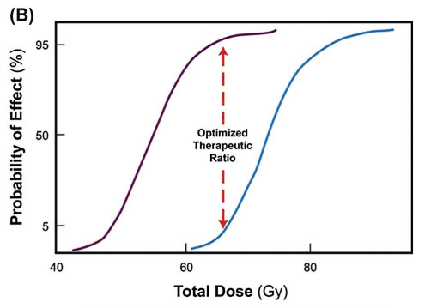
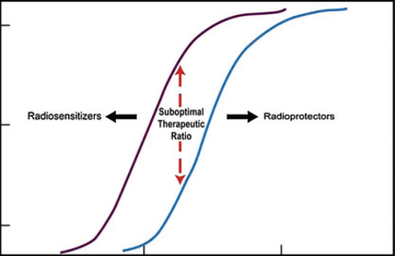
TCP – NTCP
TCP
NTCP

Slide 8
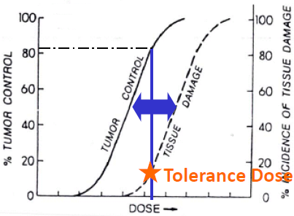
Mind the gap
The goal is to increase this gap as much as possible
Different methods, first of all dose fractionation
Notes:
Funzione sinusoide

Slide 9
Other ways to widen the gap
Innovative radiotherapy techniques
Notes:
Funzione sinusoide

Slide 10
For example
TCP
NTCP
Photons
Notes:
Funzione sinusoide

Slide 11
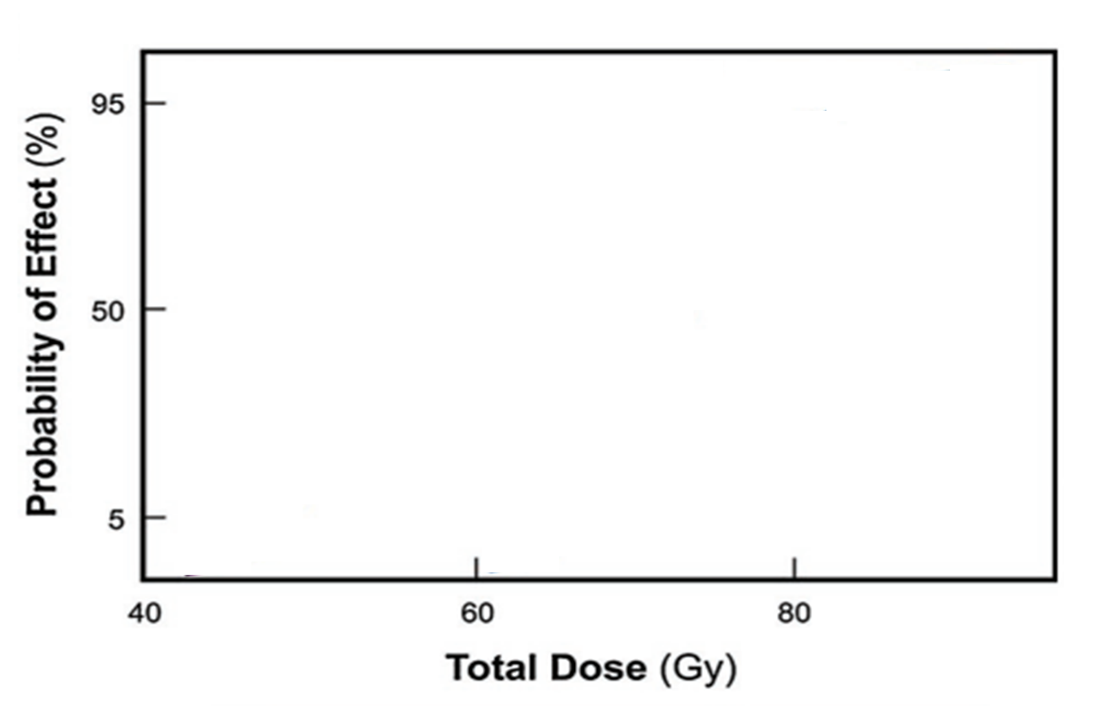
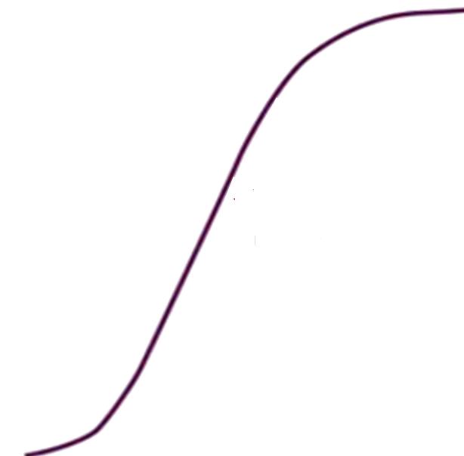
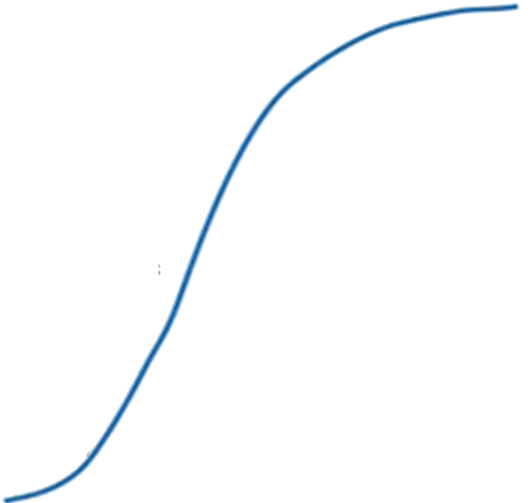
For example
TCP
NTCP
Charged particles (hadrontherapy)
Modelling
and predictions?
Notes:
Funzione sinusoide

Slide 12
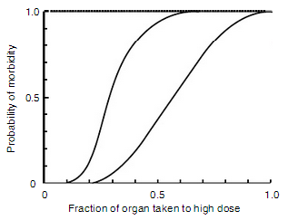
NTCP - Volume effect
NTCP modelling is complex:
different organs have different features and there are many possible complications
Small VE (spinal
cord)
The severity of radiation-induced normal-tissue damage increases as the volume of irradiated tissue increases
Large VE (kidney, lung)

Slide 13
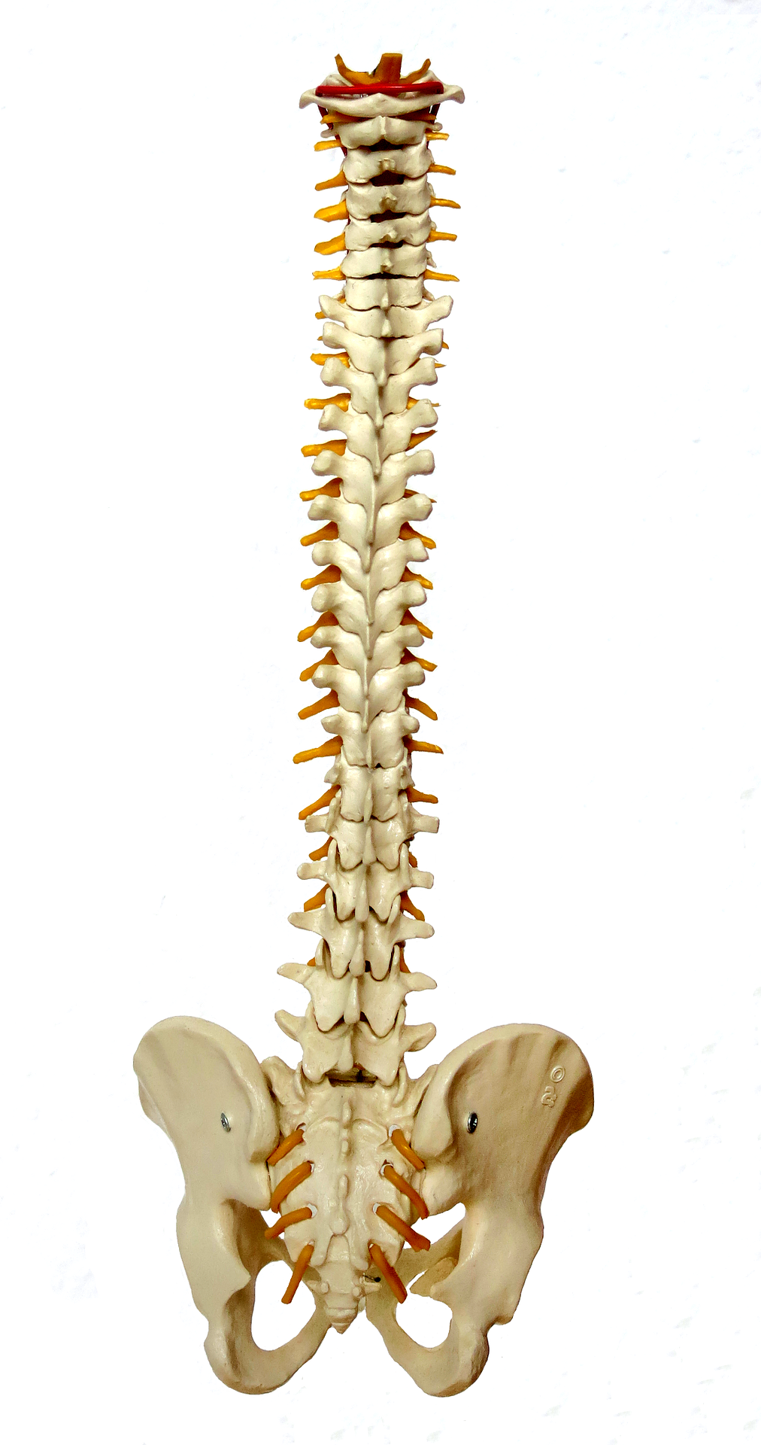
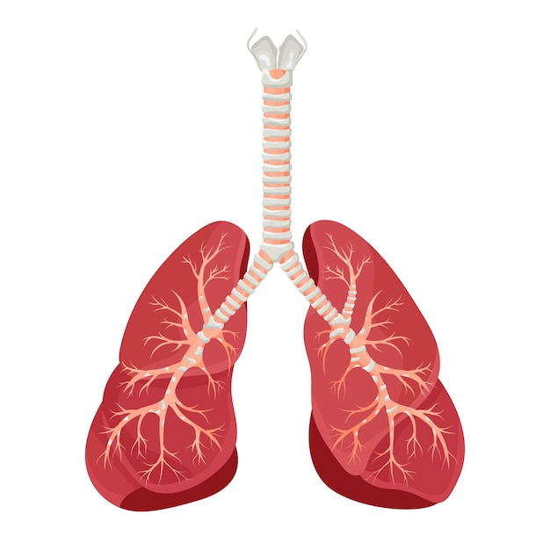
NTCP - Tissue architecture
Organs can be thought as formed by several Functional SubUnits (FSU)
FSU = main structure able to maintain the organ functions
Serial organs: damage of 1 FSU leads to whole organ complication
Parallel organs: no complication until at least M FSU are damaged

Slide 14
NTCP - Types of complications
Acute tissue reactions: deterministic effects arising shortly after the treatment. Typical of tissues with fast cellular renewing. Due to the death of many cells
Late tissue reactions: deterministic effects arising weeks or months after the treatment. Typical of tissues with slow cellular turnover. Due to the death of many cells
Stochastic effects: tipically second cancers arising long after the treatment. Due to mutations induced in irradiated cells

Slide 15

Existing NTCP Models
Phenomenological
Mechanistic

Slide 16
Existing NTCP Models
Phenomenological
Mechanistic
Data
Fit
NTCP (%)
Total Dose (Gy)

Slide 17
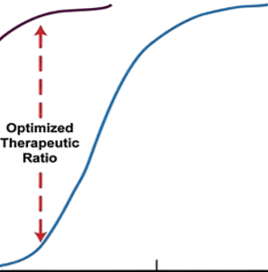
Existing NTCP Models
Phenomenological
Mechanistic
Data
Fit
NTCP (%)
Total Dose (Gy)
17

Slide 18
Existing NTCP Models
Phenomenological
Mechanistic
Simplicity
Data
Fit
NTCP (%)
Total Dose (Gy)

Slide 19
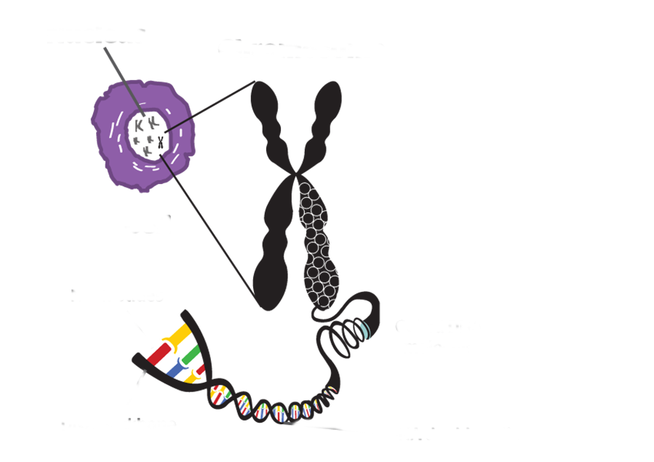
Existing NTCP Models
Phenomenological
Mechanistic
Simplicity
Data
Fit
Nucleus
Chromosome
Not account for biological mechanisms
NTCP (%)
Cell
D N A
Total Dose (Gy)

Slide 20

Existing NTCP Models
Phenomenological
Mechanistic
Simplicity
Data
Fit
Nucleus
Chromosome
Not account for biological mechanisms
NTCP (%)
Cell
D N A
Predictions in situations deviating from the validation dataset
Total Dose (Gy)

Slide 21

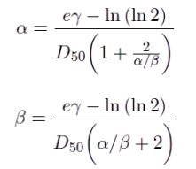


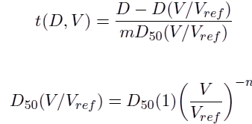



Existing NTCP Models
Phenomenological
Mechanistic
Simplicity
Data
Fit
Nucleus
Chromosome
Not account for biological mechanisms
NTCP (%)
Cell
D N A
Nucleus
Chromosome
Predictions in situations deviating from the validation dataset
Total Dose (Gy)
Cell
D N A

Slide 22
Existing NTCP Models
Phenomenological
Mechanistic
Simplicity
Parameters with physical and biological meanings
Data
Fit
Nucleus
Chromosome
Not account for biological mechanisms
NTCP (%)
Cell
D N A
Nucleus
Chromosome
Predictions in situations deviating from the validation dataset
Total Dose (Gy)
Cell
D N A

Slide 23
Existing NTCP Models
Phenomenological
Mechanistic
Simplicity
Parameters with physical and biological meanings
Data
Fit
Nucleus
Chromosome
Not account for biological mechanisms
NTCP (%)
Predictions
Cell
D N A
Nucleus
Chromosome
Predictions in situations deviating from the validation dataset
Total Dose (Gy)
Cell
D N A

Slide 24
Existing NTCP Models
Phenomenological
Mechanistic
Simplicity
Parameters with physical and biological meanings
Data
Fit
Nucleus
Chromosome
Not account for biological mechanisms
NTCP (%)
Predictions
Cell
D N A
Nucleus
Chromosome
Predictions in situations deviating from the validation dataset
Optimal parameters?
Total Dose (Gy)
Cell
D N A

Slide 25

Open Problems
Mechanistic
Parameters with physical and biological meanings
Predictions
Nucleus
Chromosome
Optimal parameters?
Cell
D N A

Slide 26



Open Problems
How to estimate the model parameters to make predictions?
Mechanistic
Parameters with physical and biological meanings
Predictions
# cells in 1 FSU
= 100 ???
Nucleus
Chromosome
Optimal parameters?
Cell
D N A
[Image credit: Biorender]

Slide 27
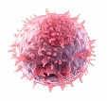

Critical Element Model
LQ cell survival model
Mechanistic
1 FSU
=
k cells
$$P_{FSU}={(1 − e^{− αnd − βnd^{2}})}^{\text{k}}$$
Serial organs
$$NTCP=1 − P_{0}=1 −{(1 −P_{FSU})}^{N}$$
k and N depend on the target features
α and β also depend on radiation quality
[Withers et al., Int. J. Radiat. Onc. Biol. Phys., 1988]

Slide 28
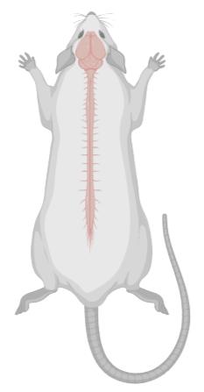
Experimental data
Late tissue reaction
Paresis grade II
[Karger et al., Int. J. Radiat. Onc. Biol. Phys., 2006]

Slide 29
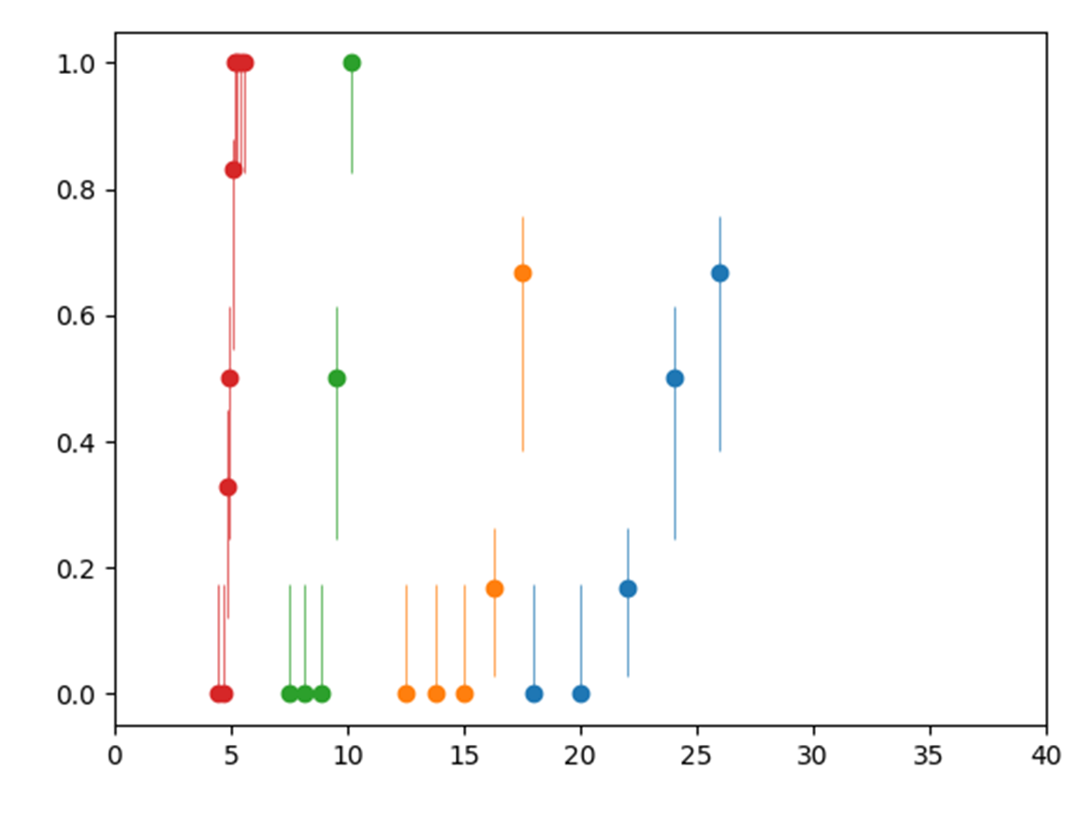
Experimental photon data
18 fx
6 fx
2 fx
1 fx
NTCP
Dose per fraction (Gy)

Slide 30
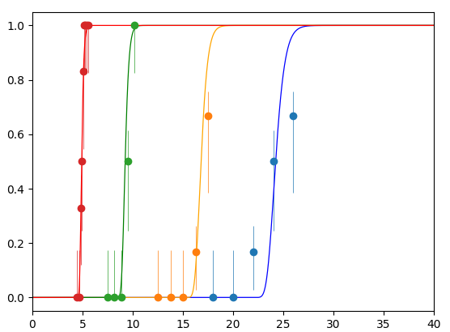
Fit with Critical Element Model
[A. Casali et al., Phys. Med. Biol., 2024]
18 fx
6 fx
2 fx
1 fx
Photon data fit
NTCP
k and N kept unchanged for ions
α and β => obtained with BIANCA
Dose per frazione (Gy)

Slide 31
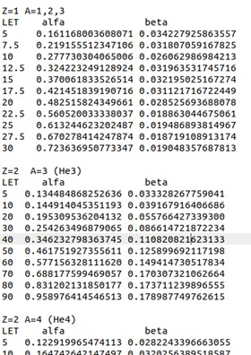
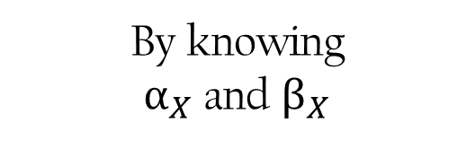
The BIANCA model
Ballarini, Carante, Radiat. Phys. And Chem., 2016
Mechanistic biophysical model
By knowing
$α_{X}$ and $β_{X}$
Database of α e β for different ions of different LET
Monochromatic
Field

Slide 32

Real mixed fields
GEANT4 simulation
7 cm
13 cm
Physics
Primary beam
Beam axis
$$H_{2}O$$

Slide 33
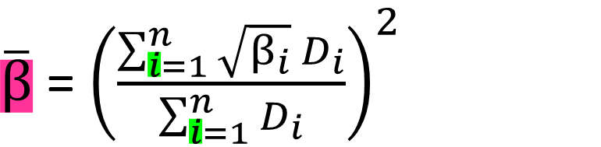
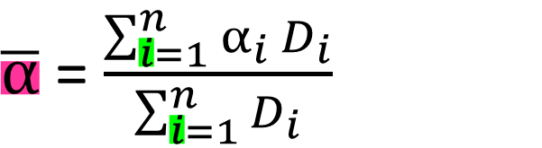

GEANT4-BIANCA interface
BIANCA
Radiobiology
$\overline{α}\text{ =}$ $\frac{\sum_{i=1}^{n}{α_{i} D_{i}}}{\sum_{i=1}^{n}{D_{i}}}$
Averaged ion
$\overline{α}$, $\overline{β}$
For each slice
$\overline{β}\text{ =}$ ${\left(\frac{\sum_{i=1}^{n}{\sqrt{β_{i}} D_{i}}}{\sum_{i=1}^{n}{D_{i}}}\right)}^{2}$
i – th particle

Slide 34
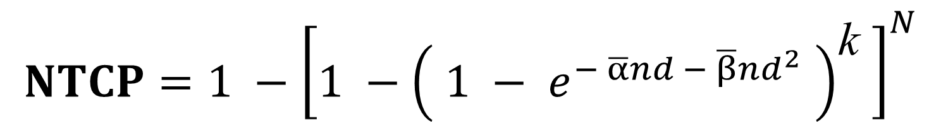
Ion NTCP predictions
Real Mixed Field
$$NTCP=1 −{\left[1 −{\left( 1 − e^{− \overline{α}nd − \overline{β}nd^{2}} \right)}^{\text{k}} \right]}^{N}$$
Full predictions of ion NTCP curves
NO free - parameters

Slide 35
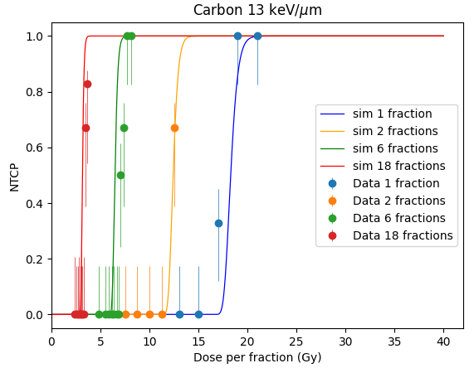
Ion NTCP predictions
18 fx
6 fx
2 fx
1 fx
Carbon 13 keV/μm
Pure prediction
(no parameter adjustment)

Slide 36
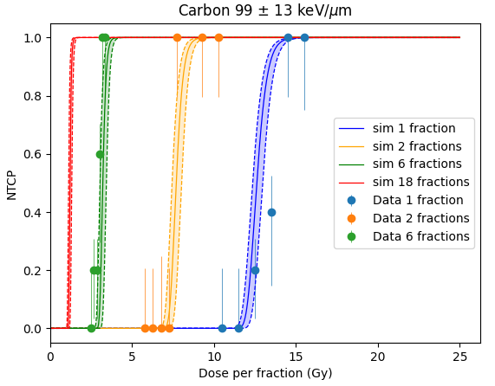
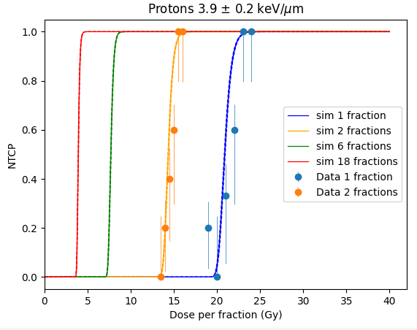
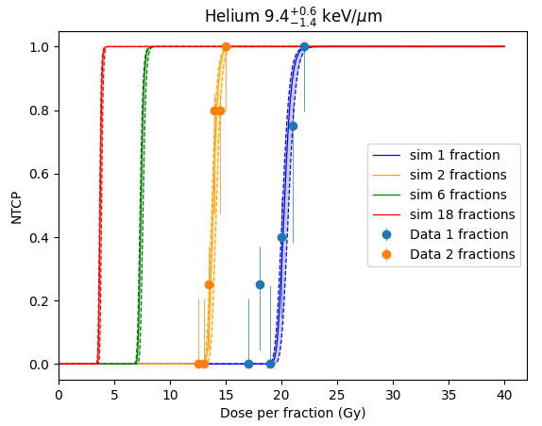
Prediction for ions
Carbon 99 keV/μm
Protons 3.9 keV/μm
Helium 9.4 keV/μm

Slide 37
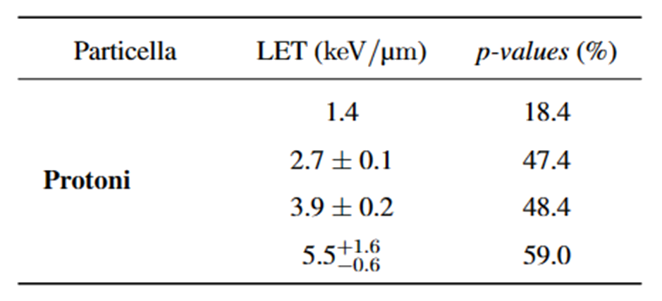
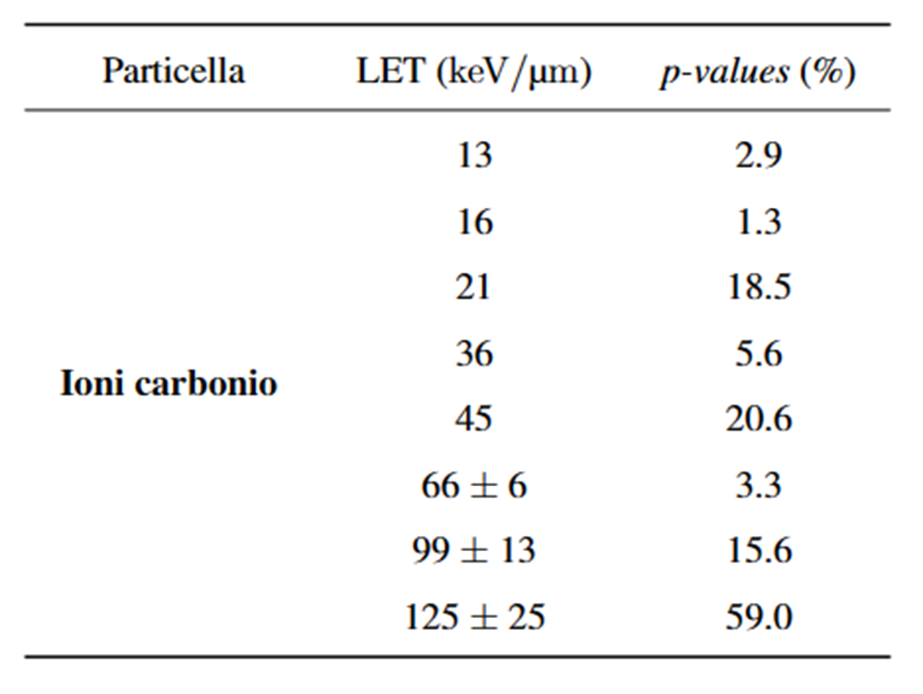
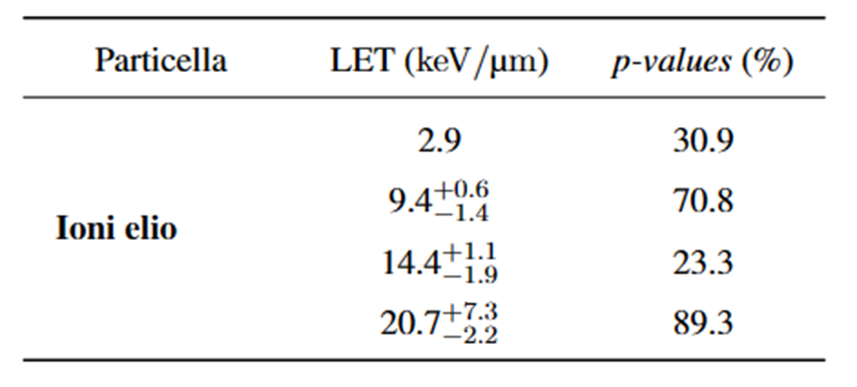
Statistical analysis
P-values
Protons
Carbon ions
He ions

Slide 38
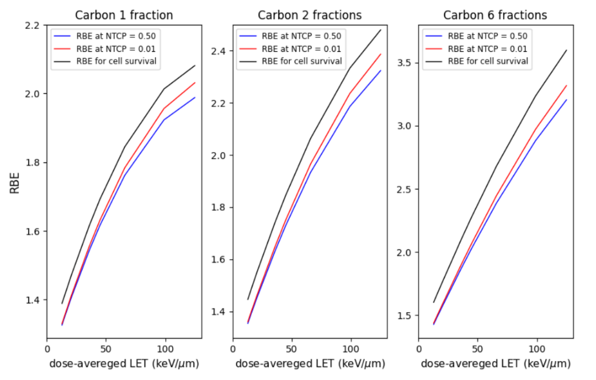

RBE calculation
Carbon ions 1 fraction
RBE with NTCP = 0.5
RBE with NTCP = 0.01
Cell survival RBE
Currently in clinics cell survival RBE
Outcome level
in RBE calculation

Slide 39
For the future
Other spinal cord data
Test/adapt the model on
Other tissue reaction types
Adapt the model to describe the volume effect
Develop a NTCP model for stochastic effects (e.g. second tumors)
Develop a TCP model with the same approach

Slide 40




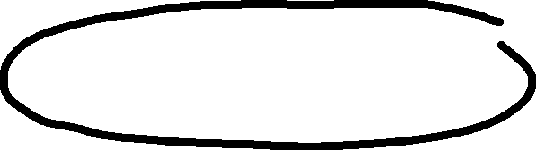































Slide 41
Backup

Slide 42
Volume definition
Gross Tumour Volume (GTV): the macroscopic, visible extension of the tumour
Clinical Target Volume (CTV): a volume of tissue containing the GTV and that accounts for microscopic extensions of the primary tumor
Planning Target Volume (PTV): a geometrical edge added to GTV/CTV, accounting for organ movement and other uncertainties
Organs at risk (OAR): normal tissues which sensitivity may affect the treatment planning (e.g. retina in eye tumors)

Slide 43


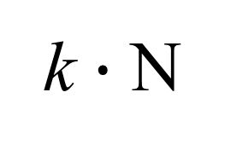
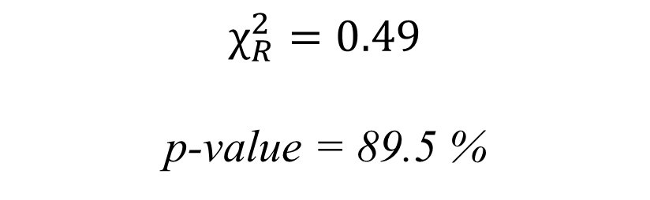
$$χ_{R}^{2}=0.49$$
p-value = 89.5 %
Analisi statistica
Parametri best-fit
α/β
k $∙$ N
1.70 Gy 4.90 Gy
4.5 $∙{10}^{6}$ cell 45 $∙{10}^{6}$ cell
2.40 Gy
27 $∙{10}^{6}$ cell

Slide 44
RBE (different outcome levels)
Carbon ions 1 fraction
Carbon ions 2 fractions
Carbon ions 6 fractions
RBE with NTCP = 0.5
RBE with NTCP = 0.01
Cell survival RBE

Slide 45
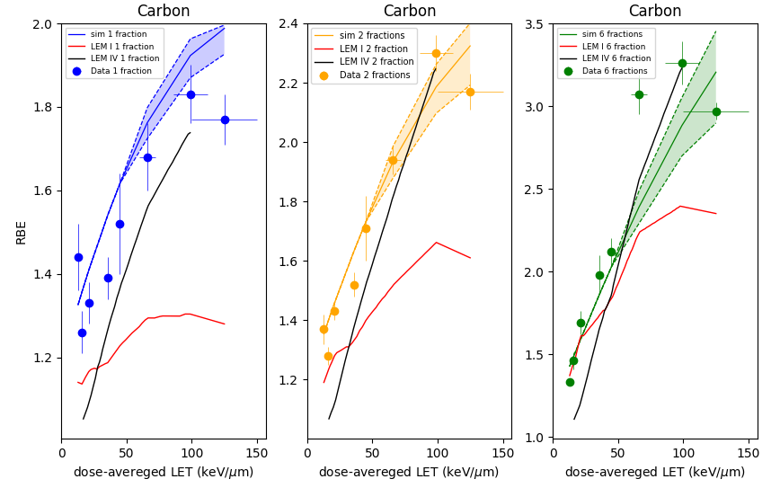
RBE (cfr LEM)

