Slide 1



Geant4-DNA Chemistry Modelling: General Overview, current status and future developments
Serena Fattori
On behalf of the Geant4-DNA Collaboration

Slide 2
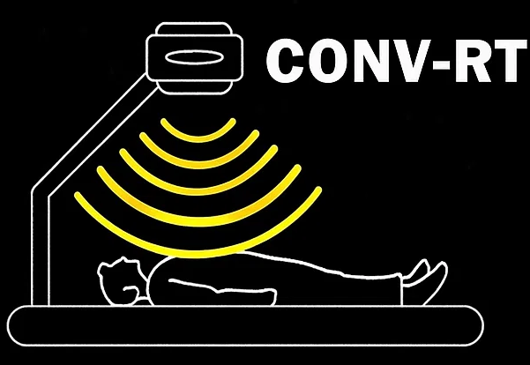
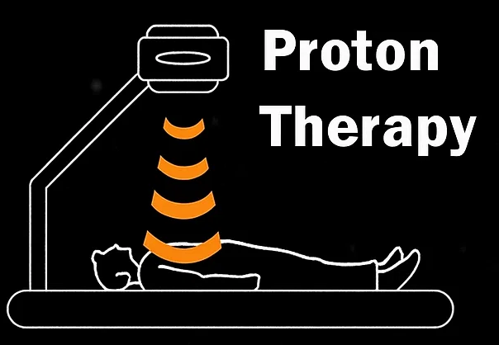
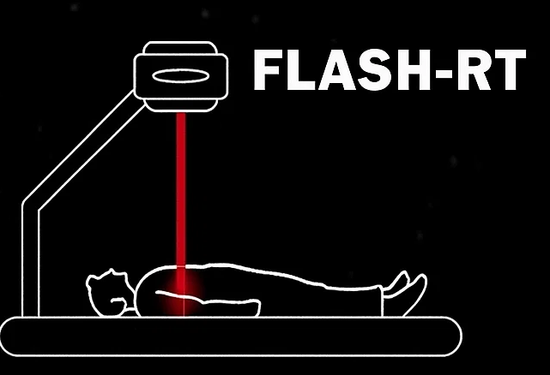
From Geant4 to Geant4-DNA: the motivation
Using advanced Monte Carlo simulations to understand cell and tissue response to novel irradiation techniques
Developing novel computational techniques that bridge mathematical modeling with clinical application

Slide 3
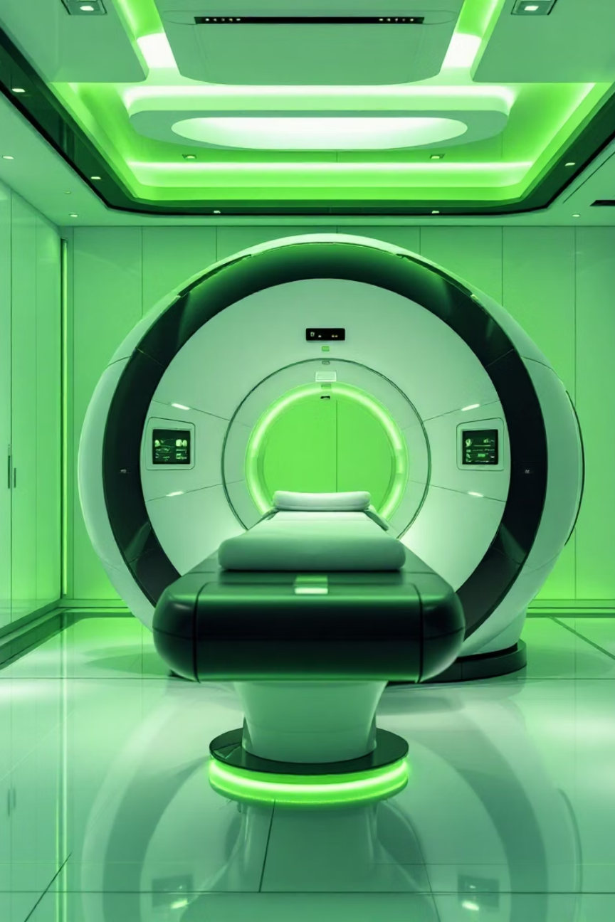
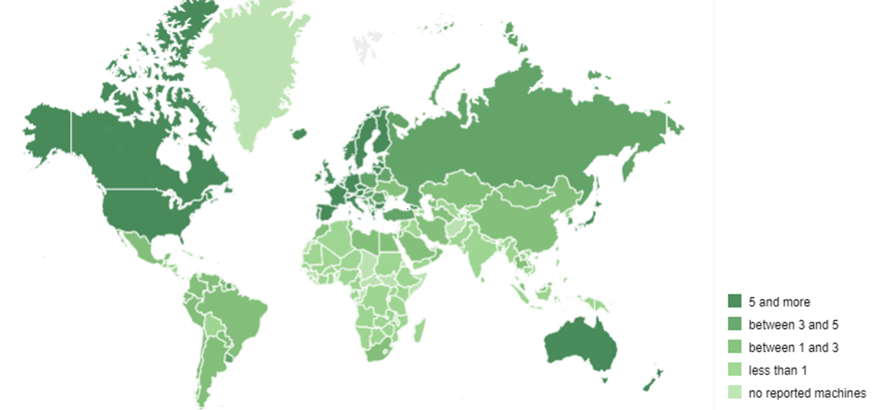
Background
Radiotherapy
medical treatment using radiation to damage cancer cells while minimizing harm to surrounding healthy tissue
1895: Wilhelm Röntgen discovers X-rays.
1896, Jan: Emil Grubbe performs the first X-ray treatment on a breast cancer patient: the success was almost instantaneous. → He founded in Feb 1896 in Chicago the first RT facility.
Today: ~ 10 000 RT centers worldwide ~ 200 in Itay (~3 per million people)
Wawrzuta D. et al,
“Global access to radiotherapy: A geospatial analysis of current disparities and optimal facility placement”, Radiotherapy and Oncology 211(2025)
10.1016/j.radonc.2025.111061
IAEA's DIRAC database

Slide 4
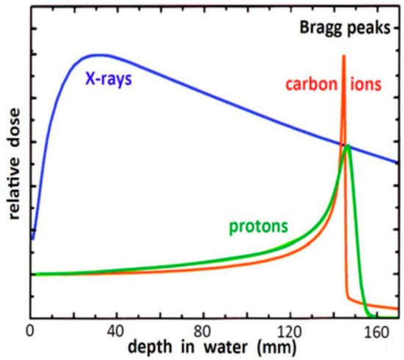
From Conventional to Hadrontherapy
Hadrontherapy vs Conventional Radiotherapy
Superior Precision
Hadrontherapy delivers maximum energy precisely at the tumour site (Bragg Peak), sparing surrounding healthy tissues
Enhanced Biological Effectiveness
Reduced Side Effects

Slide 5
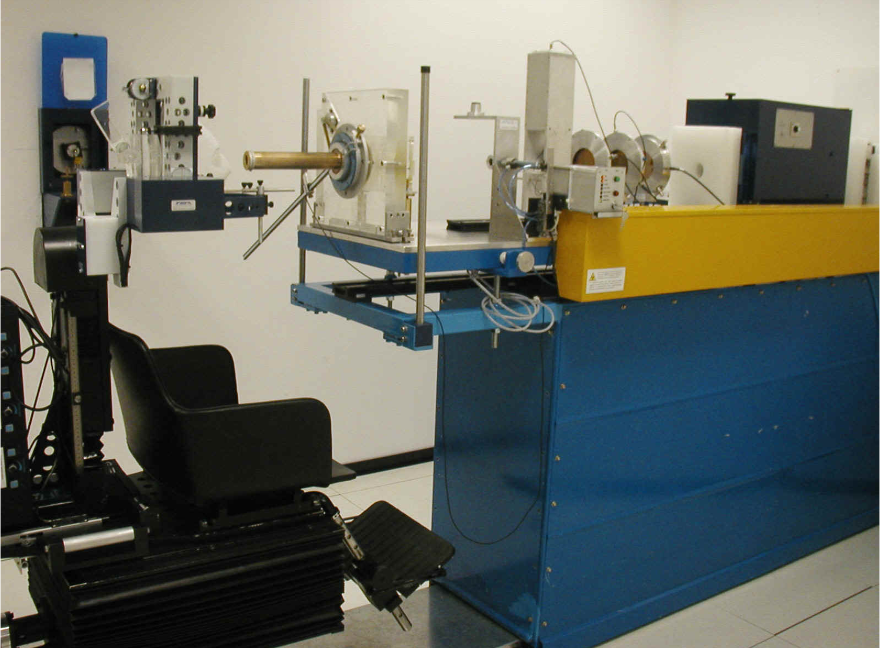
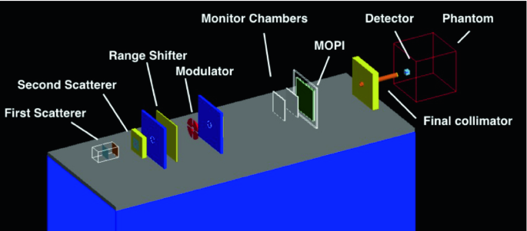
Geant4
Geant4:
Monte Carlo toolkit for simulating the passage of particles through matter, widely used in high-energy physics, medical physics, and space science.
https://geant4.web.cern.ch/
CATANA is the first Italian proton therapy facility active since March 2002
The “hadrontherapy” advanced example in Geant4 is a complete reproduction of the CATANA beamline
It enables macro- to microscale modeling of detectors, experimental setups, and shielding with detailed physics processes across a broad energy range.

Slide 6
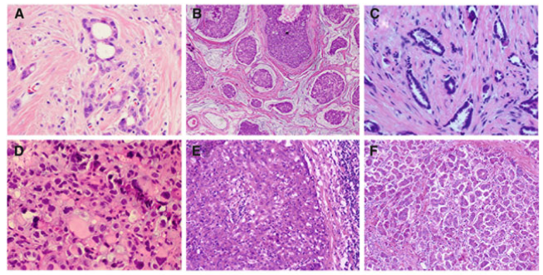
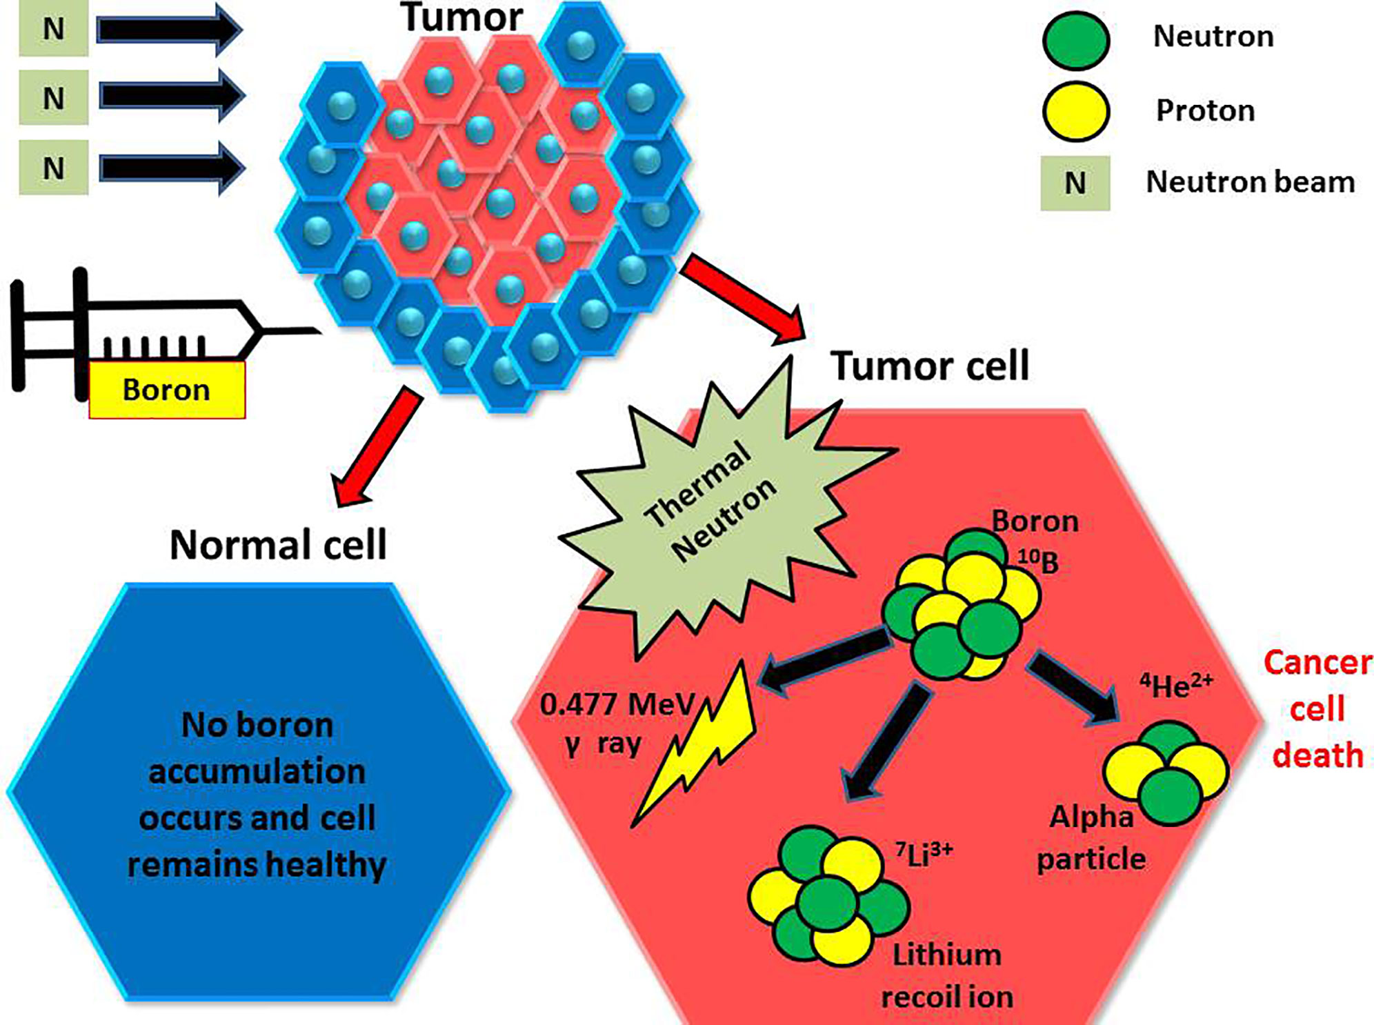
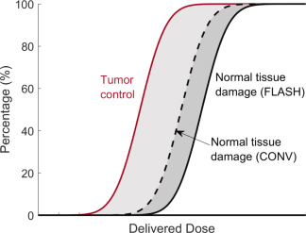
The frontier
Boron Neutron Capture Therapy This therapy uses a boron-containing drug that targets tumor cells. When irradiated with low-energy neutrons, a localized nuclear reaction specifically destroys cancer cells, protecting healthy tissues.
Biologically Adaptive Radiotherapy
This advanced method monitors the tumor's biological response, allowing for personalized adjustments to radiation dose and targeting. This optimizes efficacy and minimizes toxicity.
FLASH Radiotherapy
Dose rate ≥40Gy/s Preclinical studies across multiple animal models demonstrate its remarkable ability to further spare normal tissues whilst maintaining tumour control, potentially revolutionising cancer treatment.
Breast Cancer Heterogeneity in Primary and Metastatic Disease In book: Breast Cancer Metastasis and Drug Resistance Publisher: Springer 2013
DOI: 10.1007/978-1-4614-5647-6_5
Local Disease-Free Survival Rate (LSR) Application to Personalize Radiation Therapy Treatments in Breast Cancer Models J. Pers. Med. 2020, 10(4), 177; DOI: 10.3390/jpm10040177
Vincent Favaudon et al. “Ultrahigh dose-rate FLASH irradiation increases the differential response between normal and tumor tissue in mice”. Sci. Transl. Med.6,245ra93-245ra93(2014). DOI:10.1126/scitranslmed.3008973
Boron Neutron Capture Therapy: A Review of Clinical Applications, Front. Oncol., 26 February 2021 V. 11| DOI: 10.3389/fonc.2021.601820
A Biological-Driven Approach to Explore Dose-Escalated Ultra-Hypofractionation in Breast Cancer Radiotherapy. Biomedicines. 2025; 13(9):2154. DOI: 10.3390/biomedicines13092154

Slide 7
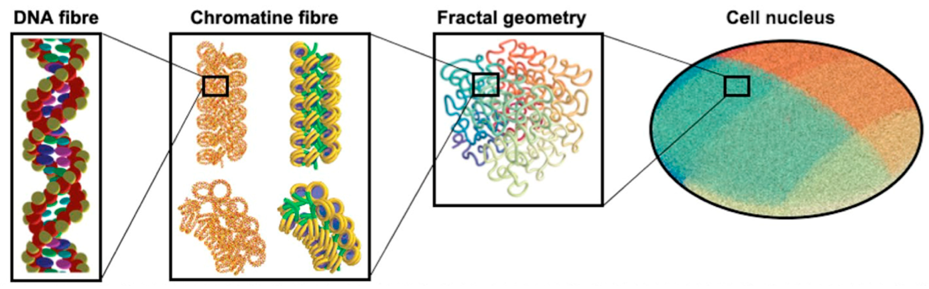
→ Geant4-DNA
Geant4-DNA extends Geant4 capabilities down to the nanoscale, enabling the simulation of radiation-induced damage to biological structures, such as DNA.
https://geant4-dna.org
It provides track-structure physics models and a chemistry module essential for studying early stages of radiolysis and DNA strand breakage at the molecular level.
Together with Geant4, it can provide a multi-scale modeling, from complex detector systems to the fundamental interactions driving biological effects of ionizing radiation.

Slide 8
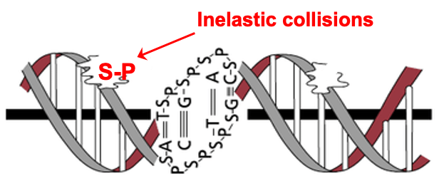
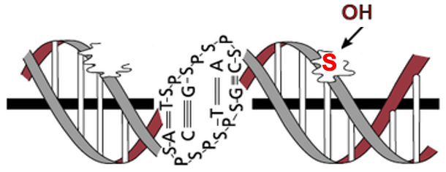
The DNA damage
°
D
I
Direct Strand Break
Indirect Strand Break
SB occurs when sufficient energy deposit in sugar-phosphate group
SB occurs when °OH radical reaction occurs with sugar.

Slide 9
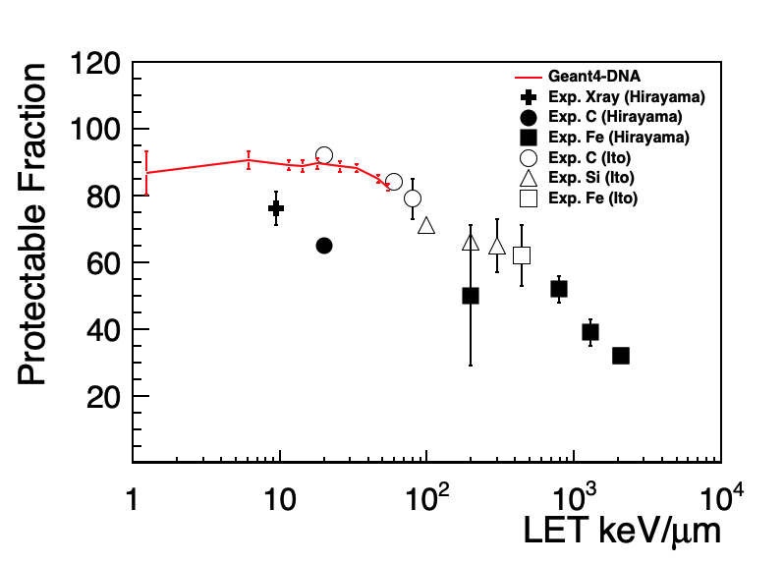
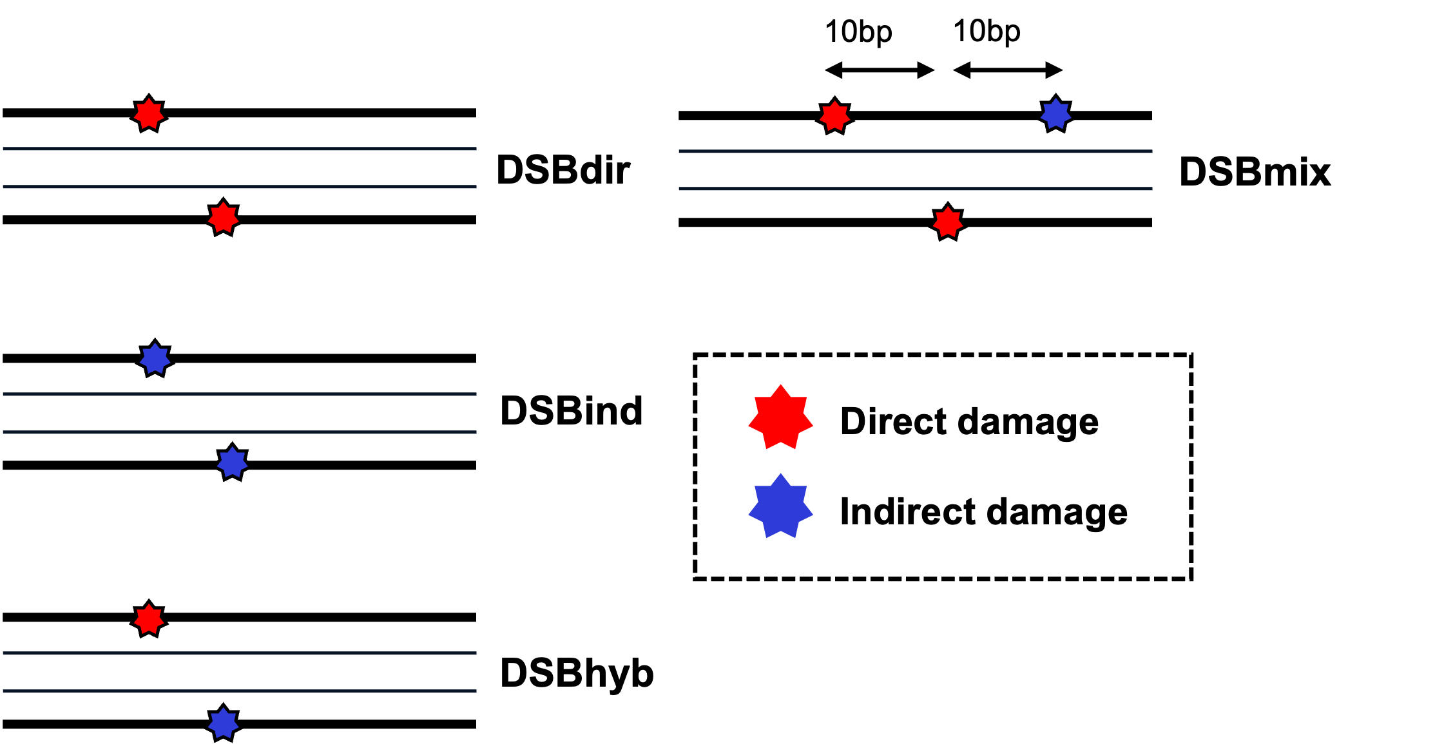
Importance of Indirect Action on DNA damage
Protectable Fraction
(damage type based)
It is well known that indirect action is the most dominant process for DNA damage given by low-LET radiation!
Ref: Sci. Rep. 10 (2020) 20788

Slide 10
Radicals from auto-ionisation states
by M. Karamitros
H₂O⁺+ e⁻→H₃O ⁺ + •OH + e⁻_{aq}
H₃O⁺
°OH
e⁻_{aq}

Slide 11
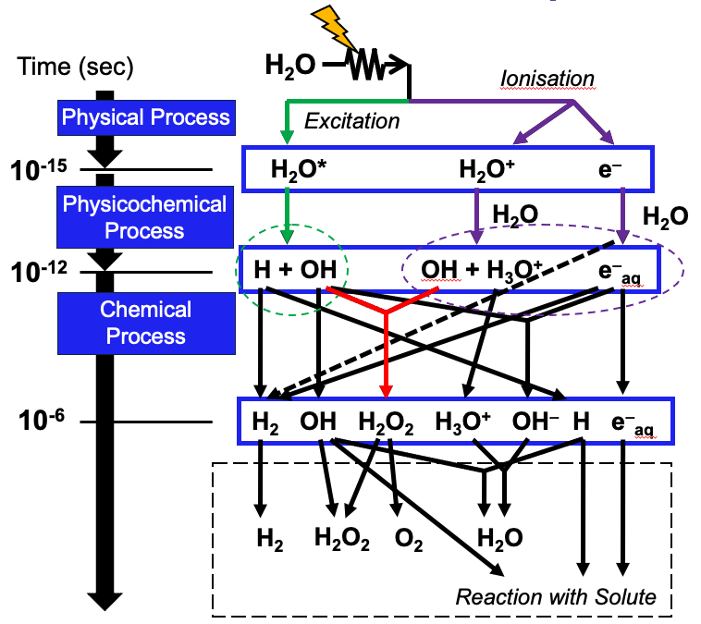
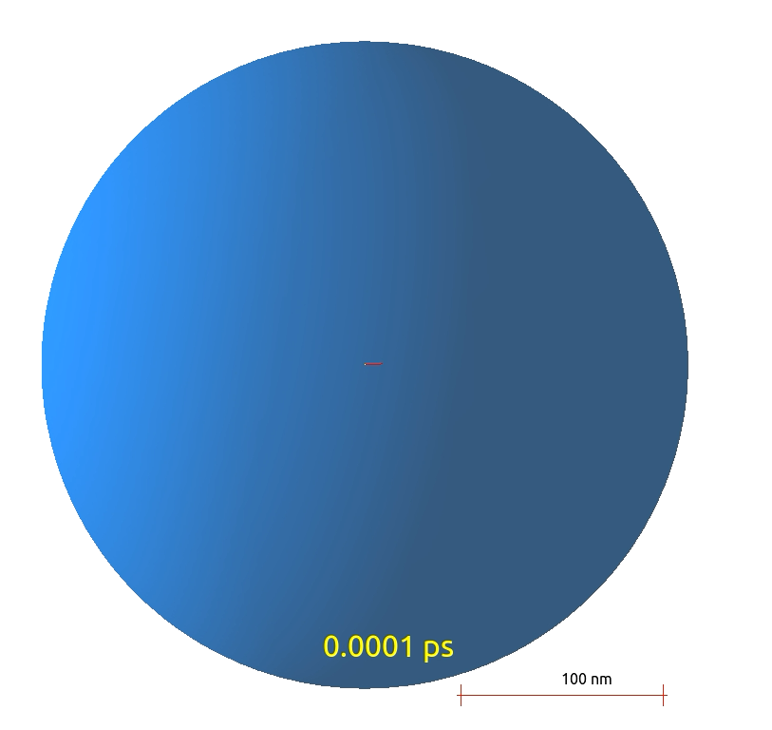
The indirect damage → the Chemical stage

Slide 12
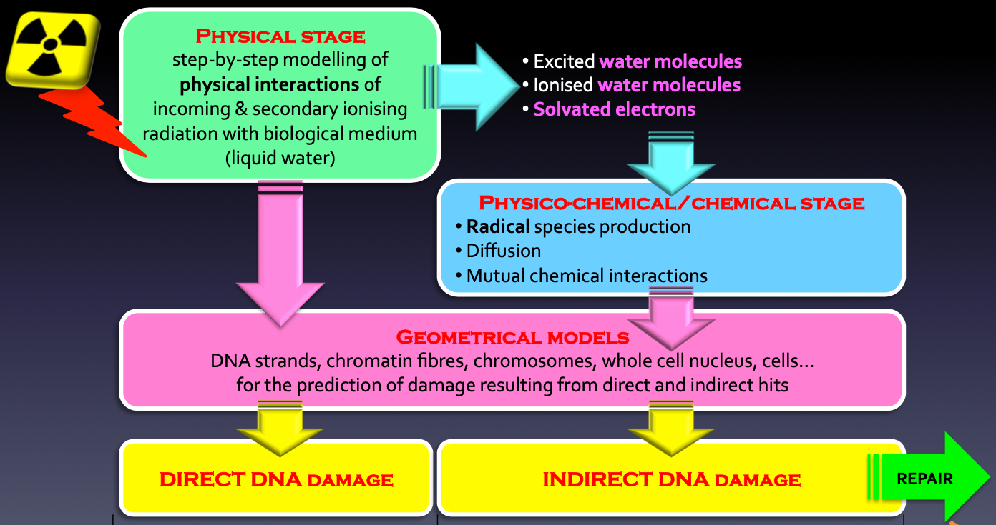

The Chemical Stage in Geant4-DNA
10⁻¹⁵ s
SBS
10⁻¹² s
Chemical stage starts when chemical species start to diffuse and react.
IRT
RDME
10⁻⁶ s
BIOLOGICAL REPAIR
Prediction yields of biological endpoints using semi-empirical biological repair model from nDSB and complex DSB fraction.
Protein/Enzyme kinetics
DNA rejoining
Cell survival
Time

Slide 13
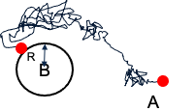
The Step-By-Step ( SBS ) approach
Brownian transport of molecules from the Smoluchowski model
Chemical species are represented by point objects which diffuse in the liquid medium (continuum).
At each step (bigger than a Minimum Time Step) the separation distance “d" of all pairs of reactants is checked.
Two species react with each other when d is below a given threshold “R”, called reaction radius.
Tracking of species
Very slow

Slide 14
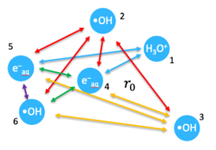

The Independent Reaction Times ( IRT ) approach
An event table is constructed with the initial chemical species positions and reaction times (calculated with probability functions) for each reactant pair of interest.
Table’s entries are sorted in ascending reaction time order and then processed one by one, starting with the pairs having the shortest reaction times.
Reaction product positions are randomly sampled within a sphere centred at the reaction site.
No longer necessary to diffuse the molecular species and to calculate the possible reactions between the species at each time step.

Slide 15
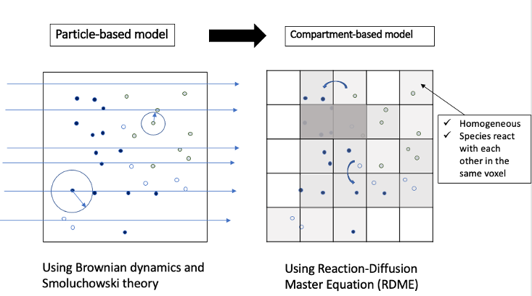
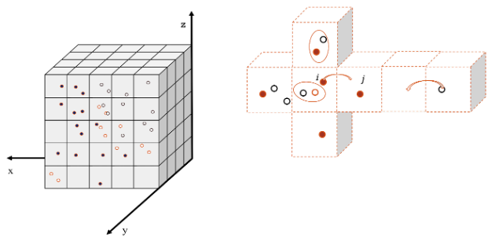
The new approach: The MESOSCOPIC Model
For SBS and IRT models, computation time remains the main ﻿drawback when simulations deal with a large number of species or long-time scales.
An alternative approach has recently been implemented in Geant4-DNA using the compartment-based representation, based on the RDME
Well-mixed species in voxels
Species can react with each other in the voxels
Diffusion is modelled by jumps between adjacent voxels

Slide 16
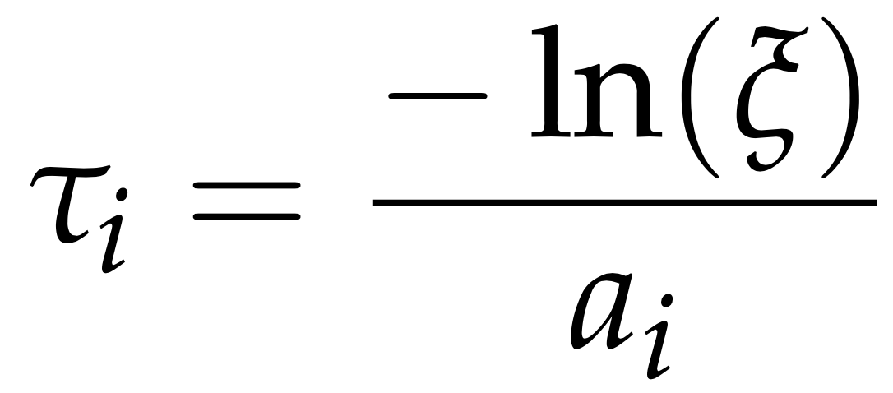

The RDME
P(n,t): probability of the system being in state n at time t.
a_{rxn}​(n′→n): reaction propensity function, giving the rate (probability per unit time) that a reaction will take the system from state n′ to n.
a_{rxn}​(n→n′′)P(n,t): outgoing term, accounting for loss of probability from state n as it reacts and transitions to a new state n′′.
a_{diff​(}n′→n): diffusion propensity function, representing the rate at which a molecule moves from a neighboring voxel to the voxel under consideration, thereby causing a transition n′→n.
a_{diff}​(n→n′′)P(n,t): loss term, corresponding to the transition of a molecule out of the current voxel/state n, decreasing its probability.
A sum over all possible reaction channels in all voxels
P(n′,t): probability that the system is currently in the previous state n′ (before the reaction occurred).
A sum over all diffusion events (i.e., species moving from one voxel to another).
P(n′,t): probability that the system is currently in the previous state n′ (before the diffusion occurred).
Calculation of the propensity functions a_{i} for all voxels
Sampling of the time when the next event occurs
Sampling which reaction or diffusion will take place according to the propensity function a_{i}
Processing the first event in the queue and changing concentrations in the voxels involved in the event:
Reaction: eliminate reactants and create products.
Diffusion: remove the particle in the voxel where it was located and add it in ﻿the voxel where it goes.
is a uniform random number sampled from a uniform distribution (0,1].

Slide 17
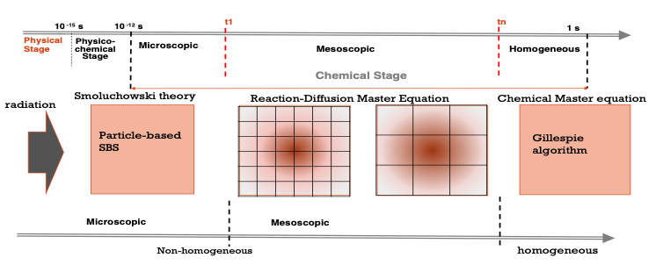
The three sub-stages
Since spur sizes are comparable with their reaction radius within a few ns (5 ns as default) after exposure, this period cannot be described by using the “well-mixed” model.
Microscopic Sub-stage
Mesoscopic Sub-stage
Homogeneous Sub-stage
Particle-based SBS method for initial high-precision tracking
Initial fine mesh resolution with increasingly coarser meshes over time
Chemical Master Equation (CME) stochastic process samples only reactive events

Slide 18
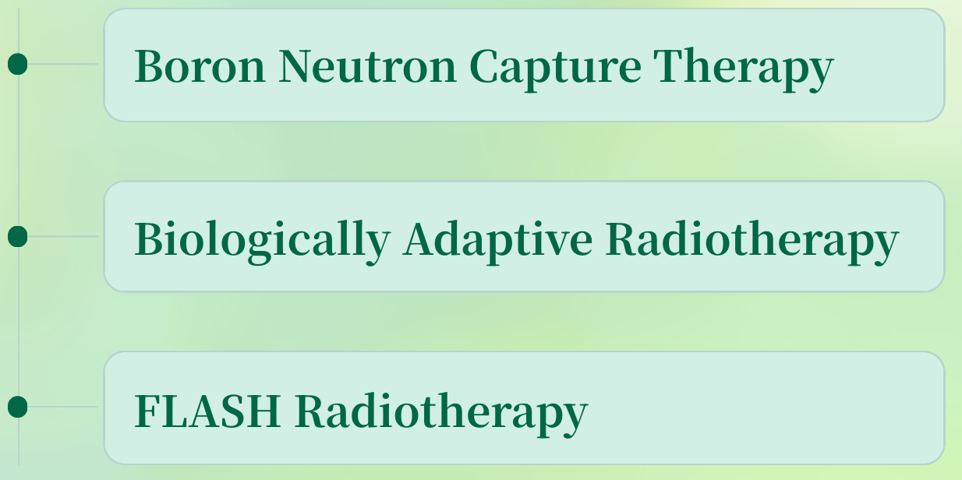
Practical Applications

Slide 19
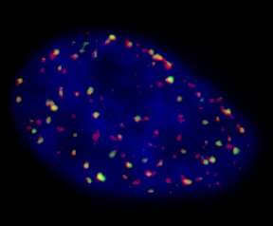
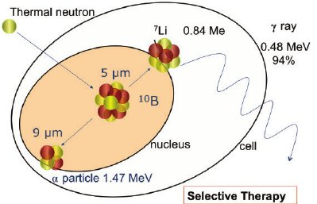
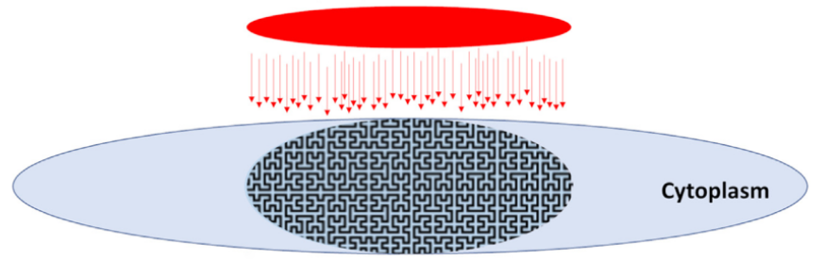

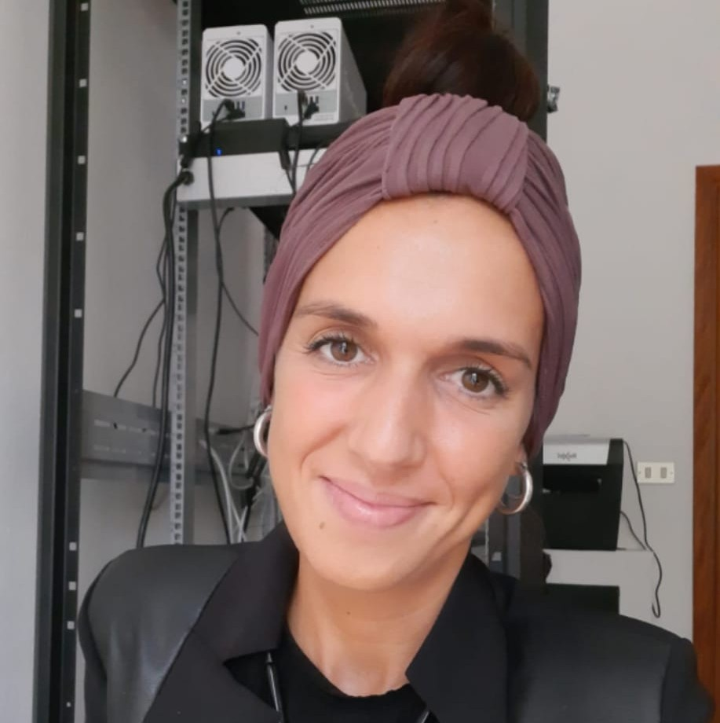

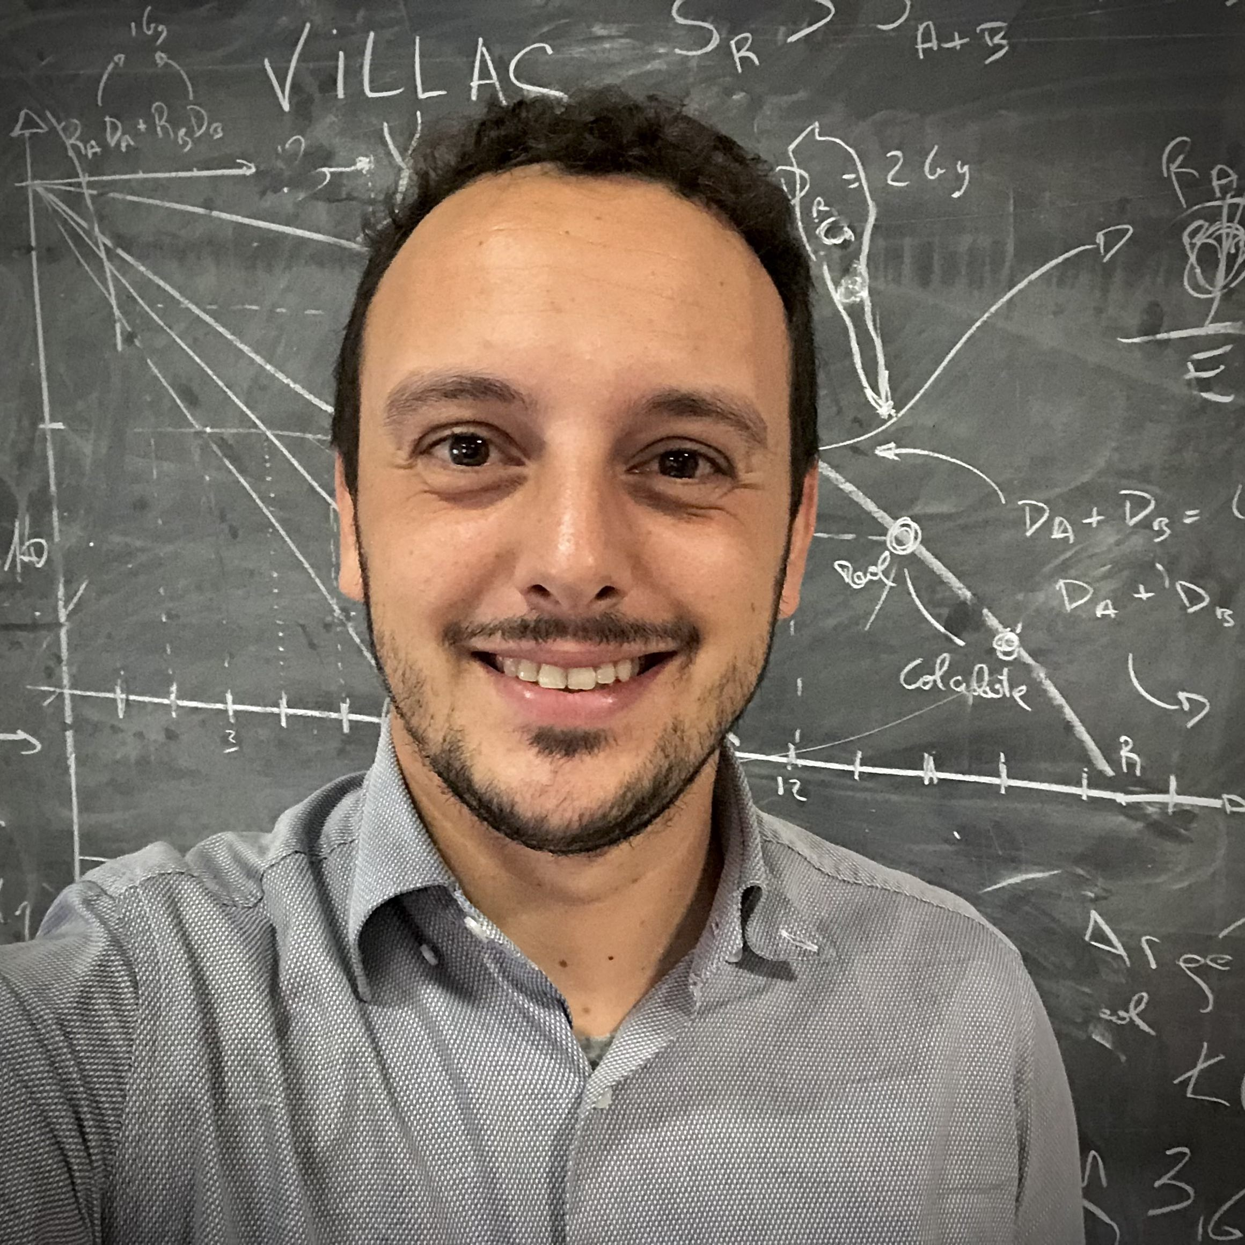

Boron Neutron Capture Therapy
Cell semi-axis (14, 2.5, 14)um
Nucleus semi-axis (7.1, 2.5 7.1)um
The Perspectives of the Boron Neutron Capture Therapy-Clinical Applications Research and Development
December 2015 Physics Procedia 66
DOI: 10.1016/j.phpro.2015.05.010
Fractal-based DNA chain structure ~6.4 Gbp inside an ellipsoidal nucleus
Final image returned by the Metafer software for a cell irradiated with 2 Gy and fixed after 5 hours. The nucleus appears in blue, γH2AX foci in red, and 53BP1 foci in green. (F. Fede, MSc thesis)
Mixed-field irradiations @TRIGA reactor (Pavia)
Single BNCT components irradiation @CIRCE (Caserta)
New BNCT Facility under construction in Caserta
→ 12:30 → 13:00
Translational BNCT: Coupling Experimental Radiobiology with Model-Based Dosimetry Speaker: Ian Postuma
Laura Bagnale Uni. "L. Vanvitelli"
Konstantinos Chatzipapas TU Delft
Ian Postuma INFN Pavia
Silva Bortolussi
Pavia University

Slide 20
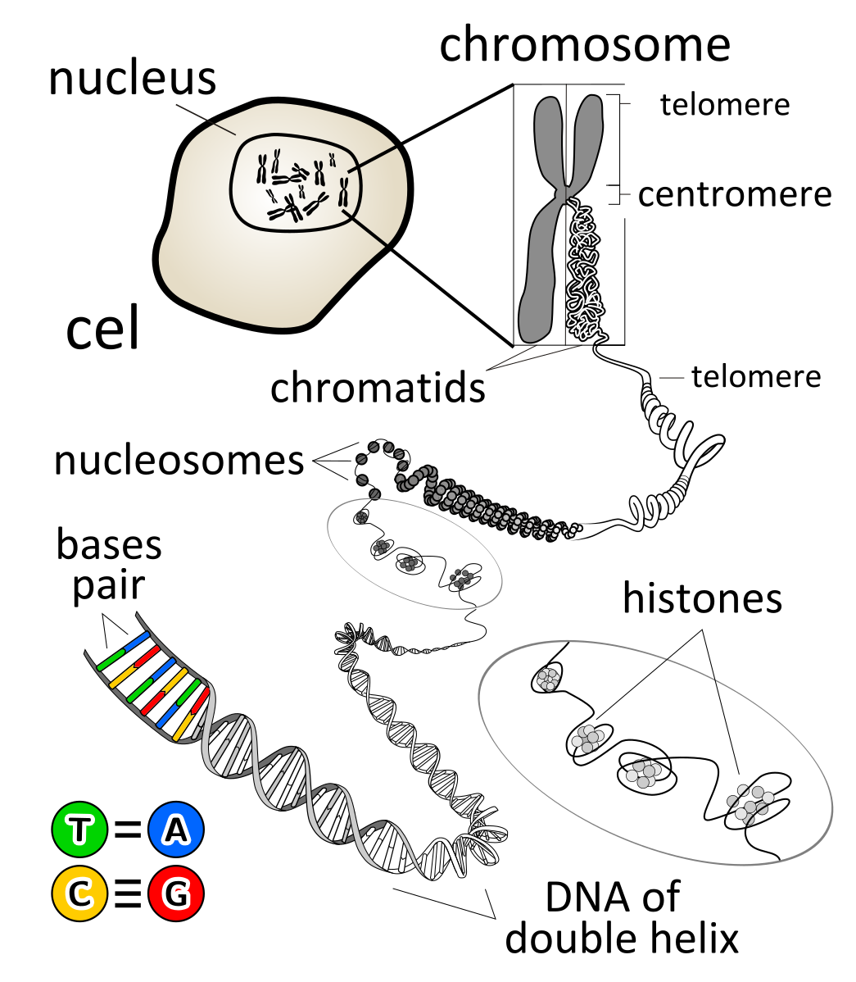

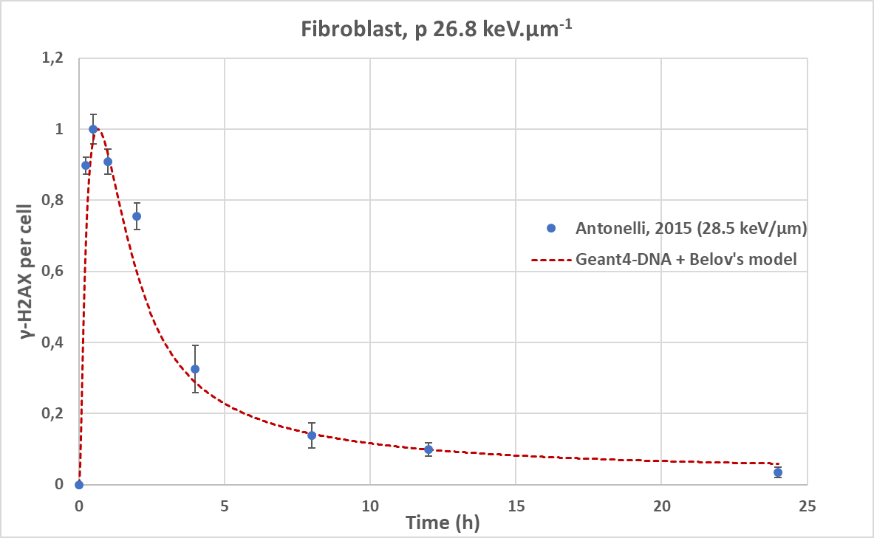
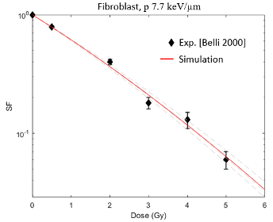


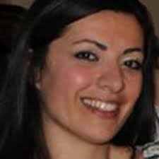

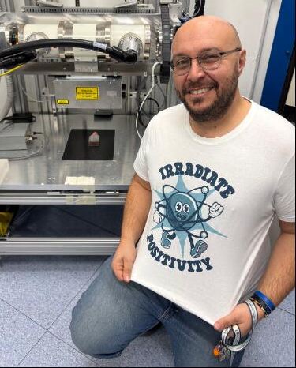

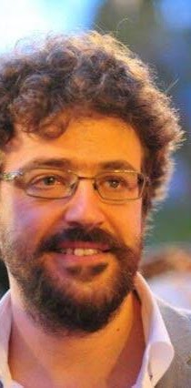
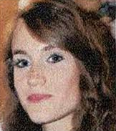
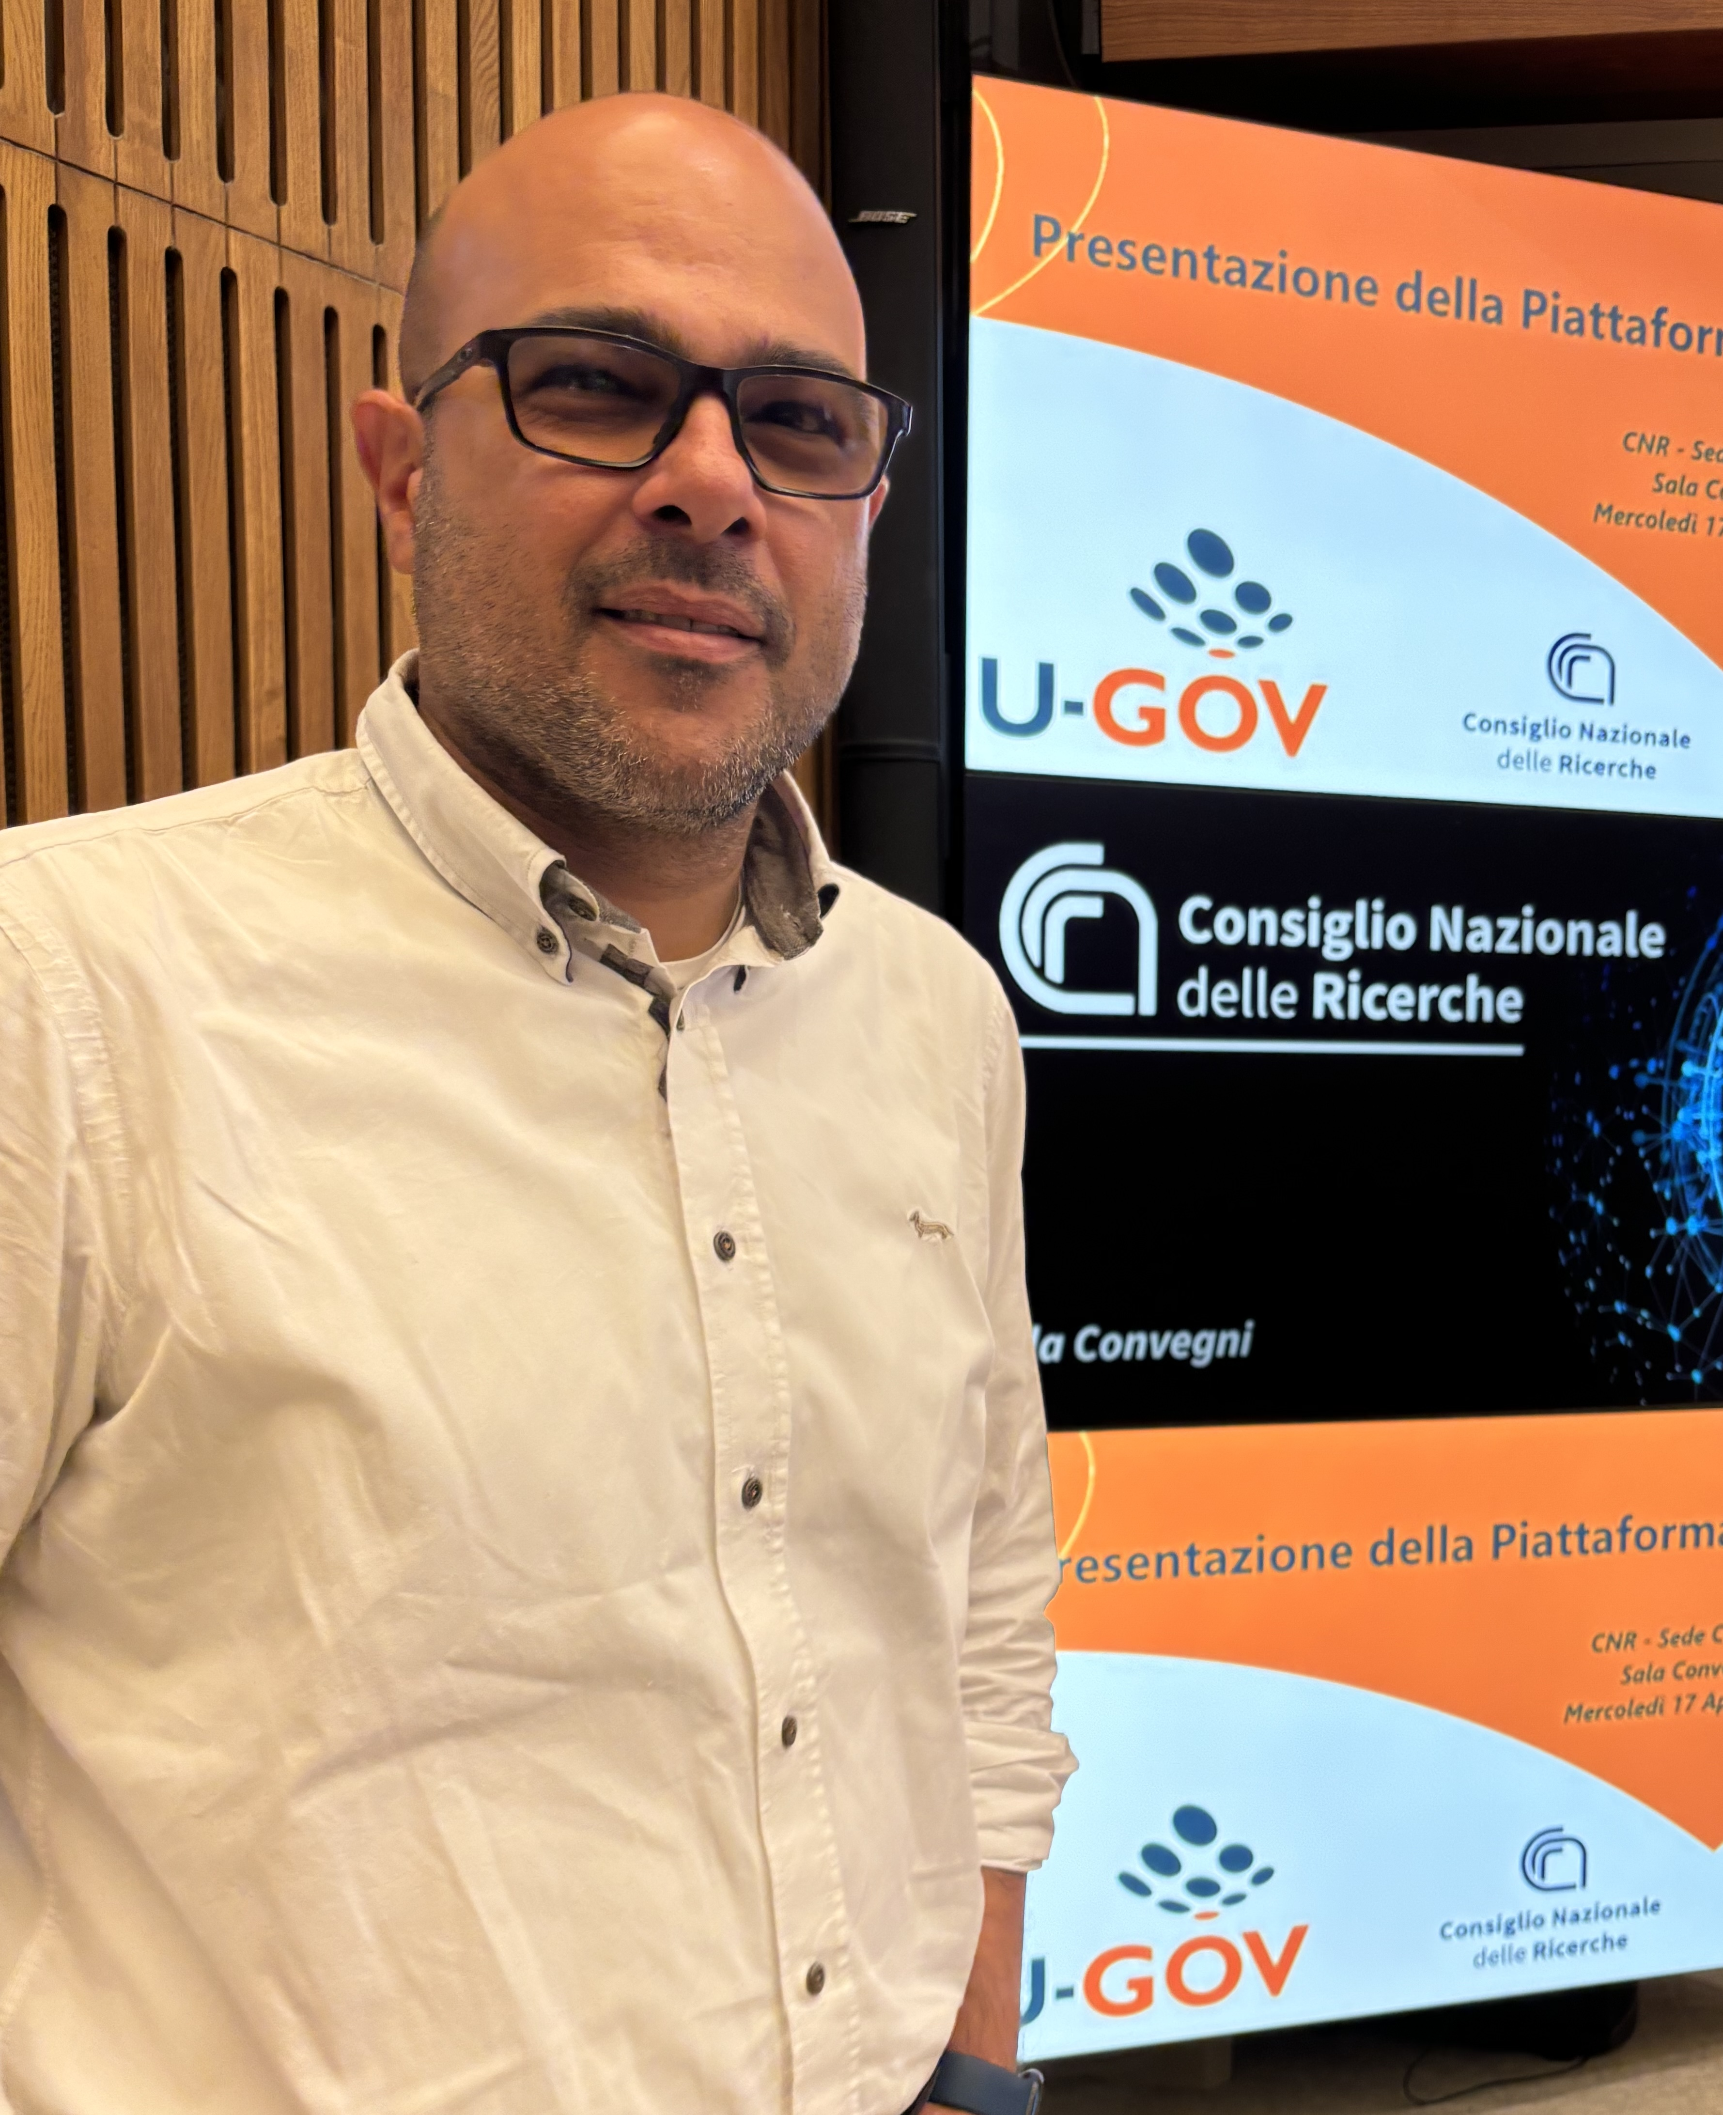
Biologically Adapted Radiotherapy
cell
The temporal evolution of the number of DSBs of specific cells is obtained according to Belov’s repair model
The Surviving Fraction (SF) of specific cells is obtained according to the Two-Lesion Kinetics (TLK) repair model depending on the ”Lethal” lesions
Samuele Calì Catania University
Konstantinos Chatzipapas TU Delft
Cristiana Alberghina CNR IBSBC
Valentina Bravatà CNR IBSBC
Marco Calvaruso CNR IBSBC
Francesco Cammarata CNR IBSBC
Giusi Forte CNR IBSBC
Luigi Minafra CNR IBSBC
Gaia Pucci CNR IBSBC
Giorgio Russo CNR IBSBC

Slide 21
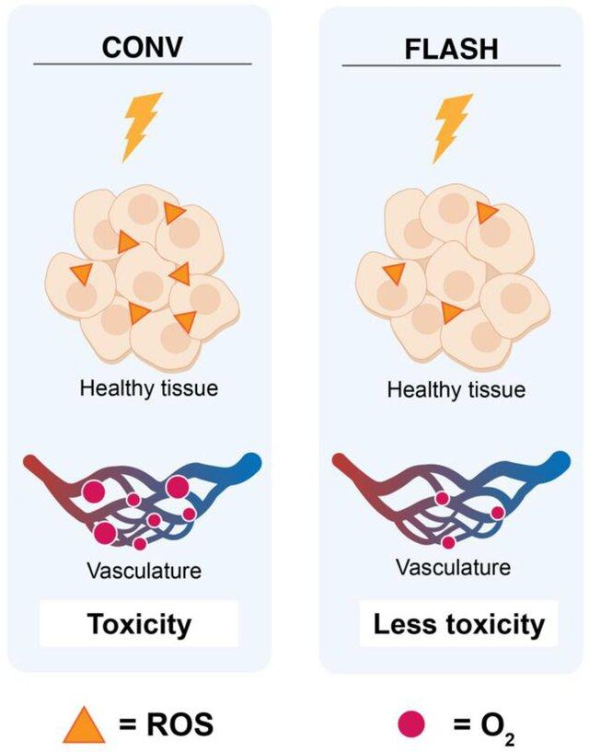













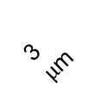
FLASH Radiotherapy
$$e^{−}$$
$$e^{−}$$
$$e^{−}$$
$$e^{−}$$
The mechanism behind the FLASH effect is still unknown.
Several hypotheses are currently under investigation.
3 $μ$m
$$O_{2}$$
$$O_{2}$$
$$O_{2}$$
$$O_{2}$$
$$O_{2}$$
$$O_{2}$$
$$O_{2}$$
$$O_{2}$$
3 $μ$m
1
$$O_{2}$$
$$O_{2}$$
$$O_{2}$$
Rapid Oxygen Depletion
$$O_{2}$$
$$O_{2}$$
$$O_{2}$$
$$O_{2}$$
$$O_{2}$$
Ultra-fast dose delivery creates transient hypoxia in normal tissues by rapidly consuming available oxygen, limiting radiation-induced damage through oxygen-dependent mechanisms.
$$O_{2}$$
$$O_{2}$$
$$O_{2}$$
$$O_{2}$$
$$O_{2}$$
Hageman E, Che P-P, Dahele M, Slotman BJ, Sminia P. Radiobiological Aspects of FLASH Radiotherapy. Biomolecules. 2022; 12(10):1376. https://doi.org/10.3390/biom12101376
3 $μ$m
2
Altered Radical Chemistry
Increased radical–radical recombination at ultra-high dose rates reduces harmful free radicals that would otherwise damage healthy cellular components.
Hoang N. Tran CNRS - Bordeaux
Anh Le Tuan VINATOM - Hanoi
Sebastien Incerti CNRS - Bordeaux

Slide 22
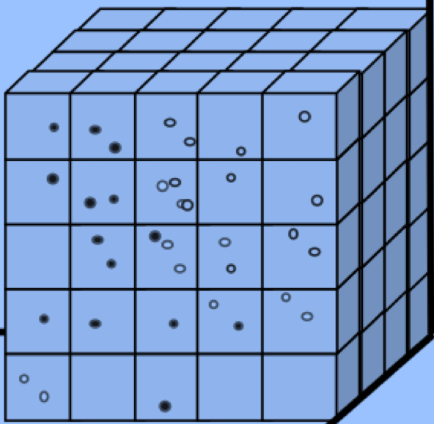
The “UHDR” example (Geant4 v. 11.2)
Tran et al., Int. J. Mol. Sci. (2021) 22 (link)
Uses the mesoscopic approach
Combination of the particle-based SBS model with the compartment-based model
Coarse-grained model: compartment based (“on-lattice”)
Simulation from heterogeneous to homogeneous states
pH control
Oxygen-control
Cut-off dose
Next sub-volume algorithm
Hierarchical algorithm for the RDME (“hRDME”)
Spatial distributions are simulated at voxel level.
Coarser meshes over time until we reached the coarsest mesh.

Slide 23
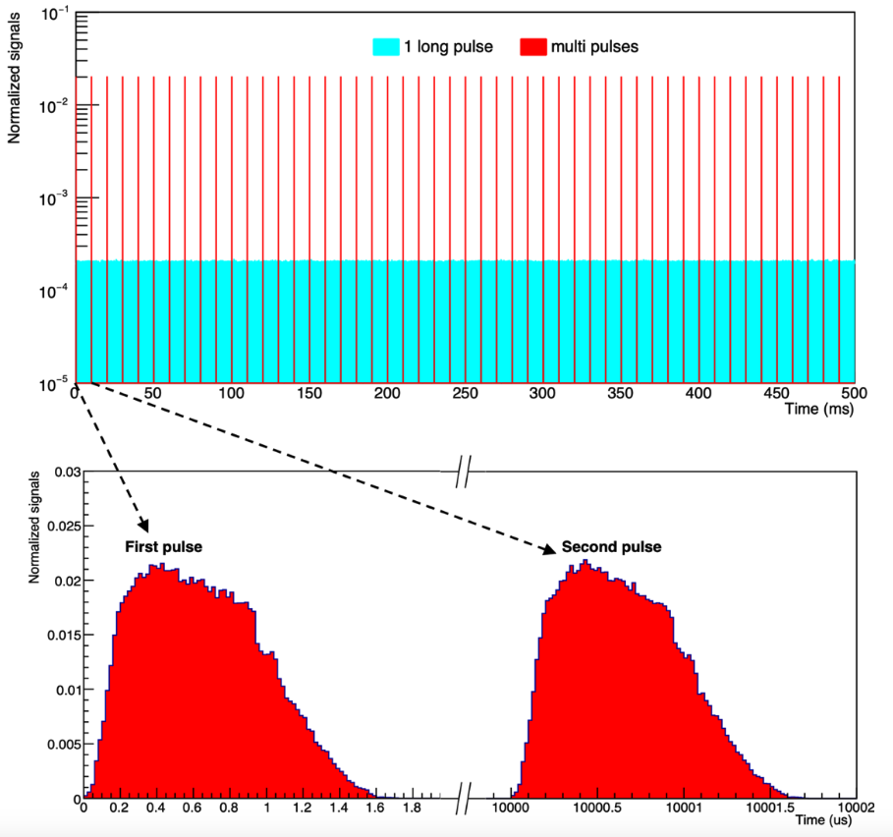
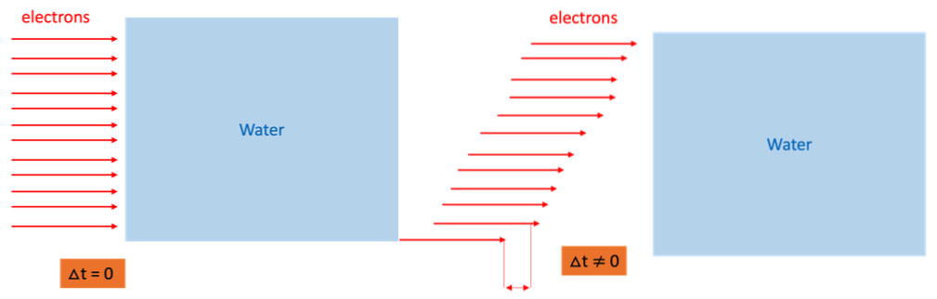
Reproduction of the ultra high dose rate irradiation pulse
Le et al., “Modeling water radiolysis with Geant4-DNA: Impact of the temporal structure of the
irradiation pulse under oxygen conditions” (link)
The limitation of the first "UHDR" example version: particle beams are simulated as a single instantaneous pulse.
In this instantaneous pulse all incident particles are emitted simultaneously, with no pulse duration.
Such irradiation conditions differ from reality, where the absorbed dose is the same for CONV and FLASH, and it is delivered over a long train of individual pulses, for a beam duration of up to a few minutes.
New version (July 2025) overcomes this issue by combining IRT with RDME, allowing to reproduce a pulse structure and train of pulses.

Slide 24
The “UHDR” example (Geant4 v. 11.2)
Tran et al., Int. J. Mol. Sci. (2021) 22 (link)
Uses the mesoscopic approach
Combination of the particle-based SBS model with the compartment-based model
Coarse-grained model: compartment based (“on-lattice”)
Simulation from heterogeneous to homogeneous states
pH control
Oxygen-control
Cut-off dose
Next sub-volume algorithm
Hierarchical algorithm for the RDME (“hRDME”)
Spatial distributions are simulated at voxel level.
Coarser meshes over time until we reached the coarsest mesh.

Slide 25
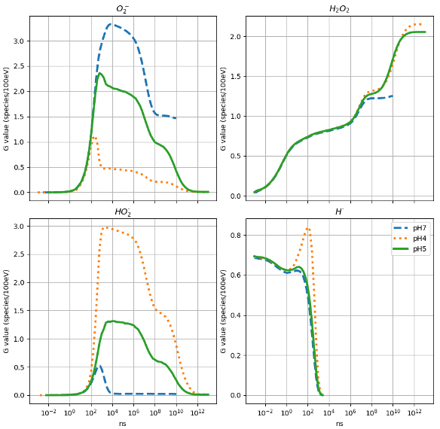
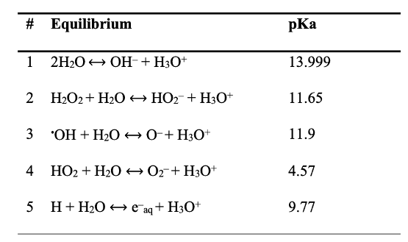
Account for the pH of the different tissues
The products of primary and secondary reactions can participate in equilibrium reactions which are associated with pKa (see the table)
Based on the [H3O⁺] and [OH-] determined by the pH, acid-base reactions associated with these pKa are simulated
pKa = -log₁₀(Ka)
Ka: acid dissociation constant

Slide 26
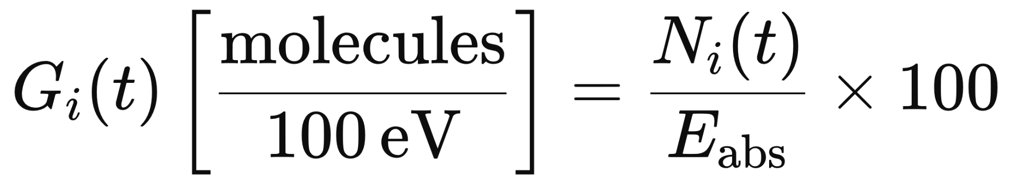
pH validation: 300 MeV proton irradiation
Comparison with Plante SBS, IRT and experimental data in: doi:10.1007/s00411-011-0368-7
of important radiolytic species:
Solvated electron: e_{aq}⁻
Hydrogen radical: H°
Hydrogen molecule: H₂
Hydrogen peroxide: H₂O₂
Hydroxyl radical: °OH
obtained for 300 MeV proton irradiation
Allen AO. (1961), The radiation chemistry of water and aqueous solutions. D. Van. Nostrand Company, Princeton, NJ
Hayon E. (1961), Effect of solute concentration on the recombination of H! and !OH in c-irradiated aqueous solutions. J Phys Chem 65:1502–1505. 10.1021/j100905a007
Cheek C.H. et al. (1962) Effect of acidity on hydrogen yield in gamma-irradiated aqueous solutions. Report of N.R.L. Progress, pp 13–16
Thomas JK, Bensasson RV (1967) Direct observation of regions of high ion and radical concentration in the radiolysis of water and ethanol. J Chem Phys 46:4147–4148. 10.1063/1.1840498
Schwarz H.A. (1969) Applications of the spur diffusion model to the radiation chemistry of aqueous solutions. J Phys Chem 73:1928–1937. 10.1021/j100726a047
Draganic ́I.G. et al. (1969) Radiolysis of HCOOH ?O2 at pH 1.3–13 and the yields of primary products in c radiolysis of water. J Phys Chem 75:2564–2571. 10.1021/j100842a018
Buxton G.V. (1972) Nanosecond pulse radiolysis of aqueous solutions containing protons and hydroxyl radical scavengers. Proc R Soc London A 328:9–21. doi:10.1098/rspa.1972.0065
Matthews R.W. et al. (1972) Elementary processes in the radiolysis of aqueous sulfuric acid solutions. Determinations of both GOH and GSO4. J Phys Chem 76:1265–1272. 10.1021/j100653a007
Sehested K. et al. (1973) The primary species yields in the 60Co c-ray radiolysis of aqueous solutions of H2SO4 between pH 7 and 0.46. Radiat Res 56: 385–399. 10.2307/3573674
Lesigne b. et al. (1973) Pulse radiolysis study of the direct effect on sulfuric acid. J Phys Chem 77:2156–2158. 10.1021/j100636a026
Wolff R.K. et al. (1973) Picosecond pulse radiolysis. IV. Yield of the solvated electron at 30 picoseconds. J Phys Chem 77:1350–1355. 10.1021/j100630a008
Draganic ́ Z.D. and Draganic I.G. ́ (1975) Formation of primary reducing yields (Geaq- and GH2) in the radiolysis of aqueous solutions of some positive ions. Int J Rad Phys Chem 7:381–386. 10.1016/0020-7055(75)90077-7
Sumiyoshi T, Katayama M (1982) The yield of hydrated electrons at 30 picoseconds. Chem Lett 11:1887–1890. 10.1246/cl.1982.1887
Shiraishi H. et al. (1988) Pulse-radiolysis study on the yield of hydrated electron at elevated temperatures. J Phys Chem 92:3011–3017. 10.1021/j100321a061
LaVerne JA, Pimblott S (1991) Scavenger and time dependences of radicals and molecular products in the electron radiolysis of water: examination of experiments and models. J Phys Chem 95:3196–3206. 10.1021/j100161a044
Elliot A.J. et al. (1993) Temperature dependence of g values for H2O and D2O irradiated with low linear energy transfer radiation. J Chem Soc Faraday Trans 89:1193–1197. 10.1039/ft9938901193
Pimblott S, LaVerne JA (1997) Stochastic simulation of the electron radiolysis of water and aqueous solutions. J Phys Chem A 101:5828–5838. 10.1021/jp970637d
LaVerne JA (2000) OH radicals and oxidizing products in the gamma radiolysis of water. Radiat Res 153:196–200. 10.1667/0033-7587(2000)153[0196:ORAOPI]2.0.CO;2
Bartels D.M. et al. (2000) Spur decay of the solvated electron in picosecond radiolysis measured with time-correlated absorption spectroscopy. J Phys Chem 104:1686– 1691. 10.1021/jp992723e
Jay-Gerin JP, Ferradini C (2000) A new estimate of the !OH radical yield at early times in the radiolysis of liquid water. Chem Phys Lett 317:388–391. 10.1016/S0009-2614(99)01397-4
Draganic ́ IG, Draganic ́ ZD (2004) The radiation chemistry of water. Academic Press, New York
Simulation Conditions:
Box Half Size: 3.2 um
Histories: 10³ primary particles
Oxygen Concentration: 0%
Physics: opt2 10.1002/mp.13048
PBC to approximate an infinite volume using a small unit cell
t_{end}: 1 us

Slide 27
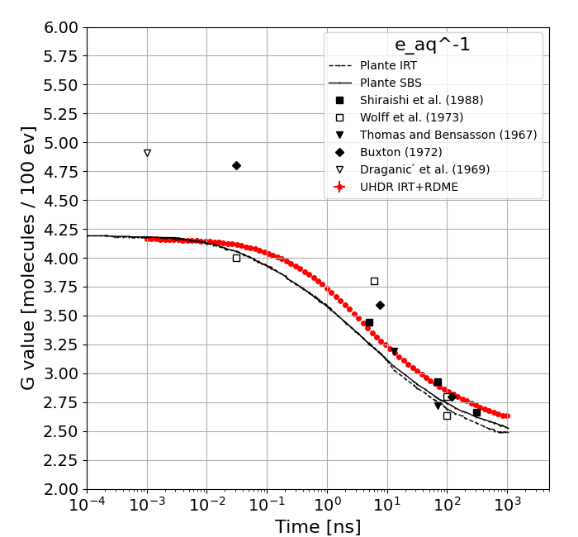
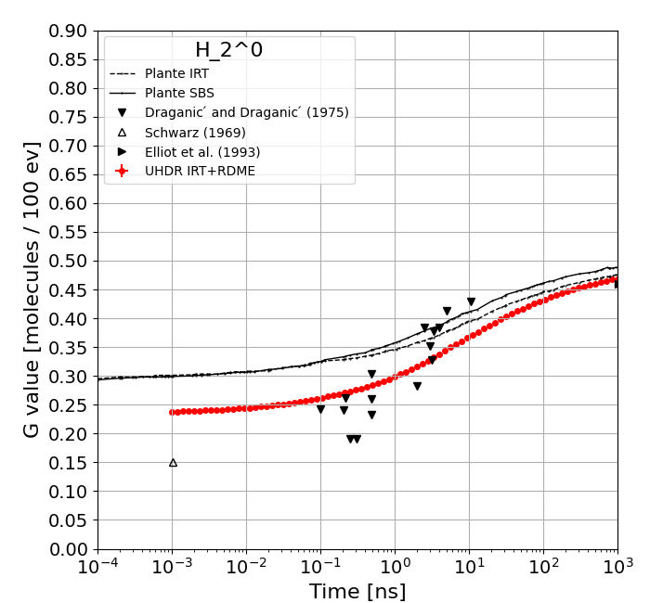
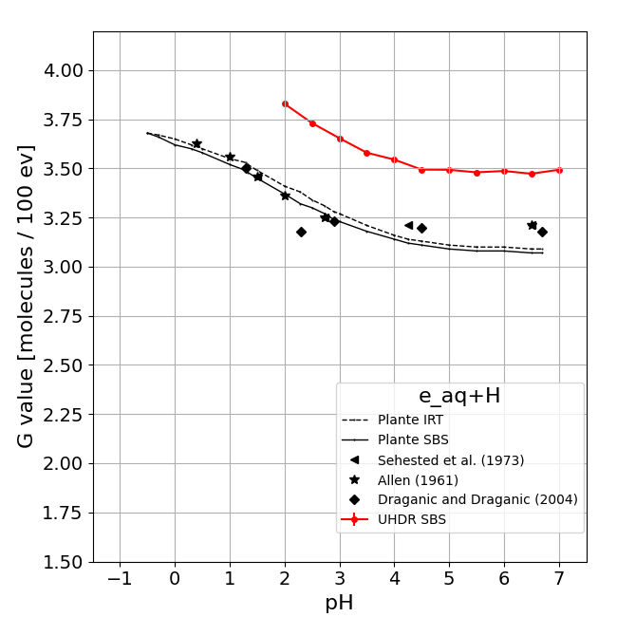





pH validation: 300 MeV proton irradiation Gvalues vs. Time at pH = 7.0 Gvalues vs. pH at t = 1 us

Slide 28




pH validation: 1 MeV electron irradiation
“Reactivity of HO₂ /O₂₋ Radicals in Aqueous Solution”
B. H. J. Bielski, D. E. Cabelli, R. L. Arudi, A. B. Ross
J. Phys. Chem. Ref. Data 14, 1041–1100 (1985) https://doi.org/10.1063/1.555739
The study examines the spontaneous disproportionation of the superoxide anion (O₂⁻) and its conjugate acid, the hydroperoxyl radical (HO₂°), specifically in aqueous solutions
HO₂ and O₂⁻ are two forms of the same radical species:
HO₂°: protonated form.
O₂⁻: deprotonated form.
They are in equilibrium: HO₂° ⇋ O₂⁻ + H⁺
Primary disproportionation reactions: (1) HO₂° + HO₂° → H₂O₂ + O₂ (2) HO₂° + O₂⁻ + H₂O → H₂O₂ + O₂ + OH⁻ The reaction between two O₂⁻ radicals is negligible.
The protonation state of the radicals depends on pH.
At low pH, HO₂° dominates → reaction (1) dominates.
At high pH, O₂⁻ dominates → reaction (2) dominates
The overall rate of their disappearance changes with pH
Their disappearance follow a second-order decay law described with the pH-dependent observed rate constant k_obs
Bielski, B.H.J., Allen, A.O., Mechanism of the disproportionation of superoxide radicals, J. Phys. Chern. 81: 1048-50 (1977). 10.1021/j100526a005
Behar, D., Czapski, G., Rabani, J., Dorfman, L.M., Schwarz, H.A., The acid dissociation constant and decay kinetics of the perhydroxyl radical. J. Phys. Chem. 74: 3209-13 (1970). 10.1021/j100711a009
Bielski, B.H.J., Schwarz, H.A., The absorption spectra and kinetics of hydrogen sesquioxide and the perhydroxyl radical. J. Phys. Chern. 72: 3836-41 (1968). 10.1021/j100857a024
Rabani, J., Nielson, S.O., Absorption spectrum and decay kinetics of O2- and HO₂ in aqueous solutions by pulse radiolysis. J. Phys. Chern. 73: 3736-44 (1969). 10.1021/j100845a030
Marklund, S., Spectrophotometric study of spontaneous disproportionation of superoxide anion radical and sensitive direct assay for superoxide dismutase, J. BioI. Chern. 251: 7504-7 (1976). 10.1016/S0021-9258(17)32878-8
Sehested, K., Bjergbakke, E., Rasmussen, O.L., Fricke, H., Reactions of H₂0₃ in the pulse-irradiated Fe(II)-02 system, J. Chern. Phys. 51: 3159-66 (l969). 10.1063/1.1672489

Slide 29








pH validation: 1 MeV electron irradiation - Results and comparisons

Slide 30



Summary
2001: Geant4-DNA was "born" thanks to the ESA
2007: First Physics Models
2014: Chemistry stage released
2019: dnadamage1: 1st fully integrated radiobiological application —> 2021 1st G4-DNA Master Thesis @LNS
2022: moleculardna —> 2025 BNCT, Biologically Adaptive Radiotherapy
2023: UHDR first release —> 2025 development in progress for FLASH

Slide 31

What Next
FLASH: multiscale Geant4 - Geant4-DNA 13:00 → 13:20
Shaping the Future: Strategic Roadmap for Ultrafast Radiation Biology with laser-driven radiations
Speaker: G.A.P. Cirrone
1
CELL GEOMETRIES
Release the new cell geometries (extend moleculardna) along with their comparisons against experimental data
Create a database for cell geometries
1
BRIDGE RADIOCHEMISTRY WITH RADIOBIOLOGY
Radiochemistry: High dose rate, Long time tracking, Toy geometry
Radiobiology: Detailed geometries, Conventional irradiation Short time tracking
→ New approaches needed to afford both functionalities
1

Slide 32
Thank you for your attention!

Slide 33
Back-up Slides

Slide 34

Geant4-DNA Physics
δ
γ
1μm
e⁻
Trajectory in real world
γ
δ
γ
δ
Track-Structure approach
All physical interactions are simulated individually in a sequential manner
Example: Geant4-DNA, PARTRAC, RITRACKS, NOREC, KURBUC, PHITS-TS…
High accuracy/Slow computing
Condensed-History approach
Several discrete physical interactions are “condensed” into a single transport step
Multiple-scattering approximation
Example: Geant4, PHITS, EGS, FLUKA, PENELOPE, MCNP…
Low accuracy /Fast computing
Ref.: Nucl. Instrum. and Meth. B 273, 95-97 (2012), Prog. Nucl. Sci. Tec. 2, 898-903 (2011)

Slide 35


SBS model in Geant4-DNA
A proton of 50 MeV at 1 ps

Slide 36

SBS model in Geant4-DNA
A proton of 50 MeV at 1 μs

Slide 37




Geant4-DNA repair mechanisms: TLK
Let: L₁(t) num. simple DSB at time t, L₂(t) num. complex DSB at time t
The evolution of L₁(t) and L₂(t) follows:
- λ1: repair probability of sDSB
- λ2: repair probabilityof cDSBs
- η: probability of interaction
between two DSBs to form
lethal lesions
The evolution of lethal lesion L_{LETHAL}(t) is:
- β₁ probability of lethal misrepair for sDSBs
- β₂ probability of lethal misrepair for cDSBs
The survival fraction S(t) is:

