Slide 1

Chapter 27: Conclusions
and Future Upgrades
Massimo Ferrario
INFN-LNF
This project has received funding from the European Union´s Horizon Europe research and innovation program under grant agreement No. 101079773
IX TDR Review Committee Meeting
June 16-18, 2025

Slide 2
Describe your Chapter
Enabling Technologies and Future Outlook
ARIA FEL
High Repetition Rate Operation (400 Hz)
  C-band Photo-injector and laser
  Discharge Capillary
Gamma Ray Source
Path towards 5 GeV
Staging for Linear Collider Application

Slide 3
Enabling Technologies and Future Outlook
Key innovations include the integration of high-gradient X-band radiofrequency structures, which offer accelerating fields of ~60 MV/m, enabling significant reduction in linac length while maintaining beam quality.
The use of plasma channels for wakefield acceleration represents a transformative step in compact beam energy boosting, with gradients exceeding 1 GV/m and ongoing development toward reproducible, beam-quality-preserving plasma stages.
Advances in ultrafast synchronization systems, achieving sub-10 femtosecond timing jitter between lasers and electron bunches, are also critical enablers for pump–probe experiments and precision beam–plasma interaction control.
…………
Looking forward, the facility has been designed with a modular and flexible architecture to accommodate future experimental needs and technological advancements. Planned upgrade pathways include the addition of new beamlines, such as a FEL for VUV radiation in the optical klystron configuration with seeded harmonic generation to enhance spectral purity, and the extension of the plasma module to provide higher energies or multi-stage acceleration. R&D efforts toward higher repetition rates (up to 400 Hz) are already underway and will be integrated following the testing of the C-band photo-injector and the new discharge capillary design. Moreover, the facility’s infrastructure is capable of supporting other emerging technologies such as dielectric accelerators, THz-driven acceleration, and hybrid plasma injection schemes.
Through these enabling technologies and its forward-compatible architecture, EuPRAXIA@SPARC_LAB will continue to drive accelerator innovation, serve as a reference platform for compact FEL development, and contribute to the strategic evolution of Europe’s research infrastructure landscape in the decades to come.

Slide 4
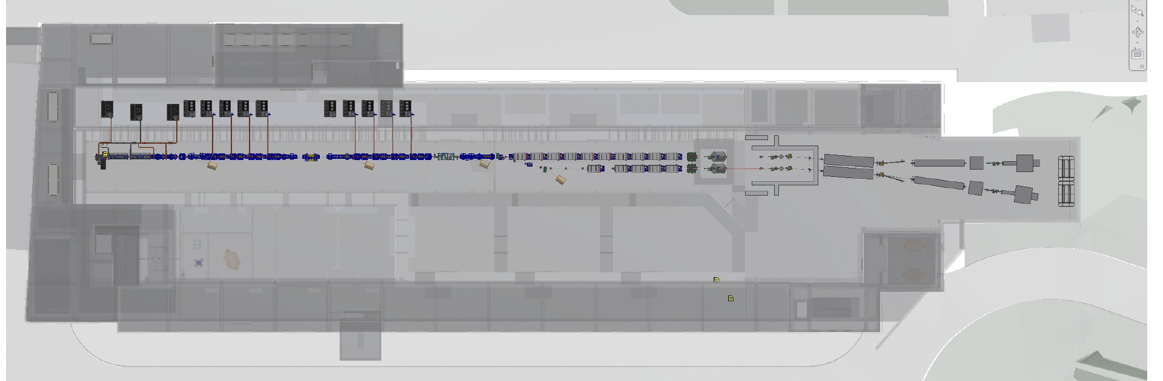
Possible Upgraded Components
C-band
400 Hz
ARIA
Gamma

Slide 5
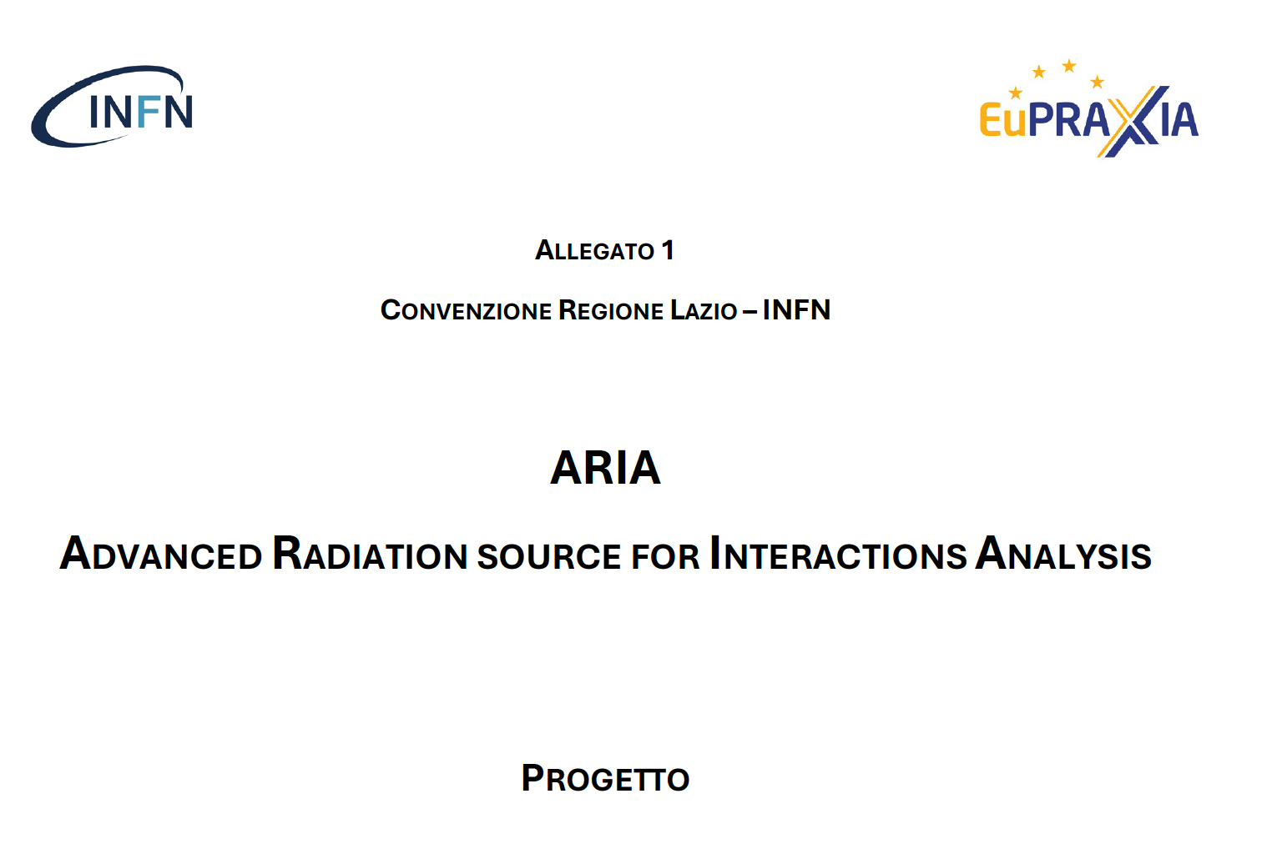
ARIA

Slide 6
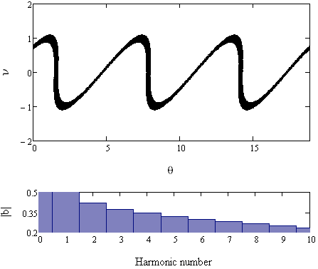
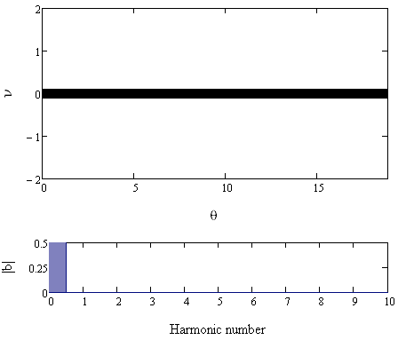
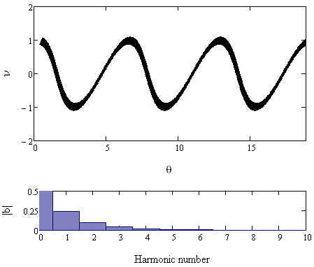
ARIA
SEEDED FEL line – Full coherence = laser-like statistics
Undulator parameters | ARIA
 | Modulator | Radiator
Period (mm) | 100 | 55
Active length (m) | 3.0 | 8.4
Seeding laser | OPA configuration
Seeding wavelengths (nm) | 320-400 + 600-800
Seeding energy | >20 µJ
Seeding duration | 200 fs
Modulator
Radiators
Seed
Dispersive section
Seed
n^{th} harmonic radiation
e-beam
modulated e-beam
Wavelength range 50 – 180 nm – continuously tunable – 10-100 uJ pulse energy
Total physical length 20 m (not just magnetic) modulator – dispersive section – 4 radiators
Variable polarization (circular left/right, horizontal and vertical)
Design almost readily available. Could be ready for users since the first commissioning phase. Would contribute to establish a user community for the EupraXia at SparcLab user facility
Density modulated beam
initial beam phase space
Energy modulated beam
One of the higher order harmonics is amplified
Energy
Energy
Energy
Phase
Phase
Phase

Slide 7
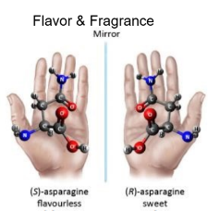
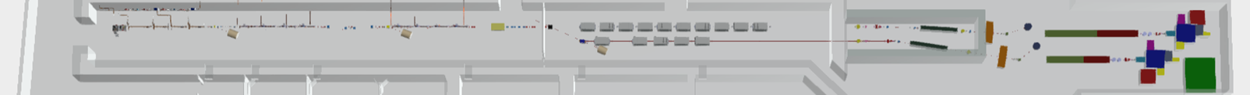
ARIA beamline scientific case
Defining experimental techniques and typology of samples (and applications)
Gas phase & Atmosphere
(Earth & Planets)
Aerosols
(Pollution, nanoparticles)
Molecules & gases
(spectroscopies, time-of-flight)
Proteins
(spectroscopies)
Surfaces
(ablation & deposition)
Photoemission
Spectroscopy
Photoelectron Circular
Dichroism
Raman spectroscopy
Photo-fragmentation of molecules
Time of Flight Spectroscopy
50 m

Slide 8
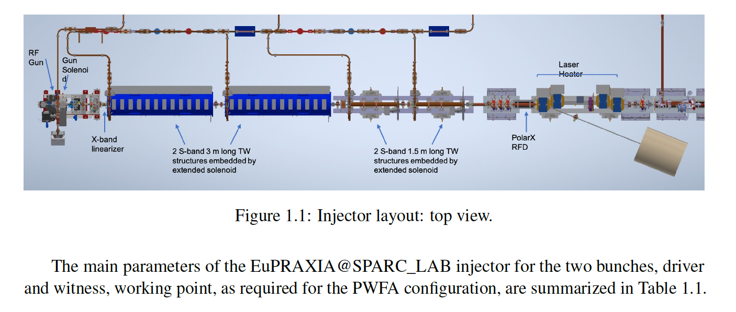
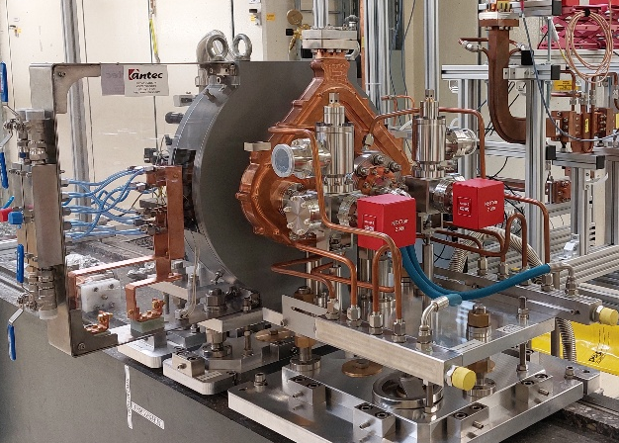
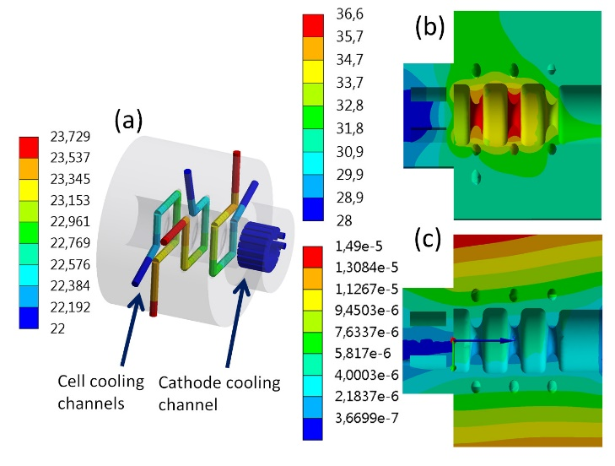
C-band Photoinjector
Parameter | Value
Resonant frequency | 5.712 (5.712)
E_{cath}/√P_{diss} [MV/(m⋅MW^{0.5})] | 51.4
rf input power [MW] | 18(19)
Cathode peak field [MV/m] | 160
Rep. rate [Hz] | 100-400
Quality factor | 11900 (11900)
Filling time [ns] | 166 (147)
Coupling coefficient | 3 (3.5)
rf pulse length [ns] | 300
Mode sep. π-π/2 [MHz] | 47 (48.3)
E_{surf}/E_{cath} | 0.96
Mod. Poy. vector [W/μm²] | 2.5
Pulsed heating [ºC] | 16
Average diss. Power [W] | 250-1000
The new C-Band RF gun, developed in the context of the European I.FAST and INFN Commission V projects, has been realized.
It is a 2.6 cell standing wave cavity with a four-port mode launcher, designed to operate with short rf pulses (300 ns) and cathode peak field larger than 160 MV/m.
In the context of the X-band linacs of the EuPRAXIA@SPARC_LAB projectand XLS design study the possibility to implement a full C-band injector is attractive for both the reachable beam parameters and compactness than for the possibility to operate at high repetition rate (up to 1 kHz).

Slide 9

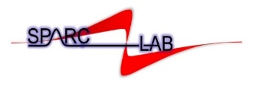
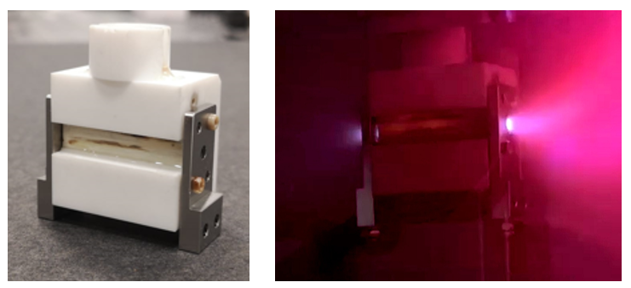
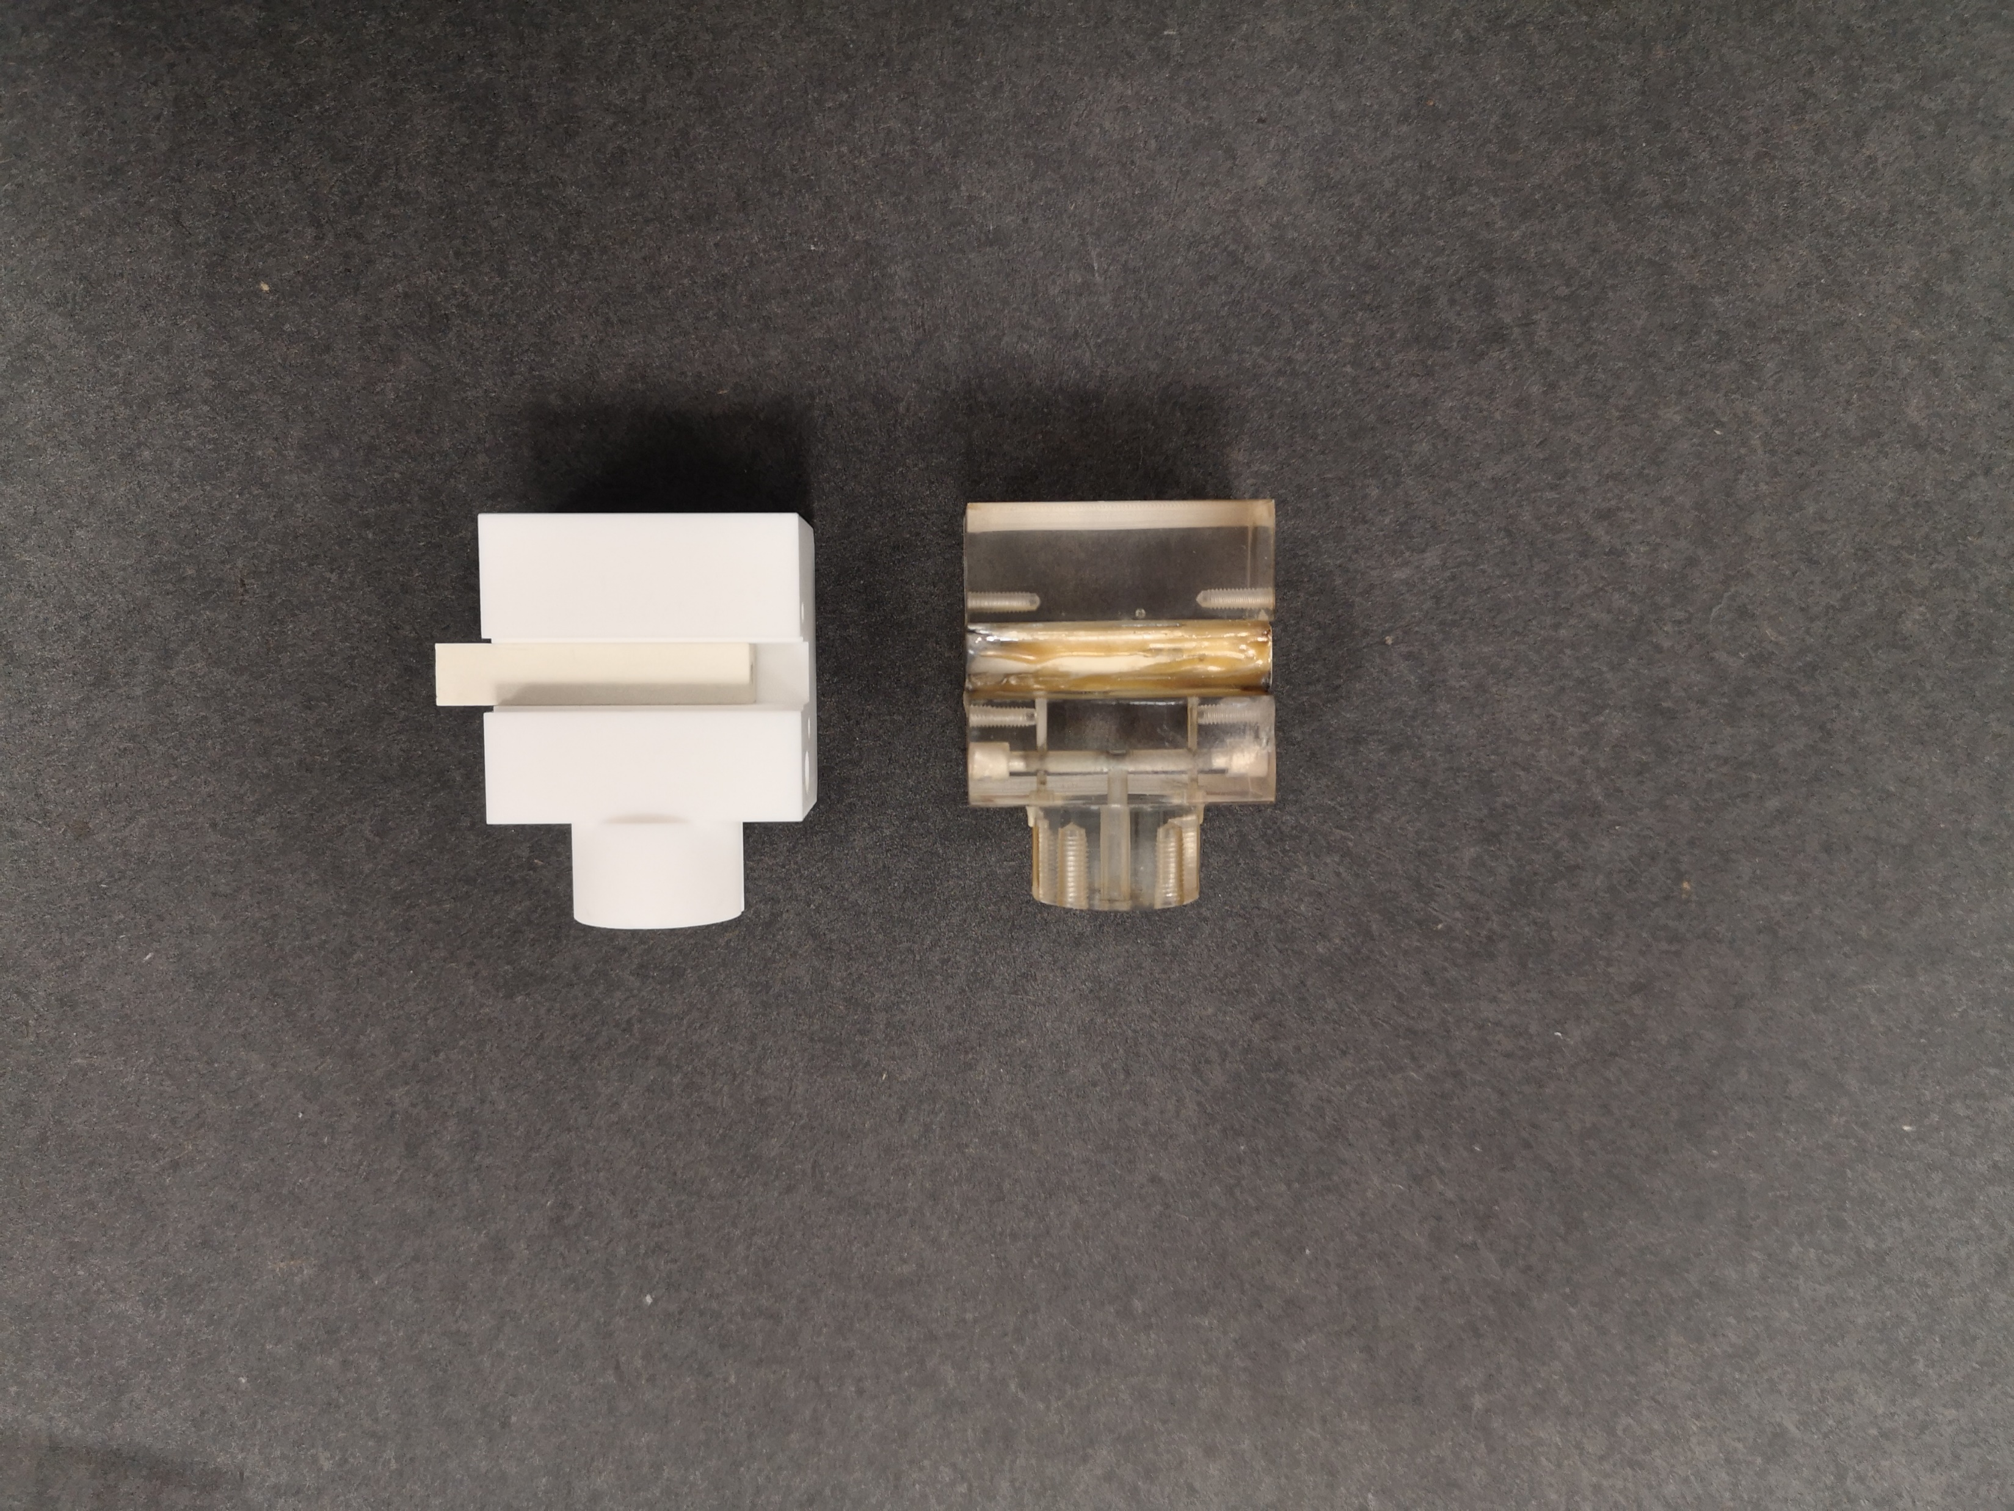
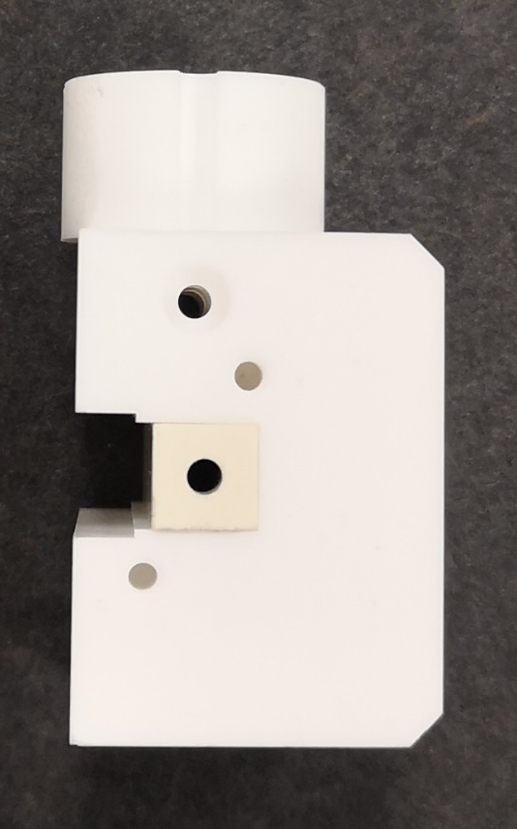
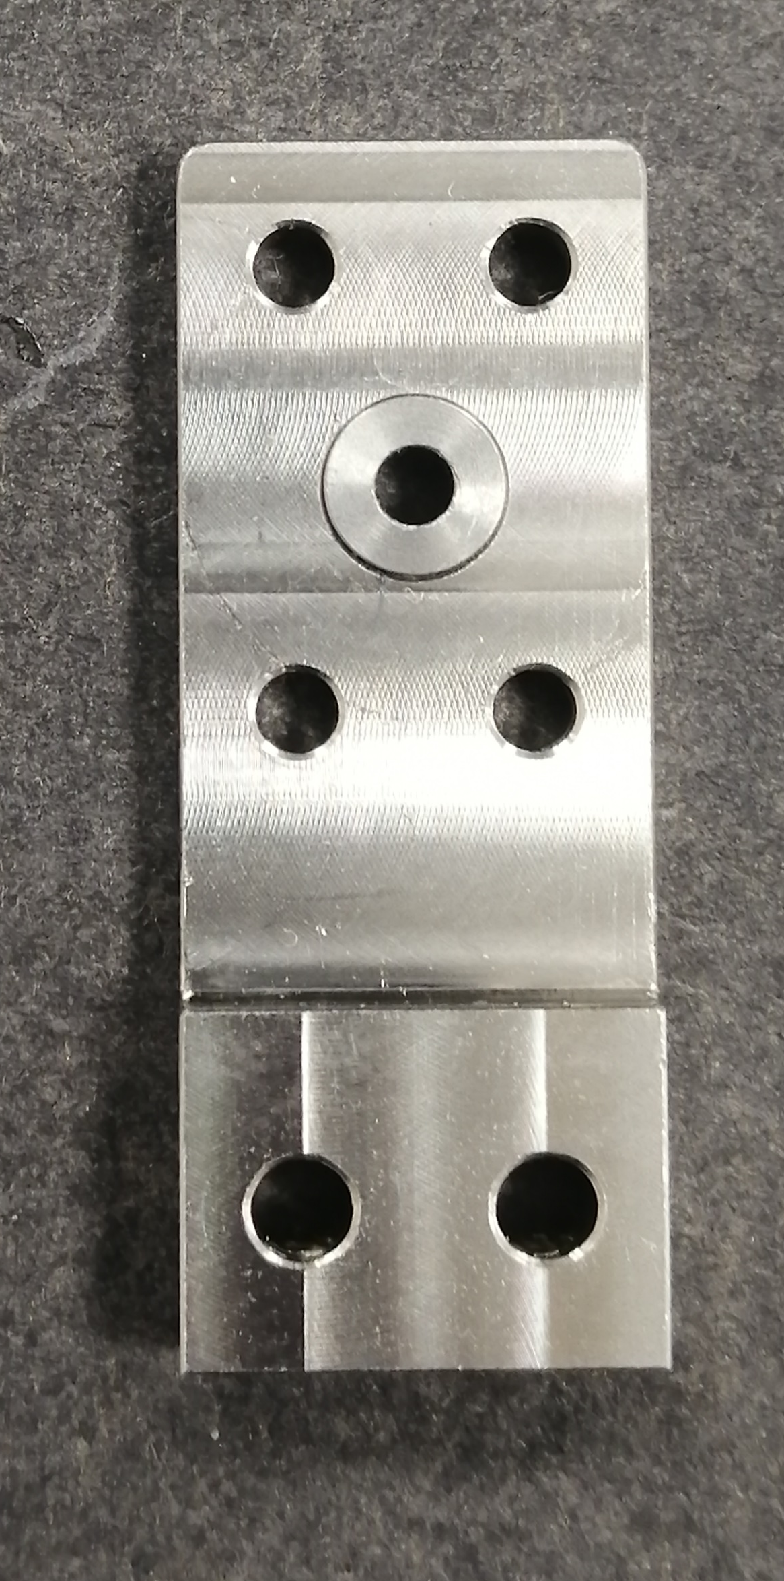
Advanced ceramic capillaries for high repetition rate operation
Gas-filled discharge capillaries
Shapal (Aluminum Nitride) and Macor (glass-ceramic)
High thermal conductivity (92 W/mK for Shapal)
High max operating temperature (2000 and 1000°C)
Good machinability, cost-effectiveness and availability for large geometries
Molybdenum
3 cm long, 2 mm diameter
Shapal
Stainless
steel
Macor
Crincoli, L. et al. Advanced ceramic plasma discharge capillaries for high repetition rate operation. Sci Rep 15, 12456 (2025).
Lucio Crincoli | Laser-Plasma Accelerators Workshop 2025 (LPAW 2025), Ischia (Naples, Italy), 16/04/2025
9

Slide 10
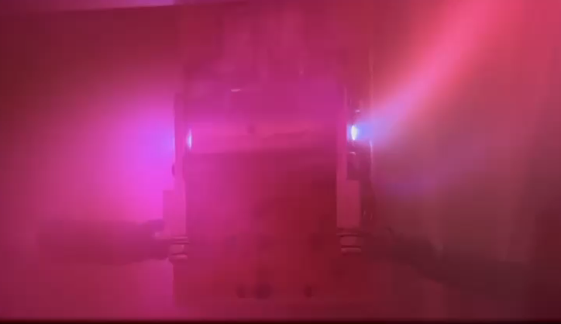
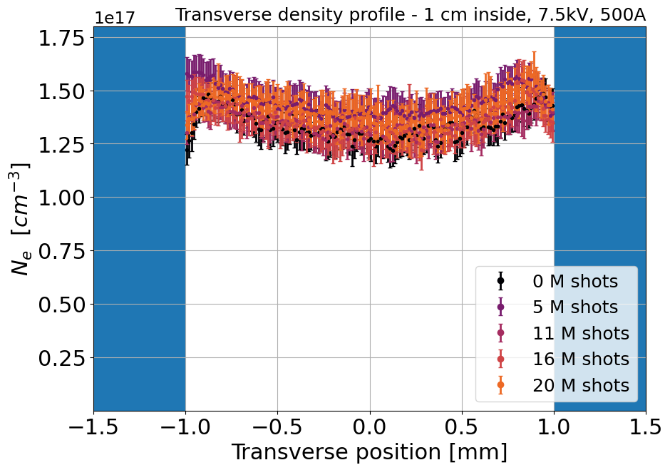
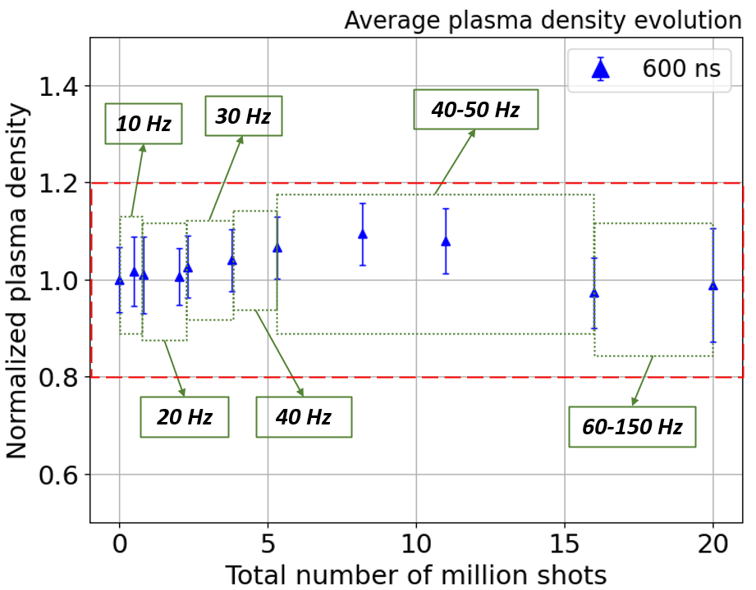
Gas-filled discharge capillaries
100 Hz repetition rate discharge
Advanced ceramic capillaries for high repetition rate operation
Long-term operation up to 150 Hz
N₂ 80-100 mbar in continuous flow
Preservation of plasma properties and device integrity
Crincoli, L. et al. Advanced ceramic plasma discharge capillaries for high repetition rate operation. Sci Rep 15, 12456 (2025).
Lucio Crincoli | Laser-Plasma Accelerators Workshop 2025 (LPAW 2025), Ischia (Naples, Italy), 16/04/2025
10

Slide 11
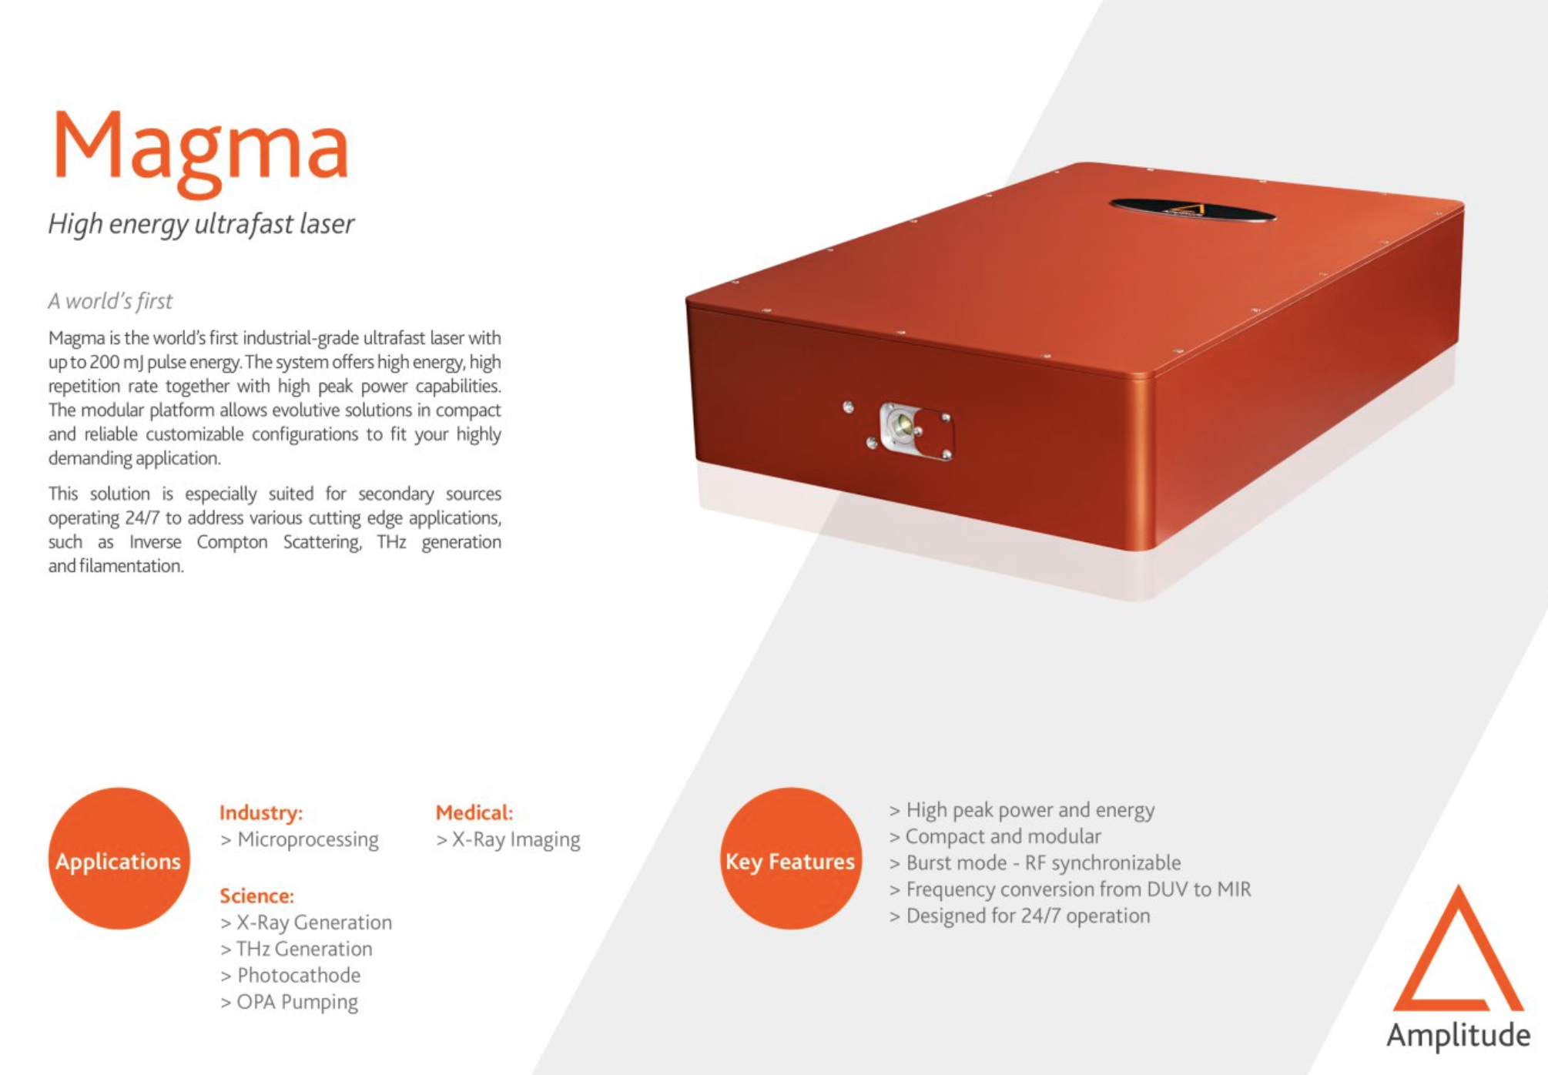
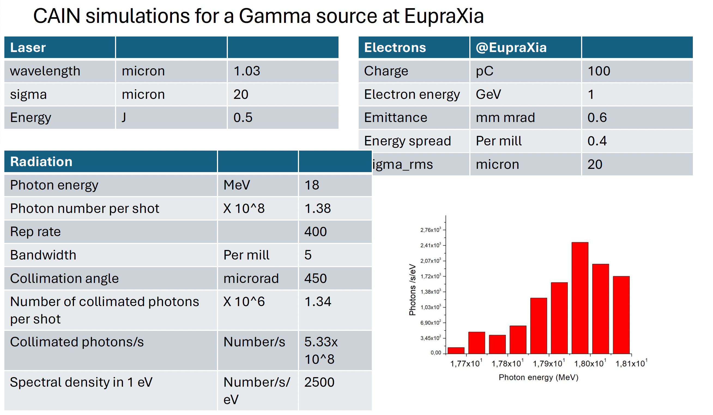
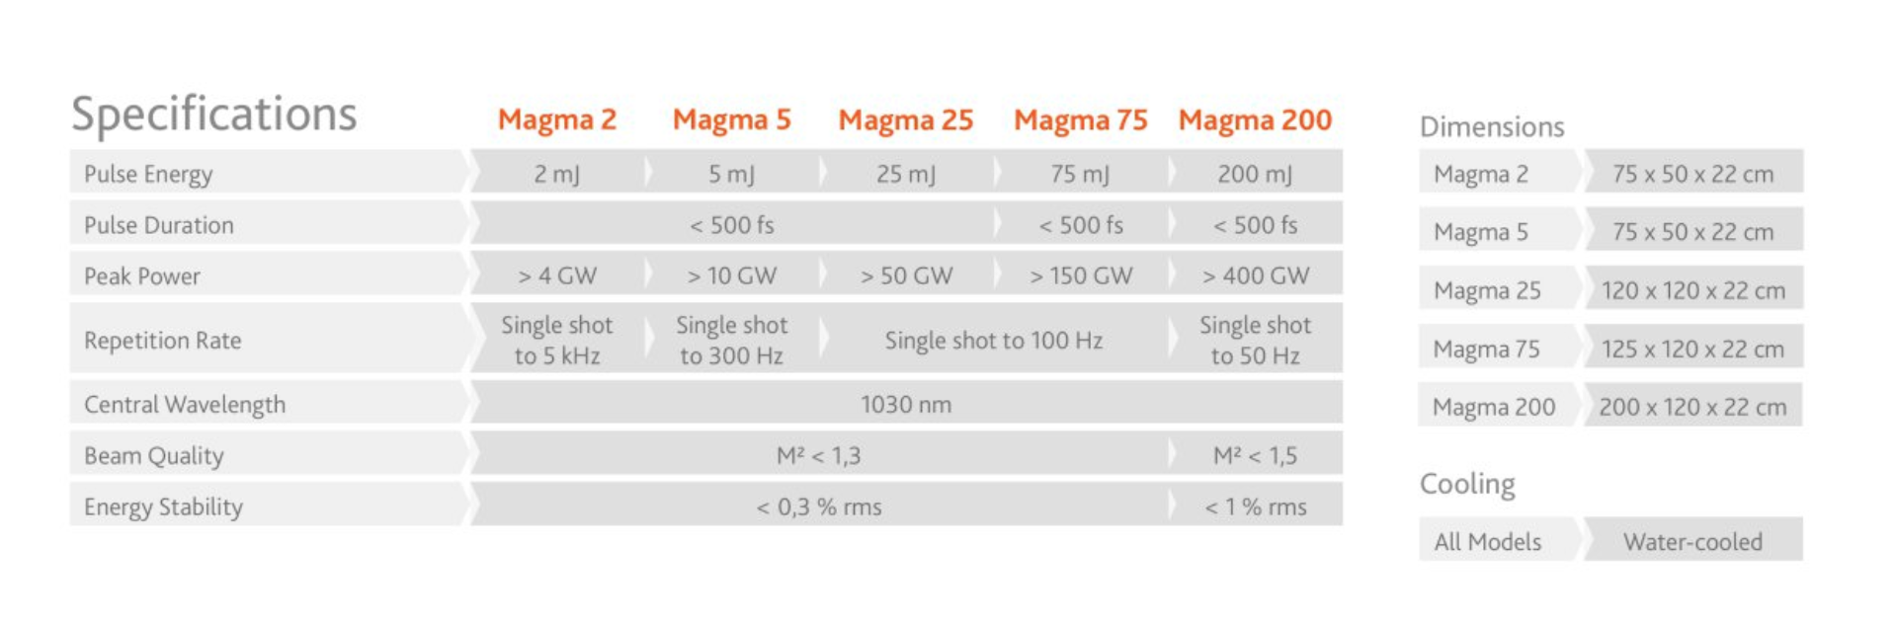
Gamma ray Source

Slide 12
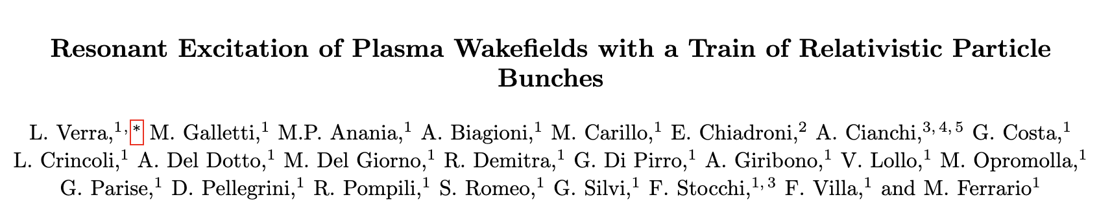
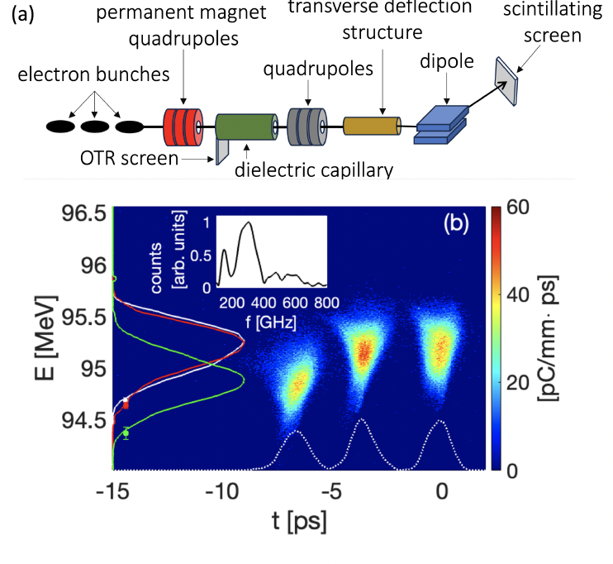
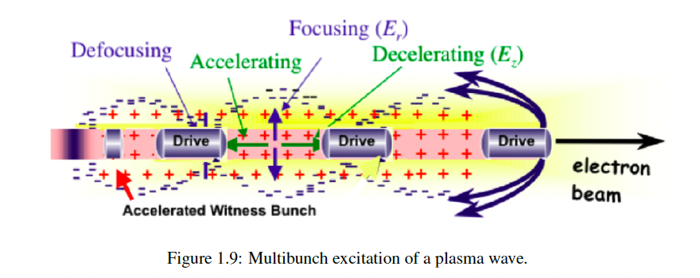
Path towards 5 GeV – High Transformer Ratio

Slide 13
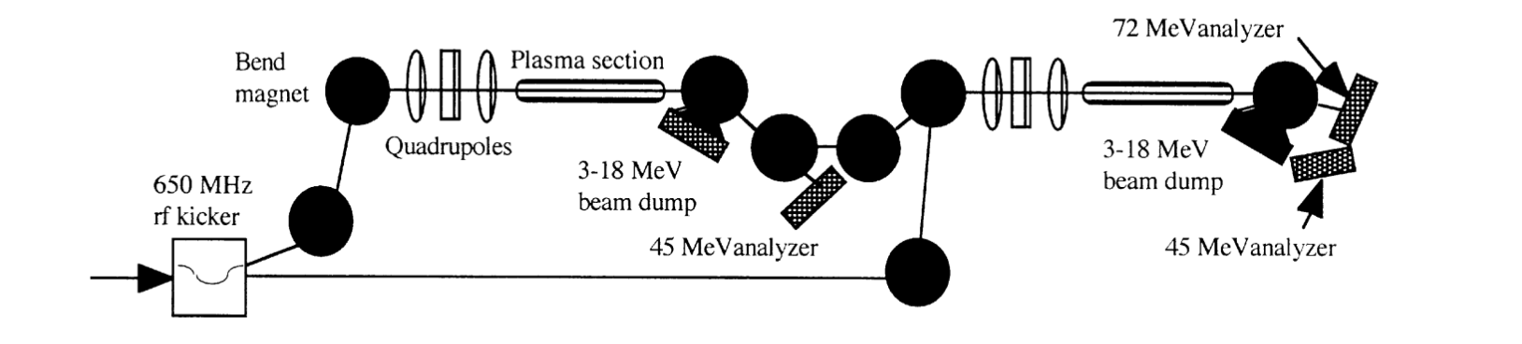
PWFA － Staging – a possible contribution to ESPP
The most outstanding challenge in PWFA:
J. Rosenzweig et al., NIM A 410 (1998) 532—543
In each of them:
Inject the driver bunch
Inject and match the witness bunch with appropriate beam loading
Accelerated with high gradient and high net energy gain
Extract (i.e., reduce divergence)
Dispose of spent driver

Slide 14
Technological Readiness Level
Sub - systems | TRL | Comments
ARIA Undulators | 8 | System complete and qualified – The technology is proven to work in its final form and under expected conditions.
C-Band Gun | 5 | Technology validated in relevant environment – The technology is tested in a simulated or relevant environment
Plasma Module | 5 | Extensive R&D has been made to validate the plasma capillary technology and solid results have proved the validity of the technical choice. A full system proven in a real environment is expected to be done in the next year
Gamma ray source | 7 | System prototype demonstration in operational environment – A working prototype is demonstrated in a real operational setting.
Staging for LC | 4 | Technology validated in lab – Basic technological components are integrated to establish that they work together.

Slide 15
Conclusions
Except for ARIA, still very preliminary investigations
To be written, probably just as a short contribution

