Slide 1
Chapter 25 : System Engineering
Fara Cioeta
Configuration Manager EuPRAXIA@SPAR_LAB
INFN- LNF
This project has received funding from the European Union´s Horizon Europe research and innovation program under grant agreement No. 101079773
IX TDR Review Committee Meeting
June 16-18, 2025

Slide 2
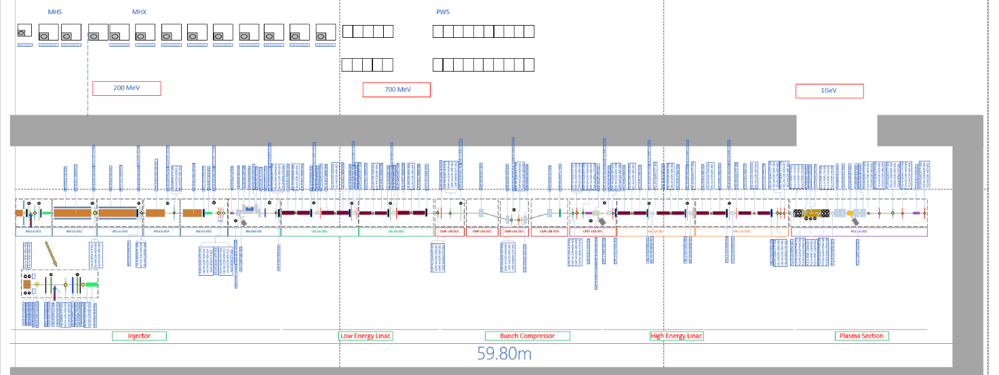
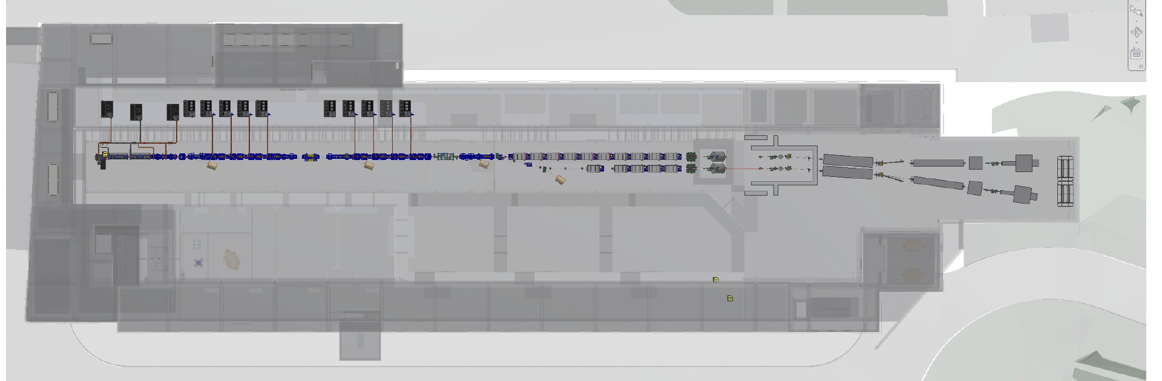
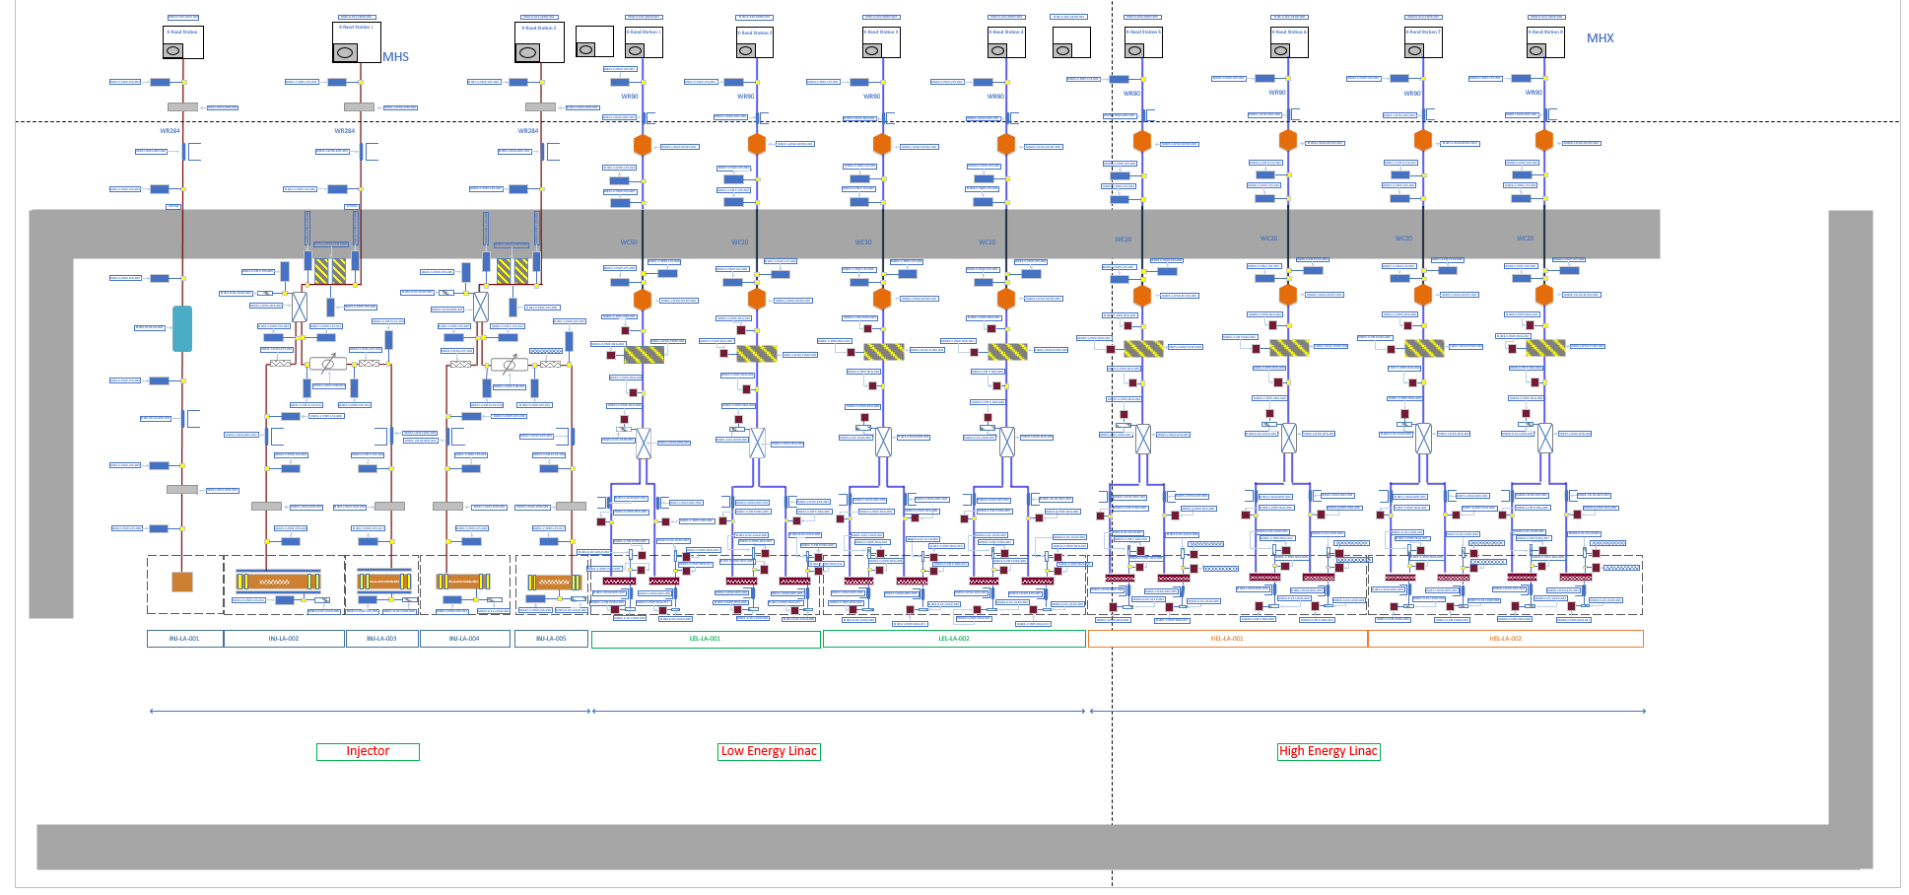
My Area
The scope of System Engineering is comprehensive, as it oversees various management aspects related to the development of the accelerator machine.
2

Slide 3
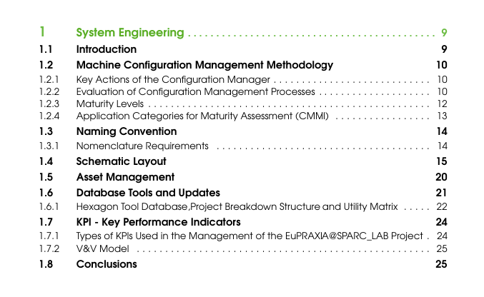
Index Chapter 25 of TDR
Systems Engineering is an interdisciplinary field of engineering that focuses on the development, design, integration, and management of complex artificial systems as EuPRAXIA@SPARC_Lab. It provides a structured process that helps organizations design and implement systems tailored to their specific requirements. As a specialized branch within Project Management (PM), Systems Engineering offers tools and methodologies essential for the realization of functional and sophisticated systems. It demands close collaboration among engineers, physicists, technicians, and other experts to successfully create and operate advanced technological infrastructures
3

Slide 4
Global Goals
Centralized configuration management
Requirements traceability through a dedicated database
Integration of digital tools for monitoring and management
Structured asset management
Definition of KPIs for performance monitoring
Effective coordination between subsystems
4

Slide 5
Achievements: Systems Engineering CMMI
The maturity of the configuration management process was assessed using the CMMI (Capability Maturity Model Integration) framework. EuPRAXIA@SPARC_LAB is currently in a transition phase between level 3 (Defined) and level 5 (Optimizing). This transition state reflects the different degrees of development maturity in the various aspects of project management. In particular, while individual subsystems have reached a level of maturity consistent with Level 5 - characterised by continuous improvement and process optimisation - the integration of these subsystems is still evolving. Efforts are underway to achieve full optimisation at the system level. These initiatives include: Continuous integration of subsystems, the improvement of validation and verification processes, and the evolution of digital tools for greater automation in performance monitoring and strategic decision-making
Level | Name | Description
1 | Initial | Asset management is reactive and ad hoc. No formal processes or documentation.
2 | Managed | Basic asset tracking exists. Some planning and maintenance are documented.
3 | Defined | Standardized processes are in place. Roles and responsibilities are clear.
4 | Quantitatively Managed | Performance is measured using KPIs. Data-driven decisions are made.
5 | Optimizing | Continuous improvement and innovation. Predictive maintenance is implemented.
5

Slide 6
Planned Actions (beyond the TDR)
Ongoing integration of subsystems
Advancement of digital tools to enhance automation
Effective coordination among subsystems to support integration and to finalized the Utility Matrix
Certain KPIs may require revision or updates based on project developments
Improvement of validation and verification processes
Experimental database setup: transition to production phase once the machine becomes operational and integration with OpenCAD BIM tool.
6

Slide 7
Conclusions
The EuPRAXIA@SPARC_LAB project represents an advanced model of integration between systems engineering, digitalization, and predictive asset management for complex scientific infrastructures. The configuration management process has been assessed according to the CMMI framework, currently positioned in a transition phase between Level 3 (Defined) and Level 5 (Optimizing), with several subsystems already compliant with the highest standards.
The adoption of the Hexagon EAM platform enables full component traceability, predictive maintenance planning, and performance monitoring through technical, economic, and safety-related KPIs. The Project Breakdown Structure (PBS) and Utility Matrix support the functional decomposition of the accelerator, ensuring both design and operational consistency.
The project stands as a benchmark for the management of scientific infrastructures, thanks to its approach focused on innovation, standardization, and continuous improvement.
"The chapter is aligned with the overall project requirements and provides a solid foundation for future technical integration."
7

