Slide 1
Chapter 24: Integration and Implementation
Mario DEL FRANCO
on behalf of the WA11 collaboration team
IX TDR Review Committee Meeting
June 16-18, 2025

Slide 2
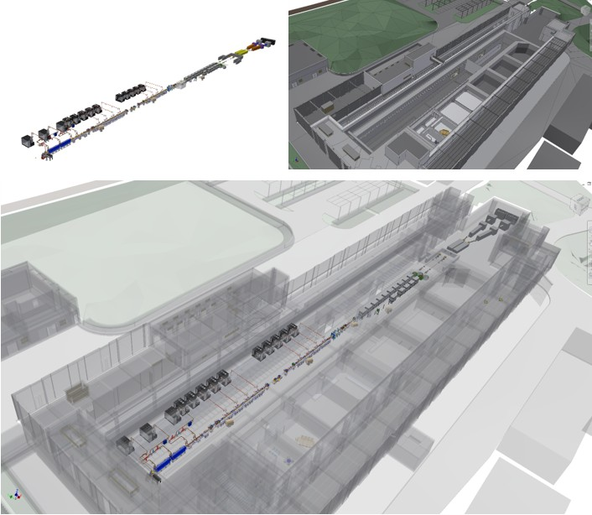
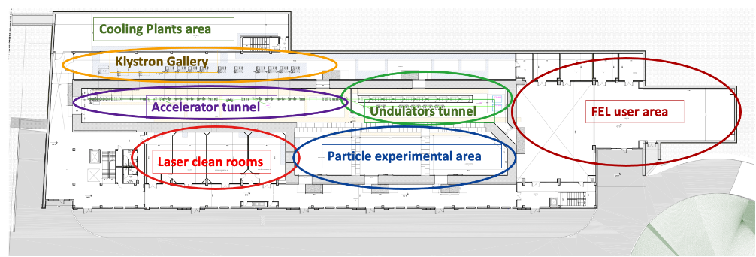
Infrastructure + Machine
Machine
Building
Eupraxia
61,95 mt
35,85mt
50,2 mt
150 mt

Slide 3
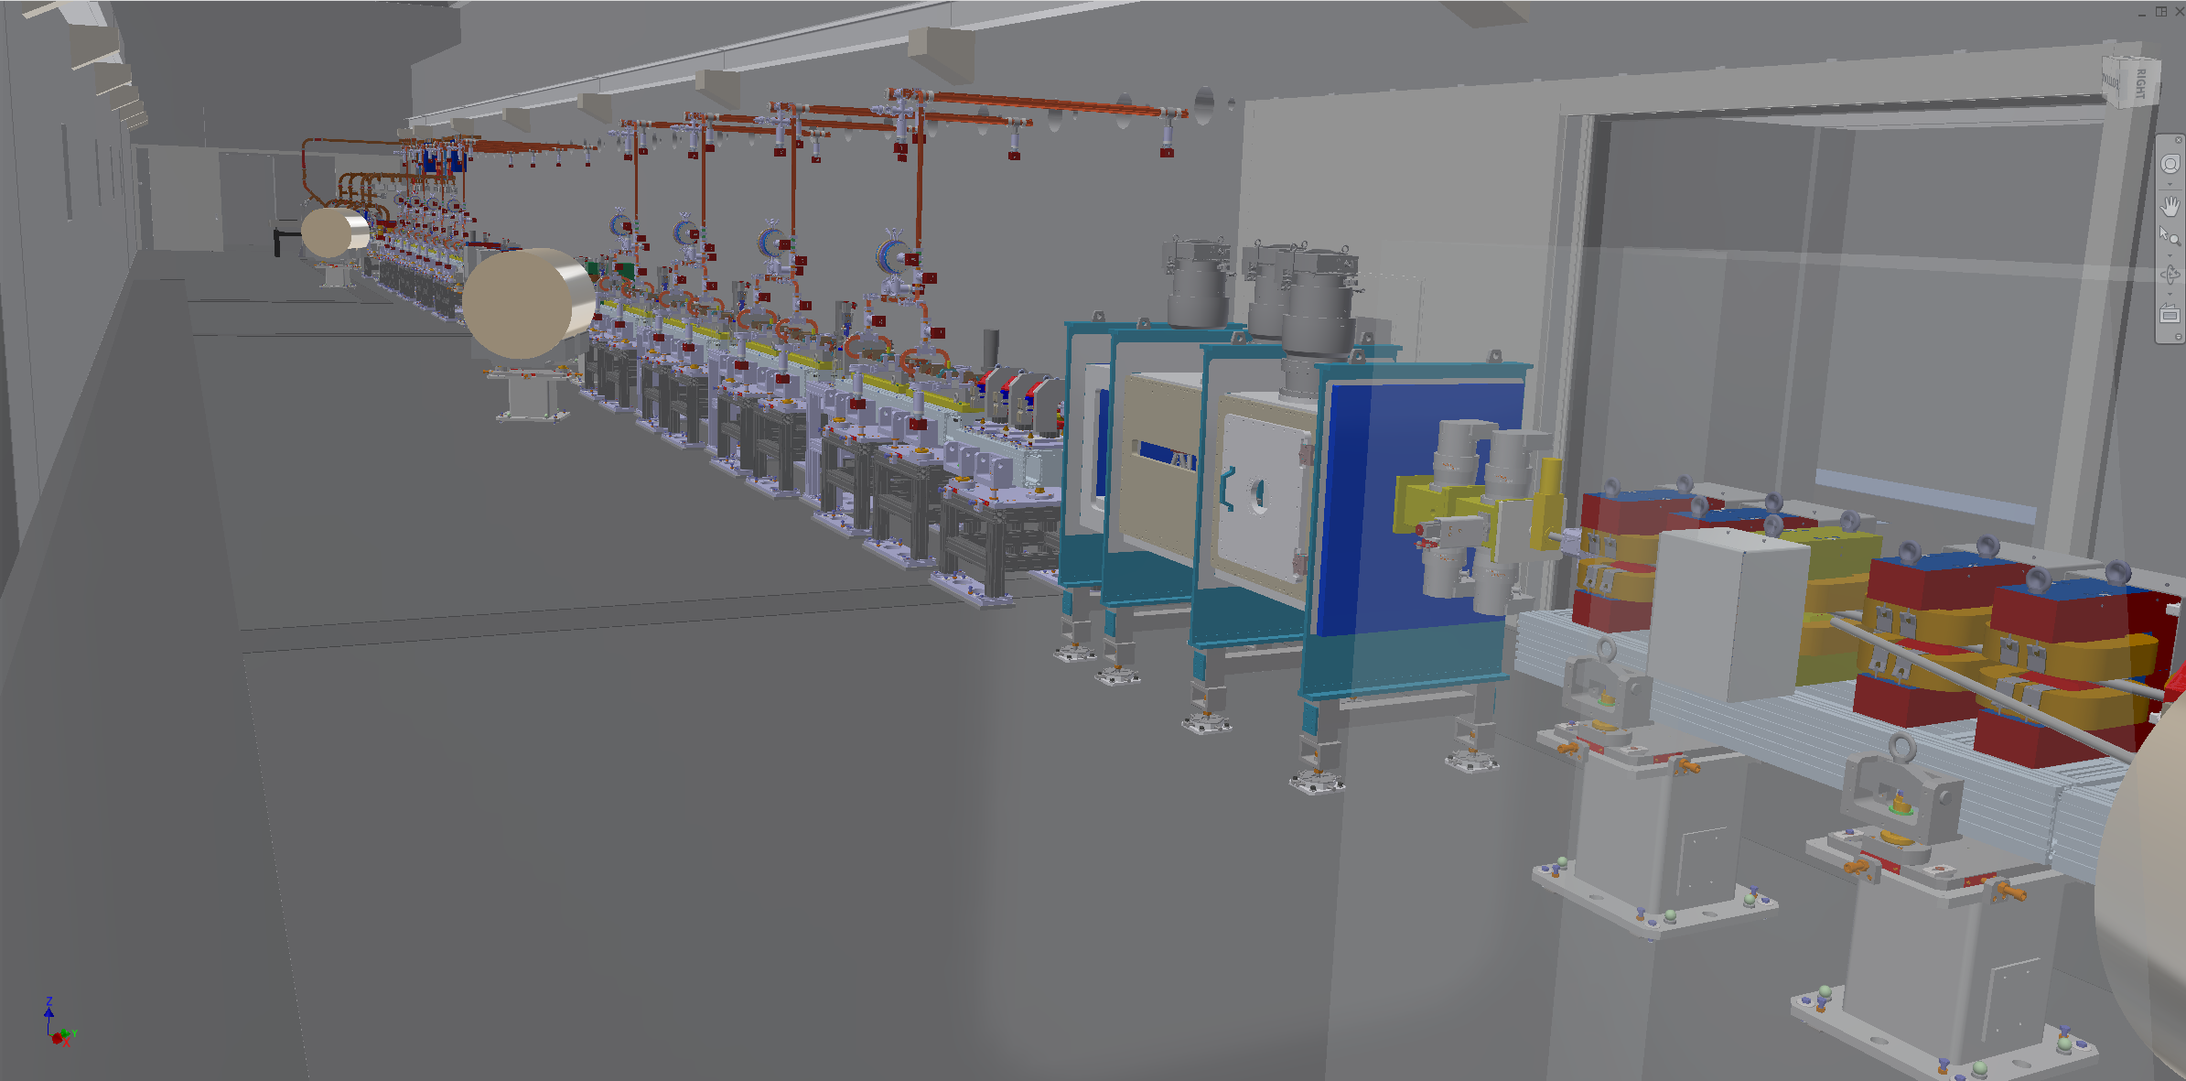
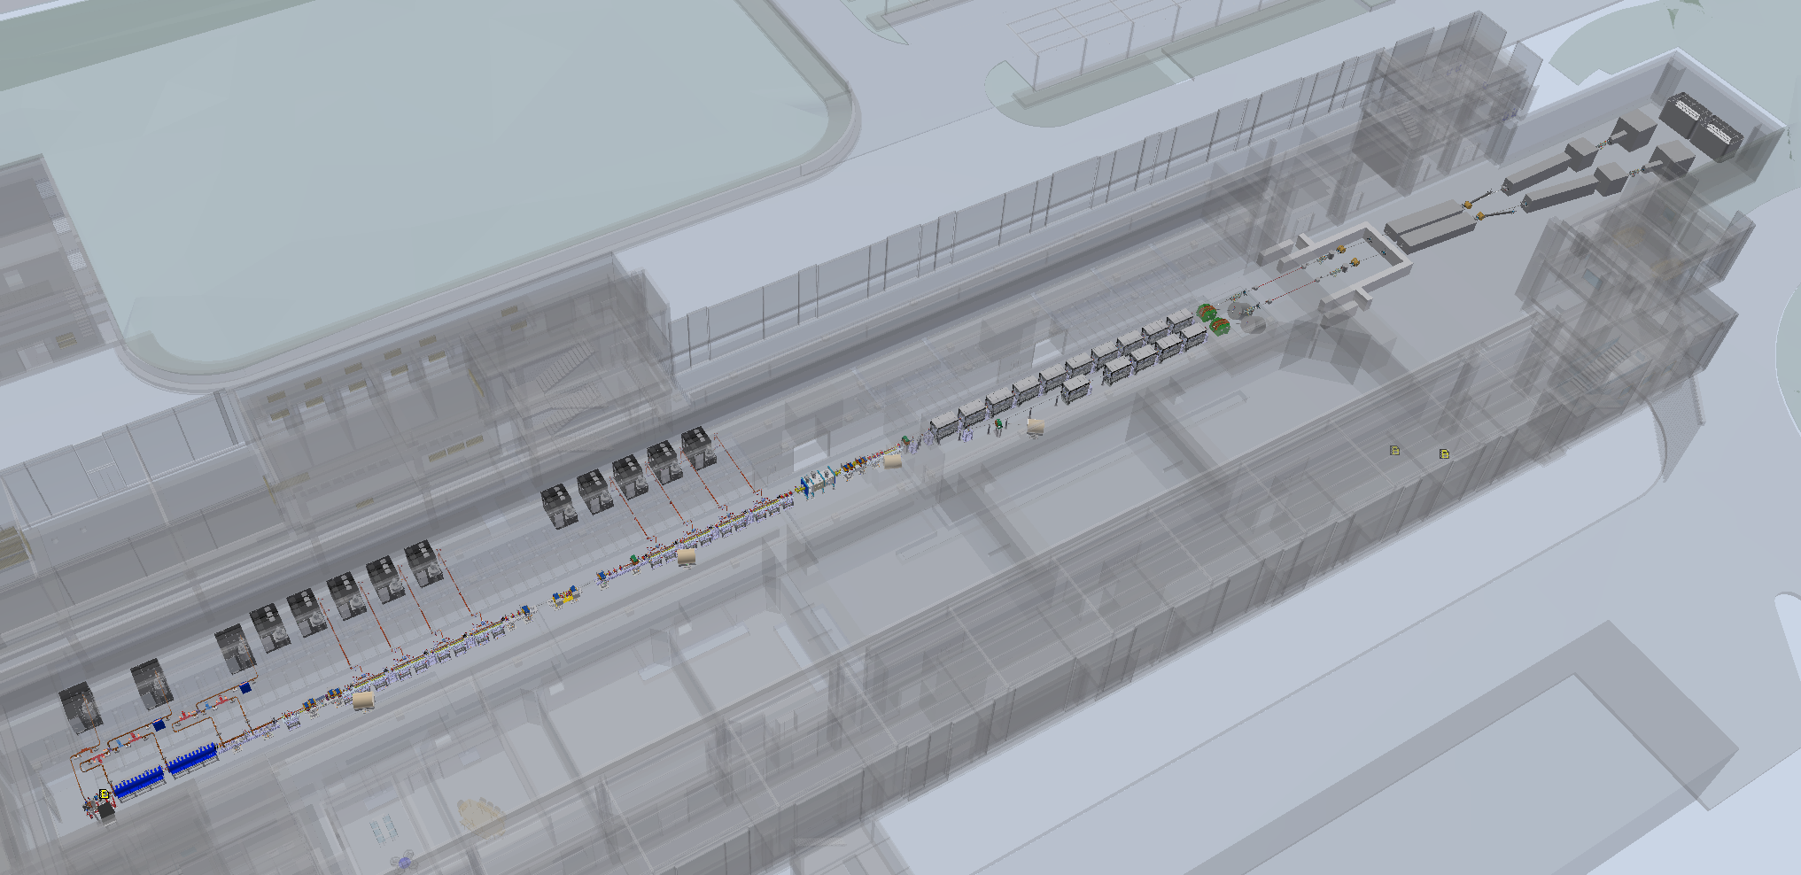
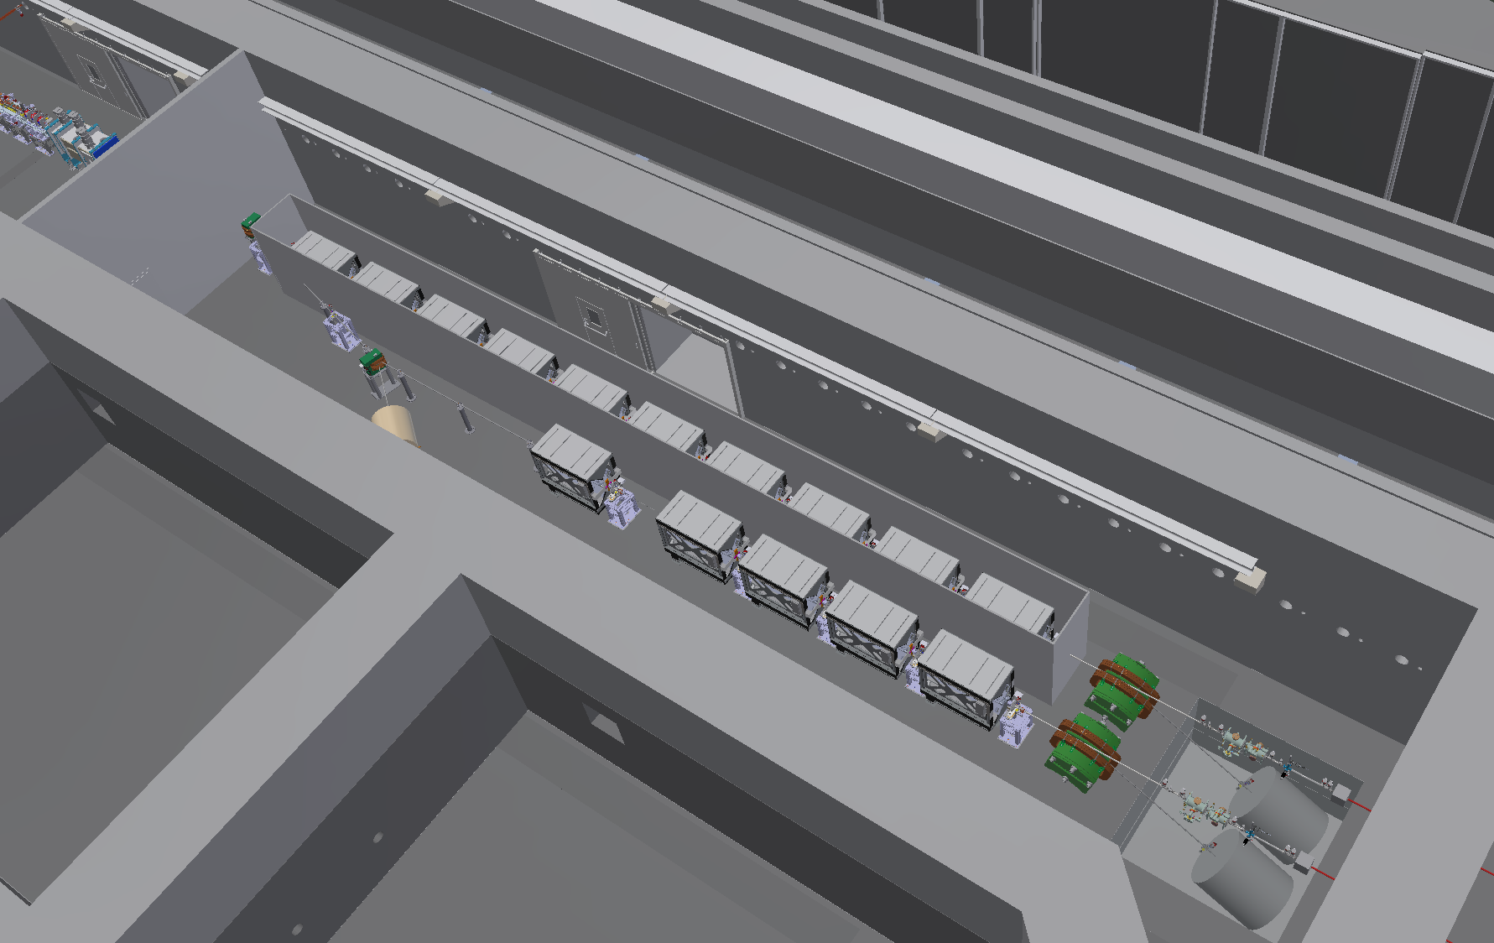
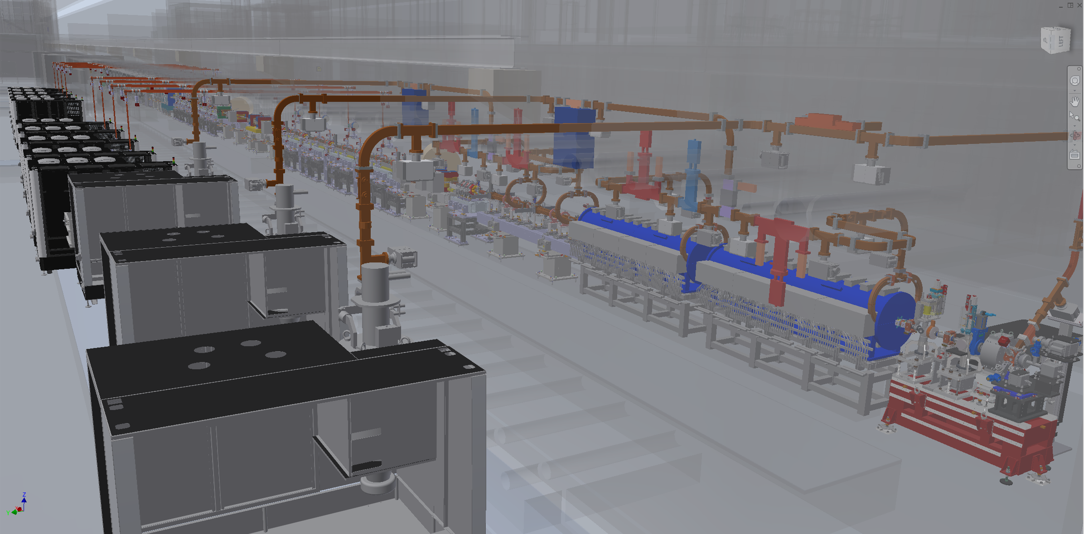
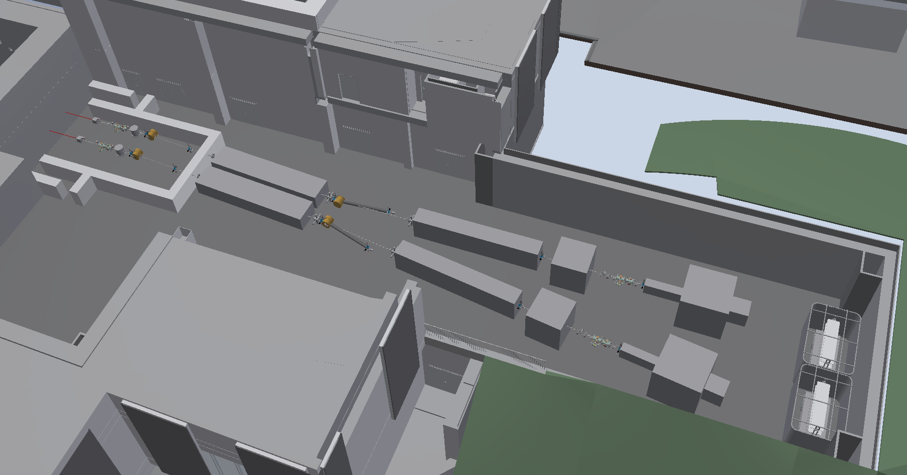
Layout Macchina
Accelerator tunnel (Gun POV)
Accelerator tunnel (PLASMA POV)
EuPRAXIA LAYOUT
Undulators tunnel
FEL user area
Klystron gallery

Slide 4
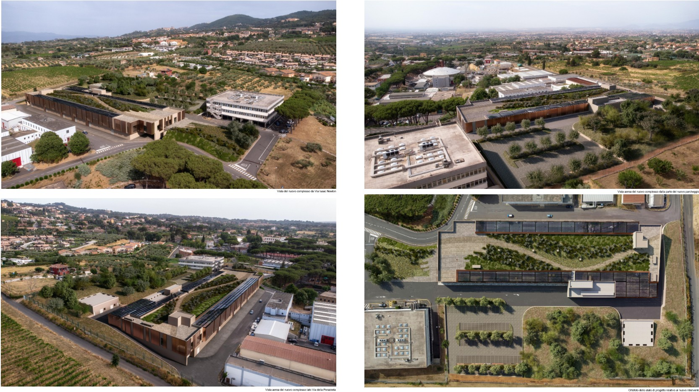
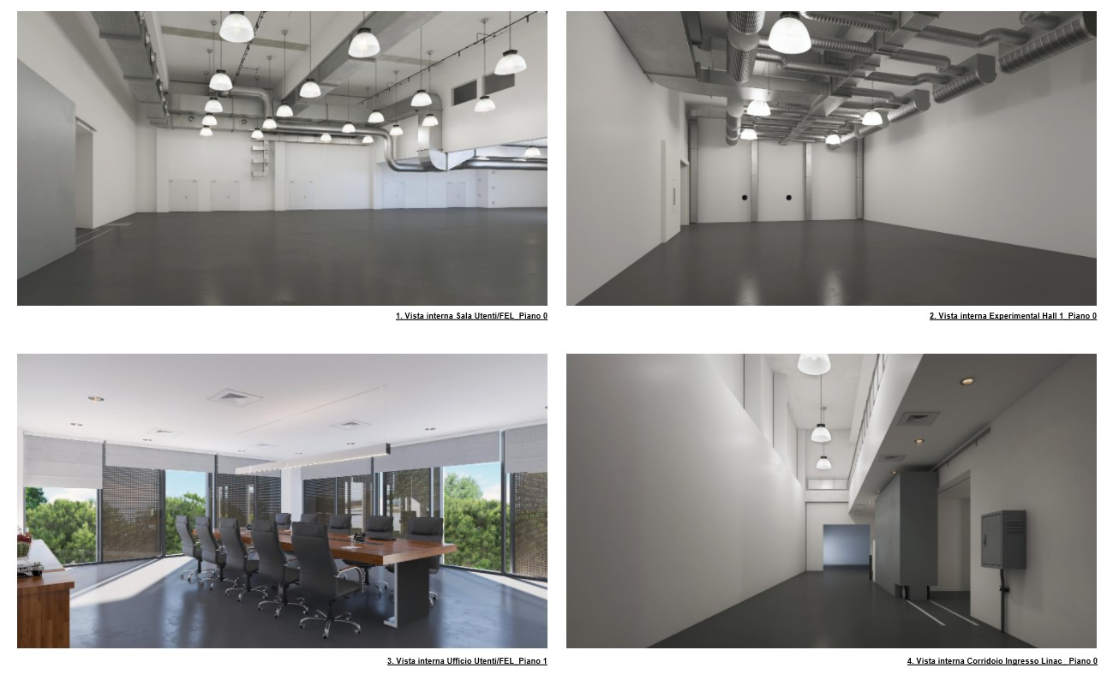
Building
FEL user area
Experimental Hall 1
Users Room
Corridor Entrance LINAC

Slide 5
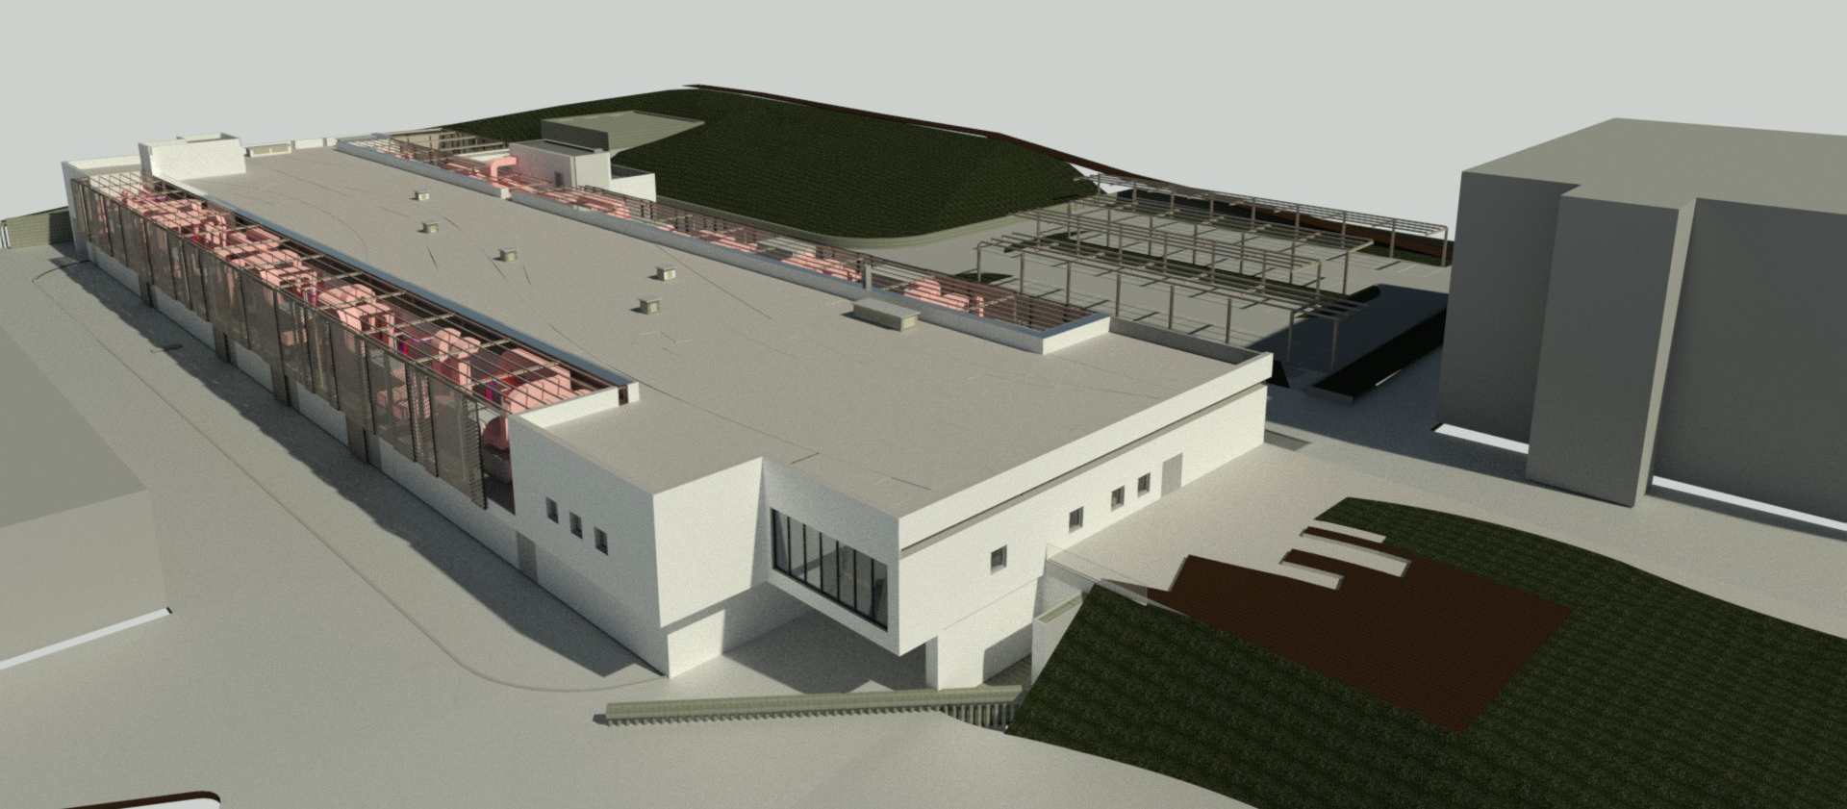
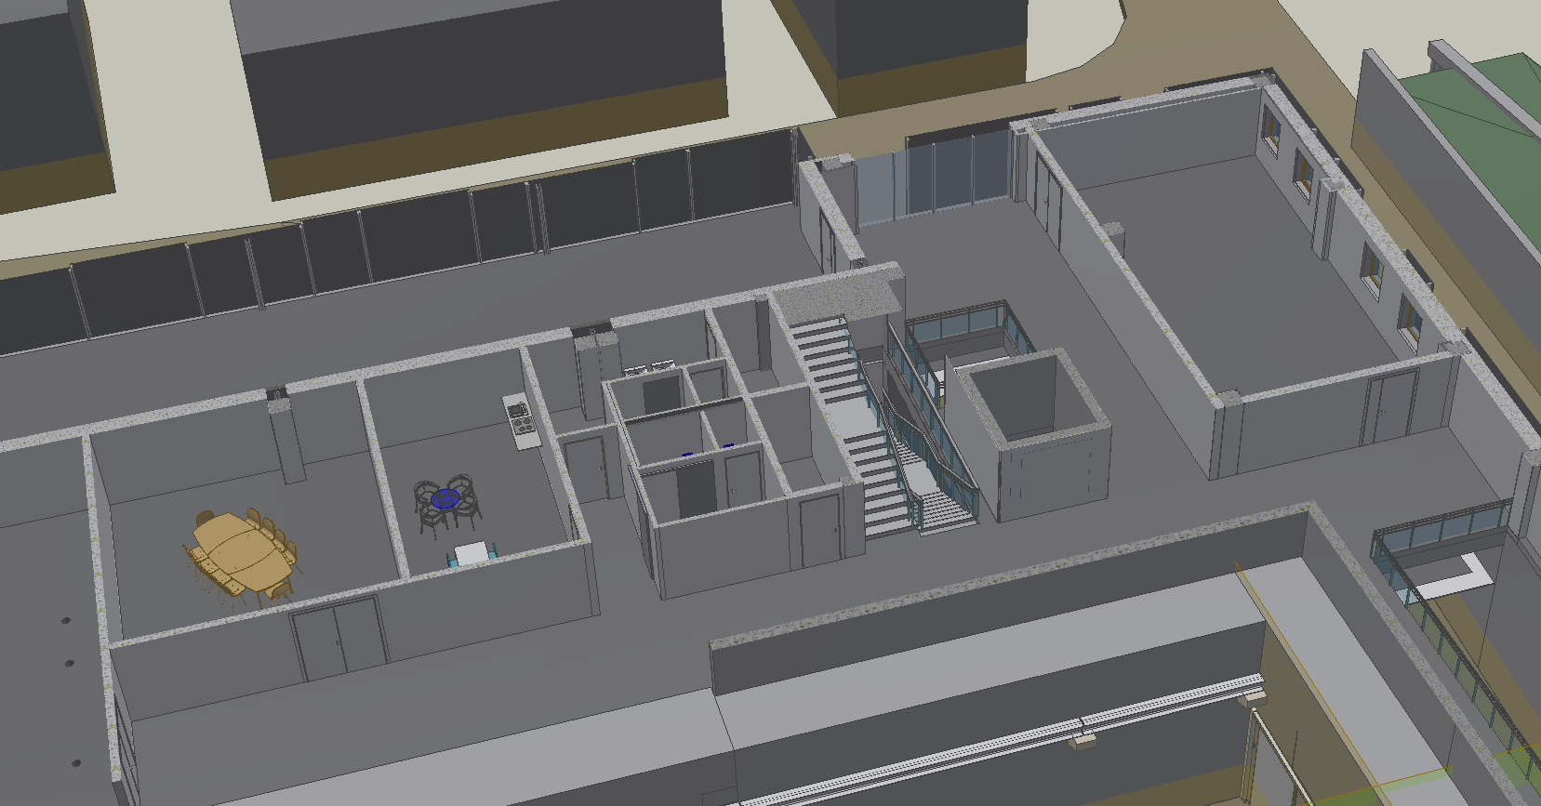
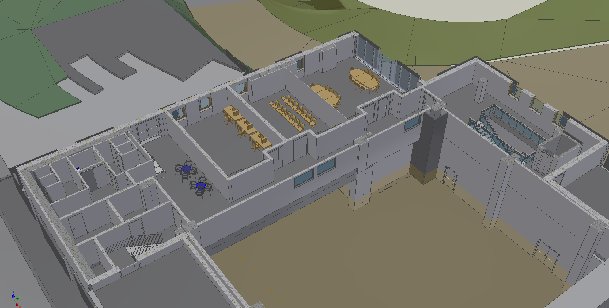
Building
Users Rooms
Control
Room
Meeting
Room
Kitchen

Slide 6
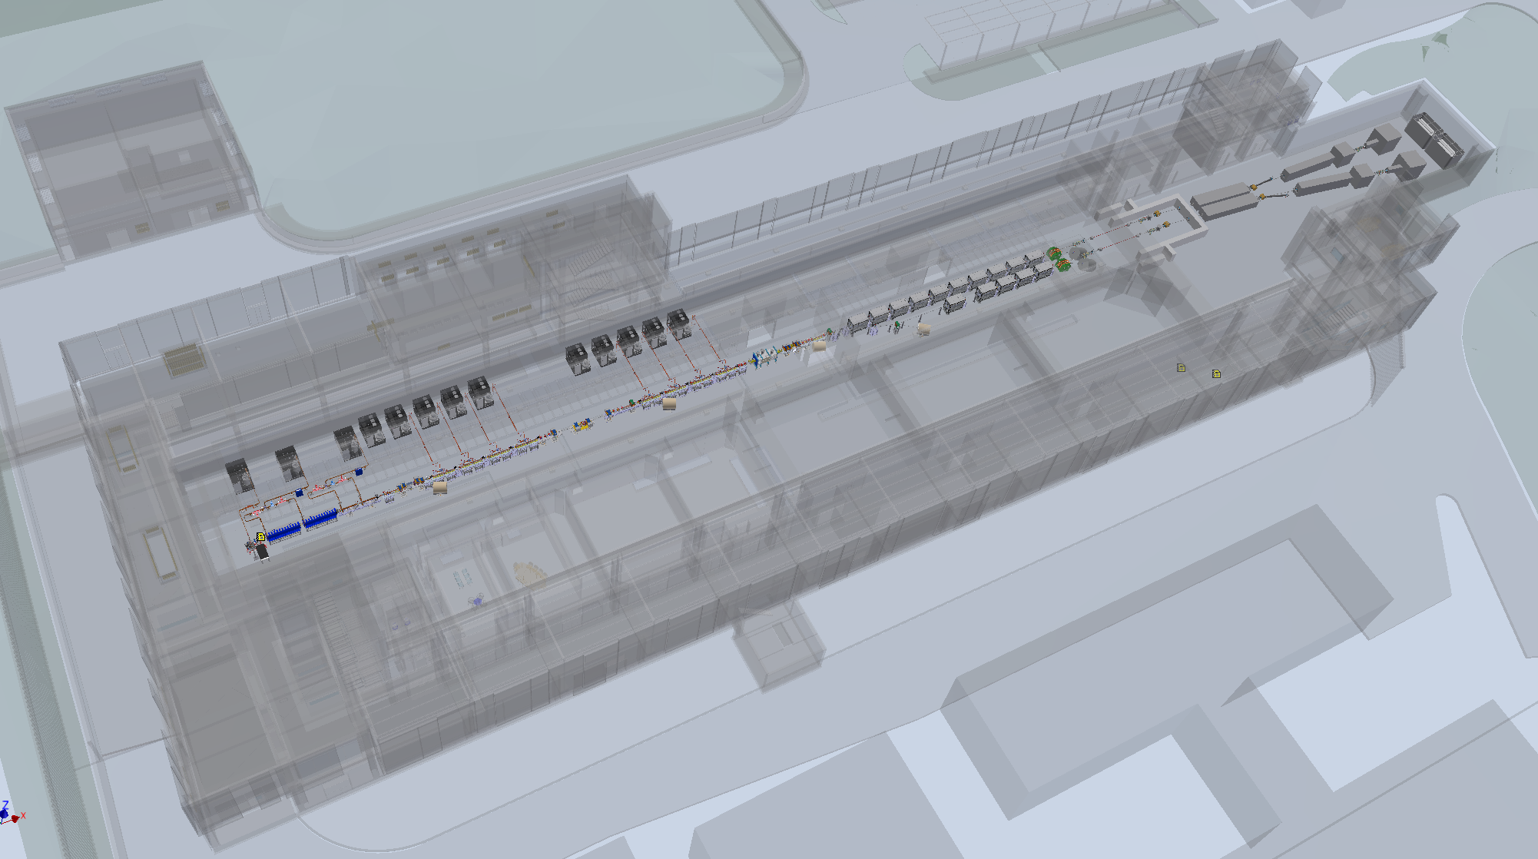
Integration Approach: Beginning
EuPRAXIA LAYOUT
Machine Layout
New elements
Known elements
Designed
in details
Defined with
the WP involved
Already designed
or available
From the beginning, every effort has been made to optimize the layout by making the most efficient use of the available space to enhance achievable performance. Multiple iterations between work packages (WPs) and work areas (WAs) have led to a solution that maximizes the exploitation of the allocated spaces within the building.

Slide 7
Integration Approach: Correlation
Piping definition. The internal and external diameters influence the bellows and their longitudinal footprint, affecting alignment, operational movements, and vacuum impedance.
The detailed designs of quadrupoles, dipoles, and correctors are essential for assessing the final spatial footprint and overall machine ergonomics, particularly in terms of longitudinal space requirements and clearance distances to mitigate cross-talk effects.
VACUUM
Beam dynamics validation. It must verify the optical transport with respect to the magnetic centers associated with the magnetic elements and the vacuum line.
BEAM DYNAMICS
MAGNETS
The flags have been dimensioned by optimizing space and machine interconnections. BPMs and Cavity BPMs have been properly defined and strategically positioned.
Several support structures and motion systems are yet to be designed. The required lattice points must be identified and verified to ensure safety and maintainability.
DIAGNOSTICS
MECHANICS
Continuous iterations are essential to validate the compatibility of the design preferences and to optimize both performance and spatial constraints

Slide 8
Integration Approach
The machine layout was defined starting from the photoinjector, using components consistent with the specifications required by the project.
Where compatible, all elements with known designs and performance — either previously developed or commercially available for other projects — were adopted. For components without such precedents, schematic representations were created.
In both cases, only components with performance equal to or exceeding project requirements were included.
In the future this approach ensures that, when custom components are designed, their size and/or weight will likely be lower than those currently considered.
This minimizes the risk of interference or under-dimensioning of support structures and/or associated mechanical handling systems.

Slide 9
From Design to Commissioning
The successful implementation of a plasma-based particle accelerator is fundamentally dependent on the smooth integration of the machine with its civil infrastructure.
This is not a sequential process but a concurrent, collaborative endeavor, requiring shared design environments, clear interface definitions, and an appreciation for the sensitivities of both sides.
Civil infrastructure must do more than host the accelerator. It must enhance its performance, stability, and future adaptability. When done correctly, this integration becomes a cornerstone of scientific excellence, operational safety, and long-term success.

