Slide 1
Chapter 23: Radiation Protection and Safety
F. Chiarelli, R. Donghia, A. Esposito, D. Chiti, B. Nese
(Frascati National Labs (INFN – LNF))
This project has received funding from the European Union´s Horizon Europe research and innovation program under grant agreement No. 101079773
IX TDR Review Committee Meeting
June 16-18, 2025

Slide 2
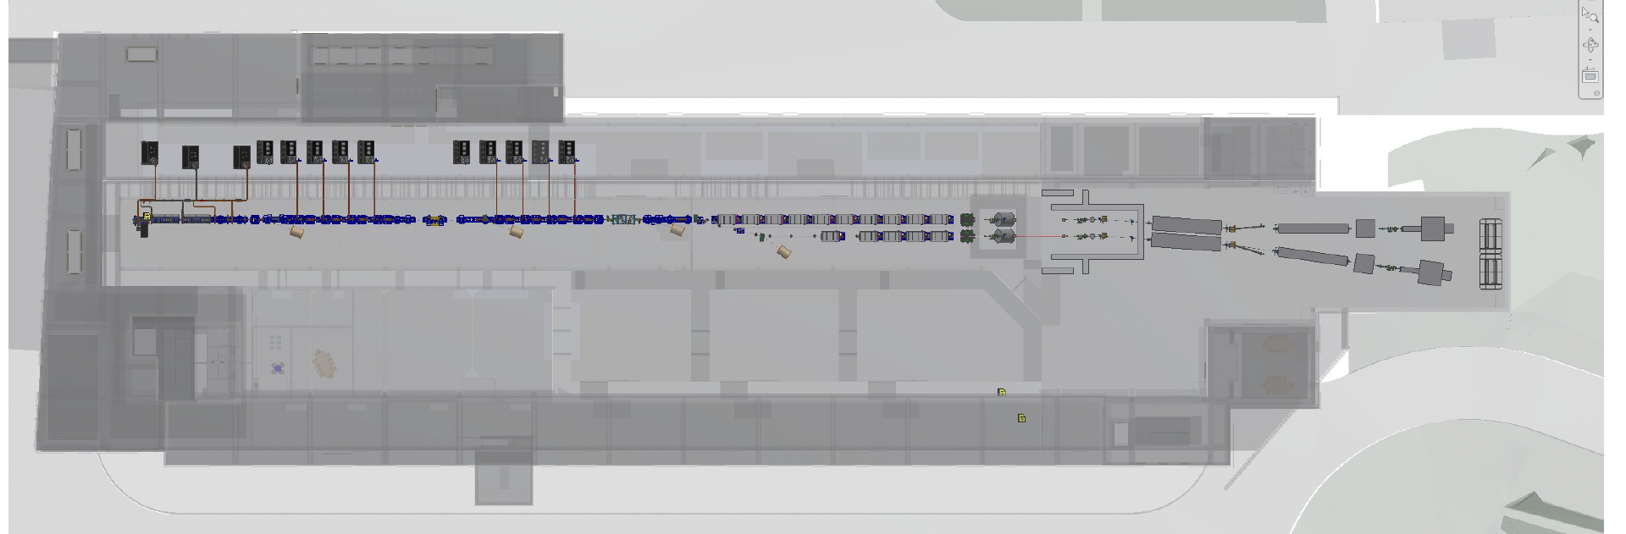
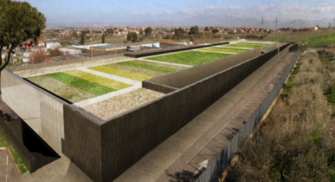
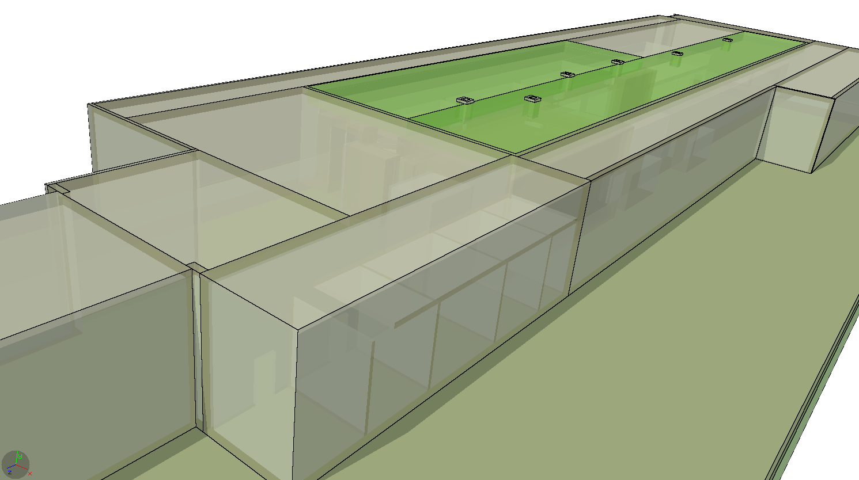
My Area
Radiation protection studies regard the entire facility, with particular attention to areas associated with actual or potential radiation exposure, including: - The linac bunker
- The FEL area - The front-end systems - The modulator hall - All adjoining zones
- The external areas
The RP measures aim to ensure the safety of personnel, the public, and the environment in accordance with regulatory standards.

Slide 3
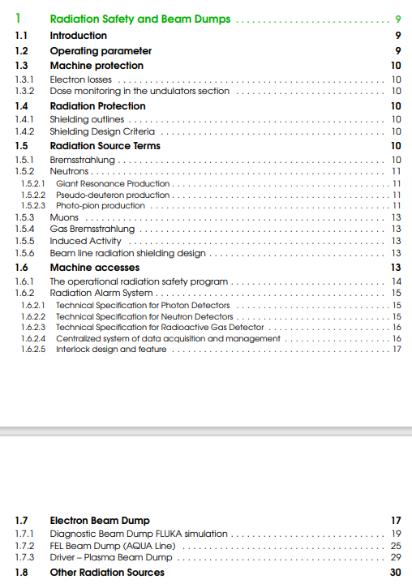
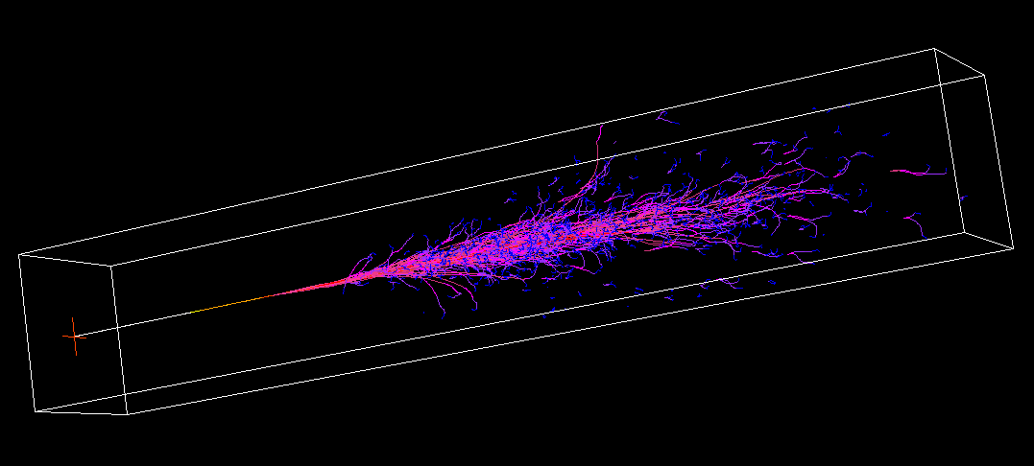
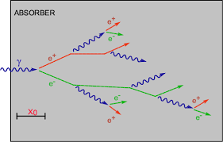
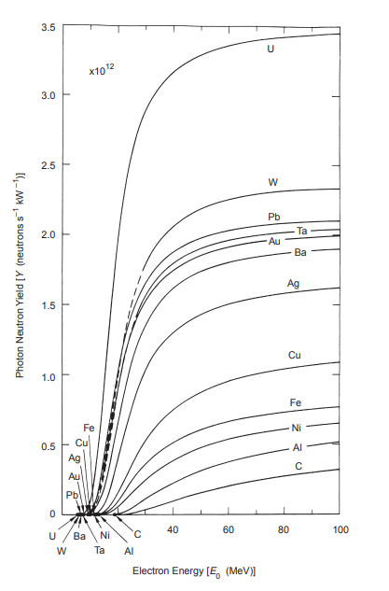
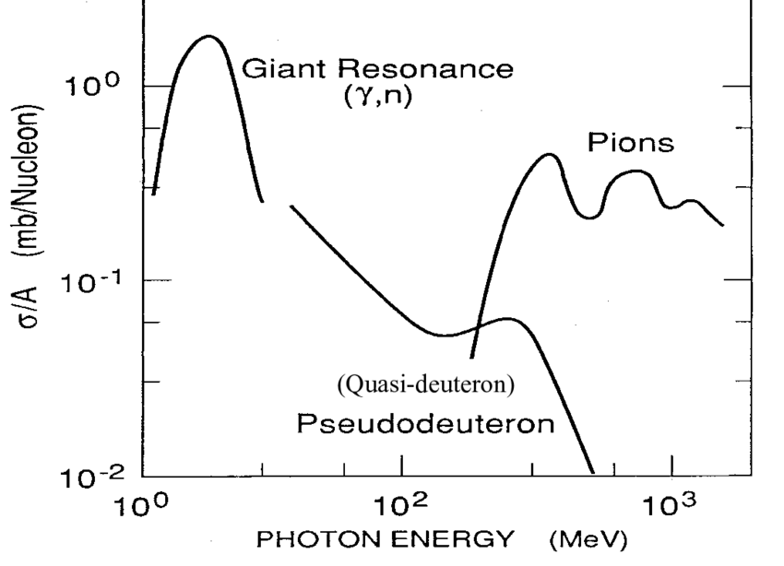
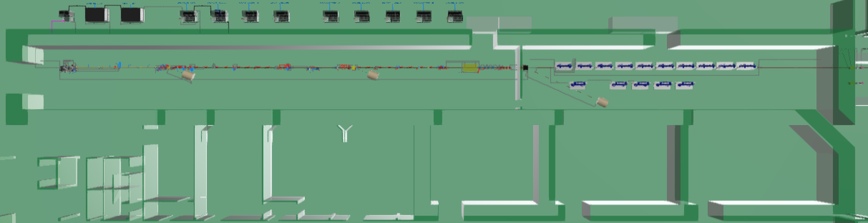
Describe your Chapter
Radiation goals for external areas:
0.25 µSv/h

Slide 4
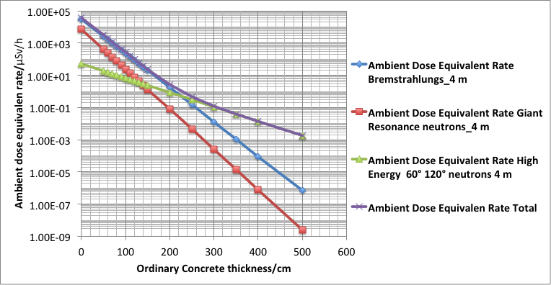
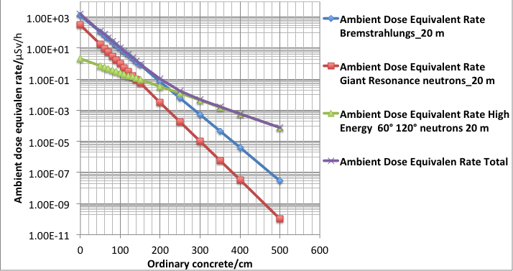
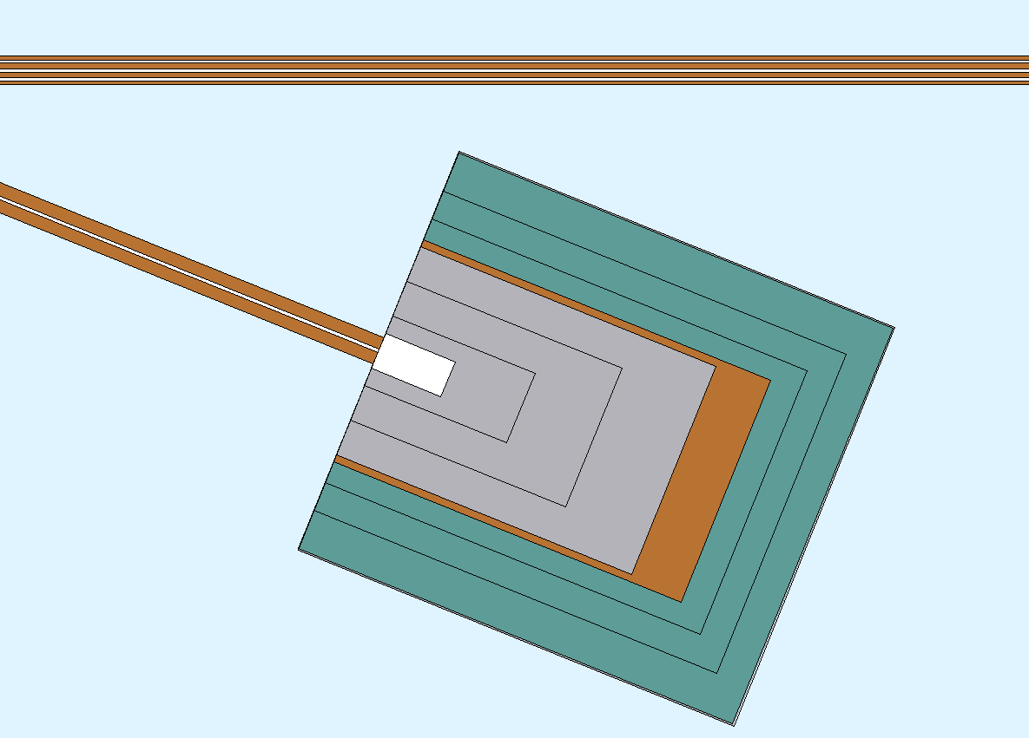
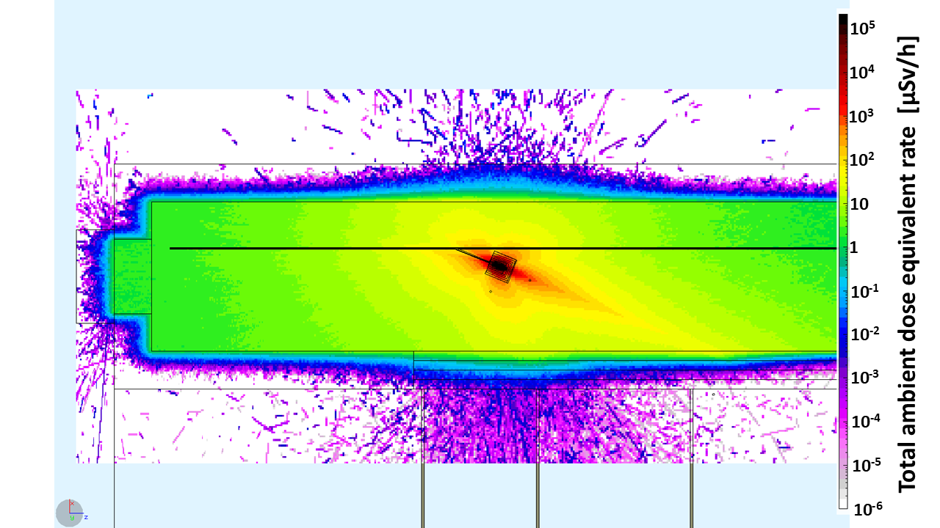
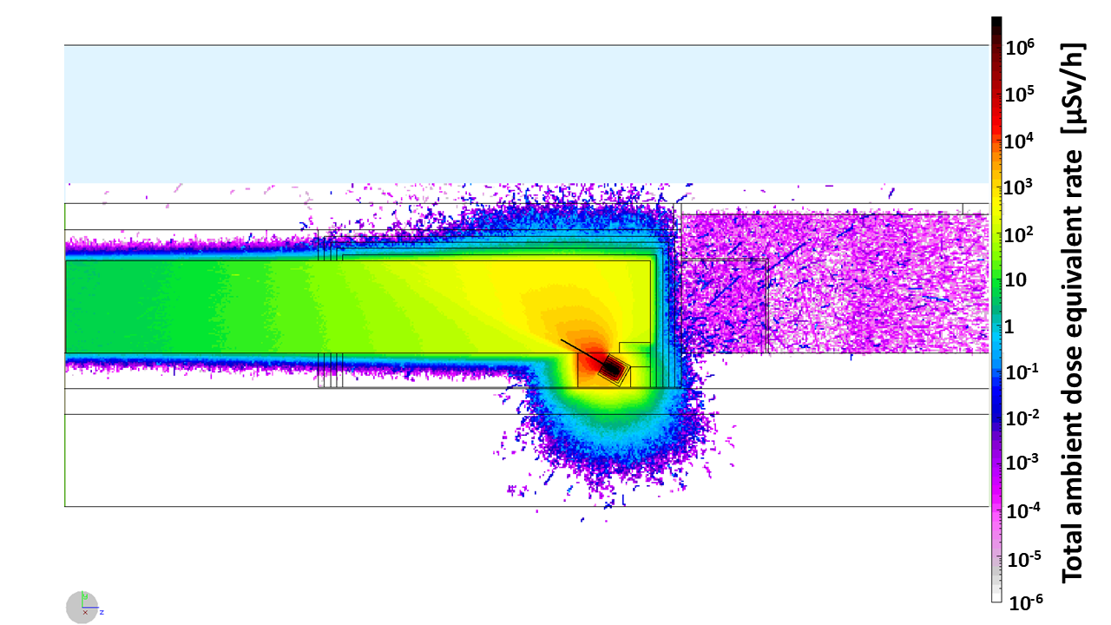
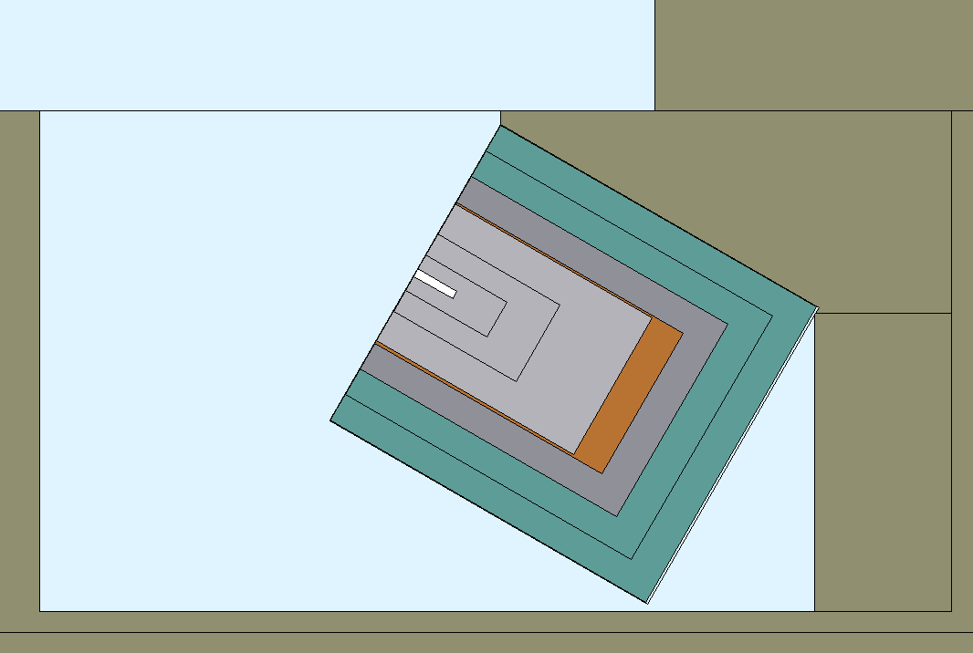
Global Goals: (Brief description of system objectives and specs)
The Radiation Protection evaluation aim to ensure the safety of personnel, the public, and the environment in accordance with regulatory standards (Italian Legislative Decree No. 101/2020, ICRP recommendations).
Exposure levels kept under control through:
A 2 m shielding thickness of ordinary concrete
Three diagnostic beam dump
Aluminun
Copper
Polyethylene
A fixed beam dump
Aluminun
Copper
Lead
Polyethylene

Slide 5
Achievements: Technological Readiness Level (Sub-Components)
All subsystems relevant to radiation protection are subject to the license request, which will be submitted once all parameters have been finalized.
The TRL currently assigned to each subsystem is provisional and may be updated as the project evolves.
TRL LEVEL | TRL Description
TRL 1 | Basic principles observed – Scientific research begins to be translated into applied research and development (R&D).
TRL 2 | Technology concept formulated – The basic principles are explored and practical applications are identified.
TRL 3 | Experimental proof of concept – Active R&D is initiated, including analytical and laboratory studies to validate predictions.
TRL 4 | Technology validated in lab – Basic technological components are integrated to establish that they work together.
TRL 5 | Technology validated in relevant environment – The technology is tested in a simulated or relevant environment
TRL 6 | Technology demonstrated in relevant environment – A prototype system is tested in an environment similar to the operational one.
TRL 7 | System prototype demonstration in operational environment – A working prototype is demonstrated in a real operational setting.
TRL 8 | System complete and qualified – The technology is proven to work in its final form and under expected conditions.
TRL 9 | Actual system proven in operational environment – The technology is fully commercialized and operational in its intended setting.
Sub - systems | TRL | Comments
Diagnostic Beam Dump | 5 | The design and dimensions have been validated through FLUKA simulations. Physical construction has not yet been initiated.
Fixed Beam Dump | 5 | Similar to diagnostic dumps: validated by FLUKA studies; not yet constructed.
Driver Beam Dump | 4 | Work in progress through dedicated FLUKA – INFN simulations.
Radiation Shielding | 7 | The barrier design has been evaluated analytically.
Safety Intelock System | 4 | The concept has been outlined, but detailed design and implementation planning are still pending.
Radiation Detector / Monitor | 7 | The technical specifications are defined, but the system has not yet been procured, and the exact types of instruments are still under review.

Slide 6
Pending Items: (What is still in progress or incomplete.)
Driver beam dump design (FLUKA – INFN simulation)
Structure very similar to the diagnostic beam dump → Al – Cu – Polyethylene
Al core → used to obtain the complete development of the EM cascade, minimizing the photons produced and consequently the number of neutrons produced.
Cu layer → placed immediately downstream of the core and surrounding it, serving the dual purpose of attenuating the forward-directed electromagnetic component and enhancing heat dissipation resulting from beam absorption;
Polyethylene cover → needed to attenuate, moderate and absorb the different neutron component emitted by the photo-production reactions;
Increase the prompt radiation attenuation
A thickness ordinary concrete local shielding will be included around the dump in order to
to ensure sufficient attenuation of the delayed radiation
This structure is still undergoing optimization. The final version will be completed as soon as possible, once fixed the driver beam parameters.

Slide 7
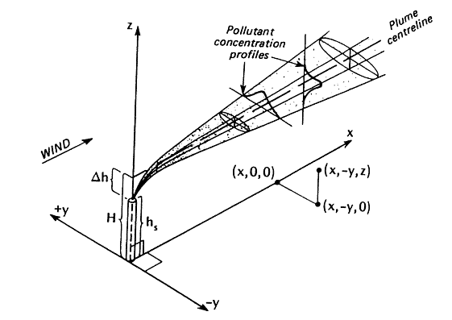
Planned Actions: (Beyond TDR)
Preliminary activation analysis (FLUKA – INFN simulation)
Diagnostic and Fixed Beam Dump components →Phase project’s decomissioning
Earth layer – Water → possible enviromental contamination
Air → possible waiting time / air exchange regulation
Preliminary activation doses scenarios (FLUKA – INFN simulation)
- Exposition for the workers related to possible intervention scenarios (activation doses + submersion doses) - Exposition for the public related to the bunker air exchange (evaluated with the software HotSpot)
Detailed beam loss scenarios
Implementation of the complete facility geometry in the FLUKA environment in order to study potential beam losses along the machine.

Slide 8
Dependencies / Risks (optional): (Any blocking issues or critical path items.)
Blocking issue:
No blocking issues identified at this stage, except for the operating license, which is currently under preparation and will be submitted in line with the project timeline.
Critical path items
CPU time for the FLUKA simulations

Slide 9
Conclusions
In conclusion, all evaluations and simulations carried out so far are compliant and consistent with the project, as they are based on irradiation conditions defined in accordance with established parameters.
The driver beam dump will be completed once fixed all beam parameters.
All missing evaluations and scenarios will be developed and integrated as soon as possible.

