Slide 1
Chapter 16: Timing and synchronisation
Marco Bellaveglia, Luca Piersanti, Angelo Stella
(INFN - LNF)
This project has received funding from the European Union´s Horizon Europe research and innovation program under grant agreement No. 101079773
IX TDR Review Committee Meeting
June 16-18, 2025

Slide 2
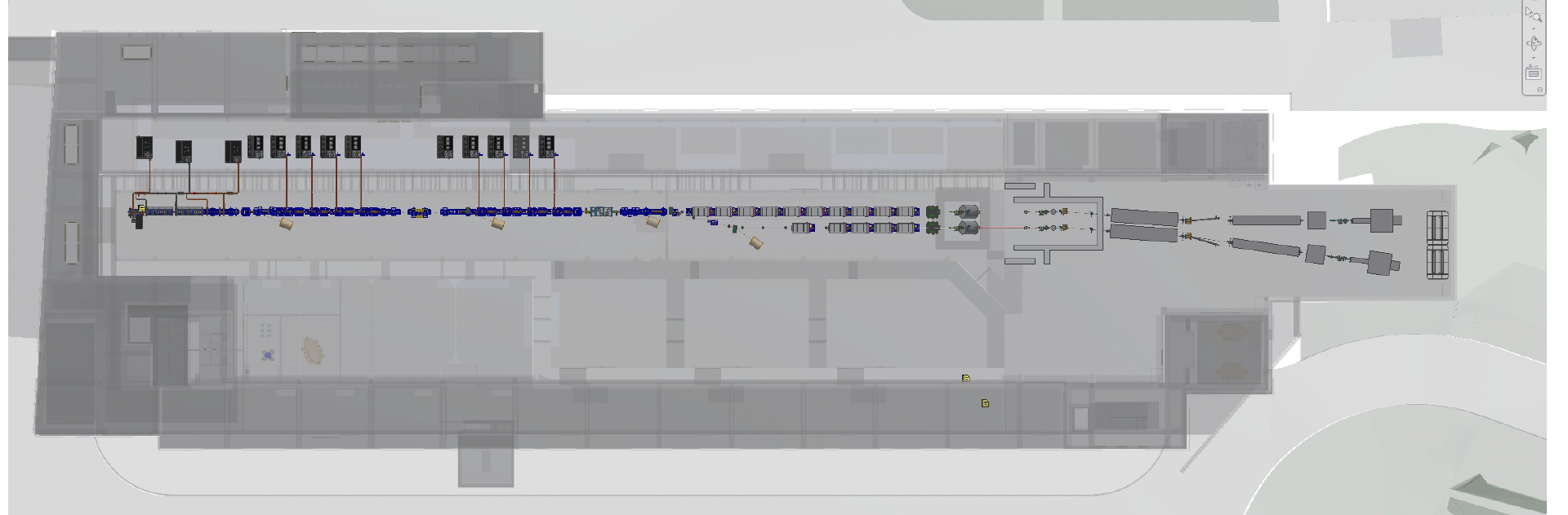
My Area
Timing and synch receivers
Timing and synch receivers
Timing and synch generators

Slide 3
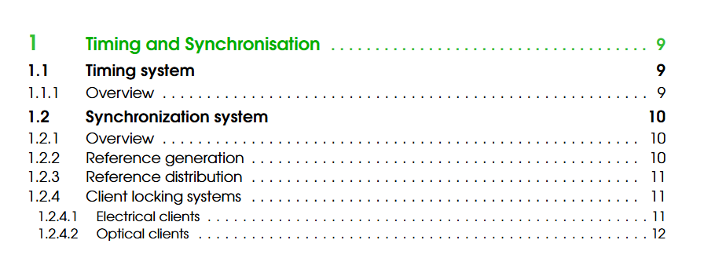
Describe your Chapter

Slide 4
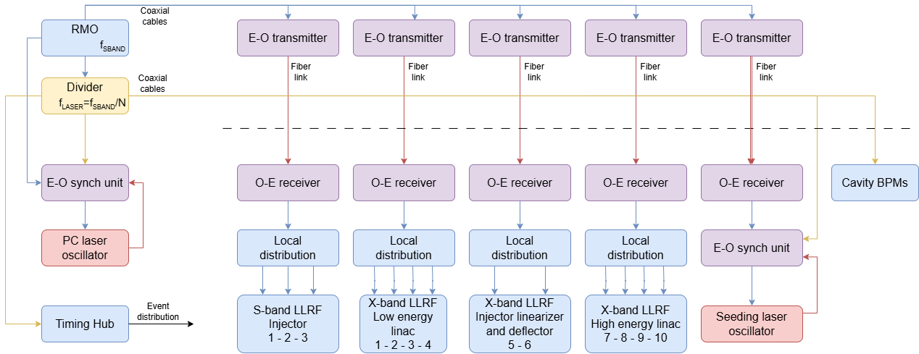
Global Goals: (Brief description of system objectives and specs)
Timing system
Event based system generating and distributing clock signals synchronous with RF frequency ( jitter ~25 ps rms) typically at bunch rate, in order to coordinate all accelerator components
Modular architecture based on event generator and receiver modules linked, within a tree network, through a bidirectional optical fiber link
Multiple Events generation at the base clock frequency (RF/36=83.293 MHz) or any submultiple
Triggers generation with programmable polarity, width, delay
Easily configurable and scalable to support all required users
Delay compensation mechanism to measure propagation delay between two knots
Interface with EPICS for control, monitoring, remote configuration, and data-logging
Synchronization system
Generation of the high frequency (~3 GHz) and low frequency (~80 MHz) reference signals
Distribution of the reference signals along the facility by means of stabilized links (< 10 fs RMS stability)
Locking of the clients (mainly LLRF and laser oscillators) to the reference frequency by means of dedicated electronics (< 10 fs RMS stability)

Slide 5
Achievements: Technological Readiness Level (Sub-Components)
Sub - systems | TRL | Comments
Reference generation | 9 | Reference Master Oscillators are available on the market and have been extensively tested in real environments with very good performance
Reference distribution | 9 | Stabilized fiber links for reference signal distribution are available on the market and are presently used in accelerator environments (e.g. in SwissFEL)
RF locking system | 9 | The LLRF modules are directly fed by the reference signal emerging from stabilized links. Locking electronics is not needed and no added jitter is foreseen
Laser locking system | 8 | A laser locking system, developed at LNF, is running in the SPARC_LAB environment with good performance since many years, but an upgrade is necessary to be compliant with the EuPRAXIA@SPARC_LAB requirements. Commercial products are also available on the market and already meet the EuPRAXIA@SPARC_LAB requirements. A test in collaboration with one of the leading companies is already planned at LNF to confirm its specifications
Event Generator & Receiver modules | 9 | System already proven in operational environment. Technology is fully commercialized and operational

Slide 6
Pending Items: (What is still in progress or incomplete.)
Timing system:
TDR is complete
To complete the executive design, the following aspects still require attention:
Accurate sizing of the number of final users, starting from an initial estimate of ~100 trigger outputs
Detailed planning for the installation and positioning of receiver modules must be finalized taking into account the specific requirements and locations of end-users across the accelerator facility, to minimize signal latency and ensure reliable signal distribution
Synchronization system:
TDR is almost complete, it misses only minor changes to be consistent with other chapters
To complete executive design we need the following steps:
The laser locking system is under study/test to be compliant with the synchronization specs
Custom developed electronics is running at the SPARC_LAB facility, but needs more R&D to reach the desired performance
Commercial products are also available and already satisfy the synchronization requirements
Study on cable duct with thermal/vibration isolation to minimize jitter/drifts, in collaboration with civil infrastructure and RF teams, is under way
Detailed layout positioning of the link end for the seeding laser oscillator must be discussed in detail with the laser team members, no issues are foreseen

Slide 7
Planned Actions: (What will be done, by when.)
Timing system
TDR has been completed
Synchronization system:
Minor changes in the TDR will be implemented in few days. They concern:
Implementation of referees indication
Improving consistency with other chapters

Slide 8
Dependencies / Risks (optional): (Any blocking issues or critical path items.)
No blocking issues are foreseen

Slide 9
Conclusions
Timing system design is complete, meeting the specifications.
Synchronization system design is finished, and it is compliant with the accelerator specs. Only the laser locking system has to be upgraded, performing R&D for a in house solution or purchasing it from industry. In any case many labs are already running it with performance that meets the EuPRAXIA@SPARC_LAB requirements; thus, no blocking issues are foreseen. Another possible issue can be the minimization of drifts for the coaxial cables passing through rooms with not suitable thermal stability (e.g. klystron gallery). This topic is under discussion with civil engineering/RF teams to use a dedicated cable duct with thermal/vibration isolation. This mainly refers to the cables used to read signals from the linac. Their path goes from the linac hall to the klystron gallery, where the LLRF modules are located.

