Slide 1
Chapter 11: FEL and Undulators
L. Giannessi
on behalf of the WA6 collaboration team:
F. Curciarello, F. Nguyen, A. Petralia (ENEA),
Vittoria Petrillo (Un. Milano)
I. Balossino, M. Del Franco, M. Galletti, A. Giribono, A. Ghigo, M. Opromolla, L. Sabbatini, A. Selce, C. Vaccarezza, A. Vannozzi, F. Villa (Laboratori Nazionali di Frascati)
This project has received funding from the European Union´s Horizon Europe research and innovation program under grant agreement No. 101079773
IX TDR Review Committee Meeting
June 16-18, 2025

Slide 2
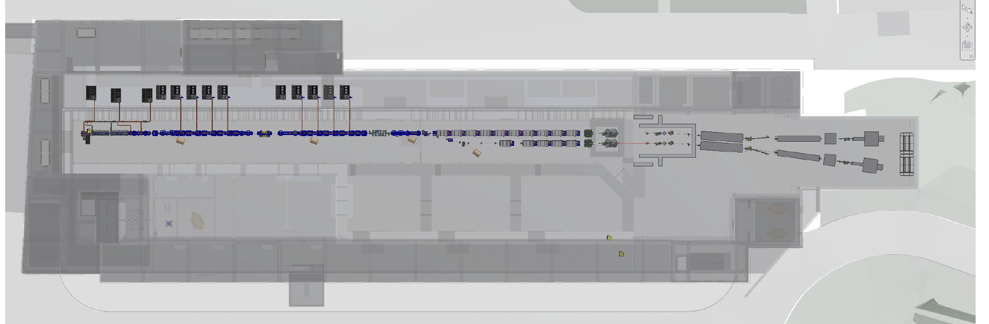
AQUA FEL and Undulators

Slide 3
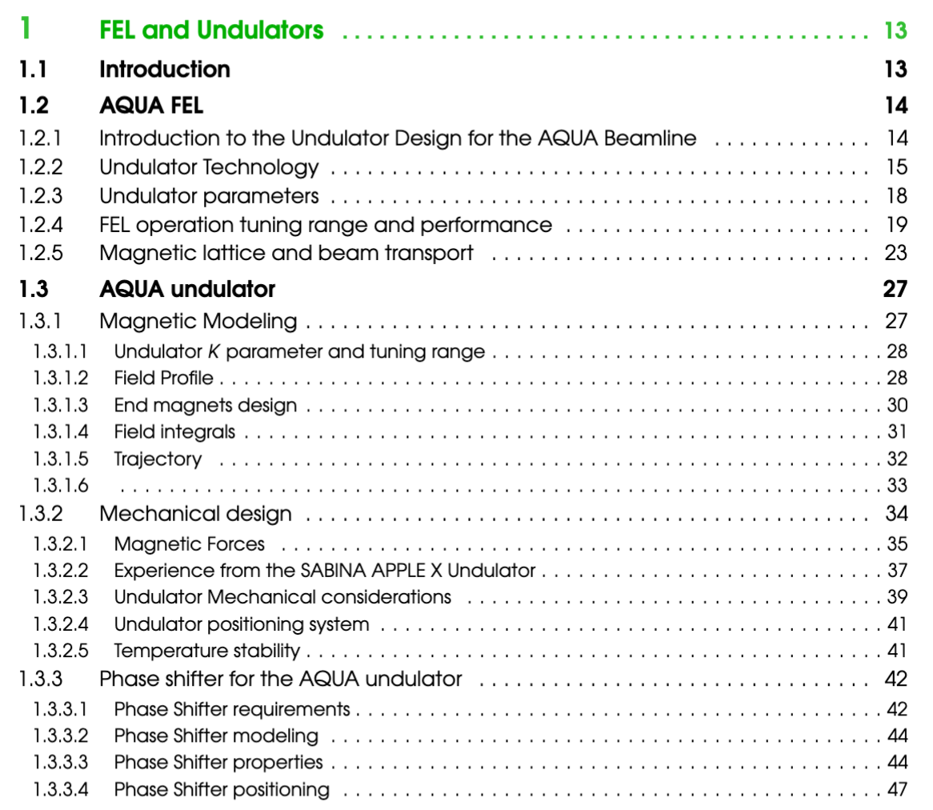
Chapter 11
Definition of undulator type, period,
length
Tuning range, expected performances, beam transport
APPLE–X Magnetic model, good field region, field integrals, trajectory
Consideration on magnetic forces, mechanical design, positioning , temperature stability
Magnetic design of phase shifters

Slide 4
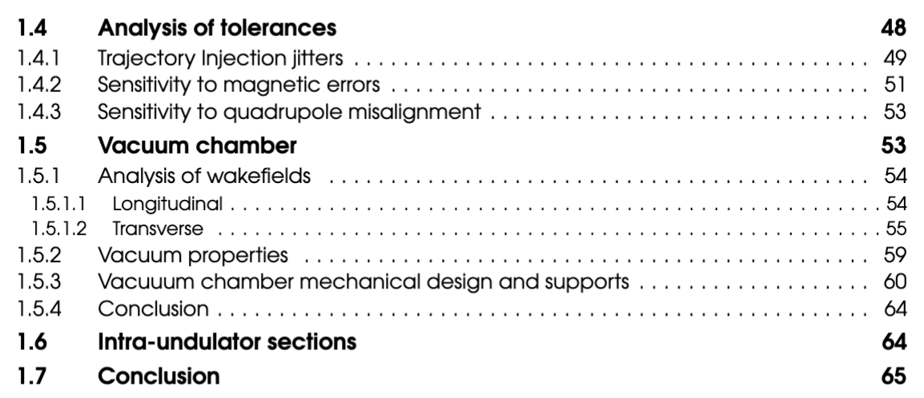
Chapter 11
Analysis of tolerances: injection jitters, magnetic errors, quadrupole misalignments
Design of the vacuum chamber, wakefields, vacuum properties
Intra-undulator sections: quadrupoles, steerers, BPM, flags,

Slide 5
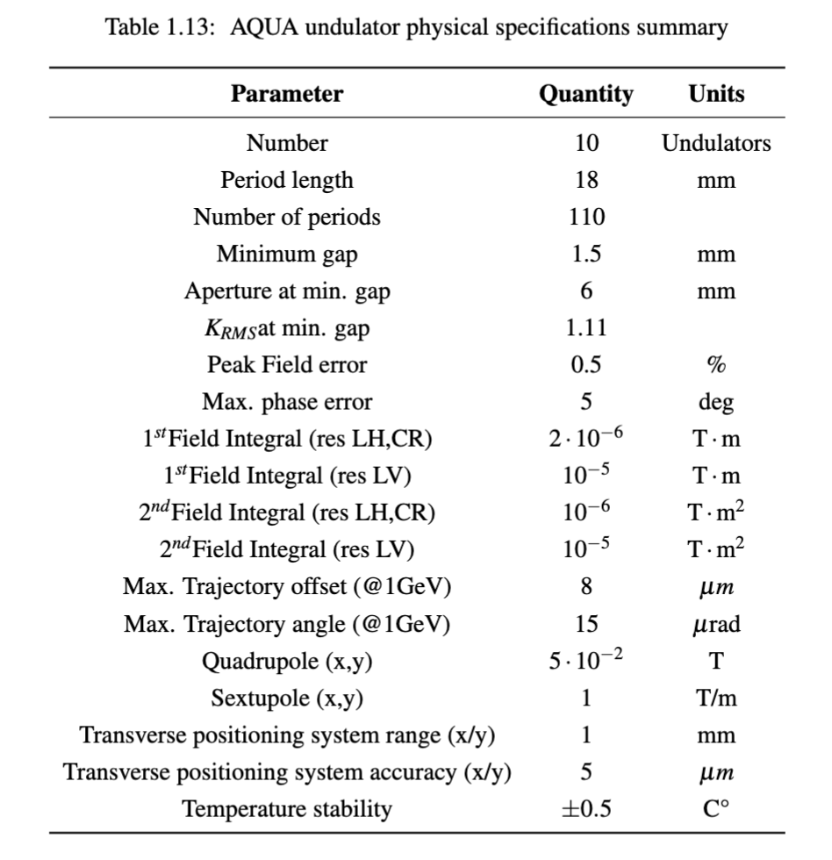
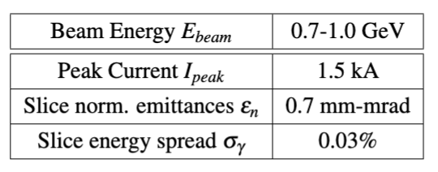
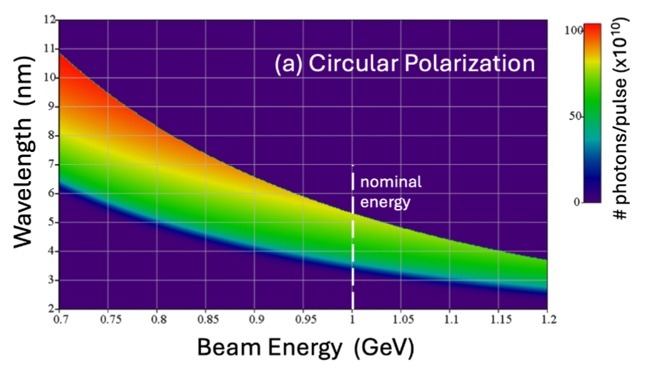
Global Goals: (Brief description of system objectives and specs)
Minimal beam parameters
Tuning range and performances
(Circular pol. in the example)

Slide 6
Achievements: Technological Readiness Level (Sub-Components)
Sub - systems | TRL | Comments
FEL | 9 | FEL design based on reliable simulations (Genesis 1.3) and calculations which were benchmarked with real devices.
Undulators | 7 | Short period undulators were realised at many facilities, including SPARC_LAB Apple X - Type undulators Technology demonstrated in other facilities (SwissFEL, EuXFEL, etc.)
Phase shifters | 9 | Phase shifters are operational at most multi-undulator FEL beamlines
Vacuum chamber | 4 | Vacuum chamber with 300 μm walls, tolerance on alignment 500 μm. Vacuum levels simulated in comparable operational environment.
Quadrupoles | 9 | Quadrupoles are within standard parameters
Steerers | 9 | In-air steerers with the required specifications are standard at many facilities
C-BPM | 9 | Cavity BPM with the required specifications are available at PSI (add reference)
YAG – CCD- Diagnostics | 9 | Standard hardware
TRL LEVEL | TRL Description
TRL 1 | Basic principles observed – Scientific research begins to be translated into applied research and development (R&D).
TRL 2 | Technology concept formulated – The basic principles are explored and practical applications are identified.
TRL 3 | Experimental proof of concept – Active R&D is initiated, including analytical and laboratory studies to validate predictions.
TRL 4 | Technology validated in lab – Basic technological components are integrated to establish that they work together.
TRL 5 | Technology validated in relevant environment – The technology is tested in a simulated or relevant environment
TRL 6 | Technology demonstrated in relevant environment – A prototype system is tested in an environment similar to the operational one.
TRL 7 | System prototype demonstration in operational environment – A working prototype is demonstrated in a real operational setting.
TRL 8 | System complete and qualified – The technology is proven to work in its final form and under expected conditions.
TRL 9 | Actual system proven in operational environment – The technology is fully commercialized and operational in its intended setting.

Slide 7
Planned Actions: (What will be done, by when.)
TDR - Completed

Slide 8
Planned Actions: (What will be done, by when, beyond TDR)
Vacuum chamber:
Set Up a vacuum chamber module to test vacuum, positioning system, design and feasibility
Undulator:
Define responsibilities.
Market Consultation / Request for Information (RFI) (in progress)
Issue a Request for Information to potential industrial suppliers to: Gauge market capability and interest, Identify available production technologies, Understand timelines and cost ranges
Preparation of Tender Documents (by fall 2025 ?)
Prepare and issue a formal Call for Tender or Request for Proposal (RFP) including:
Technical specifications/Terms and conditions (incoterms, liability, penalties, etc.)/Fabrication, testing, and delivery milestones/Evaluation criteria (price, quality, references, schedule, etc.)
Selection of Suppliers by end of 2025
Evaluate proposals/Shortlist qualified vendors/Possibly conduct factory audits or ask for prototype samples/Finalize the technical and contractual negotiations
Contract Award and Kick-Off 1stQ 2026 (?, when budget available)
Set up a project management framework for progress tracking, reviews, and quality control
Assign the contract
Organise measurement laboratory (Sabbatini or Petralia @ENEA) 2026 and beyond

Slide 9
Conclusions
Free-Electron Laser
The analysis of the FEL configuration is carried out with reliable methods as simulations (Genesis 1.3) and models.
Ideal, conservative beam parameters have been used, differently with respect to those considered e.g. in Chapter "Beam dynamics", where start to end simulations are presented. The beam can in principle be better than the one considered for the undulator design.
This mitigates the risk related to the possibility that magnetic field errors, quadrupole misalignments, or pointing instabilities reduce FEL performance.
UNDULATOR
The magnetic design of the undulator indicates the scheme used for SABINA can be extended to the AQUA requirements
Tolerances and specifications are considered challenging but within the present undulator technology
OTHER COMPONENTS
The key components of the undulator system are mostly available "off-the shelf" with few exceptions, such as the vacuum chamber, which will require prototyping and test.
The "TDR" is considered complete, further work will be required by the integration of the second FEL beamline ARIA

